Slide 1
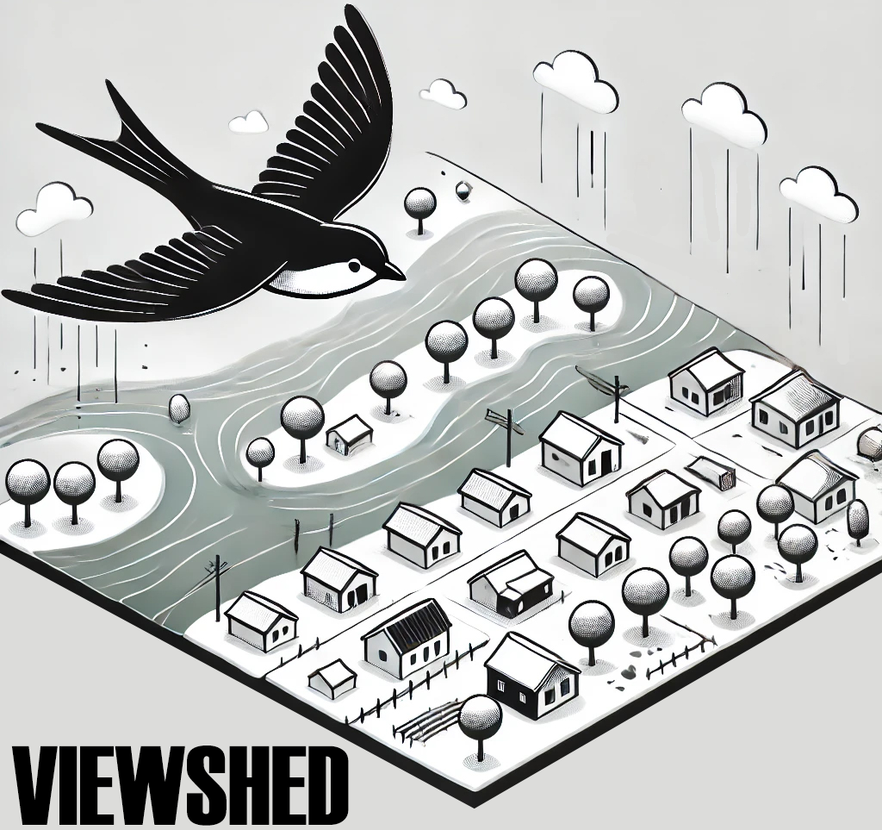
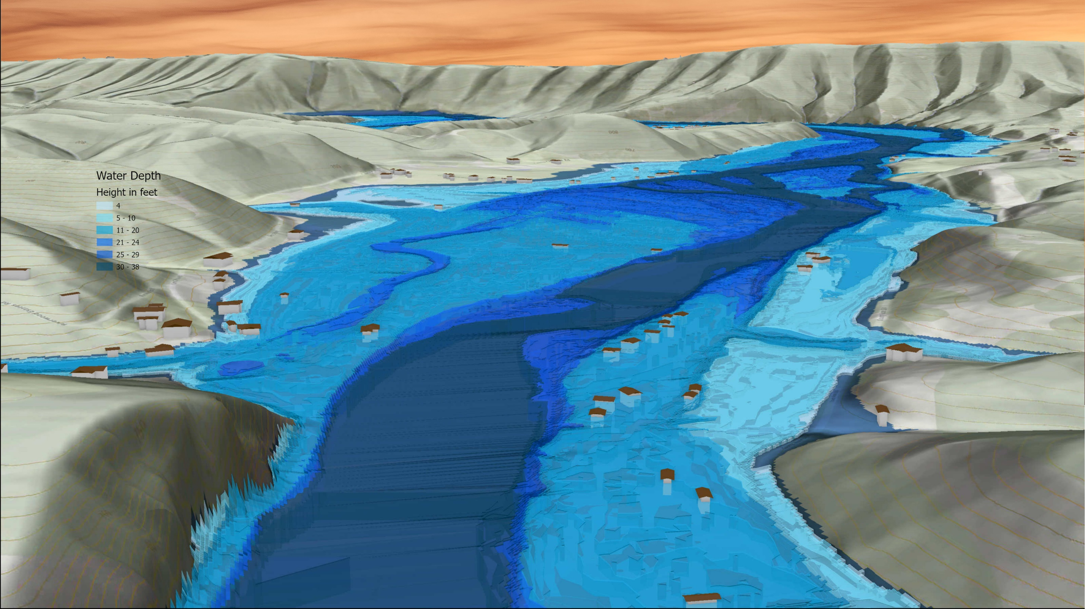
FEMA 1% Annual Chance (100-year)
Hampshire Unincorporated Area, WV
South Branch Potomac River
South Branch Potomac River

