Slide 1
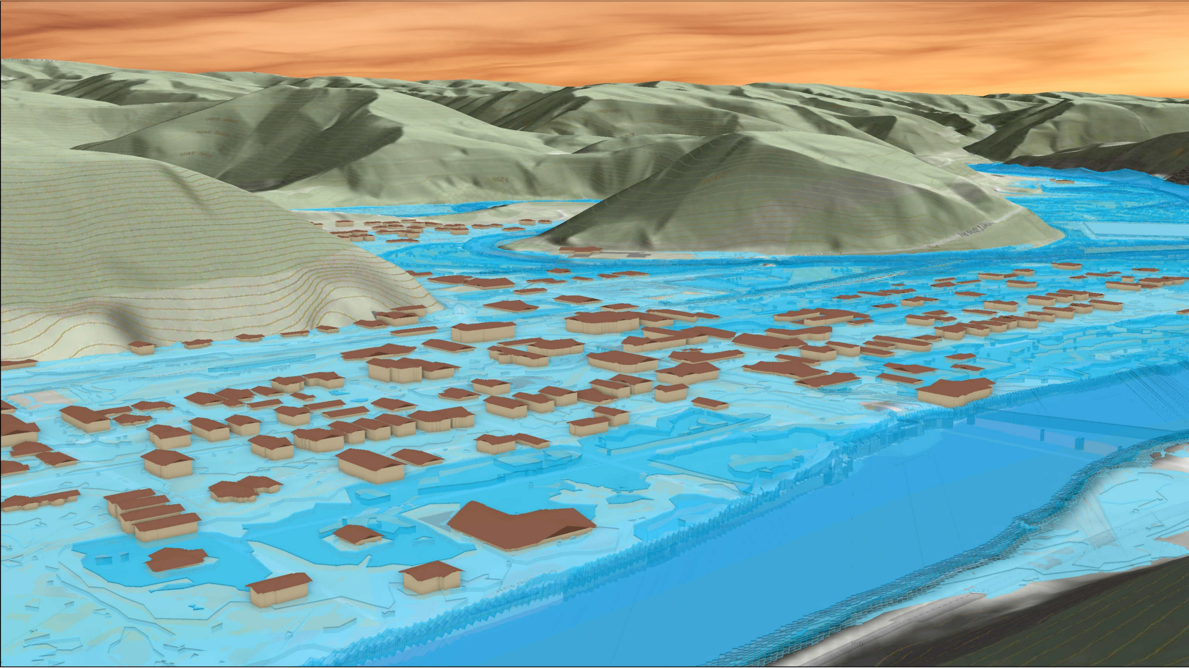
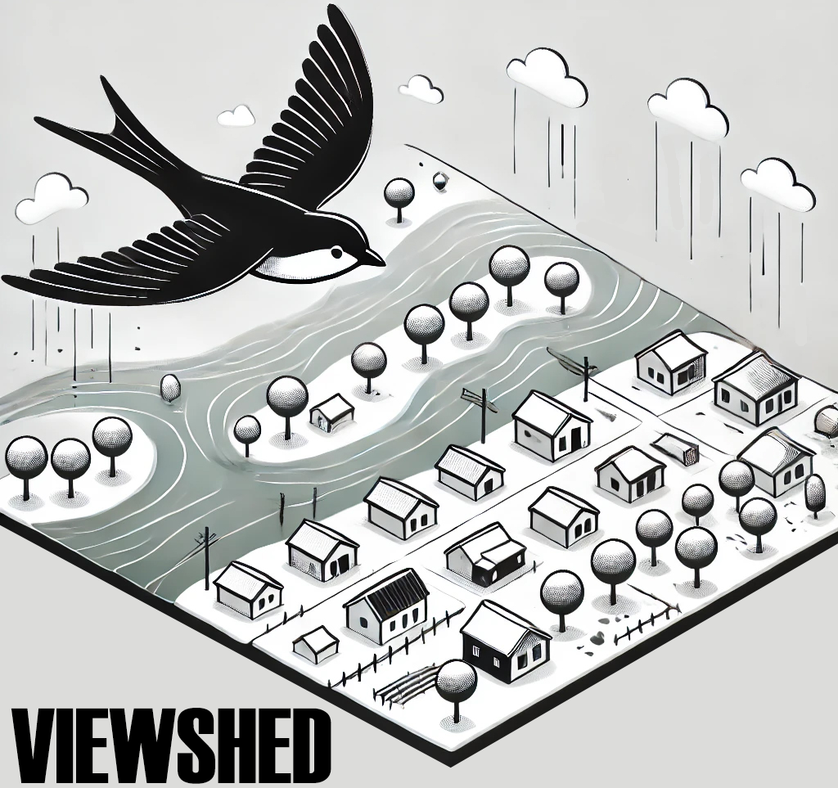
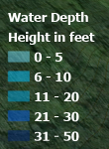
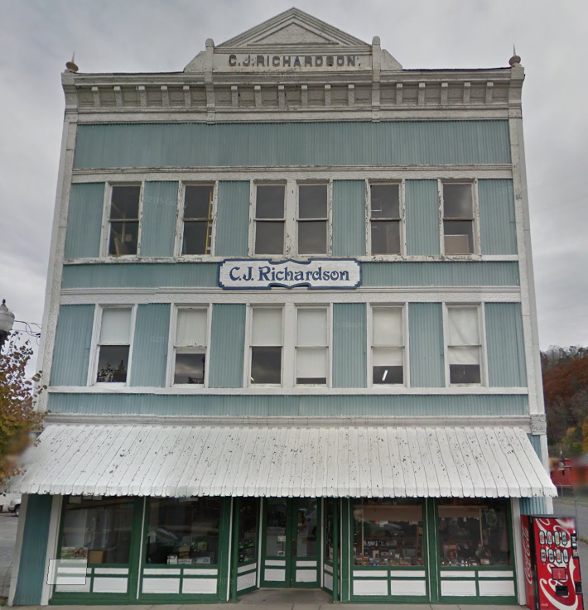
FEMA 1% Annual Chance (100-year)
Marlinton, WV
309 8th St, Marlinton, WV, 24954
Knapp Creek
Greenbrier River

