Slide 1
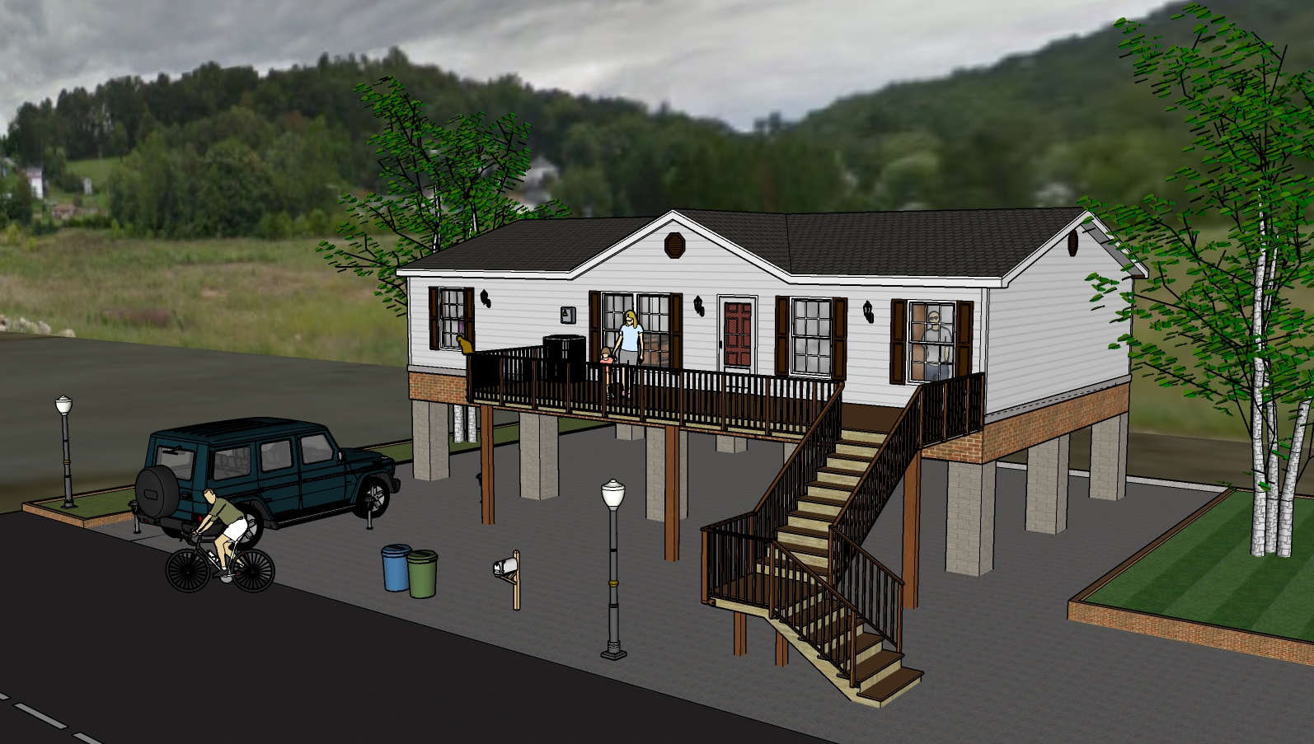
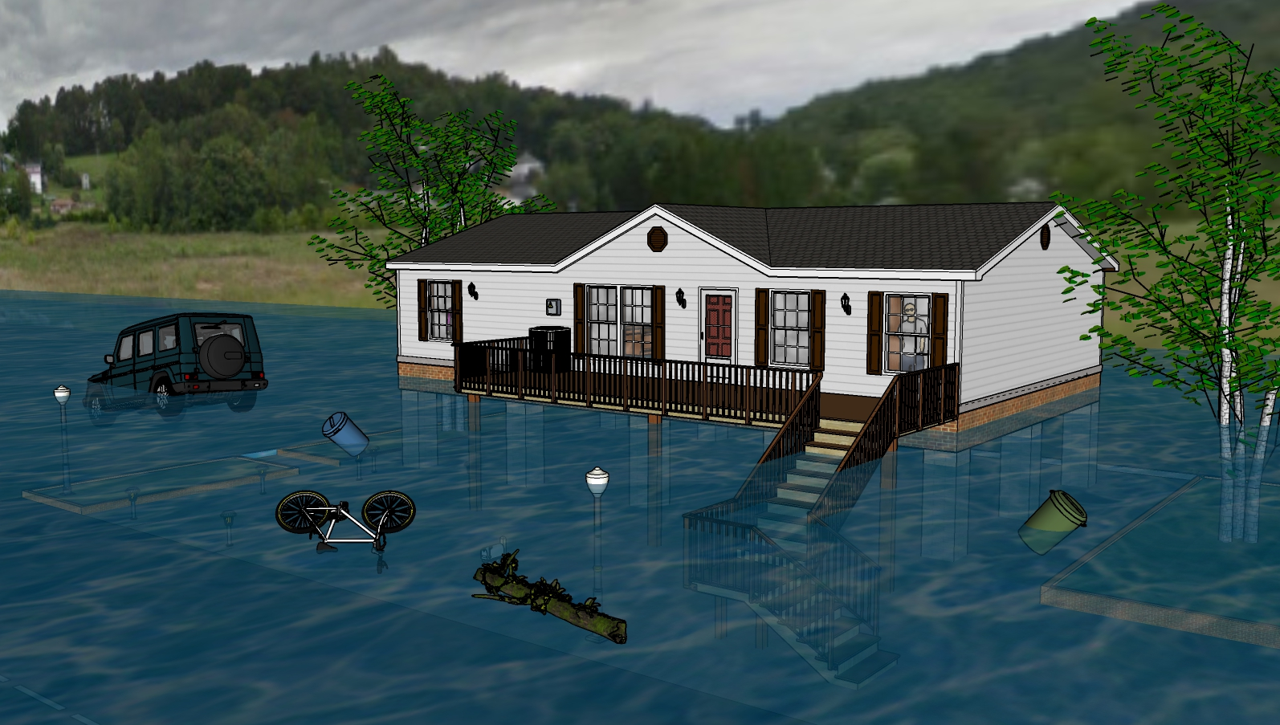
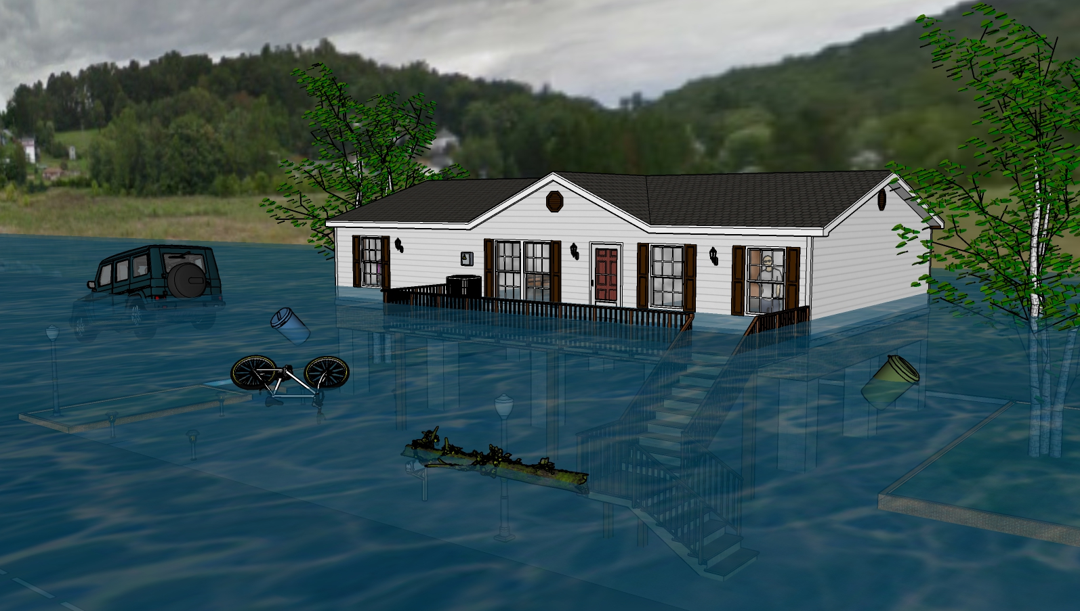
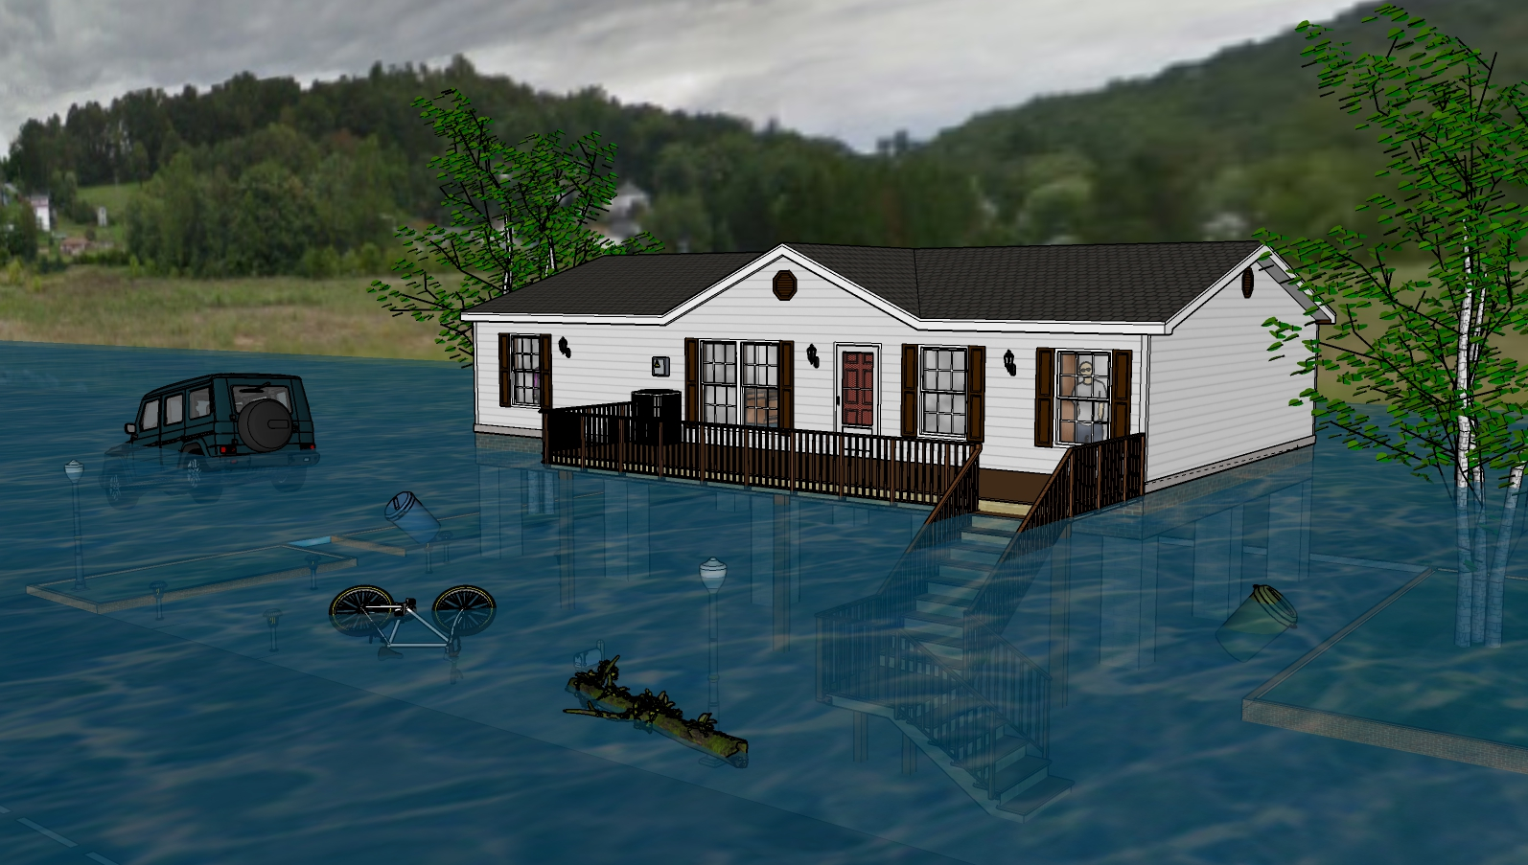
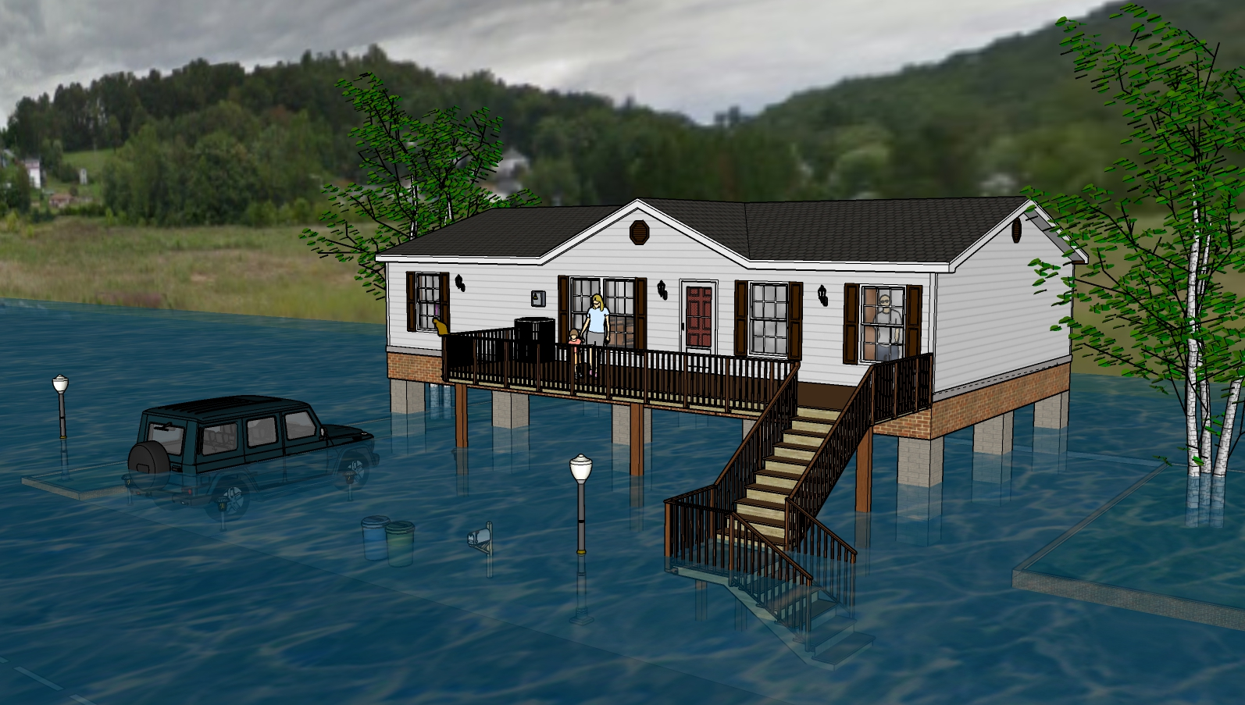
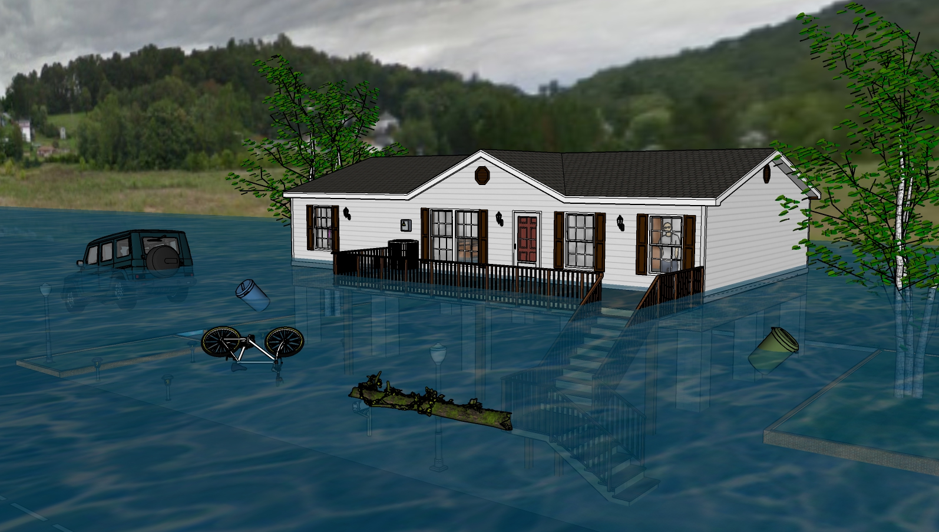
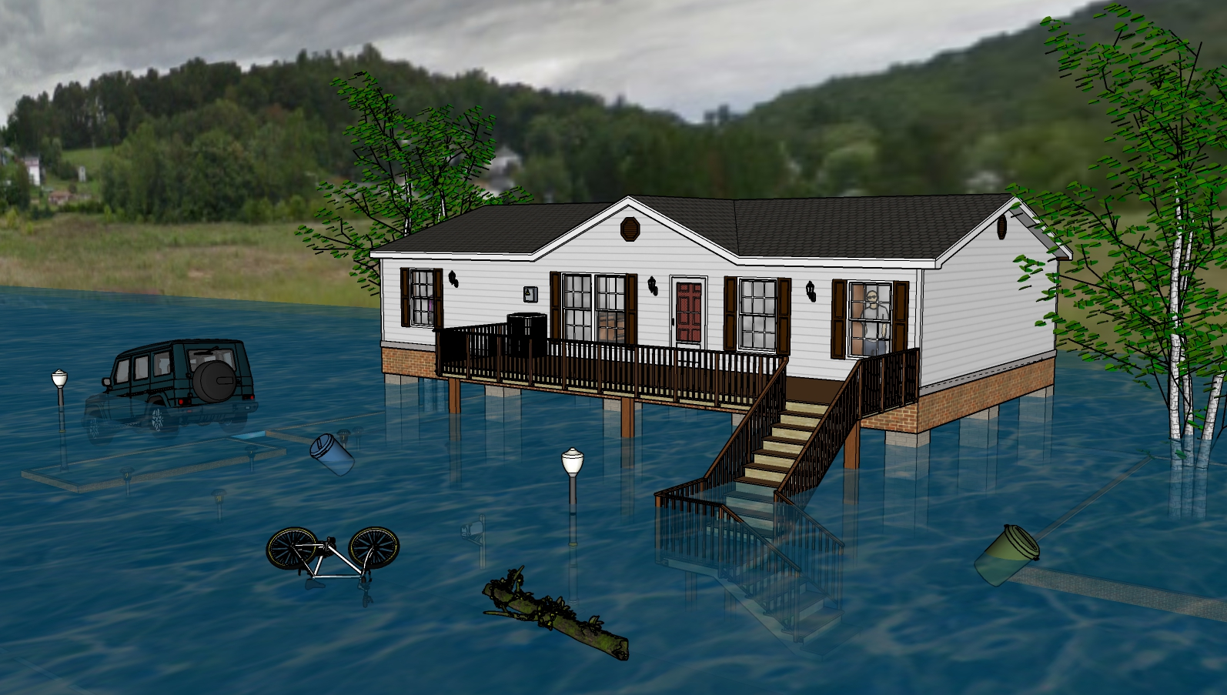
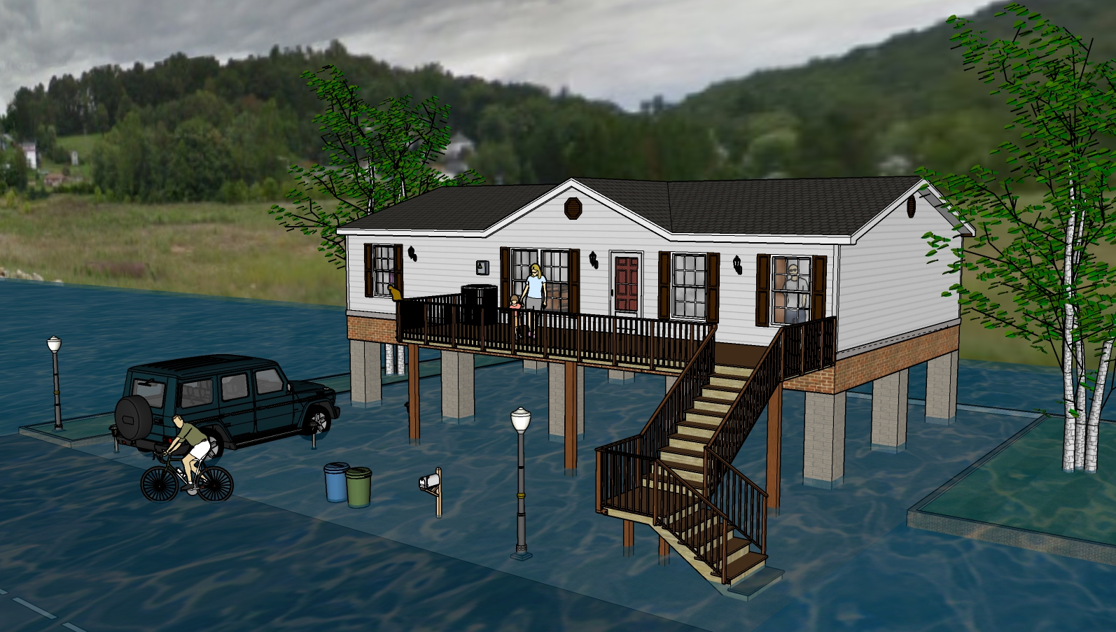
Not Inundated
8 Feet Water Depth
11 Feet Water Depth
9 Feet Water Depth
4 Feet Water Depth
10 Feet Water Depth
6 Feet Water Depth
1 Foot Water Depth
2 Feet Water Depth

Slide 2
One Foot Water Depth
8 Feet Water Depth
11 Feet Water Depth
9 Feet Water Depth
4 Feet Water Depth
10 Feet Water Depth
6 Feet Water Depth
1 Foot Water Depth
2 Feet Water Depth

Slide 3
Two Feet Water Depth
8 Feet Water Depth
11 Feet Water Depth
9 Feet Water Depth
4 Feet Water Depth
10 Feet Water Depth
6 Feet Water Depth
1 Foot Water Depth
2 Feet Water Depth

Slide 4
Four Feet Water Depth
8 Feet Water Depth
11 Feet Water Depth
9 Feet Water Depth
4 Feet Water Depth
10 Feet Water Depth
6 Feet Water Depth
1 Foot Water Depth
2 Feet Water Depth

Slide 5
Six Feet Water Depth
8 Feet Water Depth
11 Feet Water Depth
9 Feet Water Depth
4 Feet Water Depth
10 Feet Water Depth
6 Feet Water Depth
1 Foot Water Depth
2 Feet Water Depth

Slide 6
Eight Feet Water Depth
8 Feet Water Depth
11 Feet Water Depth
9 Feet Water Depth
4 Feet Water Depth
10 Feet Water Depth
6 Feet Water Depth
1 Foot Water Depth
2 Feet Water Depth

Slide 7
Nine Feet Water Depth
8 Feet Water Depth
11 Feet Water Depth
9 Feet Water Depth
4 Feet Water Depth
10 Feet Water Depth
6 Feet Water Depth
1 Foot Water Depth
2 Feet Water Depth

Slide 8
Ten Feet Water Depth
8 Feet Water Depth
11 Feet Water Depth
9 Feet Water Depth
4 Feet Water Depth
10 Feet Water Depth
6 Feet Water Depth
1 Foot Water Depth
2 Feet Water Depth

Slide 9
Eleven Feet Water Depth
8 Feet Water Depth
11 Feet Water Depth
9 Feet Water Depth
4 Feet Water Depth
10 Feet Water Depth
6 Feet Water Depth
1 Foot Water Depth
2 Feet Water Depth

Slide 10
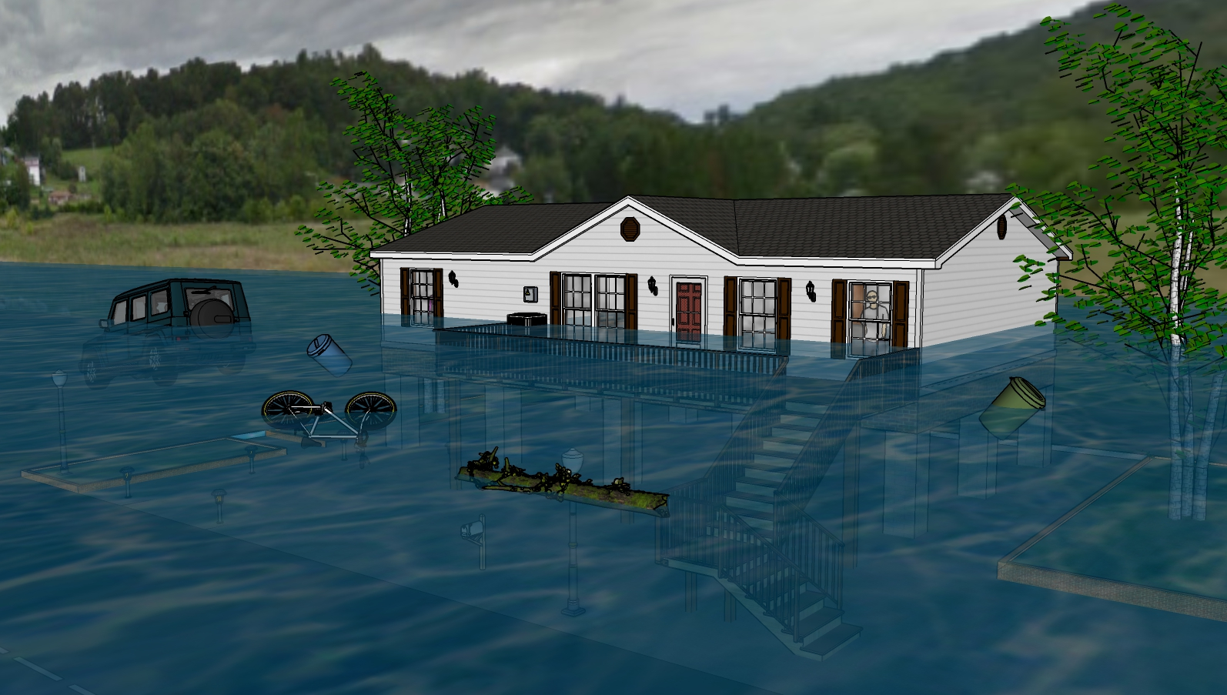
Twelve Feet Water Depth
8 Feet Water Depth
11 Feet Water Depth
9 Feet Water Depth
4 Feet Water Depth
10 Feet Water Depth
6 Feet Water Depth
1 Foot Water Depth
2 Feet Water Depth

Slide 11
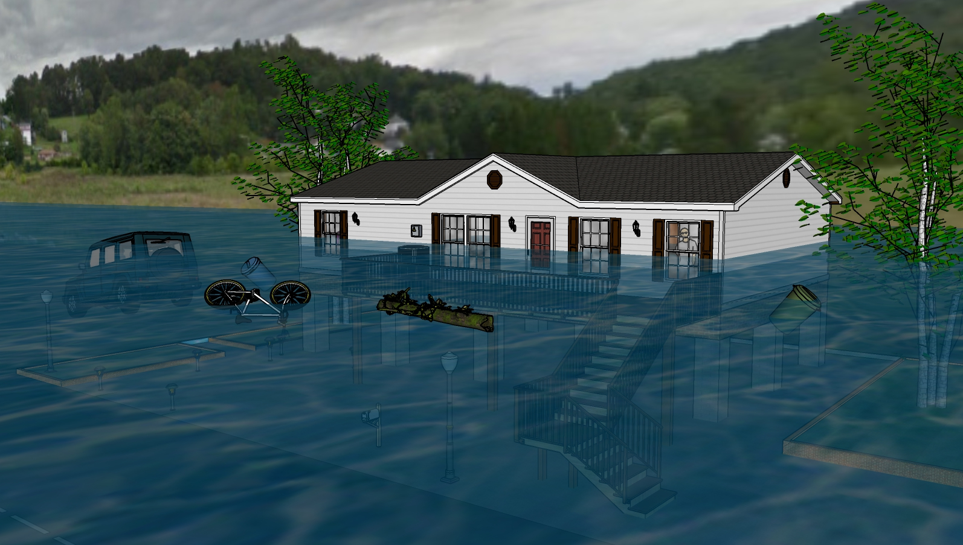
Thirteen Feet Water Depth
8 Feet Water Depth
11 Feet Water Depth
9 Feet Water Depth
4 Feet Water Depth
10 Feet Water Depth
6 Feet Water Depth
1 Foot Water Depth
2 Feet Water Depth

Slide 12
Fourteen Feet Water Depth
8 Feet Water Depth
11 Feet Water Depth
9 Feet Water Depth
4 Feet Water Depth
10 Feet Water Depth
6 Feet Water Depth
1 Foot Water Depth
2 Feet Water Depth

