Slide 1
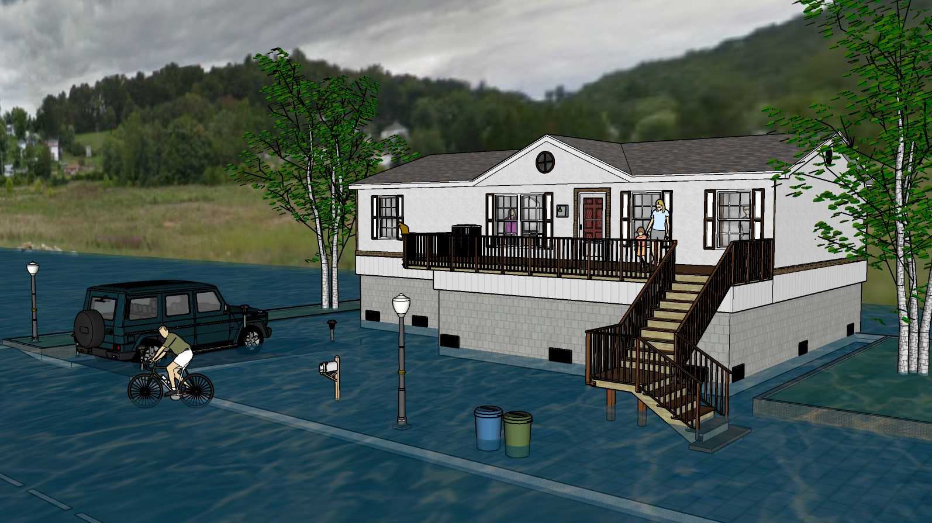
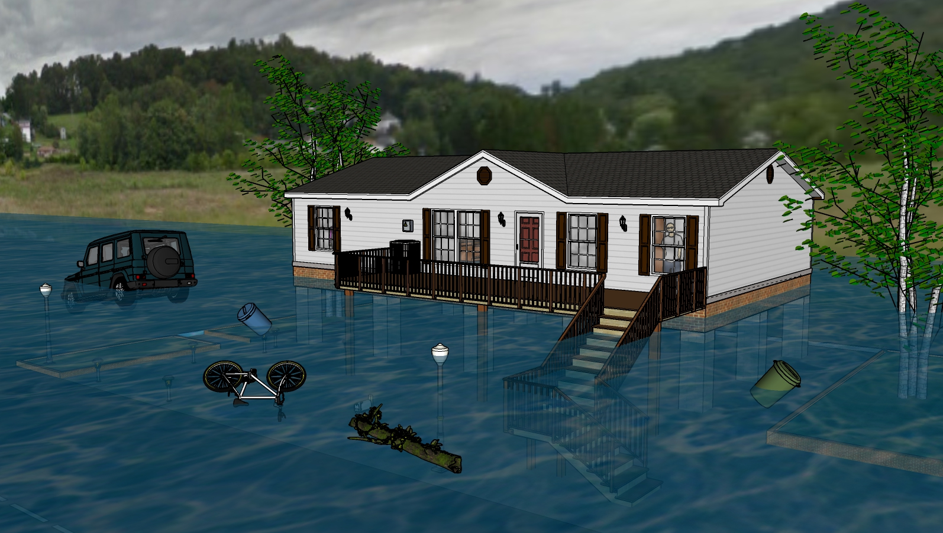
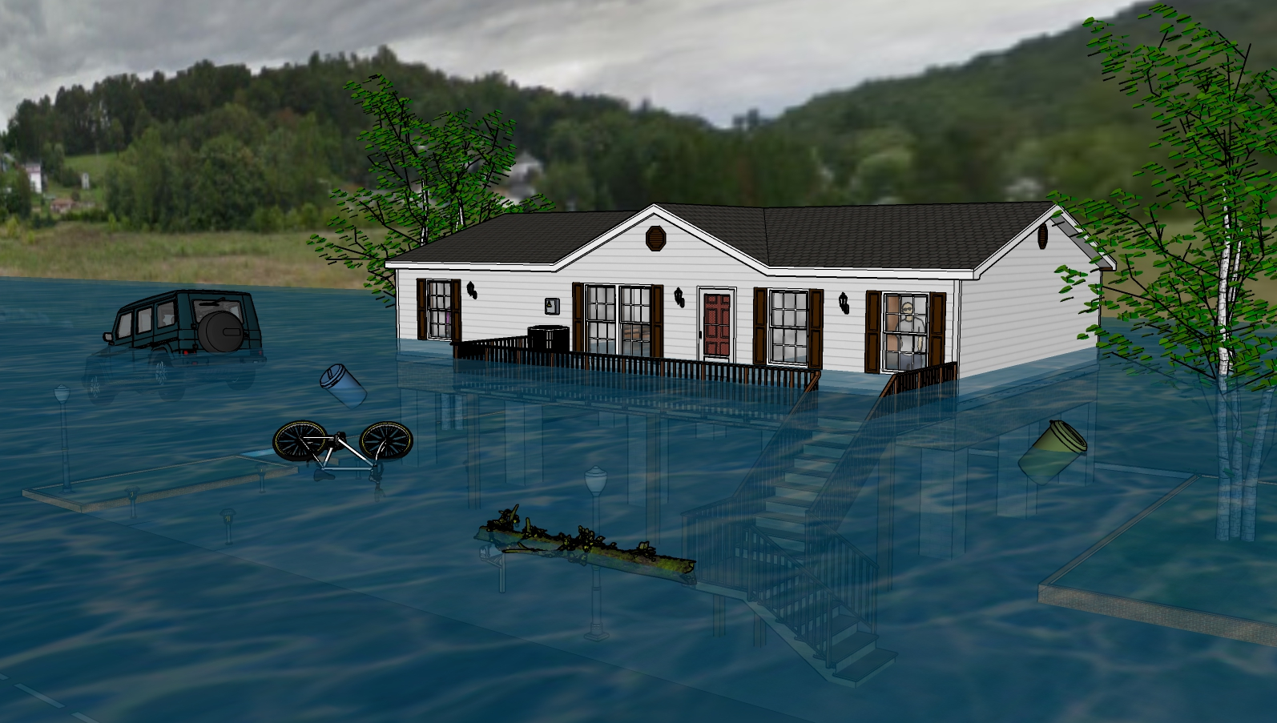
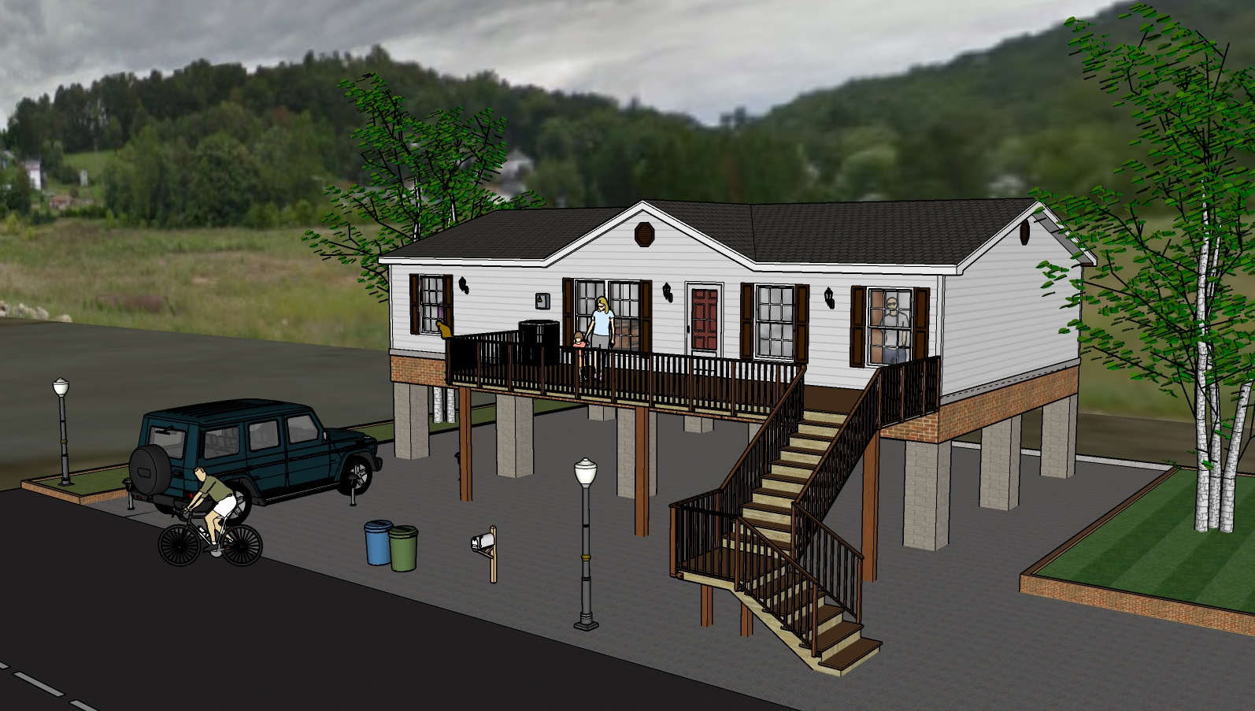
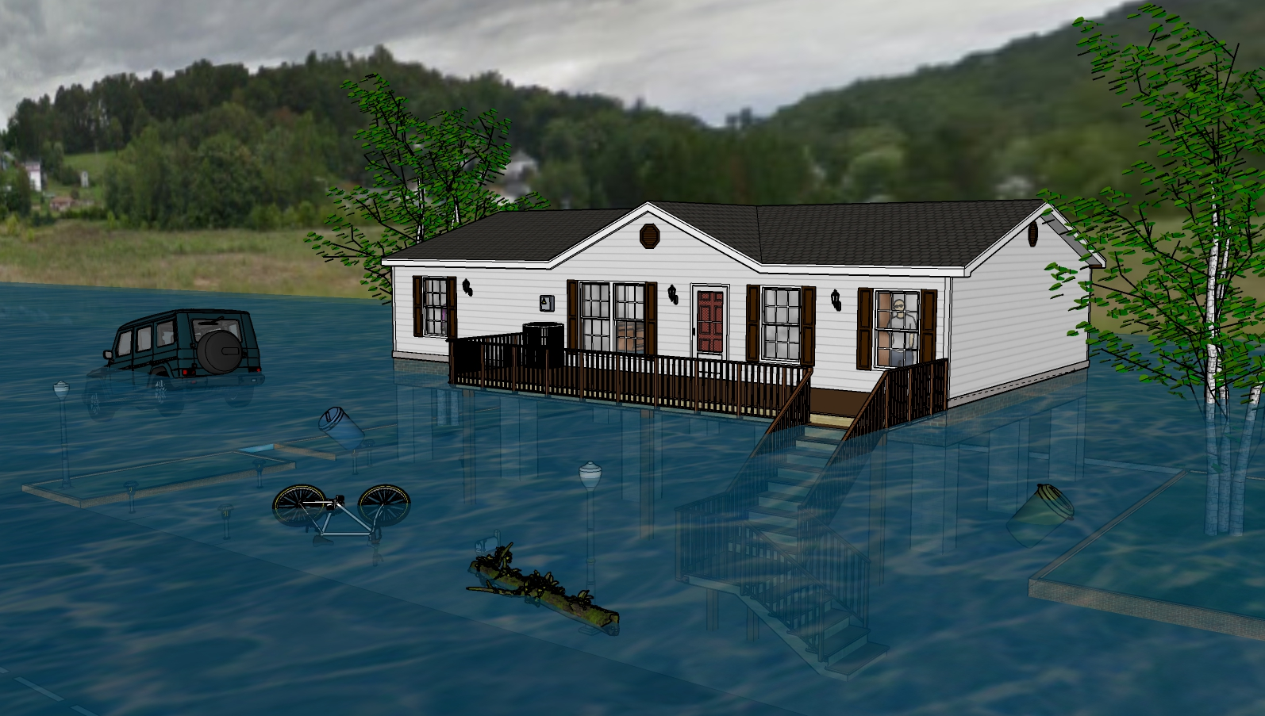
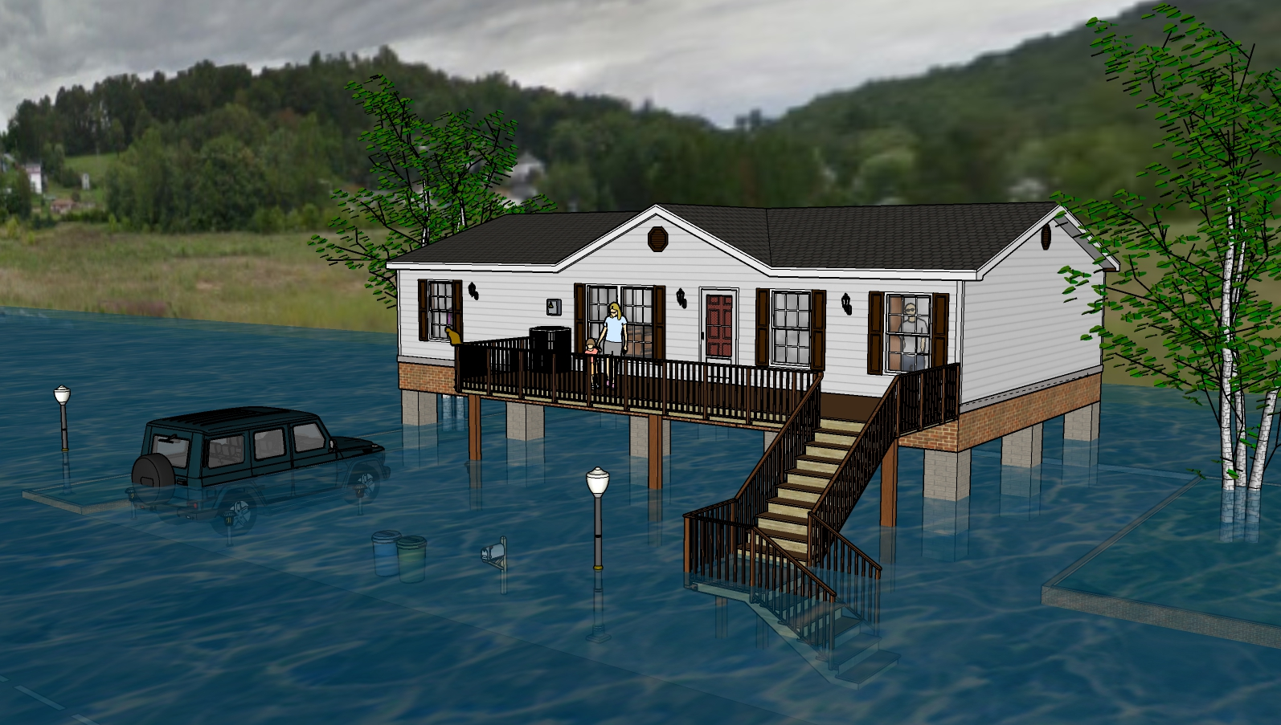
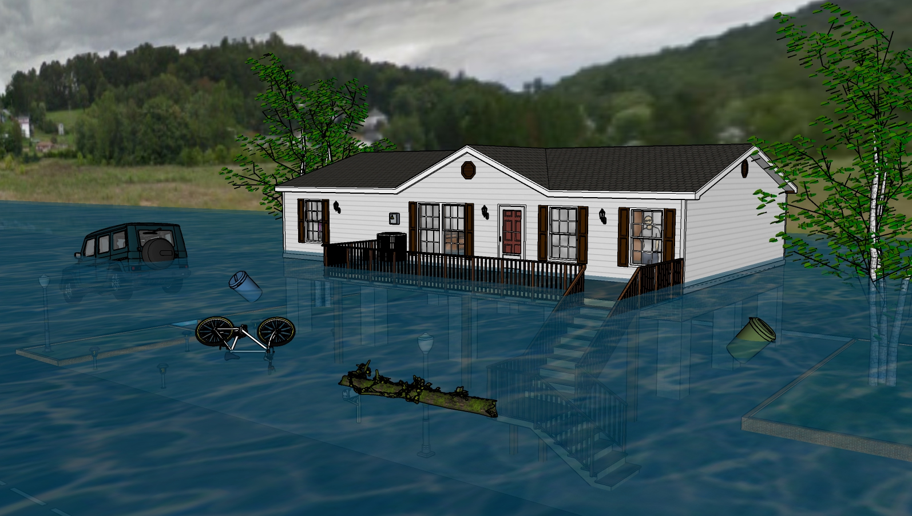
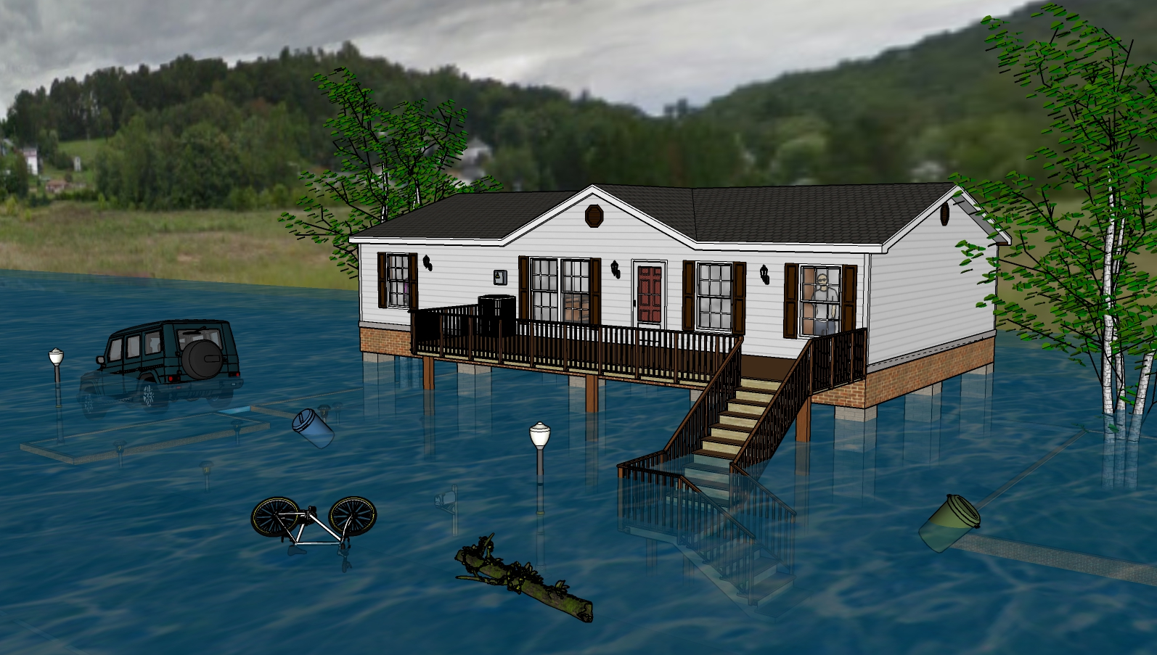
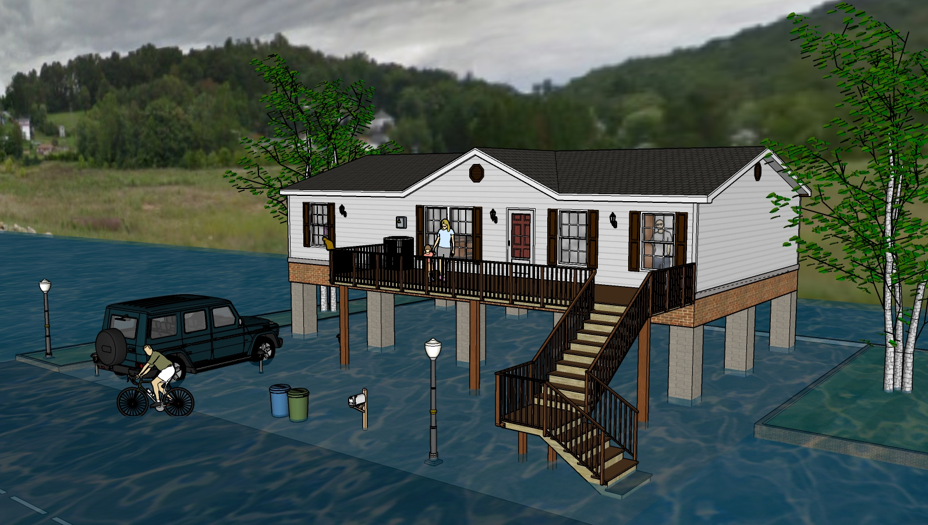
One Foot Water Depth
8 Feet Water Depth
11 Feet Water Depth
9 Feet Water Depth
4 Feet Water Depth
10 Feet Water Depth
6 Feet Water Depth
1 Foot Water Depth
2 Feet Water Depth

Slide 2
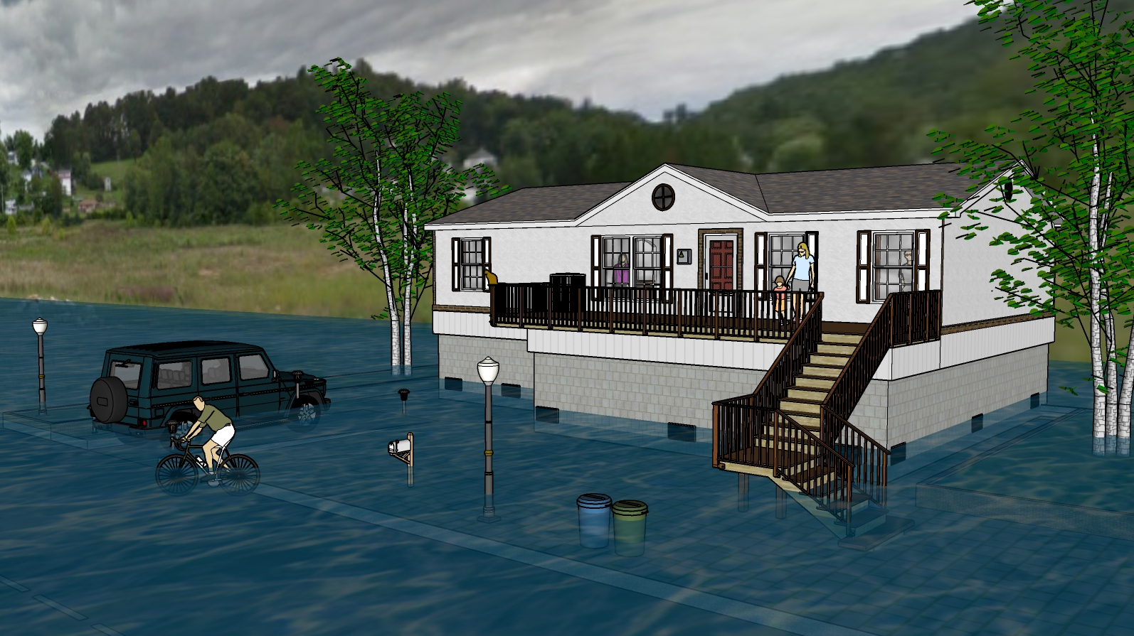
Two Feet Water Depth
8 Feet Water Depth
11 Feet Water Depth
9 Feet Water Depth
4 Feet Water Depth
10 Feet Water Depth
6 Feet Water Depth
1 Foot Water Depth
2 Feet Water Depth

Slide 3
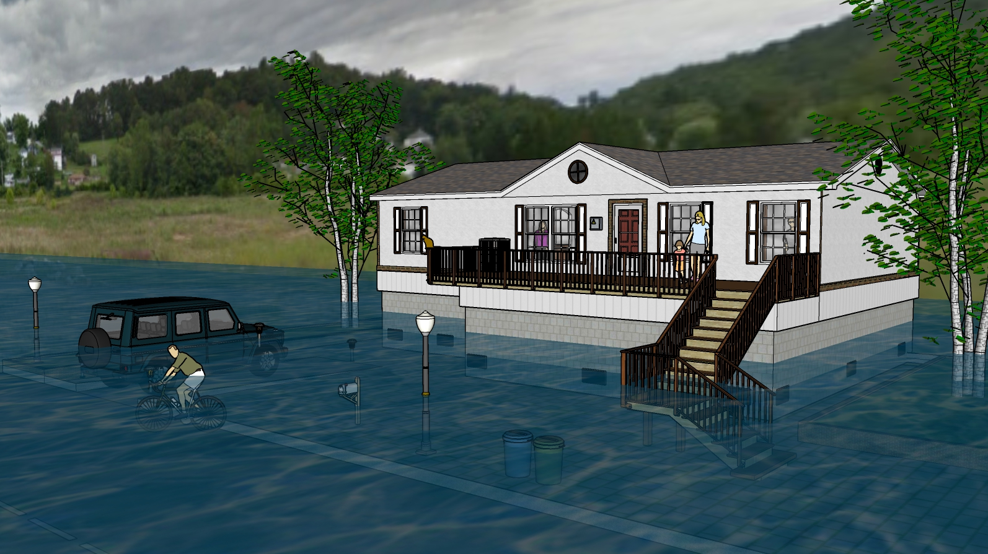
Four Feet Water Depth
8 Feet Water Depth
11 Feet Water Depth
9 Feet Water Depth
4 Feet Water Depth
10 Feet Water Depth
6 Feet Water Depth
1 Foot Water Depth
2 Feet Water Depth

Slide 4
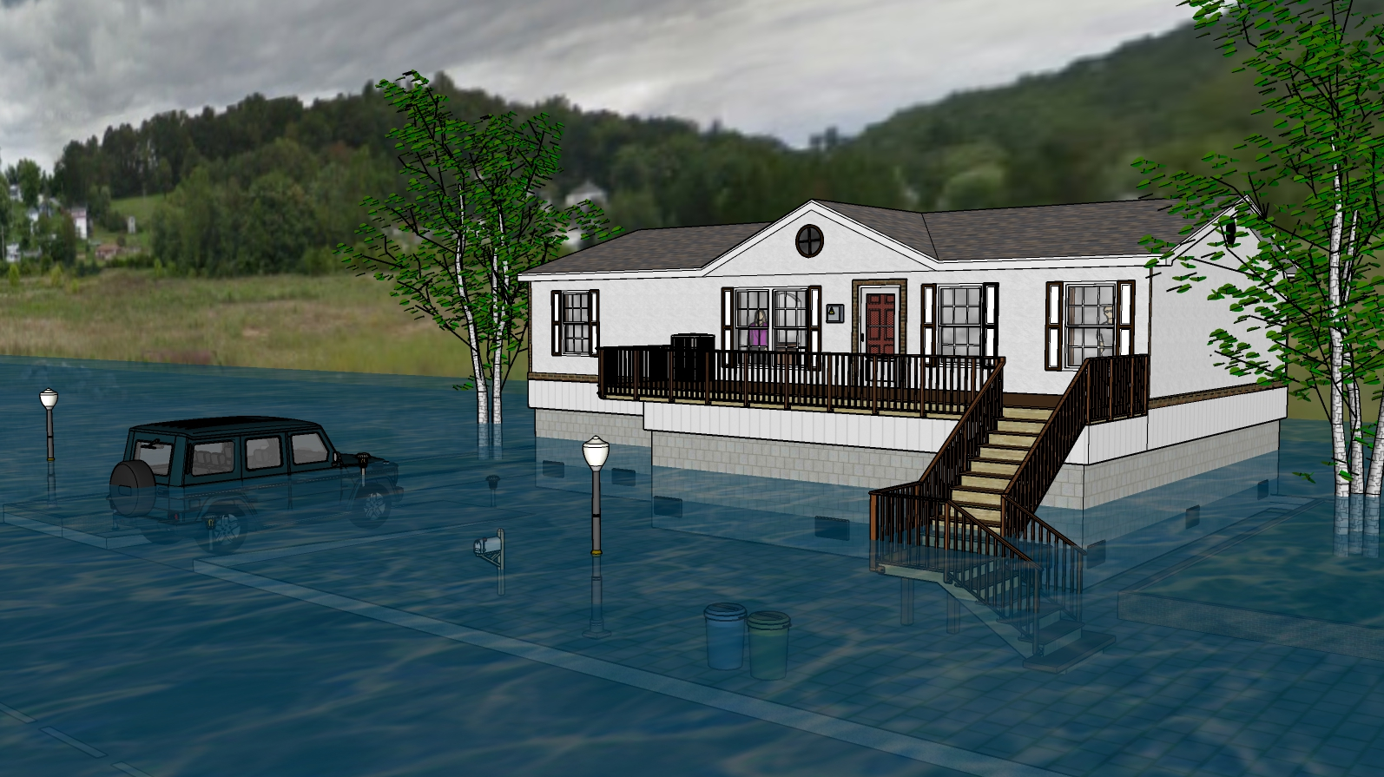
Six Feet Water Depth
8 Feet Water Depth
11 Feet Water Depth
9 Feet Water Depth
4 Feet Water Depth
10 Feet Water Depth
6 Feet Water Depth
1 Foot Water Depth
2 Feet Water Depth

Slide 5
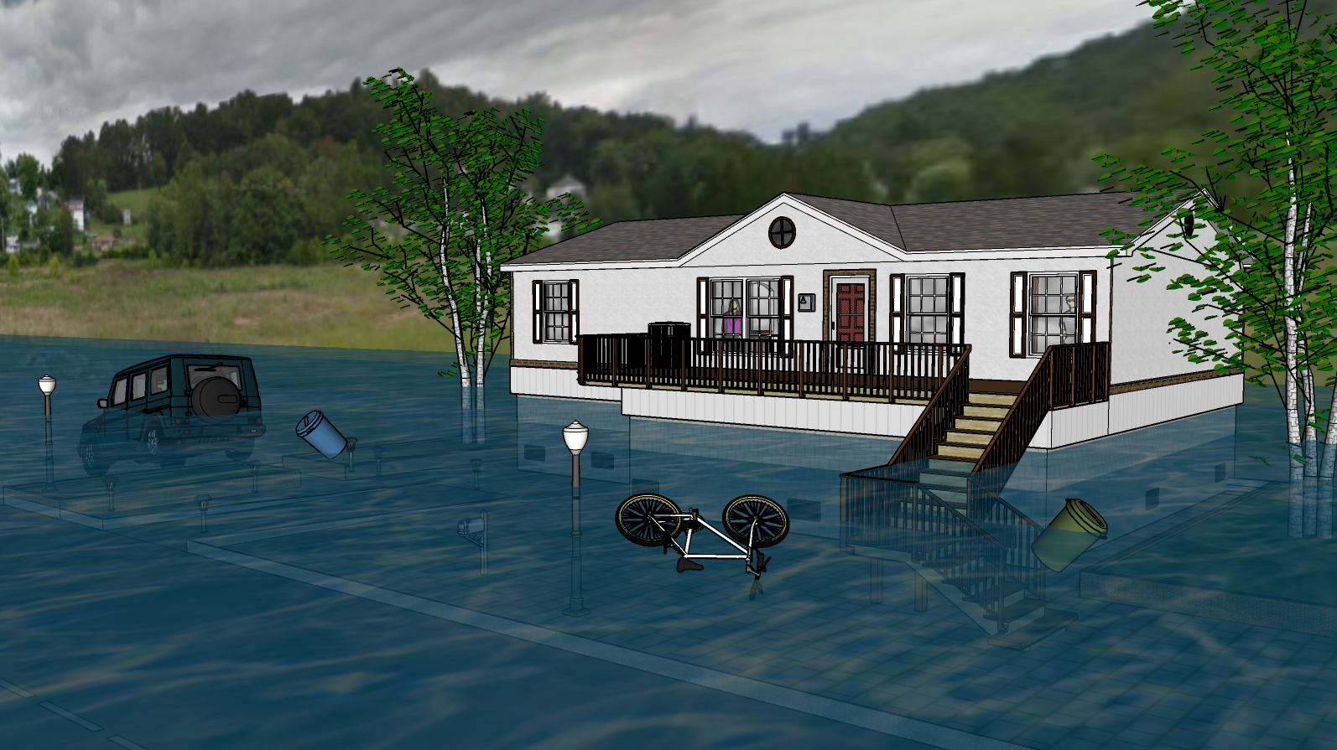
Eight Feet Water Depth
8 Feet Water Depth
11 Feet Water Depth
9 Feet Water Depth
4 Feet Water Depth
10 Feet Water Depth
6 Feet Water Depth
1 Foot Water Depth
2 Feet Water Depth

Slide 6
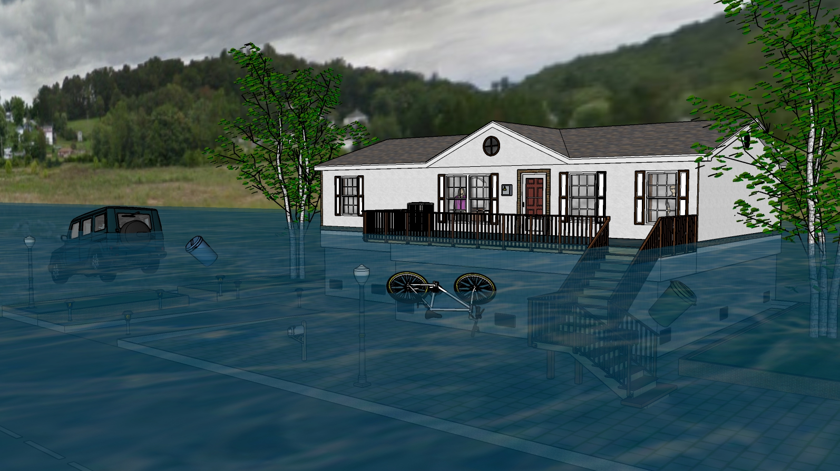
Nine Feet Water Depth
8 Feet Water Depth
11 Feet Water Depth
9 Feet Water Depth
4 Feet Water Depth
10 Feet Water Depth
6 Feet Water Depth
1 Foot Water Depth
2 Feet Water Depth

Slide 7
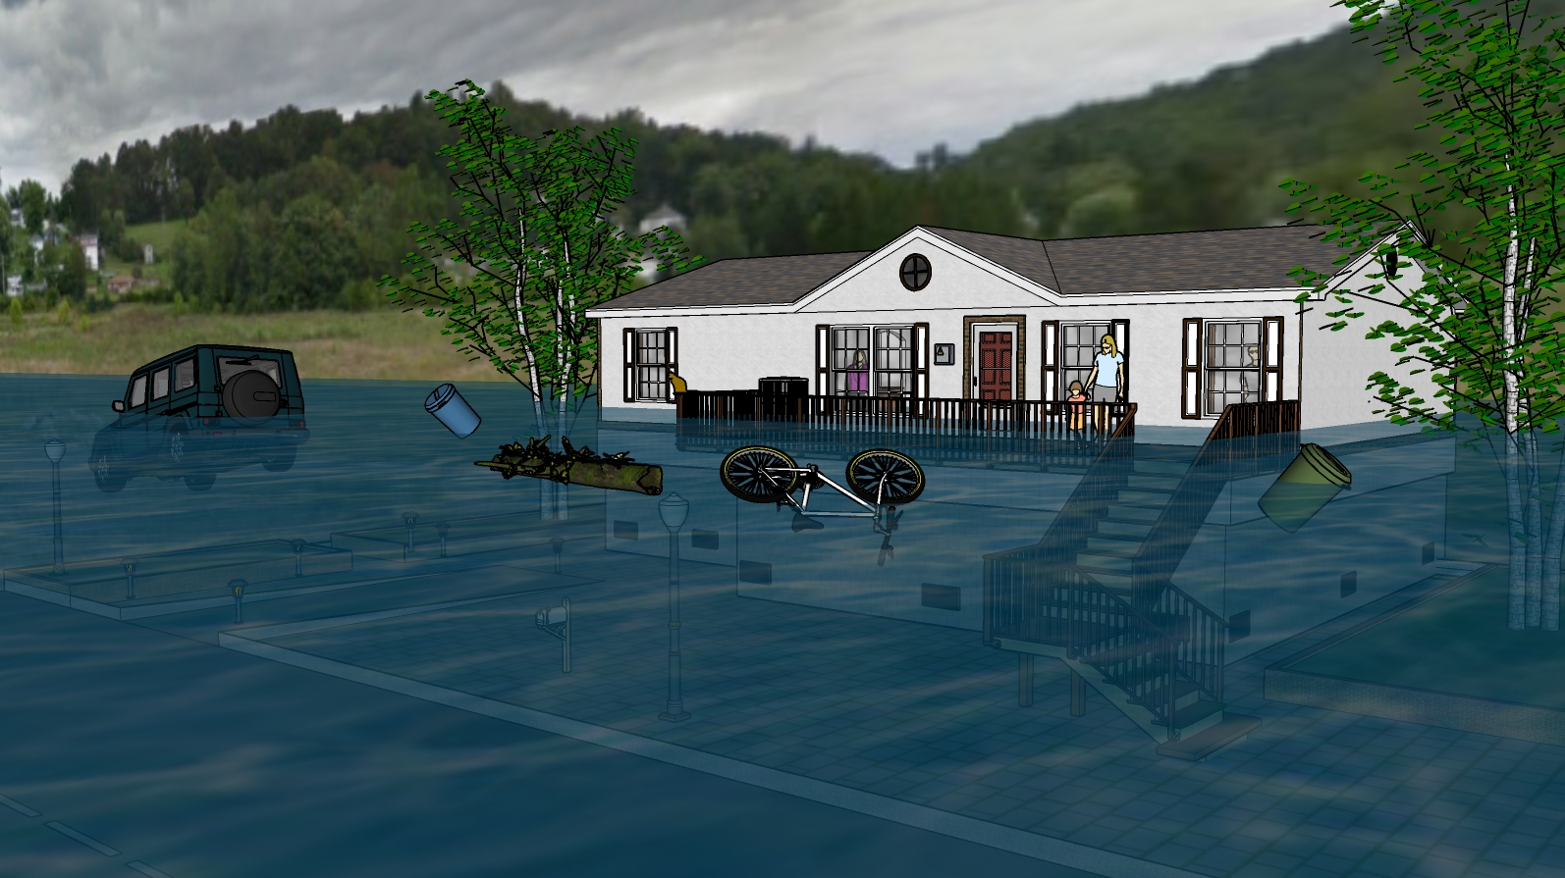
Ten Feet Water Depth
8 Feet Water Depth
11 Feet Water Depth
9 Feet Water Depth
4 Feet Water Depth
10 Feet Water Depth
6 Feet Water Depth
1 Foot Water Depth
2 Feet Water Depth

Slide 8
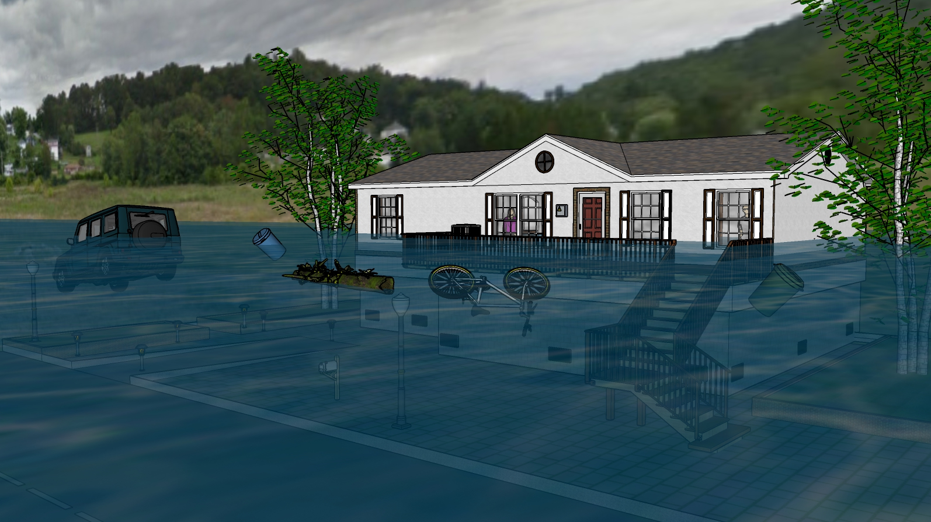
Eleven Feet Water Depth
8 Feet Water Depth
11 Feet Water Depth
9 Feet Water Depth
4 Feet Water Depth
10 Feet Water Depth
6 Feet Water Depth
1 Foot Water Depth
2 Feet Water Depth

Slide 9
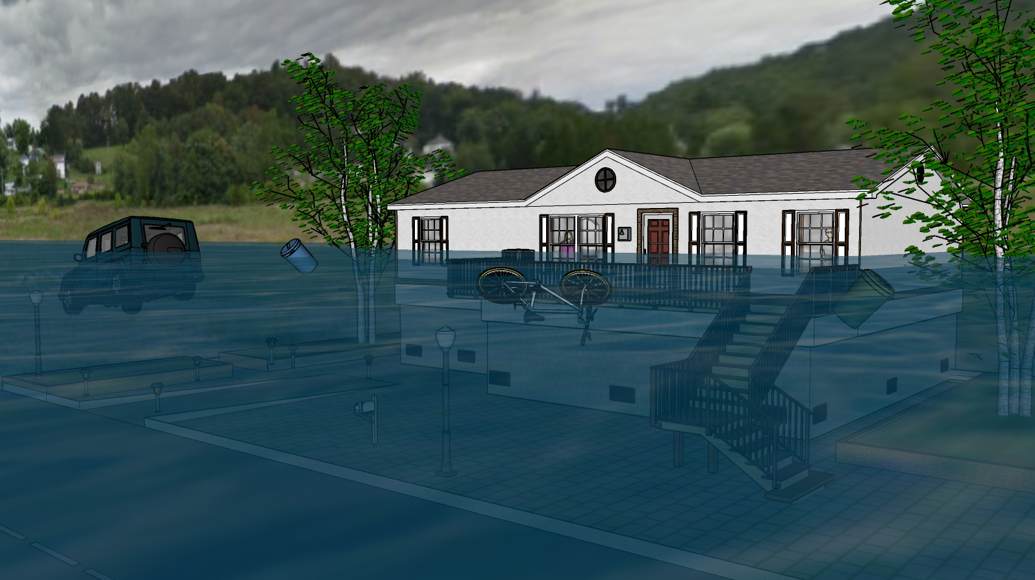
Twelve Feet Water Depth
8 Feet Water Depth
11 Feet Water Depth
9 Feet Water Depth
4 Feet Water Depth
10 Feet Water Depth
6 Feet Water Depth
1 Foot Water Depth
2 Feet Water Depth

Slide 10
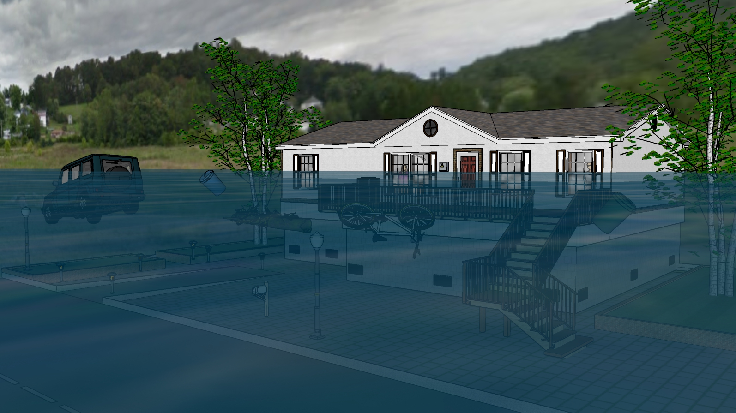
Thirteen Feet Water Depth
8 Feet Water Depth
11 Feet Water Depth
9 Feet Water Depth
4 Feet Water Depth
10 Feet Water Depth
6 Feet Water Depth
1 Foot Water Depth
2 Feet Water Depth

Slide 11
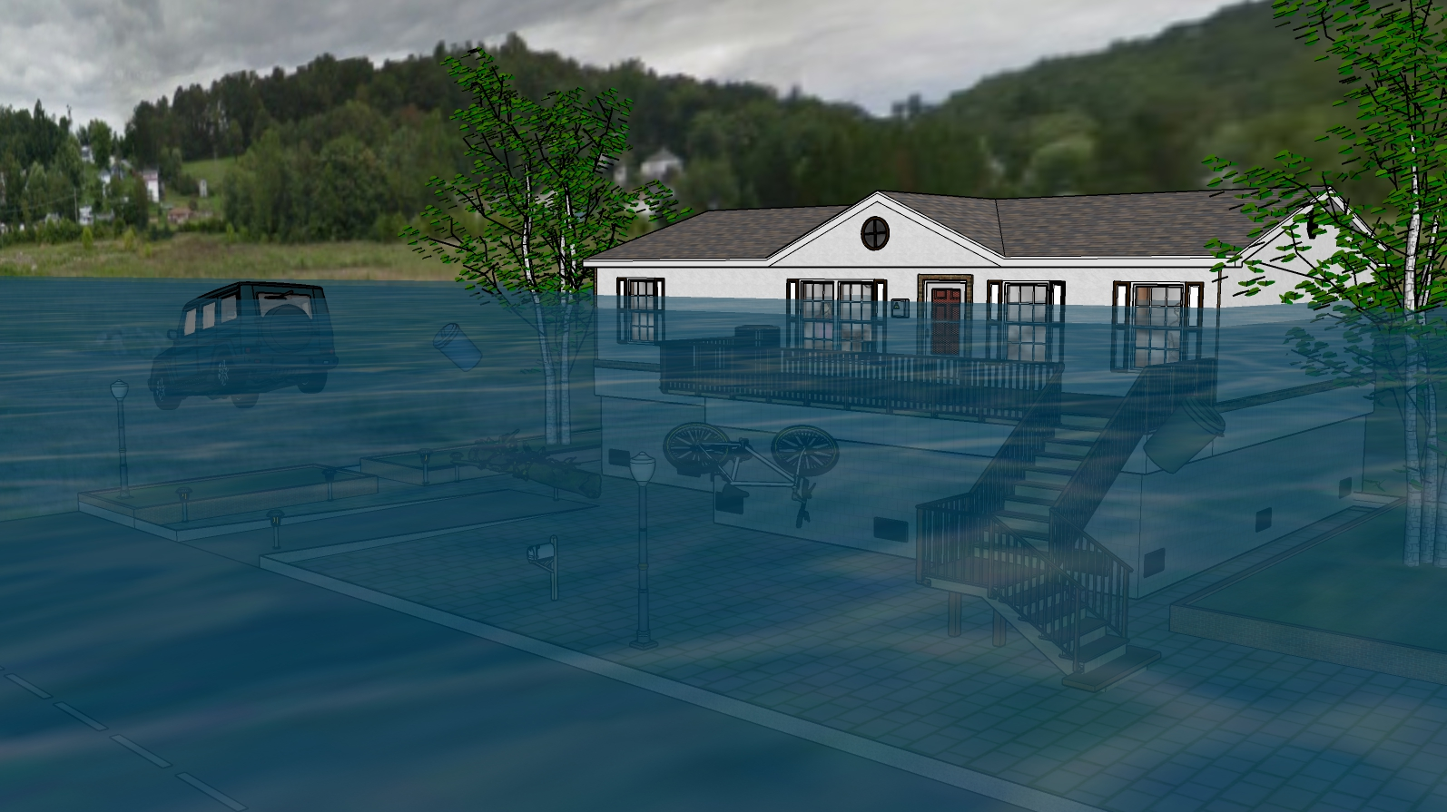
Fourteen Feet Water Depth
8 Feet Water Depth
11 Feet Water Depth
9 Feet Water Depth
4 Feet Water Depth
10 Feet Water Depth
6 Feet Water Depth
1 Foot Water Depth
2 Feet Water Depth

