Slide 1
Federally-Declared Flood Disasters
(DCL DSTR)
West Virginia University WV GIS Technical Center
April 2024

Slide 2
Declared Flood Disasters
Major Category | Detailed Category | Code | Indicator | Short Description | Unit
Flood Hazard Risk | Declared Disasters | DCL_DSTR | Declared Flood Disasters | Number of federally-declared flood disasters in the county since 1953 | #
Rationale | Recommendations | Data Source
Previous disasters indicate potential for future risk. In addition, the recentness of a flood disaster has proven to increase communities' willingness to seek/accept change/mitigation. In West Virginia, many flood control structures (e.g., dams, levees, flood walls) built in the 20th Century have decreased the number of major flood disasters. | A major disaster declaration provides a wide range of federal assistance programs for individuals and public infrastructure, including funds for both emergency and permanent work. Historical flooding including high water marks should be incorporated into communities’ flood reduction efforts to include areas of mitigation interest. | Open FEMA

Slide 3
Declared Flood Disasters; Rankings
Top 20% Ranking:
NAME | WV RPDC Region | Declared Disasters | Last Disaster | Percent Rank Declared Disasters | Score Category
Mingo County, West Virginia | 2 | 28 | 3/4/2021 | 100.0% | Very High
Lincoln County, West Virginia | 2 | 27 | 3/4/2021 | 96.3% | Very High
Logan County, West Virginia | 2 | 27 | 3/4/2021 | 96.3% | Very High
Kanawha County, West Virginia | 3 | 24 | 3/4/2021 | 94.4% | Very High
Wayne County, West Virginia | 2 | 23 | 3/4/2021 | 92.6% | Very High
Cabell County, West Virginia | 2 | 21 | 3/4/2021 | 88.9% | Very High
Wyoming County, West Virginia | 1 | 21 | 3/14/2015 | 88.9% | Very High
Boone County, West Virginia | 3 | 20 | 3/4/2021 | 85.2% | Very High
Raleigh County, West Virginia | 1 | 20 | 3/14/2015 | 85.2% | Very High
Percent Rank Declared Disasters: Percent rank score for number of declared flood disasters;
Calculated in Excel: PERCENTRANK.INC on Declared Disasters array
Score Category: Indicator class (category) based on the legend (Very High, Relatively High, Moderate, Relatively Low, or Very Low)
Scores Legend:
80 to 100 | Very High | Red text: 90 to 100 Very High
60 to 79.9 | Relatively High
40 to 59.9 | Moderate
20 to 39.9 | Relatively Low
0 to 19.9 | Very Low
Bottom 20% Ranking:
Berkeley County, West Virginia | 9 | 12 | 7/8/2012 | 14.8% | Very Low
Grant County, West Virginia | 8 | 12 | 6/30/2019 | 14.8% | Very Low
Jefferson County, West Virginia | 9 | 12 | 6/3/2018 | 14.8% | Very Low
Ritchie County, West Virginia | 5 | 12 | 4/11/2015 | 14.8% | Very Low
Hampshire County, West Virginia | 8 | 11 | 6/3/2018 | 5.6% | Very Low
Mineral County, West Virginia | 8 | 11 | 6/3/2018 | 5.6% | Very Low
Monroe County, West Virginia | 1 | 11 | 6/29/2016 | 5.6% | Very Low
Morgan County, West Virginia | 9 | 11 | 6/3/2018 | 5.6% | Very Low
Wood County, West Virginia | 5 | 11 | 7/14/2015 | 5.6% | Very Low
Brooke County, West Virginia | 11 | 9 | 4/11/2015 | 0.0% | Very Low
Hancock County, West Virginia | 11 | 9 | 11/8/2012 | 0.0% | Very Low
Pleasants County, West Virginia | 5 | 9 | 4/15/2015 | 0.0% | Very Low
Total federally-declared flood disasters in West Virginia: | 64
Total in USA: | 2,397

Slide 4
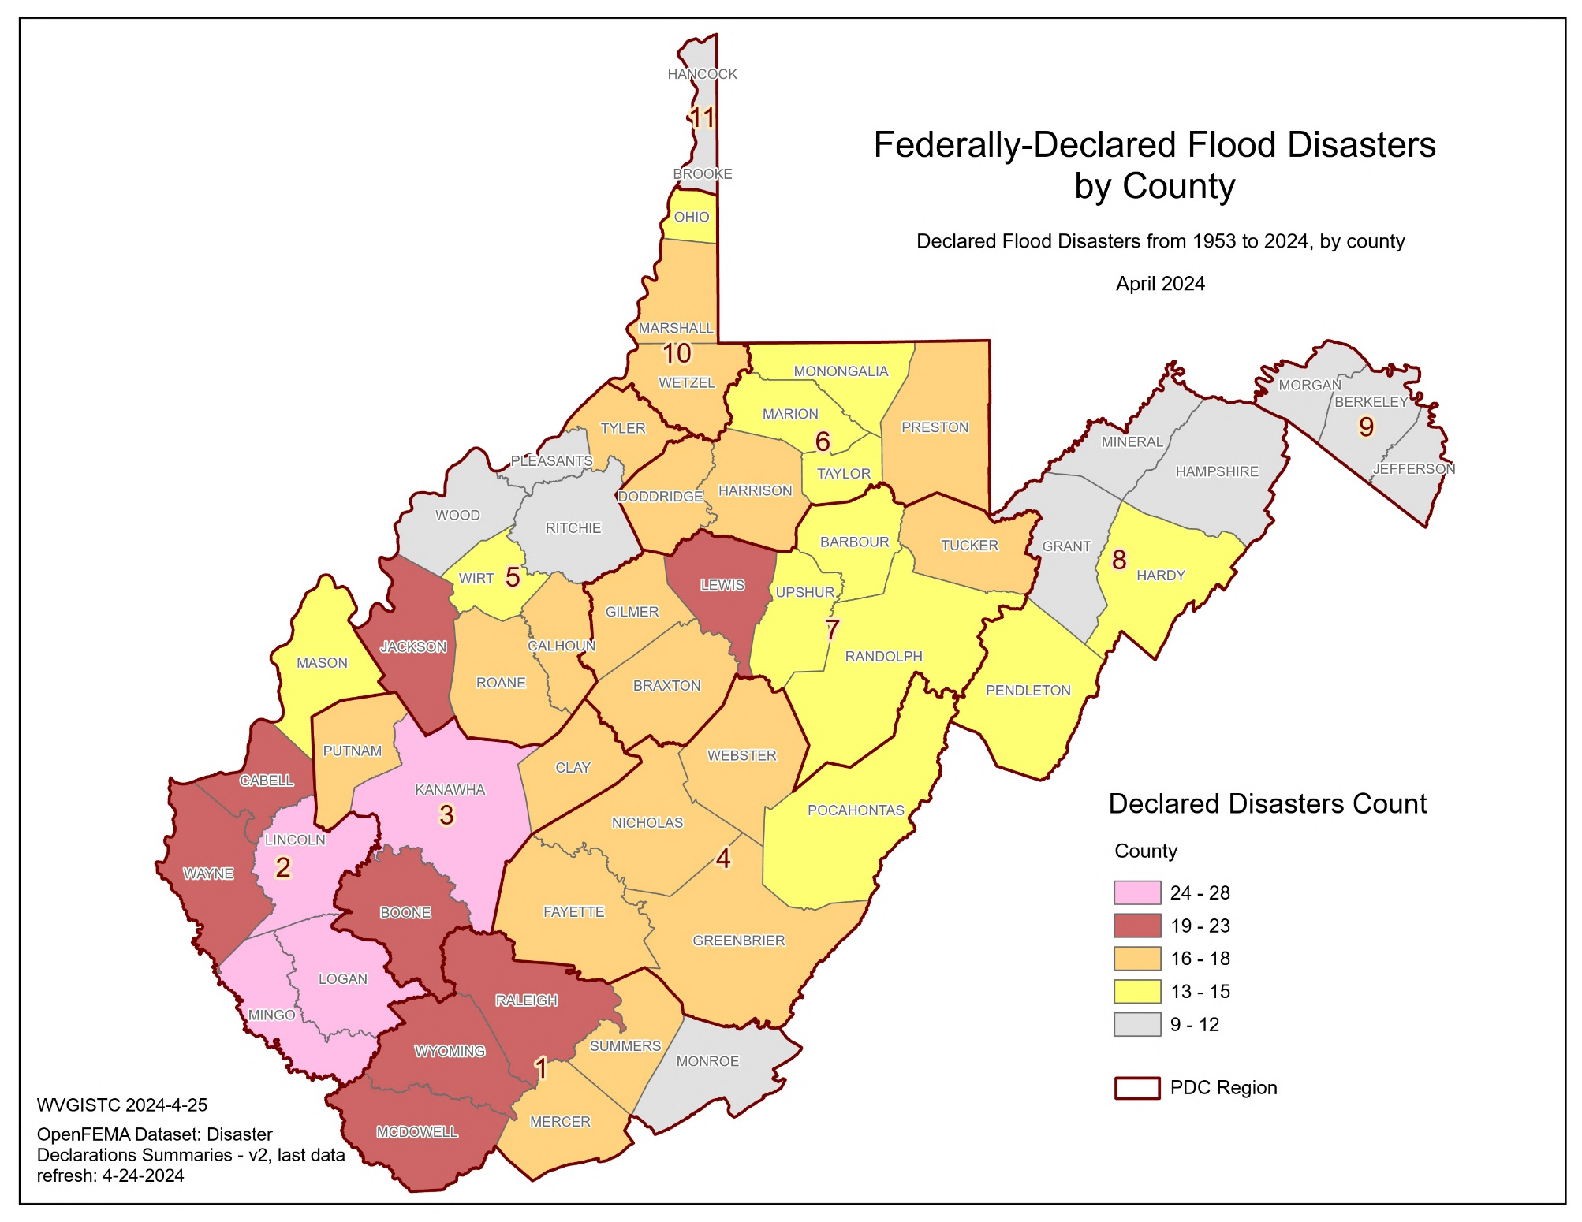
Declared Flood Disasters; Maps
Top 5 Counties | RPDC Region | Federally-Declared Flood Disasters | Last Disaster Date
Mingo | 2 | 28 | 3/4/2021
Lincoln | 2 | 27 | 3/4/2021
Logan | 2 | 27 | 3/4/2021
Kanawha | 3 | 24 | 3/4/2021
Wayne | 2 | 23 | 3/4/2021

Slide 5
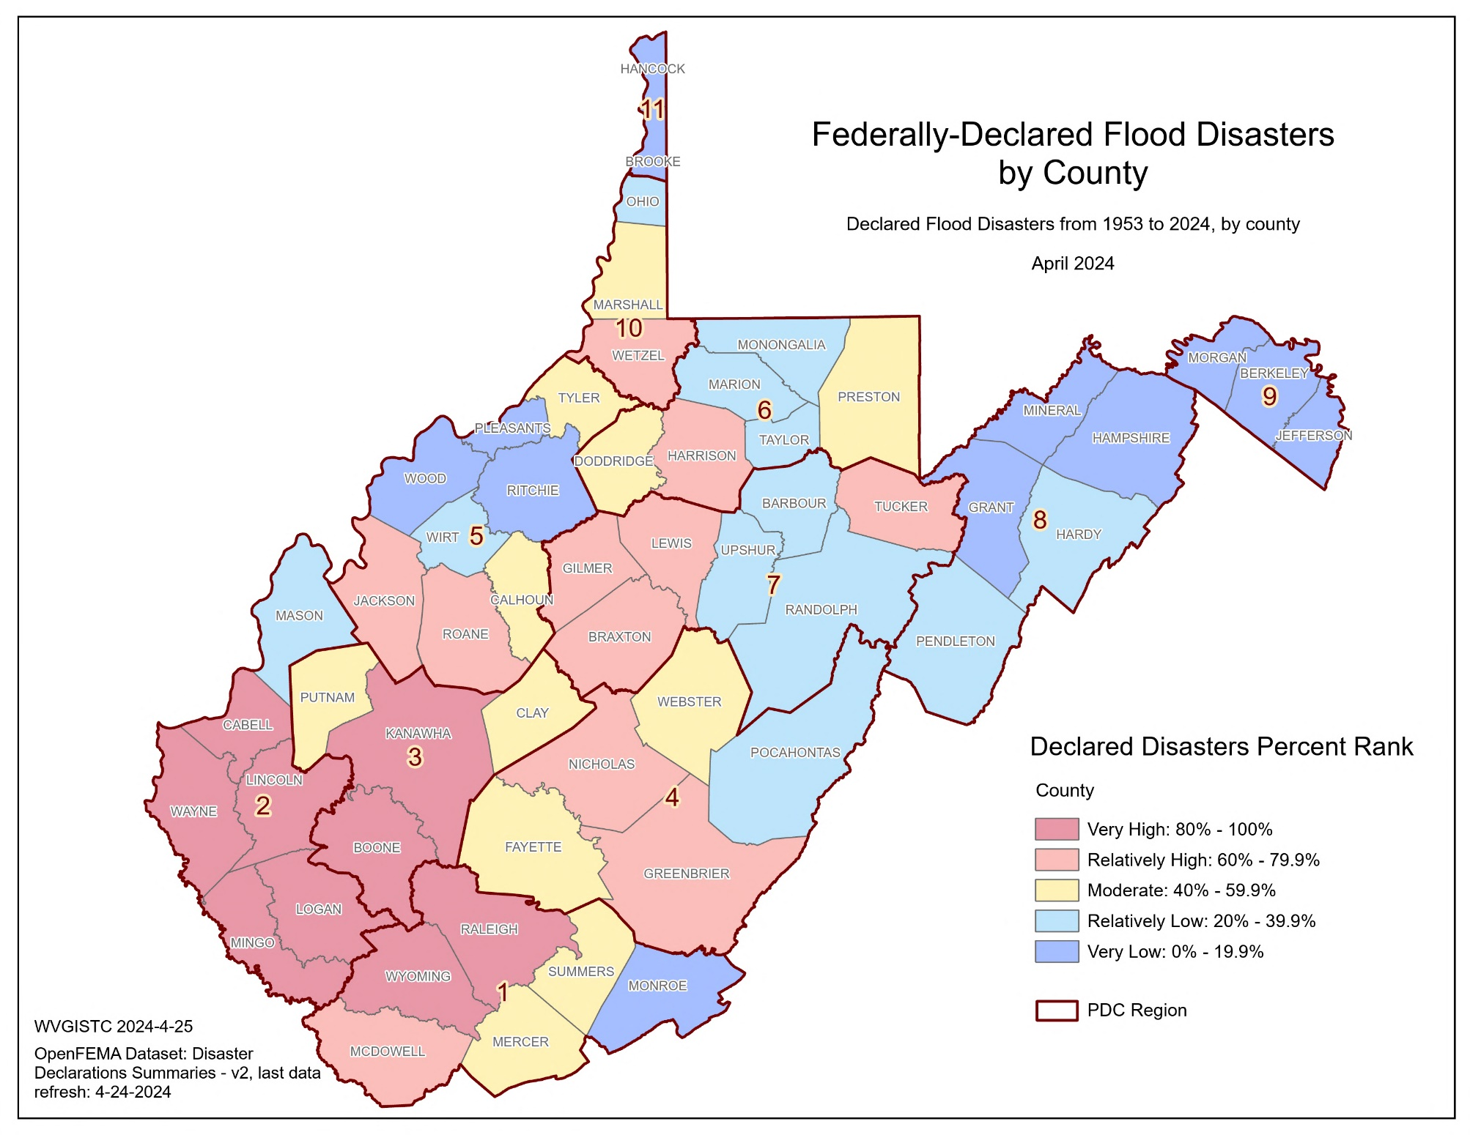
Declared Flood Disasters; Maps

Slide 6
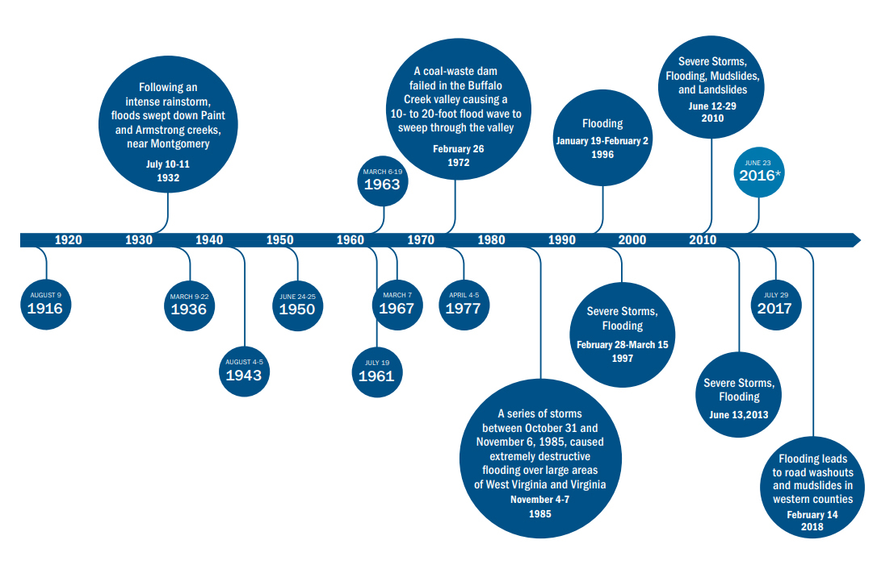
Declared Flood Disasters; Historic Events
Timeline of notable flood events in WV (1916 – 2018)
Source:
Federal Emergency Management Agency (FEMA). Understanding flood dangers in central West Virginia: Lessons learned from the June 2016 flood. https://www.fema.gov/sites/default/files/documents/Region_III_WV_FloodReport.pdf

Slide 7
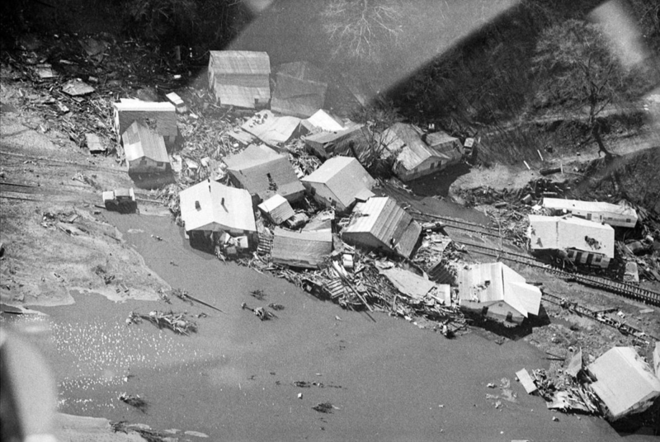
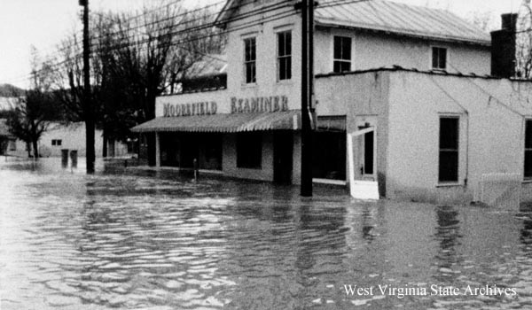
Declared Flood Disasters; Deadliest Events since 1954
July 1961 (22 + 2 landslide fatalities)
Image: Kanawha County (Image link)
February 1972 (125 fatalities including 4 missing)
Image: Huntington (Image link)
November 1985 (47 fatalities in WV)
Image: Moorefield (Image link)
June 2016 (23 fatalities)
Image: Rainelle (Image link)
Fatalities data source: https://www.wvencyclopedia.org/assets/0003/4074/Deadliest_Floods_in_WestVirginia_History.pdf

Slide 8
Declared Flood Disasters; Focus Communities
Federally-Declared Flood Disasters for the Counties of Focus Study Communities
(Rainelle, White Sulphur Springs, Clendenin, Richwood, Marlinton, and Camden-on-Gauley)
Indicator | Greenbrier County | Kanawha County | Nicholas County | Pocahontas County | Webster County | Statewide Median
Federally-Declared Flood Disasters | 18 | 24 | 18 | 15 | 17 | 16
Last Disaster Date | 6/29/2016 | 3/4/2021 | 6/29/2016 | 6/29/2016 | 6/29/2016 | Latest in the state: 8/30/2023
Declared Flood Disasters Percent Ranks | 64.8% (Relatively High) | 94.4% (Very High) | 64.8% (Relatively High) | 33.3% (Relatively Low) | 55.6% (Moderate) | -
Percent Rank Legend:
Very High: 80% to 100%
Relatively High: 60% to 79.9%
Moderate: 40% to 59.9%
Relatively Low: 20% to 39.9%
Very Low: 0% to 19.9%
Red: 90% to 100%

Slide 9
Declared Flood Disasters; Findings
Summary of Findings:
64 flood disasters have been federally declared in West Virginia since 1953 which equals to 2.7% of the total federally-declared flood disasters nationwide.
Mingo County has experienced the highest number of disasters (28) since 1954 while Pleasants County has the lowest number (9).
Harrison, Roane, Calhoun, and Clay counties have experienced the most recent federally-declared flood disaster (8/30/2023) while Berkeley and Hancock counties have not had such an event since August 2012.
Counties experiencing the highest or most recent disasters may bear a greater impact from these events, but they might also have increased awareness and willingness to seek mitigation regarding such disasters. Conversely, in counties with the lowest or least recent disasters, additional efforts may be necessary to effectively communicate the associated risks.
Declared Flood Disasters Spatial Distribution:
Counties with the highest number of federally-declared disasters are mostly clustered in the Southwestern part of the state.
Counties with the lowest number of federally-declared disasters are mostly clustered in the Eastern Panhandle.
Focus Communities Highlights:
About the counties where the focus study communities are located:
Kanawha County has the highest number of federally-declared flood disasters (n=24, among the top 10%) followed by Greenbrier and Nicholas counties (n=18, among the top 20%).
Kanawha County has experienced the most recent disaster (3/4/2021) among these counties.

