Slide 1
Building Count in SFHA
(BLDG SFHA)
West Virginia University WV GIS Technical Center
February 2024

Slide 2
Building Count in SFHA
Major Category | Detailed Category | Code | Indicator | Short Description | Unit
Structure Risk | Building Counts / Ratios | BLDG_SFHA | Building Count in SFHA | All primary insurable structures in the effective 100-year Floodplain or Special Flood Hazard Area (SFHA) | #
Rationale | Recommendations | Data Source
The higher number of buildings in the floodplain indicates higher physical and human exposure to riverine flooding. If a building owner has a mortgage from a federally regulated lender and the property is in the Special Flood Hazard Area, then the building owner is required by Federal law to carry flood insurance. The building count in the SFHA is a programming variable required for those communities participating in FEMA’s Community Rating System (CRS) program. | Communities with a high floodplain building count should actively engage property owners about flood insurance and minimizing flood losses of property owners. See Floodsmart.gov for more information. Communities can become more resilient to flooding by exceeding the minimum NFIP requirements. Higher building standards adopted by local communities may include increasing the freeboard of the base flood elevation; or encourage property owners to build to the higher 500-year flood elevation or historical high-water mark. Floodplain managers and emergency planners should pre-load at-risk structures into substantial damage estimator software. Local officials should review early warning systems as well as short-term shelters located outside the floodplain and away from inundated roads. State and county leaders should prioritize pre-disaster planning for communities with many flood-prone buildings. | All political scales: FEMA Special Flood Hazard Area (SFHA) for effective 1%-Annual-Chance Floodplains; Watershed and Stream scales: Effective and Advisory Floodplains for 1% Annual-Chance event; BLRA

Slide 3
Building Count in SFHA; Top 20% Rankings
RANK | All Communities | Percent_Rank | Incorporated Communities | Percent_Rank | Unincorporated Areas | Percent_Rank | Counties | Percent_Rank | Regions | Percent_Rank
1 | Kanawha County* | 100.0% | Wheeling** | 100.0% | Kanawha County* | 100.0% | KANAWHA | 100.0% | 3 | 100%
2 | Logan County* | 99.6% | Charleston | 99.5% | Logan County* | 98.1% | LOGAN | 98.1% | 2 | 90%
3 | Wheeling** | 99.2% | Dunbar | 99.0% | Mingo County* | 96.2% | OHIO | 96.2% | 1 | 80%
4 | Mingo County* | 98.8% | Wellsburg | 98.5% | Boone County* | 94.4% | BOONE | 94.4%
5 | Boone County* | 98.4% | New Martinsville | 98.0% | Lincoln County* | 92.5% | MINGO | 92.5%
6 | Lincoln County* | 98.1% | Huntington** | 97.6% | Mercer County* | 90.7% | CABELL | 90.7%
7 | Mercer County* | 97.7% | Buckhannon | 97.1% | Raleigh County* | 88.8% | MCDOWELL | 88.8%
8 | Raleigh County* | 97.3% | Milton | 96.6% | Wayne County* | 87.0% | WAYNE | 87.0%
9 | Wayne County* | 96.9% | Clarksburg | 96.1% | Cabell County* | 85.1% | LINCOLN | 85.1%
10 | Cabell County* | 96.6% | Marlinton | 95.7% | Putnam County* | 83.3% | MERCER | 83.3%
11 | Charleston | 96.2% | South Charleston | 95.2% | Wood County* | 81.4% | WOOD | 81.4%
12 | Putnam County* | 95.8% | Rainelle | 94.7%
13 | Wood County* | 95.4% | Weston | 94.2%
14 | McDowell County* | 95.1% | Moundsville | 93.8%
15 | Wyoming County* | 94.7% | Welch | 93.3%
16 | Randolph County* | 94.3% | Benwood | 92.8%
17 | Hampshire County* | 93.9% | Vienna | 92.3%
18 | Dunbar | 93.6% | White Sulphur Springs | 91.4%
19 | Mason County* | 93.2% | Clendenin | 91.4%
20 | Marion County* | 92.8% | Buffalo | 90.9%
21 | Greenbrier County* | 92.4% | Parkersburg | 90.4%
22 | Fayette County* | 92.1% | Madison | 90.0%
23 | Clay County* | 91.7% | Gary | 89.5%
24 | Wetzel County* | 91.3% | Keyser | 89.0%
25 | Jackson County* | 90.9% | Richwood | 88.5%
26 | Webster County* | 90.6% | Philippi | 88.0%
27 | Harrison County* | 90.2% | Parsons | 87.6%
28 | Wellsburg | 89.8% | Princeton | 87.1%
29 | New Martinsville | 89.4% | Elkins | 86.6%
30 | Summers County* | 89.0% | Wayne | 86.1%
31 | Huntington** | 88.7% | Spencer | 85.7%
32 | Monongalia County* | 88.3% | Hartford | 85.2%
33 | Braxton County* | 87.9% | Mannington | 84.7%
34 | Doddridge County* | 87.5% | Chesapeake | 84.2%
35 | Lewis County* | 87.2% | St. Albans | 83.8%
36 | Nicholas County* | 86.8% | Oceana | 83.3%
37 | Upshur County* | 86.4% | Alderson** | 82.8%
38 | Marshall County* | 86.0% | New Cumberland | 82.3%
39 | Roane County* | 85.7% | Morgantown | 81.9%
40 | Mineral County* | 85.3% | Weirton** | 81.4%
41 | Buckhannon | 84.9% | Man | 80.9%
42 | Tyler County* | 84.5% | Ravenswood | 80.4%
43 | Berkeley County* | 84.2% | Bridgeport | 80.0%
44 | Jefferson County* | 83.8%
45 | Calhoun County* | 83.4%
46 | Wirt County* | 83.0%
47 | Morgan County* | 82.7%
48 | Milton | 82.3%
49 | Pocahontas County* | 81.9%
50 | Clarksburg | 81.5%
51 | Preston County* | 81.2%
52 | Hardy County* | 80.8%
53 | Marlinton | 80.0%
54 | Monroe County* | 80.0%
Colors:
Black --> Incorporated areas Brown --> Unincorporated areas Green --> Counties (Total) Red --> Split communities Blue --> Incorporated communities participating in the National Flood Insurance Program (NFIP) with no regulatory Special Flood Hazard Area (SFHA) Purple --> Incorporated communities with no regulatory Special Flood Hazard Area (SFHA) not participating in the National Flood Insurance Program (NFIP) (not mentioned in the FEMA's Community Status Book Report)
Black on blue: Six incorporated communities included in the detailed risk study (Camden-on-Gauley, Clendenin, Rainelle, Richwood, White Sulphur Springs, and Marlinton)

Slide 4
Building Count in SFHA; Top 20% Rankings
Top Building Counts in High Risk Effective and Advisory Floodplains
(Percent rank >= 80%) at stream level
* Only the Streams with more than 100 buildings in the above floodplains were considered.
RANK | Streams with Building Counts > 100 | Percent_Rank
1 | Ohio River | 100.0%
2 | Kanawha River | 99.3%
3 | Elk River | 98.7%
4 | Greenbrier River | 98.0%
5 | Guyandotte River | 97.4%
6 | Tug Fork | 96.7%
7 | LIttle Kanawha River | 96.1%
8 | Mud River | 95.4%
9 | Island Creek | 94.8%
10 | Pond Fork | 94.1%
11 | Buckhannon River | 93.5%
12 | Coal River | 92.9%
13 | Buffalo Creek | 92.2%
14 | Big Coal River | 91.6%
15 | Pigeon Creek | 90.9%
16 | Tygart Valley River | 90.3%
17 | Wheeling Creek | 89.6%
18 | Fourpole Creek | 89.0%
19 | Twelvepole Creek | 88.3%
20 | Pocatalico River | 87.7%
21 | Campbells Creek | 87.0%
22 | New Creek | 86.4%
23 | West Fork River | 85.1%
24 | South Branch Potomac River | 85.1%
25 | Huff Creek | 84.5%
26 | Clear Fork | 83.8%
27 | Cabin Creek | 83.2%
28 | Dry Fork | 82.5%
29 | West Fork Twelvepole Creek | 81.9%
30 | Potomac River | 81.2%
31 | Middle Grave Creek | 80.6%
32 | Little Coal River | 80.0%
Top Building Counts in High Risk Effective and Advisory Floodplains
(Percent rank >= 80%) at watershed level
RANK | Watershed | Percent_Rank
1
2
3
4
5
6
7

Slide 5
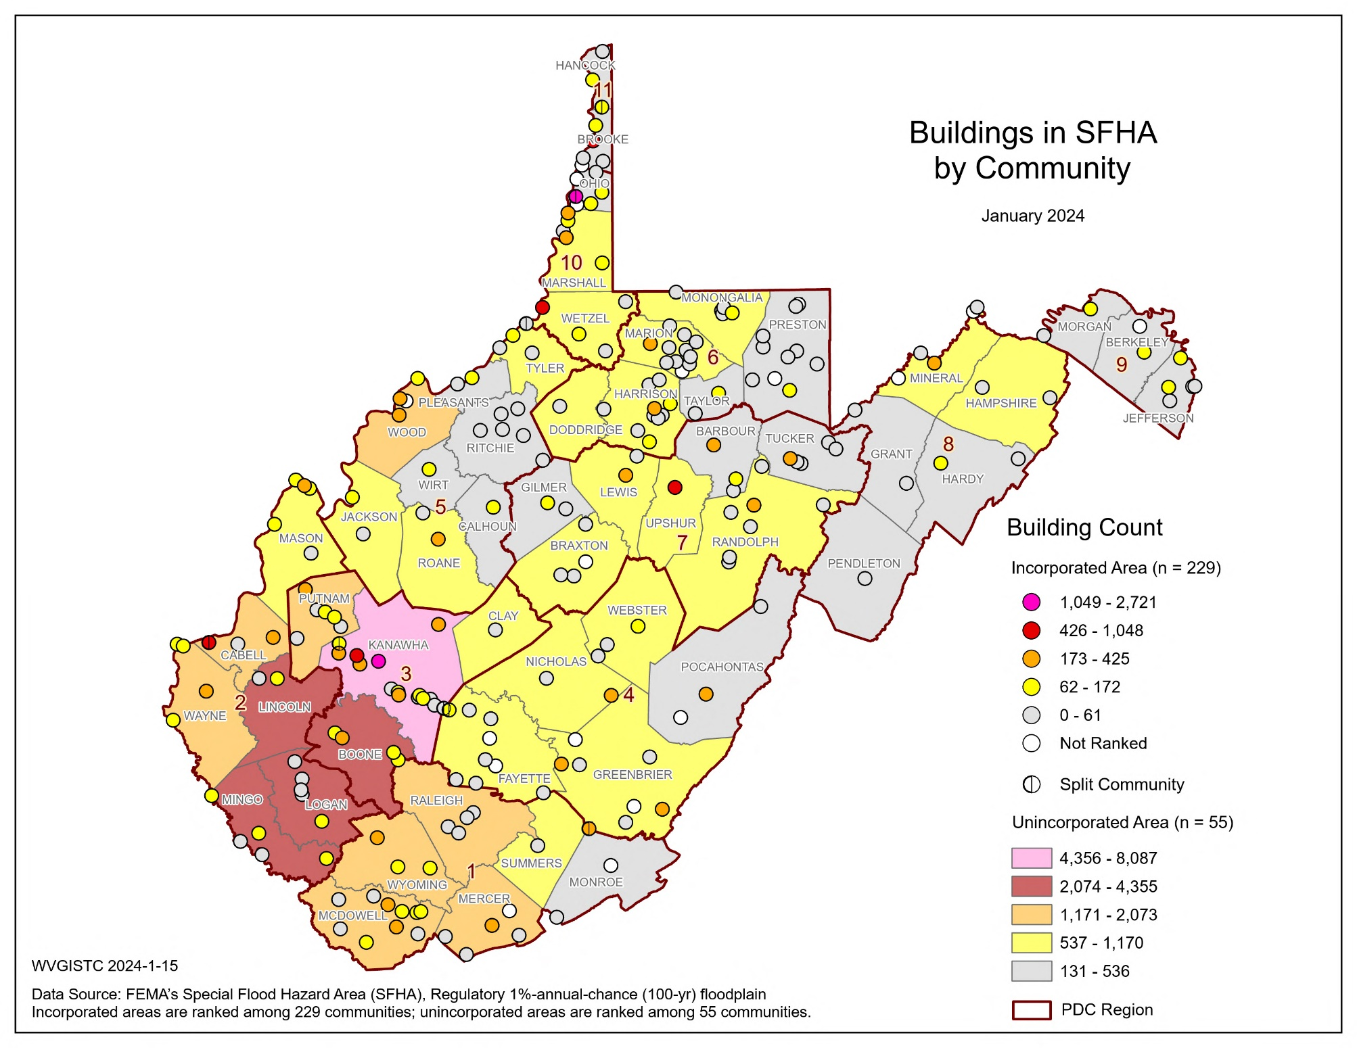
Building Count in SFHA; Maps
Top 5 Communities | County | RPDC Region | BLDG SFHA
Kanawha County* | Kanawha | 3 | 8,087
Logan County* | Logan | 2 | 4,355
Wheeling** | Ohio/Marshall | 10 | 2,721
Mingo County* | Mingo | 2 | 2,672
Boone County* | Boone | 3 | 2,615
* Unincorporated area
** Split community

Slide 6
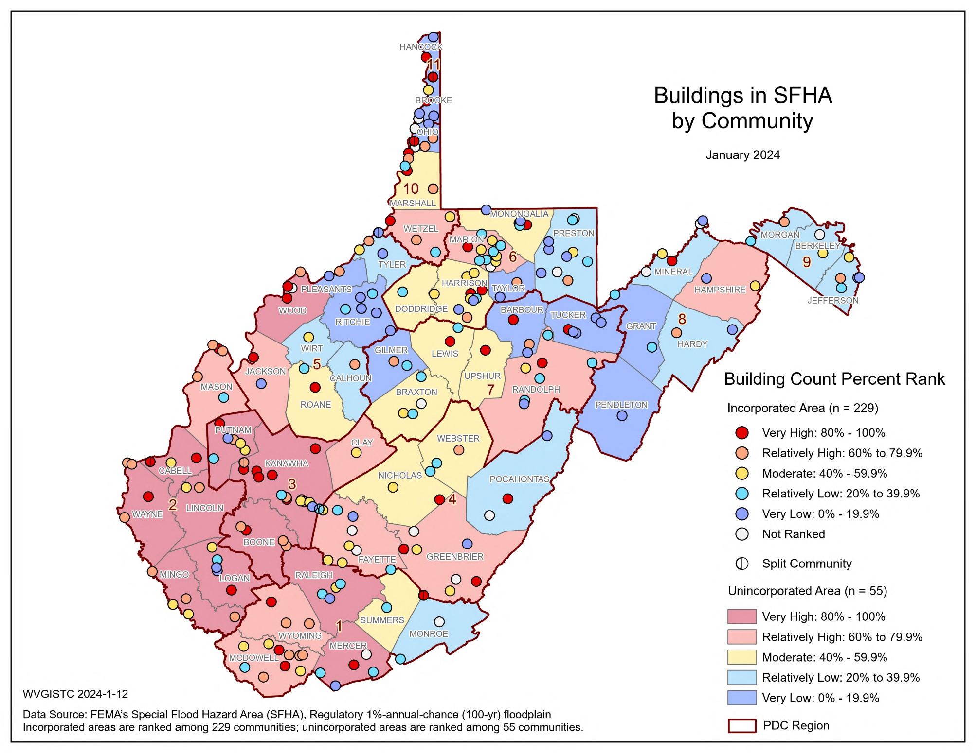
Building Count in SFHA; Maps

Slide 7
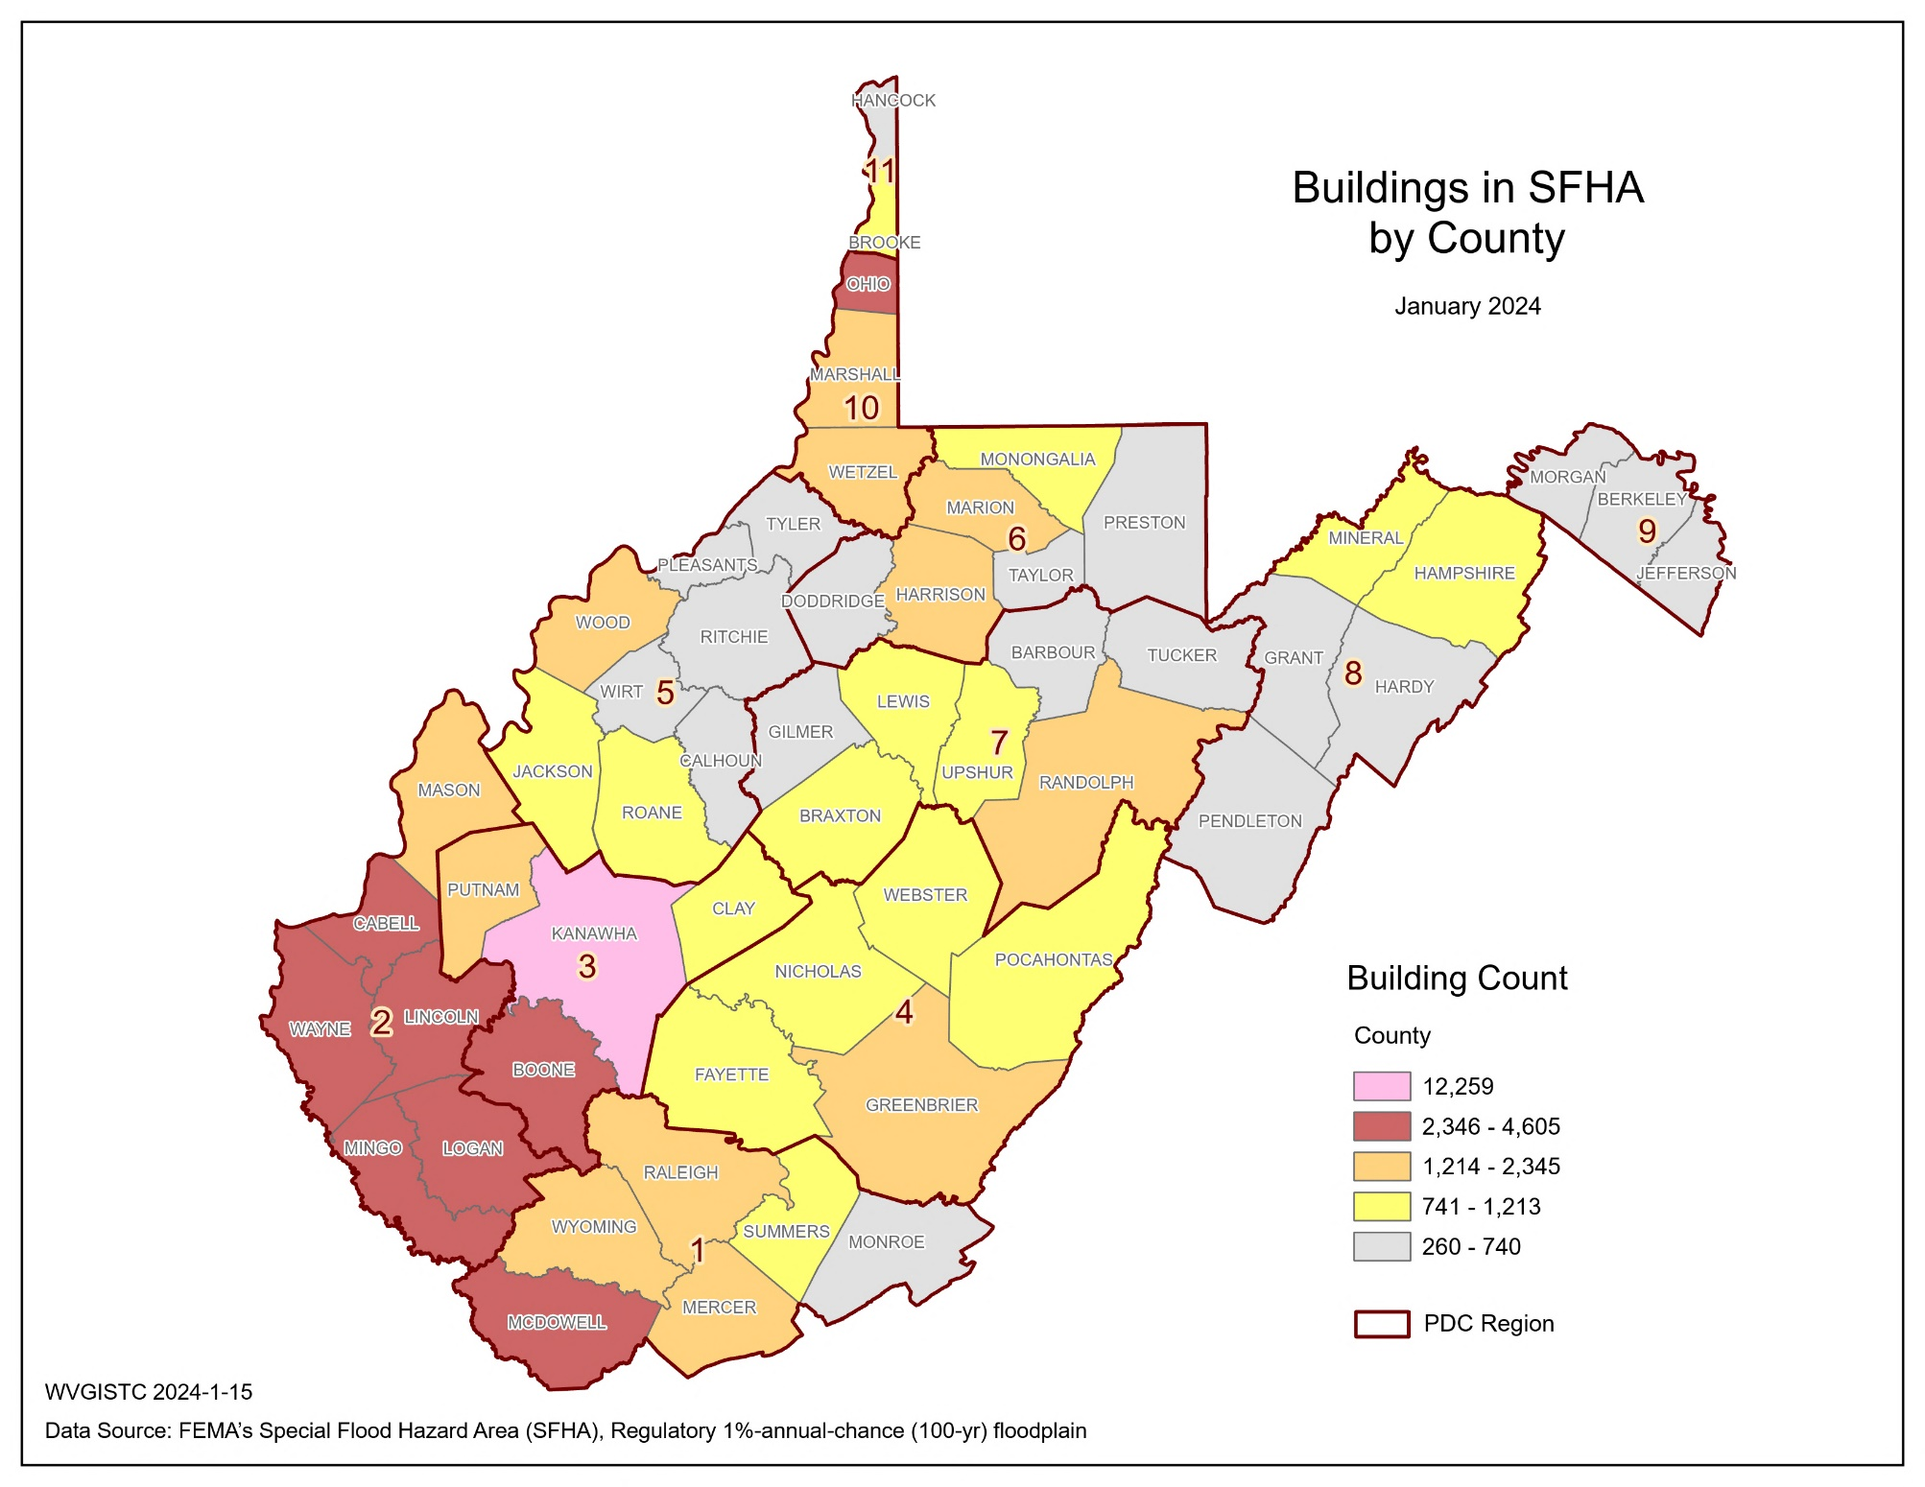
Building Count in SFHA; Maps
Top 5 Counties | RPDC Region | BLDG SFHA
Kanawha | 3 | 12,259
Logan | 2 | 4,605
Ohio | 10 | 3,260
Boone | 3 | 3,201
Mingo | 2 | 3,032

Slide 8
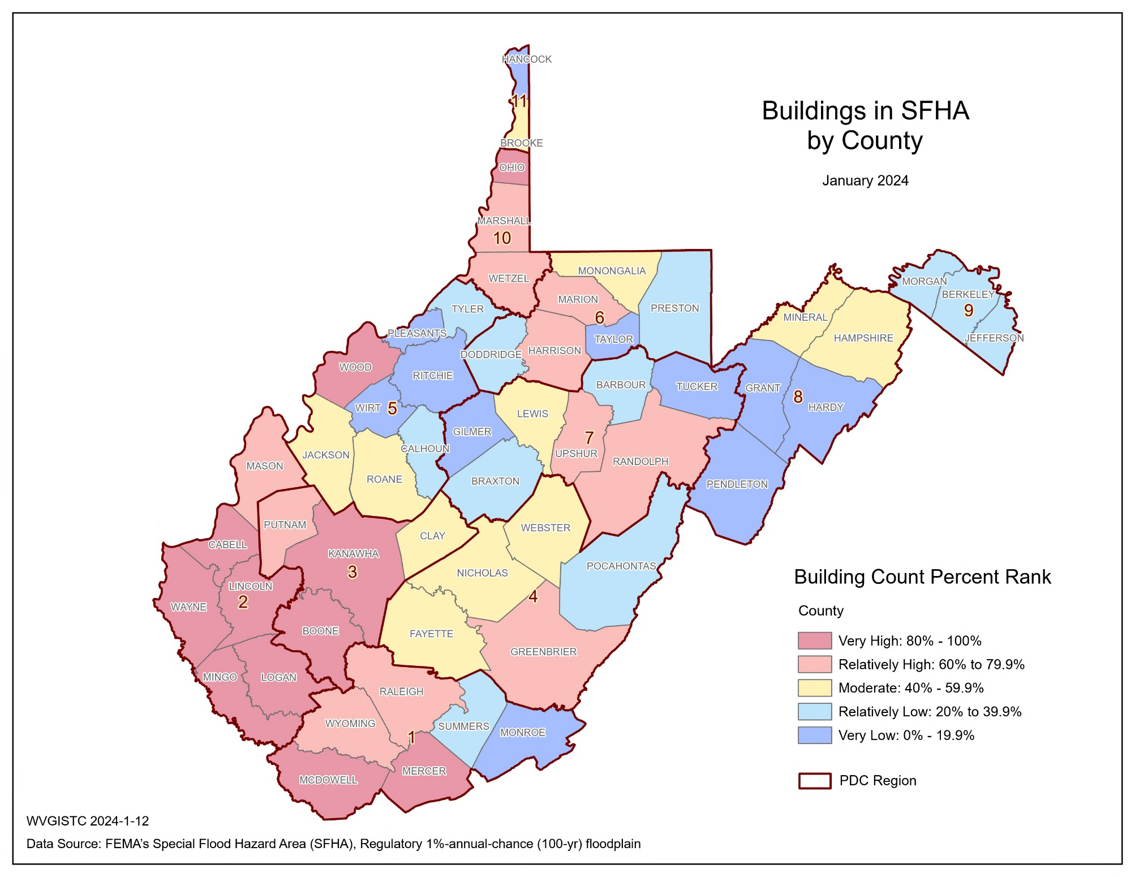
Building Count in SFHA; Maps

Slide 9
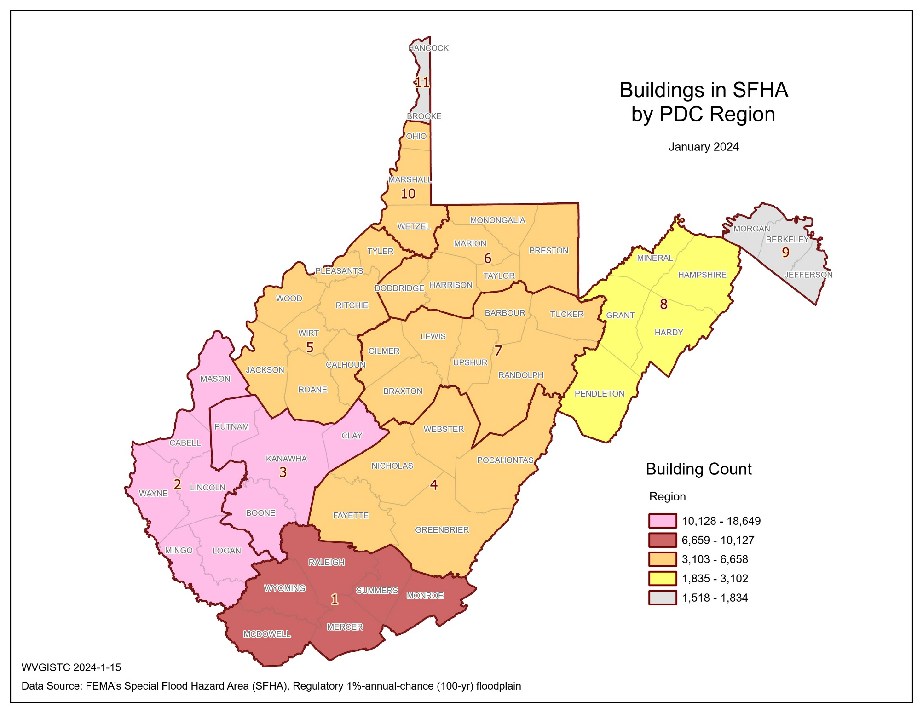
Building Count in SFHA; Maps
Top 3 Regions | BLDG SFHA
3 | 18,649
2 | 17,047
1 | 10,127

Slide 10
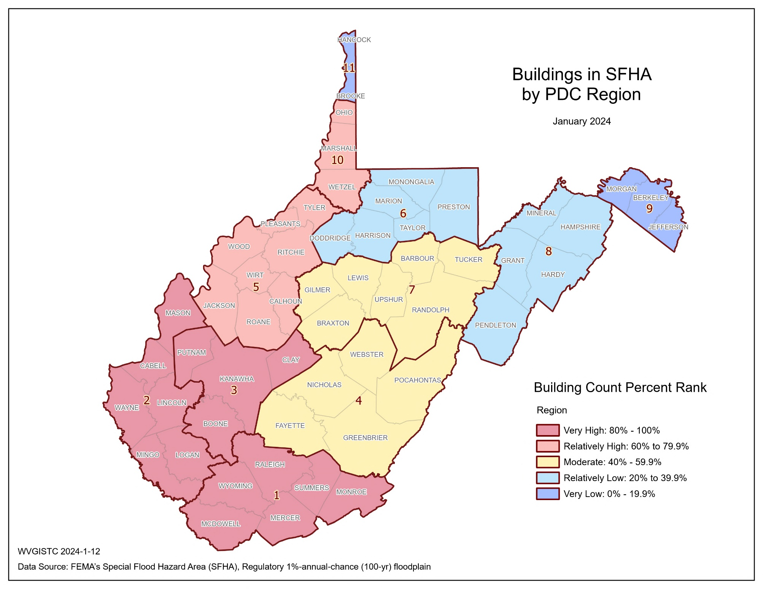
Building Count in SFHA; Maps

Slide 11
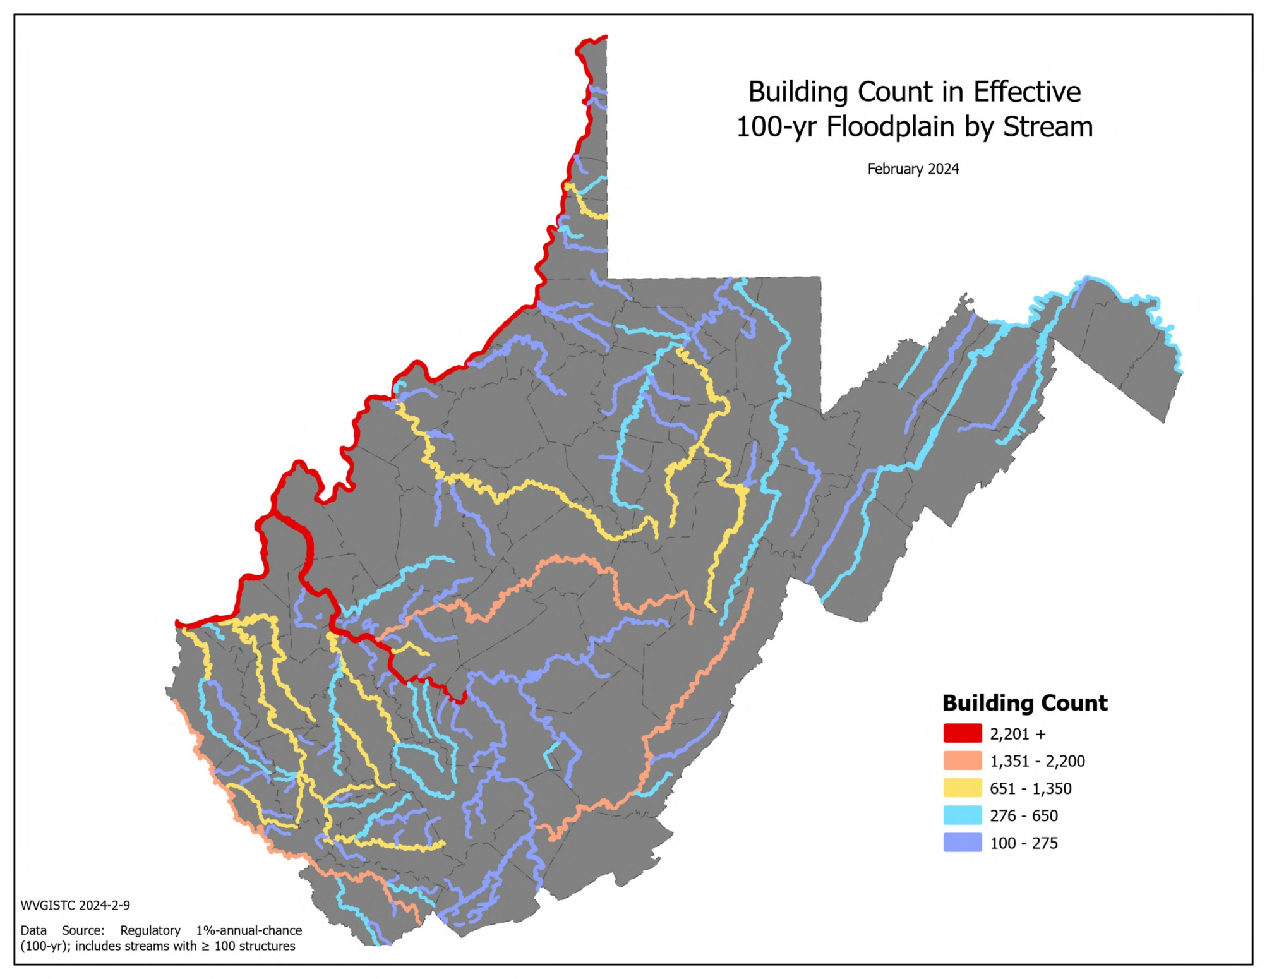
Building Count in High-Risk Floodplain; Maps
Top 5 Streams with Building Counts > 100 | BLDG SFHA
Ohio River | 6,922
Kanawha River | 5,279
Elk River | 2,181
Greenbrier River | 1,620
Guyandotte River | 1,230

Slide 12
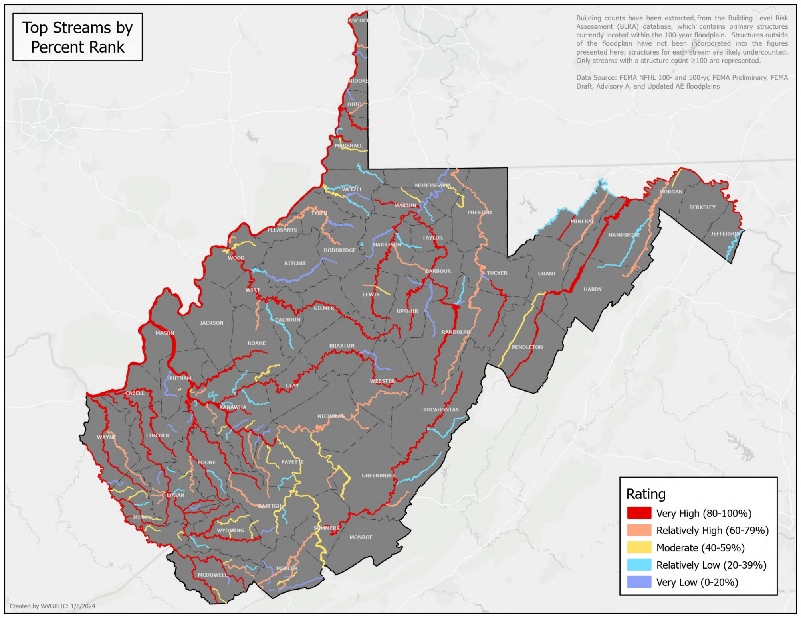
Building Count in High-Risk Floodplain; Maps

Slide 13
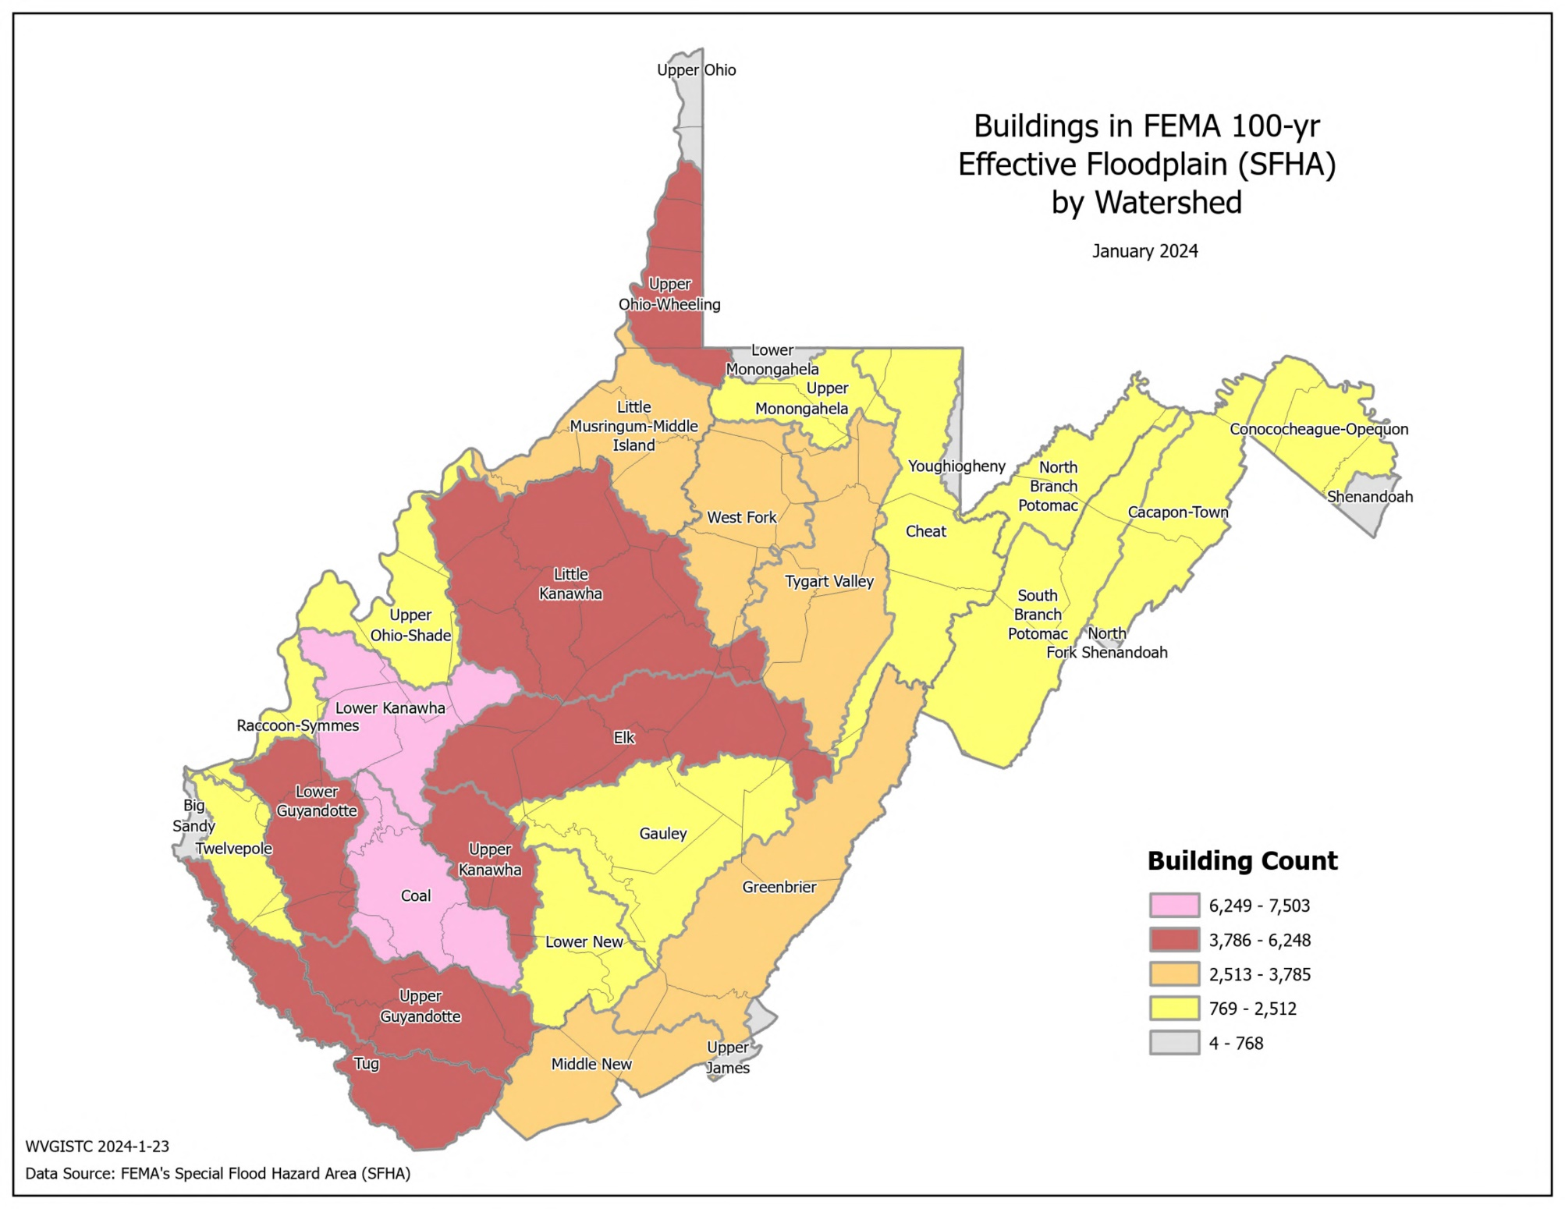
Building Count in High-Risk Floodplain; Maps
Top 5 Watersheds | BLDG SFHA
Lower Kanawha | 7,503
Coal | 6,257
Upper Guyandotte | 6,223
Upper Ohio-Wheeling | 5,849
Tug | 5,536

Slide 14
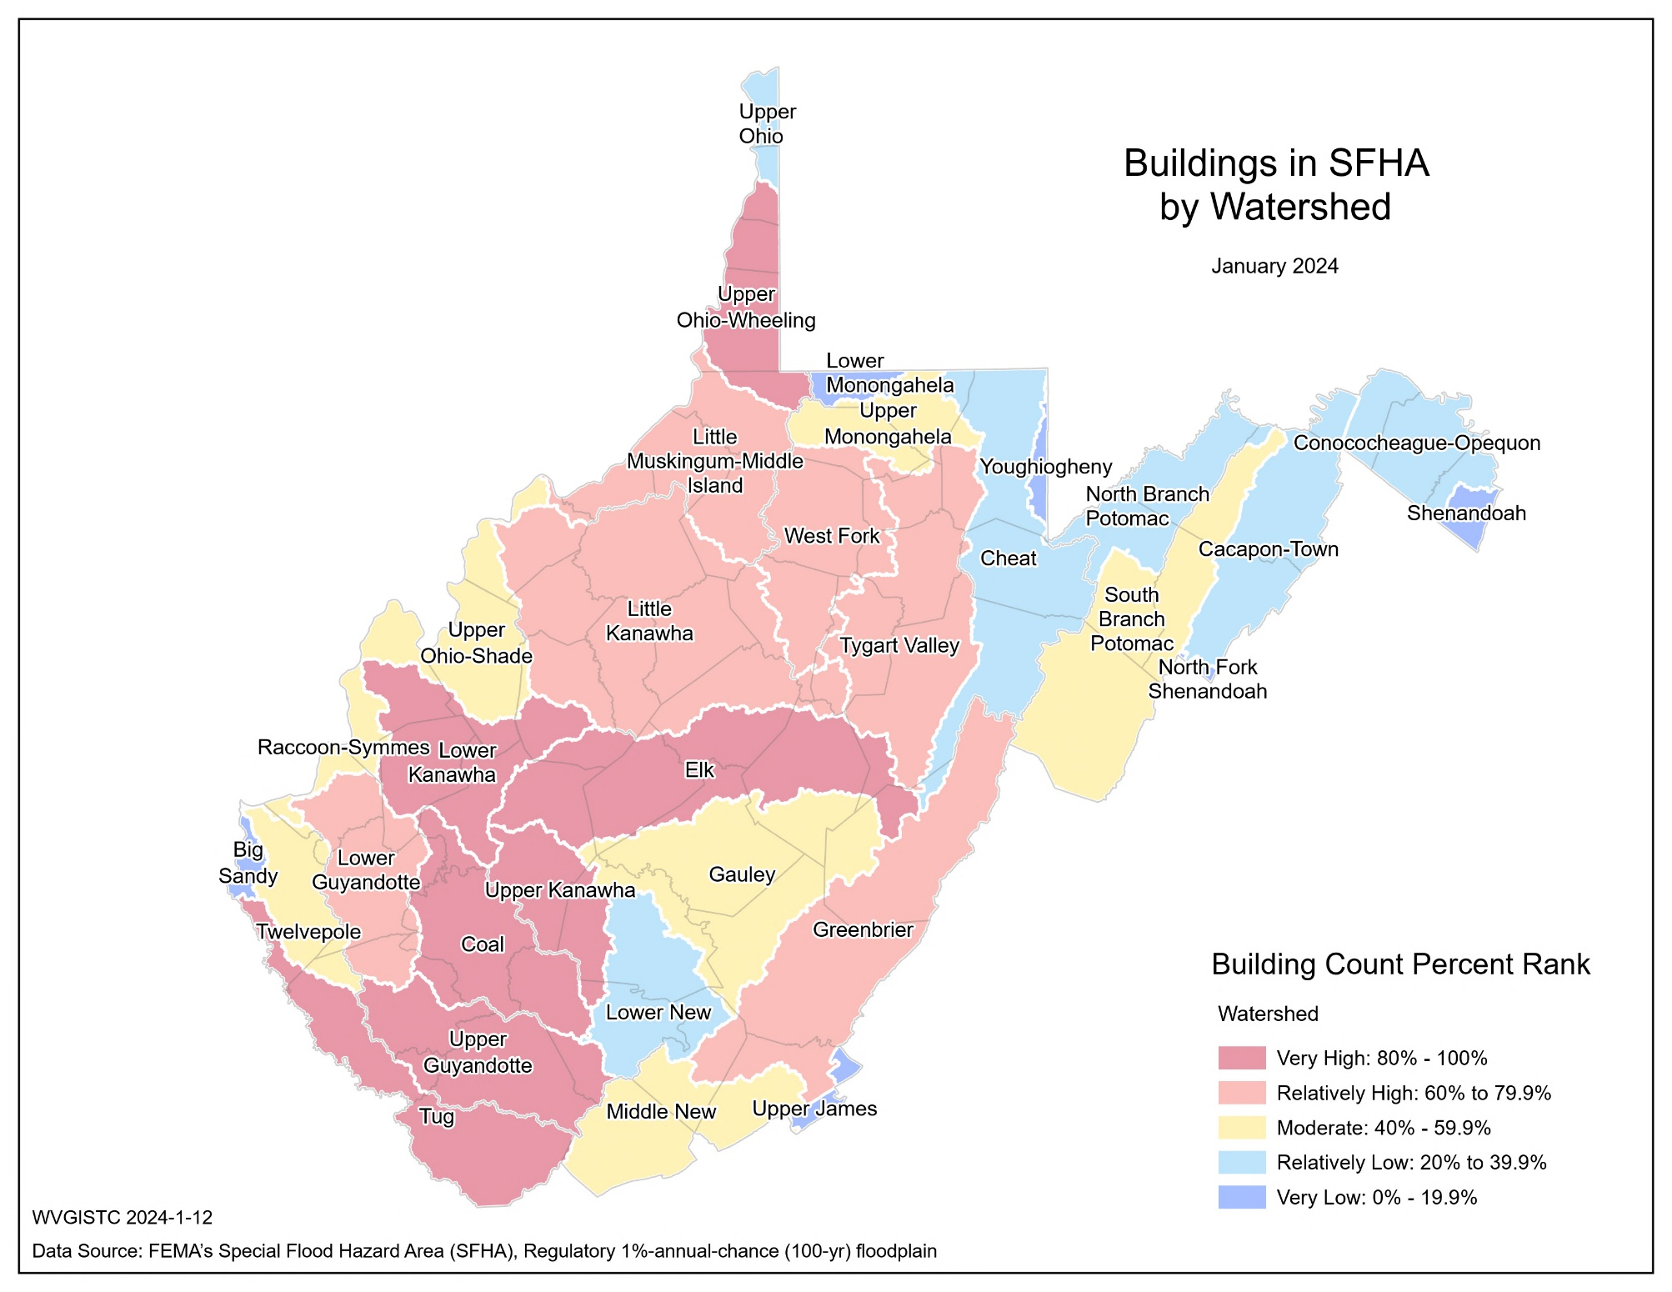
Building Count in High-Risk Floodplain; Maps

Slide 15
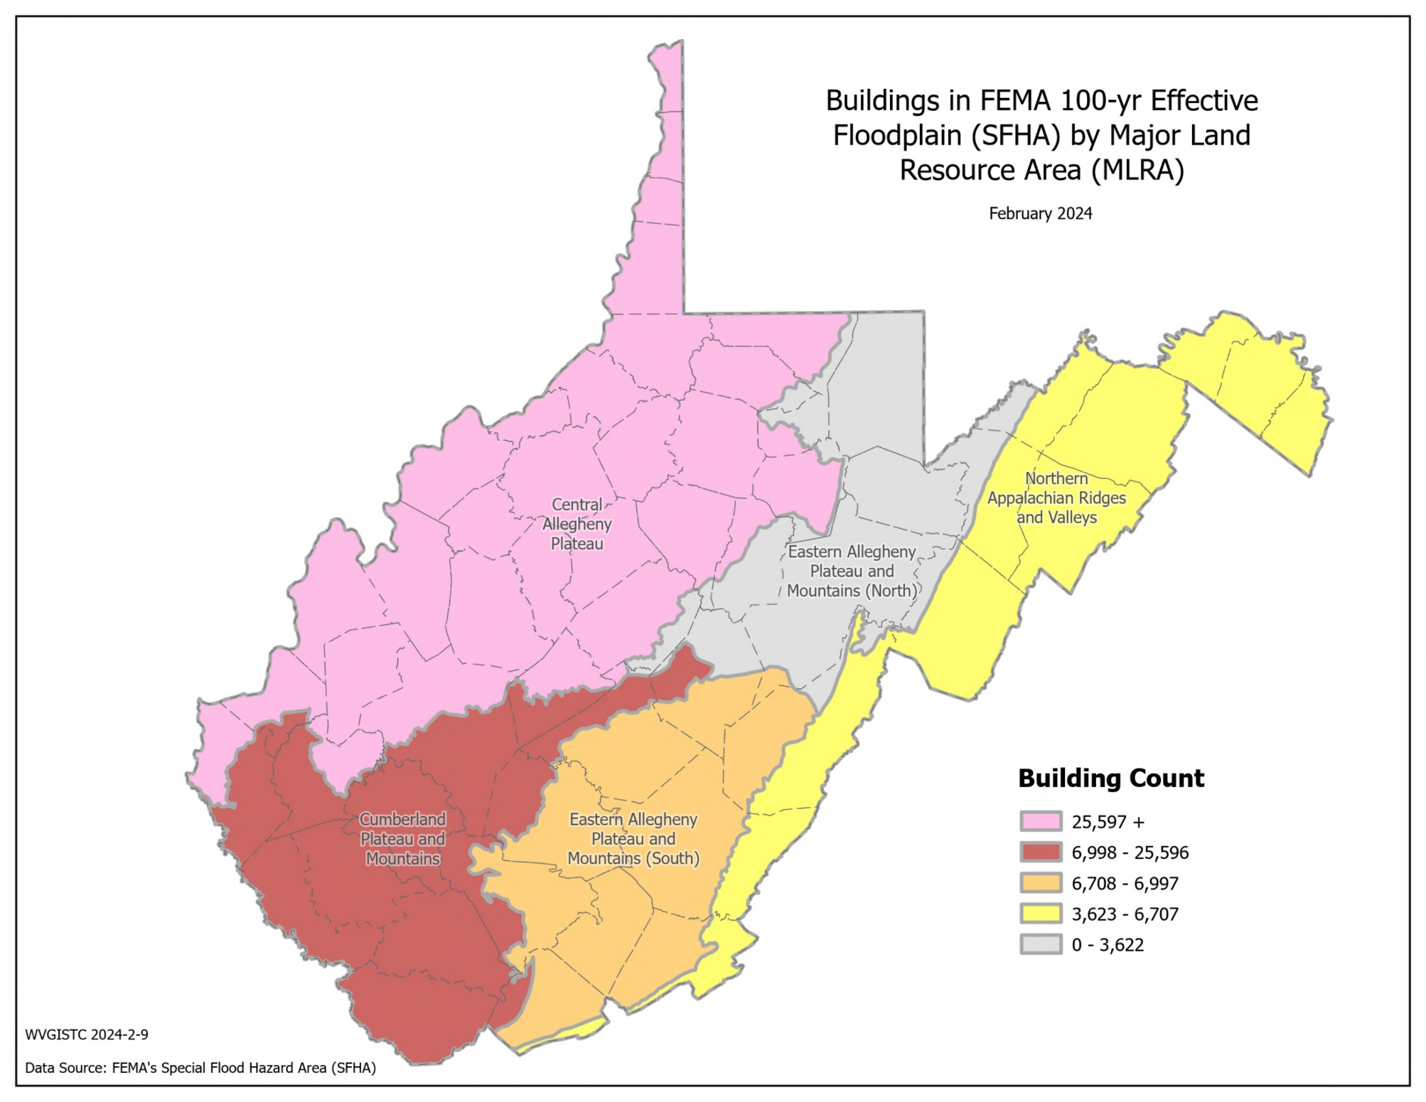
Building Count in High-Risk Floodplain; Maps
Source for MLRA: https://www.nrcs.usda.gov/sites/default/files/2022-10/AgHandbook296_text_low-res.pdf

Slide 16
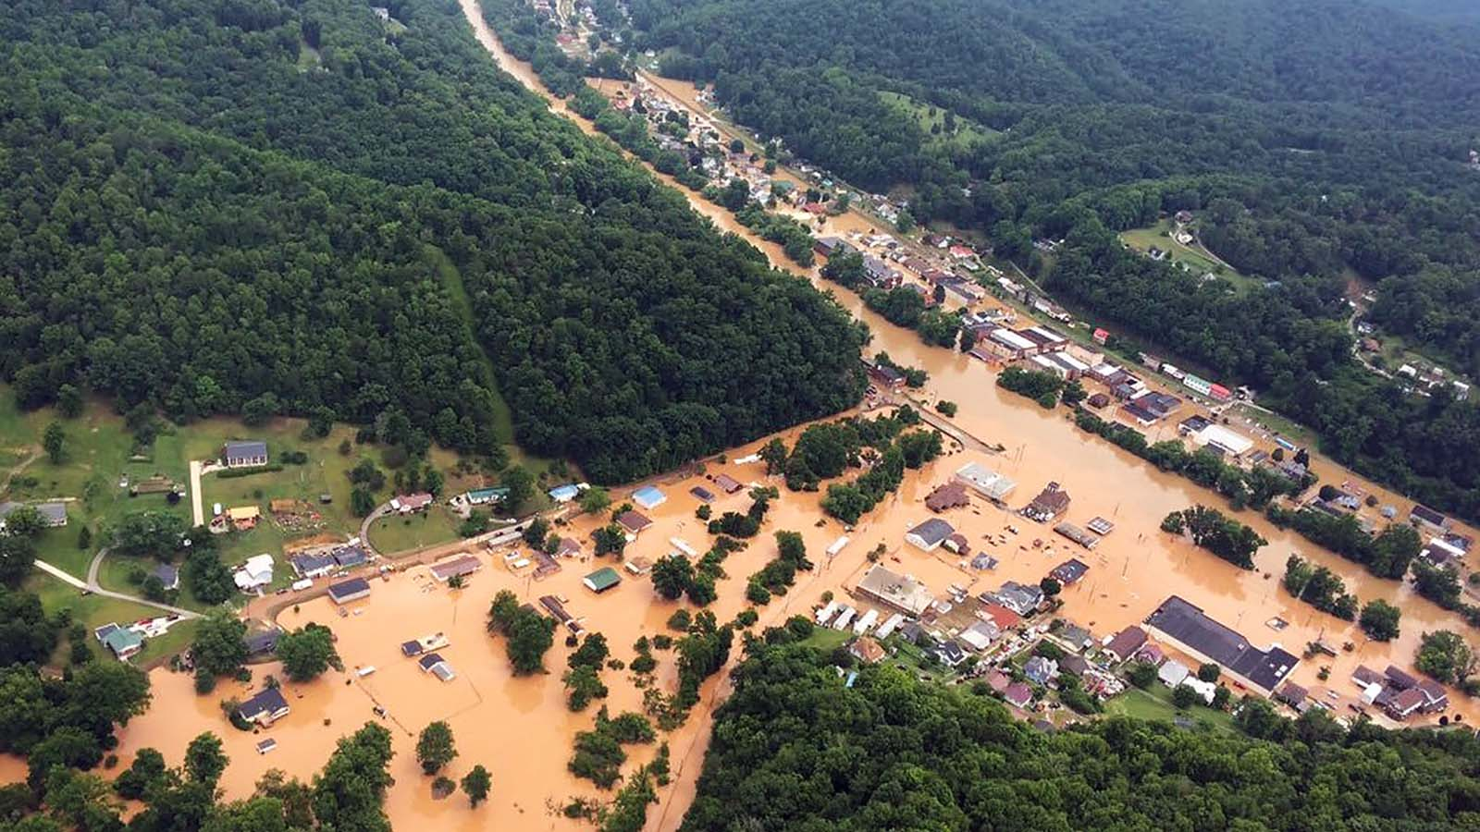
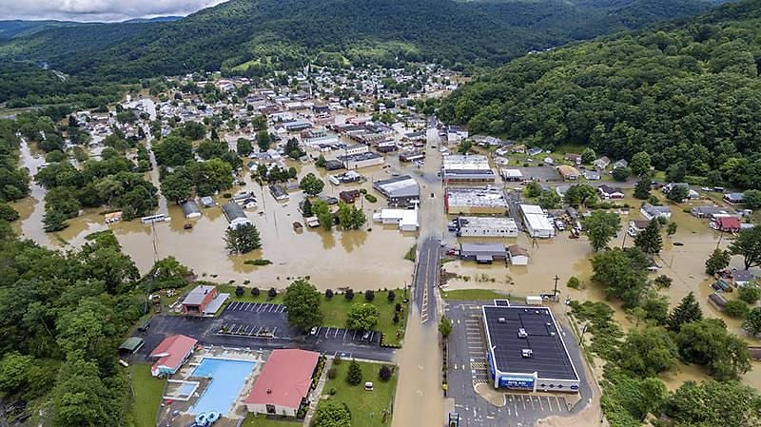
Building Count in SFHA; Exposure Images
Clendenin, June 2016 (Image link)
Rainelle, June 2016 (Image link)

Slide 17
Building Count in SFHA; Focus Communities
Indicator | White Sulphur Springs | Rainelle | Clendenin | Richwood | Marlinton | Camden-on-Gauley | Statewide Median
Count in Approx. A | 0 | 0 | 0 | 0 | 68 | 4 | 0
Count in AE | 219 | 293 | 301 | 137 | 275 | 17 | 32
Count in AE Floodway | 83 | 43 | 1 | 124 | 14 | 0 | 0
Count in AO | 0 | 0 | 0 | 0 | 0 | 0 | 0
Count in AH | 0 | 0 | 0 | 0 | 0 | 0 | 0
Count in Detailed Sum | 302 | 336 | 302 | 261 | 289 | 17 | 39
Building Count in SFHA | 302 | 336 | 302 | 261 | 357 | 21 | 49
Building Count in SFHA Percent Ranks | 91.4% (Very High) | 94.7% (Very High) | 91.4% (Very High) | 88.5% (Very High) | 95.7% (Very High) | 23.8% (Relatively Low) | -
Percent Rank Legend:
Very High: 80% to 100%
Relatively High: 60% to 79.9%
Moderate: 40% to 59.9%
Relatively Low: 20% to 39.9%
Very Low: 0% to 19.9%
Red: 90% to 100%

Slide 18
Building Count in SFHA; Findings
Top 10 communities with the highest building counts in SFHA:
BLDG SFHA, Top 10 Communities | BLDG SFHA, Top 10 Communities
Rank | Community | County | RPDC Region | Approx. A | AE | AE Floodway | AO | AH | Detailed Sum | Effective SFHA Total | Percent Rank
INCORPORATED | INCORPORATED
1 | Wheeling** | Ohio/Marshall | 10 | 15 | 176 | 176 | 0 | 0 | 2,706 | 2,721 | 100.0%
2 | Charleston | Kanawha | 3 | 261 | 1,396 | 22 | 0 | 0 | 1,418 | 1,679 | 99.5%
3 | Dunbar | Kanawha | 3 | 72 | 975 | 1 | 0 | 0 | 976 | 1,048 | 99.0%
4 | Wellsburg | Brooke | 11 | 0 | 790 | 1 | 0 | 0 | 791 | 791 | 98.5%
5 | New Martinsville | Wetzel | 10 | 0 | 701 | 89 | 0 | 0 | 790 | 790 | 98.0%
6 | Huntington** | Cabell/Wayne | 2 | 4 | 106 | 106 | 0 | 0 | 769 | 773 | 97.6%
7 | Buckhannon | Upshur | 7 | 10 | 570 | 18 | 0 | 0 | 588 | 598 | 97.1%
8 | Milton | Cabell | 2 | 0 | 382 | 43 | 0 | 0 | 425 | 425 | 96.6%
9 | Clarksburg | Harrison | 6 | 0 | 329 | 64 | 0 | 0 | 393 | 393 | 96.1%
10 | Marlinton | Pocahontas | 4 | 68 | 275 | 14 | 0 | 0 | 289 | 357 | 95.7%
** Split community
Rank | Community | RPDC Region | Approx. A | AE | AE Floodway | AO | AH | Detailed Sum | Effective SFHA Total | Percent Rank
UNINCORPORATED | INCORPORATED
1 | Kanawha | 3 | 1,962 | 4,765 | 1,360 | 0 | 0 | 6,125 | 8,087 | 100.0%
2 | Logan | 2 | 883 | 2,541 | 931 | 0 | 0 | 3,472 | 4,355 | 98.1%
3 | Mingo | 2 | 848 | 1,429 | 395 | 0 | 0 | 1,824 | 2,672 | 96.2%
4 | Boone | 3 | 575 | 1,621 | 419 | 0 | 0 | 2,040 | 2,615 | 94.4%
5 | Lincoln | 2 | 1,944 | 442 | 61 | 0 | 0 | 503 | 2,447 | 92.5%
6 | Mercer | 1 | 885 | 998 | 190 | 0 | 0 | 1,188 | 2,073 | 90.7%
7 | Raleigh | 1 | 1,215 | 780 | 10 | 0 | 0 | 790 | 2,005 | 88.8%
8 | Wayne | 2 | 670 | 1,024 | 222 | 0 | 0 | 1,246 | 1,916 | 87.0%
9 | Cabell | 2 | 720 | 917 | 65 | 0 | 0 | 982 | 1,702 | 85.1%
10 | Putnam | 3 | 329 | 1,237 | 18 | 0 | 0 | 1,255 | 1,584 | 83.3%
Top 5 counties with the highest building counts in SFHA:
Rank | County | RPDC Region | Approx. A | AE | AE Floodway | AO | AH | Detailed Sum | Effective SFHA Total | Percent Rank
1 | KANAWHA | 3 | 2,426 | 8,404 | 1,429 | 0 | 0 | 9,833 | 12,259 | 100.0%
2 | LOGAN | 2 | 884 | 2,785 | 936 | 0 | 0 | 3,721 | 4,605 | 98.1%
3 | OHIO | 10 | 426 | 2,644 | 190 | 0 | 0 | 2,834 | 3,260 | 96.2%
4 | BOONE | 3 | 579 | 2,115 | 507 | 0 | 0 | 2,622 | 3,201 | 94.4%
5 | MINGO | 2 | 848 | 1,711 | 473 | 0 | 0 | 2,184 | 3,032 | 92.5%

Slide 19
Building Count in SFHA; Findings
Summary of Findings:
At the county level, Kanawha County has the highest number of primary structures located in the effective high-risk (100-year) floodplain or SFHA with 12,259 structures followed by Logan County with 4,605 exposed buildings.
Among all incorporated communities in the state, Wheeling has the highest number of primary structures located in the effective high-risk (100-year) floodplain or SFHA with 2,721 structures followed by Charleston and Dunbar with 1,679 and 1,048 exposed buildings, respectively.
Among all unincorporated areas in the state, Kanawha is ranked first for the number of primary structures located in the effective high-risk (100-year) floodplain or SFHA with 8,087 structures followed by Logan Unincorporated Area with 4,355 exposed buildings.
At the stream level, the Ohio River has the highest number of buildings exposed to a 1%-annual-chance (100-year) high-risk flood with 7,257 structures followed by the Kanawha River with 6,490 exposed buildings.
The higher number of primary buildings located in the high-risk floodplain can indicate higher physical and human exposure to such floods which can lead to higher losses.
Building Count in SFHA Spatial Distribution:
Counties with the highest number of primary structures located in the SFHA are clustered in the Southwestern part of the state.
Focus Communities Highlights:
Marlinton (n=357), Rainelle (n= 336), White Sulphur Springs (n= 302), and Clendenin (n= 302), are among the top 10% incorporated communities in terms of the number of primary structures located in the effective high-risk (100-year) floodplain or SFHA.
Marlinton is also among the top 20% communities (both incorporated and unincorporated) for the number of primary structures located in the SFHA.
Richwood (n=261) is among the top 20% incorporated communities for the number of primary structures located in the SFHA.

