Slide 1
Floodplain Area
(SFHA)
(Unincorporated Area Scale and Larger)
West Virginia University WV GIS Technical Center
February 2024

Slide 2
Floodplain Area
Major Category | Detailed Category | Code | Indicator | Short Description | Unit
Flood Hazard Risk | Floodplain Area | SFHA | Floodplain Area (Unincorporated Area Scale and Larger) | Acreage of modified Special Flood Hazard Area (SFHA), or 1%-annual-chance (100-yr) floodplain Areas excluded from Total aSFHA: Open water lakes > 10 acres; Large river bank-to-bank > 500 ft.; Federal lands > 10 acres. | Acres
Rationale | Recommendations | Data Source
For unincorporated areas and at the county level, it can be more challenging for communities larger in geographic size to enforce their floodplain management ordinance. Often larger jurisdictions have more acres and miles of floodplain extent than compared to smaller communities. In smaller communities, the floodplain area is compacted and thus new development in the floodplain should be easier to monitor than larger rural areas or countywide. The acreage of the SFHA (aSFHA) is a programming variable required for those communities participating in FEMA’s Community Rating System (CRS) program. | Larger jurisdictions must be vigilant in monitoring and permitting new development for an expansive geographic area that includes a large amount floodplain area/miles. | FEMA FIRM Streams and Waterbodies (USGS NHD 24K), National Public Lands (USGS PAD-US)

Slide 3
Floodplain Area; Top 20% Rankings
RANK | All Communities | Percent_Rank | Unincorporated Areas | Percent_Rank | Counties | Percent_Rank | Regions | Percent_Rank
1 | Hampshire County* | 100.0% | Hampshire County* | 100.0% | HAMPSHIRE | 100.0% | 5 | 100%
2 | Mason County* | 99.6% | Mason County* | 98.1% | KANAWHA | 98.1% | 8 | 90%
3 | Kanawha County* | 99.2% | Kanawha County* | 96.2% | MASON | 96.2% | 2 | 80%
4 | Greenbrier County* | 98.9% | Greenbrier County* | 94.4% | GREENBRIER | 94.4%
5 | Randolph County* | 98.5% | Randolph County* | 92.5% | RANDOLPH | 92.5%
6 | Webster County* | 98.2% | Webster County* | 90.7% | WOOD | 90.7%
7 | Wood County* | 97.8% | Wood County* | 88.8% | WEBSTER | 88.8%
8 | Hardy County* | 97.5% | Hardy County* | 87.0% | HARDY | 87.0%
9 | Jackson County* | 97.1% | Jackson County* | 85.1% | JACKSON | 85.1%
10 | Pendleton County* | 96.8% | Pendleton County* | 83.3% | WAYNE | 83.3%
11 | Wayne County* | 96.4% | Wayne County* | 81.4% | PENDLETON | 81.4%
12 | Lincoln County* | 96.1%
13 | Berkeley County* | 95.7%
14 | Cabell County* | 95.4%
15 | Pocahontas County* | 95.0%
16 | Preston County* | 94.6%
17 | Putnam County* | 94.3%
18 | Nicholas County* | 93.9%
19 | Mineral County* | 93.6%
20 | Raleigh County* | 93.2%
21 | Jefferson County* | 92.9%
22 | Morgan County* | 92.5%
23 | Harrison County* | 92.2%
24 | Wirt County* | 91.8%
25 | Tyler County* | 91.5%
26 | Ritchie County* | 91.1%
27 | Braxton County* | 90.8%
28 | Boone County* | 90.4%
29 | Monroe County* | 90.1%
30 | Tucker County* | 89.7%
31 | Mercer County* | 89.3%
32 | Grant County* | 89.0%
33 | Lewis County* | 88.6%
34 | Roane County* | 88.3%
35 | Gilmer County* | 87.9%
36 | Wetzel County* | 87.6%
37 | Calhoun County* | 87.2%
38 | Barbour County* | 86.9%
39 | Upshur County* | 86.5%
40 | Clay County* | 86.2%
41 | Doddridge County* | 85.8%
42 | Mingo County* | 85.5%
43 | Marshall County* | 85.1%
44 | Logan County* | 84.8%
45 | Marion County* | 84.4%
46 | Wyoming County* | 84.0%
47 | Monongalia County* | 83.7%
48 | Fayette County* | 83.3%
49 | Summers County* | 83.0%
50 | Pleasants County* | 82.6%
51 | McDowell County* | 82.3%
52 | Taylor County* | 81.9%
53 | Brooke County* | 81.6%
54 | Wheeling** | 81.2%
55 | Parkersburg | 80.9%
56 | Ohio County* | 80.5%
57 | Huntington** | 80.2%
Colors:
Black --> Incorporated areas Brown --> Unincorporated areas Green --> Counties (Total) Red --> Split communities Blue --> Incorporated communities participating in the National Flood Insurance Program (NFIP) with no regulatory Special Flood Hazard Area (SFHA) Purple --> Incorporated communities with no regulatory Special Flood Hazard Area (SFHA) not participating in the National Flood Insurance Program (NFIP) (not mentioned in the FEMA's Community Status Book Report)
Black on blue: Six incorporated communities included in the detailed risk study (Camden-on-Gauley, Clendenin, Rainelle, Richwood, White Sulphur Springs, and Marlinton)

Slide 4
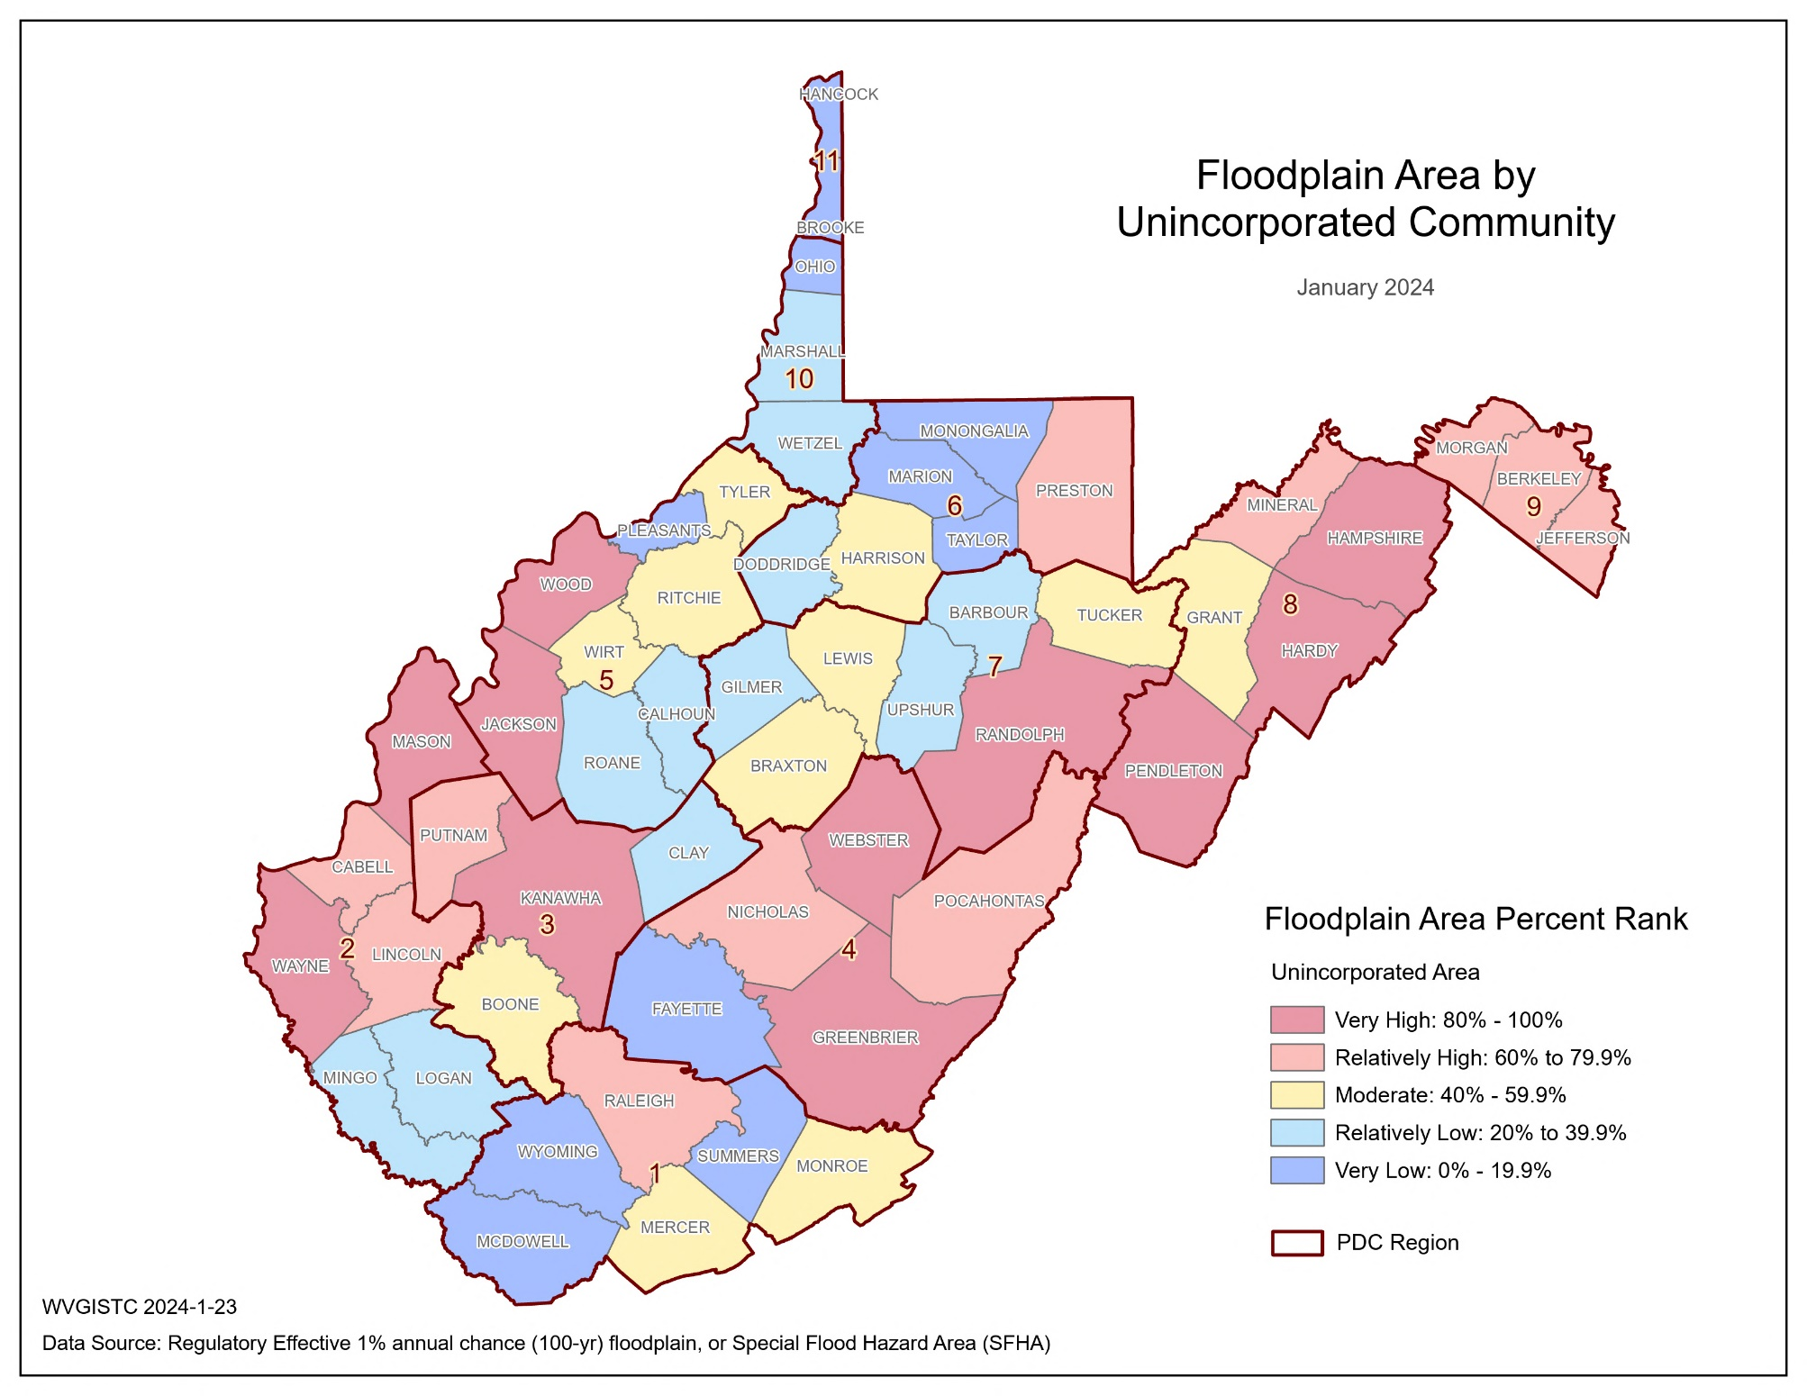
Floodplain Area; Maps
Top 5 Unincorporated Communities | RPDC Region | Modified Total SFHA Area (acres)
Hampshire County* | 8 | 26,373
Mason County* | 2 | 21,862
Kanawha County* | 3 | 20,983
Greenbrier County* | 4 | 20,700
Randolph County* | 7 | 19,838
* Unincorporated area

Slide 5
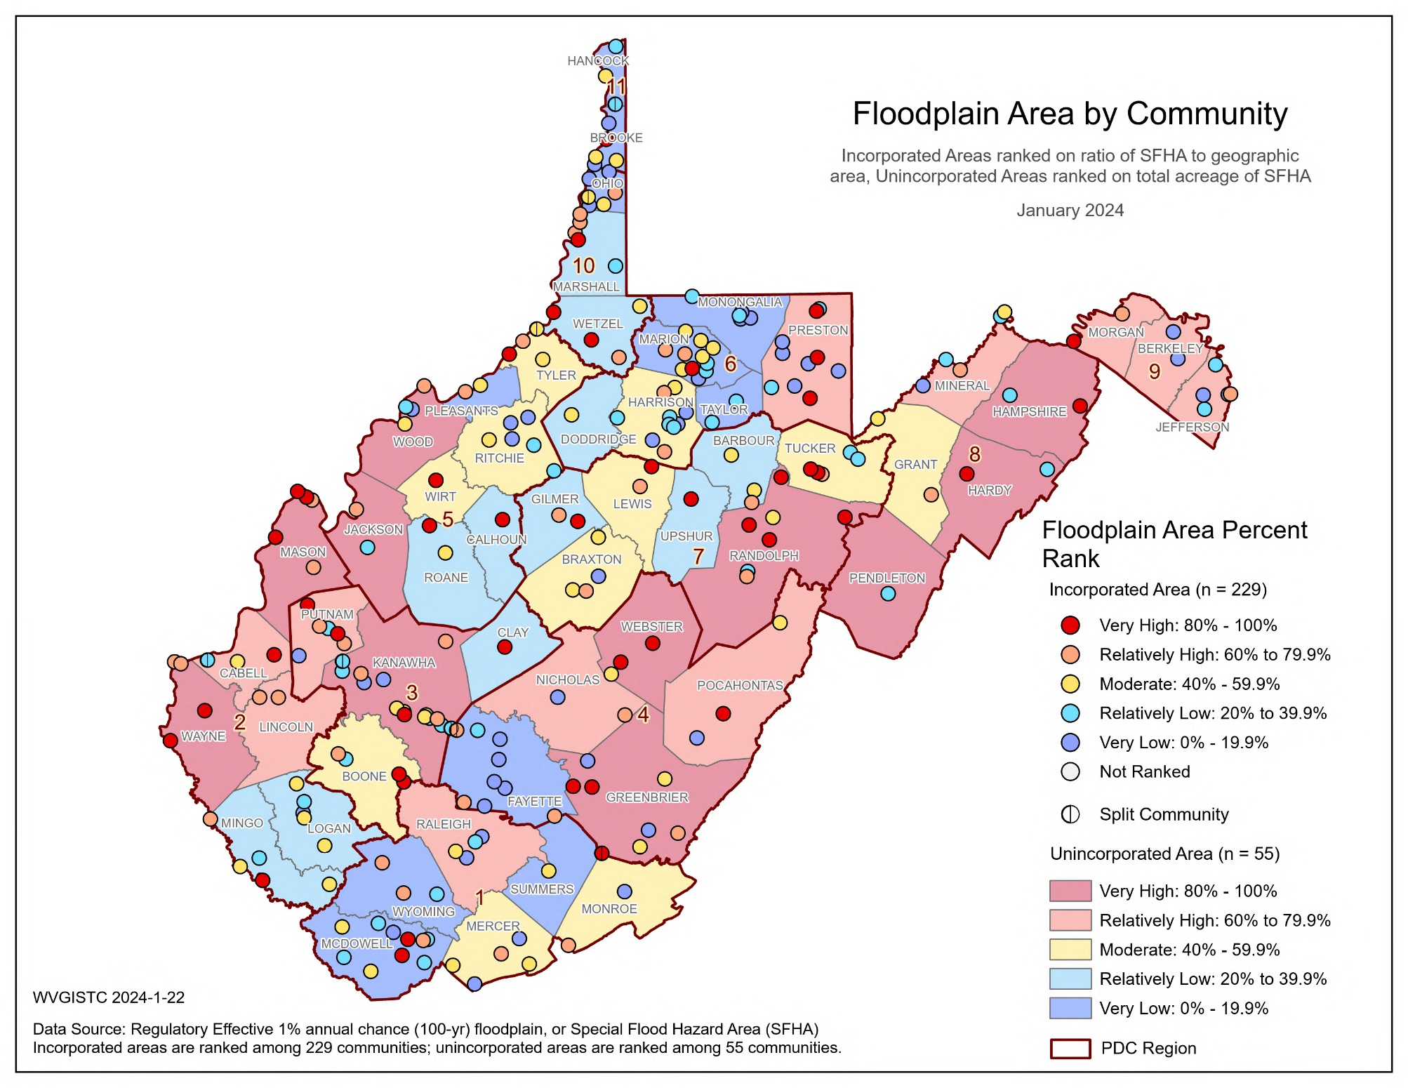
Floodplain Area; Maps

Slide 6
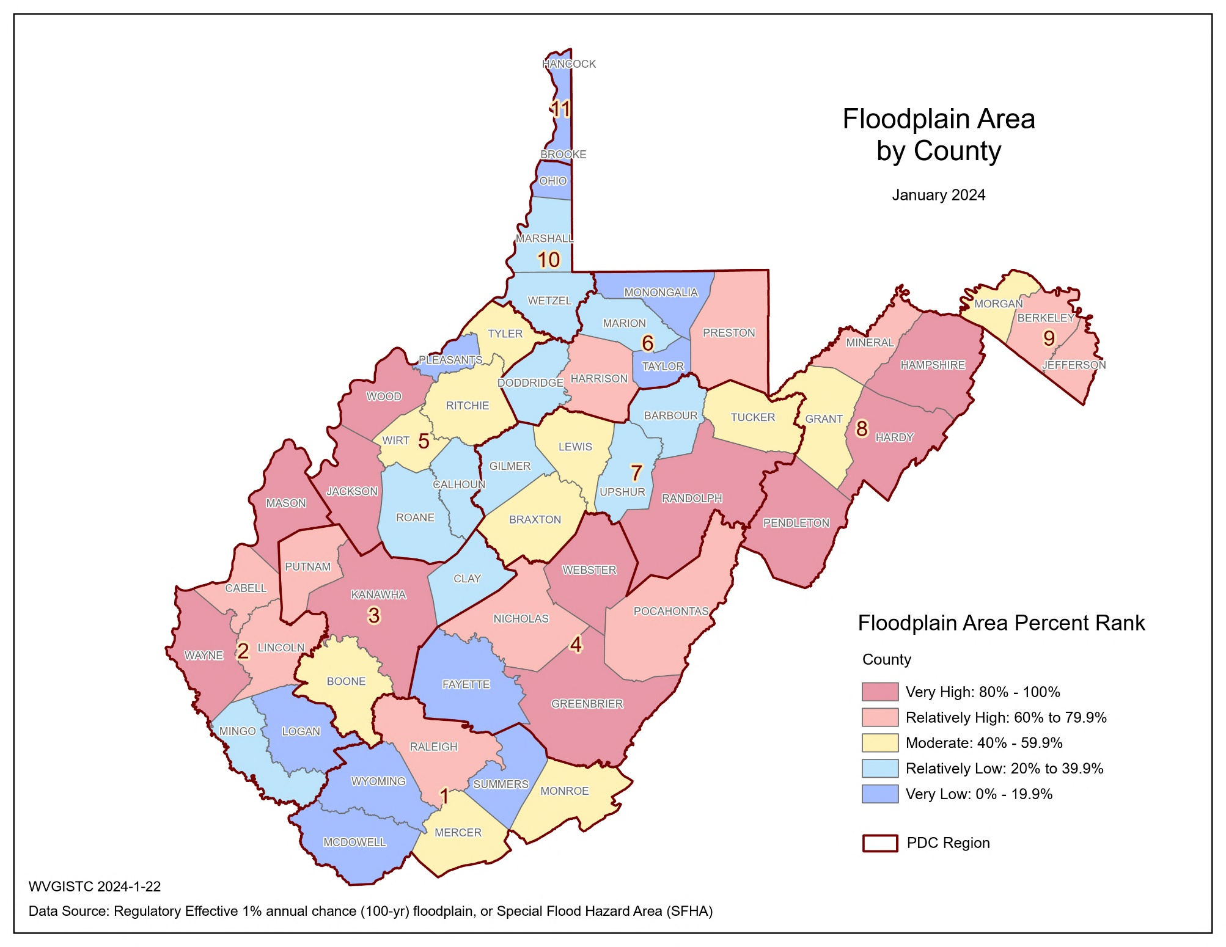
Floodplain Area; Maps
Top 5 Counties | RPDC Region | Modified Total SFHA Area (acres)
Hampshire | 8 | 26,607
Kanawha | 3 | 23,929
Mason | 2 | 23,117
Greenbrier | 4 | 21,615
Randolph | 7 | 20,523

Slide 7
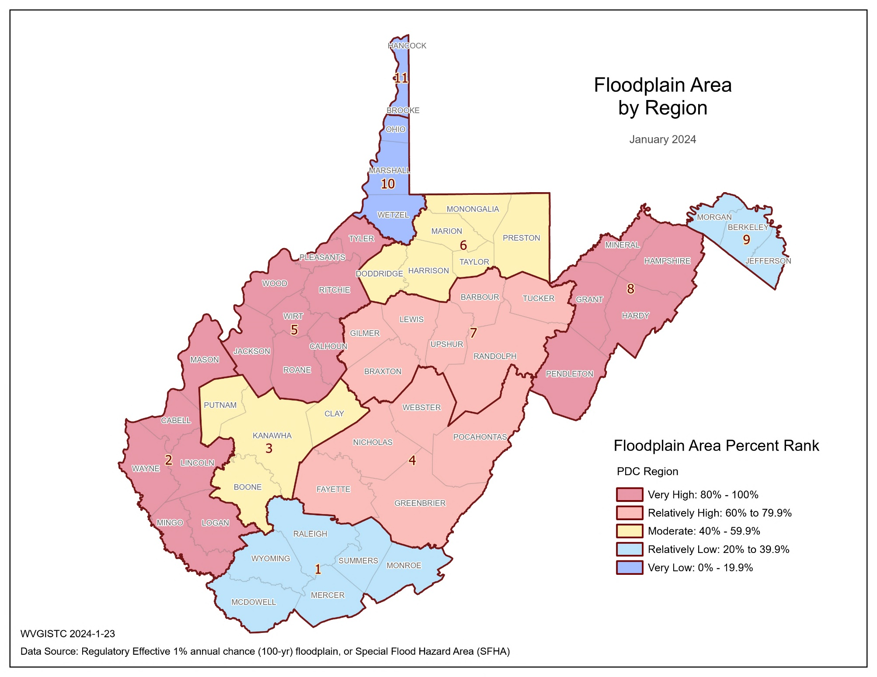
Floodplain Area; Maps
Top 3 Regions | Modified Total SFHA Area (acres)
5 | 76,780
8 | 74,648
2 | 72,366

Slide 8
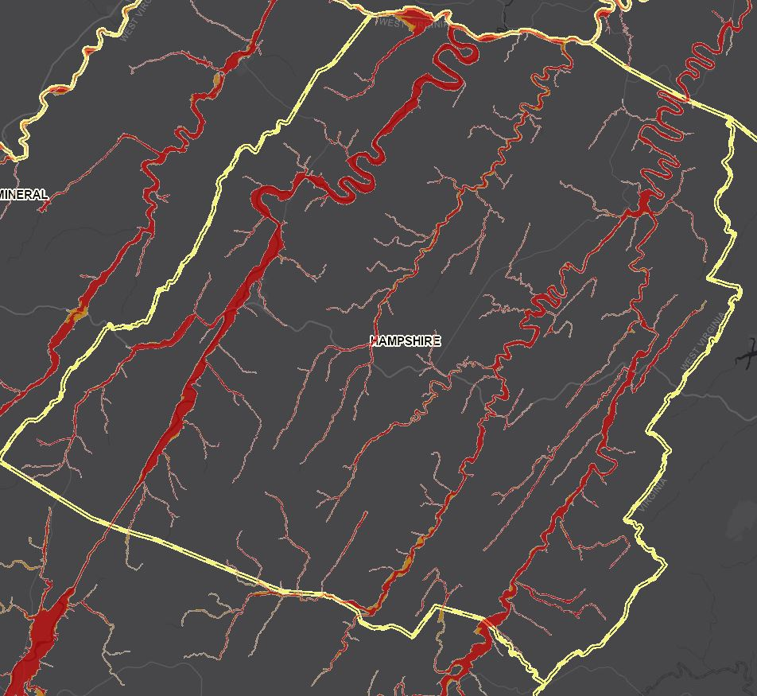
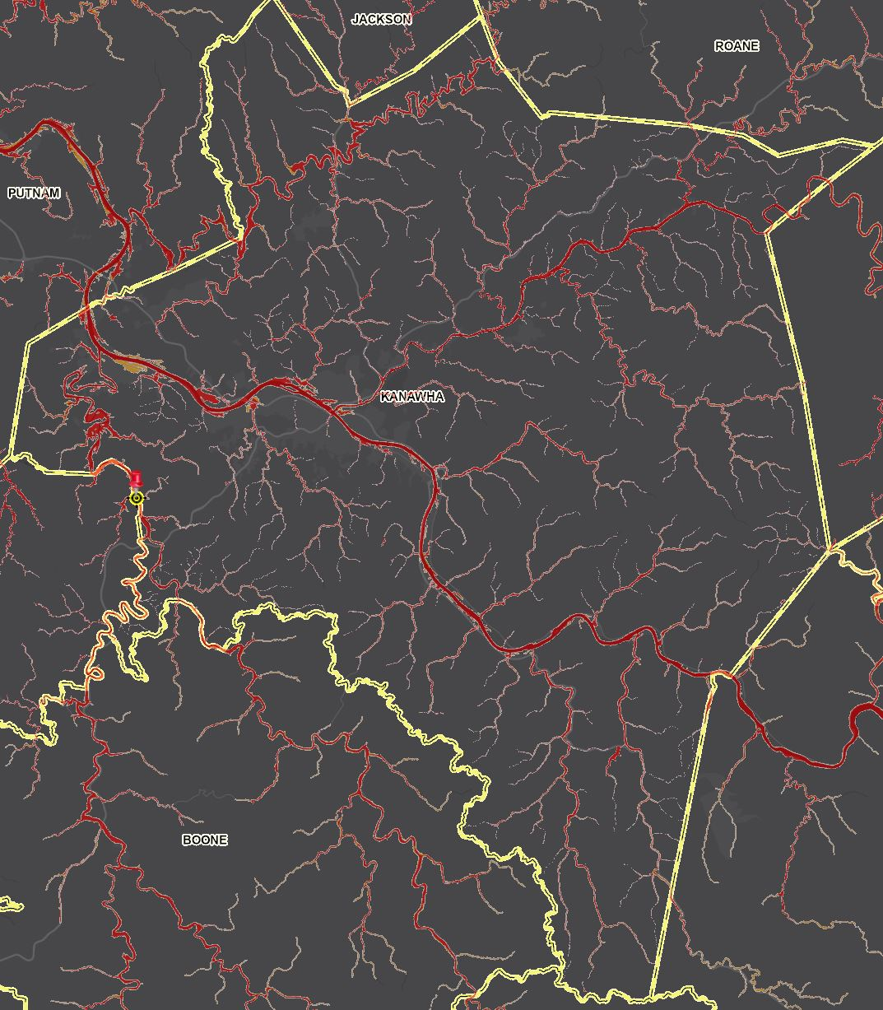
Floodplain Area; WV Flood Tool
A WV Flood Tool Screenshot of the floodplains in Hampshire County (Image link)
A WV Flood Tool Screenshot of the floodplains in Kanawha County (Image link)

Slide 9
Floodplain Area; Findings
Top 10 unincorporated communities with the highest floodplain areas:
SFHA, Top 10 Unincorporated Communities
Rank | Community | RPDC Region | Total SFHA Area (acres) | Water Bodies > 10 acres & Wide Streams > 500 ft. | Federal Lands (> 10 acres) | Modified Total SFHA Area (acres) (Minus large water bodies and federal lands) | Percent Rank
UNINCORPORATED
1 | Hampshire County* | 8 | 26,409 | 9 | 27 | 26,373 | 100.0%
2 | Mason County* | 2 | 30,008 | 7,993 | 26 | 21,989 | 99.6%
3 | Kanawha County* | 3 | 21,456 | 473 | 0 | 20,983 | 99.2%
4 | Greenbrier County* | 4 | 22,674 | 463 | 1,511 | 20,700 | 98.9%
5 | Randolph County* | 7 | 25,982 | 20 | 6,124 | 19,838 | 98.5%
6 | Webster County* | 4 | 22,052 | 435 | 4,062 | 17,555 | 98.2%
7 | Wood County* | 5 | 22,895 | 5,113 | 415 | 17,367 | 97.8%
8 | Hardy County* | 8 | 17,090 | 55 | 152 | 16,883 | 97.5%
9 | Jackson County* | 5 | 19,109 | 3,912 | 155 | 15,042 | 97.1%
10 | Pendleton County* | 8 | 15,005 | 118 | 769 | 14,118 | 96.8%
Top 5 counties with the highest floodplain areas:
SFHA, Top 5 Counties
Rank | County | RPDC Region | Total SFHA Area (acres) | Water Bodies > 10 acres & Wide Streams > 500 ft. | Federal Lands (> 10 acres) | Modified Total SFHA Area (acres) (Minus large water bodies and federal lands) | Percent Rank
1 | HAMPSHIRE | 8 | 26,643 | 9 | 27 | 26,607 | 100.0%
2 | KANAWHA | 3 | 25,863 | 1934 | 0 | 23,929 | 98.1%
3 | MASON | 2 | 31,694 | 8,551 | 26 | 23,117 | 96.2%
4 | GREENBRIER | 4 | 23,589 | 463 | 1,511 | 21,615 | 94.4%
5 | RANDOLPH | 7 | 26,,676 | 29 | 6,124 | 20,523 | 92.5%
Percent Rank Legend:
Very High: 80% to 100%
Red: 90% to 100%

Slide 10
Floodplain Area; Findings
Summary of Findings:
The total modified area of floodplains (aSFHA) in West Virginia, excluding large open water lakes (> 10 acres), large rivers (bank-to-bank > 500 ft.), and federal lands (> 10 acres), amounts to 528,635 acres which constitutes 3.4% of the state's total land area.
At the county level, Hampshire County has the highest modified area of floodplains (aSFHA) with 26,607 acres followed by Kanawha County with 23,929 acres.
Among all unincorporated areas in the state, Hampshire is ranked first for the modified area of floodplains (aSFHA) with 26,373 acres followed by Mason Unincorporated Area with 21,989 acres.
Floodplain Area Spatial Distribution:
Counties with the highest modified acreage of floodplains are mostly located in two clusters in the Eastern and Western parts of the state.

