Slide 1
Floodplain Area Ratio
(SFHA RT)
(Incorporated Place Scale)
West Virginia University WV GIS Technical Center
February 2024

Slide 2
Floodplain Area Ratio
Major Category | Detailed Category | Code | Indicator | Short Description | Unit
Flood Hazard Risk | Floodplain Area | SFHA_RT | Floodplain Area Ratio (Incorporated Place Scale) | Special Flood Hazard Area (SFHA) acreage to Total Community Area | %
Rationale | Recommendations | Data Source
At the community level, incorporated places with a higher ratio of floodplain area to community area face more significant challenges for development. Small towns in which a high percentage of their total incorporated land is in the Special Flood Hazard Area (SFHA) often have a higher flood exposure than other communities. Essential facilities and other significant structures that provide critical services to the community are often located in high-risk floodplains of smaller communities. Recently the small communities of Henderson (Mason), Matoaka (Mercer County), and Rhodell (Raleigh) with a high percentage of floodplain area have dissolved and are now unincorporated. | Smaller jurisdictions must be vigilant in relocating critical facilities away from the floodplain along with enforcing its floodplain management ordinance for any development. Although expensive to build and maintain, engineering flood control structures like levees, floodwalls, and dams protect vulnerable flood-prone communities. | FEMA Flood Insurance Rate Map (FIRM) Streams and Waterbodies (USGS NHD 24K), National Public Lands (USGS PAD-US)

Slide 3
Floodplain Area Ratio; Top 20% Rankings
RANK | All Communities | Percent_Rank | Incorporated Communities | Percent_Rank
1 | Sylvester | 100.0% | Sylvester | 100.0%
2 | Friendly | 99.6% | Friendly | 99.5%
3 | Addison | 99.2% | Addison | 99.1%
4 | Hambleton | 98.9% | Hambleton | 98.6%
5 | Reedy | 98.5% | Reedy | 98.2%
6 | Bruceton Mills | 98.2% | Bruceton Mills | 97.8%
7 | Buffalo | 97.8% | Buffalo | 97.3%
8 | Parsons | 97.5% | Parsons | 96.9%
9 | Pine Grove | 97.1% | Pine Grove | 96.4%
10 | Matewan | 96.8% | Matewan | 96.0%
11 | Elizabeth | 96.4% | Elizabeth | 95.6%
12 | Chesapeake | 96.1% | Chesapeake | 95.1%
13 | Albright | 95.7% | Albright | 94.7%
14 | Rowlesburg | 95.4% | Rowlesburg | 94.2%
15 | Capon Bridge | 95.0% | Capon Bridge | 93.8%
16 | Gary | 94.6% | Gary | 93.4%
17 | New Martinsville | 94.3% | New Martinsville | 92.9%
18 | Hartford | 93.9% | Hartford | 92.5%
19 | Whitesville | 93.6% | Whitesville | 92.1%
20 | Milton | 93.2% | Milton | 91.6%
21 | Paw Paw | 92.9% | Paw Paw | 91.2%
22 | Grantsville | 92.5% | Grantsville | 90.7%
23 | Buckhannon | 92.2% | Buckhannon | 90.3%
24 | Jane Lew | 91.8% | Jane Lew | 89.9%
25 | Marlinton | 91.5% | Marlinton | 89.4%
26 | Wellsburg | 91.1% | Wellsburg | 89.0%
27 | Sand Fork | 90.8% | Sand Fork | 88.5%
28 | Rainelle | 90.4% | Rainelle | 88.1%
29 | Bancroft | 90.1% | Bancroft | 87.7%
30 | Point Pleasant | 89.7% | Point Pleasant | 87.2%
31 | Alderson** | 89.3% | Alderson** | 86.8%
32 | Montrose | 89.0% | Montrose | 86.4%
33 | Clay | 88.6% | Clay | 85.9%
34 | Rupert | 88.3% | Rupert | 85.5%
35 | Womelsdorf (Coalton) | 87.9% | Womelsdorf (Coalton) | 85.0%
36 | Cowen | 87.6% | Cowen | 84.6%
37 | Kimball | 87.2% | Kimball | 84.2%
38 | Harman | 86.9% | Harman | 83.7%
39 | Fort Gay | 86.5% | Fort Gay | 83.3%
40 | Wayne | 86.2% | Wayne | 82.8%
41 | Mason | 85.8% | Mason | 82.4%
42 | Monongah | 85.5% | Monongah | 82.0%
43 | Moundsville | 85.1% | Moundsville | 81.5%
44 | Beverly | 84.8% | Beverly | 81.1%
45 | Moorefield | 84.4% | Moorefield | 80.7%
46 | Kermit | 84.0% | Kermit | 80.2%
47 | New Haven | 83.7%
48 | Glenville | 83.3%
49 | Clendenin | 83.0%
50 | Hendricks | 82.6%
51 | Richwood | 82.3%
52 | Ceredo | 81.9%
53 | Hamlin | 81.6%
54 | Pax | 81.2%
55 | Eleanor | 80.9%
56 | West Hamlin | 80.5%
57 | Williamstown | 80.2%
Colors:
Black --> Incorporated areas Brown --> Unincorporated areas Green --> Counties (Total) Red --> Split communities Blue --> Incorporated communities participating in the National Flood Insurance Program (NFIP) with no regulatory Special Flood Hazard Area (SFHA) Purple --> Incorporated communities with no regulatory Special Flood Hazard Area (SFHA) not participating in the National Flood Insurance Program (NFIP) (not mentioned in the FEMA's Community Status Book Report)
Black on blue: Six incorporated communities included in the detailed risk study (Camden-on-Gauley, Clendenin, Rainelle, Richwood, White Sulphur Springs, and Marlinton)

Slide 4
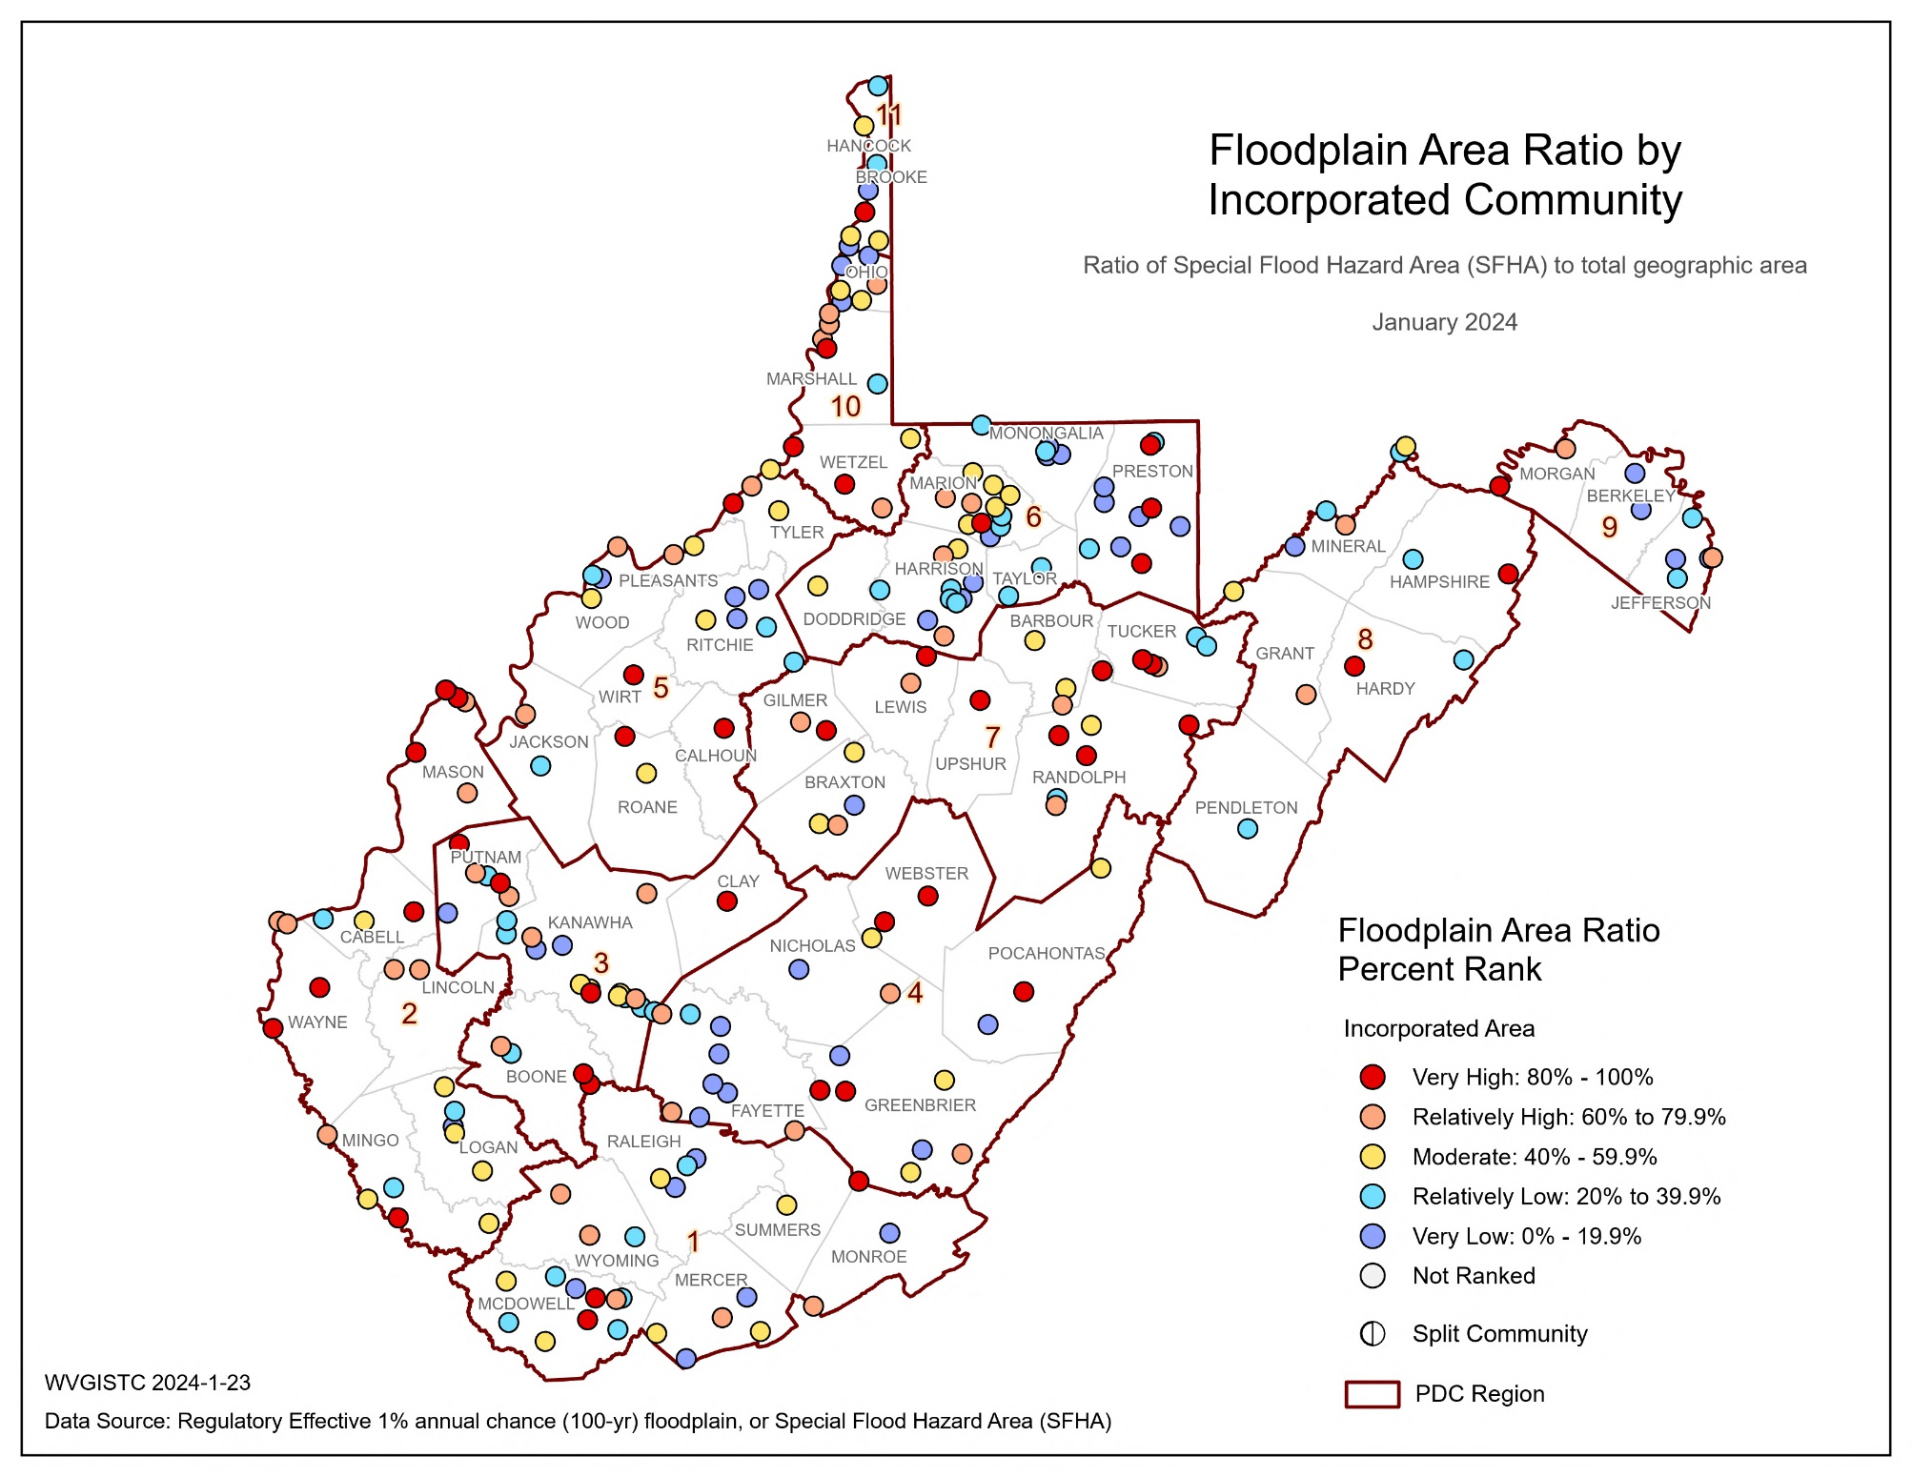
Floodplain Area Ratio; Maps

Slide 5
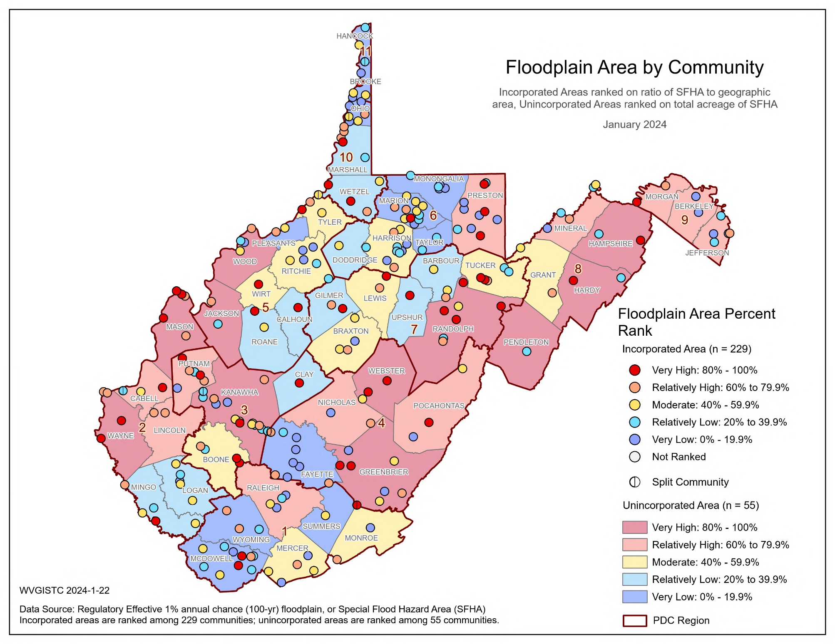
Floodplain Area Ratio; Maps

Slide 6
Floodplain Area Ratio; Focus Communities
Indicator | White Sulphur Springs | Rainelle | Clendenin | Richwood | Marlinton | Camden-on-Gauley | Statewide Median
Total SFHA Area (acres) | 267 | 223 | 235 | 247 | 494 | 35 | 77
Water Bodies > 10 acres & Wide Streams > 500 ft. | 0 | 0 | 0 | 0 | 0 | 0 | 0
Federal Lands (> 10 acres) | 0 | 0 | 0 | 0 | 0 | 0 | 0
Modified Total SFHA Area (acres) (Minus large water bodies and federal lands) | 267 | 223 | 235 | 247 | 494 | 35 | 74
Total Community Area (acres) | 1,214 | 714 | 974 | 1,068 | 1,566 | 214 | 559
Ratio of aSFHA to Community Area | 22.0% | 31.2% | 24.1% | 23.1% | 31.5% | 16.4% | 13.8%
Floodplain Area Ratio Percent Ranks | 74.2% (Relatively High) | 87.7% (Very High) | 78.6% (Relatively High) | 77.7% (Relatively High) | 89.0% (Very High) | 58.5% (Moderate) | -
Percent Rank Legend:
Very High: 80% to 100%
Relatively High: 60% to 79.9%
Moderate: 40% to 59.9%
Relatively Low: 20% to 39.9%
Very Low: 0% to 19.9%
Red: 90% to 100%

Slide 7
Floodplain Area Ratio; Findings
Top 10 incorporated communities with the highest Floodplain Area Ratio:
BLDG SFHA Ratio, Top 10 Communities | BLDG SFHA, Top 10 Communities
Rank | Community | County | RPDC Region | Total SFHA Area (acres) | Water Bodies > 10 acres & Wide Streams > 500 ft. | Federal Lands (> 10 acres) | Modified Total SFHA Area (acres) (Minus large water bodies and federal lands) | Total Community Area (acres) | Ratio of aSFHA to Community Area | Percent Rank
INCORPORATED | INCORPORATED
1 | Sylvester | Boone | 3 | 27 | 0 | 0 | 27 | 34 | 79.4% | 100.0%
2 | Friendly | Tyler | 5 | 43 | 5 | 0 | 38 | 65 | 58.5% | 99.5%
3 | Addison | Webster | 4 | 171 | 0 | 0 | 171 | 303 | 56.4% | 99.1%
4 | Hambleton | Tucker | 7 | 83 | 0 | 0 | 83 | 166 | 50.0% | 98.6%
5 | Reedy | Roane | 5 | 60 | 0 | 0 | 60 | 125 | 48.0% | 98.2%
6 | Bruceton Mills | Preston | 6 | 17 | 0 | 0 | 17 | 36 | 47.2% | 97.8%
7 | Buffalo | Putnam | 3 | 342 | 0 | 0 | 342 | 745 | 45.9% | 97.3%
8 | Parsons | Tucker | 7 | 230 | 0 | 0 | 230 | 529 | 43.5% | 96.9%
9 | Pine Grove | Wetzel | 10 | 103 | 0 | 0 | 103 | 243 | 42.4% | 96.4%
10 | Matewan | Mingo | 2 | 145 | 0 | 0 | 145 | 348 | 41.7% | 96.0%

Slide 8
Floodplain Area Ratio; Findings
Summary of Findings:
The median ratio of modified area of floodplains (aSFHA) to community area for all incorporated places statewide is 13.8%.
Among the incorporated communities, Sylvester in Boone County has the highest ratio (79.4%) followed by Friendly in Tyler County (58.5%).
Focus Communities Highlights:
Marlinton and Rainelle are among the top 20% incorporated communities in terms of the ratio of modified area of floodplains (aSFHA) to community area with 31.5% and 31.2% of their areas covered with such high-risk zones, respectively.
Clendenin (24.1%), Richwood (23.1%), and White Sulphur Springs (22.0%) are among the top 40% incorporated communities in terms of the ratio of modified area of floodplains (aSFHA) to community area.
The ratio of modified area of floodplains (aSFHA) to community area is higher than the statewide median for all incorporated areas (13.8%) in all six focus communities.

