Slide 1
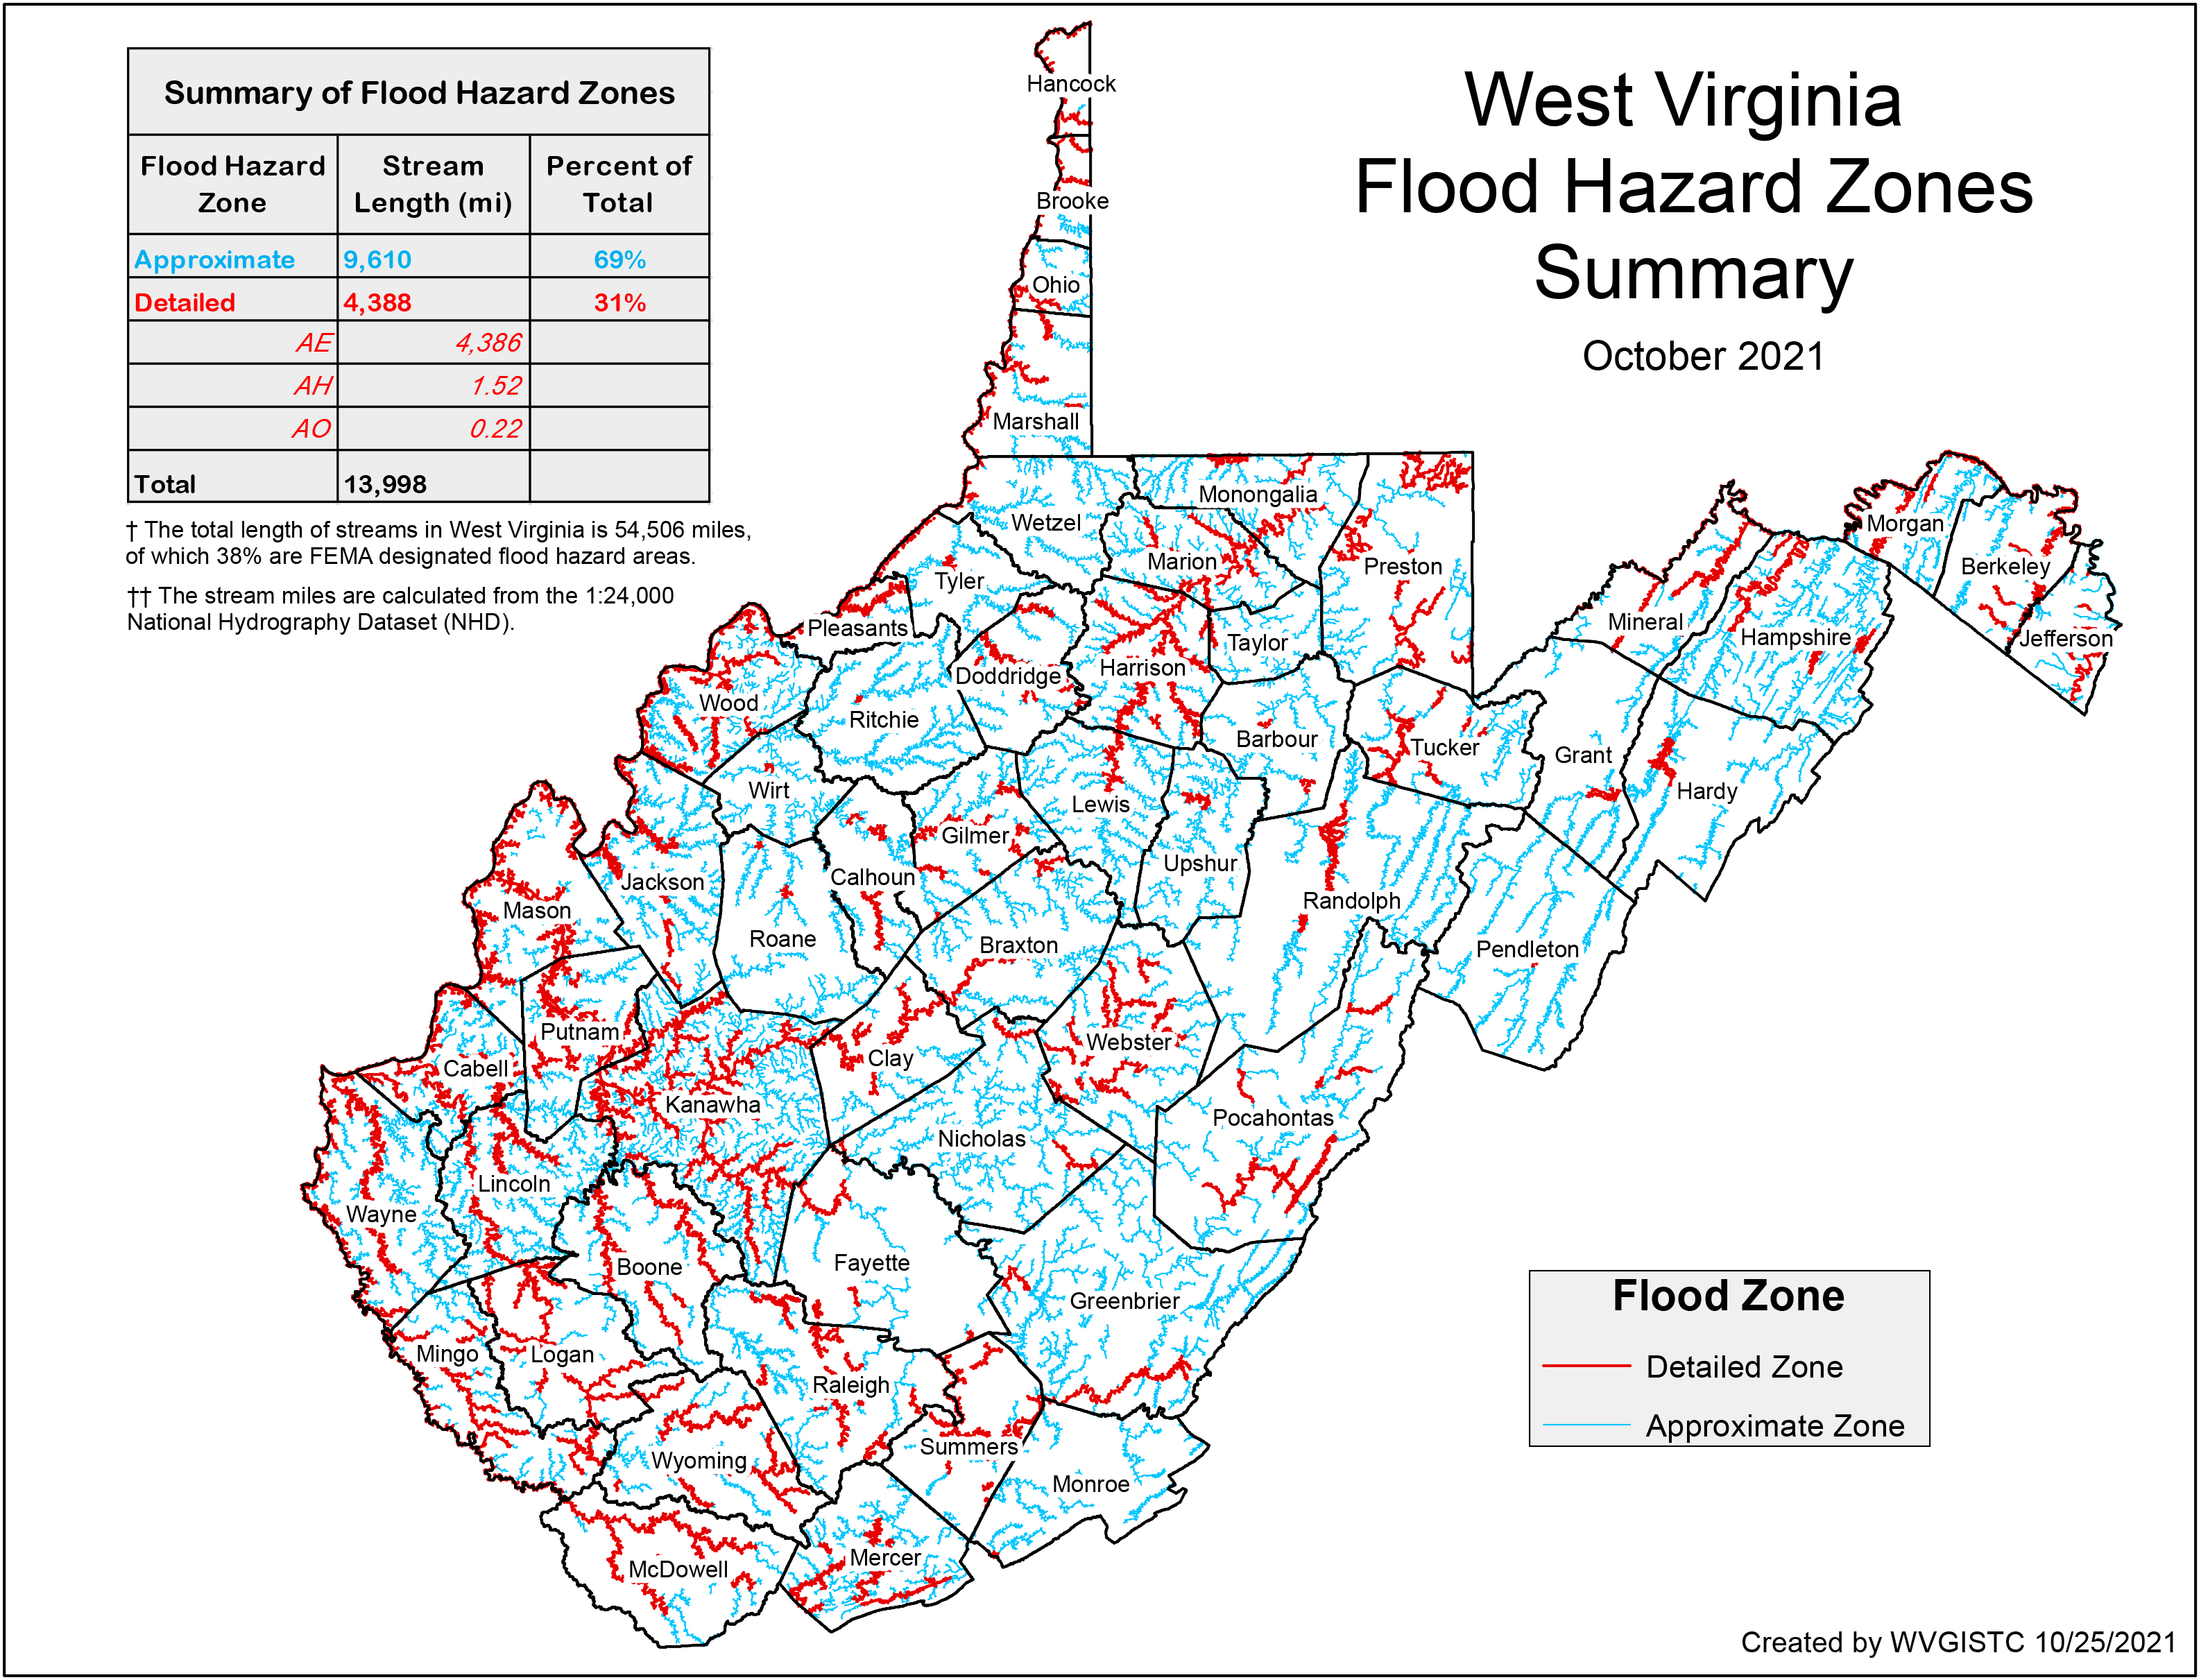
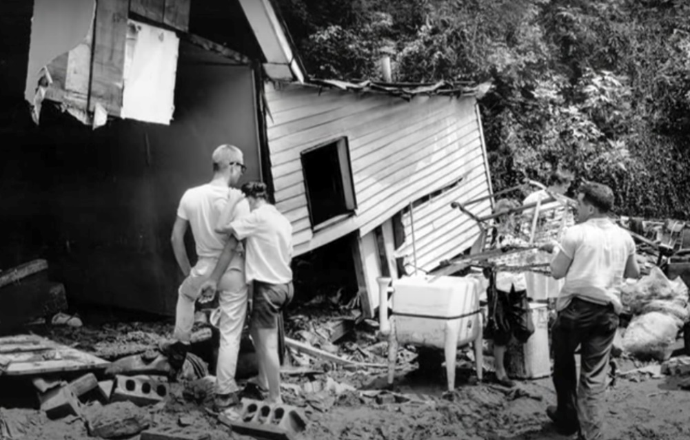
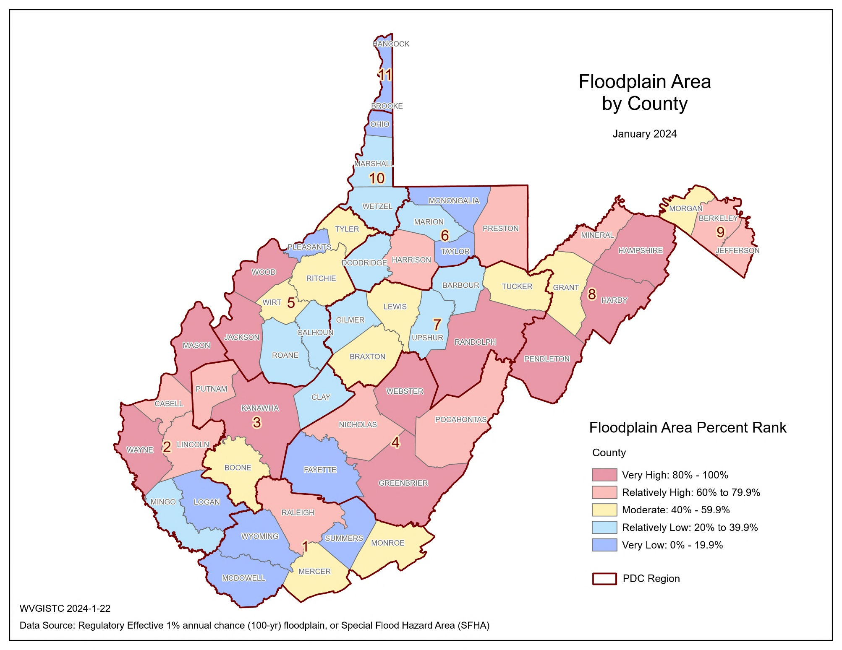
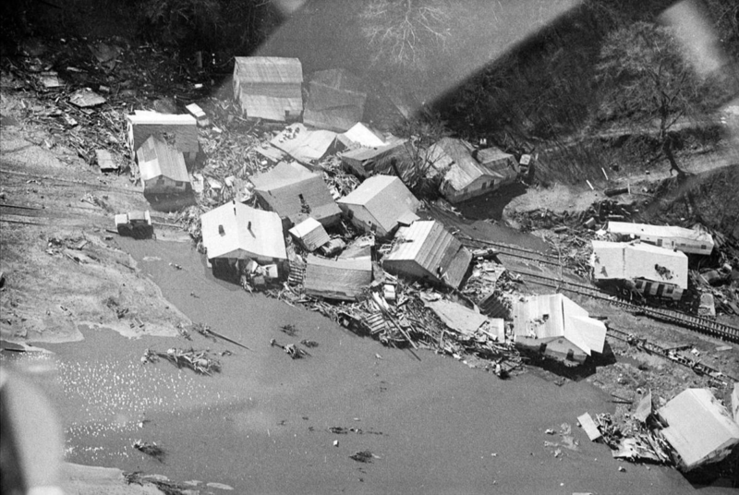
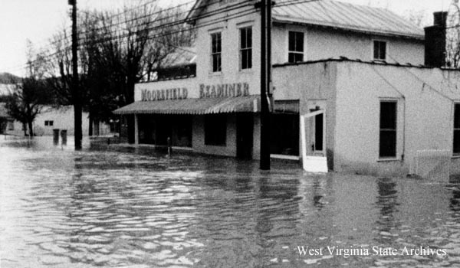
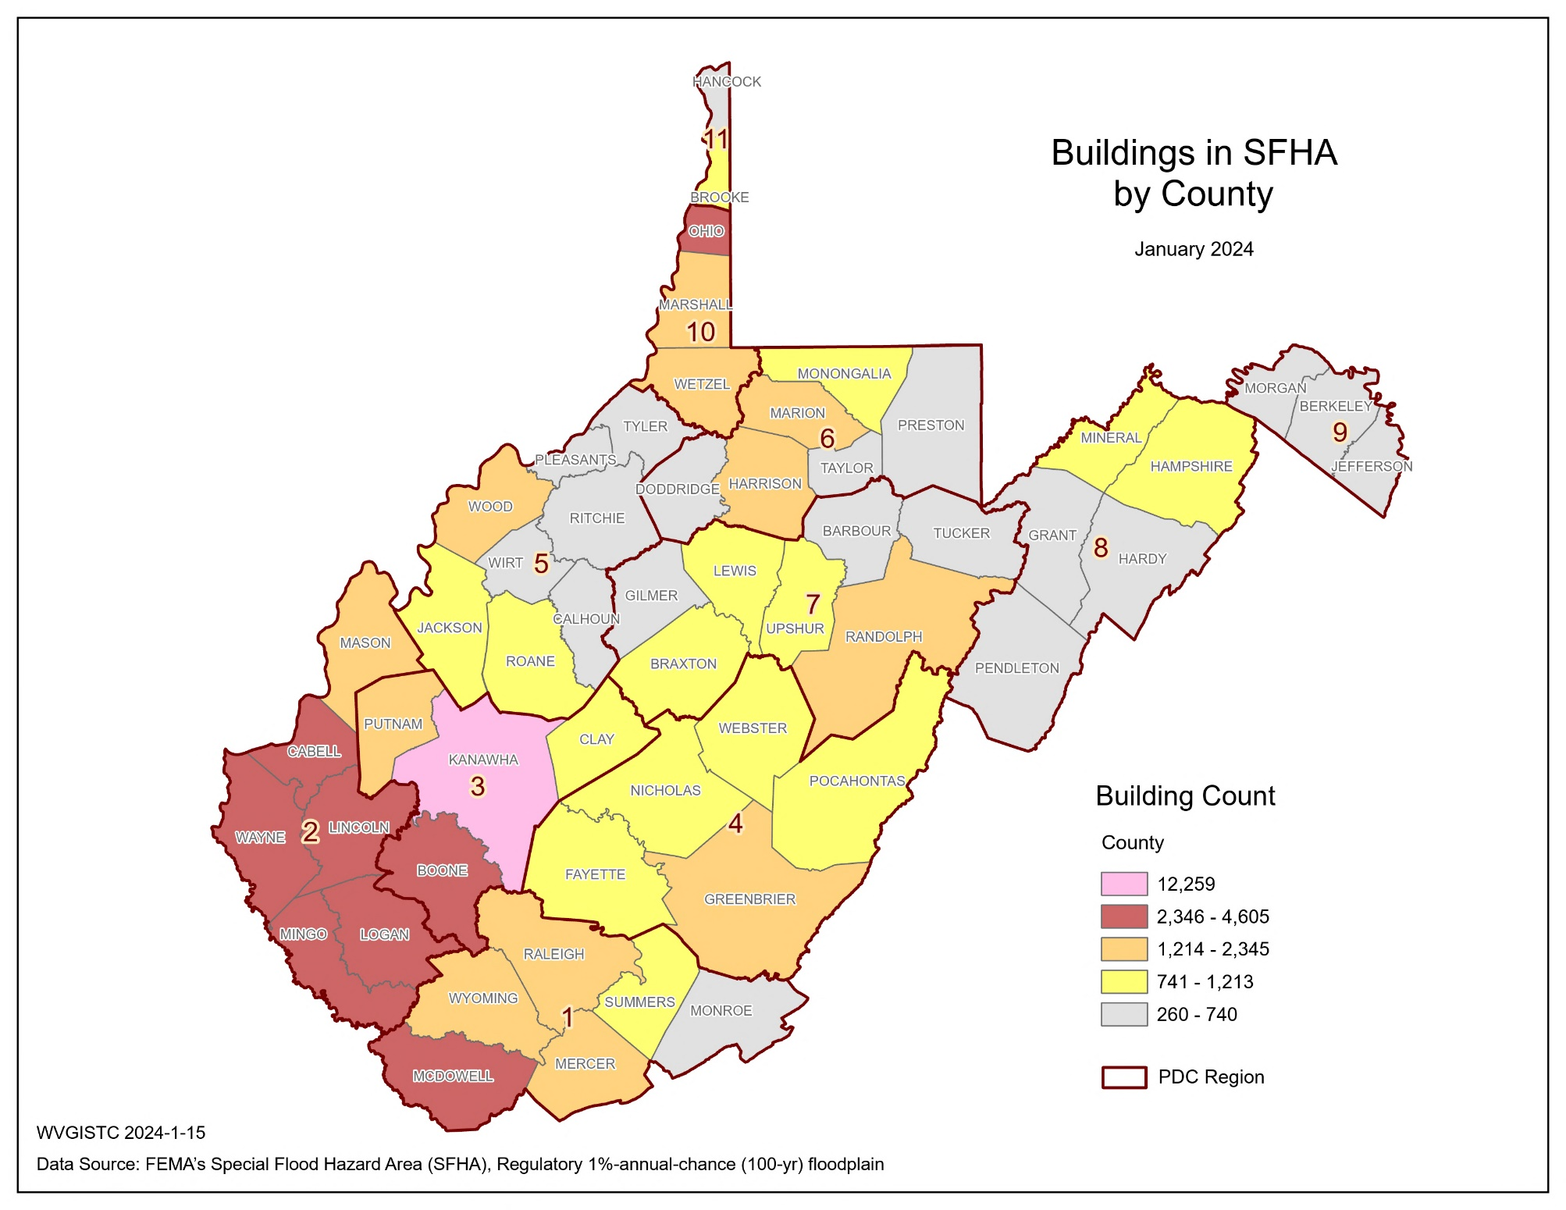
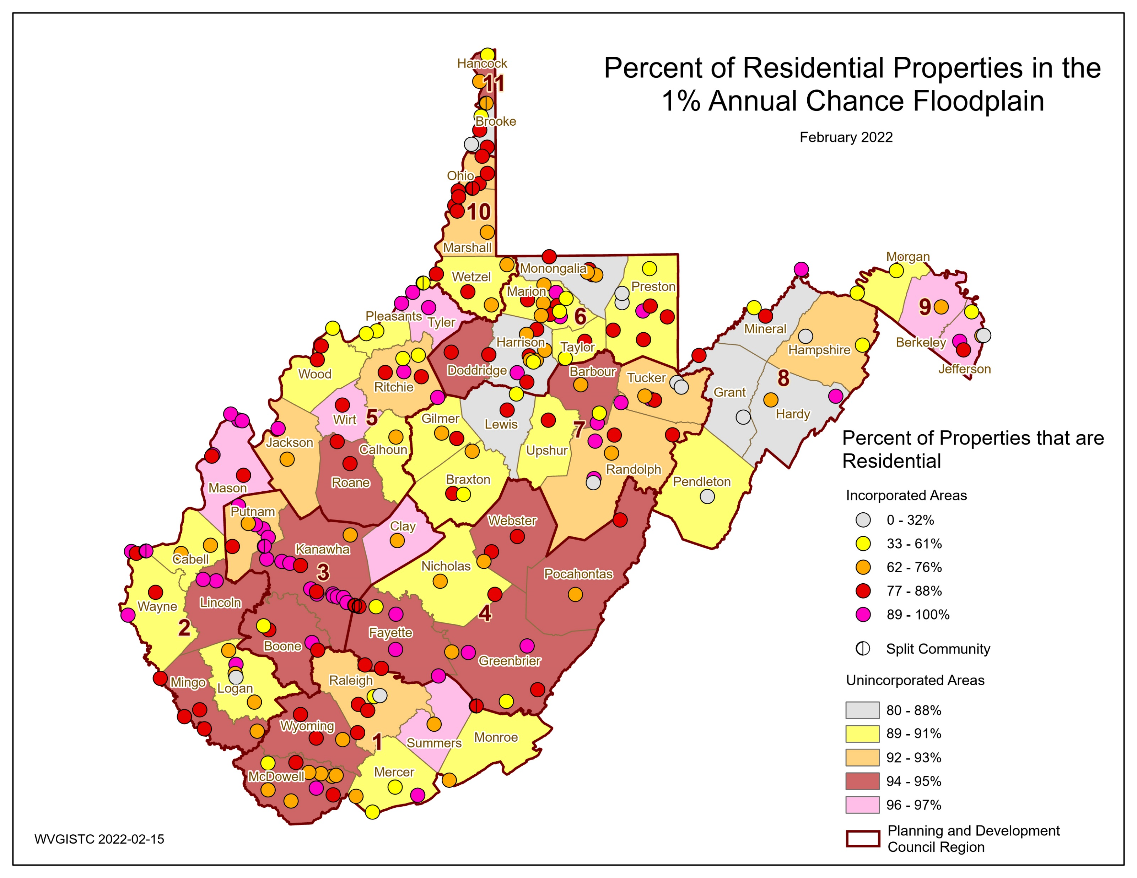
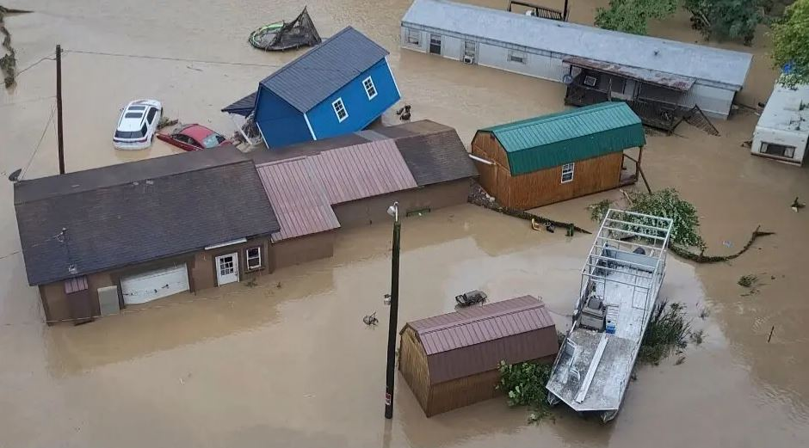
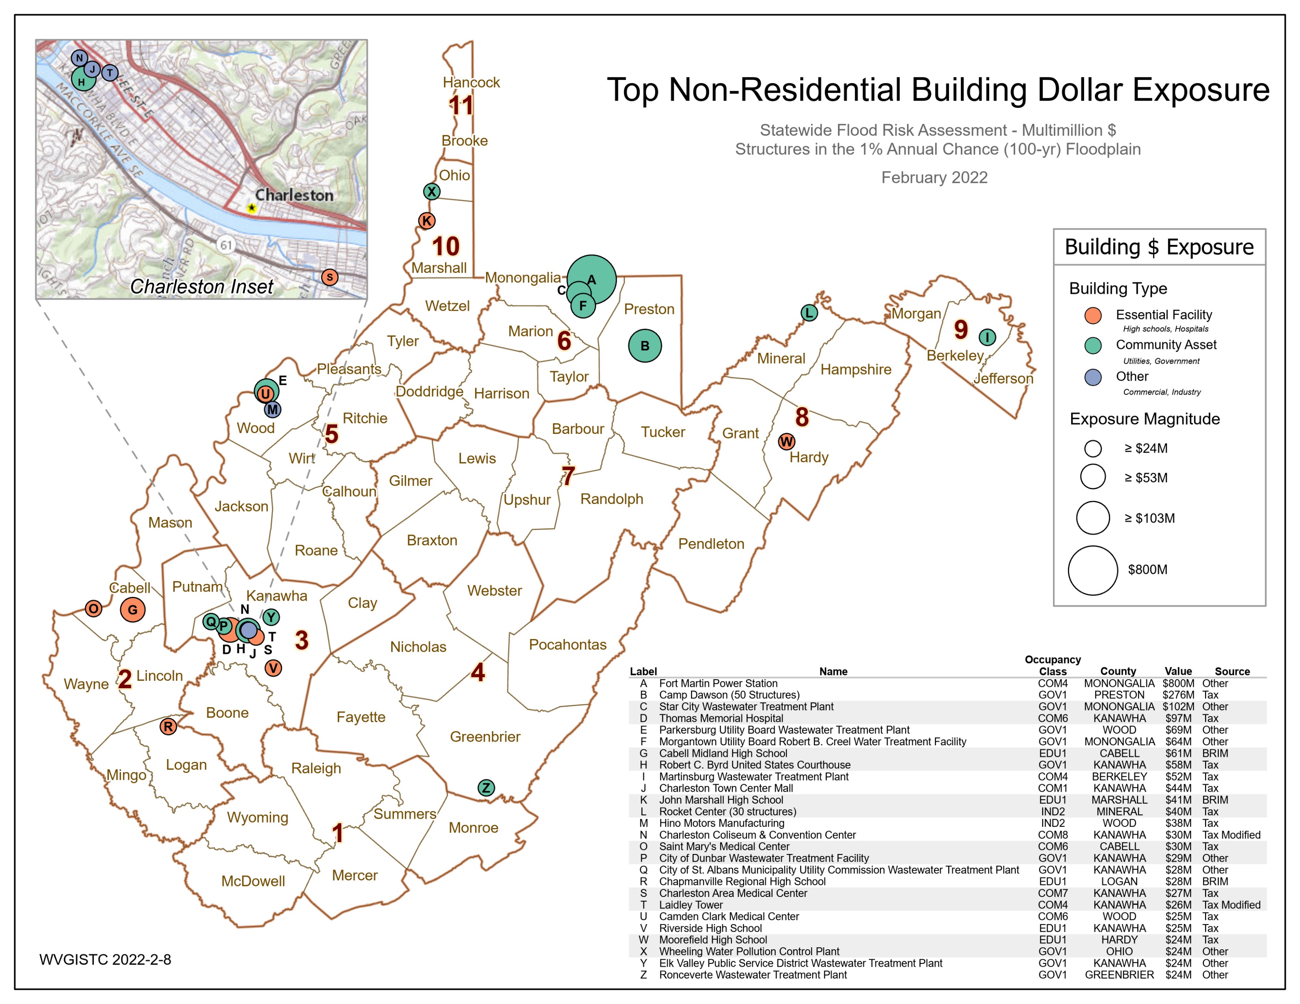
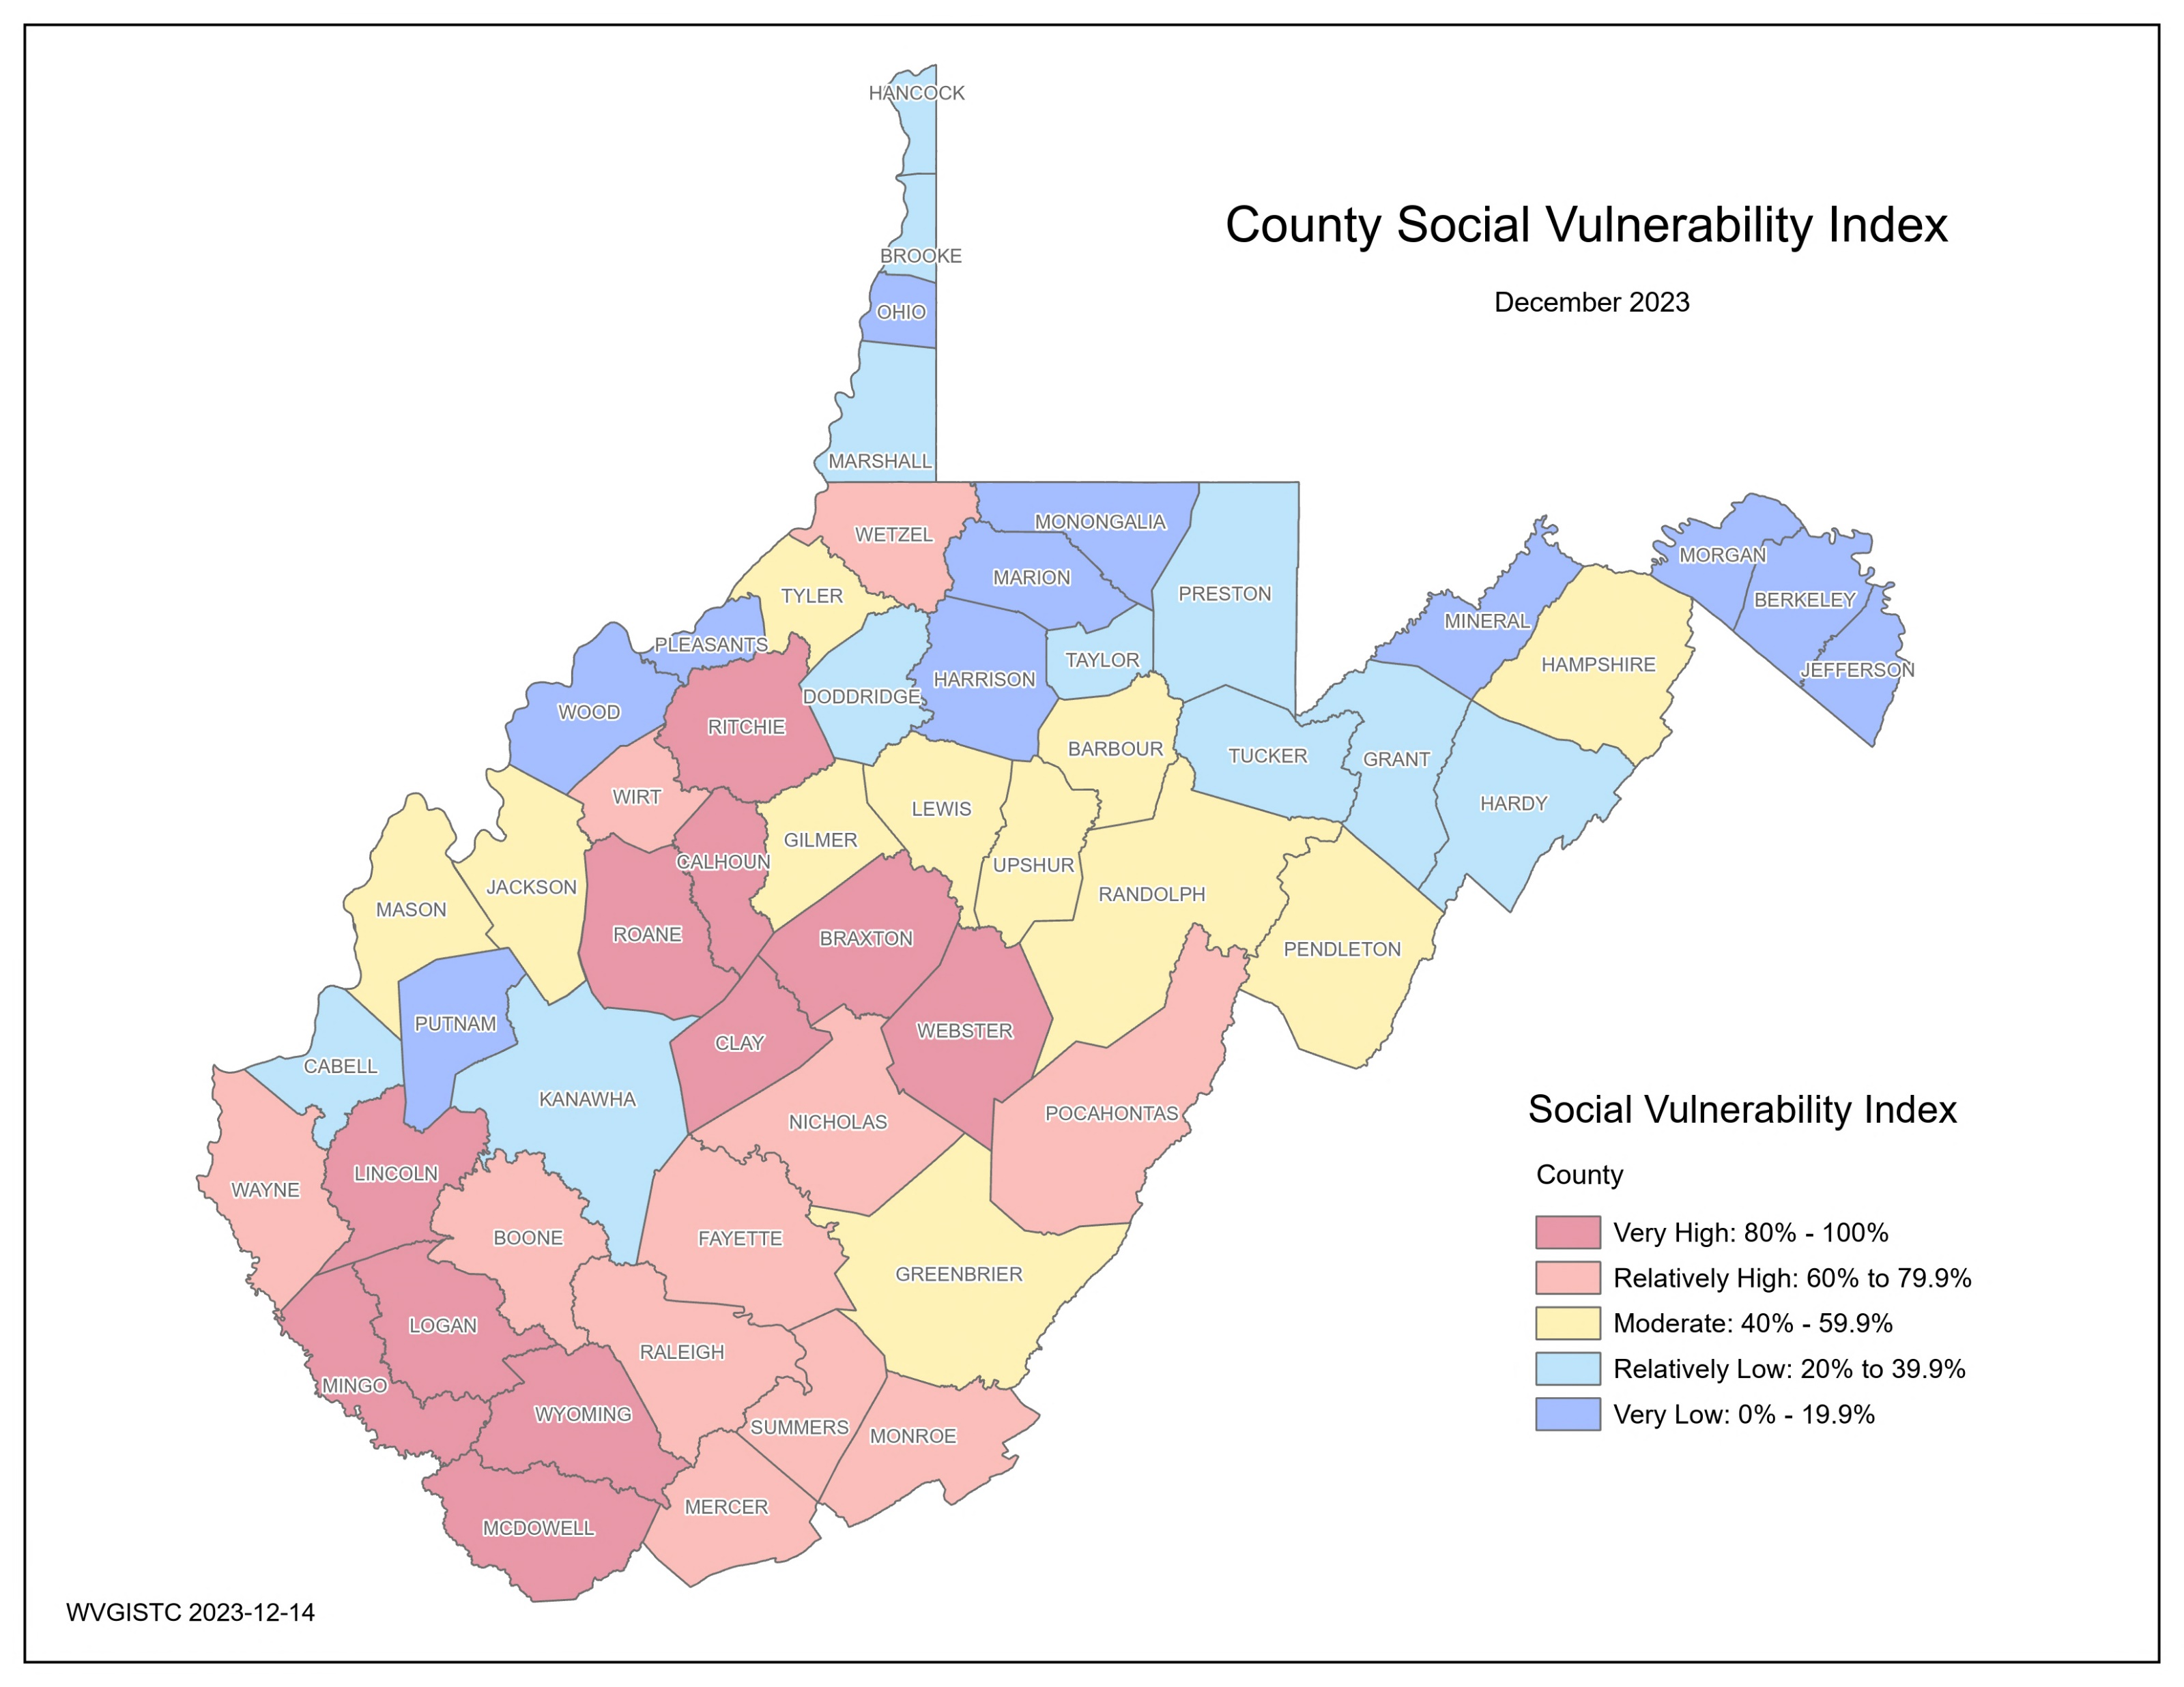
Statewide Flood Risk Assessment, WVFRF, Feb. 2024
Flood Hazard Risk
Total Modified Area of Regulatory Floodplains (aSFHA) in West Virginia, excluding large open water lakes (> 10 acres), large rivers (bank-to-bank > 500 ft.), and federal lands (> 10 acres): 528,635 acres (3.4% of the State’s Area)
31% of the state has mapped Detailed Flood Zones containing 65% of the buildings in Regulatory Floodplains
Top 5 Counties | Modified Total SFHA Area (acres)
Hampshire | 26,607
Kanawha | 23,929
Mason | 23,117
Greenbrier | 21,615
Randolph | 20,523
July 1961 (22 + 2 landslide fatalities), Kanawha County
32 Federally-Declared Flood Disasters in West Virginia since 1953
February 1972 (125 fatalities including 4 missing), Huntington
Structure Risk
Building Counts / Ratios
Structures in Regulatory Floodplain (SFHA): 83,556 (8.2% Bldgs. in WV)
Structures in High-Risk Advisory Zones: 13,503
Structures in All High-Risk Floodplains: 97,059 (9.6% of Bldgs. in WV)
Buildings in High-Risk Floodway: 8,239 (9.9% of SFHA Bldgs.)
Structures in Estimated Depths of Greater than 10 ft: 2,015
November 1985 (47 fatalities in WV), Moorefield
June 2016 (23 fatalities), Rainelle
Near Kimball, McDowell County, July 2001
Building Types / Value
Total Building Value in Floodplain: $10,473M
Exposed Residential Count Ratio: 88.6%
Residential Value in Floodplain: $4,324M (41.3%)
High-Value (> 1M) Residential Count: 36
Non-Residential Value in Floodplain: $6,149M
Top 5 Counties | BLDG. in SFHA
Kanawha | 12,259
Logan | 4,605
Ohio | 3,260
Boone | 3,201
Mingo | 3,032
Building Year / New Construction
Pre-FIRM in Floodplain Ratio: 73.7%
Post-FIRM in Floodplain Ratio: 26.3%
Majority of Building Stock is RESIDENTIAL. Unincorporated Areas typically have higher residential building counts than Incorporated Places.
Transportation Infrastructure
Inundated Roads: 2,550 miles (6.4%)
Flood Depth > 3 ft: 1,267 miles
Vulnerable Structures
Manufactured Homes in Floodplain: 23,329 (24%)
Floodplain Buildings with Basements Ratio: 27.9%
One-Story Floodplain Residential Buildings Ratio: 75.4%
Renter-Occupied Housing in Floodplain Ratio: 26.6%
Low-Value (< $10K) Floodplain Buildings Ratio: 7.4%
Physical Damage Estimates
Total Estimated Building Loss: $854.6M
(8.2% of Exposure Value)
Substantial Damage Buildings: 6,587 (6.8% of Floodplain Bldgs.)
Chesapeake, Kanawha County, August 2023
Significant Structures
Floodplain Essential Facilities: 491 (25.6% in WV)
(K 12 Schools, 911 Centers, Police/Fire Depts., Hospitals, Nursing Homes)
Floodplain Non-Hist. Community Assets: 2,116
(Religious, government, utility, EMS, postsecondary educational)
Floodplain Historical Community Assets: 3,159
(National Register, in historic districts before 1930)
People / Social Risk
Social Vulnerability Index (WV SVI)
(0% to 100%)
Combines indicators of:
Poverty Rate
Unemployment Rate
Vulnerable Ages Rate
Disability Rate
Population without a High School Diploma
Population Change
Median Housing Unit Value
Percentage of Mobile Homes in Housing Units
Top 5 Counties | WV SVI
McDowell | 100.0%
Wyoming | 98.1%
Mingo | 96.3%
Clay | 94.4%
Webster | 92.6%
Human Exposure
Population Residing in High-Risk Floodplains:
200,255 (11.1% of WV population)
2016 Flood Fatalities
23 Victims
Three younger than 15 yrs.
Eleven 15 to 64 yrs.
Nine over 65 yrs.
Five with Health Conditions or Disabilities
Nine Risky Behavior
Human Impacts
Population Displaced: 118,856 (6.6% of WV population)
Short-Term Shelter Population: 22,930 (5,697 Companion Pets)

