Slide 1

Logo
West Virginia Risk Explorer Architecture
GSU = Geographic Scale Unit
Identify GSU
(scale, location, report type)
(1) VIEW MAP*
(Spatial Access Gateway to Web Reports, Flagged Indicators, & Visualizations)
(2) VIEW REPORTS
(Non-Spatial Access Gateway to Web Reports)
(3) Web Reports*
Rankings
Statistics
Data Values
Graphics
Risk Factors 80th Pctl.
Risk Factors 0-100 Pctl.
Risk Comparison
Building Level (password)
(4) LIBRARY*
Visual Media & Document Catalog
Videos
Animations
Static Graphics
Dashboards
Reports
Other Docs
Full Risk Data Report
(Region-County-Community Scales;
1 Table)
Mobile Friendly
Scales = State, Regional Council, County, Community, Unincorporated Area, Incorporated Place, Watershed, River/Stream, Building (Reports Only)
Separate tab
* User Shared Links: Maps, Reports, or Catalog Query Web URLs
External Links

Slide 2


RE
West Virginia Risk Explorer
View Map
View Reports
Learn More
About
Landing page similar to NRI
West Virginia Risk Explorer
A localized exploration tool for understanding
riverine flood risk at nine geographic scales of analysis
View Map
View Reports
Flood Visualizations
Dashboard
Hazard Library
Access Data
Benefits
Other Risk Tools
West Virginia
Flood Resiliency

Slide 3

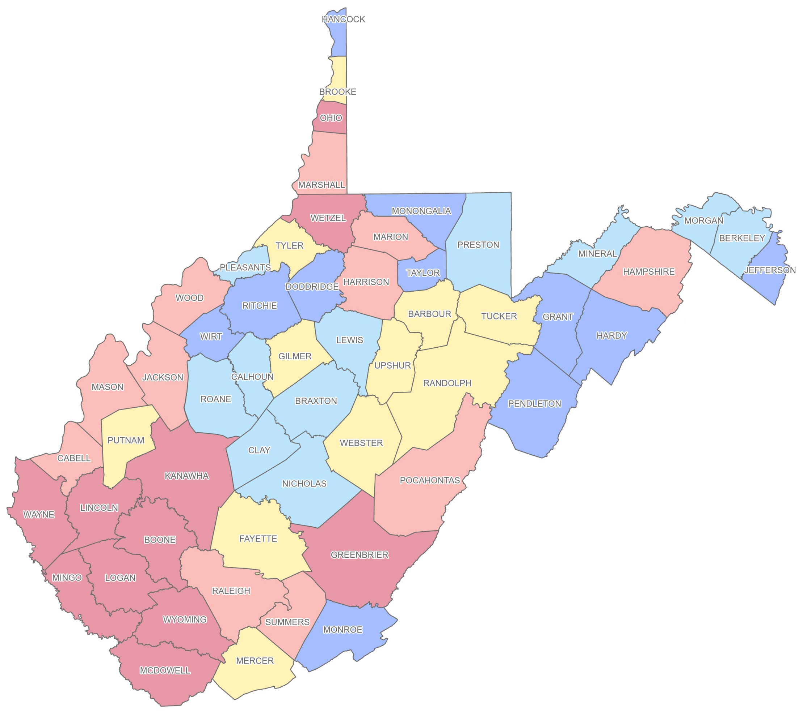



RE
West Virginia Risk Explorer
View Map
View Reports
Learn More
About
Select Map Type
Select Indicator
Select Geographic Scale
Select Geographic Unit
Help
Percent Ranks
Cumulative Index
County Scale
ALL
Compare Risk
Values
Find a county or address
Legend
Flood Risk Level:
Very High
Relatively High
Moderate
Relatively Low
Very Low
Change Base Map

Slide 4

RE
West Virginia Risk Explorer
View Map
View Reports
Learn More
About
Select Map Type
Select Indicator
Select Geographic Scale
Select Geographic Unit
Help
Percent Ranks
Cumulative Index
County Scale
ALL
Compare Risk
Values
Cumulative Index
Floodplain Area
Floodplain Length
Flood Declared Disasters
Flood Depth Median
Building Floodplain Count
Building Floodway Count
Building Floodplain Ratio
Building Density
Building Median Value
Bldg. Mobile Homes Ratio
Bldg. Subgrade Basements Ratio
Find a county or address
Legend
Flood Risk Level:
Very High
Relatively High
Moderate
Relatively Low
Very Low
Change Base Map

Slide 5
RE
West Virginia Risk Explorer
View Map
View Reports
Learn More
About
Select Map Type
Select Indicator
Select Geographic Scale
Select Geographic Unit
Help
Percent Ranks
Cumulative Index
County Scale
ALL
Compare Risk
Values
State
PDC Region
County
Community
Incorporated Place
Unincorporated Area
Watershed
Major Stream
Find a county or address
Legend
Flood Risk Level:
Very High
Relatively High
Moderate
Relatively Low
Very Low
Change Base Map

Slide 6
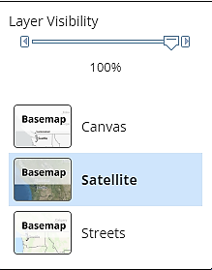
RE
West Virginia Risk Explorer
View Map
View Reports
Learn More
About
Select Map Type
Select Indicator
Select Geographic Scale
Select Geographic Unit
Help
Percent Ranks
Cumulative Index
County Scale
ALL
Compare Risk
Values
Find a county or address
Legend
Flood Risk Level:
Very High
Relatively High
Moderate
Relatively Low
Very Low
Change Base Map

Slide 7
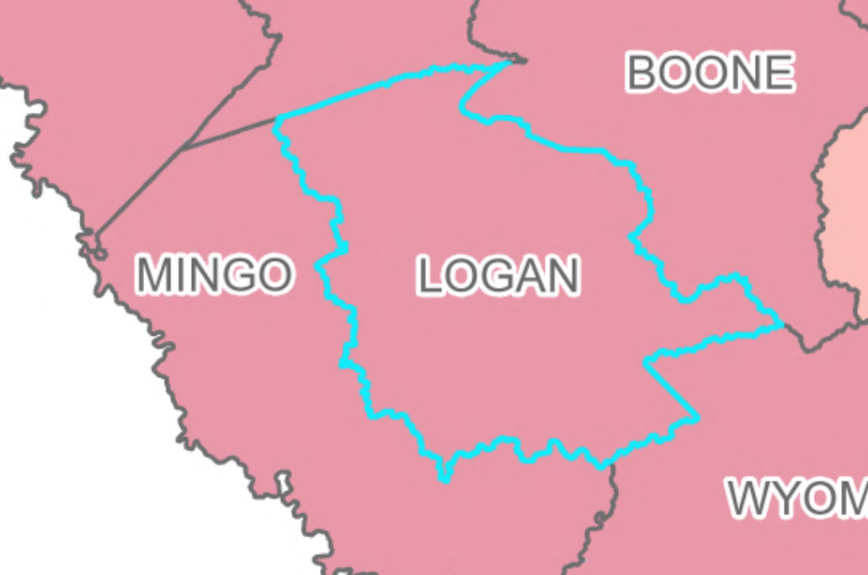

RE
West Virginia Risk Explorer
View Map
View Reports
Learn More
About
Select Map Type
Select Indicator
Select Geographic Scale
Select Geographic Unit
Help
Percent Ranks
Cumulative Index
County Scale
LOGAN
Compare Risk
Values
Logan County, WV
Region 2
View Report
Find a county or address
Cumulative Flood Risk Score 94.4% VERY HIGH
Rank in 55 counties 4th
For 12 of 25 risk indicators among the top 10% counties.
For 15 of 25 risk indicators among the top 20% counties.
High-Risk
All
High-Risk Indicators
Value
Percent Rank
More Info.
Flood Declared Disasters
27
96.2%
Building Floodplain Count
4,498
98.1%
Building Floodway Count
961
98.1%
Building Floodplain Ratio
17.8%
94.4%
Building Density
0.81
98.1%
Legend
Bldg. Mobile Homes Ratio
35.5%
87.0%
Flood Risk Level:
Essential Facilities
18
88.8%
Roads Inundated Ratio
Very High
14.6%
96.2%
Community Assets Non-Historical
Relatively High
115
96.2%
Moderate
Bldg. Substantial Damage Count
306
92.5%
Bldg. Previous Damage Claims
2,418
98.1%
Relatively Low
Repetitive Loss Structures
1,110
98.1%
Very Low
Population in Floodplain Ratio
33.8%
94.4%
Change Base Map
Population Displaced Ratio
23.0%
96.2%
WV Social Vulnerability Index
88.9%
88.9%

Slide 8
RE
West Virginia Risk Explorer
View Map
View Reports
Learn More
About
Select Map Type
Select Indicator
Select Geographic Scale
Select Geographic Unit
Help
Percent Ranks
Cumulative Index
County Scale
LOGAN
Compare Risk
Values
Cumulative Index
Floodplain Area
Floodplain Length
Flood Declared Disasters
Flood Depth Median
Building Floodplain Count
Building Floodway Count
Building Floodplain Ratio
Building Density
Building Median Value
Bldg. Mobile Homes Ratio
Bldg. Subgrade Basements Ratio
Logan County, WV
Region 2
View Report
Find a county or address
Cumulative Flood Risk Score 94.4% VERY HIGH
Rank in 55 counties 4th
For 12 of 25 risk indicators among the top 10% counties.
For 15 of 25 risk indicators among the top 20% counties.
High-Risk
All
High-Risk Indicators
Value
Percent Rank
More Info.
Flood Declared Disasters
27
96.2%
Building Floodplain Count
4,498
98.1%
Building Floodway Count
961
98.1%
Building Floodplain Ratio
17.8%
94.4%
Building Density
0.81
98.1%
Legend
Bldg. Mobile Homes Ratio
35.5%
87.0%
Flood Risk Level:
Essential Facilities
18
88.8%
Roads Inundated Ratio
Very High
14.6%
96.2%
Community Assets Non-Historical
Relatively High
115
96.2%
Moderate
Bldg. Substantial Damage Count
306
92.5%
Bldg. Previous Damage Claims
2,418
98.1%
Relatively Low
Repetitive Loss Structures
1,110
98.1%
Very Low
Population in Floodplain Ratio
33.8%
94.4%
Change Base Map
Population Displaced Ratio
23.0%
96.2%
WV Social Vulnerability Index
88.9%
88.9%

Slide 9
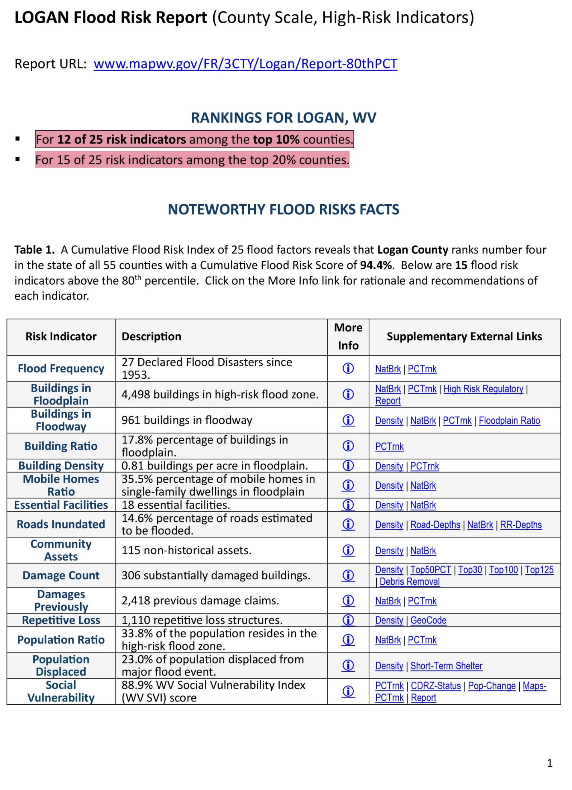

RE
West Virginia Risk Explorer
View Map
View Reports
Learn More
About
High-Risk Indicators Report
All Risk Indicators Report
Risk Comparison Report
Full Risk Data Report
Building Level Report (on request)

Slide 10
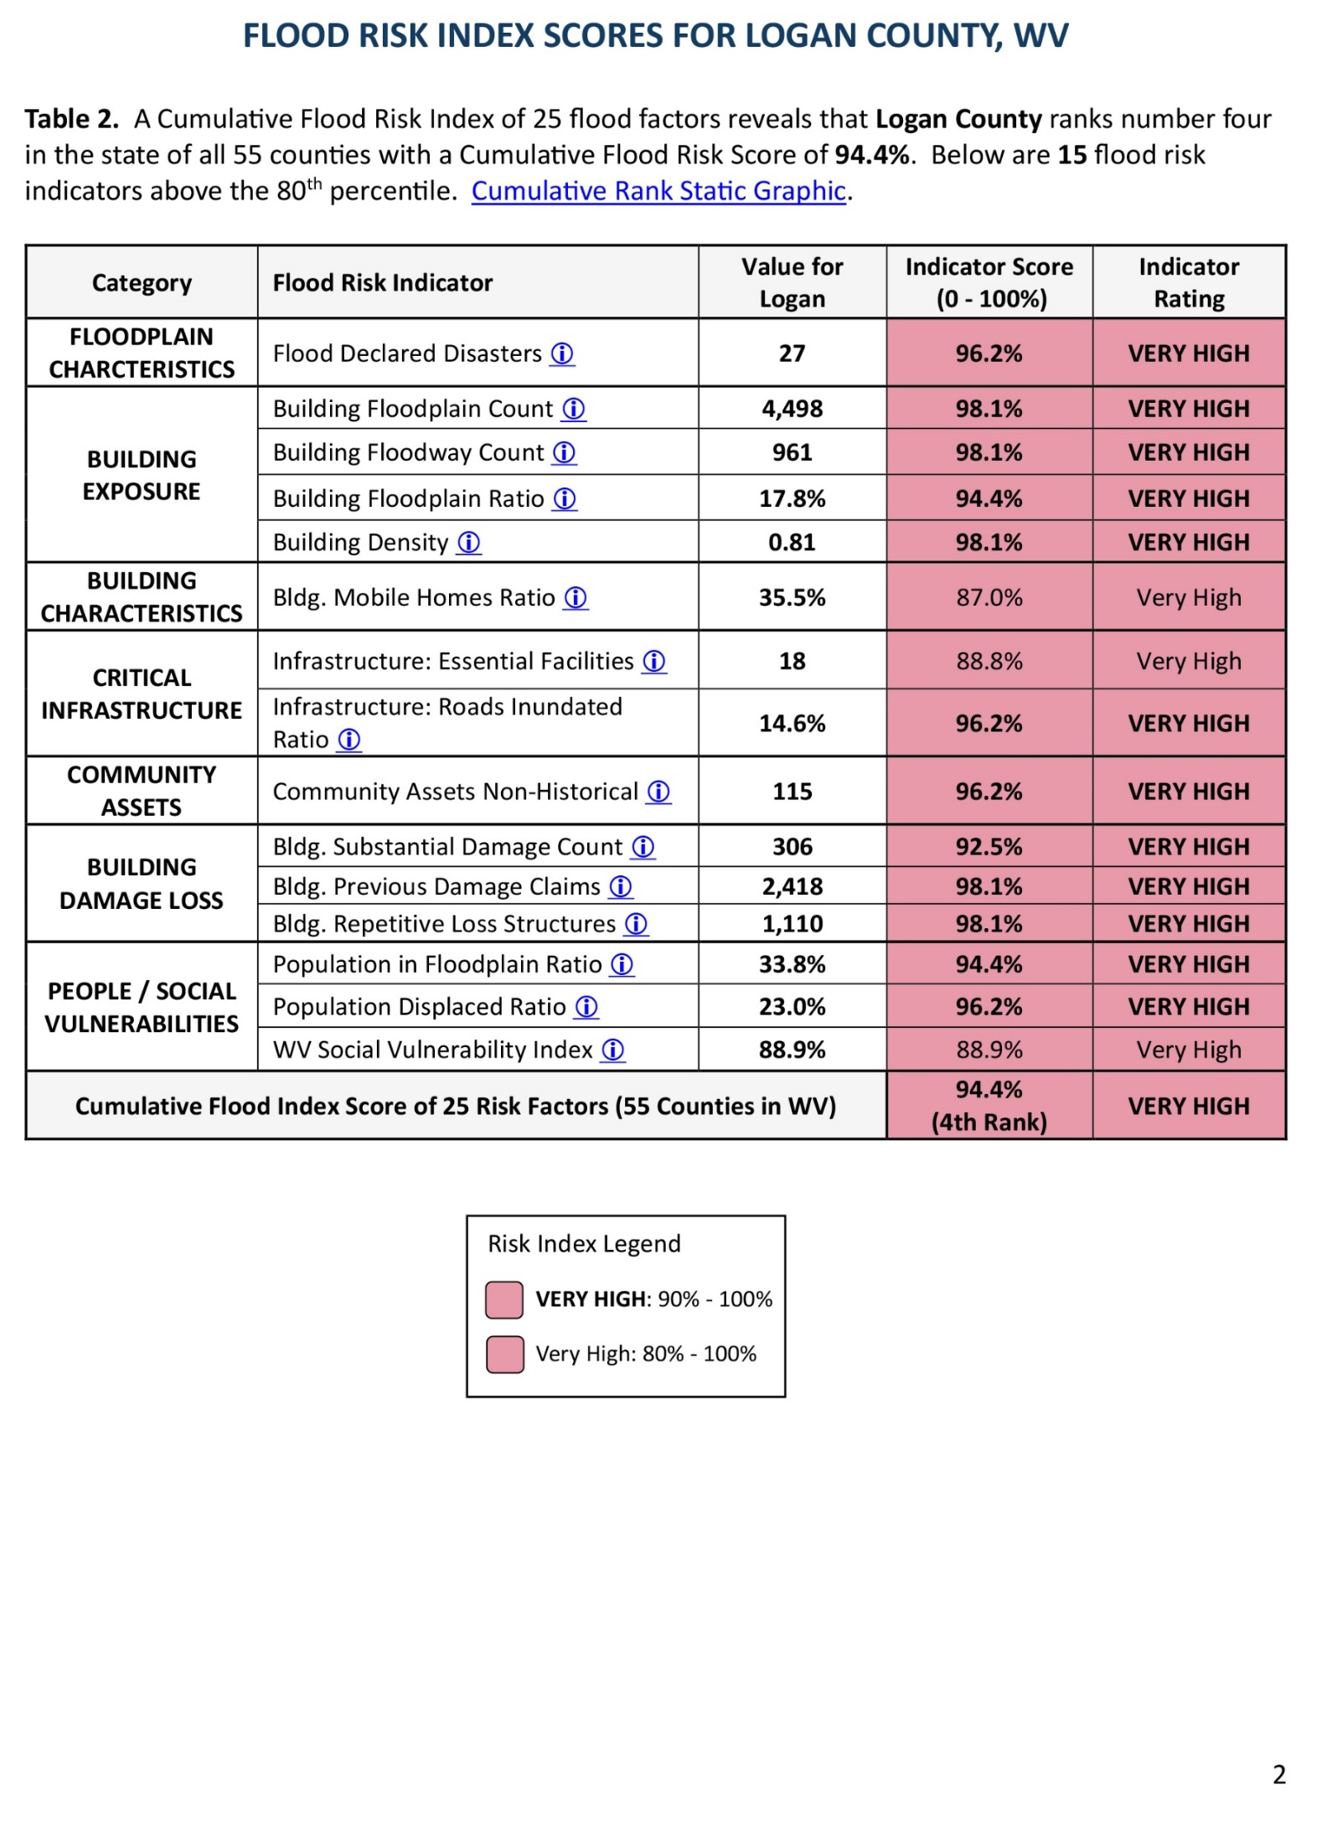
RE
West Virginia Risk Explorer
View Map
View Reports
Learn More
About
High-Risk Indicators Report
All Risk Indicators Report
Risk Comparison Report
Full Risk Data Report
Building Level Report (on request)

Slide 11
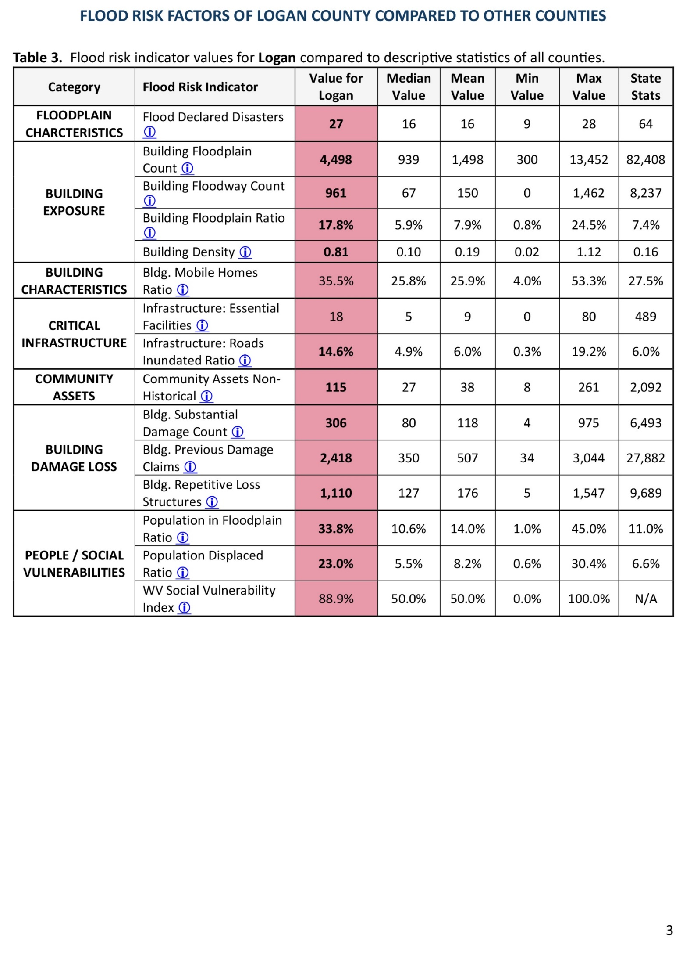
RE
West Virginia Risk Explorer
View Map
View Reports
Learn More
About
High-Risk Indicators Report
All Risk Indicators Report
Risk Comparison Report
Full Risk Data Report
Building Level Report (on request)

Slide 12
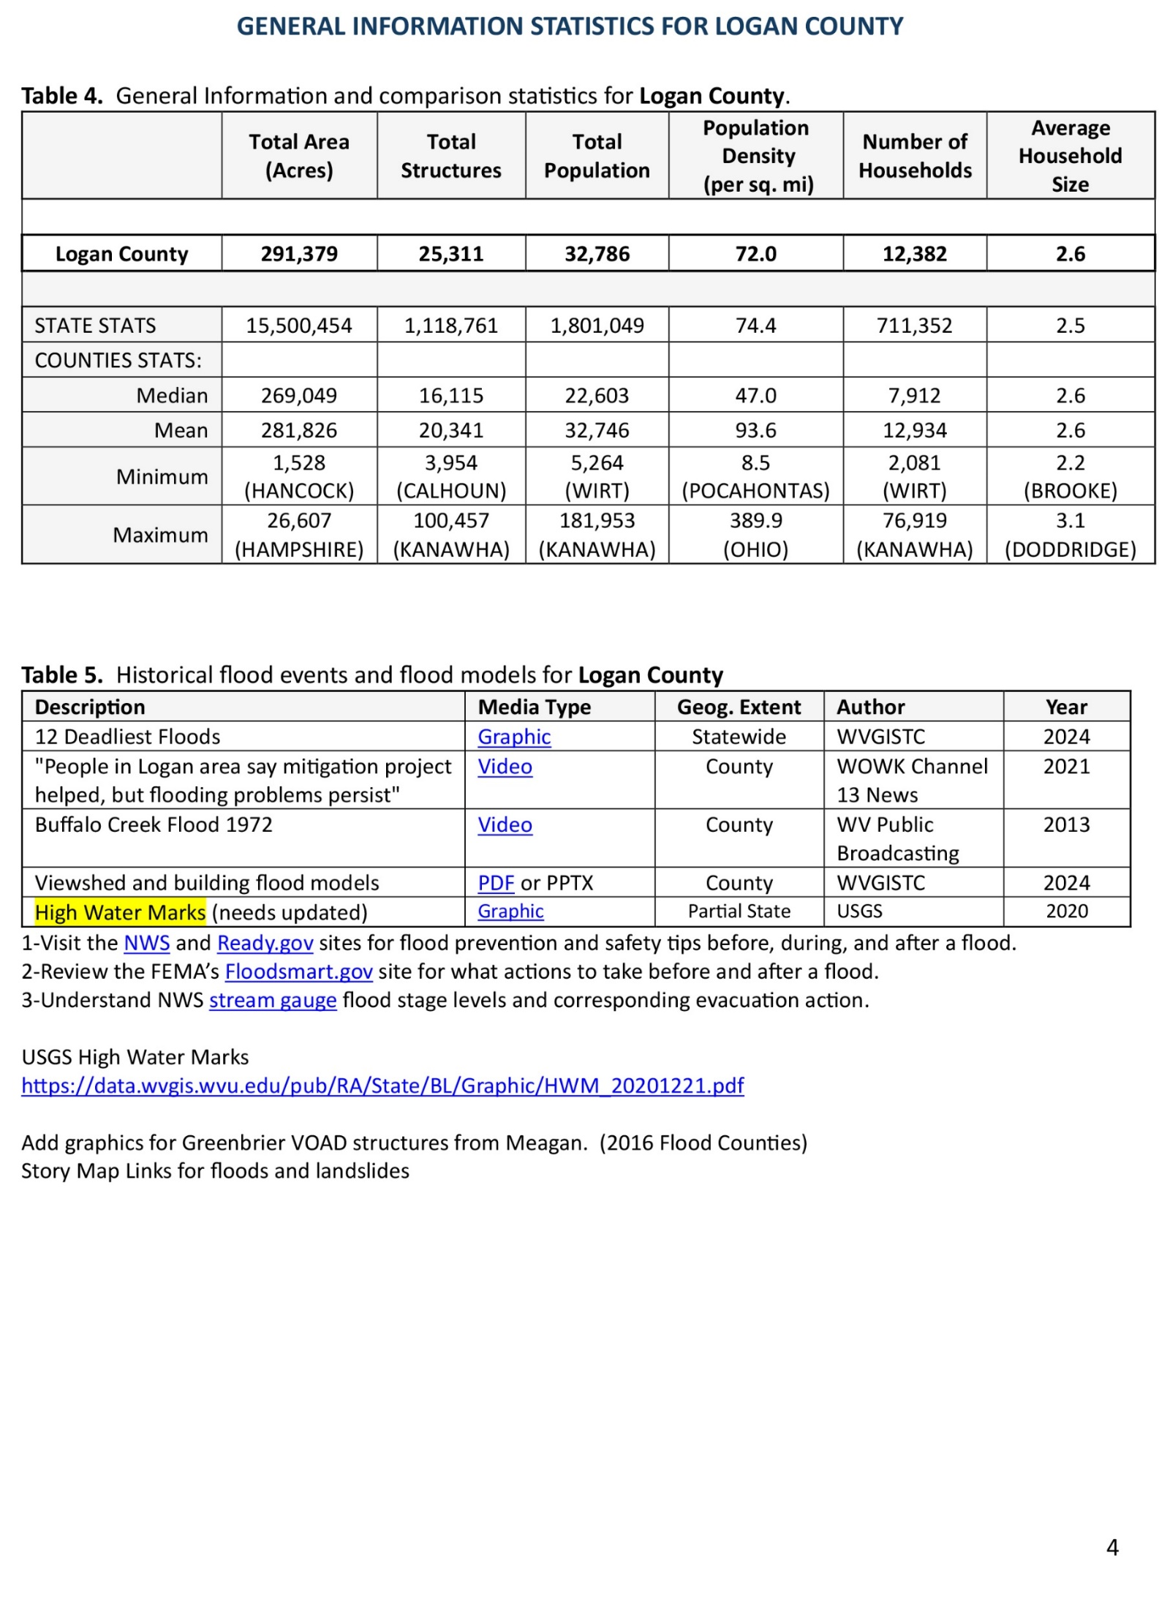
RE
West Virginia Risk Explorer
View Map
View Reports
Learn More
About
High-Risk Indicators Report
All Risk Indicators Report
Risk Comparison Report
Full Risk Data Report
Building Level Report (on request)

Slide 13
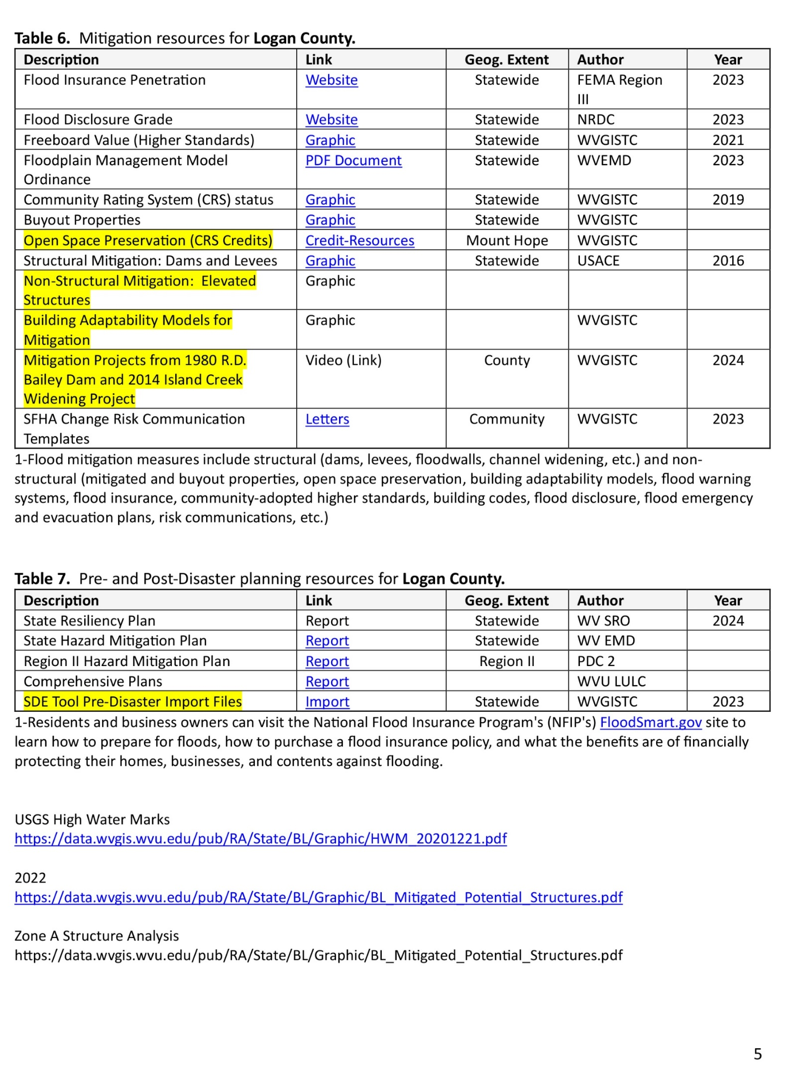
RE
West Virginia Risk Explorer
View Map
View Reports
Learn More
About
High-Risk Indicators Report
All Risk Indicators Report
Risk Comparison Report
Full Risk Data Report
Building Level Report (on request)

Slide 14
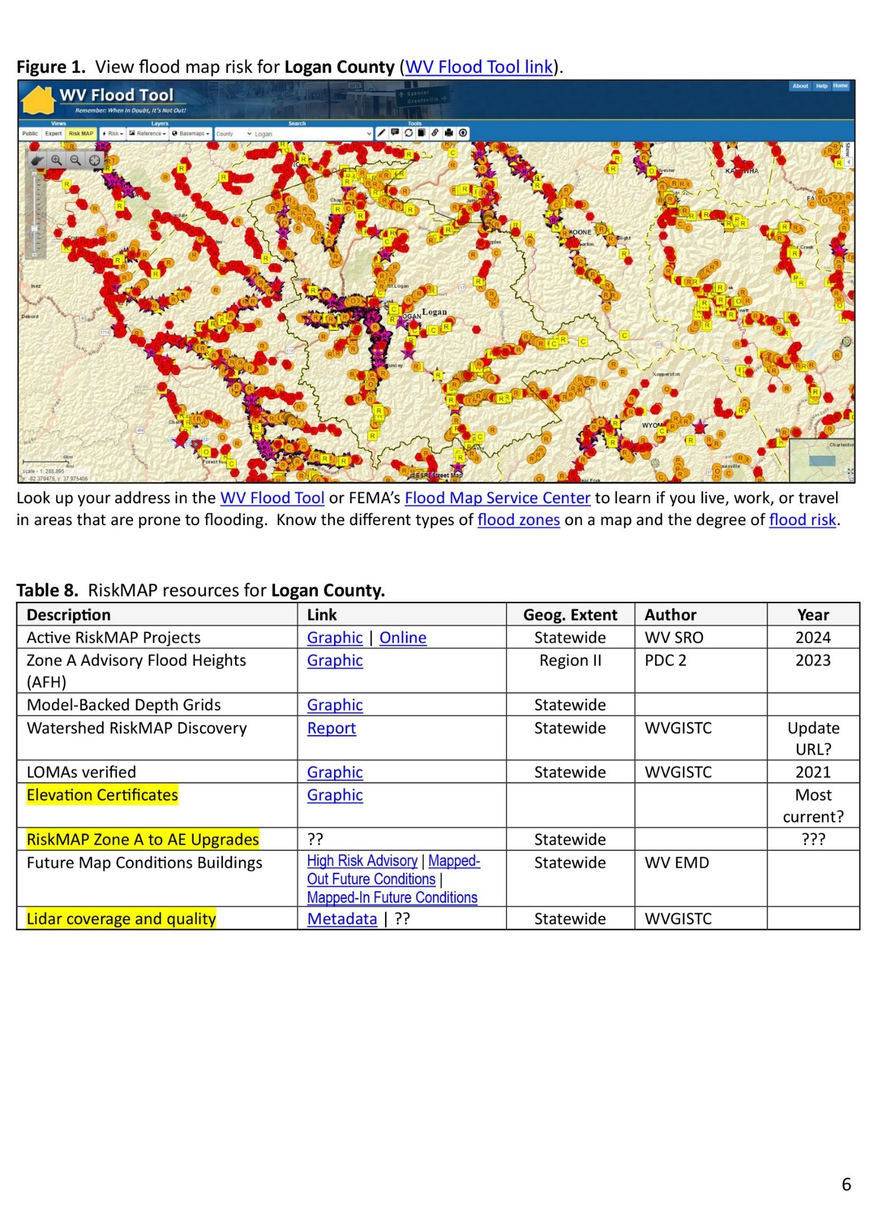
RE
West Virginia Risk Explorer
View Map
View Reports
Learn More
About
High-Risk Indicators Report
All Risk Indicators Report
Risk Comparison Report
Full Risk Data Report
Building Level Report (on request)

Slide 15
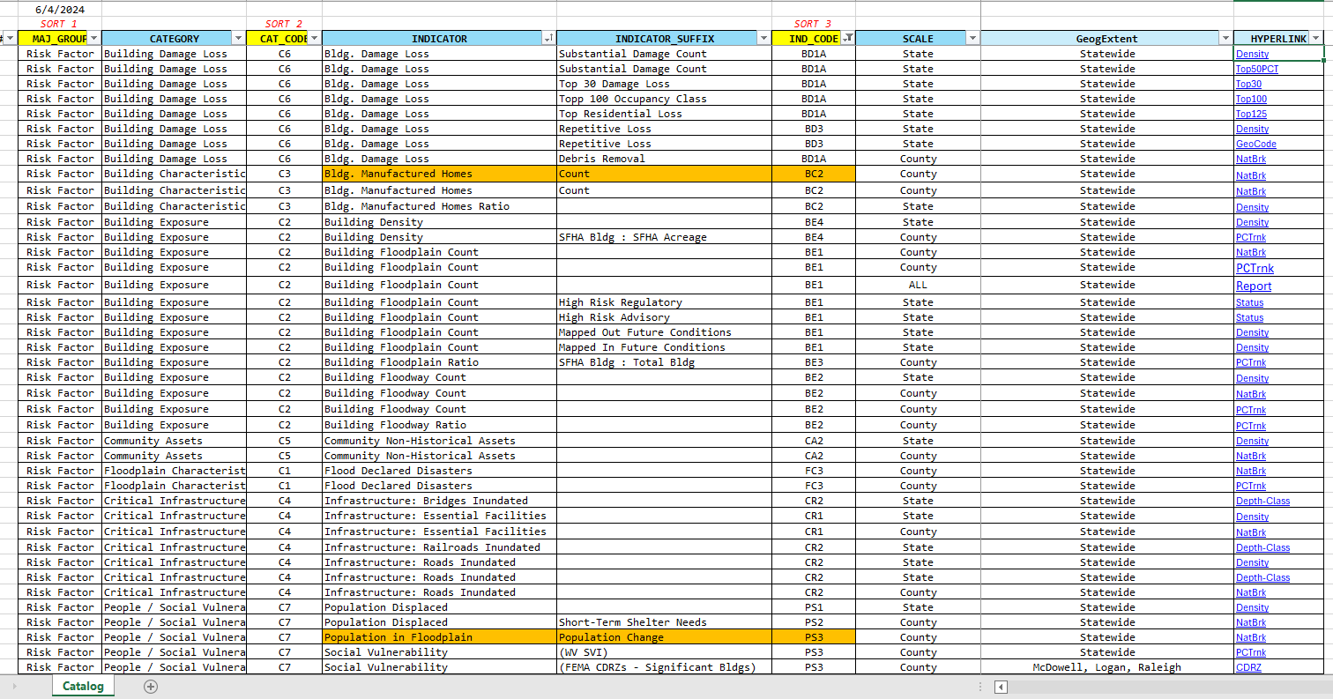
RE
West Virginia Risk Explorer
View Map
View Reports
Learn More
About

