Slide 1
Logo
West Virginia Risk Explorer Architecture
GSU = Geographic Scale Unit
Identify GSU (scale, location, report type)
(1) VIEW MAP* (Spatial Access Gateway to Web Reports, Flagged Indicators, & Visualizations)
(2) VIEW REPORTS (Non-Spatial Access Gateway to Web Reports)
(3) Web Reports*
Rankings
Statistics
Data Values
Graphics
Risk Factors 80th Pctl. Risk Factors 0-100 Pctl.
Risk Comparison
Building Level (password)
(4) LIBRARY* Visual Media & Document Catalog
Videos
Animations
Static Graphics
Reports
Other Docs
Full Risk Data Report (Region-County-Community Scales; 1 Table)
Mobile Friendly
Scales = State, Regional Council, County, Community, Unincorporated Area, Incorporated Place, Watershed, River/Stream, Building (Reports Only)
Separate tab
* User Shared Links: Maps, Reports, or Catalog Query Web URLs
External Links

Slide 2
West Virginia
Flood Resiliency
View Map
View Reports
Learn More
About
Landing page similar to NRI
West Virginia Risk Explorer
View Map
View Reports
Risk Visualizations
Methodology
Documents Library
Other Resources
Frequently Asked Questions
Contact Us

Slide 3
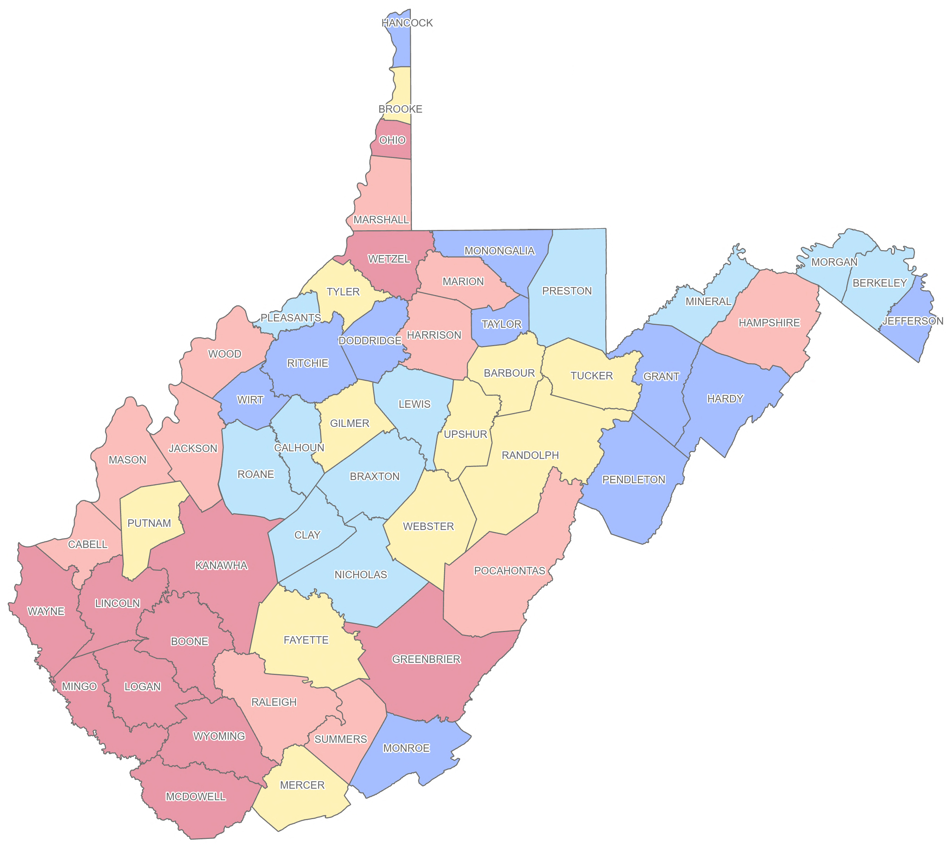
West Virginia
Flood Resiliency
West Virginia Risk Explorer
View Map
View Reports
Learn More
About
RE
Cumulative Index
County Scale
Help
Find a county or address
Legend
Flood Risk Level:
Very High
Relatively High
Moderate
Relatively Low
Very Low
Change Base Map

Slide 4
West Virginia
Flood Resiliency
West Virginia Risk Explorer
View Map
View Reports
Learn More
About
RE
Cumulative Index
County Scale
Help
Cumulative Index
Floodplain Area
Floodplain Length
Declared Flood Disasters
Median Flood Depth
Building Floodplain Count
Building Floodway Count
Building Floodplain Ratio
Building Density
Median Building Value
Mobile Homes Ratio
Subgrade Basements Ratio
Find a county or address
Legend
Flood Risk Level:
Very High
Relatively High
Moderate
Relatively Low
Very Low
Change Base Map

Slide 5
West Virginia
Flood Resiliency
West Virginia Risk Explorer
View Map
View Reports
Learn More
About
RE
Cumulative Index
County Scale
Help
State
PDC Region
County
Community
Incorporated Place
Unincorporated Area
Watershed
Major Stream
Find a county or address
Legend
Flood Risk Level:
Very High
Relatively High
Moderate
Relatively Low
Very Low
Change Base Map

Slide 6
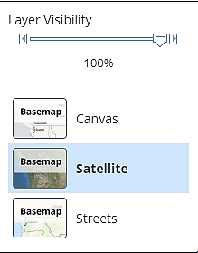
West Virginia
Flood Resiliency
West Virginia Risk Explorer
View Map
View Reports
Learn More
About
RE
Cumulative Index
County Scale
Help
Find a county or address
Legend
Flood Risk Level:
Very High
Relatively High
Moderate
Relatively Low
Very Low
Change Base Map

Slide 7
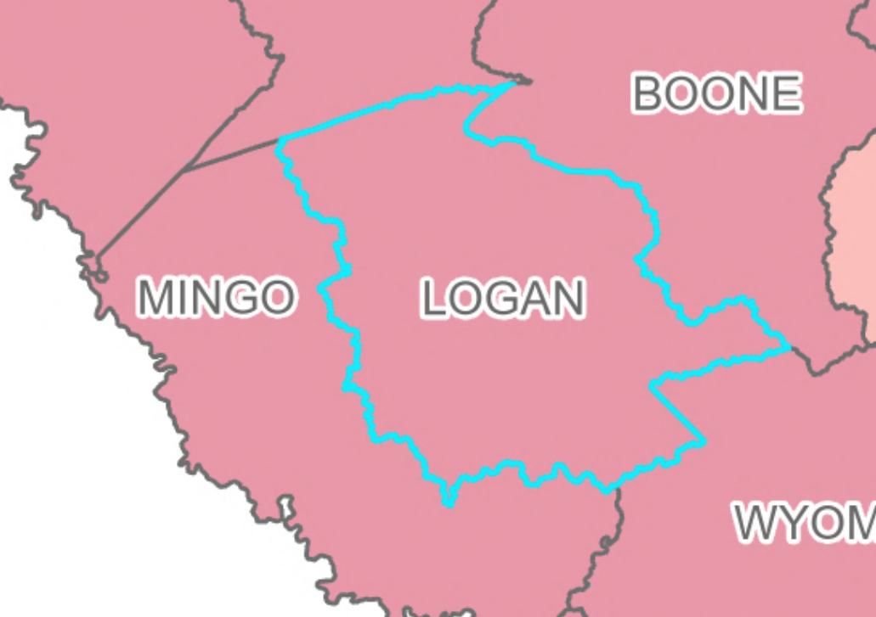
West Virginia
Flood Resiliency
West Virginia Risk Explorer
View Map
View Reports
Learn More
About
RE
Cumulative Index
County Scale
Help
Logan County, WV
Region 2
View Report
Logan
Cumulative Flood Risk Score 94.4% Very High
Rank in 55 counties 4th
12 of 25 risk indicators reach the 90th percentile.
15 of 25 risk indicators reach the 80th percentile.
80th
All
80th Percentile Indicators
Value
Percent Rank
More Info.
Declared Flood Disasters
27
96.2%
Building Floodplain Count
4,498
98.1%
Building Floodway Count
961
98.1%
Building Floodplain Ratio
17.8%
94.4%
Building Density
0.81
98.1%
Mobile Homes Ratio
35.5%
87.0%
Legend
Essential Facilities
18
88.8%
Flood Risk Level:
Roads Inundated Ratio
14.6%
96.2%
Very High
Non-Historical Community Assets
115
96.2%
Relatively High
Substantial Damage Count
306
92.5%
Moderate
Previous Damage Claims
2,418
98.1%
Relatively Low
Repetitive Loss Structures
1,110
98.1%
Population Ratio
Very Low
33.8%
94.4%
Change Base Map
Population Displaced
23.0%
96.2%
WV Social Vulnerability Index
88.9%
88.9%

Slide 8
West Virginia
Flood Resiliency
West Virginia Risk Explorer
View Map
View Reports
Learn More
About
RE
Cumulative Index
County Scale
Help
Cumulative Index
Floodplain Area
Floodplain Length
Declared Flood Disasters
Median Flood Depth
Building Floodplain Count
Building Floodway Count
Building Floodplain Ratio
Building Density
Median Building Value
Mobile Homes Ratio
Subgrade Basements Ratio
Logan County, WV
Region 2
View Report
Logan
Cumulative Flood Risk Score 94.4% Very High
Rank in 55 counties 4th
12 of 25 risk indicators reach the 90th percentile.
15 of 25 risk indicators reach the 80th percentile.
80th
All
80th Percentile Indicators
Value
Percent Rank
More Info.
Declared Flood Disasters
27
96.2%
Building Floodplain Count
4,498
98.1%
Building Floodway Count
961
98.1%
Building Floodplain Ratio
17.8%
94.4%
Building Density
0.81
98.1%
Mobile Homes Ratio
35.5%
87.0%
Legend
Essential Facilities
18
88.8%
Flood Risk Level:
Roads Inundated Ratio
14.6%
96.2%
Very High
Non-Historical Community Assets
115
96.2%
Relatively High
Substantial Damage Count
306
92.5%
Moderate
Previous Damage Claims
2,418
98.1%
Relatively Low
Repetitive Loss Structures
1,110
98.1%
Population Ratio
Very Low
33.8%
94.4%
Change Base Map
Population Displaced
23.0%
96.2%
WV Social Vulnerability Index
88.9%
88.9%

Slide 9
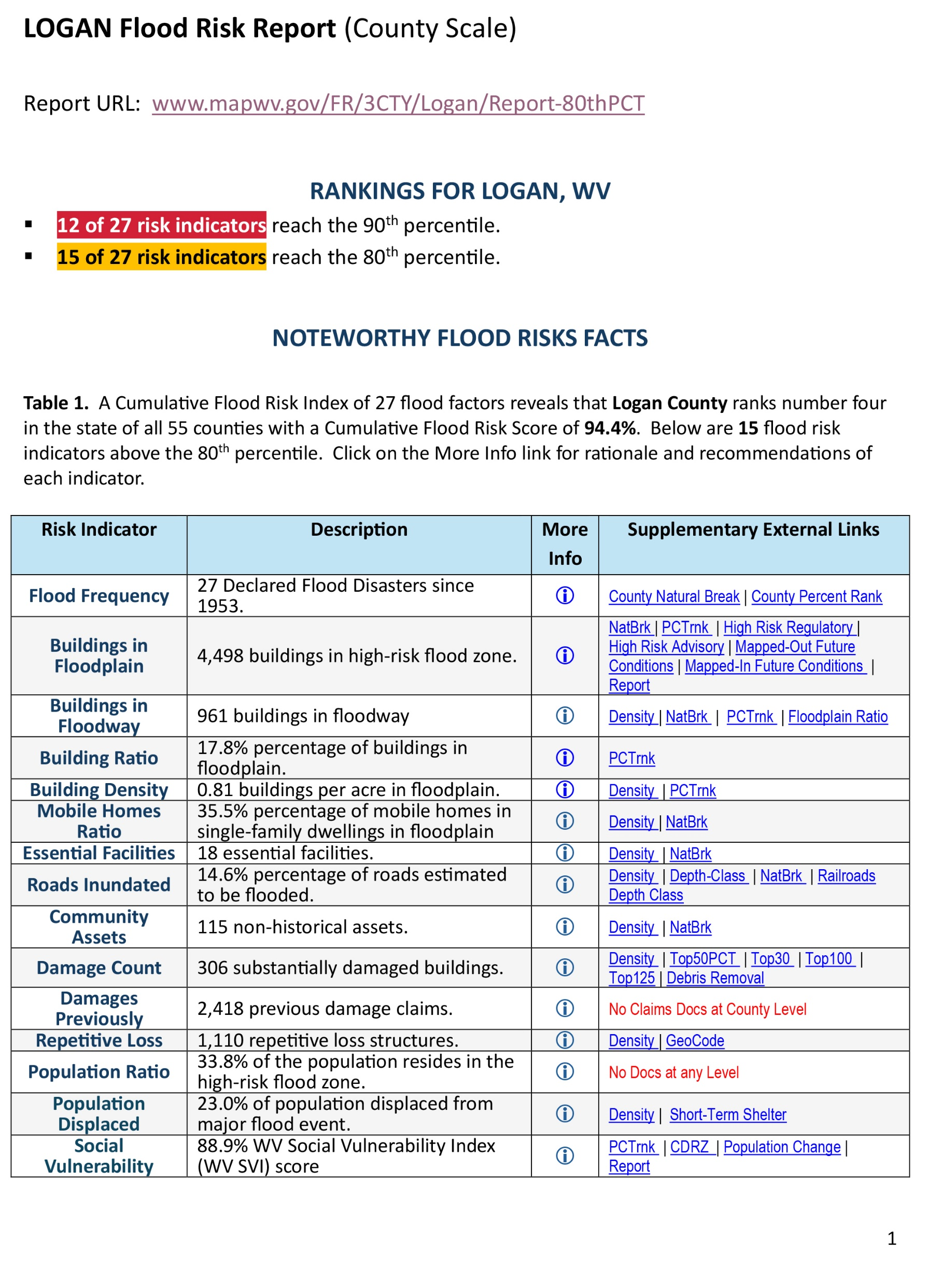
West Virginia
Flood Resiliency
West Virginia Risk Explorer
View Map
View Reports
Learn More
About
RE
80th Percentile Risk Indicators Report
All Risk Indicators Report
Risk Comparison Report
Full Risk Data Report
Building Level Report (on request)

Slide 10
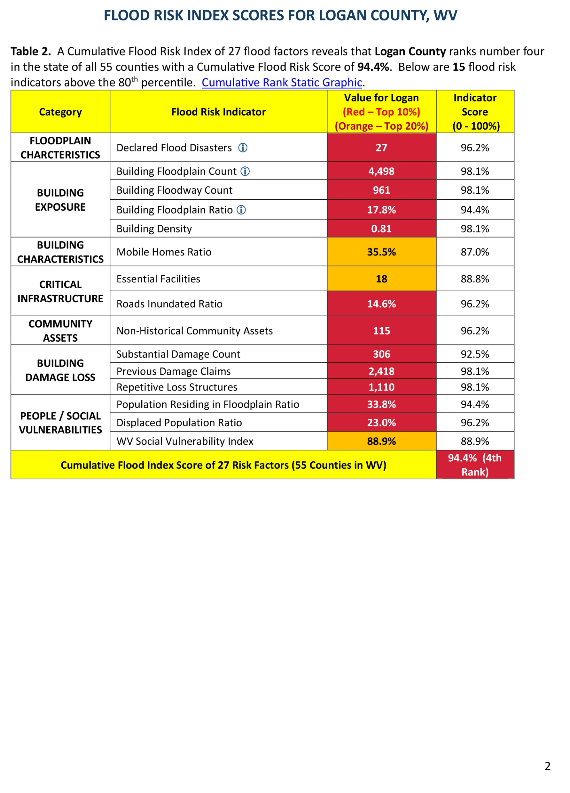
West Virginia
Flood Resiliency
West Virginia Risk Explorer
View Map
View Reports
Learn More
About
RE
80th Percentile Risk Indicators Report
All Risk Indicators Report
Risk Comparison Report
Full Risk Data Report
Building Level Report (on request)

Slide 11
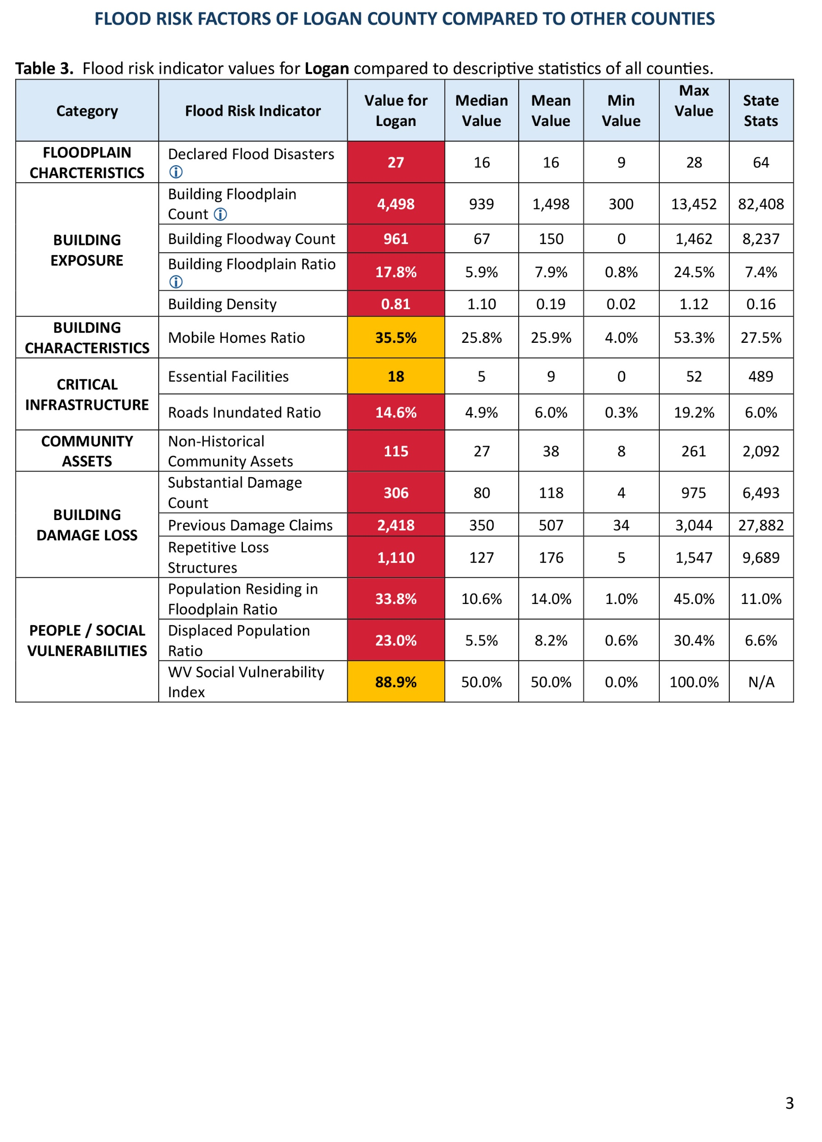
West Virginia
Flood Resiliency
West Virginia Risk Explorer
View Map
View Reports
Learn More
About
RE
80th Percentile Risk Indicators Report
All Risk Indicators Report
Risk Comparison Report
Full Risk Data Report
Building Level Report (on request)

Slide 12
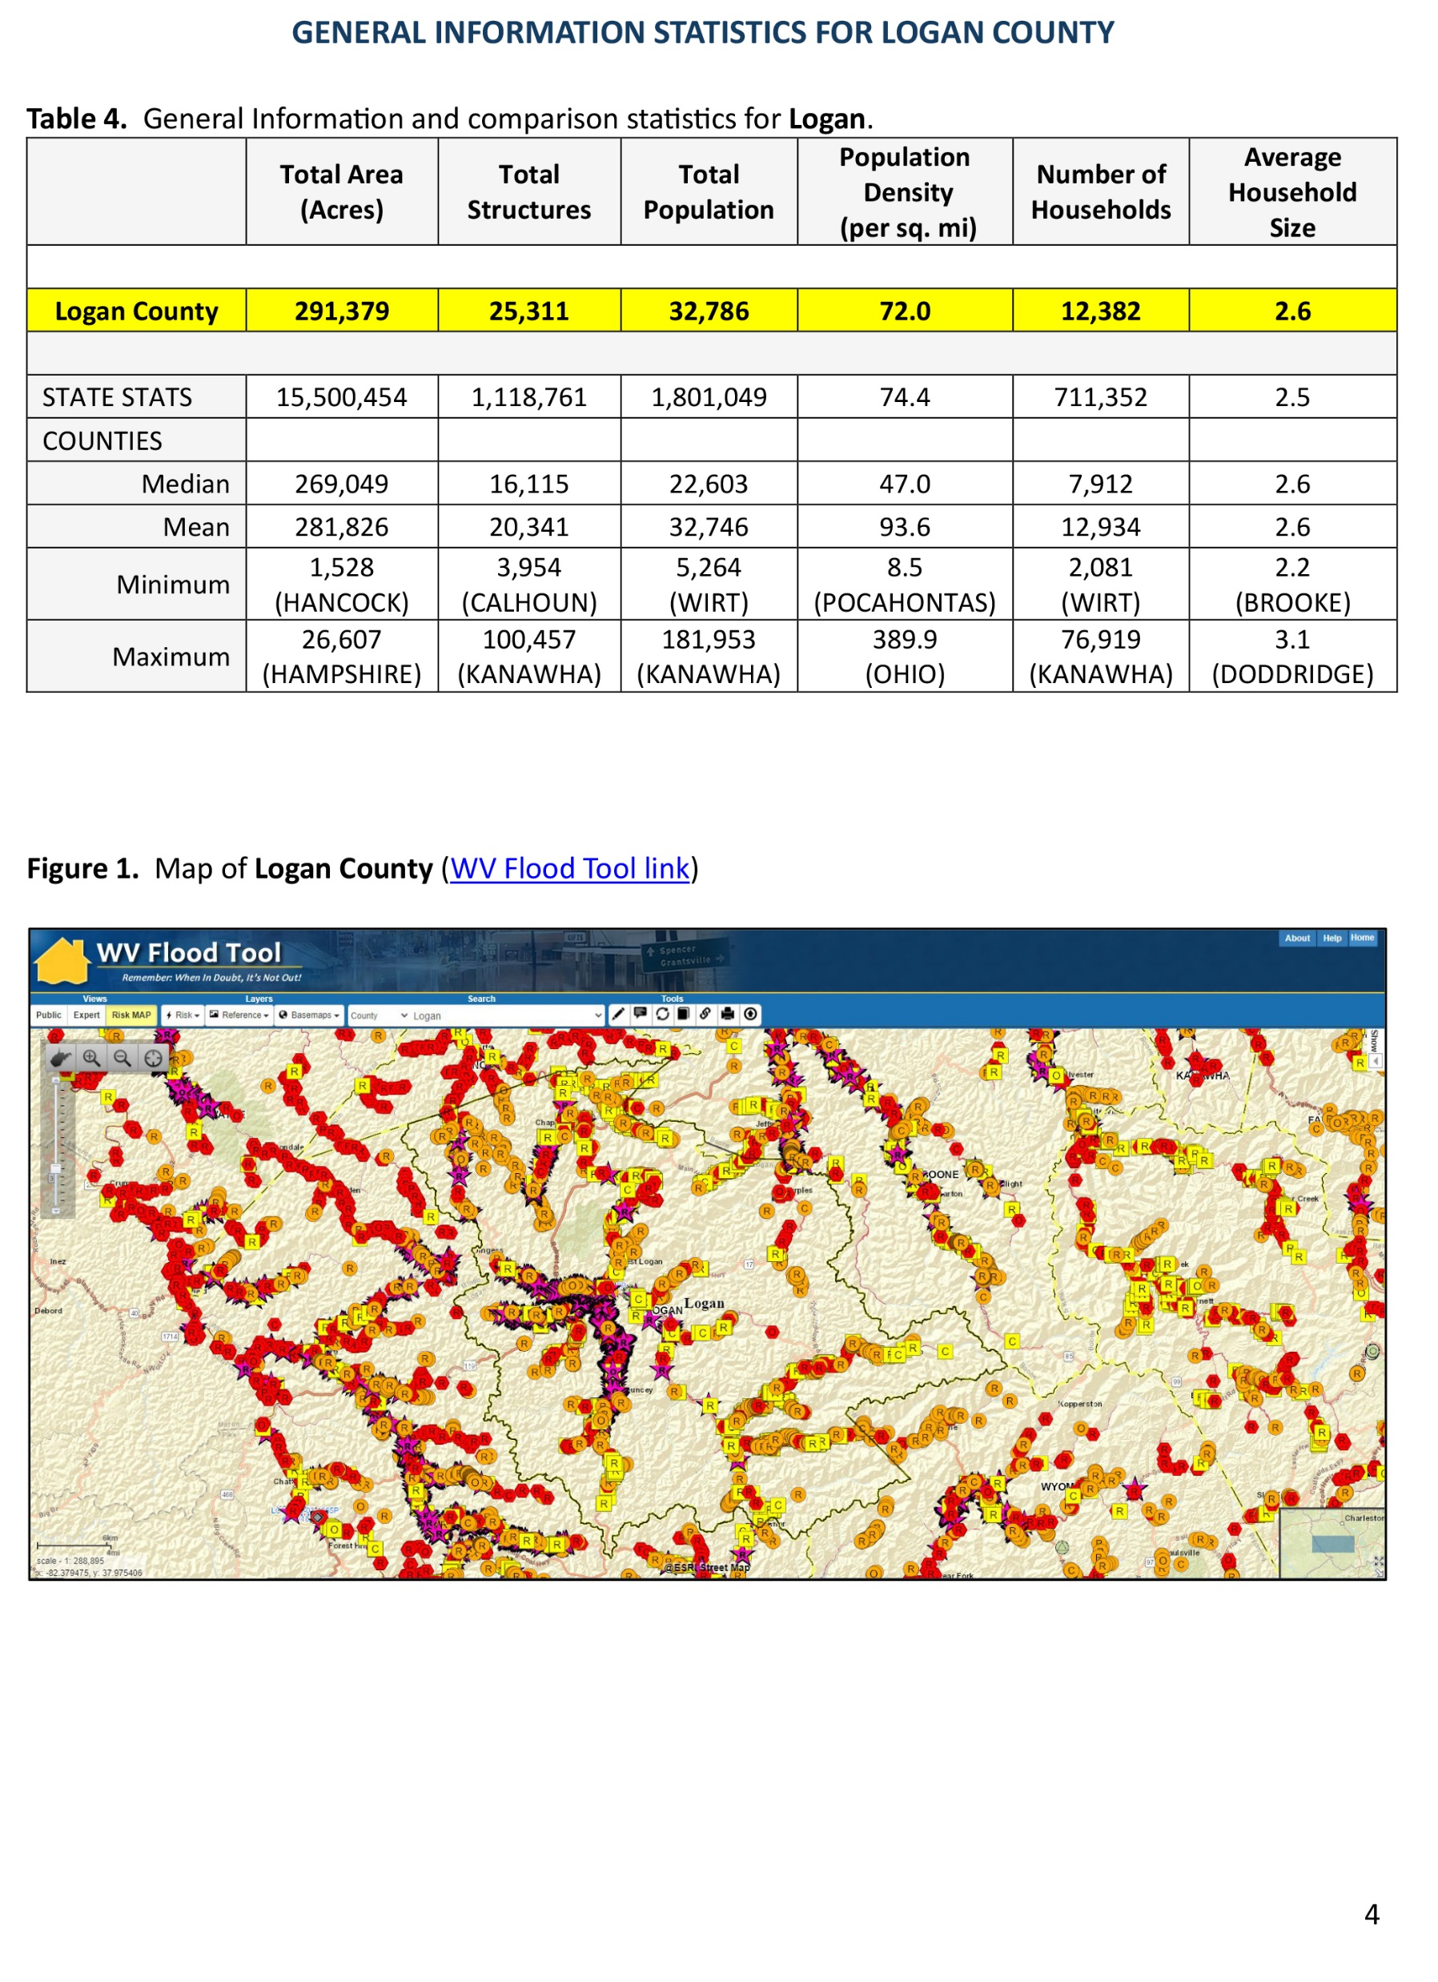
West Virginia
Flood Resiliency
West Virginia Risk Explorer
View Map
View Reports
Learn More
About
RE
80th Percentile Risk Indicators Report
All Risk Indicators Report
Risk Comparison Report
Full Risk Data Report
Building Level Report (on request)

Slide 13
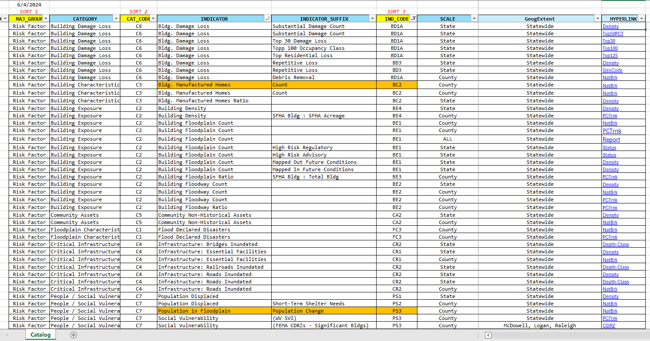
West Virginia
Flood Resiliency
West Virginia Risk Explorer
View Map
View Reports
Learn More
About
RE

