Slide 1
Berkeley County– Proposed Shelter Model
Building-Level
Building-Level
Assessment Records
Population
Displacement
Building Characteristics
Occupancy Class
Flood Depth Value >=1 ft
Based on limitations of physical access
Community-Level
Average Household Size
*Short-term Shelter Needs
Community-Level
U.S. Census Data
Population & Household Size
Income
Age
Ethnicity
Housing Characteristics
Can be used in the future models
*According to FEMA (2017), "A Short-Term Shelter is in an existing facility (or facilities), such as a school, community center, convention center, or church temporarily converted to provide safe, accessible, and secure short-term housing for disaster survivors." It provides safe and accessible locations with a wide range of services for the survivors for up to two weeks.

Slide 2
Berkeley County– Displacement
BASE MODEL: Flood Model Hazus-MH Technical Manual
MODIFICATIONS: Scale of calculations changed to buildings
DATA:
Hazard Occupancy Code and Flood Depth Value from assessment data of Berkeley County at the scale of buildings (Building Inventory)
Average Household Size of the communities from census data (2017 American Community Survey (ACS) 5-Year Estimates downloaded from "American Fact Finder“)
METHOD:
Extraction of the buildings located in flood zones with the depth value of 1 ft or more
Estimating the number of the residential units in each building using the occupancy code
Calculation of the estimated residing population in each building using the average household size of the community
Adding the population of the buildings in each community

Slide 3
Berkeley County– Displacement
DEFINED EQUATION:
$${\#DI}_{IN}=\sum_{j=1}^{n}{{(ResUNIT}_{IN}×{AveHHSize}_{COMM})}$$
Where:
#DI_{IN} = the number of displaced individuals as a result of inundation with the depth equal or more than 1 foot
ResUNIT_{IN}= the number of residential units in each building located within the area of inundation with the depth equal or more than 1 foot
AveHHSize_{COMM}= the average household size of the community where the building is located
j= the number of residential buildings within the flooded area with the depth equal or more than 1 foot
A part of the population displacement table at building level

Slide 4
Berkeley County– Shelter Needs
BASE MODEL: Flood Model Hazus-MH Technical Manual
MODIFICATIONS: Income classes updated based on the inflation rate
DATA:
Displaced Population estimated in the previous part
Household Income and Age from census data (2017 American Community Survey (ACS) 5-Year Estimates downloaded from "American Fact Finder“)
METHOD:
Based on "Flood Model Hazus-MH Technical Manual", Chapter 13, at the scale of communities:
Calculation of the percentage of households in the income classes:
- IM1: HH Income per year < $20,000
- IM2: $20,000 <= HH Income per year < $30,000
- IM3: $30,000 <= HH Income per year < $50,000
- IM4: $50,000 <= HH Income per year < $60,000
- IM5: $60,000 <= HH Income per year
Calculation of the percentage of individuals in the age classes:
AM1: Less than 15 years
AM2: 15 to 64 years
AM3: 65 years or more

Slide 5
Berkeley County– Shelter Needs
MODIFICATIONS TO INCOME CLASSES:
The inflation rate of 1990 to 2017 (1.87) was slightly changed while applying to make the intervals match the census data
Income Class | Original and Hazus Models | Modified Model
IM1 | HH Income < $10,000 | HH Income < $20,000
IM2 | $10,000 <= HH Income < $15,000 | $20,000 <= HH Income < $30,000
IM3 | $15,000 <= HH Income < $25,000 | $30,000 <= HH Income < $50,000
IM4 | $25,000 <= HH Income < $35,000 | $50,000 <= HH Income < $60,000
IM5 | $35,000 <= HH Income | $60,000 <= HH Income

Slide 6
Berkeley County– Shelter Needs
USED EQUATIONS:
$$\#STP=\sum_{k=1}^{5}{\sum_{m=1}^{3}{\left[α_{km}×DP×{HI}_{k}×{HA}_{m}\right]}}$$
Where:
#STP = Number of people using established shelters
α_{km} = a constant calculated as below
DP = Displaced population by inundation with equal or more than 1 foot depth (from the previous stage)
HI_{k} = Percentage of population in the k^{th} income class
HA_{m} = Percentage of population in m^{th} age class
$$\left.α_{km}=(IW×{IM}_{k})+(AW×{AM}_{k}\right)$$
Where:
IW = Shelter category weight for income (0.8)
AW = Shelter category weight for age (0.2)
IM_{k} = Relative modification factor for income (calculated using table 13.2 in the manual)
AM_{m} = Relative modification factor for age (calculated using table 13.2 in the manual)

Slide 7
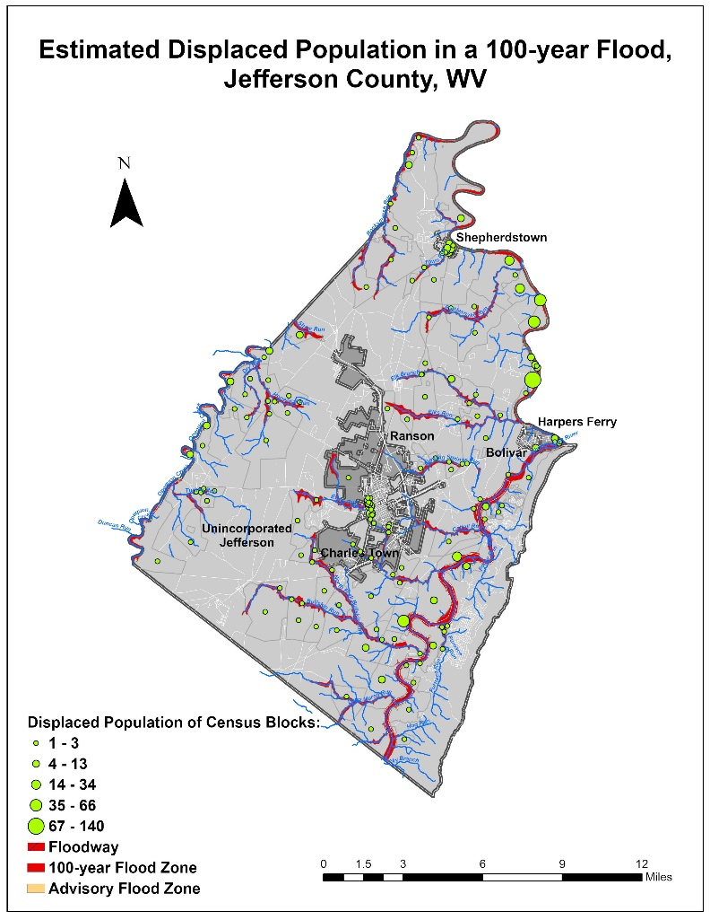
Berkeley County– Results
MAP- Estimated Displaced Population in a 100-year Flood, Berkeley County
MAP- Estimated Shelter Needs in a 100-year Flood, Berkeley County

Slide 8
Berkeley County– Results
Unincorporated Area
Martinsburg
CID | Community Name | County | Community Type | Total Community Population | Average Residential Household Size | Population Residing in High Risk Flood Zone | Percentage of Population Residing in High Risk Flood Zone | Number of Households with inundation water depth >= 1 foot | Displaced Population | Percentage of Population in Flood Zones Displaced | Estimated Population in Need of Short Term Shelter | Percentage of Population in Flood Zones in Need of Shelter | Companion Dogs Shelter Need | Companion Cats Shelter Need
540282 | Berkeley County* | BERKELEY | Unincorporated | 93834 | 2.7 | 1719.9 | 2% | 265 | 716 | 42% | 106 | 6% | 15 | 10
540006 | Martinsburg | BERKELEY | Incorporated | 17451 | 2.4 | 211.2 | 1% | 36 | 87 | 41% | 18 | 9% | 3 | 2
Total in County |  |  | - | 111285 | 2.628 | 1931.1 | 2% | 301 | 803 | 42% | 124 | 6% | 18 | 12

Slide 9
Future Directions
Include more variables relevant to housing characteristics in the shelter model such as:
Housing Ownership Type (Owned or Rental)
Occupancy Type (Single family, Multi-family, & Mobile Home)
Geography: Urban versus Rural
Research and review the actual shelter data of floods provided by the American Red Cross to test the model
Data preparation for unincorporated areas missing in the census data by subtracting the demographic data of the communities from those of the county
Automate data processing of the required variables for displacement and shelter estimations
Customize Open Hazus “FAST” Flood Assessment Structure Tool including population displacement and shelter needs
“… the task of estimating and preparing for shelter demand is still very challenging.” (Dr. John Harrald, 2019)
“The results of all modeling efforts should be interpreted with a degree of skepticism.” (Harrald et al., 1994, p.13)
“Any model is a selective representation of reality.” (Harrald et al., 1994, p.14)

