Slide 1
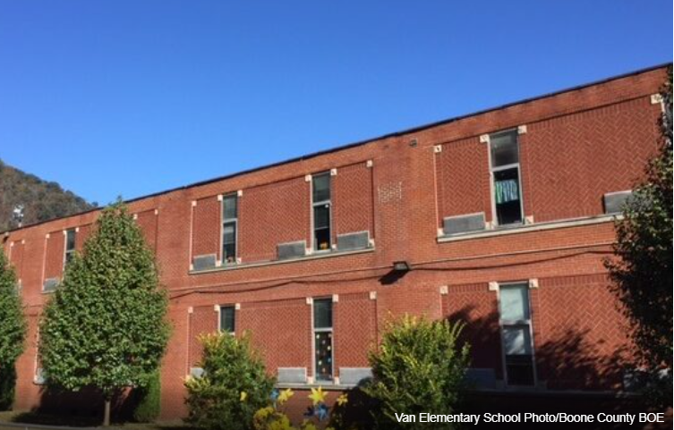
Essential Facilities in Coal Watershed
Ranked by Damage Loss
Rank | Building ID | Facility Name | Facility Type | Community Name | County | Building Appraisal¹ | Flood Zone Designation | In Floodway | Stream | Building Damage Percent | Building Loss USD² | Flood Tool Link
1 | 20-16-012F-0005-0000_7776 | Andrews Heights Elementary School | School | Kanawha County* | KANAWHA | $2,754,743 | AE | No | Coal River | 9% | $247,927 | FT
2 | 03-01-018A-0001-0000_338 | Van Elementary School | School | Boone County* | BOONE | $1,878,640 | AE | Yes | Pond Fork | 10% | $185,985 | FT
3 | 03-03-0003-0063-0000_404 | Madison Middle School | School | Madison | BOONE | $2,901,390 | AE | No | Little Coal River | 6% | $159,576 | FT
4 | 03-08-0026-0082-0000_15908 | Ramage Elementary School | School | Boone County* | BOONE | $1,224,740 | AE | Yes | Spruce Fork | 10% | $122,474 | FT
5 | 41-02-0009-0122-0002_4851 | Clear Fork District Elementary School | School | Raleigh County* | RALEIGH | $745,960 | AE | No | Clear Fork | 15% | $110,402 | FT
6 | 03-06-0011-0040-0000_10008 | Sherman High School | School | Boone County* | BOONE | $2,928,440 | AE | No | Big Coal River | 3% | $84,925 | FT
7 | 03-09-0001-0056-0000_37949 | Whitesville Elementary School | School | Whitesville | BOONE | $1,998,440 | AE | No | Big Coal River | 3% | $61,952 | FT
8 | 41-05-0021-0018-0003_172 | Coal River Volunteer Fire Department | Fire Station | Raleigh County* | RALEIGH | $608,100 | A (Advisory Flood Heights available) | No | Marsh Fork | 9% | $51,689 | FT
9 | 20-16-012F-0005-0001_7826 | Tornado Volunteer Fire Department | Fire Station | Kanawha County* | KANAWHA | $120,000 | AE | No | Coal River | 27% | $32,520 | FT
10 | 23-04-0080-0012-0000_25 | Sharples Volunteer Fire Department | Fire Station | Logan County* | LOGAN | $304,314 | A (Advisory Flood Heights available) | No | Spruce Fork | 8% | $27,084 | FT
¹ Colored cells show building values of greater than $1M. ² Colored cells show building loss of greater than $100K.
03-01-018A-0001-0000_338
Van Elementary School
03-08-0026-0082-0000_15908
Ramage Elementary School

Slide 2
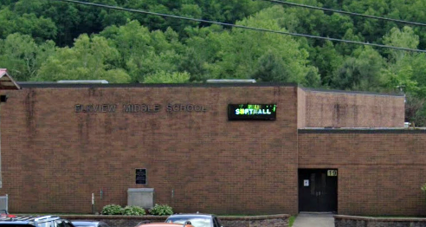
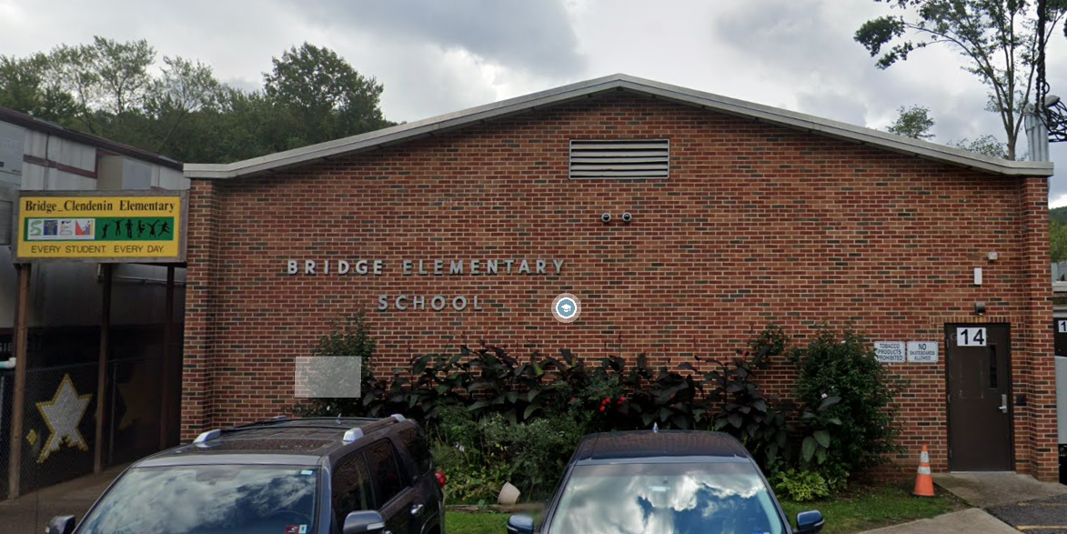
Essential Facilities in Elk Watershed
Ranked by Damage Loss
Rank | Building ID | Facility Name | Facility Type | Community Name | County | Building Appraisal¹ | Flood Zone Designation | In Floodway | Stream | Building Damage Percent | Building Loss USD² | Flood Tool Link
1 | 20-15-0023-0078-0000_5090 | Elkview Middle School | School | Kanawha County* | KANAWHA | $11,453,001 | AE | No | Elk River | 3% | $297,778 | FT
2 | 20-15-0023-0077-0000_5120 | Bridge/Clendenin Elementary School | School | Kanawha County* | KANAWHA | $1,904,230 | AE | Yes | Elk River | 9% | $171,381 | FT
3 | 20-15-023A-0081-0000_902 | Kanawha County Sheriff's Office - Elkview Detachment | Police Station | Kanawha County* | KANAWHA | $804,700 | AE | Yes | Elk River | 10% | $82,079 | FT
4 | 20-02-0007-0034-0000_103 | Clendenin Police Department | Police Station | Clendenin | KANAWHA | $185,340 | AE | No | Elk River | 16% | $30,025 | FT
5 | 08-04-0015-0002-0003_5462 | Big Otter Volunteer Fire Department | Fire Station | Clay County* | CLAY | $264,800 | AE | No | Big Otter Creek | 9% | $22,508 | FT
6 | 20-02-0007-0040-0000_109 | Clendenin Volunteer Fire Department | Fire Station | Clendenin | KANAWHA | $80,000 | AE | No | Elk River | 16% | $12,880 | FT
¹ Colored cells show building values of greater than $1M. ² Colored cells show building loss of greater than $100K.
20-15-0023-0078-0000_5090
Elkview Middle School
20-15-0023-0077-0000_5120
Bridge/Clendenin Elementary School

Slide 3
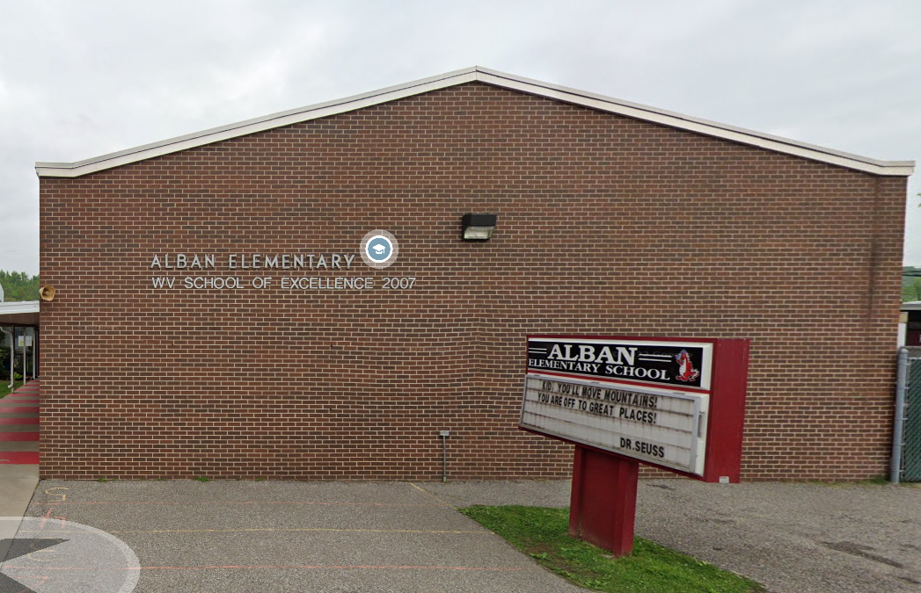
Essential Facilities in Lower Kanawha Watershed
Ranked by Damage Loss
Rank | Building ID | Facility Name | Facility Type | Community Name | County | Building Appraisal¹ | Flood Zone Designation | In Floodway | Stream | Building Damage Percent | Building Loss USD² | Flood Tool Link
1 | 44-09-0012-0071-0000_90 | Walton Elementary / Middle School | School | Roane County* | ROANE | $6,125,650 | A (Advisory Flood Heights available) | No | Pocatalico River | 9% | $551,309 | FT
2 | 20-16-008E-0040-0001_6500 | Riverside Health and Rehabilitation Center | Nursing Home | Kanawha County* | KANAWHA | $1,585,400 | AE | No | Kanawha River | 9% | $141,101 | FT
3 | 20-17-0005-0011-0000_2030 | Alban Elementary School | School | St. Albans | KANAWHA | $3,591,331 | Updated AE | No | Kanawha River | 1% | $21,548 | FT
4 | 20-26-0013-0016-0000_907 | Dunbar Fire Department Station 1 | Fire Station | Dunbar | KANAWHA | $90,000 | AE | No | Kanawha River | 4% | $3,600 | FT
5 | 40-11-0151-0049-0005_18988 | Winfield Volunteer Fire Department - Frazier Bottom - Substation | Fire Station | Putnam County* | PUTNAM | $71,700 | AE | No | Kanawha River | 1% | $1,004 | FT
¹ Colored cells show building values of greater than $1M. ² Colored cells show building loss of greater than $100K.
20-17-0005-0011-0000_2030
Alban Elementary School
20-16-008E-0040-0001_6500
Riverside Health and Rehabilitation Center

Slide 4
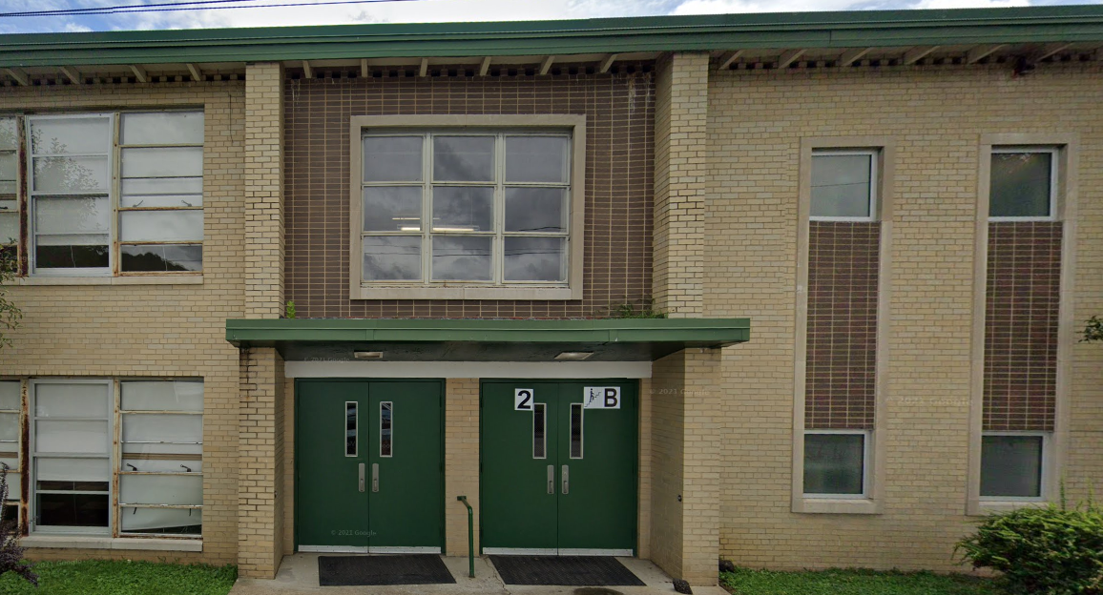
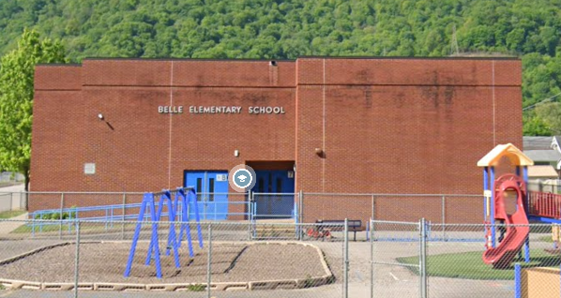
Essential Facilities in Upper Kanawha Watershed
Ranked by Damage Loss
Rank | Building ID | Facility Name | Facility Type | Community Name | County | Building Appraisal¹ | Flood Zone Designation | In Floodway | Stream | Building Damage Percent | Building Loss USD² | Flood Tool Link
1 | 20-04-0004-0123-0000_200 | Cedar Grove Elementary School | School | Cedar Grove | KANAWHA | $10,953,599 | AE | No | Kanawha River | 6% | $690,077 | FT
2 | 20-29-0004-0345-0000_401 | Belle Elementary School | School | Belle | KANAWHA | $4,177,476 | AE | No | Kanawha River | 4% | $162,922 | FT
3 | 20-06-0001-0001-0000_119 | Glasgow Volunteer Fire Department | Fire Station | Glasgow | KANAWHA | $231,674 | AE | No | Kanawha River | 13% | $30,349 | FT
4 | 20-05-0001-0022-0000_130 | East Bank Middle School | School | East Bank | KANAWHA | $10,503,035 | AE | No | Kanawha River | 0% | $21,006 | FT
5 | 20-03-0026-0029-0001_2208 | Belle Volunteer Fire Department - Substation 2 | Fire Station | Kanawha County* | KANAWHA | $155,730 | AE | No | Kanawha River | 11% | $16,507 | FT
6 | 20-20-0003-0078-0000_12404 | Chesapeake City Clerk | Police Station | Chesapeake | KANAWHA | $100,000 | AE | No | Kanawha River | 5% | $4,700 | FT
7 | 20-03-040C-0003-0001_17 | Chesapeake Volunteer Fire Department - Substation 2 | Fire Station | Kanawha County* | KANAWHA | $38,300 | AE | Yes | Fields Creek | 11% | $4,136 | FT
8 | 10-03-048C-0032-0000_12588 | Loup Creek Volunteer Fire Department - Robson | Fire Station | Fayette County* | FAYETTE | $312,900 | A (Advisory Flood Heights available) | No | Loop Creek | 1% | $2,816 | FT
9 | 20-23-019H-9999-9999_3924 | Malden Volunteer Fire Department | Fire Station | Kanawha County* | KANAWHA | $194,606 | AE | No | Kanawha River | 1% | $2,530 | FT
10 | 20-23-018B-0038-0000_136 | Olive Branch Christian Academy | School | Kanawha County* | KANAWHA | $50,400 | Updated AE | No | Kanawha River | 3% | $1,714 | FT
¹ Colored cells show building values of greater than $1M. ² Colored cells show building loss of greater than $100K.
20-04-0004-0123-0000_200
Cedar Grove Elementary School
20-29-0004-0345-0000_401
Belle Elementary School

Slide 5
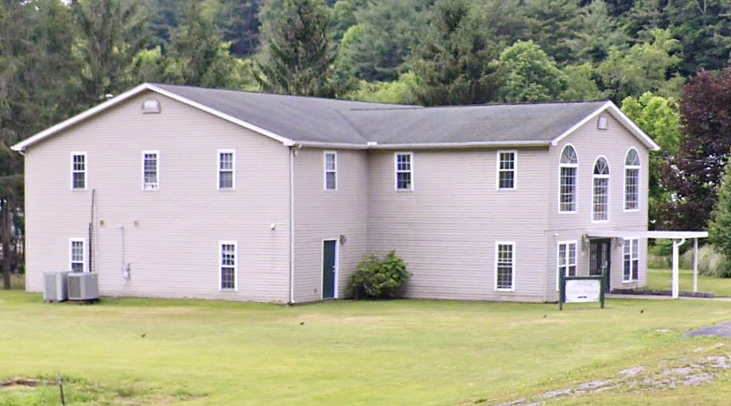
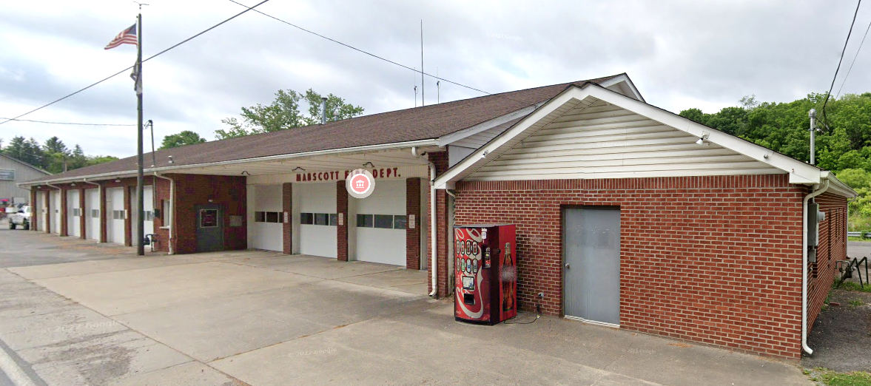
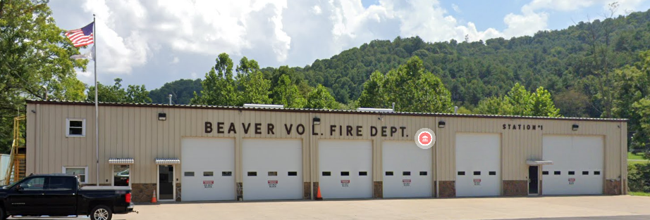
Essential Facilities in Lower New Watershed
Ranked by Damage Loss
Rank | Building ID | Facility Name | Facility Type | Community Name | County | Building Appraisal | Flood Zone Designation | In Floodway | Stream | Building Damage Percent | Building Loss USD | Flood Tool Link
1 | 41-04-0001-0021-0000_103 | Mabscott Christian Academy | School | Mabscott | RALEIGH | $480,400 | AE | No | Whitestick Creek | 44% | $210,593 | FT
2 | 41-08-1003-0108-0000_147 | Beaver Volunteer Fire Department Station 1 | Fire Station | Raleigh County* | RALEIGH | $566,280 | AE | No | Beaver Creek | 11% | $62,285 | FT
3 | 41-04-0002-0026-0000_407 | Mabscott Volunteer Fire Department | Fire Station | Mabscott | RALEIGH | $77,660 | AE | No | Whitestick Creek | 10% | $8,143 | FT
41-04-0001-0021-0000_103
Mabscott Christian Academy
41-04-0002-0026-0000_407
Mabscott Volunteer Fire Department
8-1003-0108-0000_147
Beaver Volunteer Fire Department Station 1

