Slide 1
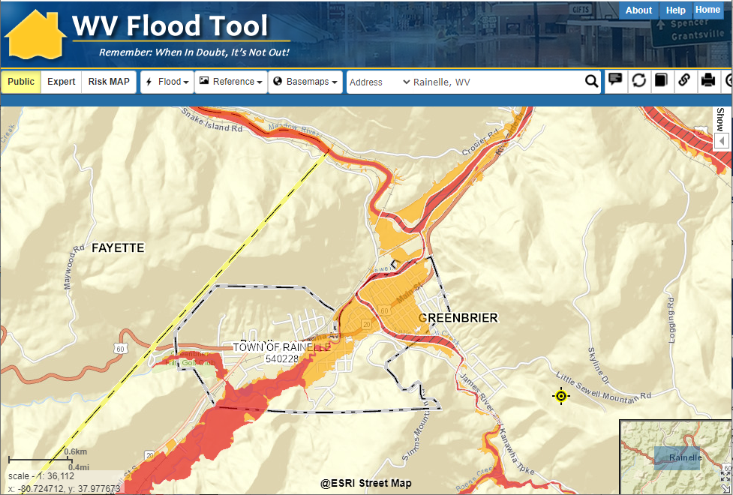
Rainelle

Slide 2
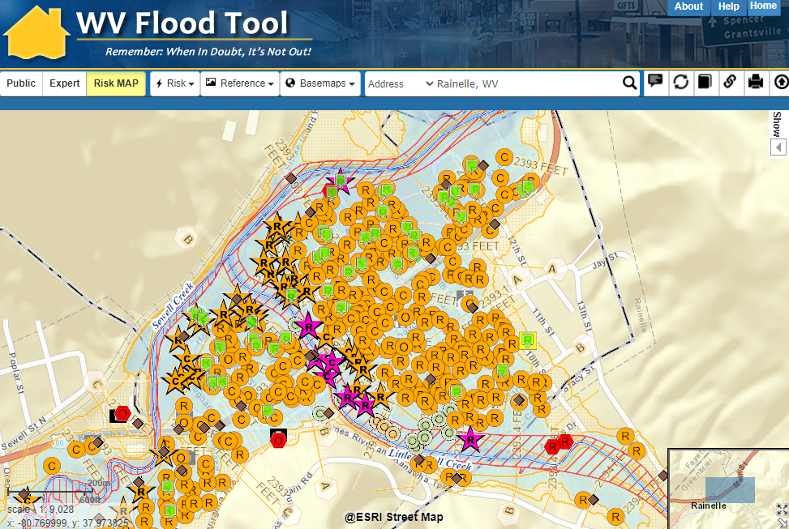
Rainelle

Slide 3
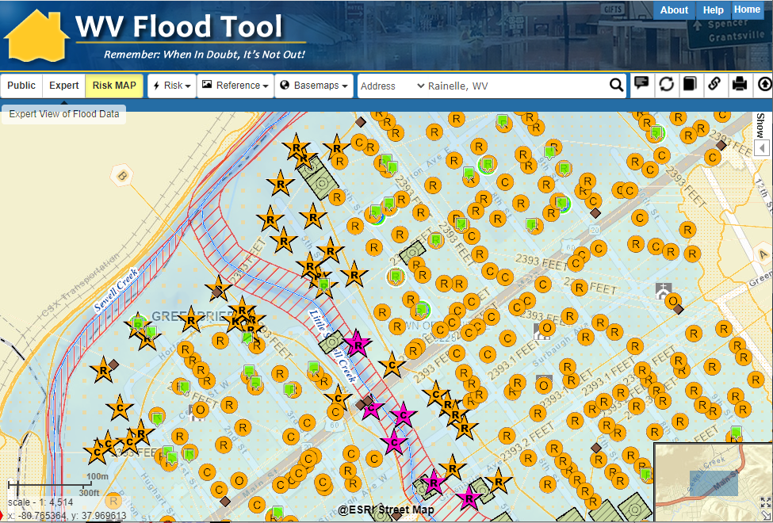
Rainelle

Slide 4
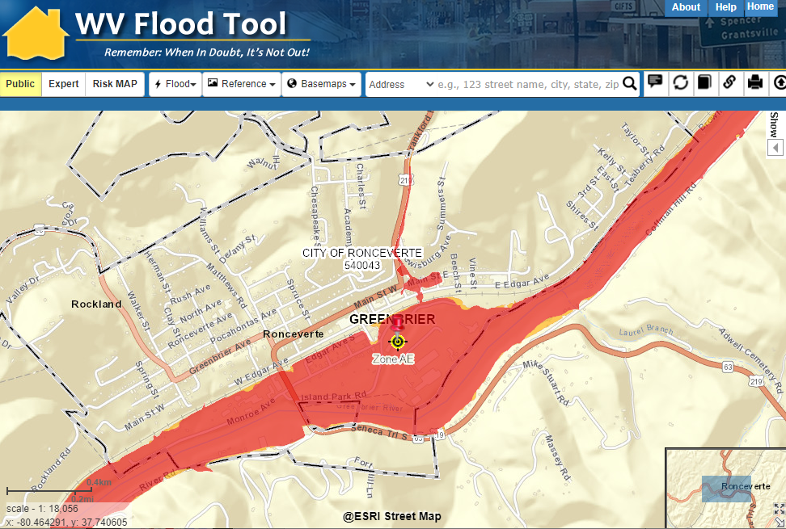
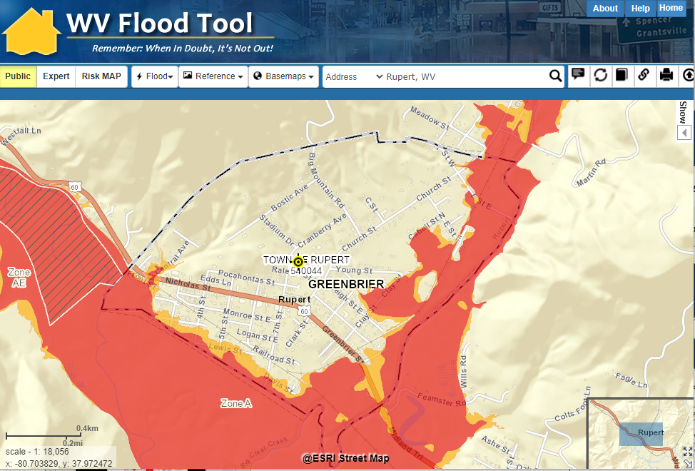
Ronceverte

Slide 5
Ronceverte

Slide 6
Rupert, WV

Slide 7
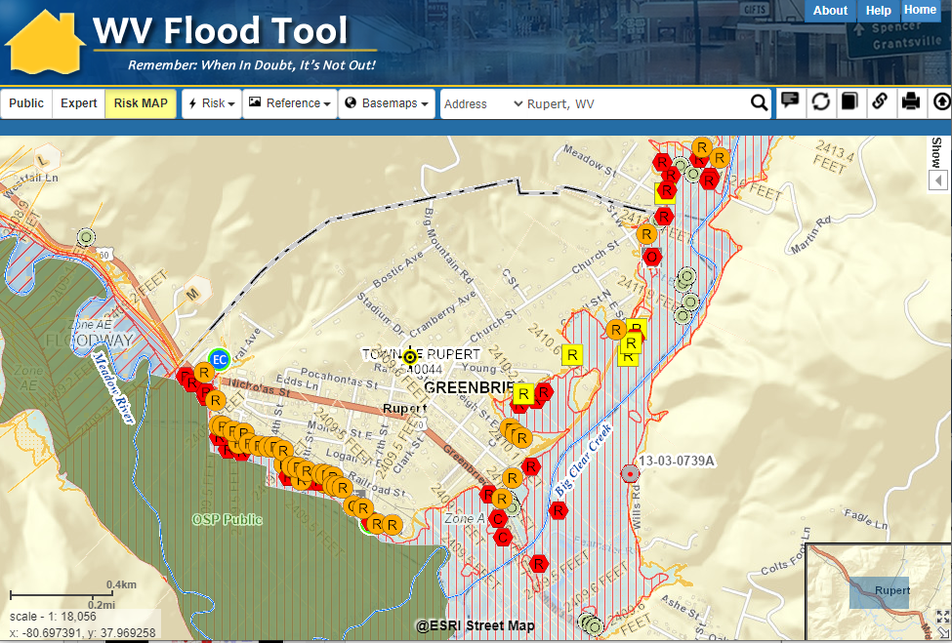
Rupert, WV

Slide 8
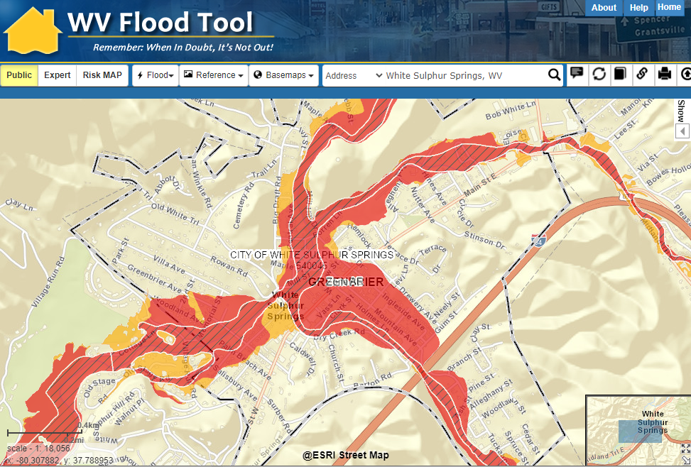
White Sulphur Springs, WV

Slide 9
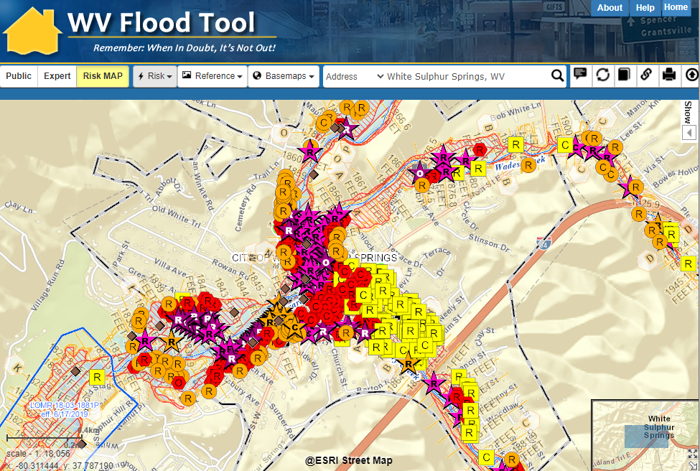
White Sulphur Springs, WV

Slide 10
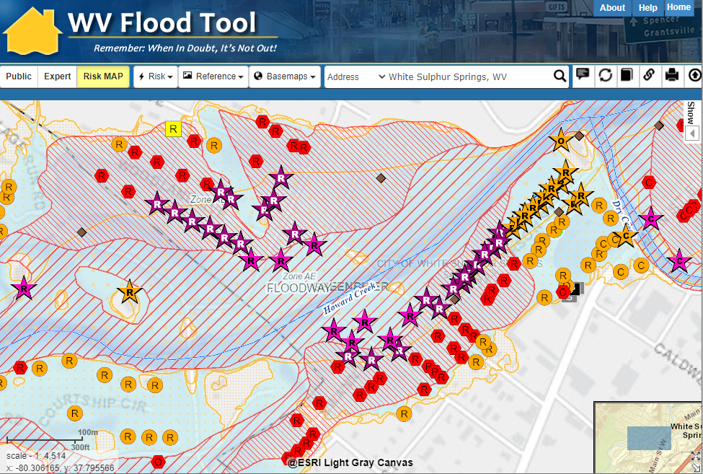
White Sulphur Springs, WV

Slide 11
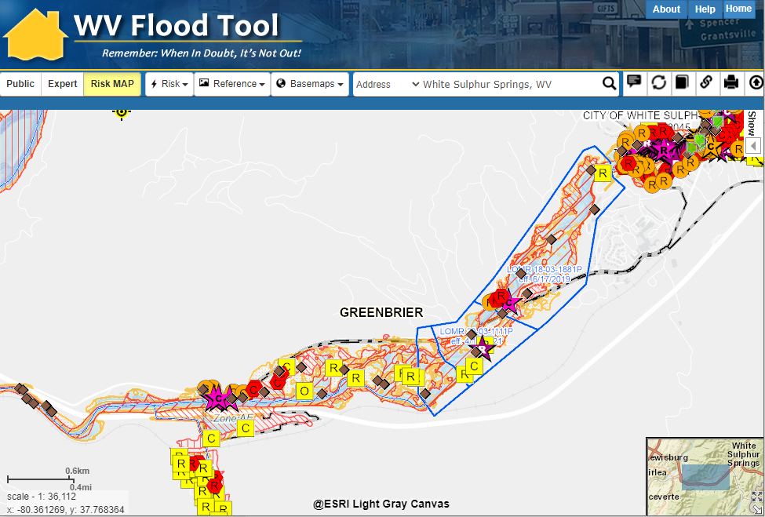
White Sulphur Springs, WV

Slide 12
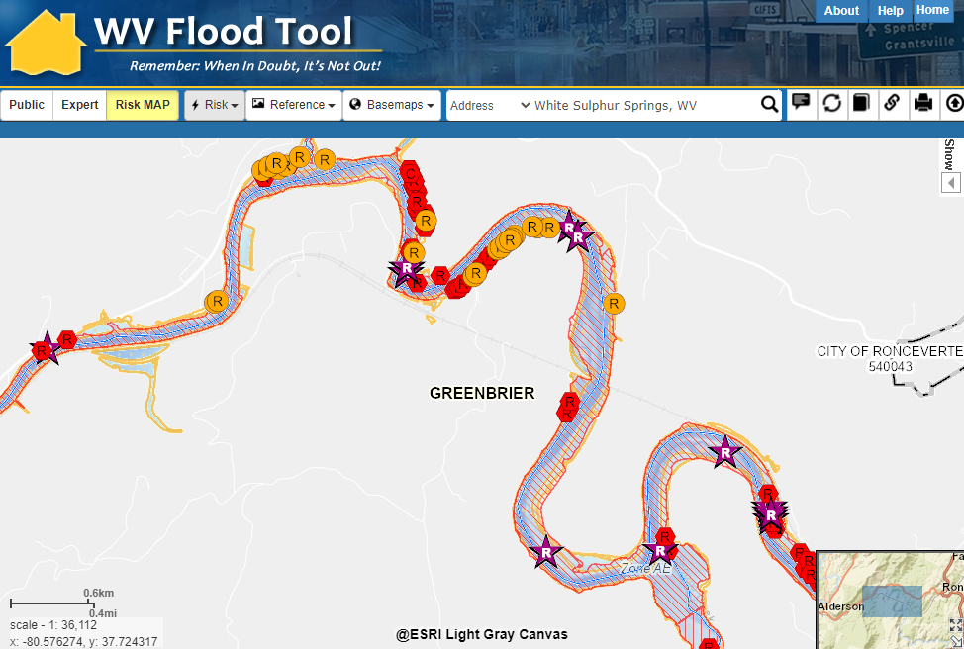
Greenbrier River between Alderson & Ronceverte

Slide 13
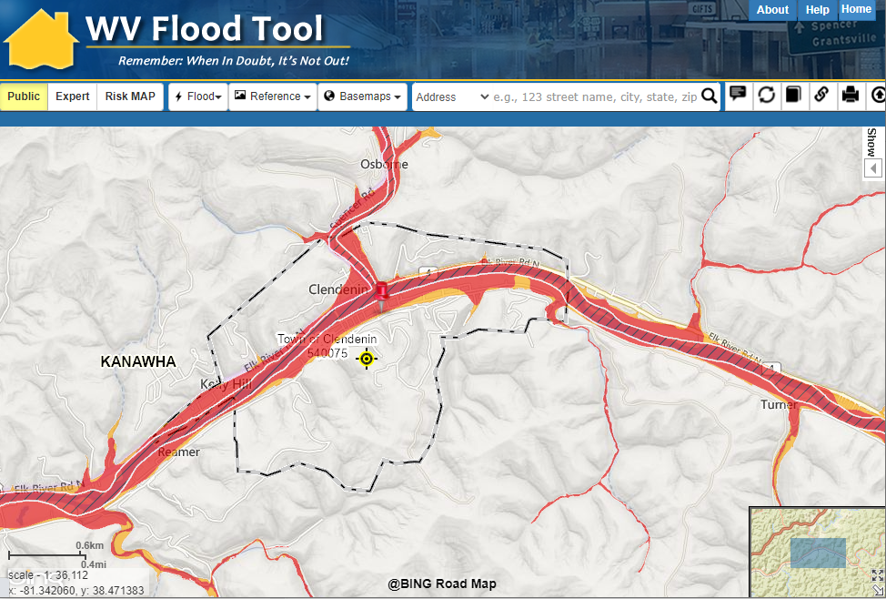
Clendenin, WV

Slide 14
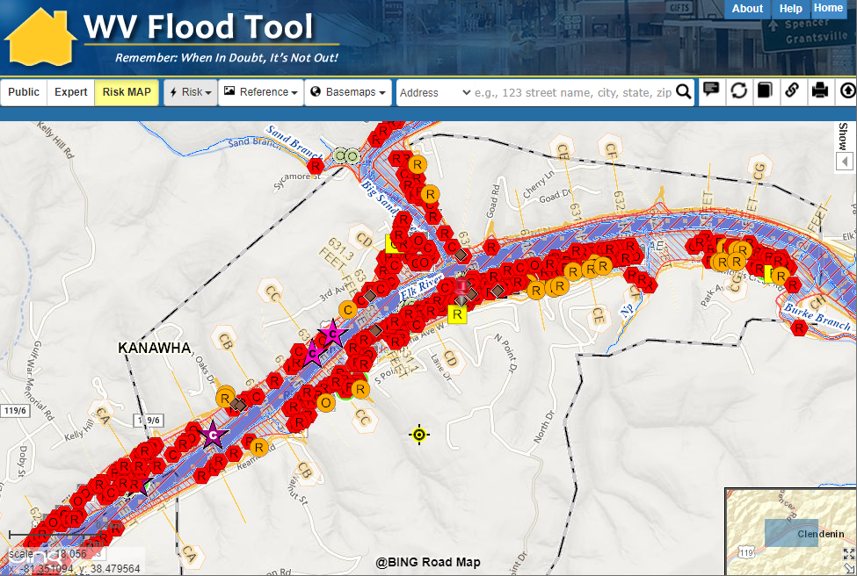
Clendenin, WV

Slide 15
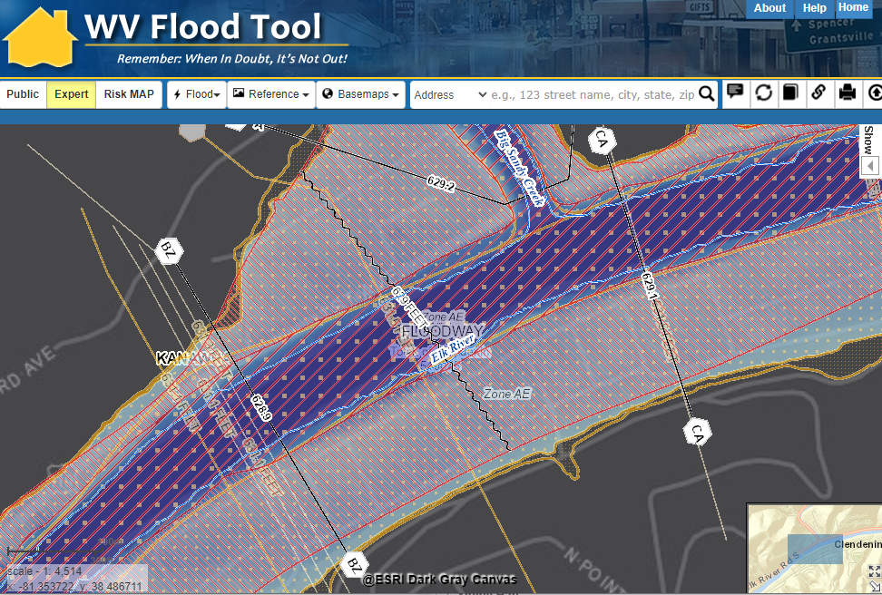
Clendenin, WV – BFE Increase

Slide 16
Clendenin, WV

Slide 17
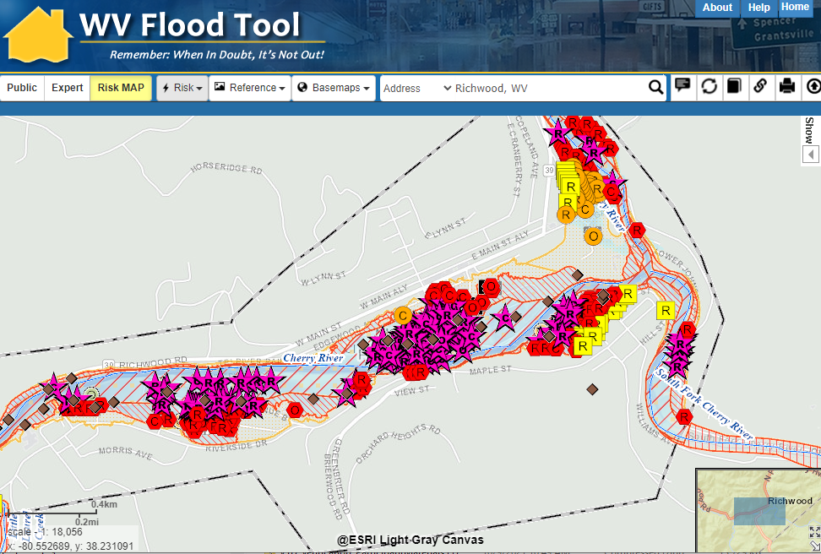
Richwood, WV

Slide 18
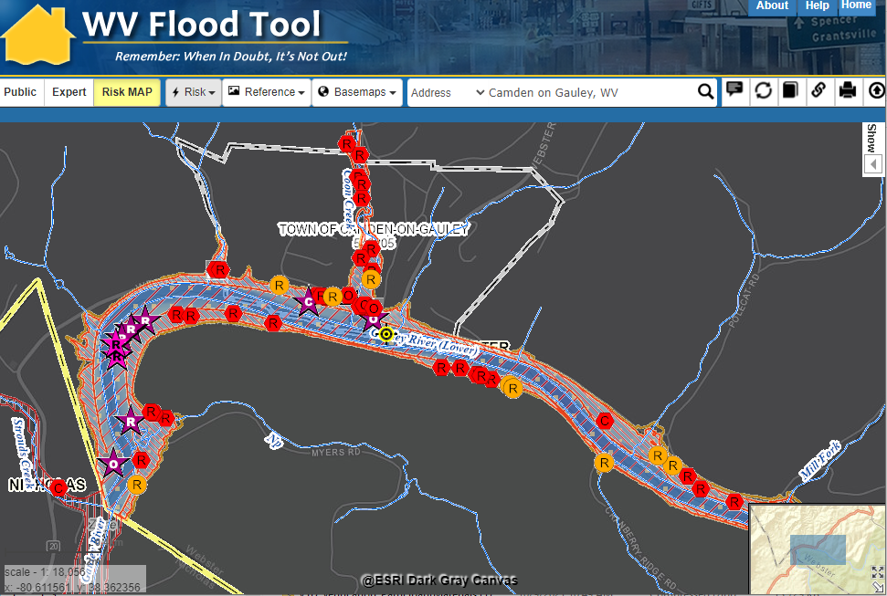
Camden on Gauley, WV

