Slide 1
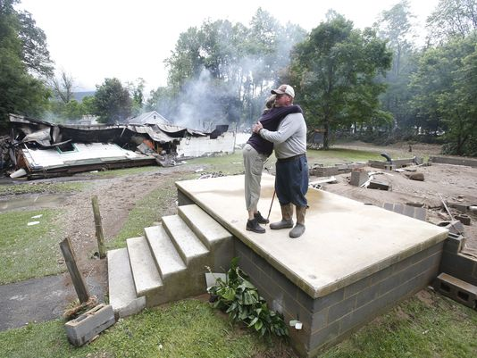
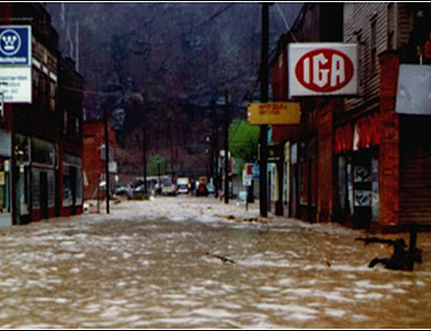
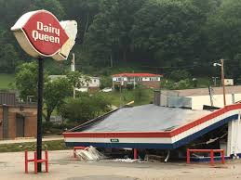
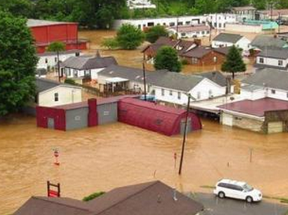
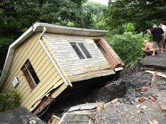
Statewide Flood Risk Assessment & WV Flood Tool
(TEIF – Total Exposure in Floodplain)
Kurt Donaldson and Maneesh Sharma
WV GIS Technical Center
West Virginia University
kdonalds@wvu.edu
April 19, 2022
WV State Mitigation Planning Workshop
← Devastating June 2016 Flood

Slide 2
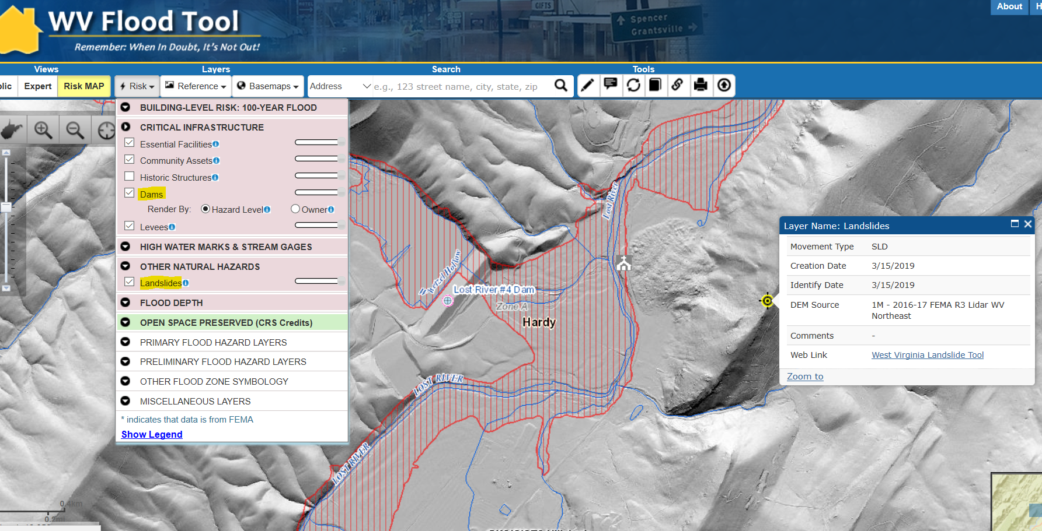
Risk Assessment Layers on Flood Tool
Landslide
Dam
Flood Zone
https://www.mapwv.gov/flood/map/?wkid=102100&x=-8771562&y=4715438&l=7&v=2
https://www.google.com/maps/@38.9409315,-78.805837,1690a,35y,44.59t/data=!3m1!1e3
Potential Flood, Dam Failure and Landslide Vulnerabilities on WV Flood Tool’s RiskMAP View
Hardy County, West Virginia

Slide 3
WV Statewide Risk Assessment
Building Level Risk Assessment

Slide 4

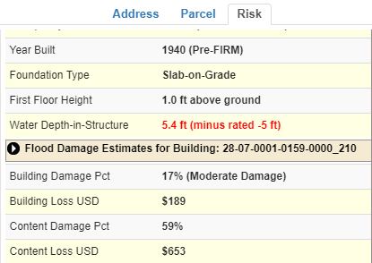
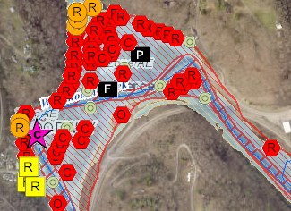
WV Building-Level Flood Risk Assessment
BUILDING INVENTORY
Primary Building
Identification &
Hazus Attributes
Essential Facilities & Community Assets
FLOOD LOSS MODELS
Open Hazus FAST
Flood Depths
Building Damage Estimates
COMMUNITY ENGAGEMENT
Risk Assessment
Data Verification
Mitigation Actions Identified
BLDG. LEVEL RISK ASSESSMENT (BLRA) DATABASE
Building Level & Community Level Outputs
Building-Level Flood Risk Assessments support:
Hazard Mitigation Plans
Floodplain Management
Community Assisted Visits
Community Rating System
BLRA Cycle and Methodology
1
Benefits
More detailed and accurate assessments
Automated scripts generate outputs quickly
Cost savings through efficiencies
Helps multiple stakeholders
Comprehensive Building Risk Spatial Database
4
Building-Level Risk Assessment (BLRA) Cycle
2
3
Methodology
Consistent methodology statewide
Semi-automated workflows
Continuous cycle to improve and update assessments
Tabular Output
Map Output
Published to WV Flood Tool

Slide 5
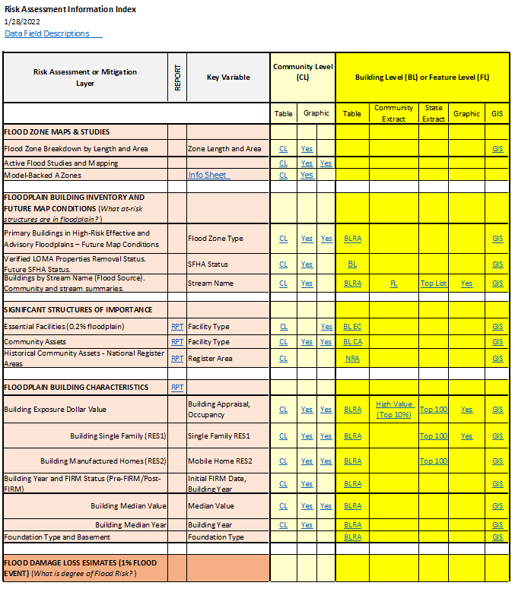
Access Risk Assessment Info
Use the Risk Information Index to access Data and Products
Building Level Risk Assessment (BLRA) Products
GIS Files
Tables (Excel)
  Community Level (CL)
  Building (or Feature) Level (BL) with links to online maps
    Table Extracts
    Top Lists
Maps
  Interactive Web Maps
  Graphics and Maps
Reports (Word Docs)
3D Flood Visualizations
Most of the risk assessment data can be viewed on the RiskMAP View of the WV Flood Tool

Slide 6
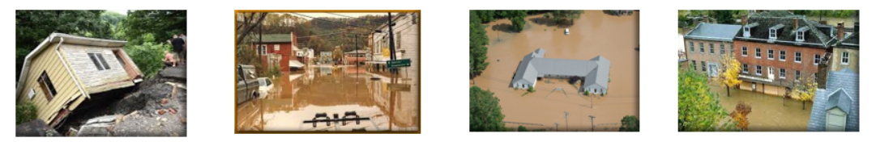
Risk Assessment Data Verification
Use Building-Level (BL) Tables to identify Most Vulnerable Structures
Statewide BLRA (GIS)
BLRA County Tables organized by region
BLRA Data Extract Tables: High Building Value, High Damage Loss, High Minus Ratings
BLRA Statewide Top Lists: Building Value, Flood Depth, Damage Loss $, Damage Loss %, Minus Rated, Mitigated Structures
Risk Indicator Matrices: Exposure and Damage Loss Matrices of Risk Indicators

Slide 7
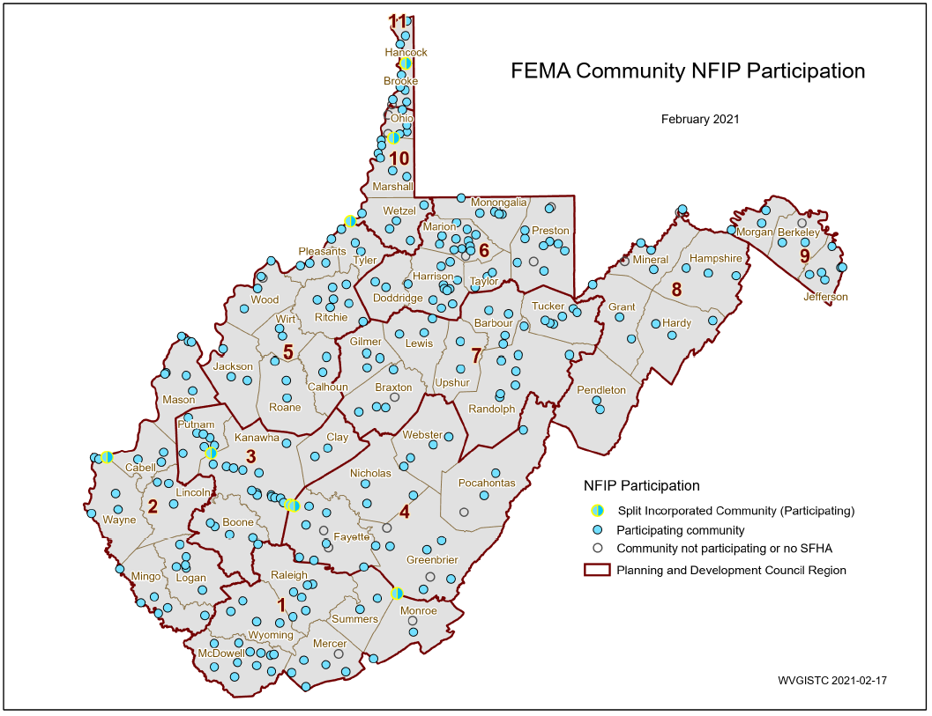
Statewide Hazard Assessment
213 incorporated areas
+55 unincorporated areas
268 NFIP Communities
+18 no SFHA communities
286 WV Communities
+ 8 split communities
294 Statistical Geographies
294 Statistical Geographies form
286 Communities which form
55 Counties which form
11 PDC Regions which form
1 Statewide Flood Risk Assessment
94% of WV Communities have Special Flood Hazard Areas (SFHA)
268 Flood-Prone Communities
SPLIT COMMUNITY | COUNTY 1 | COUNTY 2
Alderson | Greenbrier | Monroe
Huntington | Cabell | Wayne
Montgomery | Fayette | Kanawha
Nitro | Kanawha | Putnam
Paden City | Tyler | Wetzel
Smithers | Fayette | Kanawha
Wheeling | Marshall | Ohio
Weirton | Brooke | Hancock
PDF Map

Slide 8
Statewide Flood Risk Assessment
Detailed Floodplain
Building Inventory
Building Inventory Objectives
  Identify Primary Structures points
  Verify Building Identification
    E-911 Address
    Parcel geometry and assessment record
    Aerial and StreetView Images
    Building Sketches (parcel assessment record)
  Determine Building Characteristics (Occupancy Class, Cost, Basement, Foundation Type, Stories, Area, etc.)
    Default Characteristics derived from Assessment Records
    Overriding Modified Building Characteristics from user-defined values
  Ensure Building Point in most Restrictive Flood Zone
  Iterative Process and QC Checks to make more accurate
Record Data Issues and Data Gaps
1
BUILDING INVENTORY
Primary Building
Identification &
Hazus Attributes
Essential Facilities & Community Assets

Slide 9

Building Inventory
GIS Specialist conducting Building Inventory

Slide 10
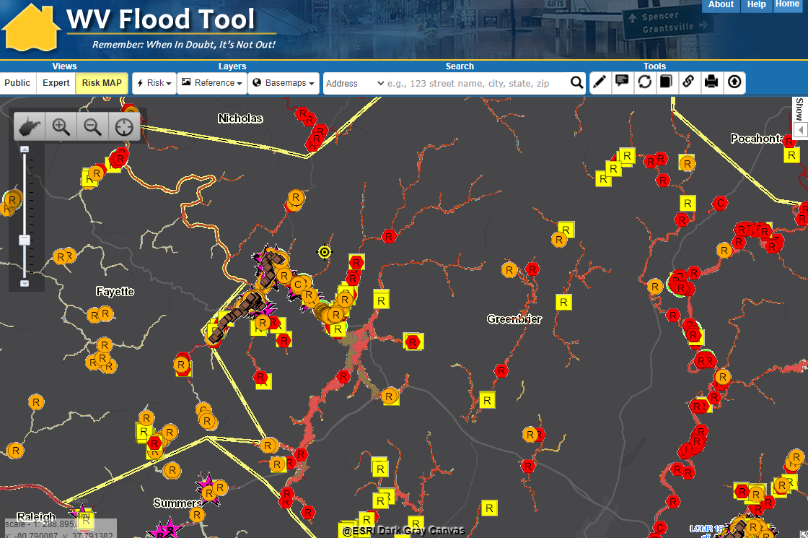
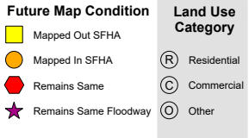
2021 R4 Floodplain Building Inventory
Refer to Overview and Other Resources about WV Flood Tool
Enhanced inventory of more than 98,000 building in high-risk floodplains completed by WVU in 2021 and published to WV Flood Tool
Vulnerability Risk Assessment
https://www.mapwv.gov/flood/map/?wkid=102100&x=-8985707&y=4589317&l=3&v=2

Slide 11
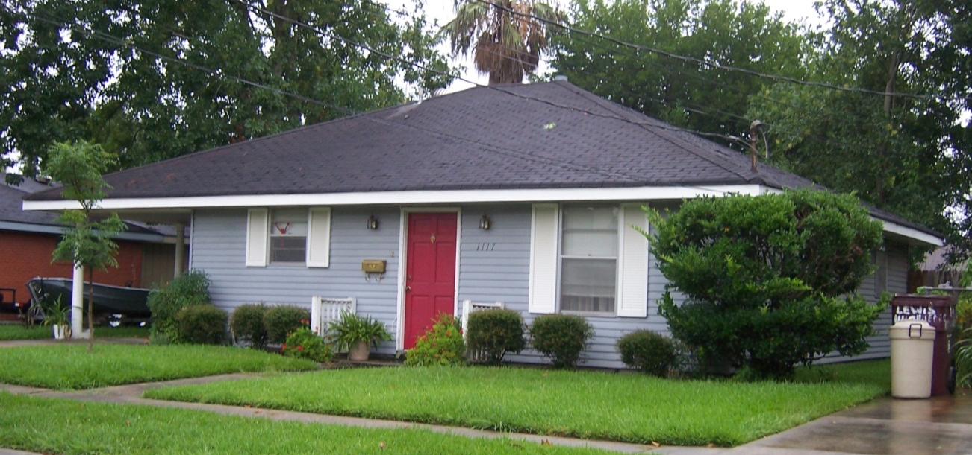
Building Definition
CRS Manual Page 300-4
301.a Definition of “Building”
2 or more exterior walls and a roof affixed to a site
Manufactured (mobile) home
Travel trailer without wheels

Slide 12
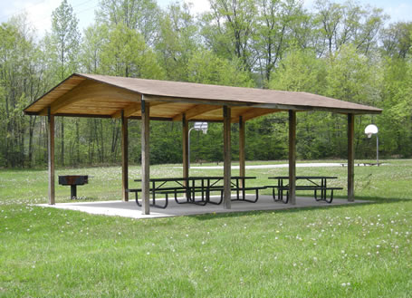
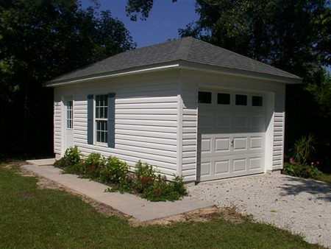
Primary Structure: Not a Building
CRS Manual Page 300-5
“Not a Building”
Open pavilions, carports, underground pump stations, trailers, etc. are not buildings
Accessory structures are not counted
All primary structures in high-risk flood zones are inventoried.
Essential Facilities in moderate-risk flood zones also inventoried.

Slide 13
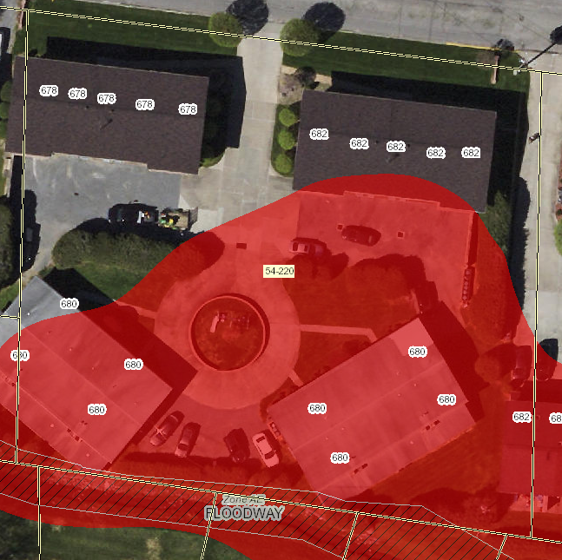
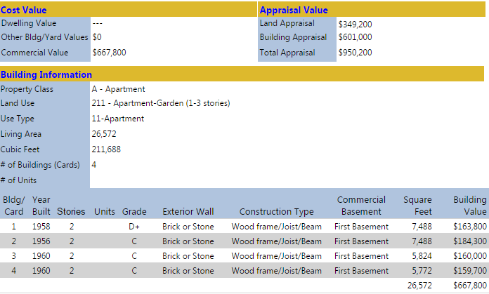
Multiple Structures in a Single Parcel
Single Building Point for Multiple Buildings on a Single Parcel/Assessment
  Outbuildings and detached structures associated with a Primary Structure as a single point that correlates with Building Appraisal Value.
  Multiple buildings associated with commercial, industrial, or agricultural sites are identified as a single Primary Structure point if all structures are in the flood zone and can be correlated with Total Building Appraisal Value in Assessment Report.
Multiple Building Points in Single Parcel/Assessment (see example below – 4 Apt. Bldgs.)
  Points are associated with each Primary Structure in Flood Zone. Associated Model Input Parameters (Cost, Area, Occupancy Class, etc.) are recorded as separate building records. 3 apartments below are primary.
682
PID: 31-15-0054-0215-0000
Flood Tool Assessment Report
680B
680A
682
680A
680B
Flood Tool Map View
The Web Parcel Assessment Reports provide a breakdown of individual building values and characteristics in single parcel

Slide 14
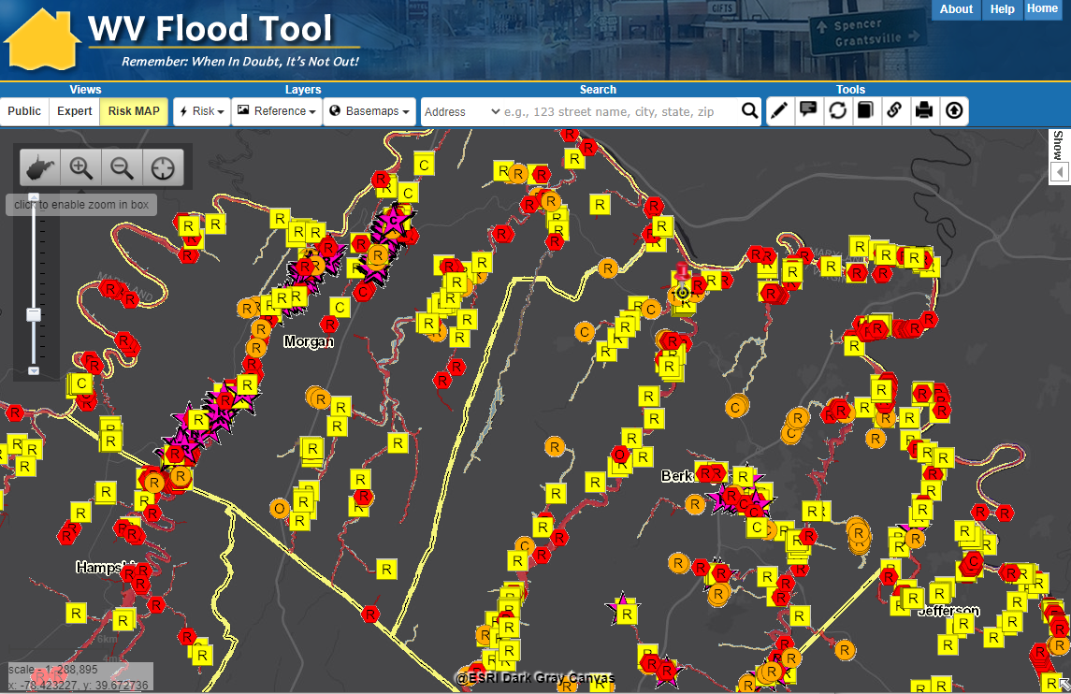
2021 R9 Floodplain Building Inventory
https://www.mapwv.gov/flood/map/?wkid=102100&x=-8680577&y=4786710&l=3&v=2

Slide 15
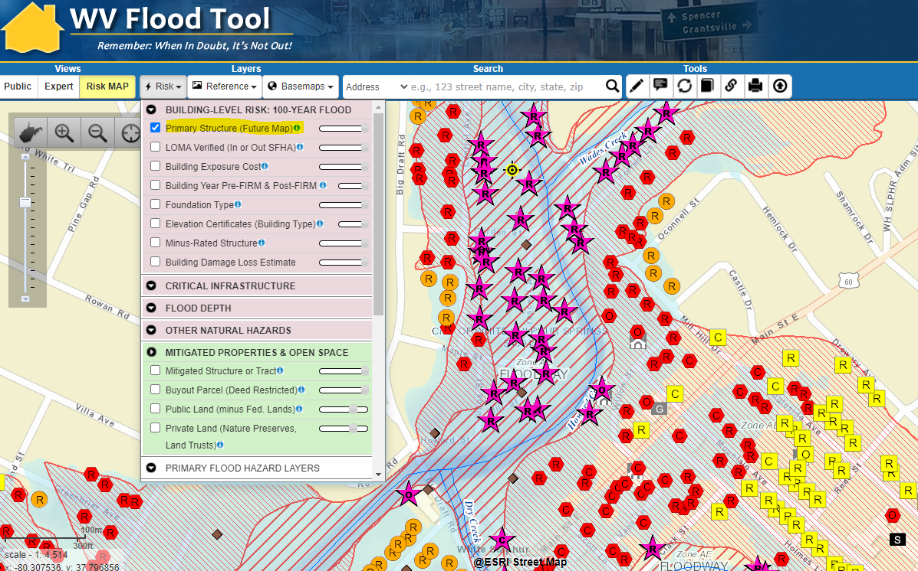
Floodplain Building-Level Risk
All Risk Assessment and Mitigation Layers are displayed on the RiskMAP View of the WV Flood Tool
High-Risk Effective & Advisory
1%-Annual-Chance (100-Yr) Floodplains
White Sulphur Springs
https://www.mapwv.gov/flood/map/?wkid=102100&x=-8938946&y=4550516&l=9&v=2

Slide 16
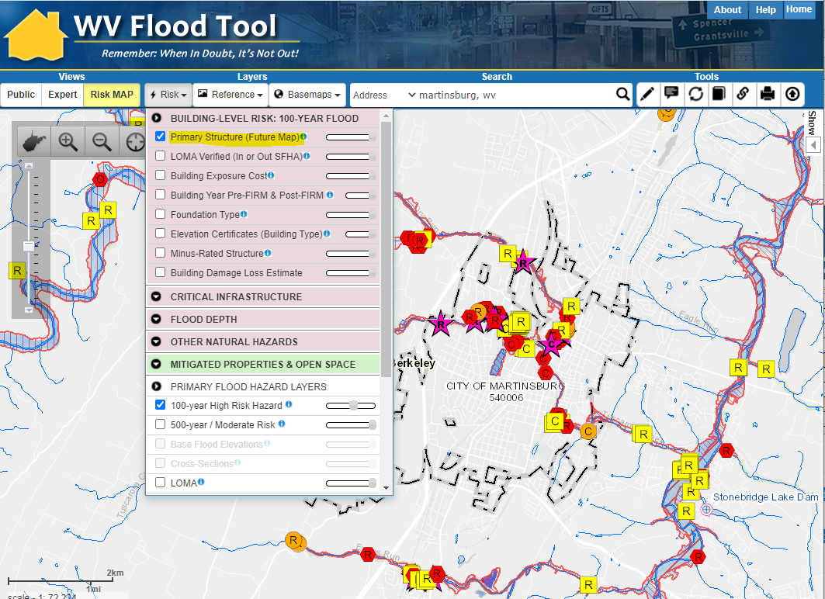
Primary Structures (Martinsburg)
Martinsburg’s primary structures viewable on the Risk MAP View of the WV Flood Tool. Symbol letters indicate general occupancy (Residential, Commercial, Other Non-Residential).

Slide 17
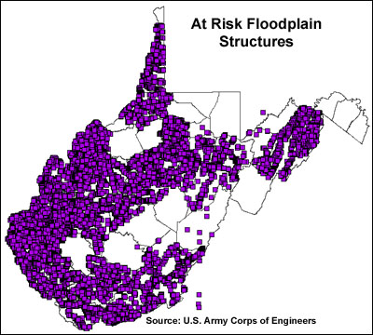
2002 Building Inventory
Building Inventories
Nearly 20 years ago more than 80,000 structures in the floodplain were inventoried by the Pittsburgh District Army Corps of Engineers using statewide 1996-99 1-meter resolution Digital Orthophoto Quarter Quads. A combination of FEMA's Q3 and DFIRM floodplain data (available for 37 of the 55 counties) was overlaid onto DOQQ's.
<< USACE Inventoried Floodplain Structures >>
http://wvgis.wvu.edu/data/dataset.php?ID=230

Slide 18
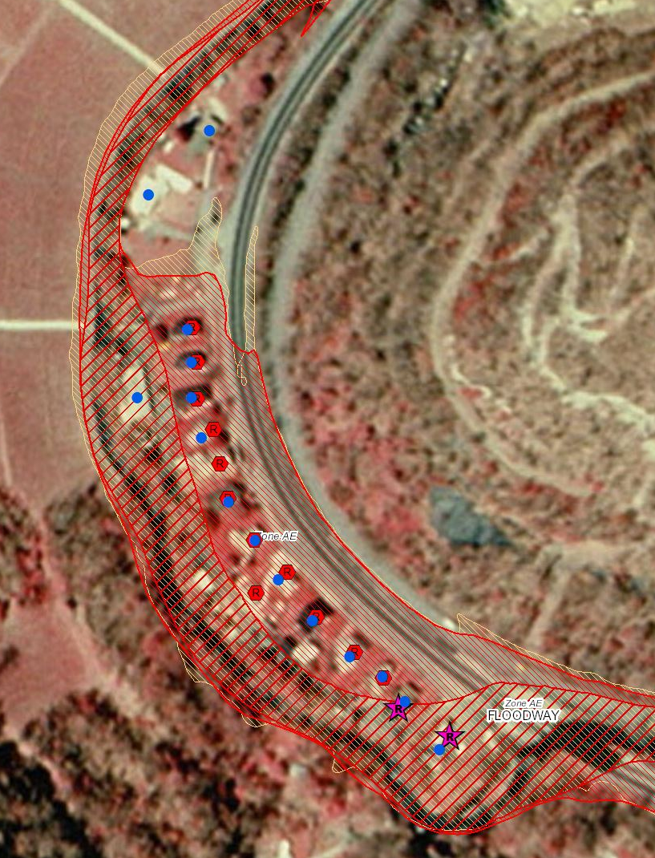
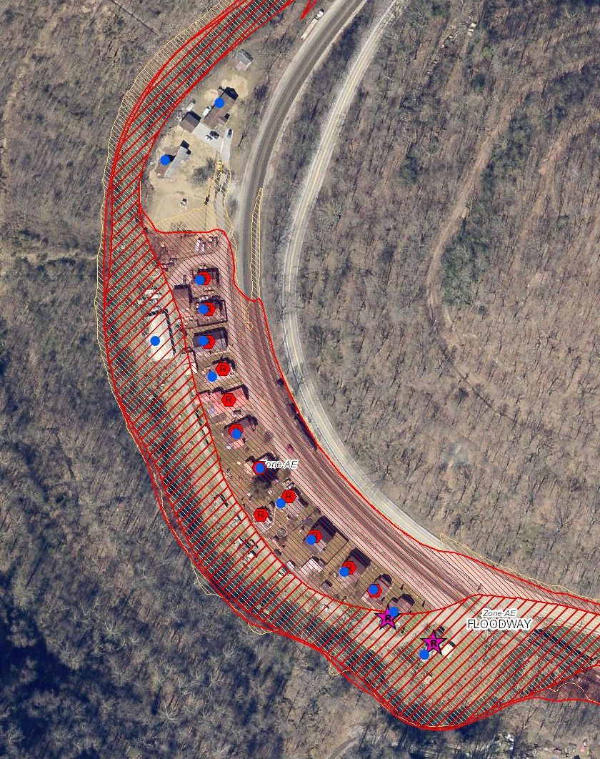
Statewide Building Inventories
https://www.mapwv.gov/flood/map/?wkid=102100&x=-9070843&y=4497058&l=11&v=2
1998 Aerial Imagery
2018 Aerial Imagery
Elkhorn Creek, McDowell County
2002 USACE Inventory
2021 WVU Inventory

Slide 19
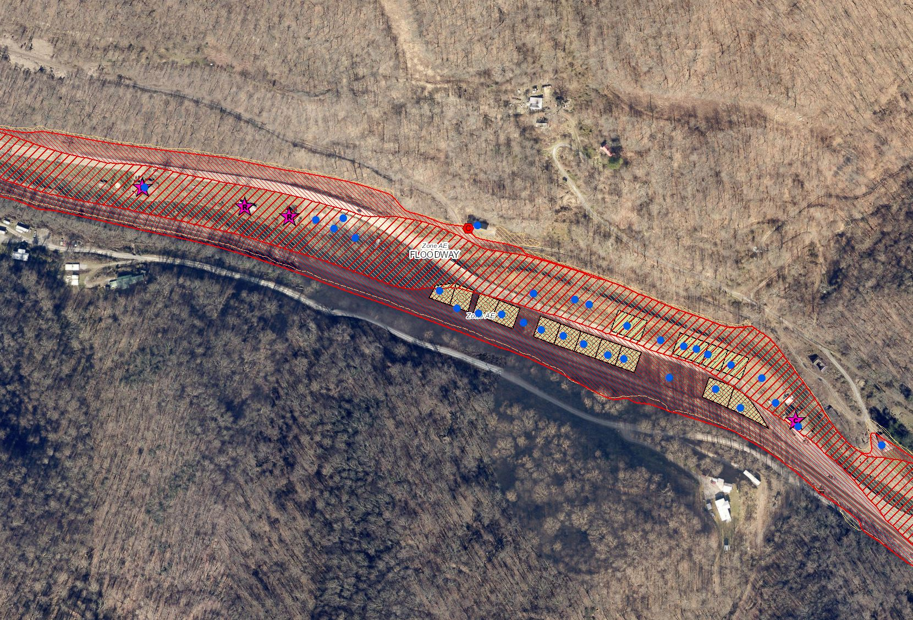
USACE 2002 Building Inventory
https://www.mapwv.gov/flood/map/?wkid=102100&x=-9069713&y=4496689&l=10&v=2
Buyout Properties since
2002 USACE Inventory
2002 USACE Inventory
Elkhorn Creek, McDowell County

Slide 20
WV Statewide Risk Assessment
GIS Data for Enhanced Building Inventory

Slide 21
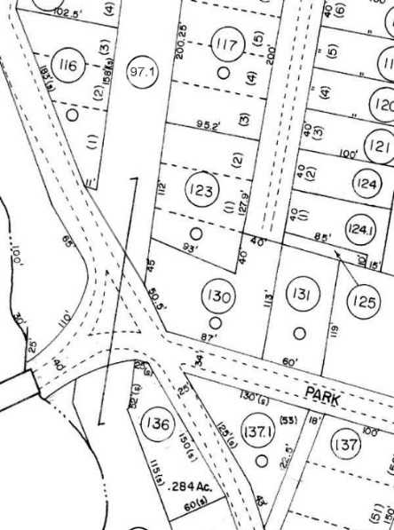
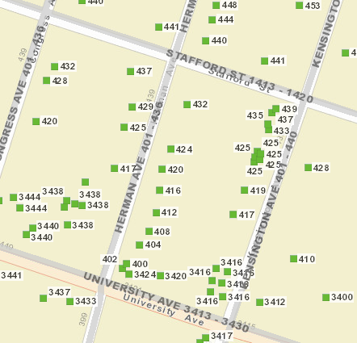
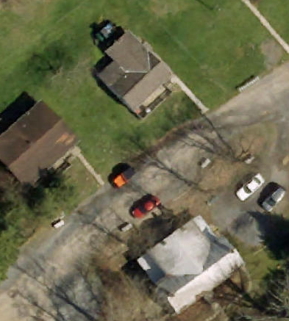
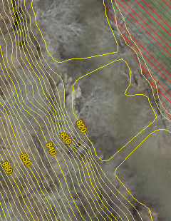
GIS Data Development
Parcels Site Addresses Aerial Imagery Elevation
1
BUILDING INVENTORY
GIS Reference & Elevation Data
Flood Studies
Depth & WSEL Grids
Building Stock
Migrate six counties from paper to digital parcels
Flood-risk communities with missing or incorrect E-911 addresses
County Leaf-off imagery no older than 5 years
Statewide 1-meter DEM and 1-ft. contours. Flood Studies, Depth & WSEL Grids
Parcels, Assessment Records, Aerial Imagery
important for pinpointing flood-risk structures
More info about WV Flood Tool’s Reference Layers

Slide 22
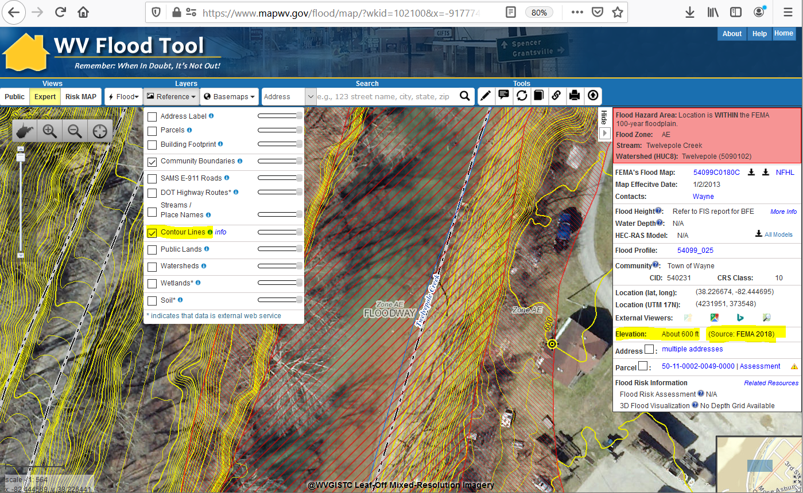
Ground Elevation: 1-ft. Contours
https://www.mapwv.gov/flood/map/?wkid=102100&x=-9177701&y=4611497&l=13&v=1
Make Contour Lines visible under REFERENCE LAYERS
1-FOOT CONTOUR ELEVATION VALUE OF 600 FEET MATCHES 1-METER GRID SURFACE ELEVATION OF 600 FEET DISPLAYED IN QUERY RESULTS PANEL
1-ft Contours Display at two Highest Zoom Levels (1:564 and 1:282 Map Scales)
Elevation: 600 ft.
Source: FEMA 2018
600 ft.
1-foot contours published for 10 counties
FEMA LiDAR-Derived Products: 1-Meter DEM and 1-Foot Contours

Slide 23
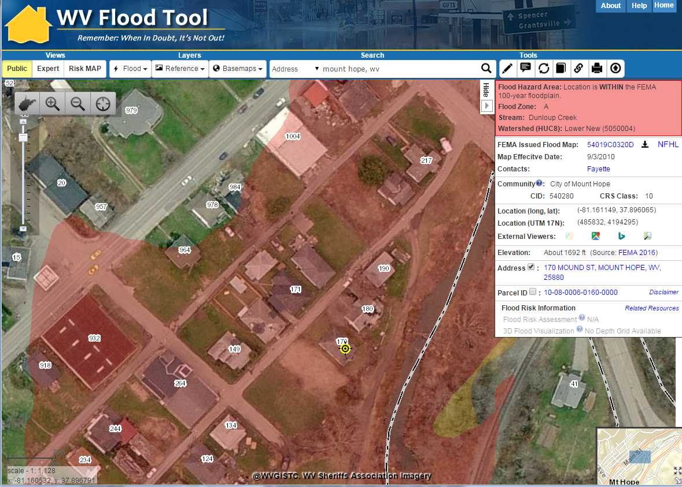
Mount Hope – 2010 Imagery
https://www.mapwv.gov/flood/map/?wkid=102100&x=-9034811&y=4564776&l=11&v=1

Slide 24
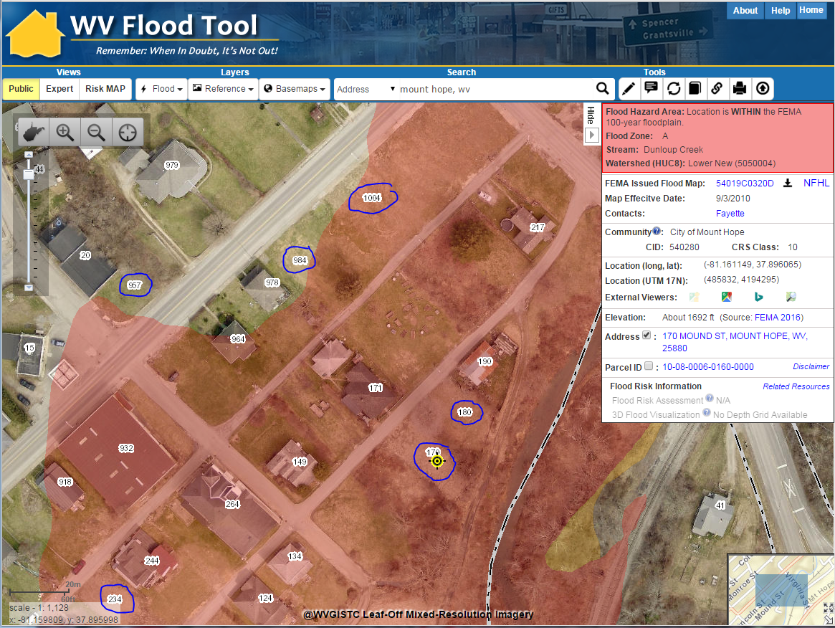
Mount Hope – 2015 Imagery
https://www.mapwv.gov/flood/map/?wkid=102100&x=-9034811&y=4564776&l=11&v=1
The 2015 aerial imagery shows structures have been removed but E-911 addresses are still indicated

Slide 25
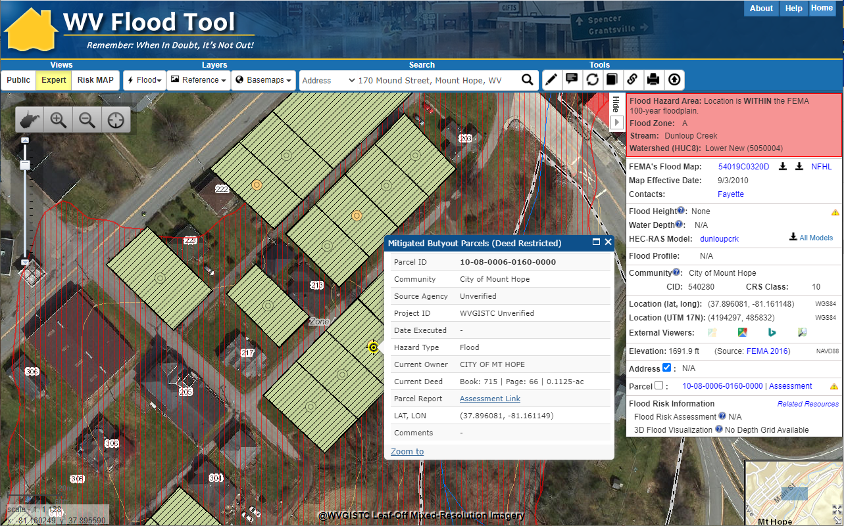
Mount Hope – 2020 Imagery
The 2020 aerial imagery showing buyout properties (green polygons) and updated E-911 addresses
https://www.mapwv.gov/flood/map/?wkid=102100&x=-9034818&y=4564756&l=12&v=1

Slide 26
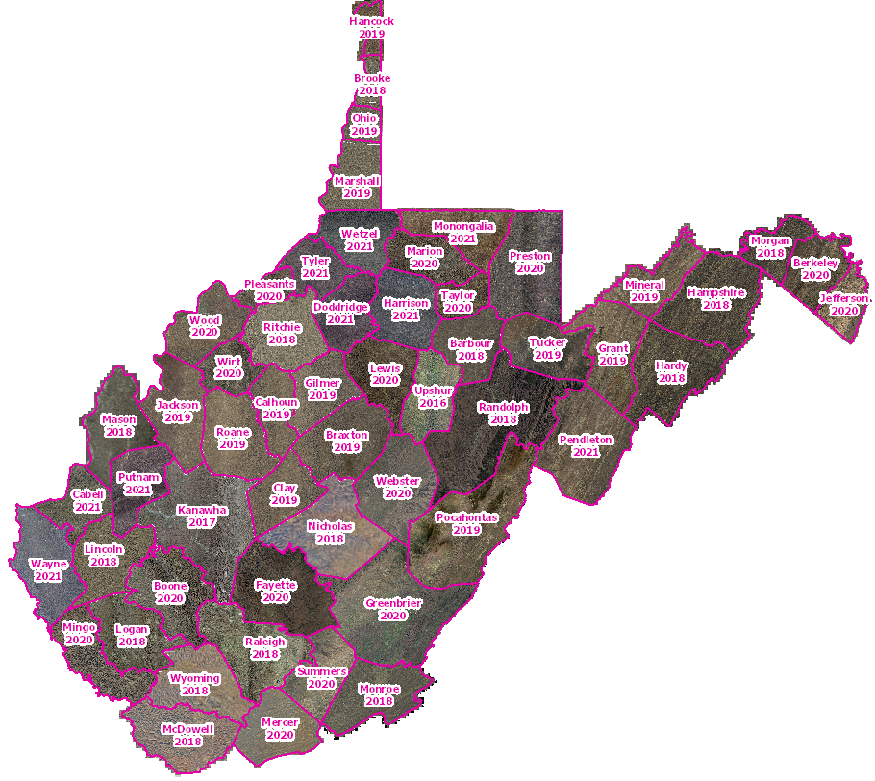
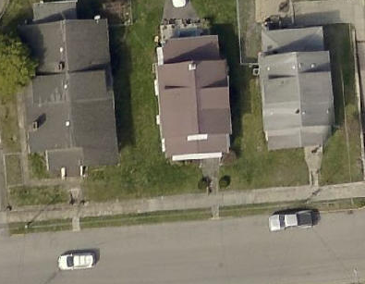
Leaf-Off Aerial Imagery Web Service
https://services.wvgis.wvu.edu/arcgis/rest/services/Imagery_BaseMaps_EarthCover/wv_imagery_WVGISTC_leaf_off_mosaic/MapServer?f=jsapi
Counties provide leaf-off imagery
for State Imagery Web Service
Cached to 1:282 Zoom Level or Map Scale
2021 Harrison County
Aerial Imagery

Slide 27
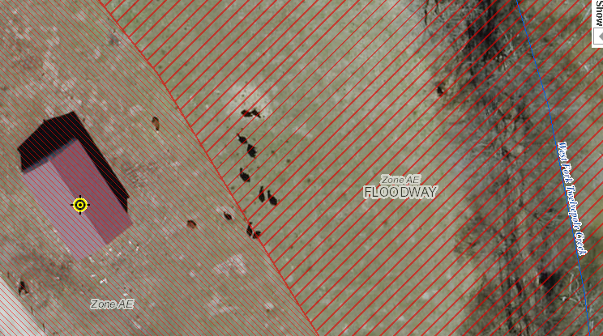
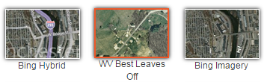
New 2019 Leaf-Off Aerial Imagery
http://www.mapwv.gov/floodtest/?wkid=102100&x=-9176629&y=4583554&l=13&v=1
New 2019 Imagery
on Flood Tool
Braxton
Cabell
Calhoun
Clay
Doddridge
Gilmer
Harrison
Jackson
Marshall
Monongalia
Ohio
Pocahontas
Putnam
Roane
Taylor
Tucker
Tyler
Wayne
Wetzel
Wirt
4-Inch Pixel Resolution
Choose WV Best Leaves Off Base Map
Cows in the Floodway
West Fork Twelvepole Creek, Wayne County

Slide 28
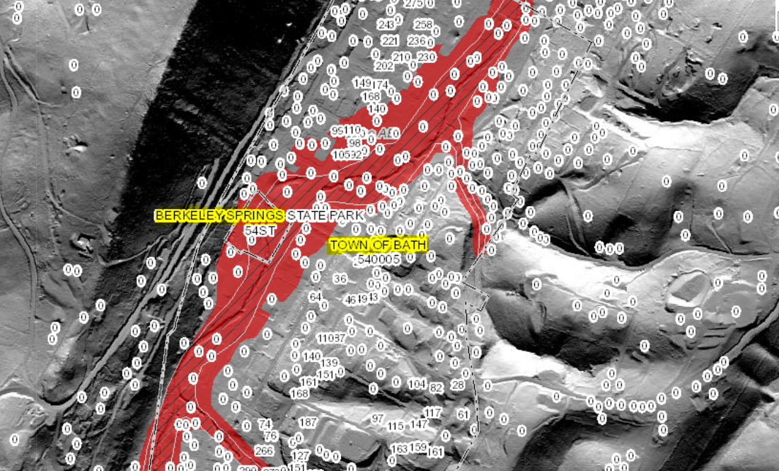
Statewide E-911 Addresses
Missing Address Site Numbers
Berkeley Springs, WV

Slide 29
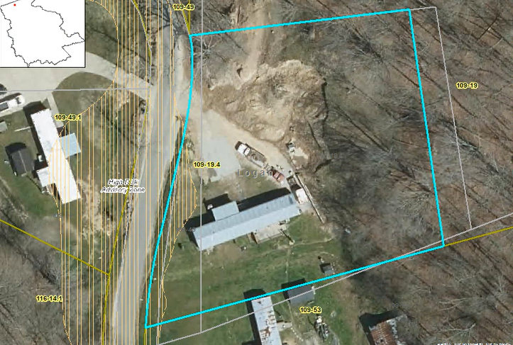
Improved Property Parcel Mapping
Logan
County
Parcel 23-02-0109-0019-0004
High Risk Advisory Zone
Parcel Geometry Map Accuracy Improved
1322 WEST FORK RD TRLR, WEST FORK, WV, 25508
https://mapwv.gov/parcel/?pid=23-02-0109-0019-0004

Slide 30
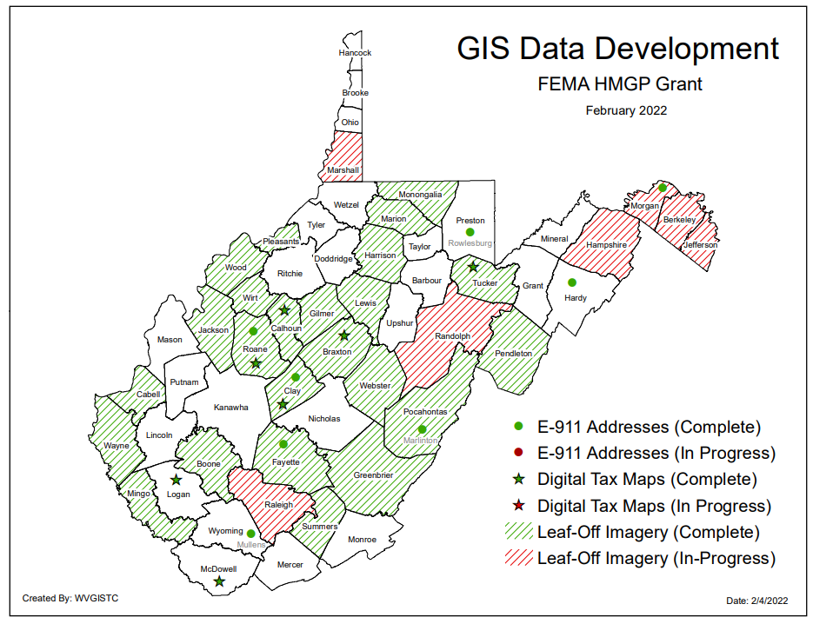
State GIS Data Contracts
2 State Contracts for Aerial Imagery, Parcels, and Addresses
Map PDF

Slide 31
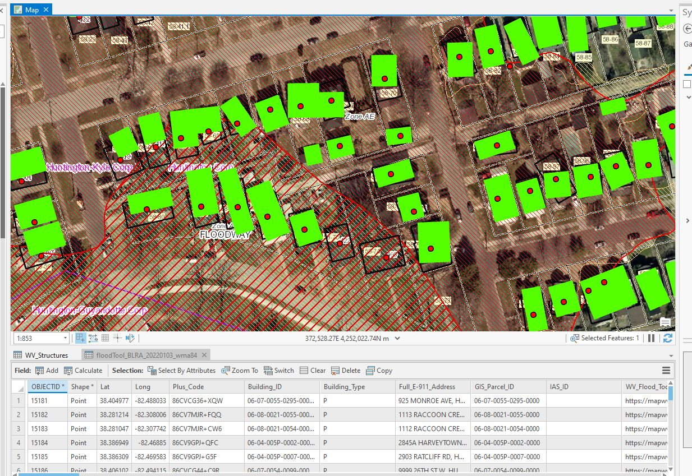
Building Footprints
2018 Microsoft Building Footprints (for WV): 1,020,048 structure footprints
2021 FEMA's USA Structures (for WV): 1,085,876 structure footprints
2022 WVU Building Footprints (in progress)
Verification Layer: WV Building-Level Risk Assessment (BLRA): 98,467 points of primary structures located in the 1%-annual-chance floodplain

Slide 32
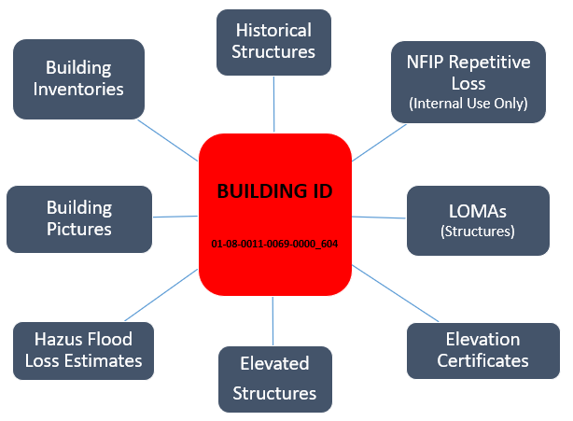
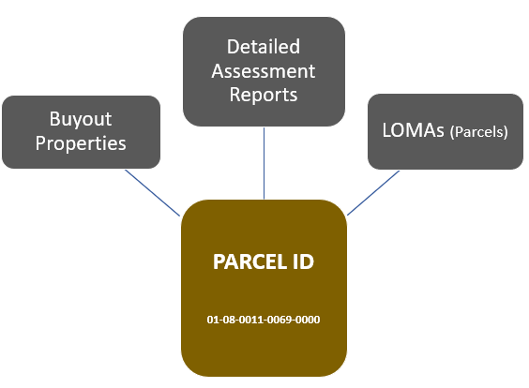
Building Unique Identifier
Click here for more info on Building Identification
Parcel ID | 01-08-0011-0069-0000
01 | - | 08 | - | 0011 | - | 0069 | - | 0000
County |  | District |  | Map |  | Parcel |  | Suffix
Address | 604 S Main St, Philippi, West Virginia, 26416
Building Identifier (Parcel ID + Address No.) | 01-08-0011-0069-0000_604
Link to Property Record
Link to Structure Record

Slide 33
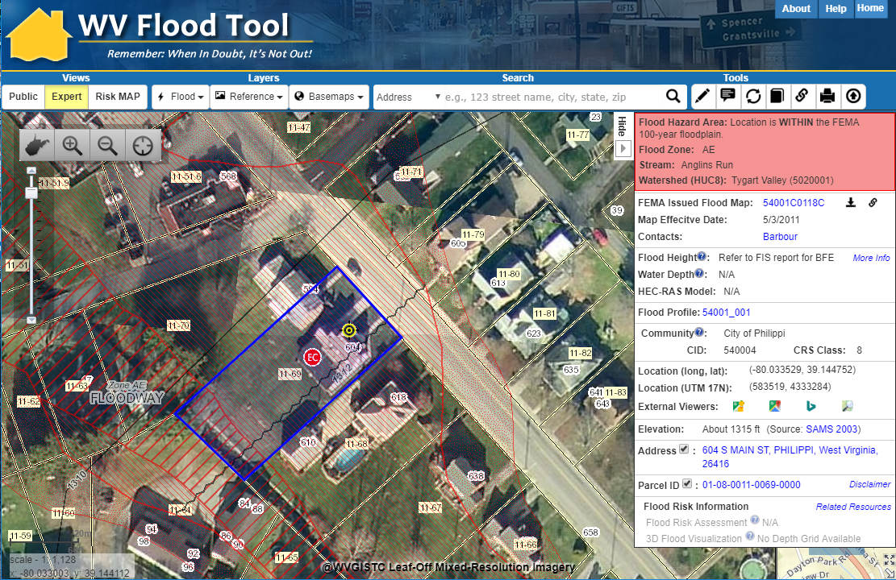
Property Identification – Bldg. ID
SHARE LINK
604 S. Main St., Philippi, WV 26416
Address: 604 Main St, Philippi, WV 26416
Parcel ID: 01-08-0011-0069-0000
X,Y COORD.
ADDRESS
Building ID:
(Parcel ID + Address No.)
01-08-0011-0069-0000_604
PARCEL
Share Link: https://www.mapwv.gov/flood/map/?wkid=102100&x=-8909292&y=4742427&l=12&v=1

Slide 34
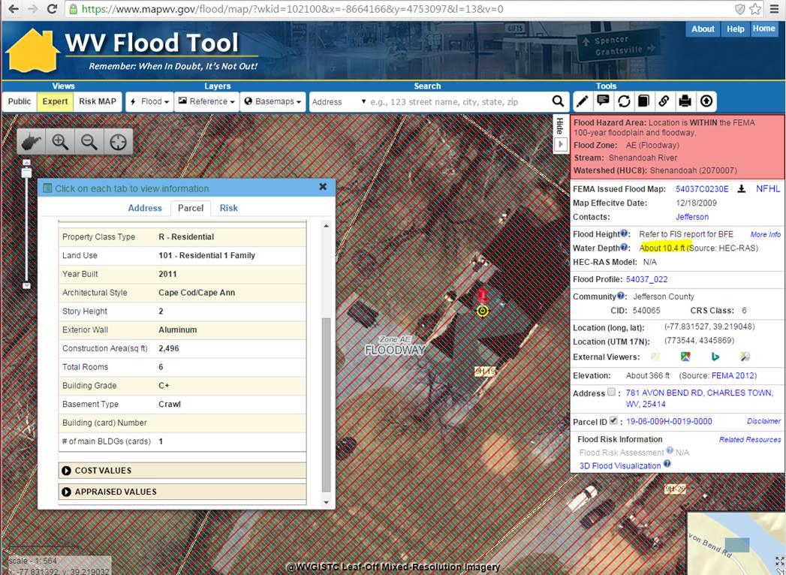
Building 19-07-022B-0021-0000_7170
Building ID: 19-07-022B-0021-0000_7170
10 ft. Water Depth
Built 2011
Crawl Basement
<< 781 Avon Bend Road, Charles Town, WV 25414 >>
https://www.mapwv.gov/flood/map/?wkid=102100&x=-8664166&y=4753097&l=13&v=0

Slide 35
Risk Assessment
FLOOD ZONE MAP INFORMATION
What flood zone map information is available now or in the future?

Slide 36
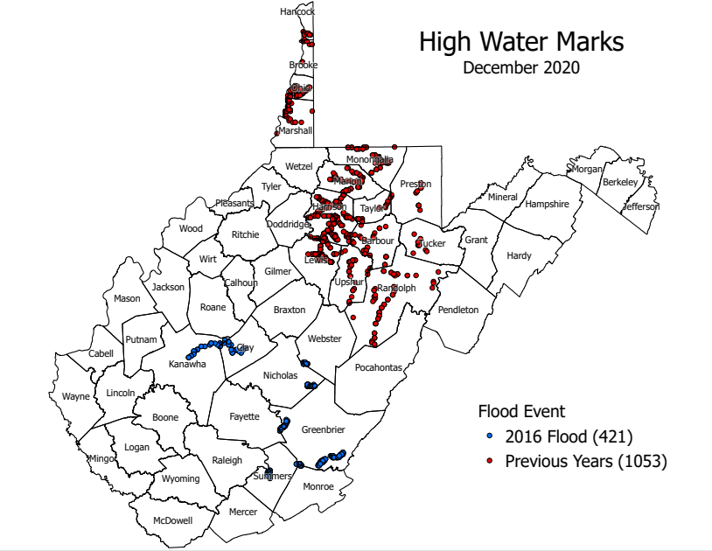
Historical Flood Information
STORY MAPS:
Flood Risk in West Virginia: What We Learned from the June 2016 Flood
WV Flooded Towns, June 2016. The Historic Flooding of Southern West Virginia on June 23, 2016
High-Water Marks Graphic
Historical flood information including high water marks of past flooding events should be reviewed.
FEMA Region 3 Report
Understanding Flood Dangers in Central West Virginia: LESSONS LEARNED FROM THE JUNE 2016 FLOOD

Slide 37
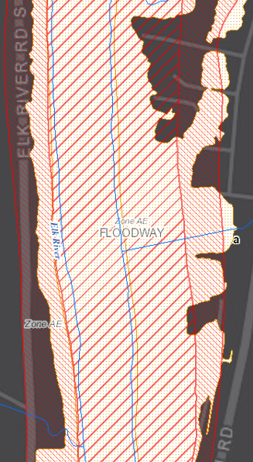
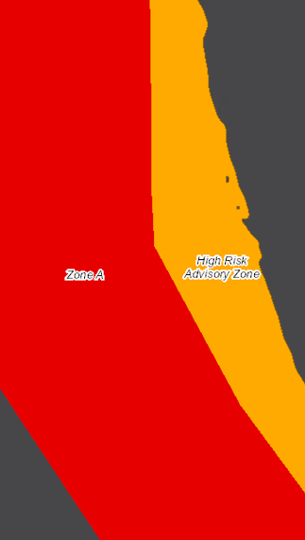
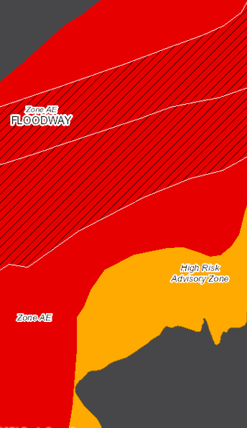
High Risk Advisory Zones
More info on High-Risk Advisory Zones
Preliminary NFHL
Advisory A
Updated AE
Preliminary NFHL
Advisory A
Updated AE

Slide 38
Advisory: Building Future Map Conditions
Residential Structure “remains same” in SFHA
High-Risk Effective & Advisory
1%-Annual-Chance (100-Yr) Floodplains
Residential Structure “mapped out” of SFHA
Commercial Structure “mapped in” of SFHA
Future Map Conditions for structures are inventoried for counties with mapped High-Risk Advisory Floodplains
WV Flood Tool Map Link

Slide 39
Map Revisions→High Risk Advisory Zones
Advisory Flood Zone* | Map Revision Type | Initiated | Applicable Zones
Preliminary NFHL or DFIRM | Risk MAP Restudy or Study | FEMA | A and AE Zones
Draft NFHL or DFIRM | Risk MAP Restudy or Study | FEMA | A and AE Zones
Advisory A | AFH Model-Backed Studies | State CTP | Approximate A Zone
Updated AE | Non-Restudy Redelineation | State CTP | AE Zone
* Note: Advisory Floodplains may be mapped outside of the official FIRM
High-Risk Advisory Zone Flood Products:
(1) Advisory Floodplain Boundary, (2) Flood Height Grid, (3) Flood Depth Grid
Refer to WV Flood Tool Glossary for more information

Slide 40
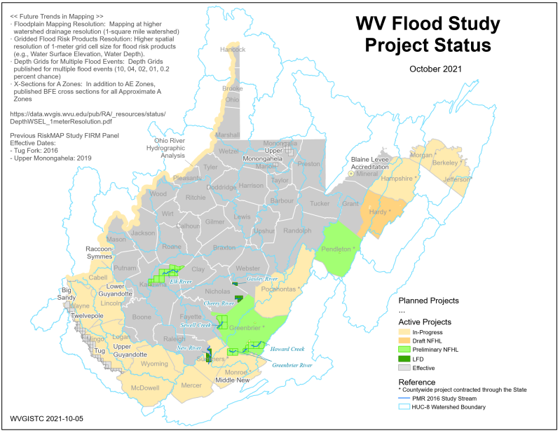
Active FEMA Flood Studies
FEMA is creating new flood maps for communities in eastern and southern West Virginia. All flood maps will be updated with the new LiDAR.
Flood Study Project Status Map PDF

Slide 41

Draft NFHL
Draft NFHL
Draft NFHL Flood Zone: Pre-Preliminary FEMA National Flood Hazard Layers (NFHL) pending to become effective on updated Flood Insurance Rate Maps (FIRMs)

Slide 42

Preliminary NFHL (Rainelle, WV)
Rainelle, Greenbrier County
Example of mapped in structures to new SFHA from Preliminary Flood Study of Rainelle, WV. Mapped in structures (orange circles) and flood loss estimates are updated in the statewide Building Level Risk Assessment (BLRA).

Slide 43

Draft NFHL (Summers County)
Draft NFHL
Example of mapped in structures to new SFHA from Preliminary Flood Study along Summer-Greenbrier county border near Glenray. Mapped in structures (orange circles) and flood loss estimates are updated in the statewide Building Level Risk Assessment (BLRA).

Slide 44


New Flood Maps
FEMA is creating new flood maps for select communities in Region 4 which will alter the floodplain boundaries and base flood elevations. The new flood maps will affect the at-risk building inventories as well. The BFE is increasing 6 feet at this location.
Gauley River
The June 2016 Flood High-Water Mark was 9.1 feet for Building 51-04-0003-0007-0000_91 located near the town Camden-On-Gauley (Webster County) on the Gauley River. The Base Flood Elevation is increasing by 6 feet on the new FEMA flood maps for this location.

Slide 45

Zone A Mapping (Advisory)
15 Counties have no Advisory Base Flood Heights for A Zones
PDF Map
Advisory Flood Height Handout

Slide 46

AE Redelineation (Advisory)
All Non-Restudy Areas:
Redelineated AE Floodplains with Depth/WSEL grids mapped using LiDAR-derived 1-meter elevation data resolution
PDF Map
Redelineation Methodology

Slide 47

Updated AE: BFE Non-Restudy
NFHL X-Section
Popup Window
FLOOD HEIGHTS (Example for Pocahontas County)
Non-Restudy Base Flood Elevation Heights displayed in Flood Query Results Panel
Data Products: Redelineated Floodplains, Water Surface Elevation Grid, Depth Grid
Flood Query Panel
https://www.mapwv.gov/flood/map/?wkid=102100&x=-8916222&y=4610916&l=12&v=1

Slide 48

Updated AE (Camp Dawson)

Slide 49

Updated AE (Camp Dawson)
Major Riverine Flooding Forecasted for Camp Dawson on 1 March 2021.
USGS Cheat River Stream Gage at Rowlesburg, WV

Slide 50



Updated AE (Camp Dawson)
Camp Dawson, Preston County, a military complex on the Cheat River, has one of the highest cumulative building dollar exposures ($276M) and building damage loss estimates ($20M) in the State. A hydrograph on March 1, 2021, predicted major riverine flooding at 22.2 ft. (8 feet above flood stage of 16 feet); however, fortunately the flooding forecast for major flooding did not occur.
High value building exposure of Camp Dawson structures in AE Zone (WV Flood Tool Risk Map View)

Slide 51

Updated AE Depth (Camp Dawson)
https://www.mapwv.gov/flood/map/?wkid=102100&x=-8868186&y=4786467&l=9&v=2

Slide 52
Flood Risk Assessment
FLOODPLAIN BUIDLING INVENTORY & FUTURE MAP CONDITIONS
What buildings are at risk?
Other Flood Risk Indicators
FEMA Risk Indicators: Community Engagement Prioritization (CEP) 2019
Disadvantaged Community Graphics

Slide 53
Statewide Building Inventory
Building Estimates
84,351 structures in SFHA
13,996 structures in “High-Risk” Advisory (Orange Zones)
354 Essential Facilities in High-Risk Flood Zones
(K-12 Schools, 911 Centers, Police/Fire Stations Depts., Hospitals, Nursing Homes)
38 Essential Facilities in Regulatory Floodway
503 Essential Facilities total in both high and moderate risk floodplains
Buildings
Pre-FIRM/Post-FIRM
67% are Pre-FIRM (majority)
26% are Post-FIRM
7% are unknown
Based on Building Year of assessment data
Community | Buildings in SFHA
Kanawha County* | 8,890
Logan County* | 5,247
Mingo County* | 3,393
Boone County* | 3,313
Wheeling** | 2,836
Lincoln County* | 2,563
McDowell County* | 2,408
Raleigh County* | 2,252
Mercer County* | 2,233
Wyoming County* | 2,226
Wayne County* | 2,221
Putnam County* | 1,902
Cabell County* | 1,887
Charleston | 1,872
Wood County* | 1,562
Fayette County* | 1,528
Randolph County* | 1,268
Greenbrier County* | 1,182
Marion County* | 1,162
Huntington** | 1,148
All ESSENTIAL FACILITIES SHOULD BE FIELD VERIFIED
Top 20 Communities
Building Counts by Flood Zone

Slide 54

Building Stock in Flood Zones
Although only 31% of the State has mapped Detailed Flood Zones (AE / AO / AH), the Detailed Flood Zones contain 65% of the Building Stock Located in SFHA. Most of the buildings are in mapped Detailed Flood Zones.
FLOOD HAZARD ZONES
Stream Miles Length
69% Approximate A
31% Detailed Zones
Special Flood Hazard Area
84,351 buildings
35% in Approximate Zone A
65% in Detailed Zone AE (9% in Regulatory Floodway)
BUILDINGS IN NON-REGULATORY ZONES
13,966 Structures (14%) mapped in High-Risk Zone Advisory A / AE
98,317 Total High-Risk
BUILDINGS IN SHADED X
Moderate Risk
44,415 structures in 500-YR floodplains
9,718 structures in Levee Protected Zones
PDF Map

Slide 55

Potential Detailed Flood Studies
Objective: Evaluate potential Approximate A Zone rivers/streams for more comprehensive Detailed Flood Studies where clusters of buildings with high damage potential exist. The cluster analysis identifies a higher density (or higher development) of structures located in the Approximate A Zone. Refer to Zone A Cluster Analysis for more information.
Zone A Cluster PDF Tax Maps

Slide 56
Potential Detailed Flood Studies
Rank | 1 | 2 | 3 | 4 | 5
BUILDING COUNT | Buckhannon | East Fork Twelvepole | Potomac | Shenandoah | Cacapon
 | 47 | 42 | 38 | 31 | 28
BUILDING DOLLAR EXPOSURE | Shenandoah | Cheat | Buckhannon | Tygart Valley | Potomac
 | $10.7M | $3.1M | $2.0M | $2.0M | $1.9M
BUILDING DAMAGE LOSS | Shenandoah | Cheat | Potomac | Buckhannon | Tygart Valley
 | $5.5M | $1.7M | $1.3M | $1.3M | $1.3M
DAMAGE ≥ 50% | Buckhannon | East Fork Twelvepole | Potomac | Shenandoah | Cacapon
 | 44 | 38 | 35 | 25 | 25
Water Depth in Structure ≥ 10 feet: Flooding exceeds entire first floor of non-elevated structures
River/Stream Name | Flood Depth Value (ft.) | Web Link | County | Flood Depth Source | Hazard Occupancy Code | Building Exposure ($)
Shenandoah River | 33.0 | FT | JEFFERSON COUNTY | HEC-RAS | COM8 | 532,300
South Branch Potomac | 28.5 | FT | HARDY COUNTY | HEC-RAS | RES2 | 1,710
Gauley River | 24.3 | FT | FAYETTE COUNTY | HEC-RAS | RES1 | 9,000
Beech Fork | 24.2 | FT | WAYNE COUNTY | HEC-RAS | GOV1 | 496,266
New River | 20.6 | FT | FAYETTE COUNTY | HEC-RAS | RES1 | 18,100
Highest Building Flood Depth for Approximate A Zone Rivers/Streams (table extract). Sorted on building flood depth. Click on Flood Tool map link to view location.
Zone A Cluster Analysis

Slide 57

Potential Detailed Flood Studies
WV Flood Tool’s Risk MAP View – Building Damage Loss Estimate Percent Layer: In the Risk MAP View of the WV Flood Tool, the risk assessment layer, Building Damage Loss Estimate (%), provides a relationship between high flood depths and flood loss estimates of substantially damaged structures
(> 50% damage). High building-level damage percentages typically correlate to structures in Approximate A Zones with high base flood depths for a 1% annual chance flood.
Zone A Cluster Analysis

Slide 58


Potential Detailed Flood Studies
Shenandoah River (Harpers Ferry) Zone A Cluster
A high-value wastewater treatment plant is associated with the high building exposure values of this Zone A cluster. Building 19-05-0004-0025-0000_744 has high-water marks on building side.
Harpers Ferry, WV
High Water Marks
Building Damage Loss Estimate:
Purple triangle symbol indicates Substantial Damage of Structure > 50%
https://www.mapwv.gov/flood/map/?wkid=102100&x=-8652936&y=4767965&l=11&v=2
Zone A Cluster Analysis

Slide 59
Acreage of the SFHA (Top 20)
Sample Community-Level Tabular Report
Top 20 Unincorporated / Incorporated Areas with Highest Acreage of SFHA (aSFHA)
County Unincorporated | Modified aSFHA
HAMPSHIRE COUNTY | 26,388
MASON COUNTY | 21,771
KANAWHA COUNTY | 21,196
GREENBRIER COUNTY | 20,060
RANDOLPH COUNTY | 19,842
WOOD COUNTY | 17,523
HARDY COUNTY | 16,850
JACKSON COUNTY | 15,300
WAYNE COUNTY | 13,521
PENDLETON COUNTY | 13,218
LINCOLN COUNTY | 11,137
BERKELEY COUNTY | 10,300
CABELL COUNTY | 10,278
POCAHONTAS COUNTY | 10,092
PRESTON COUNTY | 9,965
PUTNAM COUNTY | 9,934
NICHOLAS COUNTY | 8,999
WEBSTER COUNTY | 8,907
MINERAL COUNTY | 8,885
RALEIGH COUNTY | 8,719
Incorporated Place | County | Modified aSFHA
CHARLESTON, CITY OF (SPLIT) | KANAWHA COUNTY | 1,486
WHEELING, CITY OF (SPLIT) | OHIO COUNTY | 1,318
PARKERSBURG, CITY OF | WOOD COUNTY | 1,217
HUNTINGTON, CITY OF (SPLIT) | CABELL COUNTY | 823
NEW MARTINSVILLE, CITY OF | WETZEL COUNTY | 652
BUCKHANNON, CITY OF | UPSHUR COUNTY | 616
POINT PLEASANT, CITY OF | MASON COUNTY | 614
MOUNDSVILLE, CITY OF | MARSHALL COUNTY | 563
MARLINTON, TOWN OF | POCAHONTAS COUNTY | 494
MOOREFIELD, TOWN OF | HARDY COUNTY | 475
WEIRTON, CITY OF (SPLIT) | HANCOCK COUNTY | 456
CLARKSBURG, CITY OF | HARRISON COUNTY | 453
FAIRMONT,CITY OF | MARION COUNTY | 408
MORGANTOWN, CITY OF | MONONGALIA COUNTY | 387
MILTON, CITY OF | CABELL COUNTY | 377
BUFFALO, TOWN OF | PUTNAM COUNTY | 342
ELEANOR, TOWN OF | PUTNAM COUNTY | 340
PRINCETON, CITY OF | MERCER COUNTY | 332
BARBOURSVILLE, VILLAGE OF | CABELL COUNTY | 314
DUNBAR, CITY OF | KANAWHA COUNTY | 313
Modified aSFHA = Total aSFHA minus (1) large water bodies and (2) federal lands > 10 acres

Slide 60

Ratio of aSFHA to Community Area
Unincorporated Areas
Ratio = Acreage of SFHA (aSFHA) divided by Community Area
County Unincorporated | aSFHA
MASON COUNTY | 7.8%
WOOD COUNTY | 7.6%
JEFFERSON COUNTY | 6.8%
HAMPSHIRE COUNTY | 6.4%
CABELL COUNTY | 6.1%
MORGAN COUNTY | 5.7%
WIRT COUNTY | 5.4%
JACKSON COUNTY | 5.1%
BERKELEY COUNTY | 5.1%
TYLER COUNTY | 4.9%
PUTNAM COUNTY | 4.6%
HARDY COUNTY | 4.5%
PLEASANTS COUNTY | 4.5%
MINERAL COUNTY | 4.3%
WAYNE COUNTY | 4.2%
LINCOLN COUNTY | 4.0%
KANAWHA COUNTY | 3.9%
CALHOUN COUNTY | 3.6%
HARRISON COUNTY | 3.3%
BROOKE COUNTY | 3.3%
7.6%
5.4%
5.1%
7.8%
2.2%
4.6%
6.1%
3.9%
Data Table Source: Ratio of aSFHA to Community Area

Slide 61

Ratio of aSFHA to Community Area
Top 20 Incorporated Areas with Highest Ratio of SFHA Acreage to Community Area
Incorporated Places | County | aSFHA
FRIENDLY, TOWN OF | TYLER COUNTY | 58.5%
HAMBLETON, TOWN OF | TUCKER COUNTY | 50.0%
REEDY, TOWN OF | ROANE COUNTY | 48.0%
BRUCETON MILLS | PRESTON COUNTY | 47.2%
PARSONS, CITY OF | TUCKER COUNTY | 43.5%
ELIZABETH, TOWN OF | WIRT COUNTY | 42.9%
HENDERSON, TOWN OF | MASON COUNTY | 42.6%
PINE GROVE, TOWN OF | WETZEL COUNTY | 42.4%
MATEWAN, TOWN OF | MINGO COUNTY | 41.7%
CAPON BRIDGE TOWN | HAMPSHIRE COUNTY | 40.0%
SMITHERS, TOWN OF | KANAWHA COUNTY | 40.0%
CHESAPEAKE, TOWN OF | KANAWHA COUNTY | 39.4%
ALBRIGHT,TOWN OF | PRESTON COUNTY | 38.9%
ROWLESBURG, TOWN OF | PRESTON COUNTY | 38.5%
GARY, CITY OF | MCDOWELL COUNTY | 37.9%
NEW MARTINSVILLE | WETZEL COUNTY | 37.6%
MILTON, CITY OF | CABELL COUNTY | 37.5%
ALDERSON, TOWN OF | MONROE COUNTY | 37.3%
HARTFORD, TOWN OF | MASON COUNTY | 36.4%
BANCROFT, TOWN OF | PUTNAM COUNTY | 35.5%
Bruceton Mills, WV
47%
Ratio = Acreage of SFHA (aSFHA) divided by Community Area

Slide 62

Building Risk by River/Stream
Ohio River has highest building count and damages estimate
Stream | Bldg. Count | Bldg. Exposure ($) | Building Damage ($) | SDE ≥ 50%
Ohio River | 7,230 | $886M | $114M | 907
Kanawha River | 6,939 | $1,467M | $52M | 254
Elk River | 2,442 | $234M | $17M | 179
Guyandotte River | 1,404 | $184M | $5M | 45
Greenbrier River | 1,396 | $102M | $22M | 290
Little Kanawha River | 1,136 | $148M | $10M | 113
Mud River | 1,132 | $105M | $9M | 63
Island Creek (Logan Co) | 1,110 | $54M | $9M | 168
Clear Fork | 1,078 | $50M | $6M | 95
Pond Fork | 952 | $63M | $4M | 128
Buffalo Creek (Logan Co) | 930 | $41M | $4M | 57
PDF Map

Slide 63

Building Risk by Region
Regions 10 and 11 high density
Region 3
Highest % and Density
Regions 1, 2, and 3 comprise 56% of flood-risk buildings
PDF Map

Slide 64

R4 Building Risk by Flood Source
Building Counts and Building Exposure $ Values by Stream Name
Flood Sources | Building Count | Dollar Exposure ($)
FAYETTE COUNTY
Armstrong Creek | 275 | $13,334K
Kanawha River | 242 | $46,459K
GREENBRIER COUNTY
Greenbrier River* | 528 | $60,728K
Howard Creek* | 364 | $94,870K
Sewell Creek* | 333 | $14,716K
Dry Creek | 197 | $19,183K
NICHOLAS COUNTY
Cherry River* | 374 | $15,719K
POCAHONTAS COUNTY
Greenbrier River** | 418 | $29,097K
Knapp Creek | 110 | $13,882K
WEBSTER COUNTY
Elk River | 312 | $16,938K
Gauley River** | 106 | $8,420K
* 2016 Disaster Restudy
Greenbrier River totals for Greenbrier and Pocahontas counties: 946 buildings in 1% floodplain, $90M dollar exposure
Greenbrier River in Region 4 has the most structures in the 1%-annual-chance floodplain
Howard Creek in Greenbrier County has the highest building dollar exposure of all communities in Region 4
Computed for 1% (100-yr) floodplain
RA Tables: Buildings by River/Stream Name
Region 4 PDF Map Primary Flood Sources

Slide 65

Building Risk by Watershed
Lower Kanawha Watershed
has highest building count, building exposure, and damage loss estimate
PDF Map

Slide 66
Countywide Building Counts (Top 20)
Primary buildings in the High-Risk effective and advisory 1%-annual chance (100-yr) floodplains
Rank | County | Region # | BUILDING TYPE |  |  |  | HIGH-RISK FLOOD ZONES |  |  | Floodplain Building Ratio
 |  |  | % Resi-dential | % Com-mercial | % Other | % Unknown | Effective | Advisory | Total Bldg. Count
1 | KANAWHA | 3 | 89% | 7% | 3% | 1% | 12,847 | 2,071 | 14,918 | 15%
2 | LOGAN | 2 | 87% | 9% | 3% | 2% | 4,539 | 939 | 5,478 | 30%
3 | MCDOWELL | 1 | 87% | 5% | 3% | 5% | 3,678 | 1,395 | 5,073 | 26%
4 | BOONE | 3 | 78% | 6% | 3% | 13% | 3,727 | 1,068 | 4,795 | 39%
5 | MINGO | 2 | 86% | 5% | 5% | 4% | 3,114 | 749 | 3,863 | 24%
6 | OHIO | 10 | 85% | 9% | 5% | 0% | 3,142 | 175 | 3,317 | 17%
7 | WYOMING | 1 | 90% | 5% | 4% | 1% | 2,019 | 1,145 | 3,164 | 24%
8 | CABELL | 2 | 86% | 7% | 5% | 2% | 2,368 | 518 | 2,886 | 7%
9 | GREENBRIER | 4 | 78% | 8% | 12% | 2% | 1,714 | 1,004 | 2,718 | 12%
10 | RALEIGH | 1 | 84% | 8% | 8% | 1% | 2,350 | 363 | 2,713 | 6%
11 | LINCOLN | 2 | 83% | 3% | 14% | 1% | 2,555 | 91 | 2,646 | 22%
12 | WAYNE | 2 | 89% | 4% | 5% | 2% | 2,421 | 219 | 2,640 | 12%
13 | WOOD | 5 | 87% | 7% | 6% | 0% | 2,463 | 103 | 2,566 | 6%
14 | MERCER | 1 | 89% | 6% | 4% | 1% | 2,295 | 206 | 2,501 | 7%
15 | PUTNAM | 3 | 85% | 5% | 10% | 0% | 2,066 | 384 | 2,450 | 9%
16 | WETZEL | 10 | 71% | 7% | 21% | 1% | 2,006 | 91 | 2,097 | 21%
17 | MASON | 2 | 67% | 4% | 27% | 3% | 1,859 | 95 | 1,954 | 13%
18 | RANDOLPH | 7 | 78% | 7% | 11% | 4% | 1,697 | 225 | 1,922 | 11%
19 | HARRISON | 6 | 80% | 6% | 13% | 1% | 1,475 | 409 | 1,884 | 5%
20 | FAYETTE | 4 | 85% | 7% | 7% | 1% | 1,254 | 551 | 1,805 | 7%
Top 5 Counties with highest building counts: Kanawha (14,918), Logan (5,478), and McDowell (5,073), Boone (4,795), and Mingo (3,683)
Top 5 counties with highest percentage of countywide buildings in the high-risk floodplains: Boone (39%), Logan (30%), McDowell (26%), Wyoming (24%), Mingo (24%), and Lincoln (22%)

Slide 67

Countywide: # Buildings in 1% Floodplain
County-Wide
Primary structures located in high-risk effective and advisory 1%-annual-chance (100 year) floodplains
895
1,161
883
1,805
2,718
In Region 4, Greenbrier County has the most buildings in the 1% Annual Chance Floodplain
PDF Map

Slide 68

% of Buildings in High-Risk Floodplain
Countywide Map
Community Map
High Percentage of Marlinton’s Buildings in Floodplain

Slide 69
Community Building Counts (Top 20)
Communities
Unincorporated Areas
Incorporated Places
Rank | Community Name | Region | Total Buildings
1 | Kanawha County* | 3 | 8,890
2 | Logan County* | 2 | 5,247
3 | Mingo County* | 2 | 3,393
4 | Boone County* | 3 | 3,313
5 | Wheeling** | 10 | 2,836
6 | Lincoln County* | 2 | 2,563
7 | McDowell County* | 1 | 2,408
8 | Raleigh County* | 1 | 2,252
9 | Mercer County* | 1 | 2,233
10 | Wyoming County* | 1 | 2,226
11 | Wayne County* | 2 | 2,221
12 | Putnam County* | 3 | 1,902
13 | Cabell County* | 2 | 1,887
14 | Charleston | 3 | 1,872
15 | Wood County* | 5 | 1,562
16 | Fayette County* | 4 | 1,528
17 | Randolph County* | 7 | 1,268
18 | Greenbrier County* | 4 | 1,182
19 | Marion County* | 6 | 1,162
20 | Huntington** | 2 | 1,148
County Unincorporated | Total Buildings
Kanawha County* | 8,890
Logan County* | 5,247
Mingo County* | 3,393
Boone County* | 3,313
Lincoln County* | 2,563
McDowell County* | 2,408
Raleigh County* | 2,252
Mercer County* | 2,233
Wyoming County* | 2,226
Wayne County* | 2,221
Putnam County* | 1,902
Cabell County* | 1,887
Wood County* | 1,562
Fayette County* | 1,528
Randolph County* | 1,268
Greenbrier County* | 1,182
Marion County* | 1,162
Hampshire County* | 1,094
Harrison County* | 1,019
Monongalia County* | 1,004
Community Name | Total Buildings
Wheeling** | 2,836
Charleston | 1,872
Huntington** | 1,148
Dunbar | 1,068
New Martinsville | 817
Wellsburg | 791
Nitro** | 732
St. Albans | 683
Buckhannon | 606
Keyser | 511
Clarksburg | 455
White Sulphur Springs | 428
Milton | 419
South Charleston | 389
Marlinton | 381
Welch | 366
Oceana | 358
Rainelle | 340
Weston | 339
Moundsville | 335
* Unincorporated Area
** Split Community
Primary buildings inventoried in 2022 the High-Risk 1%-annual chance (100-yr) floodplains. The building inventory includes both regulatory effective Special Flood Hazard Areas (SFHA) and non-regulatory advisory flood zones.

Slide 70

Community Level: # Bldgs. in 1% Floodplain
Community-Wide
Region 4 has a total of 7,123 structures in the high-risk effective and advisory 1%-annual-chance (100 yr.) floodplains valued at $525,285 million. Greenbrier County (ranked 15th in the State) has the highest countywide building count in the region.
Primary structures located in high-risk effective and advisory 1%-annual-chance (100 year) floodplains
White Sulphur Springs
White Sulphur Springs has the most buildings in the 1% Annual Chance Floodplain for Region 4
PDF Map

Slide 71


R4 County and Community Rankings
Risk Assessment:
White Sulphur Springs INCORPORATED AREA has the highest 1% flood zone building counts and dollar exposure
Fayette and Greenbrier UNINCORPORATED AREAS have the highest building counts and dollar exposure, respectively.
Greenbrier COUNTY has the highest building counts and dollar exposure
Highest number of primary structures in the 1% floodplain:
White Sulphur Springs (incorporated)
Fayette County Unincorporated (unincorporated area)
Greenbrier County (countywide)
Highest building dollar exposure in the 1% floodplain:
White Sulphur Springs (incorporated)
Greenbrier County Unincorporated (unincorporated)
Greenbrier County (countywide)
** Split Community
Source: Region 4 Community-Level Building Exposure Table

Slide 72
R4 Community Bldgs Risk by Flood Zone
Region 4 Table
Community-Level Flood Zone Breakdown
Risk Assessment:
According to future flood maps, Fayette, Greenbrier, and Pocahontas counties have many structures being mapped into the higher risk 1%-annual-chance floodplain.
Webster Unincorporated and Richwood Incorporated have the most structures in the floodway. Buildings in the main channel of the river or stream, or close to the flood source, will be subject to the greatest flood depths, highest velocities, and greatest debris potential.

Slide 73

Building Value ($) Floodplain Exposure
High Building Values of military complexes in Preston and Mineral counties result in increased Unincorporated ranking
Community Map
County Map

Slide 74

Median Building Value
PDF Map

Slide 75



Building Risk Reports
Incorporate information from Risk Assessment Reports into local hazard mitigation planning
All Regions: Building Types & Exposure
All Regions: Essential Facilities Report
All Regions: Community Assets Report

Slide 76






Residential versus Non-Residential
Community | RESIDENTIAL |  |  |  |  | COMMERCIAL NON-RESIDENTIAL |  | OTHER NON-RESIDENTIAL |  | TOTAL BUILDING VALUE
Community Name | # | % Count |  | Value ($) | % Value | # | Value ($) | # | Value ($) | # | Value ($) | Rank¹
Ansted | 1 | 100.0% |  | $66K | 100.0% | 0 | $0K | 0 | $0K | 1 | $66K | 19
Fayette County* | 1425 | 93.2% |  | $50,385K | 66.9% | 57 | $6,523K | 47 | $18,398K | 1529 | $75,307K | 2
Gauley Bridge | 21 | 46.7% |  | $869K | 27.4% | 24 | $2,302K | 0 | $0K | 45 | $3,171K | 11
Meadow Bridge | 21 | 91.3% |  | $695K | 96.8% | 2 | $23K | 0 | $0K | 23 | $718K | 16
Montgomery** | 13 | 86.7% |  | $1,083K | 25.2% | 1 | $1,000K | 1 | $2,215K | 15 | $4,298K
Mount Hope | 32 | 84.2% |  | $787K | 65.1% | 4 | $101K | 2 | $322K | 38 | $1,210K | 14
Oak Hill | 50 | 90.9% |  | $2,262K | 95.3% | 5 | $111K | 0 | $0K | 55 | $2,373K | 12
Pax | 32 | 82.1% |  | $925K | 67.9% | 3 | $98K | 4 | $340K | 39 | $1,362K | 13
Smithers** | 63 | 85.1% |  | $2,064K | 55.8% | 8 | $837K | 3 | $796K | 74 | $3,698K
FAYETTE | 1658 | 91.1% |  | $59,136K | 64.1% | 104 | $10,994K | 57 | $22,071K | 1819 | $92,201K | 2
Alderson** | 121 | 84.6% |  | $6,485K | 56.7% | 17 | $1,028K | 5 | $3,931K | 143 | $11,443K | 5**
Falling Springs | 3 | 100.0% |  | $157K | 100.0% | 0 | $0K | 0 | $0K | 3 | $157K | 18
Greenbrier County* | 1101 | 93.1% |  | $103,297K | 77.7% | 68 | $6,511K | 13 | $23,065K | 1182 | $132,873K | 1
Rainelle | 253 | 74.4% |  | $8,392K | 55.4% | 78 | $5,751K | 9 | $1,006K | 340 | $15,149K | 4
Ronceverte | 34 | 50.7% |  | $1,354K | 4.5% | 32 | $4,436K | 1 | $24,000K | 67 | $29,790K | 3
Rupert | 58 | 93.5% |  | $2,321K | 73.2% | 2 | $291K | 2 | $561K | 62 | $3,173K | 10
White Sulphur Springs | 375 | 87.6% |  | $18,910K | 36.4% | 42 | $5,144K | 11 | $27,940K | 428 | $51,994K | 1
GREENBRIER | 1945 | 87.4% |  | $140,916K | 57.6% | 239 | $23,161K | 41 | $80,503K | 2225 | $244,580K | 1
Nicholas County* | 624 | 90.2% |  | $21,060K | 68.1% | 42 | $6,646K | 26 | $3,230K | 692 | $30,936K | 4
Richwood | 265 | 80.5% |  | $7,518K | 55.8% | 47 | $1,399K | 17 | $4,556K | 329 | $13,473K | 6
Summersville | 23 | 63.9% |  | $1,497K | 11.3% | 11 | $1,657K | 2 | $10,109K | 36 | $13,263K | 7
NICHOLAS | 912 | 86.3% |  | $30,075K | 52.1% | 100 | $9,703K | 45 | $17,895K | 1057 | $57,672K | 5
Durbin | 23 | 85.2% |  | $645K | 72.4% | 2 | $157K | 2 | $89K | 27 | $891K | 15
Marlinton | 286 | 75.1% |  | $15,309K | 44.3% | 82 | $9,635K | 13 | $9,586K | 381 | $34,529K | 2
Pocahontas County* | 502 | 93.0% |  | $23,166K | 84.7% | 23 | $2,460K | 15 | $1,731K | 540 | $27,358K | 5
POCAHONTAS | 811 | 85.5% |  | $39,120K | 62.3% | 107 | $12,252K | 30 | $11,406K | 948 | $62,779K | 4
Addison | 107 | 84.9% |  | $3,855K | 32.7% | 15 | $3,053K | 4 | $4,892K | 126 | $11,799K | 8
Camden-On-Gauley | 13 | 61.9% |  | $263K | 45.9% | 4 | $32K | 4 | $279K | 21 | $573K | 17
Cowen | 28 | 80.0% |  | $814K | 15.4% | 4 | $92K | 3 | $4,375K | 35 | $5,281K | 9
Webster County* | 839 | 94.1% |  | $25,759K | 51.1% | 27 | $2,685K | 26 | $21,957K | 892 | $50,400K | 3
WEBSTER | 987 | 91.9% |  | $30,690K | 45.1% | 50 | $5,861K | 37 | $31,502K | 1074 | $68,053K | 3
SUMMARY | 6,313 | 88.5% |  | $299,937K | 56.3% | 600 | $61,971K | 210 | $163,376K | 7,123 | $525,285K
Alderson (Greenbrier/Monroe) Split Community Total:
Alderson** | 175 | 0.0% | $8,869K |  | 60.4% | 24 | $1,482K | 10 | $4,332K | 209 | $14,683K | 5
Building Dollar Exposure Report:
Residential versus Non-Residential
¹ Group Rank on Community Type: County, Unincorporated, Incorporated. Table ranking by Region and not Statewide.

Slide 77

Non-Residential % of Building Stock
Majority of Building Stock is RESIDENTIAL. Incorporated Places typically have high non-residential building counts than Unincorporated Areas.
PDF Map

Slide 78

Non-Residential Value ($) of Building Stock
Monongalia, Preston, and Mineral Unincorporated Areas have utilities and military complexes of high value that significantly increases total non-residential values
PDF Map

Slide 79

Non-Residential Building Exposure
Top non-residential structure in the 1%-annual-chance floodplain with the highest building value for REGION 4 is the Ronceverte Wastewater Treatment Plant ($24M)
PDF Map

Slide 80

Non-Residential Utilities
Utility structures have some of the highest building values in the State
PDF Map

Slide 81
R4 Non-Residential: High Bldg. Values
Highly valued buildings in 1% Floodplain for Fayette County. Which high-valued-structures are vulnerable to riverine flooding?
FAYETTE COUNTY Community Name | WV Flood Tool Link | FAYETTE COUNTY Owner Name or Building ID | Hazard Occupancy Code | General Occupancy | Building Appraisal
Smithers** | FT | BOARD OF EDUCATION FAY CO | EDU1 | Other | $ 17,343,724
Montgomery** | FT | LAIRD FOUNDATION INC | COM6 | Commercial | $ 5,254,600
Smithers** | FT | BOARD OF EDUCATION FAY CO | EDU1 | Other | $ 4,213,763
Fayette County* | FT | WHITE OAK PUBLIC SERVICE DIST | COM4 | Commercial | $ 4,000,000
Fayette County* | FT | CITY OF MT HOPE | COM4 | Commercial | $ 3,000,000
Montgomery** | FT | LIVING WATERS CHRISTIAN FELLOWSHIP (TRUSTEES) | REL1 | Other | $ 2,214,940
Fayette County* | FT | ARMSTRONG PUB SERV DIST | COM4 | Commercial | $ 2,000,000
Fayette County* | FT | CLONCH INDUSTRIES INC | IND1 | Commercial | $ 1,285,200
Unincorporated ** Split Community
Region 4: Tabular Building-Level Report Link: https://data.wvgis.wvu.edu/pub/RA/State/BL/BLRA/R4_BLRA_Full_List/
Region 4: Top 10% Data Extract of High Building Dollar Exposure: https://data.wvgis.wvu.edu/pub/RA/State/BL/Extract/HighBldgValue/
State Top 100: Building Exposure: https://data.wvgis.wvu.edu/pub/RA/State/BL/Top-List/Top100/
Community Engagement and Verification: Region 4 has a total of 7,123 structures in the 1%-annual-chance floodplain valued at $525,285 million
Building-Level Verification: Verify the highly valued buildings using the building-level risk assessment (BLRA) table, Top 10% data extract high-building dollar exposure, statewide top building exposure listing, and Risk MAP View of the WV Flood Tool. For buildings inventoried in the 1% floodplains, review the most expensive residential and non-residential buildings located in the high-risk flood zones sorted on building appraisal value from largest to smallest value. Identify building-level mitigation and outreach strategies.

Slide 82
R4 Non-Residential: High Bldg. Values
Highly valued buildings in 1% Floodplain for Greenbrier County. Which high-valued-structures are vulnerable to riverine flooding?
GREENBRIER COUNTY Community Name | WV Flood Tool Link | GREENBRIER COUNTY Owner Name or Building ID | Hazard Occupancy Code | General Occupancy | Building Appraisal
Ronceverte | FT | THE CITY OF RONCEVERTE WWP | GOV1 | Other | $24,000,000
White Sulphur Springs | FT | GREENBRIER CO BD OF ED | EDU1 | Other | $ 8,542,982
Greenbrier County* | FT | W V DEPARTMENT OF CORRECTION | GOV1 | Other | $ 4,067,092
Alderson** | FT | BOARD OF EDUCATION | EDU1 | Other | $ 3,508,927
Ronceverte | FT | B A MULLICAN LUMBER & MANUFACT URING CO L P | IND1 | Commercial | $ 2,043,400
Rainelle | FT | PARK CENTER INC | COM1 | Commercial | $ 1,443,900
White Sulphur Springs | FT | BANK OF WHITE SULPHUR SPRINGS | COM5 | Commercial | $ 1,186,700
Greenbrier County* | FT | WHATCOAT UNITED METHODIST CHURCH | REL1 | Other | $ 768,240
Unincorporated ** Split Community
Region 4: Tabular Building-Level Report Link: https://data.wvgis.wvu.edu/pub/RA/State/BL/BLRA/R4_BLRA_Full_List/
Region 4: Top 10% Data Extract of High Building Dollar Exposure: https://data.wvgis.wvu.edu/pub/RA/State/BL/Extract/HighBldgValue/
State Top 100: Building Exposure: https://data.wvgis.wvu.edu/pub/RA/State/BL/Top-List/Top100/

Slide 83

Residential % of Building Stock
Majority of Building Stock is RESIDENTIAL. Unincorporated Areas typically have higher residential building counts than Incorporated Places.
PDF Map

Slide 84

Residential Value ($) of Building Stock
Monongalia, Preston, and Mineral Unincorporated Areas have utilities and military complexes of high value that significantly increases total non-residential values
PDF Map

Slide 85

Residential: Top Single-Family $ Exposure
74% of million-dollar RESIDENTIAL structures in State are located along Howard Creek in Greenbrier County
Howard Creek
PDF Map

Slide 86



Residential: High Building $ Exposure
Four Homes along Howard Creek with Total Building Value of $8.2 million mapped into new Draft Floodplain. Building status changed when newer Preliminary Floodplain published in 2021.
White Sulphur Springs
Mapped-In Draft Floodplain (Future SFHA)
https://www.mapwv.gov/flood/map/?wkid=102100&x=-8942775&y=4547402&l=11&v=2

Slide 87

Residential: Mobile Home %
23% of the mobile homes in West Virginia are in the High-Risk Flood Zones
27% of the total residential buildings located in the 1% floodplain are manufactured homes
Manufactured homes are of lightweight construction and more vulnerable to flood damage
13.8% of the total occupied residential units in West Virginia compared to a 5.5% U.S. average. (Source: Census)
PDF Map

Slide 88



Permanent Structures?
Building ID: 02-08-0001-0030-0000_3458
https://www.mapwv.gov/flood/map/?wkid=102100&x=-8663702&y=4797889&l=11&v=2

Slide 89

Recreational Vehicles
<< WV Quick Guide resource >>
https://emd.wv.gov/MitigationRecovery/Documents/Floodplain%20Management%20in%20WV%20Quick%20Guide.pdf

Slide 90
Residential: Single Family Dwellings
Community |  | SINGLE FAMILY HOME |  | MANUFACTURED (MOBILE) HOME |  |  | SINGLE FAMILY TOTAL
Community Name | County | Count | Value ($) | Count | % Count | Value ($) | Count | Value ($) | Group Rank¹
Ansted | FAYETTE | 1 | $66K | 0 | 0.0% | $0K | 1 | $66K | 18
Fayette County* | FAYETTE | 1165 | $44,640K | 239 | 17.0% | $4,131K | 1404 | $48,771K | 2
Gauley Bridge | FAYETTE | 17 | $619K | 1 | 5.6% | $10K | 18 | $629K | 15
Meadow Bridge | FAYETTE | 13 | $551K | 7 | 35.0% | $113K | 20 | $664K | 13
Montgomery** | FAYETTE | 11 | $931K | 1 | 8.3% | $15K | 12 | $945K | 3
Mount Hope | FAYETTE | 31 | $771K | 1 | 3.1% | $16K | 32 | $787K | 12
Oak Hill | FAYETTE | 47 | $2,173K | 2 | 4.1% | $39K | 49 | $2,212K | 7
Pax | FAYETTE | 28 | $827K | 4 | 12.5% | $97K | 32 | $925K | 10
Smithers** | FAYETTE | 54 | $1,802K | 6 | 10.0% | $77K | 60 | $1,879K | 2
 | FAYETTE | 1367 | $52,379K | 261 | 16.0% | $4,499K | 1628 | $56,877K | 2
Alderson** | GREENBRIER | 107 | $5,786K | 10 | 8.5% | $248K | 117 | $6,034K | 1
Falling Springs | GREENBRIER | 2 | $137K | 1 | 33.3% | $20K | 3 | $157K | 17
Greenbrier County* | GREENBRIER | 822 | $96,262K | 264 | 24.3% | $6,626K | 1086 | $102,888K | 1
Rainelle | GREENBRIER | 229 | $7,621K | 16 | 6.5% | $579K | 245 | $8,200K | 3
Ronceverte | GREENBRIER | 29 | $1,138K | 0 | 0.0% | $0K | 29 | $1,138K | 9
Rupert | GREENBRIER | 45 | $1,974K | 11 | 19.6% | $329K | 56 | $2,302K | 6
White Sulphur Springs | GREENBRIER | 338 | $15,856K | 4 | 1.2% | $125K | 342 | $15,981K | 1
 | GREENBRIER | 1572 | $128,774K | 306 | 16.3% | $7,926K | 1878 | $136,699K | 1
Nicholas County* | NICHOLAS | 455 | $17,833K | 165 | 26.6% | $2,939K | 620 | $20,772K | 5
Richwood | NICHOLAS | 217 | $6,725K | 42 | 16.2% | $630K | 259 | $7,356K | 4
Summersville | NICHOLAS | 19 | $1,423K | 3 | 13.6% | $55K | 22 | $1,478K | 8
 | NICHOLAS | 691 | $25,981K | 210 | 23.3% | $3,624K | 901 | $29,605K | 5
Durbin | POCAHONTAS | 15 | $499K | 7 | 31.8% | $130K | 22 | $629K | 14
Marlinton | POCAHONTAS | 244 | $8,263K | 22 | 8.3% | $354K | 266 | $8,617K | 2
Pocahontas County* | POCAHONTAS | 400 | $21,017K | 90 | 18.4% | $1,504K | 490 | $22,521K | 4
 | POCAHONTAS | 659 | $29,779K | 119 | 15.3% | $1,988K | 778 | $31,767K | 3
Addison | WEBSTER | 95 | $3,434K | 11 | 10.4% | $211K | 106 | $3,645K | 5
Camden-On-Gauley | WEBSTER | 9 | $171K | 4 | 30.8% | $92K | 13 | $263K | 16
Cowen | WEBSTER | 13 | $423K | 15 | 53.6% | $391K | 28 | $814K | 11
Webster County* | WEBSTER | 598 | $20,815K | 238 | 28.5% | $4,885K | 836 | $25,700K | 3
 | WEBSTER | 715 | $24,842K | 268 | 27.3% | $5,580K | 983 | $30,422K | 4
SUMMARY |  | 5,004 | $261,756K | 1,164 | 19.6% | $23,616K | 6,168 | $285,371K
Building Dollar Exposure Report:
Single Family Dwellings
¹ Group Rank on Community Type: County, Unincorporated, Incorporated. Table ranking by Region and not Statewide.

Slide 91
State Flood Risk Assessment
SIGNIFICANT STRUCTURES OF IMPORTANCE
What critical facilities are at risk?

Slide 92

Essential Facilities 0.2% Floodplain
Fayette County is ranked 8th in the State for the most essential facilities. The town of Marlinton is ranked 7th of all incorporated places.
8
4
5
16
4
PDF Map

Slide 93
Essential Facilities
Includes Schools, Hospitals, Nursing Homes, Police Stations, Fire Stations, and E-911 Dispatch Centers
Rank | Community Name | County | Community Type | WV RPDC Region | Essential Facilities in High & Moderate Risk Flood Zones
1 | Kanawha County* | KANAWHA | Unincorporated | 3 | 23
2 | Charleston | KANAWHA | Incorporated | 3 | 19
3 | Huntington** | CABELL & WAYNE | Incorporated | 2 | 16
4 | Wayne County* | WAYNE | Unincorporated | 2 | 12
5 | Boone County* | BOONE | Unincorporated | 3 | 12
6 | Logan County* | LOGAN | Unincorporated | 2 | 11
7 | Mingo County* | MINGO | Unincorporated | 2 | 10
8 | South Charleston | KANAWHA | Incorporated | 3 | 9
9 | Raleigh County* | RALEIGH | Unincorporated | 1 | 8
10 | Wheeling** | MARSHALL & OHIO | Incorporated | 10 | 8
11 | McDowell County* | MCDOWELL | Unincorporated | 1 | 7
12 | Lincoln County* | LINCOLN | Unincorporated | 2 | 6
13 | Weston | LEWIS | Incorporated | 7 | 6
14 | New Martinsville | WETZEL | Incorporated | 10 | 6
15 | Welch | MCDOWELL | Incorporated | 1 | 5
16 | Cabell County* | CABELL | Unincorporated | 2 | 5
17 | Madison | BOONE | Incorporated | 3 | 5
18 | Dunbar | KANAWHA | Incorporated | 3 | 5
19 | Buffalo | PUTNAM | Incorporated | 3 | 5
20 | Fayette County* | FAYETTE | Unincorporated | 4 | 5
Essential Facilities Table and Reports

Slide 94


R4 Essential Facilities
Marlinton
Risk Assessment
58% or 15 of the 26 flood-prone communities in Region 4 have essential facilities vulnerable to flooding. The county with the most essential facilities is Fayette County (ranked 8th for all counties), while the incorporated town with the highest number of facilities is Marlinton (ranked 7th for all municipalities in State) in Pocahontas County. Hospitals and nursing homes with immobile patients or residents are particularly vulnerable to a flood disaster. Small towns situated mostly in the floodplain are more challenged than unincorporated areas or larger cities to identify suitable sites that provide a high level of protection from flooding.
The town of Marlinton (Pocahontas County) and Fayette County have a large number of essential facilities
WV Flood Tool Map Link: https://www.mapwv.gov/flood/map/?wkid=102100&x=-8915613&y=4610416&l=8&v=2
R4 Essential Facilities Report

Slide 95
R4 Essential Facilities
Community Name | County | Facility Name | Facility Type | Flood Tool Link | Flood Depth | Building Damage Percent
Alderson** | GREENBRIER | Alderson Elementary School | School | FT | 3.5 | 8.0
Marlinton | POCAHONTAS | Marlinton Police Department | Police Station | FT | 2.2 | 7.6
Marlinton | POCAHONTAS | Marlinton Volunteer Fire Department | Fire Station | FT | 2.2 | 7.7
Fayette County* | FAYETTE | Loup Creek Volunteer Fire Department - Robson | Fire Station | FT | 1.1 | 0.9
* Unincorporated Area
** Split Community
Community Engagement and Verification: There are 25 facilities in the high risk effective and advisory 1%-annual-chance (100-yr) flood level and 12 facilities in the moderate risk 0.2%-annual-chance (500-yr) flood level. No essential facilities exist in the Regulatory Floodway.
Review the accuracy and completeness of all active essential facilities. Report any facilities that are missing. Verify the facilities and location using the CL Report / Tables, BL Tables, and RiskMAP View of the WV Flood Tool.

Slide 96

Community Assets (Non-Historical)
Marlinton
PDF Map
The town of Marlinton has six government and two utility buildings

Slide 97

Community Assets
Marlinton
Risk Assessment
Community Assets: A total of 170 community assets (non-historical) were inventoried in the 1%-annual-chance floodplain for the Region 4 Planning and Development Council. Fayette County has the largest number of inventoried community resources (n=53) of which the majority are religious buildings. The town of Marlinton (ranked 3rd of all incorporated areas) has six government and two utility buildings (ranked 5th) located in the floodplain.
The town of Marlinton (Pocahontas County) and Fayette County have many community assets
R4 Community Assets Report
WV Flood Tool Map Link:
https://www.mapwv.gov/flood/map/?wkid=102100&x=-8914626&y=4611336&l=8&v=2

Slide 98
Community Assets
Community Name | County | Historical Place | Facility Type | Flood Tool Link | Flood Depth | Building Damage Percent
Ronceverte | GREENBRIER | Ronceverte Water Treatment Plant | Utilities | FT | 9.6 | 21%
Fayette County* | FAYETTE | United States Postal Service Office | Government | FT | 7.0 | 15%
Webster County* | WEBSTER | United States Postal Service | Government | FT | 5.5 | 7%
Webster County* | WEBSTER | Craigsville Public Service District | Utilities | FT | 5.1 | 29%
Fayette County* | FAYETTE | New River Gorge Visitor Contact Center | Government | FT | 4.8 | 14%
* Unincorporated Area
** Split Community
Community Engagement and Verification: A total of 170 community assets (non-historical) and 102 historical buildings were inventoried in the 1%-annual-chance floodplain for the Region 4
Review the accuracy and completeness of all active community assets. Report any structures that are missing. Verify the buildings and location using the CL Report / Tables, BL Tables, and Risk MAP View of the WV Flood Tool. Review and identify mitigation strategies for the community assets vulnerable to flooding.

Slide 99

Highly Valued ($) Utility
$24M Ronceverte Wastewater Treatment Plant (on the State’s Top 100 List)
Mitigation: Examples of mitigation measures for utilities include:
Emergency response plan
Barriers around key assets
Elevated electrical equipment
Emergency generators
Bolted down chemical tanks
The Ronceverte Wastewater Treatment Plant is the highest valued, non-residential flood-prone structure inventoried for Region 4.
Flood Tool Map Link
Risk Assessment: In 2018, the new Ronceverte's wastewater treatment plant was constructed at a cost of $24 million. All structures of the wastewater treatment plant are in the effective high-risk floodplain at a 1% (100-year) estimated flood inundation depth of 9.5 feet. At the treatment plant location, the 0.2% (500-year) estimated flood inundation depth is about two feet higher than that of the 1% floodplain. The USGS high water marks show the maximum inundation of 3.24 feet above the ground at the facility site for the 2016 flood event. The structures are also located in a preliminary floodplain at a 1% (100-year) estimated inundation depth of 6.5 feet. The preliminary floodplain delineated based on the new flood study is under review to become effective.

Slide 100

Historical Structures (Building Year)
The towns of Mount Hope and Ronceverte are two of the oldest communities in the region with building year median values of 1920
Mount Hope
Ronceverte
PDF Map

Slide 101
Historical Community Assets
Historical Buildings (Region 4)
Community Name | County | Facility Name | Facility Type | Flood Tool Link | Flood Depth | Building Damage Percent
Mount Hope | FAYETTE | Mount Hope Historic District | National Register | FT | 6.8 | 46%
Fayette County* | FAYETTE | Bank of Glen Jean | National Register | FT | 4.8 | 14%
Alderson** | GREENBRIER | Alderson Historic District | National Register | FT | 4.8 | 14%
Ronceverte | GREENBRIER | Ronceverte Historic District | National Register | FT | 4.4 | 43%
Mount Hope | FAYETTE | Mount Hope Historic District | National Register | FT | 4.3 | 13%
Alderson** | GREENBRIER | Alderson Historic District | National Register | FT | 4.2 | 27%
Source Data: https://data.wvgis.wvu.edu/pub/RA/State/BL/CommunityAsset/
* Unincorporated Area
** Split Community
Risk Assessment: Buildings identified within National Register Areas or registered historic districts are older than 1930. Greenbrier County is ranked 7th in the State as having the most historical buildings (n=56) in the high-risk floodplain of which the majority are located in the city of Ronceverte (ranked 14th of all incorporated areas). The split community of Alderson and the city of Mount Hope also have significant numbers of historical buildings in the high-risk floodplain (18 and 16 rank respectively).
Mitigation: A designated historic structure can obtain the benefit of subsidized flood insurance through the NFIP even if it has been substantially improved or substantially damaged so long as the building maintains its historic designation.

Slide 102


National Register Areas
National Register Areas (Region 4)
Community Name | County | Historic Name | # Bldg. Points in NR Area (estimate) | Flood Tool Link
Alderson** | GREENBRIER | Alderson Historic District | 45 | FT
Ronceverte | GREENBRIER | Ronceverte Historic District | 35 | FT
Mount Hope | FAYETTE | Mount Hope Historic District | 18 | FT
Richwood | NICHOLAS | Downtown Richwood Historic District | 10 | FT
Risk Assessment: For communities with the most National Register Areas in the State that intersect the 1% floodplain, Greenbrier County (12 NR Areas) is ranked 4th and Fayette County (7 NR Areas) ranked 7th
Alderson Historic District
Ronceverte Historic District

Slide 103

Board of Risk & Insurance Management (BRIM)
The BRIM database provides building values for schools and other tax-exempt state facilities
The WV Board of Risk and Insurance Management (BRIM) database according to the 2018 data extract stores facility and building value information for more than 150 West Virginia State agencies (e.g., State Capitol, DNR Park Buildings, DOH Facilities, DOE Schools, WVU Buildings) representing 15,111 records, The building values are important source for tax exempt buildings that have no or unreliable replacement values listed in the statewide tax assessment database. Only 48% (n=7,304) of the total records of the non-spatial BRIM database have city-style addresses, of which only 41% (n=6,273) of the records could be spatially geocoded to site or street address matches.
PDF Map
Upgrading and maintaining the Board of Risk and Insurance Management (BRIM) as a spatial database is a Mitigation Action Goal of the Statewide Hazard Mitigation Plan.

Slide 104
Flood Risk Assessment
Flood Damage Loss Models
What is the degree of damage or flood loss?
2
FLOOD LOSS MODELS
Open Hazus FAST
Flood Depths
Building Damage Estimates
Other Flood Risk Indicators
FEMA Risk Indicators: Community Engagement Prioritization (CEP) 2019
Disadvantaged Community Graphics

Slide 105

Hazus Flood Loss Estimation Program
A GIS-based natural hazard analysis tool developed and freely distributed by FEMA
Riverine Hazus Level-2 Analysis
1% Annual Flood Event
Python Programs
FEMA’s Hazus Flood Assessment Structure Tool (FAST)
Slide courtesy of FEMA

Slide 106

Depth-Damage Function (DDF) Values

Slide 107
Post-FIRM Structure in Floodway
Building ID | 19-06-009H-0019-0000_781
Full E-911 Address | 781 AVON BEND RD, CHARLES TOWN, WV, 25414
Full Owner Address | 9299 ALL SAINTS RD, LAUREL, MD 20723
GIS Parcel ID | 19-06-009H-0019-0000
Lat | 39.218996
Long | -77.83151391
Plus Code | 87F46599+H9X
WV Flood Tool Link | https://mapwv.gov/flood/map/?wkid=102100&x=-8664164.49652&y=4753089.59353&l=13&v=0
WV Parcel Assessment Link | https://mapwv.gov/Assessment/Detail/?PID=1906009H001900000000
CID | 540065
Community Name | JEFFERSON COUNTY *
Stream Name | Shenandoah River
Watershed (HUC8) | Shenandoah (2070007)
Flood Zone Designation | Effective 100 yr Zone AE - Floodway
Floodway | Yes
Year Built | 2011
FIRM Status | Post-FIRM
Hazard Occupancy Code | RES1
Stories | 2
Basement Type | Crawl
First Floor Height | 4.0
Building Appraisal | $170,200
Structure Area | 2496
Flood Depth Value | 9.8
Flood Depth Source | HEC-RAS
WSEL Value | 376.0
WSEL Source | UAE
Ground Elevation | 366.2
Ground Elevation Source | 2012 FEMA Jefferson, Berkeley & Morgan Lidar
Grade | C+
Tax Class | 2
Land Use Description | Residential 1 Family
Exterial Wall Type | Aluminum
Building ID | 19-06-009H-0019-0000_781
Full E-911 Address | 781 AVON BEND RD, CHARLES TOWN, WV, 25414
GIS Parcel ID | 19-06-009H-0019-0000
Plus Code | 87F46599+H9X
WV Flood Tool Link | https://mapwv.gov/flood/map/?wkid=102100&x=-8664164.49652&y=4753089.59353&l=13&v=0
WV Parcel Assessment Link | https://mapwv.gov/Assessment/Detail/?PID=1906009H001900000000
Full Owner Address | 9299 ALL SAINTS RD, LAUREL, MD 20723
Occ | RES1
Cost | 170200
NumStories | 2
FoundationType | 5
FirstFloorHt | 4
Area | 2496
UserDefinedFltyId | 453
Latitude | 39.218996
Longitude | -77.83151391
Depth_Grid | 9.825653
Depth_in_Struc | 5.825653076
flExp | 1
SOID | R12N
BDDF_ID | 107
BldgDmgPct | 23.7
BldgLossUSD | $40,254
ContentCostUSD | $85,100.00
CDDF_ID | 23.00
ContDmgPct | 37.95
ContentLossUSD | $32,299
DebrisID | RES1NBFT4
Debris_Tot
Restor_Days_Min | 270
Restor_Days_Max | 450
GridName | AFH_wm.tif
3
BLDG. LEVEL RISK ASSESSMENT (BLRA) DATABASE
Building Level & Community Level Outputs
Building Inputs
Water Depth Input
OpenHazus
FAST Utility Building Impact Output

Slide 108

Top Non-Residential Loss Estimates
PDF Map

Slide 109

Top Residential Damage Loss ($)
PDF Map

Slide 110

Median Damage Value
PDF Map

Slide 111

Substantial Damage Estimates
PDF Map

Slide 112



R9 Substantial Damage Estimates
Community Name | County | Count Total | Value Total | TEIF Loss Total | TEIF Loss Ratio Total | Median Percent Damage | Median Dollar Damage | Debris Damage Total | High Damage Count (BldgDmgPct >= 50% OR BldgLossUSD > $10k)
Berkeley County* | BERKELEY | 635 | $52,931K | $5,729K | 11% | 65% | $15K | 6,172 | 188
Martinsburg | BERKELEY | 75 | $62,324K | $14,105K | 23% | 9% | $4K | 136 | 8
 | BERKELEY | 710 | $115,255K | $19,834K | 17% | 54% | $13K | 6,308 | 196
Jefferson County* | JEFFERSON | 526 | $70,260K | $6,047K | 9% | 39% | $21K | 4,434 | 183
Bolivar | JEFFERSON | 3 | $251K | $118K | 47% | 48% | $37K | 135 | 3
Charles Town | JEFFERSON | 27 | $3,180K | $27K | 1% | 4% | $3K | 12 | 0
Harpers Ferry | JEFFERSON | 31 | $6,965K | $4,785K | 69% | 74% | $131K | 4,683 | 30
Ranson | JEFFERSON | 80 | $5,305K | $16K | 0.3% | 4% | $2K | 4 | 0
Shepherdstown | JEFFERSON | 66 | $18,724K | $1,058K | 6% | 8% | $14K | 427 | 38
 | JEFFERSON | 733 | $104,685K | $12,052K | 12% | 30% | $21K | 9,695 | 254
Morgan County* | MORGAN | 484 | $69,867K | $7,057K | 10% | 41% | $16K | 4,368 | 166
Bath | MORGAN | 129 | $35,224K | $2,621K | 7% | 10% | $11K | 698 | 44
Paw Paw | MORGAN | 30 | $2,770K | $16K | 1% | 6% | $3K | 19 | 0
 | MORGAN | 643 | $107,862K | $9,695K | 9% | 22% | $14K | 5,085 | 210
Damage Loss Tables
Statewide 17% $6K
Generated using FEMA’s Hazus flood loss software program for a 1%-annual-chance (100-yr) flood event

Slide 113

Flood Damage Visualizations
<< Harpers Ferry Flood Risk 3D Visualization Movie >> https://data.wvgis.wvu.edu/pub/RA/_resources/3Dflood/HarpersFerry_Jefferson_3D_Flood_2020_mp4.mp4

Slide 114

Debris Removal
PDF Map

Slide 115

Post-FIRM Structures (New Development)
PDF Map

Slide 116

Post-FIRM Minus-Rated Structures
PDF Map

Slide 117

Road Inundation: 1% Flood
<< Highest Road Flooding Risk in the Nation >> According to the nonprofit First Street Foundation’s October 2021 report titled "The 3rd National Risk Assessment: Infrastructure on the Brink," 46 percent of the roads in the state and 51 percent of the state’s critical facilities — the highest state-level figures in the Nation — would be closed by flooding.
PDF Map

Slide 118

Road Inundation: 1% Flood

Slide 119

Road Inundation Models
Community Name | County | Roads in Flood Plain (miles) | Roads Flooded (miles) | Roads Below 1ft (Ratio) | Roads 1 to 3ft (Ratio) | Roads Above 3ft (Ratio)
Berkeley County* | BERKELEY | 25.7 | 17.0 | 21% | 22% | 57%
Martinsburg | BERKELEY | 0.8 | 0.5 | 60% | 20% | 20%
 | BERKELEY | 26.5 | 17.5 | 22% | 22% | 55%
Bath | MORGAN | 1.7 | 1.5 | 7% | 47% | 47%
Morgan County* | MORGAN | 35.7 | 22.0 | 13% | 17% | 70%
Paw Paw | MORGAN | 0.7 | 0.1 | 0% | 0% | 100%
 | MORGAN | 38.1 | 23.6 | 13% | 19% | 69%
1%-annual-chance (100-yr) flood event
US 522 Warm Spring Run
I-81 Middle Creek

Slide 120
Population in Floodplains
Unincorporated Areas
Incorporated Places
County Unincorporated | WV RPDC Region | % of Population Residing in High- Risk Flood Zone
Boone County* | 3 | 42%
Logan County* | 2 | 37%
McDowell County* | 1 | 34%
Lincoln County* | 2 | 33%
Mingo County*` | 2 | 31%
Tyler County* | 5 | 29%
Wetzel County* | 10 | 29%
Doddridge County* | 6 | 28%
Webster County* | 4 | 28%
Clay County* | 3 | 28%
Wyoming County* | 1 | 25%
Pendleton County* | 8 | 23%
Kanawha County* | 3 | 23%
Wirt County* | 5 | 21%
Tucker County* | 7 | 20%
Summers County* | 1 | 18%
Wayne County* | 2 | 17%
Ritchie County* | 5 | 17%
Pocahontas County* | 4 | 16%
Calhoun County* | 5 | 16%
Community Name | County | % of Population Residing in High-Risk Flood Zone
Keystone | MCDOWELL | 100%
Northfork | MCDOWELL | 100%
Rhodell | RALEIGH | 100%
Henderson | MASON | 100%
Friendly | TYLER | 100%
Anawalt | MCDOWELL | 87%
Kimball | MCDOWELL | 86%
Sylvester | BOONE | 86%
Gary | MCDOWELL | 77%
Nitro** | KANAWHA & PUTNAM | 70%
Hartford | MASON | 66%
Marlinton | POCAHONTAS | 65%
Valley Grove | OHIO | 64%
Bruceton Mills | PRESTON | 60%
Smithfield | WETZEL | 60%
Harman | RANDOLPH | 58%
Wellsburg | BROOKE | 56%
Clendenin | KANAWHA | 56%
Buffalo | PUTNAM | 54%
Kermit | MINGO | 52%
** Split Community
Data Source
12% of West Virginia’s total population live in the high-risk flood zones

Slide 121


Short-Term Shelter Needs
Incorporated Areas
Unincorporated Areas
PDF Map
PDF Map
Generated using FEMA’s Hazus flood loss guidelines for a 1%-annual-chance (100-yr) flood event

Slide 122

Population Change
Municipality | Population Growth Rate
Rainelle | -20.9%
White Sulphur Springs | -9.1%
Clendenin | -30.4%
Richwood | -19.1%
Camden-on-Gauley | -25.4%
These disadvantaged communities had a negative population growth rate between the 2010 and 2020 censuses. FEMA's report Community Resilience Indicator Analysis: County-Level Analysis of Commonly Used Indicators from Peer-Reviewed Research uses population change as a risk factor. A reduction in population reduces local tax income and community resources to respond to a disaster.
Data Source
Community Map
County Map

Slide 123
State Risk Assessment
DATA FIELD VERIFICATION of MITIGATED PROPERTIES
COMMUNITY ENGAGMENT
IDENTIFY MITIGATED ACTIONS FOR HAZARD MITIGATION PLANS
What mitigation actions can be identified

Slide 124

Field Verification
Modified Foundation Type and First Floor Height – Rerun Hazus Flood Loos Model
4
COMMUNITY ENGAGEMENT
Risk Assessment
Data Verification
Mitigation Actions Identified
781 Avon Bend Road, Charles Town, WV 25414
Parcel ID: 19-06-009H-0019-0000
Building ID: 19-06-009H-0019-0000_781
WV Flood Tool Link:
https://mapwv.gov/flood/map/?wkid=102100&x=-8664165&y=4753090&l=13&v=1

Slide 125

Field Verification
Field Verification of the structure located at 781 Avon Bend Road in Charles Town along the Shenandoah River in the Regulatory Floodway reveals that this Post-FIRM (2011) structure is built on a piles foundation. The Foundation Type/First Floor Height will be changed in the Building Inventory and the OpenHazus Flood Assessment Structure Tool (FAST) utility executed again for this structure.
The estimated Base Flood Water Depth for this structure is 10 feet.
781 Avon Bend Road, Charles Town, WV 25414
Building ID 19-06-009H-0019-0000_781
WV Flood Tool Link:
https://mapwv.gov/flood/map/?wkid=102100&x=-8664165&y=4753090&l=13&v=1
Field Verification is important to improve the accuracy of certain properties!
Field Verified from Shenandoah River

Slide 126

Mitigated Properties - Verification
Buckhannon, WV
Elevation Certificate
of Elevated Structure (Bldg. Diagrams 5-8)
Verify
MITIGATED STRUCTURE
Verify
BUYOUT PROPERTY Parcel
https://mapwv.gov/flood/map/?wkid=102100&x=-8929946&y=4721378&l=10&v=2

Slide 127

Buyout Properties
PDF Map

Slide 128


Mitigated Structure – EC Bldg. #6
Building Diagram 6: Elevated Building with Enclosure (using piers, piles, posts)
Partial Enclosure

Slide 129



Mitigated Structure – First Floor Height
Use Elevation Certificates and Building Pictures to identify Residential Elevated Structures > 5 ft.
Base Flood Depth
is 6.7 ft.
Newly built Elevated Structure not shown on aerial imagery
Elevation Certificate (Diagram 7)
631.0 ft. (C2b) – 619.0 ft. (C2f) = 12 ft.
19 steps x 7” rise = 11 ft.
16 blocks x 8” = 11 ft.
Building Picture
https://www.mapwv.gov/flood/map/?wkid=102100&x=-9056061&y=4648497&l=12&v=1

Slide 130




Example Mitigated Structure
Elevated Building on Solid Foundation Walls (Full-Story)
Walkout Opening
Building 08-06-0006-0058-0001 on the Elk River in Clay County
Full-Story Enclosure

Slide 131

Potential Structures for Mitigation
Source Graphic

Slide 132

Potential Structures for Wet Floodproofing
Source Graphic

Slide 133


Areas of Mitigation Interests /
Repetitive Loss Areas
Repetitive Loss Areas
Substantial Damage Estimates
High-Water Marks
Buyout Properties
https://www.mapwv.gov/flood/map/?wkid=102100&x=-8669471&y=4802931&l=9&v=2

Slide 134

Areas of Mitigation (AoMI) Interest
In progress
PDF Map

Slide 135

Areas of Mitigation (AoMI) Interest
PDF Map
PDF Map

Slide 136

Repetitive Loss Structures
PDF Map
PDF Map

Slide 137
Local Community Engagement
COMMUNITY ENGAGMENT & VERIFICATION
Floodplain Building Risk Inventory
Essential Facilities & Community Assets
Mitigated Structures
Buyout Properties
Areas of Mitigation Interest
Other Mitigation Activities
Local Hazard Mitigation Plan
+
Risk Assessment Data for Community Engagement, Verification, and Identifiable Mitigation Actions incorporated into Local Hazard Plans
Primary Objective: Incorporating Mitigation Actions in Local Hazard Mitigation Planning

Slide 138
Community Engagement Focus 1-2
 |  |  | Tables |  | Map | Report
Primary Focus Areas of Statewide Risk Assessment | Community Engagement | Specific Activities for Mitigation Plan | Com- munity Level (CL) | Bldg. (BL) or Feature (FL) Level | Flood Tool Risk MAP | Report | Include Answers to Questions below in Hazard Mitigation Plan
Floodplain Building Risk Inventory | Incorporate 1% Annual Chance Floodplain Building Risk Assessment Inventory into Mitigation and NFIP/CRS Management Activities | For pre-disaster planning and emergency preparedness, preload floodplain structures into FEMA’s Substantial Damage Estimator Tool |  | Yes |  |  | For each community, quantify the number and type of buildings structures at risk for a 1%-annual-chance flood event to include the degree of flood risk?
 |  | Local outreach to property owners about SFHA changes from new flood studies |  | Yes
 |  | Include Community-Level Flood Risk Assessment Profile of Built Environment into Hazard Mitigation Plan | Yes | Yes | Yes | Yes
Essential Facilities & Community Assets | Identify Mitigation Actions for Essential Facilities and Community Assets | Confirm essential facilities inventoried in high and moderate risk floodplains | Yes | Yes | Yes |  | Which essential facilities and community assets are most vulnerable to flooding? Which facilities can be mitigated?
 |  | For mitigation plan, identify a minimum of two (2) mitigation actions for essential facilities and community assets for each county | Yes | Yes | Yes | Yes
 |  | Incorporate essential facility and community assessment risk assessment tables in hazard mitigation plan
Local Community Engagement
Hazard Mitigation Plan Engagement

Slide 139
Floodplain Building Risk Assessment
Incorporate Riverine 1% Annual Chance Floodplain Building Inventory into
Mitigation and NFIP/CRS Management Activities
Include Community-Level Flood Risk Assessment Profile of Built Environment into Hazard Mitigation Plan: Incorporate into hazard mitigation plan community-level floodplain building counts, SFHA future map building conditions, building dollar exposure, building type (Residential/Non-Residential Occupancy Type, Building Year Pre/Post-FIRM), and building damage estimates (Minus Rated Structures, 1% Damage Loss Flood Models)
Preload Flood Risk Structures into FEMA’s Substantial Damage Estimator Tool: Upload building inventory data into SDE. The entire statewide flood risk inventory of 98,000 1% floodplain structures can be preloaded into FEMA’s SDE Tool.
  SDE Assessments: Install FEMA’s Substantial Damage Estimator Tool version 3.0. Preload 1% floodplain countywide residential/non-residential structures into FEMA’s damage estimator software. Communities are eligible for CRS credit for preloaded structures in SDE. https://www.fema.gov/emergency-managers/risk-management/building-science/substantial-damage-estimator-tool
  As part of pre-disaster planning and emergency readiness, each county should perform a residential and non-residential substantial damage assessment for potential high damage loss structures. Submit damage estimates and feedback for mitigation plan and maintenance.
  Flood Map Restudy (if applicable). Prepare community outreach communications for flood restudies (mapped into SFHA, mapped out of SFHA). Restudied areas require updating floodplain management ordinance and an opportunity to review state model ordinance and incorporate higher standards.

Slide 140



Preload Structures into SDE
Incorporate 1% Floodplain Building Risk Assessment Inventory into Mitigation and NFIP/CRS Management Activities
STEP 1: Community preloads Floodplain Properties into FEMA’s Substantial Damage Estimator software
STEP 2: Community performs practice Substantial Damage Assessments for Residential and Non-Residential Properties
Greenbrier County has 2,225 Structures that can be uploaded
SDE Upload Files and Instructions

Slide 141


Flood Study Map Changes
Incorporate 1% Floodplain Building Risk Assessment Inventory into Mitigation and NFIP/CRS Management Activities
White Sulphur Springs has 68 buildings being mapped into the SFHA
FEMA Region 3 Toolkit for New Flood Studies
Mail Merge Template for SFHA Mapped-in Structures

Slide 142
Essential Facilities & Community Assets
Identify Mitigation Actions for Essential Facilities and Community Assets
For mitigation plan, incorporate a minimum of two (2) identifiable mitigation actions for essential facilities and community assets for each county.
Compare existing essential facilities inventoried to previous plan update and denote any mitigation progress.
Review top statewide building listing of high-value dollar essential facilities/community assets exposure and substantial damage.
Identify socio-economic effects if key facilities are not restored to original function within days after flood event.
Review existing emergency action plans.
Incorporate into CRS Activity 510 Floodplain Management Planning (FMP)

Slide 143
Community Engagement Focus 3-5
 |  |  | Tables |  | Map
Primary Focus Areas of Statewide Risk Assessment | Community Engagement | Specific Activities for Mitigation Plan | Com- munity Level (CL) | Bldg. (BL) or Feature (FL) Level | Flood Tool Risk MAP | Include Answers to Questions below in Hazard Mitigation Plan
Mitigated Structures | Validate Mitigated Structures and Post-FIRM Development | Determine if Post-FIRM minus-rated structures are mitigated | Yes | Yes | Yes | Which Post-FIRM structures in the 1% floodplain have been mitigated?
 |  | In the mitigation plan, include a table that describes the number and types of mitigated structures for each flood prone community | Ongoing | Yes | Yes
Buyout Properties | Confirm Mitigated Buyout Properties | Confirm buyout properties are allowable for open space purposes only | Yes | Yes | Yes | How many mitigated buyout properties in each community exist?
 |  | In the mitigation plan, include a table that lists the number of verified and unverified mitigated buyout properties | Yes | Yes | Yes
Areas of Mitigation Interest | Evaluate Areas of Mitigation Interest or Repetitive Loss Areas | Determine the mitigation status of Post-FIRM building construction, repetitive loss structures, substantial damage estimates, and buyout properties for designated Areas of Mitigation Interest. |  | Yes |  | What are the Areas of Mitigation Interest or Repetitive Loss Areas identified for mitigation?
 |  | In the mitigation plan, include a table that lists and describes the areas of mitigation interest for each community | Ongoing | Yes
Local Community Engagement
Hazard Mitigation Plan Engagement

Slide 144
Mitigated Structures
Validate Mitigated Structures and Post-FIRM Development
Mitigation Plan Cross Walk Requirements: For mitigation plan, verify Post-FIRM mitigated structures provided in minus-rated property tables.
Determine if Post-FIRM minus-rated structures are mitigated. Focus initially on structures with the highest minus ratings (or highest water-in-depth values) and high dollar loss estimates. For each structure of interest identify if a permit and elevation certificate are on file. Annotate permit and elevation certificate information on minus-rated table. Submit building pictures if no elevation certificates exist.
In the mitigation plan, include a table that describes the number and types of mitigated structures for each flood prone community.
Identify mitigation actions for specific structures, to include outreach/education to community/ homeowners about mitigation best practices, mitigation funding opportunities, NFIP office involvement for non-compliant structures).

Slide 145
Buyout Properties
Confirm Mitigated Buyout Properties
Mitigation Plan Cross Walk Requirements: For mitigation plan, validate verified and unverified properties.
Confirm buyout properties are allowable for open space purposes only. Every three years communities are required to inspect and certify that buyout properties are uses only for allowable open space purposes. Source: https://www.fema.gov/sites/default/files/2020-07/fy15_hma_addendum.pdf
  Verify all deed-restricted buyout properties are shown on the WV Flood Tool.
  Unverified properties (possible buyout properties) are compiled from the statewide property tax database where the parcel intersects the high-risk 1% floodplain, maximum building value is $1000, and part of the owner name contains “commission” or “council” or “city” or “town.”
In the mitigation plan, include a table that lists the number of verified and unverified mitigated buyout properties.
List a minimum of two properties for each county that should be considered for buyout mitigation. Discuss potential properties in mitigation plan.

Slide 146
Areas of Mitigation (AoMI) Interest
Areas of Mitigation (AoMI) are identified by Repetitive Loss structures, Substantial Damage Model Estimates, Mitigated Properties, Flood Depths, High-Water Marks, and Similar Topography. Graphics of reference data for AoMI determinations:
Areas of Mitigation Interest (AoMI)
Repetitive Loss Structures
Buyout Properties
High Flood Depths or Water Depths-in-Structure
High-Water Marks
Building Damage $ Non-Residential |Building Damage $ Residential
Substantial Damage Estimates

Slide 147

Community Rating System
8.5x11 PDF Graphic
11x17 PDF Graphic

