Slide 1
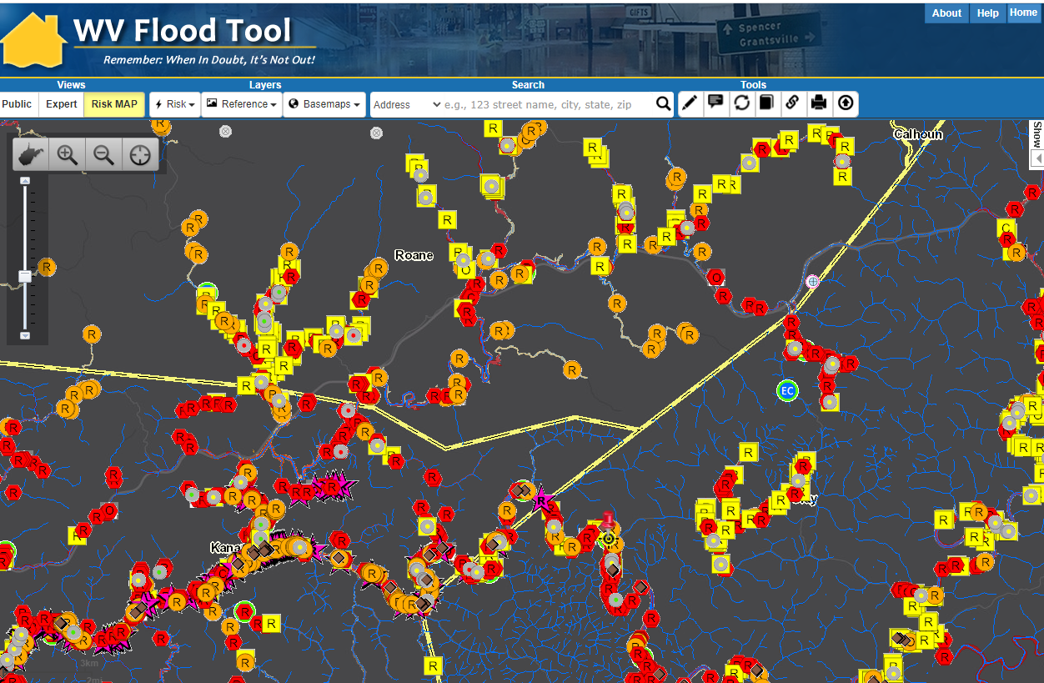
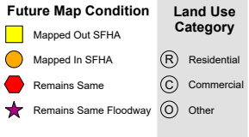
Regions 3 & 5 Flood Risk Assessment
Regions 3 & 5 Vulnerability Risk Assessment
Kurt Donaldson, WVU
2/8/2022

Slide 2
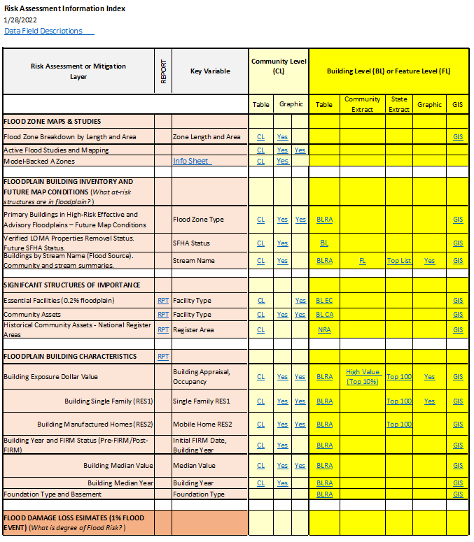
Access Risk Assessment Info
Use the Risk Information Index to access Data and Products
Building Level Risk Assessment (BLRA) Products
GIS Files
Tables (Excel)
Community Level (CL)
Building (or Feature) Level (BL) with links to online maps
Table Extracts
Top Lists
Maps
Interactive Web Maps
Graphics and Maps
Reports (Word Docs)
3D Flood Visualizations
Most of the risk assessment data can be viewed on the RiskMAP View of the WV Flood Tool

Slide 3
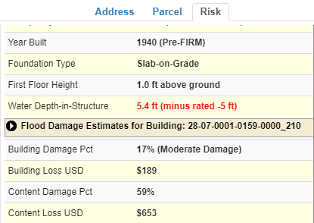
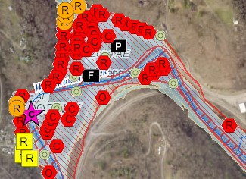
WV Building-Level Flood Risk Assessment
BUILDING INVENTORY
Primary Building Identification & Hazus Attributes Essential Facilities & Community Assets
FLOOD LOSS MODELS Open Hazus FAST
Flood Depths Building Damage Estimates
COMMUNITY ENGAGEMENT
Risk Assessment Data Verification
Mitigation Actions Identified
BLDG. LEVEL RISK ASSESSMENT (BLRA) DATABASE
Building Level & Community Level Outputs
Building-Level Flood Risk Assessments support:
Hazard Mitigation Plans
Floodplain Management
Community Assisted Visits
Community Rating System
BLRA Cycle and Methodology
1
Benefits
More detailed and accurate assessments
Automated scripts generate outputs quickly
Cost savings through efficiencies
Helps multiple stakeholders
Comprehensive Building Risk Spatial Database
4
Building-Level Risk Assessment (BLRA) Cycle
2
3
Methodology
Consistent methodology statewide
Semi-automated workflows
Continuous cycle to improve and update assessments
Tabular Output
Map Output
Published to WV Flood Tool

Slide 4
WV 268 Flood-Prone Communities
Region 4 has 26 Flood-Prone Communities in the National Flood Insurance Program
11 Regional Planning & Development Councils (55 Counties)
Region | # Counties | # Communities | Split Communities across County Boundary | Communities not participating in NFIP or no SFHA | # NFIP Communities¹
Region 1² | 6 | 32 |  | Athens, Union | 30
Region 2 | 6 | 31 | Huntington |  | 31
Region 3 | 4 | 29 | Nitro |  | 29
Region 4 | 5 | 31 | Alderson, Montgomery, Smithers | Fayetteville³, Hillsboro, Lewisburg, Quinwood³, Thurmond | 26
Region 5 | 8 | 30 | Paden City | North Hills | 29
Region 6 | 6 | 45 |  | Brandonville, Tunnelton, White Hall | 42
Region 7 | 7 | 31 |  | Flatwoods | 30
Region 8 | 5 | 17 |  | Carpendale, Elk Garden | 15
Region 9 | 3 | 12 |  | Hedgesville | 11
Region 10 | 3 | 18 | Wheeling | Bethlehem, Clearview | 16
Region 11 | 2 | 10 | Weirton | Windsor Heights | 9
total | 55 | 286 | 8 | 18 | 268
¹ Source: FEMA's Community Status Source Book ² Region 1 dissolved community of Rhodell (Raleigh County) included in NFIP count. Town of Matoaka (Mercer County) is not included. ³ Communities include SFHA or non-regulatory floodplain
Split Communities Alderson, Montgomery and Smithers are members of Region 4
Split Community Paden City is a member of Region 5

Slide 5
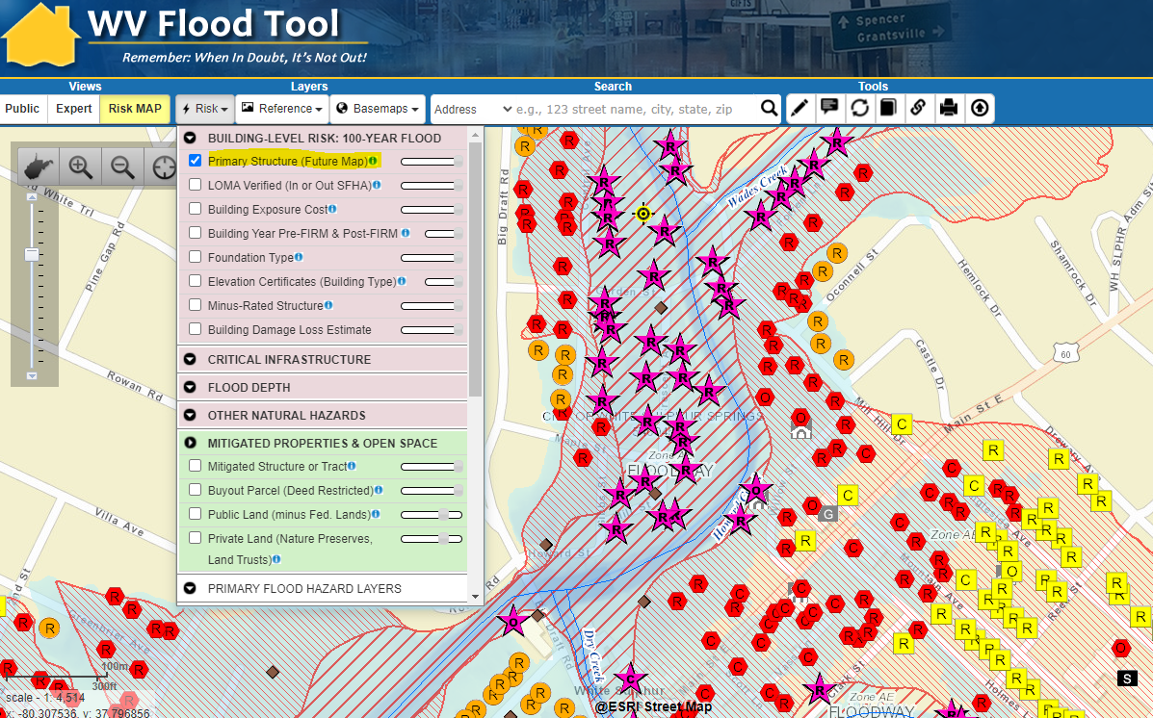
Floodplain Building-Level Risk
All Risk Assessment and Mitigation Layers are displayed on the RiskMAP View of the WV Flood Tool
High-Risk Effective & Advisory
1%-Annual-Chance (100-Yr) Floodplains

Slide 6
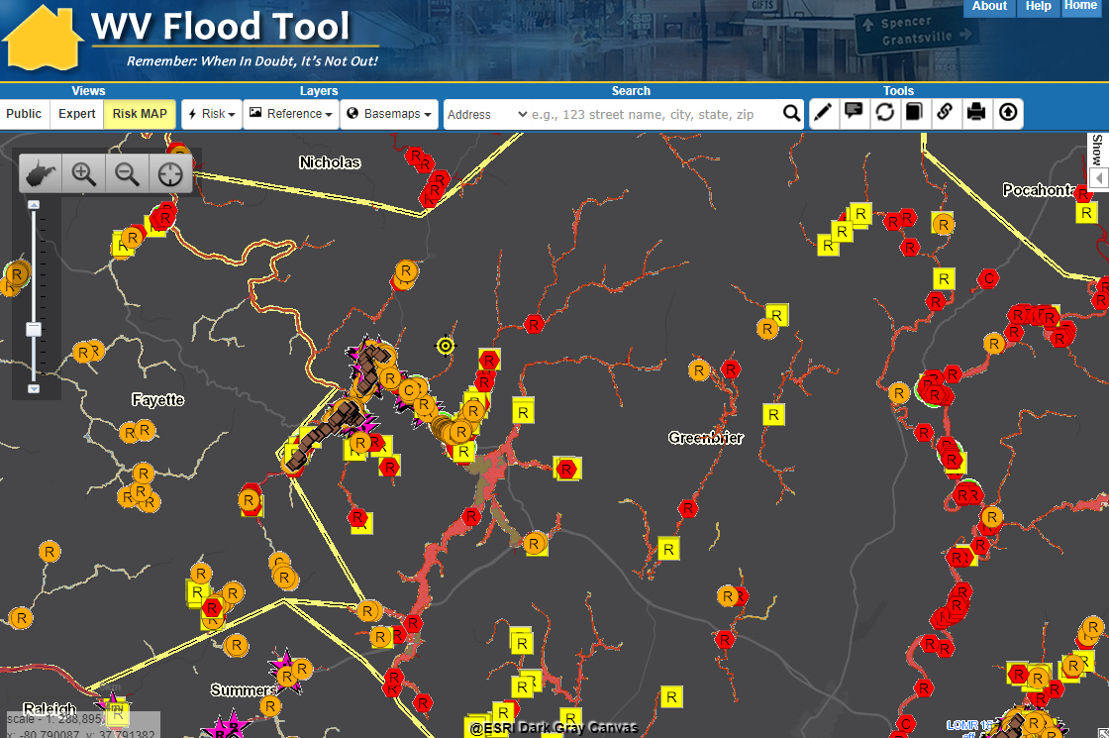
Building Future Map Conditions
Residential Structure “remains same” in SFHA
High-Risk Effective & Advisory
1%-Annual-Chance (100-Yr) Floodplains
Residential Structure “mapped out” of SFHA
Commercial Structure “mapped in” of SFHA
Future Map Conditions for structures are inventoried for counties with mapped High-Risk Advisory Floodplains

Slide 7
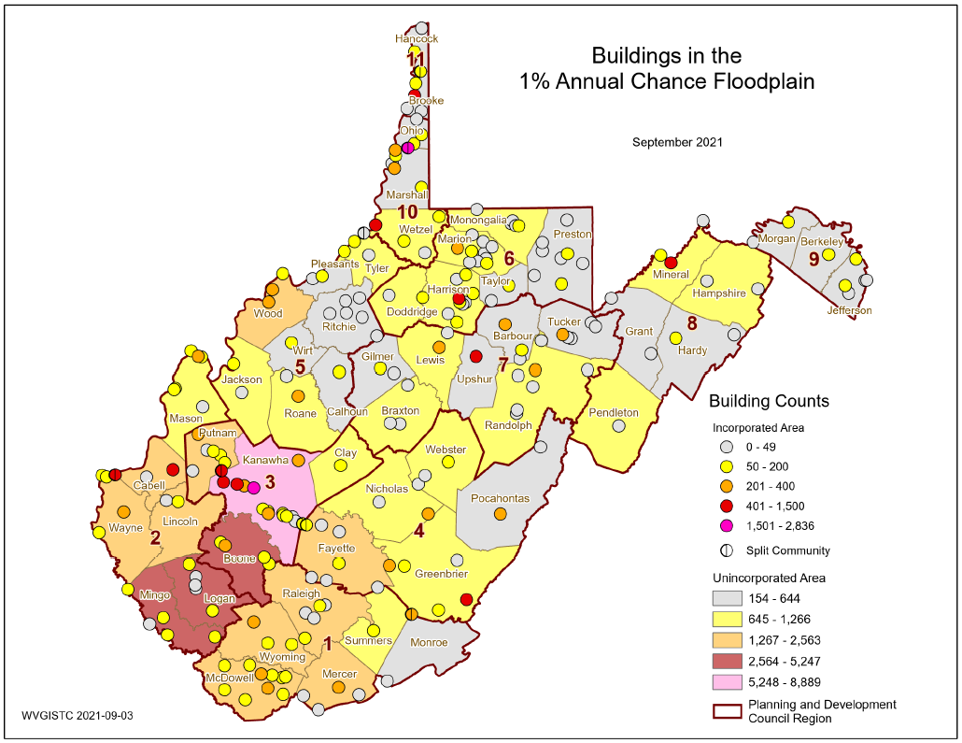
Buildings in 1% Floodplain
Community-Wide
Kanawha County (Region 3) has the most buildings in the 1% Annual Chance Floodplain
Graphic Link

Slide 8
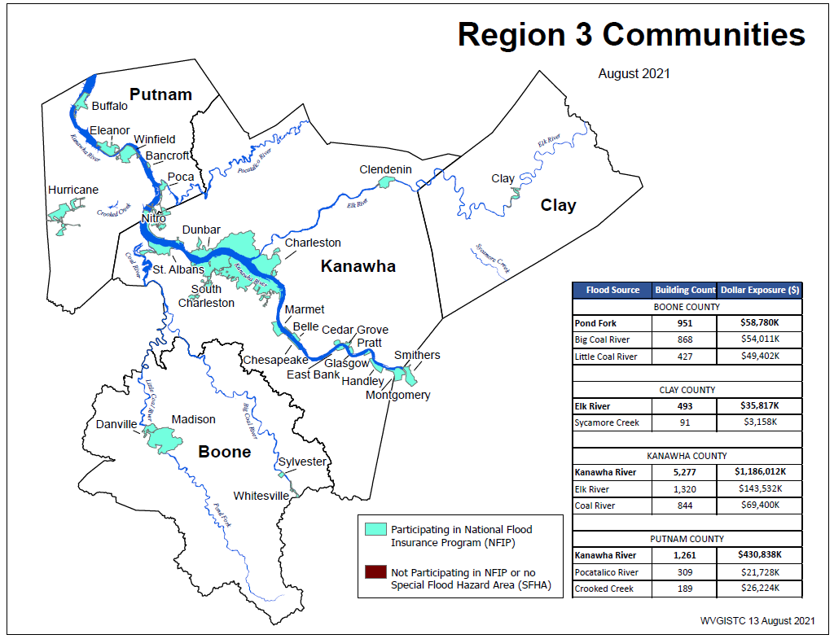
Building Risk by Flood Source
Source data and graphic
Computed for 1% (100-yr) floodplain

Slide 9
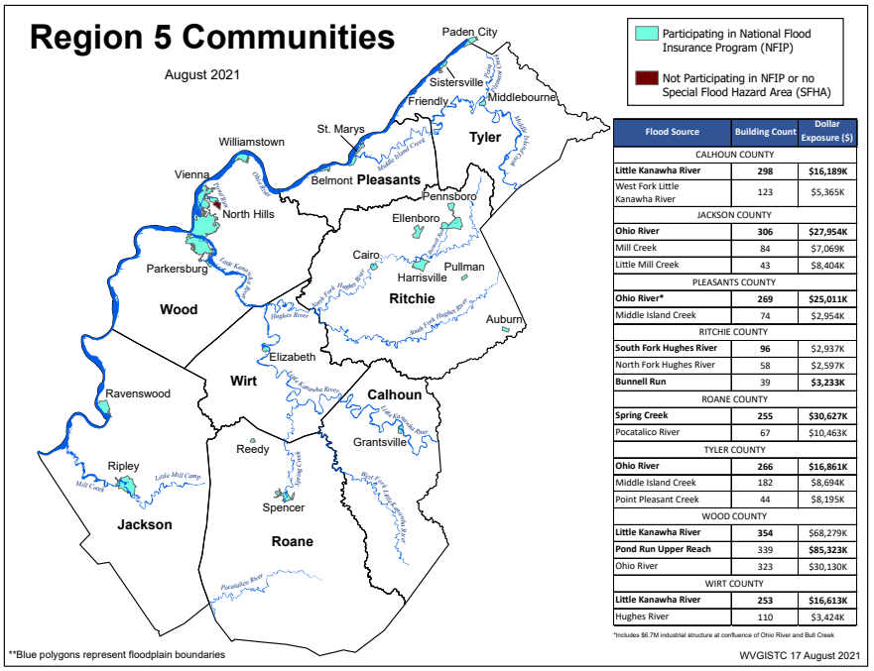
Building Risk by Flood Source
Computed for 1% (100-yr) floodplain
Source data and graphic

Slide 10
Building Risk Reports
Incorporate information from Risk Assessment Reports into local hazard mitigation planning
Regions 3 & 5 Building Types & Exposure
Regions 3 & 5 Essential Facilities Report
Regions 3 & 5 Community Assets Report

Slide 11
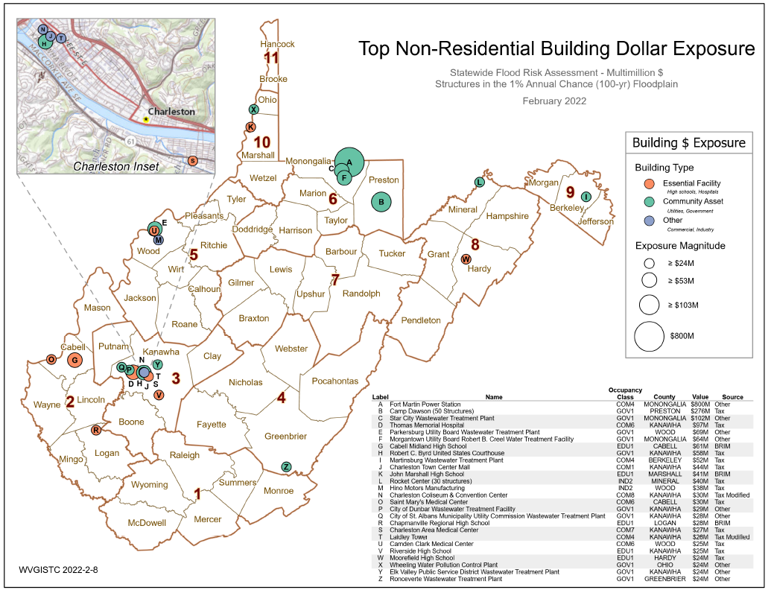
Non-Residential Building Exposure
Source Graphic

Slide 12
Building Level Risk Assessment (BLRA)
Use Building-Level (BL) Tables to identify Most Vulnerable Structures
Statewide BLRA (GIS)
BLRA County Tables organized by region
BLRA Data Extract Tables: High Building Value, High Damage Loss, High Minus Ratings
BLRA Statewide Top Lists: Building Value, Flood Depth, Damage Loss $, Damage Loss %, Minus Rated, Mitigated Structures

Slide 13
Community Level Risk Profiles
Use Community-Level (CL) Tables to supplement FEMA’s Jurisdictional Flood Risk Dashboards
Example Jurisdictional Dashboards
Refer to the Risk Matrices EXPOSURE and DAMAGE LOSS to develop community risk profiles

Slide 14
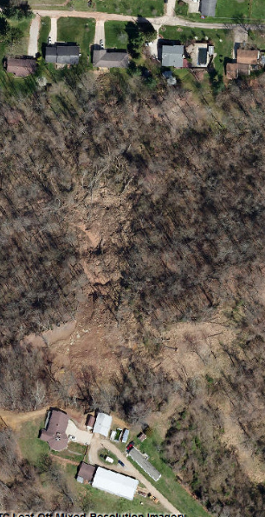
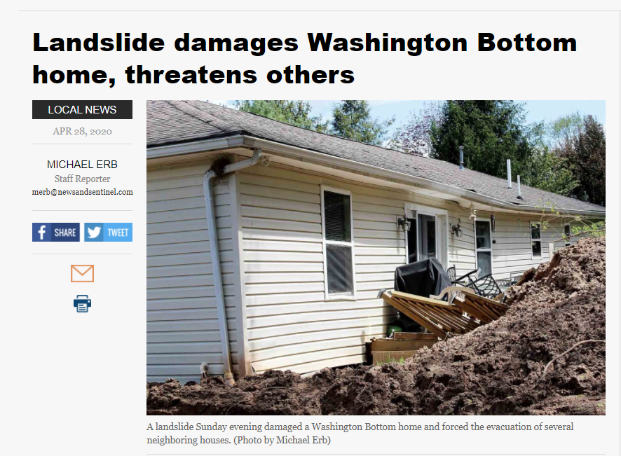
Landslide Susceptibility Maps
Landslide risk assessment REPORTS and MAPS
Impacted Home
Higher Risk
Landslide Susceptibility Zone
April 2020 Landslide
Wood County Impacted home moved from foundation
Landslide Susceptibility
Spring 2020 Aerial Imagery

Slide 15
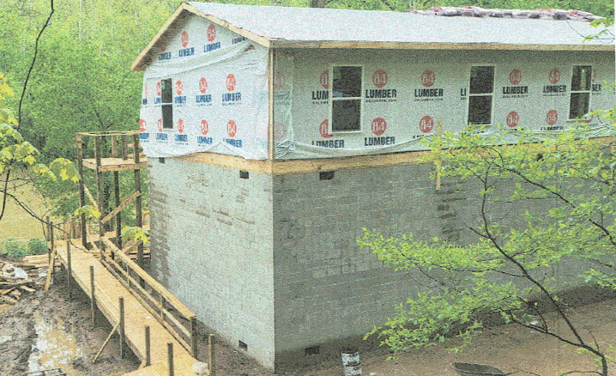
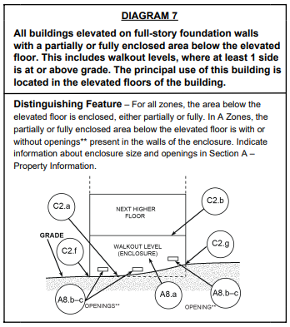
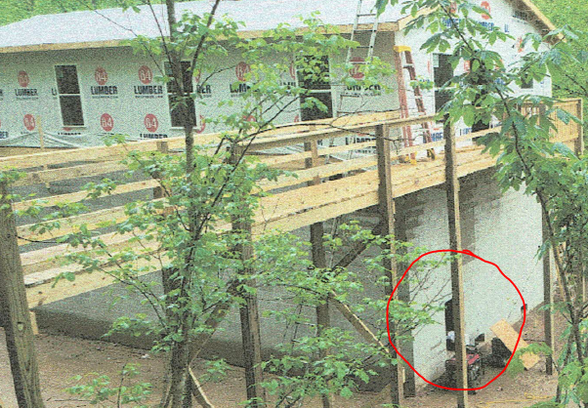
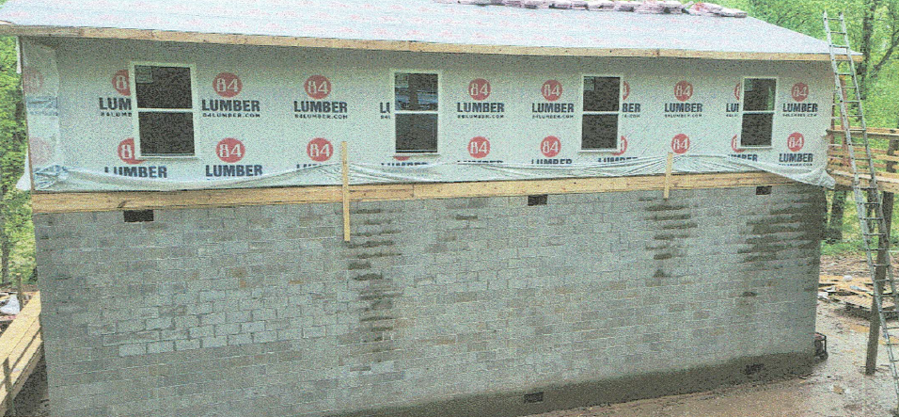
Example Mitigated Structure
Elevated Building on Solid Foundation Walls (Full-Story)
Walkout Opening
Building 08-06-0006-0058-0001 on the Elk River in Clay County
Full-Story Enclosure

Slide 16
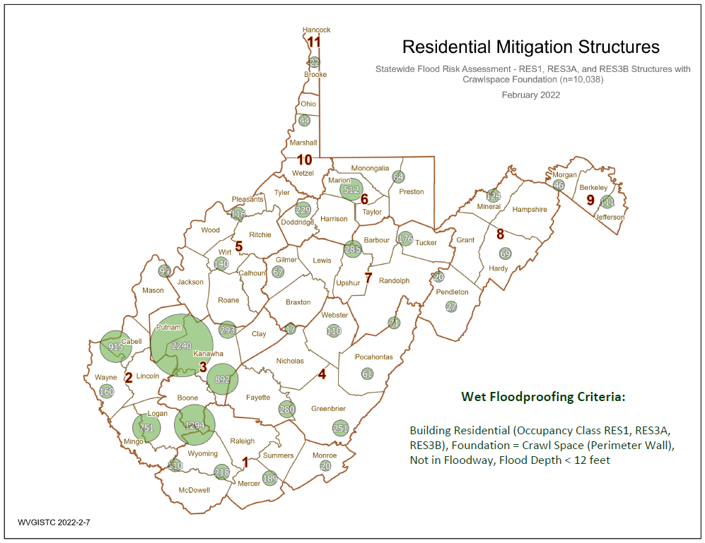
Potential Structures for Mitigation
Source Graphic

Slide 17
Areas of Mitigation (AoMI) Interest
Areas of Mitigation (AoMI) are identified by Repetitive Loss structures, Substantial Damage Model Estimates, Mitigated Properties, Flood Depths, High-Water Marks, and Similar Topography. Graphics of reference data for AoMI determinations:
Areas of Mitigation Interest (AoMI)
Repetitive Loss Structures
Buyout Properties
High Flood Depths or Water Depths-in-Structure
High-Water Marks
Building Damage $ Non-Residential |Building Damage $ Residential
Substantial Damage Estimates

