Slide 1
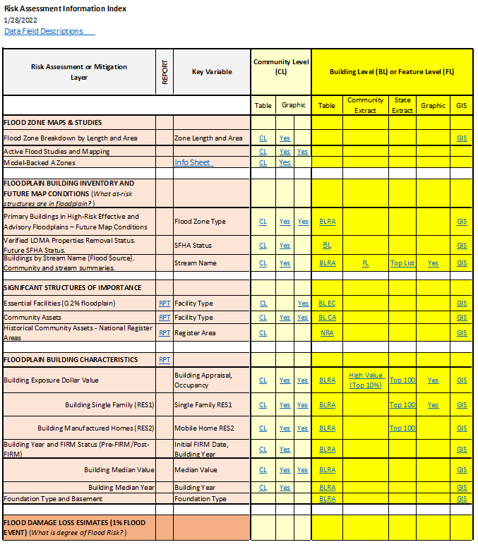
Access Risk Assessment Info
Use the Risk Information Index to access Data and Products
Building Level Risk Assessment (BLRA) Products
GIS Files
Tables (Excel)
  Community Level
  Building (and Feature) Levels with links to online maps
    Table Extracts
    Top Lists
Maps
  Interactive Web Maps
  Graphics and Maps
Reports (Word Docs)
3D Flood Visualizations
Most of the risk assessment data can be viewed on the RiskMAP View of the WV Flood Tool

Slide 2
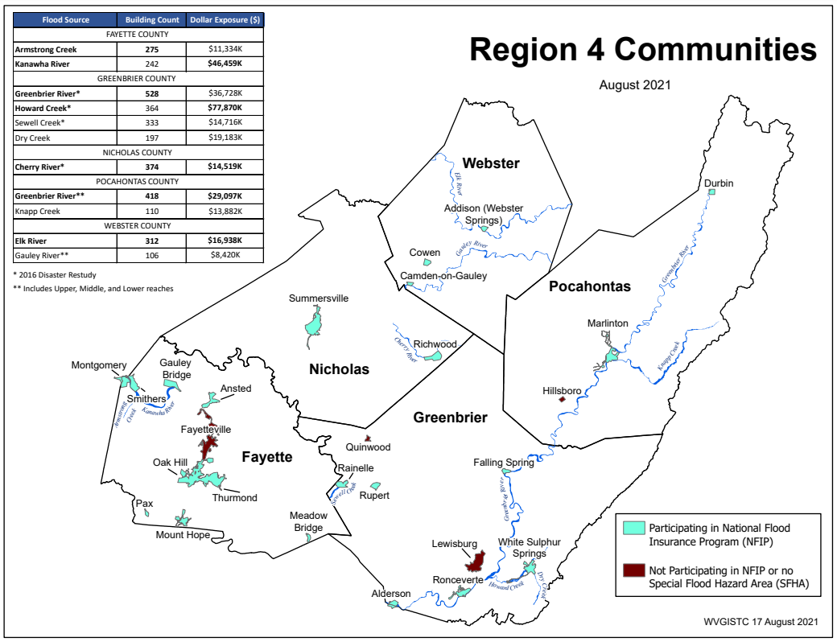
Building Risk by Flood Source
Building Counts and Building Exposure $ Values by Stream Name
Flood Sources | Building Count | Dollar Exposure ($)
FAYETTE COUNTY
Armstrong Creek | 275 | $13,334K
Kanawha River | 242 | $46,459K
GREENBRIER COUNTY
Greenbrier River* | 528 | $60,728K
Howard Creek* | 364 | $94,870K
Sewell Creek* | 333 | $14,716K
Dry Creek | 197 | $19,183K
NICHOLAS COUNTY
Cherry River* | 374 | $15,719K
POCAHONTAS COUNTY
Greenbrier River** | 418 | $29,097K
Knapp Creek | 110 | $13,882K
WEBSTER COUNTY
Elk River | 312 | $16,938K
Gauley River** | 106 | $8,420K
* 2016 Disaster Restudy
Greenbrier River totals for Greenbrier and Pocahontas counties: 946 buildings in 1% floodplain, $90M dollar exposure
Greenbrier River in Region 4 has the most structures in the 1%-annual-chance floodplain
Howard Creek in Greenbrier County has the highest building dollar exposure of all communities in Region 4
Computed for 1% (100-yr) floodplain
RA Tables: Buildings by River/Stream Name
Region 4 PDF Map Primary Flood Sources

Slide 3
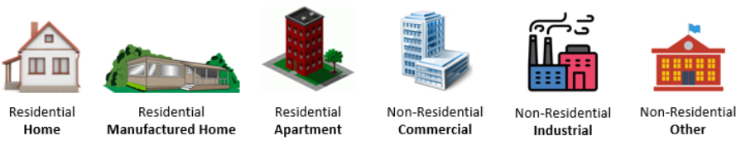


R4 Buildings Risk Reports
Incorporate information from R4 Risk Assessment Reports into local hazard mitigation planning
Region 4 Building Types & Exposure
Region 4 Essential Facilities Report
Region 4 Community Assets Report

