Slide 1
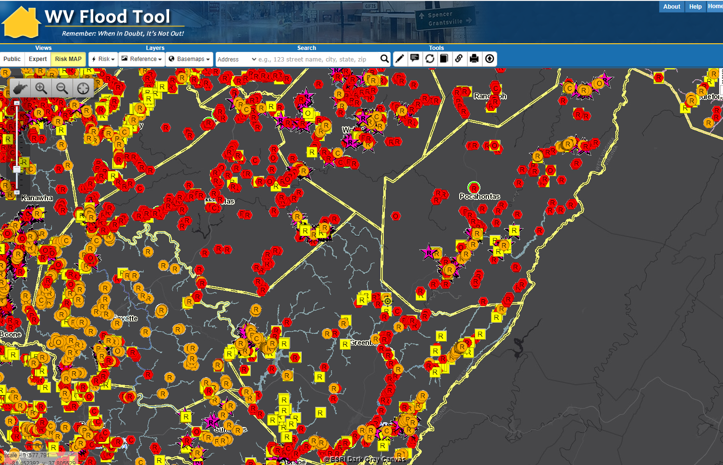
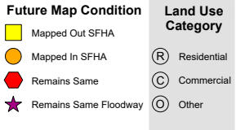
Region 4 Flood Risk Assessment
Webster
Pocahontas
Nicholas
Region 4
Vulnerability Risk Assessment
Kurt Donaldson, WVU
10/15/2021
Greenbrier
Fayette

Slide 2
Local Community Engagement
COMMUNITY ENGAGMENT & VERIFICATION
Floodplain Building Risk Inventory
Essential Facilities & Community Assets
Mitigated Structures
Buyout Properties
Areas of Mitigation Interest
Other Mitigation Activities
Local Hazard Mitigation Plan
+
Risk Assessment Data for Community Engagement, Verification, and Identifiable Mitigation Actions incorporated into Local Hazard Plans
Primary Objective: Incorporating Mitigation Actions in Local Hazard Mitigation Planning

Slide 3
Community Engagement Focus 1-2
 |  |  | Tables |  | Map | Report
Primary Focus Areas of Statewide Risk Assessment | Community Engagement | Specific Activities for Mitigation Plan | Com- munity Level (CL) | Bldg. (BL) or Feature (FL) Level | Flood Tool Risk MAP | Report | Include Answers to Questions below in Hazard Mitigation Plan
Floodplain Building Risk Inventory | Incorporate 1% Annual Chance Floodplain Building Risk Assessment Inventory into Mitigation and NFIP/CRS Management Activities | For pre-disaster planning and emergency preparedness, preload floodplain structures into FEMA’s Substantial Damage Estimator Tool |  | Yes |  |  | For each community, quantify the number and type of buildings structures at risk for a 1%-annual-chance flood event to include the degree of flood risk?
 |  | Local outreach to property owners about SFHA changes from new flood studies |  | Yes
 |  | Include Community-Level Flood Risk Assessment Profile of Built Environment into Hazard Mitigation Plan | Yes | Yes | Yes | Yes
Essential Facilities & Community Assets | Identify Mitigation Actions for Essential Facilities and Community Assets | Confirm essential facilities inventoried in high and moderate risk floodplains | Yes | Yes | Yes |  | Which essential facilities and community assets are most vulnerable to flooding? Which facilities can be mitigated?
 |  | For mitigation plan, identify a minimum of two (2) mitigation actions for essential facilities and community assets for each county | Yes | Yes | Yes | Yes
 |  | Incorporate essential facility and community assessment risk assessment tables in hazard mitigation plan
Local Community Engagement
Hazard Mitigation Plan Engagement

Slide 4
Floodplain Building Risk Assessment
Incorporate Riverine 1% Annual Chance Floodplain Building Inventory into
Mitigation and NFIP/CRS Management Activities
Include Community-Level Flood Risk Assessment Profile of Built Environment into Hazard Mitigation Plan: Incorporate into hazard mitigation plan community-level floodplain building counts, SFHA future map building conditions, building dollar exposure, building type (Residential/Non-Residential Occupancy Type, Building Year Pre/Post-FIRM), and building damage estimates (Minus Rated Structures, 1% Damage Loss Flood Models)
Preload Flood Risk Structures into FEMA’s Substantial Damage Estimator Tool: Upload building inventory data into SDE. The entire statewide flood risk inventory of 98,000 1% floodplain structures can be preloaded into FEMA’s SDE Tool.
  SDE Assessments: Install FEMA’s Substantial Damage Estimator Tool version 3.0. Preload 1% floodplain countywide residential/non-residential structures into FEMA’s damage estimator software. Communities are eligible for CRS credit for preloaded structures in SDE. https://www.fema.gov/emergency-managers/risk-management/building-science/substantial-damage-estimator-tool
  As part of pre-disaster planning and emergency readiness, each county should perform a residential and non-residential substantial damage assessment for potential high damage loss structures. Submit damage estimates and feedback for mitigation plan and maintenance.
  Flood Map Restudy (if applicable). Prepare community outreach communications for flood restudies (mapped into SFHA, mapped out of SFHA). Restudied areas require updating floodplain management ordinance and an opportunity to review state model ordinance and incorporate higher standards.

Slide 5
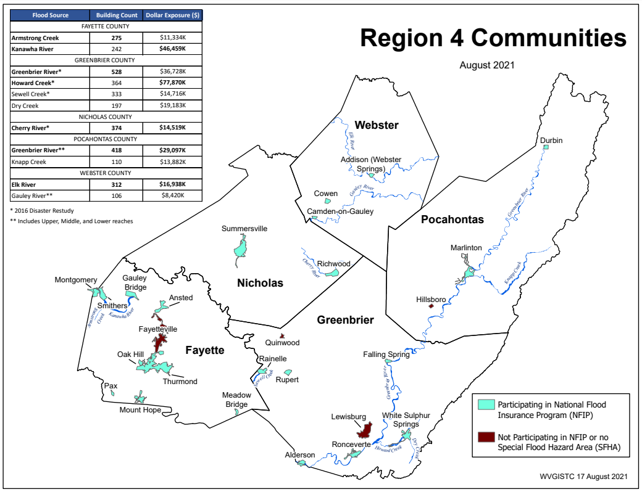
Floodplain Building Risk (Region 4)
Building Counts and Building Exposure $ Values by Stream Name
Flood Sources | Building Count | Dollar Exposure ($)
FAYETTE COUNTY
Armstrong Creek | 275 | $13,334K
Kanawha River | 242 | $46,459K
GREENBRIER COUNTY
Greenbrier River* | 528 | $60,728K
Howard Creek* | 364 | $94,870K
Sewell Creek* | 333 | $14,716K
Dry Creek | 197 | $19,183K
NICHOLAS COUNTY
Cherry River* | 374 | $15,719K
POCAHONTAS COUNTY
Greenbrier River** | 418 | $29,097K
Knapp Creek | 110 | $13,882K
WEBSTER COUNTY
Elk River | 312 | $16,938K
Gauley River** | 106 | $8,420K
* 2016 Disaster Restudy
Greenbrier River totals for Greenbrier and Pocahontas counties: 946 buildings in 1% floodplain, $66M dollar exposure
Computed for 1% (100-yr) floodplain
RA Tables: State Top Streams Overview | Region 4
Region 4 PDF Map of Primary Flood Sources

Slide 6
268 Flood-Prone Communities
11 Regional Planning & Development Councils (55 Counties)
Region | # Counties | # Communities | Split Communities across County Boundary | Communities not participating in NFIP or no SFHA | # NFIP Communities¹
Region 1² | 6 | 32 |  | Athens, Union | 30
Region 2 | 6 | 31 | Huntington |  | 31
Region 3 | 4 | 29 | Nitro |  | 29
Region 4 | 5 | 31 | Alderson, Montgomery, Smithers | Fayetteville³, Hillsboro, Lewisburg, Quinwood³, Thurmond | 26
Region 5 | 8 | 30 | Paden City | North Hills | 29
Region 6 | 6 | 45 |  | Brandonville, Tunnelton, White Hall | 42
Region 7 | 7 | 31 |  | Flatwoods | 30
Region 8 | 5 | 17 |  | Carpendale, Elk Garden | 15
Region 9 | 3 | 12 |  | Hedgesville | 11
Region 10 | 3 | 18 | Wheeling | Bethlehem, Clearview | 16
Region 11 | 2 | 10 | Weirton | Windsor Heights | 9
total | 55 | 286 | 8 | 18 | 268
¹ Source: FEMA's Community Status Source Book ² Region 1 dissolved community of Rhodell (Raleigh County) included in NFIP count. Town of Matoaka (Mercer County) is not included. ³ Communities include SFHA or non-regulatory floodplain
Split Communities Alderson, Montgomery and Smithers are members of Region 4
Split Community Paden City is a member of Region 5

Slide 7
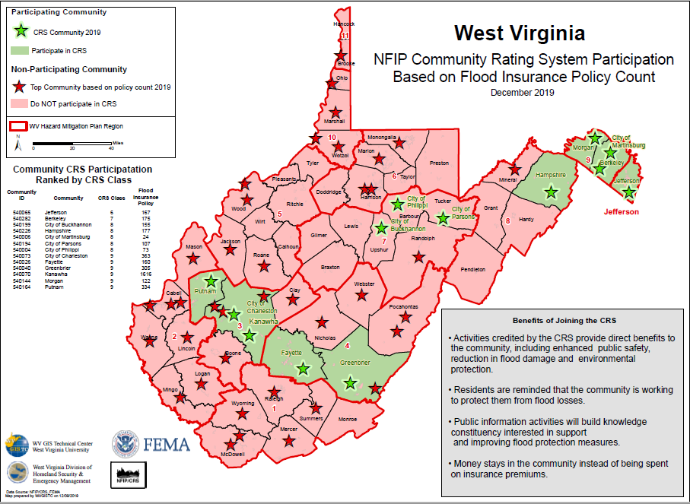
CRS: Fayette & Greenbrier Counties

Slide 8
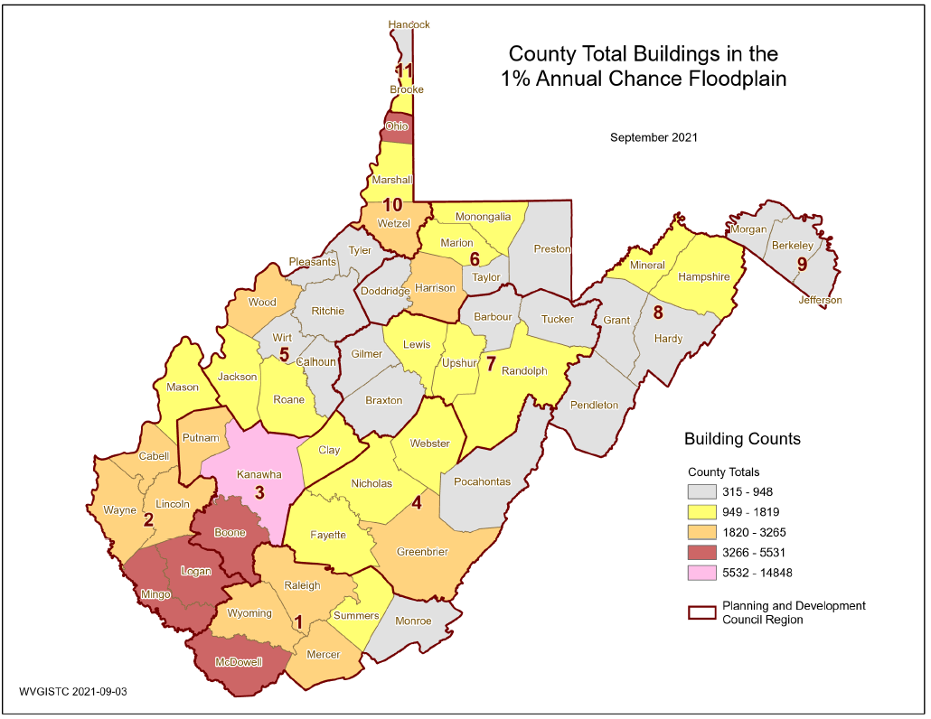
Buildings in 1% Floodplain
County-Wide
1,074
1,056
948
1,819
2,225

Slide 9
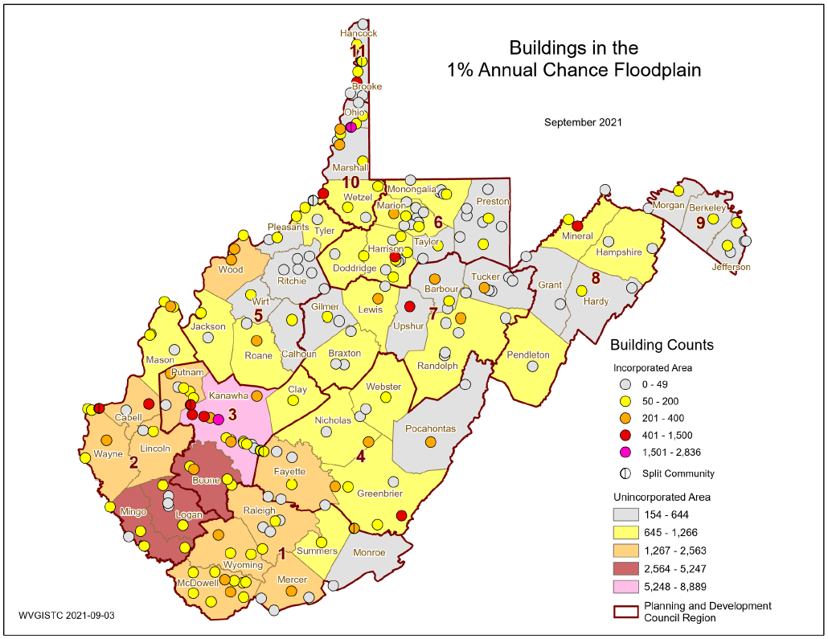
Buildings in 1% Floodplain
Community-Wide

Slide 10
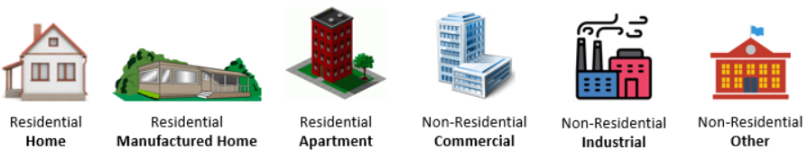
Residential versus Non-Residential
Community | RESIDENTIAL |  |  |  | COMMERCIAL NON-RESIDENTIAL |  | OTHER NON-RESIDENTIAL |  | TOTAL BUILDING VALUE
Community Name | # | % Count | Value ($) | % Value | # | Value ($) | # | Value ($) | # | Value ($) | Rank¹
Ansted | 1 | 100.0% | $66K | 100.0% | 0 | $0K | 0 | $0K | 1 | $66K | 18
Fayette County* | 1425 | 93.2% | $50,385K | 75.7% | 57 | $6,523K | 47 | $9,666K | 1529 | $66,575K | 2
Gauley Bridge | 21 | 46.7% | $869K | 27.4% | 24 | $2,302K | 0 | $0K | 45 | $3,171K | 10
Meadow Bridge | 21 | 91.3% | $695K | 96.8% | 2 | $23K | 0 | $0K | 23 | $718K | 15
Montgomery** | 13 | 86.7% | $1,083K | 25.2% | 1 | $1,000K | 1 | $2,215K | 15 | $4,298K
Mount Hope | 32 | 84.2% | $787K | 65.1% | 4 | $101K | 2 | $322K | 38 | $1,210K | 13
Oak Hill | 50 | 90.9% | $2,262K | 95.3% | 5 | $111K | 0 | $0K | 55 | $2,373K | 11
Pax | 32 | 82.1% | $925K | 67.9% | 3 | $98K | 4 | $340K | 39 | $1,362K | 12
Smithers** | 63 | 85.1% | $2,064K | 55.8% | 8 | $837K | 3 | $796K | 74 | $3,698K
FAYETTE | 1658 | 91.1% | $59,136K | 70.8% | 104 | $10,994K | 57 | $13,338K | 1819 | $83,469K | 2
Alderson** | 121 | 84.6% | $6,485K | 56.7% | 17 | $1,028K | 5 | $3,931K | 143 | $11,443K
Falling Springs | 3 | 100.0% | $157K | 100.0% | 0 | $0K | 0 | $0K | 3 | $157K | 17
Greenbrier County* | 1101 | 93.1% | $103,297K | 88.8% | 68 | $6,511K | 13 | $6,523K | 1182 | $116,332K | 1
Rainelle | 253 | 74.4% | $8,392K | 55.4% | 78 | $5,751K | 9 | $1,006K | 340 | $15,149K | 3
Ronceverte | 34 | 50.7% | $1,354K | 20.5% | 32 | $4,436K | 1 | $825K | 67 | $6,616K | 6
Rupert | 58 | 93.5% | $2,321K | 73.2% | 2 | $291K | 2 | $561K | 62 | $3,173K | 9
White Sulphur Springs | 375 | 87.6% | $18,910K | 54.0% | 42 | $5,144K | 11 | $10,940K | 428 | $34,994K | 1
GREENBRIER | 1945 | 87.4% | $140,916K | 75.0% | 239 | $23,161K | 41 | $23,786K | 2225 | $187,863K | 1
Nicholas County* | 624 | 90.2% | $21,060K | 68.1% | 42 | $6,646K | 26 | $3,230K | 692 | $30,936K | 4
Richwood | 265 | 80.5% | $7,518K | 59.1% | 47 | $1,399K | 17 | $3,804K | 329 | $12,721K | 4
Summersville | 23 | 65.7% | $1,497K | 45.9% | 11 | $1,657K | 1 | $109K | 35 | $3,263K | 8
NICHOLAS | 912 | 86.4% | $30,075K | 64.1% | 100 | $9,703K | 44 | $7,143K | 1056 | $46,920K | 5
Durbin | 23 | 85.2% | $645K | 72.4% | 2 | $157K | 2 | $89K | 27 | $891K | 14
Marlinton | 286 | 75.1% | $15,309K | 44.3% | 82 | $9,635K | 13 | $9,586K | 381 | $34,529K | 2
Pocahontas County* | 502 | 93.0% | $23,166K | 84.7% | 23 | $2,460K | 15 | $1,731K | 540 | $27,358K | 5
POCAHONTAS | 811 | 85.5% | $39,120K | 62.3% | 107 | $12,252K | 30 | $11,406K | 948 | $62,779K | 3
Addison | 107 | 84.9% | $3,855K | 32.7% | 15 | $3,053K | 4 | $4,892K | 126 | $11,799K | 5
Camden-On-Gauley | 13 | 61.9% | $263K | 45.9% | 4 | $32K | 4 | $279K | 21 | $573K | 16
Cowen | 28 | 80.0% | $814K | 15.4% | 4 | $92K | 3 | $4,375K | 35 | $5,281K | 7
Webster County* | 839 | 94.1% | $25,759K | 59.3% | 27 | $2,685K | 26 | $14,976K | 892 | $43,419K | 3
WEBSTER | 987 | 91.9% | $30,690K | 50.3% | 50 | $5,861K | 37 | $24,521K | 1074 | $61,072K | 4
SUMMARY | 6,313 | 88.5% | $299,937K | 64.5% | 600 | $61,971K | 209 | $80,194K | 7,122 | $442,103K

Slide 11
Single Family Dwellings
Community |  | SINGLE FAMILY HOME |  | MANUFACTURED (MOBILE) HOME |  |  | SINGLE FAMILY TOTAL
Community Name | County | Count | Value ($) | Count | % Count | Value ($) | Count | Value ($) | Group Rank¹
Ansted | FAYETTE | 1 | $66K | 0 | 0.0% | $0K | 1 | $66K | 18
Fayette County* | FAYETTE | 1165 | $44,640K | 239 | 17.0% | $4,131K | 1404 | $48,771K | 2
Gauley Bridge | FAYETTE | 17 | $619K | 1 | 5.6% | $10K | 18 | $629K | 15
Meadow Bridge | FAYETTE | 13 | $551K | 7 | 35.0% | $113K | 20 | $664K | 13
Montgomery** | FAYETTE | 11 | $931K | 1 | 8.3% | $15K | 12 | $945K | 3
Mount Hope | FAYETTE | 31 | $771K | 1 | 3.1% | $16K | 32 | $787K | 12
Oak Hill | FAYETTE | 47 | $2,173K | 2 | 4.1% | $39K | 49 | $2,212K | 7
Pax | FAYETTE | 28 | $827K | 4 | 12.5% | $97K | 32 | $925K | 10
Smithers** | FAYETTE | 54 | $1,802K | 6 | 10.0% | $77K | 60 | $1,879K | 2
 | FAYETTE | 1367 | $52,379K | 261 | 16.0% | $4,499K | 1628 | $56,877K | 2
Alderson** | GREENBRIER | 107 | $5,786K | 10 | 8.5% | $248K | 117 | $6,034K | 1
Falling Springs | GREENBRIER | 2 | $137K | 1 | 33.3% | $20K | 3 | $157K | 17
Greenbrier County* | GREENBRIER | 822 | $96,262K | 264 | 24.3% | $6,626K | 1086 | $102,888K | 1
Rainelle | GREENBRIER | 229 | $7,621K | 16 | 6.5% | $579K | 245 | $8,200K | 3
Ronceverte | GREENBRIER | 29 | $1,138K | 0 | 0.0% | $0K | 29 | $1,138K | 9
Rupert | GREENBRIER | 45 | $1,974K | 11 | 19.6% | $329K | 56 | $2,302K | 6
White Sulphur Springs | GREENBRIER | 338 | $15,856K | 4 | 1.2% | $125K | 342 | $15,981K | 1
 | GREENBRIER | 1572 | $128,774K | 306 | 16.3% | $7,926K | 1878 | $136,699K | 1
Nicholas County* | NICHOLAS | 455 | $17,833K | 165 | 26.6% | $2,939K | 620 | $20,772K | 5
Richwood | NICHOLAS | 217 | $6,725K | 42 | 16.2% | $630K | 259 | $7,356K | 4
Summersville | NICHOLAS | 19 | $1,423K | 3 | 13.6% | $55K | 22 | $1,478K | 8
 | NICHOLAS | 691 | $25,981K | 210 | 23.3% | $3,624K | 901 | $29,605K | 5
Durbin | POCAHONTAS | 15 | $499K | 7 | 31.8% | $130K | 22 | $629K | 14
Marlinton | POCAHONTAS | 244 | $8,263K | 22 | 8.3% | $354K | 266 | $8,617K | 2
Pocahontas County* | POCAHONTAS | 400 | $21,017K | 90 | 18.4% | $1,504K | 490 | $22,521K | 4
 | POCAHONTAS | 659 | $29,779K | 119 | 15.3% | $1,988K | 778 | $31,767K | 3
Addison | WEBSTER | 95 | $3,434K | 11 | 10.4% | $211K | 106 | $3,645K | 5
Camden-On-Gauley | WEBSTER | 9 | $171K | 4 | 30.8% | $92K | 13 | $263K | 16
Cowen | WEBSTER | 13 | $423K | 15 | 53.6% | $391K | 28 | $814K | 11
Webster County* | WEBSTER | 598 | $20,815K | 238 | 28.5% | $4,885K | 836 | $25,700K | 3
 | WEBSTER | 715 | $24,842K | 268 | 27.3% | $5,580K | 983 | $30,422K | 4
SUMMARY |  | 5,004 | $261,756K | 1,164 | 19.6% | $23,616K | 6,168 | $285,371K

Slide 12
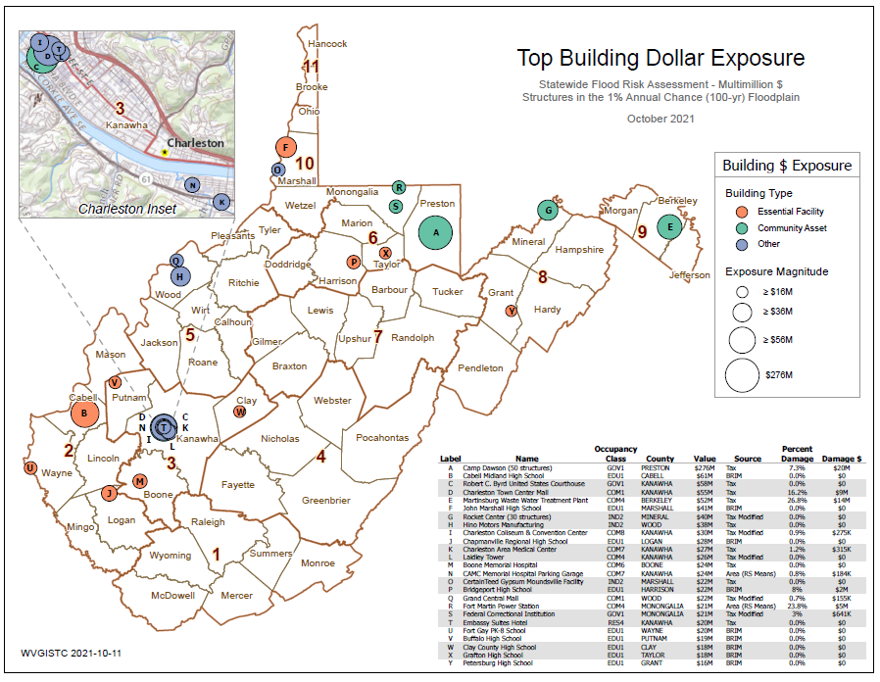
Top Building Dollar $ Exposure

Slide 13
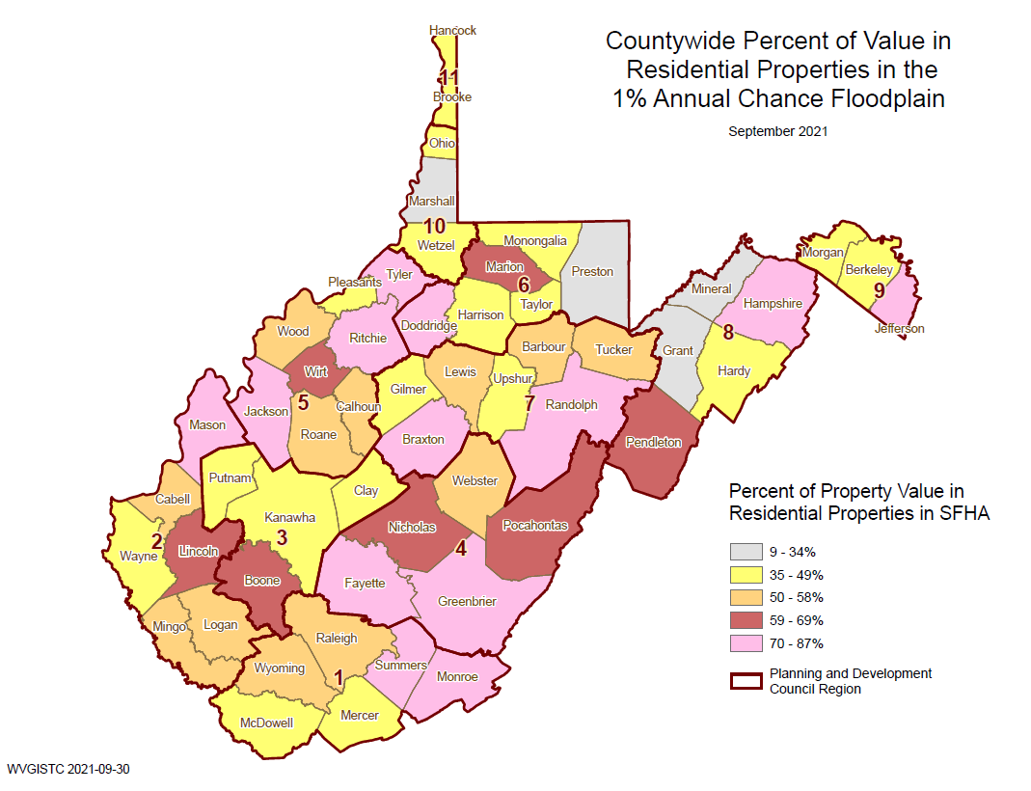
Residential Building Value %
Building Stock Value mostly RESIDENTIAL
Top NON-RESIDENTIAL Bldg. Value:
Marlinton ($25M)
White Sulphur Springs ($17M)
Webster Springs ($8M)
Rainelle ($7M)
Alderson ($6M)
Ronceverte($5M)
Richwood ($5M)
53%
64%
62%
71%
75%

Slide 14
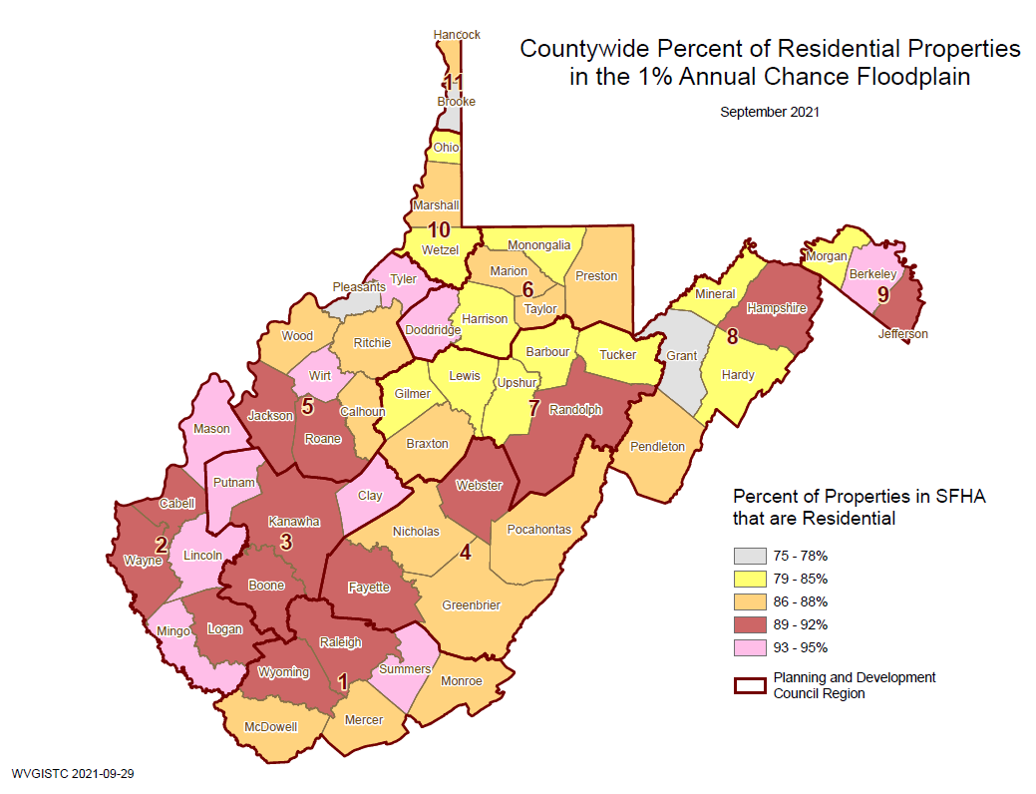
Residential Property Value %
Building Stock Value mostly RESIDENTIAL
Top NON-RESIDENTIAL Bldg. %:
Gauley Bridge (53% Non-Residential)
Ronceverte(49%)
Camden-on-Gauley (38%)
Summersville (34%)
Marlinton(25%)
92%
87%
86%
91%
87%

Slide 15
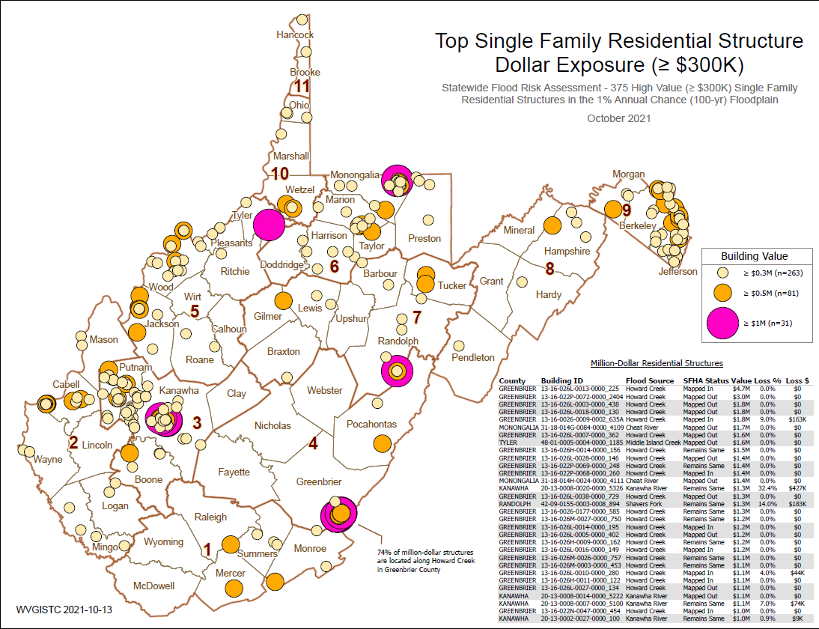
Top Single Family Dwelling $ Exposure
74% of million-dollar structures in State are located along Howard Creek in Greenbrier County

Slide 16
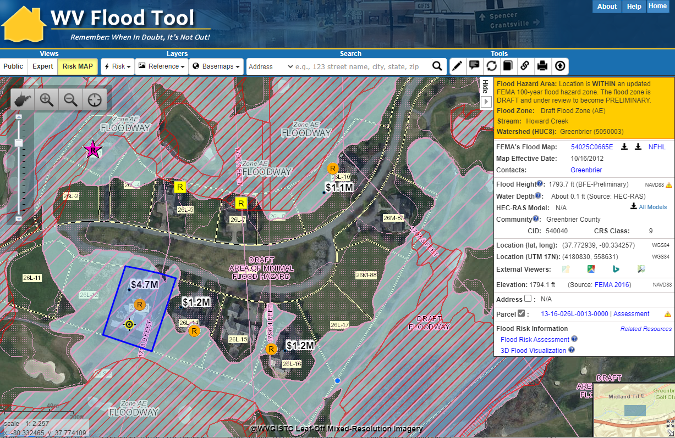
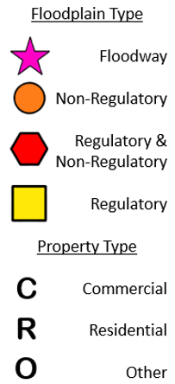
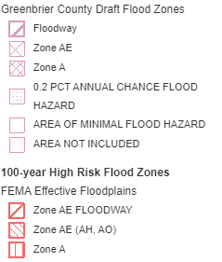
Building $ Exposure – Map Verification
Four Homes along Howard Creek with Total Building Value of $8.2 million mapped into new Draft Floodplain
White Sulphur Springs
Mapped-In Draft Floodplain (Future SFHA)
https://www.mapwv.gov/flood/map/?wkid=102100&x=-8942775&y=4547402&l=11&v=2

Slide 17
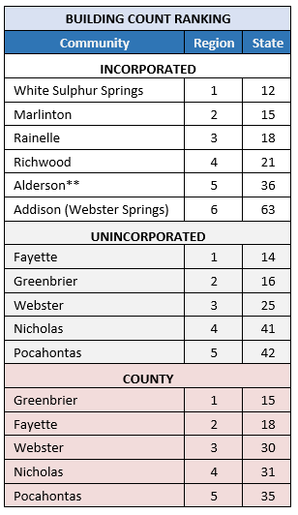
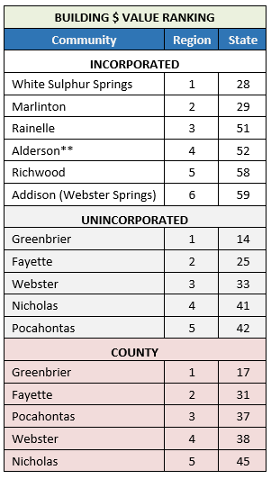
Building Counts & Value ($)
** Split Community
Source: Region 4 Community-Level Building Exposure Table
Highest number of primary structures in the 1% floodplain:
White Sulphur Springs (incorporated)
Fayette County Unincorporated (unincorporated area)
Greenbrier County (countywide)
Highest building dollar exposure in the 1% floodplain:
White Sulphur Springs (incorporated)
Greenbrier County Unincorporated (unincorporated)
Greenbrier County (countywide)

Slide 18
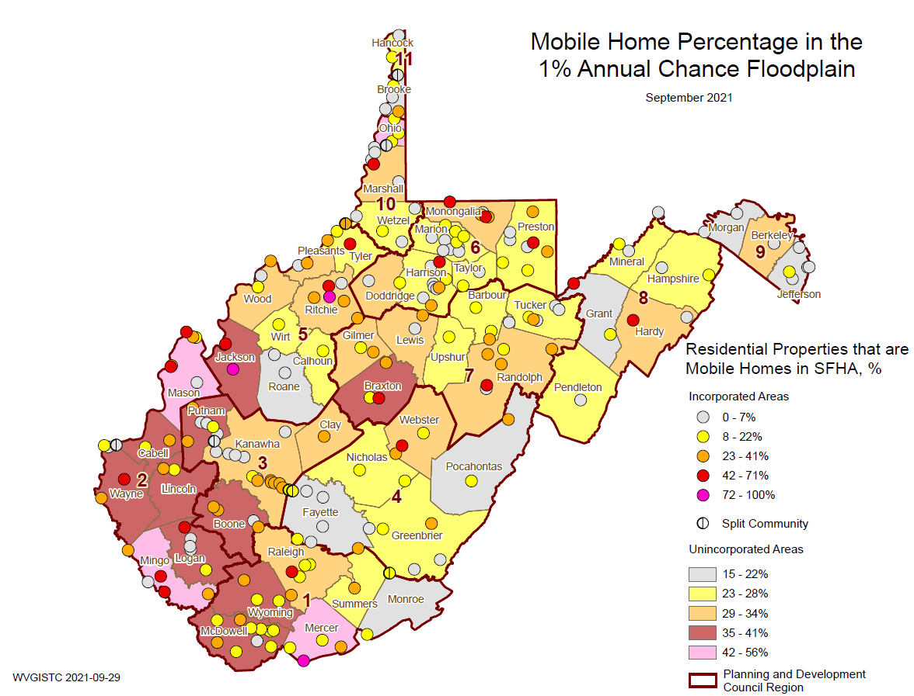
Mobile Home %
Webster County
Cowen (54%)
Camden-On-Gauley (31%)
Webster Unincorporated (29%)
Manufactured homes are of lightweight construction and more vulnerable to flood damage

Slide 19
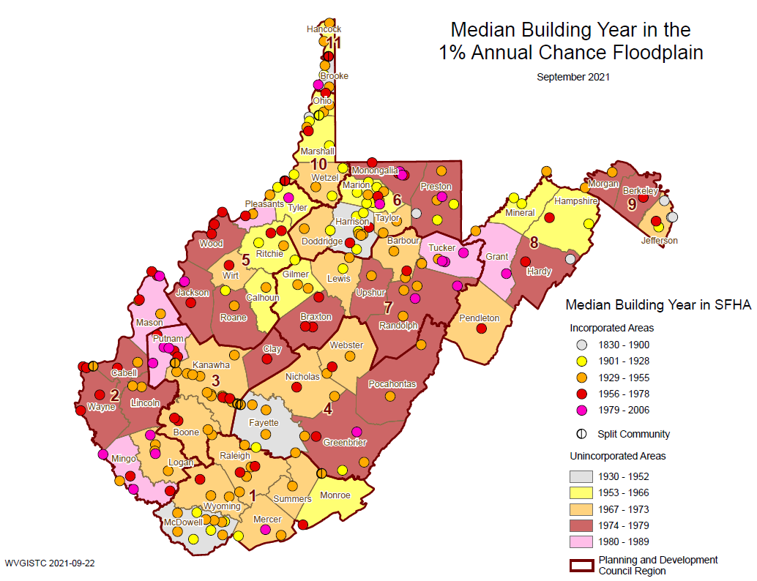
Median Bldg. Year – 1% Floodplain
The towns of Mount Hope and Ronceverte are two of the oldest communities in the region with building year median values of 1920

Slide 20
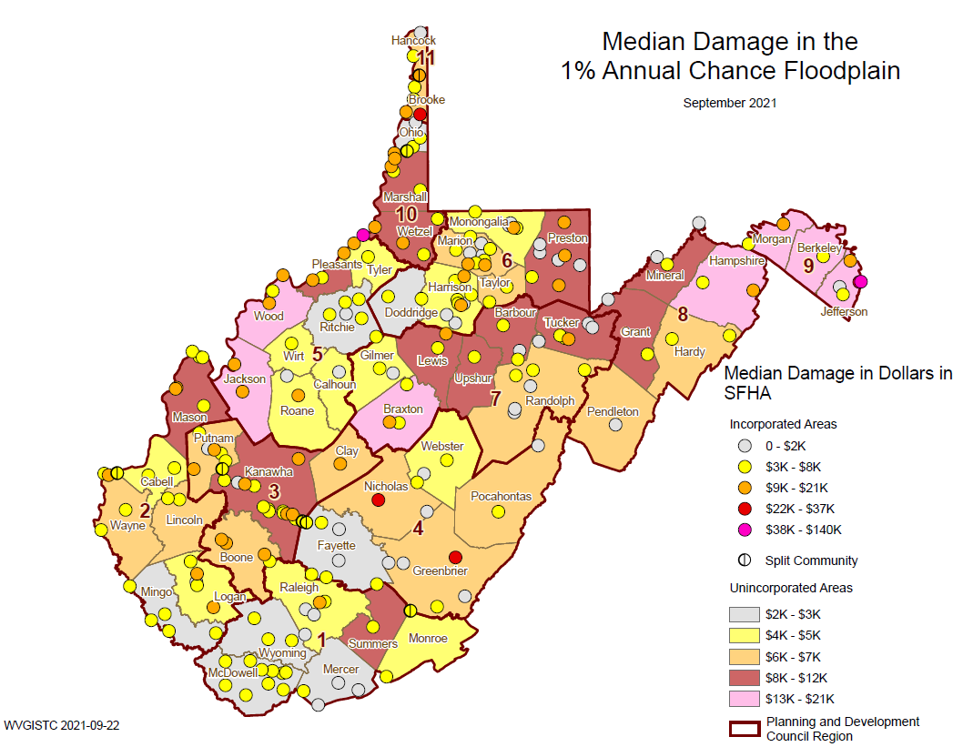
Median Building Damage %
Region 4 Communities
Camden-On-Gauley (27%)
Nicholas Unincorporated (23%)
Summersville (22%)
Greenbrier Unincorporated (18%)
Pocahontas Unincorporated (17%)
Pax (16%)
Marlinton (15%)
Webster Unincorporated (15%)
Alderson (14%)
Mount Hope (13%)

Slide 21
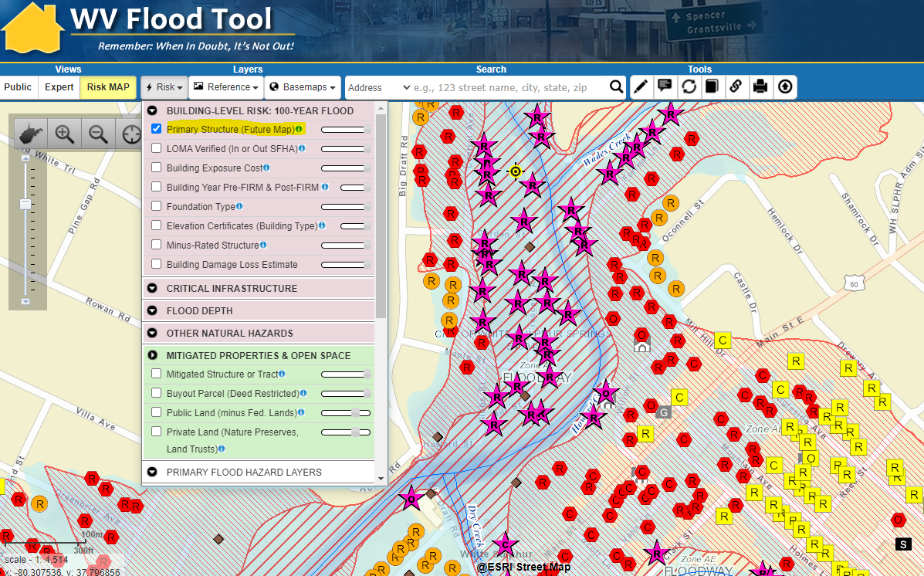
Floodplain Building-Level Risk
High-Risk Effective & Advisory
1%-Annual-Chance (100-Yr) Floodplains

Slide 22
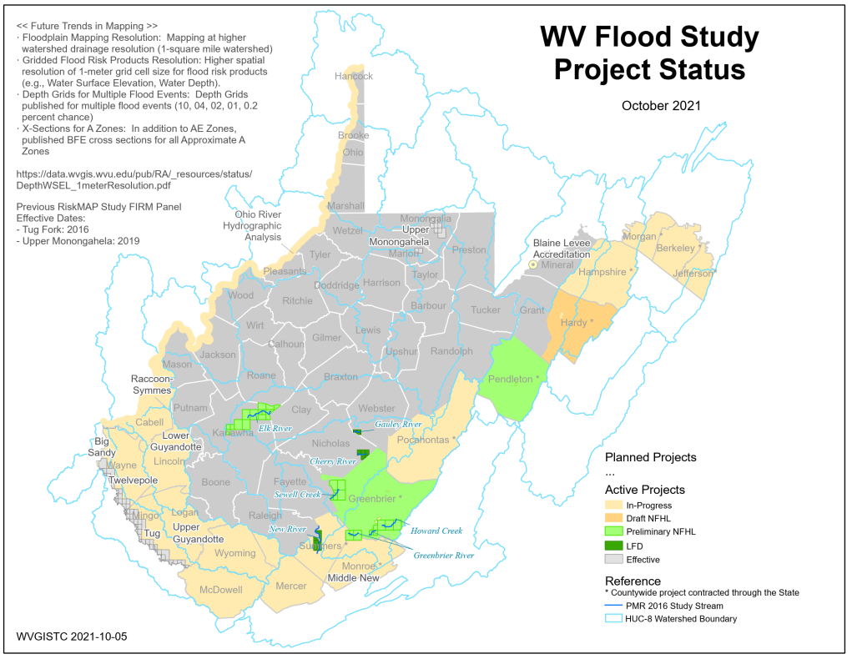
Active Flood Studies
Flood Study Project Status Map PDF

Slide 23
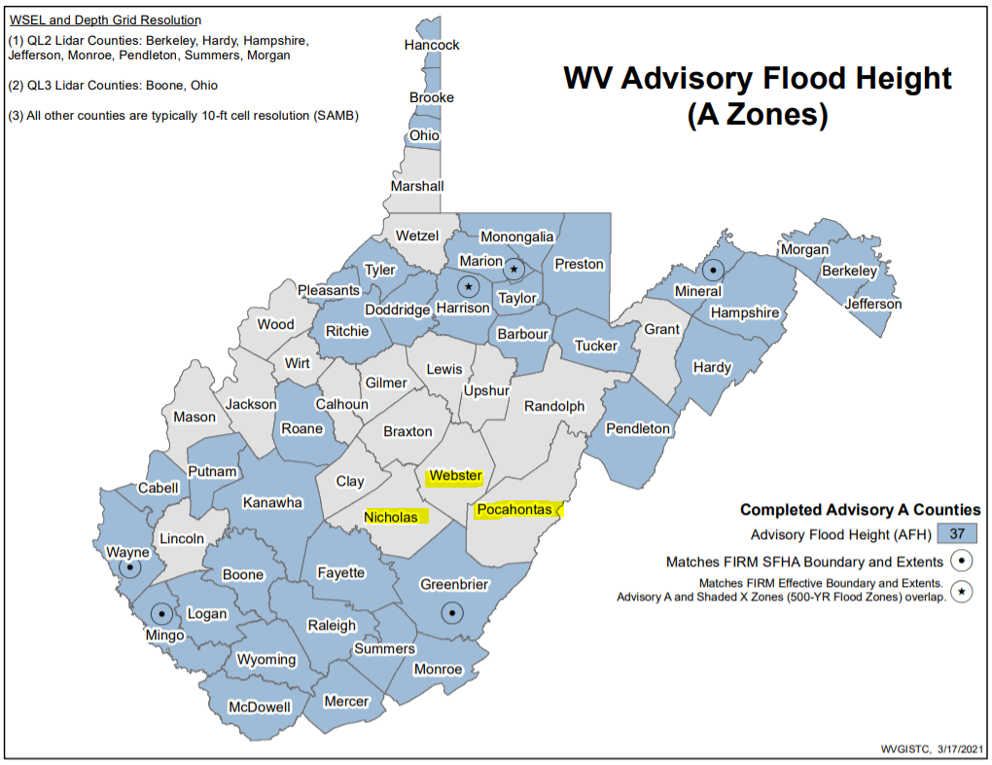
A Zone 1% Depth Grids
No Model-Backed Base Flood Depth Grids exist for Nicholas, Pocahontas, and Webster Counties
Less accurate Hazus depth grid is utilized for Building Damage Loss Estimates
AFH Status Graphic
More Info

Slide 24
Future Building Map Conditions
SFHA AND FUTURE MAP CONDITIONS | Select counties have non-regulatory, advisory flood zones (orange zones on WV Flood Tool) that indicate future map conditions of the Special Flood Hazard Area (SFHA).
Floodway | Floodways cans be dangerous because water may flow very fast. Development is not allowed unless there is "no rise" in flood elevations, floodway elevations, and floodway widths are certified. Structures in floodways may require special consideration for mitigation measures.
No Change SFHA | No Change in SFHA designation where High-Risk Effective and Advisory Floodplains overlap. When future map restudies are completed and new FIRMs become effective, it is predicted that structures with this designation are neither "mapped in" nor "mapped out" of the SFHA.
Mapped In SFHA | Structures potentially "mapped-in" the SFHA according to mapped High-Risk Advisory Floodplains based on more accurate topography and model-backed A Zones. The "mapped-in" structures most likely will be included in the SFHA when future FEMA Restudies are done and new FIRMS become effective. Communities should review all "mapped-in" structures. Homeowners are at higher risk to flooding and should be contacted about Flood Insurance Preferred Risk Policies and other potential mitigation measures.
Mapped Out SFHA | Structures potentially "mapped-out" the SFHA according to mapped Advisory Floodplains and most likely will NOT be included in the SFHA when the new FIRMs become effective from future Restudies. Communities should review all "mapped-out" structures for LiDAR LOMAs. Although these structures may be mapped to a lesser flood risk designation, property owners should be encouraged to purchase Flood Insurance Preferred Risk Policies at lower premiums. Morgan County example | Berkeley County example

Slide 25
Community-Level Building Counts
Region 4 Table
Community-Level Flood Zone Breakdown

Slide 26
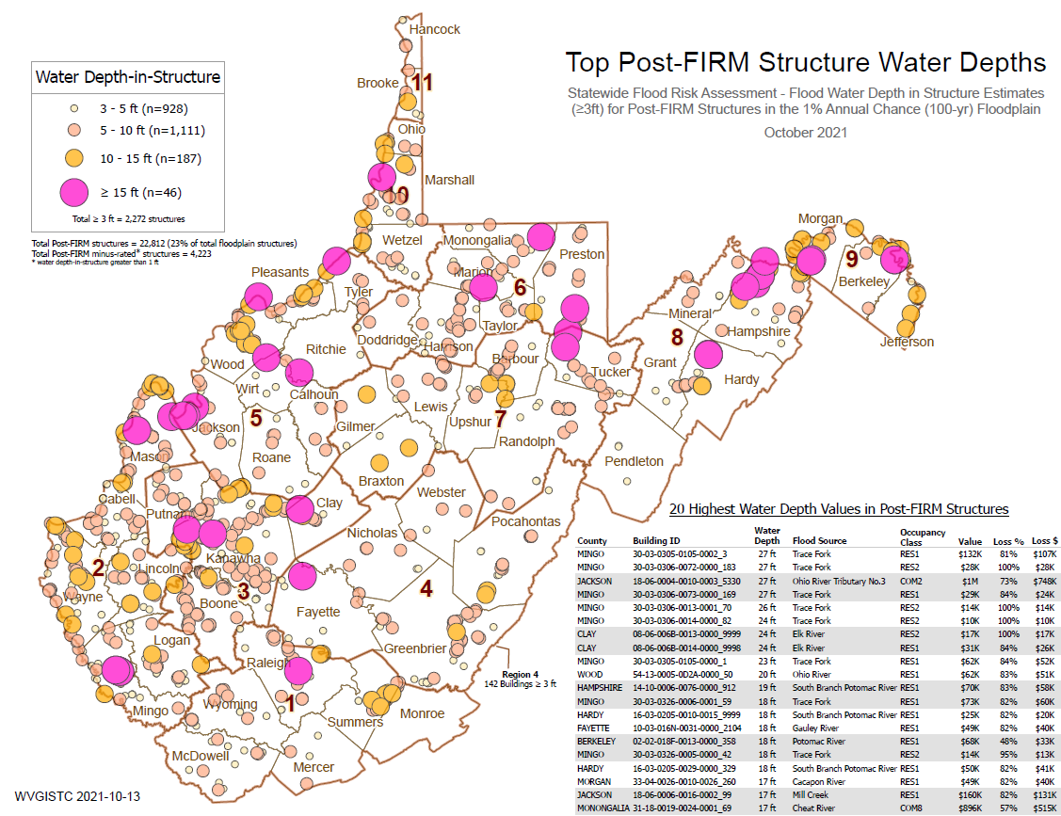
Post-FIRM Minus-Rated Structures
Post-FIRM is 23%
>= Minus 3 Rated is 4%
142 buildings have a Minus -3 or greater rating in Region 4

Slide 27
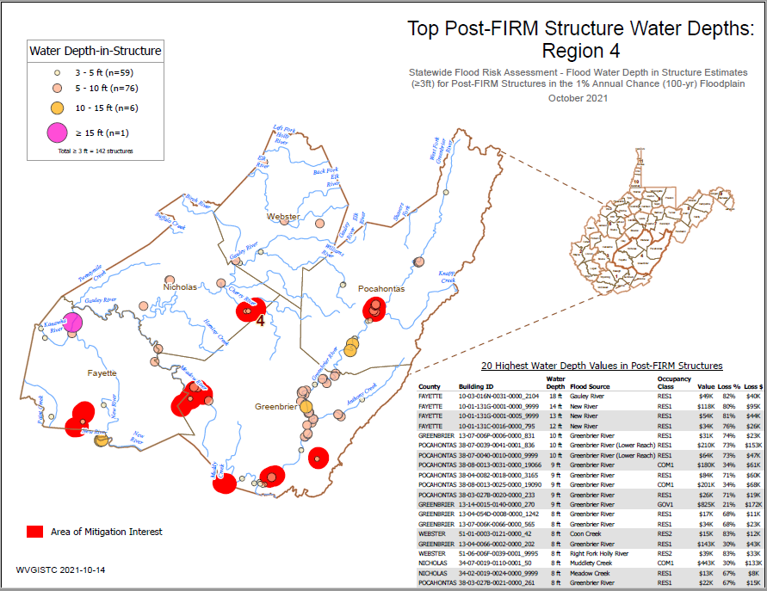
Post-FIRM Minus-Rated (Region 4)

Slide 28
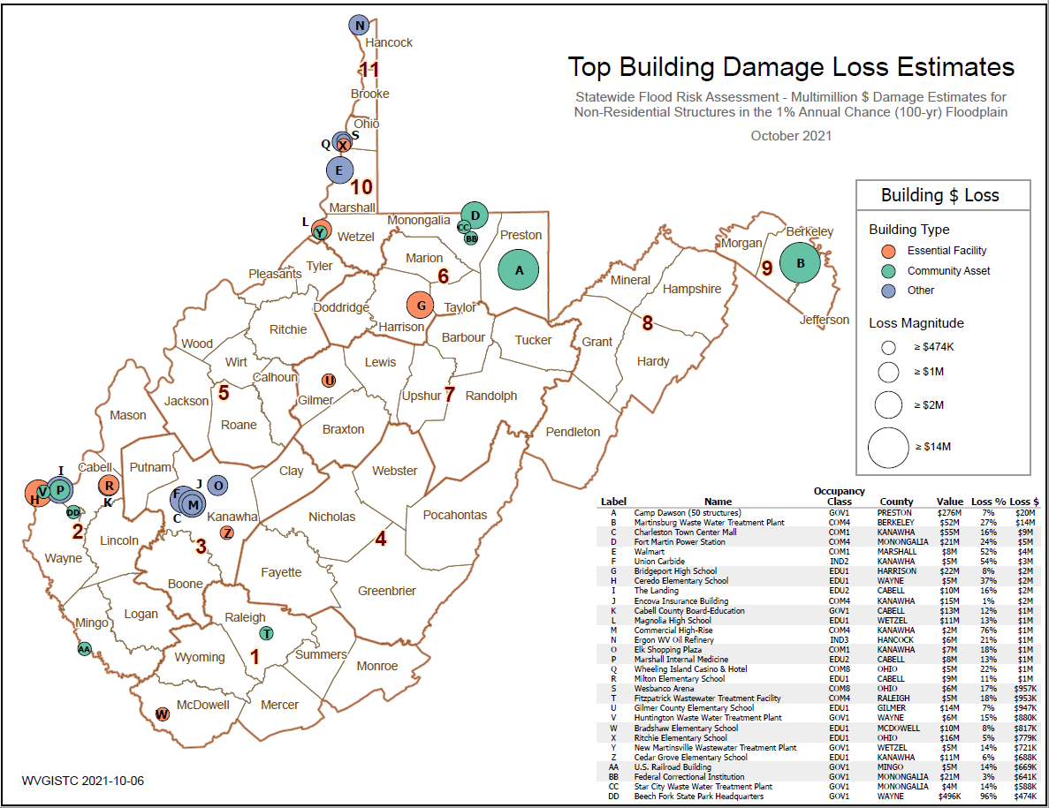
Top Building Damage Loss Estimates

Slide 29

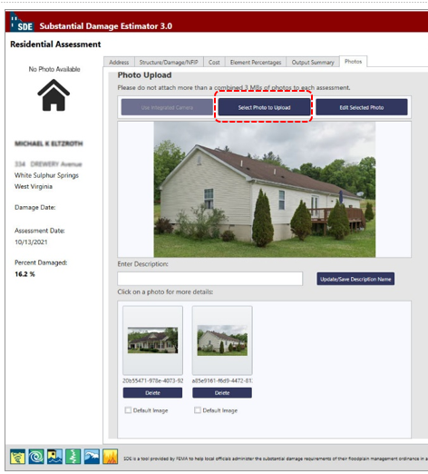
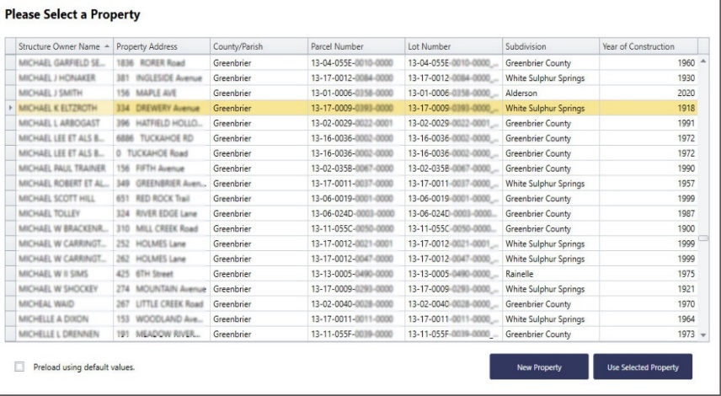
Preload Structures into SDE
Incorporate 1% Floodplain Building Risk Assessment Inventory into Mitigation and NFIP/CRS Management Activities
STEP 1: Community preloads Floodplain Properties into FEMA’s Substantial Damage Estimator software
STEP 2: Community performs practice Substantial Damage Assessments for Residential and Non-Residential Properties
Greenbrier County has 2,225 Structures that can be uploaded
SDE Upload Files and Instructions

Slide 30
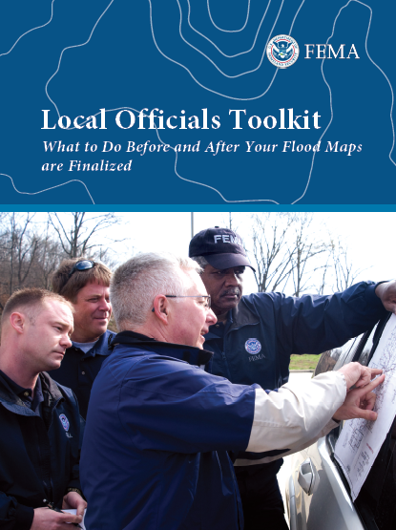
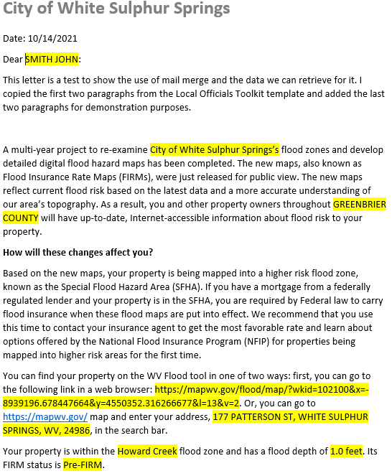
Flood Study Map Changes
Incorporate 1% Floodplain Building Risk Assessment Inventory into Mitigation and NFIP/CRS Management Activities
White Sulphur Springs has 68 buildings being mapped into the SFHA
FEMA Region 3 Toolkit for New Flood Studies
Mail Merge Template for SFHA Mapped-in Structures

Slide 31
Essential Facilities & Community Assets
Identify Mitigation Actions for Essential Facilities and Community Assets
For mitigation plan, incorporate a minimum of two (2) identifiable mitigation actions for essential facilities and community assets for each county.
Compare existing essential facilities inventoried to previous plan update and denote any mitigation progress.
Review top statewide building listing of high-value dollar essential facilities/community assets exposure and substantial damage.
Identify socio-economic effects if key facilities are not restored to original function within days after flood event.
Review existing emergency action plans.
Incorporate into CRS Activity 510 Floodplain Management Planning (FMP)

Slide 32


Essential Facilities & Community Assets
Region 4 Building Type & Exposure
Region 4 Essential Facilities Report
Region 4 Community Assets Report

Slide 33
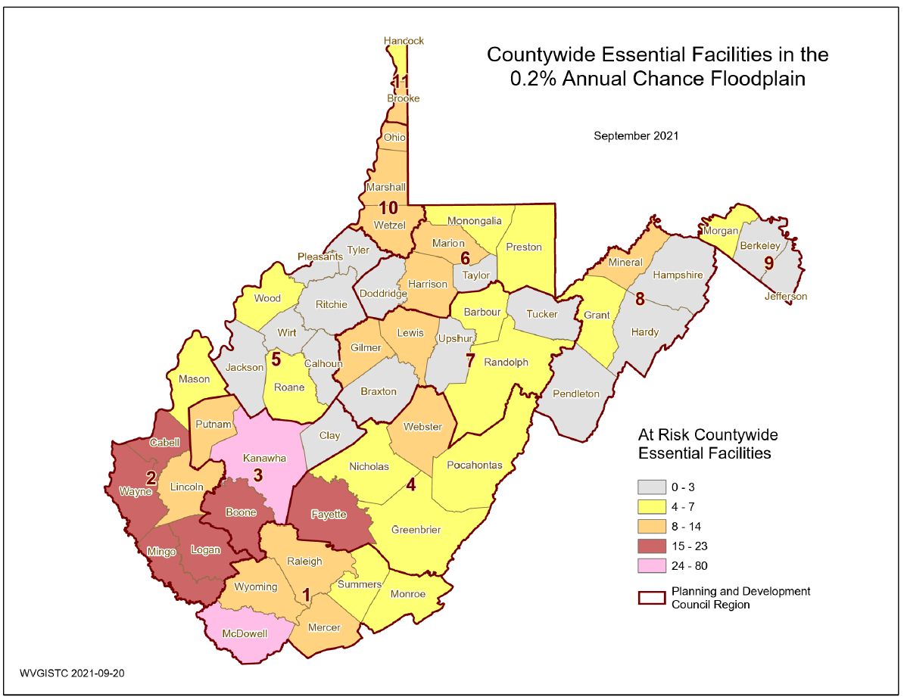
Essential Facilities 0.2% Floodplain
Fayette County is ranked 8th in the State for the most essential facilities. The town of Marlinton is ranked 7th of all incorporated places.
8
Region
4
5
16
4

Slide 34
Essential Facilities: Community Level
COMMUNITY IDENTIFICATION |  |  | ESSENTIAL FACILITIES
CID | Community Name | County | Police Station | Fire Station | 911 Center | School | Hospital | Nursing Home | TOTAL
540027 | Ansted | FAYETTE | 0 | 0 | 0 | 0 | 0 | 0 | 0
540026 | Fayette County* | FAYETTE | 0 | 3 | 0 | 2 | 0 | 0 | 5
540294 | Gauley Bridge | FAYETTE | 1 | 1 | 0 | 0 | 0 | 0 | 2
540028 | Meadow Bridge | FAYETTE | 0 | 0 | 0 | 0 | 0 | 0 | 0
540029 | Montgomery** | FAYETTE | 1 | 0 | 0 | 0 | 1 | 1 | 3
540280 | Mount Hope | FAYETTE | 0 | 0 | 0 | 0 | 0 | 0 | 0
540031 | Oak Hill | FAYETTE | 0 | 0 | 0 | 0 | 0 | 0 | 0
540032 | Pax | FAYETTE | 0 | 1 | 0 | 0 | 0 | 0 | 1
540033 | Smithers** | FAYETTE | 2 | 1 | 0 | 2 | 0 | 0 | 5
SUM | Ranked 8th in State | FAYETTE | 4 | 6 | 0 | 4 | 1 | 1 | 16
540041 | Alderson** | GREENBRIER | 0 | 0 | 0 | 1 | 0 | 0 | 1
540243 | Falling Springs | GREENBRIER | 0 | 0 | 0 | 0 | 0 | 0 | 0
540040 | Greenbrier County* | GREENBRIER | 0 | 0 | 0 | 0 | 0 | 0 | 0
540228 | Rainelle | GREENBRIER | 0 | 1 | 0 | 0 | 0 | 0 | 1
540043 | Ronceverte | GREENBRIER | 0 | 0 | 0 | 0 | 0 | 0 | 0
540044 | Rupert | GREENBRIER | 0 | 0 | 0 | 0 | 0 | 0 | 0
540045 | White Sulphur Springs | GREENBRIER | 1 | 0 | 0 | 1 | 0 | 0 | 2
SUM |  | GREENBRIER | 1 | 1 | 0 | 2 | 0 | 0 | 4
540146 | Nicholas County* | NICHOLAS | 0 | 1 | 0 | 0 | 0 | 0 | 1
540147 | Richwood | NICHOLAS | 2 | 1 | 0 | 0 | 0 | 0 | 3
540148 | Summersville | NICHOLAS | 0 | 0 | 0 | 0 | 0 | 0 | 0
SUM |  | NICHOLAS | 2 | 2 | 0 | 0 | 0 | 0 | 4
540158 | Durbin | POCAHONTAS | 0 | 0 | 0 | 0 | 0 | 0 | 0
540159 | Marlinton (Ranked 7th for all municipalities in State) | POCAHONTAS | 2 | 1 | 0 | 1 | 0 | 1 | 5
540283 | Pocahontas County* | POCAHONTAS | 0 | 0 | 0 | 0 | 0 | 0 | 0
SUM |  | POCAHONTAS | 2 | 1 | 0 | 1 | 0 | 1 | 5
540204 | Addison (Berkeley Springs) | WEBSTER | 0 | 1 | 1 | 1 | 0 | 0 | 3
540205 | Camden-On-Gauley | WEBSTER | 1 | 0 | 0 | 0 | 0 | 0 | 1
540206 | Cowen | WEBSTER | 0 | 0 | 0 | 1 | 0 | 0 | 1
540203 | Webster County* | WEBSTER | 0 | 2 | 0 | 1 | 0 | 0 | 3
SUM |  | WEBSTER | 1 | 3 | 1 | 3 | 0 | 0 | 8
Community-Level Report
What is at Risk?

Slide 35
Essential Facilities: Bldg. Level
Community Name | County | Facility Name | Facility Type | Flood Tool Link | Flood Depth | Building Damage Percent
Camden-On-Gauley | WEBSTER | Camden on Gauley Police Department | Police Station | FT | 6.3 | 15.6
Alderson** | GREENBRIER | Alderson Elementary School | School | FT | 3.5 | 8.0
Marlinton | POCAHONTAS | Marlinton Police Department | Police Station | FT | 2.2 | 7.6
Marlinton | POCAHONTAS | Marlinton Volunteer Fire Department | Fire Station | FT | 2.2 | 7.7
Fayette County* | FAYETTE | Loup Creek Volunteer Fire Department - Robson | Fire Station | FT | 1.1 | 0.9
Webster County* | WEBSTER | Erbacon Volunteer Fire Department | Fire Station | FT | 1.0 | 0.0
Marlinton | POCAHONTAS | Pocahontas County 911 Center | Police Station | FT | 1.0 | 0.0
Marlinton | POCAHONTAS | Marlinton Elementary School | School | FT | 0.8 | 0.0
Fayette County* | FAYETTE | Armstrong Creek Volunteer Fire Department | Fire Station | FT | 0.8 | 0.0
Fayette County* | FAYETTE | Covenant Promise Christian Academy | School | FT | 0.5 | 0.0
Webster County* | WEBSTER | Hacker Valley Elementary School | School | FT | 0.4 | 0.0
White Sulphur Springs | GREENBRIER | White Sulphur Springs Police Department | Police Station | FT | 0.2 | 0.0
Webster County* | WEBSTER | Hacker Valley Volunteer Fire Department | Fire Station | FT | 0.1 | 0.0
Addison | WEBSTER | Webster County Office of Emergency Services/ E-911 | 911 Center | FT | 0.1 | 0.0
Richwood | NICHOLAS | Richwood Police Department | Police Station | FT | 0.1 | 0.0
Rainelle | GREENBRIER | Rainelle Volunteer Fire Department | Fire Station | FT | 0.1 | 0.0
Pax | FAYETTE | Pax Volunteer Fire Department | Fire Station | FT | 0.1 | 0.0
Building-Level Report
Degree of Risk?
* Unincorporated Community
** Split Community

Slide 36
Community Assets
Non-Historical Community Assets: Fayette County has the largest number of inventoried community resources (n=53) and ranked 12th in the State of which the majority are religious buildings. Fayette Unincorporated is ranked 10th of all unincorporated areas. The town of Marlinton is ranked 8th of all incorporated areas in the State with the most community assets.
Historical Community Assets: Greenbrier County is ranked 7th in the State as having the most historical buildings (n=56) in the high-risk floodplain of which the majority are located in the city of Ronceverte (ranked 14th of all incorporated areas). The split community of Alderson and the city of Mount Hope also have significant numbers of historical buildings in the high-risk floodplain (18 and 16 respectively).
Mitigation: A designated historic structure can obtain the benefit of subsidized flood insurance through the NFIP even if it has been substantially improved or substantially damaged so long as the building maintains its historic designation.

Slide 37
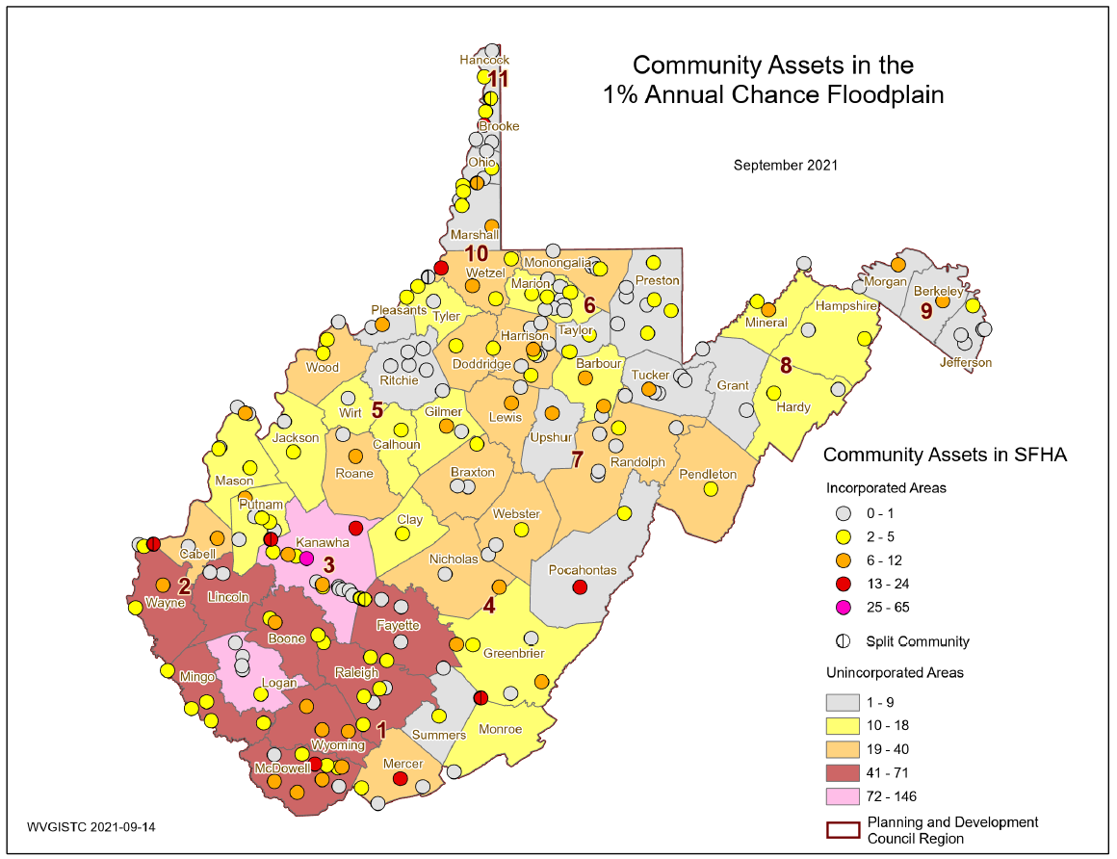
Community Assets (Non Historical)
Region 4 Communities
Fayette Unincorporated (45)
Webster Unincorporated (24)
Nicholas Unincorporated (23)
Marlinton (13)
Alderson (8)
Richwood (8)

Slide 38
Community Engagement Focus 3-5
 |  |  | Tables |  | Map
Primary Focus Areas of Statewide Risk Assessment | Community Engagement | Specific Activities for Mitigation Plan | Com- munity Level (CL) | Bldg. (BL) or Feature (FL) Level | Flood Tool Risk MAP | Include Answers to Questions below in Hazard Mitigation Plan
Mitigated Structures | Validate Mitigated Structures and Post-FIRM Development | Determine if Post-FIRM minus-rated structures are mitigated | Yes | Yes | Yes | Which Post-FIRM structures in the 1% floodplain have been mitigated?
 |  | In the mitigation plan, include a table that describes the number and types of mitigated structures for each flood prone community | Ongoing | Yes | Yes
Buyout Properties | Confirm Mitigated Buyout Properties | Confirm buyout properties are allowable for open space purposes only | Yes | Yes | Yes | How many mitigated buyout properties in each community exist?
 |  | In the mitigation plan, include a table that lists the number of verified and unverified mitigated buyout properties | Yes | Yes | Yes
Areas of Mitigation Interest | Evaluate Areas of Mitigation Interest or Repetitive Loss Areas | Determine the mitigation status of Post-FIRM building construction, repetitive loss structures, substantial damage estimates, and buyout properties for designated Areas of Mitigation Interest. |  | Yes |  | What are the Areas of Mitigation Interest or Repetitive Loss Areas identified for mitigation?
 |  | In the mitigation plan, include a table that lists and describes the areas of mitigation interest for each community | Ongoing | Yes
Local Community Engagement
Hazard Mitigation Plan Engagement

Slide 39
Mitigated Structures
Validate Mitigated Structures and Post-FIRM Development
Mitigation Plan Cross Walk Requirements: For mitigation plan, verify Post-FIRM mitigated structures provided in minus-rated property tables.
Determine if Post-FIRM minus-rated structures are mitigated. Focus initially on structures with the highest minus ratings (or highest water-in-depth values) and high dollar loss estimates. For each structure of interest identify if a permit and elevation certificate are on file. Annotate permit and elevation certificate information on minus-rated table. Submit building pictures if no elevation certificates exist.
In the mitigation plan, include a table that describes the number and types of mitigated structures for each flood prone community.
Identify mitigation actions for specific structures, to include outreach/education to community/ homeowners about mitigation best practices, mitigation funding opportunities, NFIP office involvement for non-compliant structures).

Slide 40
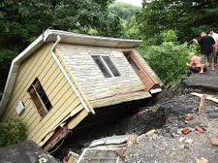
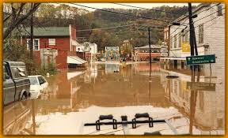
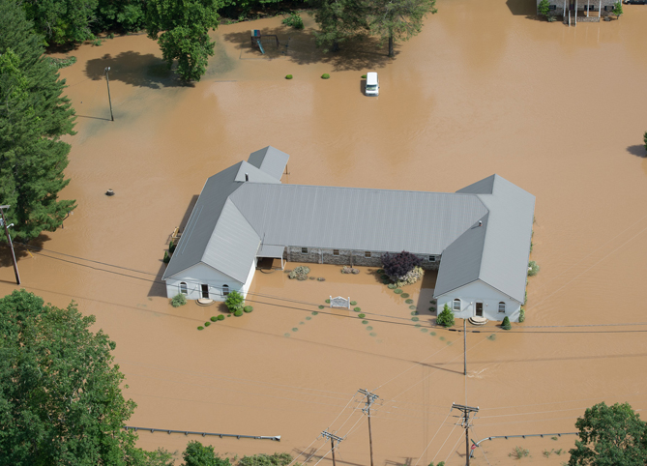
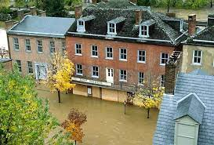
Substantial Damage Estimates
County | Building Count Total | Bldg. Value $ Total in Floodplain | TEIF Loss Total | TEIF Loss Ratio Total | Debris Damage Total (tons) | High Damage Count & $ Loss | MINUS-RATED > 2 & POST-FIRM | Average Percent Damage | Median Percent Damage | Average Dollar Damage | Median Dollar Damage
FAYETTE | 1819 | $83,469K | $5,113K | 6% | 4,540 | 175 | 17 | 19% | 12% | $6K | $3K
GREENBRIER | 2225 | $187,863K | $11,294K | 6% | 5,921 | 348 | 100 | 18% | 12% | $9K | $4K
NICHOLAS | 1056 | $46,920K | $2,414K | 5% | 2,556 | 76 | 9 | 20% | 13% | $7K | $3K
POCAHONTAS | 948 | $62,779K | $5,682K | 9% | 5,068 | 167 | 49 | 21% | 16% | $10K | $5K
WEBSTER | 1074 | $61,072K | $2,472K | 4% | 1,661 | 80 | 6 | 20% | 15% | $8K | $4K
Statewide 17% $6K
Generated using FEMA’s Hazus flood loss software program for a 1%-annual-chance (100-yr) flood event

Slide 41
RA Verification Tables
https://data.wvgis.wvu.edu/pub/RA/Region4/BLRA/4-6_BLRA_Extract
High Building Dollar Exposure: 10% of total counts of county (the same way as determining community counts)
High Building Damage Estimates: All buildings with >50% damage percent and > $10,000 building loss
Minus Rated Post-FIRM: All buildings with water depth-in-structure > 1 ft. and appraisal value > $50,000 that are not Pre-FIRM

Slide 42
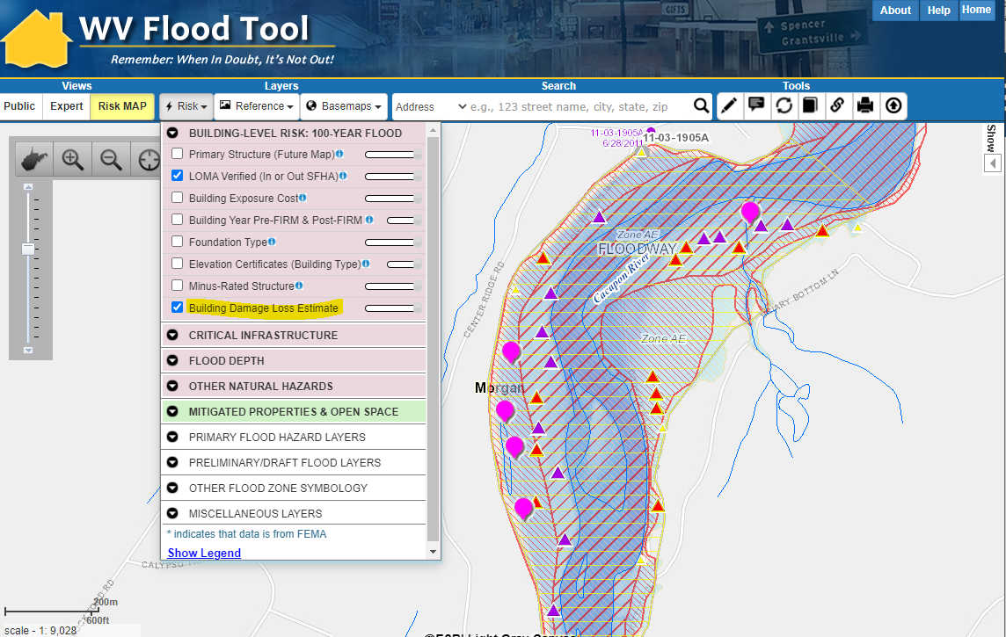
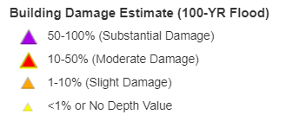
Repetitive Loss Areas
Repetitive Loss Areas
Substantial Damage Estimates
Buyout Properties
https://www.mapwv.gov/flood/map/?wkid=102100&x=-8715156&y=4808078&l=8&v=2

Slide 43
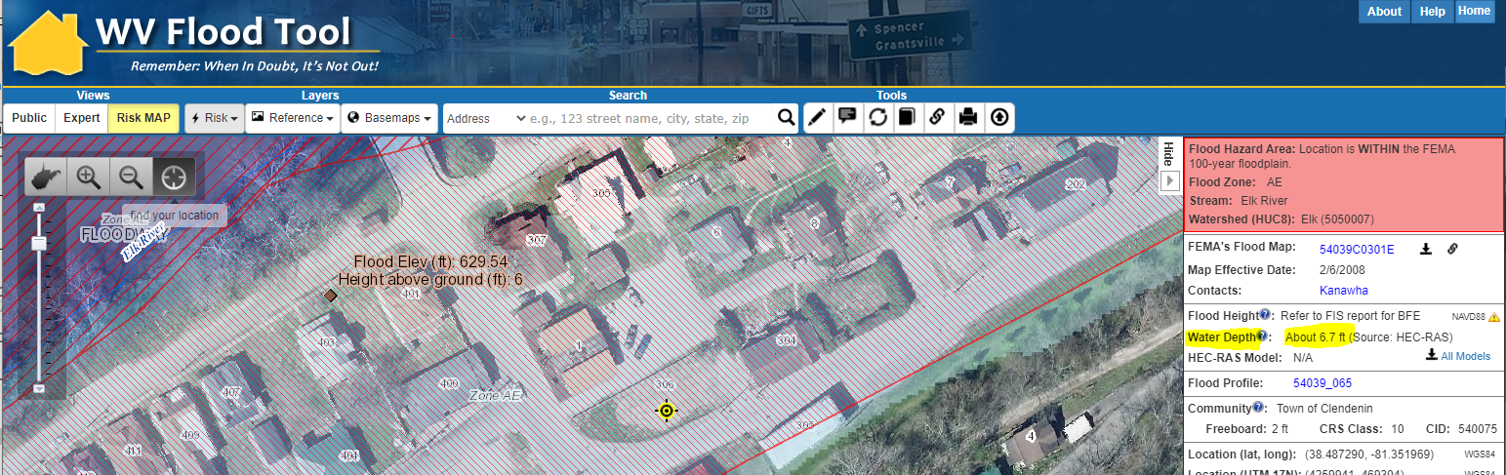
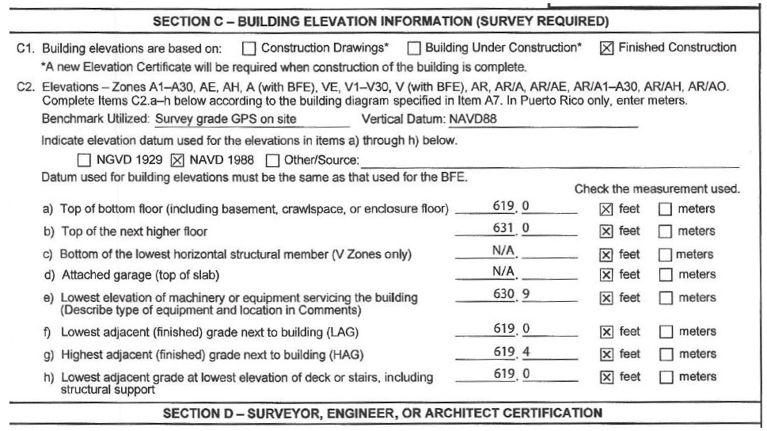
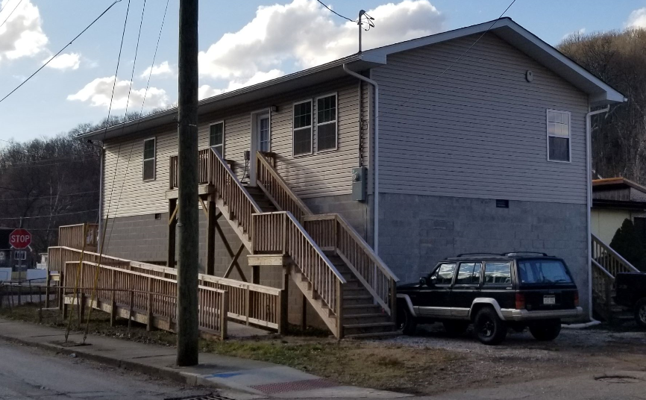
Mitigated Structure – First Floor Height
Use Elevation Certificates and Building Pictures to identify Residential Elevated Structures > 5 ft.
Base Flood Depth
is 6.7 ft.
Newly built Elevated Structure not shown on aerial imagery
Elevation Certificate (Diagram 7)
631.0 ft. (C2b) – 619.0 ft. (C2f) = 12 ft.
19 steps x 7” rise = 11 ft.
16 blocks x 8” = 11 ft.
Building Picture
https://www.mapwv.gov/flood/map/?wkid=102100&x=-9056061&y=4648497&l=12&v=1

Slide 44
Buyout Properties
Confirm Mitigated Buyout Properties
Mitigation Plan Cross Walk Requirements: For mitigation plan, validate verified and unverified properties.
Confirm buyout properties are allowable for open space purposes only. Every three years communities are required to inspect and certify that buyout properties are uses only for allowable open space purposes. Source: https://www.fema.gov/sites/default/files/2020-07/fy15_hma_addendum.pdf
  Verify all deed-restricted buyout properties are shown on the WV Flood Tool.
  Unverified properties (possible buyout properties) are compiled from the statewide property tax database where the parcel intersects the high-risk 1% floodplain, maximum building value is $1000, and part of the owner name contains “commission” or “council” or “city” or “town.”
In the mitigation plan, include a table that lists the number of verified and unverified mitigated buyout properties.
List a minimum of two properties for each county that should be considered for buyout mitigation. Discuss potential properties in mitigation plan.

Slide 45
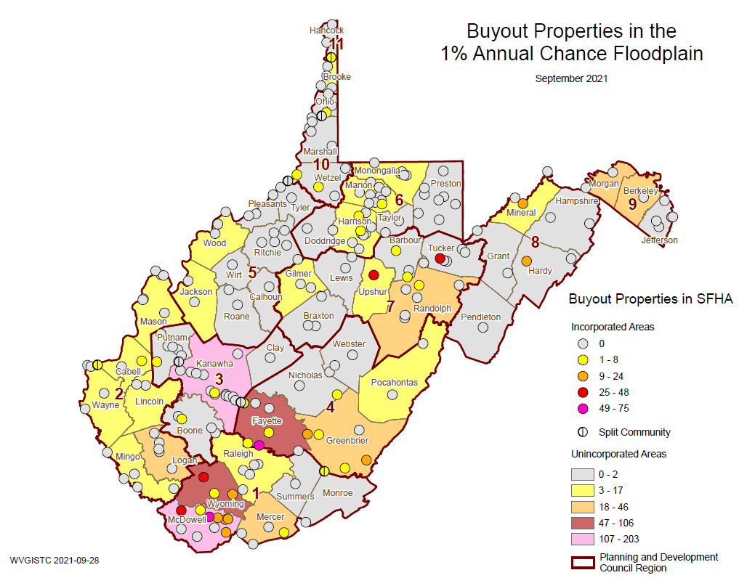
Buyout Properties
Mitigated
Buyout Properties

Slide 46
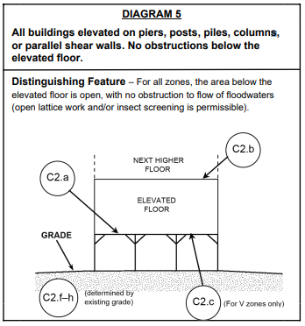
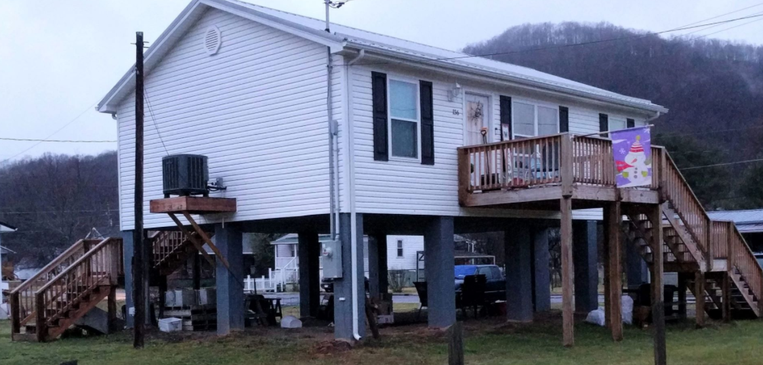
(7) Mitigated Structure – EC Bldg. #5
Building Diagram 5: Elevated Building with no Enclosure

Slide 47
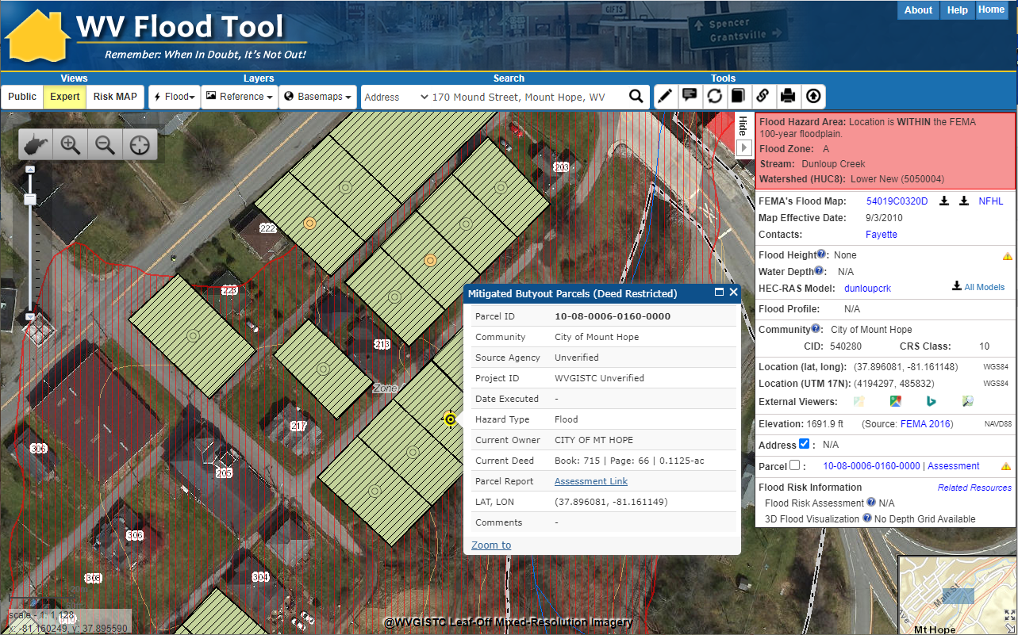
Buyout Properties – Map Verification
Mount Hope, WV (Fayette County)
https://www.mapwv.gov/flood/map/?wkid=102100&x=-9034818&y=4564756&l=12&v=1

Slide 48
Floodplain Measurements
Floodplain Area (acres)
Community Name | County | Total Community Area (acres) | Total SFHA Area (acres) | Modified Total SFHA Area (acres)¹ | Ratio of aSFHA to Community Area
BERKELEY COUNTY * | BERKELEY COUNTY | 201,588 | 8,837 | 8,820 | 4.4%
MARTINSBURG | BERKELEY COUNTY | 4,259 | 139 | 128 | 3.0%
HEDGESVILLE, TOWN OF | BERKELEY COUNTY | 85 | 0 | 0 | 0.0%
MORGAN COUNTY* | MORGAN COUNTY | 146,585 | 7,231 | 7,210 | 4.9%
BATH | MORGAN COUNTY | 215 | 20 | 20 | 9.3%
PAW PAW | MORGAN COUNTY | 340 | 119 | 119 | 35.0%
¹ Areas excluded from Total aSFHA: Open water lakes > 10 acres; Large river bank-to-bank > 500 ft.; Federal lands > 10 acres
Floodplain Length (miles)
Community Name | County | Stream Length(mi) -Zones: AE,AH,AO | Stream Length (mi) -Effective A | Stream Length (mi) – Advisory A | Total Length (mi) | Detailed Zone % | Approx. A Zone % | Advisory Zone %
BERKELEY COUNTY * | BERKELEY COUNTY | 67.9 | 90.2 | 55.6 | 213.7 | 32% | 42% | 26%
MARTINSBURG | BERKELEY COUNTY | 4.1 | 0.5 | 0.5 | 5.1 | 81% | 10% | 9%
 | BERKELEY COUNTY | 72.1 | 90.7 | 56.0 | 218.8 | 33% | 41% | 26%
BATH | MORGAN COUNTY | 1.4 | 0.0 | 0.0 | 1.4 | 97% | 1% | 1%
MORGAN COUNTY* | MORGAN COUNTY | 36.3 | 121.4 | 14.8 | 172.5 | 21% | 70% | 9%
PAW PAW | MORGAN COUNTY | 0.2 | 0.7 | 0.0 | 0.9 | 23% | 77% | 0%
 | MORGAN COUNTY | 37.8 | 122.1 | 14.8 | 174.8 | 22% | 70% | 8%

Slide 49
Local Community Engagement
Risk Assessment Engagement
State Mitigation Office
State NFIP
Regional Councils
WVU GIS Technical Center
Other State-Level Support
State-Level Support for
Local Community Engagement
Select local community engagement activities may need to be (1) group training focused on a specific subject matter or (2) one-on-one technical assistance.

Slide 50
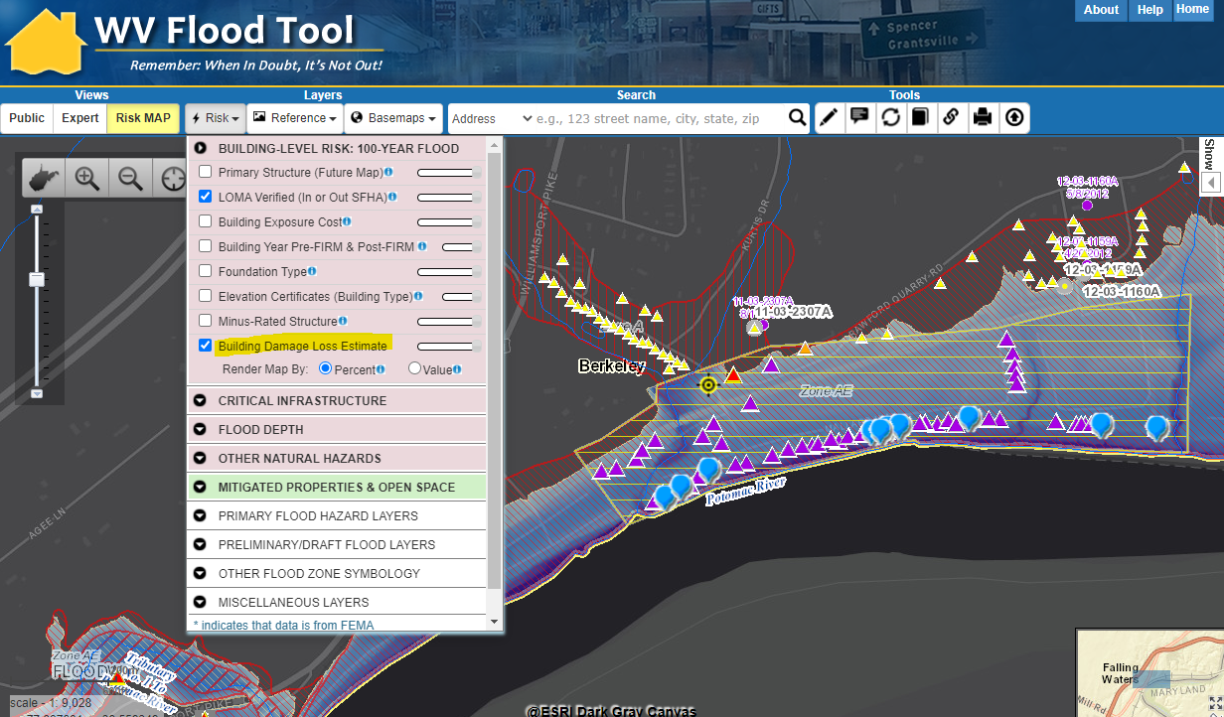
Repetitive Loss Areas
Repetitive Loss Areas
Substantial Damage Estimates
Buyout Properties
https://www.mapwv.gov/flood/map/?wkid=102100&x=-8669471&y=4802931&l=9&v=2

Slide 51
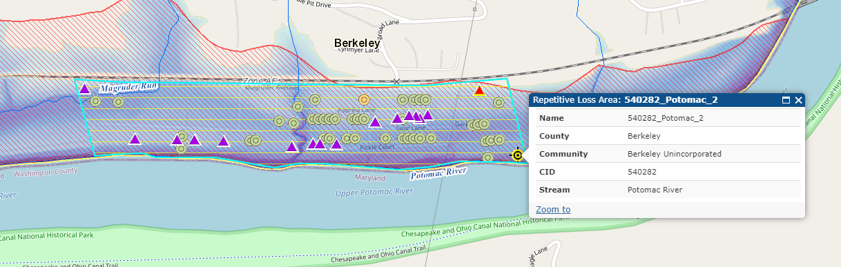
Repetitive Loss Areas
Area of Mitigation Interest | County | Community | Steam Name | RL_Area | FT
540006_Dry_Run_1 | Berkeley | Martinsburg | Dry Run | Yes | FT
540282_Back_Creek_1 | Berkeley | Berkeley Unincorporated | Back Creek | Yes | FT
540282_Potomac_1 | Berkeley | Berkeley Unincorporated | Potomac River | Yes | FT
540282_Potomac_2 | Berkeley | Berkeley Unincorporated | Potomac River | Yes | FT
540282_Potomac_3 | Berkeley | Berkeley Unincorporated | Potomac River | Yes | FT
540282_Potomac_4 | Berkeley | Berkeley Unincorporated | Potomac River | Yes | FT
540282_Potomac_5 | Berkeley | Berkeley Unincorporated | Potomac River | Yes | FT
540282_Potomac_6 | Berkeley | Berkeley Unincorporated | Potomac River | Yes | FT

Slide 52
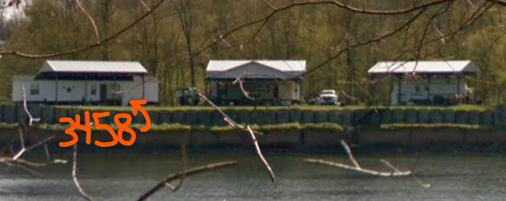
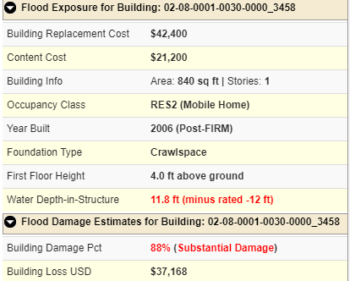
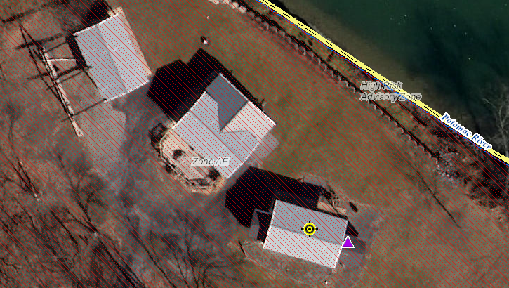
Permanent Structures
Building ID: 02-08-0001-0030-0000_3458
https://www.mapwv.gov/flood/map/?wkid=102100&x=-8663702&y=4797889&l=11&v=2

Slide 53
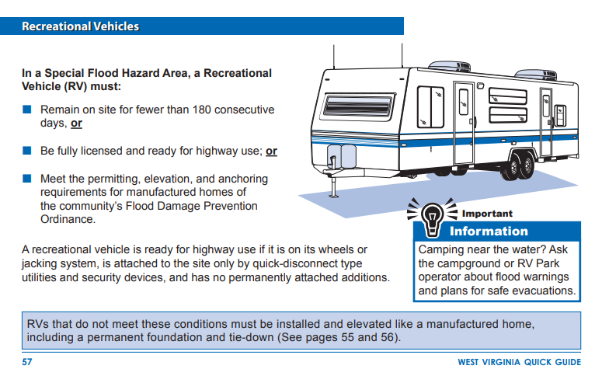
Recreational Vehicles
<< WV Quick Guide resource >>
https://emd.wv.gov/MitigationRecovery/Documents/Floodplain%20Management%20in%20WV%20Quick%20Guide.pdf

Slide 54

Top Single Family Dwelling Loss Estimates

Slide 55
Top Single Family Dwelling Damage Loss

Slide 56


Short-Term Shelter Needs
Incorporated Areas
Unincorporated Areas
Generated using FEMA’s Hazus flood loss guidelines for a 1%-annual-chance (100-yr) flood event

Slide 57


Debris Removal
Incorporated Areas
Unincorporated Areas
Generated using FEMA’s Hazus flood loss software program for a 1%-annual-chance (100-yr) flood event

Slide 58



Minus-Rated Structure
https://msc.fema.gov/portal/availabilitySearch?addcommunity=540133&communityName=MINGO%20COUNTY%20UNINCORPORATED%20AREAS#searchresultsanchor
https://map1.msc.fema.gov/firm?id=540133IND0
https://map1.msc.fema.gov/firm?id=5401330087C

Slide 59

Road Inundation Models
Community Name | County | Roads in Flood Plain (miles) | Roads Flooded (miles) | Roads Below 1ft (Ratio) | Roads 1 to 3ft (Ratio) | Roads Above 3ft (Ratio)
Berkeley County* | BERKELEY | 25.7 | 17.0 | 21% | 22% | 57%
Martinsburg | BERKELEY | 0.8 | 0.5 | 60% | 20% | 20%
 | BERKELEY | 26.5 | 17.5 | 22% | 22% | 55%
Bath | MORGAN | 1.7 | 1.5 | 7% | 47% | 47%
Morgan County* | MORGAN | 35.7 | 22.0 | 13% | 17% | 70%
Paw Paw | MORGAN | 0.7 | 0.1 | 0% | 0% | 100%
 | MORGAN | 38.1 | 23.6 | 13% | 19% | 69%
1%-annual-chance (100-yr) flood event
US 522 Warm Spring Run
I-81 Middle Creek

Slide 60


High Hazard Potential Dams
County | Total Count | High Hazard | Significant Hazard | Low Hazard | Undetermined Hazard
BERKELEY COUNTY | 11 | 3 | 3 | 0 | 5
JEFFERSON COUNTY | 6 | 0 | 1 | 2 | 3
MORGAN COUNTY | 24 | 12 | 3 | 1 | 8
Source: National Inventory of Dams 2020 Database
Community-Level Risk Assessment Tables: https://data.wvgis.wvu.edu/pub/RA/State/CL/

Slide 61
Downstream Communities
DAM NAME | DAM HEIGHT (Feet) | MAX. STORAGE (Acre-Feet) | HAZARD CLASS | EAP | LINK | DAM JURISDICTION | IN-BETWEEN JURISDICTIONS | FARTHEST¹ IMPACTED JURISDICTION
JENNINGS RANDOLPH DAM | 296 | 130,900 | High | Y | FT | Mineral | Mineral, Piedmont, Keyser, Carpendale, Ridgeley, Hampshire, Morgan, Paw Paw, Berkley, Jefferson, Shepherdstown | Harpers Ferry
SAVAGE RIVER DAM | 184 | 31,800 | High | Y | FT | Garrett | Mineral, Piedmont, Keyser, (?) | (?)
LAKE HOLIDAY DAM | 129 | 1,260 | High | Y | FT | Frederick | (?) | (?)
SLEEPY CREEK DAM | 38 | 4,890 | High | Y | FT | Berkeley | Morgan | (?)
GRASSHOPPER HOLLOW TAILINGS DAM | 129 | 1,260 | High | Y | FT | Morgan | Berkeley Springs | (?)
Community Engagement and Verification:
Refer to the WV Flood Tool map and tables to evaluate high-hazard potential dams in which failure is expected to result in loss of life. Review the Emergency Action Plans (EAP) and dam failure inundation maps of all high hazard dams and identify the farthest downstream community impacted.

Slide 62

Warm Spring Run Dams (Morgan)
Eight high hazard flood-control dams upstream of Berkeley Springs
Map Link: https://www.mapwv.gov/flood/map/?wkid=102100&x=-8708803&y=4809463&l=7&v=2

Slide 63

Landslide Susceptibility
COMMUNITY IDENTIFICATION |  | LANDSLIDE SUSCEPTIBILITY |  |  |  |  |  |  |  |  | TOTALS Med-High
 |  | High Susceptibility |  |  | Medium Susceptibility |  |  | Low Susceptibility |  |  | Bldg. Count | Bldg. Value
Community Name | County | Total - H Count | Total-H Value | Total-H Percent | Total - M Count | Total-M Value | Total-M Percent | Total - L Count | Total-L Value | Total-L Percent | Total Count | Total Value
Berkeley County* | BERKELEY | 6 | $1,277K | 0.01% | 490 | $53,165K | 1.0% | 48086 | $6,630,364K | 99% | 496 | $54,442K
Hedgesville | BERKELEY | 0 | $0K | 0.00% | 2 | $114K | 1.1% | 177 | $15,352K | 99% | 2 | $114K
Martinsburg | BERKELEY | 1 | $111K | 0.01% | 17 | $2,694K | 0.2% | 9273 | $1,073,817K | 100% | 18 | $2,805K
 | BERKELEY | 7 | $1,388K | 0.01% | 509 | $55,973K | 0.9% | 57536 | $7,719,533K | 99% | 516 | $57,361K
Bath | MORGAN | 0 | $0K | 0.00% | 19 | $1,733K | 3.5% | 523 | $65,979K | 96% | 19 | $1,733K
Morgan County* | MORGAN | 9 | $503K | 0.07% | 328 | $29,704K | 2.6% | 12073 | $1,136,331K | 97% | 337 | $30,207K
Paw Paw | MORGAN | 0 | $0K | 0.00% | 0 | $0K | 0.0% | 345 | $16,166K | 100% | 0 | $0K
 | MORGAN | 9 | $503K | 0.07% | 347 | $31,437K | 2.6% | 12941 | $1,218,475K | 97% | 356 | $31,940K

Slide 64



Landslide Risk
https://www.mapwv.gov/flood/map/?wkid=102100&x=-8704711&y=4796138&l=4&v=2

Slide 65
Risk Assessment Verification
Field Verification
Community Engagement

Slide 66




Building Substantial Damaged
https://www.mapwv.gov/flood/map/?wkid=102100&x=-8990248&y=4525455&l=11&v=2
Foundation and First Floor Height from Assessment Record are not correct. Needs to be modified.
ADDENDUM INFORMATION
Substantial Damage of structure not adjusted for 9 ft. elevated First Floor
16 steps x 7” rise = 9 ft.
Large number of substantial damaged structures along Greenbrier River, Summers County

Slide 67

Mitigated Properties - Verification
Buckhannon, WV
Elevation Certificate
of Elevated Structure (Bldg. Diagrams 5-8)
Verify
MITIGATED STRUCTURE
Verify
BUYOUT PROPERTY Parcel
https://mapwv.gov/flood/map/?wkid=102100&x=-8929946&y=4721378&l=10&v=2

Slide 68


Mitigated Structure – EC Bldg. #6
Building Diagram 6: Elevated Building with Enclosure (using piers, piles, posts)
Partial Enclosure

Slide 69




Mitigated Structure – EC Bldg. #7
Building Diagram 7: Elevated Building on Solid Foundation Walls (Full-Story)
Building Diagram 5
Walkout Opening
Full-Story Enclosure
Building Picture

Slide 70


Mitigated Structure – EC Bldg. #8
Building Diagram 8: Elevated Building with Crawlspace (Enclosure)
Crawlspace Enclosure

Slide 71

Quick Verification Guide and Survey
Complete Online Survey Form when Finished

