Slide 1
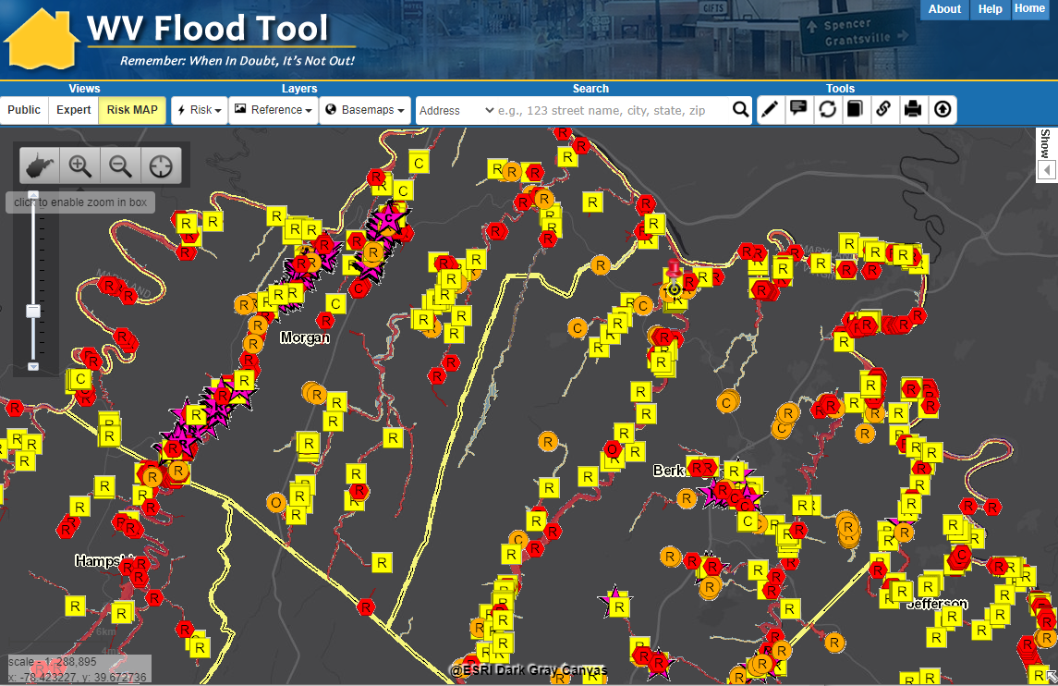
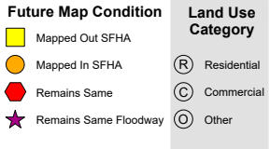
Region 9 Flood Risk Assessment
Berkeley County Vulnerability Risk Assessment
Kurt Donaldson, WVU
8/24/2021

Slide 2
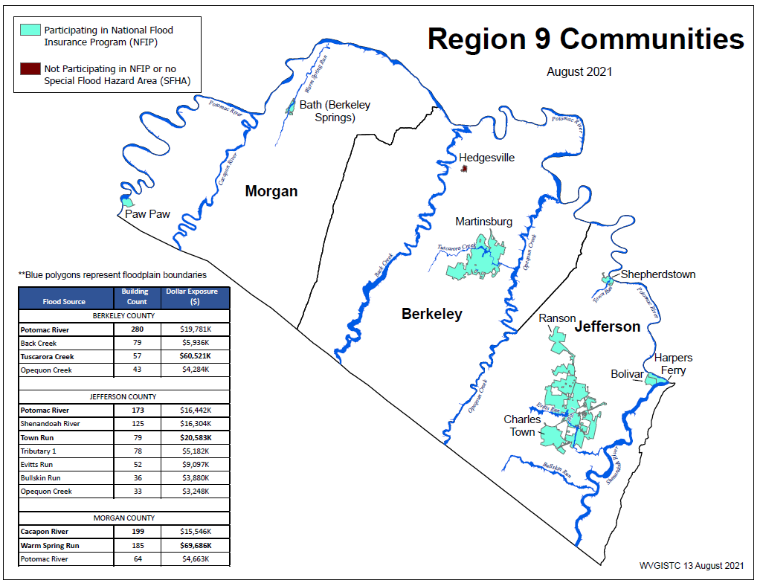
Primary Flood Sources (Berkeley)
Computed for 1% (100-yr) floodplain
Region 9 PDF Map Link
Flood Source | Building Count | Dollar Exposure ($)
BERKELEY COUNTY
Potomac River | 280 | $19,781K
Back Creek | 79 | $5,936K
Tuscarora Creek | 57 | $60,521K
Opequon Creek | 43 | $4,284K

Slide 3
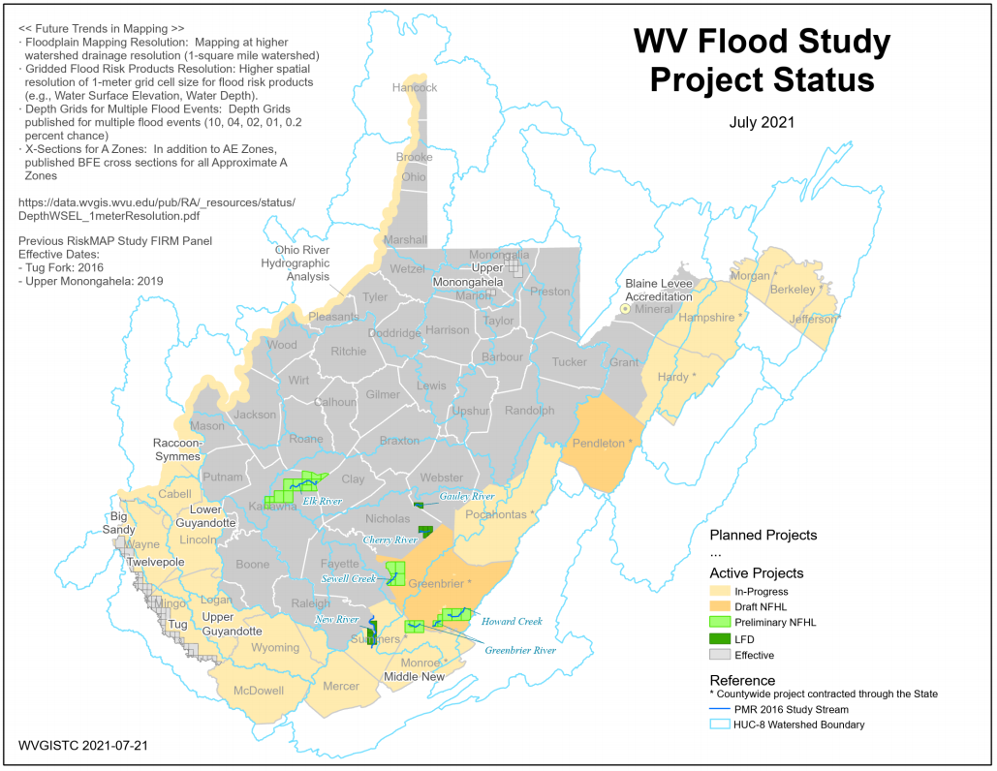
Active Flood Studies
Yellow Spring Run (Morgan)
Evans Run (Berkeley)
Flood Study Project Status Map PDF

Slide 4
Floodplain Measurements
Floodplain Area (acres)
Community Name | County | Total Community Area (acres) | Total SFHA Area (acres) | Modified Total SFHA Area (acres)¹ | Ratio of aSFHA to Community Area
BERKELEY COUNTY * | BERKELEY COUNTY | 201,588 | 8,837 | 8,820 | 4.4%
MARTINSBURG | BERKELEY COUNTY | 4,259 | 139 | 128 | 3.0%
HEDGESVILLE, TOWN OF | BERKELEY COUNTY | 85 | 0 | 0 | 0.0%
MORGAN COUNTY* | MORGAN COUNTY | 146,585 | 7,231 | 7,210 | 4.9%
BATH | MORGAN COUNTY | 215 | 20 | 20 | 9.3%
PAW PAW | MORGAN COUNTY | 340 | 119 | 119 | 35.0%
¹ Areas excluded from Total aSFHA: Open water lakes > 10 acres; Large river bank-to-bank > 500 ft.; Federal lands > 10 acres
Floodplain Length (miles)
Community Name | County | Stream Length(mi) -Zones: AE,AH,AO | Stream Length (mi) -Effective A | Stream Length (mi) – Advisory A | Total Length (mi) | Detailed Zone % | Approx. A Zone % | Advisory Zone %
BERKELEY COUNTY * | BERKELEY COUNTY | 67.9 | 90.2 | 55.6 | 213.7 | 32% | 42% | 26%
MARTINSBURG | BERKELEY COUNTY | 4.1 | 0.5 | 0.5 | 5.1 | 81% | 10% | 9%
 | BERKELEY COUNTY | 72.1 | 90.7 | 56.0 | 218.8 | 33% | 41% | 26%
BATH | MORGAN COUNTY | 1.4 | 0.0 | 0.0 | 1.4 | 97% | 1% | 1%
MORGAN COUNTY* | MORGAN COUNTY | 36.3 | 121.4 | 14.8 | 172.5 | 21% | 70% | 9%
PAW PAW | MORGAN COUNTY | 0.2 | 0.7 | 0.0 | 0.9 | 23% | 77% | 0%
 | MORGAN COUNTY | 37.8 | 122.1 | 14.8 | 174.8 | 22% | 70% | 8%

Slide 5
Building Counts by Flood Zone
Community Name | County |  | SFHA - FUTURE MAP CONDITIONS |  |  |  |  | HIGH-RISK FLOOD ZONES
 |  |  | Floodway | No Change SFHA | Mapped in SFHA | Mapped Out SFHA |  | Effective | Advisory | Total
Berkeley County* | BERKELEY |  | 6 | 325 | 88 | 216 |  | 547 | 88 | 635
Martinsburg | BERKELEY |  | 7 | 39 | 8 | 21 |  | 67 | 8 | 75
 | BERKELEY |  | 13 | 364 | 96 | 237 |  | 614 | 96 | 710
Bolivar | JEFFERSON |  | 0 | 0 | 3 | 0 |  | 0 | 3 | 3
Charles Town | JEFFERSON |  | 5 | 12 | 1 | 9 |  | 26 | 1 | 27
Harpers Ferry | JEFFERSON |  | 0 | 1 | 30 | 0 |  | 1 | 30 | 31
Jefferson County* | JEFFERSON |  | 37 | 233 | 39 | 217 |  | 487 | 39 | 526
Ranson | JEFFERSON |  | 3 | 49 | 0 | 28 |  | 80 | 0 | 80
Shepherdstown | JEFFERSON |  | 0 | 62 | 1 | 3 |  | 65 | 1 | 66
 | JEFFERSON |  | 45 | 357 | 74 | 257 |  | 659 | 74 | 733
Bath | MORGAN |  | 56 | 34 | 16 | 23 |  | 113 | 16 | 129
Morgan County* | MORGAN |  | 102 | 209 | 38 | 135 |  | 446 | 38 | 484
Paw Paw | MORGAN |  | 0 | 13 | 0 | 17 |  | 30 | 0 | 30
 | MORGAN |  | 158 | 256 | 54 | 175 |  | 589 | 54 | 643

Slide 6
Buildings Inventories
High-Risk Effective & Advisory
1%-Annual-Chance (100-Yr) Floodplains

Slide 7
Future Building Map Conditions
SFHA AND FUTURE MAP CONDITIONS | Select counties have non-regulatory, advisory flood zones (orange zones on WV Flood Tool) that indicate future map conditions of the Special Flood Hazard Area (SFHA).
Floodway | Floodways cans be dangerous because water may flow very fast. Development is not allowed unless there is "no rise" in flood elevations, floodway elevations, and floodway widths are certified. Structures in floodways may require special consideration for mitigation measures.
No Change SFHA | No Change in SFHA designation where High-Risk Effective and Advisory Floodplains overlap. When future map restudies are completed and new FIRMs become effective, it is predicted that structures with this designation are neither "mapped in" nor "mapped out" of the SFHA.
Mapped In SFHA | Structures potentially "mapped-in" the SFHA according to mapped High-Risk Advisory Floodplains based on more accurate topography and model-backed A Zones. The "mapped-in" structures most likely will be included in the SFHA when future FEMA Restudies are done and new FIRMS become effective. Communities should review all "mapped-in" structures. Homeowners are at higher risk to flooding and should be contacted about Flood Insurance Preferred Risk Policies and other potential mitigation measures.
Mapped Out SFHA | Structures potentially "mapped-out" the SFHA according to mapped Advisory Floodplains and most likely will NOT be included in the SFHA when the new FIRMs become effective from future Restudies. Communities should review all "mapped-out" structures for LiDAR LOMAs. Although these structures may be mapped to a lesser flood risk designation, property owners should be encouraged to purchase Flood Insurance Preferred Risk Policies at lower premiums. Morgan County example | Berkeley County example

Slide 8
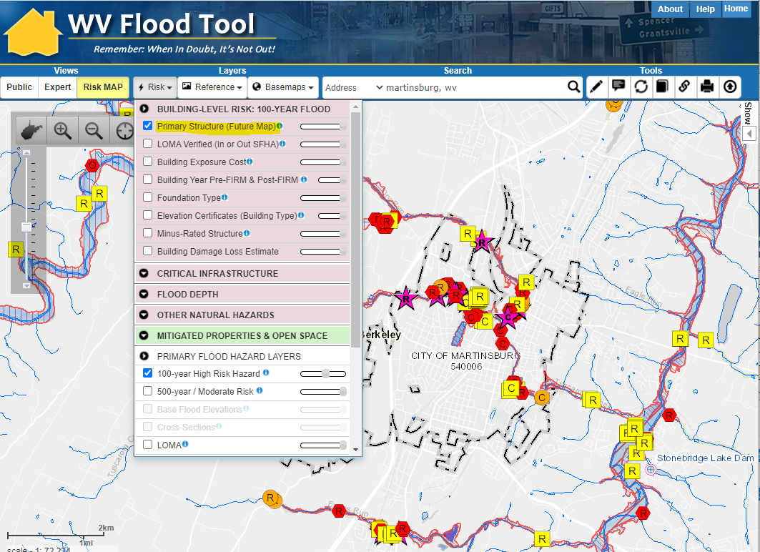
Primary Structures (Martinsburg)
Martinsburg’s primary structures viewable on the Risk MAP View of the WV Flood Tool. Symbol letters indicate general occupancy (Residential, Commercial, Other Non-Residential).

Slide 9

Community Assets
Community Name | County | Historical Place | Facility Type | Flood Tool Link | Flood Depth | Building Damage Percent
Berkeley County* | BERKELEY | Little Falls Chapel | Religious | FT | 6.4 | 11%
Martinsburg | BERKELEY | Holy Grace Church of God | Religious | FT | 3.4 | 11%
Martinsburg | BERKELEY | Martinsburg Sewage Treatment Plant | Utilities | FT | 4.8 | 9%
Bath | MORGAN | Morgan County Courthouse | Government | FT | 2.6 | 7%
Bath | MORGAN | Morgan County Public Library | Government | FT | 2.9 | 7%
Community Engagement and Verification:
Review the accuracy and completeness of all active community assets. Report any structures that are missing. Verify the buildings and location using the Table and Risk MAP View of the WV Flood Tool. Review and identify mitigation strategies for the community assets vulnerable to flooding.

Slide 10
Historical Community Assets
Community Name | County | Facility Name | Facility Type | Flood Tool Link | Flood Depth | Building Damage Percent
Berkeley County* | BERKELEY | Darkesville Historic District | National Register | FT | 5.2 | 22%
Berkeley County* | BERKELEY | Darkesville Historic District | National Register | FT | 4.7 | 13%
Martinsburg | BERKELEY | Tuscarora Creek Historic District | National Register | FT | 2.5 | 11%
Martinsburg | BERKELEY | Tuscarora Creek Historic District | National Register | FT | 2.1 | 14%
Berkeley County* | BERKELEY | Darkesville Historic District | National Register | FT | 2.1 | 8%
Berkeley County* | BERKELEY | Mill Creek Historic District | National Register | FT | 1.1 | 4%
Town Name | County | Building ID | Historical Name | Facility Type | Flood Tool Link | Flood Depth | Building Damage Percent
Bath | MORGAN | 33-03-001A-0015-0000_129 | Town of Bath Historic District | National Register | FT | 8.3 | 27%
Bath | MORGAN | 33-03-002A-0040-0000_33 | Town of Bath Historic District | National Register | FT | 7.8 | 40%
Bath | MORGAN | 33-03-002A-0041-0000_33A | Town of Bath Historic District | National Register | FT | 6.6 | 37%
Berkeley County ranks 2nd in the State for the most National Register Areas that intersect the 1% floodplain.
Mitigation: A designated historic structure can obtain the benefit of subsidized flood insurance through the NFIP even if it has been substantially improved or substantially damaged so long as the building maintains its historic designation.

Slide 11
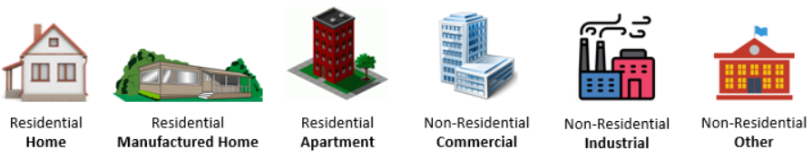
Residential versus Non-Residential
Community | RESIDENTIAL |  |  |  | COMMERCIAL NON-RESIDENTIAL |  | OTHER NON-RESIDENTIAL |  | TOTAL BUILDING VALUE
Community Name | # | % Count | Value ($) | % Value | # | Value ($) | # | Value ($) | # | Value ($) | Rank¹
Berkeley County* | 619 | 97% | $50,593K | 96% | 12 | $1,965K | 4 | $373K | 635 | $52,931K | 3
Martinsburg | 51 | 68% | $6,124K | 10% | 21 | $55,166K | 3 | $1,035K | 75 | $62,324K | 1
BERKELEY | 670 | 94% | $56,717K | 49% | 33 | $57,131K | 7 | $1,408K | 710 | $115,255K | 1
Bolivar | 3 | 100% | $251K | 100% | 0 | $0K | 0 | $0K | 3 | $251K | 8
Charles Town | 23 | 85% | $2,073K | 65% | 4 | $1,107K | 0 | $0K | 27 | $3,180K | 6
Harpers Ferry | 6 | 19% | $722K | 10% | 25 | $6,243K | 0 | $0K | 31 | $6,965K | 4
Jefferson County* | 505 | 96% | $60,022K | 85% | 14 | $4,889K | 7 | $5,349K | 526 | $70,260K | 1
Ranson | 79 | 99% | $5,206K | 98% | 0 | $0K | 1 | $100K | 80 | $5,305K | 5
Shepherdstown | 38 | 58% | $7,873K | 42% | 24 | $6,057K | 4 | $4,794K | 66 | $18,724K | 3
JEFFERSON | 654 | 89% | $76,146K | 73% | 67 | $18,295K | 12 | $10,243K | 733 | $104,685K | 3
Bath | 64 | 50% | $7,226K | 21% | 52 | $11,499K | 13 | $16,499K | 129 | $35,224K | 2
Morgan County* | 439 | 91% | $35,347K | 51% | 38 | $11,135K | 7 | $23,386K | 484 | $69,867K | 2
Paw Paw | 16 | 53% | $1,133K | 41% | 13 | $1,507K | 1 | $130K | 30 | $2,770K | 7
MORGAN | 519 | 81% | $43,705K | 41% | 103 | $24,141K | 21 | $40,015K | 643 | $107,862K | 2
SUMMARY | 1843 | 3 | $176,569K | 54% | 203 | $99,567K | 40 | $51,666K | 2086 | $327,802K
* Unincorporated
¹ Group Rank on Community Type: County, Unincorporated, Incorporated
Region 9 Tabular Community-Level Report: https://data.wvgis.wvu.edu/pub/RA/State/CL/ (Building Exposure)

Slide 12
Single Family Dwellings
Community |  | SINGLE FAMILY HOME |  | MANUFACTURED (MOBILE) HOME |  |  | SINGLE FAMILY TOTAL
Community Name | County | Count | Value ($) | Count | % Count | Value ($) | Count | Value ($) | Group Rank¹
Berkeley County* | BERKELEY | 404 | $45,448K | 206 | 34% | $3,947K | 610 | $49,396K | 2
Martinsburg | BERKELEY | 41 | $4,507K | 0 | 0% | $0K | 41 | $4,507K | 4
 | BERKELEY | 445 | $49,956K | 206 | 32% | $3,947K | 651 | $53,903K | 2
Bolivar | JEFFERSON | 3 | $251K | 0 | 0% | $0K | 3 | $251K | 8
Charles Town | JEFFERSON | 21 | $1,991K | 0 | 0% | $0K | 21 | $1,991K | 5
Harpers Ferry | JEFFERSON | 6 | $722K | 0 | 0% | $0K | 6 | $722K | 7
Jefferson County* | JEFFERSON | 421 | $56,946K | 77 | 15% | $2,311K | 498 | $59,257K | 1
Ranson | JEFFERSON | 65 | $4,494K | 10 | 13% | $351K | 75 | $4,845K | 3
Shepherdstown | JEFFERSON | 35 | $7,191K | 0 | 0% | $0K | 35 | $7,191K | 1
 | JEFFERSON | 551 | $71,595K | 87 | 14% | $2,663K | 638 | $74,257K | 1
Bath | MORGAN | 52 | $5,542K | 3 | 5% | $53K | 55 | $5,595K | 2
Morgan County* | MORGAN | 367 | $33,782K | 66 | 15% | $1,211K | 433 | $34,993K | 3
Paw Paw | MORGAN | 12 | $806K | 0 | 0% | $0K | 12 | $806K | 6
 | MORGAN | 431 | $40,130K | 69 | 14% | $1,265K | 500 | $41,394K | 3
SUMMARY |  | 1,427 | $161,680K | 362 | 20% | $7,875K | 1,789 | $169,555K
* Unincorporated
¹ Group Rank on Community Type: County, Unincorporated, Incorporated
Region 9 Tabular Community-Level Report: https://data.wvgis.wvu.edu/pub/RA/State/CL/ (Building Exposure)

Slide 13
Highly Valued ($) Buildings
Highly valued buildings in 1% Floodplain for Berkeley County. Which high-valued-structures are vulnerable to riverine flooding?
Community Name | WV Flood Tool Link | Owner Name or Building ID | Hazard Occupancy Code | General Occupancy | Building Appraisal
Martinsburg | FT | Martinsburg Treatment Plant | COM4 | Commercial | $ 51,776,300
Martinsburg | FT | COUNTY COUNCIL OF BERKELEY COUNTY WEST VIRGINIA | COM2 | Commercial | $ 945,800
Berkeley County* | FT | SHEPHERDS COVE LLC | RES1 | Residential | $ 851,200
Martinsburg | FT | CITY OF MARTINSBURG | GOV1 | Other | $ 785,600
Berkeley County* | FT | 02-04-0003-0049-0000_1340 | RES1 | Residential | $ 714,000
Berkeley County* | FT | 02-02-0017-0040-0000_1210 | RES1 | Residential | $ 638,100
Martinsburg | FT | MAGYARI PROPERTIES LLC | IND2 | Commercial | $ 573,200
Berkeley County* | FT | 02-02-005A-0055-0000_315 | RES1 | Residential | $ 559,900
* Unincorporated
Region 9 Tabular Building-Level Report Link: https://data.wvgis.wvu.edu/pub/RA/Region9/BLRA/4_BldgDollarExposure
Community Engagement and Verification:
Building-Level Verification: Verify the highly valued buildings using the building-level table and Risk MAP View of the WV Flood Tool. For buildings inventoried in the 1% floodplains, review the most expensive residential and non-residential buildings located in the high-risk flood zones sorted on building appraisal value from largest to smallest value. Identify building-level mitigation and outreach strategies.

Slide 14
Risk Assessment – Building $ & Type
Berkeley County ranks fourth in the State for its countywide median building replacement value of $62,000 and much higher than the statewide median building replacement value of $37,000. It ranks second for median single-family dwelling replacement value of $96,000 and above the statewide median value of $44,000.
Berkeley County – 94% of the primary buildings are residential whereas 51% of the countywide building stock dollar value is non-residential.
Berkeley County Unincorporated (ranked 12th in the State and 1st in Region 9) has the highest percentage (34%) of manufactured homes for single family dwelling building stock.
Berkeley County ranks 2nd in the State for the most National Register Areas that intersect the 1% floodplain.
Berkeley County ranks 11th in the State for the highest percentage of Post-FIRM structures or new development.
The city of Martinsburg (ranked 1st of all incorporated areas) has four utilities located in the high-risk floodplain.

Slide 15
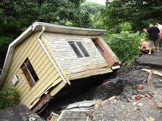
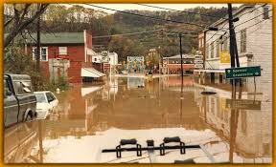
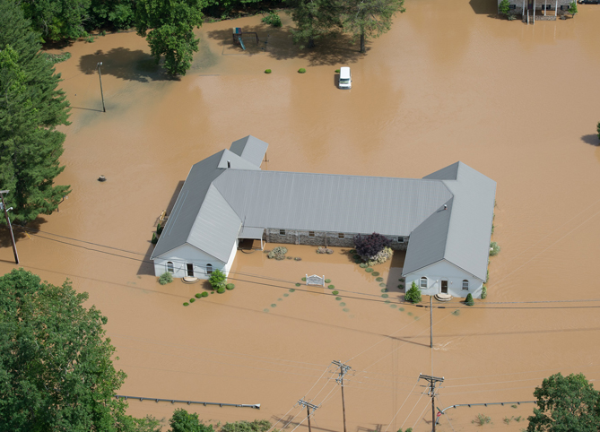
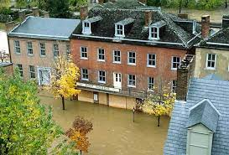
Substantial Damage Estimates
Community Name | County | Count Total | Value Total | TEIF Loss Total | TEIF Loss Ratio Total | Median Percent Damage | Median Dollar Damage | Debris Damage Total | High Damage Count (BldgDmgPct >= 50% OR BldgLossUSD > $10k)
Berkeley County* | BERKELEY | 635 | $52,931K | $5,729K | 11% | 65% | $15K | 6,172 | 188
Martinsburg | BERKELEY | 75 | $62,324K | $14,105K | 23% | 9% | $4K | 136 | 8
 | BERKELEY | 710 | $115,255K | $19,834K | 17% | 54% | $13K | 6,308 | 196
Jefferson County* | JEFFERSON | 526 | $70,260K | $6,047K | 9% | 39% | $21K | 4,434 | 183
Bolivar | JEFFERSON | 3 | $251K | $118K | 47% | 48% | $37K | 135 | 3
Charles Town | JEFFERSON | 27 | $3,180K | $27K | 1% | 4% | $3K | 12 | 0
Harpers Ferry | JEFFERSON | 31 | $6,965K | $4,785K | 69% | 74% | $131K | 4,683 | 30
Ranson | JEFFERSON | 80 | $5,305K | $16K | 0.3% | 4% | $2K | 4 | 0
Shepherdstown | JEFFERSON | 66 | $18,724K | $1,058K | 6% | 8% | $14K | 427 | 38
 | JEFFERSON | 733 | $104,685K | $12,052K | 12% | 30% | $21K | 9,695 | 254
Morgan County* | MORGAN | 484 | $69,867K | $7,057K | 10% | 41% | $16K | 4,368 | 166
Bath | MORGAN | 129 | $35,224K | $2,621K | 7% | 10% | $11K | 698 | 44
Paw Paw | MORGAN | 30 | $2,770K | $16K | 1% | 6% | $3K | 19 | 0
 | MORGAN | 643 | $107,862K | $9,695K | 9% | 22% | $14K | 5,085 | 210
Statewide 17% $6K
Generated using FEMA’s Hazus flood loss software program for a 1%-annual-chance (100-yr) flood event

Slide 16
RA Verification Tables
https://data.wvgis.wvu.edu/pub/RA/Region9/BLRA/4-6_BLRA_Extract
High Building Dollar Exposure: 10% of total counts of county (the same way as determining community counts)
High Building Damage Estimates: All buildings with >50% damage percent and > $10,000 building loss
Minus Rated Post-FIRM: All buildings with water depth-in-structure > 1 ft. and appraisal value > $50,000 that are not Pre-FIRM

Slide 17
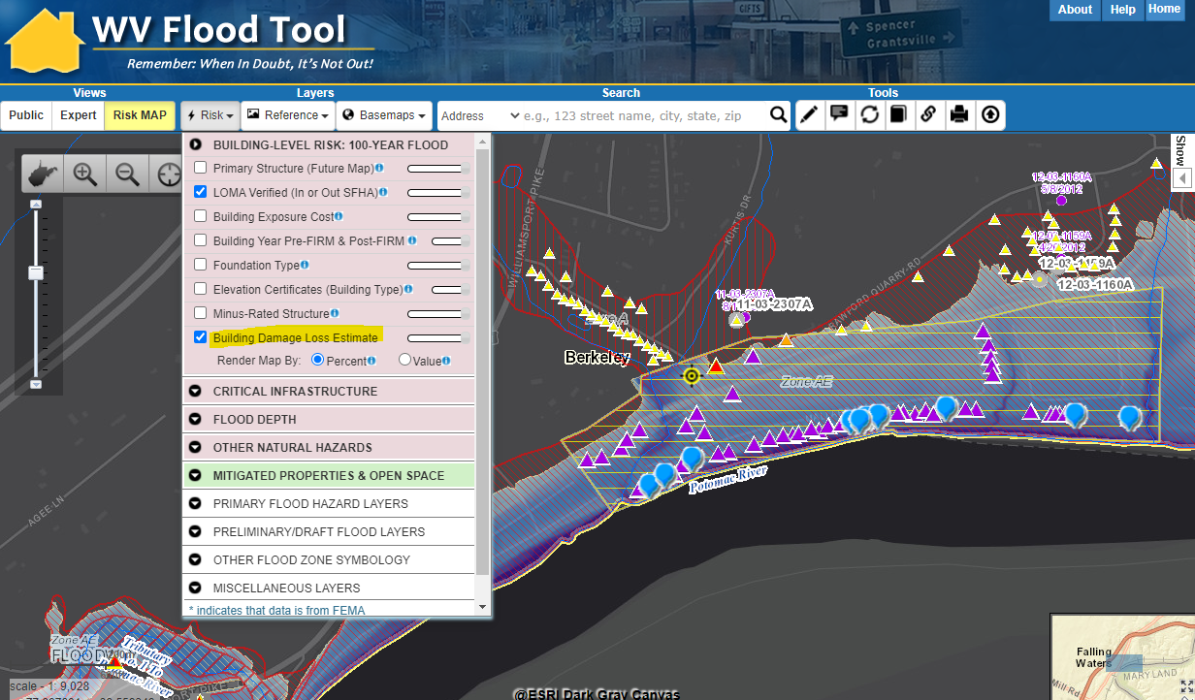
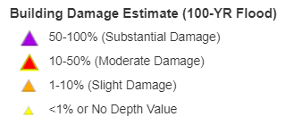
Repetitive Loss Areas
Repetitive Loss Areas
Substantial Damage Estimates
Buyout Properties
https://www.mapwv.gov/flood/map/?wkid=102100&x=-8669471&y=4802931&l=9&v=2

Slide 18
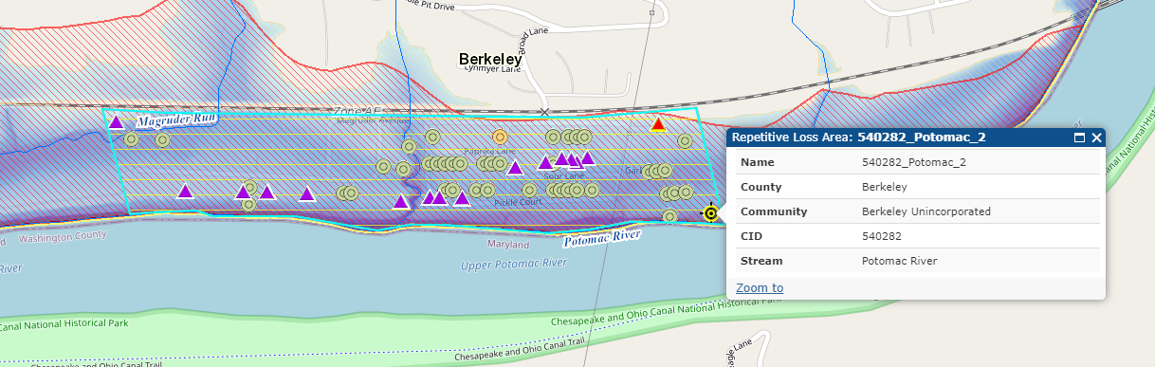
Repetitive Loss Areas
Area of Mitigation Interest | County | Community | Steam Name | RL_Area | FT
540006_Dry_Run_1 | Berkeley | Martinsburg | Dry Run | Yes | FT
540282_Back_Creek_1 | Berkeley | Berkeley Unincorporated | Back Creek | Yes | FT
540282_Potomac_1 | Berkeley | Berkeley Unincorporated | Potomac River | Yes | FT
540282_Potomac_2 | Berkeley | Berkeley Unincorporated | Potomac River | Yes | FT
540282_Potomac_3 | Berkeley | Berkeley Unincorporated | Potomac River | Yes | FT
540282_Potomac_4 | Berkeley | Berkeley Unincorporated | Potomac River | Yes | FT
540282_Potomac_5 | Berkeley | Berkeley Unincorporated | Potomac River | Yes | FT
540282_Potomac_6 | Berkeley | Berkeley Unincorporated | Potomac River | Yes | FT

Slide 19
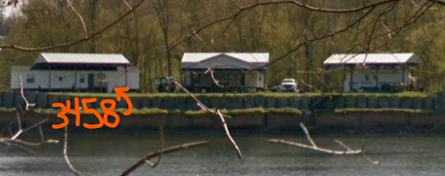
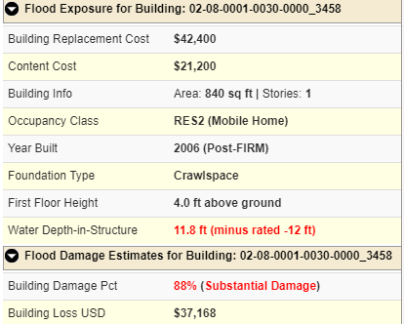
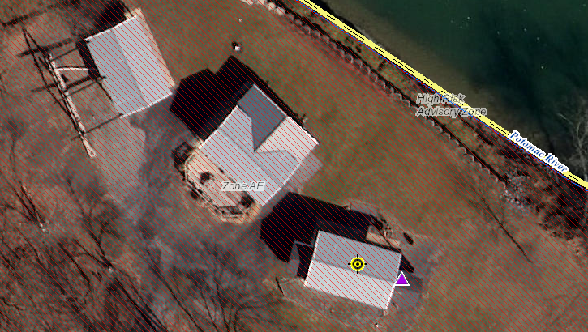
Permanent Structures
Building ID: 02-08-0001-0030-0000_3458
https://www.mapwv.gov/flood/map/?wkid=102100&x=-8663702&y=4797889&l=11&v=2

Slide 20
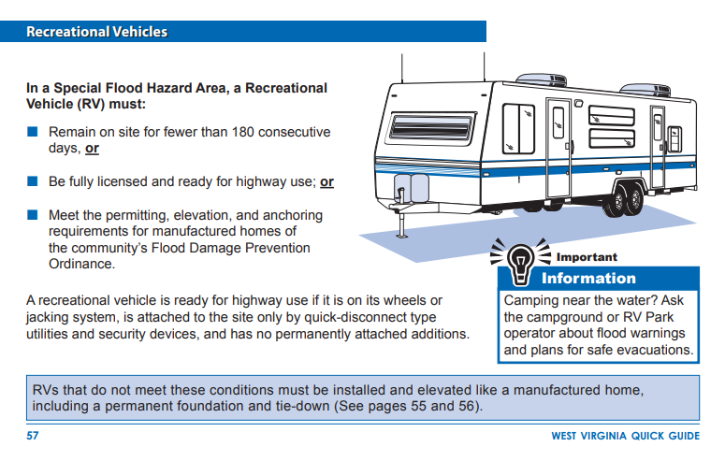
Recreational Vehicles
<< WV Quick Guide resource >>
https://emd.wv.gov/MitigationRecovery/Documents/Floodplain%20Management%20in%20WV%20Quick%20Guide.pdf

Slide 21
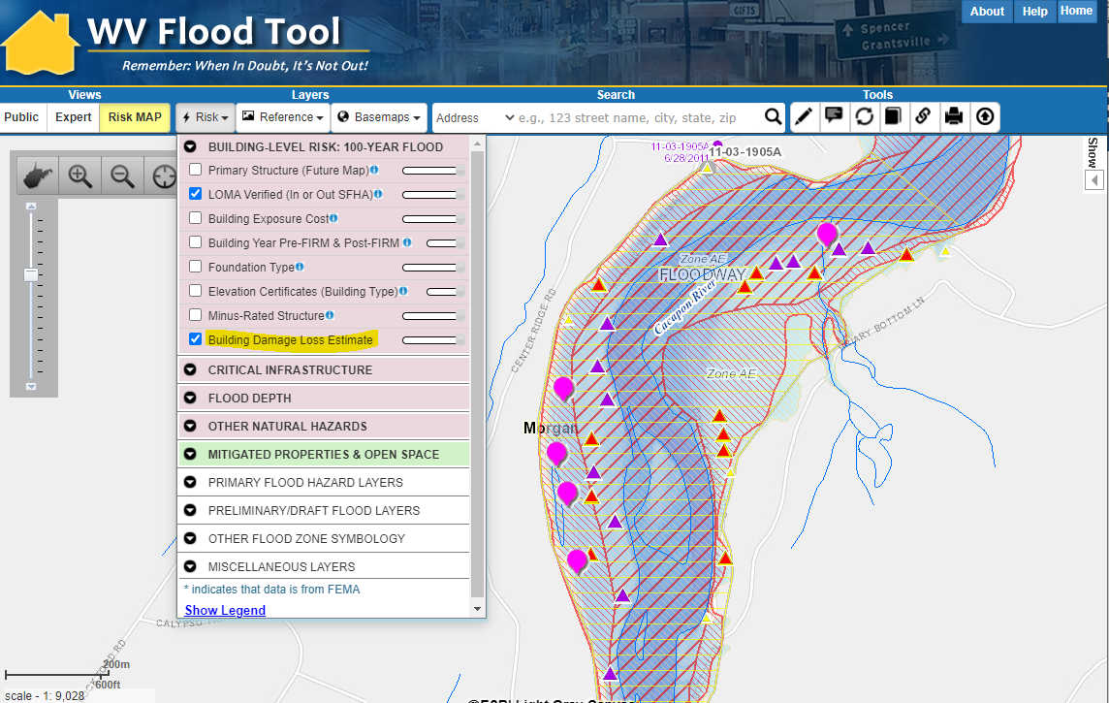
Repetitive Loss Areas
Repetitive Loss Areas
Substantial Damage Estimates
Buyout Propeties
https://www.mapwv.gov/flood/map/?wkid=102100&x=-8715156&y=4808078&l=8&v=2

Slide 22
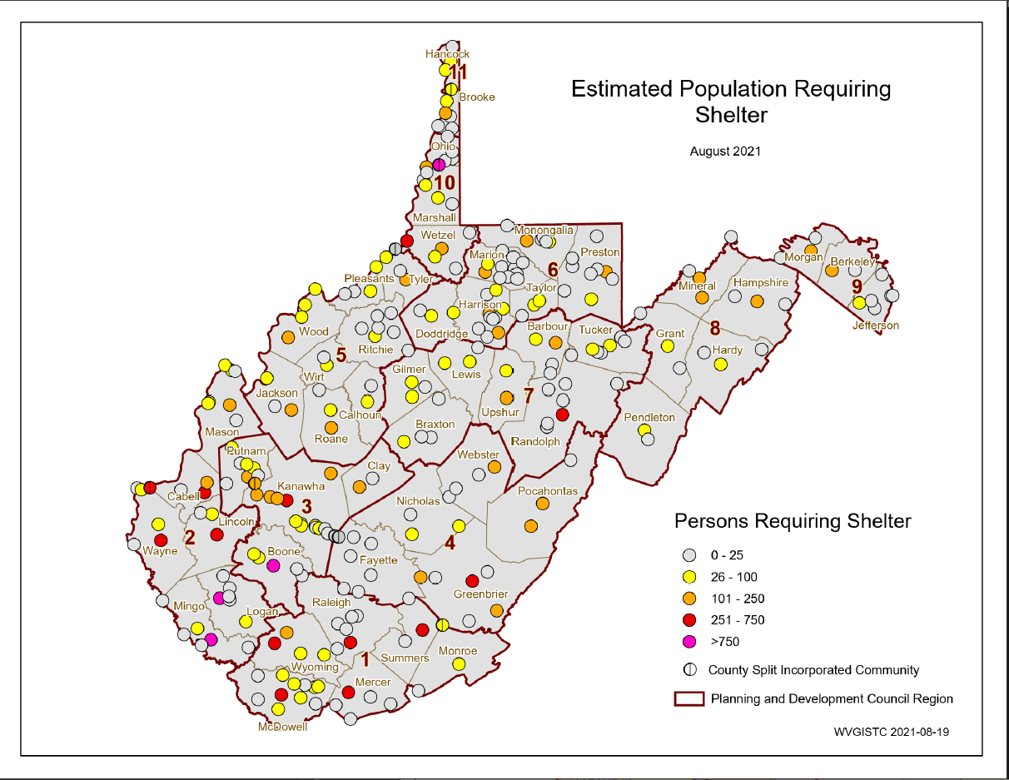
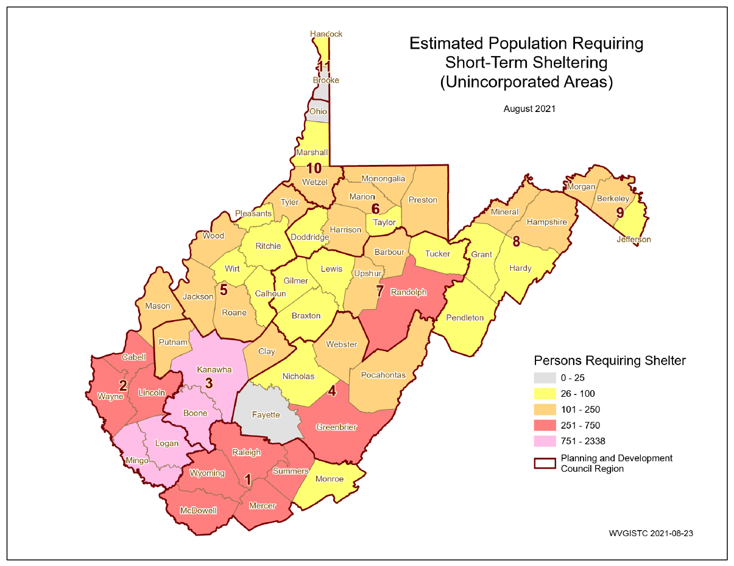
Short-Term Shelter Needs
Incorporated Areas
Unincorporated Areas
Generated using FEMA’s Hazus flood loss guidelines for a 1%-annual-chance (100-yr) flood event

Slide 23
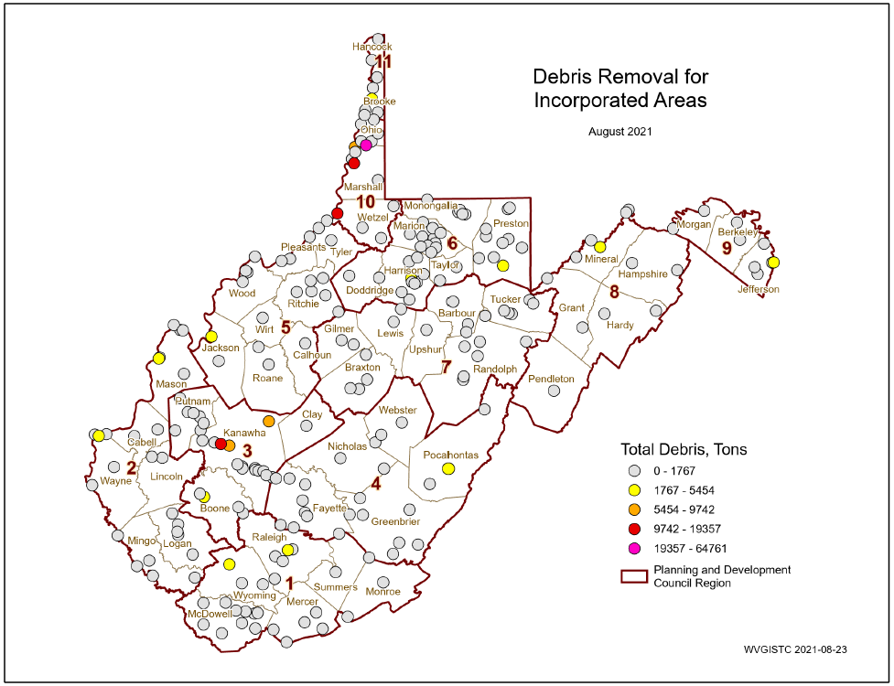
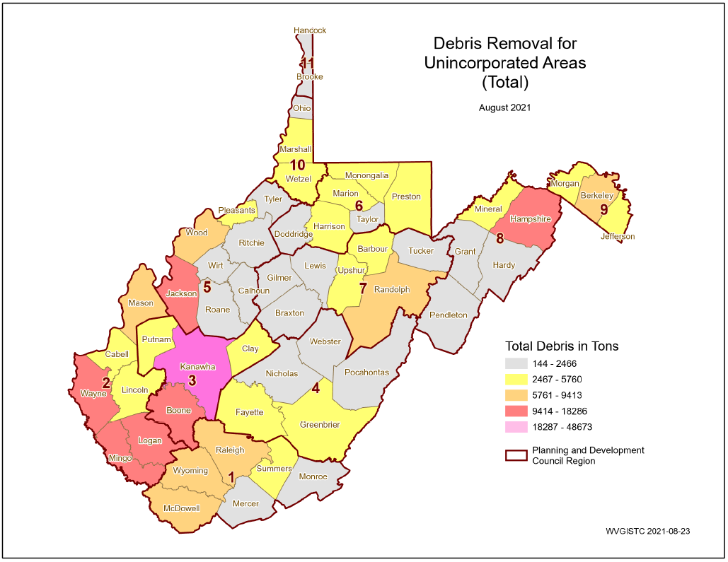
Debris Removal
Incorporated Areas
Unincorporated Areas
Generated using FEMA’s Hazus flood loss software program for a 1%-annual-chance (100-yr) flood event

Slide 24
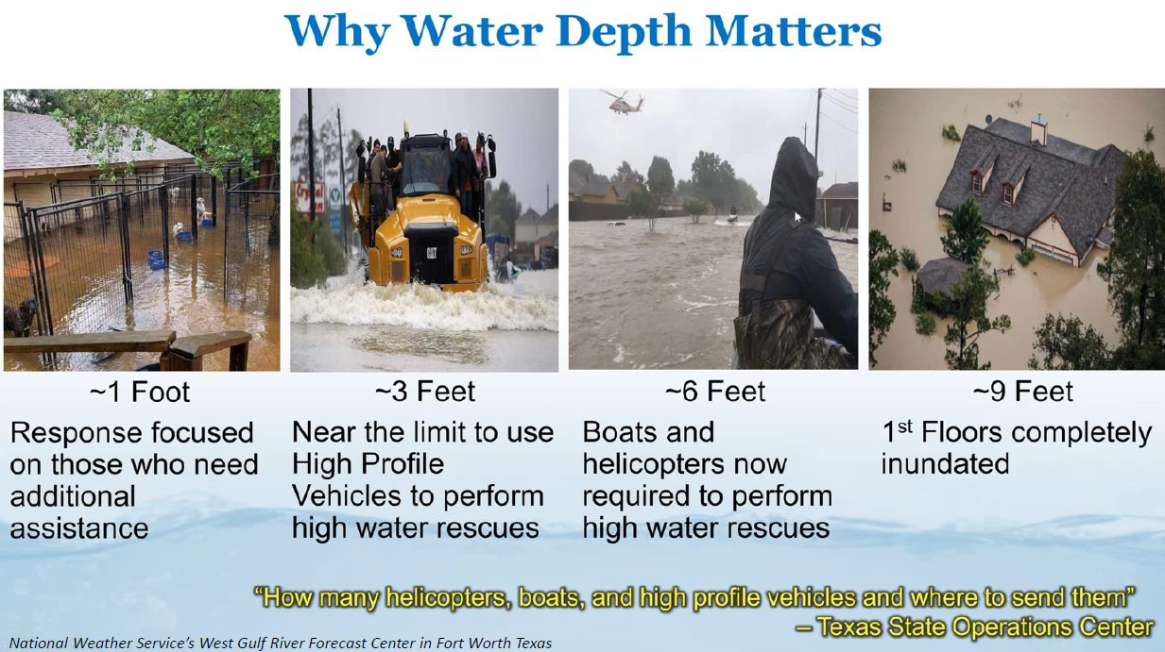
Road Inundation Models
Community Name | County | Roads in Flood Plain (miles) | Roads Flooded (miles) | Roads Below 1ft (Ratio) | Roads 1 to 3ft (Ratio) | Roads Above 3ft (Ratio)
Berkeley County* | BERKELEY | 25.7 | 17.0 | 21% | 22% | 57%
Martinsburg | BERKELEY | 0.8 | 0.5 | 60% | 20% | 20%
 | BERKELEY | 26.5 | 17.5 | 22% | 22% | 55%
Bath | MORGAN | 1.7 | 1.5 | 7% | 47% | 47%
Morgan County* | MORGAN | 35.7 | 22.0 | 13% | 17% | 70%
Paw Paw | MORGAN | 0.7 | 0.1 | 0% | 0% | 100%
 | MORGAN | 38.1 | 23.6 | 13% | 19% | 69%
1%-annual-chance (100-yr) flood event
US 522 Warm Spring Run
I-81 Middle Creek

Slide 25
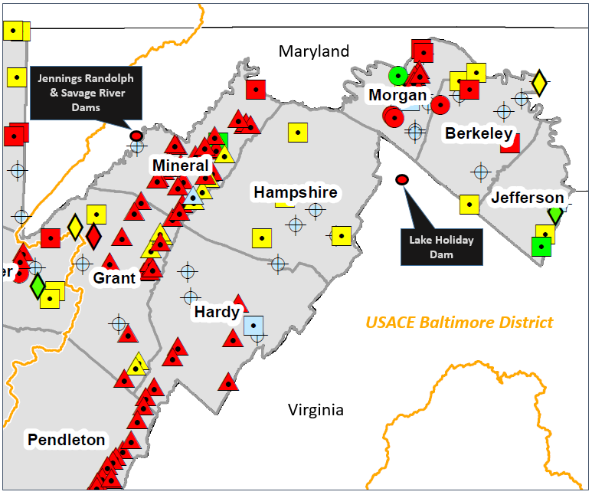
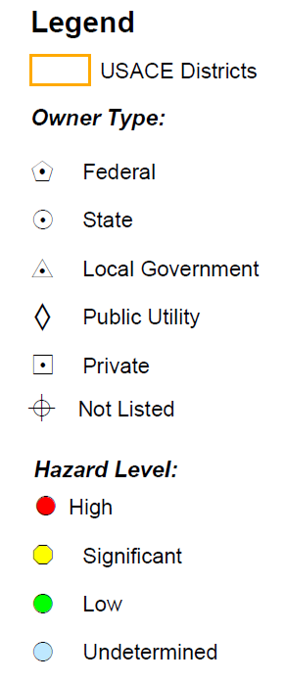
High Hazard Potential Dams
County | Total Count | High Hazard | Significant Hazard | Low Hazard | Undetermined Hazard
BERKELEY COUNTY | 11 | 3 | 3 | 0 | 5
JEFFERSON COUNTY | 6 | 0 | 1 | 2 | 3
MORGAN COUNTY | 24 | 12 | 3 | 1 | 8
Source: National Inventory of Dams 2020 Database
Community-Level Risk Assessment Tables: https://data.wvgis.wvu.edu/pub/RA/State/CL/

Slide 26
Downstream Communities
DAM NAME | DAM HEIGHT (Feet) | MAX. STORAGE (Acre-Feet) | HAZARD CLASS | EAP | LINK | DAM JURISDICTION | IN-BETWEEN JURISDICTIONS | FARTHEST¹ IMPACTED JURISDICTION
JENNINGS RANDOLPH DAM | 296 | 130,900 | High | Y | FT | Mineral | Mineral, Piedmont, Keyser, Carpendale, Ridgeley, Hampshire, Morgan, Paw Paw, Berkley, Jefferson, Shepherdstown | Harpers Ferry
SAVAGE RIVER DAM | 184 | 31,800 | High | Y | FT | Garrett | Mineral, Piedmont, Keyser, (?) | (?)
LAKE HOLIDAY DAM | 129 | 1,260 | High | Y | FT | Frederick | (?) | (?)
SLEEPY CREEK DAM | 38 | 4,890 | High | Y | FT | Berkeley | Morgan | (?)
GRASSHOPPER HOLLOW TAILINGS DAM | 129 | 1,260 | High | Y | FT | Morgan | Berkeley Springs | (?)
Community Engagement and Verification:
Refer to the WV Flood Tool map and tables to evaluate high-hazard potential dams in which failure is expected to result in loss of life. Review the Emergency Action Plans (EAP) and dam failure inundation maps of all high hazard dams and identify the farthest downstream community impacted.

Slide 27
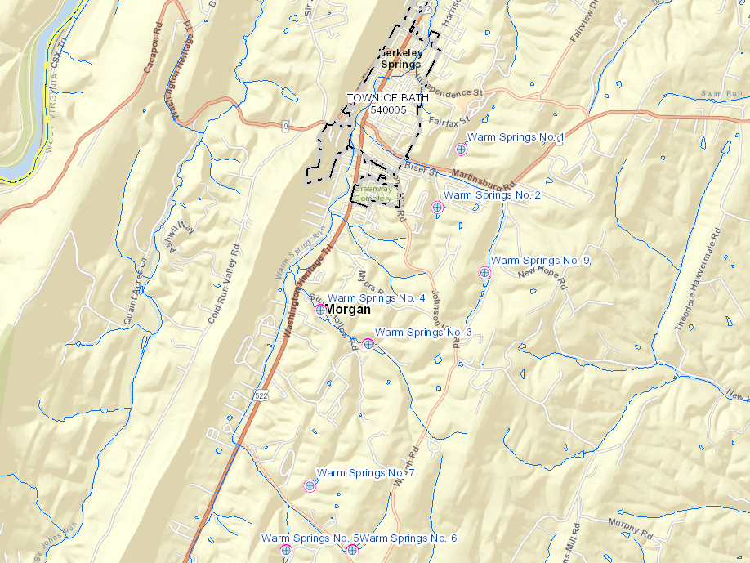
Warm Spring Run Dams (Morgan)
Eight high hazard flood-control dams upstream of Berkeley Springs
Map Link: https://www.mapwv.gov/flood/map/?wkid=102100&x=-8708803&y=4809463&l=7&v=2

Slide 28
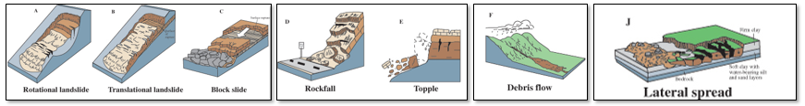
Landslide Susceptibility
COMMUNITY IDENTIFICATION |  | LANDSLIDE SUSCEPTIBILITY |  |  |  |  |  |  |  |  | TOTALS Med-High
 |  | High Susceptibility |  |  | Medium Susceptibility |  |  | Low Susceptibility |  |  | Bldg. Count | Bldg. Value
Community Name | County | Total - H Count | Total-H Value | Total-H Percent | Total - M Count | Total-M Value | Total-M Percent | Total - L Count | Total-L Value | Total-L Percent | Total Count | Total Value
Berkeley County* | BERKELEY | 6 | $1,277K | 0.01% | 490 | $53,165K | 1.0% | 48086 | $6,630,364K | 99% | 496 | $54,442K
Hedgesville | BERKELEY | 0 | $0K | 0.00% | 2 | $114K | 1.1% | 177 | $15,352K | 99% | 2 | $114K
Martinsburg | BERKELEY | 1 | $111K | 0.01% | 17 | $2,694K | 0.2% | 9273 | $1,073,817K | 100% | 18 | $2,805K
 | BERKELEY | 7 | $1,388K | 0.01% | 509 | $55,973K | 0.9% | 57536 | $7,719,533K | 99% | 516 | $57,361K
Bath | MORGAN | 0 | $0K | 0.00% | 19 | $1,733K | 3.5% | 523 | $65,979K | 96% | 19 | $1,733K
Morgan County* | MORGAN | 9 | $503K | 0.07% | 328 | $29,704K | 2.6% | 12073 | $1,136,331K | 97% | 337 | $30,207K
Paw Paw | MORGAN | 0 | $0K | 0.00% | 0 | $0K | 0.0% | 345 | $16,166K | 100% | 0 | $0K
 | MORGAN | 9 | $503K | 0.07% | 347 | $31,437K | 2.6% | 12941 | $1,218,475K | 97% | 356 | $31,940K

Slide 29
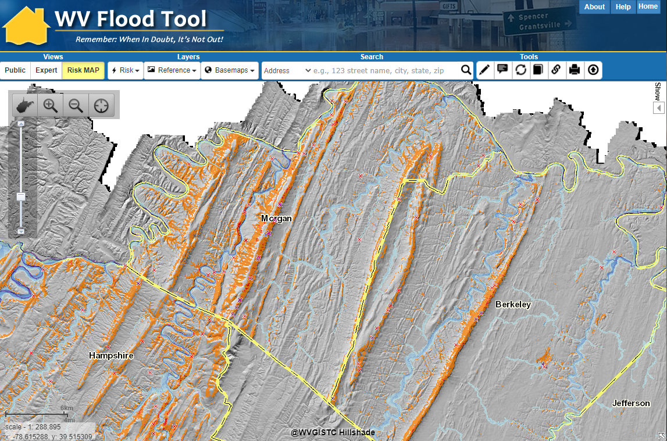
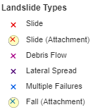
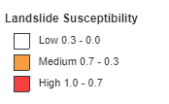
Landslide Risk
https://www.mapwv.gov/flood/map/?wkid=102100&x=-8704711&y=4796138&l=4&v=2

Slide 30
Risk Assessment Verification
Field Verification
Community Engagement

Slide 31
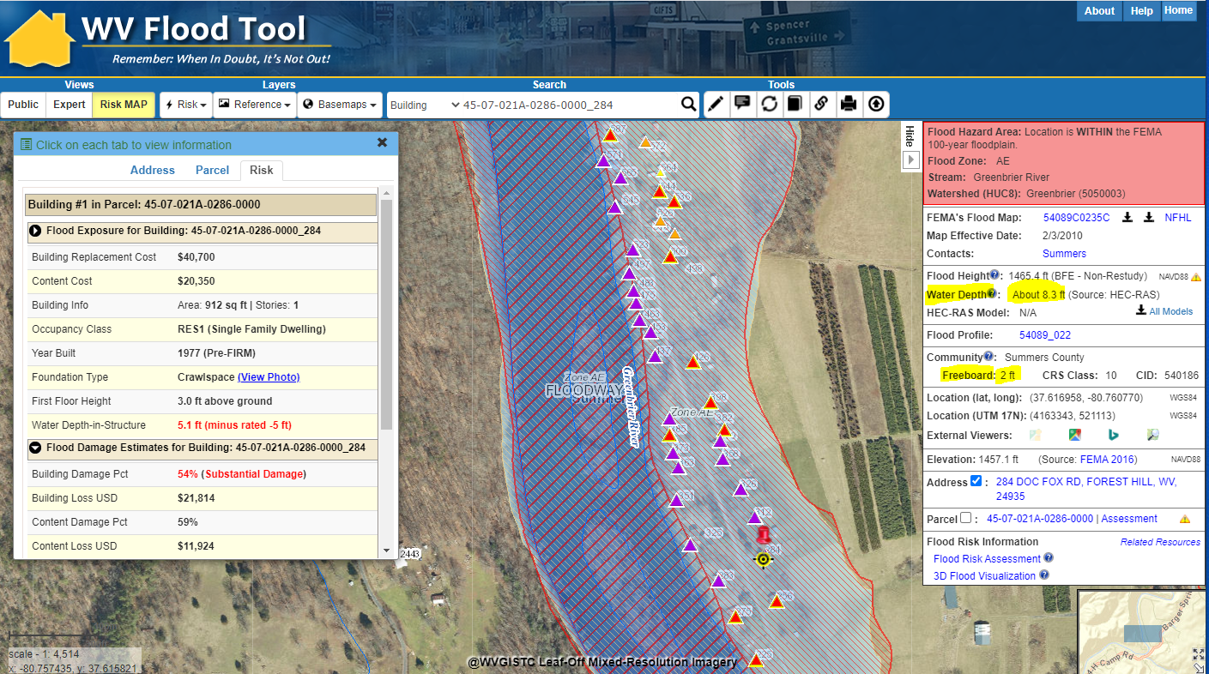

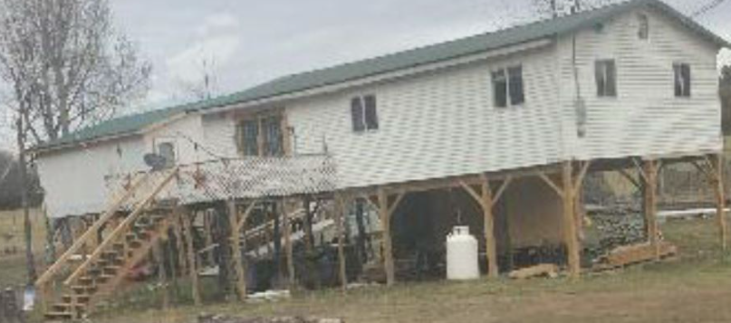
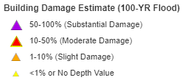
Building Substantial Damaged
https://www.mapwv.gov/flood/map/?wkid=102100&x=-8990248&y=4525455&l=11&v=2
Foundation and First Floor Height from Assessment Record are not correct. Needs to be modified.
ADDENDUM INFORMATION
Substantial Damage of structure not adjusted for 9 ft. elevated First Floor
16 steps x 7” rise = 9 ft.
Large number of substantial damaged structures along Greenbrier River, Summers County

Slide 32
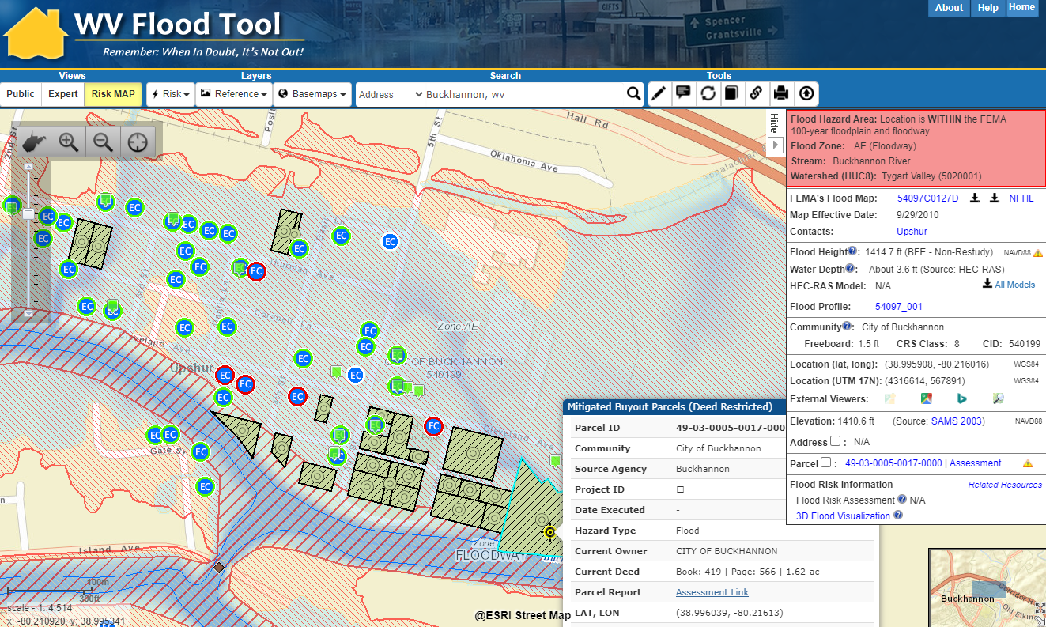
Mitigated Properties - Verification
Buckhannon, WV
Elevation Certificate
of Elevated Structure (Bldg. Diagrams 5-8)
Verify
MITIGATED STRUCTURE
Verify
BUYOUT PROPERTY Parcel
https://mapwv.gov/flood/map/?wkid=102100&x=-8929946&y=4721378&l=10&v=2

Slide 33
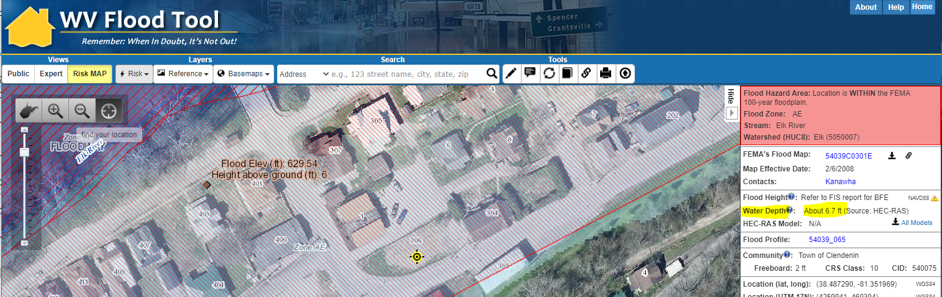
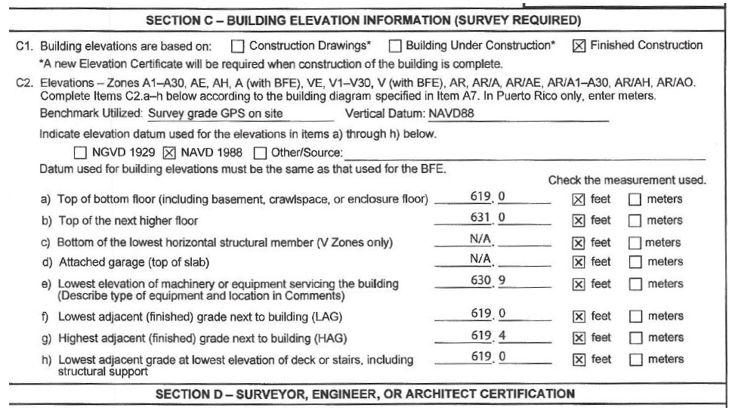
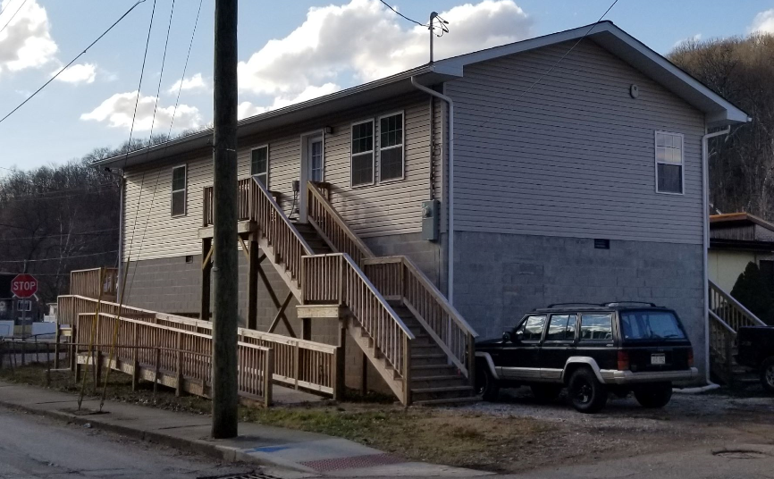
Mitigated Structure – First Floor Height
Use Elevation Certificates and Building Pictures to identify Residential Elevated Structures > 5 ft.
Base Flood Depth
is 6.7 ft.
Newly built Elevated Structure not shown on aerial imagery
Elevation Certificate (Diagram 7)
631.0 ft. (C2b) – 619.0 ft. (C2f) = 12 ft.
19 steps x 7” rise = 11 ft.
16 blocks x 8” = 11 ft.
Building Picture
https://www.mapwv.gov/flood/map/?wkid=102100&x=-9056061&y=4648497&l=12&v=1

Slide 34
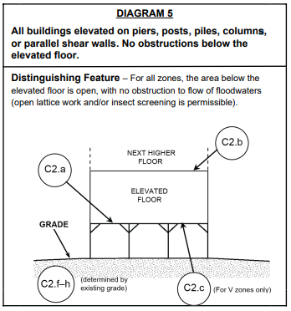
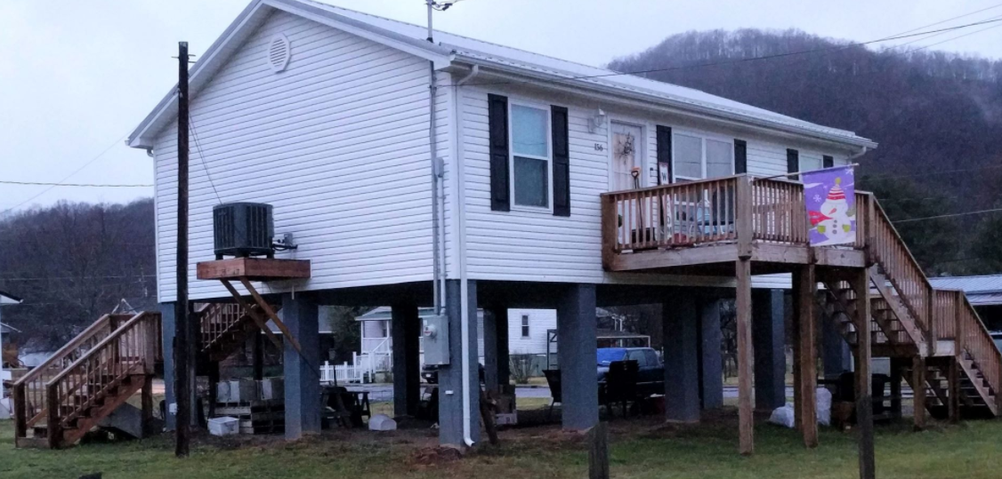
(7) Mitigated Structure – EC Bldg. #5
Building Diagram 5: Elevated Building with no Enclosure

Slide 35
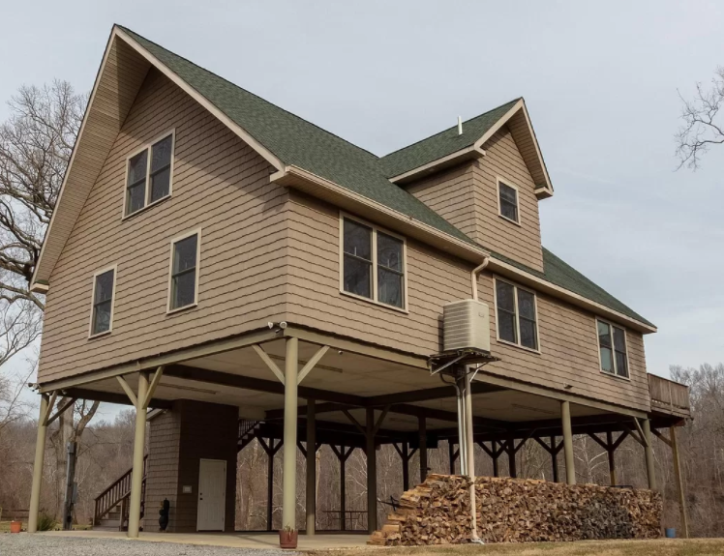
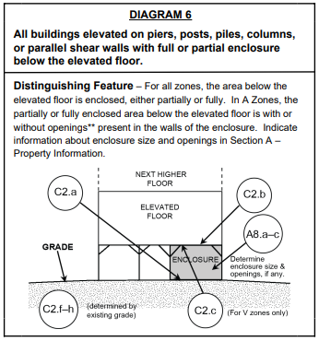
Mitigated Structure – EC Bldg. #6
Building Diagram 6: Elevated Building with Enclosure (using piers, piles, posts)
Partial Enclosure

Slide 36
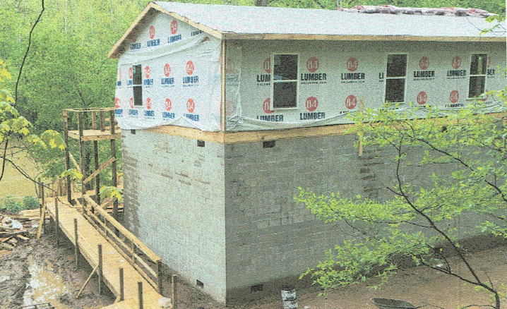
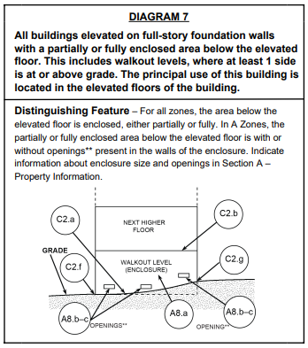
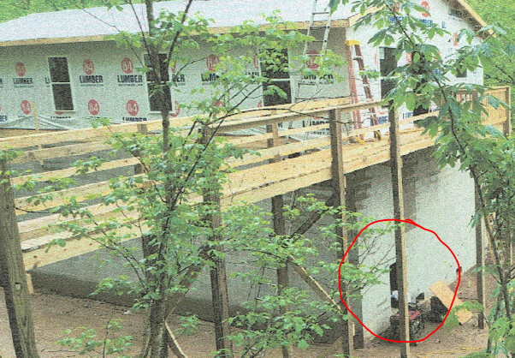
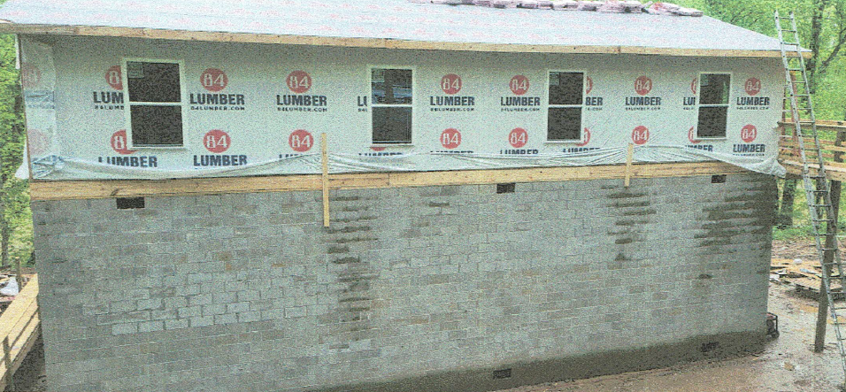
Mitigated Structure – EC Bldg. #7
Building Diagram 7: Elevated Building on Solid Foundation Walls (Full-Story)
Building Diagram 5
Walkout Opening
Full-Story Enclosure
Building Picture

Slide 37
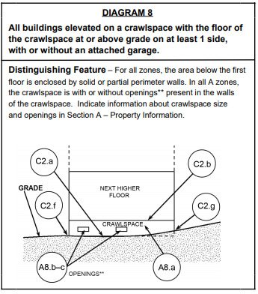
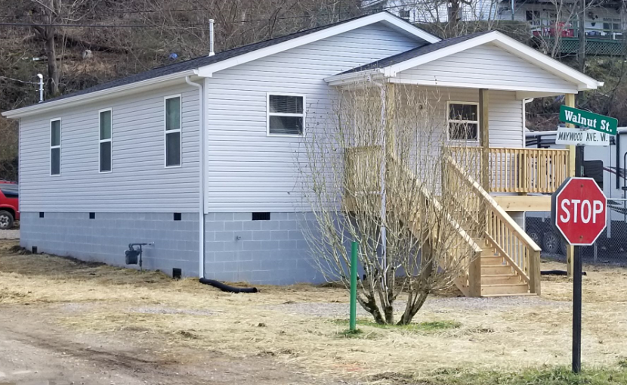
Mitigated Structure – EC Bldg. #8
Building Diagram 8: Elevated Building with Crawlspace (Enclosure)
Crawlspace Enclosure

Slide 38
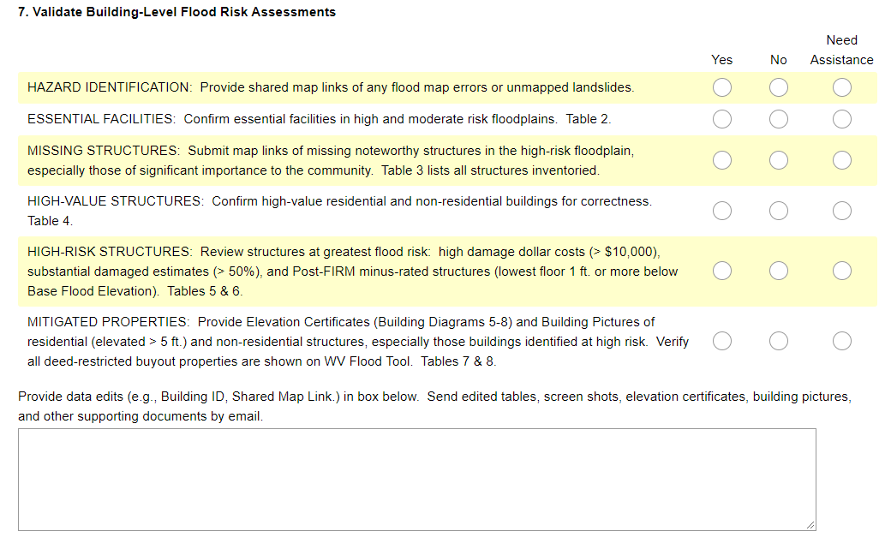
Quick Verification Guide and Survey
Complete Online Survey Form when Finished

