Slide 1
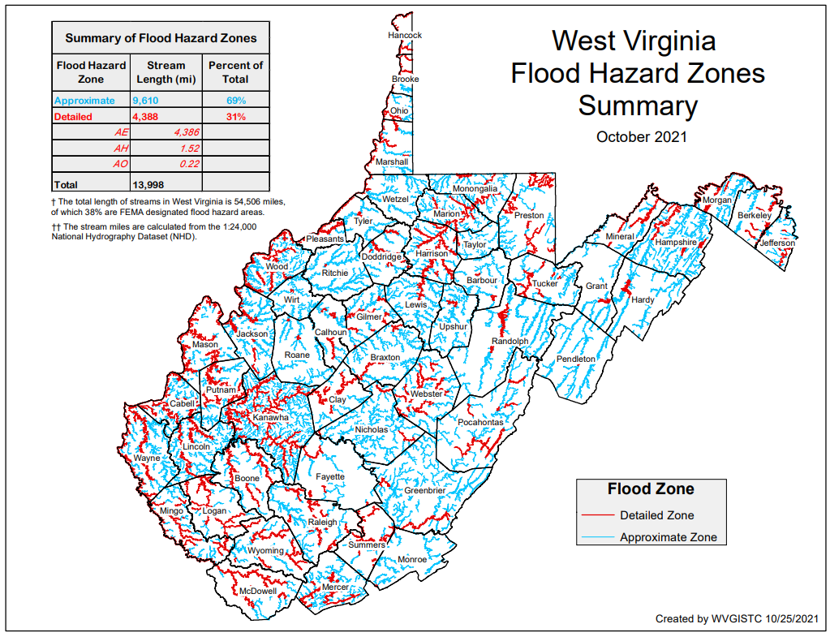
Building Stock in Flood Zones
Although only 31% of the State has mapped Detailed Flood Zones (AE / AO / AH), the Detailed Flood Zones contain 65% of the Building Stock Located in SFHA. Most of the buildings are in mapped Detailed Flood Zones.
FLOOD HAZARD ZONES
Stream Miles Length
69% Approximate A
31% Detailed Zones
Special Flood Hazard Area
84,351 buildings
35% in Approximate Zone A
65% in Detailed Zone AE (9% in Regulatory Floodway)
BUILDINGS IN NON-REGULATORY ZONES
13,966 Structures (14%) mapped in High-Risk Zone Advisory A / AE
98,317 Total High-Risk
BUILDINGS IN SHADED X
Moderate Risk
44,415 structures in 500-YR floodplains
9,718 structures in Levee Protected Zones
PDF Map

