Slide 1
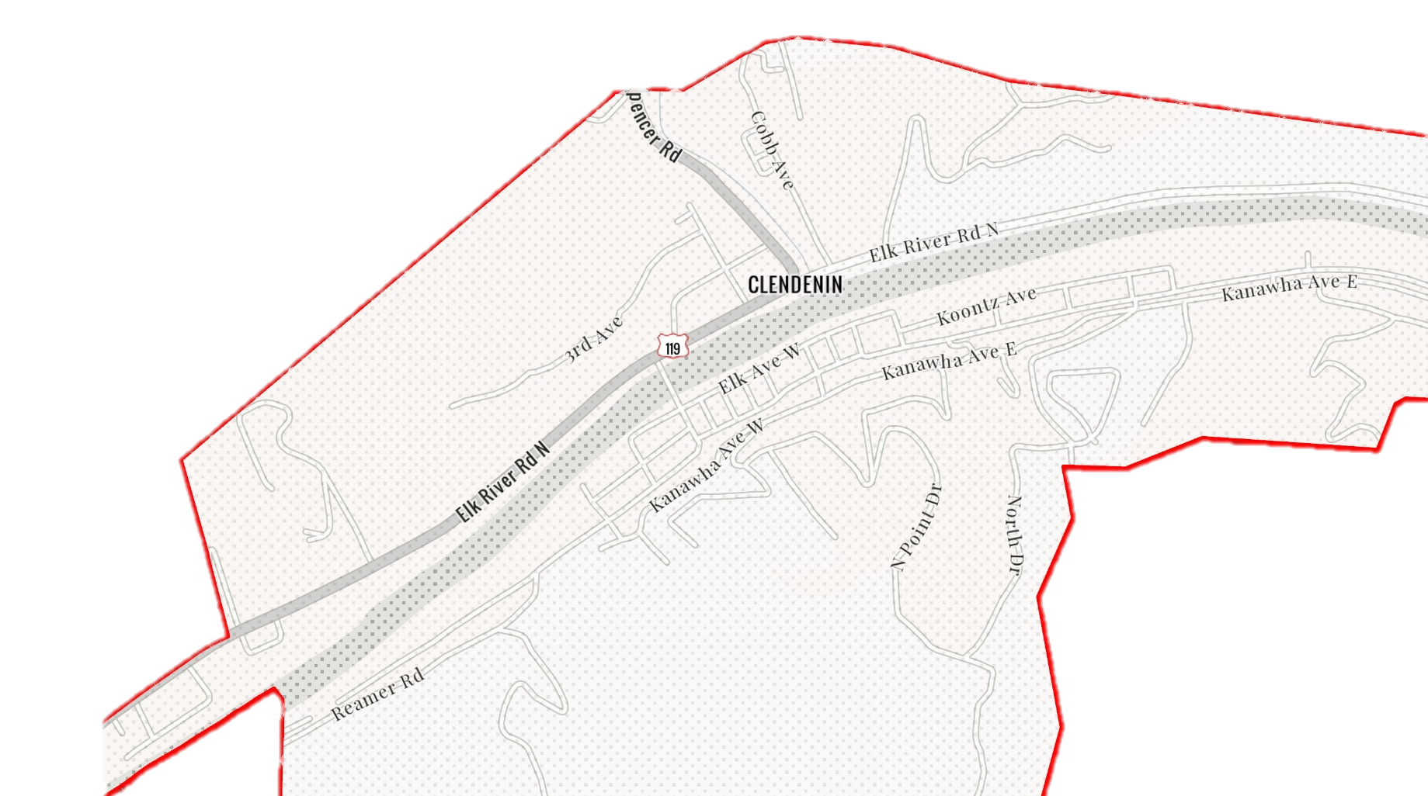
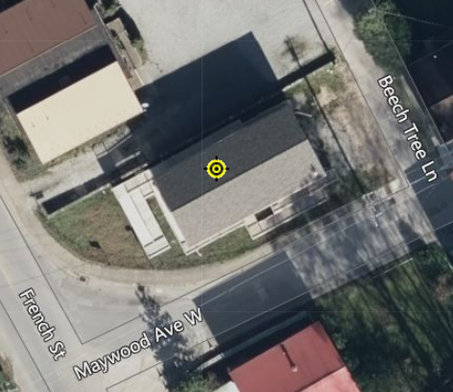
Clendenin
20-02-0006-0044-0000_306
306 Maywood Ave., Clendenin, WV, 25045
Building Flood Profile

Slide 2
The Design Flood Elevation (DFE) should be the BFE plus 2 feet of freeboard. The DFE should also be above the high-water marks of the 2016 flood plus freeboard.
306 Maywood Ave., Clendenin, WV, 25045
20.5’ (FEMA 0.2% / 500-Yr)
12.3’ (FEMA 1% / 100-Yr)
10.5’ (2016 High Water)
2.0’ (FEMA 10% / 10-Yr)
Building 20-02-0006-0044-0000_306
FLOOD DEPTHS:
FEMA
USGS 2016 Flood High Water Mark

Slide 3
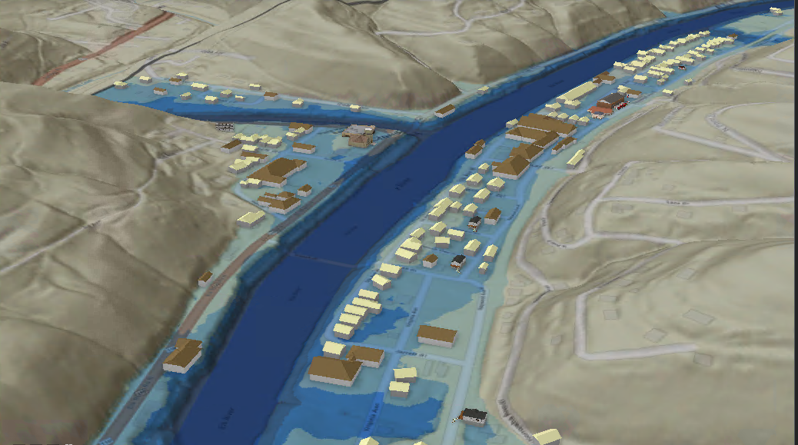
FEMA 1% Annual Chance (100-year)
Clendenin, WV
Big Sandy Creek
0.1 ft.
FLOOD DEPTH
38.1 ft.
306 Maywood Ave
Elk River
Residential
Non-Residential
23.5% of Clendenin is in the 1% Annual Flood Chance
26% probability of flooding at least once over 30 years

