Slide 1


Risk MAP (Pocahontas Co. Preliminary Flood Maps)
Risk Mapping (New Preliminary Flood Maps)
Understand Flood Map Changes (BFEs, Floodplains/Floodways)
Floodplain Building Counts
SFHA Building Changes and Outreach Letters
LOMAs (SFHA mapped out)
Risk Analysis (Risk Identification)
Large Floodplain Area (acres) and Length (miles)
Highest number of floodway structures
Higher Number of Critical Infrastructure/Essential Facilities and Community Assets
High Building Damage Losses
High Repetitive Loss Structures and Paid Claims
High Population Exposure
Risk Planning (Flood resiliency)
Swift Grant Funding for RL Structures
Preload Structures into FEMA SDE Software
Validate floodplain building inventory
Plan for Inundated Roads
Verify Buyout Properties
Apply for CRS status
Use stream gauge stages and ground elevation for emergency planning
Publish Elevation Certificates on WV Flood Tool

Slide 2
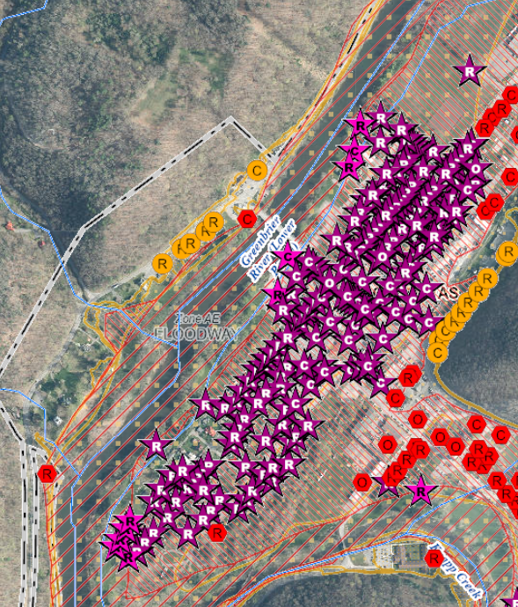
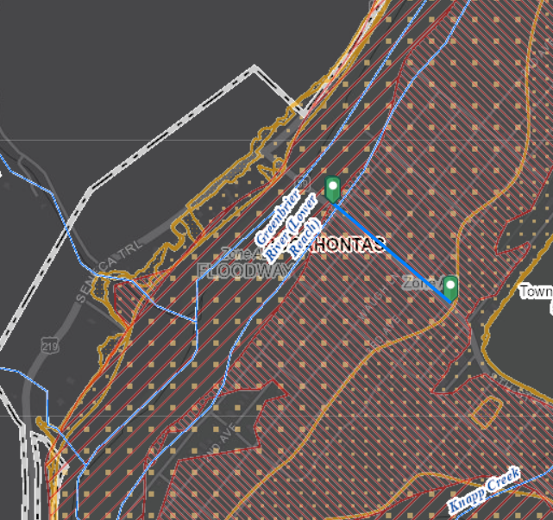
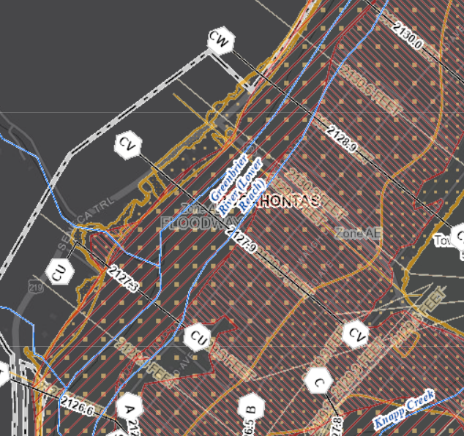
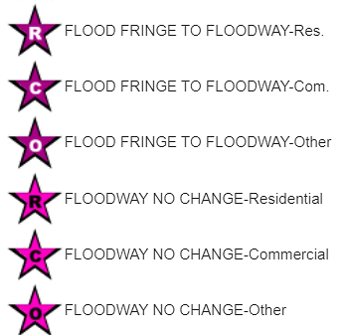
Buildings in Preliminary Floodway
Floodway Increase in Marlinton
Buildings in the floodway channel of a stream or close to the flood source, will be subject to the greatest flood depths, highest velocities, and greatest debris potential.
Community | Buildings in Preliminary Floodway | Buildings in Effective Floodway | Net Change in Floodway
Marlinton | 190 | 14 | + 176
Floodway width expanded significantly
up to 300 yards (900 ft)
Base Flood Elevation increased
to about 2 feet
2130.6 - 2128.9
= 1.7 ft
300 yd
Flood Tool Link

Slide 3
Preliminary Floodplain Building Counts
COMMUNITY IDENTIFICATION
Community Name | Community Type | Estimated structures in the Community | Estimated structures in the preliminary flood high hazard area | Estimated structures newly mapped in | Estimated structures newly mapped out
Pocahontas County* | Incorporated | 6,218 | 399 | 154 | 169
Durbin | Incorporated | 187 | 14 | 9 | 2
Hillsboro | Incorporated | 179 | 0 |  | 0
Marlinton** | Incorporated | 673 | 371 | 43 | 29
 | County | 7,257 | 784 | 206 | 200
* Unincorporated
** Marlinton has a total of 190 floodway structures, of which 176 were moved from floodplain fringe to floodway, an increase of 1,157%.
County Net Change in structures: + 6
County Net Change in floodway structures: + 192

Slide 4
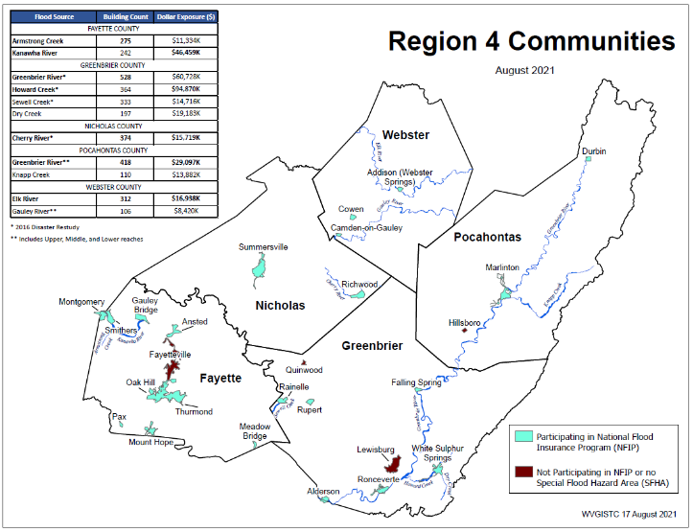
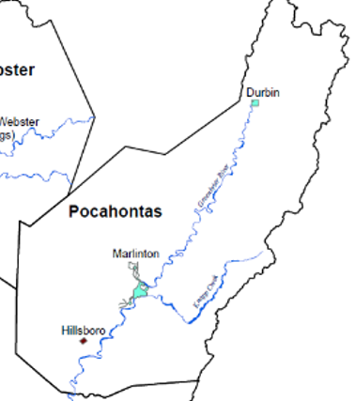
Building Counts & Values by Rivers (2021)
Marlinton, WV
Top Rivers with highest building counts are Greenbrier River (418) and Knapp Creek (110).

Slide 5
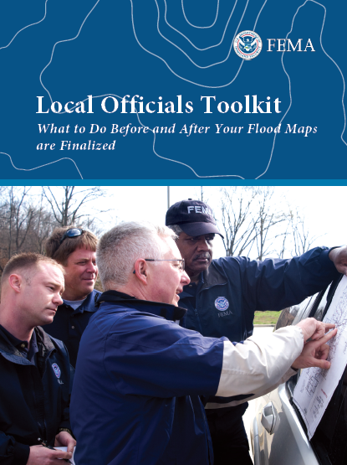
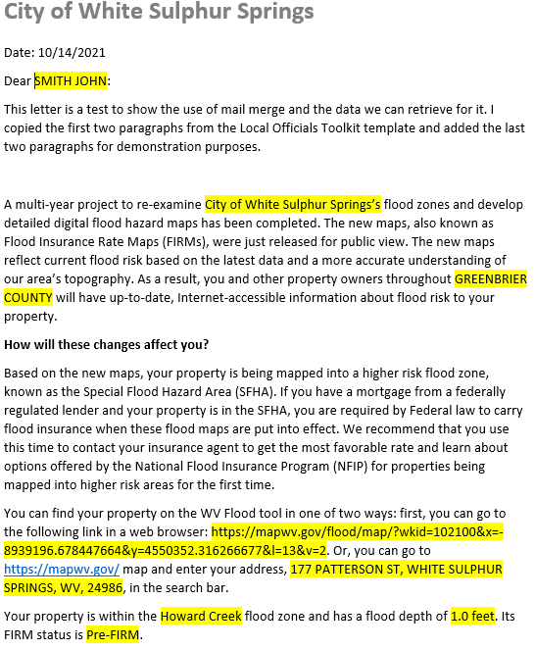
SFHA Map Change Letters
Incorporate 1% Floodplain Building Risk Assessment Inventory into Mitigation and NFIP/CRS Management Activities
White Sulphur Springs has 68 buildings being mapped into the SFHA
Counties which recently sent outreach letters to homeowners:
Hardy County
Risk MAP
Kanawha County - Elk River PMR
Greenbrier County Risk MAP
FEMA Region 3 Toolkit for New Flood Studies
Mail Merge Template for SFHA Mapped-in Structures

Slide 6
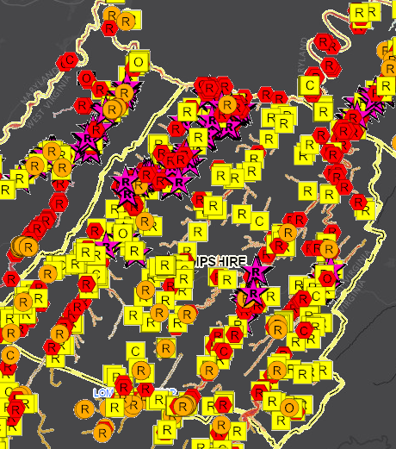
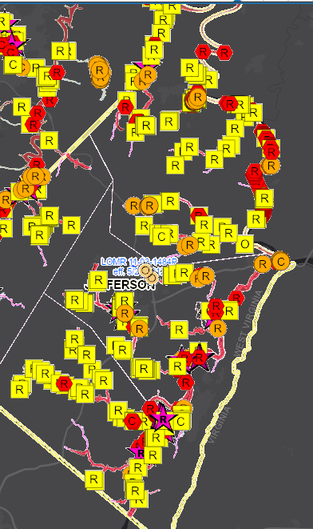
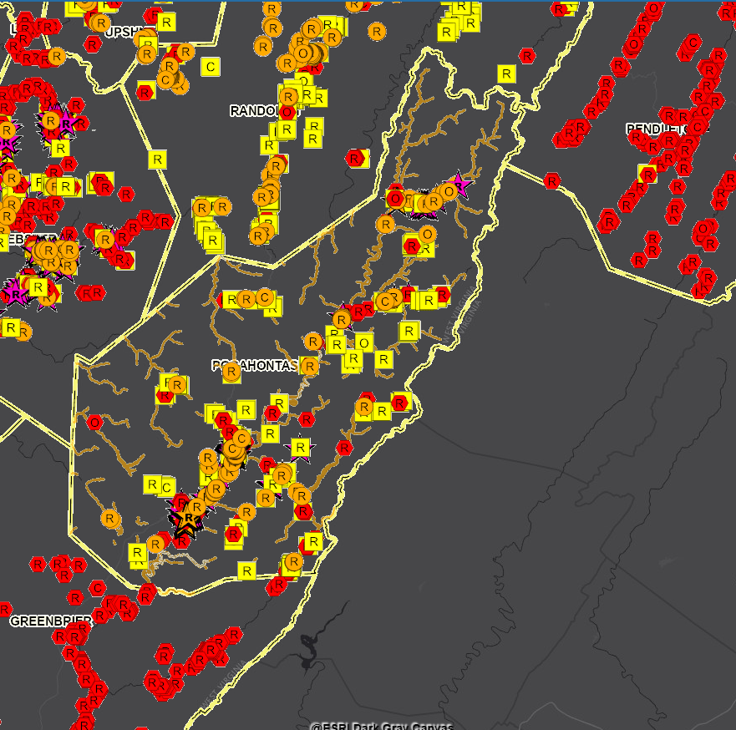
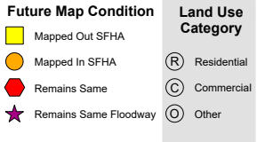
Building SFHA Change (LiDAR LOMAs)
Hampshire County
Jefferson County
Pocahontas County
399
Mapped Out
200
Mapped Out
All building symbols in the floodplain fringe will become “red color” once flood maps are effective
276
Mapped Out
Floodway

Slide 7
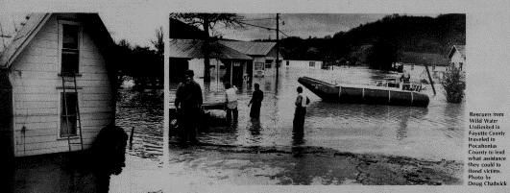
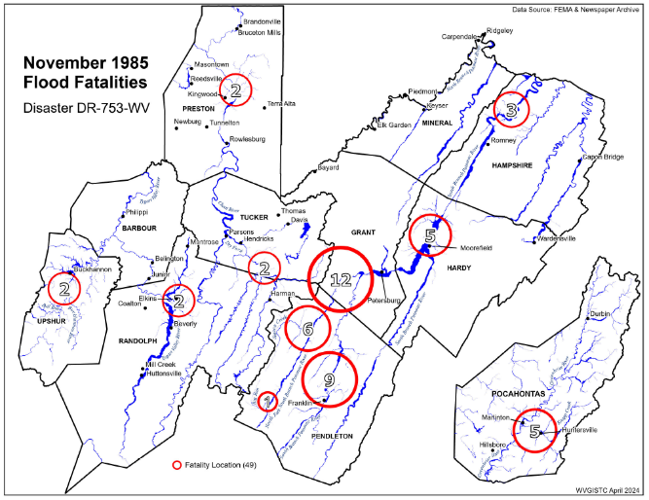
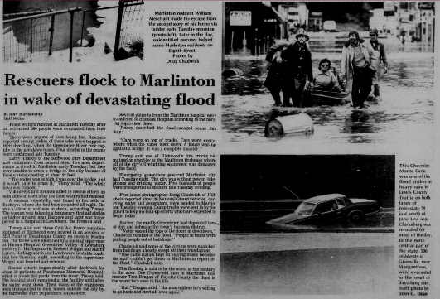
Historical Flood Research (Marlinton, WV)
November 1985 Flood (47 fatalities)

Slide 8
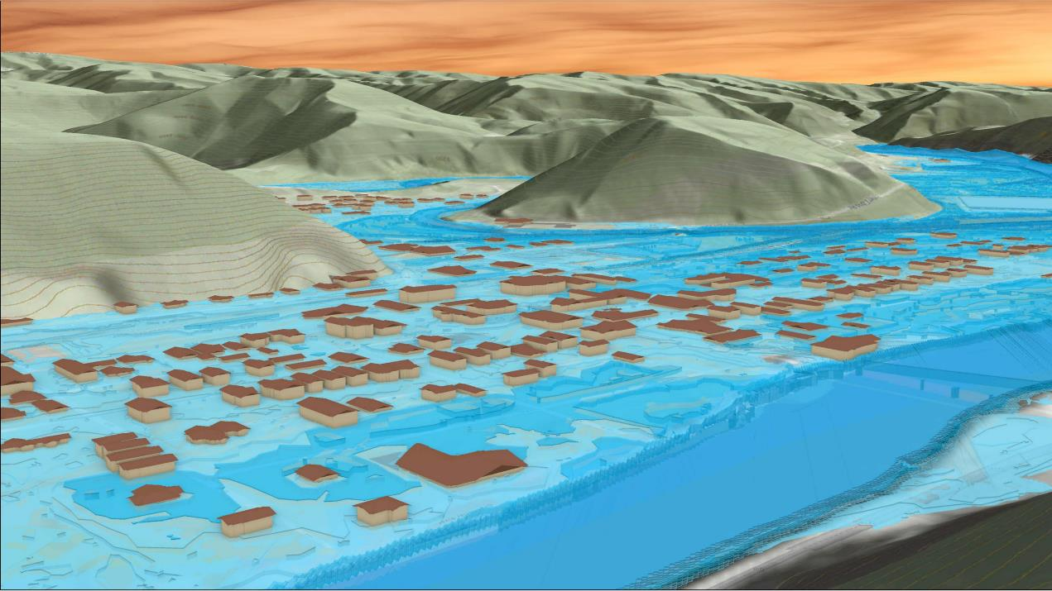
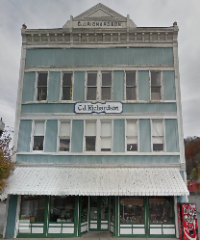
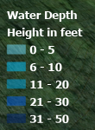
Site Hazard Study (Marlinton)
309 8th St, Marlinton, WV, 24954
Knapp Creek
309 8th St, Marlinton, WV
Greenbrier River
FEMA 1% Annual Chance (100-year)
26% probability of flooding at least once over 30 years
Community Scale Flood Visualization

Slide 9
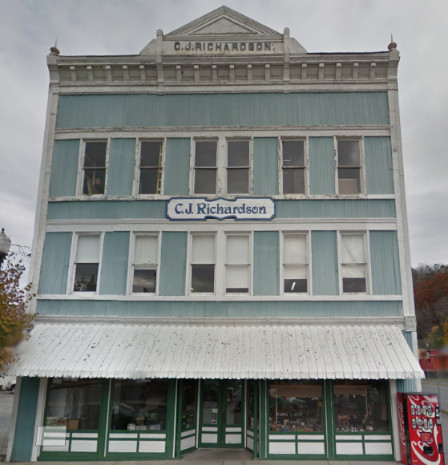

Site Hazard Study (Marlinton)
1985 Flood High Water Mark
8.8’ (Preliminary NFHL 0.2% / 500-Yr )
7’ (1985 High Water Mark)
5.2’ (FEMA Preliminary NFHL 1% / 100-Yr)
309 8th St, Marlinton, WV, 24954
3.6’ (FEMA 1% / 100-Yr)
Building: 38-08-0003-0023-0000
2.7’ (FEMA 2% / 50-Yr)
Commercial Structure built in 1900
Building Scale Visualization

Slide 10
Supplemental Risk Assessment
Pocahontas County
Among Top 10%
Indicators | Pocahontas County | Pocahontas Unincorporated Area | Marlinton | Durbin | State
Floodplain Characteristics
Floodplain Area (Acres) | 10,641 | 10,089 | 494 | 58 | 528,635
Floodplain Area Ratio | 1.8% | 1.7% | 31.5% | 15.8% | 3.4%
Floodplain Length (Miles) | 513 | 503 | N/A | N/A | 16,059
Maximum Flood Depth (Feet) | 9.2 | 9.2 | 9.0 | 6.7 | 38.7
Median Flood Depth (Feet) | 3.4 | 2.1 | 4.0 | 1.4 | 2.0
Building Counts
Total Community/County Structures | 7,257 | 6,218 | 673 | 187 | 1,118,761
Buildings in High-Risk Floodplains | 984 | 568 | 400 | 16 | 98,119
Building Ratio in Floodplain | 13.6% | 9.1% | 59.4% | 8.6% | 8.8%
Building Density in Floodplain (Buildings/Acres) | 0.09 | 0.05 | 0.81 | 0.28 | 0.19
Buildings “Mapped In” SFHA | 206 | 154 | 43 | 9 | 13,267
Buildings “Mapped Out” SFHA | 200 | 169 | 29 | 2 | 15,509
Net Change in SFHA | + 6 | - 15 | + 14 | + 7 | - 2,242
Buildings in Preliminary Floodway | 308 | 113 | 190 | 2 | 8,637
Buildings in Effective Floodway | 73 | 55 | 14 | 1 | 8,299
Net Change in Floodway | + 235 | + 58 | + 176 | + 1 | + 338
Among Top 20%
1
First Rank
Rankings done separately for counties, unincorporated areas, and 229 incorporated places
1
Notes:
Modified Floodplain Area: Total Special Flood Hazard Area (aSFHA) – [Open water lakes > 10 acres] – [Large rivers bank-to-bank > 500 ft.] – [Federal lands > 10 acres]
Floodplain Length Breakdown: Pocahontas County → Detailed: 17.2%, Approximate: 57.2%, Advisory: 25.7% Pocahontas Unincorporated Area → Detailed: 16.2%, Approximate: 57.7%, Advisory: 26.1%
Marlinton → Detailed: 68.6%, Approximate: 28.4%, Advisory: 3.0% Durbin → Detailed: 100%, Approximate: 0%, Advisory: 0%

Slide 11
Supplemental Risk Assessment…
Pocahontas County
Among Top 10%
Indicators | Pocahontas County | Pocahontas Unincorporated Area | Marlinton | Durbin | State
Building Characteristics
Median Building Value in Floodplain | $32,550 | $33,400 | $32,300 | $21,600 | $38,200
Residential Count Ratio in Floodplain | 84.1% | 91.0% | 74.8% | 75.0% | 88.5%
Mobile Homes Ratio of Single-Family Dwellings in Floodplain | 15.1% | 18.8% | 8.1% | 25.0% | 27.5%
One-Story Ratio in Floodplain | 72.3% | 84.5% | 55.0% | 70.6% | 83.9%
Buildings with Basement Ratio in Floodplain | 14.8% | 9.2% | 23.3% | 5.9% | 24.8%
Pre-FIRM Ratio in Floodplain | 77.2% | 69.6% | 88.1% | 75.0% | 70.1%
Critical Infrastructure
Essential Facilities | 6 | 0 | 5 | 1 | 489
Roads Inundated (Miles) | 113.3 | 97.5 | 14.5 | 1.3 | 6,503
Inundated Roads Ratio | 4.9% | 4.4% | 22.8% | 13.1% | 6.0%
Community Assets
Historical Community Assets | 10 | 6 | 4 | 0 | 2,758
Non-Historical Community Assets | 24 | 9 | 13 | 2 | 2,093
Among Top 20%
Rankings done separately for counties, unincorporated areas, and 229 incorporated places
Notes:
Essential Facilities identified in both 1%-annual-chance (100-year) and 0.2%-annual-chance (500-year) floodplains.
State values and ratios calculated for all floodplain buildings (from BLRA) in the state.
Buildings in High-Risk Floodplain Breakdown:
Pocahontas County → in Effective: 778, in Advisory: 206 Pocahontas Unincorporated Area → in Effective: 414, in Advisory: 154
Marlinton → in Effective: 357, in Advisory: 43
Durbin → in Effective: 7, in Advisory: 9
Pre-FIRM Ratio in Floodplain also includes Post-FIRM regulated to Pre-FIRM (Mapped into SFHA).

Slide 12
Supplemental Risk Assessment…
Pocahontas County
Among Top 10%
Indicators | Pocahontas County | Pocahontas Unincorporated Area | Marlinton | Durbin | State
People / Social
Population Residing in Floodplain Ratio | 26.7% | 14.9% | 85.6% | 11.3% | 11.1%
Displaced Population Ratio | 21.2% | 10.4% | 76.0% | 4.1% | 6.6%
Population in Need of Short-Term Shelter | 340 | 137 | 201 | 2 | 22,930
WV SVI | 70.4% | 74.1% | 60.4% | 40.5% | N/A
Estimated / Previous Damage
Building Flood Loss Ratio | 8.5% | 10.1% | 7.6% | 8.1% | 8.6%
Substantial Damage Count | 53 | 34 | 16 | 3 | 6,493
Substantial Damage Count Ratio | 5.4% | 6.0% | 4.0% | 18.8% | 6.6%
Minus Rated (>1ft) Post-FIRM Count Ratio | 7.3% | 8.6% | 5.8% | 0.0% | 4.8%
Median Building Damage Value (>= $1K) | $7,756 | $8,759 | $7,109 | $5,600 | $7,657
Total Number of Claims since 1978 | 745 | 155 | 585 | 5 | 27,880
Total Paid Claims since 1978 | $15,696K | $2,209K | $13,448K | $39K | $368,292K
Number of Repetitive Losses | 280 | 28 | 252 | 0 | 9,716
Among Top 20%
Rankings done separately for counties, unincorporated areas, and 229 incorporated places
Notes:
WV SVI, between 0 to 100%, based on eight social and economic indicators to measure a population's vulnerability to flood hazards: Poverty Rate, Unemployment Rate, Vulnerable Ages Rate, Disability Rate, Population without a High School Diploma Ratio, Population Change, Median Housing Value, and Mobile Homes as percentage of housing units
Population estimation models based on the building inventory in 1%-annual-chance (100-year) floodplain and Census Bureau’s 2021 American Community Survey, 5-year estimates.
Substantial Damage: Estimated damage of equal to or greater than 50% of building value before the event
Minus Rated (>1ft): The first flood level more than 1 ft below the base flood elevation (BFE)
Post-FIRM: Constructed after community's initial Flood Insurance Rate Map (FIRM) date
Repetitive Loss: NFIP-insured structure that has had at least 2 paid flood losses of more than $1,000 each, in any 10-year period since 1978

Slide 13
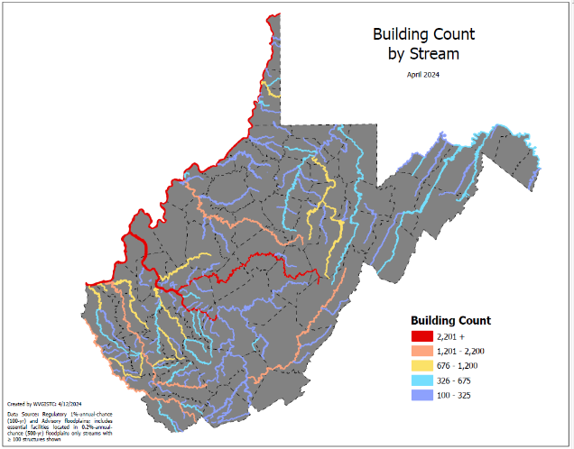
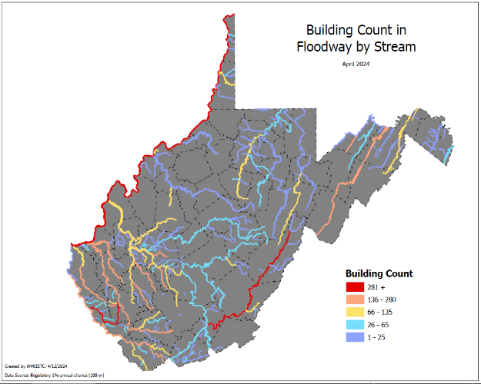
Greenbrier River (Building Counts)
Stream Name | Total Building Count
Ohio River | 7,237
Kanawha River | 7,116
Elk River | 2,253
Greenbrier River | 1,821
Stream Name | Total Floodway Count
Island Creek | 632
Greenbrier River | 513
Stream Name | Substantially Damaged
Ohio River | 920
Greenbrier River | 368
Marlinton, WV
Marlinton, WV
Buildings in SFHA
Flood Risk Indicators
Buildings in Floodway
Statewide Stream Scale

Slide 14
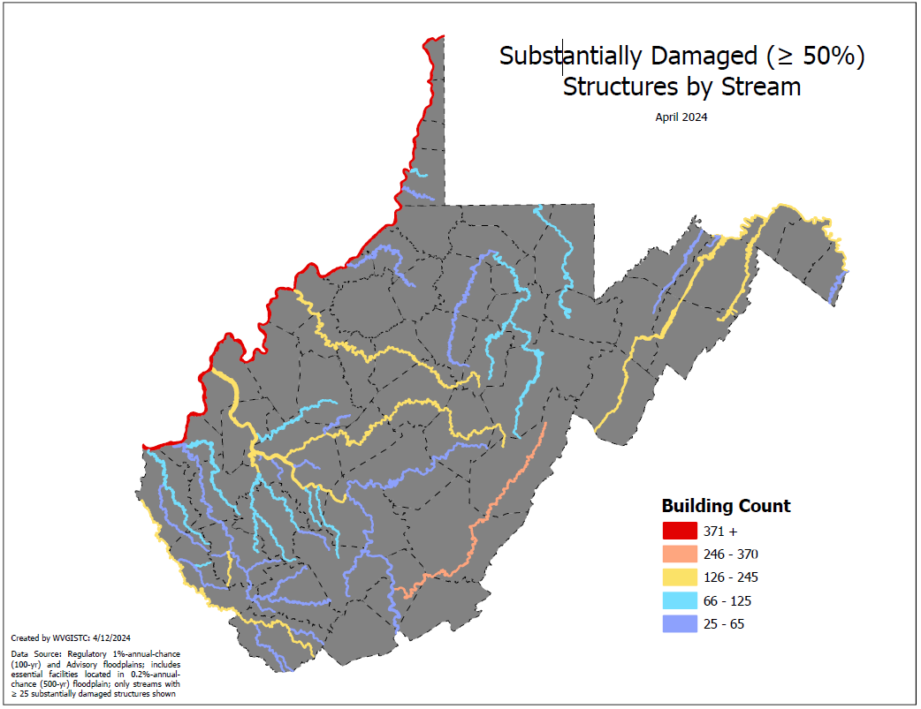
Greenbrier River (Substantial Damage Loss Estimates)
Stream Name | Substantially Damaged Building Count
Ohio River | 920
Greenbrier River | 368
Kanawha River | 243
Potomac River | 206
South Branch Potomac River | 171
Island Creek | 168
Coal River | 163
Cacapon River | 158
Elk River | 158
Tug Fork | 136
LIttle Kanawha River | 126
Pond Fork | 119
Pocatalico River | 110
Cheat River | 104
Buckhannon River | 100
Greenbrier River
Flood Risk Indicator: Substantial Damage
Statewide Stream Scale

Slide 15
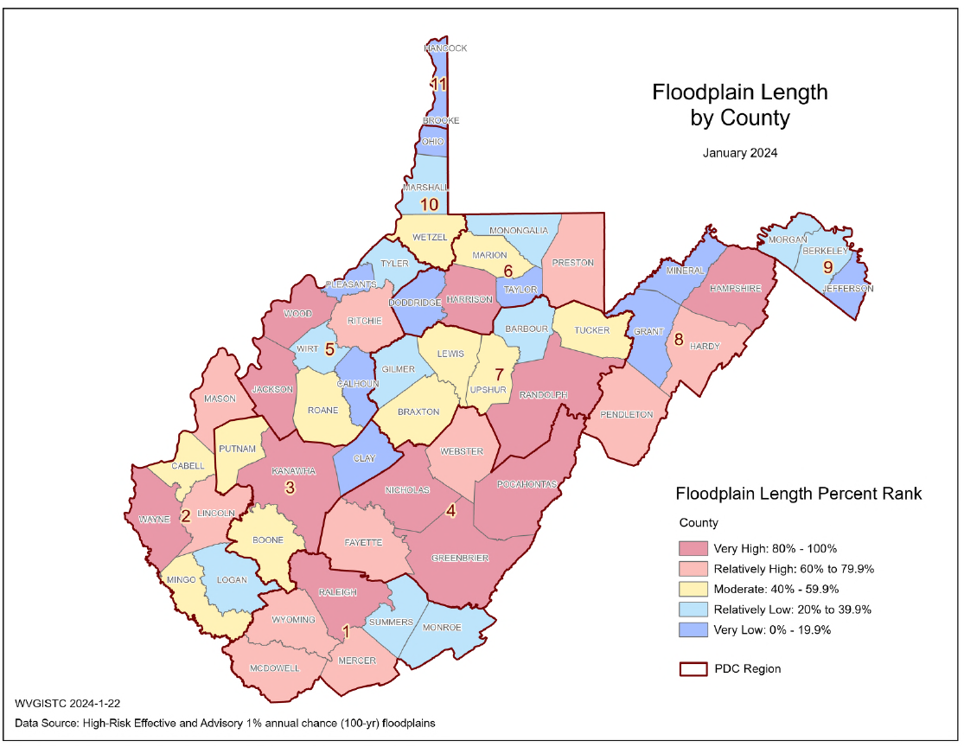

Risk Indicator: High Amount of Floodplain Miles
Pocahontas County
Larger jurisdictions and unincorporated areas of the county must be vigilant in monitoring and permitting new development for an expansive geographic area that includes a large amount floodplain area/miles.
Floodplain Miles
Total Length in Miles of Flood Zones
Flood Risk Indicator
County Scale

Slide 16
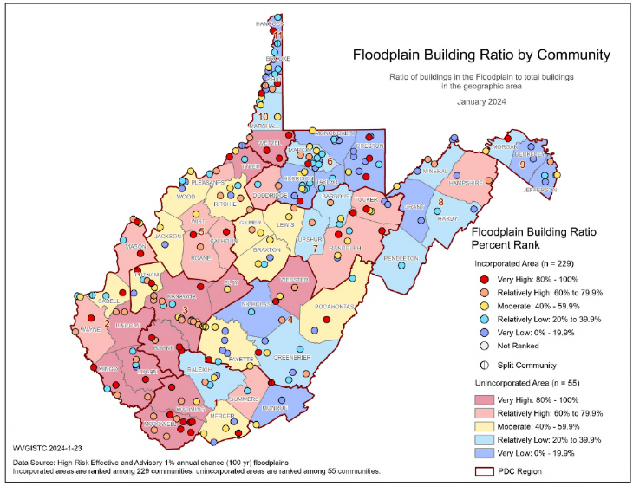
Risk Indicator: Floodplain Building Ratio (Marlinton)
266 Flood-Prone Communities
Floodplain Building Ratio
Ratio of building in floodplains to total buildings in Marlinton
94% of WV Communities have Special Flood Hazard Areas (SFHA)
Marlinton, WV
Flood Risk Indicator
Community Scale

Slide 17

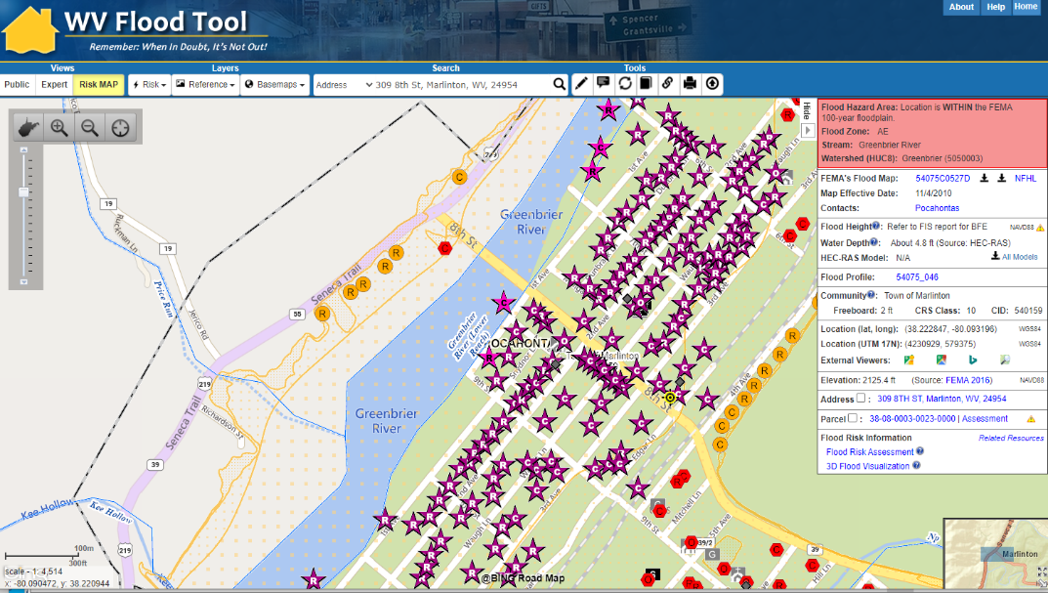
Risk Indicators: (Marlinton)
High-Risk Effective & Advisory
1%-Annual-Chance (100-Yr) Floodplains
WV Flood Tool link
Top 10% rankings among 229 incorporated places
Floodplain Characteristics
High percentage of community in in flood zone
FLOODPLAIN AREA: High percentage of municipality’s area in
Special Flood Hazard Area (SFHA)
Marlinton
Building Counts
High building counts in SFHA and floodway
PEOPLE: High number of people reside in high-risk flood zone
DAMAGE LOSS: Marlinton has a high percentage of repetitive loss structures and flood loss claims ($)
Damage Loss $
High percentage of previous losses
People
Many residents displaced from major flood event
BUILDING COUNTS: Marlinton has the highest number of structures in the floodway of all incorporated places
Floodway
1

Slide 18
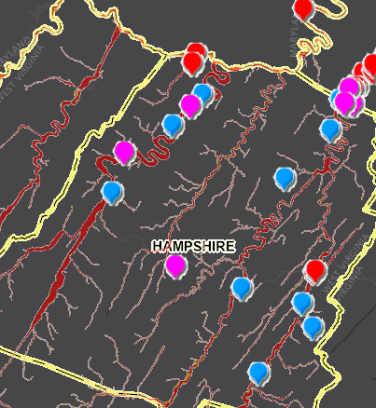
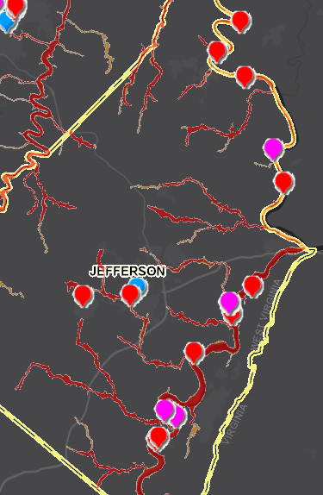
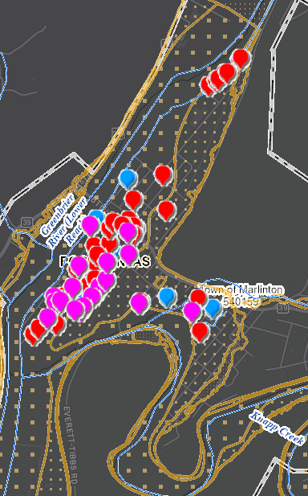



Risk Indicator: Repetitive Loss Structures (Mapped)
Hampshire County
Jefferson County
Marlinton (Pocahontas County)
Severe Repetitive Loss
(Site Address Matched)
Repetitive Loss
(Site Address Matched)
Repetitive Loss
(Street Address Matched)

Slide 19
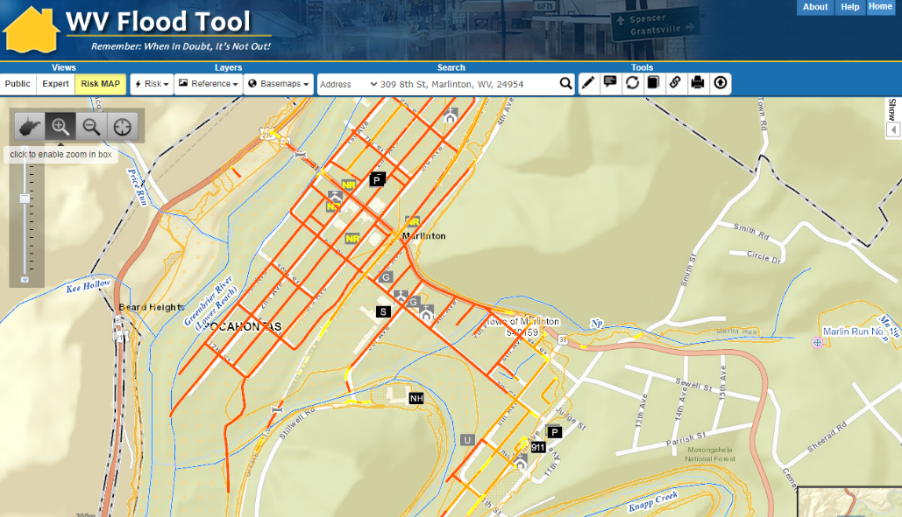
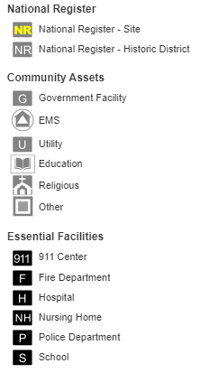
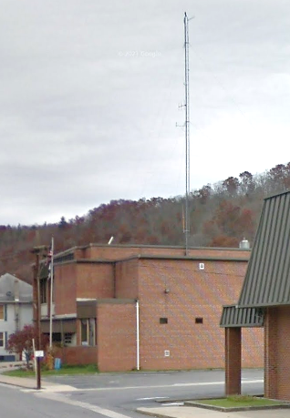
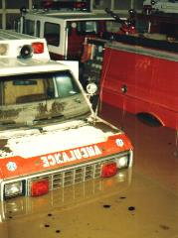
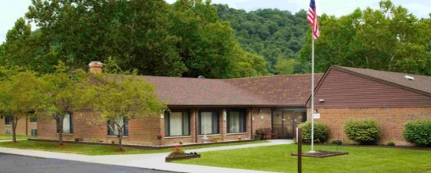

Risk Indicators: Critical Infrastructure (Marlinton)
WV Flood Tool link
Top 10% rankings among 229 incorporated places
Marlinton
INFRASTRUCTURE: High number of essential facilities and roads subject to flooding from a major event
Critical Infrastructure
High number of essential facilities & flooded roads
Flooded fire station in Marlinton, Nov. 1985
Marlinton Police Department
Highest EF Flood Depth (4 ft)
(Building ID: 38-08-0001-0096-0000_709A)
Pocahontas Center (Nursing Home)
(Building ID: 38-08-0005-0065-0002_5)

Slide 20
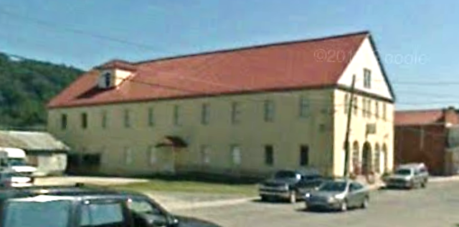
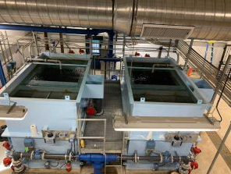
Risk Indicators: Community Assets (Marlinton)
COMMUNITY ASSETS: Marlinton has a high percentage community assets including historical assets
WV Flood Tool link
Marlinton
Top 10% rankings among 229 incorporated places
Marlinton Opera House
Highest Hist. CA Depth (4.7 ft) & Value ($148K)
(Building ID: 38-08-0002-0159-0000_818)
Community Assets
High number of non-historical community assets
Marlinton Water Plant
Highest Non-Hist. CA Value ($8.9M)
(Building ID: 38-08-0005-0088-0000_1002)
Value source inflation adjustment to 2021

Slide 21
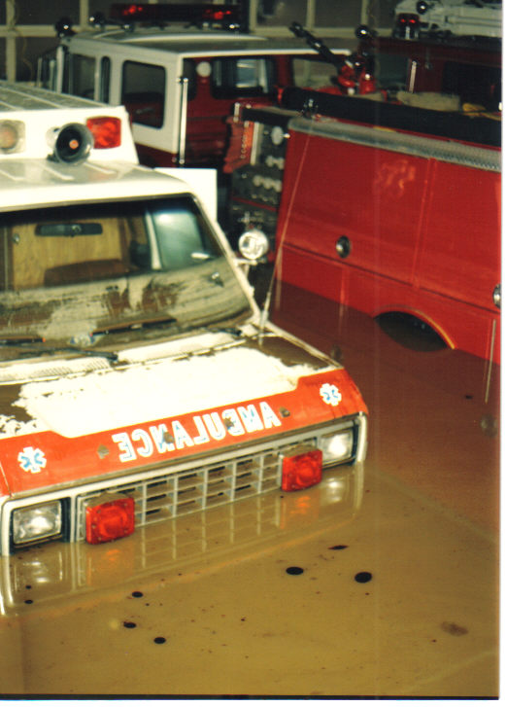


Significant Structures
Types & Rationale
Essential Facilities
Essential Facilities provide emergency services during a flood.
Hospitals and nursing homes with immobile patients are particularly susceptible to flooding. Schools often serve as refuges during floods.
Communities need to establish emergency protocols to maintain critical services amidst a flood.
Flooded fire station in Marlinton, Nov. 1985
Community Assets:
Non-Historical
Historical
Non-Historical buildings such as churches often serve as emergency shelters during floods. Flooding can disrupt critical community lifelines including safety, water, shelter, health, and energy.
Historical assets often have significant cultural value and are listed on the National Register of Historic Places.

Slide 22

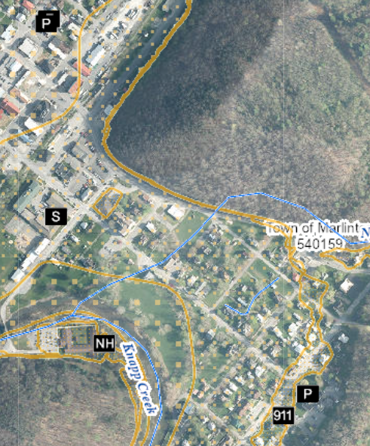
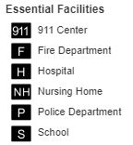
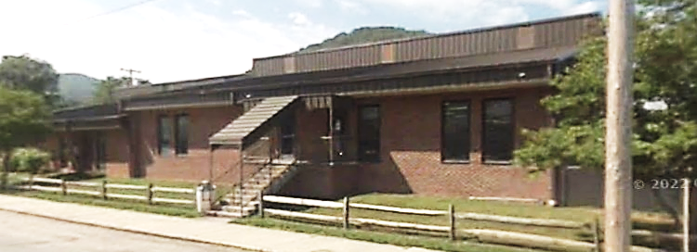

Risk Indicator: High Number of Essential Facilities
COMMUNITY | ESSENTIAL FACILITIES |  |  |  |  | FLOOD ZONE BREAKDOWN
 |  |  |  |  |  | 1%-Annual-Chance (100-yr) Floodplain |  | 0.2% (500-yr) | High & Moderate Risk
 | Police Station | Fire Station | 911 Center | School | Nursing Home | Preliminary Floodway | High-Risk 100-Yr Floodplain | Moderate-Risk 500-Yr Floodplain | Total in 100 & 500-Yr Floodplains
Durbin | 0 | 1 | 0 | 0 | 0 | 0 | 0 | 1 | 1
Marlinton | 1 | 1 | 1 | 1 | 1 | 2 | 1 | 2 | 5
 |  |  |  |  |  |  |  |  | Rank among incorporated places: 7
Marlinton
Marlinton Volunteer Fire Department
Essential Facilities in Marlinton
Among the essential facilities in Marlinton 4 are more vulnerable:
1 School, 1 Nursing Home, 2 in Floodway (Fire & Police Stations)
Marlinton Police Department
Marlinton Volunteer Fire Department and Marlinton Police Department mapped from flood fringe to floodway
Pocahontas Center (NH) and Pocahontas County 911 Center mapped from 100-yr to 500-yr
Pocahontas County Sheriffs Office mapped out high- & moderate-risk floodplains
Marlinton Elementary School
Pocahontas County Sheriffs Office
Pocahontas Center
Pocahontas County 911 Center
Marlinton Police Department
Highest EF Flood Depth (4 ft)
(Building ID: 38-08-0001-0096-0000_709A)
Marlinton Elementary School
(Building ID: 38-08-0005-0009-0000_926)
Pocahontas Center (Nursing Home)
(Building ID: 38-08-0005-0065-0002_5)

Slide 23

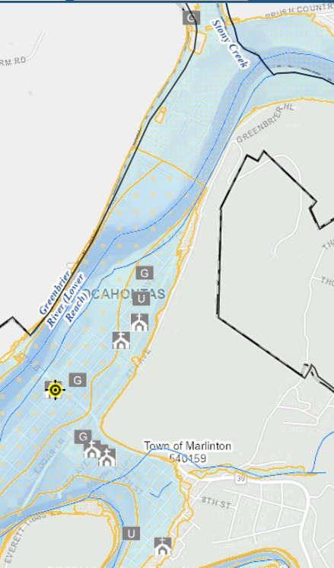
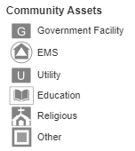

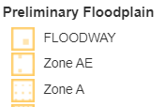
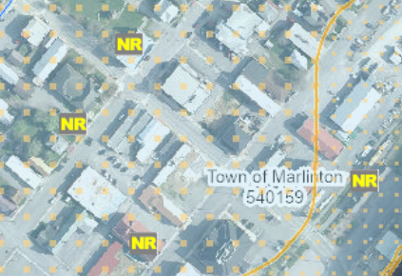

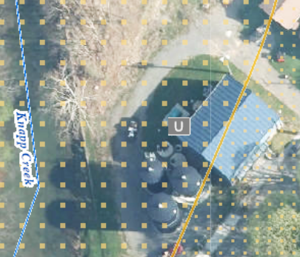
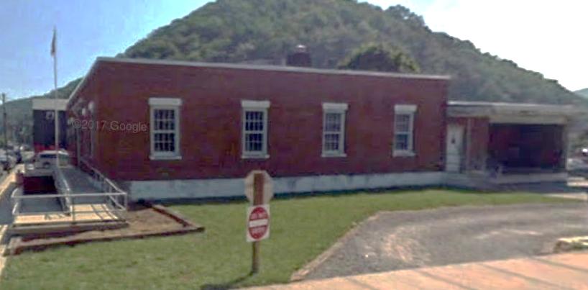

Risk Indicator: High Number of Community Assets
COMMUNITY | NON-HISTORICAL COMMUNITY ASSETS |  |  | Total Non-Historical Community Assets | HISTORICAL COMMUNITY ASSETS |  | Total Historical Community Assets
 | Religious | Government | Utility |  | National Register | In Historic Districts Older than 1930
Pocahontas County* | 7 | 2 | 0 | 9 | 1 | 5 | 6
Durbin | 0 | 2 | 0 | 2 | 0 | 0 | 0
Marlinton | 6 | 5 | 2 | 13 | 4 | 0 | 4
 |  |  |  | Rank: 9 |  |  | Rank: 29
Pocahontas County Courthouse and Jail mapped out
* Unincorporated area
Marlinton
Community Assets in Marlinton
WVDOT Division of Highways Pocahontas County Headquarters
Marlinton
IOOF Lodge Building
Pocahontas Times Print Shop
Among the community assets in Marlinton 10 are more vulnerable (in Floodway or Depths >= 3 ft)
Marlinton Chesapeake & Ohio Railroad Station
West Virginia Division of Forestry
Marlinton Opera House
Monongahela Power Company
Grace Baptist Church
New Vision Praise and Worship Center
Marlinton Municipal Building
Marlinton Presbyterian Church
USPS
McClintic Branch Library
Saint Johns Episcopal Church
Marlinton United Methodist Church
Marlinton Water Plant
Highest Non-Hist. CA Value ($8.9M)
(Building ID: 38-08-0005-0088-0000_1002)
Value source inflation adjustment to 2021
Marlinton Water Plant
Pocahontas Cooperative Parish
USPS in Marlinton
Highest Non-Hist. CA Depth (4.8 ft)
(Building ID: 38-08-0005-0006-0000_819)
Marlinton Opera House
Highest Hist. CA Depth (4.7 ft) & Value ($148K)
(Building ID: 38-08-0002-0159-0000_818)

Slide 24
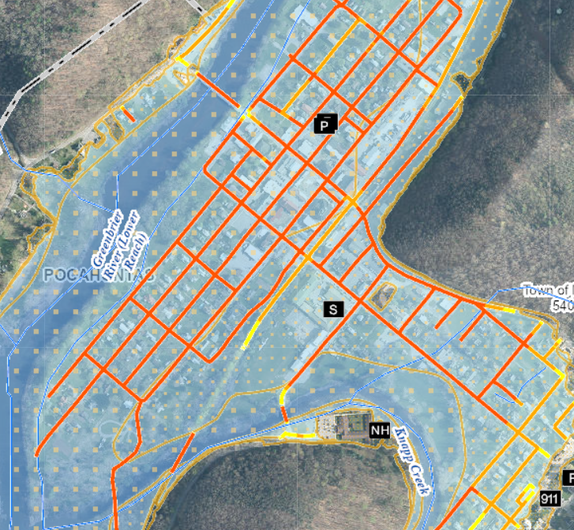
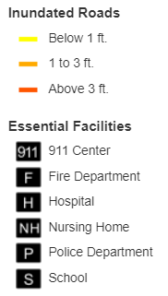
Risk Indicator: Roads Inundated
Community | Total Roads (TIGER) (Miles) | Roads Inundated (Miles) | Inundated Roads Ratio
Pocahontas County* | 2,209.8 | 97.5 | 4.4%
Durbin | 9.9 | 1.3 | 13.1%
Marlinton | 63.7 | 14.5 | 22.8%
 |  | Rank among incorporated places: 7 | Rank among incorporated places: 38
* Unincorporated area
Road Inundation and Essential Facilities in Marlinton
Marlinton
Marlinton
Flood Tool Link
A foot of water will float many vehicles and make roads impassable. About three feet is near the limit to use high profile vehicles to perform high water rescues and instead boats and helicopters are required to perform rescues.

Slide 25
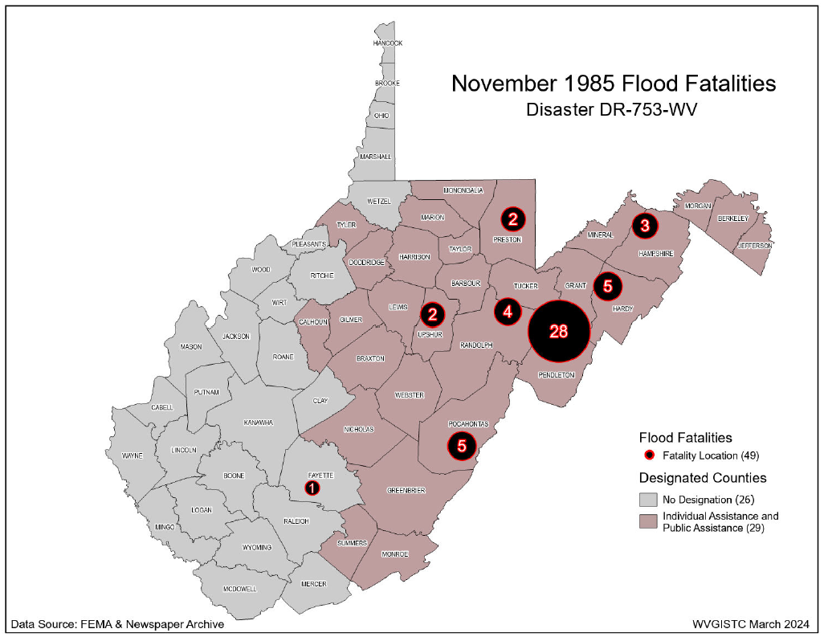

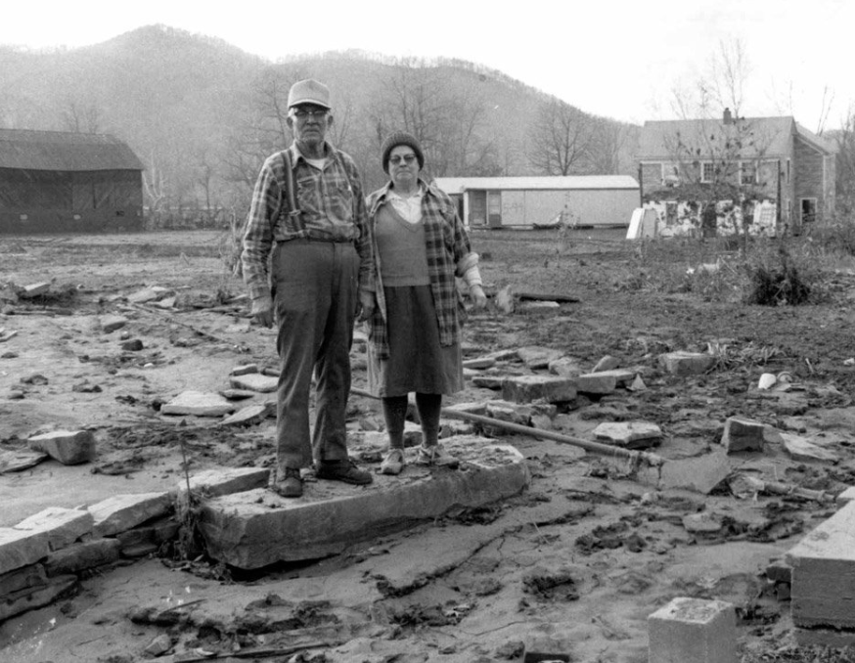
Risk Indicator: Population Exposure
Community | Total County Population | Population Residing in High-Risk Flood Zones | Population Residing in Floodplain Ratio | Estimated Displaced Population | Displaced Population Ratio | Estimated Population in Need of Short-Term Shelter
Pocahontas County* | 6,255 | 930 | 14.9% | 648 | 10.4% | 137
Durbin | 293 | 33 | 11.3% | 12 | 4.1% | 2
Marlinton | 1,329 | 1,138 | 85.6% | 1,010 | 76.0% | 201
 |  | Rank among incorporated places: 9 | Rank among incorporated places: 8 | Rank among incorporated places: 8 | Rank among incorporated places: 6 | Rank among incorporated places: 7
Marlinton
* Unincorporated area
Nov. 1985

Slide 26
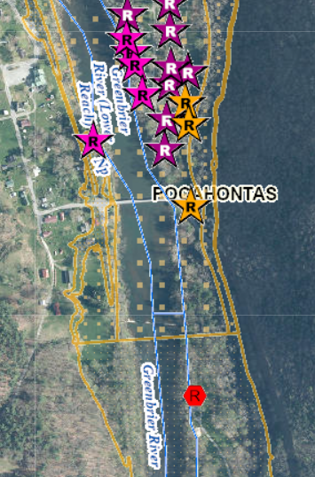

Risk Indicator: Maximum Flood Depths
Community | Maximum Flood Depth (Feet) | Median Flood Depth (Feet)
Pocahontas County* | 9.2 | 2.1
Durbin | 6.7 | 1.4
Marlinton | 9.0 | 4.0
 |  | Rank among incorporated places: 36
Marlinton
* Unincorporated area
Maximum flood depth in Marlinton (9.0 ft)
(Building ID: 38-08-0002-0183-0000_1025)
Maximum flood depth in Pocahontas County (9.2 ft)
(Building ID: 38-07-0039-0041-0001_836)

Slide 27



Preload Structures into SDE Software
Incorporate 1% Floodplain Building Risk Assessment Inventory into Mitigation and NFIP/CRS Management Activities
STEP 1: Community preloads Floodplain Properties into FEMA’s Substantial Damage Estimator software
STEP 2: Community performs practice Substantial Damage Assessments for Residential and Non-Residential Properties
Hampshire County has 1,111 Structures (both effective and preliminary floodplains) that can be uploaded
SDE Upload Files and Instructions

Slide 28

Verify Building Risk Assessments
Verify Primary Structures for High Depths
Verify Mitigation Status of Post-FIRM Structures
Use Building-Level (BL) Tables to identify Most Vulnerable Structures
Statewide BLRA (GIS)
BLRA County Tables organized by region
BLRA Data Extract Tables: High Building Value, High Damage Loss, High Minus Ratings
BLRA Statewide Top Lists: Building Value, Flood Depth, Damage Loss $, Damage Loss %, Minus Rated, Mitigated Structures
Risk Indicator Matrices: Exposure and Damage Loss Matrices of Risk Indicators
Verify Lowest Floor Elevations
Publish Elevation Certificates to WV Flood Tool
Verify Foundation & Basement Types

Slide 29

Plan for Inundated Road Impacts

Slide 30


Plan with Stream Gauges and Flood Tool
From NWS Gauge Website Stage
14 | Most areas near the river and along Knapps Creek are flooded. 5th Avenue and other sections of Marlinton are flooded. Water starts into nursing home. Homes flooded in Campbelltown.
12 | Sections of 1st, 2nd and 3rd Avenues in Marlinton are flooded. Sections of 9th Street start to flood. Sections of Campbelltown start to flood.
10 | Low areas along the river are flooded. 1st & 2nd Avenues start to flood.
https://water.weather.gov/ahps2/hydrograph.php?wfo=rlx&gage=mrlw2

Slide 31

Plan with Stream Gauges and Flood Tool
Water enters Nursing Home at 2131 ft. ground elevation or 14 ft. flood stage
WV Flood Tool (use 1-ft. ground elevation contours or displayed elevation value in query results panel)

Slide 32
Risk MAP (Pocahontas Co. Preliminary Flood Maps)
Risk Mapping (New Preliminary Flood Maps)
Understand Flood Map Changes (BFEs, Floodplains/Floodways)
Floodplain Building Counts
SFHA Building Changes and Outreach Letters
LOMAs (SFHA mapped out)
Risk Analysis (Risk Identification)
Large Floodplain Area (acres) and Length (miles)
Highest number of floodway structures
Higher Number of Critical Infrastructure/Essential Facilities and Community Assets
High Building Damage Losses
High Repetitive Loss Structures and Paid Claims
High Population Exposure
Risk Planning (Flood resiliency)
Swift Grant Funding for RL Structures
Preload Structures into FEMA SDE Software
Validate floodplain building inventory
Plan for Inundated Roads
Verify Buyout Properties
Apply for CRS status
Use stream gauge stages and ground elevation for emergency planning
Publish Elevation Certificates on WV Flood Tool

