Slide 1
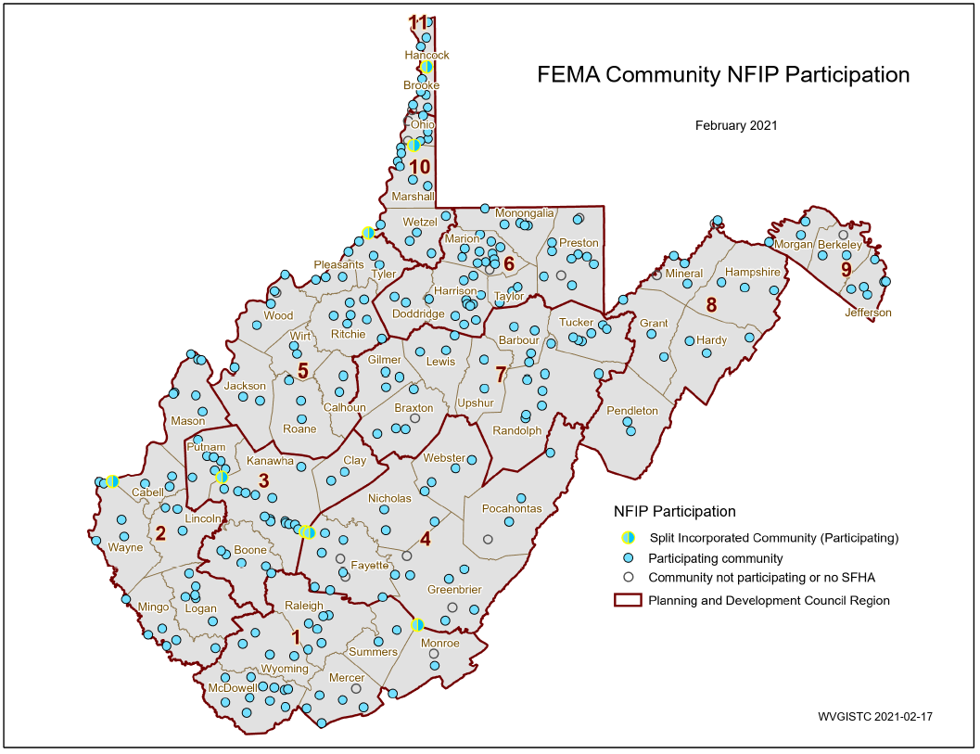
Statewide Hazard Assessment
211 incorporated areas
+55 unincorporated areas 266 NFIP Floodprone Communities +18 no SFHA communities
284 WV Communities
+ 8 split communities
292 Statistical Geographies
292 Statistical Geographies form 284 Communities which form
55 Counties which form
11 PDC Regions which form
1 Statewide Flood Risk Assessment
94% of WV Communities have Special Flood Hazard Areas (SFHA)
SPLIT COMMUNITY | COUNTY 1 | COUNTY 2
Alderson | Greenbrier | Monroe
Huntington | Cabell | Wayne
Montgomery | Fayette | Kanawha
Nitro | Kanawha | Putnam
Paden City | Tyler | Wetzel
Smithers | Fayette | Kanawha
Wheeling | Marshall | Ohio
Weirton | Brooke | Hancock
PDF Map

Slide 2
266 Flood-Prone Communities
11 Regional Planning & Development Councils (55 Counties)
Region | # Counties | # Communities | Split Communities across County Boundary | Communities not participating in NFIP or no SFHA | # NFIP Communities¹
Region 1² | 6 | 31 |  | Athens, Union | 29
Region 2 | 6 | 30 | Huntington |  | 30
Region 3 | 4 | 29 | Nitro |  | 29
Region 4 | 5 | 31 | Alderson, Montgomery, Smithers | Fayetteville³, Hillsboro, Lewisburg, Quinwood³, Thurmond | 26
Region 5 | 8 | 30 | Paden City | North Hills | 29
Region 6 | 6 | 45 |  | Brandonville, Tunnelton, White Hall | 42
Region 7 | 7 | 31 |  | Flatwoods | 30
Region 8 | 5 | 17 |  | Carpendale, Elk Garden | 15
Region 9 | 3 | 12 |  | Hedgesville | 11
Region 10 | 3 | 18 | Wheeling | Bethlehem, Clearview | 16
Region 11 | 2 | 10 | Weirton | Windsor Heights | 9
total | 55 | 284 | 8 | 18 | 266
¹ Source: FEMA's Community Status Source Book ² Region 1 dissolved community of Rhodell (Raleigh County) included in NFIP count. Town of Matoaka (Mercer County) is not included. ³ Communities include SFHA or non-regulatory floodplain
Split Communities Alderson, Montgomery and Smithers are members of Region 4
Split Community Paden City is a member of Region 5

Slide 3
Statewide Hazard Assessment
 | Community-Level Reports
355 | all report records (county, unincorporated, incorporated, split)
-55 | counties
-55 | unincorporated area
-16 | split communities
229 | incorporated places
 | All Communities (NFIP and No SFHA)
211 | NFIP incorporated areas
55 | NFIP unincorporated areas
266 | NFIP Floodprone Communities
18 | No SFHA Communities
284 | WV Communities (incorporated/unincorporated)
 | Statistical Geographies
284 | WV Communities
8 | 8 Additional split communities
292 | Statistical Geographies

