Slide 1

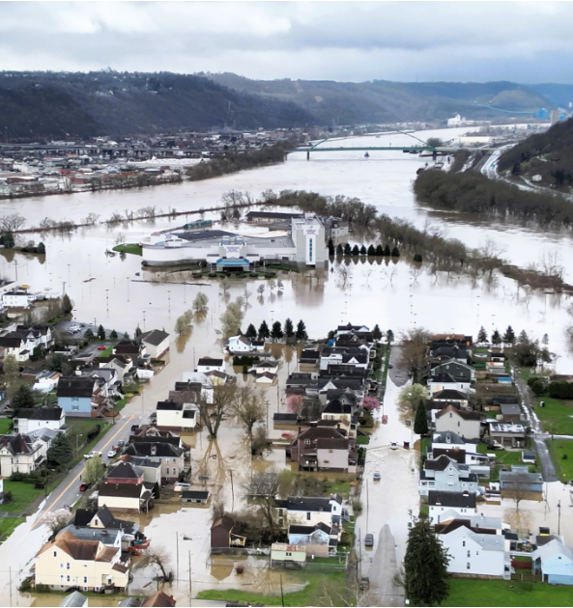
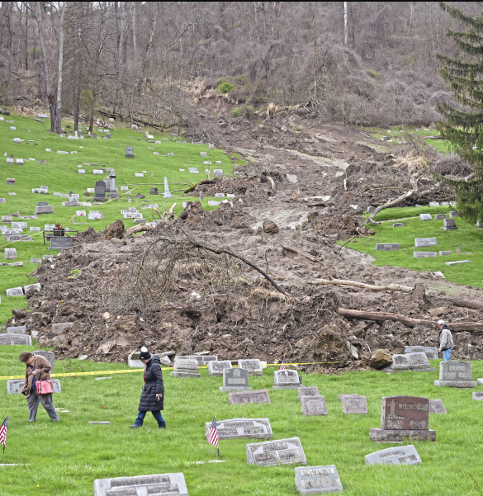
WV Flood Resiliency Framework Toolkit
Wheeling Island
Mt. Zion Cemetery (Ohio County)
Hazard identification using WV Flood Tool

Slide 2
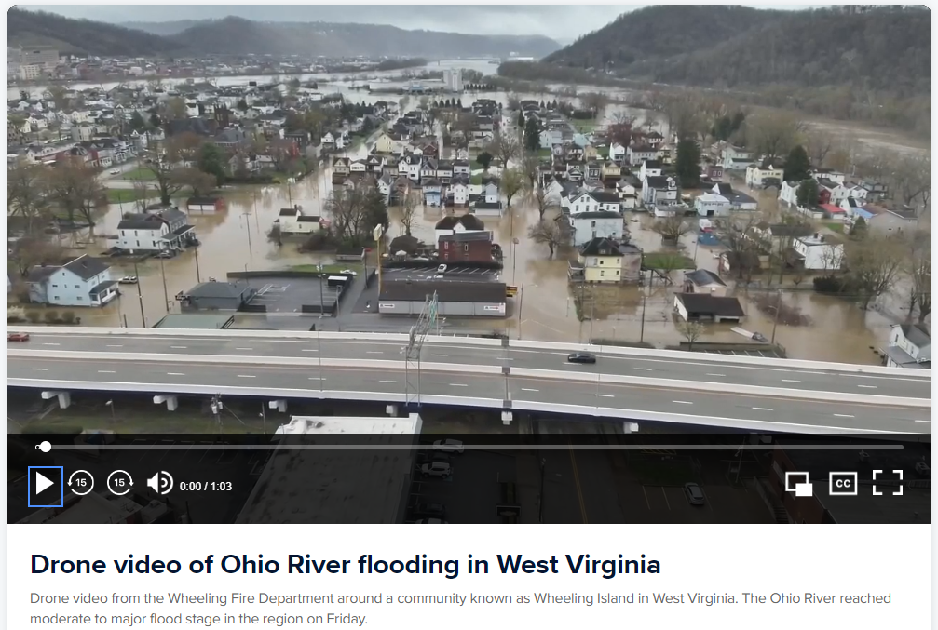
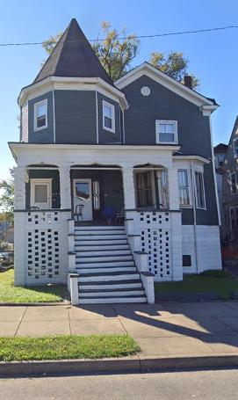
Recent Flood Event (Wheeling Island)
40 VIRGINIA ST, Wheeling, WV
Stream Gauge
Wheeling Island Hotel Casino Racetrack, WV
I-70
40 Virginia St, Wheeling
Drone Link

Slide 3
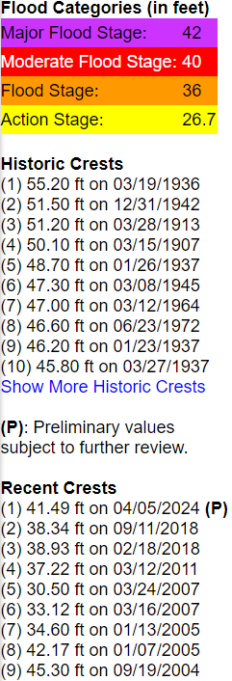
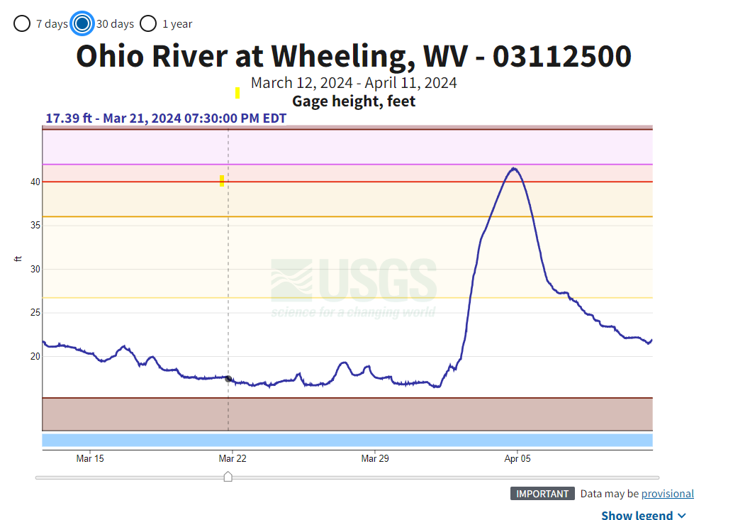
2024 Flood Crest 41.5 feet (April 5)
High Water Mark from 1936 Flood
Source: USGS Ohio River Gauge Height

Slide 4
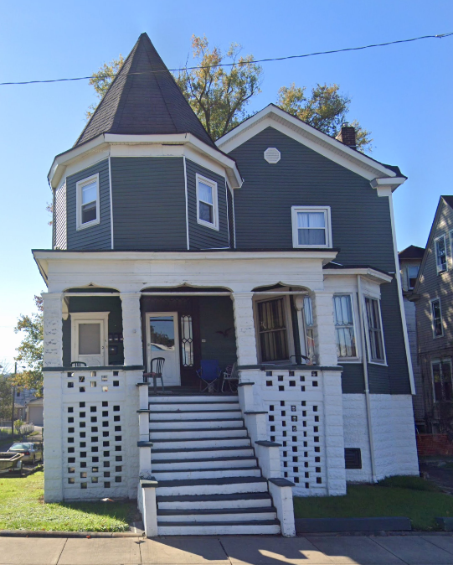
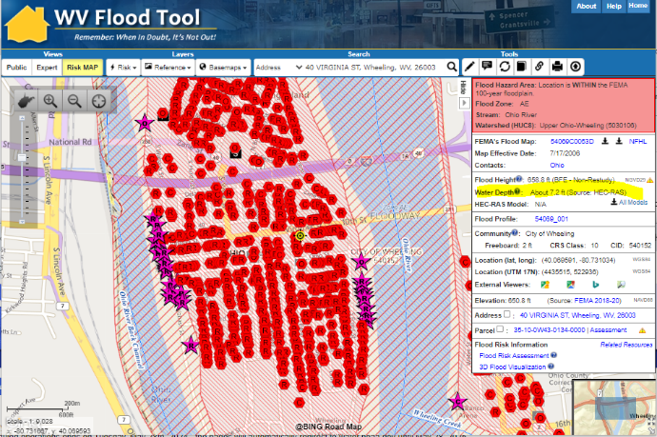
Wheeling Flood Probabilities
Flood Depth Probabilities (ft.)
FIRM Effective Date | 50 year (2%) | 100 year (1%) | 500 year (0.2%)
2006 | 4.1 | 7.2 | 10.1
1% Annual Chance (100-YR) Flood Event for 40 Virginia St., Wheeling, WV
7.2 ft. base flood depth above ground (Source: FEMA)
49 ft. flood stage gauge height (Source: USGS/NWS)
13.0 ft. (1936 HWM)
10.1’ (FEMA 0.2% / 500 YR)
7.2’ (FEMA 1% / 100 YR)
40 VIRGINIA ST, Wheeling, WV
4.1’ (FEMA 2% / 50 YR)
Building: 35-10-0W43-0134-0000_40
0.0 ft. (2024 HWM) (41.5’ flood stage)

Slide 5
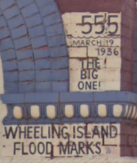
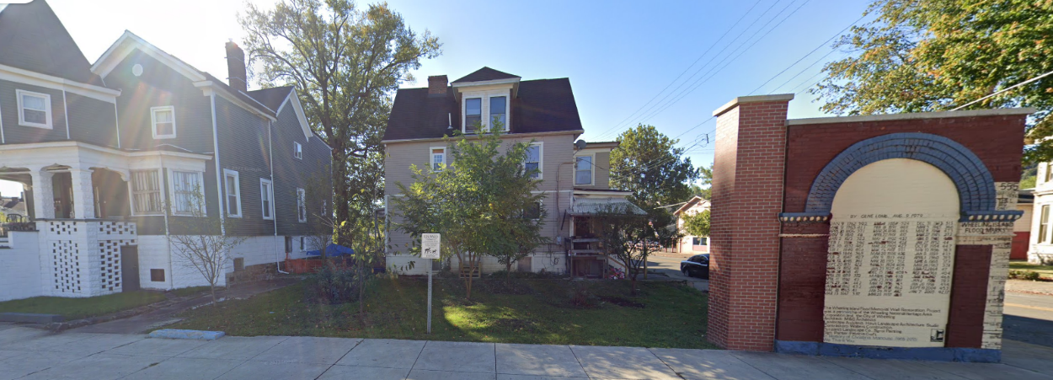
Wheeling (40 VIRGINIA ST, Wheeling, WV, 26003
High Water Mark from 1936 Flood (13 ft.)
WV Flood Tool link
1936 HWM = 607.3 ft. (gauge height = 0) + 55.2 ft. = 662.5 ft. The 1936 Flood Depth (662.5 ft. HWM minus LAG 649.5) estimate is 13 feet flooding above ground level. In structure, estimate four feet of water above lowest floor for 1936 flood.
2024 HWM = 41.5 feet crest on 5 April 2024. 607.3 ft. (gauge height = 0) + 41.5 ft. = 648.8 feet. Flooding should not have impacted this property. House just outside of drone footage.

Slide 6
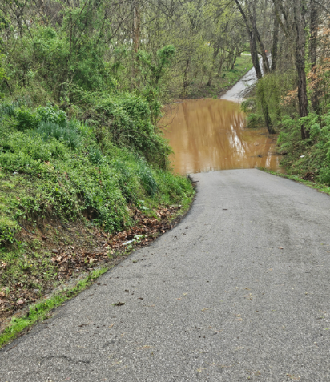
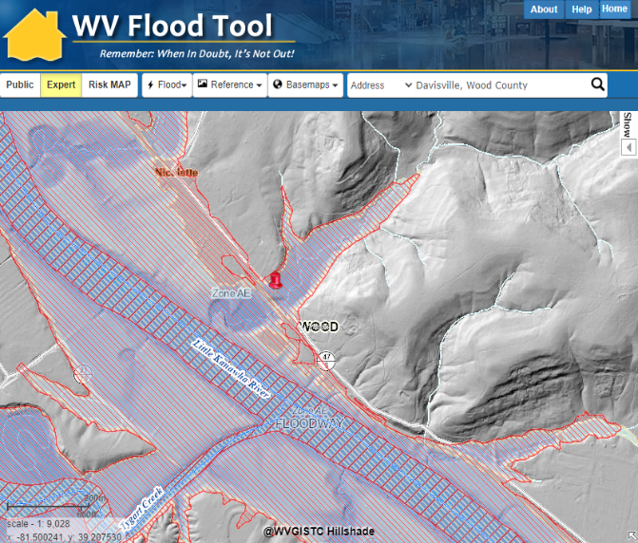
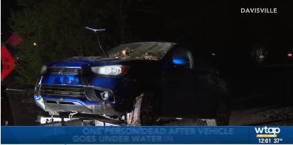

Vehicular Fatality (Wood County)
Vehicular Drowning
The driver entered the flooded area of Nicolette Road at a deep dip in the roadway. The water flipped the blue SUV vehicle over in approximately 15-20 feet of water off the roadway edge.
Valerie Swisher, 49, drowned on Nicolette Road (County Highway 47/3) on a small tributary of the Little Kanawha River.

Slide 7
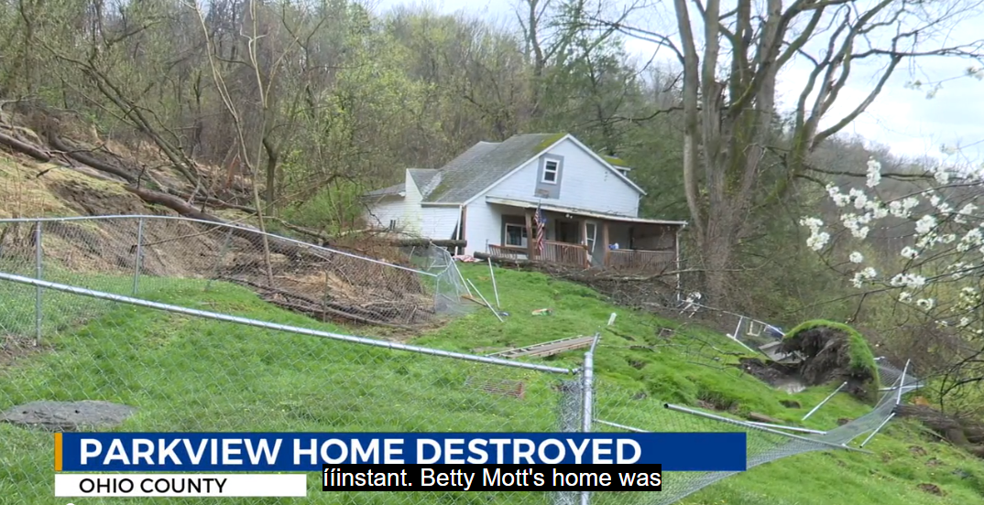
Landslides (Ohio County)
Drone Link
1311 PARK VIEW RD, Wheeling, WV,
WTRF.com

Slide 8
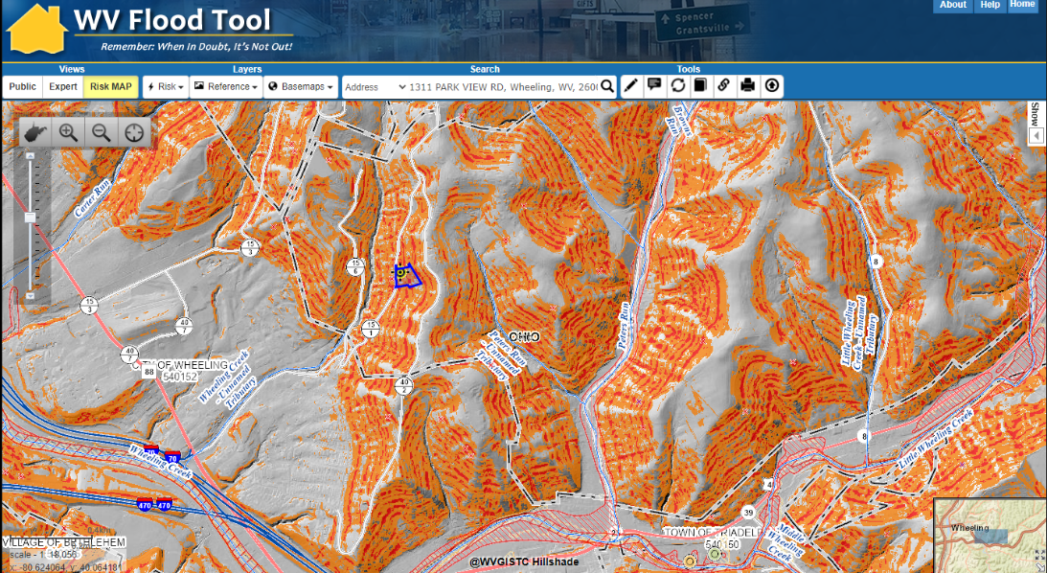
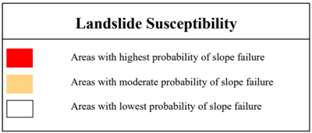
Landslides (Ohio County)
Drone Link
County-Level Scale, Generalized Susceptibility Maps
1311 PARK VIEW RD, Wheeling, WV,

Slide 9
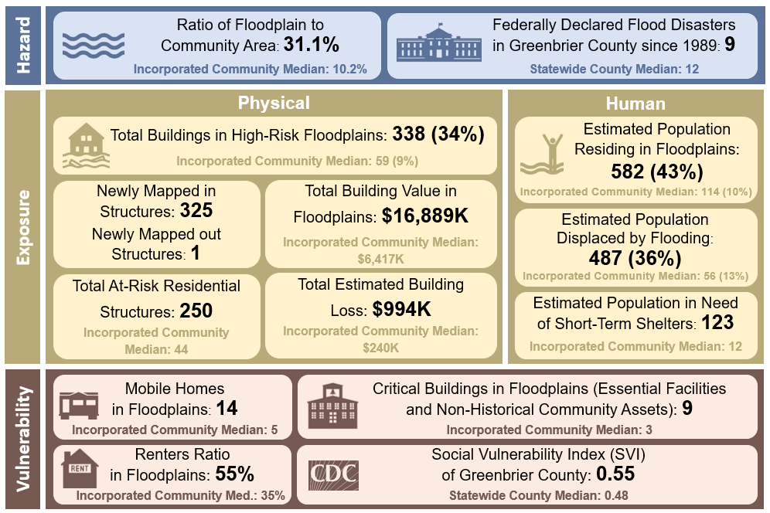
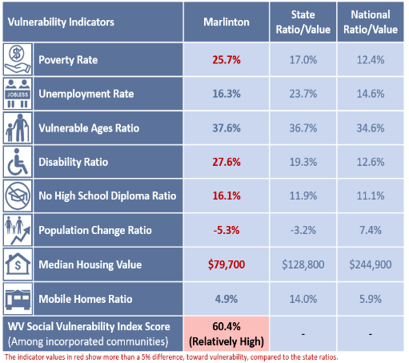
WV Flood Resiliency Framework Toolkit
Rainelle, WV
Marlinton, WV
The WV Flood Risk Index Tool aggregates hazard data to indicate the communities most at risk of riverine flooding. It incorporates flood at community and building levels for communicating risk.
WV Flood Risk Index Tool (future)

Slide 10
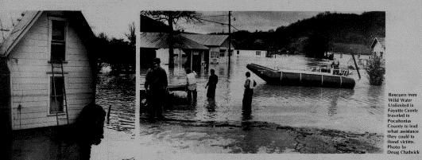
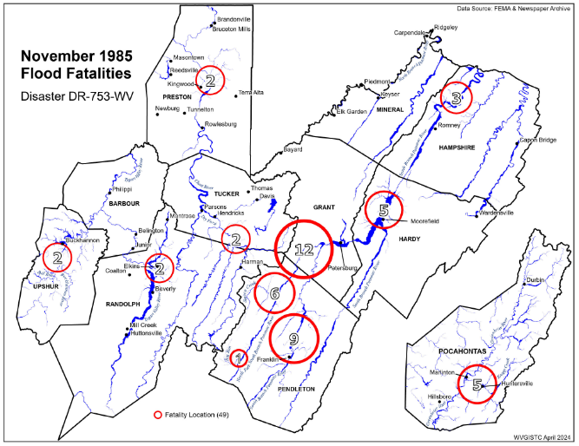
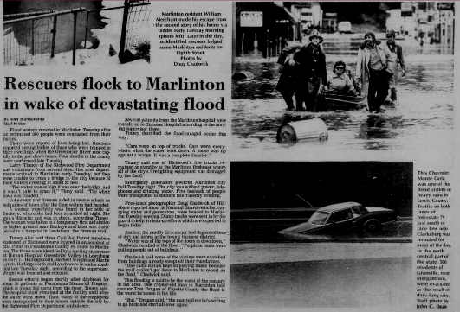
Community Impact Study (Marlinton, WV)
November 1985 Flood (47 fatalities)

Slide 11
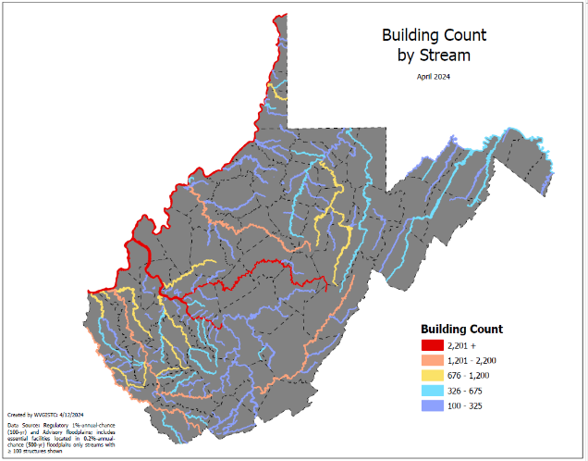
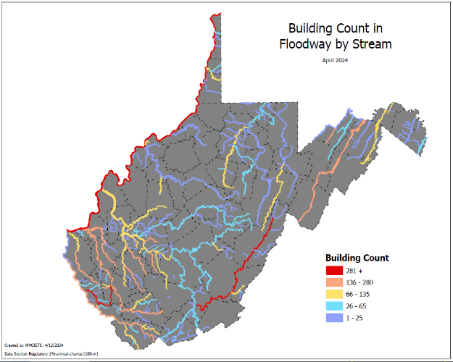
Community Impact Study (Marlinton, WV)
Stream Name | Total Building Count
Ohio River | 7,237
Kanawha River | 7,116
Elk River | 2,253
Greenbrier River | 1,821
Stream Name | Total Floodway Count
Island Creek | 632
Greenbrier River | 513
Stream Name | Substantially Damaged
Ohio River | 920
Greenbrier River | 368
Marlinton, WV
Marlinton, WV
Buildings in SFHA
Flood Risk Indicators
Buildings in Floodway
Statewide Stream Scale

Slide 12
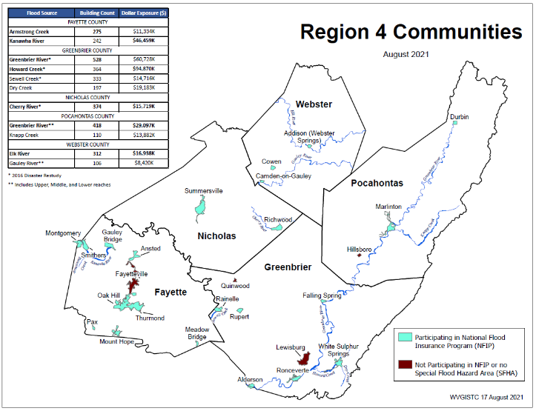
Community Impact Study (Marlinton, WV)
Building Counts & Building Values
Marlinton, WV
Flood Risk Indicators
Regional Scale

Slide 13
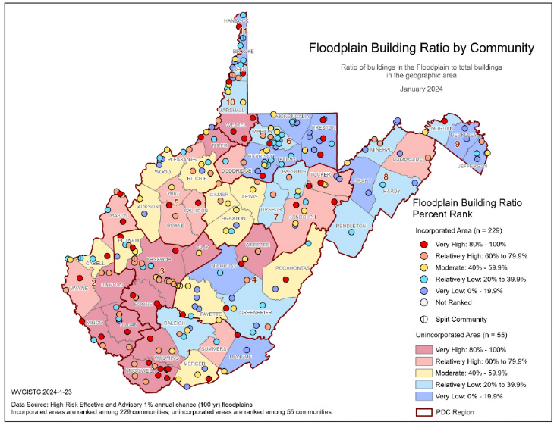
Community Impact Study (Marlinton, WV)
266 Flood-Prone Communities
Floodplain Building Ratio
94% of WV Communities have Special Flood Hazard Areas (SFHA)
Marlinton, WV
Flood Risk Indicator
Community Scale

Slide 14
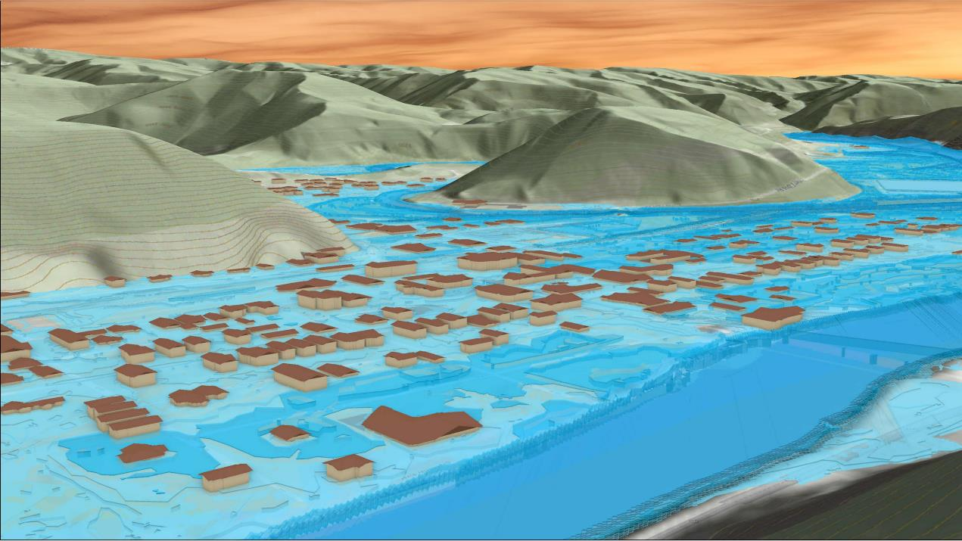
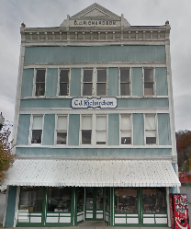
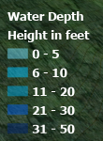
Flood Visualization (Marlinton, WV)
309 8th St, Marlinton, WV, 24954
Knapp Creek
309 8th St, Marlinton, WV
Greenbrier River
FEMA 1% Annual Chance (100-year)
26% probability of flooding at least once over 30 years
Community Scale

Slide 15
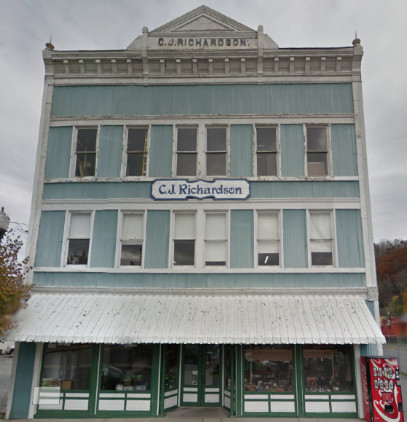
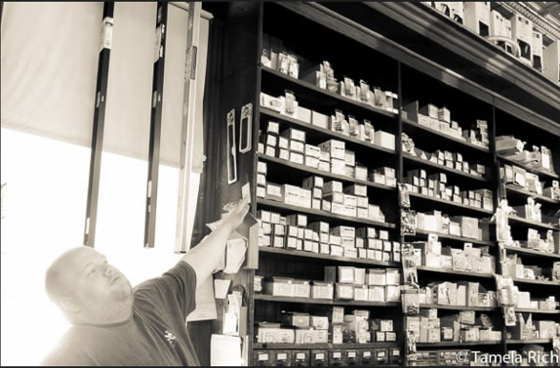
Flood Visualization (Marlinton, WV)
1985 Flood High Water Mark
8.8’ (Preliminary NFHL 0.2% / 500-Yr )
7’ (1985 High Water Mark)
5.2’ (FEMA Preliminary NFHL 1% / 100-Yr)
309 8th St, Marlinton, WV, 24954
3.6’ (FEMA 1% / 100-Yr)
Building: 38-08-0003-0023-0000
2.7’ (FEMA 2% / 50-Yr)
Commercial Structure built in 1900
Building Scale

Slide 16

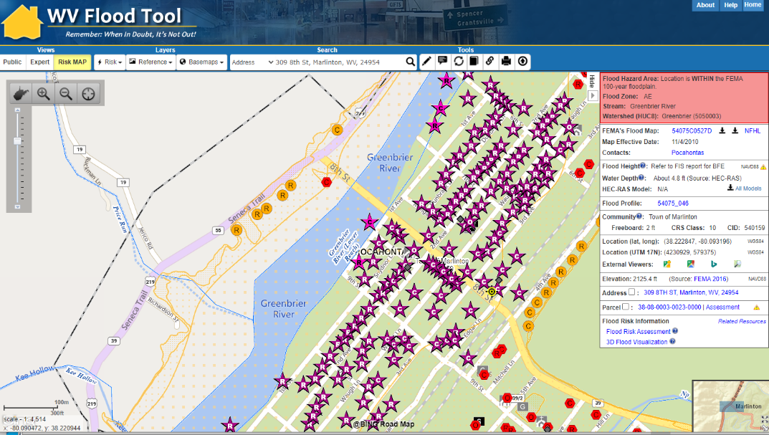
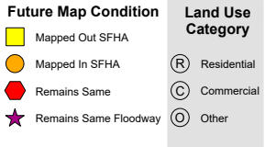
Flood Risk Assessment (Marlinton)
High-Risk Effective & Advisory
1%-Annual-Chance (100-Yr) Floodplains
WV Flood Tool link
Top 10% rankings among 229 incorporated places
Floodplain Characteristics
High percentage of community in in flood zone
FLOODPLAIN AREA: High percentage of municipality’s area in
Special Flood Hazard Area (SFHA)
Marlinton
Building Counts
High building counts in SFHA and floodway
PEOPLE: High number of people reside in high-risk flood zone
DAMAGE LOSS: Marlinton has a high percentage of repetitive loss structures and flood loss claims ($)
Damage Loss $
High percentage of previous losses
People
Many residents displaced from major flood event
BUILDING COUNTS: Marlinton has the highest number of structures in the floodway of all incorporated places
Floodway
1

Slide 17
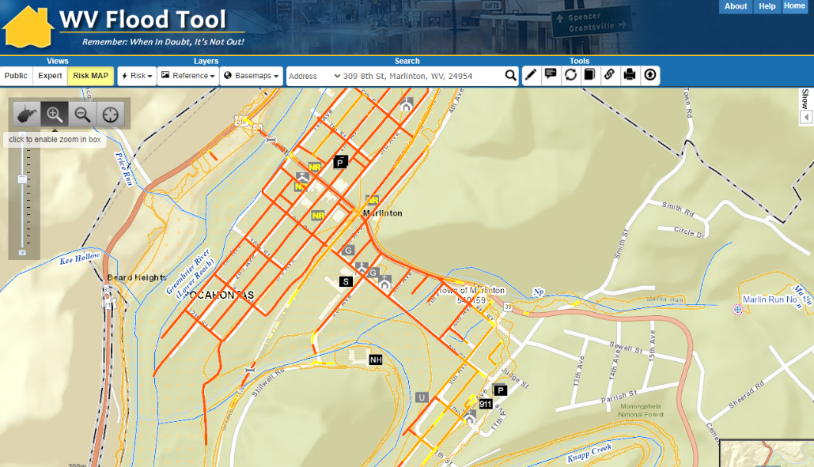
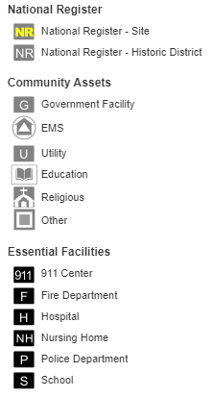
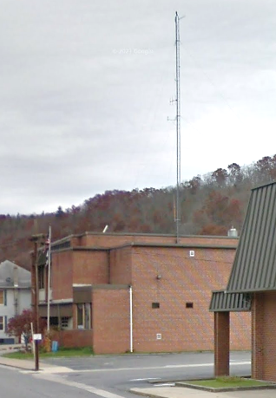
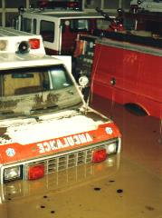
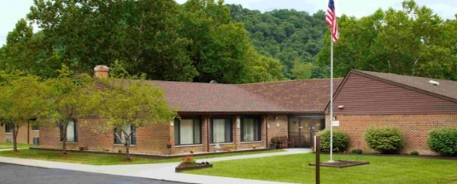

Critical Infrastructure (Marlinton)
WV Flood Tool link
Top 10% rankings among 229 incorporated places
Marlinton
INFRASTRUCTURE: High number of essential facilities and roads subject to flooding from a major event
Critical Infrastructure
High number of essential facilities & flooded roads
Flooded fire station in Marlinton, Nov. 1985
Marlinton Police Department
Highest EF Flood Depth (4 ft)
(Building ID: 38-08-0001-0096-0000_709A)
Pocahontas Center (Nursing Home)
(Building ID: 38-08-0005-0065-0002_5)

Slide 18
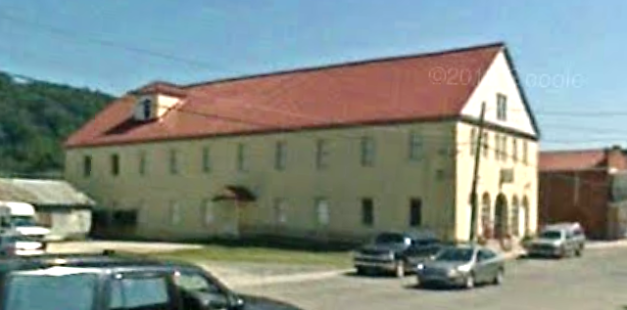
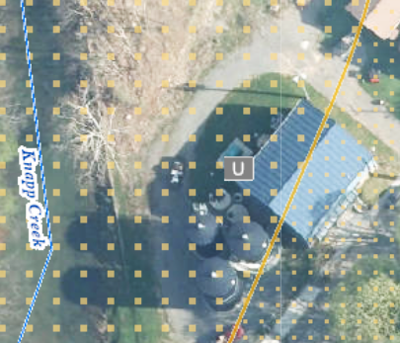
Community Assets (Marlinton)
COMMUNITY ASSETS: Marlinton has a high percentage community assets including historical
WV Flood Tool link
Marlinton
Top 10% rankings among 229 incorporated places
Marlinton Opera House
Highest Hist. CA Depth (4.7 ft) & Value ($148K)
(Building ID: 38-08-0002-0159-0000_818)
Community Assets
High number of non-historical community assets
Marlinton Water Plant
Highest Non-Hist. CA Value ($8.9M)
(Building ID: 38-08-0005-0088-0000_1002)
Value source inflation adjustment to 2021

Slide 19

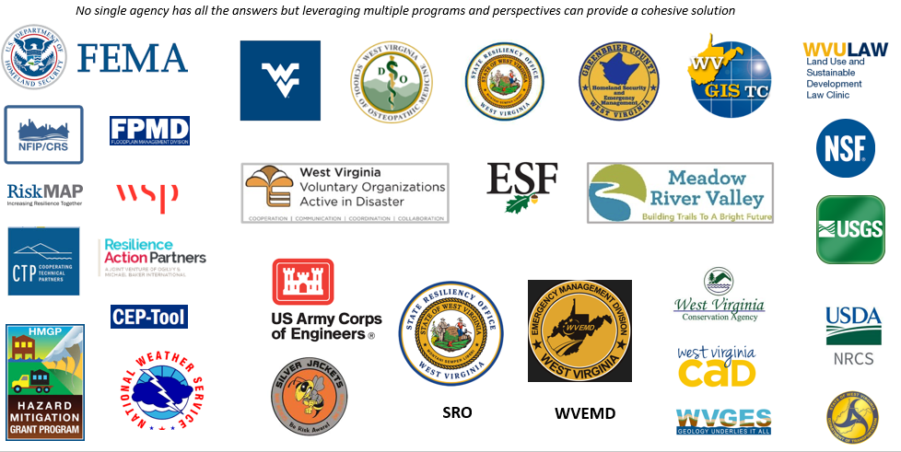
Partnerships and Interagency Coordination

