Slide 1
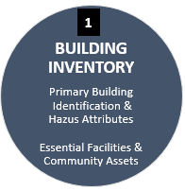
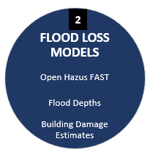
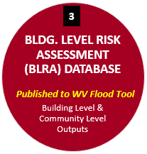
Building Inventory Workflow
Building Inventory - Processing (BIP)
Building Inventory Processing (BIP) Feature Class
Primary Insurable Structure Identification
Modified User-Defined Values
Location Identifiers (Parcel ID, E-911 Address)
Building Characteristics (Occupancy Class, Stories, Basement, Foundation, First Floor Height, Area, Cost)
Data Error Flags
Quality Control Checks
Execute Building Inventory Enhanced Script (BIE Script)
Blue Text: GIS File
Red Text: Tables
1A
Building Inventory - Enhanced (BIE)
Building Inventory Enhanced (BIE) Table #1 (iterative process to fix errors)
Building Input FAST (BIF) Table #2 for OpenHazus Flood Loss Utility
Re-execute Building Inventory Enhanced Script (BIE Script) to fix errors
1B
Hazus Flood Loss Models
Inputs: Building Input FAST (BIF) Table #2, DDF Table, Depth Grids
Output: Building Output FAST (BOF) Table #3
Execute FEMA’s OpenHazus Flood Assessment Structure Tool (FAST)
2
Unit of work at county scale
Building-Level Risk Assessment (BLRA)
Join Building Inventory Enhanced (BIE) Table #1 and Building Output FAST (BOF) Table #3 to Building Inventory GIS Feature Class
Add Future Map Conditions for Advisory Floodplains
GIS Product: Building-Level Risk Assessment (BLRA) Feature Class
Table Product: Community Level (CL) and Building Level (BL) Tables
Unit of work at state scale
3

