Slide 1
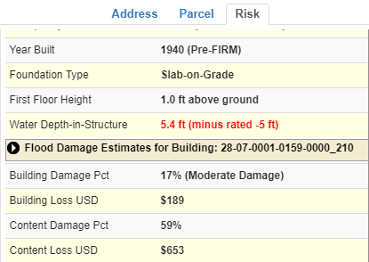
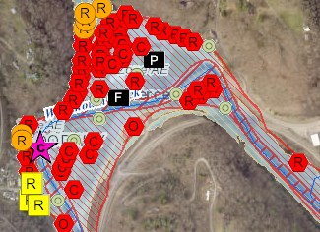
WV Building-Level Flood Risk Assessment
BUILDING INVENTORY
Primary Building Identification & Hazus Attributes Essential Facilities & Community Assets
FLOOD LOSS MODELS Open Hazus FAST
Flood Depths Building Damage Estimates
COMMUNITY ENGAGEMENT
Risk Assessment Data Verification
Mitigation Actions Identified
BLDG. LEVEL RISK ASSESSMENT (BLRA) DATABASE
Building Level & Community Level Outputs
Building-Level Flood Risk Assessments support:
Hazard Mitigation Plans
Floodplain Management
Community Assisted Visits
Community Rating System
1
Benefits
More detailed and accurate assessments
Automated scripts generate outputs quickly
Cost savings through efficiencies
Helps multiple stakeholders
Comprehensive Building Risk Spatial Database
4
Building-Level Risk Assessment (BLRA) Cycle
2
3
Methodology
Consistent methodology statewide
Semi-automated workflows
Continuous cycle to improve and update assessments
Tabular Output
Map Output
Published to WV Flood Tool

