Slide 1
Flood Zone Determination Sequence
HIGH:
100-YR Effective Floodplain
HIGH:
Preliminary NFHL (AE or A)
MODERATE: 500-YR Effective Floodplain & Levee Reduced Risk
MODERATE:
Within 75-ft of Flood Zone
LOW:
No identified Flood Risk
HIGH
Draft NFHL (AE or A)
HIGH
Advisory A
Non-Regulatory
HIGH
Updated AE
Non-Regulatory
High-Risk Advisory Zones
7/7/2021

Slide 2
WV Flood Map Revisions
A major driver for flood map revisions in West Virginia is new Light Detection and Ranging (LiDAR) elevation data that allows for a dramatic increase in the accuracy of flood hazard mapping. This new high-resolution topography supports 1-foot contours and 1-meter digital elevation models. Ongoing flood studies in West Virginia are categorized as FEMA-Initiated or State-Initiated Studies. FEMA-Initiated Studies: A FEMA-initiated study or restudy revises some or all of a community's effective flood map, resulting in both regulatory and flood risk products. FEMA’s Risk Mapping, Assessment, and Planning (Risk MAP) program provides communities with flood risk information that is used for developing regulatory and flood risk products. Once the new regulatory flood maps are finalized, a community has six months to adopt the map revisions in their local floodplain ordinance. For example, the 2016 Flood Study used new topography and high-water marks to create detailed flood studies with regulatory products for eight stream reaches in Greenbrier, Kanawha, Monroe, Nicholas, Summers, and Webster counties. State-Initiated Studies: State-initiated map revisions, typically through the FEMA's CTP Initiative, are smaller-scale studies limited in size and scope. State flood mapping initiatives incorporate new topography with hydrology and hydraulics (H&H) models to generate high-risk advisory flood zone data. This includes the statewide map initiative of Approximate A Zones using engineering analyses to produces new floodplain boundaries, Advisory Flood Heights (Advisory BFEs) and flood depth grids for streams draining a minimum two-square mile watershed area. The advisory flood height values should be used with caution for sites in proximity to hydraulic structures (bridges/culverts/dams) or near the confluence of a larger stream. Another statewide map initiative involves the redelineation of AE Zones to produce high-risk advisory flood zones, non-restudy BFE and water depth grids. Redelineation is the method of updating effective flood hazard boundaries to match updated topographic data based on the computed water surface elevations from effective models; no new engineering analyses are performed as part of the redelineation methodology. Importantly, State-Initiated Studies produce high-risk advisory flood hazard information that will likely be incorporated into future effective regulatory or community identified floodplains.

Slide 3
Map Revisions→High Risk Advisory Zones
Advisory Flood Zone* | Map Revision Type | Initiated | Applicable Flood Zones
Preliminary NFHL or DFIRM | Risk MAP Restudy or Study | FEMA | A and AE Zones
Draft NFHL or DFIRM | Risk MAP Restudy or Study | FEMA | A and AE Zones
Advisory A | AFH Model-Backed Studies | State CTP | Approximate A Zone
Updated AE | Non-Restudy Redelineation | State CTP | AE Zone
* Note: Advisory Floodplains may be mapped outside of the SFHA of the official FIRM
High-Risk Advisory Zone Flood Products: (1) Advisory Floodplain Boundary, (2) Flood Height Grid, (3) Flood Depth Grid

Slide 4
High Risk Advisory Zones
High-Risk Advisory Zones: High-risk advisory zones – Preliminary NFHL, Draft NFHL, Advisory A, or Updated AE – are non-regulatory 1%-annual-chance flood zones represented as orange-colored flood zones in the WV Flood Tool. These advisory flood zones are generated from new model-backed flood studies or from redelineation mapping. Redelineation is the method of updating effective flood hazard boundaries to match updated topographic data based on the computed water surface elevations from effective models. The public should be informed that these non-regulatory zones will most likely become effective when new Flood Insurance Rate Maps (FIRM) are published, and thus any development in these zones should be regulated to the same standards as effective high-risk flood zones. In local floodplain ordinances, communities may choose to adopt high-risk advisory zones as "community-identified floodplains" and regulated the same as the Special Flood Hazard Area of the official Flood Insurance Rate Map (FIRM). Besides showing flood prone areas that are likely to be “mapped into the SFHA” in a future FEMA Flood Restudy, the high-risk advisory zones are also beneficial in identifying Letters of Map Amendment (LOMAs) for structures or property that should be “removed from the SFHA.”

Slide 5
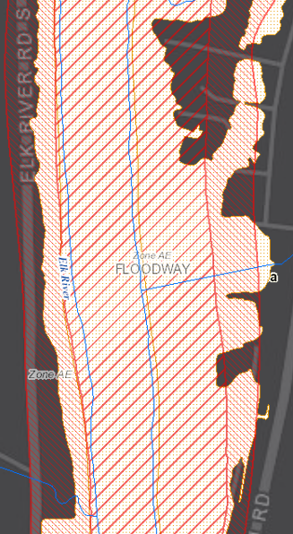
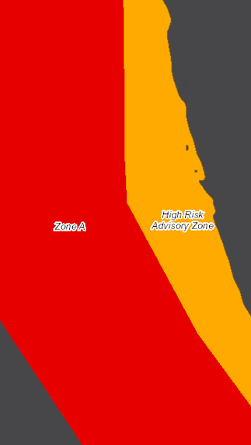
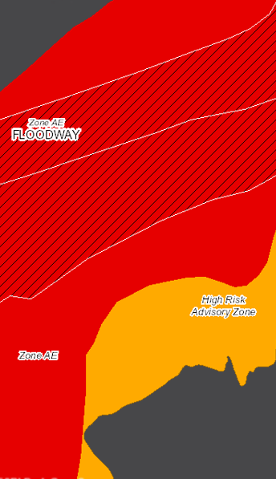
High Risk Advisory Zones
Preliminary NFHL
Advisory A
Updated AE
Preliminary/Draft NFHL
Advisory A
Updated AE

Slide 6
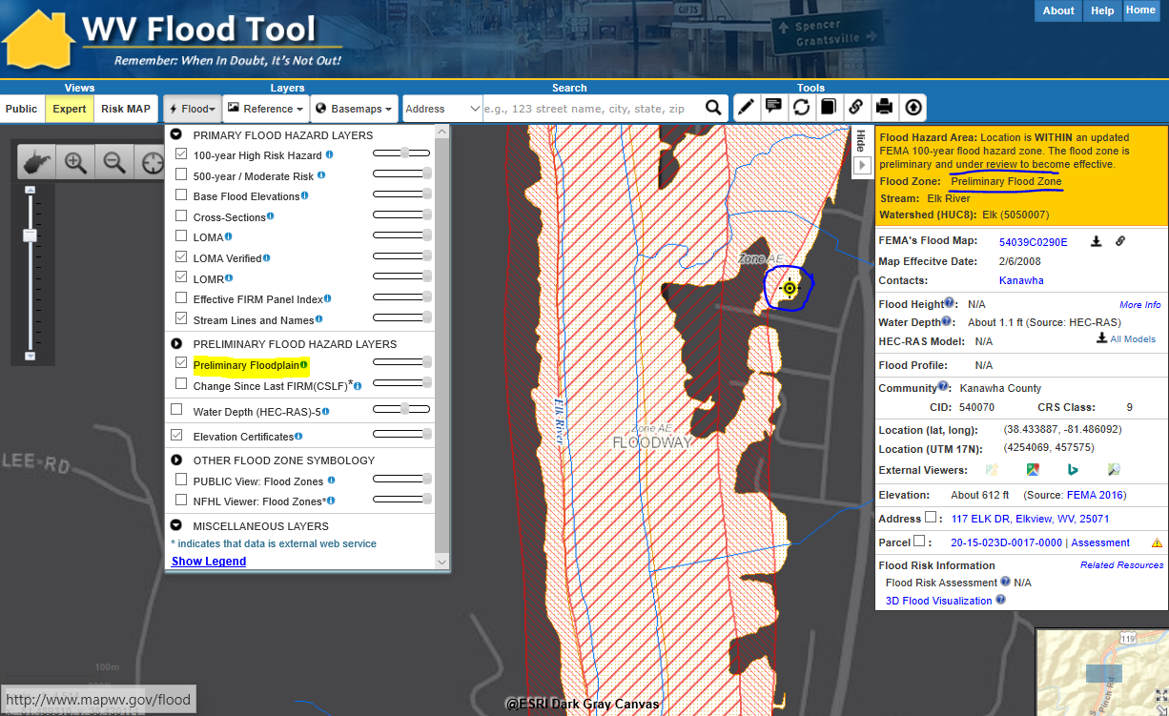
Preliminary NFHL
Preliminary NFHL
Preliminary NFHL Flood Zone: Preliminary FEMA National Flood Hazard Layers (NFHL) pending to become effective on updated Flood Insurance Rate Maps (FIRMs)

Slide 7
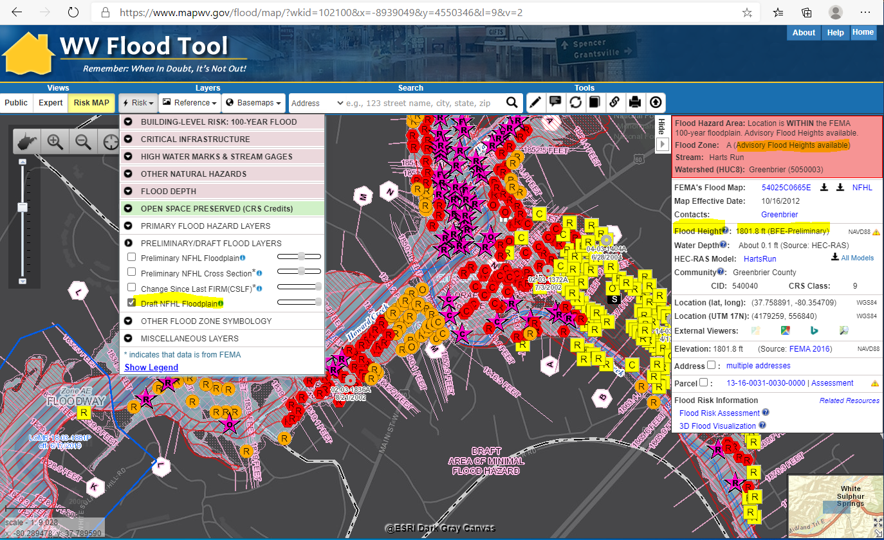
Draft NFHL
Draft NFHL
Draft NFHL Flood Zone: Pre-Preliminary FEMA National Flood Hazard Layers (NFHL) pending to become effective on updated Flood Insurance Rate Maps (FIRMs)

Slide 8
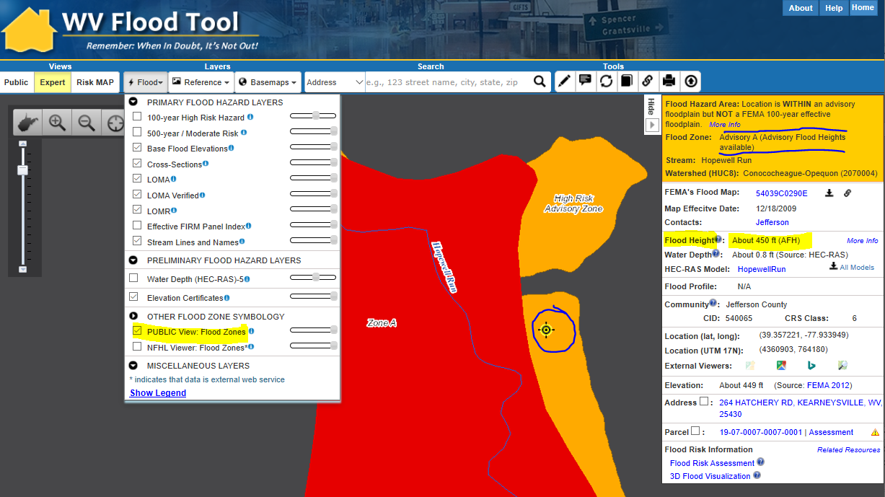
Advisory A
Advisory A
Advisory A Flood Zone: A model-backed Approximate A Zone is determined by using hydrology and hydraulics (H&H) analysis and the best available elevation data. Water Depth and Water Surface Elevation Grids are also companion products of Advisory A Zones.

Slide 9
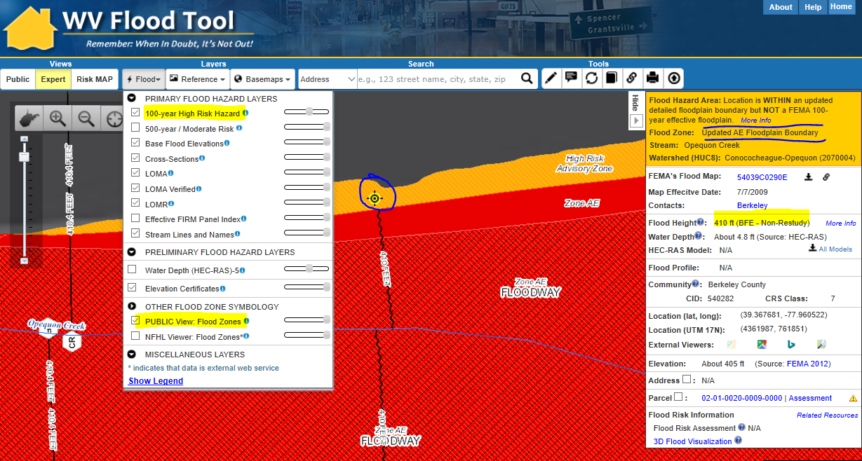
Updated AE
Updated AE
Updated AE Floodplain Boundary: A Non-Restudy where AE Zones undergo redelineation, a method of updating effective flood hazard boundaries to match updated topographic data based on the computed water surface elevations from effective models. Advisory AE Zones outside the SFHA are high-risk, non-regulatory flood zones.

Slide 10
Flood Zone Determination Sequence
HIGH:
100-YR Effective Floodplain
HIGH:
Preliminary NFHL (AE or A)
MODERATE: 500-YR Effective Floodplain & Levee Reduced Risk
MODERATE:
Within 75-ft of Flood Zone
LOW:
No identified Flood Risk
HIGH
Draft NFHL (AE or A)
HIGH
Advisory A
Non-Regulatory
HIGH
Updated AE
Non-Regulatory
Flood zone determination sequence important for programming logic
WV Flood Tool first checks query location for High Risk effective flood zones (red warning color), High Risk advisory flood zones (orange), then Moderate Risk flood zones (yellow)

Slide 11
Flood Zone: < zone designation >
Status # | Flood Risk Zone Designation | Message | Floodplain Type Label | WSEL Grid | Flood Degree Risk | Color Warning Status
1 | AE, AH (5), AO (2) | Location is WITHIN the FEMA 100-year floodplain. | Effective 100 yr Zone AE, AH, AO | BFE-R or BFE-NR | High | Red
2 | AE (Floodway) | Location is WITHIN the FEMA 100-year floodplain and floodway. | Effective 100 yr Zone AE, AH, AO - Floodway | BFE-R or BFE-NR | High | Red
3 | A | Location is WITHIN the FEMA 100-year floodplain. | Effective 100 yr Zone A | < None > | High | Red
4 | A (Advisory Flood Heights available) | Location is WITHIN the FEMA 100-year floodplain. Advisory Flood Heights available. | Effective 100 yr Zone A and Advisory Zone A | AFH or BFE-P | High | Red
5 | Preliminary NFHL Flood Zone | Location is WITHIN an updated FEMA 100-year flood hazard zone. The flood zone is preliminary and under review to become effective. | Preliminary 100 yr Zone AE or A (Shaded X not displayed or shown on Flood Query Results Panel) | BFE-P, then BFE-R, BFE-NR, AFH | High | Orange
6 | Preliminary Flood Zone (Floodway) | Location is WITHIN an updated FEMA 100-year flood hazard zone and floodway. The flood zone is preliminary and under review to become effective. | Preliminary 100 yr Zone AE – Floodway | BFE-P, then BFE-R, BFE-NR, AFH | High | Orange
7 | Draft NFHL Flood Zone | Location is WITHIN an updated FEMA 100-year flood hazard zone. The flood zone is DRAFT and under review to become PRELIMINARY. | Draft 100 yr Zone AE or A | BFE-P (A or AE Zones only) | High | Orange
8 | Updated AE Floodplain Bdry. | Location is WITHIN an updated detailed floodplain boundary but NOT a FEMA 100-year effective floodplain. | Updated Zone AE | BFE-NR | High | Orange
9 | Advisory A | Location is WITHIN an advisory floodplain but NOT a FEMA 100-year effective floodplain. | Advisory Zone A | AFH | High | Orange
10 | Shaded X (500-YR Flood) | Location is WITHIN a moderate flood risk hazard such as a FEMA 500-year floodplain. | Zone X - 0.2 PCT ANNUAL CHANCE FLOOD HAZARD | < None > | Moderate | Yellow
11 | X (Levee Protected) | Location is PROTECTED by a levee from a 100-year flood | Zone X - AREA WITH REDUCED FLOOD RISK DUE TO LEVEE | < None > | Moderate | Yellow
12 | Near Flood Zone | Location is NOT WITHIN identified flood hazard area, but within 75 feet of an identified flood hazard area. | Separate Buffer Layer | < None > | Moderate | Yellow
13 | Out of Flood Zone | Location is NOT WITHIN any identified flood hazard area. Unmapped flood hazard areas may be present. | No Record Found | < None > | Low | Green
Three Degrees of Risk: High, Moderate, Low. Four Warning Status Colors: In 100-YR Effective Floodplains (red), non-regulatory Preliminary/Draft NFHL, Advisory A, and Updated AE floodplains (orange), moderate risk or close to high- risk zones (yellow), and low risk (green). The query consists of stacked floodplain boundary layers (see next slide)

Slide 12
Flood Height Grids
Gridded Flood Height | Source | Applicable Zones
BFE Restudy | Risk MAP Studies or Physical Map Revisions (PMR) | A and AE Zones
BFE Preliminary* | Preliminary/Draft NFHL | A and AE Zones
BFE Non-Restudy* | Updated AE Redelineation | AE Zone
Advisory Flood Heights (AFH)* | AFH Model-Backed Studies | Approximate A Zone
* May include Advisory BFEs redelineated outside of official FIRM
4 Sources for Water Surface Elevation Grids:
BFE Restudy, BFE Preliminary, BFE Non-Restudy, Advisory Flood Height

Slide 13
Flood Height: < Value >
Status # | Flood Height Designation | Flood Zones | Message for FLOOD HEIGHT: | Source Message on Query Panel | More Info Link on Flood Query Results Panel
1 | Base Flood Elevation (Restudy) BFE Grid | AE Zones Flood Zone Statuses 1, 2, 5, 6 | < value> ft. (Display to 0.1) (Clickable GRID value) | (BFE Restudy) In future may include A Zones | Advisory Flood Heights (AFH) for Approximate A Zones: CAUTION CAUTION!! The advisory flood height should be used with caution in the proximity of a culvert, bridge, flood control structure or other impoundment since stream crossings were not included in the hydraulic analyses for approximate floodplains. Also, if the site is close to the confluence with a larger stream, compare the advisory flood height at the location of interest to the advisory flood height or Base Flood Elevation on the larger stream to determine whether the site is within the backwater influence of the larger stream. More information: http://www.mapwv.gov/flood/content/documents/AFHhandout.pdf Restudy and Non-Restudy AE Zones: To validate base flood elevations refer to the Flood Profiles and Flood Elevation Tables in the FIS Report. Vertical Datum for Flood Heights: The vertical datum of Base Flood Elevations (BFEs) for AE Zones recorded on official FIRMs in West Virginia is NAVD 88, except for the following counties where the FIRMs are referenced to the NGVD 29 Datum: Hampshire, Logan, McDowell, Mercer, Monroe, Ohio, and Putnam. The vertical datum of all Advisory Flood Height values for Approximate A Zones in West Virginia is NAVD 88, except for McDowell County which is NGVD 29. More information.
2 | Base Flood Elevation (Non-Restudy) Updated AE Grid | AE Zones Flood Zone Statuses 1, 2, 8 | < value> ft. (Display to 0.1) (Clickable value) | (BFE Non- Restudy)
3 | Base Flood Elevation (Non-Restudy) | AE Zones Flood Zone Statuses 1 & 2 | no value | Refer to FIS report for BFE
4 | Advisory Flood Height AFH Grid or BFE-P Grids | A Zones Flood Zone Statuses 4, 5, 6, & 9. Possible status 10. | About < value> ft. (Display to 0.1) (Clickable value) | (AFH)
5 | Preliminary Flood Height (BFE-P) | Flood Zone Statuses 5 to 7. BFE Preliminary Grid takes priority. | 5a, 6a, 7 = value 5b, 6b = no value | Grid value (BFE Preliminary), then BFE-R, BFE-NR, AFH No Value. “See FEMA Change Viewer link for Prelim. BFE”
6 | No Flood Height Information | Flood Zone Statuses 3 and 4; 9 through 13 | no value | None (Status 3 or 4) N/A (Statuses 9-13)
Invisible Composite Query Rasters for flood height values of Water Surface Elevation Level (WSEL) layers: (1) Advisory Flood Height WSEL AFH Grid (WSEL_1PCT_AFH_5ft); (2) BFE Restudy WSEL BFE Grid (WSEL_1PCT_BFE_1m); Updated AE/BFE Non-Restudy (WSEL_1PCT_Updated_AE)

Slide 14
Flood Height Grids (NFHL)
National Flood Hazard Layer (NFHL)
Effective floodplain layers
Preliminary floodplain layers
Draft floodplain layers
Restudy BFE Grids
BFE-Restudy
BFE-Preliminary

Slide 15
Flood Height Grids & WV Coverage
Effective DFIRMs
(Restudy BFEs)
(Preliminary BFEs)

Slide 16
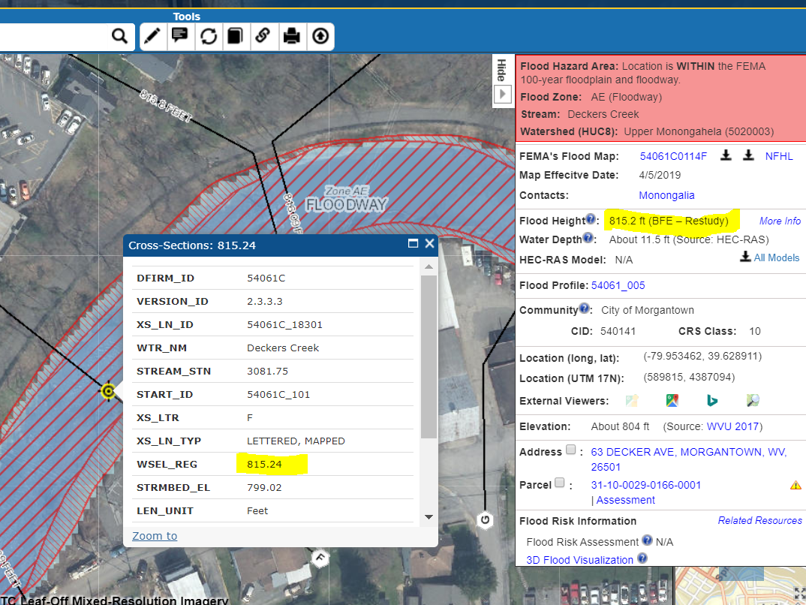
Flood Heights: BFE Restudy
FLOOD HEIGHTS
Restudy Base Flood Elevation Heights displayed in Flood Results Query Panel. Fractional values displayed to tenth of decimal.
Source: FEMA RiskMAP Restudies
Coverage: Upper Monongahela Watershed (Select Streams)
Flood Query Panel
NFHL X-Section Popup Window
RiskMAP Upper Mon. Watershed
http://www.mapwv.gov/flood/map/?wkid=102100&x=-8900332&y=4812154&l=12&v=1

Slide 17
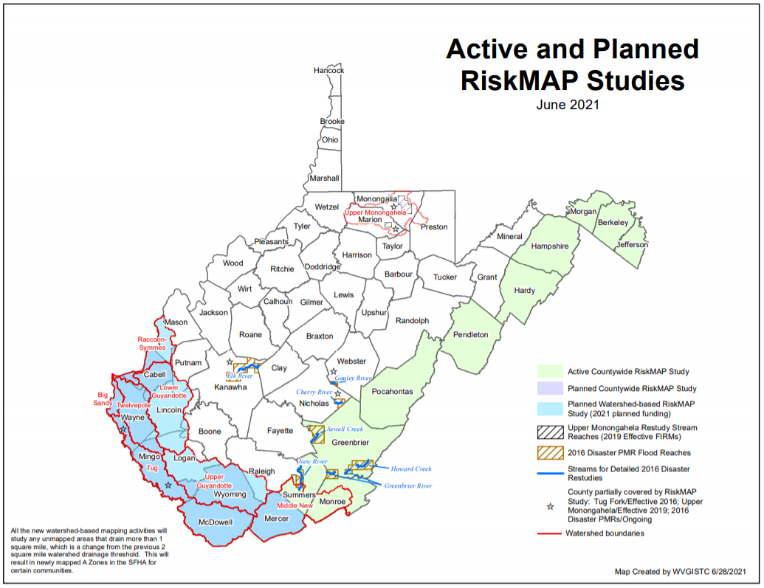
Active and Planned FEMA Studies
https://data.wvgis.wvu.edu/pub/RA/_resources/status/WV_FloodStudies.pdf

Slide 18
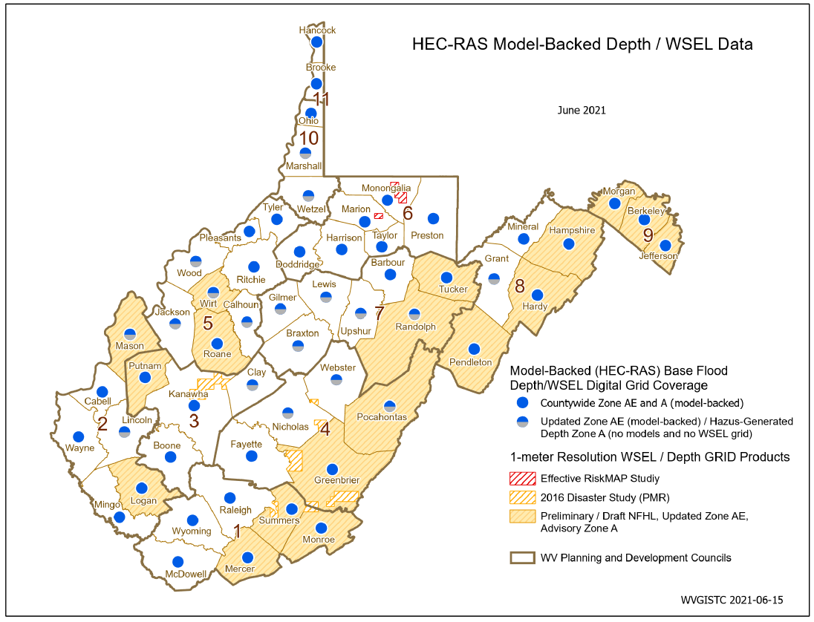
New Flood Studies
Future mapping trends:
Floodplain Mapping Resolution: Mapping at higher watershed drainage resolution (1-square mile watershed)
Gridded Flood Risk Products Resolution: Higher spatial resolution of 1-meter grid cell size for flood risk products (e.g., Flood Heights, Water Depth).
Depth Grids for Multiple Flood Events: Depth Grids published for multiple flood events (10, 04, 02, 01, 0.2 percent chance)
X-Sections for A Zones: In addition to AE Zones, published BFE cross sections for all Approximate A Zones
https://data.wvgis.wvu.edu/pub/RA/_resources/status/DepthWSEL_1meterResolution.pdf

Slide 19
Flood Height Grids
Advisory Flood Heights
(Advisory A BFEs)

Slide 20
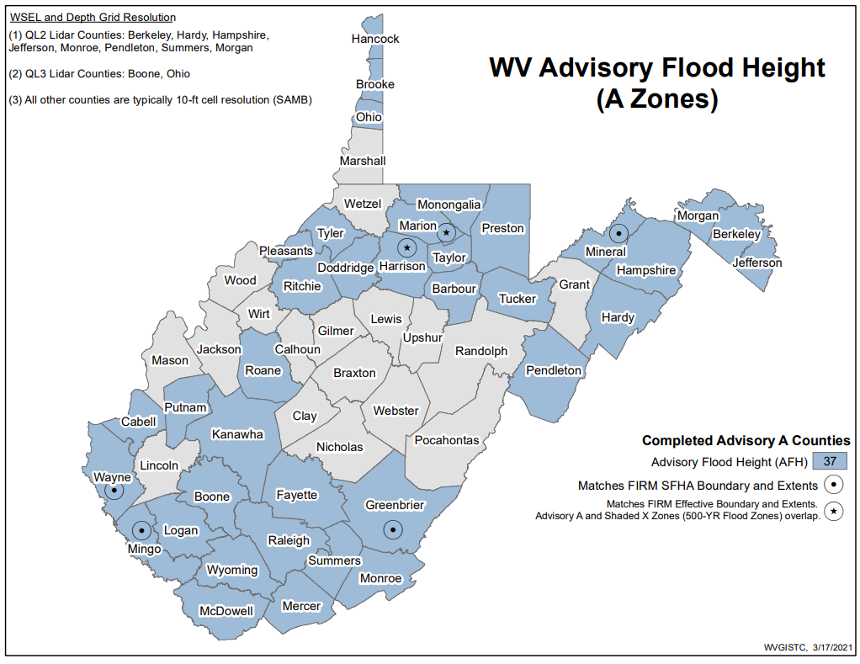
Advisory Flood Heights (AFH) Status
37 Counties have Advisory Flood Heights
Advisory A/AFH County Status
AFH Handout: https://www.mapwv.gov/flood/content/documents/AFHhandout.pdf

Slide 21
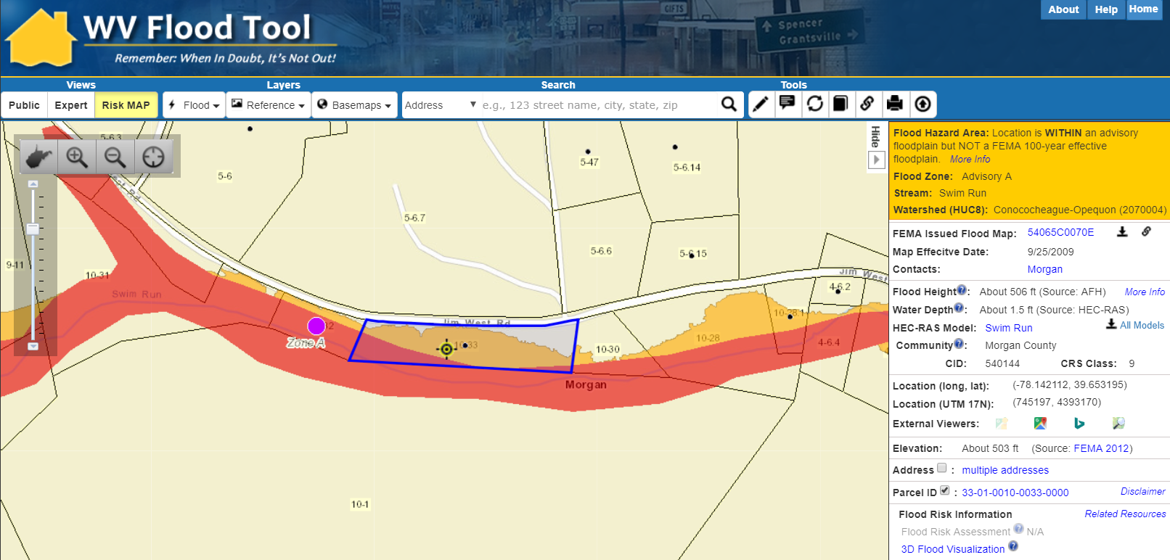
Advisory Flood Heights (AFH)
Parcel ID: 33-01-0010-0033-0000
https://www.mapwv.gov/flood/map/?wkid=102100&x=-8698746&y=4815674&l=12&v=2
Structure is WITHIN an Advisory A Floodplain but NOT a FEMA 100-year effective floodplain. Parcel ID 33-01-0010-0033-0000 in Morgan County, WV.

Slide 22
Flood Height Grids
Updated AE
(Non-Restudy BFEs)

Slide 23
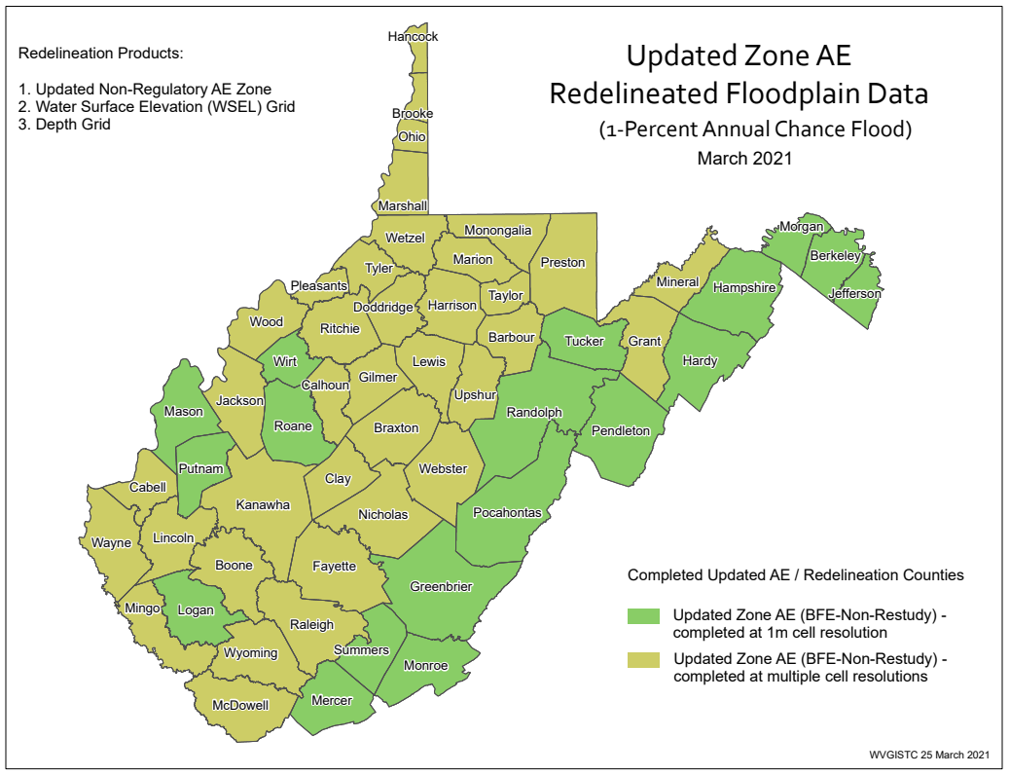
Updated AE Redelineation Counties
All Counties have Gridded BFE Values from
Updated AE Redelineation or New Flood Studies
AE Redelineation County Status

Slide 24
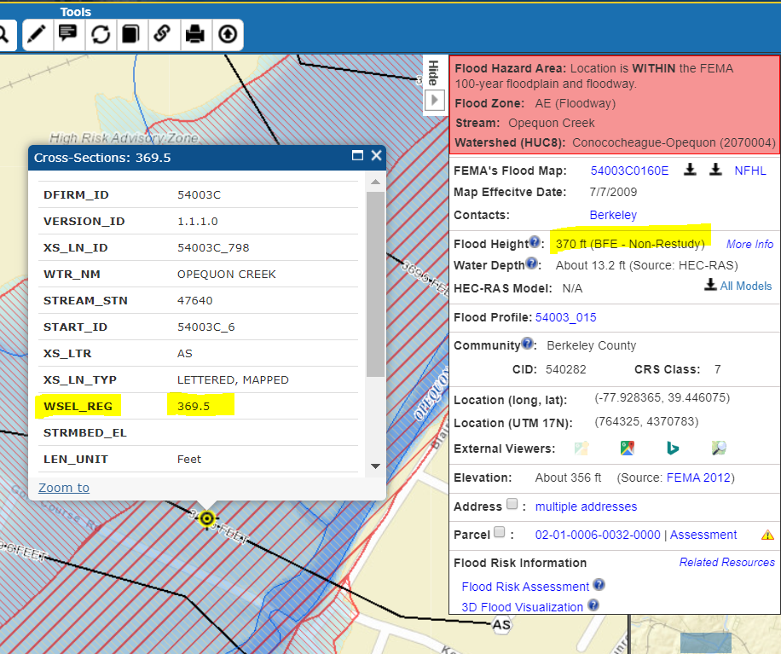
Flood Heights: BFE Non-Restudy
Flood Query Panel
FLOOD HEIGHTS
Non-Restudy Base Flood Elevation Heights displayed in Flood Results Query Panel. Integer values displayed.
Source: Flood Heights created from Updated AE Redelineation using new topography
Coverage includes Berkeley & Morgan Counties
NFHL X-Section Popup Window
http://www.mapwv.gov/flood/map/?wkid=102100&x=-8674946&y=4785771&l=10&v=1

Slide 25
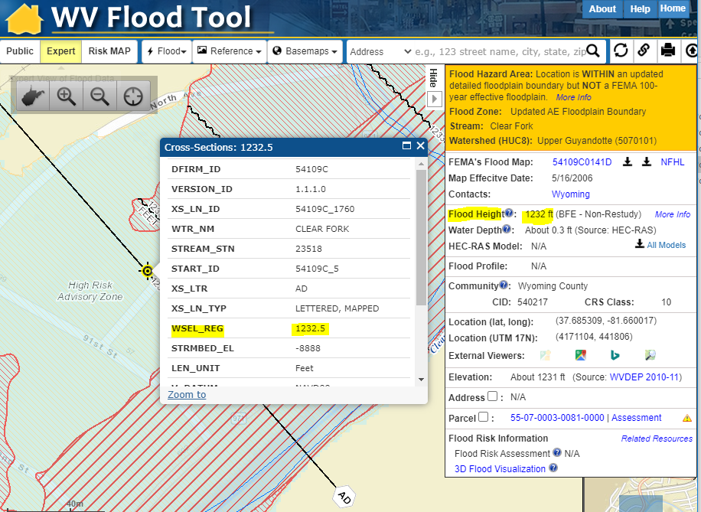
Flood Heights: BFE Non-Restudy (Cont.)
FLOOD HEIGHTS
Non-Restudy Base Flood Elevation Heights displayed in Flood Query Results Panel. Integer values displayed.
Source: Flood Heights created from Updated AE Redelineation using new topography
Coverage includes McDowell & Wyoming Counties
Flood Query Panel
NFHL X-Section Popup Window
https://www.mapwv.gov/flood/map/?wkid=102100&x=-9090351&y=4535065&l=11&v=1

Slide 26
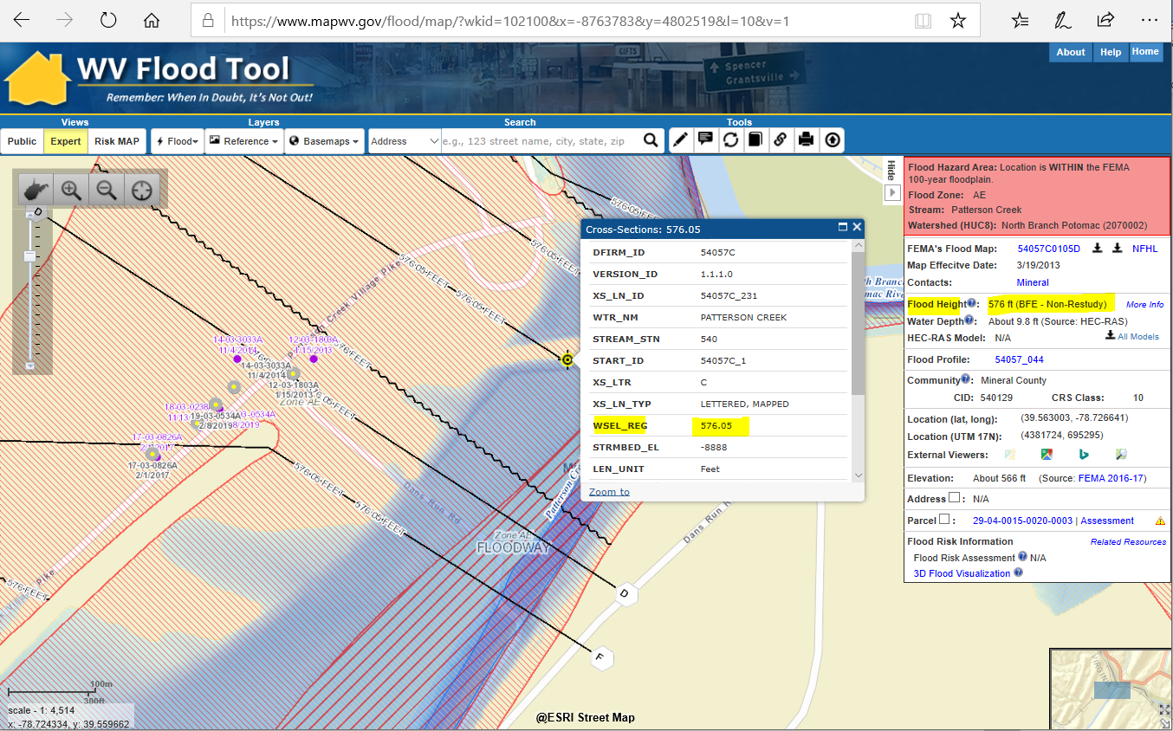
Flood Heights: BFE Non-Restudy (Cont.)
Flood Query Panel
NFHL X-Section Popup Window
FLOOD HEIGHTS (Example for Mineral County)
Non-Restudy Base Flood Elevation Heights displayed in Flood Query Results Panel
Source: Flood Heights created from Updated AE Redelineation using new topography
https://www.mapwv.gov/flood/map/?wkid=102100&x=-8763810&y=4802641&l=10&v=1

Slide 27
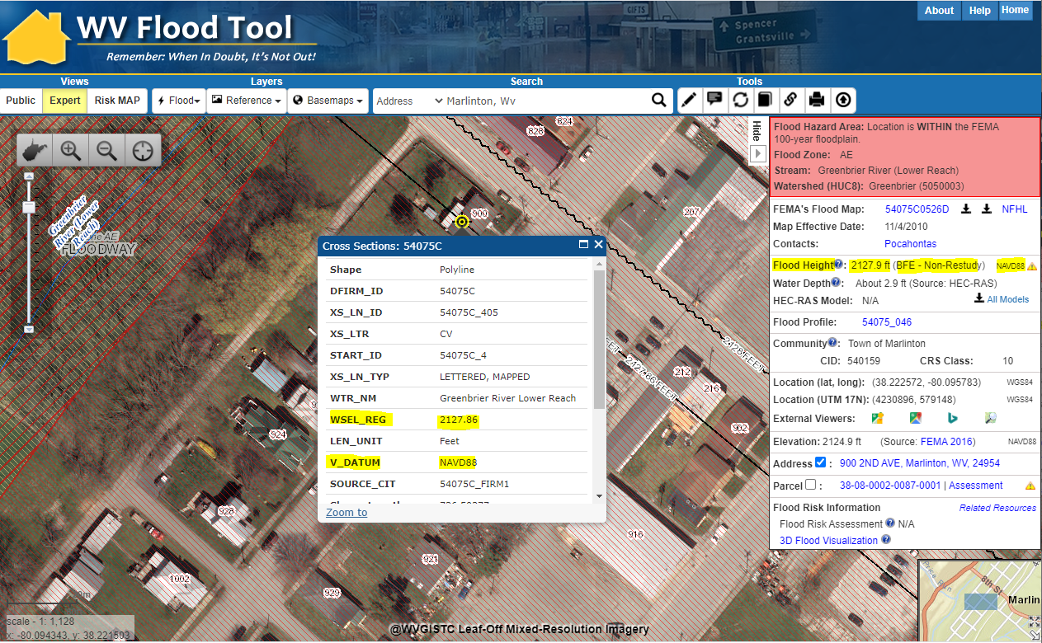
Flood Heights: BFE Non-Restudy (Cont.)
NFHL X-Section Popup Window
FLOOD HEIGHTS (Example for Pocahontas County)
Non-Restudy Base Flood Elevation Heights displayed in Flood Query Results Panel
Source: Flood Heights created from Updated AE Redelineation using new topography
Flood Query Panel
https://www.mapwv.gov/flood/map/?wkid=102100&x=-8916222&y=4610916&l=12&v=1

Slide 28
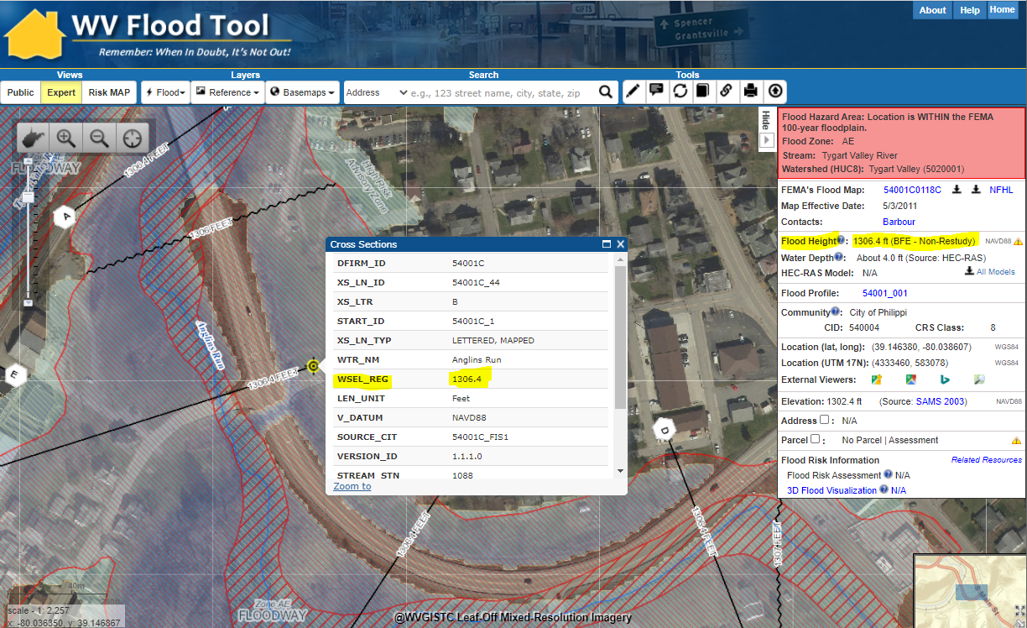
Flood Heights: BFE Non-Restudy (Cont.)
NFHL X-Section Popup Window
FLOOD HEIGHTS (Example for Barbour County)
Non-Restudy Base Flood Elevation Heights displayed in Flood Query Results Panel
Source: Flood Heights created from Updated AE Redelineation using new topography
Flood Query Panel
https://www.mapwv.gov/flood/map/?wkid=102100&x=-8909857&y=4742661&l=11&v=1

Slide 29
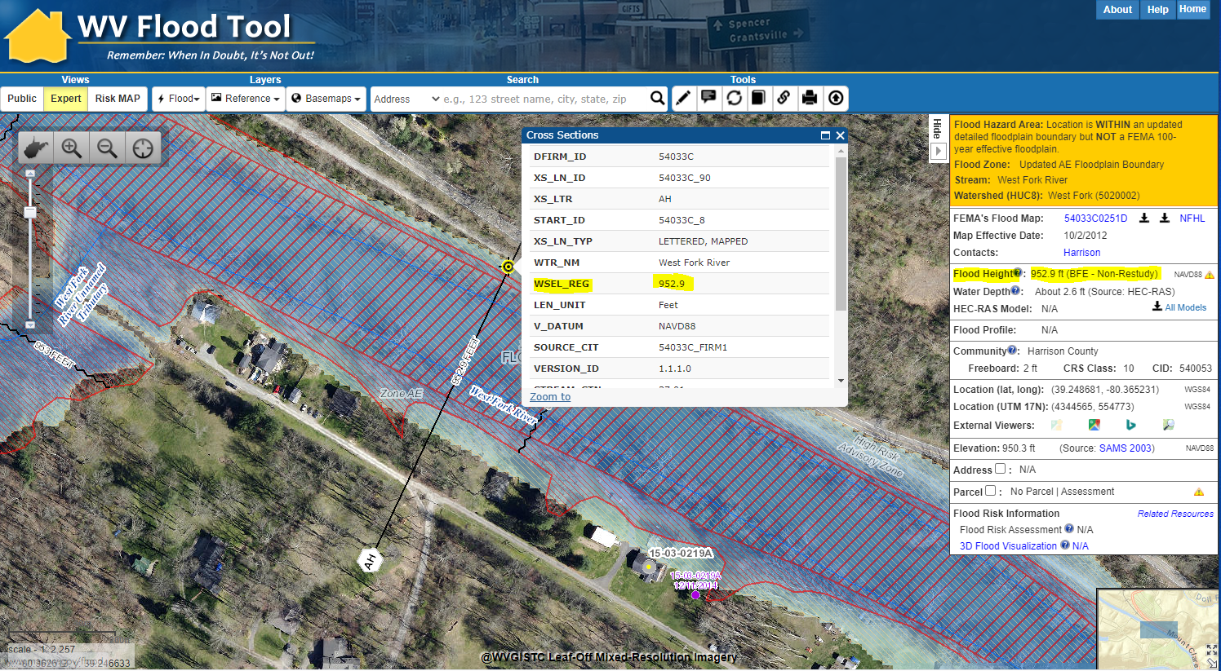
Flood Heights: BFE Non-Restudy (Cont.)
NFHL X-Section Popup Window
Flood Query Panel
FLOOD HEIGHTS (Example for Harrison County)
Non-Restudy Base Flood Elevation Heights displayed in Flood Query Results Panel
Source: Flood Heights created from Updated AE Redelineation using best available topography https://mapwv.gov/flood/map/?wkid=102100&x=-8946217&y=4757356&l=10&v=1

Slide 30
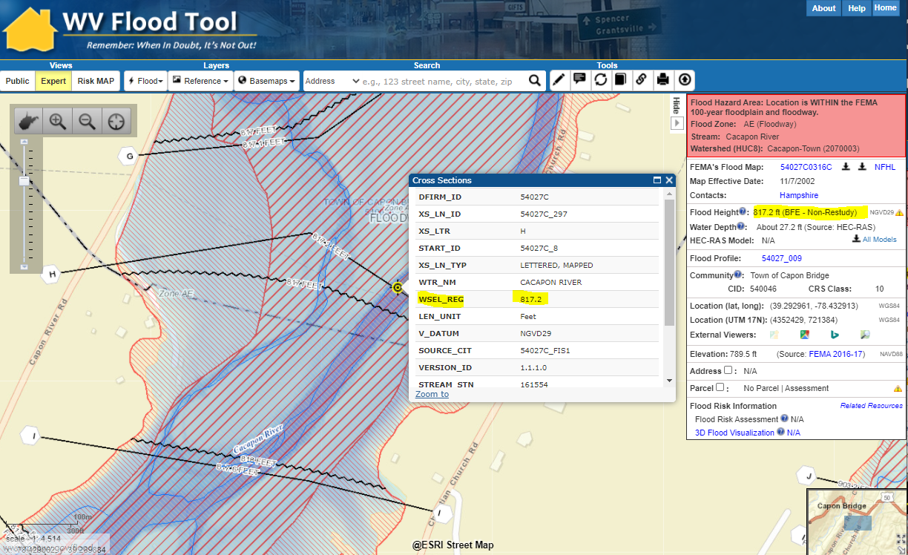
Flood Heights: BFE Non-Restudy (Cont.)
NFHL X-Section Popup Window
FLOOD HEIGHTS (Example for Hampshire County)
Non-Restudy Base Flood Elevation Heights displayed in Flood Query Results Panel
Source: Flood Heights created from Updated AE Redelineation using new topography
Flood Query Panel
https://www.mapwv.gov/flood/map/?wkid=102100&x=-8731112&y=4763723&l=10&v=1

Slide 31
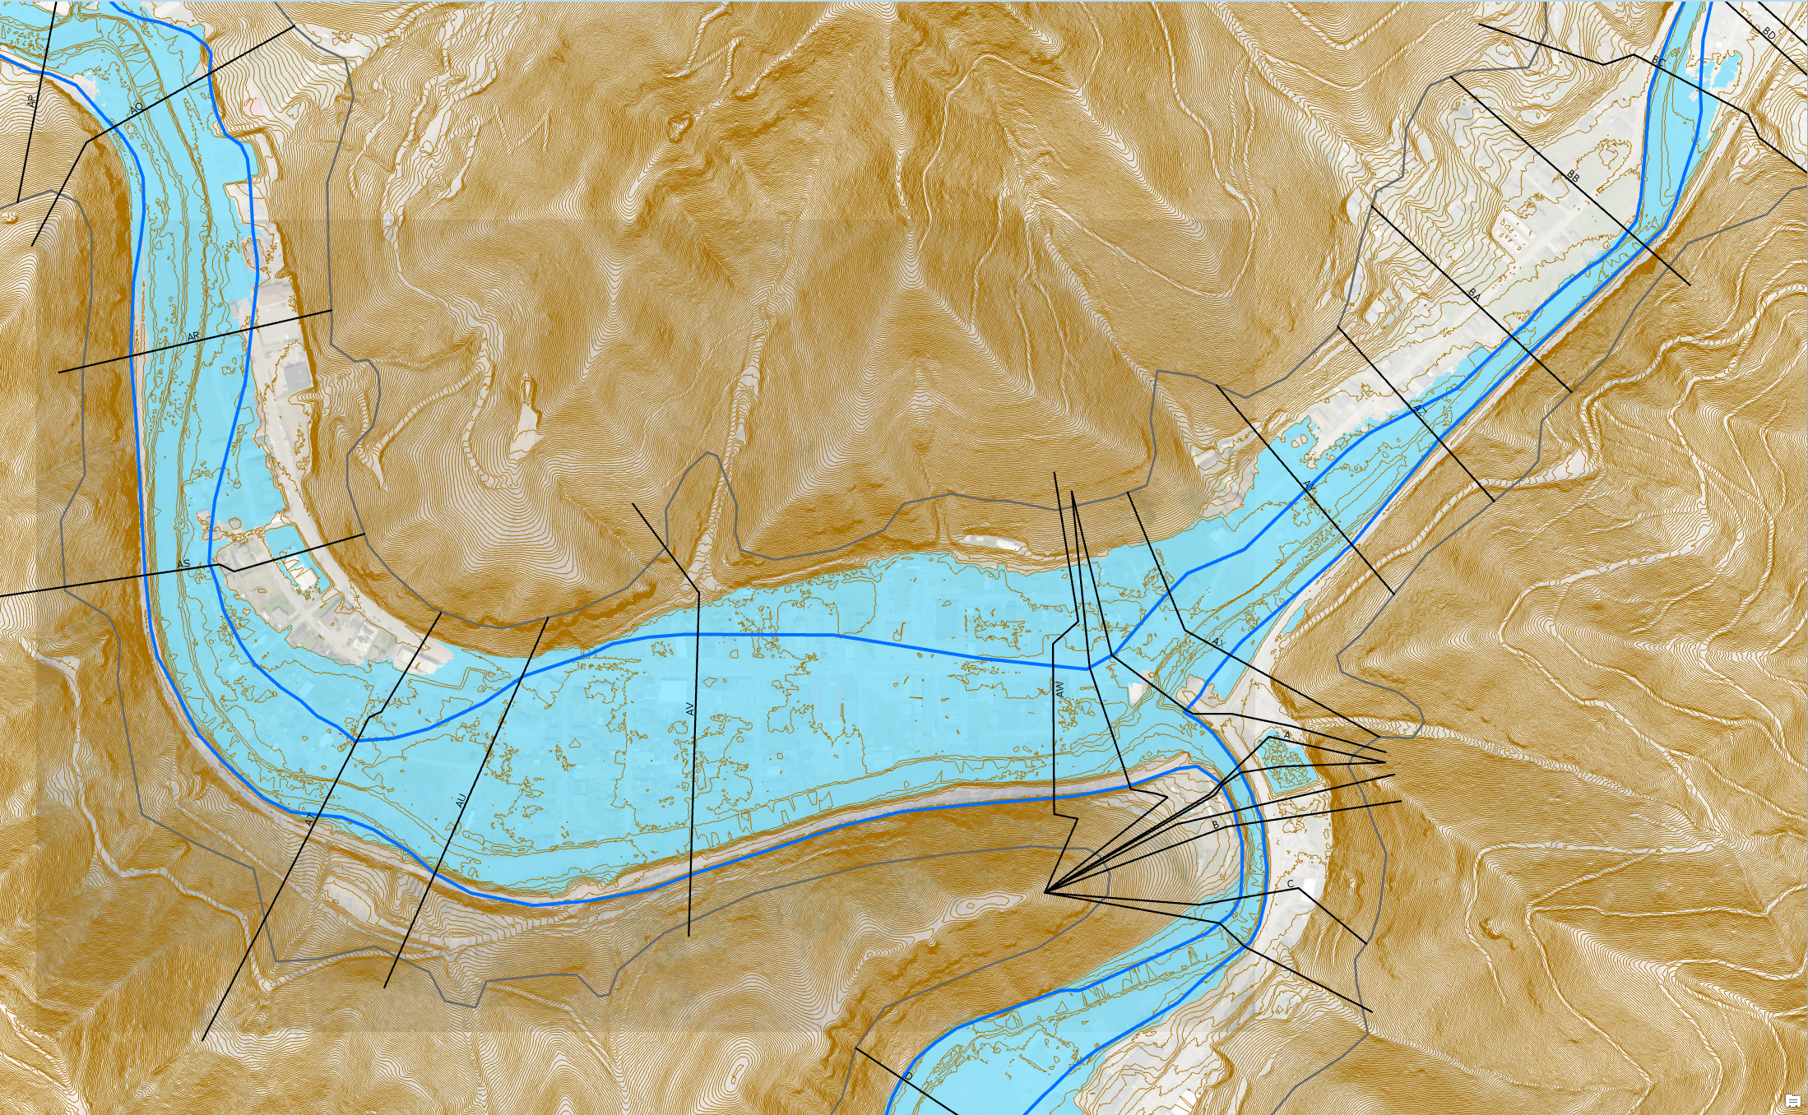
Updated AE Floodplain Boundaries -
Example
Redelineated Floodplain Using New Topo
Regulatory AE Floodplain
Updated AE Floodplain
Updated AE
Zone
Clear Fork
Oceana
Location: Clear Fork, Oceana, Wyoming County, WV
Objective: Zone AE Floodplain Redelineation and Flood Risk Products using existing LiDAR-derived elevation data
https://www.mapwv.gov/flood/map/?wkid=102100&x=-9086441&y=4536103&l=9&v=1

Slide 32
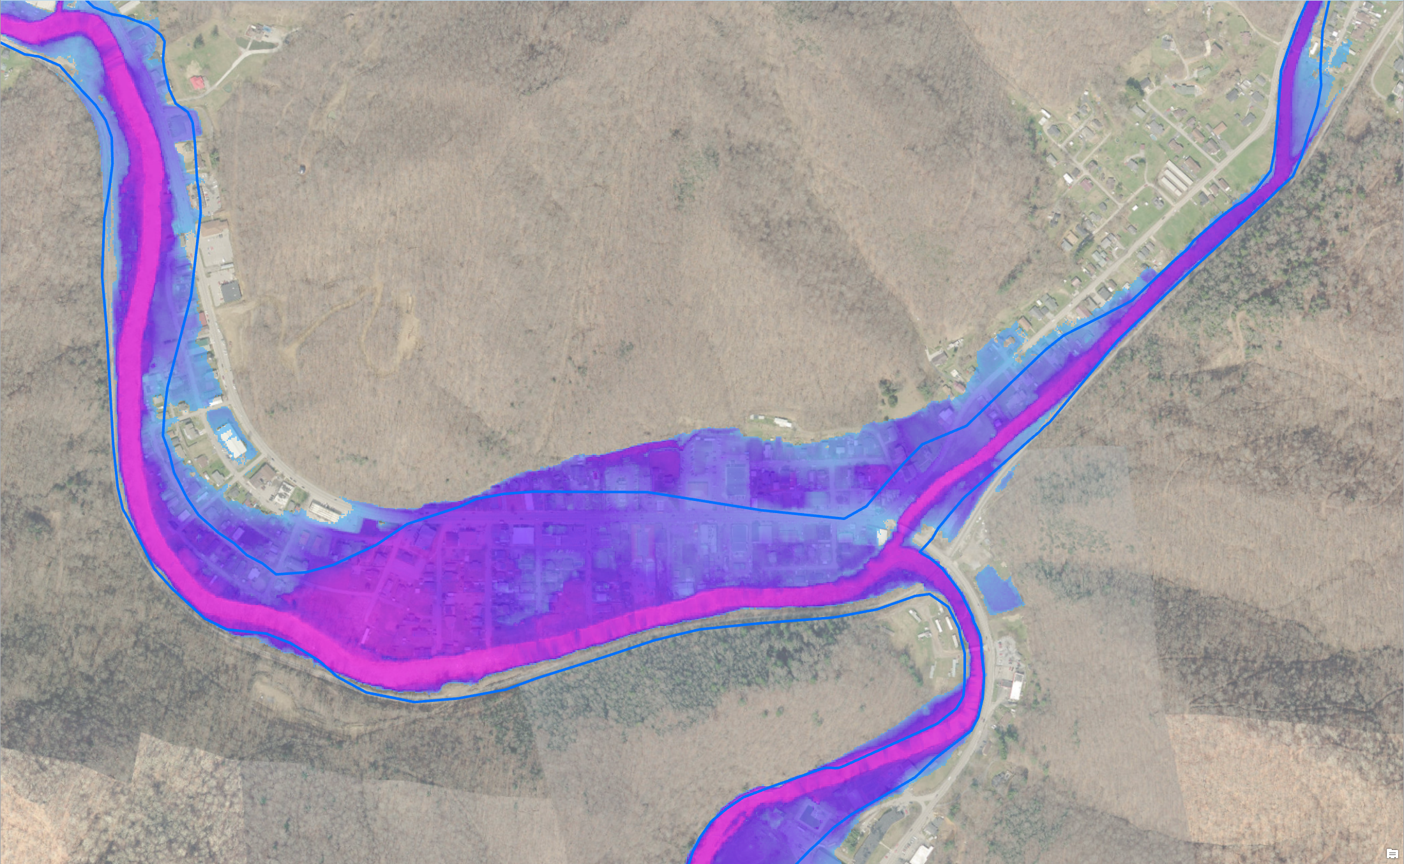
Updated AE Floodplain Boundary -
Depth Grid
Regulatory AE Floodplain
Updated AE
Water Depth
Advisory AE Water Depth
Clear Fork
Oceana
Location: Clear Fork, Oceana, Wyoming County, WV
https://www.mapwv.gov/flood/map/?wkid=102100&x=-9086441&y=4536103&l=9&v=1

Slide 33
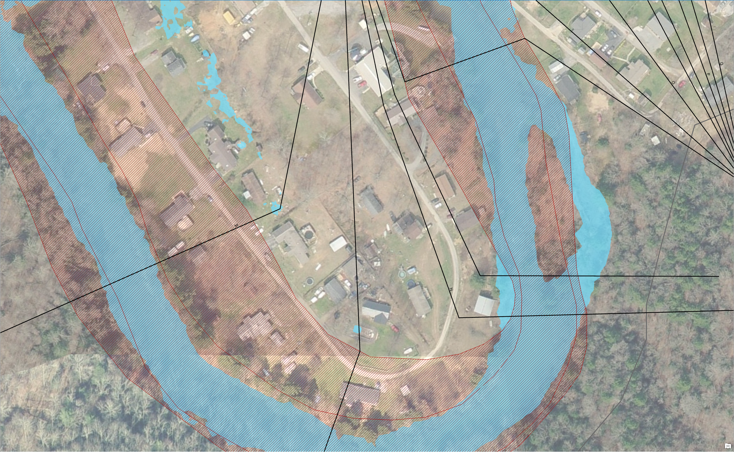
Advisory AE Determinations
Regulatory IN but Advisory OUT
Regulatory AE Zone
Advisory AE Zone
Structures IN Regulatory AE Zone and OUT Advisory AE Zone
What do you tell the public? Acquire an elevation certificate and use the Updated AE Floodplain Boundary information to request a LOMA to amend the effective NFIP map.

Slide 34
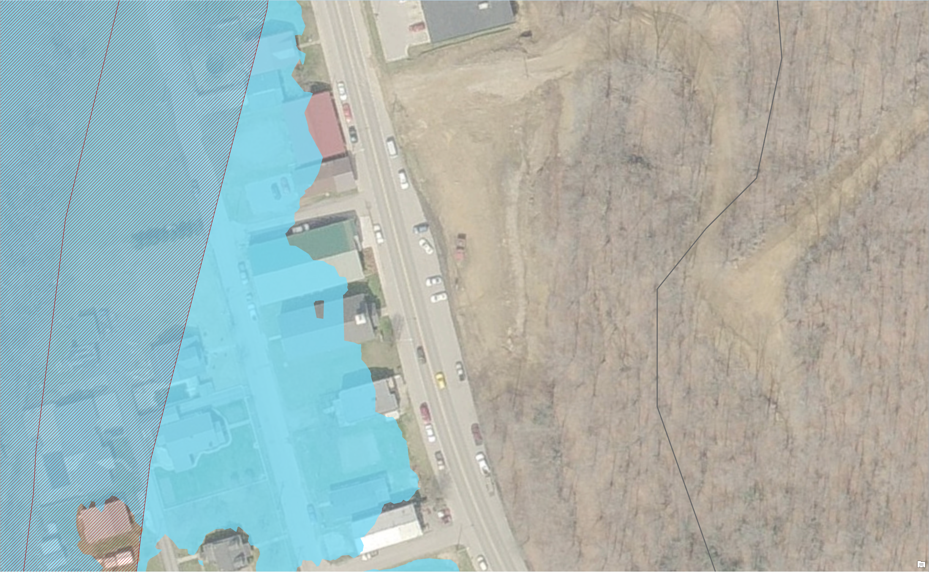
Updated AE Floodplain Boundaries
Regulatory
AE Zone
Regulatory OUT but Advisory IN
Updated
AE Zone
Structures OUT Regulatory AE Zone and IN Updated AE Floodplain Boundary
What do you tell the public? Updated AE floodplain boundary information indicates a flood hazard area and will likely be incorporated into future effective NFIP maps. New development should not occur in updated floodplains without a detailed study to show development reasonably safe from flooding. Recommend purchasing flood insurance for existing structures.

Slide 35
High-Risk Advisory Zones
Outreach Information
Buildings – Future Map Conditions

Slide 36
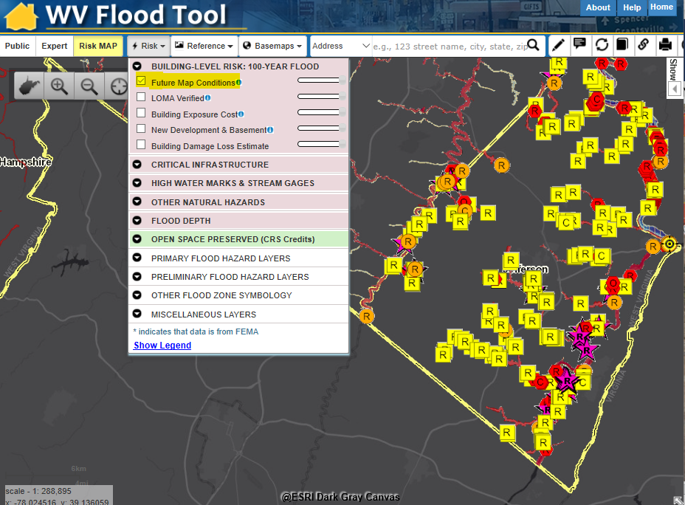
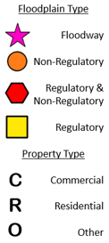
Buildings – Future Map Conditions
High Risk Non-Regulatory
Preliminary Studies
Advisory A Zones
Updated AE Zones
Regulatory Floodway
No Change
Mapped IN SFHA
Mapped Out of SFHA

Slide 37
Advisory Zones – Outreach Information
R
Regulatory IN and Advisory OUT
Regulatory OUT and Advisory IN
Both Regulatory
& Advisory
(No Change)
Effective Regulatory Floodplain
Advisory Floodplain
Union | Meaning | Building Changes | Area Changes
No Change | IN both Regulatory and Advisory | 2 | 11 m²
Advisory Only | Regulatory OUT and Advisory IN | 2 | 13 m²
Regulatory Only | Regulatory IN and Advisory OUT | 4 | 21 m²
The geographic union of Regulatory and Advisory Floodplains generates a change polygon for flood risk analysis by area. Subsequently the union polygon can be intersected with site-specific structures to analyze the impact of the Advisory Floodplain changes to the Regulatory Floodplain.

Slide 38
Advisory Zones – What is the message for property owners??
Regulatory In but Advisory Out (Lower Flood Risk) – Property owners are not at the highest risk to a 1% Annual Chance Flood but still recommend flood insurance. Owners can acquire an elevation certificate and use the advisory base flood elevation to acquire a LOMA and lower NFIP insurance rates. Yellow warning color indicates Moderate Flood Risk.
Regulatory Out but Advisory In (Higher Flood Risk) – Advisory information indicates a flood hazard area and will be incorporated into future effective regulatory or community identified floodplains. Floodplain managers should recommend property owners of existing structures in Advisory Floodplains that they are at high risk of a 1% Annual Chance Flood and recommend a Preferred Risk Flood Insurance Policy. New development should not occur in Advisory Floodplains without a detailed study to show development is reasonably safe from flooding. Orange warning color indicates High Flood Risk.
R
Regulatory IN and Advisory OUT
Regulatory OUT and Advisory IN
Both Regulatory
& Advisory
(No Change)
Effective Regulatory Floodplain
Advisory Floodplain

Slide 39
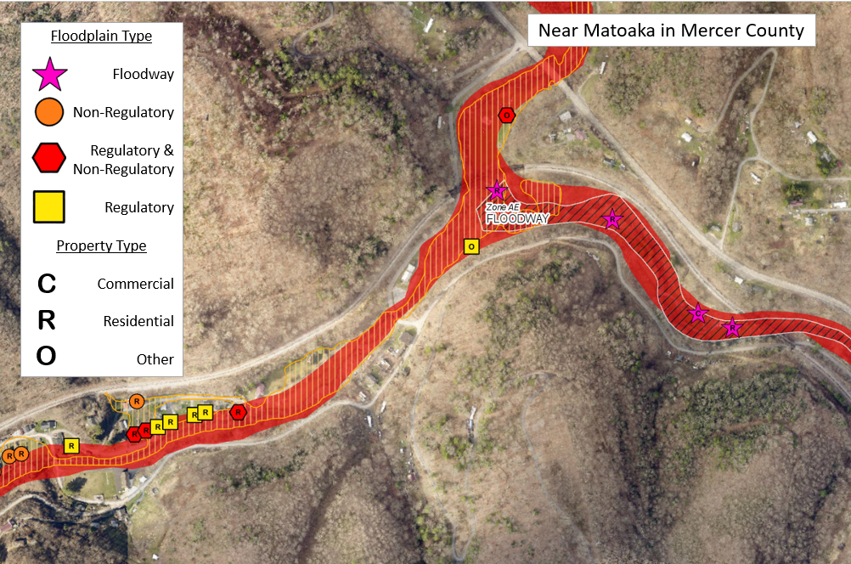
Buildings – Future Map Conditions
Regulatory Floodway
Mapped IN SFHA
No Change
Mapped Out of SFHA
High Risk Non-Regulatory
Preliminary Studies
Advisory A Zones
Updated AE Zones
Analogous to Changes Since Last FIRM (CSLF), but Building Changes Since Last FIRM (bCSLF)

Slide 40
Buildings – Future Map Conditions
Regulatory / Non-Regulatory / Floodway
Effective SFHA versus Preliminary SFHA
Effective AE Zone versus Updated AE Zone
R
R
R
R
R
C
REGULATORY ONLY
Effective AE or A Zones
REGULATORY & NON-REGULATORY
Effective SFHA & Preliminary SFHA
NON-REGULATORY ONLY
Preliminary SFHA
REGULATORY ONLY
Effective AE Zone
REGULATORY & NON-REGULATORY
Effective AE & Updated AE
NON-REGULATORY ONLY
Updated AE Zone
Map out SFHA with LOMA?
Obtain Flood
Insurance
Map out SFHA with LOMA?
Obtain PRP
Effective A Zone versus Advisory A Zone
Effective AE versus Floodway AE
O
R
R
R
AE Zone
REGULATORY ONLY
Effective A Zone
REGULATORY & NON-REGULATORY
Effective A & Advisory A
NON-REGULATORY ONLY
Advisory A Zone
O
AE Zone
R
Floodway
AE Zone
Map out SFHA with LOMA?
Obtain PRP
C

Slide 41
Buildings – Future Map Conditions
Regulatory Floodway
Mapped IN SFHA
No Change
Mapped Out of SFHA
High Risk Non-Regulatory
Preliminary Studies
Advisory A Zones
Updated AE Zones
Analogous to Changes Since Last FIRM (CSLF), but Building Changes Since Last FIRM (bCSLF)

Slide 42
Outreach: Property Mapped into Future SFHA
High-Risk Advisory A or AE Zones. High-risk advisory flood hazard information from State-Initiated Studies that will likely be incorporated into future effective regulatory or community identified floodplains. Property Mapped into Future SFHA or Community Identified Floodplain A state-based flood map study indicates that this parcel or building(s) within the parcel has been mapped into a High-Risk Advisory Zone. This property is at high risk of a 1% annual (100-Year) chance flood event A mapped High-Risk Advisory Zone (orange color on WV Flood Tool) denotes a flood hazard area that will likely be incorporated into future effective FIRM maps. New development should not occur in updated floodplains without a detailed study to show the development reasonably safe from flooding. The local floodplain management regulations required by the NFIP apply only in SFHAs. However, communities may regulate development in areas of high-risk outside the SFHA. Should a community want to regulate development beyond the FIRM, then a community may formally adopt High-Risk Advisory Zones as a “community identified floodplain” in its local floodplain ordinance. Most homeowner’s insurance policies do not provide coverage for damage due to flooding. Contact your insurance agent to learn about lower-cost “Preferred Risk Policy (PRP)” options offered by the NFIP for properties being mapped into higher-risk flood hazard areas. When a property’s flood zone changes from a non–Special Flood Hazard Zone (SFHA) to an SFHA as a result of a FIRM update, then the property owner will have to follow the guidelines of a Standard Flood Insurance Policy (SFIP). Mortgage-backed loans for properties within regulatory SFHA are required by federal law to carry flood insurance. For more information on flood insurance, visit the National Flood Insurance Program’s website, www.floodsmart.gov.
Flood Insurance Outreach Information to Property Owners for pending Flood Zone Change or Future Map Condition

Slide 43
Outreach: Property Mapped out Future SFHA
High-Risk Advisory A or AE Zones. High-risk advisory flood hazard information from State-Initiated Studies that will likely be incorporated into future effective regulatory or community identified floodplains. Property Owners Mapped out of Future SFHA or Community Identified Floodplain A state-based flood map study indicates that this parcel or building(s) within the parcel has been mapped out of a High-Risk Advisory Zone and may qualify for a Letter of Map Amendment (LOMA). The Online LOMC web application allows homeowners or their designated representatives to easily request a Letter of Map Change (LOMC). Use this site if your property was inadvertently included in a flood zone, or if the addition of fill elevated your property so that it is above the flood zone. Use the WV Flood Tool to provide supporting documents including LiDAR-based elevation information if a field survey (Elevation Certificate) is not required. A LOMA with a REMOVAL determination status will map the parcel or building out of the Special Flood Hazard Area (SFHA) and into a lower risk zone, shown on the FIRM as “X”. If you have a mortgage from a federally regulated lender, you will no longer be required by federal law to maintain flood insurance. It is important to know that many flood claims are made by property owners located outside the high-risk flood zone and that the issuance of a LOMC does not mean the structure or property is safe from all flooding. Floods greater than the 1-percent-annual-chance event (100-year flood) can, and do, occur. Therefore, because flooding also occurs in areas of moderate or minimal flood risk, FEMA recommends flood insurance coverage, even if it is not required by law or a lender. While flood insurance becomes optional, maintaining coverage is recommended as the flood risk has only been reduced, not removed. Lower cost flood insurance from the National Flood Insurance Program (NFIP) is available in low- to moderate-risk areas and you may also qualify for the even lower cost Preferred Risk Policy (PRP). Contact your insurance agent to learn more about how to convert to the PRP. For more information on flood insurance, visit www.floodsmart.gov.
Flood Insurance Outreach Information to Property Owners for pending Flood Zone Change or Future Map Condition

Slide 44
Water Depth: about <<value>>
Water Depth | Message | Sources
Water Depth: | About << value >> ft. | Model-Backed Depth Grids: Engineering Studies using modeling software like HEC-RAS: RiskMAP Restudy (Effective and Preliminary) Non-Restudy Updated AE Zones Advisory Flood Heights (Approximate A Zones) Other Depth Grids HAZUS generated USGS Inundation Layers
A statewide “composite” Flood Risk Assessment Depth Grid is created from model-backed effective and advisory depth grids at a 1-meter cell resolution.
Water Depth Grids are a flood risk assessment product – not a flood regulatory product. Water depths are important for flood loss damages and by flood visualizations of site-specific structures.
Depth grids a source of credits for CRS communities.
See FEMA’s Flood Risk Assessment Guidance (May 2016) for guidance on composite depth grids:
https://www.fema.gov/media-library-data/1469146645661-31ad3f73def7066084e7ac5bfa145949/Flood_Risk_Assessment_Guidance_May_2016.pdf

