Slide 1
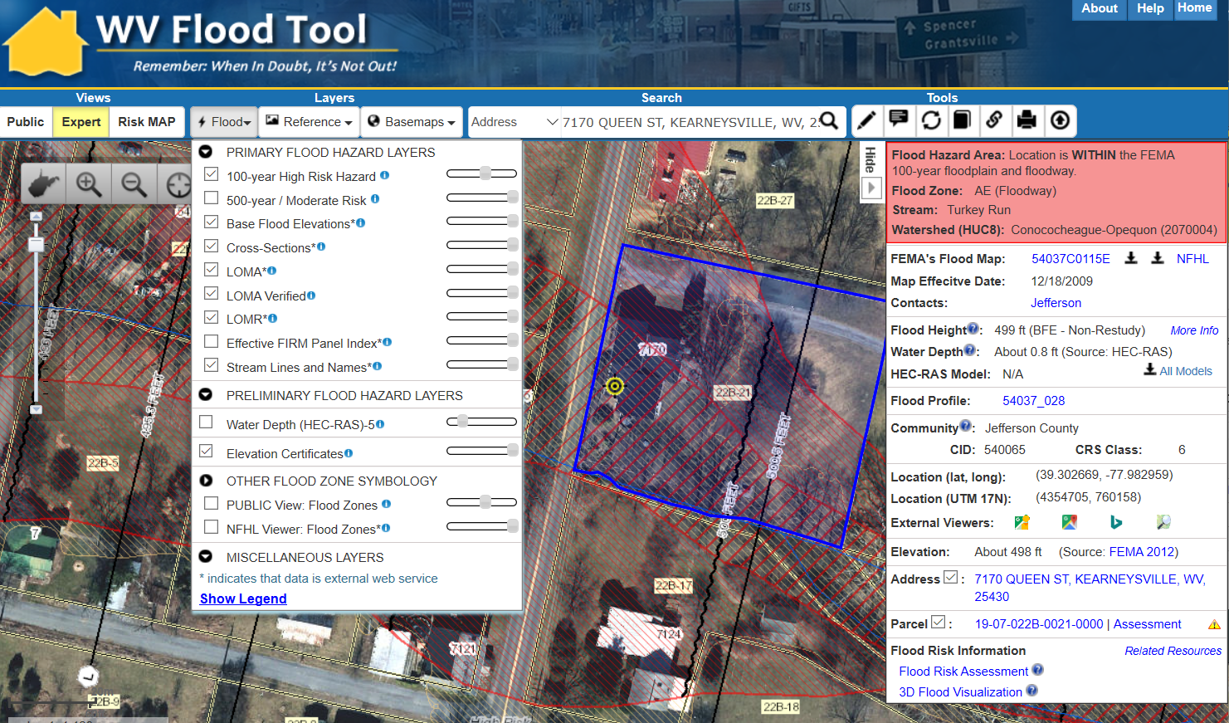
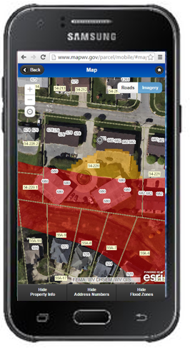
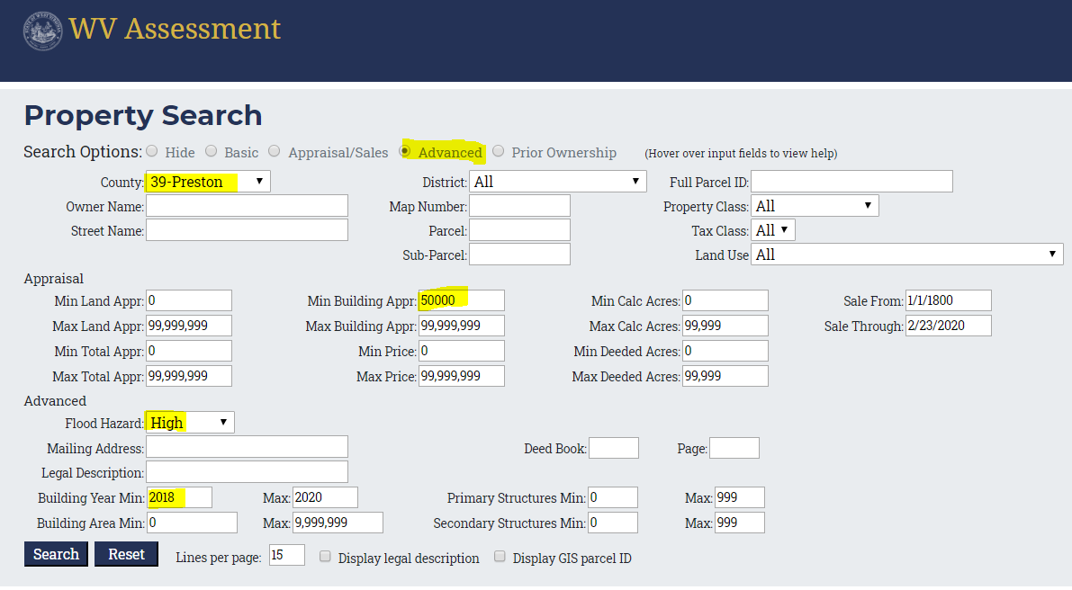
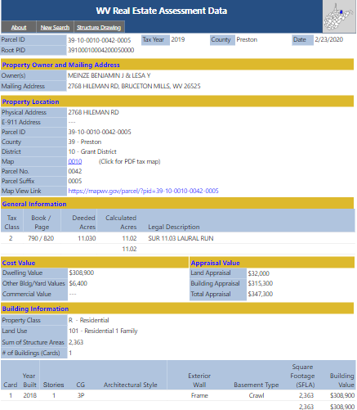
WV Flood Tool
11/07/2020
Flood Tool: Desktop
(1) Flood Tool: Desktop Version https://www.mapwv.gov/flood
(2) Flood Tool: Mobile Version https://www.mapwv.gov/flood/mmap
Public resource applications that support floodplain management and flood reduction activities
Mobile
(3) Property Search and Assessment Report https://www.mapwv.gov/property
Web Parcel Report
Query search on flood hazard zones and state assessment records
New development
Prior ownership

Slide 2
WV Flood Tool
Flood Tool Views
(www.mapwv.gov/flood)
Public View for general public
Expert View for floodplain managers
RiskMAP View for flood risk planners

Slide 3
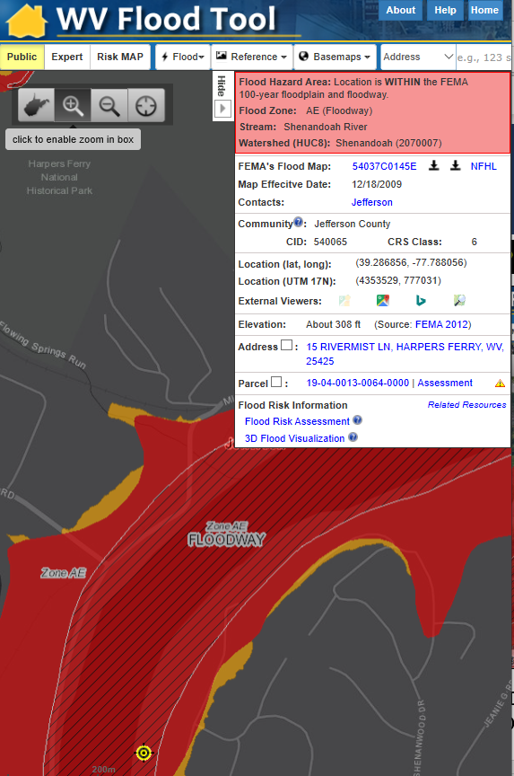
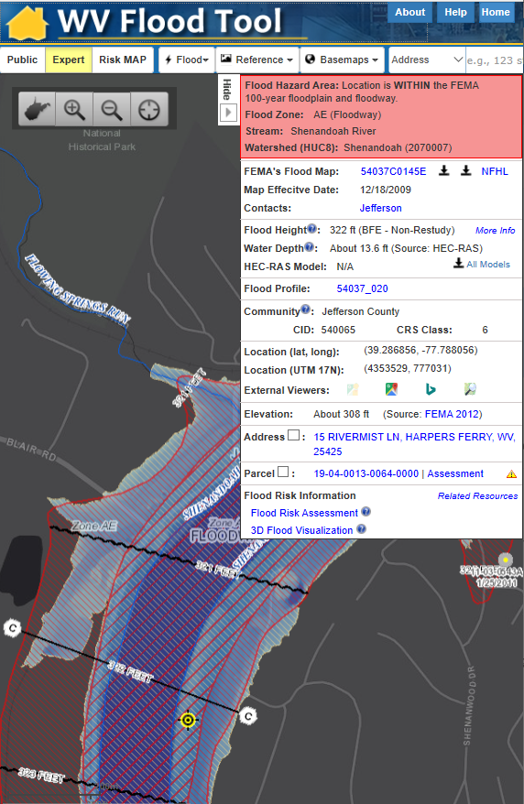
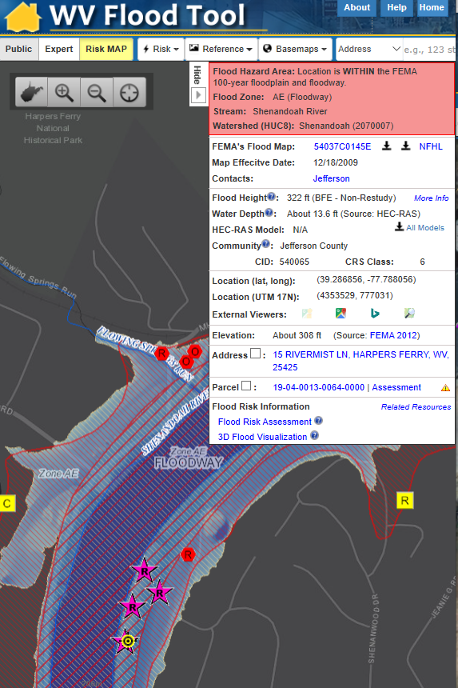
WV Flood Tool Views
Public View
Expert View
RiskMAP View
Quick Determination if IN or Out of Flood Zone
Floodplain Management and Permits, Disaster Assessments
Building-Specific Flood Risk Assessments

Slide 4
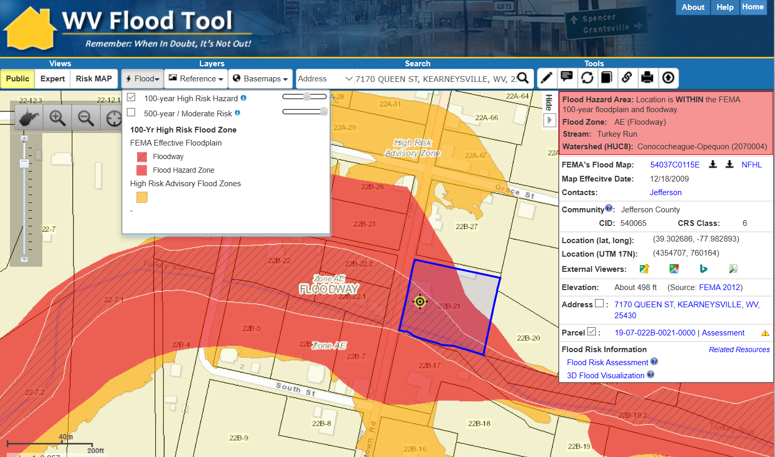
WV Flood Tool – Public View
Public View
https://www.mapwv.gov/flood/map/?v=0&pid=19-07-022B-0021-0000

Slide 5
WV Flood Tool – Expert View
Expert View
https://www.mapwv.gov/flood/map/?v=1&pid=19-07-022B-0021-0000

Slide 6
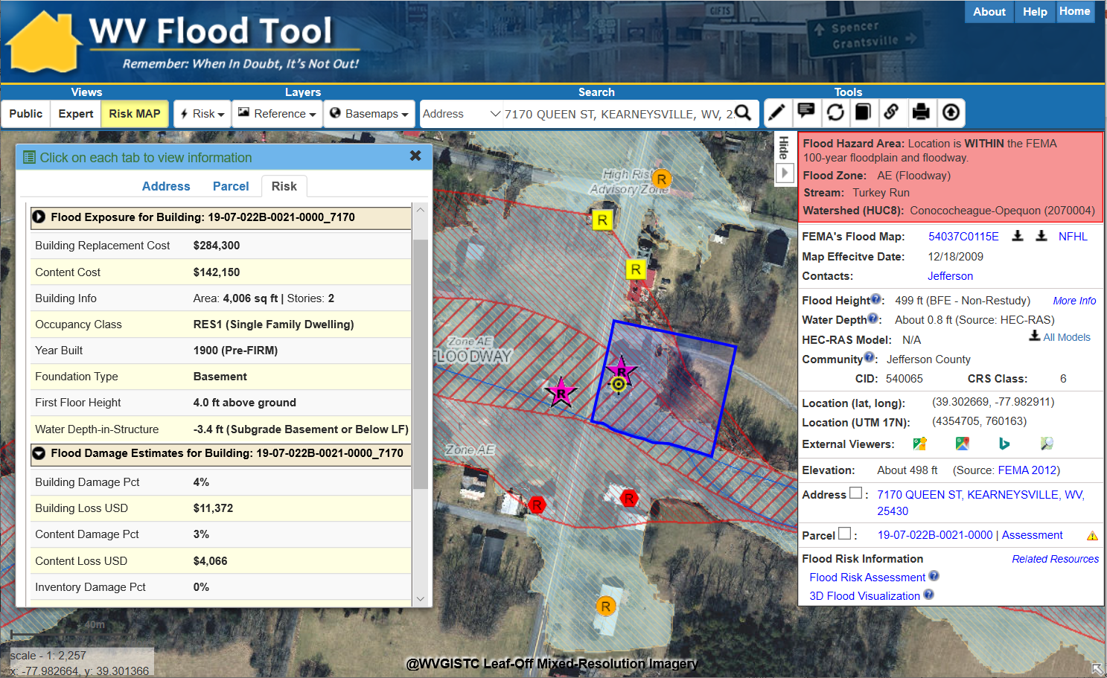
WV Flood Tool – RiskMAP View
RiskMAP View
https://www.mapwv.gov/flood/map/?v=1&pid=19-07-022B-0021-0000

Slide 7
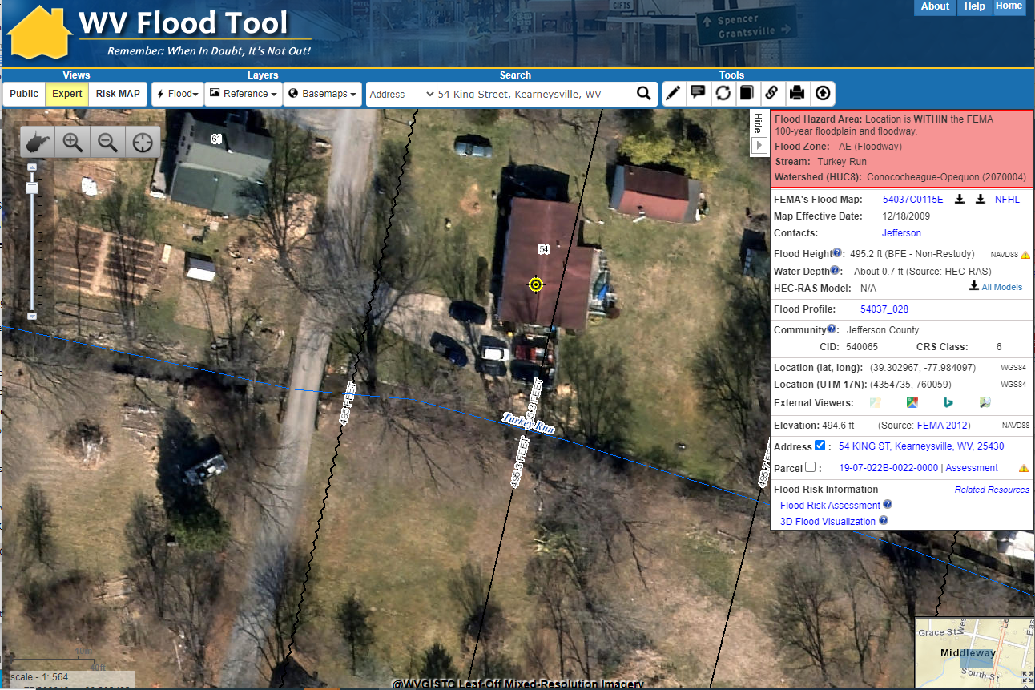
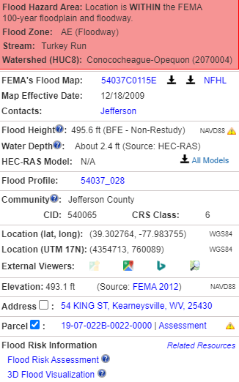
Flood Query Results Panel
# | Each Location Query Answers:
1 | In Flood Hazard Area? Flood Zone? Floodway?
2 | Stream & Watershed names?
3 | FEMA Issued Flood Map / NFHL links?
4 | Floodplain Manager Contact?
5 | Flood Height value & Vertical Datum?
6 | Water Depth value and source?
7 | HEC-RAS Model available?
8 | Flood Profile available?
9 | CRS community information?
10 | Coordinate x,y location?
11 | External Map Viewer Links?
12 | Ground elevation value and source?
13 | E-911 Address (link to address info)
14 | Parcel ID (link to property info)
15 | Flood risk assessment info?
16 | 3D flood visualization?
1
54 King St.
2
3
4
5
6
7
8
9
10
11
12
13
14
15
16
Parcel ID Web Link: https://www.mapwv.gov/flood/map/?v=1&pid=19-07-022B-0021-0000
Performance Measure: Query Results display within 5 seconds

Slide 8
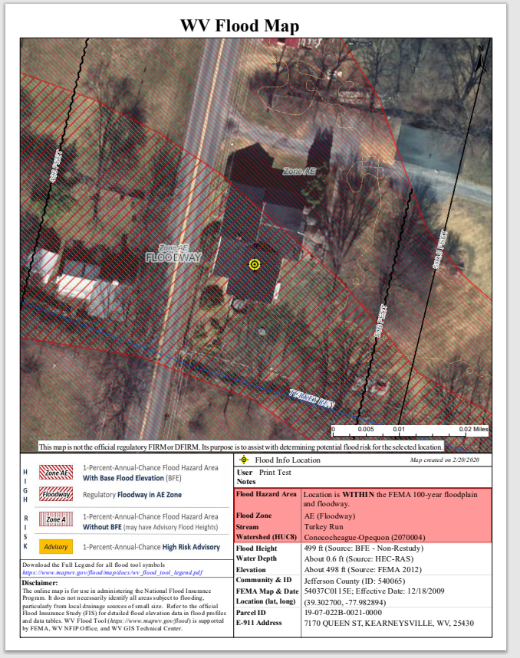
Print Out for Permits, LOMAs, etc.
Print Flood Query Results

Slide 9
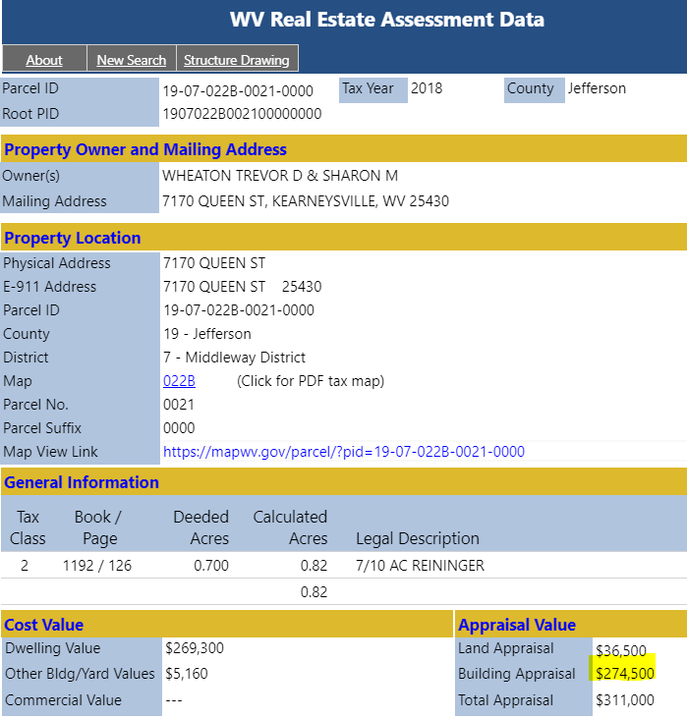
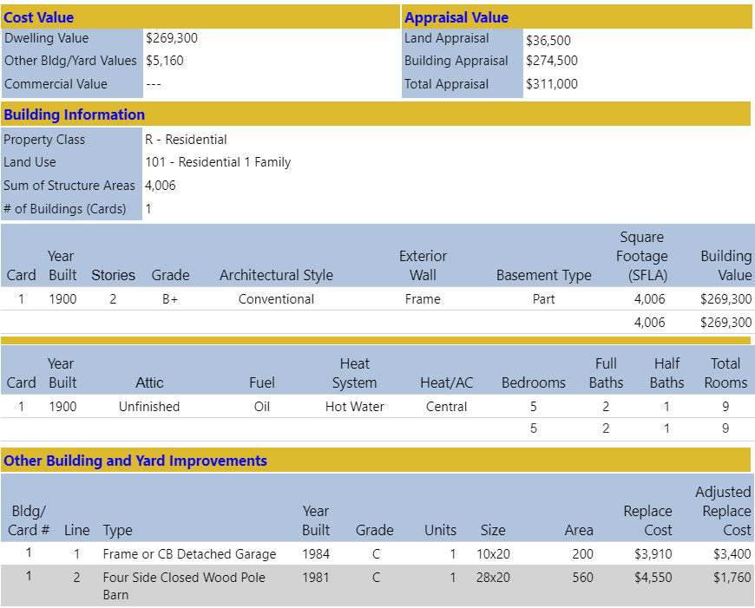
Building 19-07-022B-0021-0000_7170
Main Building Information
Owner and Property Location
Outbuildings
Legal Description
Cost Values
Property Intersect Flood Zone
Web Parcel Assessment Report for Building Identification, Building Characteristics, and Cost Values

Slide 10
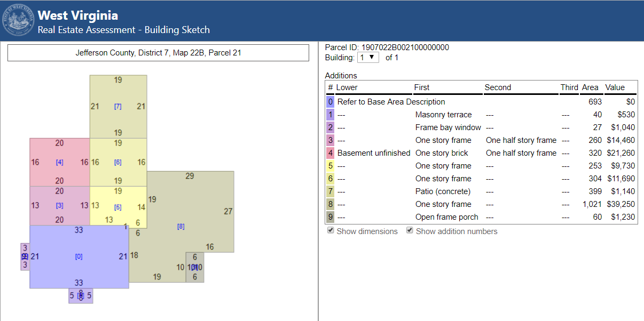
Building 19-07-022B-0021-0000_7170
Building Sketch Diagram (main area and additions)
Building Sketches from parcel assessment records are available for all Residential and Farm properties. Very useful for Building Identification.

Slide 11
Data Privacy at State Level
West Virginia Statewide Parcel Files and Attributes in Public Domain: The local and state governments have the authority to share property owner names and addresses with the public (2017 Senate Bill 588). For example, West Virginia’s parcel assessment data which includes names and addresses is publicly accessible; only sensitive information like phone numbers or security alarm information are redacted by the WV Property Tax Division before release. Both the WV Property Tax Division and county assessors are co-custodians of the parcel map files and assessment records. All the West Virginia parcel data and assessment information can be downloaded from the State Data Clearinghouse.

Slide 12
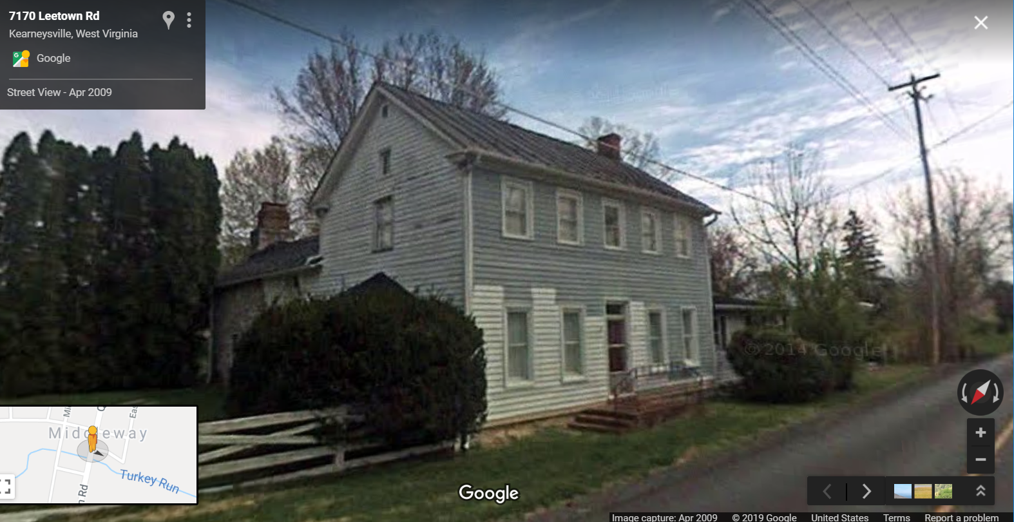
Building 19-07-022B-0021-0000_7170
Building 19-07-022B-0021-0000_7170
Flood Tool External Link to Google Street View
Flood Tool External Link to Google Street View

Slide 13
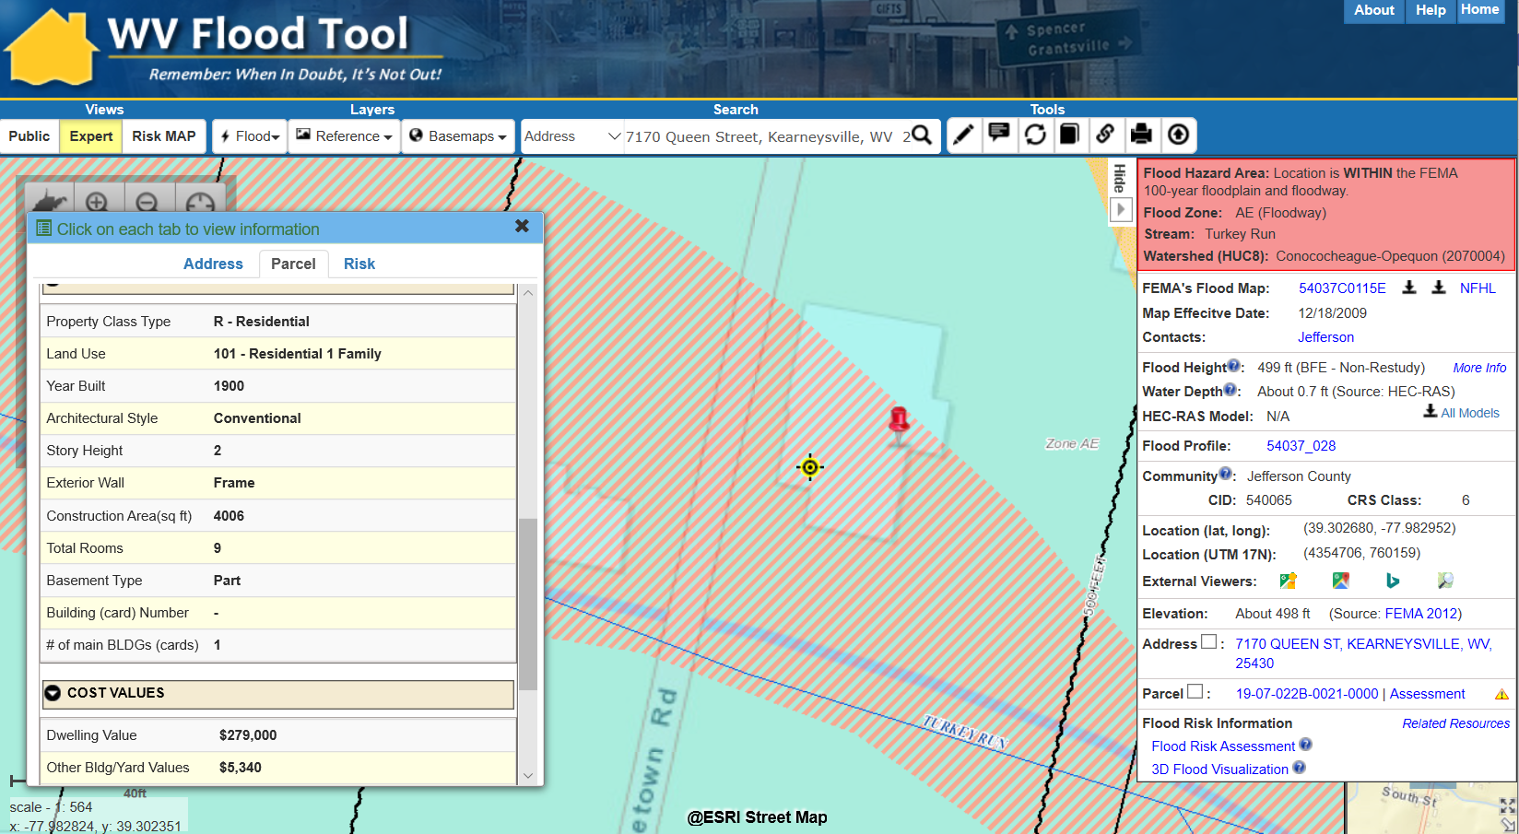
Information Links
FEMA Flood Maps
Flood Profile
Street View Picture
Elevation Metadata
Property Info
Bldg. Flood Risk
Flood Visualization
https://www.mapwv.gov/flood/map/?v=1&pid=19-07-022B-0021-0000

Slide 14
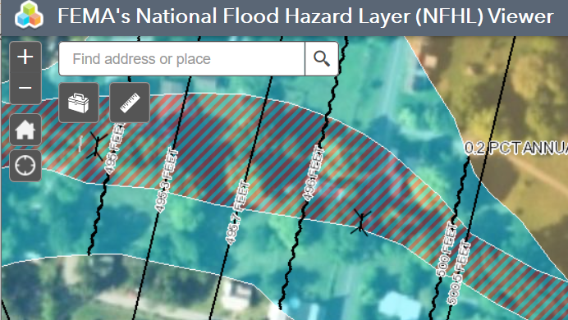
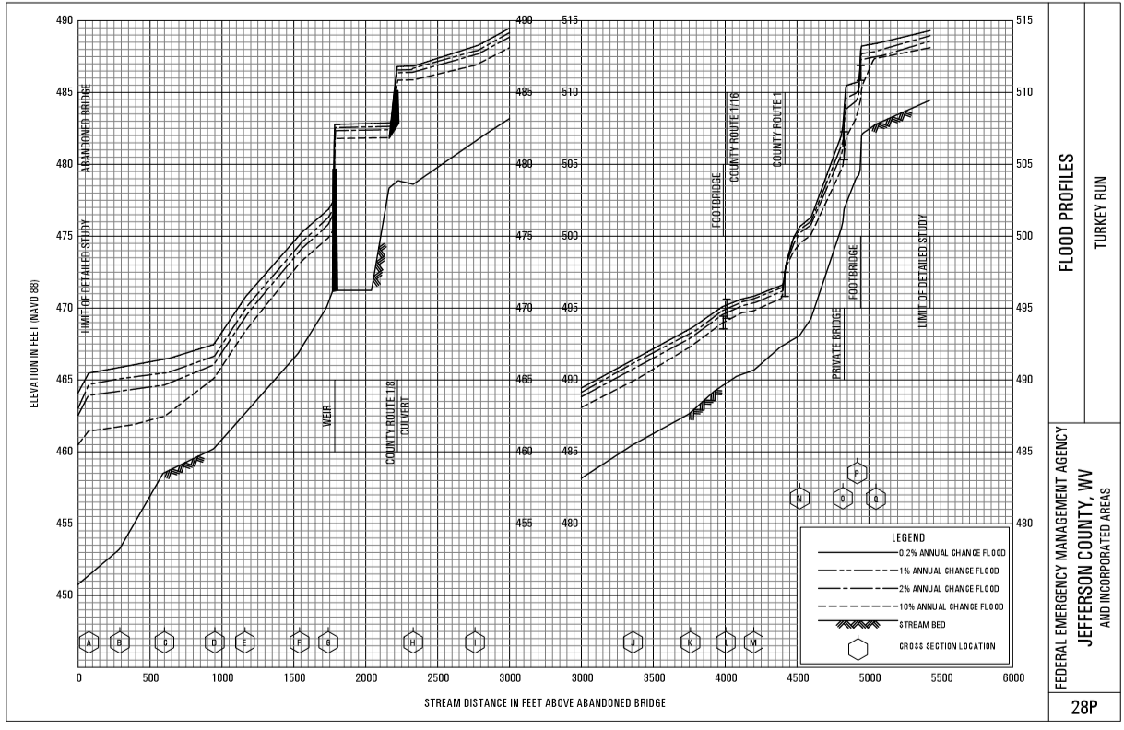
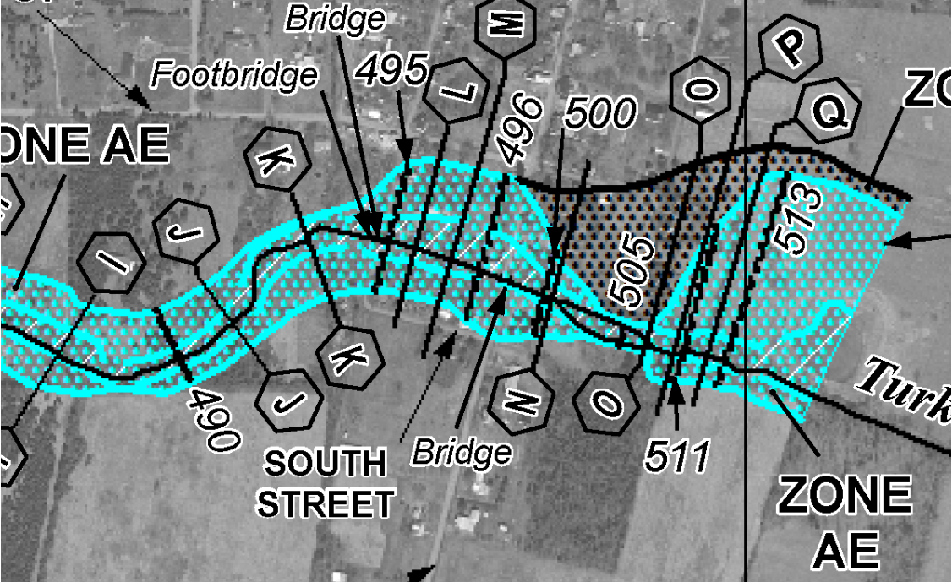
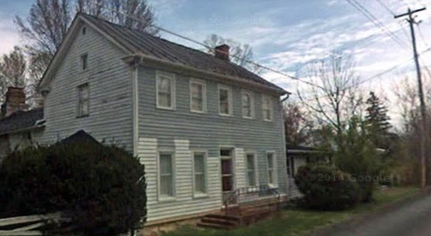
Information Links
FEMA’s NFHL Viewer
Flood Profile
FEMA Issued Flood Map
Street View Image
Building 19-07-022B-0021-0000_7170
https://www.mapwv.gov/flood/map/?v=1&pid=19-07-022B-0021-0000

Slide 15
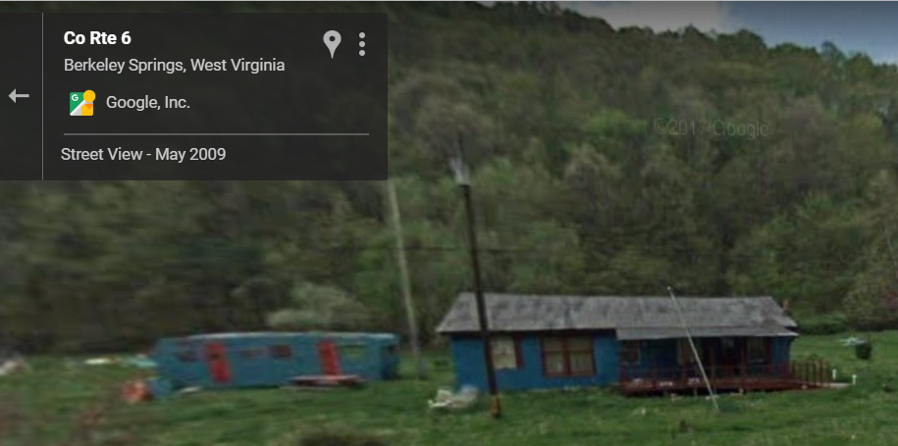
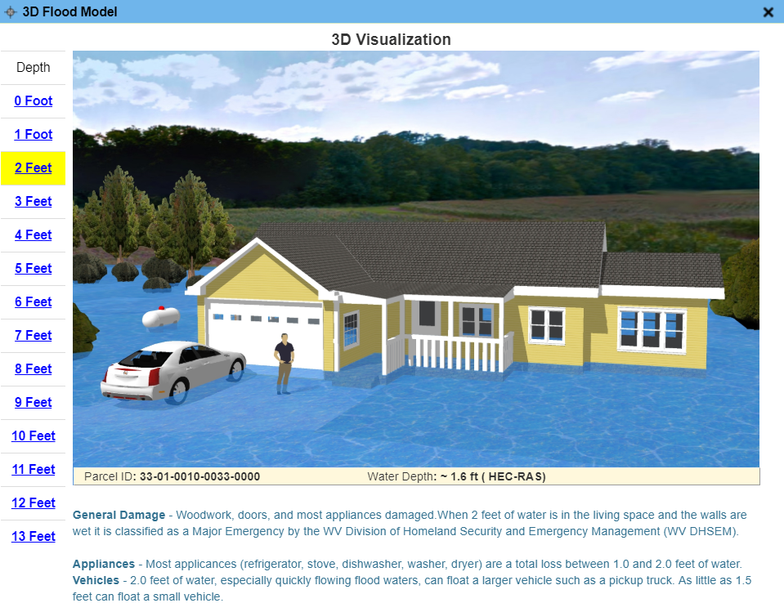
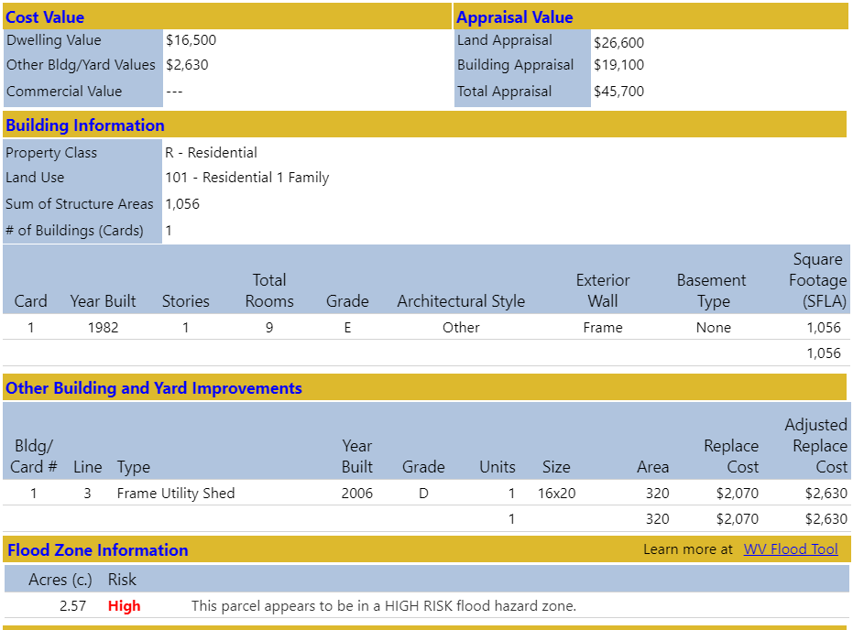
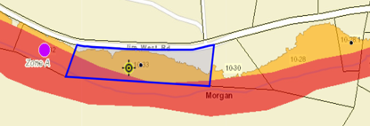
High-Risk Advisory A Zone
Parcel ID: 33-01-0010-0033-0000
Google Street View
Flood Visualization
Web Parcel Report
Flood Zone Map
http://www.mapwv.gov/Assessment/?PID=33010010003300000000

Slide 16
WV Flood Tool
3D Flood Visualizations

Slide 17
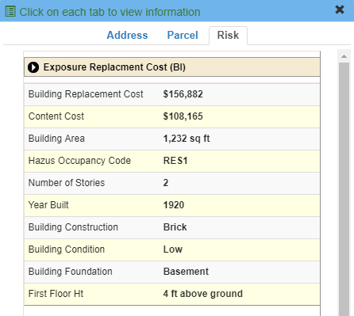
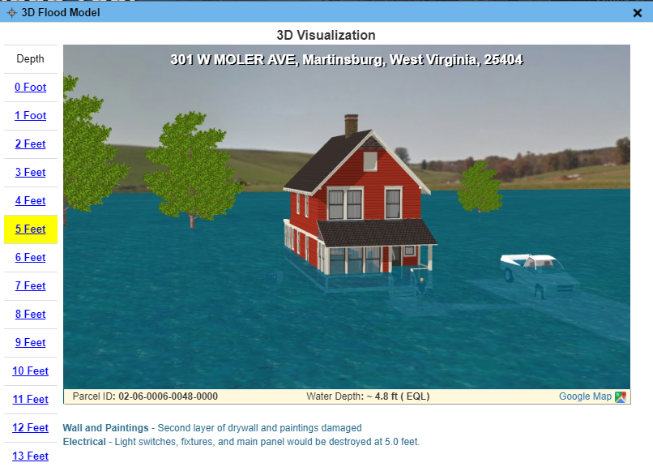
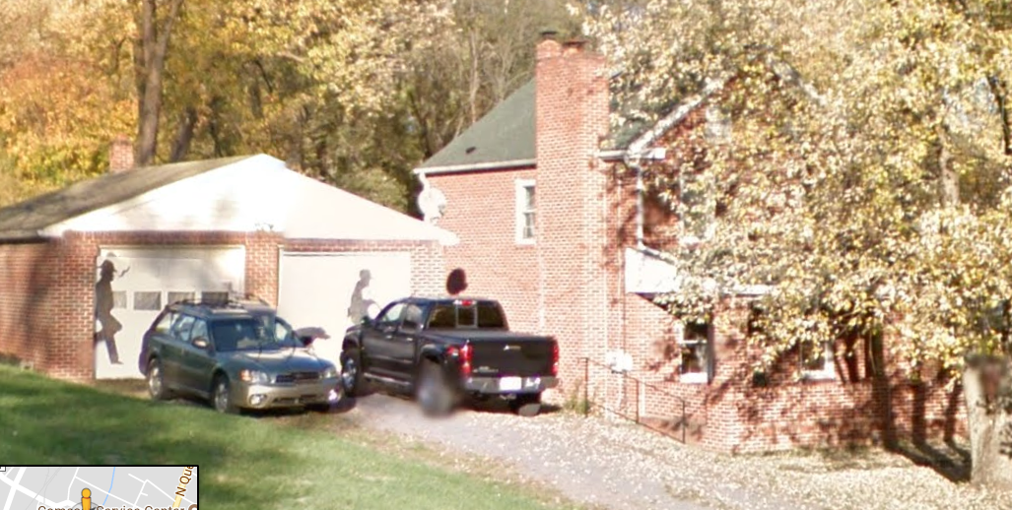
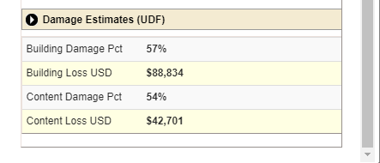
RiskMAP View – 3D Visualization
Building Exposure
Flood Depth – 3D Visualization
HAZUS Loss Estimate
Street View Image

Slide 18
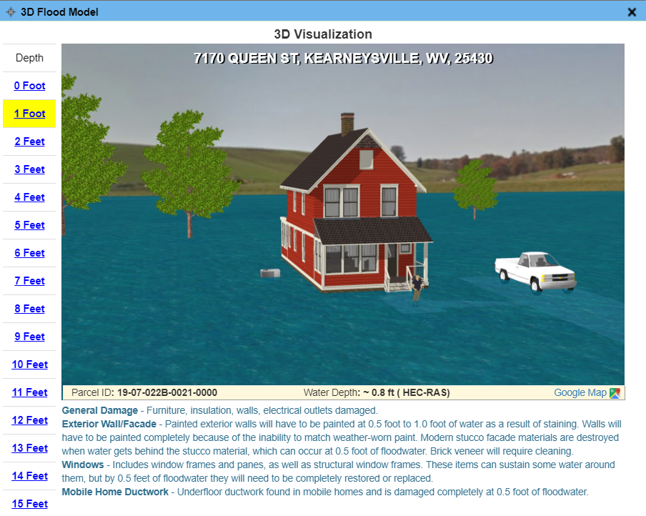
Building 7170:19-07-022B-0021-0000
3D Flood Visualization

Slide 19
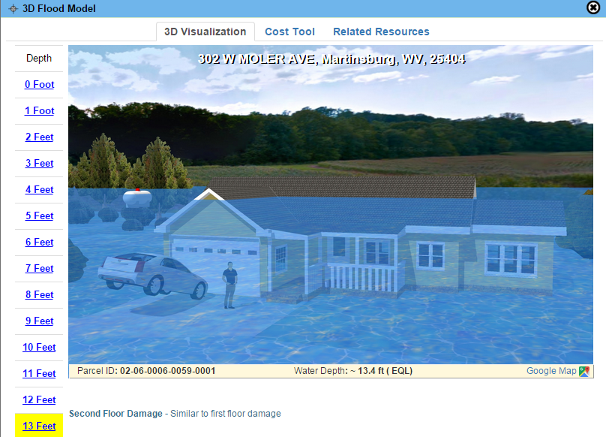
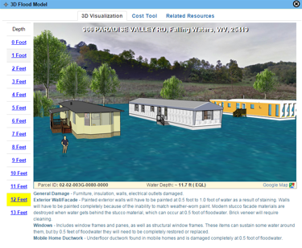
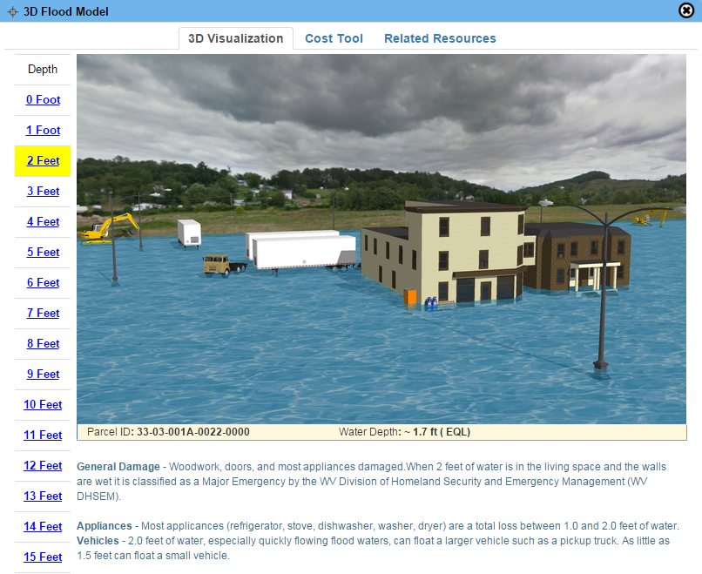
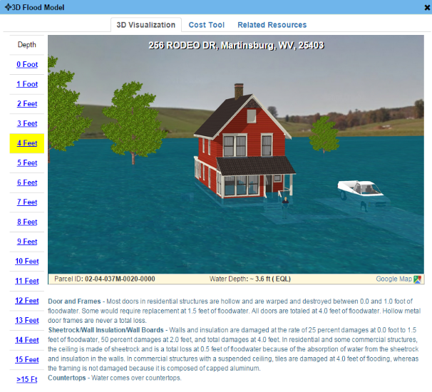
3D Flood Visualizations
Visualizations are easier for non-technical users to understand flood risks to their property in feet of water rather than comprehending the adjacent base flood elevation
1-Story Home
Mobile Home
Commercial
"The 3D visualization is really cool. Our citizen comes to the counter and says 'there is no way there can be a flood like that.' Then we show them how much water you will get in your house and how much it will cost to repair it. The 3d visual is really good! And then we like the way you can click on a parcel ID and it brings up all the information as far as property owner, tax map and parcel number, deed book, page number - everything is right there. And the building information is really good too because it tells what the structure is made of, whether it has a basement - all the information that we would have to go to another system to pull is right there.“ Source: 3D Flood Visualization Comment from Debbie Robinson, Kanawha County Planning and Development Office
2-Story Home
3D flood visualizations are available statewide for locations where flood depth grids exist. The parcel assessment data fields (land use, stories) are necessary to identify the correct property type: residential one- or two-story homes, mobile home, commercial/industrial, etc.

Slide 20
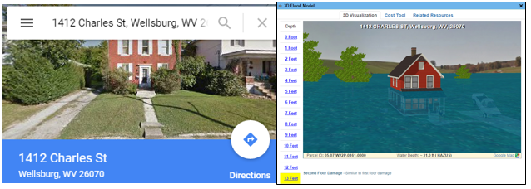
3D Flood Visualizations
Brooke County
https://www.mapwv.gov/flood/map/?v=1&pid=05-07-W22P-0161-0000
1412 Charles St, Wellsburg, WV, 26070, Parcel ID: 05-07-W22P-0161-0000
“This is the coolest thing ever….thank you!!!”
Source: 3D Flood Visualization Comment from Terri Jo Bennett, CFM, Upshur County Building Permit, Floodplain and Addressing and Mapping Coordinator
Upshur County
https://www.mapwv.gov/flood/map/?v=0&pid=49-05-0003-0031-0000
673 Vicksburg RD, Buckhannon, WV, 26201, Parcel ID: 49-05-0003-0031-0000

Slide 21
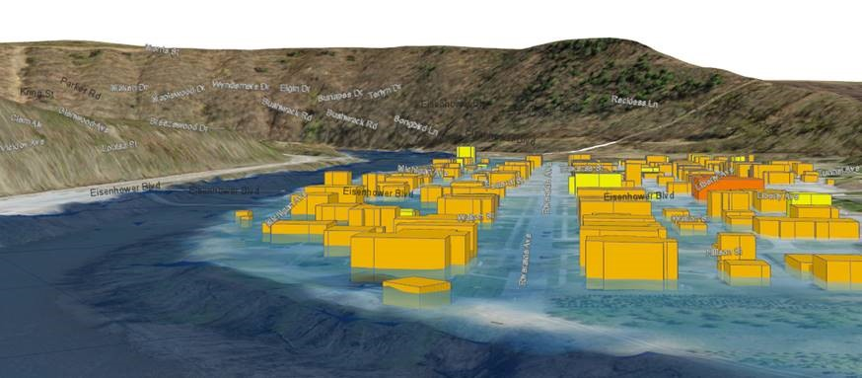
3D Flood Visualization - Community
Basic Steps for Creating 3D Flood Visualizations
Start with High-Resolution Digital Terrain Model
Overlay High-Resolution Aerial Image
Then add Streets
Then add Building Footprints
Extrude Building Footprints to Known Heights (“sugar-cube” 3D buildings)
Generate Detailed 3D Building Models
Photo-Texture the 3D Building Models
Add Trees and other Landscape/Streetscape Features
Add Flood Overlay (Riverine 1% Annual Chance Flood) Source: NEMAC
The objective is to make the 3D visualizations as realistic as possible in a minimal amount of processing time

Slide 22
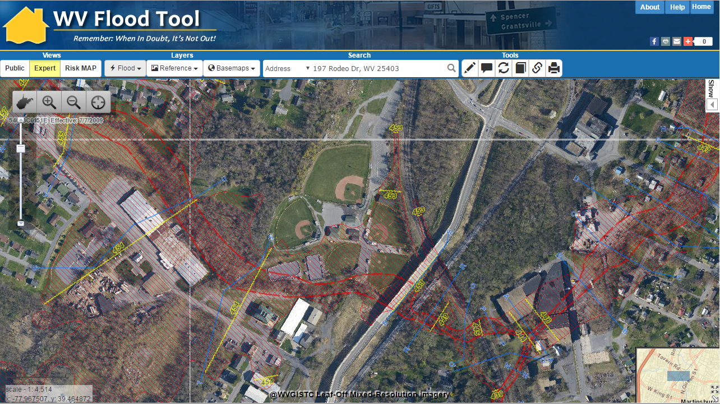
3D Flood Visualization - Community
Baltimore Street, Martinsburg, WV
3D
3D Northwest View
WV Flood Tool Conceptual Slide

Slide 23
WV Flood Tool
Property Identification

Slide 24
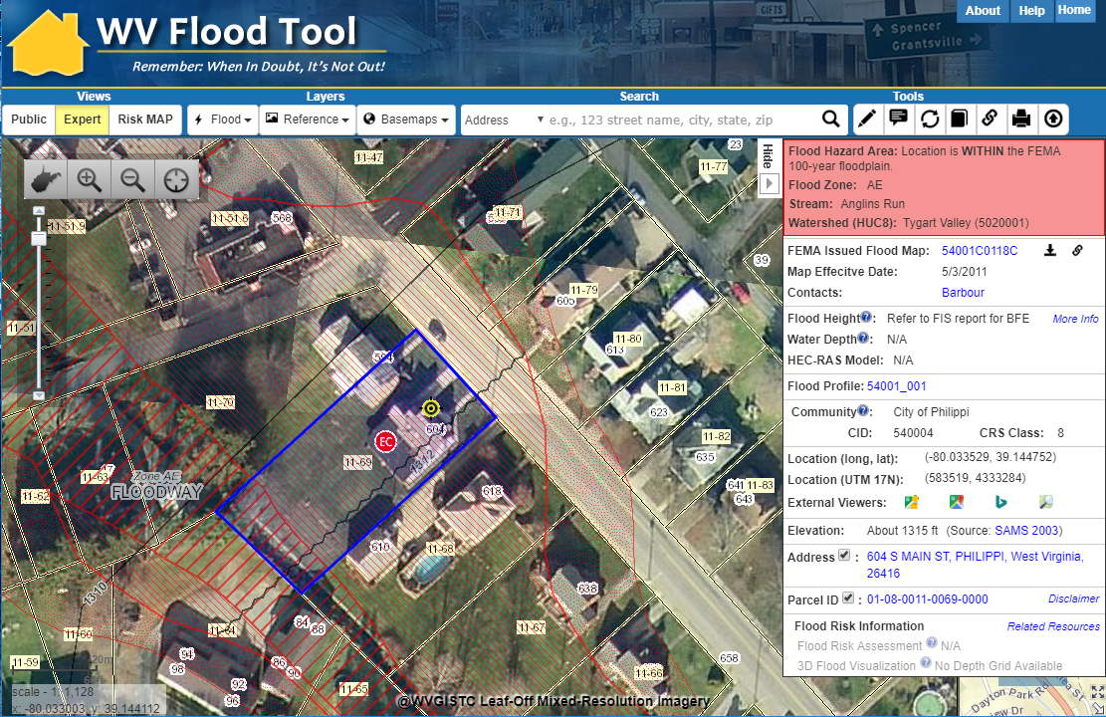
Property Identification – Bldg. ID
SHARE LINK
604 S Main Street, Philippi, WV
Address: 604 Main St, Philippi, WV 26416
Parcel ID: 01-08-0011-0069-0000
X,Y COORD.
ADDRESS
Building ID:
(Parcel ID + Address No.)
01-08-0011-0069-0000_604
PARCEL
Share Link: https://www.mapwv.gov/flood/map/?wkid=102100&x=-8909292&y=4742427&l=12&v=1

Slide 25
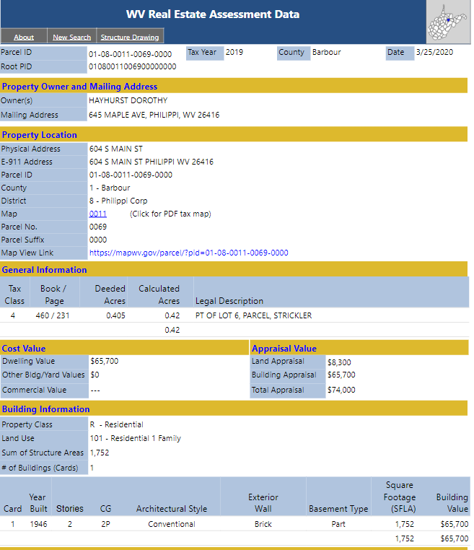
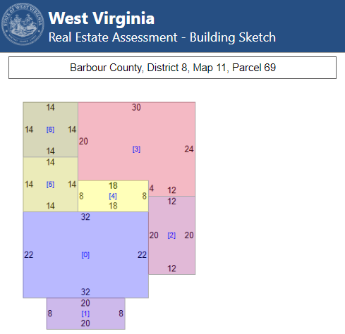
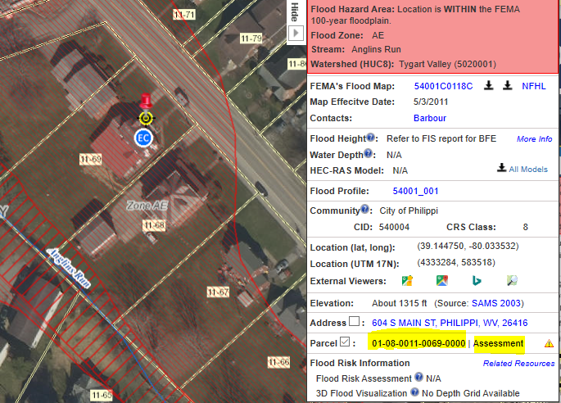
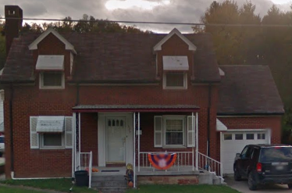
Property Parcels and Assessment Reports
E-911 and County Assessor report location at 604 S Main Street
Property Assessment Report
Building
Sketch Diagram
Map-Parcel Number 11-69
Parcel Map
Share Link: https://mapwv.gov/Assessment/Detail/?PID=01080011006900000000

Slide 26
Unique Building Identifier
Collect multiple spatial identifiers to verify location
Parcel | 01-08-0011-0069-0000
01 | - | 08 | - | 0011 | - | 0069 | - | 0000
County |  | District |  | Map |  | Parcel |  | Suffix
Address | 604 S Main St, Philippi, West Virginia, 26416
Building Identifier | 01-08-0011-0069-0000_604
X,Y Coordinate | 39.144752, -80.033529
Google Plus Code (11-digit) | 86FX4XV8+VHF
Share MAP URL Link | https://www.mapwv.gov/flood/map/?wkid=102100&x=-8909292&y=4742427&l=12&v=1
Share Parcel Assessment URL Link | http://www.mapwv.gov/Assessment/Detail/?PID=01080011006900000000
Notes: Owner Name from assessment records and Building Pictures (elevation certificates) can be helpful for property identification purposes
Proper Building and Property Identifiers are important for exchanging building-level data efficiently among local, state, and federal partners (including UDFs, LOMAs, Mitigated Buyout Properties, Elevation Certificates, Repetitive Loss Structures, etc.)
= Unique Identifiers

Slide 27
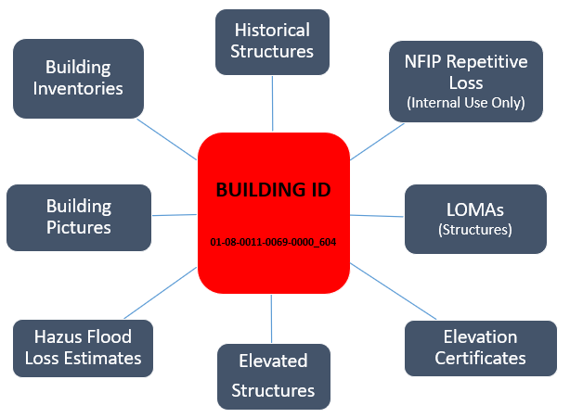
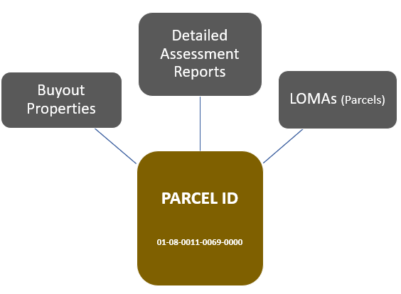
Building Unique Identifier
Building Unique Identifier
10/11/2020
Parcel ID | 01-08-0011-0069-0000
01 | - | 08 | - | 0011 | - | 0069 | - | 0000
County |  | District |  | Map |  | Parcel |  | Suffix
Address | 604 S Main St, Philippi, West Virginia, 26416
Building Identifier (Parcel ID + Address No.) | 01-08-0011-0069-0000_604
Link to Property Record
Link to Structure Record

Slide 28
Other WV Flood Tool Features
WV Flood Tool
Flood Operational Layers
Flood Zones and Symbology Types
Programming Logic (Flood Zone, Flood Height, Water Depth) for Flood Query Result Panel
High Resolution Ground Elevation Data
Property Identification / Unique Building Identifier
WV Property Viewer & Search
Uses of Flood Tool

Slide 29
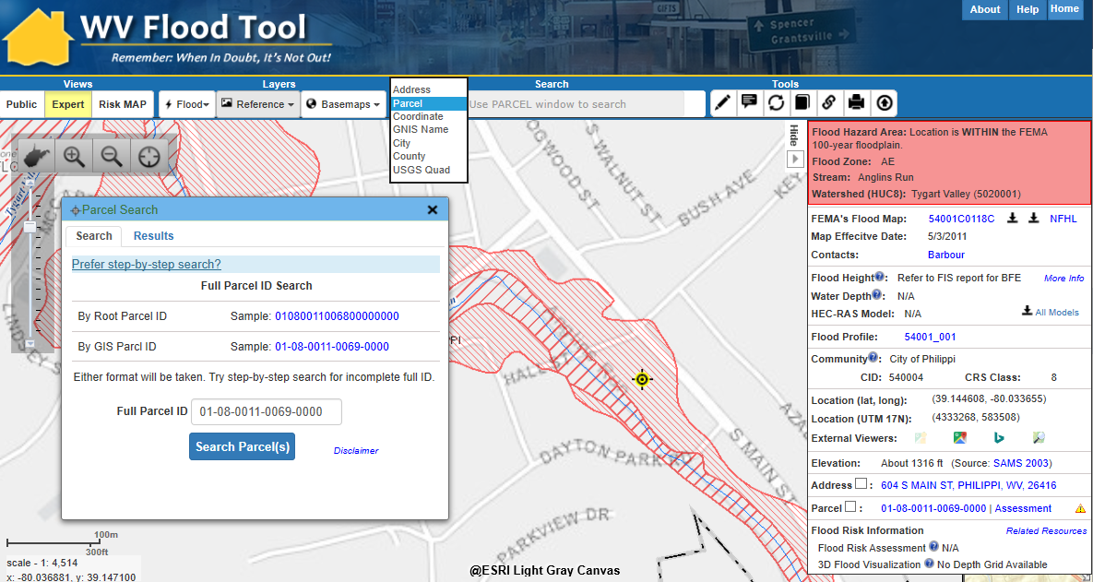
WV Flood Tool
Search and Zoom Tools

Slide 30
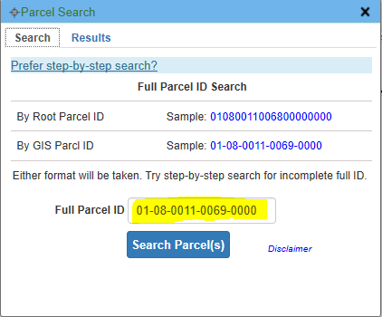
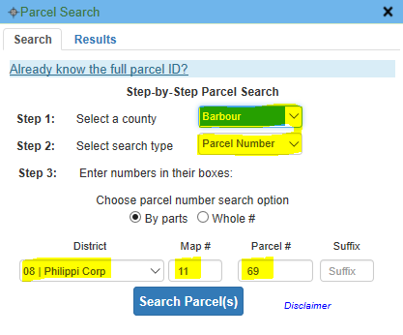
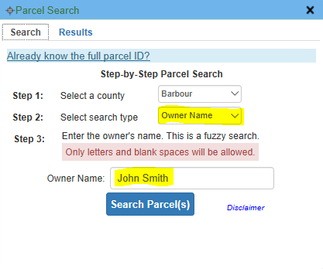
Search by Parcel
Select “Parcel” from pull down search list
Search By:
Full Parcel ID
Step-by-Step Parcel ID
Property Owner
Results (Parcel 01-08-0011-0069-0000)
01-08-0011-0069-0000
Smith John

Slide 31
WV Flood Tool
Operational
Flood Layers

Slide 32
Flood Hazard Layers
10/24/2020
FLOOD LAYERS | Public View for general public | Expert View floodplain managers | RiskMAP View flood risk reduction
Flood Hazard: Management & Risk Layers NFHL Flood Zones (Effective, Preliminary, Draft) High-Risk Advisory Flood Zones Base Flood Elevations (X-Sections, BFE Lines) LOMAs / LOMRs (Verified LOMAs**) Panel Index (links to FEMA issued map) Structures, Levees, Mile Markers* Elevation Certificates** | Yes Yes No No No No No | Yes Yes Yes Yes Yes Yes Yes | Yes Yes Yes Yes Yes Yes Yes
Flood Risk Assessment Flood Water Depths (HEC-RAS model-backed)** Other Water Depths (Hazus, USGS HWM) Historical Flood High-Water Marks Building-Level Risk Assessments** Future Map, Exposure Cost, New Development, Damage Repetitive Loss Area Analysis (RLAA)** Flood-Prone Roads, Railroads, Bridges Dams Other Natural Hazards – Landslides | No No No No No No No No No | Yes No Yes No No No No No No | Yes Yes Yes Yes Yes Yes Yes Yes Yes
Property Mitigation Elevated Structures** Open Space Preserved (e.g., Buyout Properties) | No No | No No | Yes Yes
Real-Time Flood Prediction USGS Real-Time Stream Gages* | No | No | Yes
* External Agency Web Map Services ** Partial Statewide Coverage

Slide 33
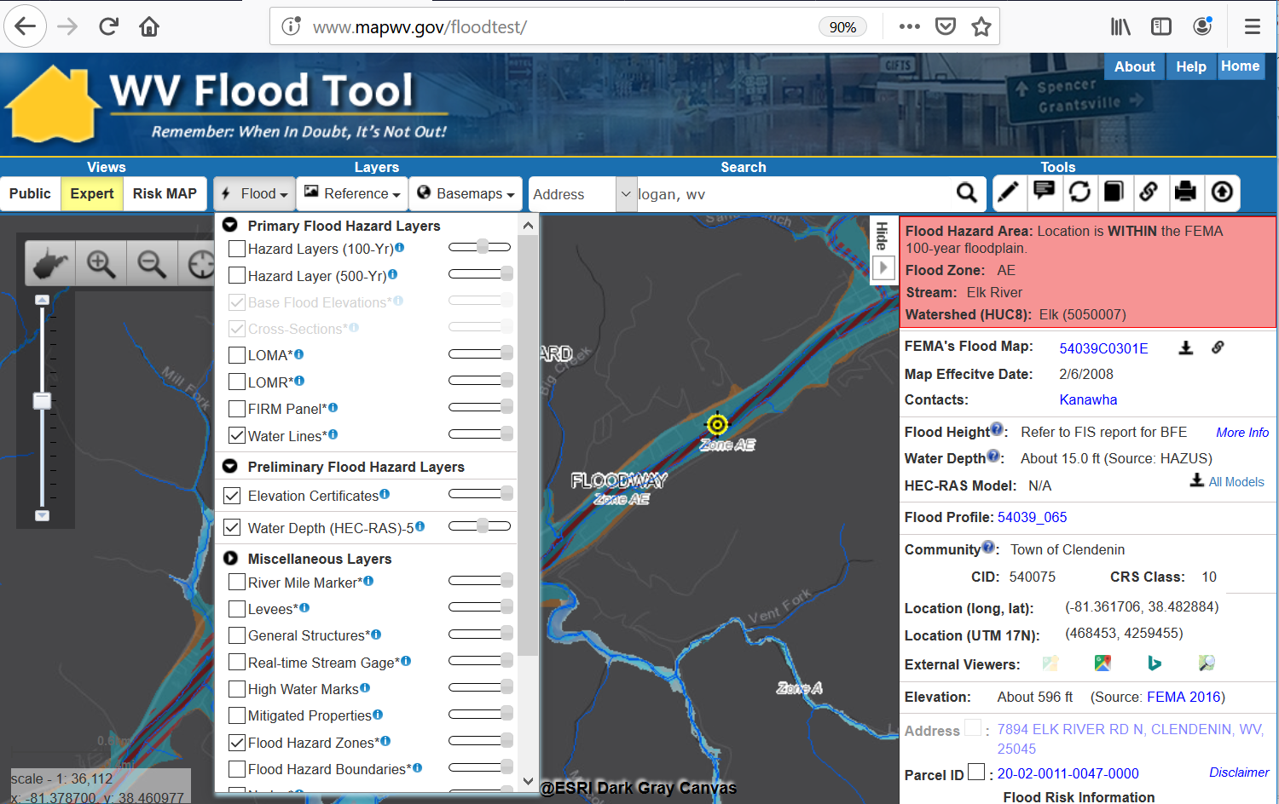
Flood Layers – Expert View

Slide 34
WV Flood Tool
Flood Zones & Symbology

Slide 35
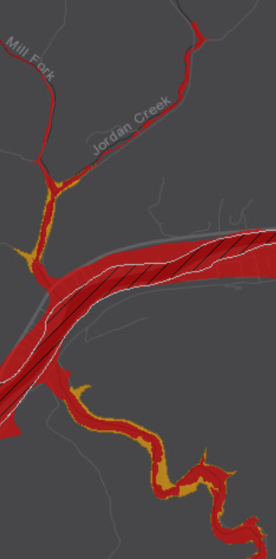
Multiple Flood Zone Symbology Types
PUBLIC View
EXPERT View
NFHL View
High Risk Regulatory (red) and Non-Regulatory (orange)
Depth Grid Underlies Flood Zones
NFHL Viewer

Slide 36
Flood Layer Symbols

Slide 37
WV Flood Tool PUBLIC VIEW - High Risk
Regulatory Floodway
1-Percent-Annual-Chance Flood Hazard Area
With Base Flood Elevation (BFE)
Zone AE
HIGH RISK
1-Percent-Annual-Chance Flood Hazard Area
Without BFE
Zone A
1-Percent-Annual-Chance Future Conditions
(High Risk Advisory Flood Zones)
Preliminary NFHL or Advisory A or Updated AE
Advisory

Slide 38
WV Flood Tool EXPERT VIEW - High Risk
also RiskMAP VIEW
1-Percent-Annual-Chance Flood Hazard Area (AE, AO, AH) With Base Flood Elevation (BFE)
Zone AE
Floodway
Regulatory Floodway in AE Zone
Zone A
1-Percent-Annual-Chance Flood Hazard Area
Without BFE (may have Advisory Flood Heights)
HIGH RISK
Preliminary
1-Percent-Annual-Chance Preliminary SFHA
High Risk Updated AE Boundary (1 PCT Future Conditions)
Updated AE
Advisory A
High Risk Advisory A Zone (1 PCT Future Conditions with Advisory Flood Heights)

Slide 39
WV Flood Tool – Moderate Risk
0.2-Percent-Annual-Chance Flood Hazard Area (500-YR Floodplain) Symbol: yellow stipple pattern
Zone X
MODERATE RISK
Area with Reduced Risk Due to Levee Symbol: yellow vertical hachure pattern
Zone X
Areas in Close Proximity of Flood Zone Boundaries are presented as a MODERATE RISK on the Flood Results Query Panel of the WV Flood Tool

Slide 40
FEMA NFHL Viewer
(FEMA NFHL Viewer)
HIGH RISK
MODERATE RISK

Slide 41
WV Flood Tool
Print Function Legend Layouts

Slide 42
Print Flood Map (Expert View)
http://www.mapwv.gov/floodtest/?wkid=102100&x=-8899682&y=4811867&l=13&v=1

Slide 43
Print Flood Map (Public View)
http://www.mapwv.gov/floodtest/?wkid=102100&x=-8679232&y=4773901&l=12&v=0

Slide 44
Flood Query Results Panel
10/11/2020
# | Each Location Query Answers:
1 | In Flood Hazard Area? Flood Zone? Floodway?
2 | Stream & Watershed names?
3 | FEMA Issued Flood Map / NFHL links?
4 | Floodplain Manager Contact?
5 | Flood Height value & Vertical Datum?
6 | Water Depth value and source?
7 | HEC-RAS Model available?
8 | Flood Profile available?
9 | CRS community information?
10 | Coordinate x,y location?
11 | External Map Viewer Links?
12 | Ground elevation value and source?
13 | E-911 Address (link to address info)
14 | Parcel ID (link to property info)
15 | Flood risk assessment info?
16 | 3D flood visualization?
1
54 King St.
2
3
4
5
6
7
8
9
10
11
12
13
14
15
16
Parcel ID Web Link: https://www.mapwv.gov/flood/map/?v=1&pid=19-07-022B-0021-0000
Performance Measure: Query Results display within 5 seconds

Slide 45
Flood Query Results Panel
Programming Logic Determinations for Flood Query Results Panel
Flood Zones – 13 zone status conditions
Flood Heights – Base Flood Heights, Advisory Flood Heights, Preliminary Flood Heights – 5 status conditions
Depth Grid – HEC-RAS Model-Backed (most accurate) or Hazus

Slide 46
Flood Zone Determination Sequence
HIGH:
100-YR Effective Floodplain
HIGH:
Preliminary NFHL (AE or A)
MODERATE: 500-YR Effective Floodplain & Levee Reduced Risk
MODERATE:
Within 75-ft of Flood Zone
LOW:
No identified Flood Risk
HIGH
Draft NFHL (AE or A)
HIGH
Advisory A
Non-Regulatory
HIGH
Updated AE
Non-Regulatory
Flood zone determination sequence important for programming logic
WV Flood Tool first checks query location for High Risk effective flood zones (red warning color), High Risk advisory flood zones (orange), then Moderate Risk flood zones (yellow)

Slide 47
Flood Zone: < zone designation >
Status # | Flood Risk Zone Designation | Message | Floodplain Type Label | WSEL Grid | Flood Degree Risk | Color Warning Status
1 | AE, AH (5), AO (2) | Location is WITHIN the FEMA 100-year floodplain. | Effective 100 yr Zone AE, AH, AO | BFE-R or BFE-NR | High | Red
2 | AE (Floodway) | Location is WITHIN the FEMA 100-year floodplain and floodway. | Effective 100 yr Zone AE, AH, AO - Floodway | BFE-R or BFE-NR | High | Red
3 | A | Location is WITHIN the FEMA 100-year floodplain. | Effective 100 yr Zone A | < None > | High | Red
4 | A (Advisory Flood Heights available) | Location is WITHIN the FEMA 100-year floodplain. Advisory Flood Heights available. | Effective 100 yr Zone A and Advisory Zone A | AFH or BFE-P | High | Red
5 | Preliminary NFHL Flood Zone | Location is WITHIN an updated FEMA 100-year flood hazard zone. The flood zone is preliminary and under review to become effective. | Preliminary 100 yr Zone AE or A (Shaded X not displayed or shown on Flood Query Results Panel) | BFE-P, then BRE-R, BFE-NR, AFH | High | Orange
6 | Preliminary Flood Zone (Floodway) | Location is WITHIN an updated FEMA 100-year flood hazard zone and floodway. The flood zone is preliminary and under review to become effective. | Preliminary 100 yr Zone AE – Floodway | BFE-P, then BFE-R, BFE-NR, AFH | High | Orange
7 | Draft NFHL Flood Zone (NEW) | Location is WITHIN an updated FEMA 100-year flood hazard zone. The flood zone is DRAFT and under review to become PRELIMINARY. | Draft 100 yr Zone AE or A | BFE-P (A or AE Zones only) | High | Orange
8 | Updated AE Floodplain Bdry. | Location is WITHIN an updated detailed floodplain boundary but NOT a FEMA 100-year effective floodplain. | Updated Zone AE | BFE-NR | High | Orange
9 | Advisory A | Location is WITHIN an advisory floodplain but NOT a FEMA 100-year effective floodplain. | Advisory Zone A | AFH | High | Orange
10 | Shaded X (500-YR Flood) | Location is WITHIN a moderate flood risk hazard such as a FEMA 500-year floodplain. | Zone X - 0.2 PCT ANNUAL CHANCE FLOOD HAZARD | < None > | Moderate | Yellow
11 | X (Levee Protected) | Location is PROTECTED by a levee from a 100-year flood | Zone X - AREA WITH REDUCED FLOOD RISK DUE TO LEVEE | < None > | Moderate | Yellow
12 | Near Flood Zone | Location is NOT WITHIN identified flood hazard area, but within 75 feet of an identified flood hazard area. | Separate Buffer Layer | < None > | Moderate | Yellow
13 | Out of Flood Zone | Location is NOT WITHIN any identified flood hazard area. Unmapped flood hazard areas may be present. | No Record Found | < None > | Low | Green
Three Degrees of Risk: High, Moderate, Low. Four Warning Status Colors: In 100-YR Effective Floodplains (red), Preliminary Flood Zones and non-regulatory Advisory A/Updated AE Floodplains, Draft (orange), moderate risk or close to high- risk zones (yellow), and low risk (green). The query consists of stacked floodplain boundary layers (see next slide)

Slide 48
Flood Height: < Value >
Status # | Flood Height Designation | Flood Zones | Message for FLOOD HEIGHT: | Source Message on Query Panel | More Info Link on Flood Query Results Panel
1 | Base Flood Elevation (Restudy) BFE Grid | AE Zones Flood Zone Statuses 1, 2, 5, 6 | < value> ft. (Display to 0.1) (Clickable GRID value) | (BFE Restudy) In future may include A Zones | Advisory Flood Heights (AFH) for Approximate A Zones: CAUTION CAUTION!! The advisory flood height should be used with caution in the proximity of a culvert, bridge, flood control structure or other impoundment since stream crossings were not included in the hydraulic analyses for approximate floodplains. Also, if the site is close to the confluence with a larger stream, compare the advisory flood height at the location of interest to the advisory flood height or Base Flood Elevation on the larger stream to determine whether the site is within the backwater influence of the larger stream. More information: http://www.mapwv.gov/flood/content/documents/AFHhandout.pdf Restudy and Non-Restudy AE Zones: To validate base flood elevations refer to the Flood Profiles and Flood Elevation Tables in the FIS Report. Vertical Datum for Flood Heights: The vertical datum of Base Flood Elevations (BFEs) for AE Zones recorded on official FIRMs in West Virginia is NAVD 88, except for the following counties where the FIRMs are referenced to the NGVD 29 Datum: Hampshire, Logan, McDowell, Mercer, Monroe, Ohio, and Putnam. The vertical datum of all Advisory Flood Height values for Approximate A Zones in West Virginia is NAVD 88, except for McDowell County which is NGVD 29. More information.
2 | Base Flood Elevation (Non-Restudy) Updated AE Grid | AE Zones Flood Zone Statuses 1, 2, 8 | < value> ft. (Display to 0.1) (Clickable value) | (BFE Non- Restudy)
3 | Base Flood Elevation (Non-Restudy) | AE Zones Flood Zone Statuses 1 & 2 | no value | Refer to FIS report for BFE
4 | Advisory Flood Height AFH Grid or BFE-P Grids | A Zones Flood Zone Statuses 4, 5, 6, & 9. Possible status 10. | About < value> ft. (Display to 0.1) (Clickable value) | (AFH)
5 | Preliminary Flood Height (BFE-P) | Flood Zone Statuses 5 to 7. BFE Preliminary Grid takes priority. | 5a, 6a, 7 = value 5b, 6b = no value | Grid value (BFE Preliminary), then BFE-R, BFE-NR, AFH No Value. “See FEMA Change Viewer link for Prelim. BFE”
6 | No Flood Height Information | Flood Zone Statuses 3 and 4; 9 through 13 | no value | None (Status 3 or 4) N/A (Statuses 9-13)
Invisible Composite Query Rasters for flood height values of Water Surface Elevation Level (WSEL) layers: (1) Advisory Flood Height WSEL AFH Grid (WSEL_1PCT_AFH_5ft); (2) BFE Restudy WSEL BFE Grid (WSEL_1PCT_BFE_1m); Updated AE/BFE Non-Restudy (WSEL_1PCT_Updated_AE)

Slide 49
Water Depth: about <<value>>
Water Depth | Message | Sources
Water Depth: | About << value >> ft. | Model-Backed Depth Grids: Engineering Studies using modeling software like HEC-RAS: RiskMAP Restudy (Effective and Preliminary) Non-Restudy Updated AE Zones Advisory Flood Heights (Approximate A Zones) Other Depth Grids HAZUS generated USGS Inundation Layers
A statewide “composite” Flood Risk Assessment Depth Grid is created from model-backed effective and advisory depth grids at a 1-meter cell resolution.
Water Depth Grids are a flood risk assessment product – not a flood regulatory product. Water depths are important for flood loss damages and by flood visualizations of site-specific structures.
Depth grids a source of credits for CRS communities.
See FEMA’s Flood Risk Assessment Guidance (May 2016) for guidance on composite depth grids:
https://www.fema.gov/media-library-data/1469146645661-31ad3f73def7066084e7ac5bfa145949/Flood_Risk_Assessment_Guidance_May_2016.pdf

Slide 50
WV Flood Tool
Ground Elevation

Slide 51
Ground Elevation
http://www.mapwv.gov/floodtest/?wkid=102100&x=-8916536&y=4610651&l=13&v=1
Source: FEMA 2016
1-FOOT CONTOUR ELEVATION VALUE OF 2125 FEET MATCHES 1-METER GRID SURFACE ELEVATION OF 2125 FEET DISPLAYED IN QUERY RESULTS PANEL
FEMA LiDAR-Derived Products: 1-M DEM and 1-Ft. Contour

Slide 52
Ground Elevation: 1-ft. Contours
https://www.mapwv.gov/flood/map/?wkid=102100&x=-9177701&y=4611497&l=13&v=1
Make Contour Lines visible under REFERENCE LAYERS
1-FOOT CONTOUR ELEVATION VALUE OF 600 FEET MATCHES 1-METER GRID SURFACE ELEVATION OF 600 FEET DISPLAYED IN QUERY RESULTS PANEL
1-ft Contours Display at two Highest Zoom Levels (1:564 and 1:282 Map Scales)
Elevation: 600 ft.
Source: FEMA 2018
600 ft.
1-foot contours published for 10 counties
FEMA LiDAR-Derived Products: 1-Meter DEM and 1-Foot Contours

Slide 53
FEMA Purchased LiDAR Coverage
FEMA has purchased $10 million in QL2 LiDAR and entire State should be processed and delivered by 2022
Quality 2 (QL2) LiDAR support 1-foot contours

Slide 54
Elevation Data Sources
Source Graphic
1-Ft. Contours for Areas 8A, 8B, 9A, 9B, 12A, 12B
2-Ft. Contours for Area 7
Elevation Metadata
FEMA is purchasing Statewide QL2 LiDAR
WV Elevation Source Listing and Graphic: https://www.mapwv.gov/floodtest/docs/WV_FloodTool_ElevationSource_Metadata.pdf

Slide 55
WV Flood Tool
Dams and Landslides

Slide 56
Dams and Landslides
Landslide
Dam
https://www.mapwv.gov/flood/map/?wkid=102100&x=-8771562&y=4715438&l=7&v=2
Dam and Landslide Risk Layers in RiskMAP View Hardy County, West Virginia

Slide 57
WV Flood Tool Updates
Mobile Application
flood
Added Search by Property Owner Name
Added Search by Parcel Identifier
Mobile Home Page

Slide 58
WV Flood Tool (Mobile)
www.mapwv.gov/flood
flood
682 Killarney Drive, Morgantown, WV
Mobile Home Page
Zoom to E-911 Address
Toggle Layers of Interest

Slide 59
WV Flood Tool (Mobile)
www.mapwv.gov/flood
682 Killarney Drive, Morgantown, WV
Touch Parcel for Flood Info
View Flood Report
View Parcel Report

Slide 60
WV Flood Tool
WV Property Viewer
www.mapwv.gov/property
Companion Product to WV Flood Tool
Powerful compound query searches can be performed on flood hazard zones and state assessment records:
New Development in Floodplains
Prior Ownership (Deed Book, Previous Owner, Legal Description). Online search of the parcel history of deed book/page numbers and other ownership information to identify the correct positional location of LOMAs and Buyout Properties.

Slide 61
WV Property App (Companion Product)
Web Visits
Detailed Property Report
Property Viewer
WV Property Viewer www.mapwv.gov/parcel WV Property Search www.mapwv.gov/ property
Property Search Tool

Slide 62
WV Property Search: New Development
“Advanced” WV Property Search: www.mapwv.gov/property
Companion Product to WV Flood Tool
Search Query Parameters for New Development in Floodplain
Search Parameters | Value
Flood Hazard | High
County | Preston
Building Year Minimum | 2017
Min. Building Year Appraisal | 50000
Property Class | Residential

Slide 63
WV Property Search: New Development
Query Results for New Development in Floodplain
https://www.mapwv.gov/assessment/Assessment?Counties=39&PropertyClass=R&MinimumBuildingValue=50000&BuildingYearMin=2017&FloodRisk=High
Search Parameters | Value
Flood Hazard | High
County | Preston
Building Year Minimum | 2017
Min. Building Year Appraisal | 50000
Property Class | Residential
2018 Structure at $315K Built in Advisory A
WV Property Search: www.mapwv.gov/property
https://mapwv.gov/flood/map/?wkid=102100&x=-8873789&y=4820097&l=13&v=0

Slide 64
WV Property Search: Deed Book
“Prior Ownership” WV Property Search: www.mapwv.gov/property
Search Query Parameters for Prior Ownership using Deed Book/Page No.
LOMA 97-03-298A, Project ROUTE 27/3 - DILLON CREEK
Correct LOMA Location
9 miles
Wrong LOMA Location
https://map1.msc.fema.gov/data/54/L/97-03-298A-540160.pdf?LOC=d08f245a47f18e659f1b75b1515425b6
LOMA 97-03-298A is not located south of Kingwood, but 9 miles to the northwest in Preston County.
The WV Property Search Tool located the correct parcel through a Deed Book Number and Page search.

Slide 65
WV Property Search: Deed Book
“Prior Ownership” WV Property Search: www.mapwv.gov/property
Search Query Parameters for Prior Ownership using Deed Book/Page No.
LOMA 97-03-298A, Project ROUTE 27/3 - DILLON CREEK
Search Parameters | Value
County | Preston
Deed Book Number | 505
Deed Book Page | 177
LOMA 97-03-298A is not located south of Kingwood, but 9 miles to the northwest in Preston County.
The WV Property Search Tool located the correct parcel through a Deed Book Number and Page search.

Slide 66
WV Property Search: Deed Book
LOMA 97-03-298A, Project ROUTE 27/3 - DILLON CREEK
Deed Book: 505/177
https://mapwv.gov/assessment//Detail/?PID=39020013008400010000
Correct parcel location of LOMA 97-03-298A was identified by a prior owner and Deed Book Number 505/177 back to year 2008

Slide 67
WV Property Search: Deed Book
“Prior Ownership” WV Property Search: www.mapwv.gov/property
LOMA 97-03-298A, Project ROUTE 27/3 - DILLON CREEK
https://www.mapwv.gov/flood/map/?wkid=102100&x=-8882817&y=4797874&l=11&v=1
Route 27/3
Positionally Verified
LOMA 97-03-298A
Parcel Detailed Report
See Parcel History in Assessment Report
Dillan Creek
1 Acre
Prior Deed 505 / 177
Correct positional location of LOMA 97-03-298A verified with LOMA Document by Deed Number (505/177), Parcel Size (1 acre), Flood Source (Dillon Creek), and Highway Number 27/3.

Slide 68
WV Property Search: Deed Book
LOMA 97-03-298A, Project ROUTE 27/3 - DILLON CREEK
Positionally Verified
LOMA 97-03-298A
LOMA Determination and Revalidation Status in Error
https://www.mapwv.gov/flood/map/?wkid=102100&x=-8882817&y=4797874&l=11&v=1
FEMA LOMA 97-03-298A: Positional Accuracy, Determination Status, and Revalidation Status in Error

Slide 69
Flood Tool Applications
Floodplain Management
Property Identification
Property Search Tools
Flood Determinations
NFIP / Community Rating System
Risk Mapping, Assessment, and Planning
Risk Identification and Mapping
Risk Assessment
Risk Mitigation & Planning
Risk Communications
Disaster Assessment

Slide 70
WV Flood Tool
Disaster Assessments
FEMA Letter dated September 29, 2017, about WV Flood Tool support for Disaster Assessments

Slide 71
Flood Risk Development Team
Full and Part-Time Staff
Xiannian Chen GIS Programmer
Jim Schindling Database Programmer
Kevin Kuhn GIS Analyst / Address-Parcel Specialist
Frank LaFone Systems Administrator
Kurt Donaldson Manager
WV GIS Technical Center West Virginia University Morgantown, WV http://wvgis.wvu.edu
Maneesh Sharma GIS Analyst / Flood Risk Specialist
Kevin Shrader GRA Building Inventory, Flood Visualization
Yibing Han
GIS Programmer
Eric Hopkins GIS Analyst / Flood Risk Specialist
Behrang Bidadian GRA
Shelter Models

Slide 72
Contact Information
WVU GIS Technical Center, West Virginia University Kurt Donaldson, GIS Manager kurt.donaldson@mail.wvu.edu, phone: (304) 293-9467
Maneesh Sharma, GIS Analyst
Maneesh.Sharma@mail.wvu.edu, phone (304) 293-9466
Eric Hopkins, GIS Analyst Eric.Hopkins@mail.wvu.edu, phone: (304) 293-9463

