Slide 1
WV Flood Tool Reference Layers
Reference Layers
Elevation
Aerial Imagery
E-911 Addresses
Parcels / Assessment Records
Building Footprints
9/30/2020 Update

Slide 2
Flood Tool Reference Layers
Elevation

Slide 3
Elevation (High Resolution)
New FEMA Elevation LiDAR: Grant, Hampshire, Hardy, Mineral, Pendleton, Mercer; partial coverage Lincoln, Mason, Putnam, Wayne Counties
2017-18 FEMA-Purchased LiDAR
1-foot contours; 1-meter resolution Digital Elevation Model (DEM)
Berkeley and Morgan Counties
Created 2-foot contours from 2012 FEMA-Purchased LiDAR DEM and published to WV Flood Tool
Logan County
2018 County-Purchased LiDAR
Published 1-foot resolution DEM to WV Flood Tool
Elevation Products on WV Flood tool
Statewide 1 to 3-meter Digital Elevation Model
Statewide Hillshade (grayscale 3D representation of the surface)
1-ft and 2-ft Contours cached to 1:282 Map Scale (computer caching ongoing)
Updated Source Elevation Metadata https://www.mapwv.gov/floodtest/docs/WV_FloodTool_ElevationSource_Metadata.pdf

Slide 4
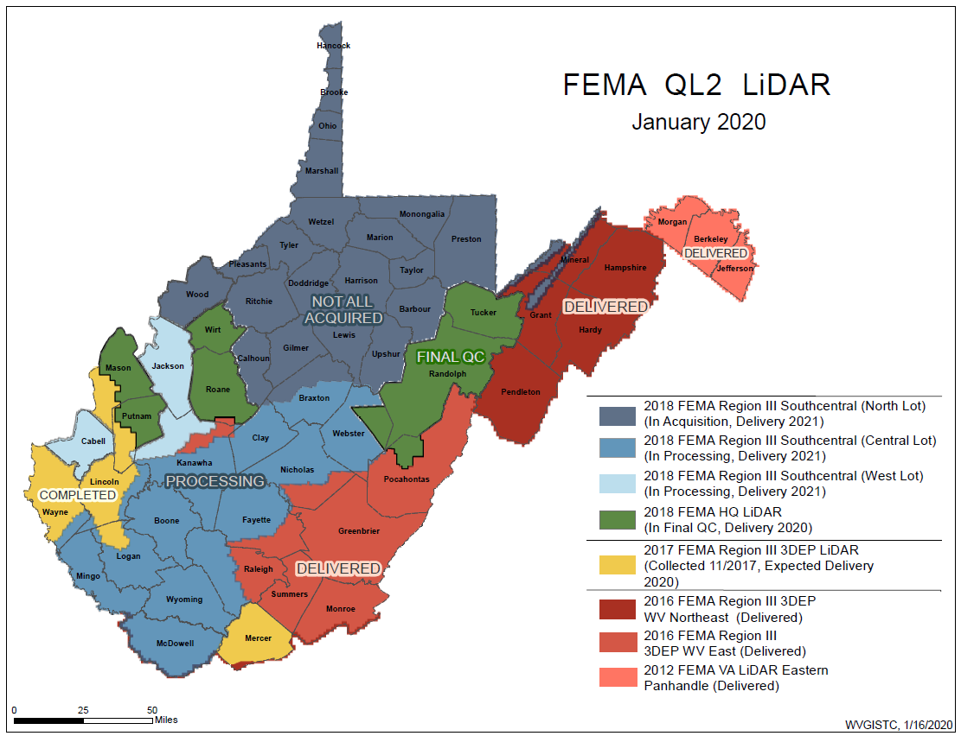
FEMA Purchased LiDAR Coverage
FEMA has purchased $10 million in QL2 LiDAR and entire State should be processed and delivered by 2022
Quality 2 (QL2) LiDAR support 1-foot contours

Slide 5
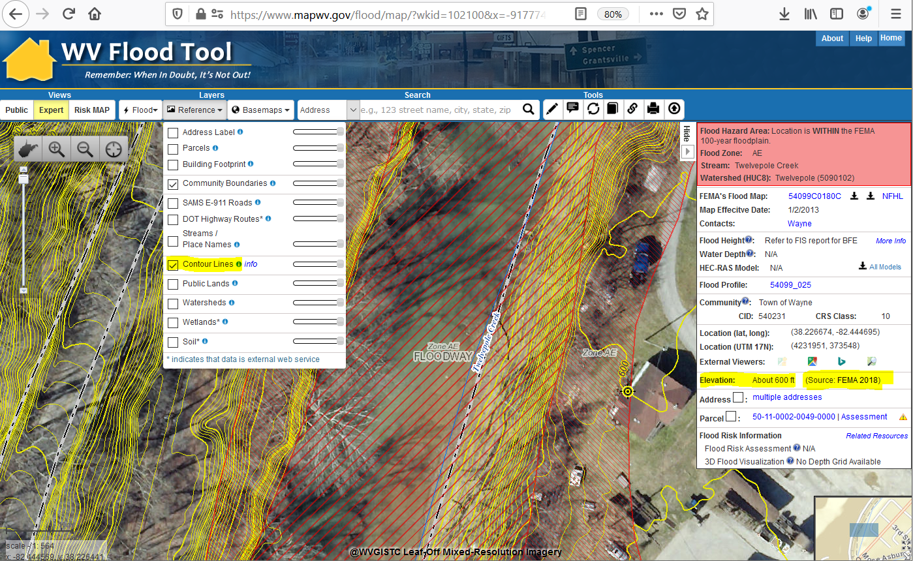
Ground Elevation: 1-ft. Contours
https://www.mapwv.gov/flood/map/?wkid=102100&x=-9177701&y=4611497&l=13&v=1
Make Contour Lines visible under REFERENCE LAYERS
1-FOOT CONTOUR ELEVATION VALUE OF 600 FEET MATCHES 1-METER GRID SURFACE ELEVATION OF 600 FEET DISPLAYED IN QUERY RESULTS PANEL
1-ft Contours Display at two Highest Zoom Levels (1:564 and 1:282 Map Scales)
Elevation: 600 ft.
Source: FEMA 2018
600 ft.
1-foot contours published for 10 counties
FEMA LiDAR-Derived Products: 1-Meter DEM and 1-Foot Contours

Slide 6
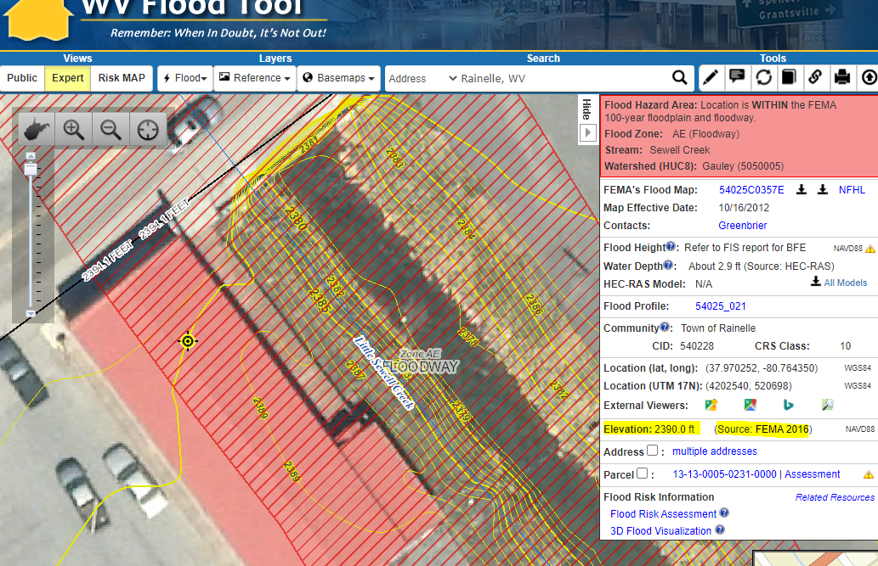
Ground Elevation: 1-ft. Contours
FEMA LiDAR-Derived Products: 1-Meter DEM and 1-Foot Contours
High-resolution aerial imagery and elevation contours cached at 15 map level scales from 1: 4,622,324 to 1:282
1:282
Map Scale
Elevation: 2390 ft.
Source: FEMA 2016
Contour Elevation: 2390 ft.
1-ft Contours Display at two Highest Zoom Levels (1:564 and 1:282 Map Scales)
1-FOOT CONTOUR ELEVATION VALUE OF 2390 FEET MATCHES 1-METER GRID SURFACE ELEVATION OF 2390 FEET DISPLAYED IN QUERY RESULTS PANEL

Slide 7
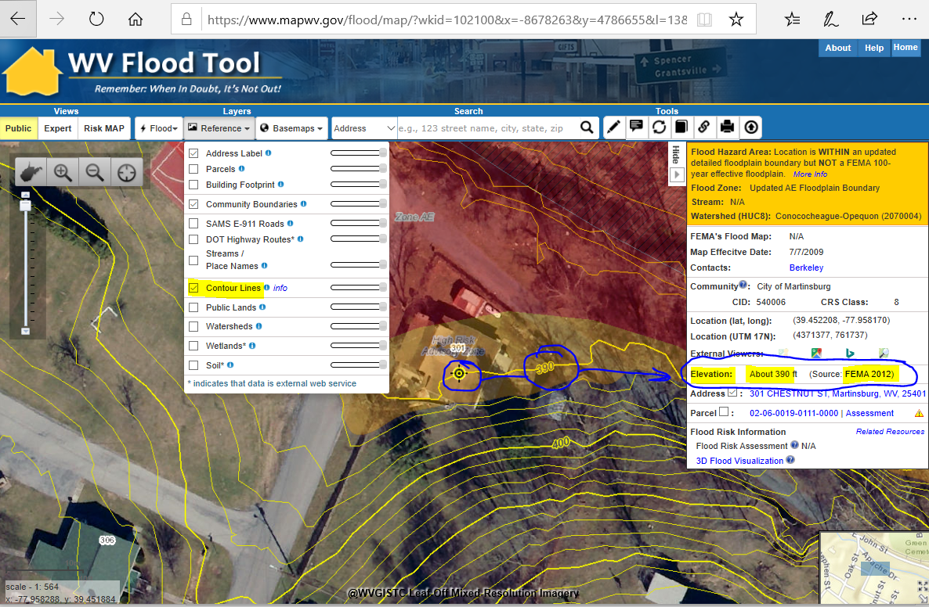
Elevation: 2-ft. Contour Creation
2-foot contours created by WVU for Berkeley and Morgan Counties
2-ft Contours Display at Highest Zoom Levels (1:564 and 1:282 Map Scales)
2-FOOT CONTOUR ELEVATION VALUE OF 390 FEET MATCHES 1-METER GRID SURFACE ELEVATION OF 390 FEET DISPLAYED IN QUERY RESULTS PANEL

Slide 8
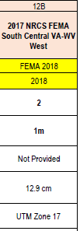
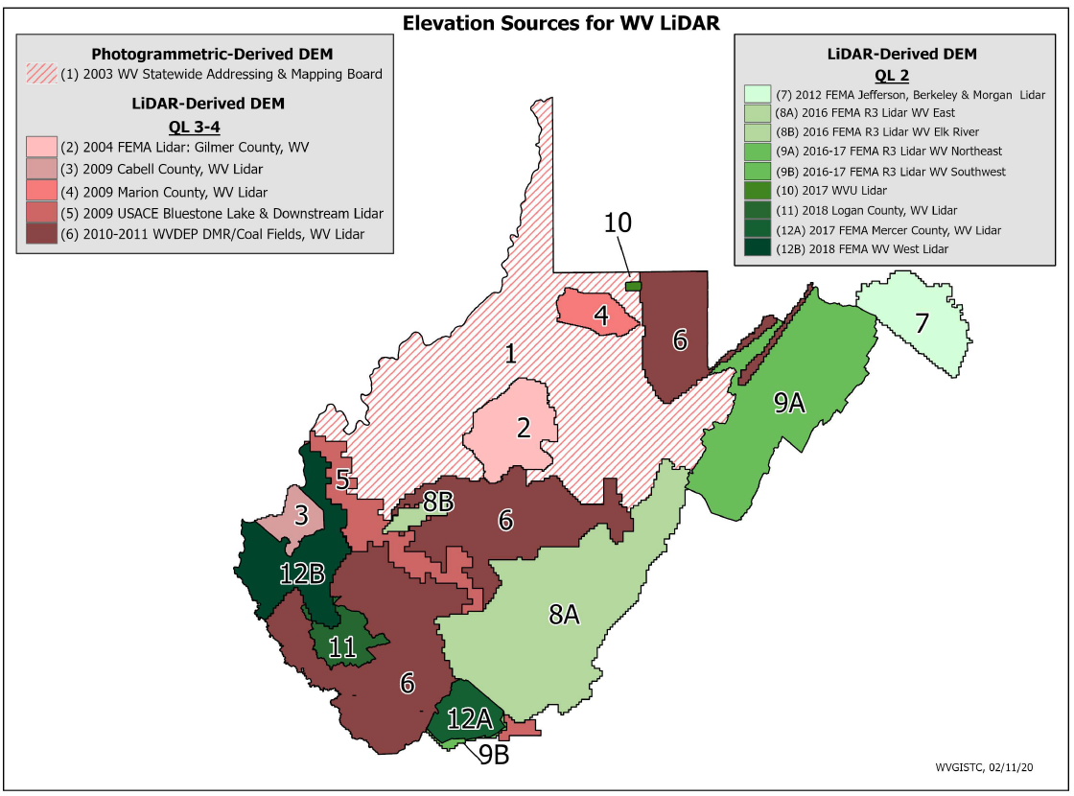
Elevation Data Sources
Source Graphic
1-Ft. Contours for Areas 8A, 8B, 9A, 9B, 12A, 12B
2-Ft. Contours for Area 7
Elevation Metadata
FEMA is purchasing Statewide QL2 LiDAR
WV Elevation Source Listing and Graphic: https://www.mapwv.gov/floodtest/docs/WV_FloodTool_ElevationSource_Metadata.pdf

Slide 9
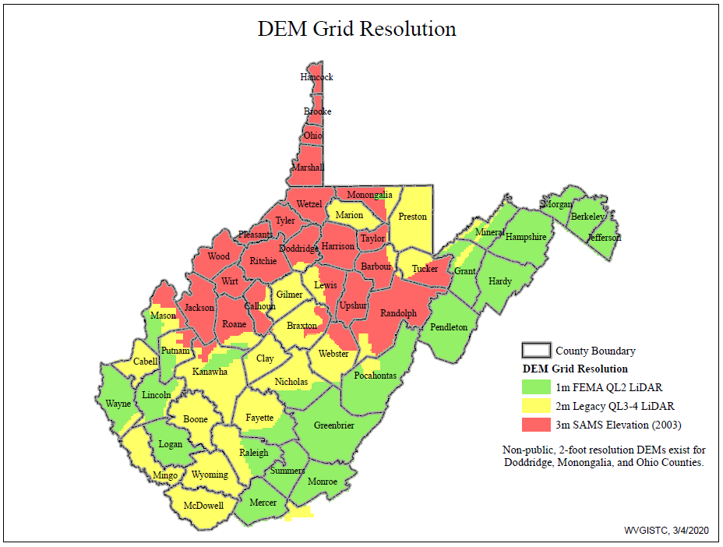
DEM Grid Resolution

Slide 10
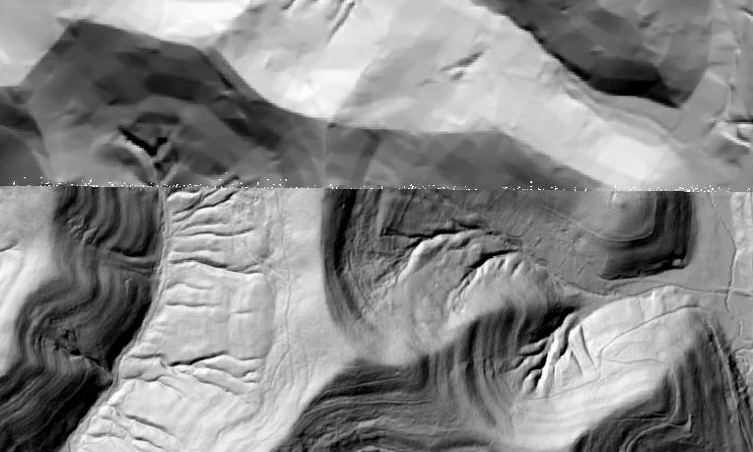
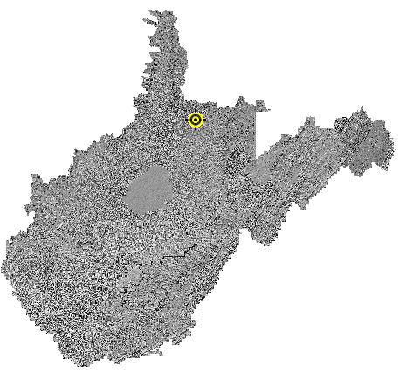
Statewide Elevation Layers
Elevation Grids, Hillshade Grids, Contours, used for Flood Depths, Imagery Orthorectification
Layer | Source | Coverage
SAMB | 2003 SAMB, 3-meter, 10-foot contours | Statewide
Lidar | Lidar, 2-foot or 1-foot contours | Select Areas
SAMB ELEVATION
WV DEP SAMB-Lidar Hillshade
LIDAR ELEVATION

Slide 11
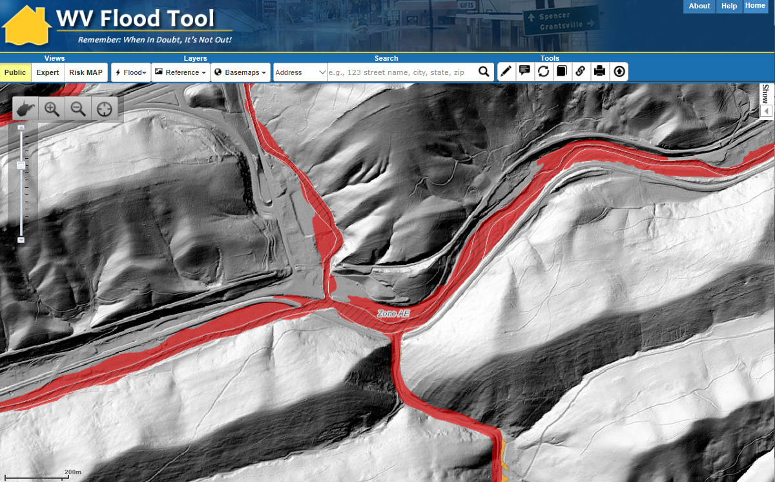
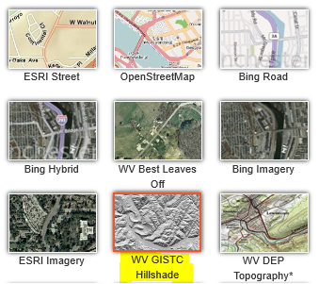
Statewide Hillshade Basemap Product
A hillshade is a grayscale 3D representation of the surface
Hillshade Basemap

Slide 12
High Resolution Contours
New FEMA LiDAR-Derived Contours are 10x better than 2003 Statewide Elevation Data Set
SAMB Elevation 10 FT Contours
FEMA LiDAR 1 FT Contours

Slide 13
Flood Tool Reference Layers
Aerial Imagery

Slide 14
New Aerial Imagery
2020 County Leaf-Of Aerial Imagery (13 Counties)
2019 County Leaf-Of Aerial Imagery (20 Counties)
2018 USDA National Agriculture Imagery Program (NAIP) 2-ft pixel resolution. Statewide Coverage.
24 Counties have tapped into the State Aerial Imagery Contract supported by the Hazard Mitigation Grant for the acquisition of 2019-21 leaf-off imagery. Most counties were captured at 4-inch resolution. Imagery resides in the public domain.
Imagery can vary greatly in resolution. Pixel resolution refers to the actual distance on the ground that each pixel represents in the orthophotography. For example, four-inch pixel resolution means that each pixel in the image covers four inches on the ground.

Slide 15
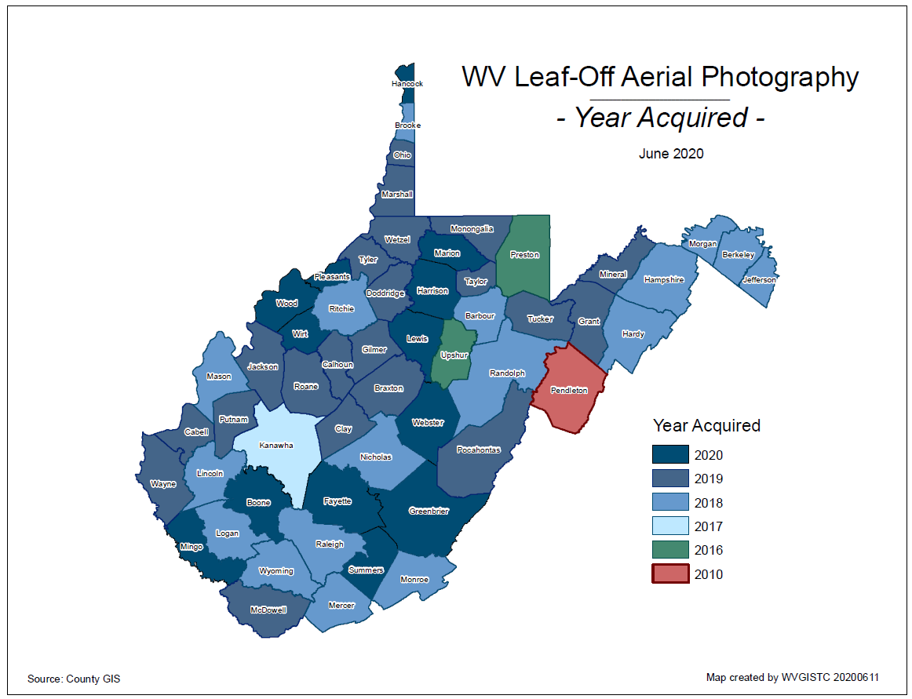
County Aerial Imagery (2020)
Year | Number
2010 | 3
2014 | 1
2016 | 3
2017 | 2
2018 | 19
2019 | 20
2020 | 13
2021 | 1
New 2020 Imagery
Boone County
Fayette County
Greenbrier County
Harrison County
Jefferson County
Lewis County
Marion County
Mingo County
Pleasants County
Summers County
Webster County
Wood County
Wirt County
Ideally, leaf-off imagery should not be older than 5 years. Imagery is important for identifying at-risk structures and accurate disaster mapping.
Select counties for 2019-21 received funding support through HMGP grant

Slide 16
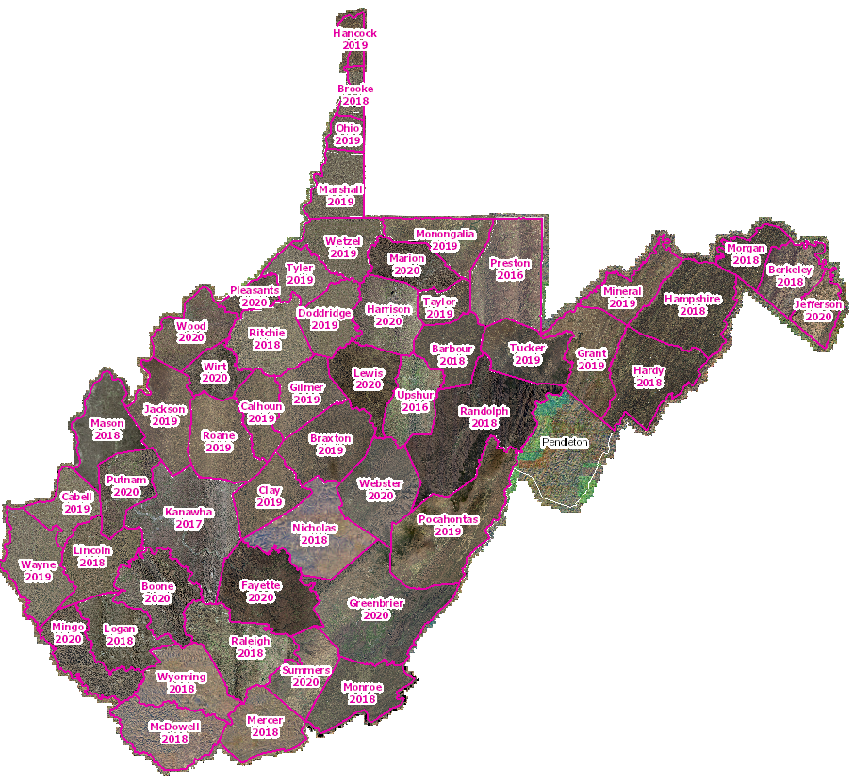
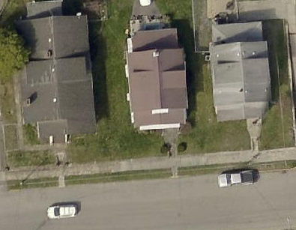
Leaf-Off Aerial Imagery Web Service
https://services.wvgis.wvu.edu/arcgis/rest/services/Imagery_BaseMaps_EarthCover/wv_imagery_WVGISTC_leaf_off_mosaic/MapServer
Counties provide leaf-off imagery
for State Imagery Web Service
Cached to 1:282 Zoom Level or Map Scale
2020 Harrison County Aerial Imagery

Slide 17
New 2019 Leaf-Off Aerial Imagery
http://www.mapwv.gov/floodtest/?wkid=102100&x=-9176629&y=4583554&l=13&v=1
New 2019 Imagery
on Flood Tool
Braxton
Cabell
Calhoun
Clay
Doddridge
Gilmer
Harrison
Jackson
Marshall
Monongalia
Ohio
Pocahontas
Putnam
Roane
Taylor
Tucker
Tyler
Wayne
Wetzel
Wirt
4-Inch Pixel Resolution
Choose WV Best Leaves Off Base Map
Cows in the Floodway
West Fork Twelvepole Creek, Wayne County

Slide 18
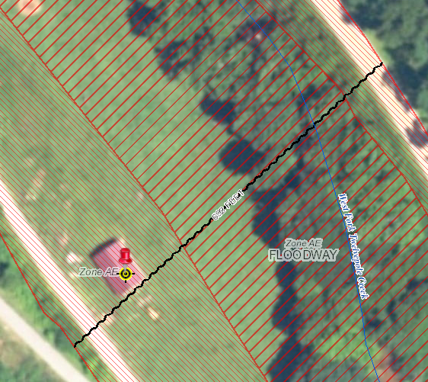
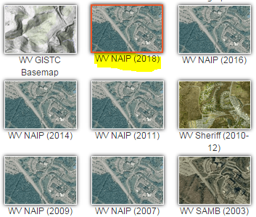
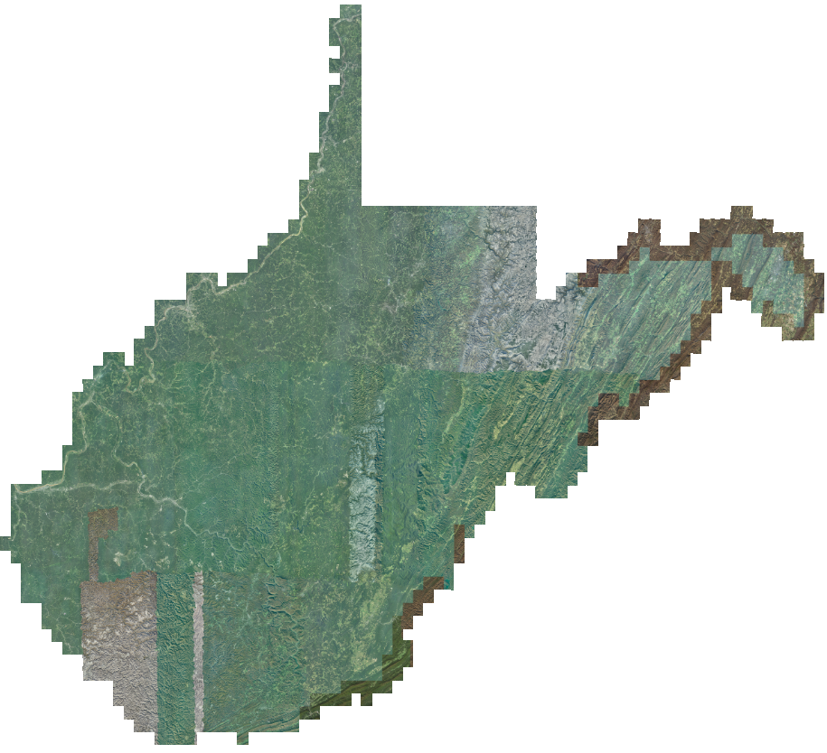
New 2018 NAIP Aerial Imagery
Choose WV NAIP (2018) from Base Map Layers Pulldown Menu
http://www.mapwv.gov/floodtest/?wkid=102100&x=-9176629&y=4583554&l=13&v=1
2-Foot Pixel Resolution
Statewide Coverage
2018 NAIP

Slide 19
Flood Tool Reference Layers
E-911 Addresses

Slide 20
E-911 Addresses
Addressable: Currently the WV Flood Tool accesses 1 million addressable structures in the Statewide Addressing and Mapping System (SAMS). It is estimated that 100,000 addressable structures are in a high-risk flood zone.
Address Matching Geocoding Services: Updated geocoding services of WV Flood Tool from new Statewide Addressing and Mapping Files
Community Addressing Projects: Incorporated new addresses from Hazard Mitigation Grant Addressing Projects
Building Identifier: The E-911 Address Number, combined with the Parcel Identifier, forms the Building Identifier for identifying structures for flood risk assessments, building pictures, LOMAs, Elevation Certificates, etc.

Slide 21
E-911 Structures in Floodplain (2018)
 | # of Structures | Percent (%)
Addressable Structures | 1,010,819 | 91%
Non-Addressable Structures | 101,928 | 9%
total | 1,112,747 | 100%
Buildings in Effective 100-YR floodplains | 99,520 | 9%
Buildings in 100-YR floodplains (Effective and Advisory A/Updated AE) | 106,967 | 10%
Buildings in 100-YR and 500-YR floodplains | 159,804 | 14%
An estimated 100,000 buildings or 9% of all statewide 1.1 million buildings are within the effective 100-YR floodplain.
An estimated 160,000 buildings or 14% of all statewide 1.1 million buildings are within the 100-YR and 500-YR floodplains.
2018 Data Source: Statewide Addressing and Mapping System (SAMS). Some counties track non-addressable structures in the floodplain while other counties do not.
A more detailed site-specific building analysis is needed statewide

Slide 22
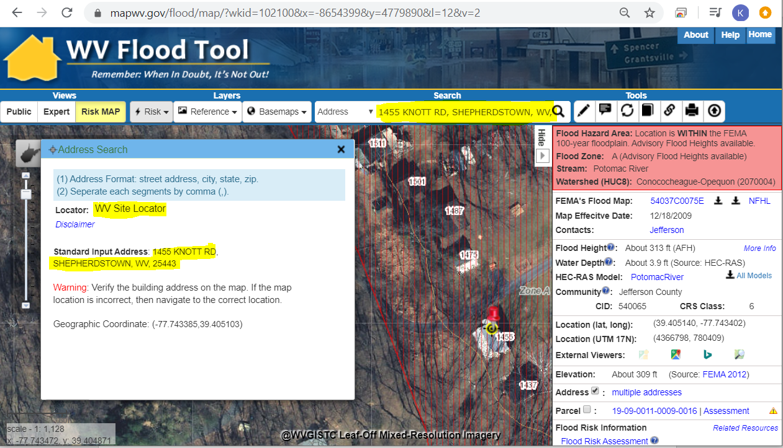
E-911 Addresses
Address Match Locators Updated on WV Flood Tool
Address Site Match Locator
Geocoding is the process of converting street addresses into geographic coordinates (latitude and longitude) to identify the position on the map
1455 Knott Road, Shepherdstown, WV

Slide 23
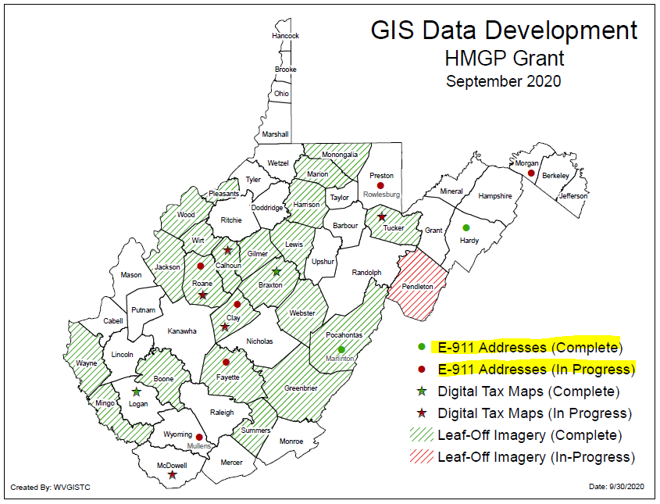
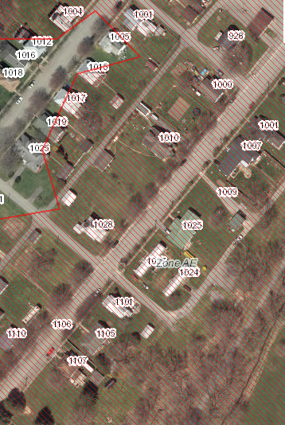
E-911 Addresses
Improved Addresses Uploaded to WV Flood Tool
HMGP Addressing Improvement Projects
Marlinton, WV

Slide 24
Flood Tool Reference Layers
Parcels / Assessment Records

Slide 25
Parcels / Assessment Records
Tax Year 2020 Parcels and Assessment Records: Updated Flood Tool with 1.4 million tax parcel and assessment records for Tax Year 2020.
Parcel Assessment Reports: Updated Parcel Web Reports including building sketch diagrams.
Building Identifier: The Parcel Identifier, combined with the E-911 Address Number, forms the Building Identifier for identifying structures for flood risk assessments, building pictures, LOMAs, Elevation Certificates, etc.

Slide 26
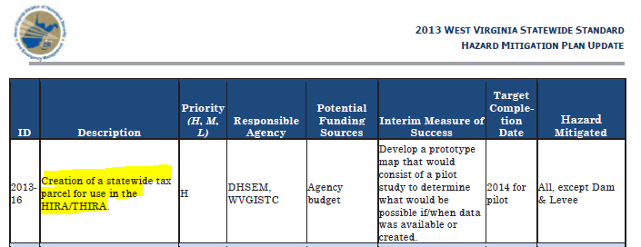
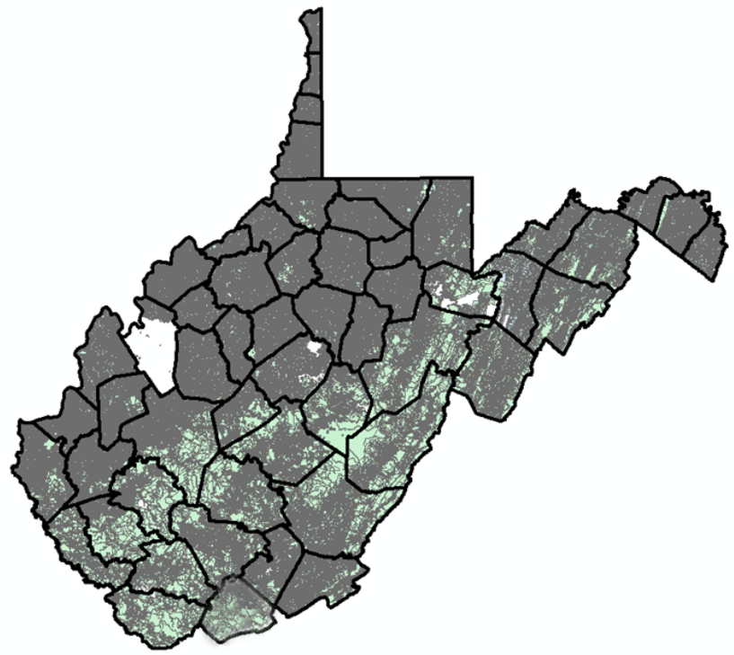
Statewide Digital Parcel File
High Priority
of
2013 State Hazard Mitigation Plan

Slide 27
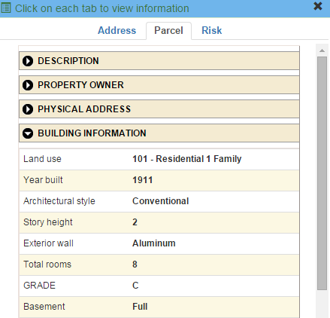
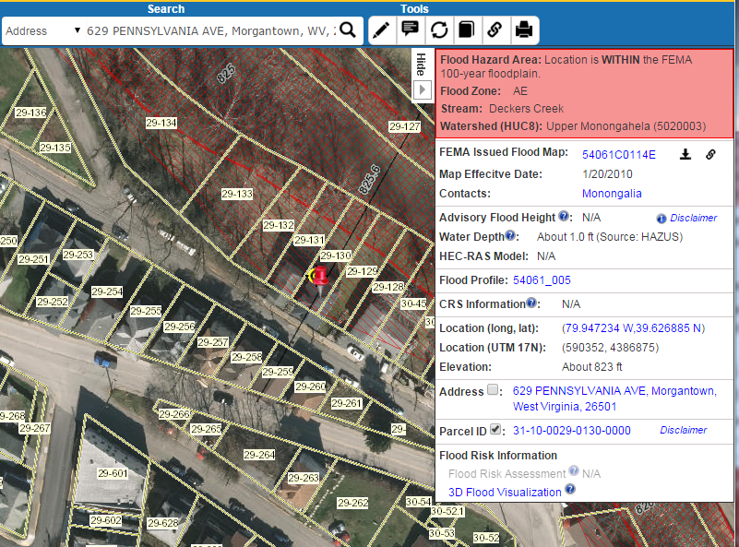
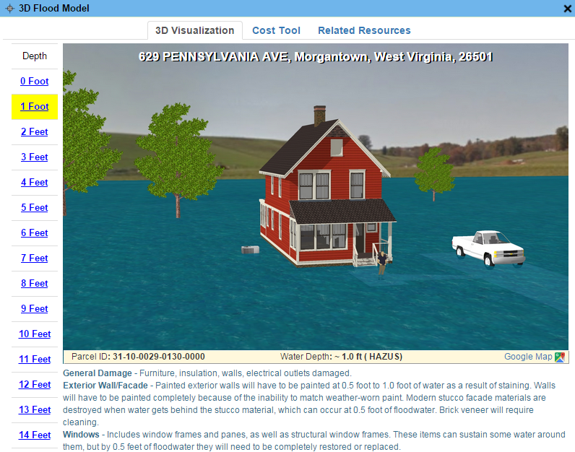
Parcels link to Owner/Building Info
629 PENNSYLVANIA AVE, Morgantown, WV, 26501
https://www.mapwv.gov/flood/map/?wkid=102100&x=-8899684&y=4811867&l=13&v=0
Residential or Farm Property

Slide 28
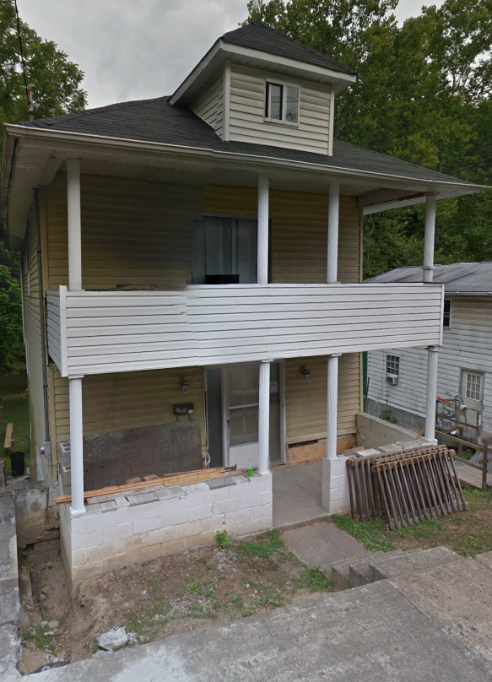
Parcels link to Owner/Building Info
Residential or Farm Property
DESCRIPTION
GIS Parcel ID | 31-10-0029-0130-0000
Legal Description | BL 12-1/2 LOT 10
Acreage (deed) | 0.0373
Tax Year | 2015
Tax Class | 4
Deed Book / Page | 1259 / 45
PROPERTY OWNER(S)
Property Owner(s) | Smith John
629 PENNSYLVANIA AVE, Morgantown, WV, 26501
https://www.mapwv.gov/flood/map/?wkid=102100&x=-8899684&y=4811867&l=13&v=0
BUILDING INFORMATION
Property Class Type | R- Residential
Land Use | 101 - Residential 1 Family
Year Built | 1911
Architectural style | Conventional
Exterior Wall | Aluminum
Stories | 2
Total Rooms | 8
Building Grade | C
Basement Type | Full
Structure Area | 1,320
Building (card) Number | 1
# of main BLDGs (cards) | 1
APPRAISED VALUES
Land Appraisal | $33,200
Building Appraisal | $29,000
Total Appraisal | $62,200

Slide 29
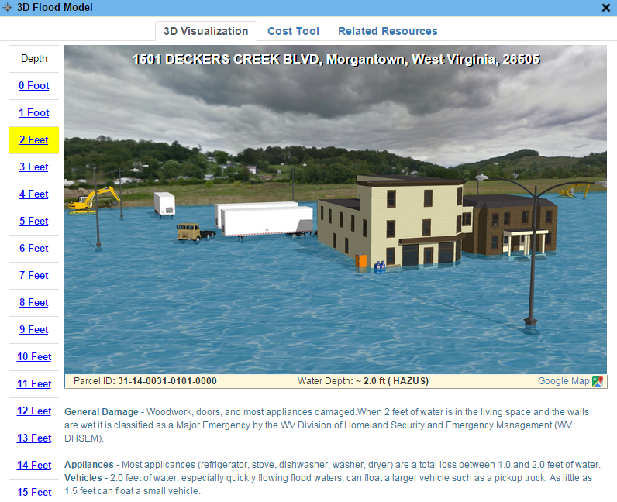
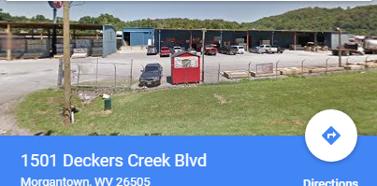
Parcels link to Owner/Building Info
Commercial or Industrial Property
DESCRIPTION | 84 Lumber
GIS Parcel ID | 31-14-0031-0101-0000
Legal Description | 5.0922 AC;SABRATON
Acreage (deed) | 5.09
Deed Book / Page | 1376 / 234
PROPERTY OWNER(S)
Property Owner(s) | SPIRIT SPE PORTFOLIO
1501 DECKERS CREEK BLVD, Morgantown, West Virginia, 26505
https://www.mapwv.gov/flood/map/?v=0&pid=31-14-0031-0101-0000
BUILDING INFORMATION
Property Class Type | C- Commercial
Land Use | 373 - Retail-Single Occupancy
Year Built | 1994
Stories | 2
Exterior Wall | Brick or Stone
Construction Type | Pre-Engineered Steel
Building Grade | D+
Basement Type | None
Business Living Area | 15,255
Cubic Feet | 292,380
Use Type | 34-Retail Store, 82- Multi-Use Office
COST VALUES
Other Bldg/Yard Values | $67,020
Commercial Value | $227,700
APPRAISED VALUES
Land Appraisal | $378,800
Building Appraisal | $294,700
Total Appraisal | $673,500

Slide 30
Total Property Parcels
West Virginia Parcel Property Class Breakdown for Tax Year 2020 (Computed from statewide master parcel file)
Code* | Property Class | # of Parcels | Percent (%) | Total Assessment Value
R | Residential | 1,089,781 | 80.7% | $76,250,249,392
F | Farm | 118,810 | 8.8% | $7,661,387,950
A | Apartment | 2,979 | 0.2% | $1,659,626,296
C | Commercial | 64,172 | 4.8% | $17,104,957,324
I | Industrial | 2,690 | 0.2% | $1,747,474,255
X | Exempt | 67,549 | 5.0% | $21,850,729,693
U | Utility | 4,124 | 0.3% | $671,794,393
Other | Not classified | 5 | 0.0% | $53,100
 |  | 1,350,110 | 100% | $126,946,272,403
 | Property Parcels intersecting 100-YR floodplain | 275,567 | 20% (of count) | $27,611,984,170
Assessment records are important for building inventories and are used to estimate the total building exposure ($) and building loss ($) for multi-hazards. Often building inventories and corresponding loss estimates are organized by property class.

Slide 31
Parcels in 100-YR Floodplain
Property Class | Count | %
Residential | 204,787 | 74%
Farm | 29,382 | 11%
Commercial | 19,231 | 7%
Other | 22,077 | 8%
total (20% of all 1.35 million parcels) | 275,567 | 100%
An estimated 275,567 property parcels or 20% of total 1.35 million statewide parcels intersect the 100-YR floodplain (Tax Year 2020)
A more detailed site-specific building analysis is needed statewide
Computed from statewide parcel file 100% complete

Slide 32
Parcels in 100-YR/500-YR Floodplains

Slide 33
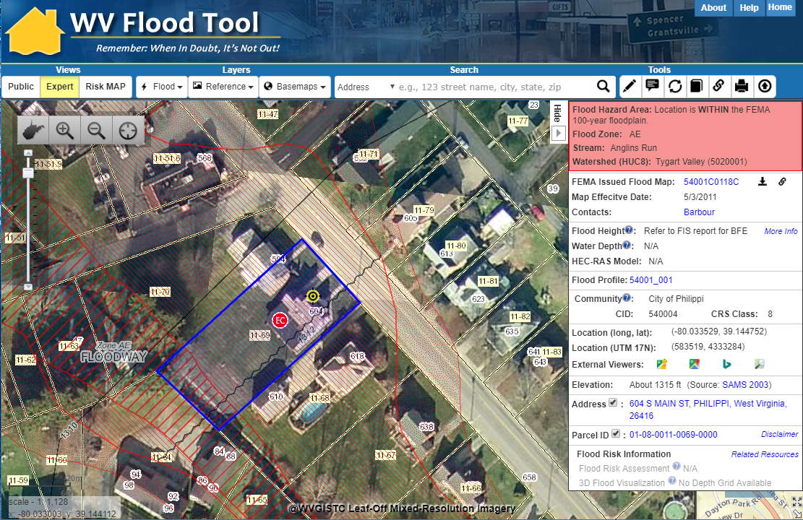
Property Identification – Bldg. ID
SHARE LINK
604 S. Main St., Philippi, WV 26416
Address: 604 Main St, Philippi, WV 26416
Parcel ID: 01-08-0011-0069-0000
X,Y COORD.
ADDRESS
Building ID:
(Parcel ID + Address No.)
01-08-0011-0069-0000_604
PARCEL
Share Link: https://www.mapwv.gov/flood/map/?wkid=102100&x=-8909292&y=4742427&l=12&v=1

Slide 34
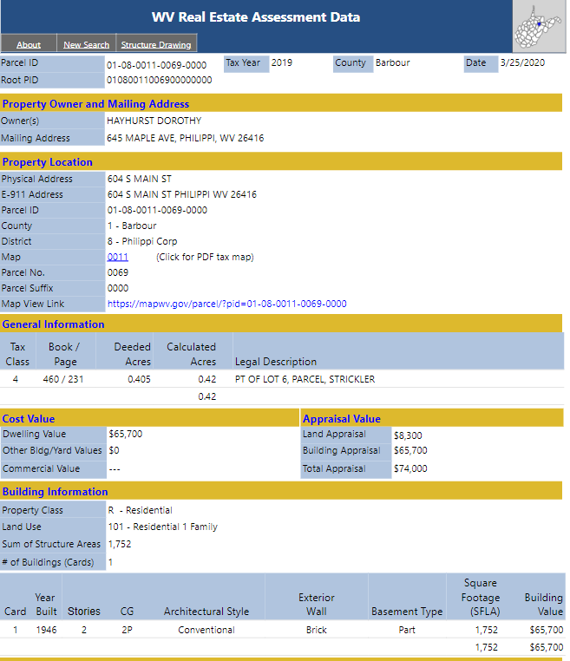
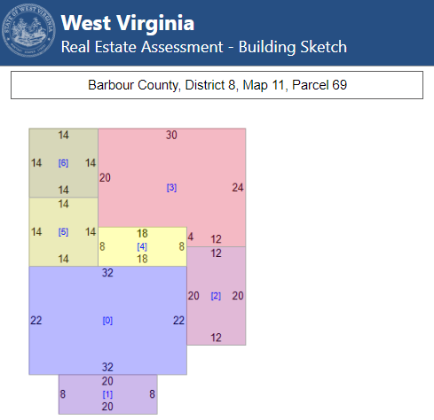
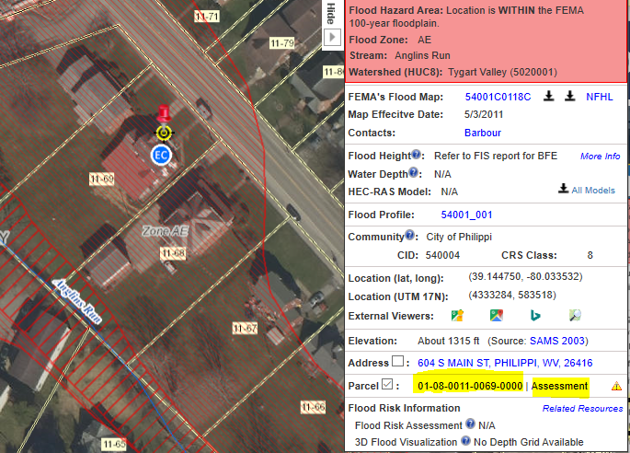
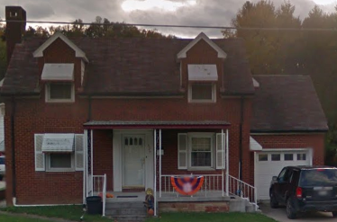
Property Parcels and Assessment Reports
E-911 and County Assessor report location at 604 S Main Street
Property Assessment Report
Building
Sketch Diagram
Map-Parcel Number 11-69
Parcel Map
Share Link: https://mapwv.gov/Assessment/Detail/?PID=01080011006900000000

Slide 35
Property Parcels
Web Assessment Reports
Ownership
Building Identification
Building Characteristics
Building Sketch Diagrams
Outbuildings
Cost Values
Land Use
Tax Class (Owner Occupied)
Parcel History (15 years)

Slide 36
Flood Tool Reference Layers
Building Footprints

Slide 37
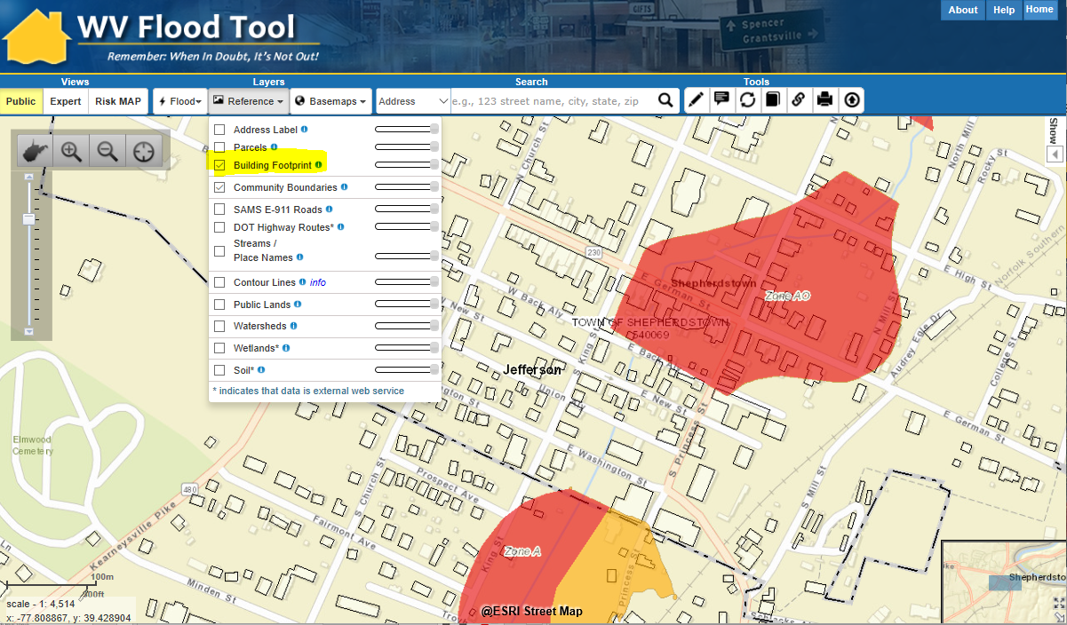
Building Footprints

Slide 38
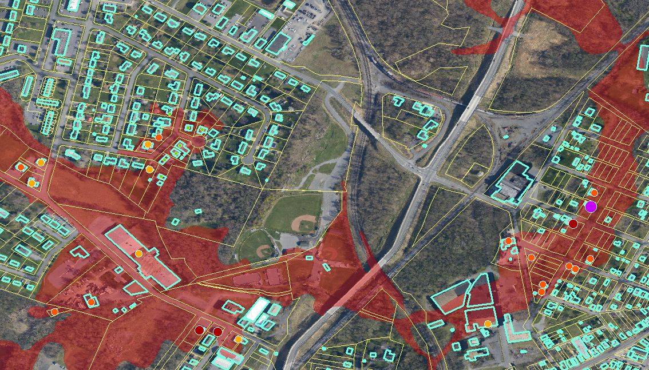
Building Footprints
Building footprints can enhance flood risk assessment maps
Building Flood Loss Damage
57% of Residential Home Damaged at a Loss of $88,834

Slide 39
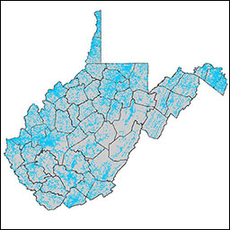
Building Footprints
Statewide building footprint reference layer created from best available sources
Layer | Source | Coverage
2003 SAMB | 2003 2-ft. resolution leaf-off imagery, Statewide Addressing & Mapping Board (large buildings only) | Statewide
Counties | 6” or better leaf-off imagery | Select Counties
2018 Microsoft Building Footprints | Statewide dataset contains 1,020,048 building footprints generated by Microsoft in 2018. The building footprint extraction was done in two stages: semantic segmentation, recognition of building pixels on aerial images, and polygonization, converting of building pixels to polygons. | Statewide
How are BUILDING FOOTPRINTS beneficial?
Improves the locational pin-pointing of structures for multi-hazard assessments
Enhances visual representation of structures on 2D flood risk maps
Necessary for 3D flood visualization models
Building footprints extruded to known heights
Beneficial to communicating flood risk to communities
2018 Microsoft Building Footprints

Slide 40
Flood Tool Reference Layers
Data Development and Integration
Local-Level Data Development
State-Level Integration

Slide 41
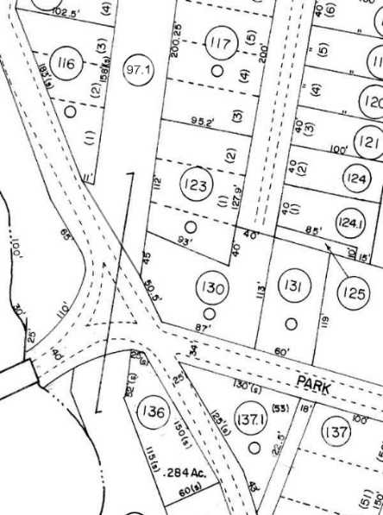
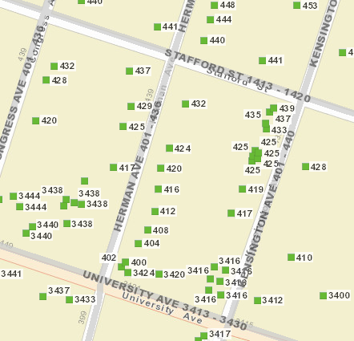
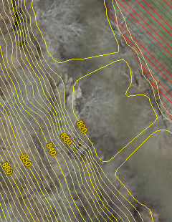
GIS Data Development
Parcels Site Addresses Aerial Imagery Elevation
Migrate six counties from paper to digital parcels
Flood-risk communities with missing or incorrect E-911 addresses
County Leaf-off imagery no older than 5 years
Statewide 1-meter DEM and 1-ft. contours. Flood Studies, Depth & WSEL Grids
Improving State’s Spatial Data Infrastructure

Slide 42
State-Level Integration
Parcels
Addresses
Imagery
Elevation
SOURCE: County Assessors
Property Tax Division
Statewide Master Parcel File / IAS
SOURCE: Local Addressing Offices
Division of Homeland Security & Emergency Management
Statewide Addressing & Mapping System
SOURCE: County Offices
WV GIS Technical Center
Statewide Leaf-Off Imagery Service
SOURCE: Local, State, primarily FEMA
WV DEP WV GISTC
Statewide Elevation Web Services
State-level integration allows for statewide mapping products and services

Slide 43
Unique Spatial Identifiers
Building and Parcel Identifiers

Slide 44
Building Spatial Identifiers
Collect multiple spatial identifiers to verify location
Parcel | 01-08-0011-0069-0000
01 | - | 08 | - | 0011 | - | 0069 | - | 0000
County |  | District |  | Map |  | Parcel |  | Suffix
Address | 604 S Main St, Philippi, West Virginia, 26416
Building Identifier | 01-08-0011-0069-0000_604
X,Y Coordinate | 39.144752, -80.033529
Google Plus Code (11-digit) | 86FX4XV8+VHF
Share MAP URL Link | https://www.mapwv.gov/flood/map/?wkid=102100&x=-8909292&y=4742427&l=12&v=1
Share Parcel Assessment URL Link | http://www.mapwv.gov/Assessment/Detail/?PID=01080011006900000000
Notes: Owner Name from assessment records and Building Pictures (elevation certificates) can be helpful for property identification purposes
Proper Building and Property Identifiers are important for exchanging building-level data efficiently among local, state, and federal partners (including UDFs, LOMAs, Mitigated Buyout Properties, Elevation Certificates, Repetitive Loss Structures, etc.)
= Unique Identifiers

Slide 45
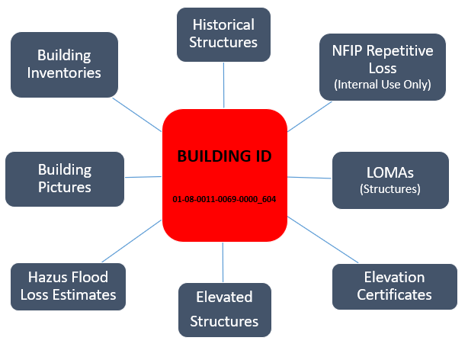
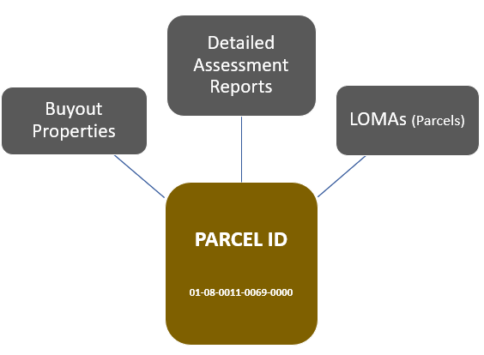
Building Unique Identifier
Parcel ID | 01-08-0011-0069-0000
01 | - | 08 | - | 0011 | - | 0069 | - | 0000
County |  | District |  | Map |  | Parcel |  | Suffix
Address | 604 S Main St, Philippi, West Virginia, 26416
Building Identifier (Parcel ID + Address No.) | 01-08-0011-0069-0000_604
Link to Property Record
Link to Structure Record

