Slide 1
WV Flood Tool Reference Layers
Reference Layers
Elevation
Aerial Imagery
E-911 Addresses
Parcels / Assessment Records
Building Footprints
Boundaries
5/24/2022 Update

Slide 2
Flood Tool Reference Layers
Elevation
Hi-resolution elevation data is required for flood studies and other applications

Slide 3
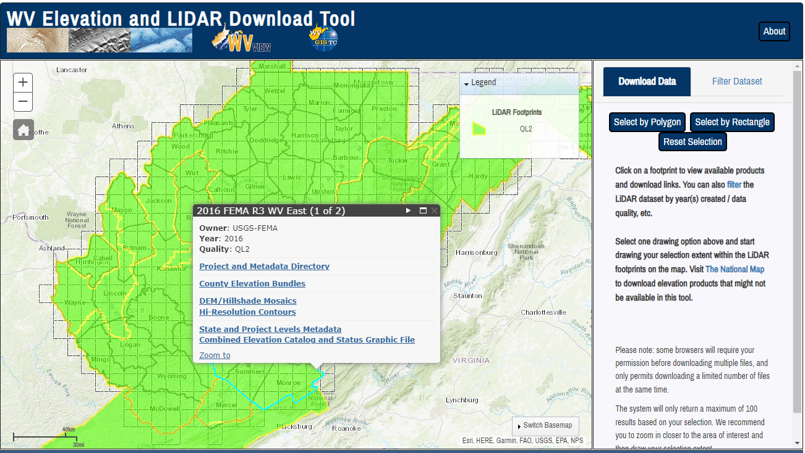
Elevation (High Resolution)
Statewide Elevation Products on WV Property Viewer and WV Flood Tool
Classified Lidar point cloud files
1-ft Contours cached to 1:282 Map Scale (2-ft. contours for Morgan-Berkeley-Jefferson)
1-meter Digital Elevation Model (created from LiDAR and breaklines)
Hillshade (grayscale 3D representation of the surface) and Slope
View products on WV Flood Tool and Property Viewer
Source Elevation Metadata: https://www.mapwv.gov/lidar-metadata
WV Elevation Download Tool: https://www.mapwv.gov/elevation
County Elevation Bundles (Lidar Point Cloud, Contours, DEM, Hillshade, Slope)
DEM Hillshade Mosaics
Hi-Resolution Contours
Compressed LiDAR LAS Files
State and Project Levels Metadata
USGS Elevation Download:
DEMs and Lidar point cloud files can be downloaded from the USGS National Map Download site as well

Slide 4
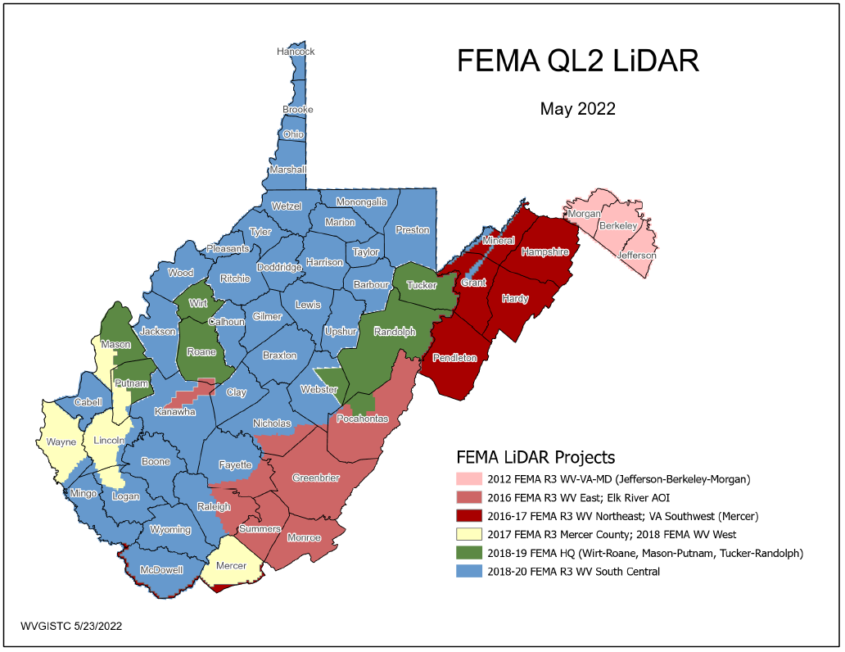
FEMA Purchased LiDAR Coverage
This past decade FEMA purchased $10 million QL2 LiDAR (2012-2020) consisting of six major project acquisitions
Quality 2 (QL2) LiDAR support 1-foot contours
PDF Map

Slide 5
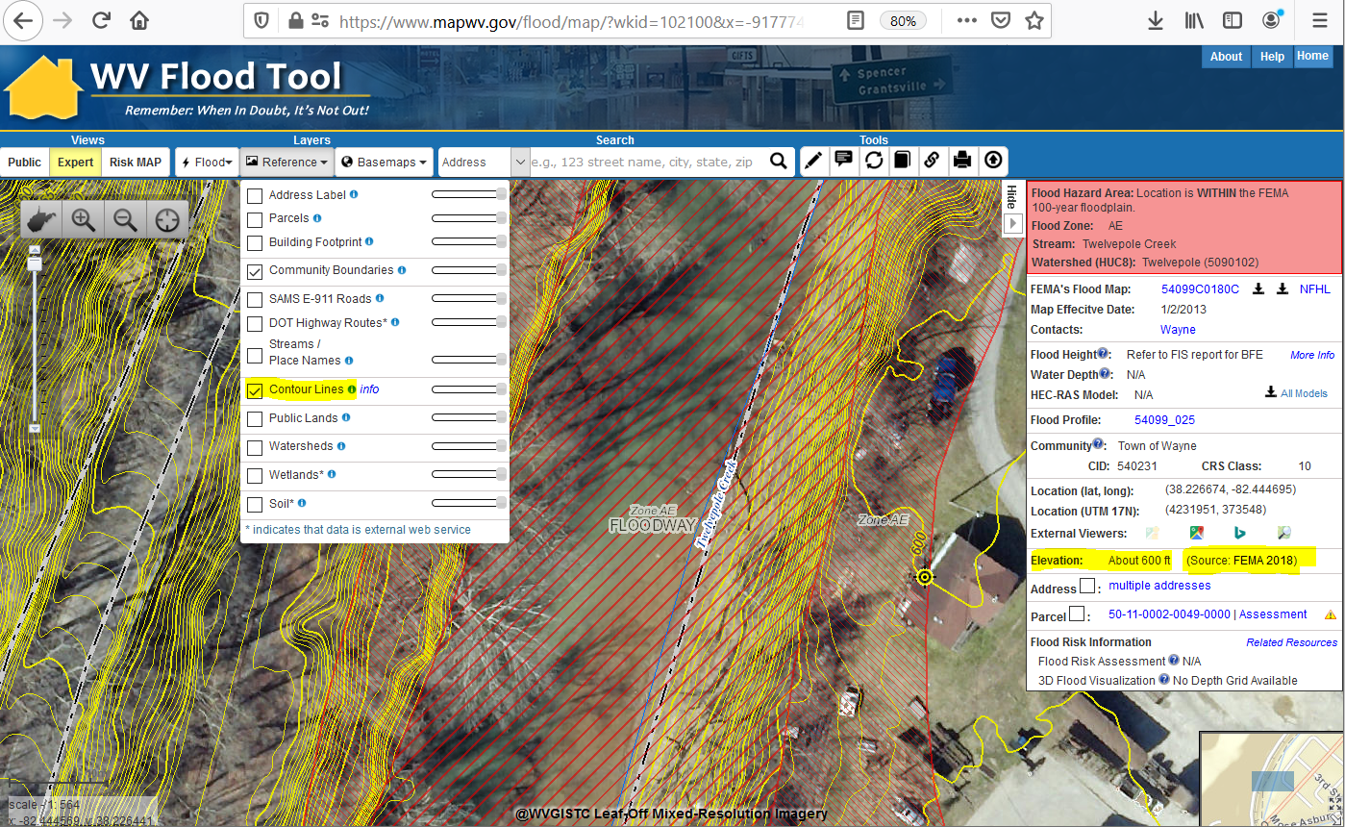
Ground Elevation: 1-ft. Contours
https://www.mapwv.gov/flood/map/?wkid=102100&x=-9177701&y=4611497&l=13&v=1
Make Contour Lines visible under REFERENCE LAYERS
1-FOOT CONTOUR ELEVATION VALUE OF 600 FEET MATCHES 1-METER GRID SURFACE ELEVATION OF 600 FEET DISPLAYED IN QUERY RESULTS PANEL
1-ft Contours Display at two Highest Zoom Levels (1:564 and 1:282 Map Scales)
Elevation: 600 ft.
Source: FEMA 2018
600 ft.
1-foot contours published for 10 counties
FEMA LiDAR-Derived Products: 1-Meter DEM and 1-Foot Contours

Slide 6
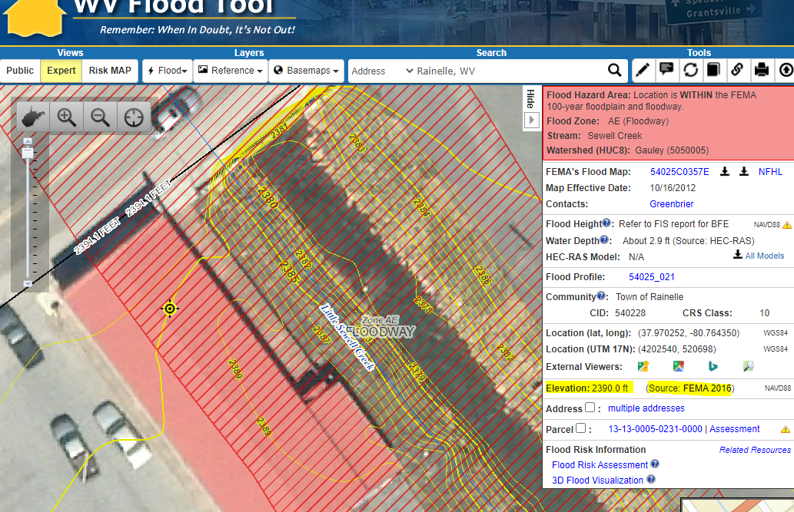
Ground Elevation: 1-ft. Contours
FEMA LiDAR-Derived Products: 1-Meter DEM and 1-Foot Contours
High-resolution aerial imagery and elevation contours cached at 15 map level scales from 1: 4,622,324 to 1:282
1:282
Map Scale
Elevation: 2390 ft.
Source: FEMA 2016
Contour Elevation: 2390 ft.
1-ft Contours Display at two Highest Zoom Levels (1:564 and 1:282 Map Scales)
1-FOOT CONTOUR ELEVATION VALUE OF 2390 FEET MATCHES 1-METER GRID SURFACE ELEVATION OF 2390 FEET DISPLAYED IN QUERY RESULTS PANEL

Slide 7
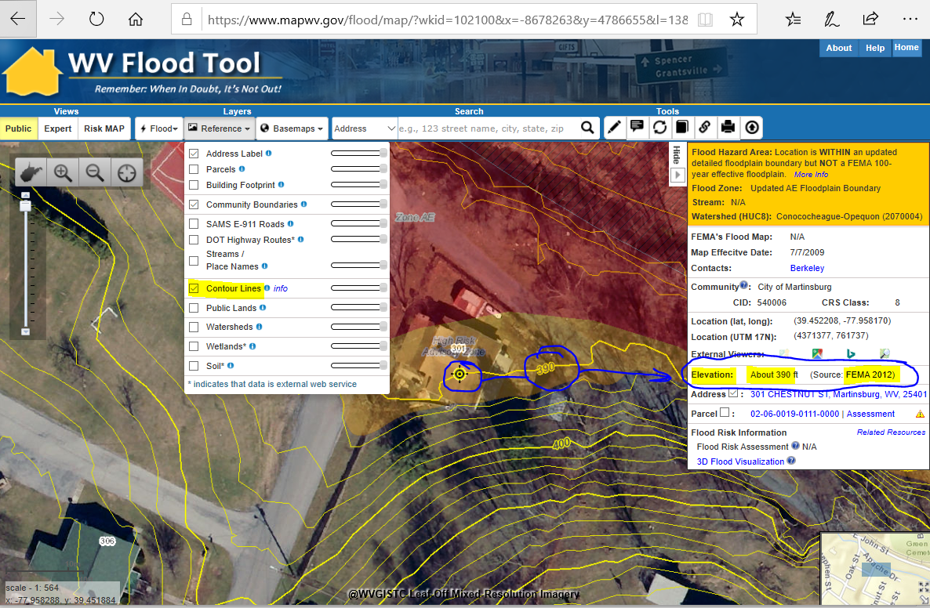
Elevation: 2-ft. Contour Creation
2-foot contours created by WVU for Berkeley and Morgan Counties
2-ft Contours Display at Highest Zoom Levels (1:564 and 1:282 Map Scales)
2-FOOT CONTOUR ELEVATION VALUE OF 390 FEET MATCHES 1-METER GRID SURFACE ELEVATION OF 390 FEET DISPLAYED IN QUERY RESULTS PANEL

Slide 8
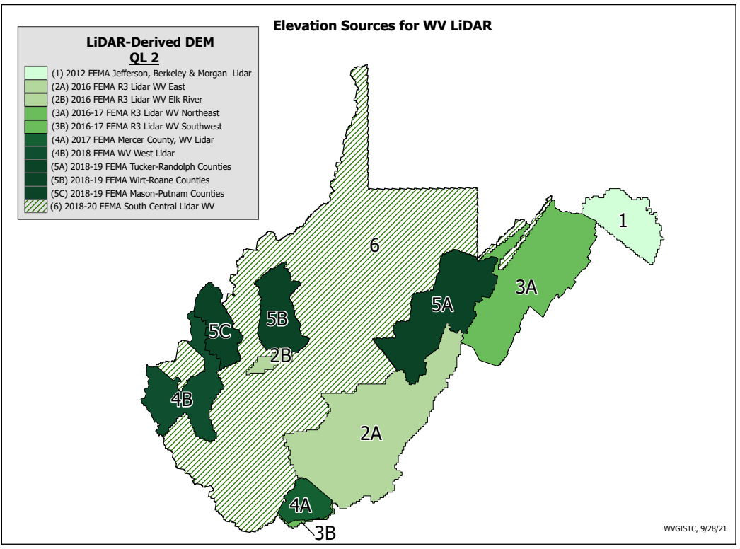
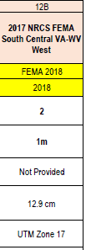
Elevation Data Sources
4B
FEMA purchased Statewide QL2 LiDAR
Elevation Metadata
1-Ft. Contours for entire State except for 2-ft contours for Area 1
WV Elevation Source Listing and Graphics: https://www.mapwv.gov/lidar-metadata

Slide 9
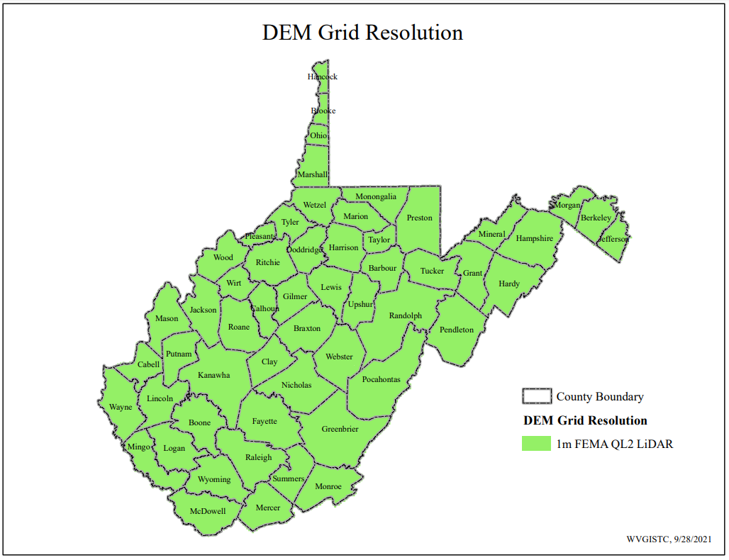
1-meter DEM Grid Resolution

Slide 10
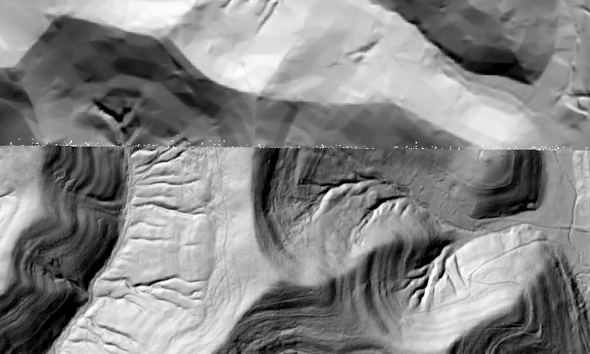
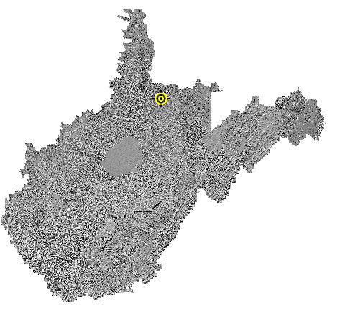
Statewide Elevation Layers
Elevation Grids, Hillshade Grids, Contours, used for Flood Depths, Imagery Orthorectification
Layer | Source | Coverage
SAMB | 2003 SAMB, 3-meter, 10-foot contours | Statewide
Lidar | Lidar, 2-foot or 1-foot contours | Select Areas
SAMB ELEVATION
WV DEP SAMB-Lidar Hillshade
LIDAR ELEVATION

Slide 11
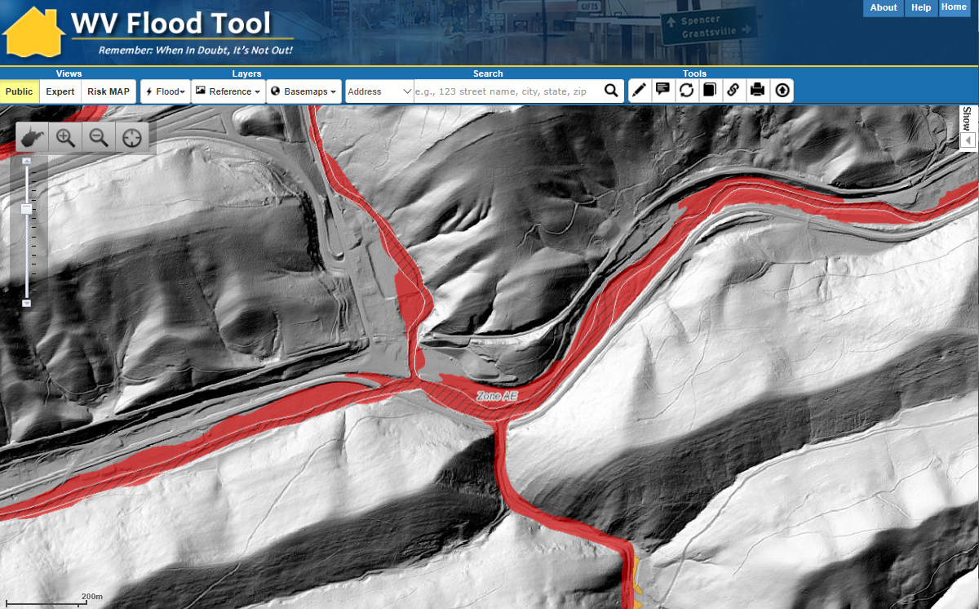
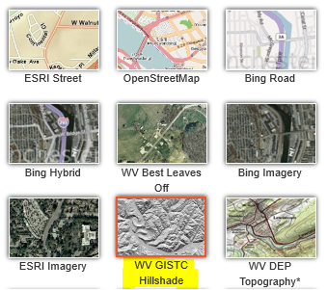
Statewide Hillshade Basemap Product
A hillshade is a grayscale 3D representation of the surface
Hillshade Basemap

Slide 12
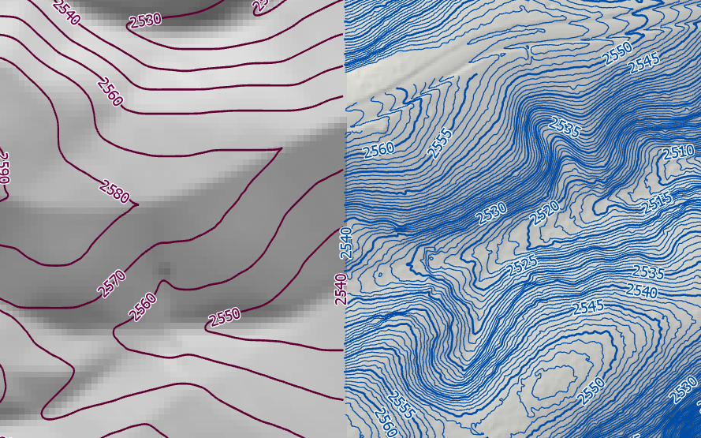
High Resolution Contours
New FEMA LiDAR-Derived Contours are 10x better than 2003 Statewide Elevation Data Set
SAMB Elevation 10 FT Contours
FEMA LiDAR 1 FT Contours

Slide 13
Flood Tool Reference Layers
Aerial Imagery
Accessibility to quality, up-to-date aerial photography is one of the most important overall indicators of the suitability of the State’s Spatial Data Infrastructure

Slide 14
Statewide Imagery Contract (2019-22)
STATEWIDE AERIAL IMAGERY CONTRACT: In February 2019, a 4-year statewide contract (2019-22) through WVU Procurement was executed to provide bulk discounts for government agencies acquiring aerial imagery in West Virginia. Thrasher Group was awarded the contract. The spring flying season is from late February to Mid-April during leaf-out and no snow conditions.
County Participation: 30 unique counties tapped into the contract and multiple counties took advantage of the contract more than once for a total of 41 county aerial imagery contracts (18,987 square miles).
Cost Share: The total cost share by counties was 85% ($713K) while grant share was $124K. The entire aerial imagery cost with no county cost share contributions only had to be paid for two disadvantaged counties (Clay and Pendleton counties).
Resolution: All counties were collected at 4-inch resolution except for Cabell (3”), Pendleton (6’”), and Randolph (6”) counties.
Flyover Coverage: A total of 18,987 square miles were flown from this state contract.
Best Leaf-Off: Replaced the legacy WV Sheriffs Association (2010-12) as the best available leaf-off imagery
Non-Exclusive Contract: County offices still had the option to contract with other companies for the same services.
Unit Costs: Aerial imagery could be purchased at four different pixel resolutions and over multiple budget cycles. Counties with limited funding qualified for grant cost-share.

Slide 15
Statewide Imagery Contract (2019-22)
STATEWIDE AERIAL IMAGERY CONTRACT
In February 2019, a 4-year statewide contract (2019-22) through WVU Procurement was executed to provide bulk discounts for government agencies acquiring aerial imagery in West Virginia. Thrasher Group was awarded the contract. The spring flying season is from late February to Mid-April during leaf-out and no snow conditions.
<< Aerial Imagery Program and Price Information >>
<< WV State Contract >>
<< MOU Template >>
<< County Aerial Imagery Year Acquired >>
<< County Aerial Imagery Resolution >>
<< Resolution Comparison – Baseball Fence >>
<< Resolution Comparison – WVU Coliseum >>
Unit Costs: Aerial imagery could be purchased at four different pixel resolutions and over multiple budget cycles. Counties with limited funding qualified for grant cost-share.
Pixel Resolution (Detail Level) | 3-inch | 4-inch | 6-inch | 12-inch
Cost per square mile | $62 | $45 | $36 | $25
Map Scale | 1” = 50’ | 1” = 67’ | 1” = 100’ | 1” = 200’
Horizontal Accuracy (ASPRS 1) | 0.5 feet | 0.66 feet | 1.0 feet | 2.0 feet
Note: 4-band stacked imagery that includes color infrared can be added at 25% of the acquisition cost

Slide 16
New Aerial Imagery
2022 County Leaf-Of Aerial Imagery (14 Counties)
2021 County Leaf-Of Aerial Imagery (4 Counties)
2020 County Leaf-Of Aerial Imagery (14 Counties)
2020 USDA National Agriculture Imagery Program (NAIP) 2-ft pixel resolution. Statewide Coverage.
30 unique counties (41 total) tapped into the State Aerial Imagery Contract supported by the Hazard Mitigation Grant for the acquisition of 2019-22 leaf-off imagery. Most counties were captured at 4-inch resolution. Imagery resides in the public domain.

Slide 17
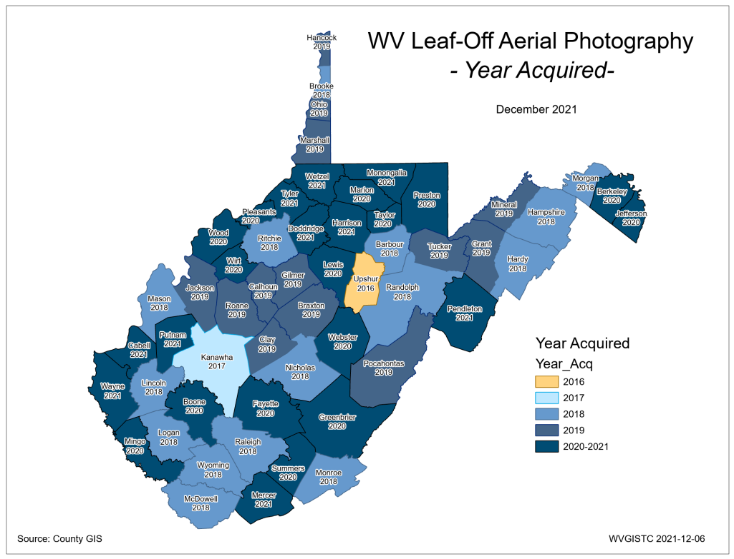
County Aerial Imagery (2021)
Year | Number
2010 | 3
2014 | 1
2016 | 3
2017 | 2
2018 | 19
2019 | 20
2020 | 14
2021 | 4
2022 | 14
New 2021-22 Imagery
Berkeley County
Cabell County
Calhoun County
Hampshire County
Harrison County
Jackson County
Jefferson County
Lewis County
Marshall County
Morgan County
Pendleton County
Pocahontas County
Raleigh County
Randolph County
Roane County
Wayne County
Wirt County
Ideally, leaf-off imagery should not be older than 5 years. Imagery is important for identifying at-risk structures and accurate disaster mapping.
Select counties for 2019-22 received funding support through HMGP grant
PDF Map

Slide 18
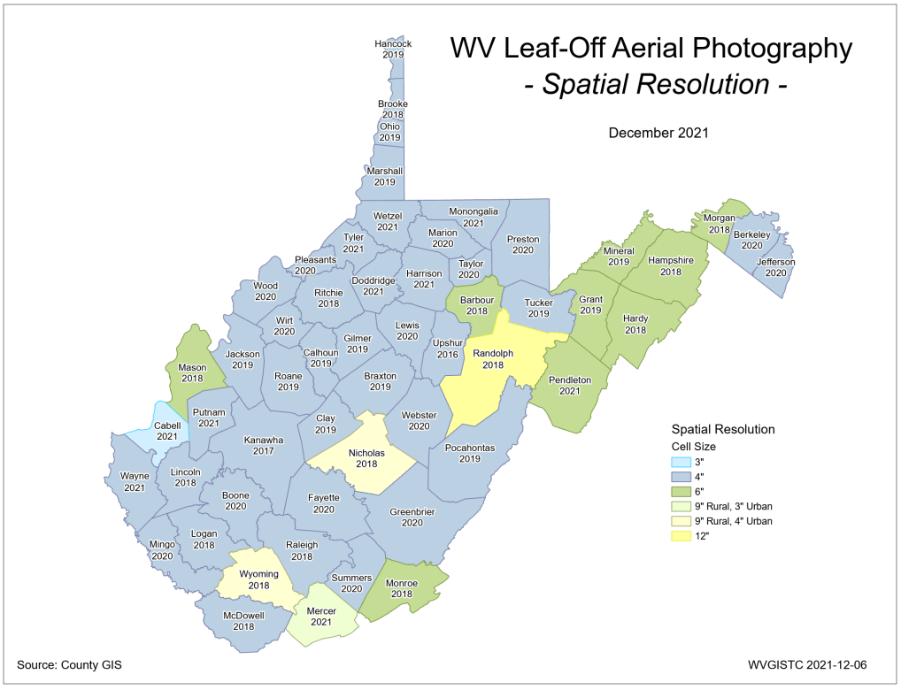
County Imagery Resolution(2021)
Aerial Imagery of most counties (95%) is captured at a countywide spatial cell resolution of 6 inches or higher
Past decade resolution increased one-half foot
Select counties for 2019-22 received funding support through HMGP grant
PDF Map

Slide 19
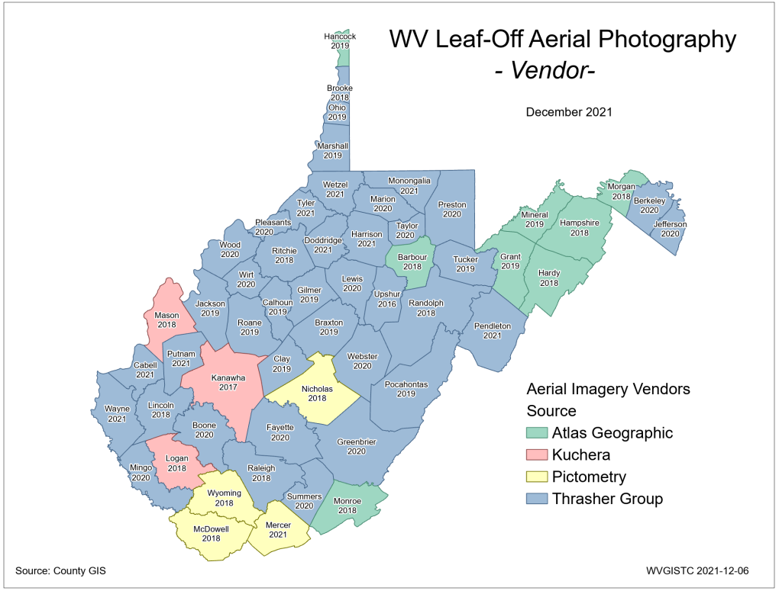
County Imagery Vendors (2021)
Select counties for 2019-22 received funding support through HMGP grant
PDF Map

Slide 20
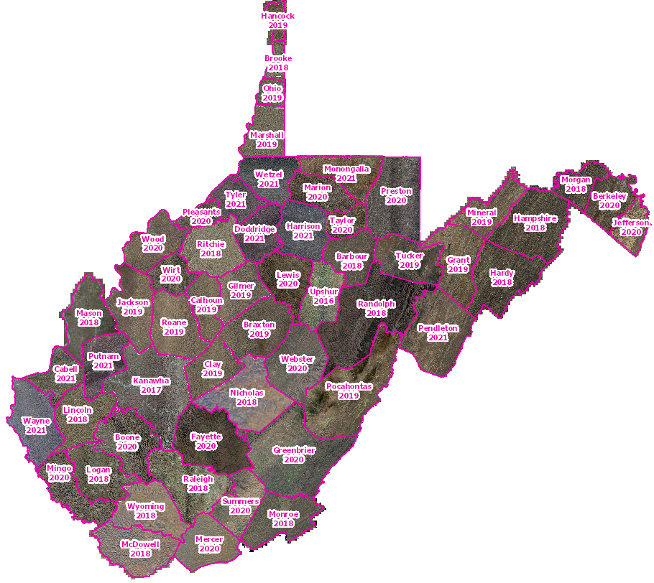
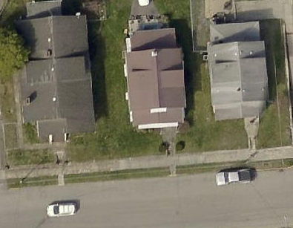
Leaf-Off Aerial Imagery Web Service
https://services.wvgis.wvu.edu/arcgis/rest/services/Imagery_BaseMaps_EarthCover/wv_imagery_WVGISTC_leaf_off_mosaic/MapServer?f=jsapi
Counties provide leaf-off imagery
for State Imagery Web Service
Cached to 1:282 Zoom Level or Map Scale
2021 Harrison County Aerial Imagery
PDF Maps

Slide 21
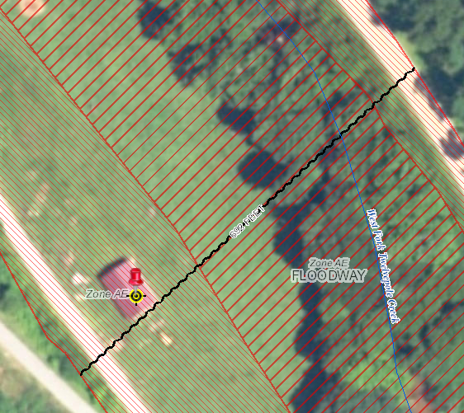
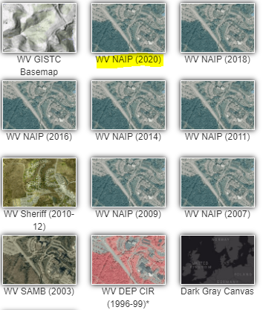
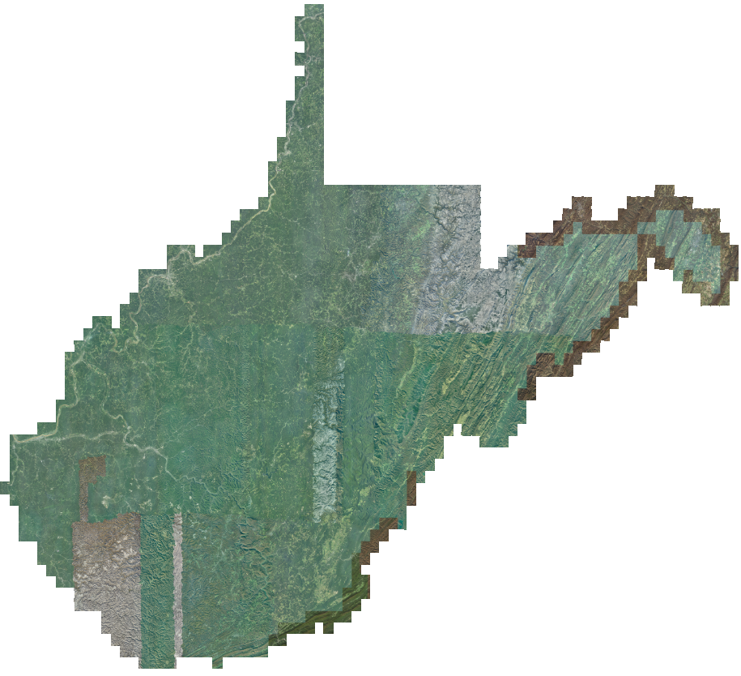
2020 NAIP Aerial Imagery
Choose WV NAIP (2020) from Base Map Layers Pulldown Menu
http://www.mapwv.gov/flood/map/?wkid=102100&x=-9176629&y=4583554&l=13&v=1
2-Foot Pixel Resolution
Statewide Coverage
2020 NAIP

Slide 22
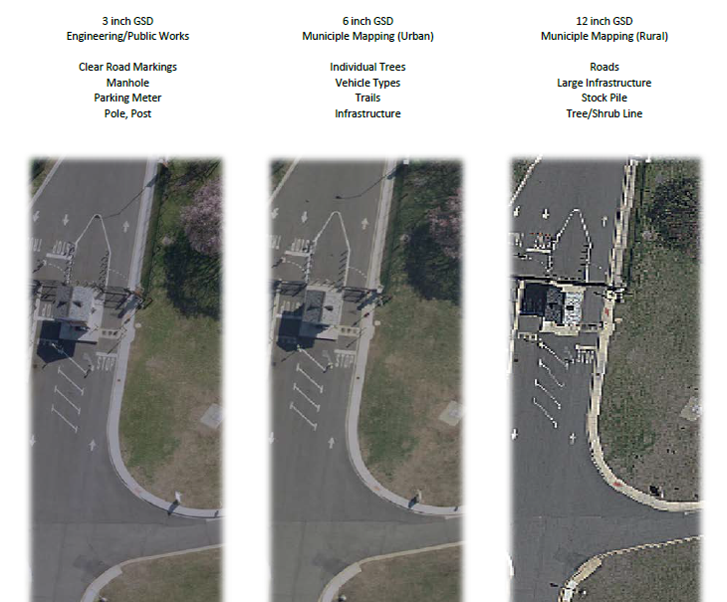
Imagery Resolution
Imagery can vary greatly in resolution. Pixel resolution refers to the actual distance on the ground that each pixel represents in the orthophotography. For example, four-inch pixel resolution means that each pixel in the image covers four inches on the ground.

Slide 23
Resolution Comparison
Resolution | 3-inch | 4-inch | 6-inch | 12-inch
Cost per square mile | $62 | $45 | $36 | $25
Mapping of: | Utilities and public works | Utilities and public works | Urban and more developed areas | Rural and less developed areas
Mapping Scale | 1:600 Map Scale 1” = 50’ | 1:800 Map Scale 1” = 67’ | 1:1200 Map Scale 1” = 100’ | 1:2400 Map Scale 1” = 200’ or 1” = 400’
Positional Accuracy | Very High | Higher than 6” Lower than 3” | Higher than 12” Lower than 4” | Lowest
Key Features Visible | Very Small Infrastructure Fire Hydrants Manhole Covers Individual people and animals Finer details on roads including markings and skid marks | Smaller Infrastructure Clearer Road Markings Power Lines | Infrastructure Property line fences Utility Poles Individual Trees Vehicle Types Road markings | Large Infrastructure Buildings Paved Roads Railroads Vehicles Tree/shrub line
Tax Parcel Conversion Projects or Re-mapping | Identifiability of small features somewhat improved over 4”. Lower cost-to-benefit ratio | Ideal for mapping fences and other survey features at a higher positional accuracy than 6” | Ideal for mapping fences, survey features, and land divisions (e.g., fences, walls, tree lines, roads) | Satisfactory for conversion projects
Other Notes | More building lean may be noticeable at 3” resolution for taller structures | 2-foot contours for engineering grade maps generated at this resolution

Slide 24
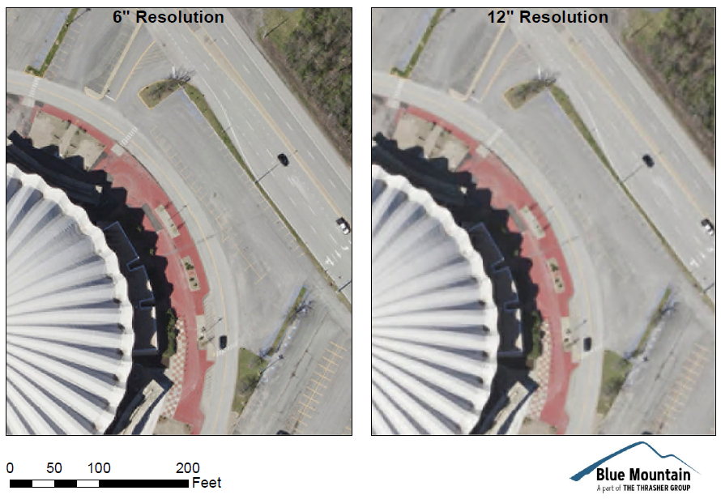
Imagery Resolution: 6- and 12-inch

Slide 25
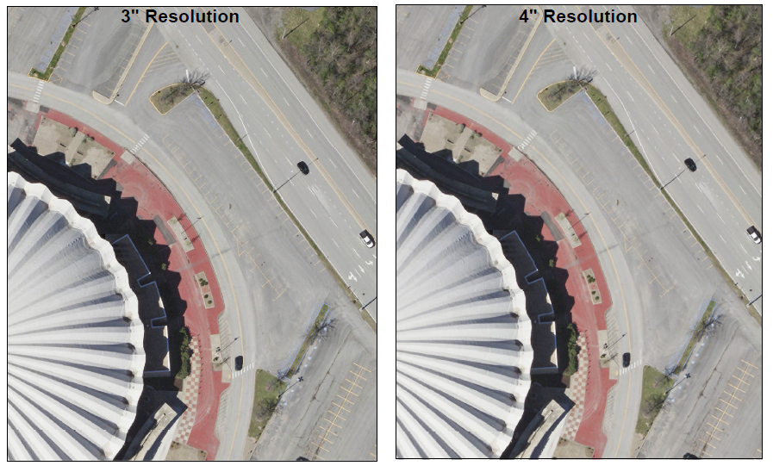
Imagery Resolution: 3- and 4-inch

Slide 26
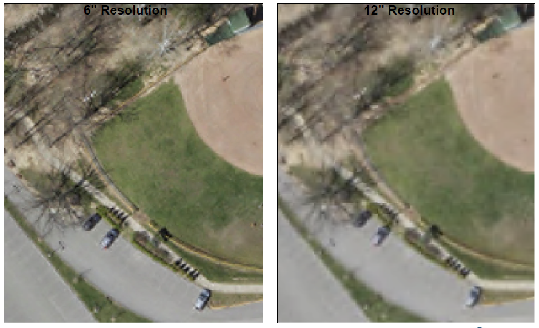
Imagery Resolution: 6- and 12-inch

Slide 27
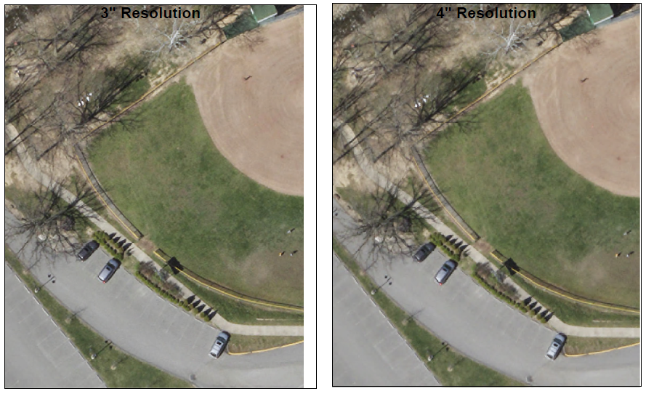
Imagery Resolution: 3- and 4-inch

Slide 28
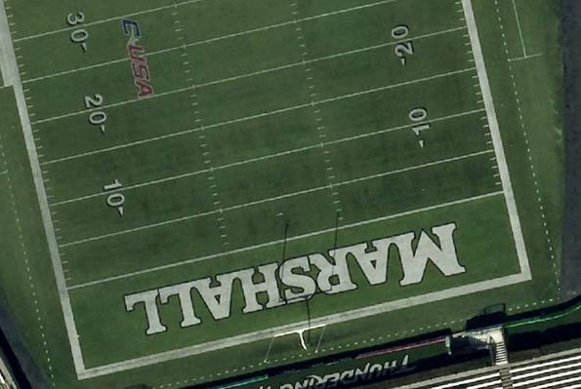
Imagery Resolution: 3-inch

Slide 29
Resolution (Cows in Wayne Co.)
4-Inch Pixel Resolution
https://www.mapwv.gov/flood/map/?wkid=102100&x=-9176629&y=4583554&l=13&v=1
Choose WV Best Leaves Off Base Map
Cows in the Floodway
West Fork Twelvepole Creek, Wayne County

Slide 30
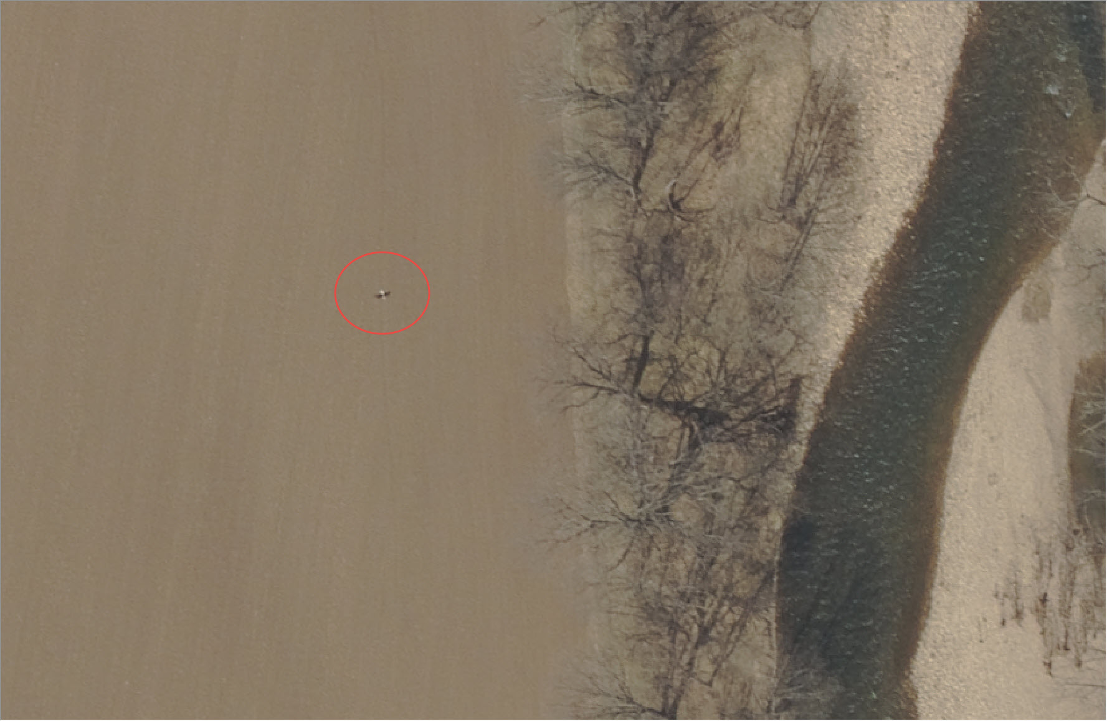
Resolution (Eagle in Pendleton Co.)
6-Inch Pixel Resolution
Bald Eagle in Pendleton County

Slide 31
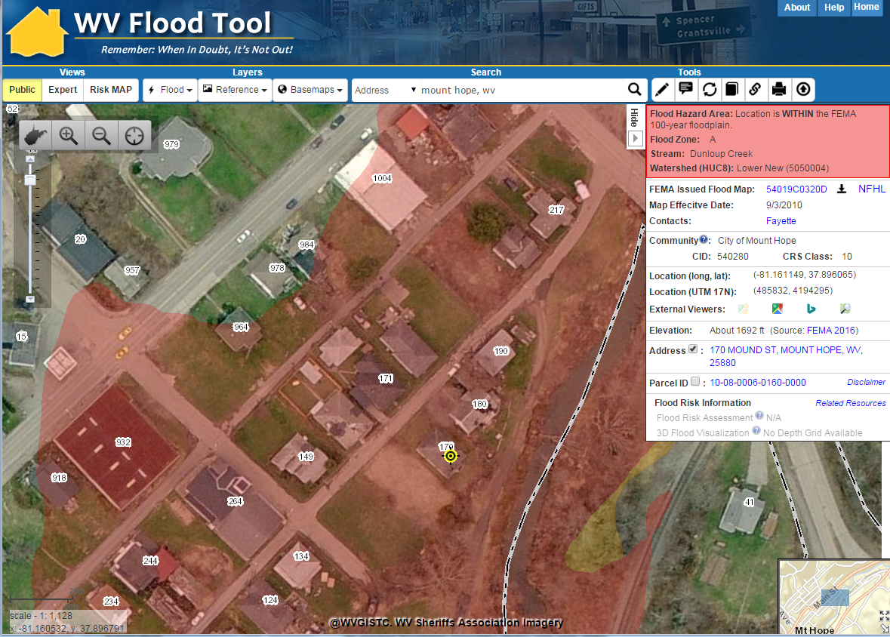
Mount Hope – 2010 Imagery
Aerial imagery change detection

Slide 32
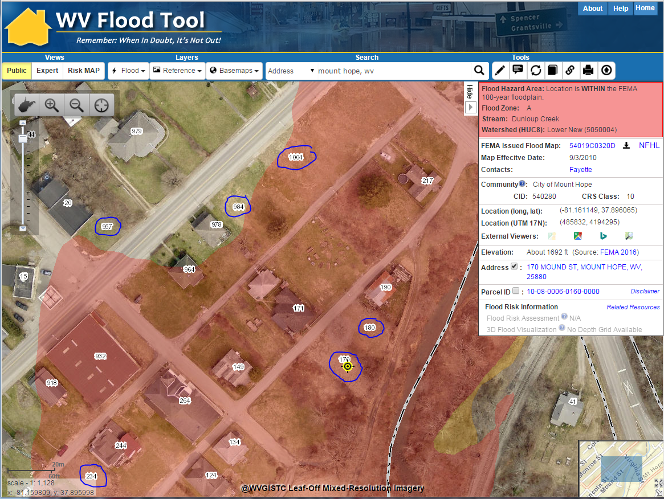
Mount Hope – 2015 Imagery
Aerial imagery change detection
The 2015 aerial imagery shows structures have been removed but E-911 addresses are still indicated

Slide 33
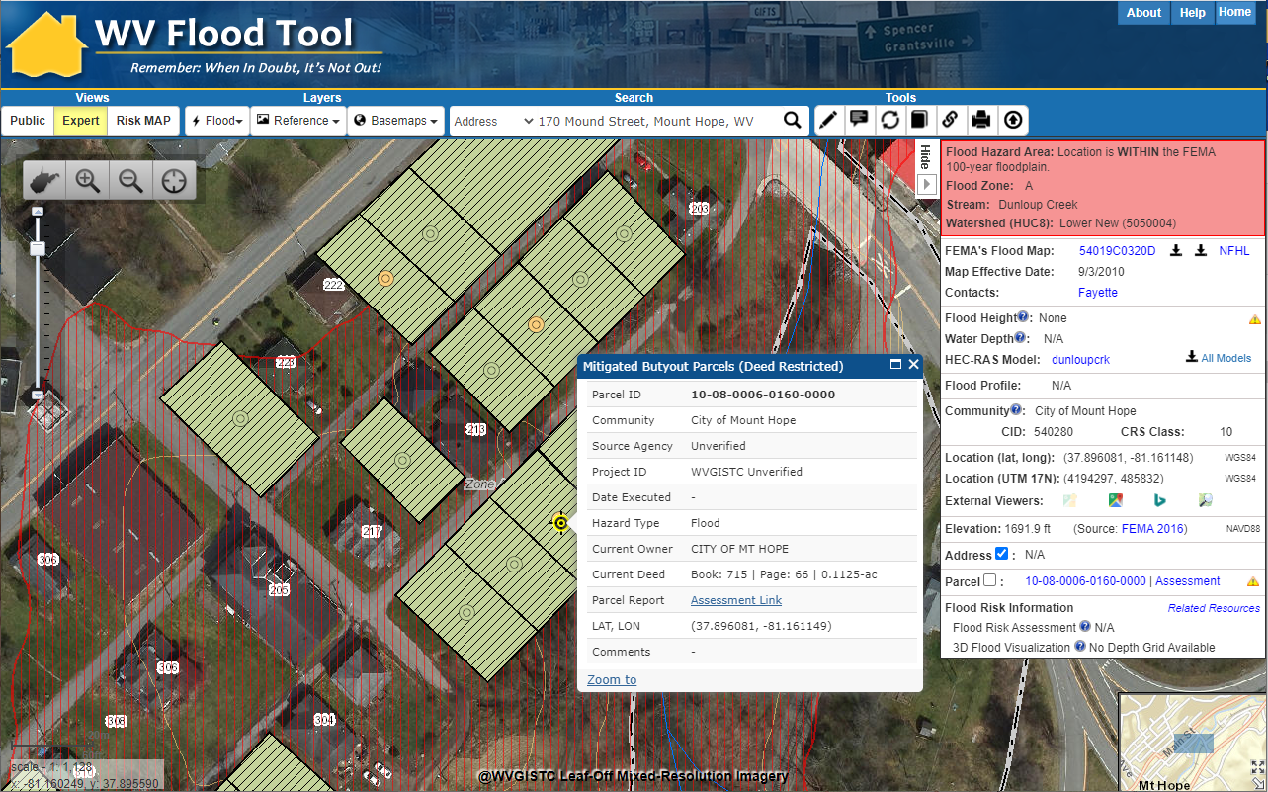
Mount Hope – 2020 Imagery
Aerial imagery change detection
The 2020 aerial imagery showing buyout properties (green polygons) and updated E-911 addresses
https://www.mapwv.gov/flood/map/?wkid=102100&x=-9034818&y=4564756&l=12&v=1

Slide 34
Flood Tool Reference Layers
E-911 Addresses

Slide 35
E-911 Addresses
Addressable: Currently the WV Flood Tool accesses 1 million addressable structures in the Statewide Addressing and Mapping System (SAMS). It is estimated that 100,000 addressable structures are in a high-risk flood zone.
Address Matching Geocoding Services: Updated geocoding services of WV Flood Tool from new Statewide Addressing and Mapping Files
Community Addressing Projects: Incorporated new addresses from Hazard Mitigation Grant Addressing Projects
Building Identifier: The E-911 Address Number, combined with the Parcel Identifier, forms the Building Identifier for identifying structures for flood risk assessments, building pictures, LOMAs, Elevation Certificates, etc.

Slide 36
E-911 Structures in Floodplain (2018)
 | # of Structures | Percent (%)
Addressable Structures | 1,010,819 | 91%
Non-Addressable Structures | 101,928 | 9%
total | 1,112,747 | 100%
Buildings in Effective 100-YR floodplains | 99,520 | 9%
Buildings in 100-YR floodplains (Effective and Advisory A/Updated AE) | 106,967 | 10%
Buildings in 100-YR and 500-YR floodplains | 159,804 | 14%
An estimated 100,000 buildings or 9% of all statewide 1.1 million buildings are within the effective 100-YR floodplain.
An estimated 160,000 buildings or 14% of all statewide 1.1 million buildings are within the 100-YR and 500-YR floodplains.
2018 Data Source: Statewide Addressing and Mapping System (SAMS). Some counties track non-addressable structures in the floodplain while other counties do not.
A more detailed site-specific building analysis is needed statewide

Slide 37
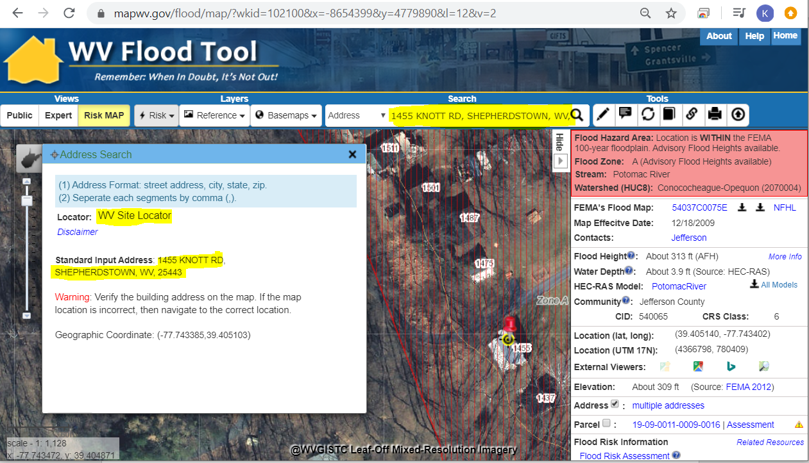
E-911 Addresses
Address Match Locators Updated on WV Flood Tool
Address Site Match Locator
Geocoding is the process of converting street addresses into geographic coordinates (latitude and longitude) to identify the position on the map
1455 Knott Road, Shepherdstown, WV

Slide 38
Statewide E-911 Address & Mapping File
Forms a unique Building Identifier for Floodplain Management and Risk Reduction Activities
Address Match Locators – Geocoding
Parcel Address Verification
Emergency Service Zone Boundaries
Other uses:
Fire insurance rates
Flood insurance discounts
Broadband, emergency, hazard reduction, and transportation planning

Slide 39
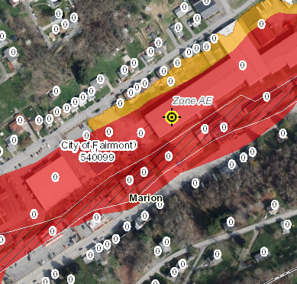
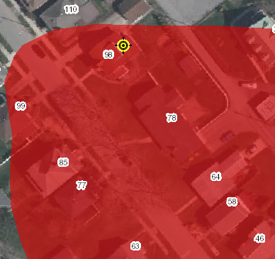
Statewide E-911 Addresses
Address Issues
Missing Address Site Numbers
Wrong Addresses (98 Graham St. should be 315 Graham St.)
Fairmont, WV
Elkins, WV

Slide 40
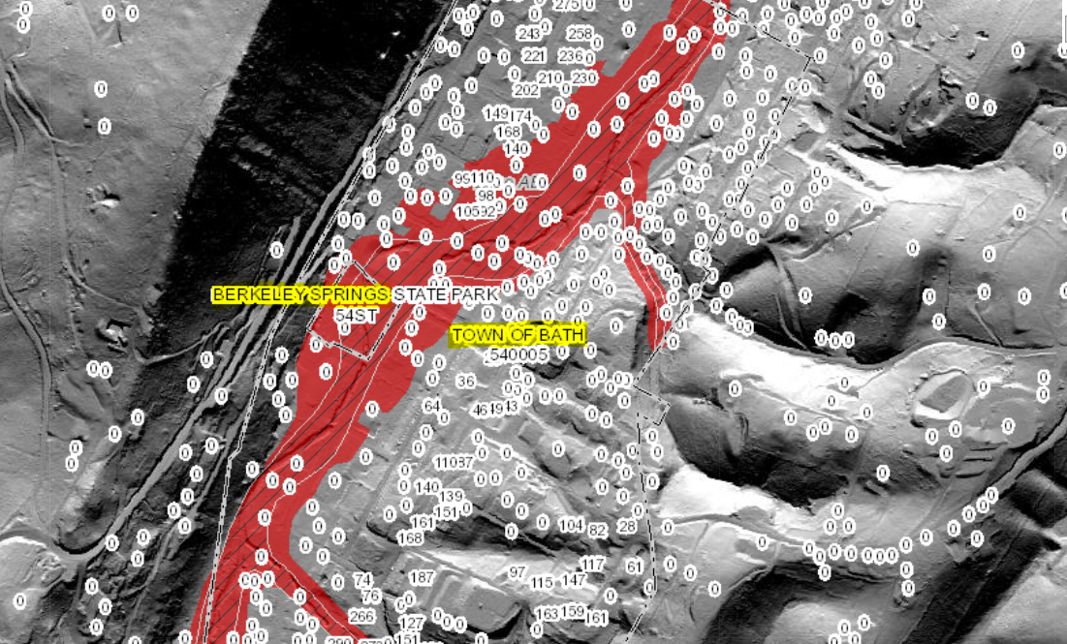
Statewide E-911 Addresses
Missing Address Site Numbers
Berkeley Springs, WV

Slide 41
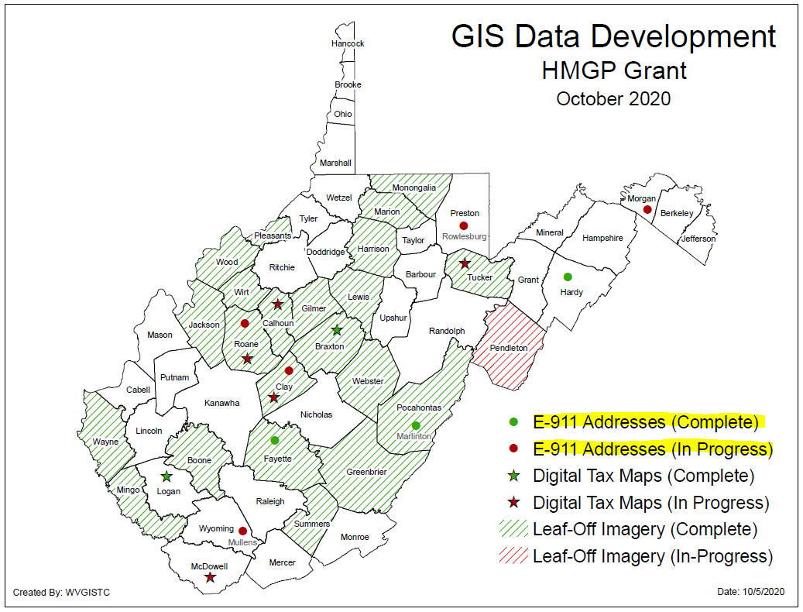
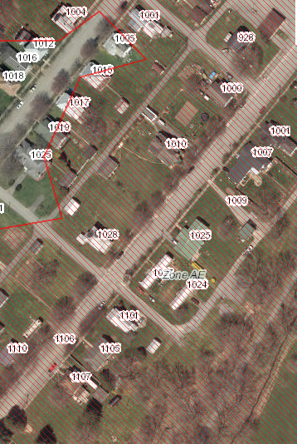
E-911 Addresses
Improved Addresses Uploaded to WV Flood Tool
HMGP Addressing Improvement Projects
Marlinton, WV

Slide 42
Flood Tool Reference Layers
Parcels / Assessment Records

Slide 43
Parcels / Assessment Records
Tax Year 2020 Parcels and Assessment Records: Updated Flood Tool with 1.4 million tax parcel and assessment records for Tax Year 2020.
Parcel Assessment Reports: Updated Parcel Web Reports including building sketch diagrams.
Building Identifier: The Parcel Identifier, combined with the E-911 Address Number, forms the Building Identifier for identifying structures for flood risk assessments, building pictures, LOMAs, Elevation Certificates, etc.

Slide 44
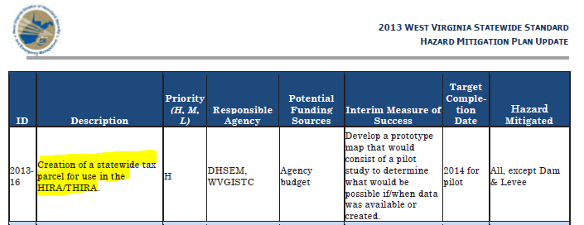
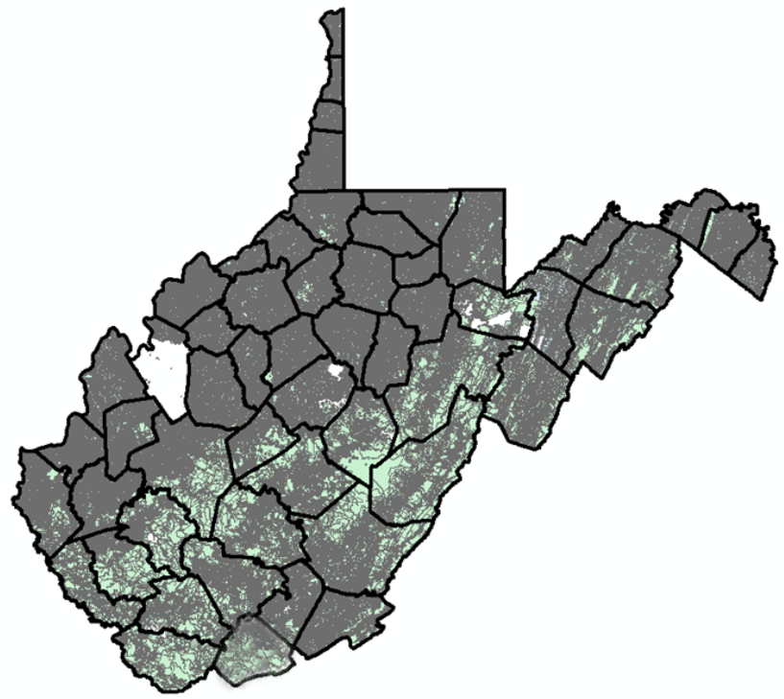
Statewide Digital Parcel File
High Priority
of
2013 State Hazard Mitigation Plan

Slide 45
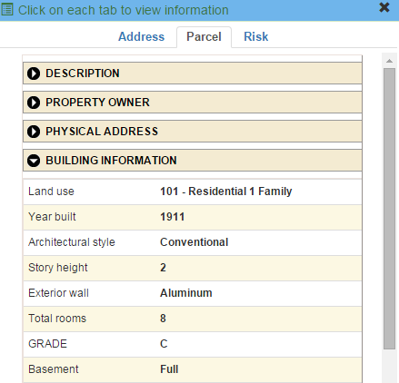
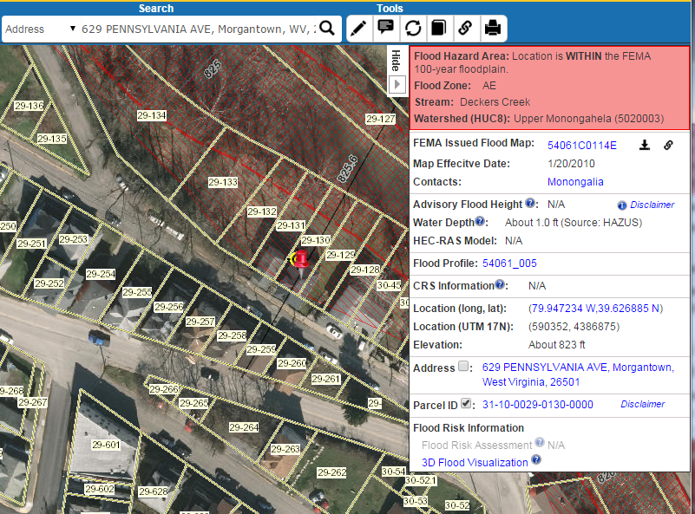
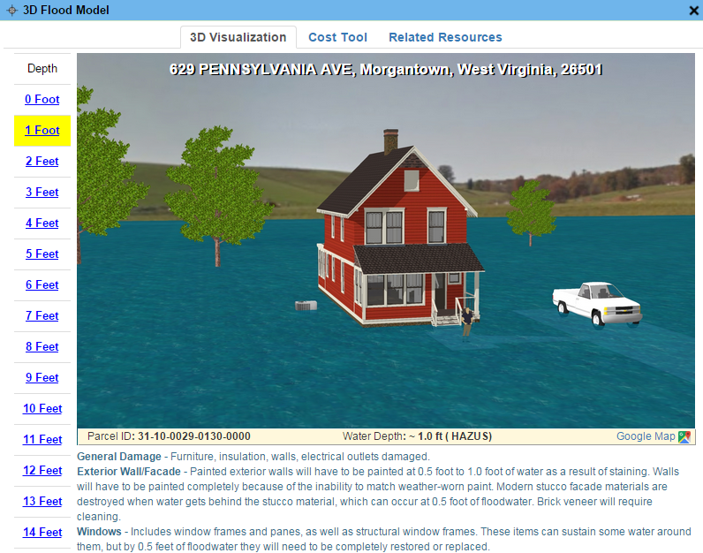
Parcels link to Owner/Building Info
629 PENNSYLVANIA AVE, Morgantown, WV, 26501
https://www.mapwv.gov/flood/map/?wkid=102100&x=-8899684&y=4811867&l=13&v=0
Residential or Farm Property

Slide 46
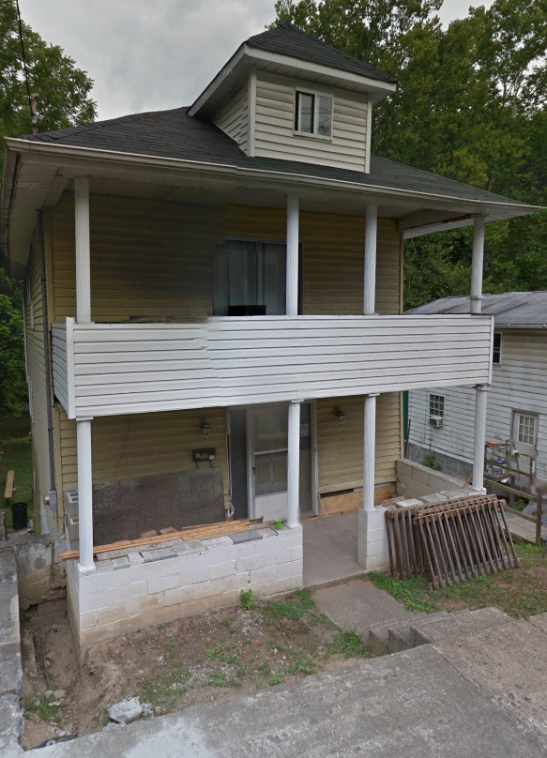
Parcels link to Owner/Building Info
Residential or Farm Property
DESCRIPTION
GIS Parcel ID | 31-10-0029-0130-0000
Legal Description | BL 12-1/2 LOT 10
Acreage (deed) | 0.0373
Tax Year | 2015
Tax Class | 4
Deed Book / Page | 1259 / 45
PROPERTY OWNER(S)
Property Owner(s) | Smith John
629 PENNSYLVANIA AVE, Morgantown, WV, 26501
https://www.mapwv.gov/flood/map/?wkid=102100&x=-8899684&y=4811867&l=13&v=0
BUILDING INFORMATION
Property Class Type | R- Residential
Land Use | 101 - Residential 1 Family
Year Built | 1911
Architectural style | Conventional
Exterior Wall | Aluminum
Stories | 2
Total Rooms | 8
Building Grade | C
Basement Type | Full
Structure Area | 1,320
Building (card) Number | 1
# of main BLDGs (cards) | 1
APPRAISED VALUES
Land Appraisal | $33,200
Building Appraisal | $29,000
Total Appraisal | $62,200

Slide 47
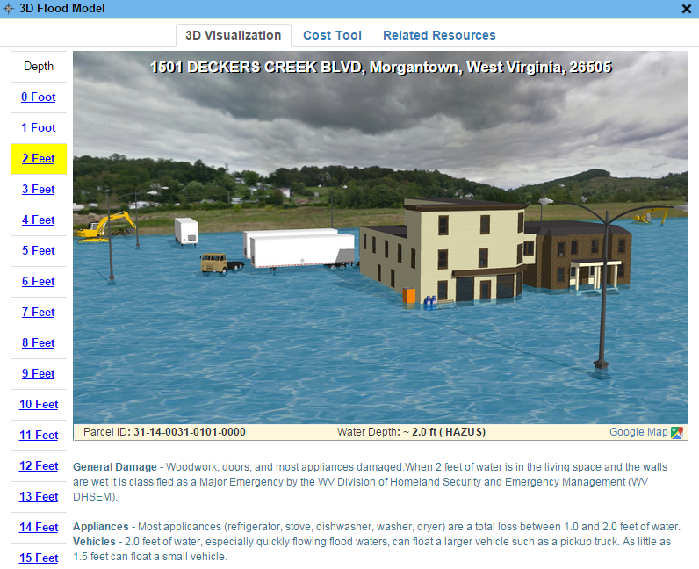
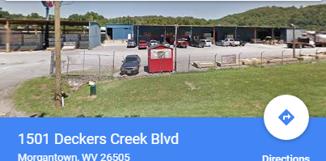
Parcels link to Owner/Building Info
Commercial or Industrial Property
DESCRIPTION | 84 Lumber
GIS Parcel ID | 31-14-0031-0101-0000
Legal Description | 5.0922 AC;SABRATON
Acreage (deed) | 5.09
Deed Book / Page | 1376 / 234
PROPERTY OWNER(S)
Property Owner(s) | SPIRIT SPE PORTFOLIO
1501 DECKERS CREEK BLVD, Morgantown, West Virginia, 26505
https://www.mapwv.gov/flood/map/?v=0&pid=31-14-0031-0101-0000
BUILDING INFORMATION
Property Class Type | C- Commercial
Land Use | 373 - Retail-Single Occupancy
Year Built | 1994
Stories | 2
Exterior Wall | Brick or Stone
Construction Type | Pre-Engineered Steel
Building Grade | D+
Basement Type | None
Business Living Area | 15,255
Cubic Feet | 292,380
Use Type | 34-Retail Store, 82- Multi-Use Office
COST VALUES
Other Bldg/Yard Values | $67,020
Commercial Value | $227,700
APPRAISED VALUES
Land Appraisal | $378,800
Building Appraisal | $294,700
Total Appraisal | $673,500

Slide 48
Total Property Parcels
West Virginia Parcel Property Class Breakdown for Tax Year 2020 (Computed from statewide master parcel file)
Code* | Property Class | # of Parcels | Percent (%) | Total Assessment Value (Land & Bldgs.)
R | Residential | 1,089,781 | 80.7% | $76,250,249,392
F | Farm | 118,810 | 8.8% | $7,661,387,950
A | Apartment | 2,979 | 0.2% | $1,659,626,296
C | Commercial | 64,172 | 4.8% | $17,104,957,324
I | Industrial | 2,690 | 0.2% | $1,747,474,255
X | Exempt | 67,549 | 5.0% | $21,850,729,693
U | Utility | 4,124 | 0.3% | $671,794,393
Other | Not classified | 5 | 0.0% | $53,100
 |  | 1,350,110 | 100% | $126,946,272,403
 | Property Parcels intersecting 100-YR floodplain | 275,567 | 20% (of count) | $27,611,984,170
Assessment records are important for building inventories and are used to estimate the total building exposure ($) and building loss ($) for multi-hazards. Often building inventories and corresponding loss estimates are organized by property class.

Slide 49
Parcels in 100-YR Floodplain
Property Class | Count | %
Residential | 204,787 | 74%
Farm | 29,382 | 11%
Commercial | 19,231 | 7%
Other | 22,077 | 8%
total (20% of all 1.35 million parcels) | 275,567 | 100%
An estimated 275,567 property parcels or 20% of total 1.35 million statewide parcels intersect the 100-YR floodplain (Tax Year 2020)
A more detailed site-specific building analysis is needed statewide
Computed from statewide parcel file 100% complete

Slide 50
Parcels in 100-YR/500-YR Floodplains

Slide 51
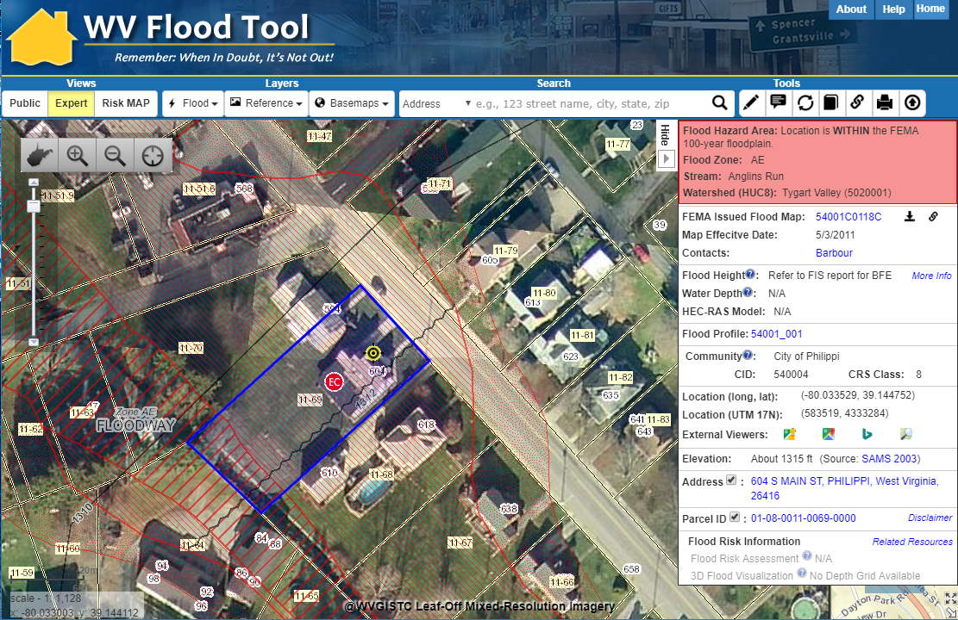
Property Identification – Bldg. ID
SHARE LINK
604 S. Main St., Philippi, WV 26416
Address: 604 Main St, Philippi, WV 26416
Parcel ID: 01-08-0011-0069-0000
X,Y COORD.
ADDRESS
Building ID:
(Parcel ID + Address No.)
01-08-0011-0069-0000_604
PARCEL
Share Link: https://www.mapwv.gov/flood/map/?wkid=102100&x=-8909292&y=4742427&l=12&v=1

Slide 52
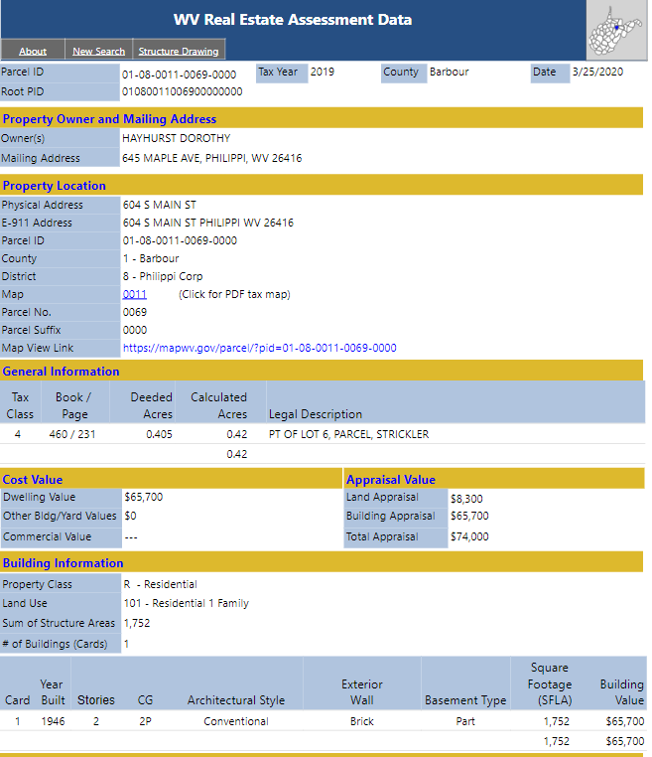
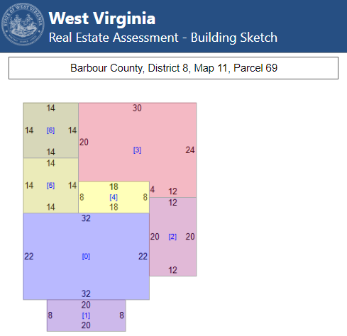
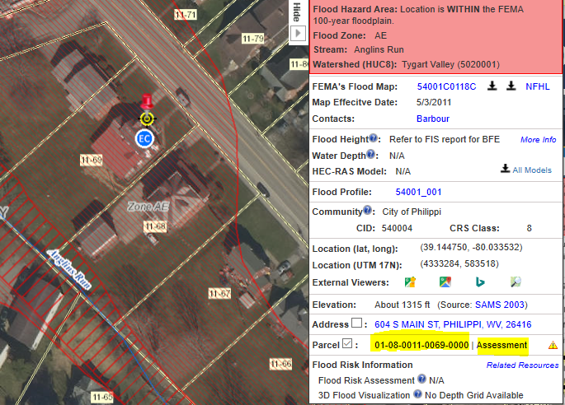
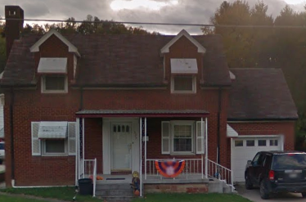
Property Parcels Assessment Reports
E-911 and County Assessor report location at 604 S Main Street
Property Assessment Report
Building
Sketch Diagram
Map-Parcel Number 11-69
Parcel Map
Share Link: https://mapwv.gov/Assessment/Detail/?PID=01080011006900000000

Slide 53
Property Parcel Assessment Reports
Web Assessment Reports
Ownership
Building Identification
Building Characteristics
Building Sketch Diagrams
Outbuildings
Cost Values
Land Use
Tax Class (Owner Occupied)
Parcel History (15 years)

Slide 54
Improved Property Parcel Mapping
Logan County
Parcel 23-02-0109-0019-0004
High Risk Advisory Zone
Parcel Geometry Map Accuracy Improved
1322 WEST FORK RD TRLR, WEST FORK, WV, 25508
https://mapwv.gov/parcel/?pid=23-02-0109-0019-0004

Slide 55
Improved Property Parcel Mapping
County | Flood Risk | 2019 | 2020 | Parcel Count Difference | Flood Zone Parcel Changes from Low/Moderate Risk to HIGH RISK 2019-2020
Braxton | High | 3,780 | 2,723 | -1,057 | 109
Braxton | Moderate | 0 | 0 | 0 | 0
Braxton | Low | 14,077 | 11,739 | -2,338 | 126
Logan | High | 12,115 | 11,152 | -963 | 324
Logan | Moderate | 1,107 | 1,085 | -22 | 23
Logan | Low | 13,973 | 13,951 | -22 | 393
Parcels Changed to High-Risk Flood Zone Designation: Individual parcels that have changed from Low or Moderate Risk to the High Flood Risk Designation between 2019 and 2020.
Parcel Count Differences: The total difference in number of parcels between 2019 and 2020. These differences may show both the number of parcels changed between 2019 and 2020 and any differences in flood zone boundaries.

Slide 56
Flood Tool Reference Layers
Building Footprints

Slide 57
Building Footprints

Slide 58
Building Footprints
Building footprints can enhance flood risk assessment maps
Building Flood Loss Damage
57% of Residential Home Damaged at a Loss of $88,834

Slide 59
Building Footprints
Statewide building footprint reference layer created from best available sources
Layer | Source | Coverage
2003 SAMB | 2003 2-ft. resolution leaf-off imagery, Statewide Addressing & Mapping Board (large buildings only) | Statewide partial (12,671)
Counties 2010-2018 | 6” or better leaf-off imagery | Select Counties
2018 Microsoft Building Footprints | Statewide dataset contains 1,020,048 building footprints generated by Microsoft in 2018. | Statewide (1 million)
2022 WVGISTC | ESRI’s Deep Learning Package | Ongoing. 13 counties completed
How are BUILDING FOOTPRINTS beneficial?
Improves the locational pin-pointing of structures for multi-hazard assessments
Enhances visual representation of structures on 2D flood risk maps
Necessary for 3D flood visualization models
Building footprints extruded to known heights
Beneficial to communicating flood risk to communities
2018 Microsoft Building Footprints

Slide 60
Building Footprints
Building footprints created from Best Leaf Off by WVU
A comparison of building footprints on Wheeling Island in Ohio County. The WVGISTC building footprints were created from 4” resolution, 2019 imagery using ESRI’s Deep Learning Package for U.S. structures.
As of May 2022, the WVGISTC has completed Building Footprint extractions for 13 West Virginia Counties. An assessment for overlap of building footprints with existing Primary Structure centroids has averaged 90% overlap for WVGISTC Footprints. This is in comparison to 75% and 66% overlap for Microsoft and Oak Ridge (US Structures) footprints, respectively.
On top of these percentages, the quality of the WVGISTC Footprints in orientation, positioning, and boundary matching is also improved.
WVGISTC – 2019 imagery
Microsoft
Oak Ridge

Slide 61
Flood Tool Reference Layers
Data Development and Integration
Local-Level Data Development
State-Level Integration

Slide 62
GIS Data Development
Parcels Site Addresses Aerial Imagery Elevation
Migrate six counties from paper to digital parcels
Flood-risk communities with missing or incorrect E-911 addresses
County Leaf-off imagery no older than 5 years
Statewide 1-meter DEM and 1-ft. contours. Flood Studies, Depth & WSEL Grids
Improving State’s Spatial Data Infrastructure

Slide 63
State-Level Integration
Parcels
Addresses
Imagery
Elevation
SOURCE: County Assessors
Property Tax Division
Statewide Master Parcel File / IAS
SOURCE: Local Addressing Offices
Division of Homeland Security & Emergency Management
Statewide Addressing & Mapping System
SOURCE: County Offices
WV GIS Technical Center
Statewide Leaf-Off Imagery Service
SOURCE: Local, State, primarily FEMA
WV DEP WV GISTC
Statewide Elevation Web Services
State-level integration allows for statewide mapping products and services

Slide 64
Unique Spatial Identifiers
Building and Parcel Identifiers

Slide 65
Building Spatial Identifiers
Collect multiple spatial identifiers to verify location
Parcel | 01-08-0011-0069-0000
01 | - | 08 | - | 0011 | - | 0069 | - | 0000
County |  | District |  | Map |  | Parcel |  | Suffix
Address | 604 S Main St, Philippi, West Virginia, 26416
Building Identifier | 01-08-0011-0069-0000_604
X,Y Coordinate | 39.144752, -80.033529
Google Plus Code (11-digit) | 86FX4XV8+VHF
Share MAP URL Link | https://www.mapwv.gov/flood/map/?wkid=102100&x=-8909292&y=4742427&l=12&v=1
Share Parcel Assessment URL Link | http://www.mapwv.gov/Assessment/Detail/?PID=01080011006900000000
Notes: Owner Name from assessment records and Building Pictures (elevation certificates) can be helpful for property identification purposes
Proper Building and Property Identifiers are important for exchanging building-level data efficiently among local, state, and federal partners (including UDFs, LOMAs, Mitigated Buyout Properties, Elevation Certificates, Repetitive Loss Structures, etc.)
= Unique Identifiers

Slide 66
Building Unique Identifier
Parcel ID | 01-08-0011-0069-0000
01 | - | 08 | - | 0011 | - | 0069 | - | 0000
County |  | District |  | Map |  | Parcel |  | Suffix
Address | 604 S Main St, Philippi, West Virginia, 26416
Building Identifier (Parcel ID + Address No.) | 01-08-0011-0069-0000_604
Link to Property Record
Link to Structure Record

