Slide 1
WV Flood Tool Reference Layers
Reference Layers
Elevation (FEMA-purchased QL2 statewide)
Aerial Imagery (HMGP 30 counties)
E-911 Addresses (HMGP 8 communities)
Parcels / Assessment Records (HMGP 7 counties)
Building Footprints
Boundaries
6/14/2022 Update
Kurt Donaldson | Eric Hopkins | Maneesh Sharma WVU GIS Technical Center (kdonalds@wvu.edu)

Slide 2
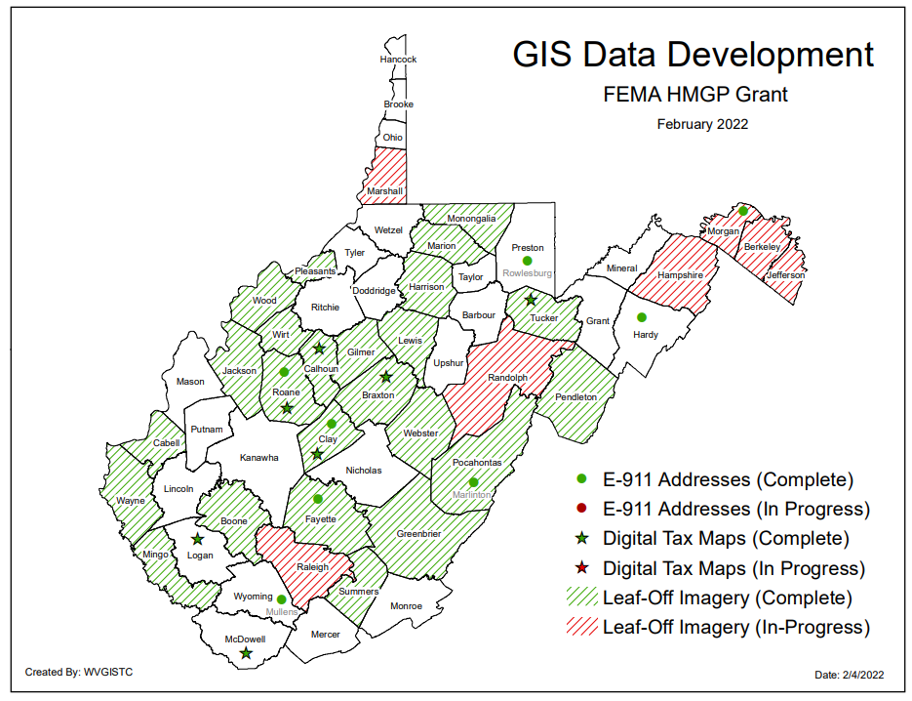
State GIS Data Contracts
2 State Contracts for Aerial Imagery, Parcels, and Addresses
45 Community Data Development Projects
Map PDF

Slide 3
Flood Tool Reference Layers
Elevation
Hi-resolution elevation data is needed for flood studies and risk assessments

Slide 4
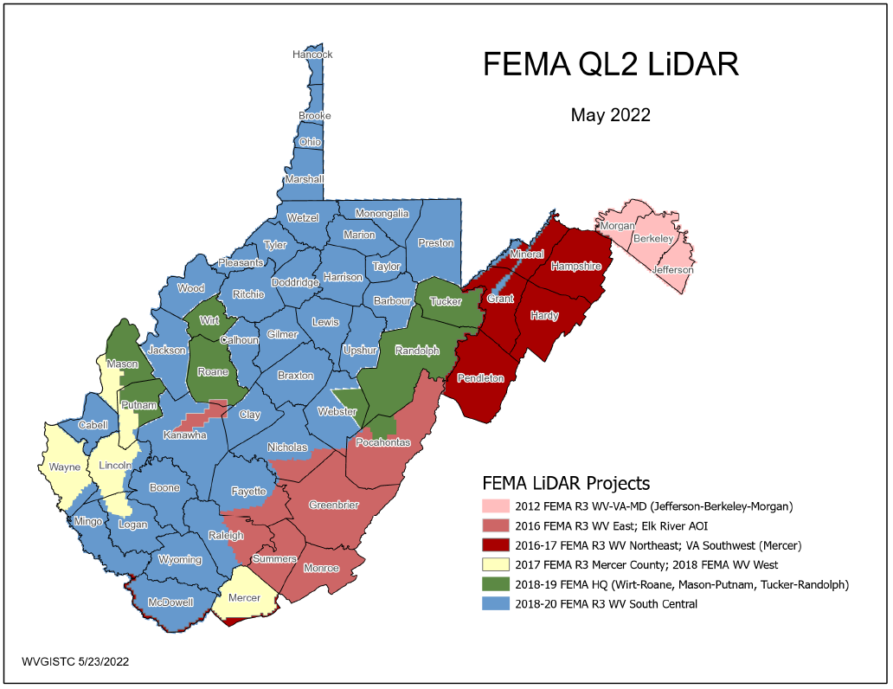
FEMA Purchased LiDAR Coverage
This past decade FEMA purchased $10 million QL2 LiDAR (2012-2020) consisting of six major project acquisitions
2020
2012
2017
2019
Quality 2 (QL2) LiDAR support 1-foot contours
2017
2016
2020
PDF Map

Slide 5
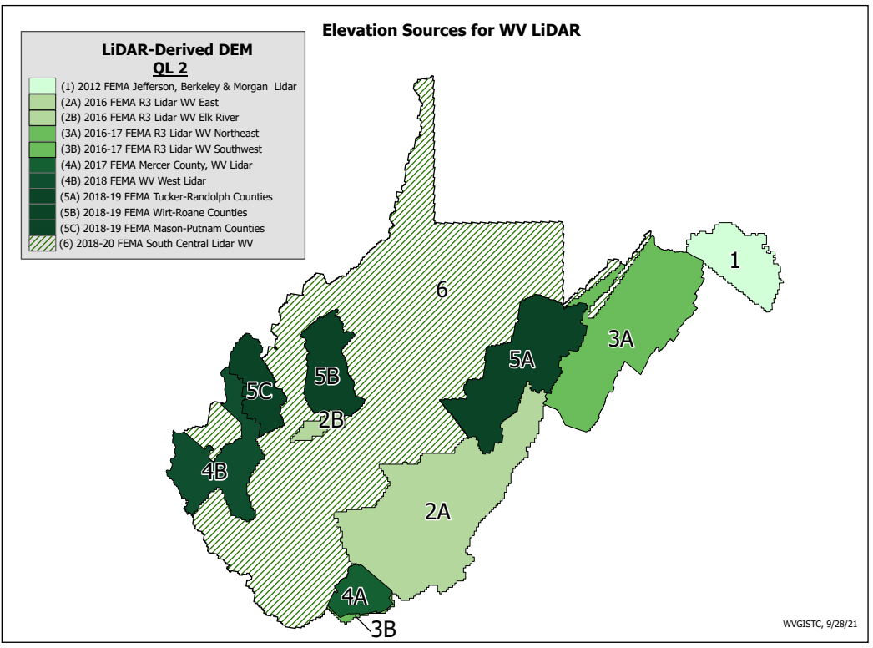
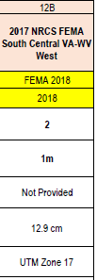
Elevation Data Sources (metadata)
4B
FEMA purchased Statewide QL2 LiDAR
Elevation Metadata
1-Ft. Contours for entire State except for 2-ft contours for Area 1
WV Elevation Source Listing and Graphics: https://www.mapwv.gov/lidar-metadata

Slide 6
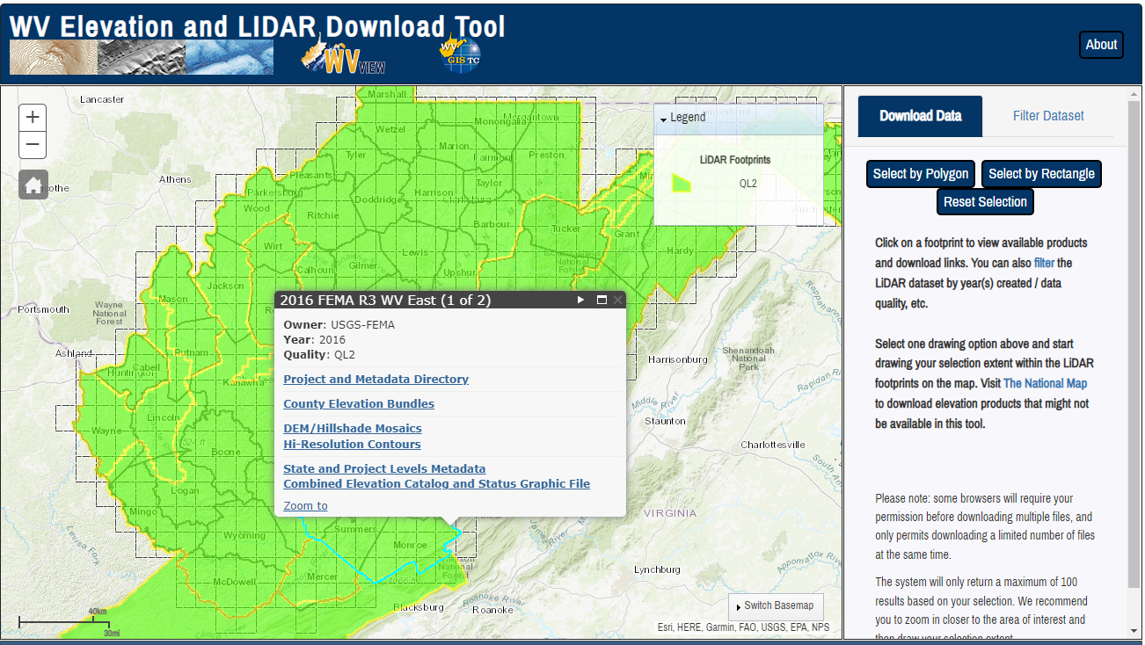
Elevation (High Resolution)
Statewide Elevation Products on WV Property Viewer and WV Flood Tool
Classified Lidar point cloud files
1-ft Contours cached to 1:282 Map Scale (2-ft. contours for Morgan-Berkeley-Jefferson)
1-meter Digital Elevation Model (created from LiDAR and breaklines)
Hillshade (grayscale 3D representation of the surface) and Slope
View products on WV Flood Tool and Property Viewer
Source Elevation Metadata: https://www.mapwv.gov/lidar-metadata
WV Elevation Download Tool: https://www.mapwv.gov/elevation
County Elevation Bundles (Lidar Point Cloud, Contours, DEM, Hillshade, Slope)
DEM Hillshade Mosaics
Hi-Resolution Contours
Compressed LiDAR LAS Files
State and Project Levels Metadata
USGS Elevation Download:
DEMs and Lidar point cloud files can be downloaded from the USGS National Map Download site as well

Slide 7
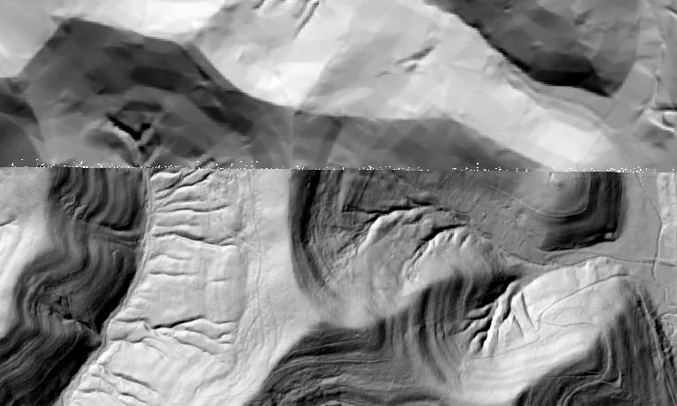
Statewide Topographic Layers (new)
Product | Contour Interval | DEM Resolution
1999 DLG | 20 feet | 30 meters
2003 SAMB | 10 feet | 3 meters
2012-202 LiDAR | 1 foot | 1 meter
Elevation layers are important for mapping flood risk, landslides, etc.
Elevation Data 20x Better than 1999
2003 ELEVATION
2020 ELEVATION

Slide 8
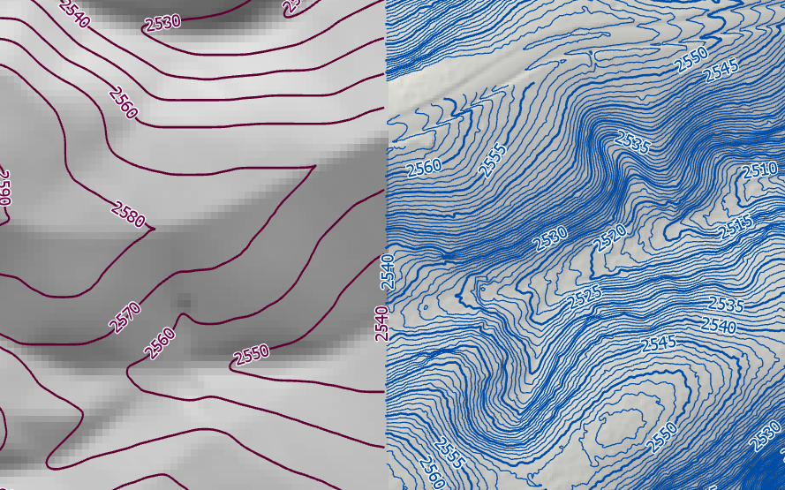
High Resolution Contours
New FEMA LiDAR-Derived Contours are 10x better than 2003 Statewide Elevation Data Set
SAMB Elevation 10 FT Contours
FEMA LiDAR 1 FT Contours

Slide 9
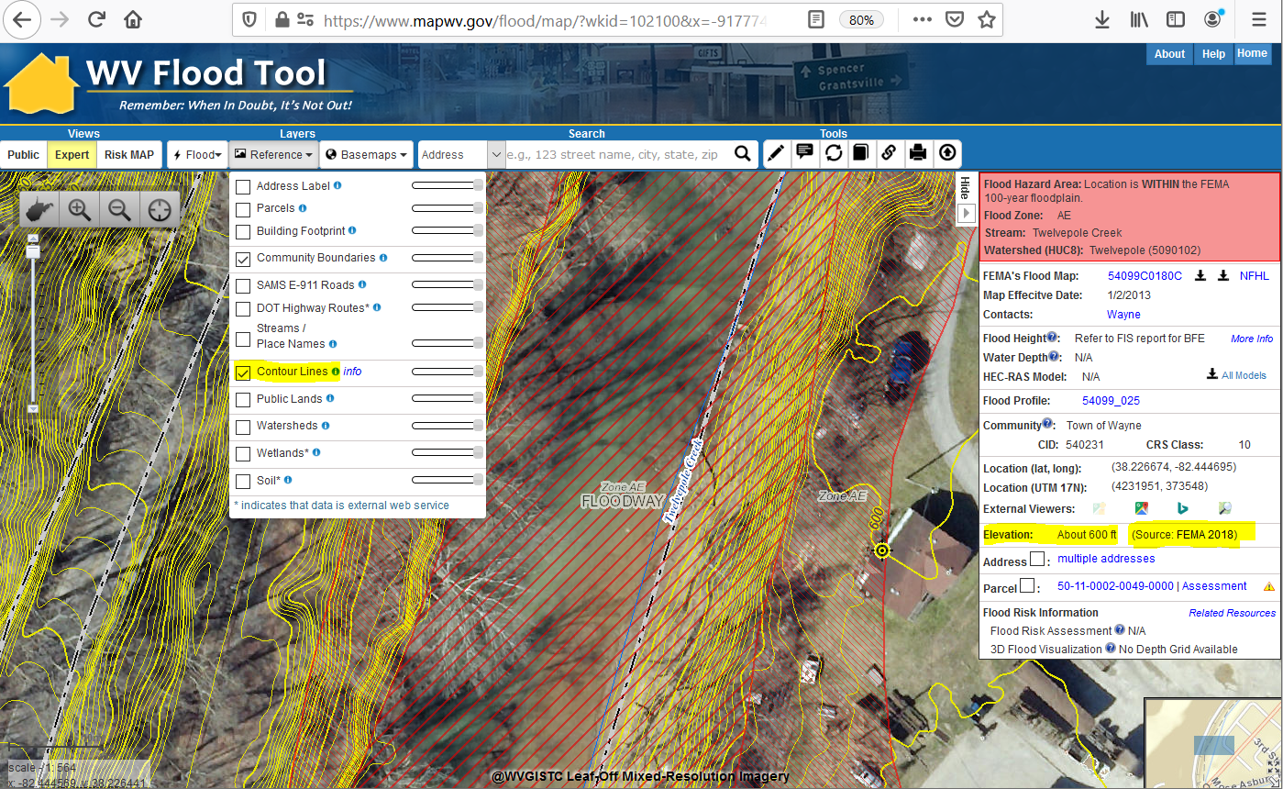
Ground Elevation: 1-ft. Contours
https://www.mapwv.gov/flood/map/?wkid=102100&x=-9177701&y=4611497&l=13&v=1
Make Contour Lines visible under REFERENCE LAYERS
1-FOOT CONTOUR ELEVATION VALUE OF 600 FEET MATCHES 1-METER GRID SURFACE ELEVATION OF 600 FEET DISPLAYED IN QUERY RESULTS PANEL
1-ft Contours Display at two Highest Zoom Levels (1:564 and 1:282 Map Scales)
Elevation: 600 ft.
Source: FEMA 2018
600 ft.
1-foot contours published for 52 counties; 2-foot for 3 counties
FEMA LiDAR-Derived Products: 1-Meter DEM and 1-Foot Contours

Slide 10
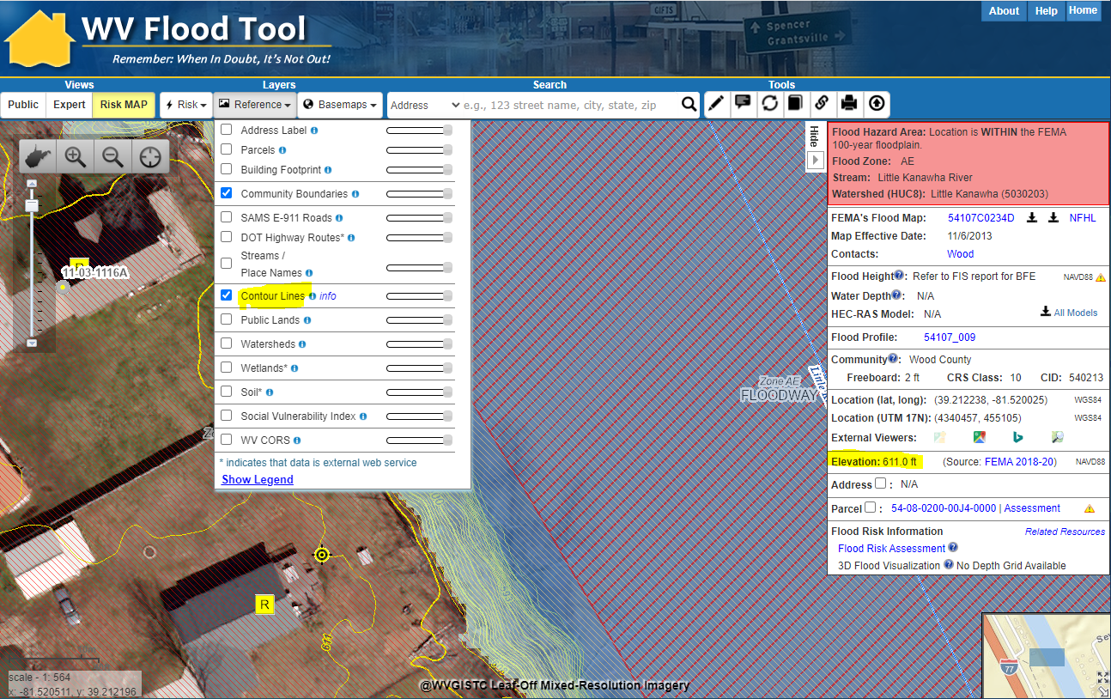
Ground Elevation: 1-ft. Contours
Make Contour Lines visible under REFERENCE LAYERS
1-FOOT CONTOUR ELEVATION VALUE OF 600 FEET MATCHES 1-METER GRID SURFACE ELEVATION OF 611 FEET DISPLAYED IN QUERY RESULTS PANEL
1-ft Contours Display at two Highest Zoom Levels (1:564 and 1:282 Map Scales)
Elevation: 611 ft.
Source: FEMA 2018-20
611 ft.
WV Flood Tool Link
High-resolution contours published for all counties
FEMA LiDAR-Derived Products: 1-Meter DEM and 1-Foot Contours

Slide 11
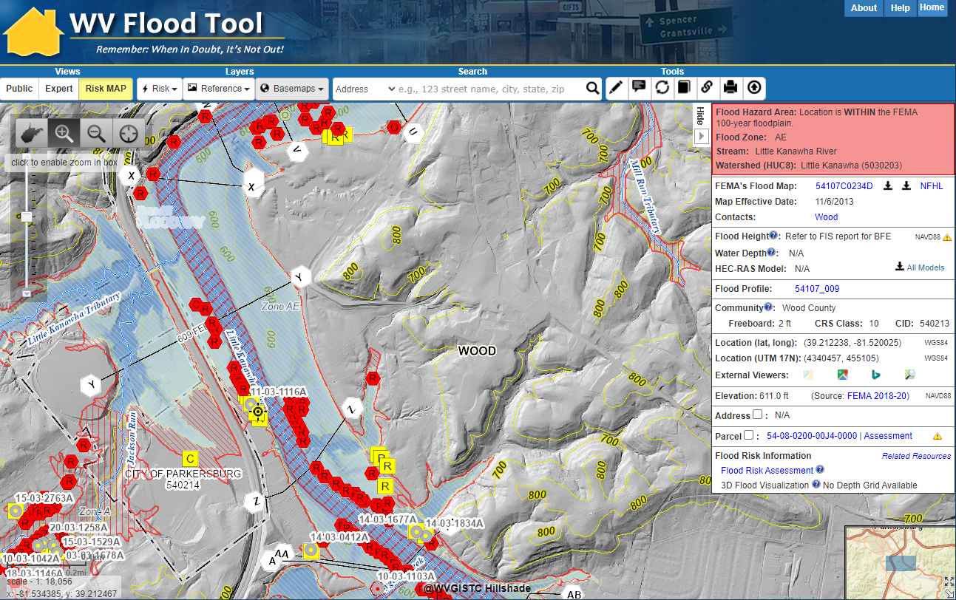
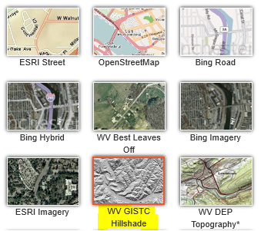
Statewide Hillshade Basemap Product
A hillshade is a grayscale 3D representation of the surface
Hillshade Basemap

Slide 12
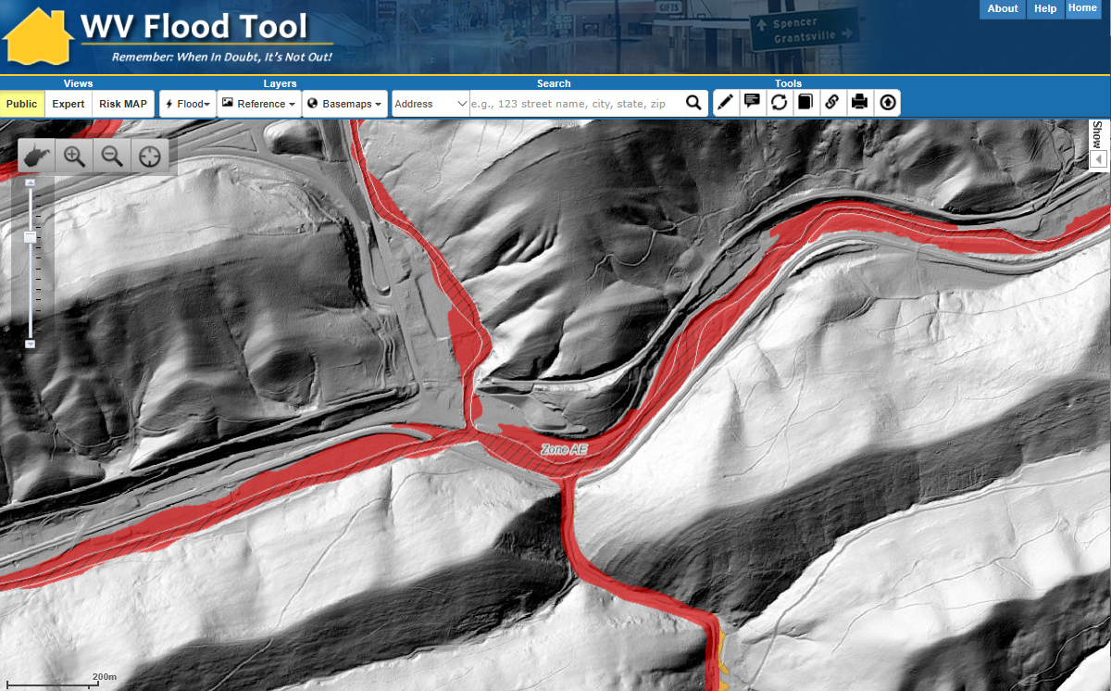
Statewide Hillshade Basemap Product
A hillshade is a grayscale 3D representation of the surface
Hillshade Basemap

Slide 13
Elevation Reference Layers
LiDAR LOMAs
LiDAR FOR MAP AMENDMENTS
LiDAR data can replace the requirement to submit elevation information certified by a licensed land surveyor or professional engineer, which can create a cost savings for property owners.
However, when the LAG is close to the BFE, LiDAR data may not be accurate enough and require certified elevations to capture the full risk of the building.
Generally, if there is two feet or more difference between the BFE and LAG, then the homeowner or community should investigate using the WV Flood Tool’s Print LOMA Map function to generate a LOMA for submission to FEMA at no charge.
LiDAR LOMA Map Overlay Examples

Slide 14
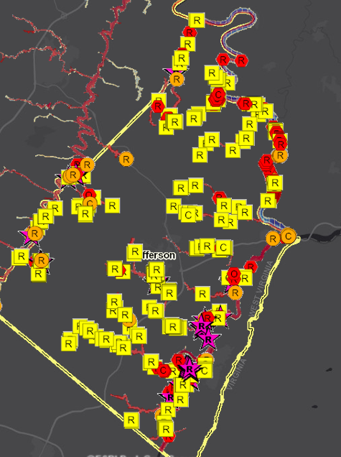
LiDAR for Map Amendments
11/29/2020
LiDAR for Letter of Map Amendment (LOMA)
Yellow Structures are potential LOMAs
LiDAR data can replace the requirement to submit elevation information certified by a licensed land surveyor or professional engineer, which can create a cost savings for property owners.
The WV Flood Tool (www.mapwv.gov/flood) can be used for the map requirement of LOMAs for properties located in A or AE Flood Zones.
High-Risk advisory flood zones identify potential structures that could be removed from the SFHA
Jefferson County Flood Risk Study – Future SFHA Map Conditions for Buildings

Slide 15
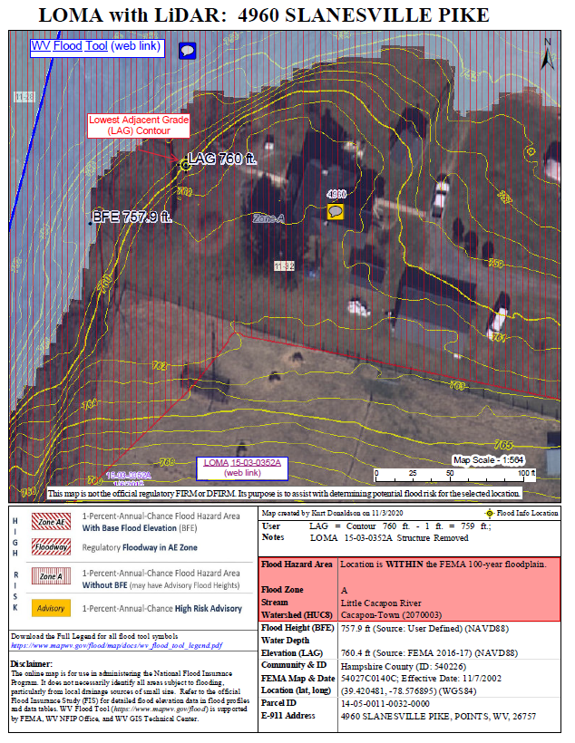
LiDAR LOMA Submission – 4 Steps
Determine if your community has QL2 or QL3 LiDAR Print LOMA Map using WV Flood Tool Supporting document for Online LOMC application Identify published building-level risk assessments for potential Mapped Out structures Determine LOMA Type: Existing Structure or Lot Determine BFE Determine LAG/LLE Add Annotation Print and Download LOMA Map Save to PDF File Further Edit/Annotate Print LOMA (optional) Submit LiDAR LOMA Map Exhibit using FEMA’s Online LOMC Portal (no fee charged)
Click here for more detailed instructions

Slide 16
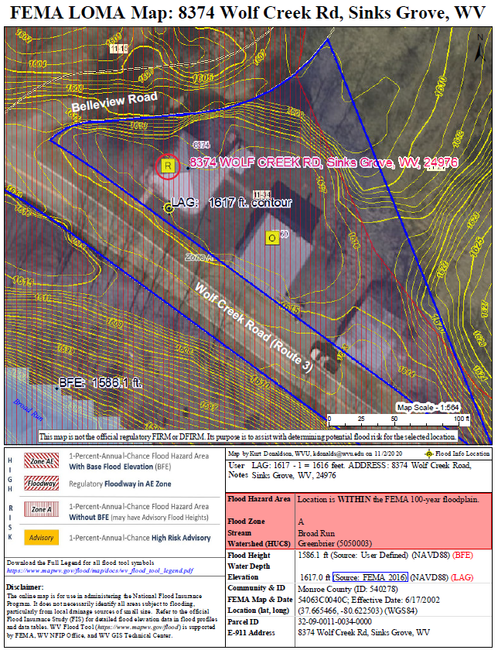
What needs to be submitted?
# | Map Elements Required
1 | Name, organization, and contact information for the map creator
2 | E-911 Address of property
3 | Road or street intersection reference
4 | Assessor’s full Parcel ID Number (APN) for the building/lot
5 | Clearly identified building and/or lot boundaries
6 | Aerial imagery that shows building footprint
7 | Date, Source, and Accuracy of the LiDAR collected (must meet Quality Level 3 standards)
8 | Vertical Datum of elevation data (e.g., NAVD 88, NGVD 29)
9 | Scale Bar
10 | North Arrow
11 | WV Flood Tool Location web link
10
3
6
32-09-0011-0034-0000
5
9
1
8
11
7
4
2
More than one map can be made to present all elements

Slide 17
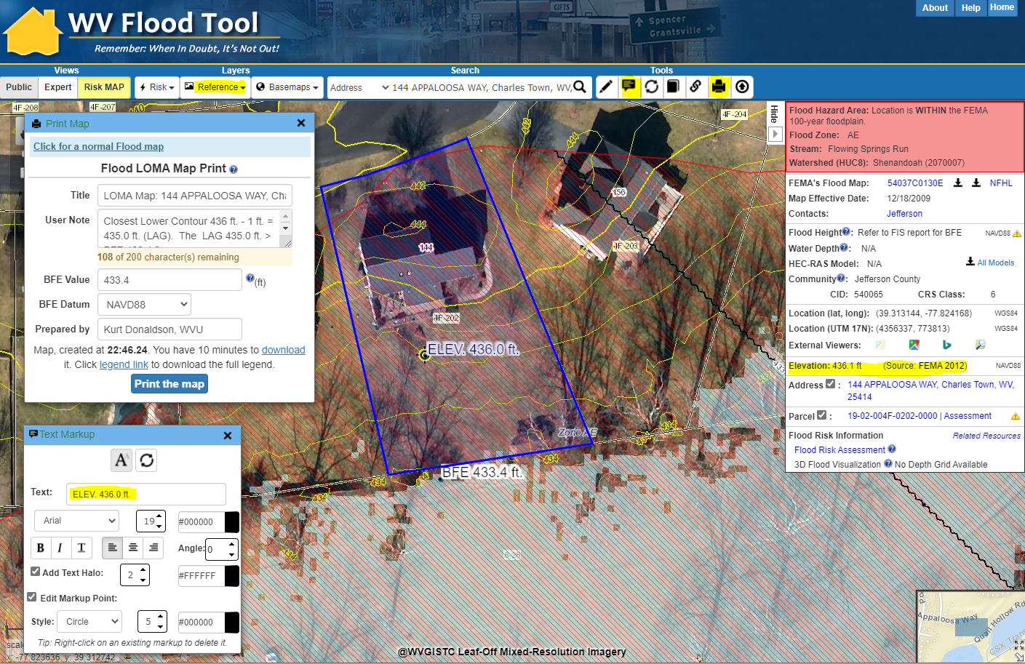
LOMA Map – Identify LAG
Ensure Contours Layer visible
Text Markup tool
Open Print Map tool and select FEMA LOMA Map link
Print LOMA
Print Map, Download, open map in new browser tab, right click on map and Save to PDF File
Elevation Value and Metadata
Flood Query Results Panel
Turn on Contours Layer in REFERENCE Layers of WV Flood Tool to view two- or one-foot contours at 1:564 and 1:282 zoom scales. Identify the Closest Lower Contour 436 ft. and verify elevation in Flood Query Results Panel. Annotate contour value 436 ft. on the map frame using Text Markup tool.
For AE Zones make BFE and X-Section Layers visible in RISK Layers
Text Markup
Flood Depth Grid
https://www.mapwv.gov/flood/map/?wkid=102100&x=-8663344&y=4766601&l=13&v=2

Slide 18
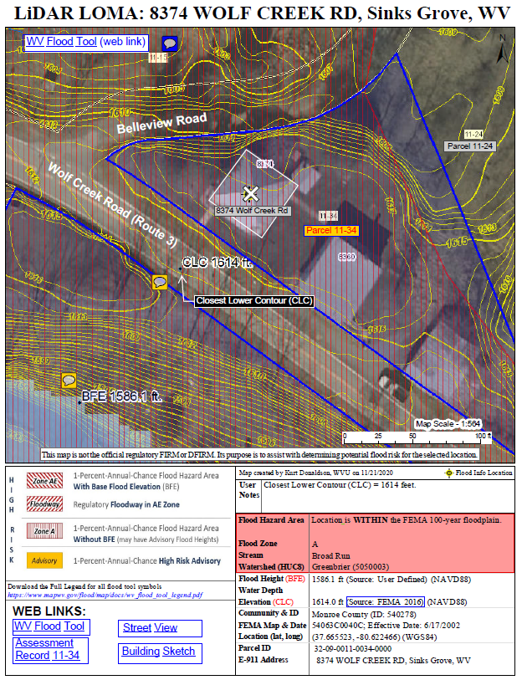
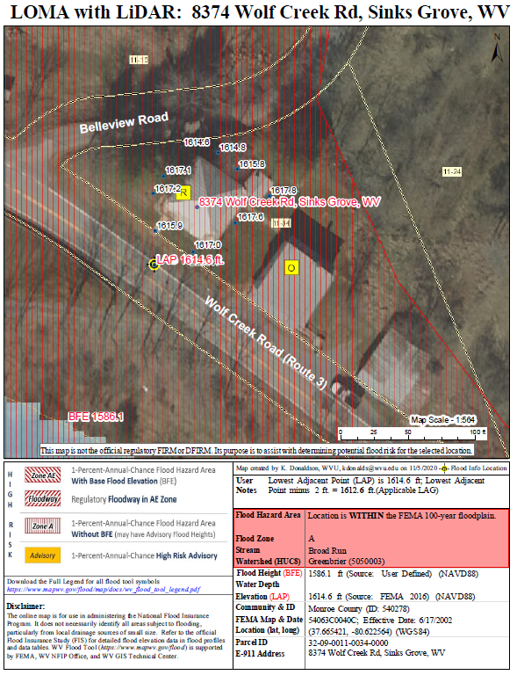
WV Flood Tool (LAG Methods)
Contours (Elevation Contours Reference Layer)
Point Data (Flood Query Results Panel)
The LAG derived from the Point Cloud Method should be close and in-line with the LAG from the Contour Method
CLC 1614 ft.
LAP 1614.6 ft.
Parcel 32-09-0011-0034-0000
Applicable LAG is 1613’ (closest lower contour of 1614’ – 1’)
Applicable LAG is 1612.6’
(lowest adjacent point 1614.6’ – 2’)

Slide 19
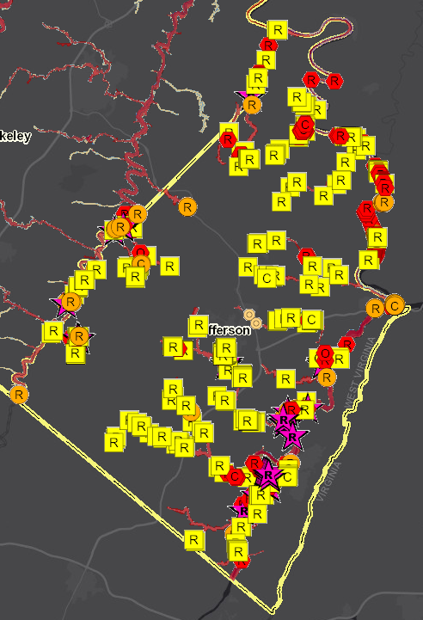
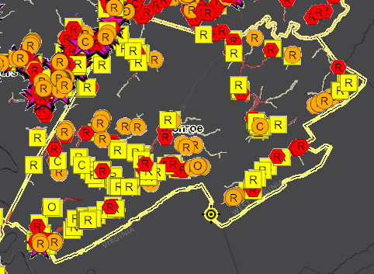
Identify LOMA Structures (Risk MAP View)
Mapped-Out SFHA Residential Structure (Potential LOMA)
Monroe
Jefferson
Structures Mapped Out of SFHA
Search on Building Risk “Mapped Out” SFHA structures (yellow square symbol) in Risk MAP View for potential LOMAs. It is estimated that Jefferson County, for example, has 250 structures that could be considered for LOMA Removal Status from the Special Flood Hazard Area (SFHA).
R
Residential
C
Commercial
O
Other

Slide 20
New Topo – Driver for Flood Studies
Advisory Flood Zone* | Map Revision Type | Initiated | Applicable Zones
Preliminary NFHL or DFIRM | Risk MAP Restudy or Study | FEMA | A and AE Zones
Draft NFHL or DFIRM | Risk MAP Restudy or Study | FEMA | A and AE Zones
Advisory A | AFH Model-Backed Studies | State CTP | Approximate A Zone
Updated AE | Non-Restudy Redelineation | State CTP | AE Zone
* Note: Advisory Floodplains may be mapped outside of the official FIRM
High-Risk Advisory Zone Flood Products: (1) Advisory Floodplain Boundary, (2) Flood Height Grid, (3) Flood Depth Grid
Refer to WV Flood Tool Glossary for more information

Slide 21
Flood Zone Determination Sequence
LiDAR LOMA Map Overlay Examples

Slide 22
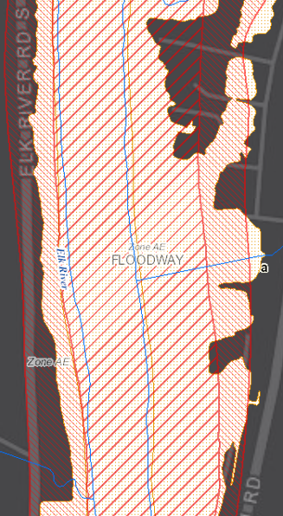
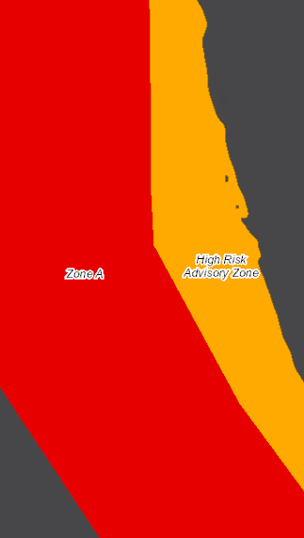
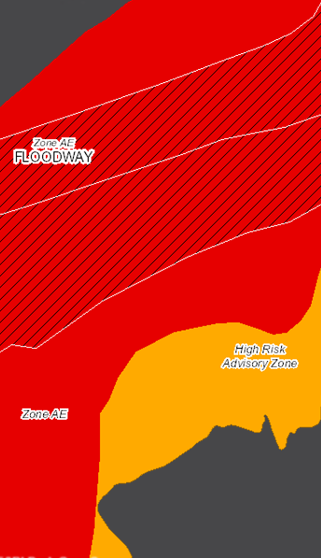
High Risk Advisory Zones
More info on High-Risk Advisory Zones
Preliminary NFHL
Advisory A
Updated AE
Preliminary NFHL
Advisory A
Updated AE

Slide 23
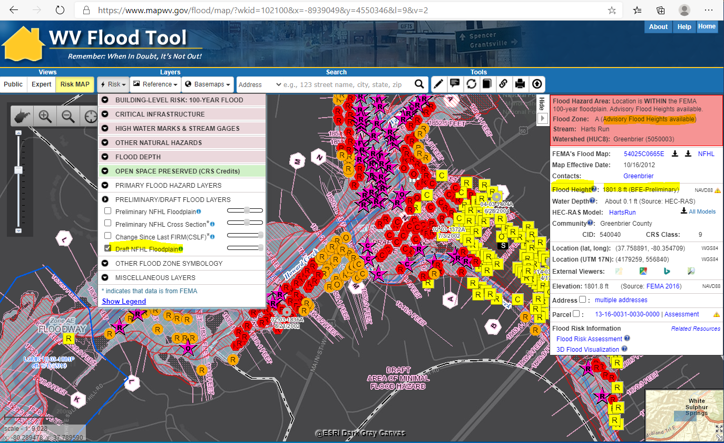
Draft NFHL
Draft NFHL
Draft NFHL Flood Zone: Pre-Preliminary FEMA National Flood Hazard Layers (NFHL) pending to become effective on updated Flood Insurance Rate Maps (FIRMs)

Slide 24
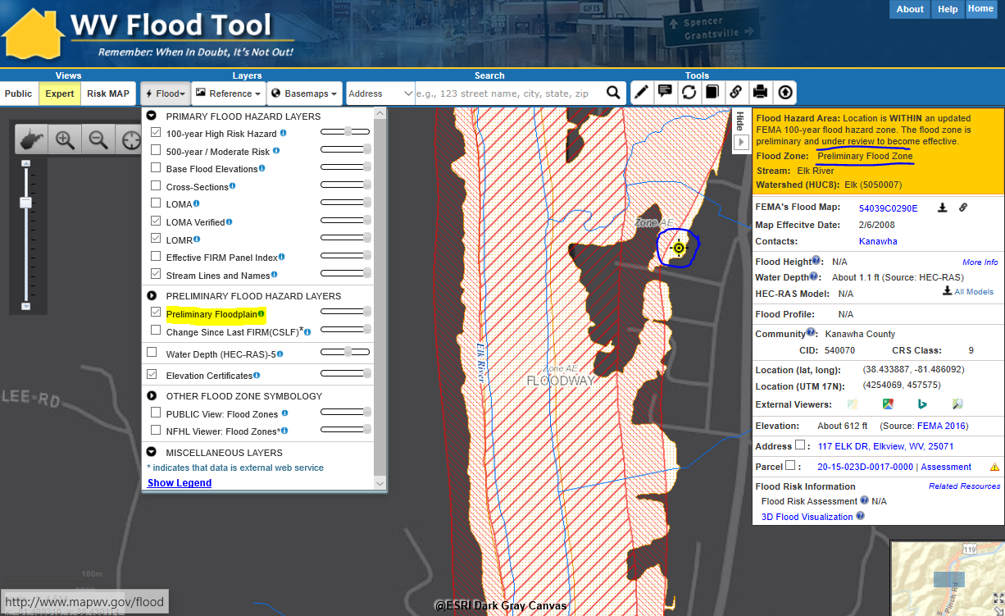
Preliminary NFHL
Preliminary NFHL
Preliminary NFHL Flood Zone: Preliminary FEMA National Flood Hazard Layers (NFHL) pending to become effective on updated Flood Insurance Rate Maps (FIRMs)

Slide 25
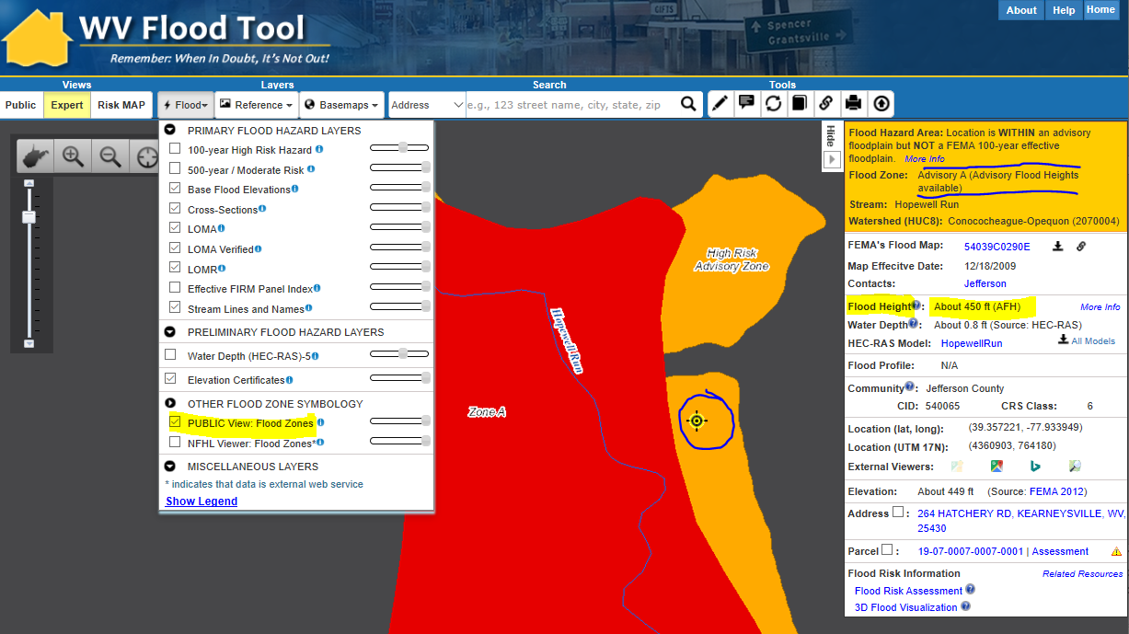
Advisory A
Advisory A
Advisory A Flood Zone: A model-backed Approximate A Zone is determined by using hydrology and hydraulics (H&H) analysis and the best available elevation data. Water Depth and Water Surface Elevation Grids are also companion products of Advisory A Zones.

Slide 26
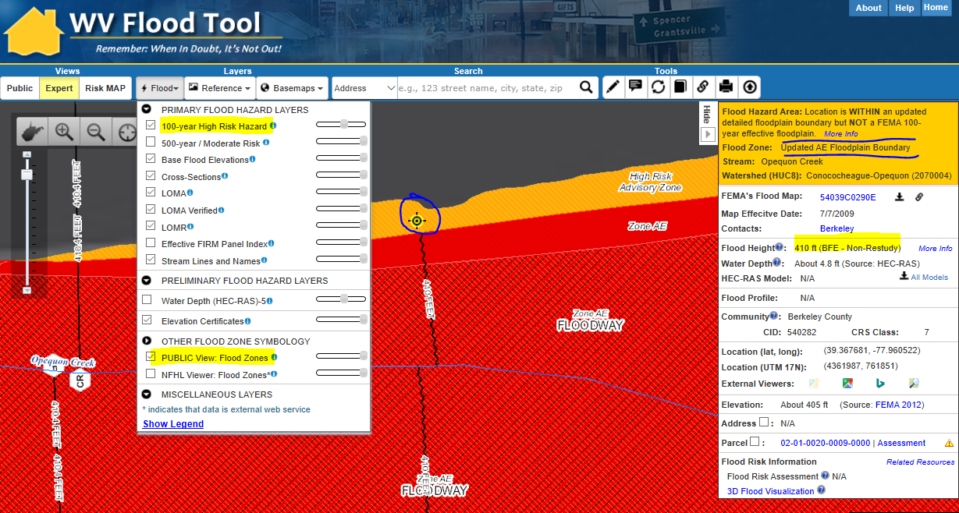
Updated AE
Updated AE
Updated AE Floodplain Boundary: A Non-Restudy where AE Zones undergo redelineation, a method of updating effective flood hazard boundaries to match updated topographic data based on the computed water surface elevations from effective models. Advisory AE Zones outside the SFHA are high-risk, non-regulatory flood zones.

Slide 27
Flood Zone Determination Sequence
HIGH:
100-YR Effective Floodplain
HIGH:
Preliminary NFHL (AE or A)
MODERATE: 500-YR Effective Floodplain & Levee Reduced Risk
MODERATE:
Within 75-ft of Flood Zone
LOW:
No identified Flood Risk
HIGH
Draft NFHL (AE or A)
HIGH
Advisory A
Non-Regulatory
HIGH
Updated AE
Non-Regulatory
Flood zone determination sequence important for programming logic
WV Flood Tool first checks query location for High-Risk effective flood zones (red warning color), High Risk advisory flood zones (orange), then Moderate Risk flood zones (yellow)

Slide 28
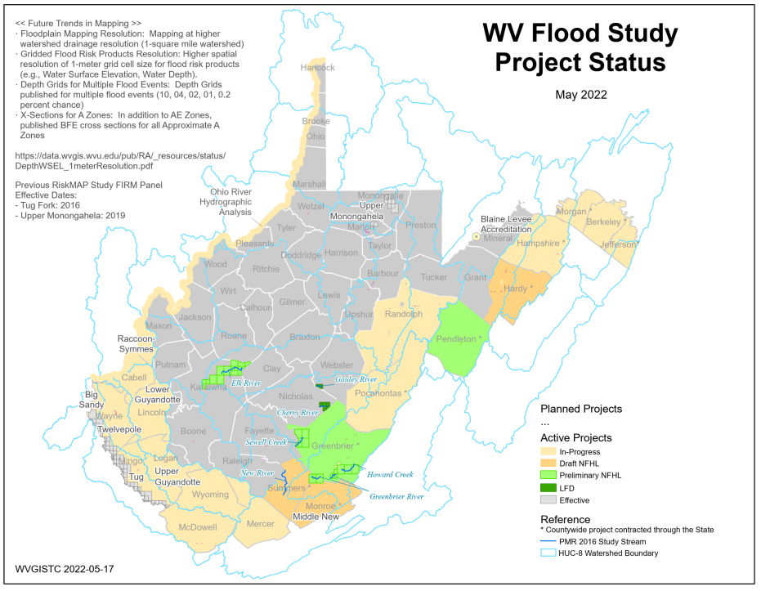
Active FEMA Flood Studies
FEMA is creating new flood maps for communities in eastern and southern West Virginia. All flood maps will be updated with the new LiDAR.
Flood Study Project Status Map PDF

Slide 29
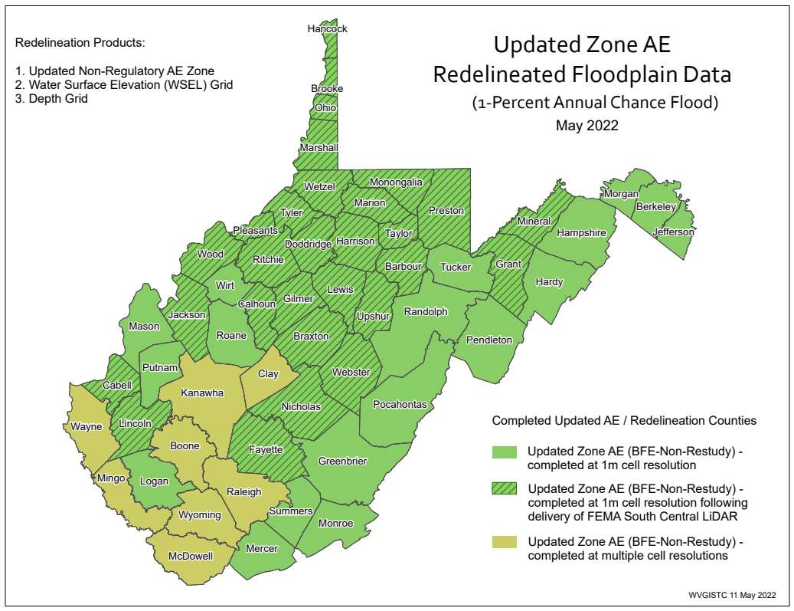
AE Redelineation (Advisory)
All Non-Restudy Areas: Redelineated AE Floodplains with Depth/WSEL grids mapped using LiDAR-derived 1-meter elevation data resolution
PDF Map
Redelineation Methodology

Slide 30
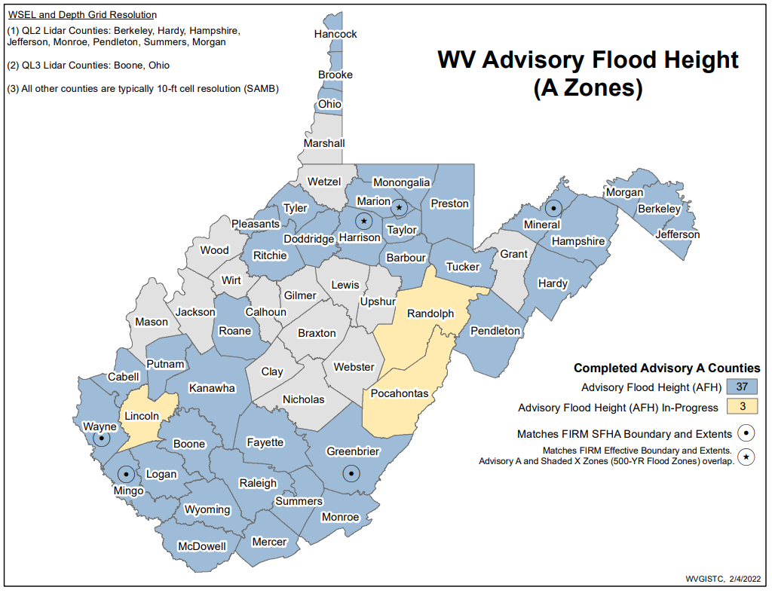
Zone A Mapping (Advisory)
15 Counties have no Advisory Base Flood Heights for A Zones
PDF Map
Advisory Flood Height Handout

Slide 31
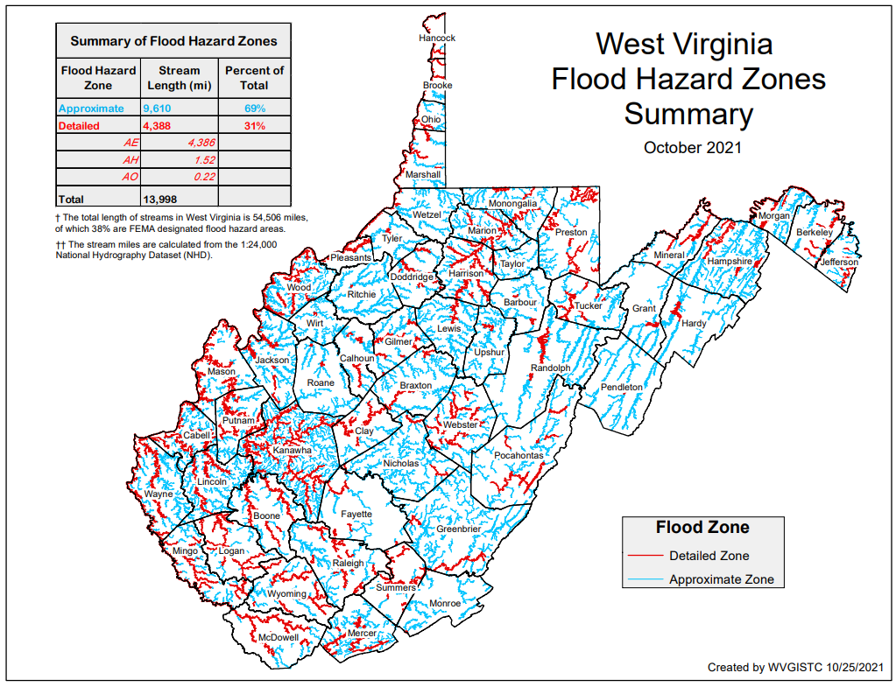
Building Stock in Flood Zones
Although only 31% of the State has mapped Detailed Flood Zones (AE / AO / AH), the Detailed Flood Zones contain 65% of the Building Stock Located in SFHA. Most of the buildings are in mapped Detailed Flood Zones.
FLOOD HAZARD ZONES
Stream Miles Length
69% Approximate A
31% Detailed Zones
Special Flood Hazard Area
84,351 buildings
35% in Approximate Zone A
65% in Detailed Zone AE (9% in Regulatory Floodway)
BUILDINGS IN NON-REGULATORY ZONES
13,966 Structures (14%) mapped in High-Risk Zone Advisory A / AE
98,347 Total High-Risk
BUILDINGS IN SHADED X
Moderate Risk
44,415 structures in 500-YR floodplains
9,718 structures in Levee Protected Zones
PDF Map

Slide 32
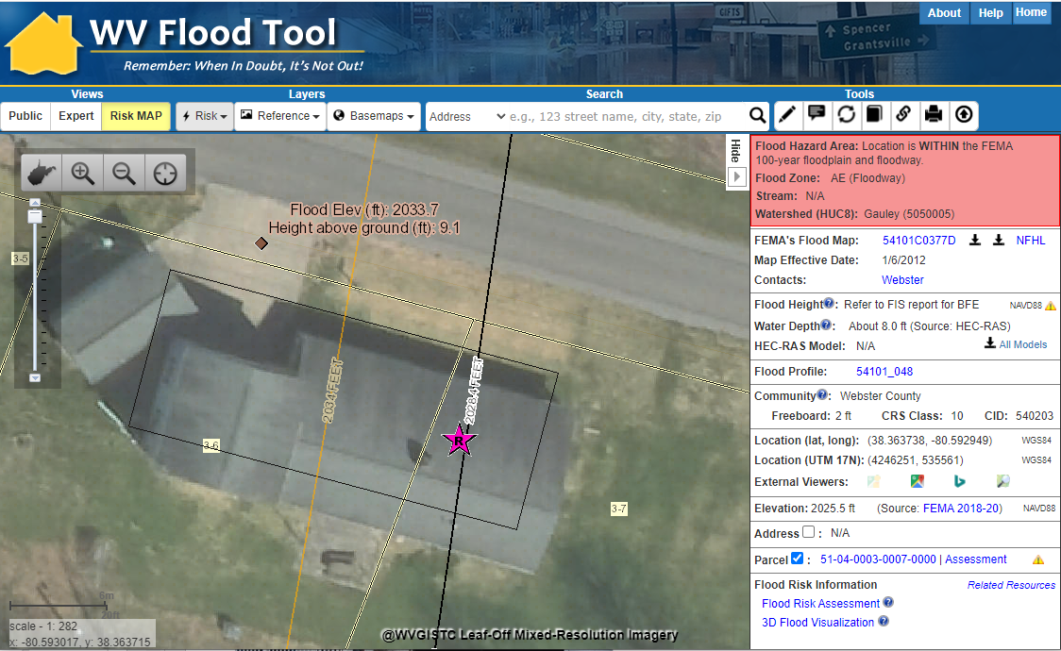
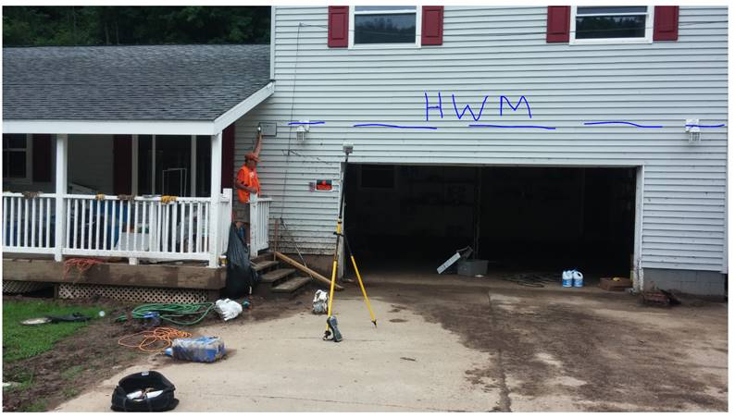
New Flood Maps
FEMA is creating new flood maps for select communities in Region 4 which will alter the floodplain boundaries and base flood elevations. The new flood maps will affect the at-risk building inventories as well. The BFE is increasing 6 feet at this location.
Gauley River
The June 2016 Flood High-Water Mark was 9.1 feet for Building 51-04-0003-0007-0000_91 located near the town Camden-On-Gauley (Webster County) on the Gauley River. The Base Flood Elevation is increasing by 6 feet on the new FEMA flood maps for this location.

Slide 33
Flood Tool Reference Layers
Aerial Imagery
Accessibility to quality, up-to-date aerial photography is one of the most important overall indicators of the suitability of the State’s Spatial Data Infrastructure

Slide 34
Statewide Imagery Contract (2019-22)
STATEWIDE AERIAL IMAGERY CONTRACT: In February 2019, a 4-year statewide contract (2019-22) through WVU Procurement was executed to provide bulk discounts for government agencies acquiring aerial imagery in West Virginia. Thrasher Group was awarded the contract. The spring flying season is from late February to mid-April during leaf-out and no snow conditions.
County Participation: 30 unique counties tapped into the contract and multiple counties took advantage of the contract more than once for a total of 41 county aerial imagery contracts (18,987 square miles).
Cost Share: The total cost share by counties was 85% ($713K) while grant share was $124K. The entire aerial imagery cost with no county cost share contributions only had to be paid for two disadvantaged counties (Clay and Pendleton counties).
Resolution: All counties were collected at 4-inch resolution except for Cabell (3”), Pendleton (6’”), and Randolph (6”) counties.
Flyover Coverage: A total of 18,987 square miles were flown from this state contract.
Best Leaf-Off: Replaced the legacy WV Sheriffs Association (2010-12) as the best available leaf-off imagery
Non-Exclusive Contract: County offices still had the option to contract with other companies for the same services.
Unit Costs: Aerial imagery could be purchased at four different pixel resolutions and over multiple budget cycles. Counties with limited funding qualified for grant cost-share.

Slide 35
New Aerial Imagery
2022 USDA NAIP Leaf-On (Statewide)
2022 County Leaf-Of Aerial Imagery (14 Counties)
2021 County Leaf-Of Aerial Imagery (4 Counties)
2020 County Leaf-Of Aerial Imagery (14 Counties)
2020 USDA National Agriculture Imagery Program (NAIP) 2-ft pixel resolution. Statewide Coverage.
30 unique counties (41 total) tapped into the State Aerial Imagery Contract supported by the Hazard Mitigation Grant for the acquisition of 2019-22 leaf-off imagery. Most counties were captured at 4-inch resolution. Imagery resides in the public domain.

Slide 36
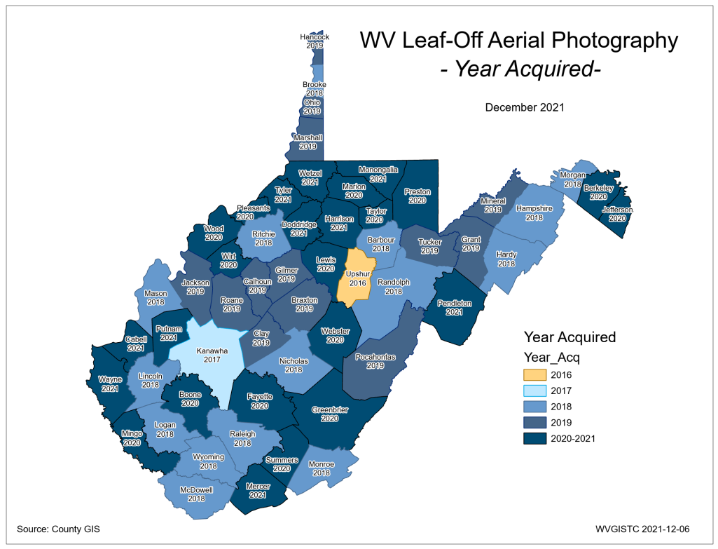
County Aerial Imagery (2021)
Year | Number
2010 | 3
2014 | 1
2016 | 3
2017 | 2
2018 | 19
2019 | 20
2020 | 14
2021 | 4
2022 | 14
New 2021-22 Imagery
Berkeley County
Cabell County
Calhoun County
Hampshire County
Harrison County
Jackson County
Jefferson County
Lewis County
Marshall County
Morgan County
Pendleton County
Pocahontas County
Raleigh County
Randolph County
Roane County
Wayne County
Wirt County
Ideally, leaf-off imagery should not be older than 5 years. Imagery is important for identifying at-risk structures and accurate disaster mapping.
Select counties for 2019-22 received funding support through HMGP grant
PDF Map

Slide 37
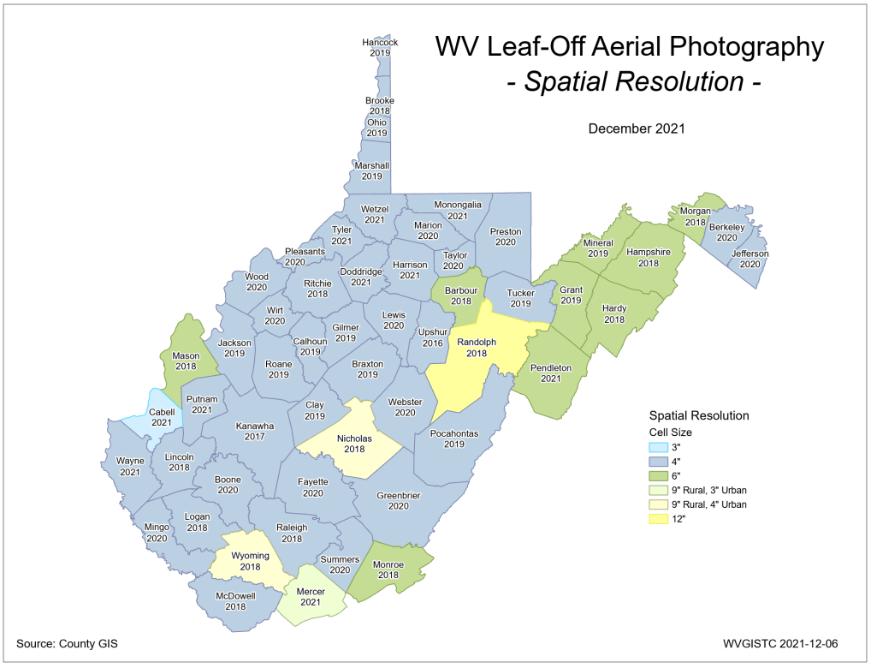
County Imagery Resolution(2021)
Aerial Imagery of most counties (95%) is captured at a countywide spatial cell resolution of 6 inches or higher
Past decade resolution increased one-half foot
Select counties for 2019-22 received funding support through HMGP grant
PDF Map

Slide 38
Resolution (Cows in Wayne Co.)
4-Inch Pixel Resolution
https://www.mapwv.gov/flood/map/?wkid=102100&x=-9176629&y=4583554&l=13&v=1
Choose WV Best Leaves Off Base Map
Cows in the Floodway
West Fork Twelvepole Creek, Wayne County

Slide 39
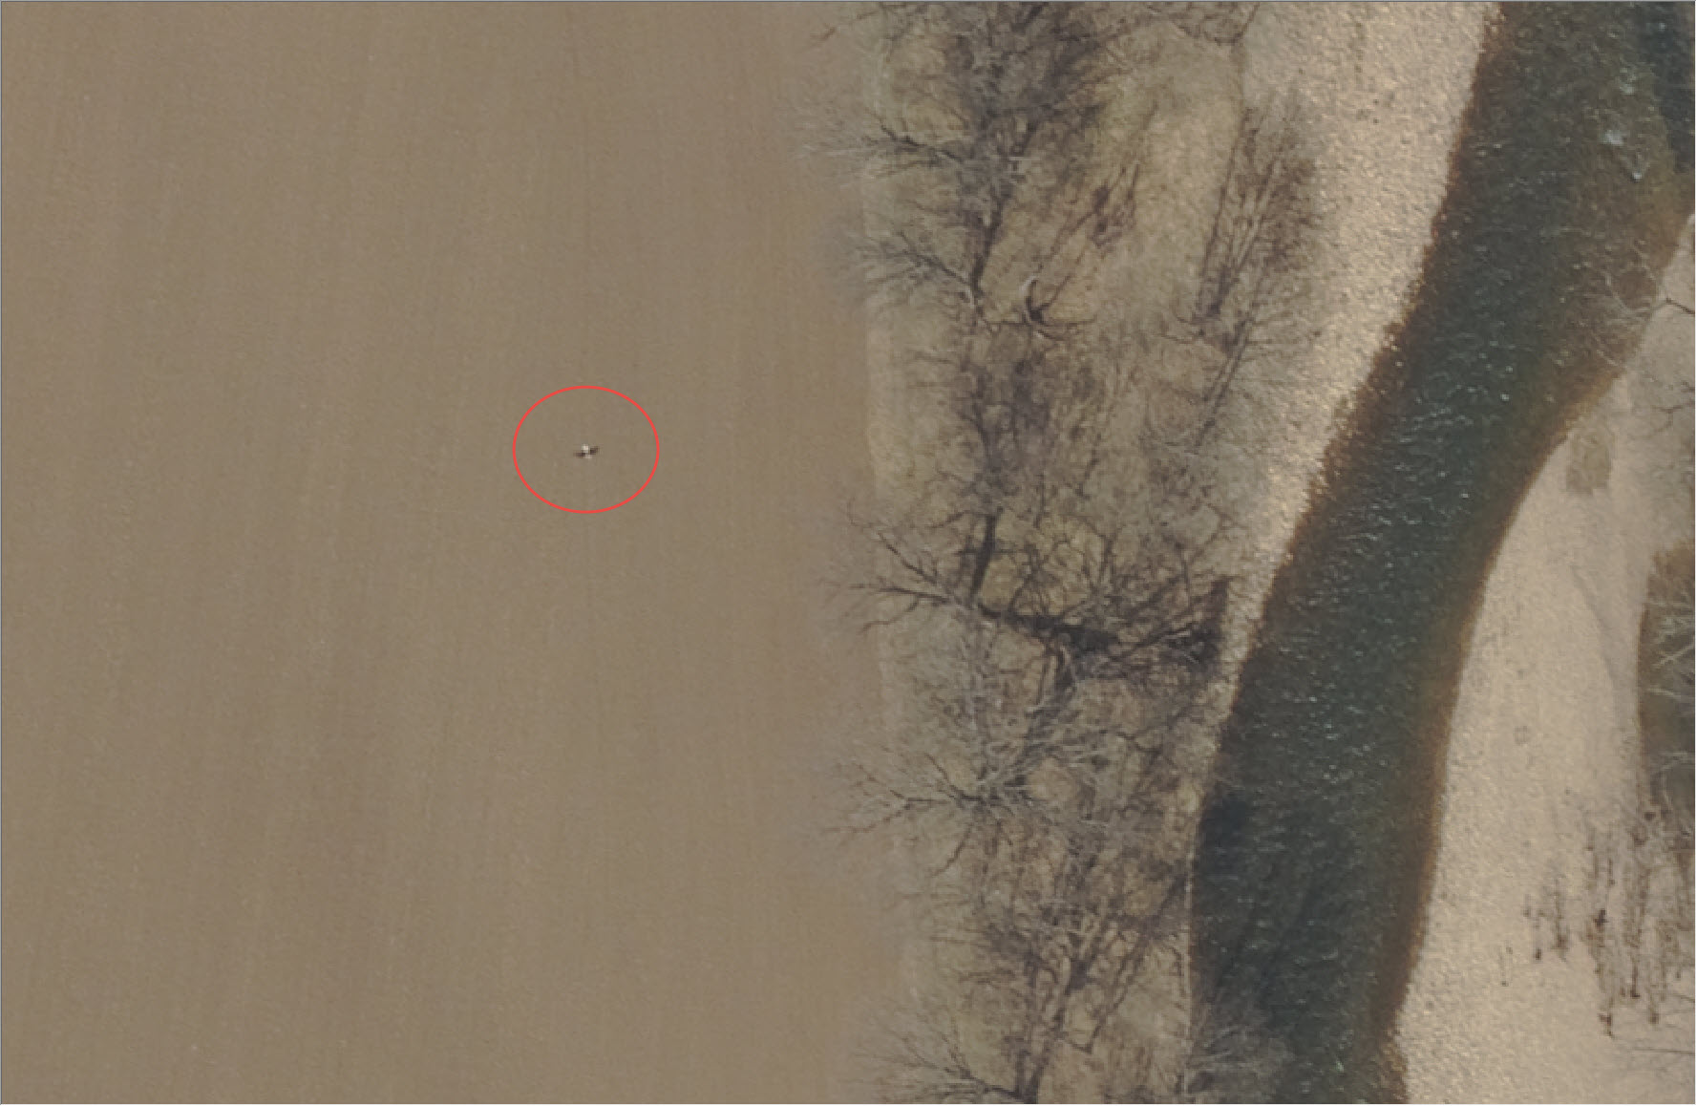
Resolution (Eagle in Pendleton Co.)
6-Inch Pixel Resolution
Bald Eagle in Pendleton County

Slide 40
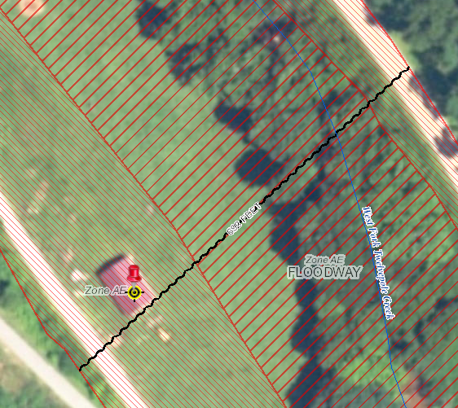
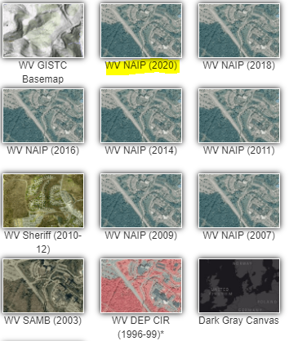
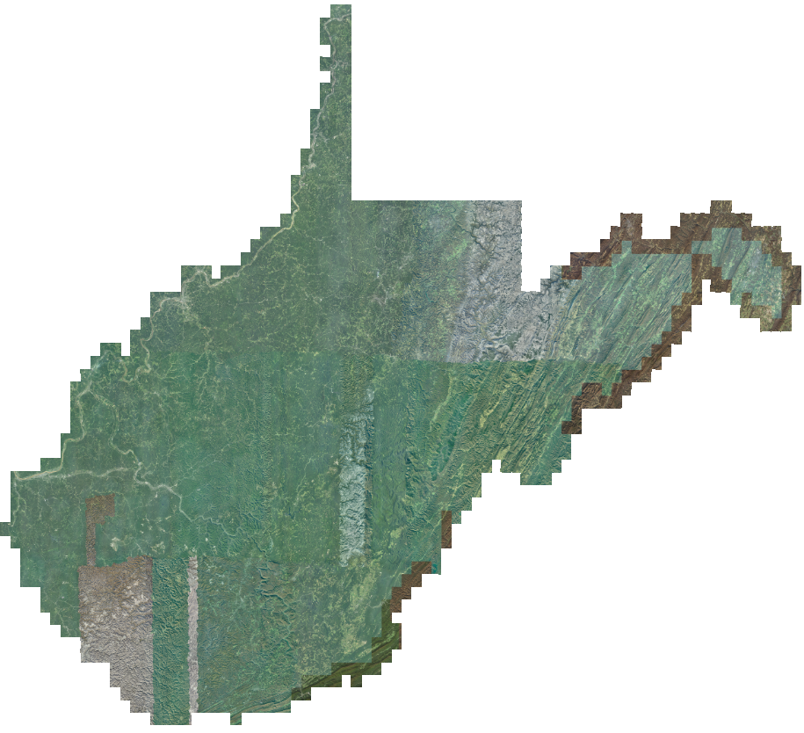
2020 NAIP Aerial Imagery
Choose WV NAIP (2020) from Base Map Layers Pulldown Menu
http://www.mapwv.gov/flood/map/?wkid=102100&x=-9176629&y=4583554&l=13&v=1
2-Foot Pixel Resolution
Statewide Coverage
2020 NAIP

Slide 41
Flood Tool Reference Layers
E-911 Addresses

Slide 42
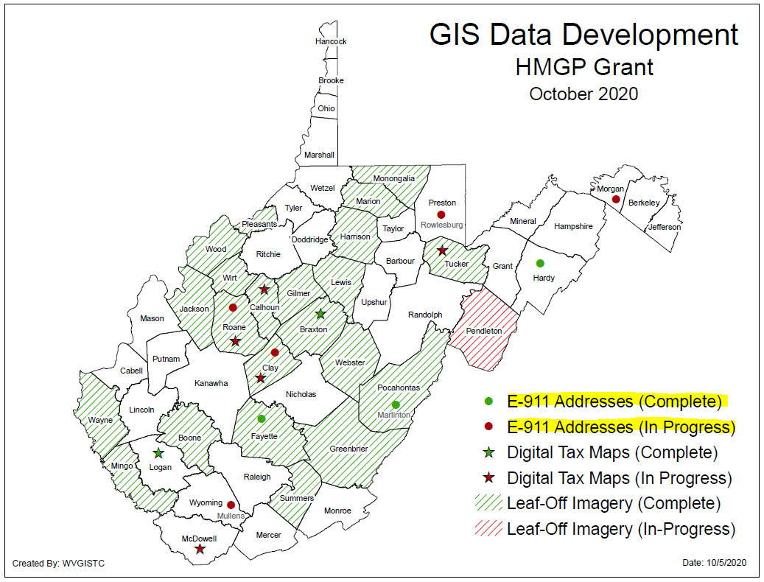
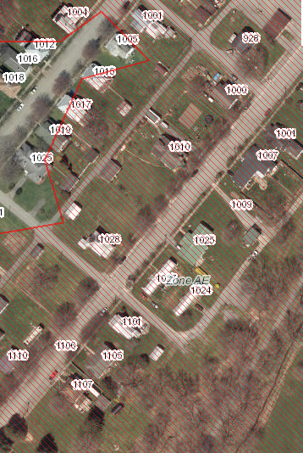
E-911 Addresses
Improved Addresses Uploaded to WV Flood Tool
HMGP Addressing Improvement Projects
Marlinton, WV

Slide 43
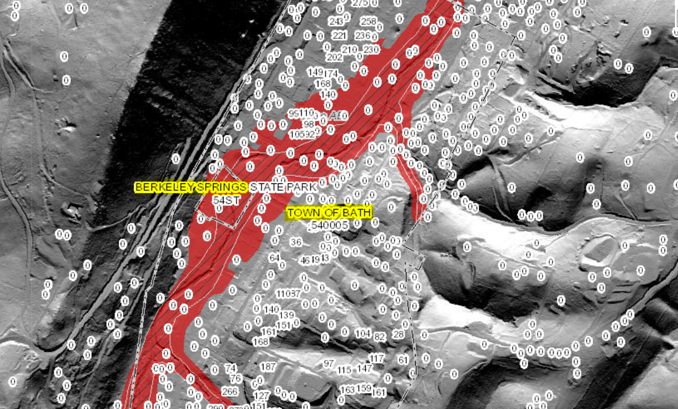
Statewide E-911 Addresses
Missing Address Site Numbers
Berkeley Springs, WV

Slide 44
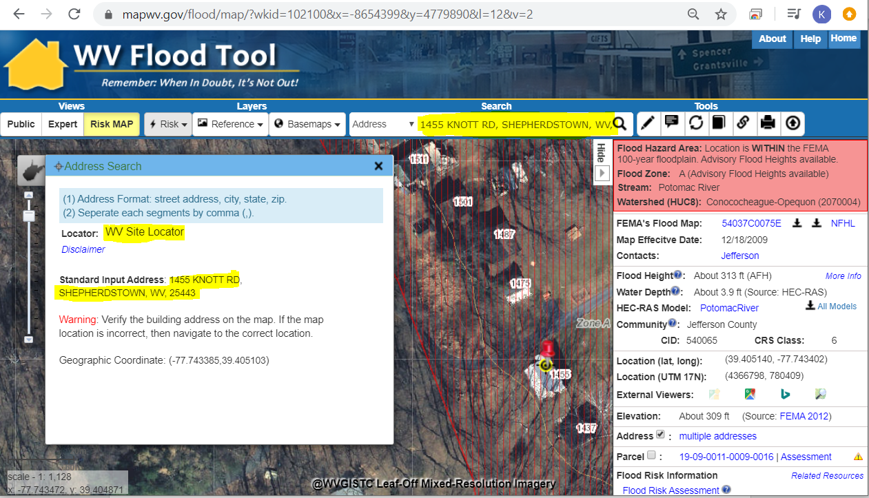
E-911 Addresses
Address Match Locators Updated on WV Flood Tool
Address Site Match Locator
Geocoding is the process of converting street addresses into geographic coordinates (latitude and longitude) to identify the position on the map
1455 Knott Road, Shepherdstown, WV

Slide 45
Flood Tool Reference Layers
Parcels / Assessment Records

Slide 46
Parcels / Assessment Records
Tax Year 2022 Parcels and Assessment Records: Currently updating Flood Tool with 1.4 million tax parcel and assessment records for Tax Year 2022.
Parcel Assessment Reports: Parcel Web Reports include links to building sketch diagrams for residential properties.
Building Identifier: The Parcel Identifier, combined with the E-911 Address Number, forms the Building Identifier for identifying structures for flood risk assessments, building pictures, LOMAs, Elevation Certificates, etc.

Slide 47
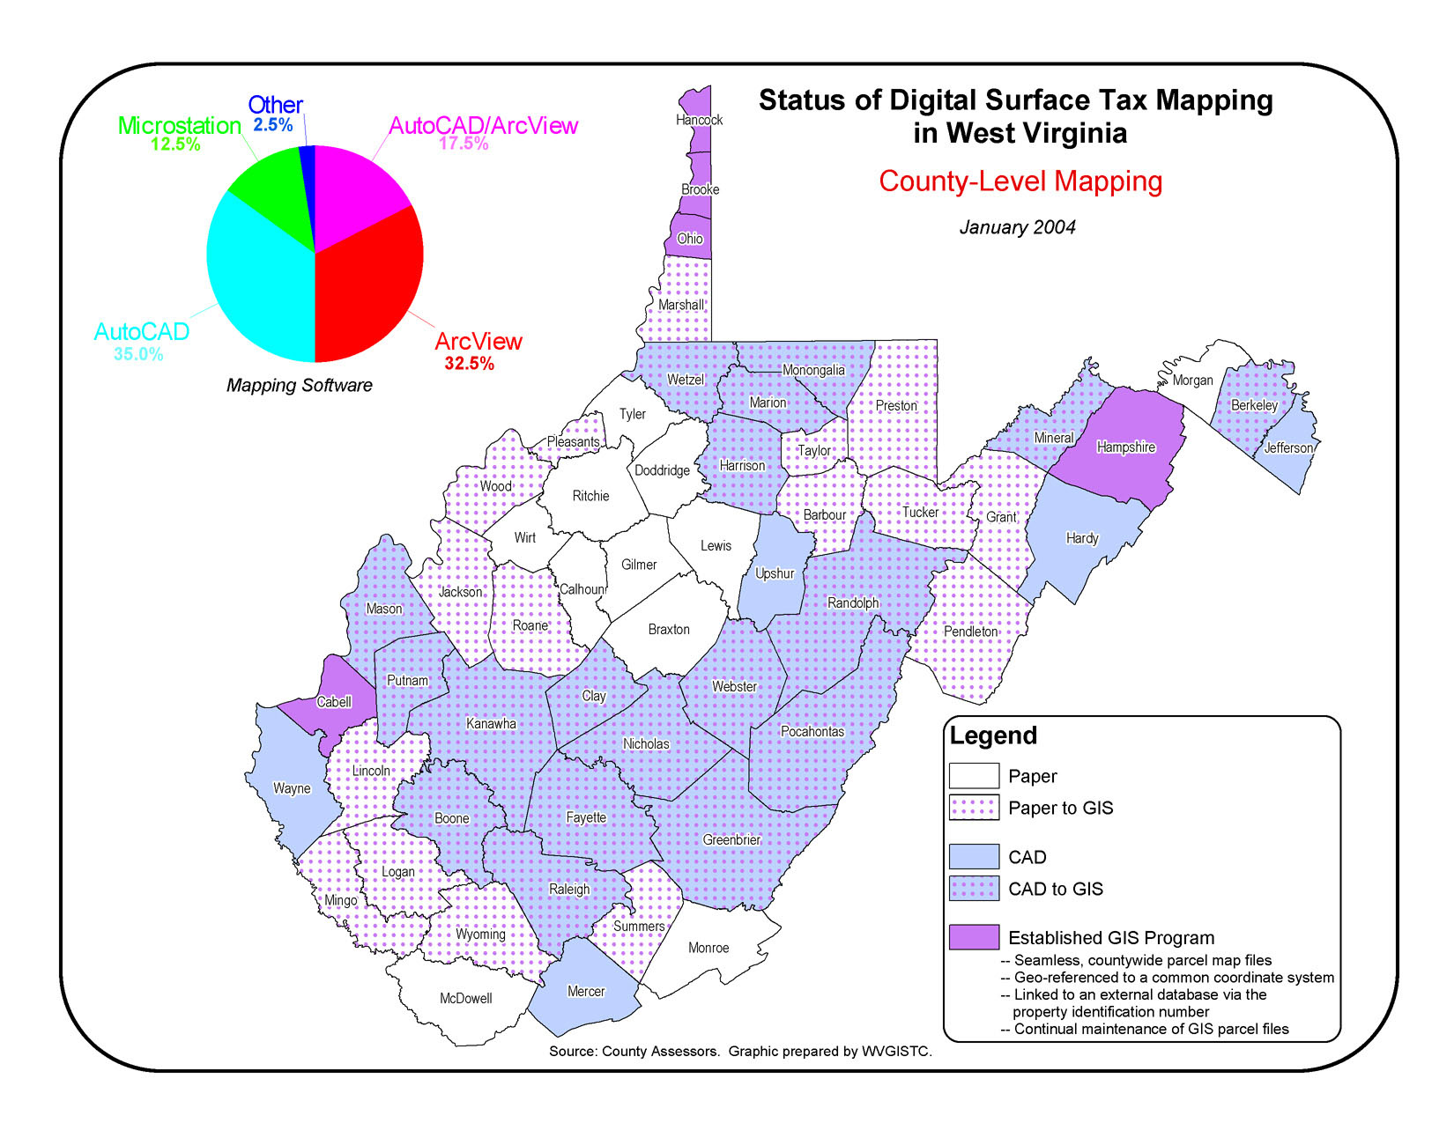
Statewide Digital Parcel File (new)
After two decades, Digital Surface Tax Parcels available statewide
A Complete GIS Statewide Parcel File exists today because of HMGP funding
In 2004 only five counties had GIS parcels.
In 2021 all 55 counties had converted their tax maps from paper to digital.

Slide 48
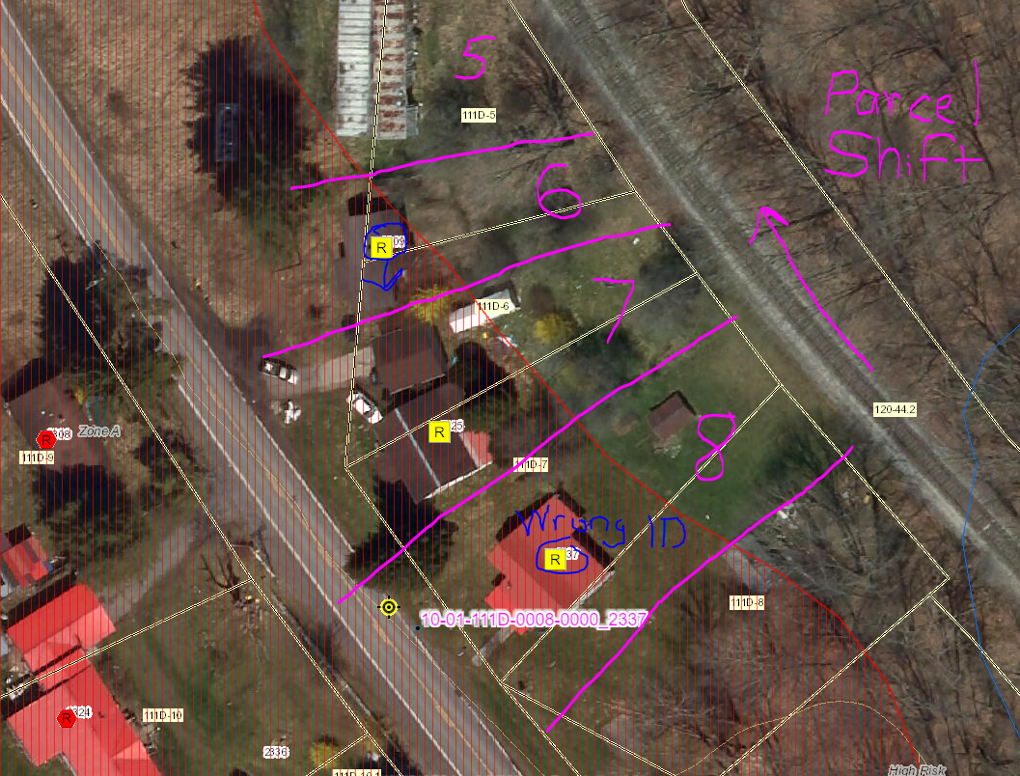
Parcel Misalignment
Parcel Shift and Building Identification Errors – Fayette County
https://www.mapwv.gov/flood/map/?wkid=102100&x=-8997850&y=4568144&l=13&v=2

Slide 49
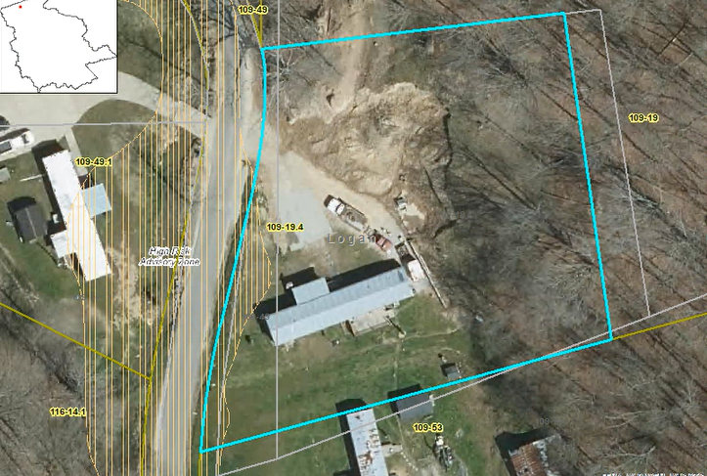
Improved Property Parcel Mapping
Logan County
Parcel 23-02-0109-0019-0004
High Risk Advisory Zone
Parcel Geometry Map Accuracy Improved
1322 WEST FORK RD TRLR, WEST FORK, WV, 25508
https://mapwv.gov/parcel/?pid=23-02-0109-0019-0004

Slide 50
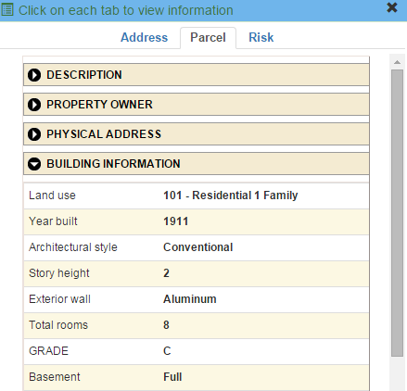
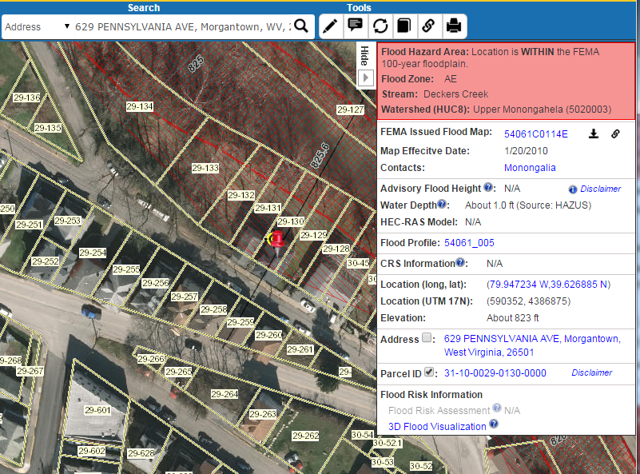
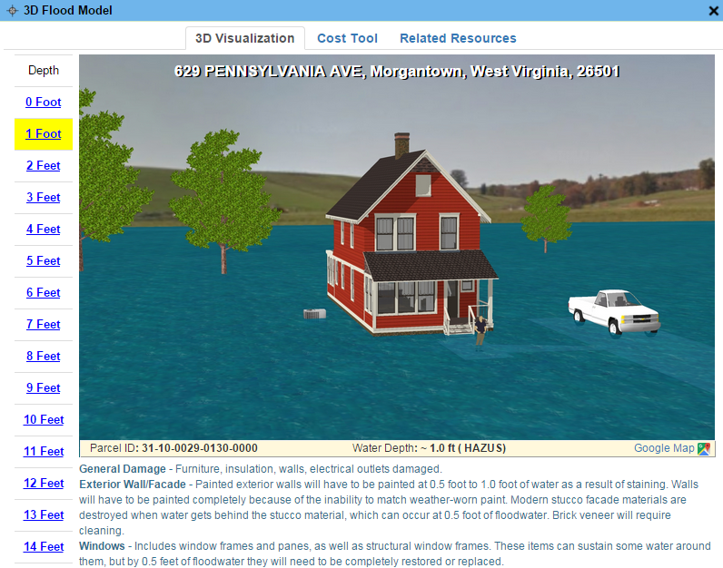
Parcels link to Owner/Building Info
629 PENNSYLVANIA AVE, Morgantown, WV, 26501
https://www.mapwv.gov/flood/map/?wkid=102100&x=-8899684&y=4811867&l=13&v=0
Residential or Farm Property

Slide 51
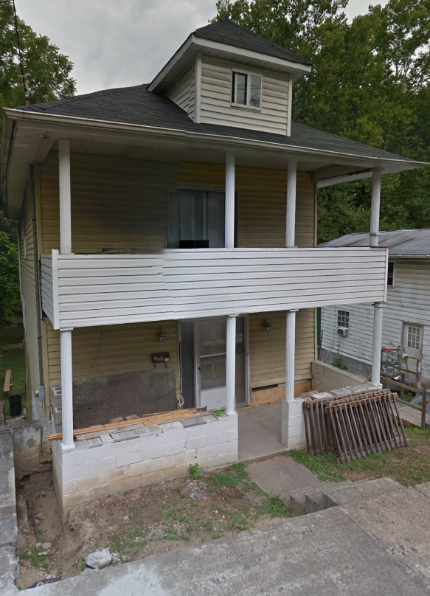
Parcels link to Owner/Building Info
Residential or Farm Property
DESCRIPTION
GIS Parcel ID | 31-10-0029-0130-0000
Legal Description | BL 12-1/2 LOT 10
Acreage (deed) | 0.0373
Tax Year | 2015
Tax Class | 4
Deed Book / Page | 1259 / 45
PROPERTY OWNER(S)
Property Owner(s) | Smith John
629 PENNSYLVANIA AVE, Morgantown, WV, 26501
https://www.mapwv.gov/flood/map/?wkid=102100&x=-8899684&y=4811867&l=13&v=0
BUILDING INFORMATION
Property Class Type | R- Residential
Land Use | 101 - Residential 1 Family
Year Built | 1911
Architectural style | Conventional
Exterior Wall | Aluminum
Stories | 2
Total Rooms | 8
Building Grade | C
Basement Type | Full
Structure Area | 1,320
Building (card) Number | 1
# of main BLDGs (cards) | 1
APPRAISED VALUES
Land Appraisal | $33,200
Building Appraisal | $29,000
Total Appraisal | $62,200

Slide 52
Total Property Parcels
West Virginia Parcel Property Class Breakdown for Tax Year 2024 (Computed from statewide master parcel file)
Code* | Property Class | # of Parcels | Percent (%) | Total Assessment Value (Land & Bldgs.)
R | Residential | 1,109,008 | 79.1% | $90,813,581,044
F | Farm | 120,822 | 8.6% | $8,865,166,220
A | Apartment | 3,130 | 0.2% | $1,900,243,334
C | Commercial | 65,047 | 4.6% | $19,077,881,022
I | Industrial | 2,716 | 0.2% | $1,974,591,588
X | Exempt | 70,962 | 5.1% | $25,513,643,525
U | Utility | 4,313 | 0.3% | $655,482,593
Other | Not classified | 25,630 | 1.8% | $22,000
 |  | 1,401,628 | 100% | $148,800,611,326
 | Property Parcels intersecting 100-YR floodplain | 296,039 | 21.1% (of count) | $33,262,501,184
Assessment records are important for building inventories and are used to estimate the total building exposure ($) and building loss ($) for multi-hazards. Often building inventories and corresponding loss estimates are organized by property class.

Slide 53
Building Unique Identifier
Click here for more info on Building Identification
Parcel ID | 01-08-0011-0069-0000
01 | - | 08 | - | 0011 | - | 0069 | - | 0000
County |  | District |  | Map |  | Parcel |  | Suffix
Address | 604 S Main St, Philippi, West Virginia, 26416
Building Identifier (Parcel ID + Address No.) | 01-08-0011-0069-0000_604
Link to Property Record
Link to Structure Record

Slide 54
Flood Tool Reference Layers
Building Footprints
Building Footprints are important for identifying flood-risk structures and flood visualizations

Slide 55
Building Footprints
Statewide building footprint reference layer created from best available sources
Layer | Source | Coverage
2003 SAMB | 2003 2-ft. resolution leaf-off imagery, Statewide Addressing & Mapping Board (large buildings only) | Statewide partial (12,671)
Counties 2010-2018 | 6” or better leaf-off imagery | Select Counties
2018 Microsoft Building Footprints | Statewide dataset contains 1,020,048 building footprints generated by Microsoft in 2018. | Statewide (1 million)
2022 WVGISTC | ESRI’s Deep Learning Package | Ongoing. 13 counties completed
How are BUILDING FOOTPRINTS beneficial?
Improves the locational pin-pointing of structures for multi-hazard assessments
Enhances visual representation of structures on 2D flood risk maps
Necessary for 3D flood visualization models
Building footprints extruded to known heights
Beneficial to communicating flood risk to communities
2018 Microsoft Building Footprints

Slide 56
Building Footprints
Building footprints created from Best Leaf Off by WVU
A comparison of building footprints on Wheeling Island in Ohio County. The WVGISTC building footprints were created from 4” resolution, 2019 imagery using ESRI’s Deep Learning Package for U.S. structures.
As of May 2022, the WVGISTC has completed Building Footprint extractions for 13 West Virginia Counties. An assessment for overlap of building footprints with existing Primary Structure centroids has averaged 90% overlap for WVGISTC Footprints. This is in comparison to 75% and 66% overlap for Microsoft and Oak Ridge (US Structures) footprints, respectively.
On top of these percentages, the quality of the WVGISTC Footprints in orientation, positioning, and boundary matching is also improved.
WVGISTC – 2019 imagery
Microsoft
Oak Ridge

Slide 57
Building Footprints
2018 Microsoft Building Footprints (for WV): 1,020,048 structure footprints
2021 FEMA's USA Structures (for WV): 1,085,876 structure footprints
2022 WVU Building Footprints (in progress)
Verification Layer: WV Building-Level Risk Assessment (BLRA): 98,467 points of primary structures located in the 1%-annual-chance floodplain

Slide 58
Flood Damage Visualizations
<< Harpers Ferry Flood Risk 3D Visualization Movie >> https://data.wvgis.wvu.edu/pub/RA/_resources/3Dflood/HarpersFerry_Jefferson_3D_Flood_2020_mp4.mp4

Slide 59
Flood Tool Reference Layers
Boundaries
Up-to-date boundary files are important for distinguishing flood zone areas of incorporated and unincorporated areas

Slide 60
Kimball, McDowell County
Kimball Municipal Boundary
Current boundary in Flood Tool is incorrect
Correct Boundary
51 primary structures in current Kimball municipality
85 primary structures in revised Kimball municipality
New boundary = additional 34 primary structures within Kimball are in a flood zone

Slide 61
Risk Assessment Layers on Flood Tool
Landslide
Dam
Flood Zone
https://www.mapwv.gov/flood/map/?wkid=102100&x=-8771562&y=4715438&l=7&v=2
https://www.google.com/maps/@38.9409315,-78.805837,1690a,35y,44.59t/data=!3m1!1e3
Potential Flood, Dam Failure and Landslide Vulnerabilities on WV Flood Tool’s RiskMAP View Hardy County, West Virginia

Slide 62
Flood Tool Reference Layers
Data Development and Integration
Local-Level Data Development
State-Level Integration

Slide 63
GIS Data Development
Parcels Site Addresses Aerial Imagery Elevation
Migrate six counties from paper to digital parcels
Flood-risk communities with missing or incorrect E-911 addresses
County Leaf-off imagery no older than 5 years
Statewide 1-meter DEM and 1-ft. contours. Flood Studies, Depth & WSEL Grids
Improving State’s Spatial Data Infrastructure

Slide 64
State-Level Integration
Parcels
Addresses
Imagery
Elevation
SOURCE: County Assessors
Property Tax Division
Statewide Master Parcel File / IAS
SOURCE: Local Addressing Offices
Division of Homeland Security & Emergency Management
Statewide Addressing & Mapping System
SOURCE: County Offices
WV GIS Technical Center
Statewide Leaf-Off Imagery Service
SOURCE: Local, State, primarily FEMA
WV GIS Technical Center
Statewide Elevation Web Services
State-level integration allows for statewide mapping products and services. WVGISTC creates and hosts these framework spatial data layers.

