Slide 1
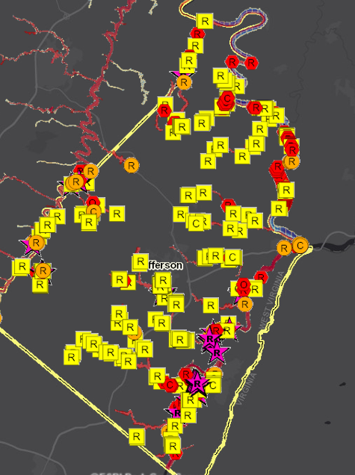
LiDAR for Map Amendments
02/07/2024
LiDAR for Letter of Map Amendment (LOMA)
Yellow Structures are potential LOMAs
If applicable, LiDAR data can replace the requirement to submit certified elevation information which can create a cost savings for property owners.
The WV Flood Tool (www.mapwv.gov/flood) can be used for the map requirement of LOMAs for properties located in A or AE Flood Zones.
Countywide Flood Risk Studies identify potential structures that could be removed from the SFHA
Jefferson County Flood Risk Study – Future SFHA Map Conditions for Buildings

Slide 2
LiDAR for Map Amendments
HOW DO I CHANGE MY FLOOD ZONE DESIGNATION? Letters of Map Amendment (LOMAs) enable property owners to request changes or updates to their property’s flood risk status to FEMA. Learn more about how to request a change to your flood zone designation at FEMA’s website. Typically, this flood zone change request using the WV Flood Tool applies to property owners at the floodplain boundary fringe (not in the floodway) of high-risk AE or Approximate A Flood Zones, for existing buildings or lots not elevated on fill (natural grade), and where there is more than two feet difference between the Base Flood Elevation (BFE) and Lowest Adjacent Grade (LAG). LiDAR FOR MAP AMENDMENTS LiDAR data can replace the requirement to submit elevation information certified by a licensed land surveyor or professional engineer, which can create a cost savings for property owners. However, when the LAG is close to the BFE, LiDAR data may not be accurate enough and require certified elevations to capture the full risk of the building. The WV Flood Tool can be used to submit LOMAs where accurate LIDAR-derived elevation contours and point data are available. Generally, if there is two feet or more difference between the BFE and LAG, then the homeowner or community should investigate using the WV Flood Tool’s Print LOMA Map function to generate a LOMA for submission to FEMA at no charge. DOES MY COMMUNITY HAVE LIDAR? All communities in West Virginia have LiDAR data available that meets the accuracy requirements. Refer to the Elevation Source Metadata which can also be accessed from the WV Flood Tool. ONLINE LOMC The Online LOMC web application allows homeowners or their designated representatives to easily request a Letter of Map Change (LOMC). Use this site if your property was inadvertently included in a flood zone, or if the addition of fill elevated your property so that it is above the flood zone. The Online LOMC tool is an alternative to the MT-1 and MT-2 paper forms and/or MT-EZ paper form. Anyone, including communities, home or property owners, their representatives, and professional surveyors and engineers, may submit a LiDAR LOMA request using the Online LOMC if the application meets the LOMA submission requirements listed in the next section.

Slide 3
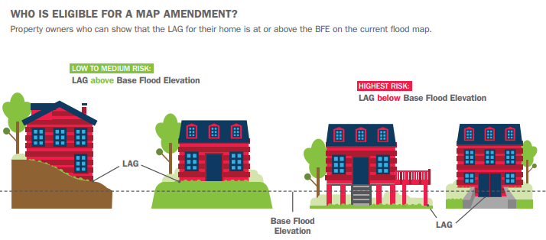
LiDAR for Map Amendments
HOW DO I CHANGE MY FLOOD ZONE DESIGNATION? Occasionally, a small area is inadvertently shown to be within the SFHA on a FIRM, even though the ground is at or above the BFE. If this occurs, an individual property owner may submit survey information to FEMA and request that FEMA issue a document that officially removes a property from the SFHA, called a Letter of Map Amendment (LOMA). Importantly, the LOMA enables property owners to request changes or updates to their property’s flood risk status to FEMA. Learn more about how to request a change to your flood zone designation at FEMA’s website.
Source: How to Request a Map Amendment (Nov. 2018)

Slide 4
When LiDAR Cannot Be Used
WHEN LIDAR CANNOT BE USED There are situations when LiDAR cannot be used in a LOMA request. These include applications involving the following: Buildings or lots elevated using fill Buildings or lots in the regulatory floodway or Zone AO. FEMA is only concerned that the subject of review is outside the floodway The location of the closest lower contour can be within the floodway Buildings under construction. Conditional determinations Requests to supersede previously issued LOMAs based on certified elevation data If the entire lot is to be reviewed, an Elevation Form is required to complete the case with the Lowest Lot Elevation certified by a licensed land surveyor or registered professional engineer.

Slide 5
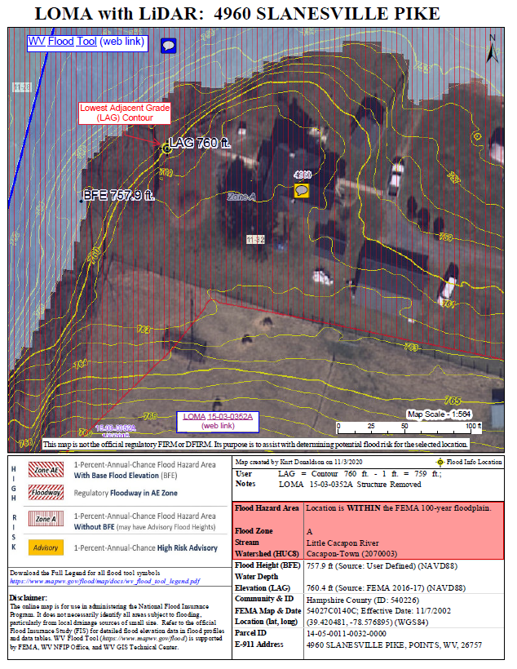
LiDAR LOMA Submission – 4 Steps
Doe all communities in West Virginia have LiDAR. Yes!!! Print Tax Parcel Map Exhibit using WV Flood Tool Supporting document for Online LOMC application Identify published building-level risk assessments for potential Mapped Out structures Determine LOMA Type: Existing Structure or Lot Determine BFE Determine LAG/LLE Add Annotation Print and Download LOMA Map Save to PDF File Further Edit/Annotate Print LOMA (optional) Submit LiDAR LOMA Map Exhibit along with Deed using FEMA’s Online LOMC Portal (no fee charged)
Click here for more detailed instructions

Slide 6
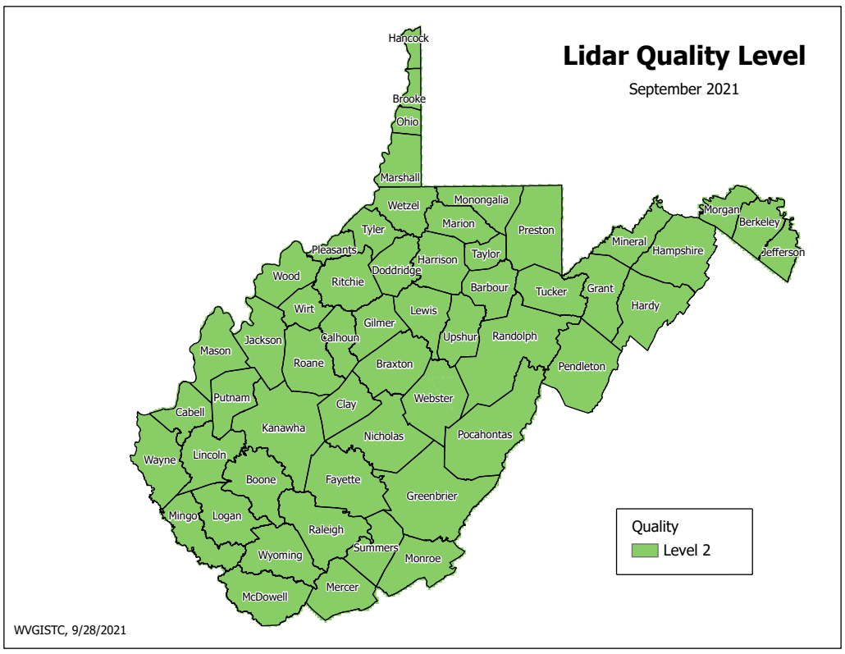
Step 1: Does My Community Have LiDAR?
In 2022, FEMA-purchased QL2 LiDAR became available for the entire State
Presently all communities have QL2 LiDAR data available. To be used in a LOMA request, LiDAR data must meet or exceed the U.S. Geological Survey (USGS) Quality Level 3 accuracy requirement. To learn more about this requirement, view the elevation source metadata for the WV Flood Tool.

Slide 7
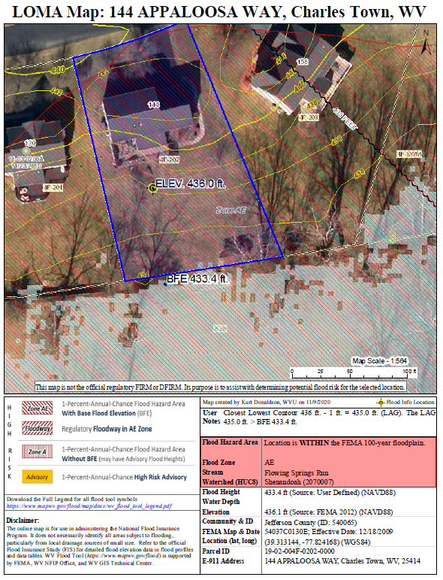
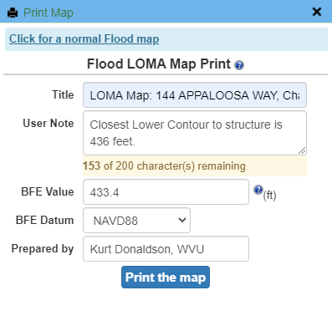
Step 2: Print LOMA Map with WV Flood Tool
Use the WV Flood Tool’s Print Tool (LOMA Option) to generate LOMA Maps

Slide 8
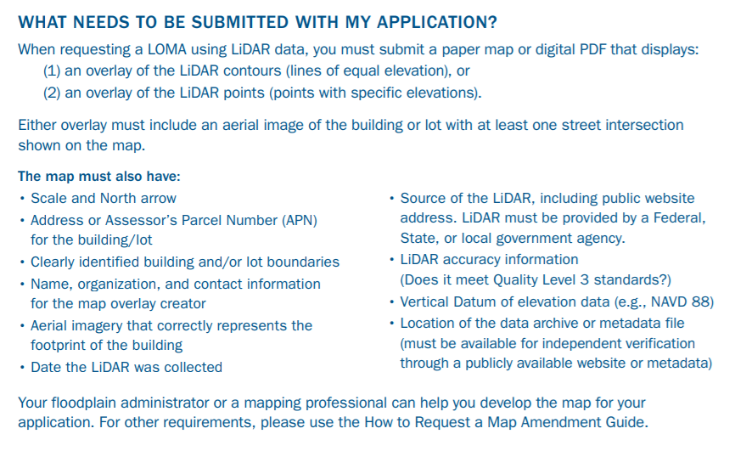
What needs to be submitted on Map?
Source: FEMA Region V Fact Sheet https://greatlakescoast.org/pubs/factSheets/Region_V_LiDAR_LOMA_FS_v3_012219_FINAL.pdf

Slide 9
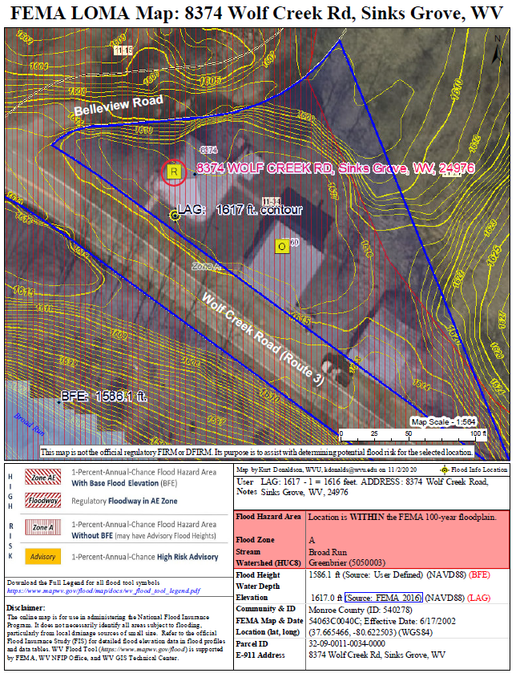
What needs to be submitted?
# | Map Elements Required
1 | Name, organization, and contact information for the map creator
2 | E-911 Address of property
3 | Road or street intersection reference
4 | Assessor’s full Parcel ID Number (APN) for the building/lot
5 | Clearly identified building and/or lot boundaries
6 | Aerial imagery that shows building footprint
7 | Date, Source, and Accuracy of the LiDAR collected (must meet Quality Level 3 standards)
8 | Vertical Datum of elevation data (e.g., NAVD 88, NGVD 29)
9 | Scale Bar
10 | North Arrow
11 | WV Flood Tool Location web link
10
3
6
32-09-0011-0034-0000
5
9
1
8
11
7
4
2
More than one map can be made to present all elements

Slide 10
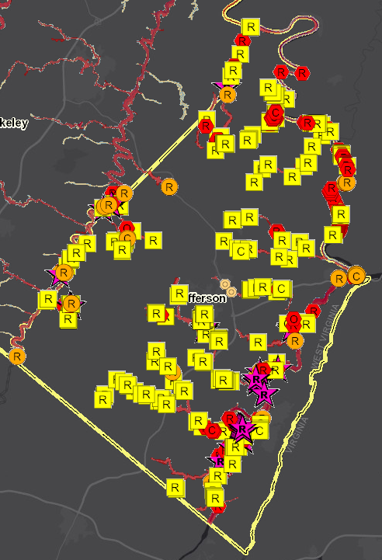
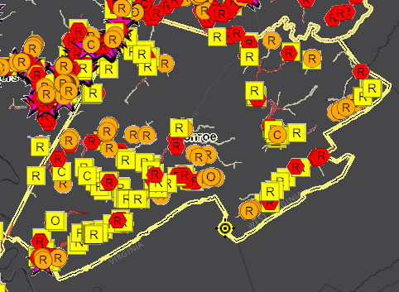
Identify LOMA Structures (Risk MAP View)
Mapped-Out SFHA Residential Structure (Potential LOMA)
Monroe
Jefferson
Structures Mapped Out of SFHA
Search on Building Risk “Mapped Out” SFHA structures (yellow square symbol) in Risk MAP View for potential LOMAs. It is estimated that Jefferson County, for example, has 250 structures that could be considered for LOMA Removal Status from the Special Flood Hazard Area (SFHA).
R
Residential
C
Commercial
O
Other

Slide 11
Jefferson County – Potential LOMAs
(1) Future Map Conditions: Floodway (32), No Change SFHA (339), Mapped In SFHA (85), Mapped Out SFHA (279)
Higher Risk
Advisory flood zone mapping indicates about 40% of Structures may quality for LOMAs
Lower Risk
(2) Building Counts (bSF)
(3) LOMAs Positional Accuracy Verified
Flood Zones | Building Counts
Buildings in High-Risk Effective Zones - SFHA (bSF) | 650
Buildings in High-Risk Advisory Zones (Mapped in SFHA) | 85
Total Buildings in High-Risk Zones (Effective and Advisory) | 735
LOMA Determination | Count | Positional Accuracy Correct | Positional Accuracy FIXED (State Flood Risk Assessment)
Non-Removal | 9 | 2 | 7
Removal | 85 | 53 | 32
Out as Shown | 13 | 4 | 9
Total | 107 | 59 | 48
 |  | 55% | 45%

Slide 12
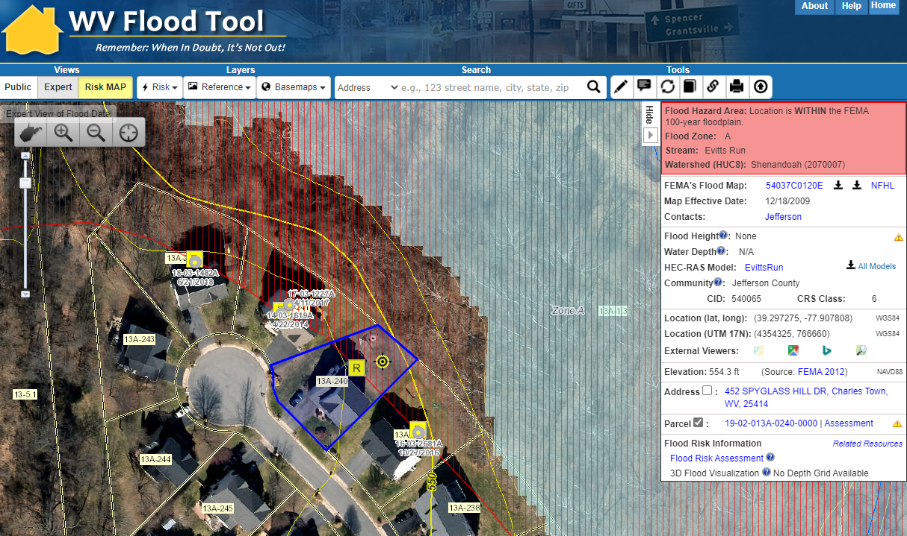
Identify Potential LOMAs (Risk MAP View)
Flood Depth Grid
Building 19-02-013A-0240-0000_452
Building 19-02-013A-0240-0000_452 should qualify for a LOMA. The adjacent properties already have certified LOMAs with a Removal determination. The significant elevation difference between the Flood Depth Grid and structure of interest also indicates a likely LOMA candidate.
https://www.mapwv.gov/flood/map/?wkid=102100&x=-8672657&y=4764344&l=12&v=2

Slide 13
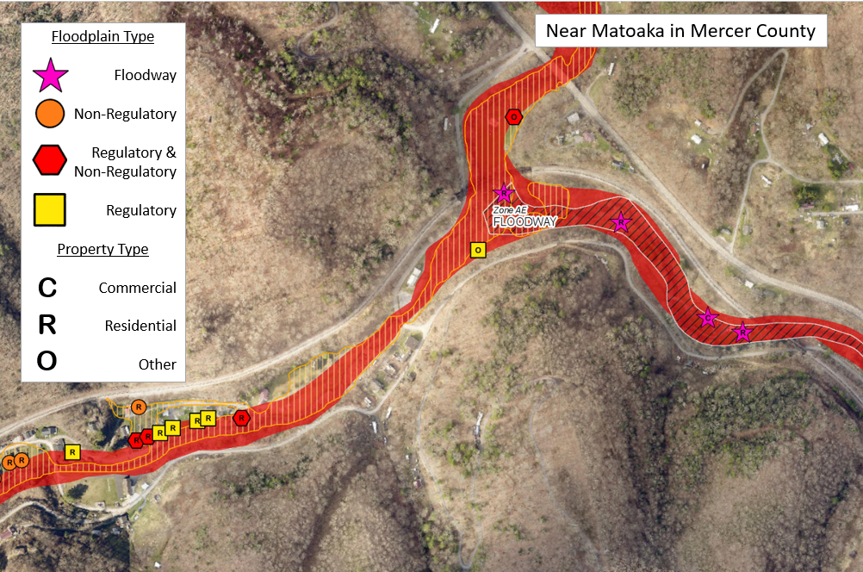
Future Map Conditions (Potential LOMAs)
C
R
O
Regulatory Floodway
Mapped IN SFHA
No Change
Mapped Out of SFHA
Mapped out SFHA Structure (Potential LOMA)
High Risk Non-Regulatory
Preliminary Studies
Advisory A Zones
Updated AE Zones
Search on Building Risk “Mapped Out” SFHA (yellow symbol) structures in Risk MAP View for potential LOMAs

Slide 14
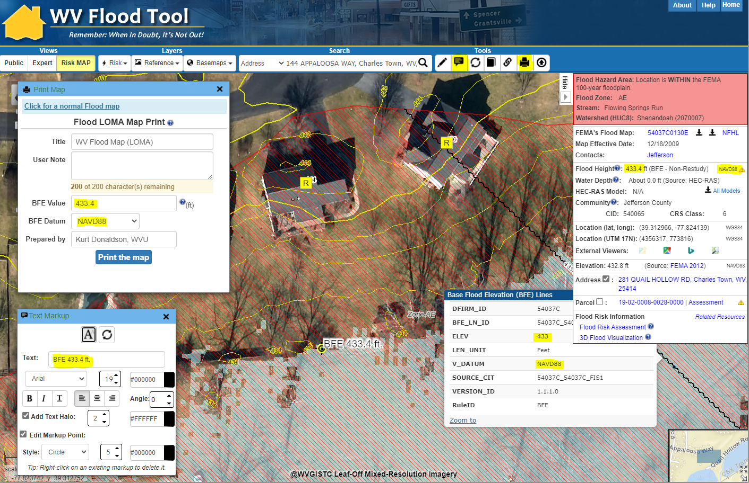
LOMA Map – Identify BFE
Text Markup tool
Open Print Map tool and select FEMA LOMA Map link
Print LOMA
BFE Value and Datum
Flood Query Results Panel
Using the Flood Depth Grid as a reference, click on closest BFE value to structure. Copy BFE Value 433.4 and Datum NAVD88 from Flood Query Results Panel to the LOMA Map Print window. Annotate flood height value 433.4 ft. on the map layout using the Text Markup tool.
For AE Zones make BFE and X-Section Layers visible in RISK Layers
Text Markup
Flood Depth Grid
https://www.mapwv.gov/flood/map/?wkid=102100&x=-8663344&y=4766601&l=13&v=2

Slide 15
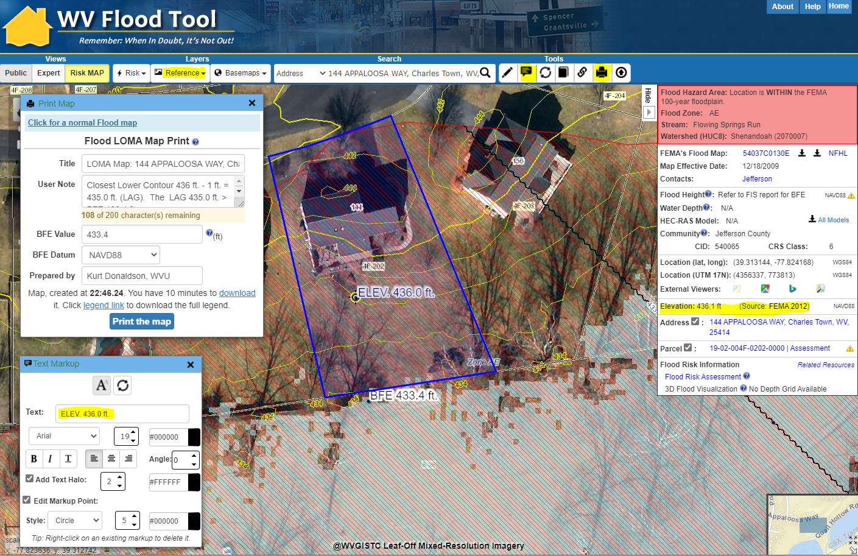
LOMA Map – Identify LAG
Ensure Contours Layer visible
Text Markup tool
Open Print Map tool and select FEMA LOMA Map link
Print LOMA
Print Map, Download, open map in new browser tab, right click on map and Save to PDF File
Elevation Value and Metadata
Flood Query Results Panel
Turn on Contours Layer in REFERENCE Layers of WV Flood Tool to view two- or one-foot contours at 1:564 and 1:282 zoom scales. Identify the Closest Lower Contour 436 ft. and verify elevation in Flood Query Results Panel. Annotate contour value 436 ft. on the map frame using Text Markup tool.
For AE Zones make BFE and X-Section Layers visible in RISK Layers
Text Markup
Flood Depth Grid
https://www.mapwv.gov/flood/map/?wkid=102100&x=-8663344&y=4766601&l=13&v=2

Slide 16
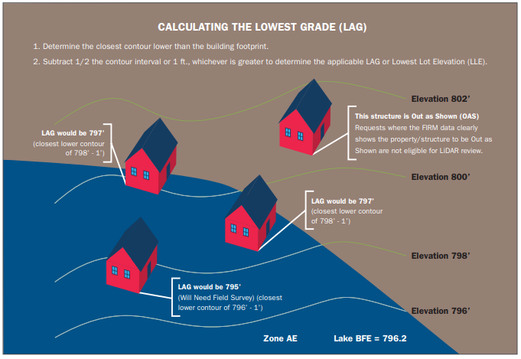
LiDAR Contour Method
Using LiDAR Contours: For LOMA submittals that include LiDAR data contours, FEMA will subtract half the contour interval or 1 foot, whichever is greater, from the lowest contour closest to (but not going through) the building (to determine the LAG) or the lot (to determine the LLE).
Calculating Lowest Adjacent Grade (LAG) – Contours

Slide 17
Calculating Elevations Using LiDAR
CALCULATING ELEVATIONS USING LIDAR The lowest adjacent grade (LAG) for a building, or the lowest lot elevation (LLE) for a lot, will be compared to the Base Flood Elevation (BFE) to determine the flood zone. If LAG/LLE is at or above the BFE on the current flood map, FEMA can issue a removal determination. For buildings or lots that cannot be removed from the high-risk flood zone using LiDAR, certified elevation data will be required for a standard LOMA determination. Using LiDAR Contours For LOMA submittals that include LiDAR data contours, FEMA will subtract half the contour interval or 1 foot, whichever is greater, from the lowest contour closest to (but not going through) the building (to determine the LAG) or the lot (to determine the LLE). Using LiDAR Point Data For submittals that include LiDAR point data, FEMA will subtract 2 feet from the lowest point closest to the building (to determine the LAG) or the lowest point on the lot (to determine the LLE). Multiple points must cover the building/lot for this method.

Slide 18
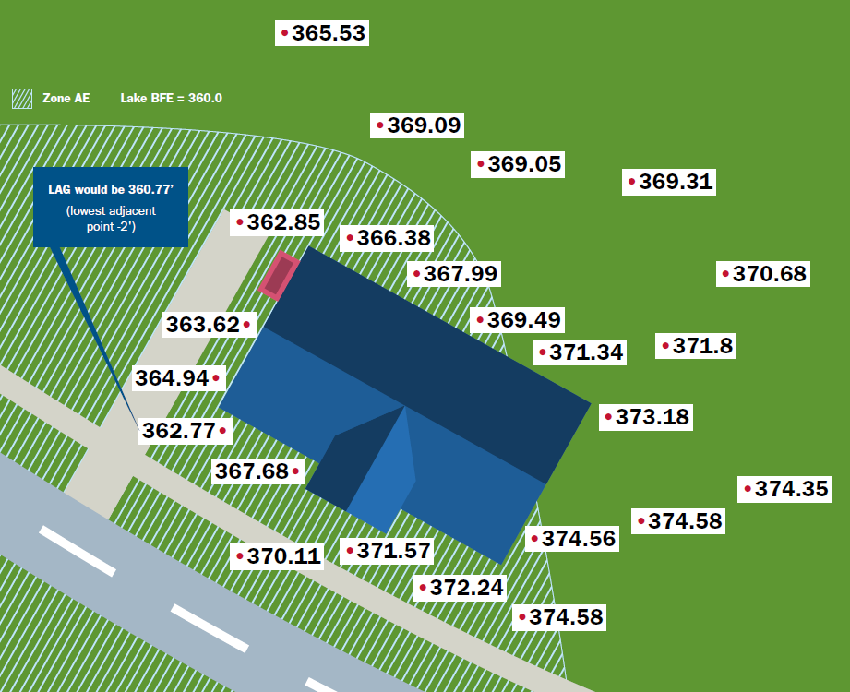
LiDAR Point Data Method
Using Point Data Method: For submittals that include LiDAR point data, FEMA will subtract 2 feet from the lowest point closest to the building (to determine the LAG) or the lowest point on the lot (to determine the LLE). Multiple points must cover the building/lot for this method.
Calculating Lowest Adjacent Grade (LAG) – Point Data

Slide 19
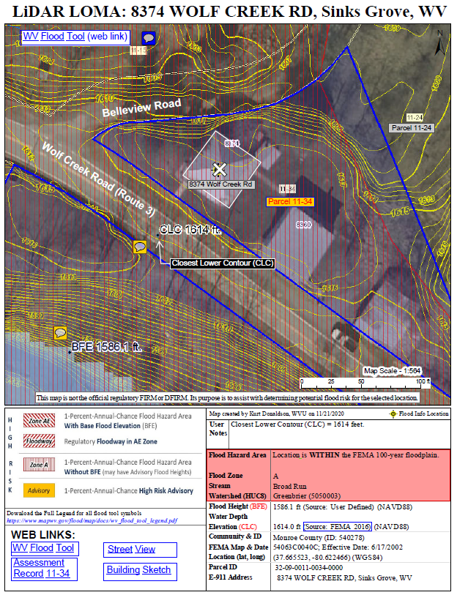
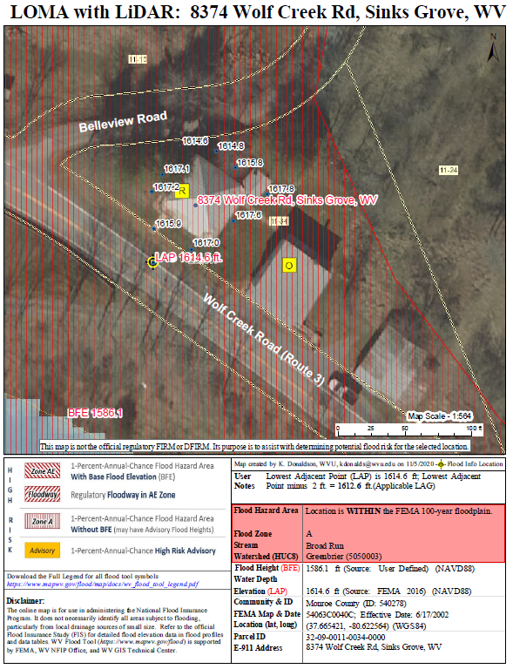
WV Flood Tool (LAG Methods)
Contours (Elevation Contours Reference Layer)
Point Data (Flood Query Results Panel)
The LAG derived from the Point Cloud Method should be close and in-line with the LAG from the Contour Method
CLC 1614 ft.
LAP 1614.6 ft.
Parcel 32-09-0011-0034-0000
Applicable LAG is 1613’ (closest lower contour of 1614’ – 1’)
Applicable LAG is 1612.6’
(lowest adjacent point 1614.6’ – 2’)

Slide 20
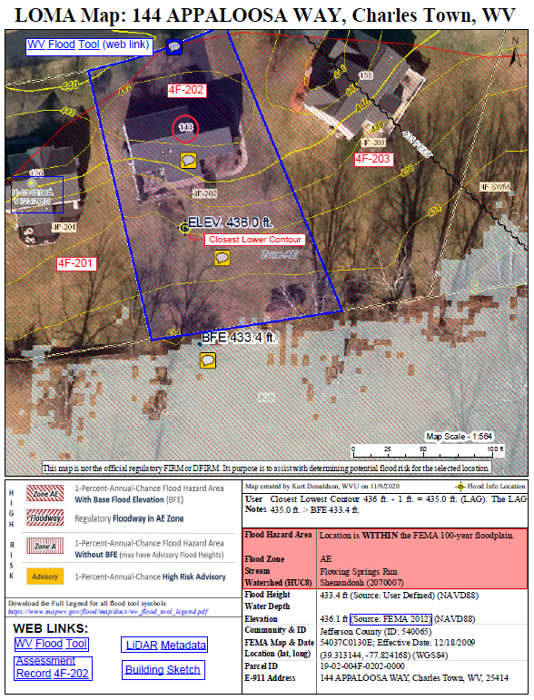
Step 3: LOMA Map – More Annotation
PDF LOMA Exhibit
More Comments and Web Links added with Adobe Acrobat Software
Annotation and Comments added
External Web links

Slide 21
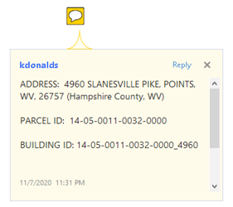
Step 3: Edit / Annotate LOMA Print Map
Use Adobe Acrobat Software to Edit Text, Add Comments and Web Links to Map Layout
Edit PDF Edit Add Text Link
Comment (annotation) Add Sticky Note Add Text Drawing Tools Import Annotation

Slide 22
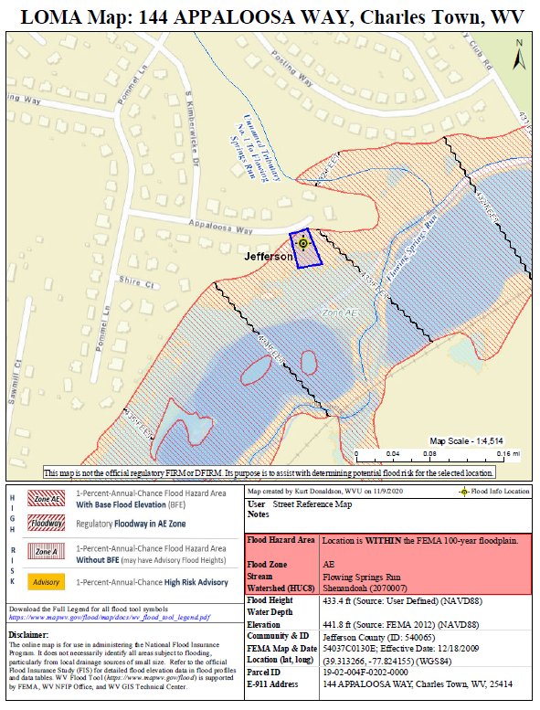
LOMA Map – Location Reference
Street Reference Map
Zoom out and switch to street base map layer to show a street intersection. Generate and save a Street Reference Map to upload as supporting document for LOMA application

Slide 23
Step 4: Submit using Online LOMC Portal
Flood Determination Details (Single Structure, Single Lot, Multiple Structures, Multiple Lots; a survey is required for portions of lots)
Community Details
E-911 Street Address & Legal Description of Property
Fill Information (Choose No)
LOMC Type (Choose LOMA)
Processing Fee (Choose No Fee Required)
Applicant Name, Mailing Address, Contact Information
Upload Supporting Documents
Copy of the Property Deed (with recordation data & stamp of the Recorder's Office) OR a Copy of the Subdivision Plat Map for property (with recordation data and stamp of the Recorder's Office) as separate files.
Tax Assessor's Map or suitable map document (WV Flood Tool should suffice)
Additional Supporting Data (WV Flood Tool PDF maps)
Print LOMA Map with BFE and LAG
Street Reference Map for property location
https://hazards.fema.gov/femaportal/onlinelomc/signin

Slide 24
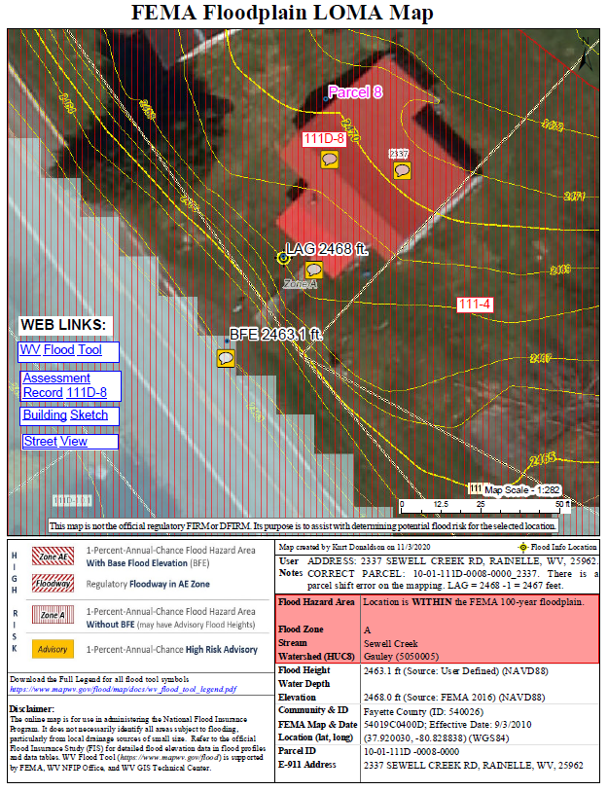
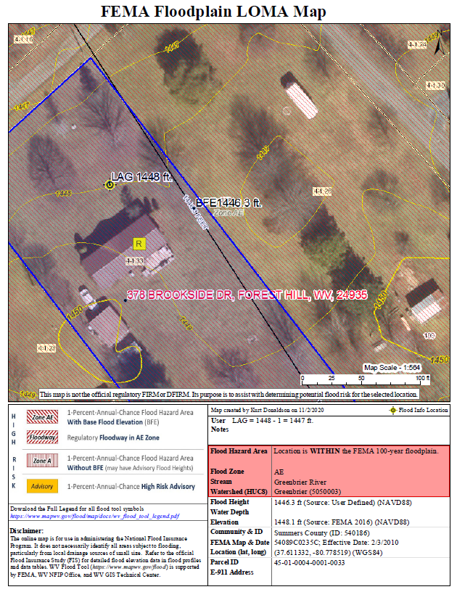
WV LOMA Examples
Fayette County
Summers County
Click here for WV LOMA Examples

Slide 25
Contact for Help
FEMA: To speak with a Map Specialist about the amendment process, contact the FEMA Map Information eXchange (FMIX) at 877-FEMA-MAP (877-336-2627) or FEMAMapSpecialist@riskmapcds.com
WV Flood Tool (www.mapwv.gov/flood) WVU GIS Technical Center, West Virginia University Kurt Donaldson, GIS Manager kurt.donaldson@mail.wvu.edu, phone: (304) 293-9467 Eric Hopkins, GIS Analyst Eric.Hopkins@mail.wvu.edu, phone: (304) 293-9463
Approximate Zone Base Flood Elevation (NOTE: Not required for LiDAR LOMA but required for elevation certificate)
Joe Trimboli, Community Planner/Geographer Joseph.K.Trimboli@usace.army.mil
Huntington District
U.S. Army Corps of Engineers
304-399-5837 (direct)

Slide 26
LIDAR LOMAs
Supplement

Slide 27
Special Feature: Datum Conversion
Vertical Datum Conversion
IMPORTANT: When submitting LOMA applications, the BFE and LAG Vertical Datums must be the same!
NGVD29 Base Flood Elevations: The LOMA Map Print Tool converts the Ground Elevation NAVD88 to NGVD29 so the BFE and LAG/LLE are the same vertical datum.

Slide 28
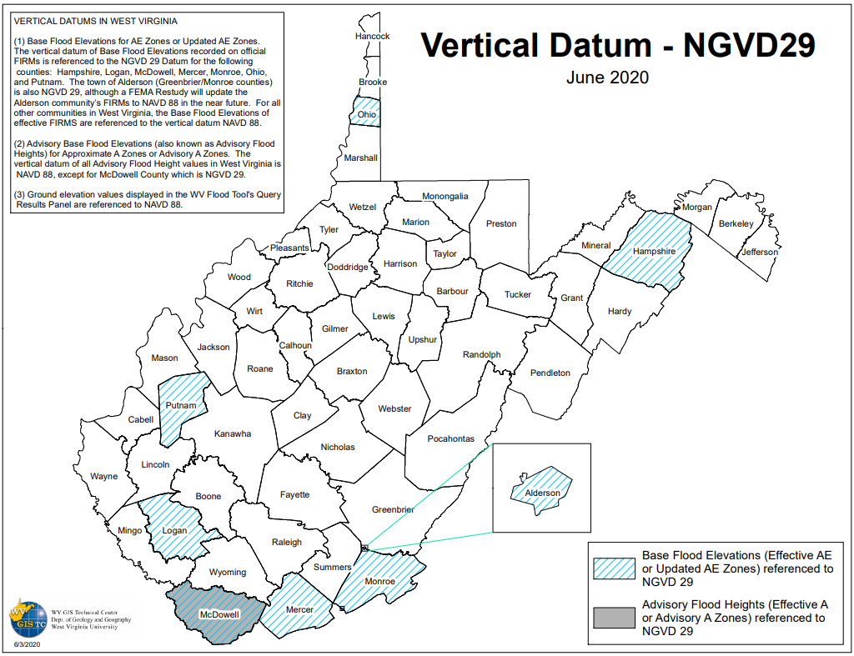
NGVD 29 Vertical Datum

Slide 29
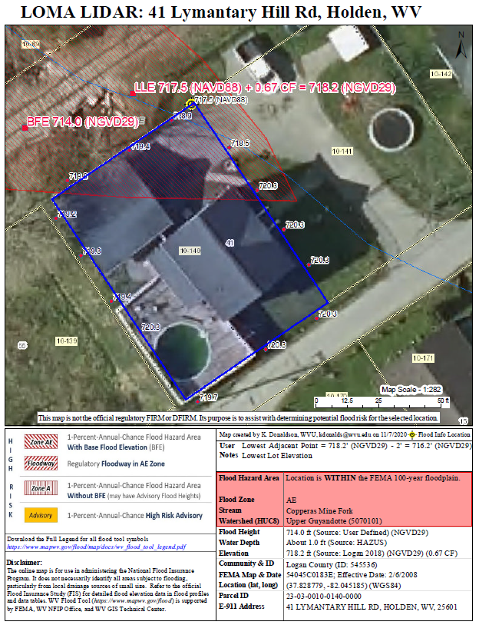
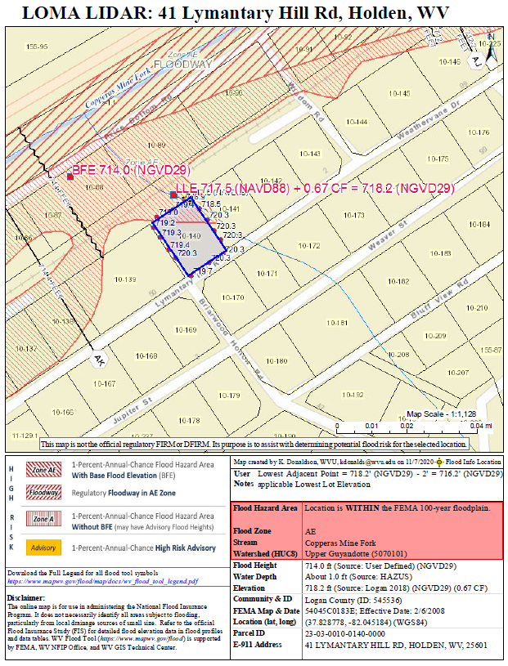
NGVD 29 Vertical Datum
Lowest Lot Elevation LOMA Map (Point Method)
Reference Map

Slide 30
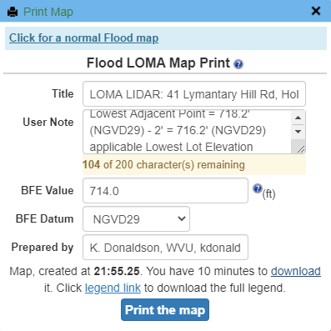
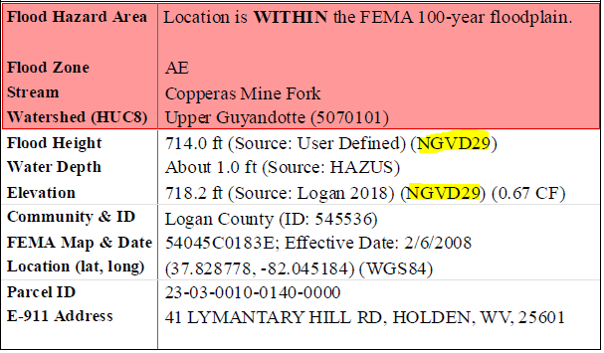
NGVD 29 Datum Conversion
The Print LOMA function converts the Ground Elevation from NAVD88 to NGVD29 to match the BFE NGVD29 Vertical Datum
NGVD29 Base Flood Elevations: The LOMA Map Print Tool converts the Ground Elevation NAVD88 to NGVD29 so the BFE and LAG/LLE are the same vertical datum
Lowest Adjacent Point 717.5 ft (NAVD88) + 0.67 ft. Conversion Factor = 718.2 ft. (NGVD29)

Slide 31
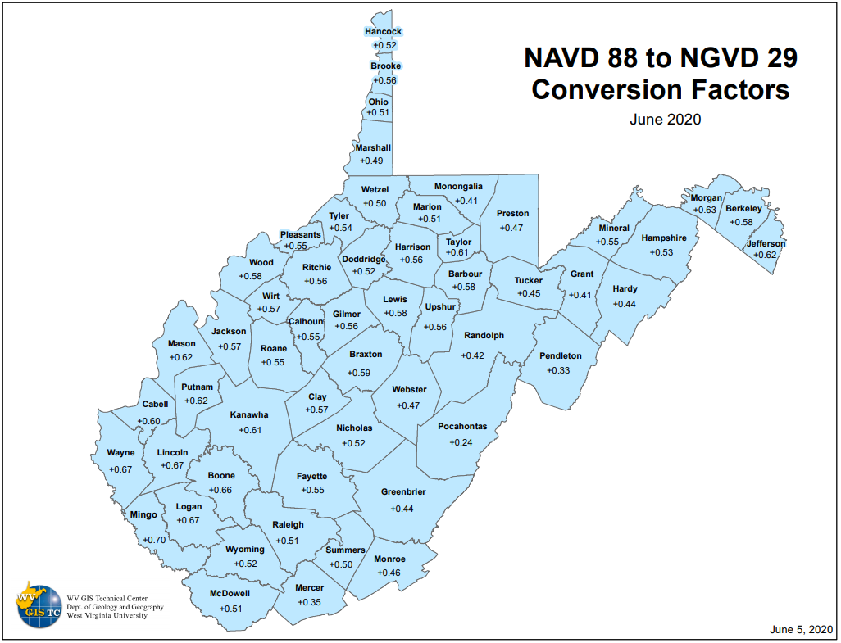
NGVD 29 Datum Conversion
The WV Flood Tool’s Print LOMA Function uses NAVD88-to-NGVD29 County Conversion Factors for converting NAVD88 Ground Elevations to match NGVD 29 Base Flood Elevations
NGVD 29 County Status Graphic NAVD 88 to NGVD 29 Conversion Factors by County NGVD 29 to NAVD 88 Conversion Factors by County

Slide 32
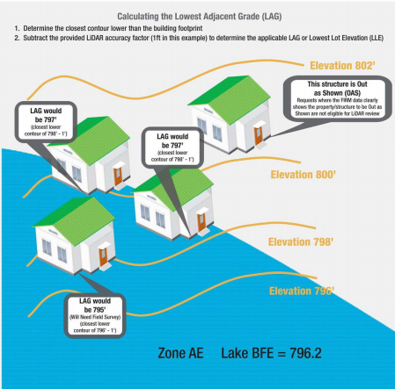
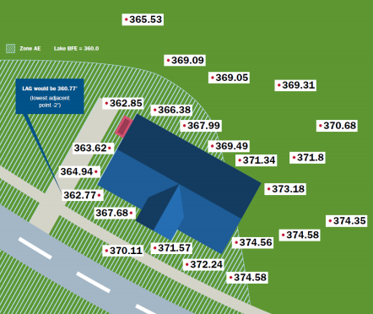
FEMA Processing Procedures
FEMA Processing Procedures of LiDAR LOMAs: LIDAR-based submissions will be reviewed based on the following criteria: The LOMA analyst will review the submitted exhibit to determine the location of the structure/property in question and identify the elevation data to be assessed. Contour submittals: The analyst will identify the lowest contour immediately adjacent to the subject (but not going through it) and subtract one-half the contour interval or 1 foot, whichever is greater, from the lowest contour closest to the structure or property to determine the applicable LAG elevation or LLE. This elevation will be compared to the BFE. LiDAR point submittals: The analyst will identify the lowest point immediately adjacent to the structure or on the property and subtract 2 feet to determine the LAG or the LLE. If the comparison of the LAG or LLE to the BFE results in a removal and all other required data was submitted, a determination can be issued. The LAG/LLE, and possibly the BFE as well, will not be published with the determination. If additional data is required to process the request (i.e., submittal form, deed, plat), it will be requested to complete the determination. If the comparison of the LAG/LLE to the BFE results in a non-removal, certified elevations will be requested in addition to any other data needed for the request.
Guidance for Flood Risk Analysis and Mapping MT-1 Technical Guidance (December 2020), LiDAR LOMA, Section 5.3, page 55

Slide 33
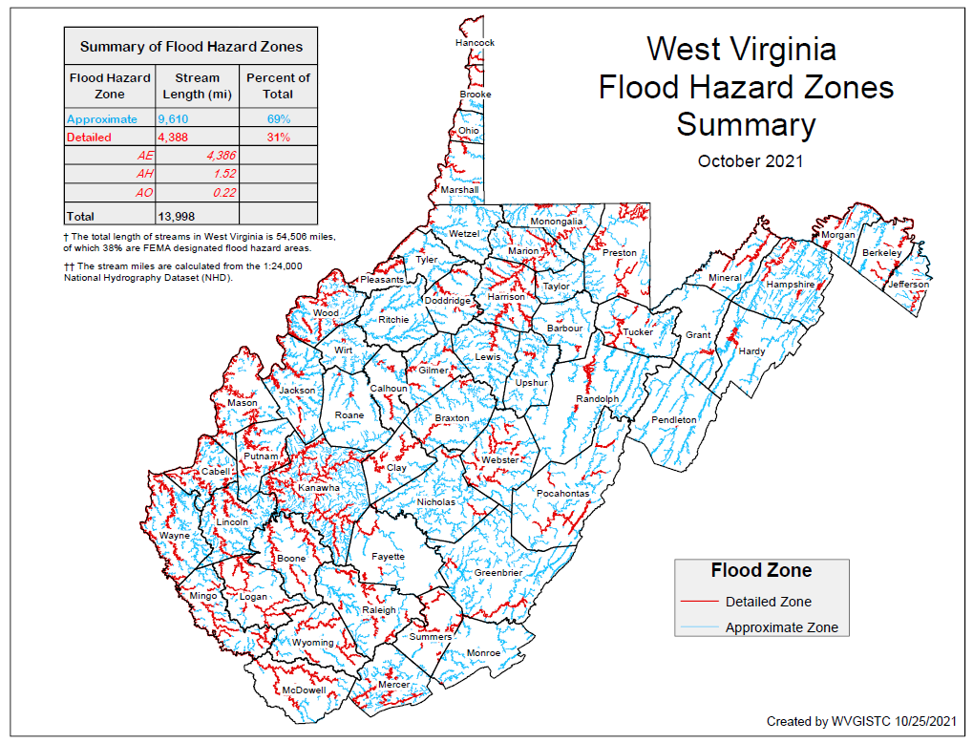
Studied and Unstudied Zone A
69% of Flood Zones (measured in stream miles) in West Virginia are Approximate A Zones
Advisory BFEs (or Advisory Flood Heights) for Approximate A Zones do not exist for all counties or for small drainage areas (less than 1 square mile)

Slide 34
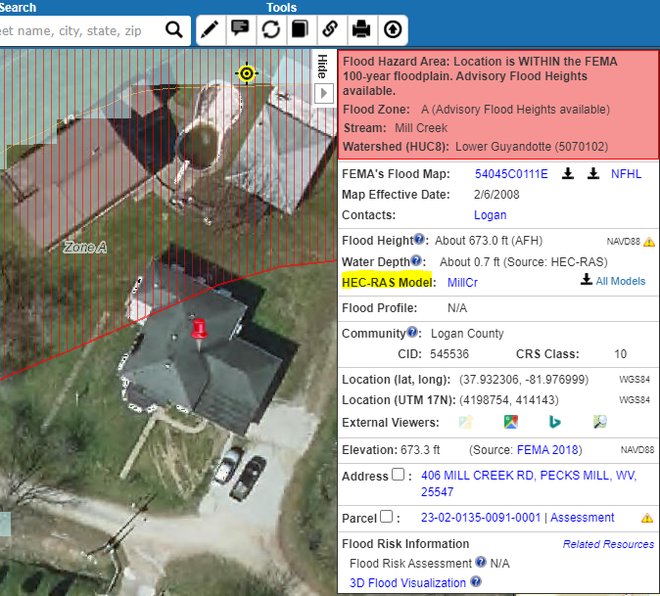
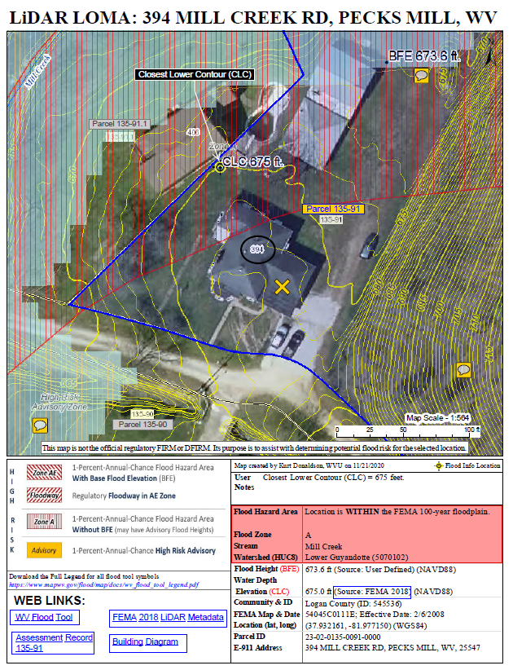
Studied Zone A (WV Flood Tool)
Studied Zone A
Studied Zone A
HEC-RAS Model for Mill Creek
FEMA’s Zone A Team always refers to the WV Flood Tool as a first resource to validate a LiDAR LOMA submitted for a Studied Zone A. The only exception would be if a certified, site specific study, is submitted with the request. In that case, the local study based on ground survey would be considered the best available data.
For consistency and accuracy, FEMA’s analysts always download the HEC-RAS model from the WV Flood tool in order to determine the appropriate BFE from the model profile plot to validate a Studied Zone A. FEMA will not rely solely on the LiDAR LOMA and BFE Exhibit generated from the WV Flood Tool.

Slide 35
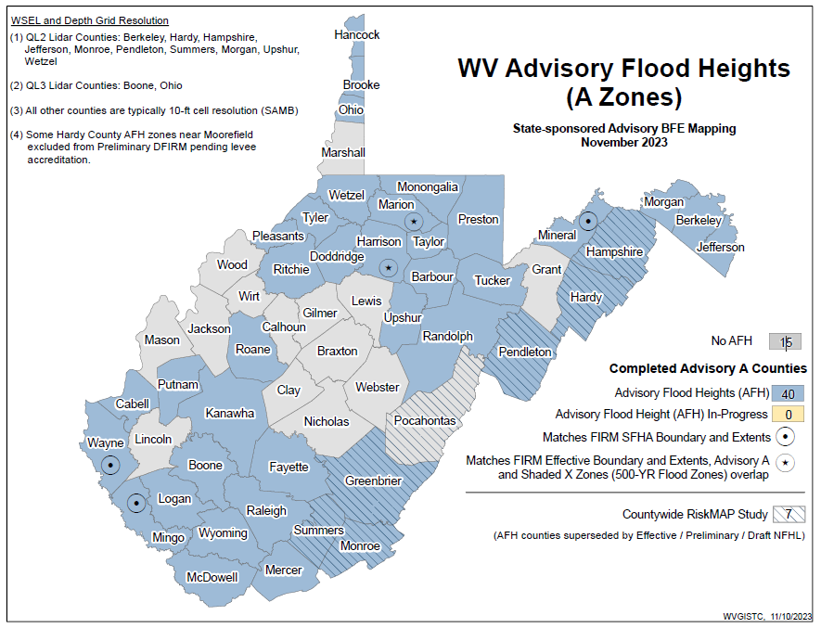
Studied Zone A (WV Flood Tool)
Advisory A / AFH Status Map
Advisory Food Heights exist for 40 counties as of November 2024

Slide 36
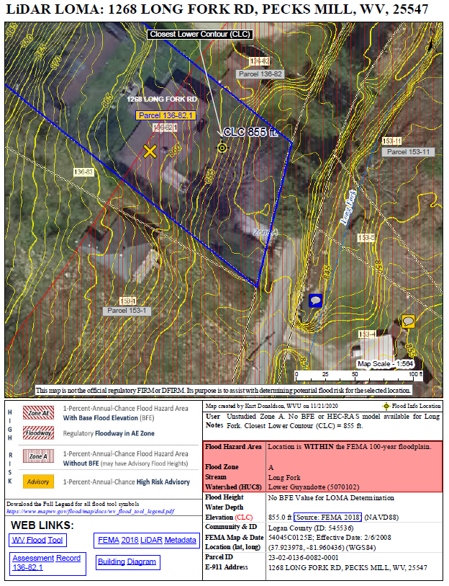
Unstudied Zone A (WV Flood Tool)
To estimate a BFE to determine if a structure can be removed from an Unstudied Zone A through the LiDAR process, FEMA recommends a simple method like Contour Interpolation.
Using the LiDAR-derived contours and LiDAR points of the WV Flood Tool, estimate the bank elevation and add a safety factor of at least two feet to be conservative. FEMA is always conservative in its BFE estimations. In cases where the LiDAR shows a property/structure above a computed BFE, then FEMA would issue the standard LiDAR removal determination.
If FEMA deems the contour or point cloud data to suggest the LAG could be lower, FEMA will use that lower value in its review. If this review would alter the outcome to be a possible non-removal, FEMA proceeds with asking for certified elevation data. FEMA does not issue non-removals based on LiDAR exhibits.
The requesters always have the option to provide any additional information and exhibits to assist with a BFE determination. However, until the drainage area and 1% discharge calculations are verified, FEMA cannot determine the BFE.
Unstudied Zone A

Slide 37
Unstudied Zone A
FEMA will attempt to calculate the BFE when a LOMA application is submitted for properties of less than 50 lots or 5 acres.
FEMA uses the best available topography to approximately model the BFEs. For areas where there is not a BFE tied to model backing that FEMA can download from the WV Flood Tool, FEMA will use whatever data is submitted or available to determine an applicable BFE for a request. FEMA will use the LiDAR available in the WV Flood Tool to capture the necessary extent to compute BFE determinations where there is no model backing. The availability of LiDAR provides FEMA with more confidence in the outcomes of these reviews and to complete a reasonable BFE determination.
For riverine flooding, FEMA measure a cross section at the upstream limit of the structure and use FEMAs Quick 2 software to apply Manning’s flow equation.
Where available, FEMA uses gage data or regional regression equations to determine the discharge for the model.
If the drainage area is too small for the parameter range FEMA may use the rational method.
If the source is a lake or depressed area, FEMA would apply stage-storage calculations or rectangular weir flow pending the identification of outlet or not.
FEMA follows the detailed methods of FEMA 256 Managing Floodplain Development in Approximate Zone A Areas that provides guidance for obtaining and developing base (100-Year) flood elevations.
Once that BFE is determined in-house, FEMA will know if the LiDAR results in a removal or will send a data request letter asking for certified elevations.
FEMA never discourages users from submitting a LiDAR LOMA because the BFE for an Unstudied Zone A is unknown. The LiDAR-derived ground elevation information submitted in the LiDAR LOMA Exhibit will be enough for FEMA to make an in-house determination.

Slide 38
LiDAR LOMA Disclaimer
LiDAR LOMA Disclaimer All cases issued using LiDAR in lieu of certified elevations will include the following disclaimer:
This determination is based on LiDAR topographic data showing the elevation of the subject property. The elevation data that were used are not certified by a Licensed Land Surveyor or Professional Engineer, but they meet or exceed FEMA requirements. This determination is subject to change if more detailed data becomes available.
Guidance for Flood Risk Analysis and Mapping MT-1 Technical Guidance (December 2020), LiDAR LOMA, Section 5.5, page 64

Slide 39
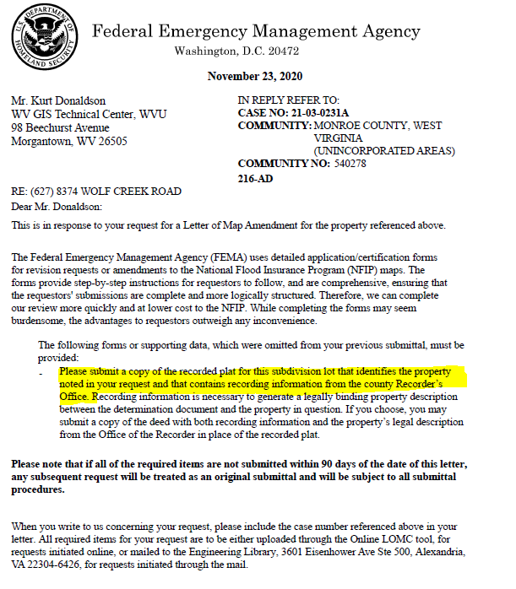
Submit all Required Documents
Make sure to submit all require documents including recorded plat or deed for property

Slide 40
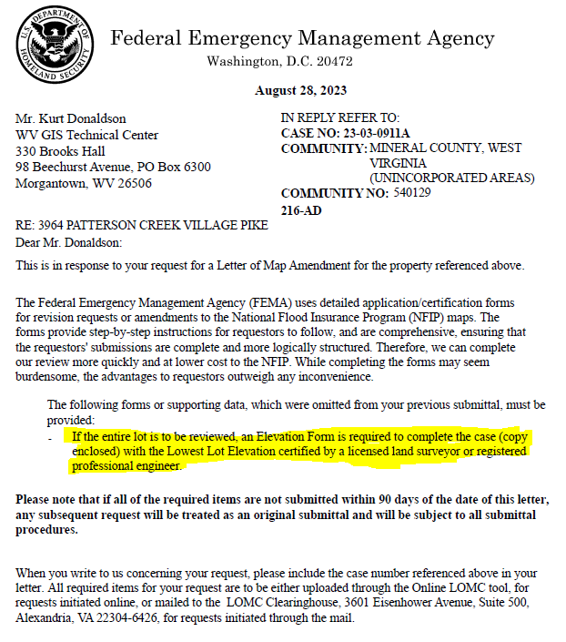
Lot LOMAs require Elevation Form
If the entire lot is to be reviewed, an Elevation Form is required to complete the case with the Lowest Lot Elevation certified by a licensed land surveyor or registered professional engineer.

Slide 41
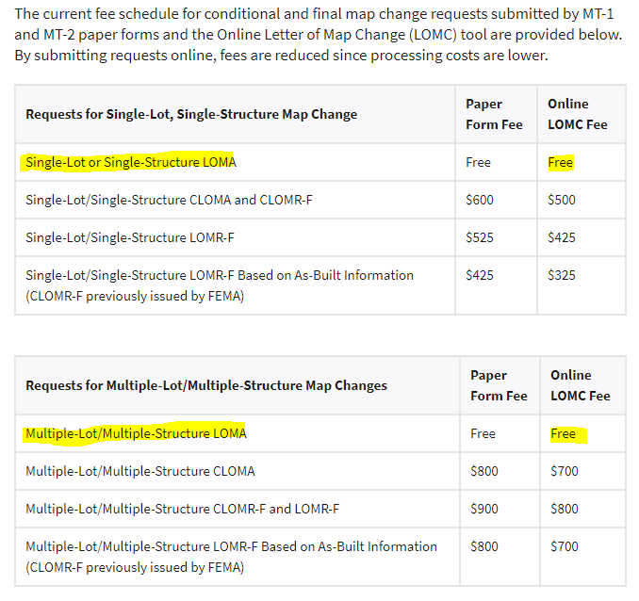
No Charge for LiDAR LOMAs
FEMA Related Fees
LOMA requests involving one or more structures: the LAG must be at or above the BFE.
LOMA requests involving one or more lots: the lowest point on each lot must be at or above the BFE.

Slide 42
RESOURCES
West Virginia WV Flood Tool LiDAR for LOMA Guide | Instructions WV LiDAR for LOMA Examples WV Elevation Source Metadata WV FEMA-Purchased LiDAR Status Map WV Advisory A / AFH Status Map WV Building and Property Identifiers WV Vertical Datums FEMA FEMA Online Letter of Map Change (LOMC) Website Online Letter of Map Change Tutorial (2018) How to Request a Map Amendment (2021) How to Request a LOMA or LOMA Based on Fill (LOMR-F) Region V LiDAR LOMA Fact Sheet (2018)

