Slide 1
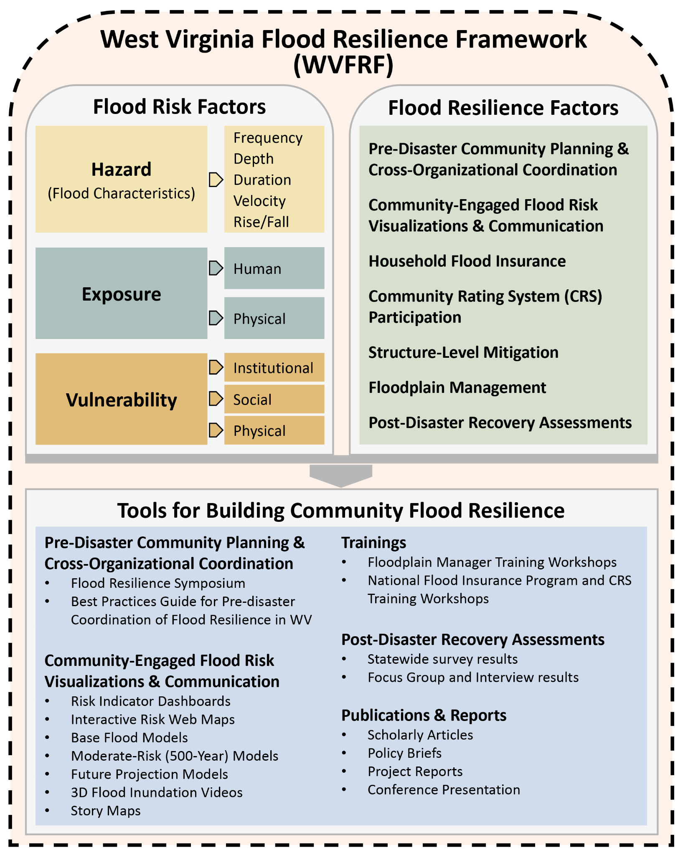
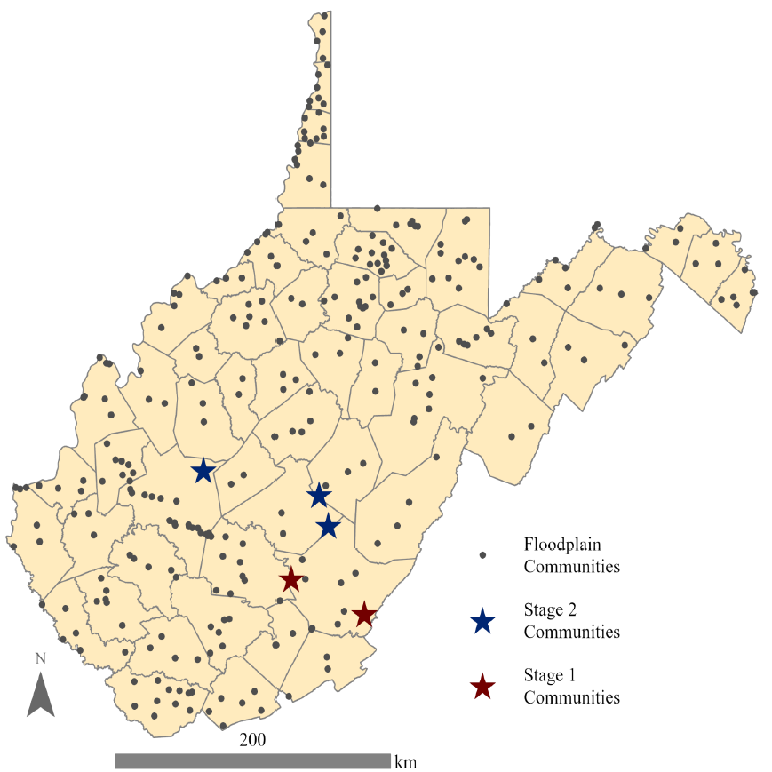
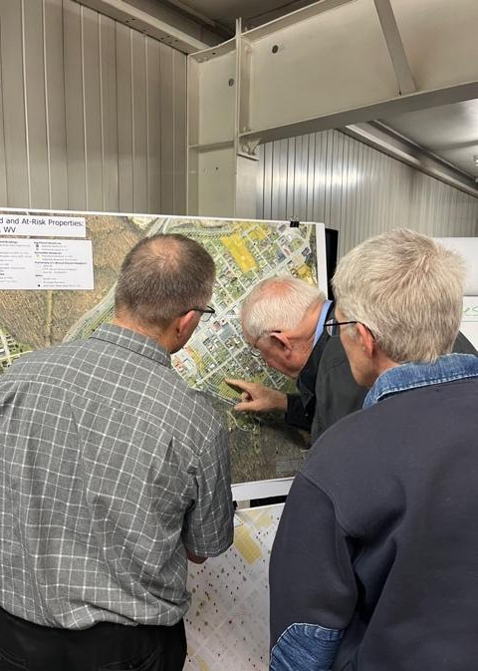
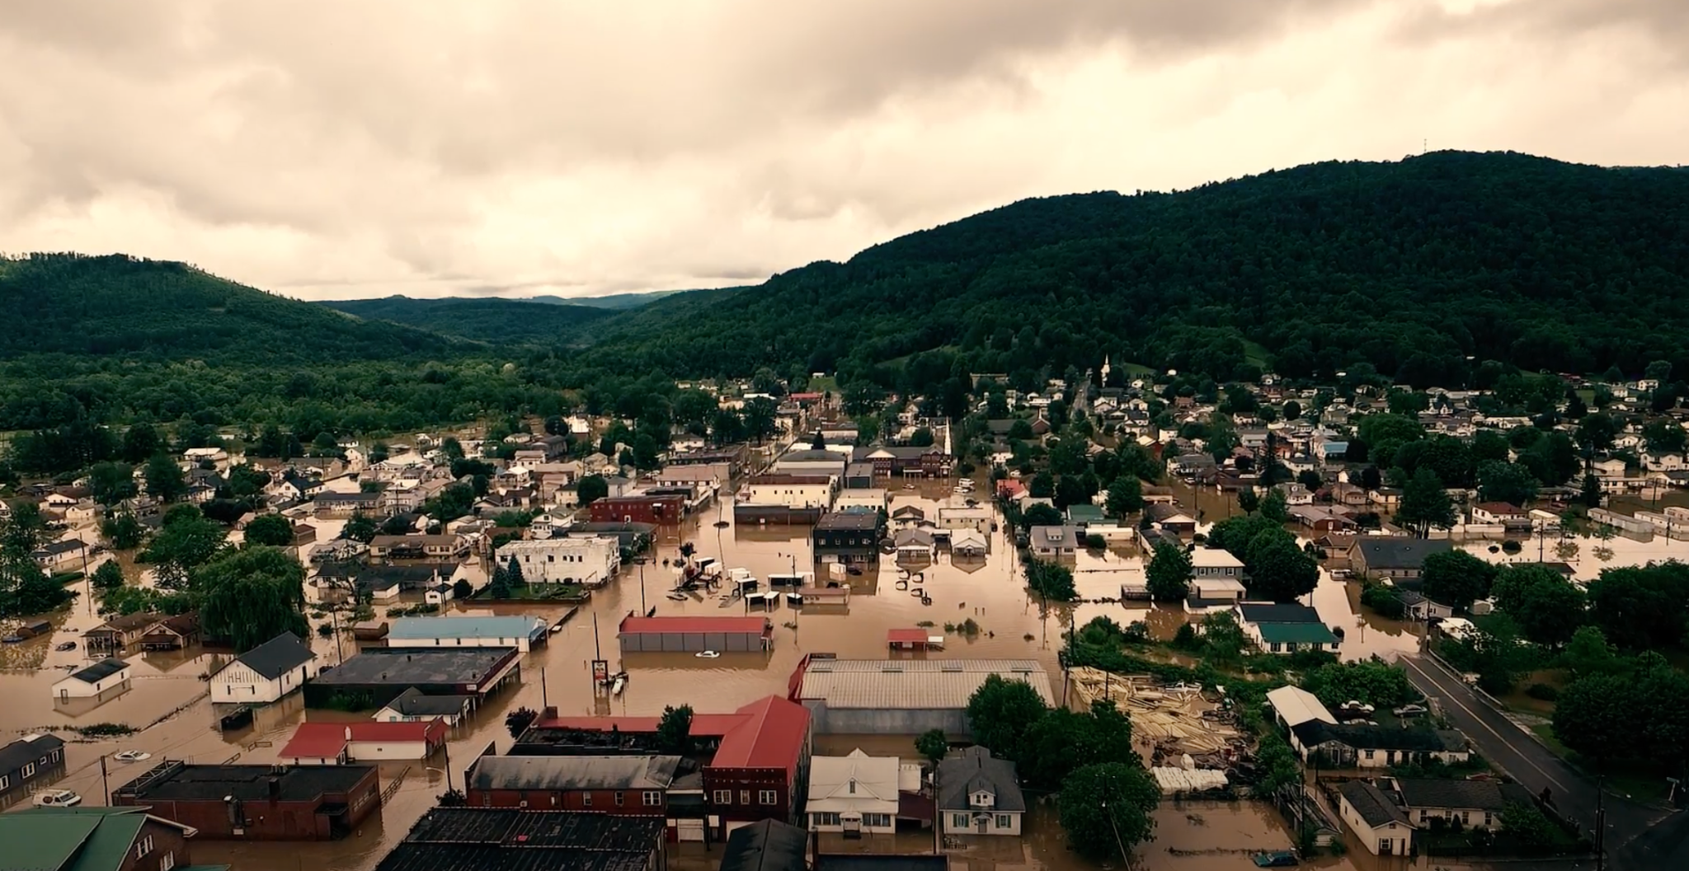
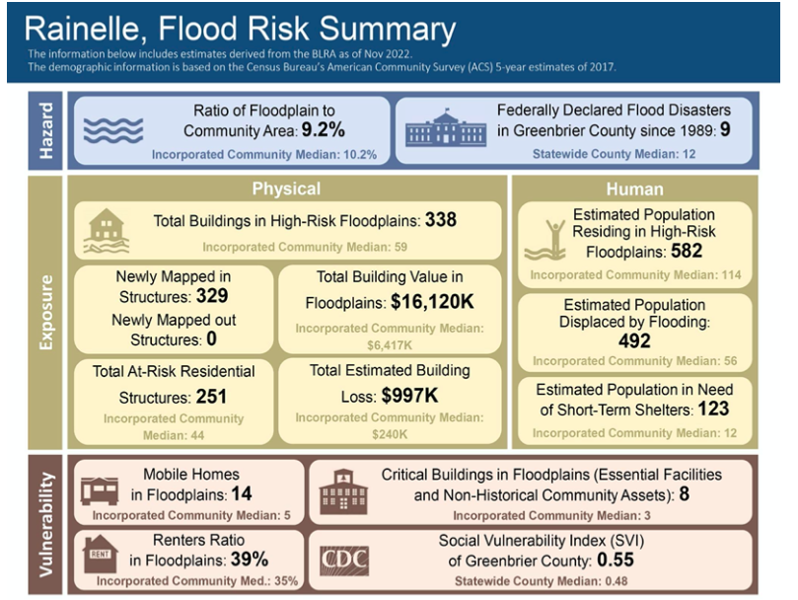
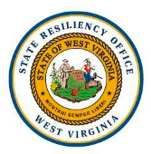
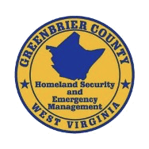
Creating the West Virginia Flood Resilience Framework for comprehensive disaster response and long-term community recovery
Background
Stage 2 Activities
West Virginia Flood Resilience Framework (WVFRF)
99% of US counties experienced at least one flood between 1996 and 2019
West Virginia (WV) has high risk of flooding, with at least one flooding-related federal disaster declared in all counties since 1996
Resilience is the ability to prepare and plan for, absorb, recover from, and more successfully adapt to adverse events
Community-engaged process
Statewide resilience survey
Flood risk visualization tools for high-risk communities using Participatory GIS
Statewide Flood Resilience Symposium
Floodplain management and flood insurance trainings
Flood risk indicator reports for all 286 floodplain communities
Creation and launch of WVFRF
A freely available online and ongoing resource for residents, local leaders, non-profit organizations, state and regional officials, and others to catalyze flood resilience for WV communities through improved flood risk knowledge, floodplain management, comprehensive disaster preparation, and long-term resilience planning
WV floodplain communities
Example of PGIS activity from Stage 1
Rainelle, WV during 2016 Flood
While designed for WV, project outcomes and processes will be transferable to communities across Appalachia and the US as a model for using social science and PGIS methods to create community-driven disaster response systems
Flood risk indicator report for Rainelle, WV
WVFRF conceptualization

