Slide 1
Structural Assessment Elements
Residential
Non-Residential
Foundation
Superstructure
Roof Covering
Exterior Finish
Interior Finish
Doors and Windows
Cabinets and countertops
Floor Finish
Plumbing
Electrical
Appliances
HVAC
Foundation
Superstructure
Roof Covering
Plumbing
Electrical
Interiors
HVAC

Slide 2
Six Foundation Types
Continuous Wall with Slab (Standard): This system consists of low concrete or masonry perimeter stem walls supported on footings and connected to a raised slab, which may be at or above grade.
Basement: a basement is a below-grade enclosure. All sides of the foundation are enclosed with at least one side below grade. The basement can be finished or unfinished.
Slab-on-Grade: The lowest floor of the house is formed by a concrete slab that sits directly on the ground.
Piles: The piles support an elevated structure and consist of multiple columns driven into the ground and embedded several feet below grade. For purposes of the SDE tool, pile types include timber and precast concrete piles.

Slide 3
Crawlspace: A shallow, unfinished space beneath the lowest floor of the structure with access to ductwork, plumbing, and other utilities. The crawlspace is enclosed on all four sides, with vents and it may be susceptible to dampness and mold. Crawlspace foundation elements generally include spread footings and piers or posts.
Piers and Posts: This system is often used on manufactured housing and consists of multiple small piers or posts that support the structure and are shallowly embedded into the ground. These foundations vary widely in quality, from code-compliant systems with proper embedment and connections, to systems that are blocks with little to no embedment and gravity loads providing connections between the structure and the foundation

Slide 4
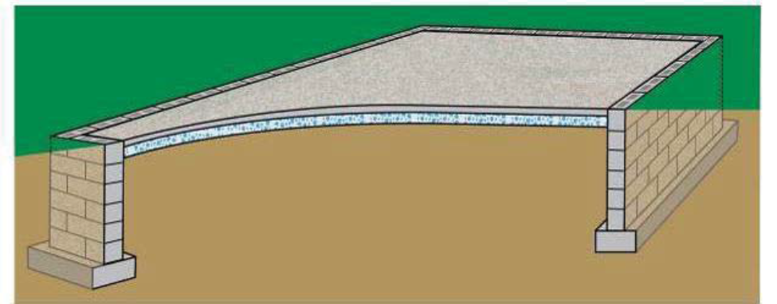
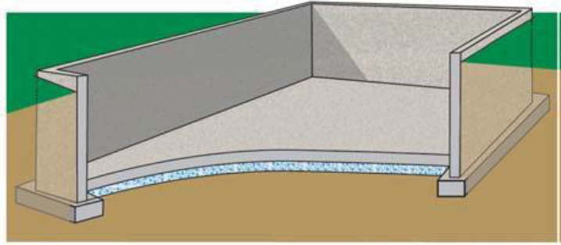
Continuous wall with slab
Basement

Slide 5
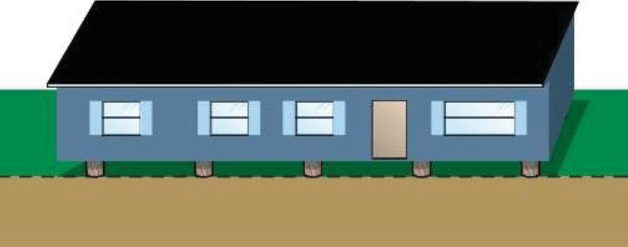
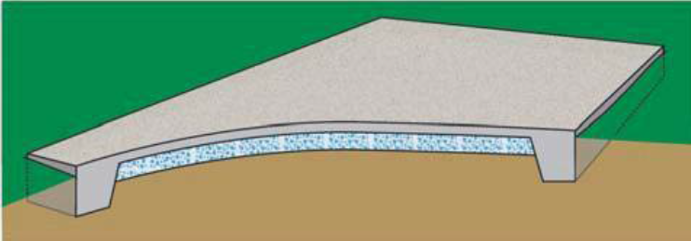
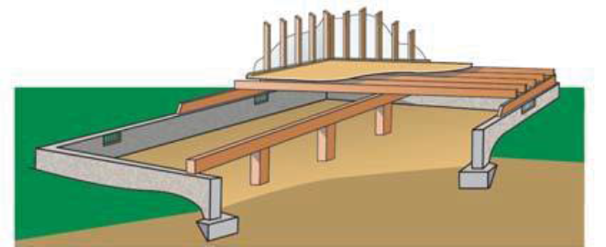
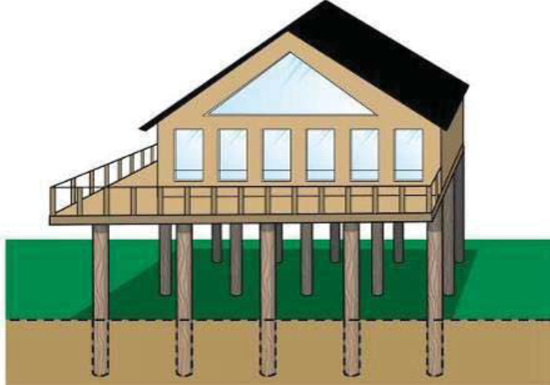
Slab-on-grade
Piers and Posts
Crawlspace
Piles

Slide 6
Superstructure Types
The superstructure includes all of the framing that provides structural support and a load path between the foundation and the roof
Stud-framed (Standard) – This common superstructure type involves using wood or steel members to structurally frame a residence and continuously carry loads from the roof to the foundation. Stud-framing is common and can be used in many combinations, depending on the exterior finishing system. Sheathing is often connected to the exterior of the stud-frames as an initial exterior layer

Slide 7
Common Brick – Brick units are stacked and mortared together to make up the exterior wall and provide the exterior structural system. The interior system can be wood-framed or constructed of additional brick-wall systems. These systems can be either unreinforced or reinforced using steel rods.
Insulating Concrete Form – This building system uses a synthetic insulation-forming system filled with concrete. This system requires an exterior finish of at least brick veneer, stucco, or siding to provide water resistance.
Masonry – Concrete masonry units (CMUs) are stacked and mortared together to make up the exterior wall and provide the exterior structural system. The interior system can be wood-framed or constructed of additional CMU wall systems. The systems can be unreinforced or reinforced using steel rods. This superstructure type may have no exterior finish, leaving the block exposed, or traditional cement-based stucco, exterior insulation finishing system (EIFS), or other exterior finishes may be attached to the CMU walls.

Slide 8
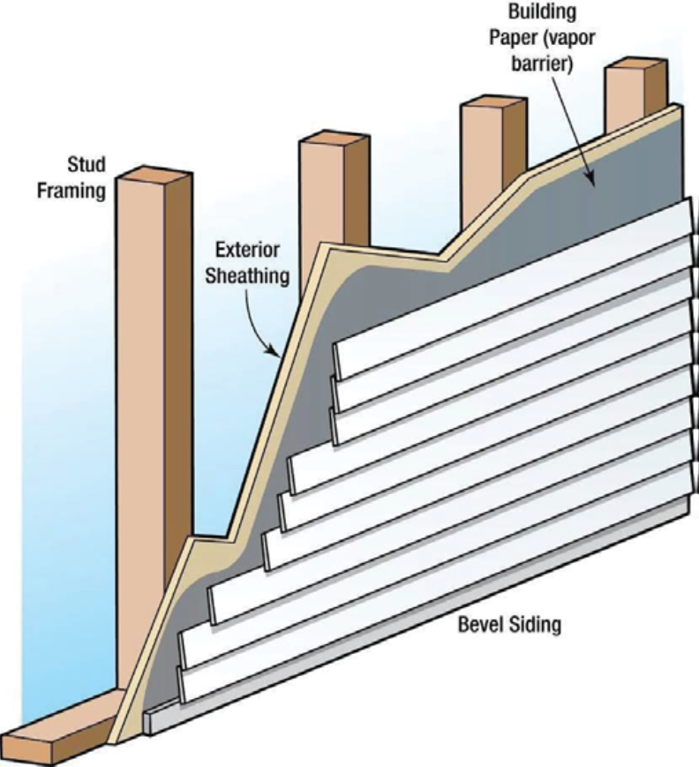
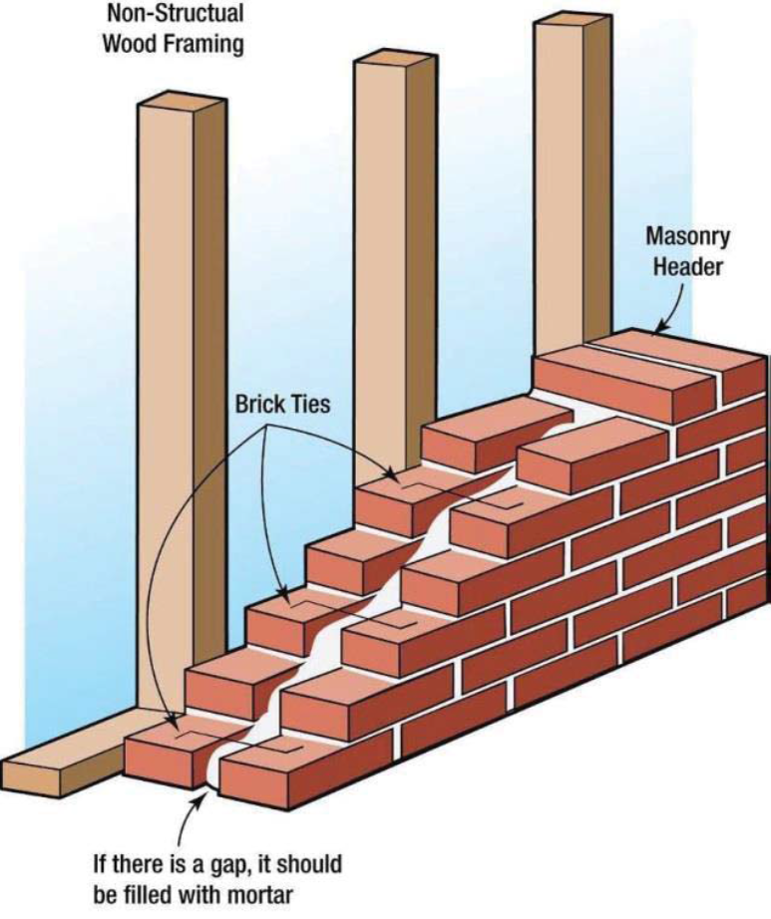
Stud-framed superstructure
Common Brick

Slide 9
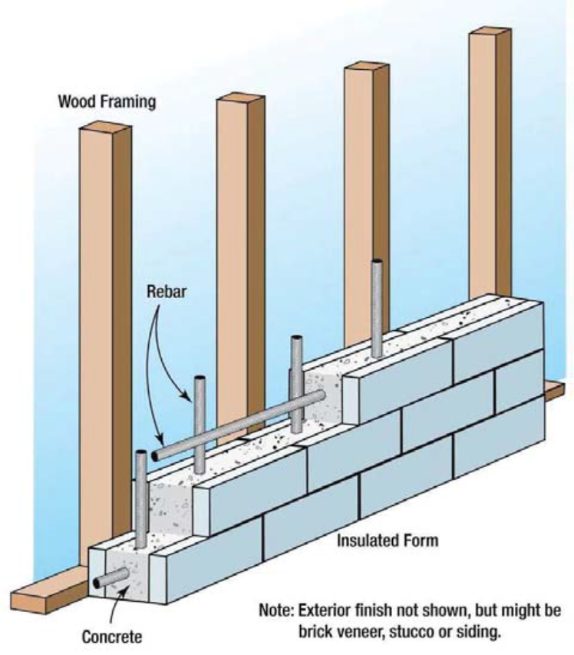
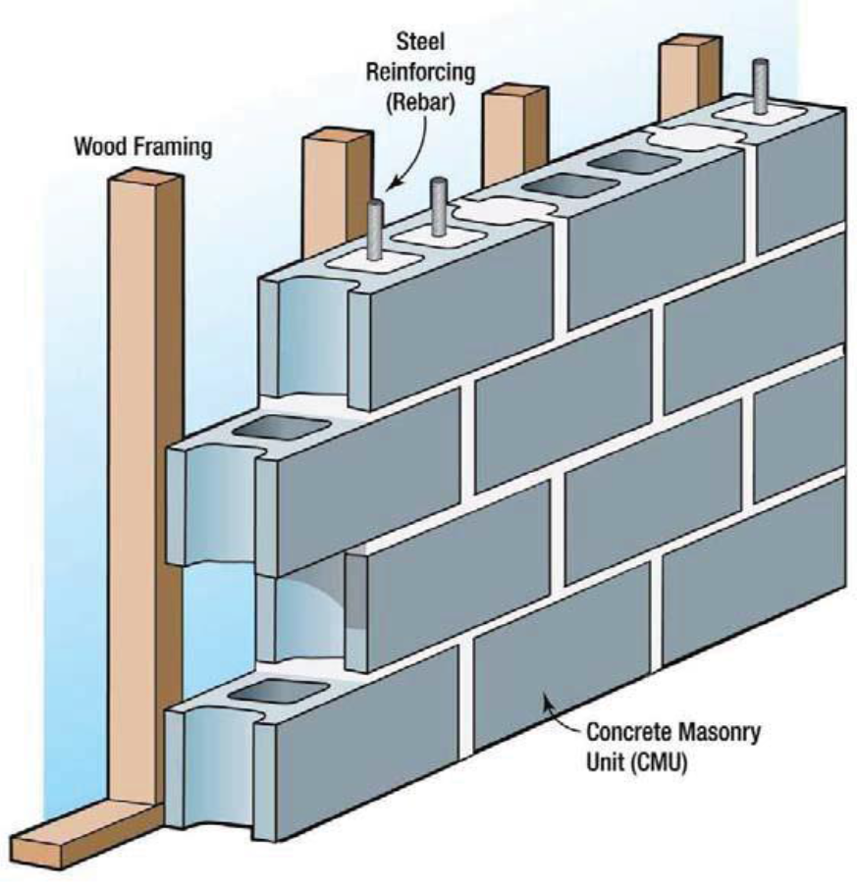
Insulating Concrete Form (ICF)
Masonry

Slide 10
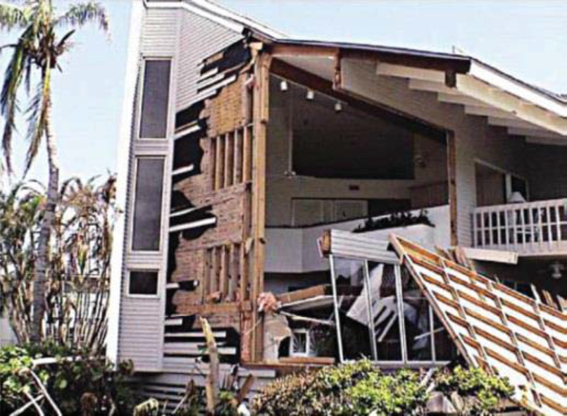
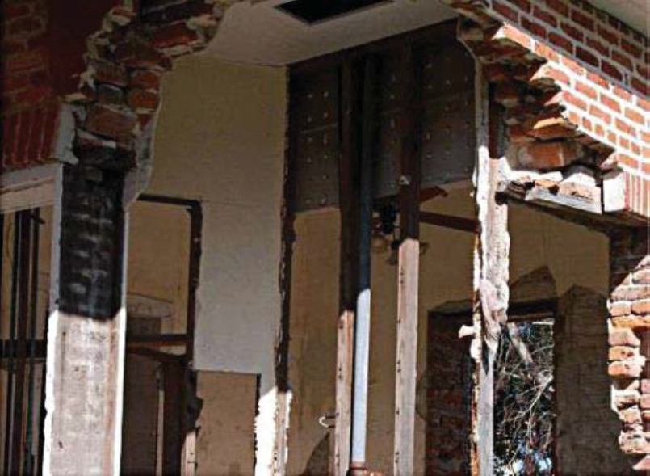
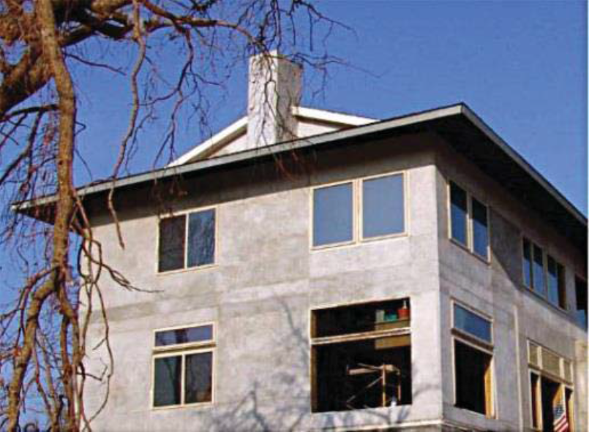
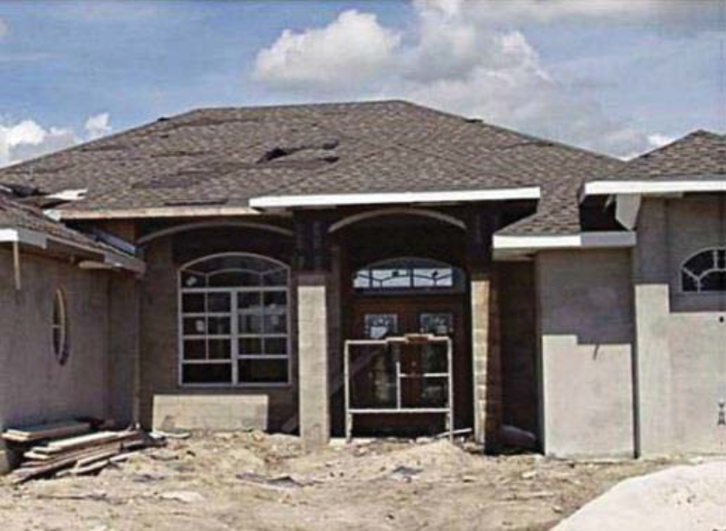
Stud-framed (standard) Common Brick
Insulating Concrete Form
Masonry

Slide 11
Roof Covering
Shingles (Asphalt, Wood, or Fiberglass) – This is the most common type of roof covering in the United States. Shingles are installed in overlapping arrangements. Shingles can have different wind resistance ratings, but also depend on their fasteners for proper resistance
Clay Tile – The tiles are often placed in parallel rows, with each row overlapping the row below it in order to hide the fastener and prevent water intrusion.
Standing Seam (Metal) – These roofs are composed of metal panels that are crimped together to form the roof covering. They typically have long life spans and good durability while typically costing significantly more than shingles.
Slate – Slate roof coverings are less common than most roof coverings because of high costs. Slate roofing can appear similar to clay tile but has different costs, performance, and material properties.

Slide 12
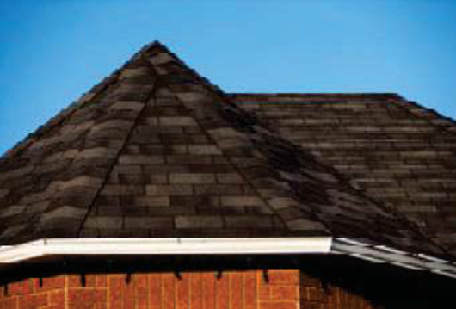
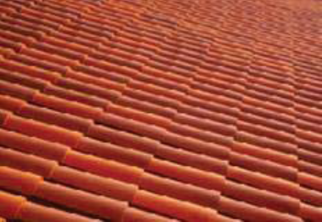
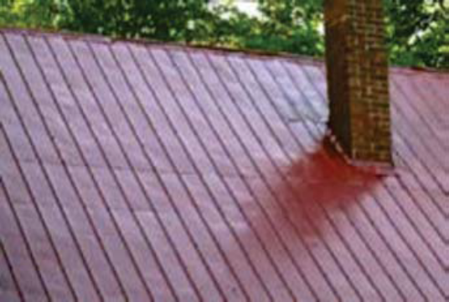
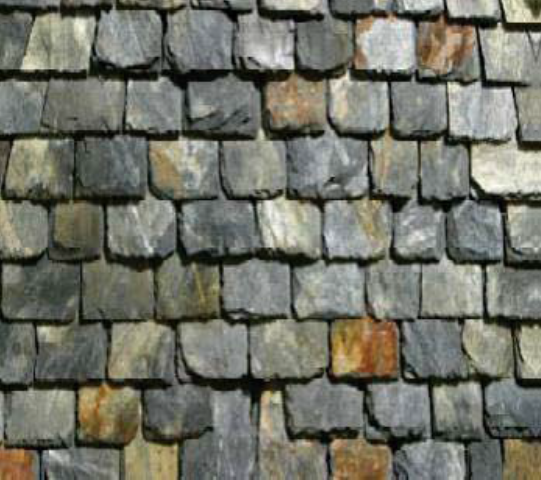
Asphalt Shingle Roof Clay Tile Roof
Standing Seam Metal Roof
Slate Roof

Slide 13
Exterior Finish Types
The exterior finish system’s primary contributions to a structure are weatherproofing and aesthetics. An exterior finish is non-structural and therefore not required if the wall material provides sufficient weather protection. For example, some older homes may have structural walls composed of brick that serve as both a structural support system and exterior finish. Newer construction may have CMU walls with no exterior finish. Preferably, all types of exterior finishes have a waterproof barrier between them and the underneath sheathing or other structural element.

Slide 14
Siding or Stucco (Standard) – The most common type of residential exterior finish in the United States is stucco or aluminum, clapboard, and wood or vinyl siding. The purpose is to protect the structure from the elements of heat/cold, rain/snow, sun, and up to a certain degree, wind while also adding an aesthetic feature through color or style. Most sections of siding are smaller than the walls they cover. Stucco involves a finish that is similar to a plaster or thin concrete compound that is mixed and applied wet onto concrete blocks, bricks, or sheets of wire mesh (metal lath) that help adhesion to the exterior of the wall.
None (common brick or structural) – This option should be selected when common brick is used (brick units are stacked and mortared together to make up the exterior structural system and the exterior finish) or when another structural material (such as CMU or ICF) is used for both the exterior wall and the exterior finish.

Slide 15
Brick veneer – A brick veneer is applied to the exterior sheathing of a stud-framed or masonry structure. The bricks are attached using brick ties nailed to the exterior sheathing. Most brick veneers have air space between the inside face of the brick and the exterior sheathing.
Exterior Insulation Finishing System (EIFS) –This option involves a non-load bearing exterior wall covering. It typically consists of several layers of materials sandwiched together into a single panel, which is then attached either adhesively or mechanically to the sheathing mounted on the outside of the wall studs. An EIFS wall normally has an exterior finish that includes an integrally reinforced base coat and a textured protective finish coat.

Slide 16
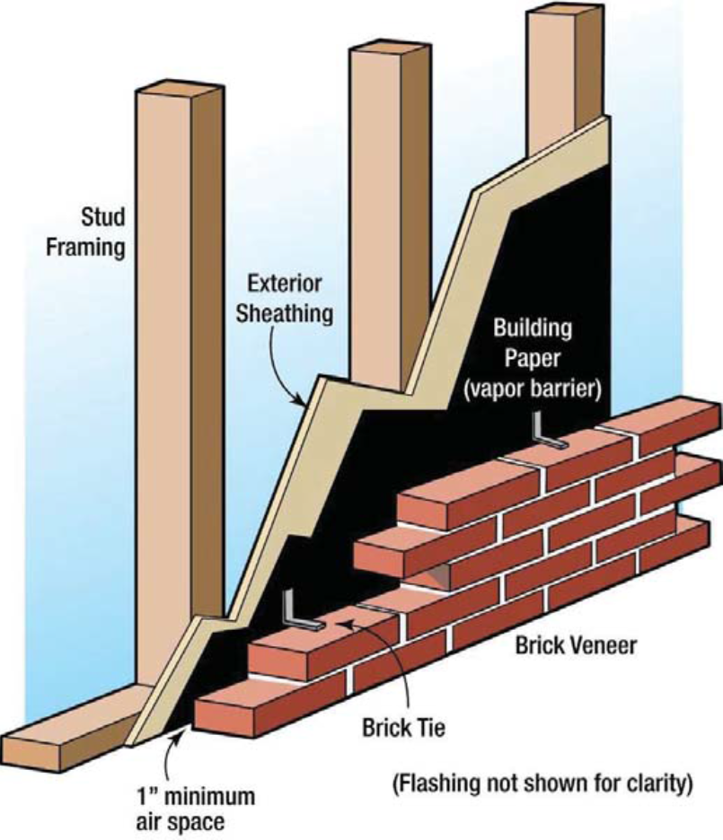
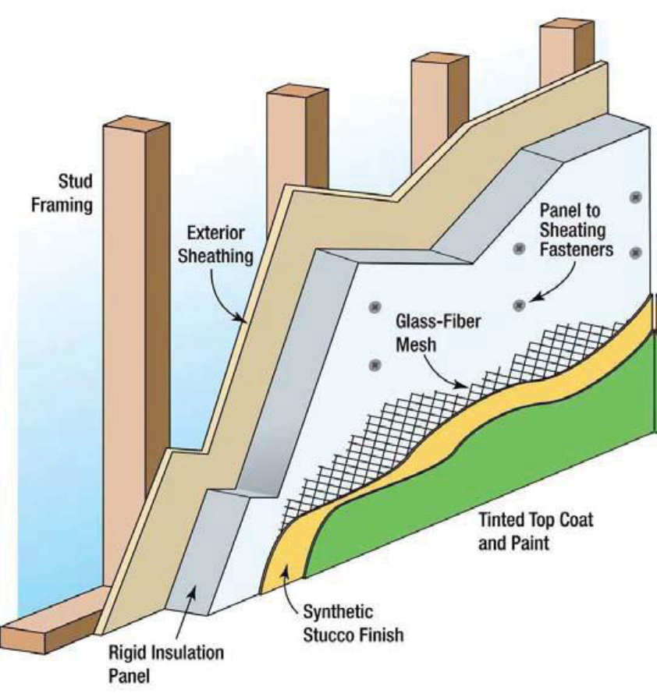
Brick veneer Exterior insulation finishing system

Slide 17
Interior Finish
Doors and Windows
Gypsum board, drywall, plaster, or paneling that makes up the wall & ceiling surfaces
Trim around door and window frames
Baseboard
Casings
Chair rails
Ceiling moldings
All interior and exterior doors and windows
Locks
Hinges
Frames
Handles

Slide 18
Cabinets & Countertops
Floor Finish
Built-in, wall mounted, or isolated cabinets and countertops (kitchens and bathrooms)
Carpet
Hardwood
Vinyl composition tile
Sheet vinyl
Ceramic tile
Marble
Does not include carpet or re-carpeting installed over finished flooring, such as wood or tile

Slide 19
Plumbing
Electrical
Incoming water service (municipal water supply or well service)
Plumbing fixtures
Water heater
Water distribution system
Wastewater collection and removal system
Electrical wiring systems (junction boxes, circuit breaker panels, distribution wiring, outlets, switches, receptacles)
Lighting
Ceiling and exhaust fans
Electric baseboard heaters

Slide 20
Appliances
HVAC: Heating, Ventilation, and Air-Conditioning
All built-in, permanent appliances in the structure
Fridge
Stove
Washer and Dryer
Dishwasher
The system with which conditioned air is distributed throughout the structure: a typical system in residential structures involves a forced-air heating system with duct work
Exterior air conditioning units
Heat pumps
Furnaces

Slide 21
HVAC: Heating, Ventilation, and Air-Conditioning
Residential structures in some areas of the country do not have heating, ventilation, and air-conditioning (HVAC) systems, especially in warmer or mild climates. The SDE tool defaults to residential structures having an HVAC system. However, the user can select no HVAC. The costs for a single system (i.e., heating or cooling alone) and a combined system that provides both heating and cooling are similar enough for the purposes of SDE. The user can select HVAC system for both heating and cooling or only one of them, or no type of system.

Slide 22
Non-Residential Structure
Foundations
Superstructure
Continuous perimeter footings
Footings
Piers
All foundation elements
Load-bearing system that extends from the foundation to the roof of the structure
Structural members that support the roof deck, such as rafters and trusses
Exterior finishes, such as exterior walls, sliding, and exterior doors

Slide 23
Roof Covering
Plumbing
Covering materials (shingles, tile, slate, metal roofing, built-up roofing)
Roof sheathing
Roof flashing
Incoming water service (municipal water supply or well service)
Plumbing fixtures
Water heater
Water distribution system
Wastewater collection and removal system
Exterior drainage (roof gutters, downspouts)
Fire protection

Slide 24
Electrical
Interiors
Electrical wiring systems
Lighting
Ceiling and exhaust fans
Electric baseboard heaters
Communications
Conveyance (escalators, elevators)
Security systems
Partitions
Interior doors
Interior surface finishes (wall, floor, and ceiling)

Slide 25
HVAC: Heating, Ventilation, and Air-Conditioning
Heating units
Cooling units
Ventilation

Slide 26
Non-Residential Structure Uses and Number of Stories
For non-residential structures, construction type is not used directly as the basis for determining the element percentage array. Instead, structure use and the number of stories are the determining factors for the array. For each structure use, the SDE tool uses representative structure types and the structure attributes to determine the element percentage arrays.

Slide 27
