Slide 1
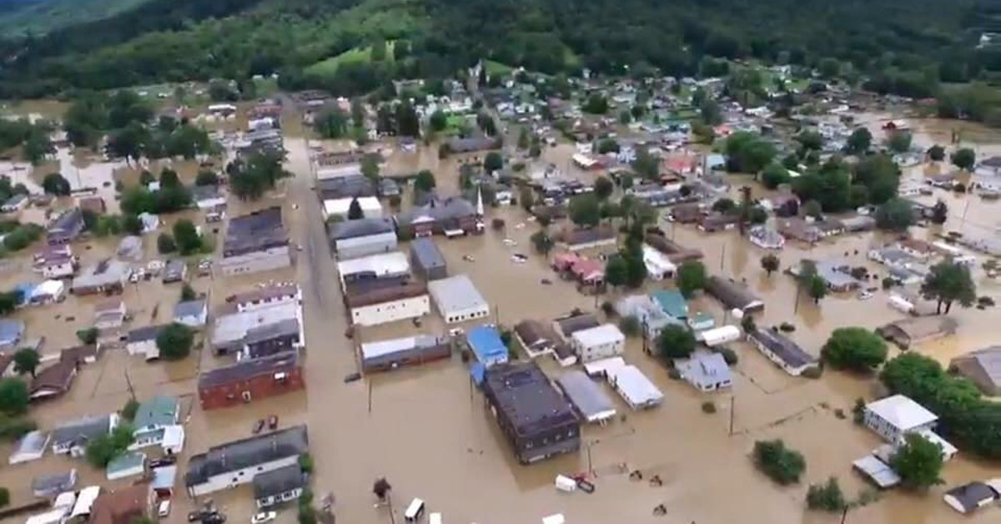
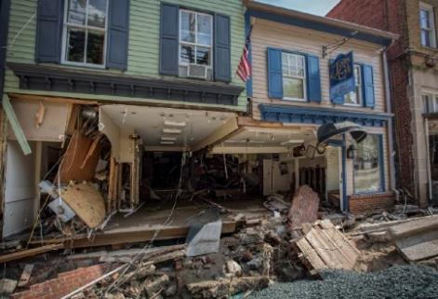
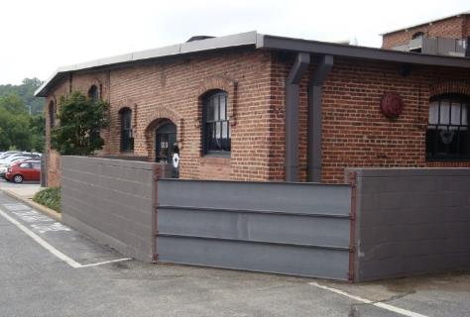






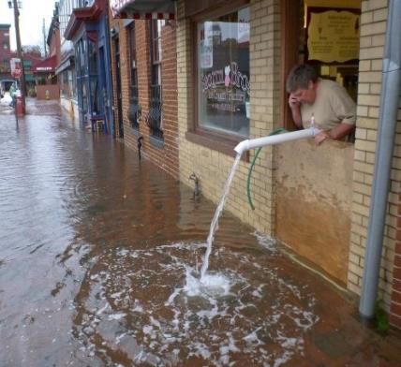
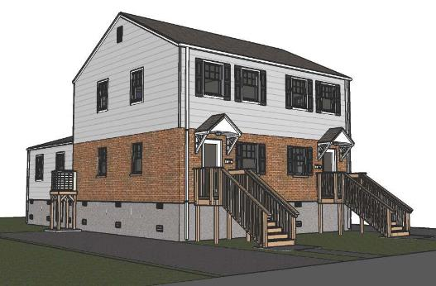





Stephen D. O’Leary AIA
Secretary, National Nonstructural Committee
Architect, Planner, Project Manager
USACE-Huntington District
Flood Risk Adaptive Measures

Slide 2
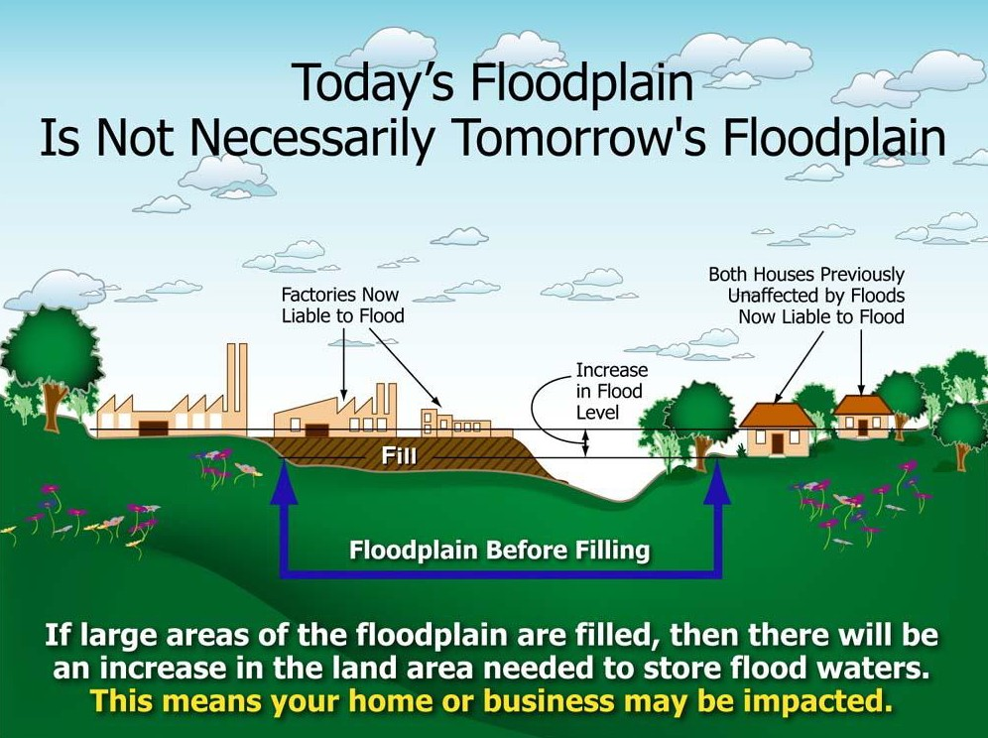
THE CHANGING FLOODPLAIN
Man-Made Dynamics

Slide 3
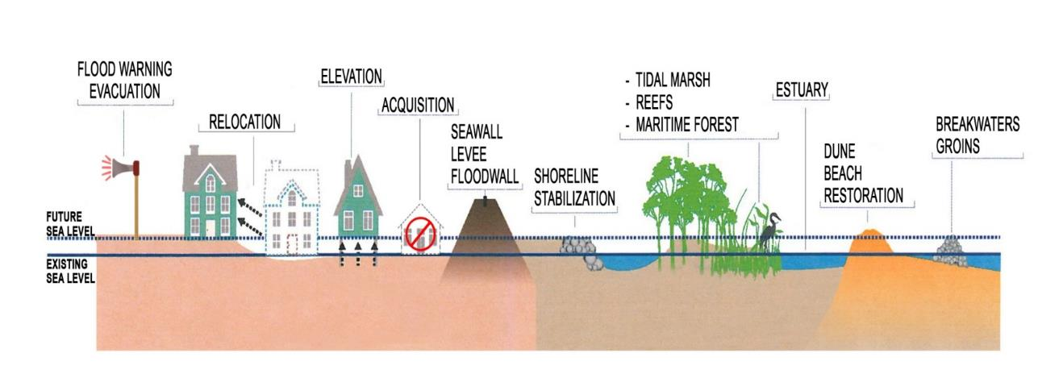
FLOOD RESILIENCY
Comprehensive/Holistic
approach to resisting catastrophic loss

Slide 4
FLOOD RISK ANALYSIS
Flood Risk = f [Hazard x Probability of Flooding x Consequences]
HAZARD is a water surface elevation for a specific flood/inundation event.
PROBABILITY of Flooding is the frequency of flooding or how often does flooding occur in a particular location. Reduce the frequency of flooding and risk is reduced.
CONSEQUENCES are the potential damages and life loss associated with flooding. The structures (critical, residential, commercial, public, and industrial), land use (agricultural, urban, public) , and infrastructure (highways, roads, rail, utilities) make up the potentially damageable assets. Reduce the consequences of flooding and risk is reduced.
Note: If critical facilities become inoperable during a flood event, the area of impact extends beyond the area of flooding (i.e. hospitals, fire and rescue, energy, communications, water and wastewater, etc.).

Slide 5
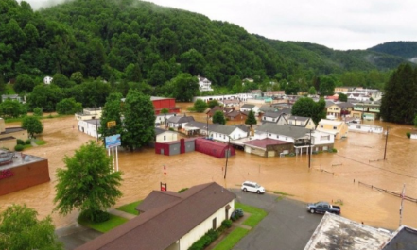

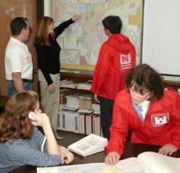
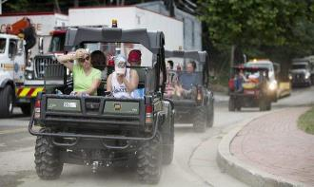
FLOOD RISK CONSEQUENCES
Life Loss
Health, Safety & Welfare
Damage to Property
Business Losses
Emergency Response Costs
Recovery Costs
Community Cohesion
Compounded Disasters
  Fire
  Hazardous Material
  Critical Facilities (Power, Potable Water Sewer, Communication)

Slide 6
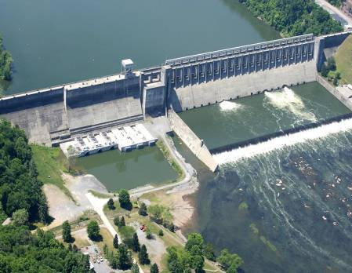
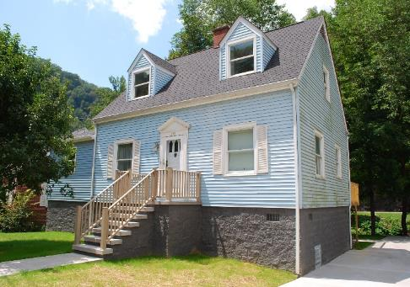
FLOOD RISK MANAGEMENT
STRUCTURAL - reduce probability:
Control / Change Hydrology
  Dams - Fed, State & Local
  Levees / Floodwalls - Local
  Diversions - Local
  Channels – Local
Scale - LARGE
NONSTRUCTURAL - reduce consequences:
Adapt to floodplain
  Flood Risk Adaptive Measures
  Property - Local/Private
  Behavior – Local/Private
  Planning/Preparedness – All
  Restore Floodplain – All
Scale – small
Notes:
FLOOD RISK CONSEQUENCES
Life Loss
Health, Safety & Welfare
Damage to Property
Business Losses
Emergency Costs
Community Cohesion
Life Loss
Health, Safety & Welfare
Damage to Property
Business Losses
Emergency Costs
Community Cohesion
Flood Risk Adaptive Measures allow people who are exposed and vulnerable to flood risk to adapt to flooding and those risks associated with flooding without changing the characteristics of the flood ……….no increased stages, velocities, or duration of flooding.

Slide 7
Or, put another way……
Flood Risk Adaptive Measures allow for people and structures that are exposed and vulnerable to flood risk to adapt to flooding and to those risks associated with flooding without changing the characteristics of the flood ……….no increased stages, velocities, or duration of flooding.

Slide 8






FLOOD RISK ADAPTIVE MEASURES
PHYSICAL
Acquisition (buyout / demolition)
Basement Fill
Elevation
Relocation (Individual Structures / Multiple Structures)
Dry Flood Proofing
Wet Flood Proofing
Barriers – Berms Walls (Temporary / Permanent)
NONPHYSICAL
Education / Communication
Flood Emergency Preparedness & Warning
Other - National Flood Insurance Program (NFIP); Floodplain Management; Land Use Regulation (Zoning); Building Codes
NATURE BASED
Low Impact Development / Green Infrastructure / Floodplain Restoration

Slide 9
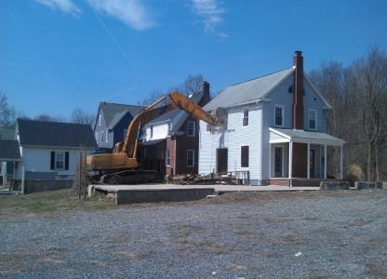
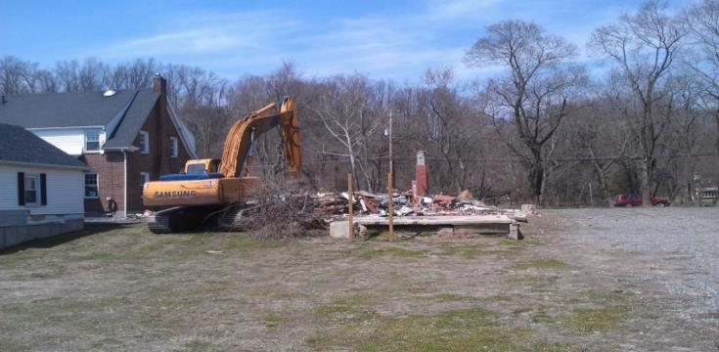
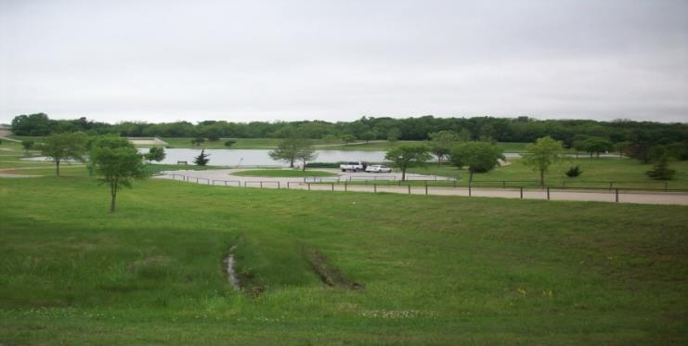
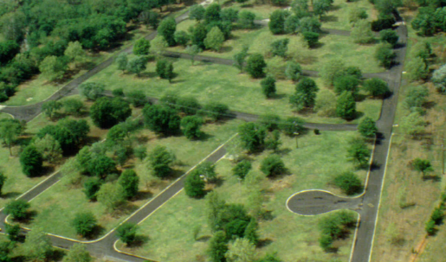
FLOOD RISK ADAPTIVE MEASURES
Acquisition
Acquire & Demolish
Opportunities & Challenges
Notes:
9

Slide 10
FLOOD RISK ADAPTIVE MEASURES
Basement Evacuate/Fill (the basics)
Evacuate Basement
  Relocate Storage/Other (Above DFE)
  Elevate Mechanical/Electrical Equipment (Above DFE)
  Remove Finishes & Demo Floor Slab
Fill Basement (Level w/Exterior Grade & Suitable fill)
Install Flood Louvers/Vents/Openings

Slide 11
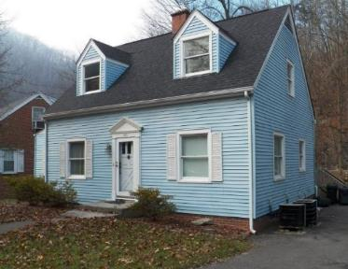
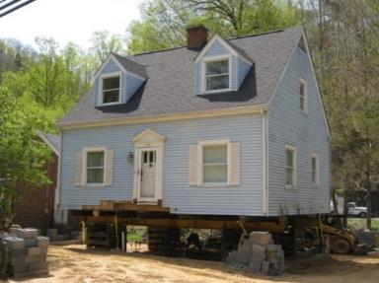
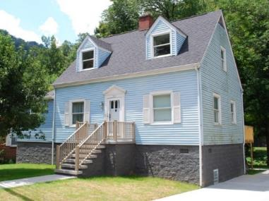
FLOOD RISK ADAPTIVE MEASURES
Elevation
Residential Structure – Grundy, VA
…is one of the most common and effective methods used to prevent flooding of living space…
…recommend design and construction by reputable/qualified
professionals and contractors…
…Not permitted in regulatory floodway…Not recommended areas of
high velocity
…Acceptable in A Zones.

Slide 12
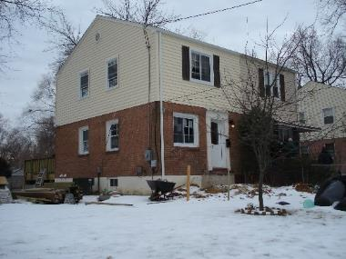
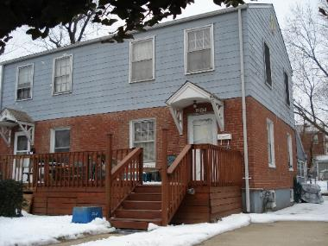
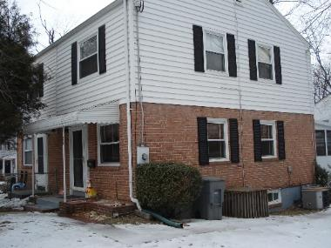
FLOOD RISK ADAPTIVE MEASURES
Elevation
Huntington, VA - Assessment
Existing
Proposed

Slide 13

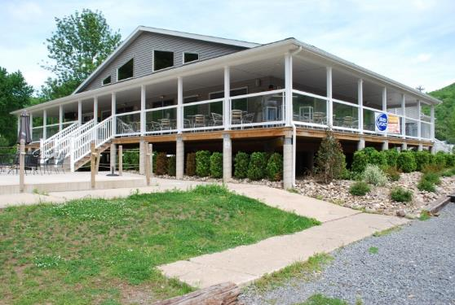
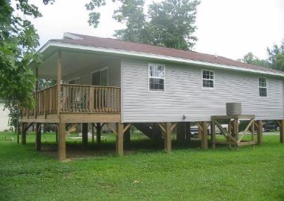
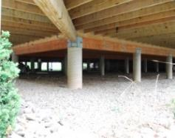
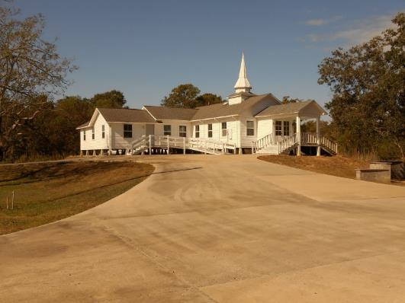
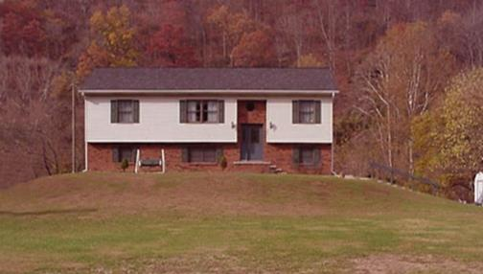
FLOOD RISK ADAPTIVE MEASURES
Elevation Utilizing Piers / Posts / Columns
Fill

Slide 14
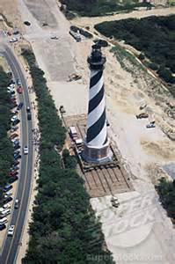
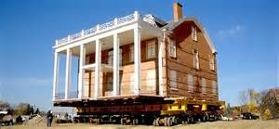
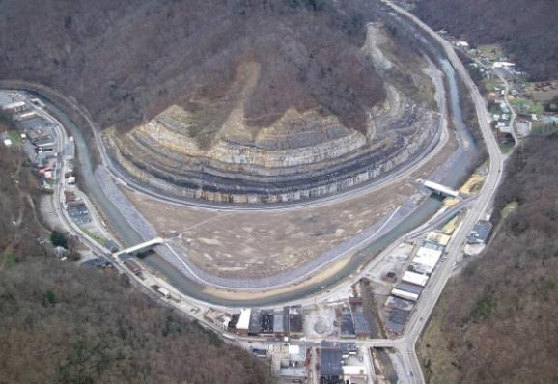
FLOOD RISK ADAPTIVE MEASURES
Relocation
Masonry Structure
Lighthouse - Cape Hatteras, NC
Grundy, VA

Slide 15
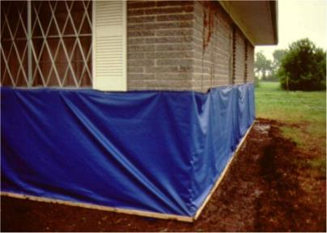
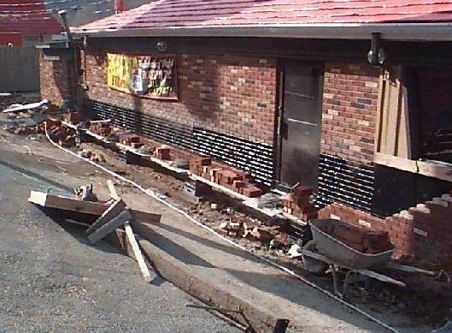
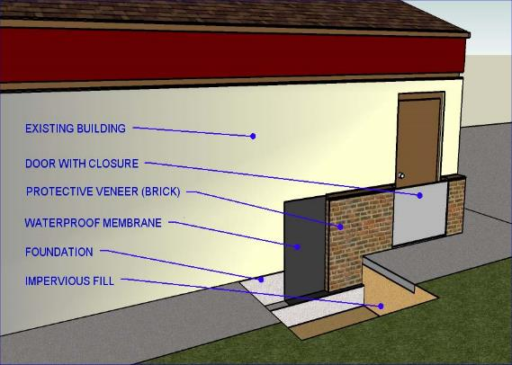
FLOOD RISK ADAPTIVE MEASURES
Dry Flood Proofing
Flood depths 3 feet or less
Structurally sound buildings
New design & construction
Retrofitting existing structures
No basement or crawl space
Dry Flood Proofing (Temporary)
Basic Dry Flood Proofing Detail
Kermit, WV (Pizza Hut)

Slide 16
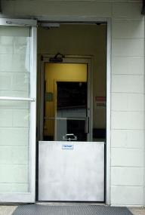
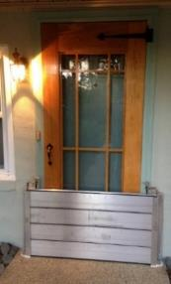
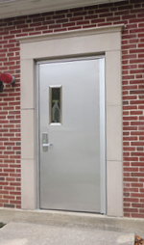
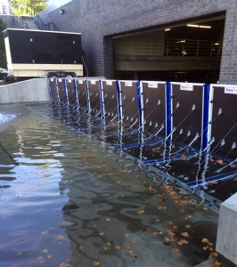
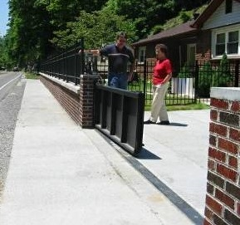
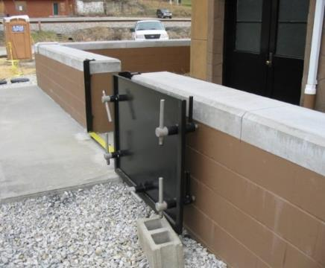
BARRIERS - CLOSURE DEVICES
Inserts
Stop Logs
Waterproof
Door
Panel System
Swing Gate (Driveway)
Wall Swing Gate

Slide 17
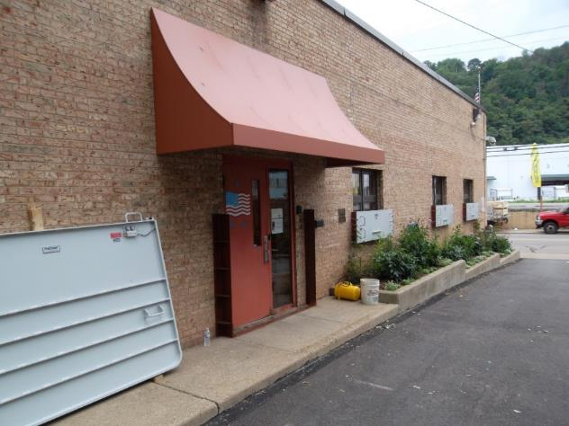
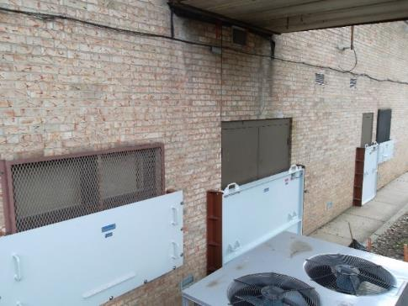
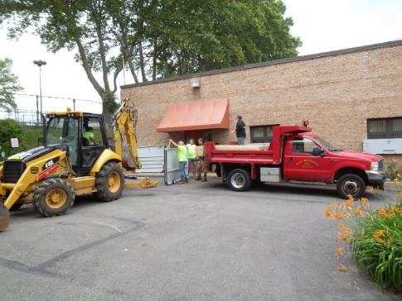
FLOOD RISK ADAPTIVE MEASURES
Dry Flood Proofing
Etna Borough, PA Municipal Bldg.
Critical Facility (EOC)
Temp Closures – Access/Egress?
Installation requires equipment & manpower

Slide 18
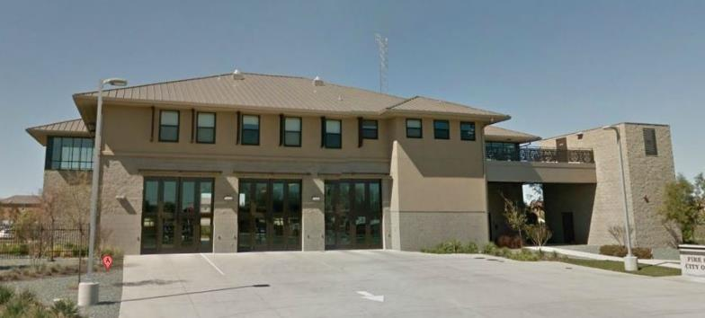
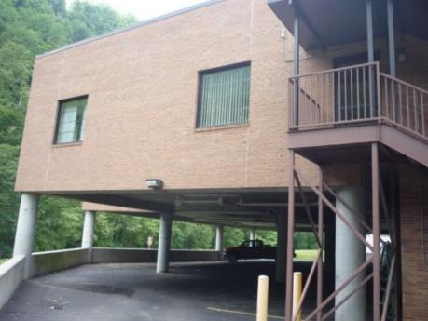
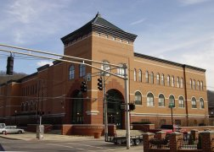
FLOOD RISK ADAPTIVE MEASURES
Wet Flood Proofing
City of Sacramento Fire Station 43 (Natomas, CA)
Church (Grundy, VA)
Town Hall (Prestonsburg, KY)

Slide 19
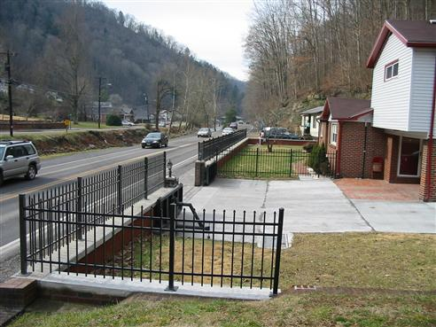
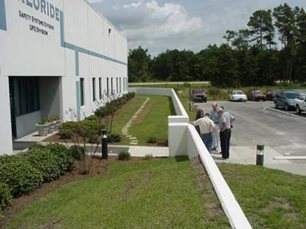
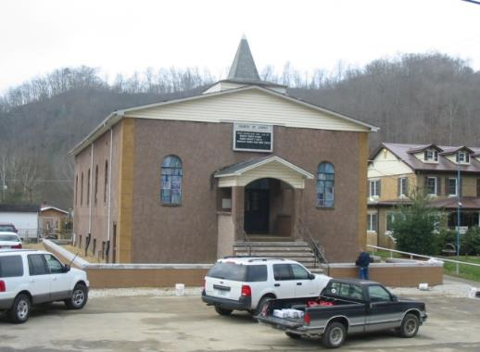
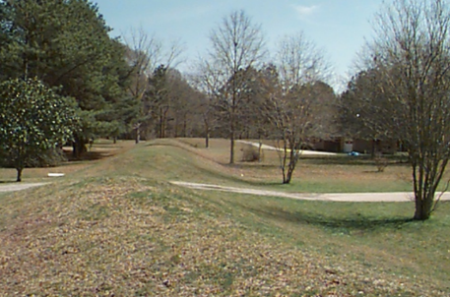
FLOOD RISK ADAPTIVE MEASURES
Barriers - Walls / Berms (USACE – Structural)
Concrete Wall (commercial)
Masonry Wall (residential Grundy, VA)
Earthen Berm
Masonry Wall (non-residential Crum, WV)

Slide 20
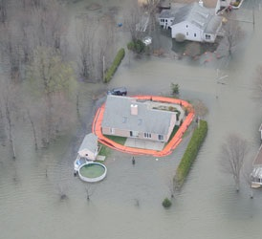




FLOOD RISK ADAPTIVE MEASURES
Barriers - Walls / Berms Temporary Perimeter Systems
PANELS (FOLDING)
PANELS (SELF RISING)
BLADDER
Notes:
Flood Barriers – Temporary Perimeter Systems
Examples of temporary perimeter systems. Images are from the National Barrier Testing and Certification Program website.
Examples are systems that have been tested and certified. NOTE - Not promoting manufacture and or system…Use is at your discretion.
Manufactures have several systems – only certain systems tested and certified.
Systems are typically reusable.
Left – Water Gate Flood Control Barrier – Plastic material self rising - Raises with water level.
Right – AquaFence Flood Protection Barrier System – Framed system
Reusable – Has to be stored somewhere.
Need Manpower to install
Can be used as closer device at larger openings
Active systems – Install prior to flood – removed after

Slide 21



FLOOD RISK ADAPTIVE MEASURES
Elevation / Wet Flood Proofing (Historic Structure)

Slide 22



FLOOD RISK ADAPTIVE MEASURES
Elevation & Wet Flood Proofing (Historic Structure)
Annapolis, Maryland
Historic District

Slide 23





FLOOD RISK ADAPTIVE MEASURES
Historic Museum Annapolis, MD
Temporary Barrier
Slab
Closure/Shield
DFE
INTERIOR EXTERIOR
FF
1%
FG
BUILDING SECTION (at Grade)
Not to Scale

Slide 24




FLOOD RISK ADAPTIVE MEASURES
Nonphysical
Awareness - Education / Outreach
Regulations (codes, zoning, floodplain management)
Warning / Evacuation
  Who / How / When
Preparedness Planning
  Response / Recovery
  Evacuation Routes
  Evacuation Centers
  Vertical Evacuation

Slide 25





FLOOD RISK ADAPTIVE MEASURES
Low Impact Development & Green Infrastructure
RAIN GARDEN
PLANTER BOX
GREEN SPACE
POROUS PAVEMENT
RAIN BARREL

Slide 26





SHARED RESPONSIBILITY & SELF HELP
GOOD
OBSERVATIONS

Slide 27







SHARED RESPONSIBILITY & SELF HELP
Elevated HVAC / WH
(Interior)
GOOD
Rain Barrel
Identify Risk
Plan / Prepare
Manipulate Landscape
Acquire/fabricate barriers
Install Flood Louvers/Vents/Openings
Elevate Mechanical/Electrical Equipment
Remove/Rehab Damageable finishes/Construction
Sewer check valve(s) / Building drain check valve(s)
Evacuate Basement (Equipment / Appliances / Storage)
Elevated HVAC (Exterior)

Slide 28
HURRICANE HARVEY AFTERMATH

Slide 29







ASSESSING THE SITUATION
Flood Characteristics
  Flood depth, Flood velocity, Flood duration, Rate of rise, Debris/Ice flows, Wave action, Floodway, Other (?)…
Site Characteristics
  Location, Soil type, Topography, Site size & geometry, Urban/Rural, Other (?)…
Building/Structure Characteristics
  Type of construction, Foundation, Condition of the building, Building Occupancy, Lower levels (Basement), Historical Significance, Additions/Modifications, Other (?)…
Other Considerations
  Building Codes, Zoning Ordinances and Local Restrictions, Other Agencies (Local / State / Federal), Aesthetics, Public Health/Safety/Welfare, Other (?)…

Slide 30



FLOOD DAMAGE REDUCTIO MATRIX

Slide 31





FLOOD BARRIER TESTING & CERTIFICATION
http://nationalfloodbarrier.org/
Partnership:
  FM Approvals
  Association of State Flood Plain Managers (ASFPM)
  USACE National Nonstructural Committee (NNC)
Four categories (currently):
  Temporary Flood Barriers
  Closure Devices
  Backwater valves
  Mitigation Pumps
Provides an unbiased process of evaluating products in terms of resistance to water forces, material properties, and consistency of product manufacturing.

Slide 32

NATIONAL NONSTRUCTURAL COMMITTEE
http://www.usace.army.mil/Missions/CivilWorks/ProjectPlanning/nfpc.aspx
Chartered: 1985
NNC Members and Advisors
Randall Behm, Chair, Omaha
Steve O’Leary, Secretary, Huntington
Kim Gavigan, Phoenix
Lea Adams, Davis (HEC)
Mary Weidel, Detroit (IWR)
Brian Rast, Kansas City (IWR)
Technical Resources
Nonstructural Techniques
Publications
Assessment Tools
National Flood Barrier Testing & Certification Program
Links to Associated Site
Google: NFPC

Slide 33







QUESTIONS?

