Slide 1
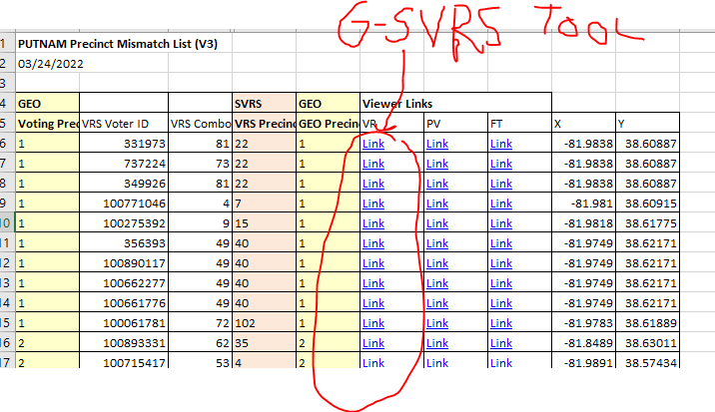
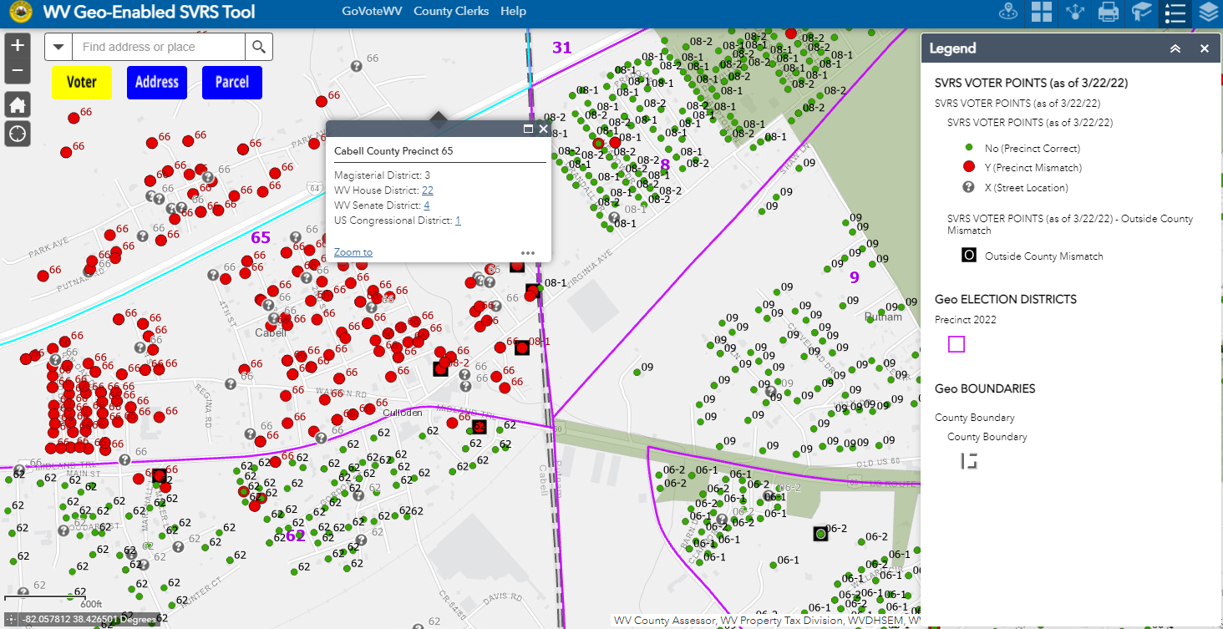
WV Redistricting GIS Products
04/05/2022
PRODUCT | DESCRIPTION | WEB LINKS
County Report Lists (Excel Spreadsheet) | Precinct Mismatch List | Download County Mismatch File
 | Voter List (all SVRS records) | Download County Voter List File
 | E-911 Site and Street Ranges | Download Select Counties
Map Viewers (Online Web) | WV Voter Map 2022 (Public) | www.mapwv.gov/vote
 | WV Geo-Enables SVRS Tool (Non-Public) formerly the redistricting web map | www.mapwv.gov/svrs
Progress Tracking (Excel Spreadsheet) | County SVRS-GEO and Address Geocoding Statuses | Table | Graphic | Geocode Status
 | Precinct SVRS-GEO Status | Table | Graphic
Online Resources | County Clerk Redistricting Resources | www.mapwv.gov/redistricting
 | Background info about Reports and Map Viewers | GEO-SVRS Reports and Map Viewers
Statewide Voter Registration System (SVRS) Reports link tabular data to Map Viewer
County Precinct Mismatch Report
G-SVRS Map Tool

Slide 2
Geo-enabled SVRS
STATEWIDE SPATIAL DATA ASSESSMENT
1 April 2022
County Summary Audit Report for SVRS Data Pull 4/1/2022
7% of the site geocoded SVRS PRECINCT records do not match the GEO PRECINCTS; or vice versa, a statewide 93% SVRS-GEO match rate. Refer to County Progress Tracking Excel table (Column N summary).
30 counties have SVRS-GEOgraphic Precinct Mismatch Rates < 5% (Column N in spreadsheet)
93% of the Total SVRS records were geocoded to site voter points (Column H in spreadsheet) and then validated by the spatial data audit.
Precinct Summary Audit Report for SVRS Data Pull 4/1/2022
79% of the precincts (1,315 of 1,674) statewide have a Precinct Mismatch Rate
< 10%. The statewide precinct-level graphic is in the process of being updated. Refer to Precinct-Level Progress Tracking Excel table (Column M).
20 precincts have less than 25 site geocoded voters in the precinct
Precinct 43 in Mingo County (town of Kermit) has the lowest address “site” geocode rate at 27.8%

Slide 3
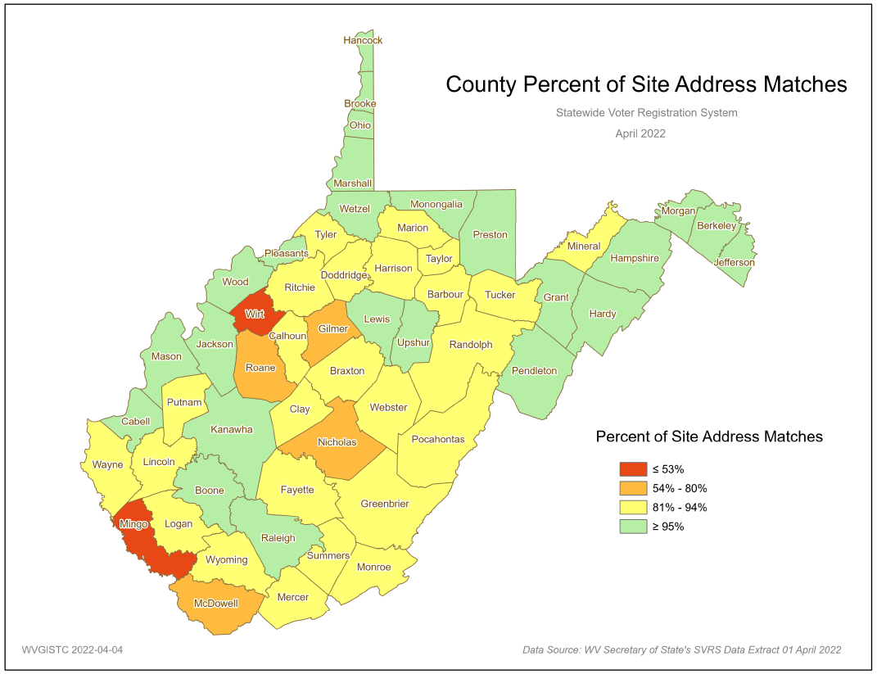
SVRS Site Geocoding Match Rate
Countywide Geocode Site Address Match Rate should be > 95%
County Percent of Site Address Matches
April 2022
Geocoding is the computational process by which a physical street address is converted into geographic coordinates, which can be used for a variety of mapping applications including redistricting.
Statewide Geocoding results:
93% site address points
6% address points
1% no match
Election management tasks should be easier for counties with high SVRS Voter Point to E-911 Address match rates
Geocoding Status Graphic

Slide 4
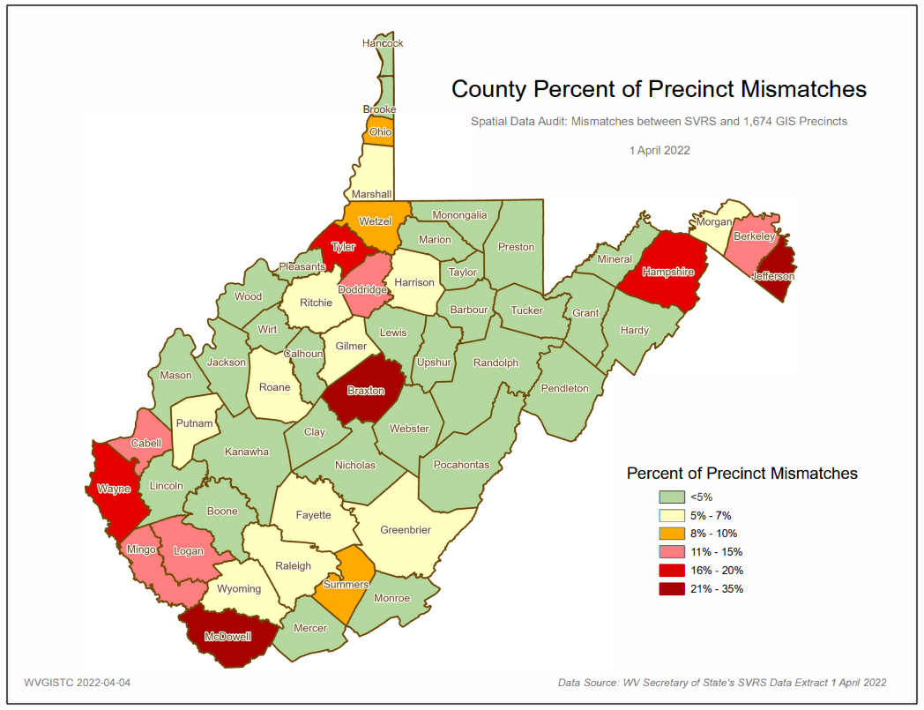
County Precinct Mismatch Status
30 counties have SVRS-GEOgraphic Precinct Mismatch Rates < 5%
SVRS Data Download 4/1/2022
Countywide SVRS-GEO Voter Mismatch Rate should be < 5%
County Mismatch Status Graphic

Slide 5
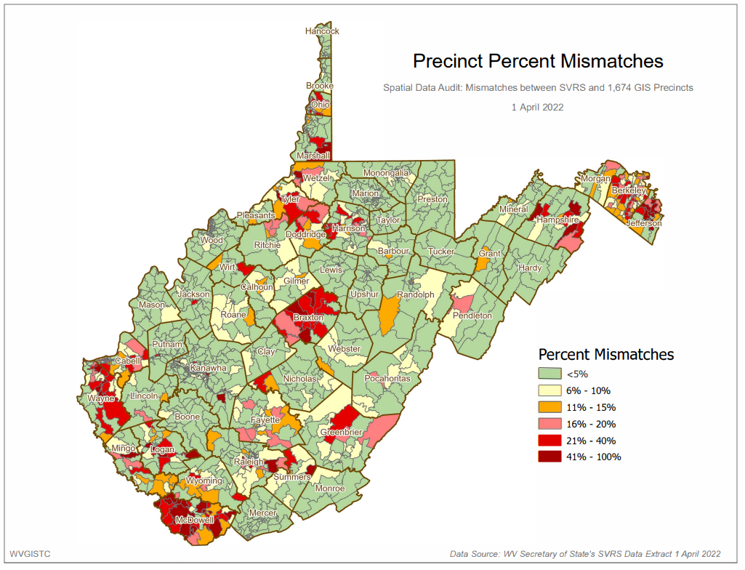
Precinct-Level Mismatch Status
SVRS Data Download 4/1/2022
79% of precincts (1,315 of 1,674) have an SVRS-GEO mismatch rate of less than < 10%
Precinct Mismatch Status Graphic

Slide 6
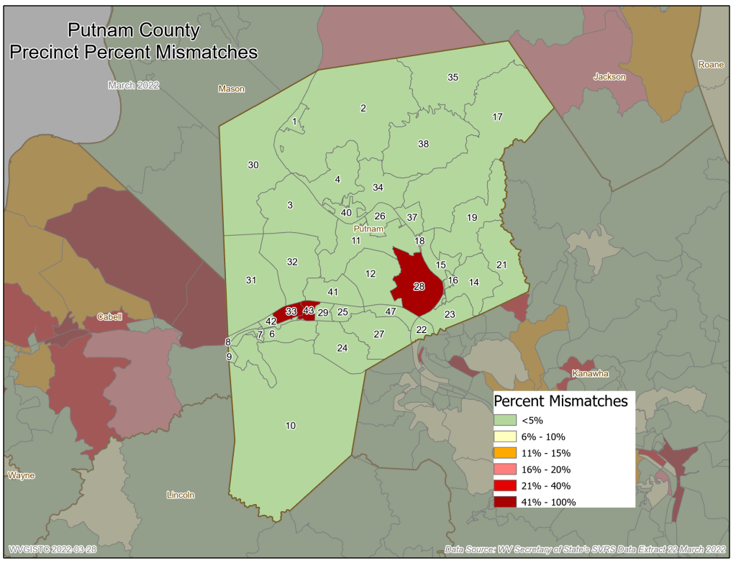
Precinct-Level Mismatch Status
Putnam Precinct Mismatch Status Graphic
A zoomed-in view of Putnam County’s precinct redistricting status of 3/22/2022 reveals it will attain a countywide “mismatch” rate of less than 5% if Precincts 28, 33, and 43 are updated in the SVRS

Slide 7
County-Level Audit (Putnam)
1
2
3
 |  |  |  |  |  | Geocoding (Address Matching)
County | Total Voting Register Records | # Precincts | # Precincts Standard-ized | # SLDBP | # Magisterial Districts | # SITE ADDRESS MATCHES | % SITE Address Matches | # STREET Address Matches | % STREET Address Matches | # UN-MATCHED Address Matches | % UN-MATCHED Address Matches
Putnam | 37,893 | 39 | 7 | 34 | 3 | 35,963 | 94.9% | 1,842 | 5% | 88 | 0%
5
4
5
6
 | Spatial Audit between SVRS Records and GEO-Election Districts
County | # Precinct Mismatches | % Precinct Mismatches | # Magisterial Mismatches | % Magisterial Mismatches | # House Mismatches | % House Mismatches | # Senate Mismatches | % Senate Mismatches | # Congressional Mismatches | % Congressional Mismatches | # County Mismatches | % County Mismatches | # Total Mismatch Flags
Putnam | 3,861 | 10.7% | 15,961 | 44% | 33,317 | 93% | 185 | 1% | 6 | 0.0% | 66 | 0.2% | 53,396
# Precincts standardized (leading zeros 02, alphabet splits, 25-6 or 25A, town suffix 12T)
State Legislative District Borders the Precinct (SLBD)
Geocode site address match rate for county (target match rate > 95%)
Number of mismatched voter points
% Precinct Matches (target mismatch rate < 5%)
Total mismatch flags
# of precincts standardized (e.g., leading zeros 02, alphabet splits, 25-6 or 25A, town suffix 12T)
# of precincts where the State Legislative District Borders the Precinct (SLBD)
Geocode site address match rate for county (target match rate > 95%)
# of mismatched voter points between SVRS Records and GEO-Election Precincts
% of precinct SVRS-GEO mismatches (target mismatch rate < 5%)
Total mismatch flags (precinct, magisterial, state house, state senate, congressional, outside county)
County Progress Table | Graphic

Slide 8
Precinct Level Audit (Putnam)
1
2
3
4
5
Precinct | County | Total Registered Voter Records | Precinct Standard-ized | SLDBP | # Precinct Mismatches | % Precinct Mismatches | Map Link
43 | Putnam | 1476 | No | Yes | 1359 | 95.0% | SVRS
33 | Putnam | 2458 | Yes | Yes | 1169 | 48.1% | SVRS
28 | Putnam | 867 | No | Yes | 823 | 99.5% | SVRS
23 | Putnam | 1296 | No | Yes | 60 | 4.9% | SVRS
37 | Putnam | 346 | No | Yes | 11 | 4.5% | SVRS
18 | Putnam | 236 | No | Yes | 5 | 3.9% | SVRS
35 | Putnam | 226 | No | Yes | 8 | 3.8% | SVRS
# Precincts standardized (leading zeros 02, alphabet splits, 25-6 or 25A, town suffix 12T)
State Legislative District Borders the Precinct (SLBD)
Geocode site address match rate for county (target match rate > 95%)
Number of mismatched voter points
% Precinct Matches (target mismatch rate < 5%)
# of SVRS precincts standardized (e.g., leading zeros 02, alphabet splits 25-6 or 25A, town suffix 12T)
# of precincts where the State Legislative District Borders the Precinct (SLBD)
# of of mismatched voter points between SVRS Records and GEO-Election Precincts
% of precinct SVRS-GEO mismatches (target mismatch rate < 5%)
Map link to precinct using GIS-Enabled SVRS Tool
Precinct Progress Table | Graphic

Slide 9
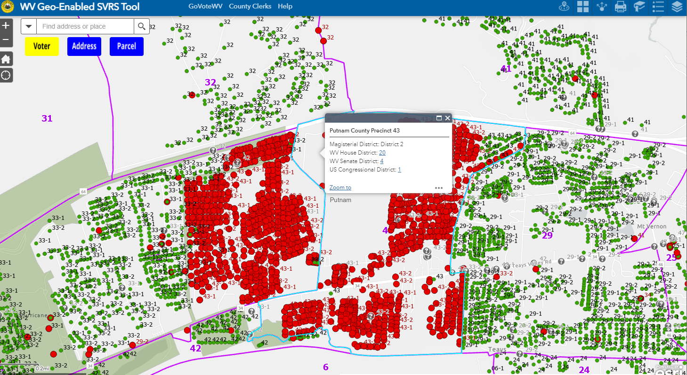
Precinct Level Audit (Putnam)
Precinct 33
Precinct 43
View specific precincts on G-SVRS Tool

Slide 10
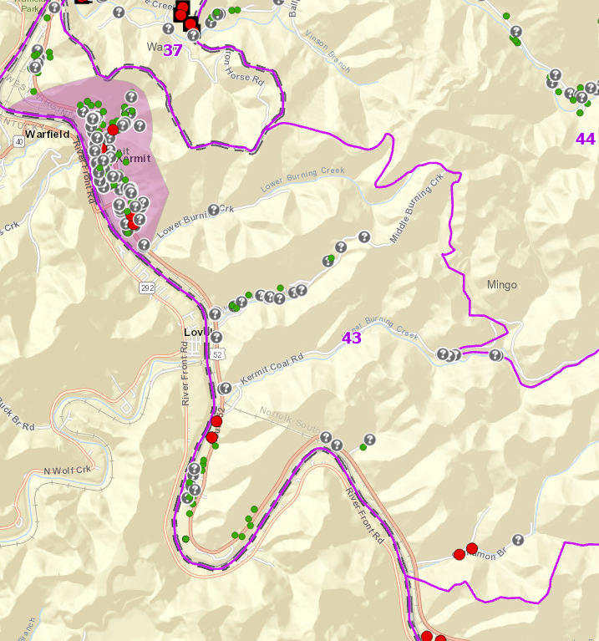
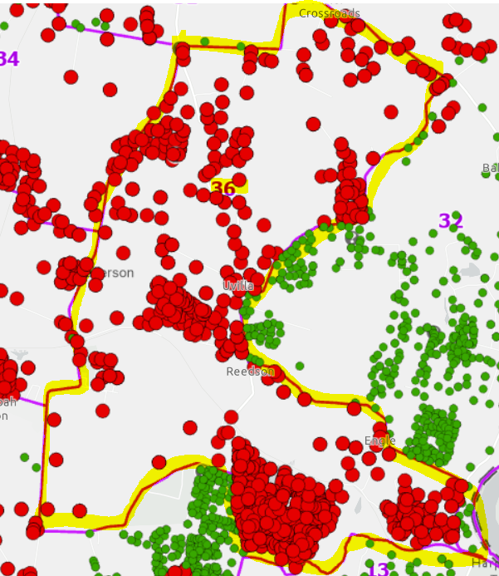
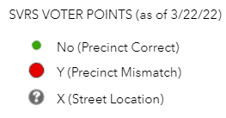
Precinct-Level Audit (3/22/22)
SVRS Precinct Mismatch Spreadsheet Report
Precinct 43 in Mingo County (town of Kermit) has the lowest address “site” geocode rate at 30.6%
Precinct 36 of Jefferson County has the largest number of Voter Precinct Mismatches at 1,440
Precinct 43
Precinct 36

Slide 11
Statewide Spatial Audit Overview
SVRS SPATIAL AUDIT 4/1/22 | COUNT | % | NOTES
SVRS Records Geocoded | 1,051,191
Precinct Mismatch | 76,093 | 7% | 7% of SVRS records do not match the GIS PRECINCT files
Magisterial District Mismatch | 136,526 | 13% | 13% of SVRS records do not match the GIS MAGISTERIAL Districts
State House | 116,667 | 11% | 11% of SVRS records do not match the GIS STATE HOUSE Districts
State Senate | 17,242 | 2% | 2% of SVRS records do not match the GIS STATE SENATE Districts
Congressional | 5,863 | 1% | 1% of SVRS records do not match the GIS CONGRESSOINAL Districts
Outside County | 1,704 | 0.2% | 0.2% of SVRS records are located OUTSIDE of the County. Points in parcels that overlap jurisdictional boundaries may be valid.
GEOCODING STATUS 4/1/22 | COUNT | % | NOTES
Total SVRS Records | 1,132,283 |  | Two Address Locators (WV SAMS & Esri) performed the geocoding
Site Address Match | 1,051,191 | 92.8% | 93% of SVRS records geocode to a site point. Some points may not be located to the building footprint or are false positives.
Street Address Match | 69,716 | 6.2% | Records not evaluated for mismatch by spatial audit
Unmatched | 11,376 | 1.0% | Records not evaluated for mismatch by spatial audit
County Site Match Rates |  |  | County Site Matches should be > 95%
Highest Site Match |  | 99.5% | Jefferson County has the highest site address match rate
Lowest Site Match |  | 49.6% | Wirt County has the lowest site address match rate
PRECINCT/MAGISTERIAL STATEWIDE COUNTS | COUNT | % | NOTES
Voting Precincts | 1,674
Precincts Standardized | 54 | 3% | 3% of SVRS Precincts have to be standardized to Geo Precincts
SLDBP | 1,251 | 75% | 75% of the precincts border State Legislative Districts
Min | 9 |  | Richie County has the least number of precincts
Max | 191 |  | Kanawha County has the highest number of precincts
Magisterial Districts | 195
Max | 8 |  | Hampshire County has the highest number of magisterial districts
State and County Level Spatial Data Assessment

Slide 12
Geo-Enabled SVRS
County Reports

Slide 13
County Redistricting Reports
Report Type | Download | Source | Description
Precinct Mismatch (also known as V3 report) | Download Link Metadata | SVRS 3/22/2022 data pull | Spatial Audit. Lists precinct mismatches between site geocoded SVRS points and GEOgraphic GIS file. Links records to Geo-Enabled SVRS (www.mapwv.gov/svrs) map view. Sorted on GEO Precinct, House Number, Street Name. Excel Spreadsheet format.
Voter List | Download Link Metadata | SVRS 3/22/2022 data pull | Spatial Audit. Lists all SVRS records and Address Matching (geocoding) status of each record: site match, street match, unmatched, and site matched outside county border. Identifies six mismatch types (precinct, magisterial, state house, state senate, congressional, and outside county) for site geocoded SVRS points. Links records to Geo-Enabled SVRS (www.mapwv.gov/svrs) map view. Sorted on GEO Precinct, House Number, and Street Name. Text CSV format which can be imported into Excel or other software. Voter lists are generated at both the state and county levels.
E-911 Street and Site Addresses | Download Link | Statewide Master Address File | Two reports that provides street range and site address information of voting precincts for redistricting. Excel spreadsheet format.
Note: Use the Excel “Freeze Panes” and “Filter” commands to navigate and screen records of interest.

Slide 14
County Precinct Mismatch Report
A spreadsheet that identifies the number of flagged Voter Points that are potentially incorrect in the SVRS. A map link to the G-SVRS Tool allows users to visualize precinct mismatches generated from the spatial audit of SVRS Voter Points. Records are sorted on Geo Precinct, House Number, and Street Address. Download County Mismatch File.
GEO | SVRS |  |  |  |  |  | SVRS | GEO | GEO Link
Voting Precinct Name (NEW) | VRS Voter ID | VRS Combo ID | VRS House Number | VRS Street Name | VRS City | VRS Zip | VRS Precinct | GEO Precinct (NEW) | G-SVRS Map Link
33 | 741486 | 3 |  | #3 GREENBRIER AVENUE | HURRICANE | 25526 | 43-1 | 33 | Link
33 | 736541 | 3 | 301 | ADA DELL COURT | HURRICANE | 25526 | 43-1 | 33 | Link
33 | 100757647 | 15 | 302 | ADA DELL COURT | HURRICANE | 25526 | 43-2 | 33 | Link
33 | 100187086 | 3 | 303 | ADA DELL COURT | HURRICANE | 25526 | 43-1 | 33 | Link
33 | 739249 | 3 | 303 | ADA DELL COURT | HURRICANE | 25526 | 43-1 | 33 | Link
33 | 100805746 | 15 | 304 | ADA DELL COURT | HURRICANE | 25526 | 43-2 | 33 | Link
33 | 100587102 | 3 | 27 | AUGUSTA LANE | HURRICANE | 25526 | 43-1 | 33 | Link
Example extract from Putnam County’s Precinct Mismatch Report

Slide 15
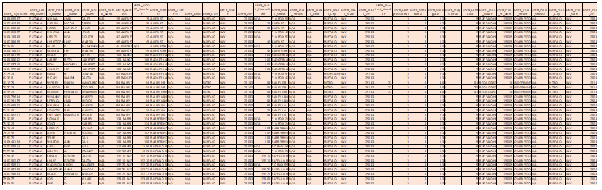
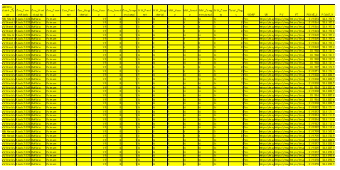
County Voter List Report
Text CSV file that lists all SVRS records and Address Matching (geocoding) status of each record: site match, street match, unmatched, and site matched outside county border. Identifies six mismatch types (precinct, magisterial, state house, state senate, congressional, and outside county) for site geocoded SVRS points. Links records to Geo-Enabled SVRS (www.mapwv.gov/svrs) map view. Download County Voter List File
SVRS Data Fields
GEOgraphic Data Fields

Slide 16
Voter List Data Fields (SVRS Fields)
DATA FIELD (SVRS) | SAMPLE SVRS RECORD 1 | SAMPLE SVRS RECORD 2
USER_ID_VOTER | 100421159 | 100741380
USER_County_Name | PUTNAM | PUTNAM
USER_Address | 116 18 MILE CREEK RD | 35 ALLEN ST
USER_HOUSE_Number | 116 | 35
USER_STREET | 18 MILE CREEK RD | ALLEN ST
USER_STREET2 | N/A | N/A
USER_UNIT | N/A | N/A
USER_CITY | BUFFALO | BUFFALO
USER_STATE | WV | WV
USER_ZIP | 25033 | 25033
USER_MAIL_HouseNum | 116 | 35
USER_MAIL_Street | 18 MILE CREEK RD | ALLEN ST
USER_MAIL_Street2 | N/A | N/A
USER_MAIL_Unit | N/A | N/A
USER_MAIL_City | BUFFALO | BUFFALO
USER_MAIL_State | WV | WV
USER_MAIL_ZIP | 25033 | 25033
USER_Precinct_Number | 1 | 1
USER_Congressional | 1 | 1
USER_Senatorial | 8 | 8
USER_Delegate | 13 | 13
USER_Magisterial | I | I
USER_ComboID | 5 | 5
USER_POLL_NAME | BUFFALO HIGH SCHOOL | BUFFALO HIGH SCHOOL
USER_POLL_St_Num | 19005 | 19005
USER_POLL_Street | CHARLESTON ROAD | CHARLESTON ROAD
USER_POLL_Street2 | N/A | N/A
USER_POLL_City | BUFFALO | BUFFALO
USER_POLL_State | WV | WV
USER_POLL_ZIP | 25033 | 25033
Columns A to AH are SVRS data fields
Data records sorted by
GEO Precinct (Column AM)
House Number (Column H)
Street Name (Column I)
Download County Voter List File

Slide 17
Voter List Data Fields (GEO Fields)
DATA FIELD (SVRS) | SAMPLE GEO RECORD 1 | SAMPLE GEO RECORD 2
Address_Match_Type | WV Site Match | WV Street Match
Geo_CensusBlock | Block 2015 | Block 2028
Geo_Municipality | Buffalo | Buffalo
Geo_County | Putnam | Putnam
Geo_Precinct | 1 | 1
Geo_Magisterial | I | I
Geo_House | 19 | 19
Geo_Senate | 8 | 8
Geo_Congressional | 1 | 1
MM_Precinct | N | X
MM_Magisterial | N | X
MM_House | Y | X
MM_Senate | N | X
MM_Congressional | N | X
MM_County | N | X
Total_Flags | 1 | 0
SLDBP | Yes | Yes
VR | G-SVRS map link | G-SVRS map link
PV | Property Viewer | Property Viewer
FT | Flood Tool | Flood Tool
POINT_X | -81.96915167 | -81.98440036
POINT_Y | 38.62528299 | 38.61527717
Columns AI to BD are GEO data fields
Data records sorted by
GEO Precinct (Column AM)
House Number (Column H)
Street Name (Column I)
Download County Voter List File

Slide 18
Voter List Metadata (GEO Fields)
Geocoded Address Match Type
Address_Match_Type | Whether the SVRS address point was a site match, street match or unmatched in the geocoding process. Two geocoder locators are used: WV SAMS and Esri.
GIS Administrative Boundaries
GEO_Census_Block | Census Block 2020
GEO_Municipality | Unincorporated Community (Census)
GEO_County | County Boundary (1:24,000 scale)
GIS Election GEOgraphies | 2022 Redistricting
GEO_Precinct | New Precinct District after 2022 Redistricting
GEO_Megisterial | New Magisterial District after 2022 Redistricting
GEO_House | New House District after 2022 Redistricting
GEO_Senate | New Senate District after 2022 Redistricting
GEO_Congressional | New Congressional District after 2022 Redistricting
Mismatch Flags | Mismatch between SVRS and GIS Election District
Mismatch_Precinct | "Y" if USER_Precinct_Number does not equal GEO_Precinct; "N" if equal; "X" if not applicable (all street matches and unmatched)
Mismatch_Magisterial | "Y" if USER_Magisterial does not equal GEO_Magisterial; "N" if equal; "X" if not applicable (all street matches and unmatched)
Mismatch_House | "Y" if USER_Delegate does not equal GEO_House; "N" if equal; "X" if not applicable (all street matches and unmatched)
Mismatch_Senate | "Y" if USER_Senatorial does not equal GEO_Senate; "N" if equal; "X" if not applicable (all street matches and unmatched)
Mismatch_Congressional | "Y" if USER_Congressional does not equal GEO_Congressional; "N" if equal; "X" if not applicable (all street matches and unmatched)
Mismatch_County | "Y" if USER_County_Name does not equal the geographic county the point is located; "N" if equal; "X" if not applicable (all street matches and unmatched)
Boundary Flags
Total_Flags | # of Mismatch Flags (Precinct, Magisterial, State House, State Senate, Congressional, Outside County)
SLDBP | A State Legislative District Borders Precinct (SLDBP).
Web Map Links
VR | Web map link to SVRS Geo-Enabled Tool (www.mapwv.gov/svrs)
Download Full Metadata

Slide 19
County E-911 Address Reports
Two reports that provides street range and site address information of voting precincts for redistricting. Some counties found these reports helpful for assigning street segments to precincts. Excel spreadsheet format. Download Select Counties
County | PRECINCT | Address Number | Street Name | Full Address | Place | Zip
Putnam | 1 | 6 | 6TH AVE | 6 6TH AVE | Buffalo | 25033
Putnam | 1 | 66 | 6TH AVE | 66 6TH AVE | Buffalo | 25033
Putnam | 1 | 124 | 6TH AVE | 124 6TH AVE | Buffalo | 25033
Putnam | 1 | 68 | 7TH AVE | 68 7TH AVE | Buffalo | 25033
Putnam | 1 | 106 | 7TH AVE | 106 7TH AVE | Buffalo | 25033
Putnam | 1 | 118 | 7TH AVE | 118 7TH AVE | Buffalo | 25033
Putnam | 1 | 39 | 8TH AVE | 39 8TH AVE | Buffalo | 25033
Putnam | 1 | 55 | 8TH AVE | 55 8TH AVE | Buffalo | 25033
Putnam | 1 | 64 | 8TH AVE | 64 8TH AVE | Buffalo | 25033
Putnam | 1 | 41 | 9TH AVE | 41 9TH AVE | Buffalo | 25033
Putnam | 1 | 46 | 9TH AVE | 46 9TH AVE | Buffalo | 25033
Putnam | 1 | 62 | 9TH AVE | 62 9TH AVE | Buffalo | 25033
Putnam | 1 | 63 | 9TH AVE | 63 9TH AVE | Buffalo | 25033
Putnam | 1 | 72 | 9TH AVE | 72 9TH AVE | Buffalo | 25033
Data records sorted by:
GEO Precinct
House Number
Street Name
Address Precinct Report
27,012 Putnam County address points from statewide master address file
The Address Precinct report lists all 911 addresses within a specific county precinct. This list does not reflect the voters of that precinct, only addresses.

Slide 20
County E-911 Address Reports
The Precinct Road Summary report summarizes all 911 addresses based upon the incorporated place, street name, giving a high and low address range for each unique road segment. This list provides the majority of street and address ranges per precinct, but there are known issues with roads that have discontinuous areas, or roads that traverse multiple precincts (Roads Highlighted in Orange). It is highly recommended that counties consult a map to determine proper ranges for these roads. Download Precinct Road Reports for select counties.
County | PRECINCT | MIN Address | MAX Address | Street Name | County Road ID | Place | Address Count | Multi Precinct
Putnam | 1 | 6 | 124 | 6TH AVE | Putnam - 6TH AVE | Buffalo | 3 | 1
Putnam | 1 | 68 | 118 | 7TH AVE | Putnam - 7TH AVE | Buffalo | 3 | 1
Putnam | 1 | 39 | 64 | 8TH AVE | Putnam - 8TH AVE | Buffalo | 3 | 1
Putnam | 1 | 41 | 103 | 9TH AVE | Putnam - 9TH AVE | Buffalo | 6 | 2
Putnam | 1 | 12 | 73 | ALLEN ST | Putnam - ALLEN ST | Buffalo | 7 | 1
Putnam | 1 | 35 | 125 | BADGER LN | Putnam - BADGER LN | Buffalo | 4 | 1
Putnam | 1 | 56 | 84 | BAILEY LN | Putnam - BAILEY LN | Buffalo | 3 | 1
Putnam | 1 | 18 | 188 | BARBERSHOP LN | Putnam - BARBERSHOP LN | Buffalo | 10 | 1
Putnam | 1 | 36 | 62 | BIRCH LN | Putnam - BIRCH LN | Buffalo | 6 | 1
Putnam | 1 | 106 | 20924 | BUFFALO RD | Putnam - BUFFALO RD | Buffalo | 113 | 2
Putnam | 1 | 17 | 154 | CARDINAL CT | Putnam - CARDINAL CT | Buffalo | 22 | 1
Precinct Road Summary Report
Data records sorted by
GEO Precinct
House Number
Street Name
2,285 Putnam County road summary records from statewide master address file
Field Definitions
Multi-Precinct field: Number of precincts the road appears in county
Address Count field: Number of addresses within that precinct on that road

Slide 21
Geo-Enabled SVRS
Map Viewers

Slide 22


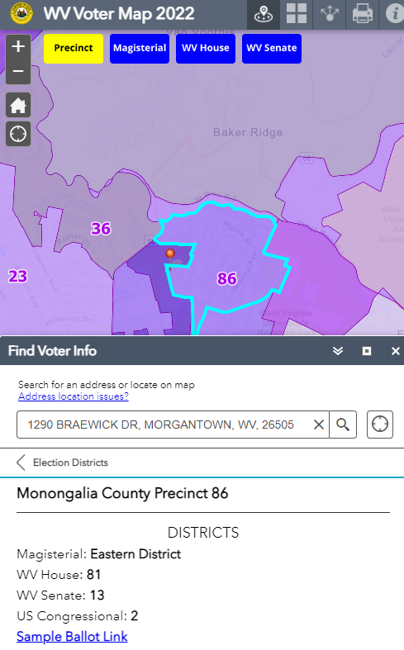
WV Voter Map 2022 (Public)
Find Voter Info function
A public web map application powered by GIS mapping technology to look up election districts and precincts by address
Statewide Extent URL: www.mapwv.gov/vote
County Extent URL Example: www.mapwv.gov/vote/county/Marion
Instructions: Enter your street address in the Find Voter Info widget to locate your residence. If the address location found by the search tool is incorrect, then use the navigation buttons and base map layers to identify the exact location.
Voter Info: The Voter Info panel lists the Voting Precinct, Magisterial District, WV House District, WV Senate District, and U.S. Congressional District.
Alternatively, if the Voter Info widget is closed, a Popup Window will display same voter information by clicking on the map fame.
Map Tools: Find Voter Info, Basemap Gallery, Share Web Link, Print, Info, and Navigation. Refer to the Help for more instructions about the different map functions

Slide 23
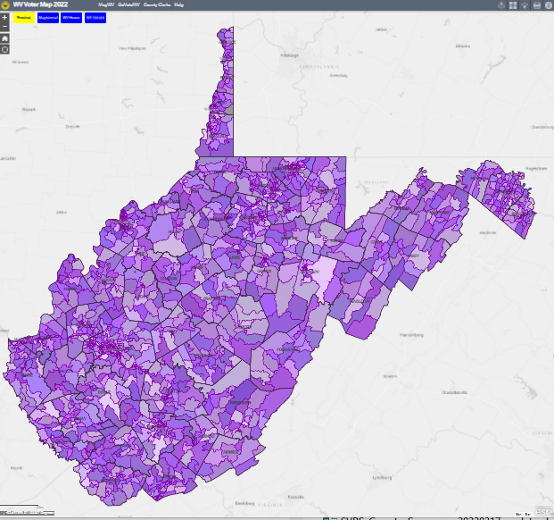
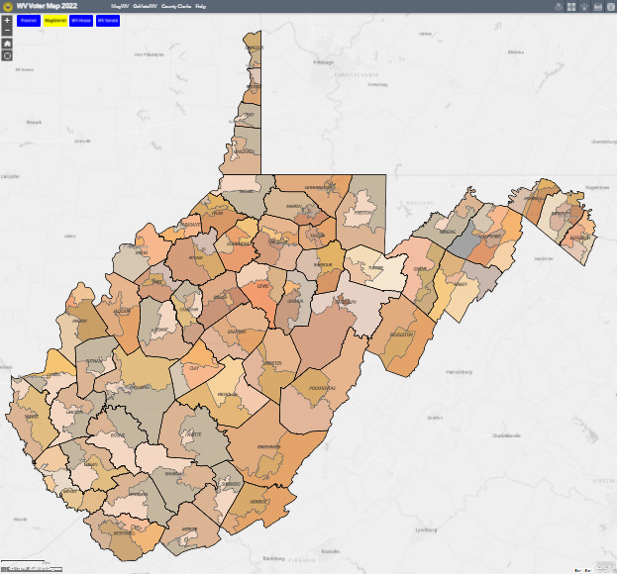


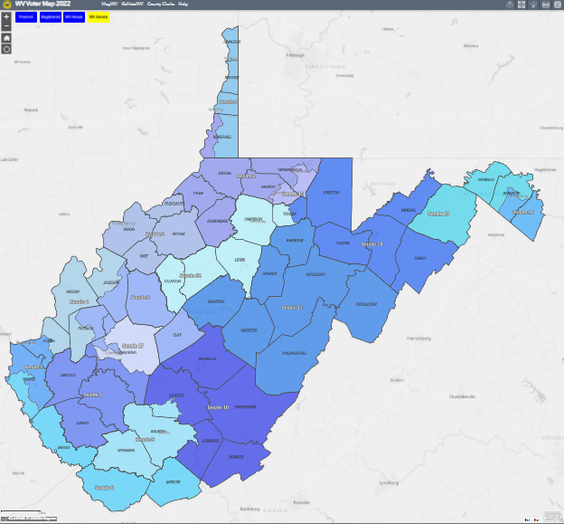
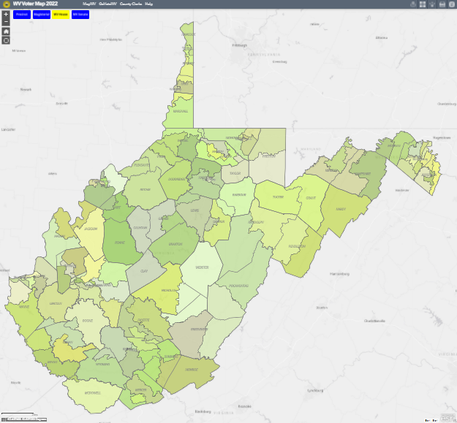


WV Voter Map 2022 (Public)
Election Layer
On / Off
Buttons
Make election layer of interest visible by selecting on/off buttons (yellow-on; blue-off). Only one election layer can be visible at a time. State Senate districts are visible by default.
Voter Precinct
Magisterial District
State House District
State Senate District
Default View

Slide 24
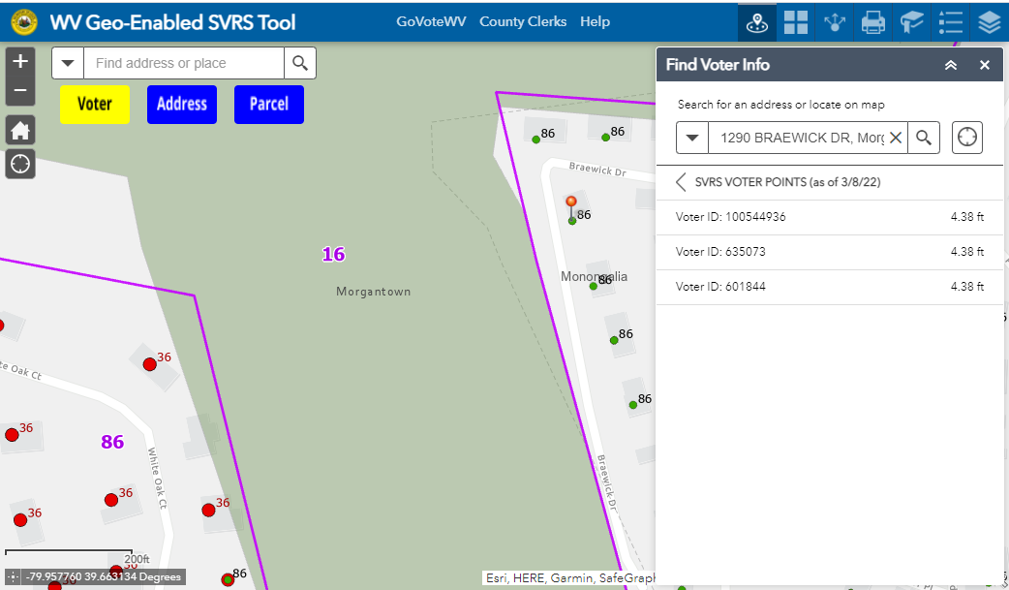
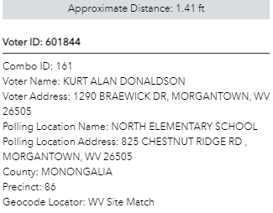
Geo-Enabled SVRS Tool (Non-Public)
A non-public web map application to visualize and validate SVRS points and election boundaries
Statewide Extent URL: www.mapwv.gov/svrs
County Extent URL Example: https://Mapwv.gov/svrs/county/Marion
SVRS Voter Point Layer Visible
(Yellow Button = Map Layer On)
Click on point to display voter info

Slide 25
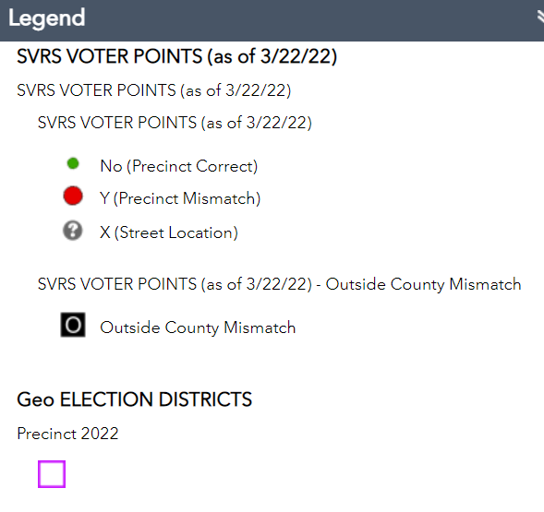
Geo-Enabled SVRS Tool
A non-public web map application to visualize and validate SVRS points and election boundaries
Statewide Extent URL: www.mapwv.gov/svrs
County Extent URL Example: https://mapwv.gov/svrs/county/Putnam
Popup Window Attributes
SVRS Voter Point Precinct Mismatch
Legend

Slide 26
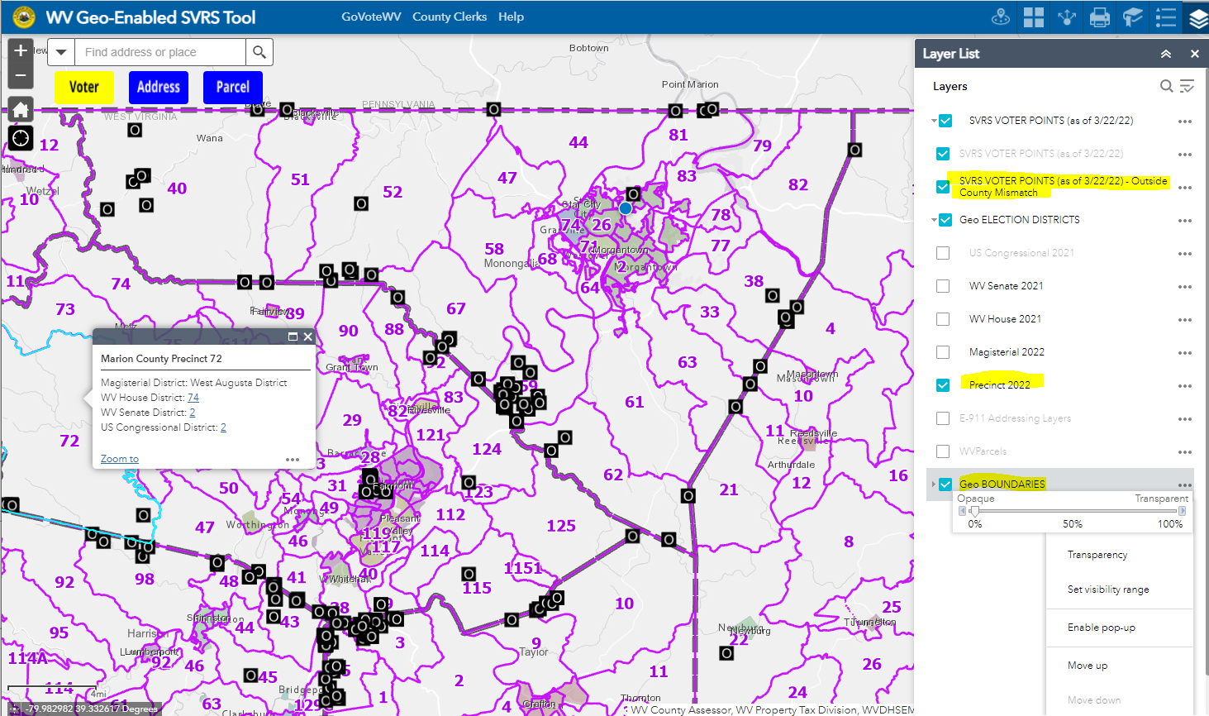
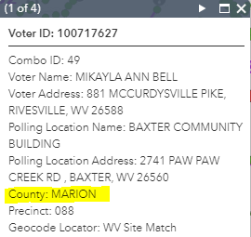
Geo-Enabled SVRS Tool
County Clerks should verify if SVRS Points Geocoded Outside County Boundary are Valid
SVRS Voter Points
OUTSIDE
County Boundary
District Popup
Voter Info Popup
Layer List
(turn layers on /off)
Incorporated Place Boundary

Slide 27
GIS Layers (G-SVRS Tool)
GIS Layers. The G-SVRS Tool makes available contextual GIS layers (E-911 addresses, tax parcels, jurisdictional boundaries, and census blocks) to verify that SVRS Voter Points are properly located and attributed. Background layers include street and aerial imagery base maps.
GEO Elections Layers. Displays precincts, magisterial, state house, state senate, and congressional layers. Precinct layer visible on default view.
SVRS Point Layer. Displays SVRS address geocoded points symbolized by spatial data precinct audit: Precinct SVRS-GIS Match (Green Dot), Precinct SVRS-GIS Mismatch (Red Dot), Match (Green Dots), or SVRS Outside County (Black Square with White Letter O). A grey circle with a question mark indicates an SVRS street match (not site match or to building footprint) and thus not accurate enough to determine a precinct mismatch type. An unmatched geocoded address (e.g., PO Box, rural address) is not shown.
E-911 Address Layers. Displays E-911 addresses and street ranges.
Parcel Layer: Displays parcel lines and owner information in Voting Widget when layer visible.
GEO Boundaries: Boundaries for counties, incorporated places, and census blocks
Background Layers: Various Street or Aerial Imagery base layers

Slide 28
Geo-Validation (G-SVRS Tool)
A GIS tool to the SVRS for assisting the County Clerks and the Secretary of State’s Office in their redistricting efforts. Another objective is to assist those counties with limited access to GIS technologies as well as producing online mapping resources.
Geo-Validate Voter Points and Geographic Boundaries
Validate Voter Points and Attributes
  Voter Precincts: Review spatial data audit of precincts to ensure voters are assigned to the correct precinct.
  Reference Layers: Use geospatial layers E-911 Addresses, Tax Parcels, and Aerial Imagery reference layers to validate Voter Point information.
  Site Address Geocode: Update street and unmatched address errors (e.g., P.O. Boxes, Rural Addresses, incomplete addresses) to site address points such that every Voter Point is located within the correct building footprint. If necessary, coordinate with the local E-911 Office about the authoritative address for residents.
Validate Geographic Boundaries (Election, Administrative, Statistical)
  Election Boundaries: Review and ensure precinct and magisterial district boundaries on the map are correct and current.
  Administrative Incorporated Place Boundary: Ensure incorporated place boundaries are correct and coincide with municipal precincts. Submit incorporated place boundary changed through Census BAS program. Refer to WV BAS Updates for past decade.
  Statistical Census Block Boundaries: Use to identify and submit census block boundary suggestions to Census as part of the 2030 Census Redistricting Data Program.

Slide 29
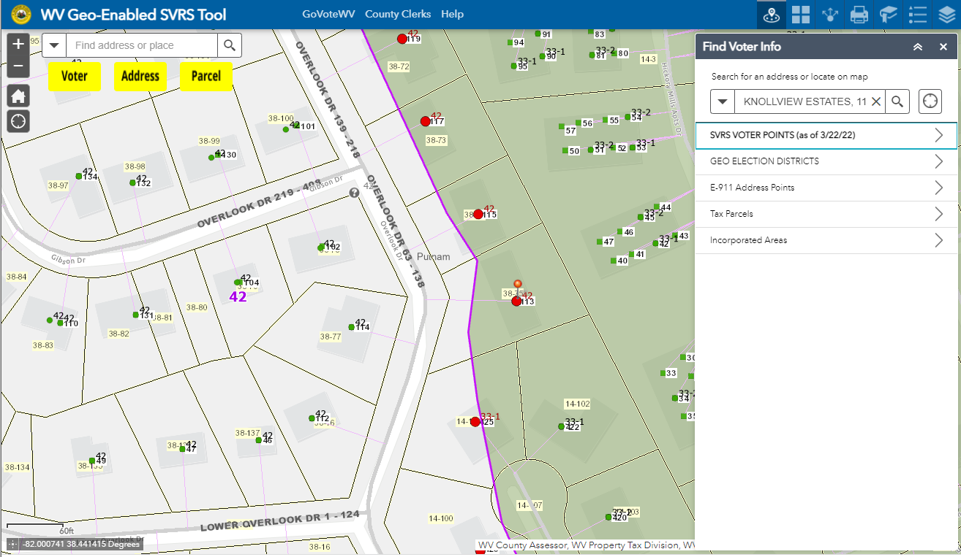
Geo-Enabled SVRS Tool
Use Tool to Geo-Validate SVRS Voter Points are in correct Precinct
Toggle Layers
On (Yellow) or Off (Blue)
VOTER INFO WIDGET
Click on the map to display attributes for SVRS Voter Point,
E-911 Address, Tax Parcel, Place Name, Voter Precinct, and Election Districts
SVRS Voter Point Precinct Mismatch
(red dot)

Slide 30
Voting Info Widget or Popup
Find Voter Info Widget: Open the widget function and click the point of interest on the map. Select the Data Content Group of interest: Election Districts (on by default), Incorporated Place (activated if point in municipality), and SVRS Voter Point, E-911 Address, and Parcel data (Voter, Address, and Parcel content groups are activated if layers are turned on or visible).
Popup Attribute Window: Alternatively, click on the map frame and cycle through the Popup Info Attributes for Election District, Voter, Address, and Parcel layers.
Voting Info Data Content Groups:
GEO Election Districts. If no Toggle Button Layers (Voter, E-911 Address, and Parcel) are turned on, then the election districts (precincts, magisterial, state house, state senate, congressional) are listed for the map location.
SVRS Voter Point. If the Voter Layer is visible, then the SVRS voter point withing 100 feet of the map point are selected. SVRS Voter ID, Voter Name, and Voter Address attributes are displayed.
Tax Parcel. If the Parcel Layer is visible, then the tax parcel owner and link to the WV Property Viewer are displayed.
E-911 Address. If the Address Layer is visible, then site and street address matches are displayed. Search buffer is narrower the more zoomed in.
Incorporated Place (Voter Info Widget Only). Name of municipality displays if location within an incorporated area.

Slide 31

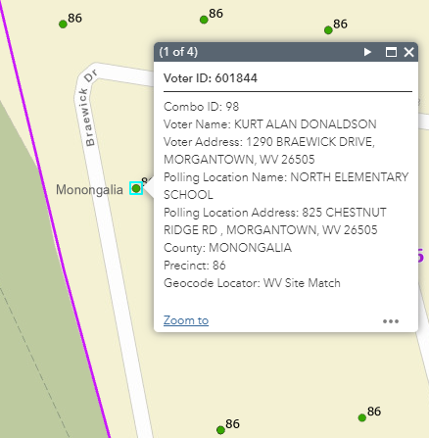
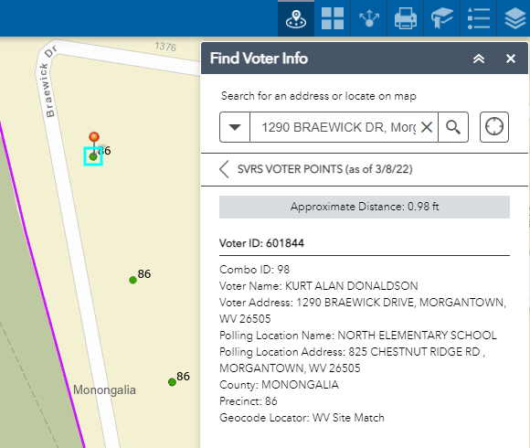
Voter Point Info (G-SVRS Tool)
Popup Window Function
Voter Info Widget
View Voter Point information two ways: Popup Window Function or Find Voter Info Widget

Slide 32

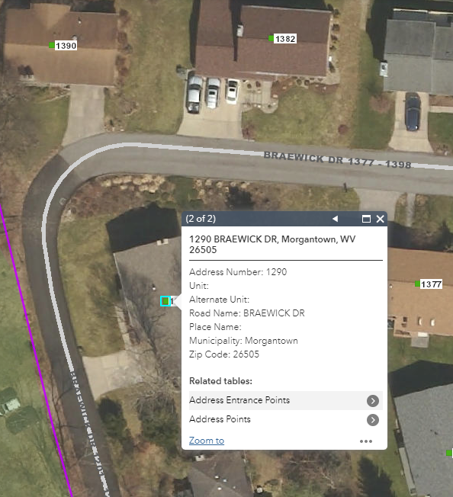
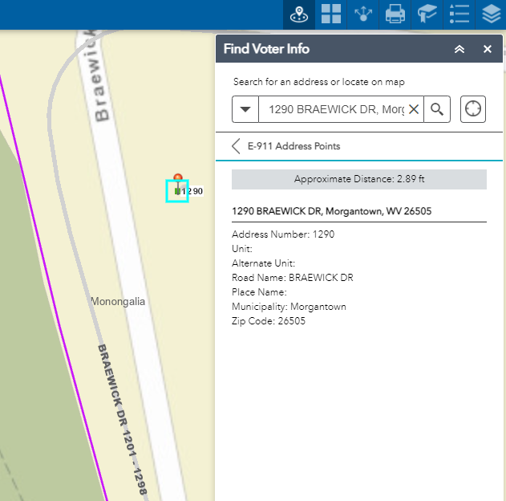
E-911 Address (G-SVRS Tool)
Popup Window Function
Voter Info Widget
View E-911 Address information two ways: Popup Window Function or Find Voter Info Widget

Slide 33

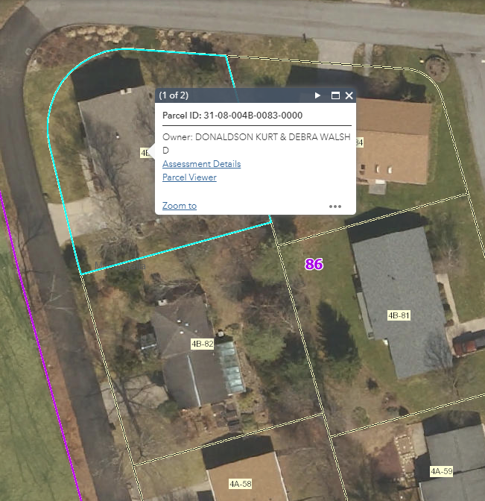
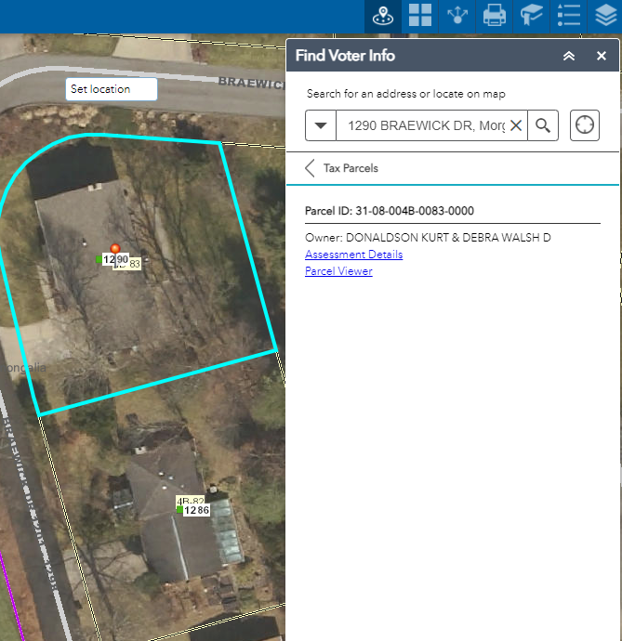
Tax Parcel (G-SVRS Tool)
Popup Window Function
Voter Info Widget
Link to WV Property Viewer or Assessment Record for more parcel information to include Owner and Physical Addresses
View Tax Parcel information two ways: Popup Window Function or Find Voter Info Widget

Slide 34
Map Tips (G-SVRS Tool)
Visualize and Geo-Validate Voter Points and Geographic Boundaries
Improve Layer Display Performance. Toggle off data layers when navigating (zoom in, zoom out, pan) to area of interest to quicken display rendering of map layers.
Display Attribute Information. The Popup Window and Find Voter Info functions display attribute information only if the Voter, Address, and Parcel layers are visible.
Shared Map Link: Use the Shared Link function to share map location of interest to others. Shared links can be done by the G-SVRS Tool function or programmatically. Example shared links for 1290 Braewick Drive, Morgantown, WV:
  URL with Long./Lat. Coordinates, Marker, Zoom Level 17:
  https://www.mapwv.gov/svrs/?marker=-79.957363;39.663569;&level=17
  URL with Address Coordinates: https://www.mapwv.gov/svrs/?find=1290%20Braewick%20Drive,%20Morgantown,%20WV
Background Layers: Select various street and imagery basemap from the Background Gallery function.
Apply Transparency to Incorporated Place Layer: Set the transparency level of the group Geo Boundaries layer in the Layer List function to make the polygon shade Incorporated Areas less opaque.
Clear Web Cache: Reset or clear the web cache if online layers are not displaying properly

Slide 35
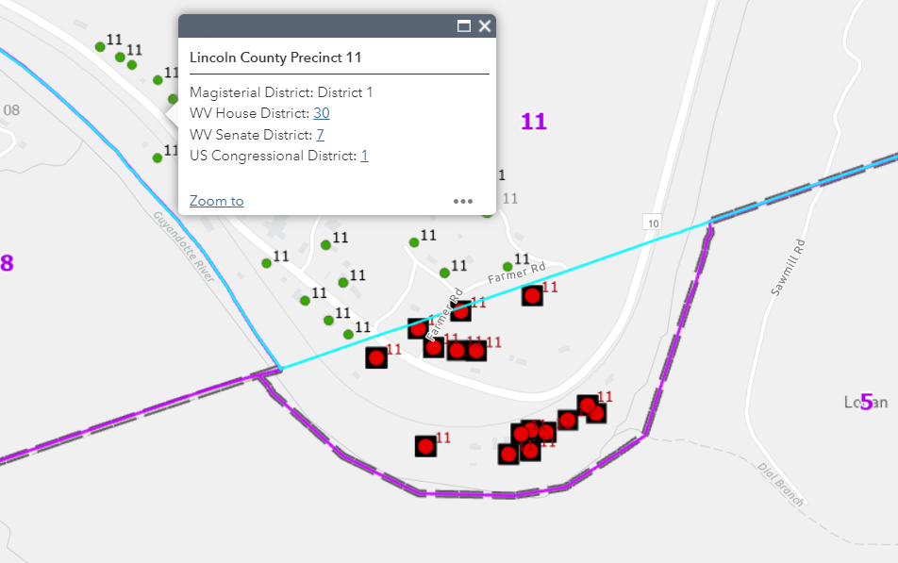

Jurisdictional Boundaries (G-SVRS Tool)
Precinct Mismatch Errors will result if County or Incorporated Place boundaries are incorrect
The Lincoln-Logan county boundary changed by the 2020 BAS was not correct for the 3/22/2022 spatial audit, resulting in mismatch and outside county precinct errors for voter points in Lincoln County Precinct 11. The GIS boundary has been updated in the G-SVRS Tool, so the precinct mismatch errors should be corrected when the next spatial audit is performed.
Old County Boundary
Correct County Boundary
Precinct 11
Lincoln
Mismatch Error
Logan

Slide 36
Future Directions
G-SVRS Tool Functions
Authentication Log-on. Investigate login feature to authenticate access to G-SVRS Tool.
Modify Voter Point Location. If an authorized user believes that the given geopoint of the address is incorrect, the user can drag the geopoint to the correct location on a map, and therefore assign a new geopoint for a given address. District assignment information is corrected in the SVRS.
Modify Flagged Voter Records. Flagged geocoded site points in error (e.g., voter point at county border) can be denoted with an exception status to override the geocoding status.
G-SVRS Tool GIS Layers
Census Boundary Layer. Add U.S. Census County Boundary layer to compare with county boundary from 1:24,000 scale USGS topographic maps.
Polling Station. Add polling stations from SVRS to Layer List and map.
Apartment Units. Improve address features to more easily distinguish multiple units located in apartment buildings
GoVoteWV Online Voter Tools
Online Voter Tools. Explore integrating GIS technologies with GoVoteWV online voter tools on the Secretary of State’s website
Address Geocoding
Improve accuracy of Geocode Locators
Provide address mismatch lists to County Clerks and E-911 Offices

Slide 37
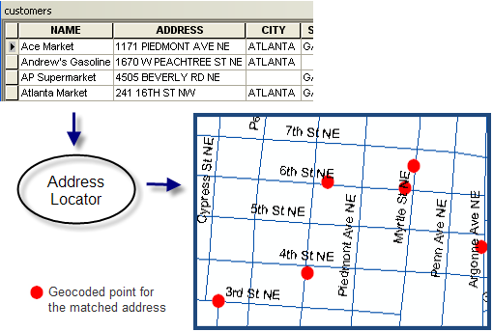
Geocoding (Address Matching)
Geocoding. Geocoding, or address matching, is the computational process by which a physical address is converted into geographic coordinates, which can be used for a variety of mapping applications. The most highly accurate and precise geocode you can return is at the address point that is within the building footprint. Created by the WV GIS Technical Center, a composite locator of public and commercial address layers geocodes voter points.
Address Match Types and Reports. Voter addresses are matched or unmatched based on geocode scores above the minimum match score. Geocoded results are classified by the Locator Type (WV Master Address file, Esri) and Locator Role (site point address, street address range, parcel, etc.)
Site Match: Match to Site address point. The location match ideally is within building footprint.
  Site Match Outside County: Voter records site-matched outside the county.
Street Match: Match to the street address range but not pinpointed to the building location. A GIS file of street address matches can be provided for counties to improve the address matching of these voter records.
Unmatched Records: Voter records could not be geocoded or geospatially pinpointed
Source Esri
Geocoding Definitions
Geocode Match Report Example

Slide 38
WV Geocoding Process
Geocode Process Sequence
Clean and standardize address formats
Geocode all addresses with WV Locator using 75% confidence level
Geocode unmatched addresses and matched site addresses scoring < 90 with ESRI Locator using 75% confidence level
Compare match scores between same match types (site or street) of WV and ESRI locator: if WV score < ESRI score and WV score < 98 then ESRI locator result replaces WV locator result
Compare output scores between WV street matches and ESRI site matches: if WV score < 90 and ESRI score >= 90 then ESRI locator result replaces WV locator result
Site Match
(WV or ESRI Locators)
Street Match
(WV or ESRI Locators)
No Match
Site Match
(WV Locator scoring > 90)
False Positives
A False Positive is an address geocoded to the wrong location

Slide 39
WV Locator
Set aside site matches scoring > 90 in WV Locator
Remaining records enter ESRI Locator
ESRI Locator
Compare site matches between 2 locators
Compare street matches between 2 locators
Compare ESRI site matches and WV street matches
Final geocoding results

Slide 40
Geocoding Locators
The composite locator combines geocoding results from both the
West Virginia (public) and Esri (commercial) address lists
91.6% of address matches are from the WV Locator
8.0% matches from the Esri Locator
0.4% unmatched from either locator

Slide 41
Override False Positives
Site geocodes that are “false positives” or geocoded to the wrong precinct can be overridden by providing a user-defined file with the voter information below
First check with…
SVRS: Clean and standardized address input into SVRS
E-911 Office: Current and accurate E-911 addresses have been uploaded by your County E-911 Office to Statewide Addressing File
WVGISTC: Not an issue that can be resolved by geocoder
Voter ID | Geo Precinct | SVRS Precinct | Address | Latitude of correct location | Longitude of correct location | Note
38444 | 1 | 4 | 84 Bells Drive, Nitro, WV, WV | 38.288530 | -81.68883 | Bad Geocode
322 | 1 | 4 | 105 Sandstone Dr, Eleanor, WV | 38.238530 | -81.68996 | Bad Geocode
8739 | 1 | 6 | 200 Midland Trail, Hurricane, WV | 38.354444 | -81.72233 | Outside County point is valid
Update G-SVRS Tool by…
Highlight site match exceptions on Precinct Mismatch Tabular Report
Add correct X,Y coordinates with Display Coordinate function to end of Precinct Mismatch Report
Use Edit SVRS Widget (in development) to mark exceptions and update X,Y coordinate

Slide 42
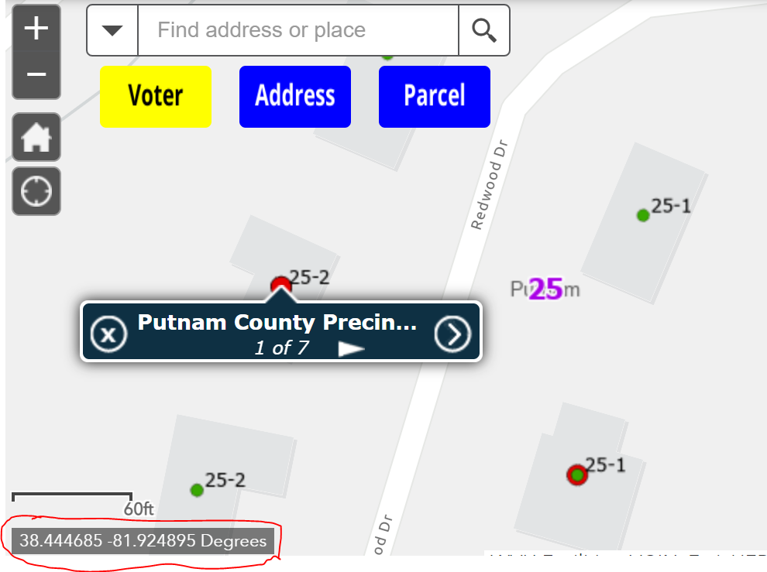
Geocode Exceptions
Use the Display Coordinate function to copy decimal degree Latitude and Longitude coordinates to Exception List
Use Display Coordinate Tool to Copy Coordinates

Slide 43
Exceptions
Site geocodes that are “false positives” or precinct mismatch errors can be overridden by providing a user-defined file with the voter information below
Voter ID | Geo Precinct | SVRS Precinct | Address | Longitude | Latitude | Note
38444 | 1 | 4 | 84 Bells Drive, Nitro, WV, WV | -81.68883 | 38.288530 | Bad Geocode
322 | 1 | 4 | 105 Sandstone Dr, Eleanor, WV | -81.68996 | 38.238530 | Bad Geocode
8739 | 1 | 6 | 200 Midland Trail, Hurricane, WV | -81.72233 | 38.354444 | Outside County point is valid
A geocode returns a false positive if the address is geocoded to the wrong location

Slide 44
Geo-Enabled SVRS
Election and Reference GIS Layers that support G-SVRS Tool

Slide 45
GIS Layers for SVRS
SVRS Voter Points
Geo Election Districts
Parcels
E-911 Addresses
Geo Boundaries
Basemap Layers
(Aerial Imagery)
Election Districts and Addresses are the most important GIS layers for geo-enabling elections

Slide 46
GIS Layers for G-SVRS Tool
Site Voter Addresses can be validated with statewide E-911 Address and Tax Parcel GIS Layers

Slide 47
GIS Layers
Data Development and Integration
  Local-Level Data Development
  State-Level Integration

Slide 48
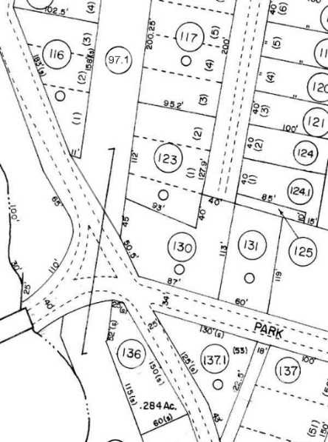
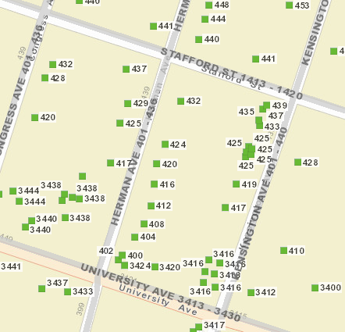
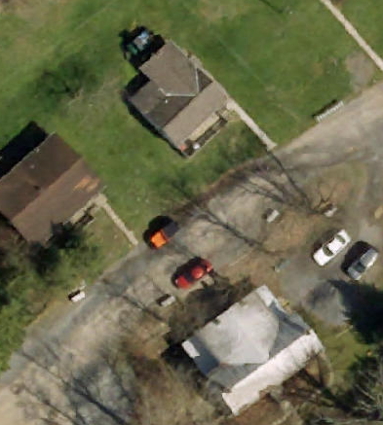
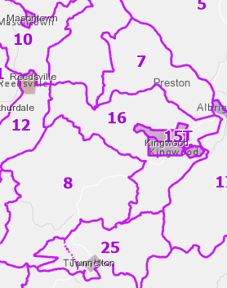
GIS Data Development
Parcels Site Addresses Aerial Imagery Election Districts
Tax Parcel layers provide owner name and address
Authoritative Source of E-911 addresses and street names
County Leaf-off imagery should be no older than 5 years
County subdivision Precinct and Magisterial Districts
Improving State’s Spatial Data Infrastructure

Slide 49
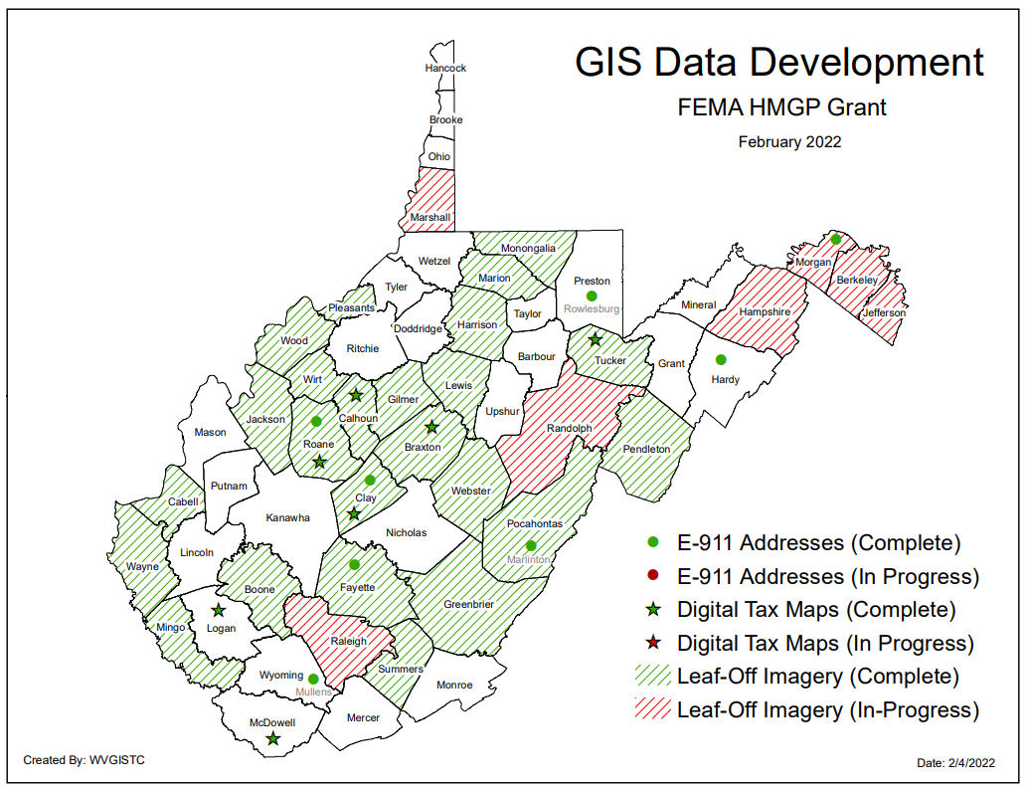
GIS Data Development Projects
Recent grant-funded GIS Data Development Projects via statewide contracts for for Addresses/Parcels and Leaf-off Aerial Imagery. Seed funding and state contracts are necessary to help disadvantaged counties.

Slide 50
State-Level Integration
Parcels
Addresses
Imagery
Voter Information
SOURCE:
County Assessors
Property Tax Division
Statewide Master Parcel File / IAS
SOURCE:
Local Addressing Offices
WV Emergency Management Division
Statewide
Addressing & Mapping System
SOURCE:
County Offices
WV GIS Technical Center
Statewide
Leaf-Off Imagery Service
SOURCE:
County Clerk
WV Secretary of State’s Office
Statewide Voter Registration System (SVRS) Geo-Enabled
State-level integration allows for statewide mapping products and services
WVU GIS Technical Center creates web map services of these key mapping layers

Slide 51
WV Addressing Stakeholders
LOCAL GOVERNMENT
County Clerks
E-911 Address Directors
County Assessors
GIS Specialists and Mappers
WV ASSOCIATIONS
WV Association of County Clerks
WV E-911 Council
WV Association of Geospatial Professionals
WV Broadband Enhancement Council
WV Association of Counties
WV Association of Assessors
STATE GOVERNMENT
WV Secretary of State’s Office
WV Emergency Management Division
WV Division of Motor Vehicles
WV Office of GIS Coordination
WV GIS Technical Center
WV Property Tax Division
WV DHHR
NATIONAL ORGANIZATIONS
U.S. Census
U.S. DOT
U.S. Postal Service
NSGIC
NENA
PRIVATE SECTOR
GIS Professional Companies
Address Vendors
CAD Vendors
Utilities
Addressing standards/workflows are important for business/government services including
Election Management Systems

Slide 52
Geo-Enabled SVRS
Other Notes

Slide 53
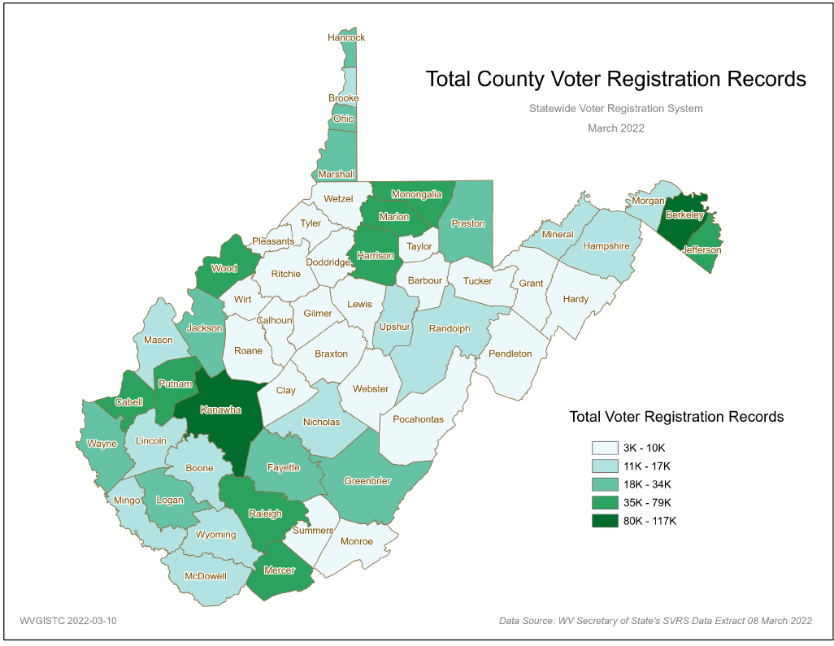
Total Voter Registration Records
Voter Registration Records

Slide 54
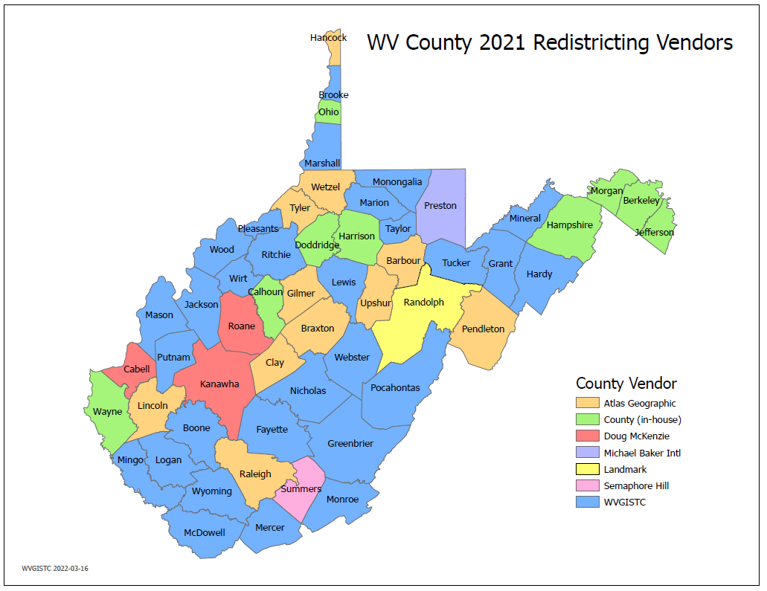
2021 Redistricting Vendors
GIS Vendors for 2021 County Redistricting

Slide 55
WV GIS Technical Center Contacts
Name | Email
Kurt Donaldson | kdonalds@wvu.edu
Eric Hopkins | eric.hopkins@mail.wvu.edu
Kevin Kuhn | kevin.kuhn@mail.wvu.edu
Frank LaFone | frank.lafone@mail.wvu.edu
Shannon Maynard | smmaynard@mail.wvu.edu
Johnna Murray | johnna.murray@mail.wvu.edu
Yibing Han | yibing.han@mail.wvu.edu
Maneesh Sharma | maneesh.sharma@mail.wvu.edu

