Slide 1

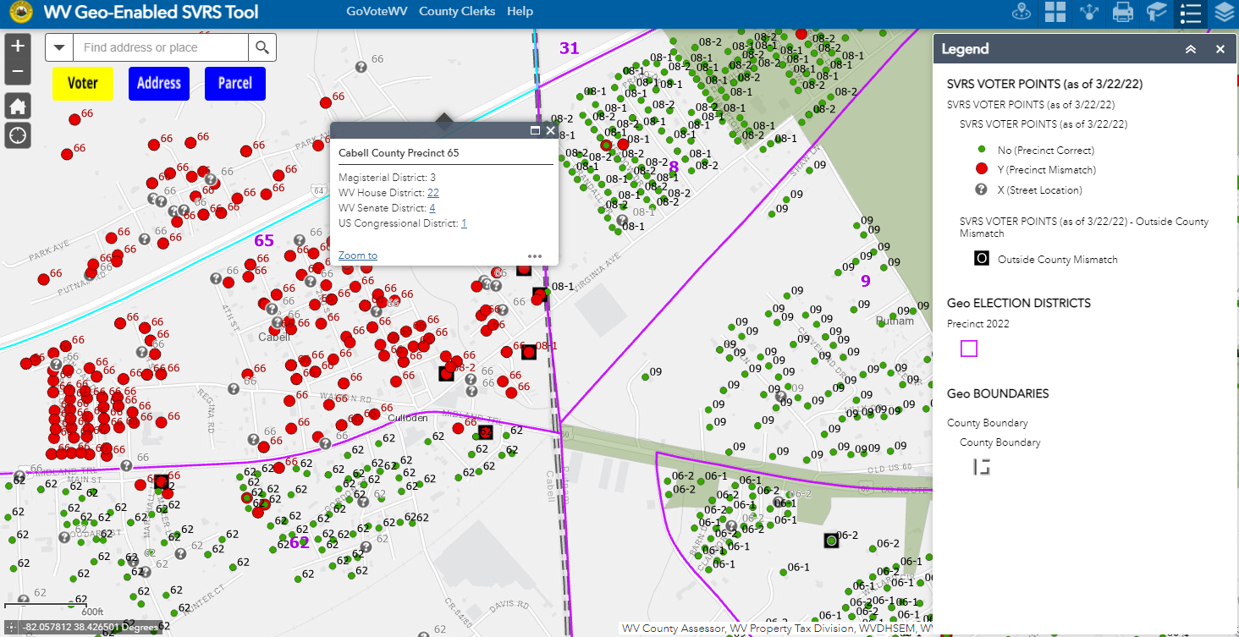
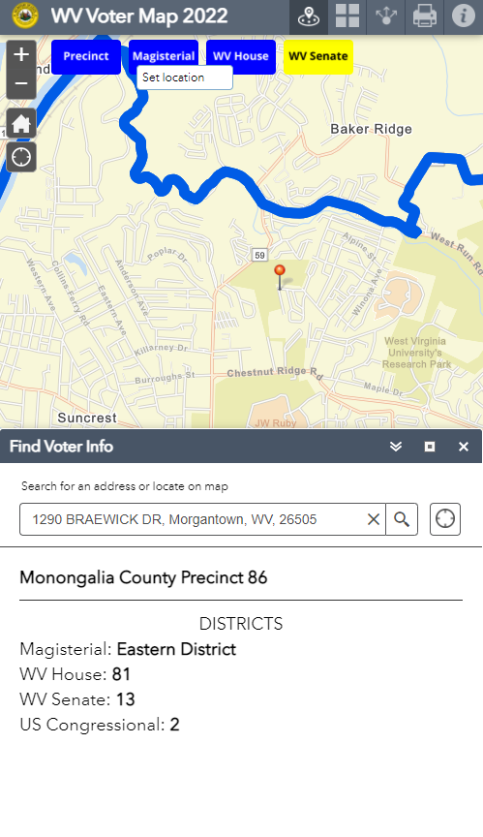
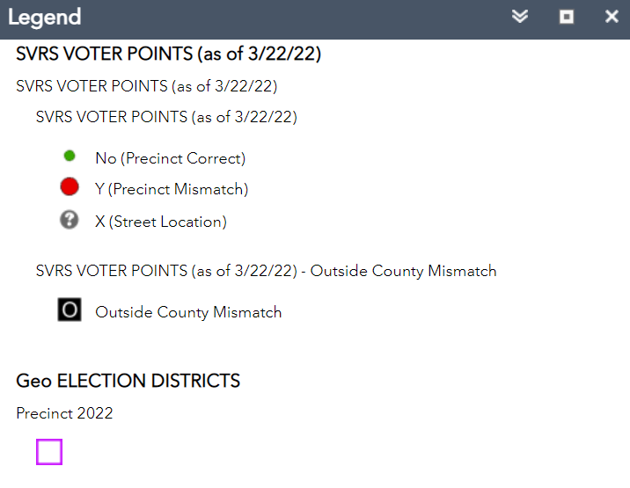
WV Geo-Enabled Elections
9/7/2023
RAISING ELECTION Accuracy and Efficiency with GIS Tools
Visualization Transparency
GeoAnalytics
Popup Window Attributes
SVRS Voter Point Precinct Mismatch
Legend
Kurt Donaldson, Manager, WV GIS Technical Center, West Virginia University, kdonalds@wvu.edu, 304-293-9467

Slide 2
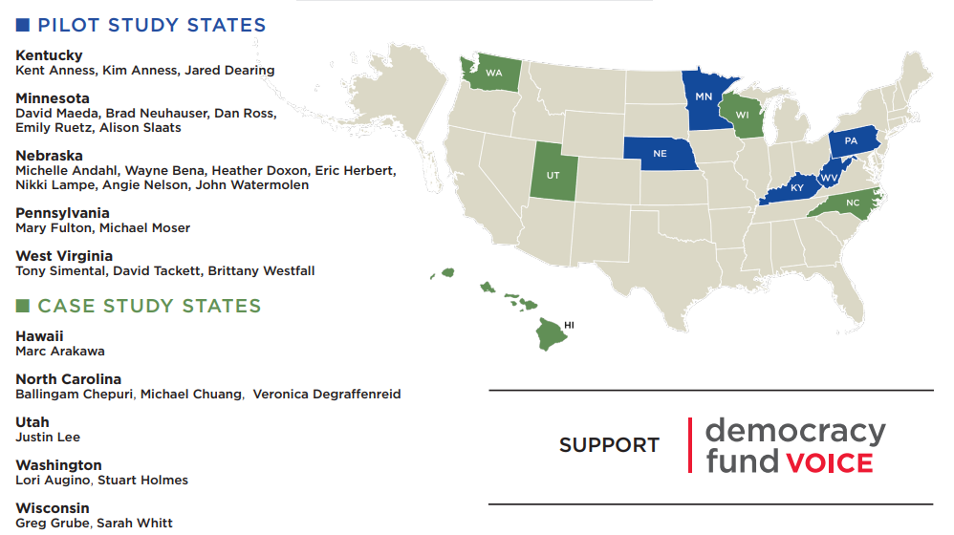
GIS in Elections Pilot Study
In March 2019, West Virginia joined five others states in a pilot study sponsored by NSGIC to further the use of GIS in elections and to publish best practices

Slide 3
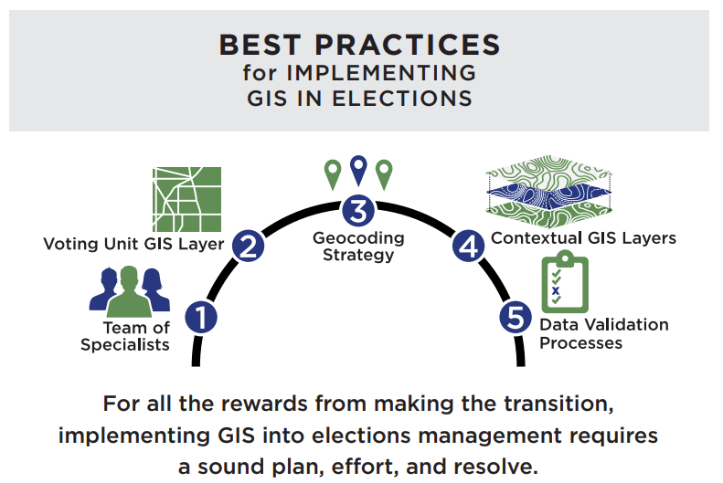
5 Best Practices for GIS in Elections
In September 2019, NSGIC published five best practices for geo-enabled elections.
Integrating GIS with the Statewide Voter Registration System (SVRS) allows for the visualization, geoanalytics, and transparency of voter data.

Slide 4


1. Convene a Team of Specialists
1
In September 2021, the State GIS Coordinator and Secretary of State’s Office contacted the WV GIS Technical Center for GIS support in Redistricting
The West Virginia GIS Technical Center, located at West Virginia University, provides coordination and technical support in the development and operations of GIS in West Virginia.
Established by Executive Order 4-93 in 1993
Six full-time staff
Funded by service agreements, external grants, and from the state‐appropriated Mineral Lands Mapping Program*
* Fund 0253, Activity 207 approved under House Bill 2222 in February 1995

Slide 5

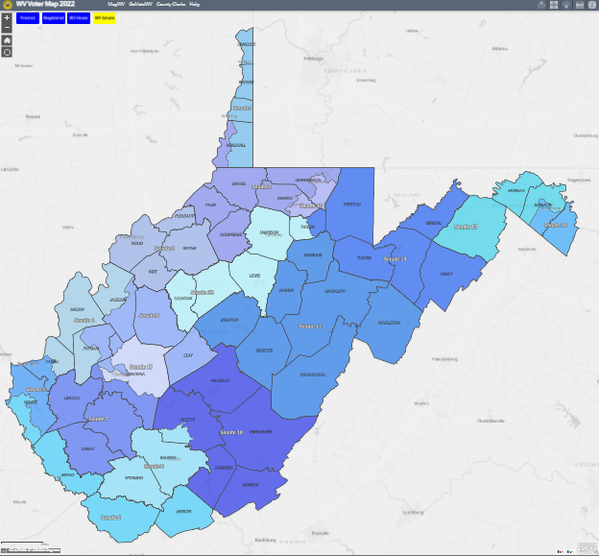
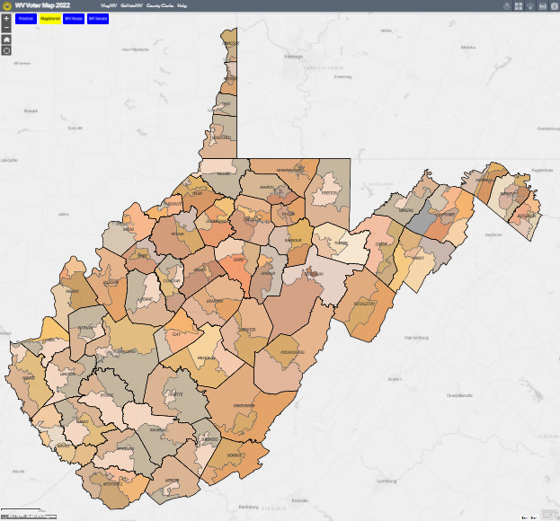
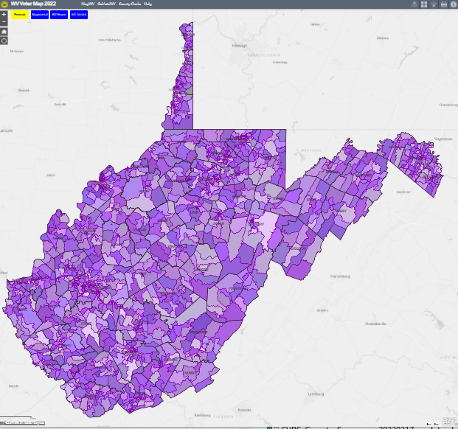

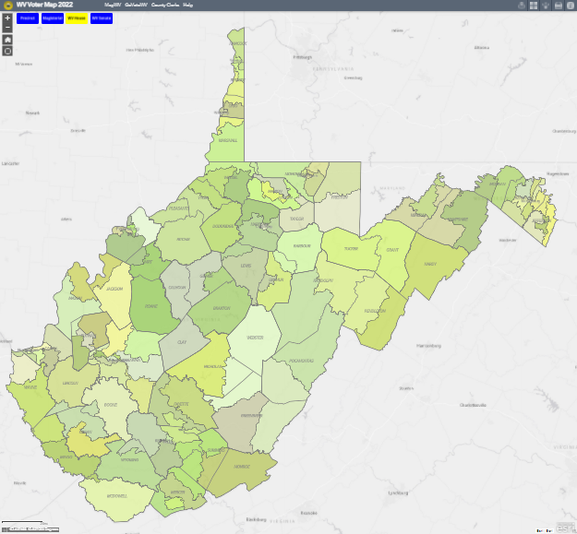



2. Statewide Voting Unit GIS Layer
2
17 WV Senate Districts 100 WV House Districts 195 Magisterial Districts 1,677 Voting Precincts
Default View

Slide 6

Interactive WV Voter Map 2022 (Public)
In March 2022, an interactive map to help voters identify new voting districts and precincts was announced for the May Primary Election
WV Voter Map Version | URL | Election Voting Districts | Links to Elected Officials | Sample Ballot | Poll Site Direct-ions
Find Voter Info | www.mapwv.gov/vote | Yes | Yes
Election Early Voting | www.mapwv.gov/vote/ev | Yes |  | Yes
Election Day | www.mapwv.gov/vote/poll | Yes |  | Yes | Yes
On the Primary Election Day of May 10 in West Virginia, the state's best-known broadcaster Hoppy Kercheval commented:
"The Secretary of State's Office has a helpful interactive website with lots of voter information. Just go to https://www.mapwv.gov/vote/ enter your address and it will tell you your polling location and have links to sample ballots."

Slide 7

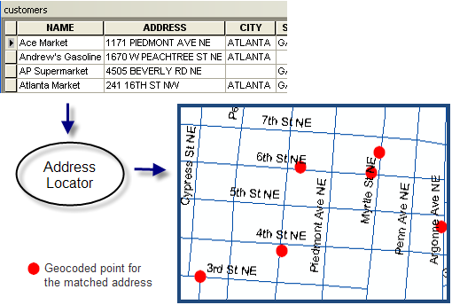
3. Geocoding Strategy
3
Geocoding, or address matching, is the computational process by which a physical address is converted into geographic coordinates.

Slide 8
Address Accuracy and Standardization Issues
Valid city-style addresses based on E-911 authoritative data need to be entered in the Statewide Voter Registration System (SVRS) to be successfully geocoded
INVALID ADDRESSES
Rural Route addresses like RT 14 BEN CREEK STAT RD BEN CK STAT RD, GILBERT, WV 25621
PO Box addresses like BOX 206-A, BAISDEN, WV 25608
General Delivery addresses like GENERAL DELIVERY, DINGESS, WV 25671
Highway Contract addresses like HC 70 BOX 520, LENORE, WV 25676
No House Numbers like CHATTAROY HOLLOW LILLY ADDITION LOT 58, CHATTAROY, WV 25667
Descriptive addresses like BELOW FOOTBALL FIELD, GILBERT, WV 25621 or ABOVE POST OFFICE, RAGLAND, WV
Incomplete addresses like KERMIT KERMIT, KERMIT, WV 25674 or PIGEON CR PIGEON CREEK
Non-Standardized addresses like MATE CREEK and MATE CRK, or MUNCY HOLLOW and MUNCY HOLLW

Slide 9
WV Composite Locator
There are approximately 1.0 million addressable structures in West Virginia. A Composite Locator is created from public and commercial address layers to geocode 1.1 million voter registration addresses. It is need for both single and bulk geocoding of voter address points.
INPUT Standardized Address; OUTPUT Match Type
Site Match
(WV or Esri Locators)
Street Match
(WV or Esri Locators)
No Matched
(Unlocated)
90% of address matches are from the WV Locator
10% matches from the commercial Esri Locator
False Positives
A False Positive is an address geocoded to the wrong location
WV Geocoding Process

Slide 10
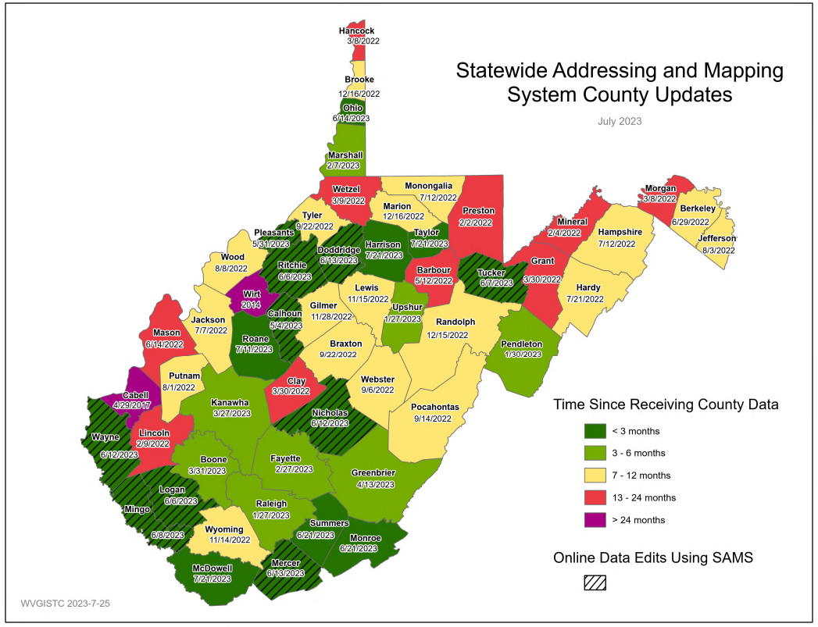
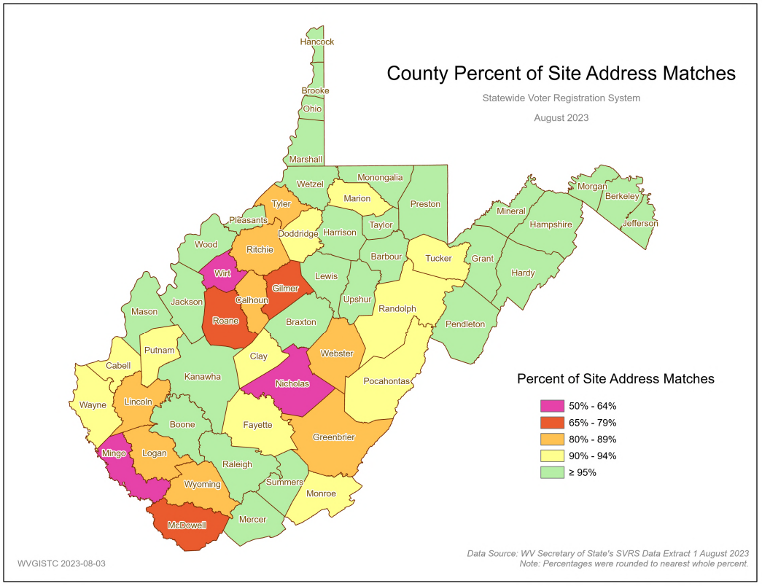
Status Graphics for Addresses
E-911 Office Updates to SAMS
County Site Address Match Rate

Slide 11

4. Contextual GIS Layers
4
Voter System GIS Layers
Voting Unit Layer
Tax Parcels (1.4 M parcels)
Legal Boundaries (232 municipal, 55 county)
Base map Layers
(Aerial Imagery)
USPS Zip Codes
Road Centerlines
Census Blocks
E-911 Address Layers
Reference or contextual GIS layers that support Geo-Enabled elections include municipal and county boundaries, tax parcels, and aerial imagery.
These GIS layers provide context for mapping election district boundaries and address locations.
Support the State’s Spatial Data Infrastructure

Slide 12
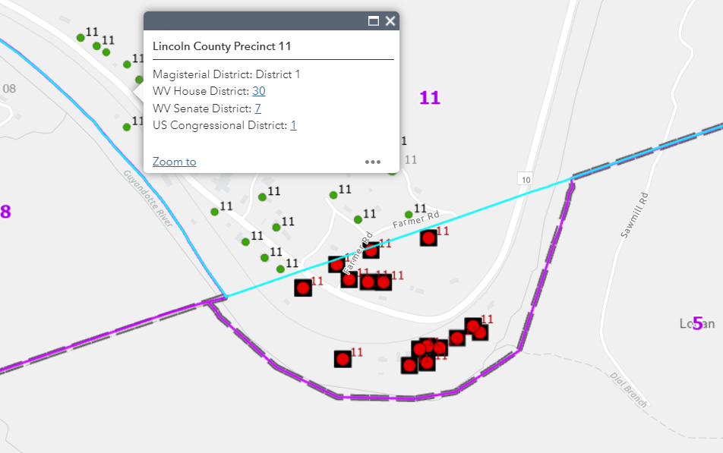

Legal Boundaries (County)
Precinct Mismatch Errors will result if County or Incorporated Place boundaries are incorrect
The Lincoln-Logan county boundary changed by the 2020 BAS was not correct for the 3/22/2022 spatial audit, resulting in mismatch and outside county precinct errors for voter points in Lincoln County Precinct 11. The GIS boundary has been updated in the G-SVRS Tool, so the precinct mismatch errors should be corrected when the next spatial audit is performed.
Old County Boundary
Correct County Boundary
Precinct 11
Lincoln
Mismatch Error
Logan

Slide 13
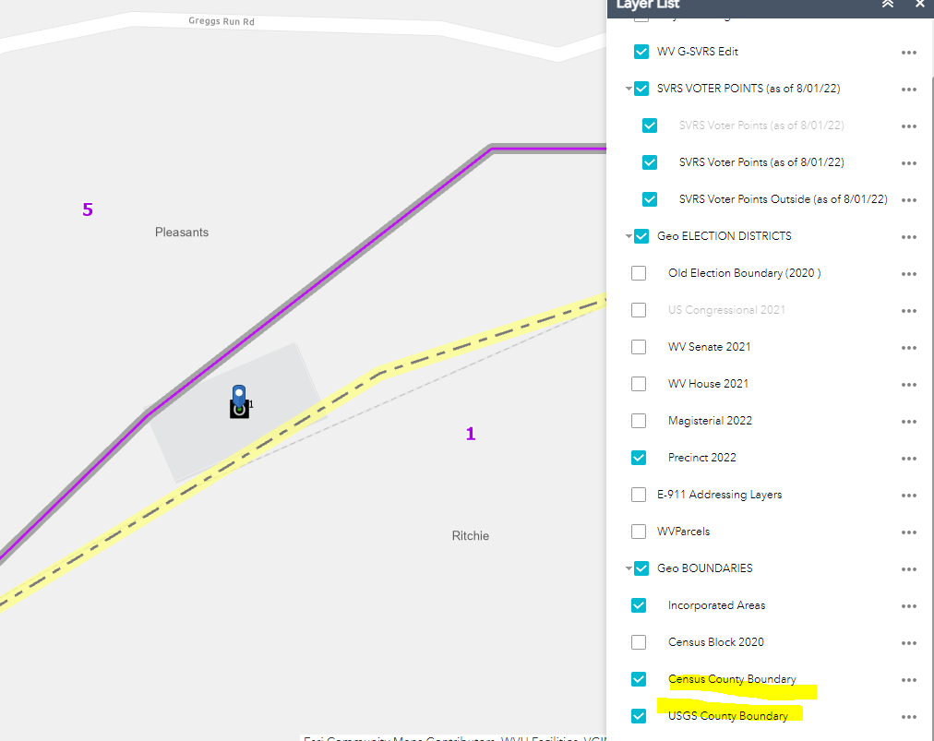
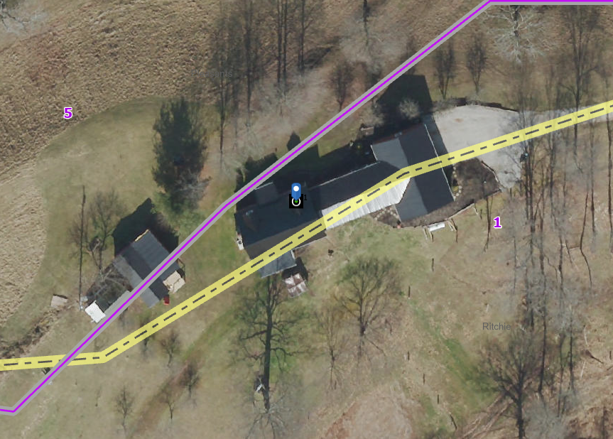
County Boundary Accuracy Improvement
The official county boundaries for West Virginia are the USGS topographic map boundaries plus recent court order updates. West Virginia is coordinating with Census BAS to improve the spatial resolution of county boundaries in West Virginia before the 2030 Census.
Census
County Boundary
Census
County Boundary
USGS
County Boundary
USGS
County Boundary
Non-coincidental USGS topo and Census boundaries
https://mapwv.gov/svrs/?marker=-81.075303,39.327192&level=20

Slide 14
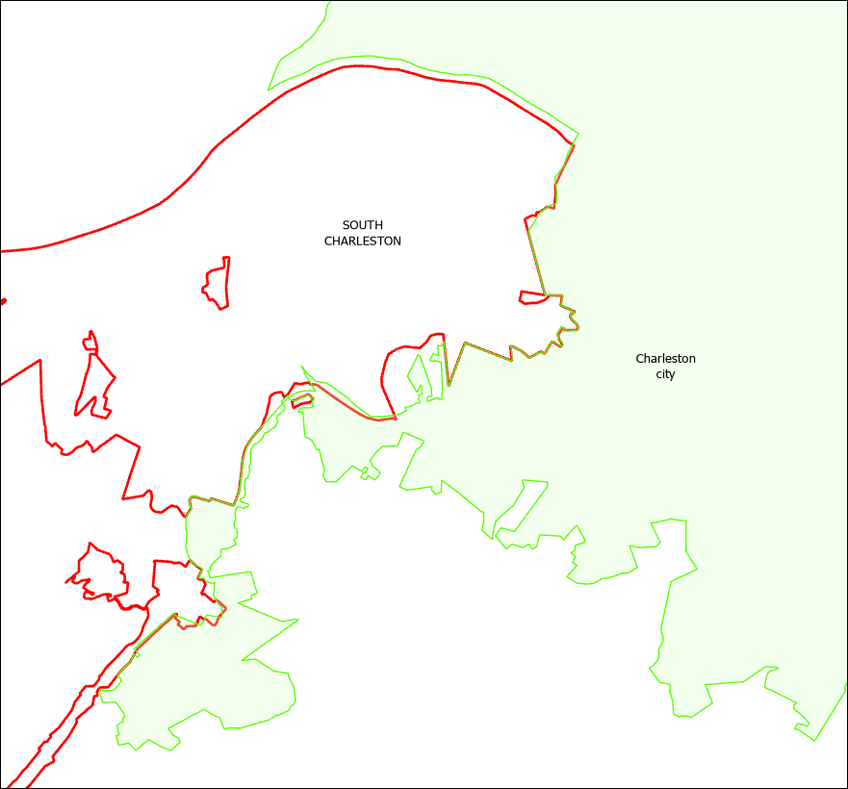
Legal Boundaries (Municipal)
Municipal or Incorporated Place Boundaries
Incorporated Place boundaries are important for defining municipal precincts
Municipal boundary corrections need to be submitted to the federal geospatial database via Census BAS for Charleston and South Charleston which have a shared boundary.
A tracking log should monitoring progress of pending community BAS submissions
South Charleston
Charleston
WV BAS Interactive Viewer of Municipal Boundaries from Census and Local Data Source

Slide 15
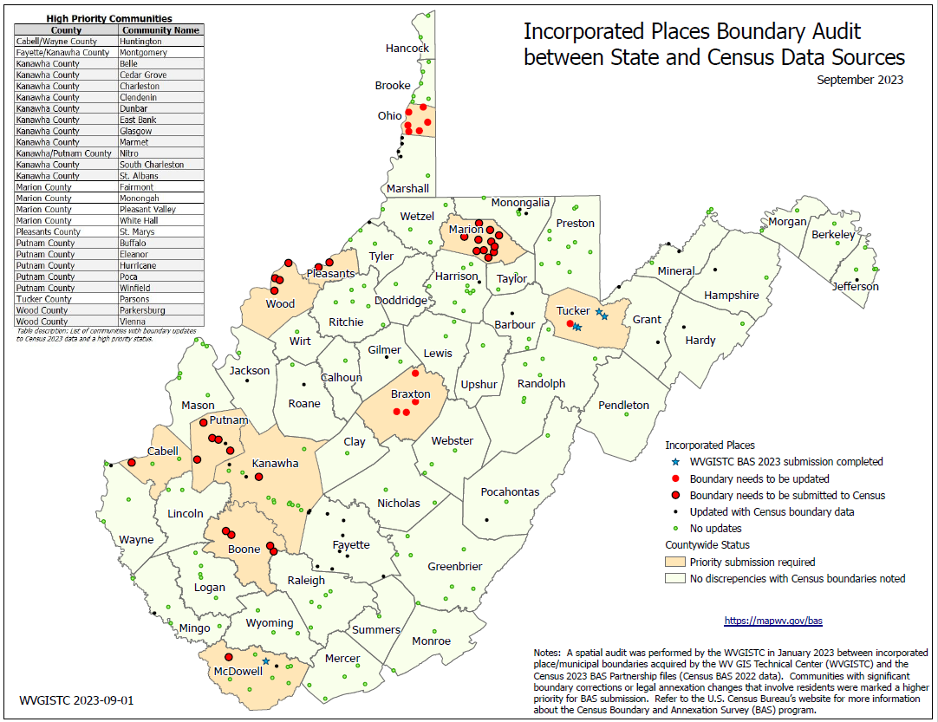
Municipal Boundary Audit / BAS Tracking
Municipal Boundary audit between Census and local data sources. Boundary changes submitted via Census BAS program.
Topic | Census Resources | State Resources
Review Boundary Data | TIGERweb¹ viewer and guide BAS Partnership Shapefiles² PDF BAS maps³ | WV Incorporated Places Viewer State Municipality GIS File WV BAS Status Graphic WV BAS Audit Table

Slide 16
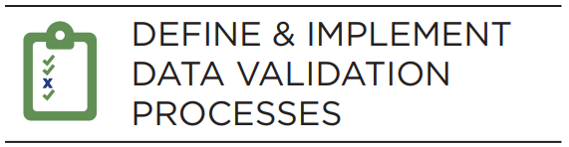
5. Data Validation Processes
5
Inputs
SVRS (List)
Election Districts (GIS)
Outputs
Visualization Tools
Address Layers (GIS Locators)
Political Boundaries (GIS)
Transparency to Public and Stakeholders
Geoanalytics
Validating the elections data using geoanalytics provides greater confidence in the elections system to administrators and the public. Monthly systematic audits include:
Verifying mapped voters fall within the correct district
Address geocoding match rates

Slide 17
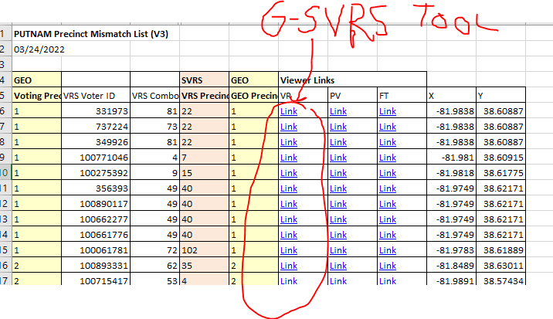
WV GIS Products
PRODUCT | DESCRIPTION | WEB LINKS
County Report Lists (Excel Spreadsheet) | Precinct Mismatch List | Download County Mismatch File
 | Voter List (all SVRS records) | Download County Voter List File
 | E-911 Site and Street Ranges | Download Select Counties
Map Viewers (Online Web) | WV Voter Map 2022 (Public) | www.mapwv.gov/vote
 | WV Geo-Enables SVRS Tool (Non-Public) formerly the redistricting web map | www.mapwv.gov/svrs
Progress Tracking (Excel Spreadsheet) | County SVRS-GEO and Address Geocoding Statuses | Table | Graphic | Geocode Status
 | Precinct SVRS-GEO Status | Table | Graphic
Online Resources | County Clerk Redistricting Resources | www.mapwv.gov/redistricting
 | Background info about Reports and Map Viewers | GEO-SVRS Reports and Map Viewers
Statewide Voter Registration System (SVRS) Reports link tabular data to Map Viewer
County Precinct Mismatch Report
G-SVRS Map Tool

Slide 18
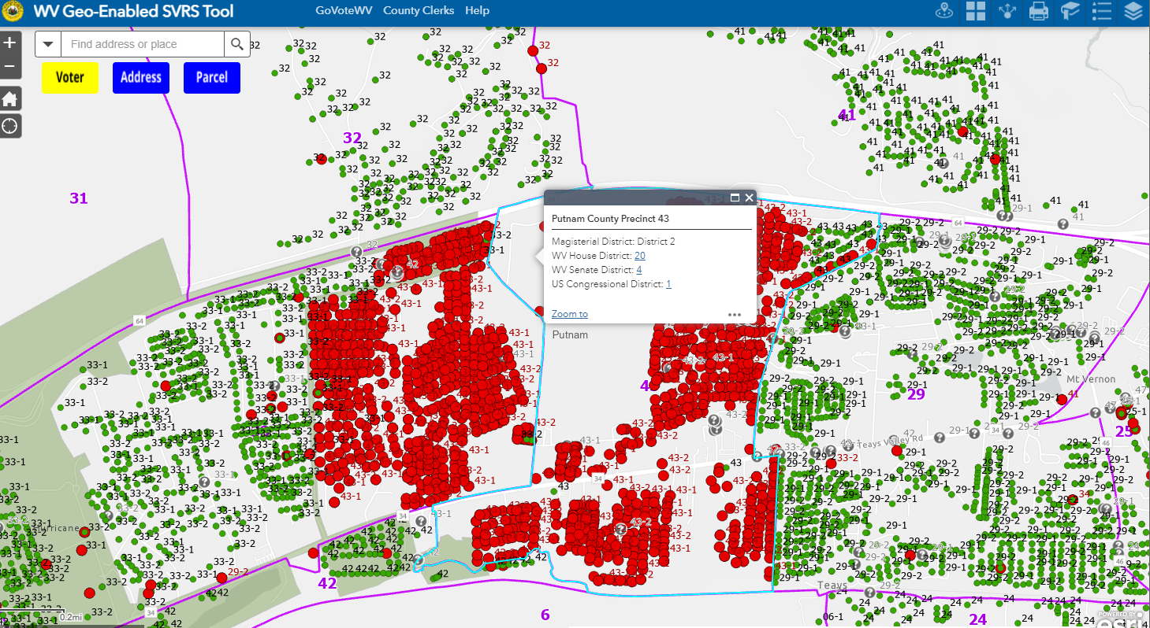
Precinct Level SVRS-Geo Audit
Precinct 33
Precinct 43
View specific precincts on G-SVRS Tool

Slide 19
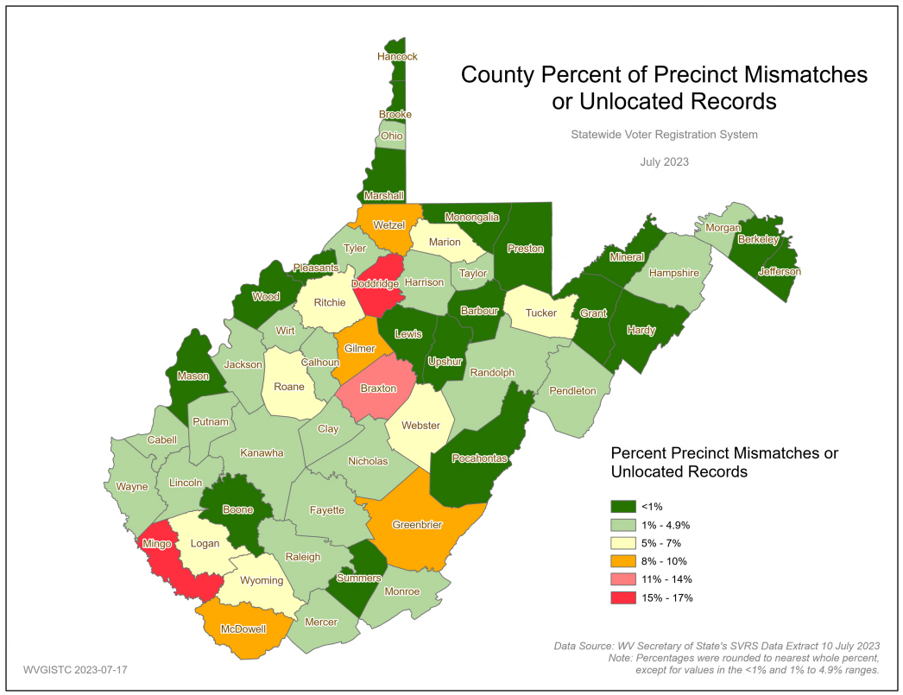
Countywide % SVRS-Geo Mismatch
State Level
SVRS-GEO mismatch 2.3%
Ideally < 1%
County Level
SVRS-GEO mismatch < 5%
Ideally < 1%

Slide 20
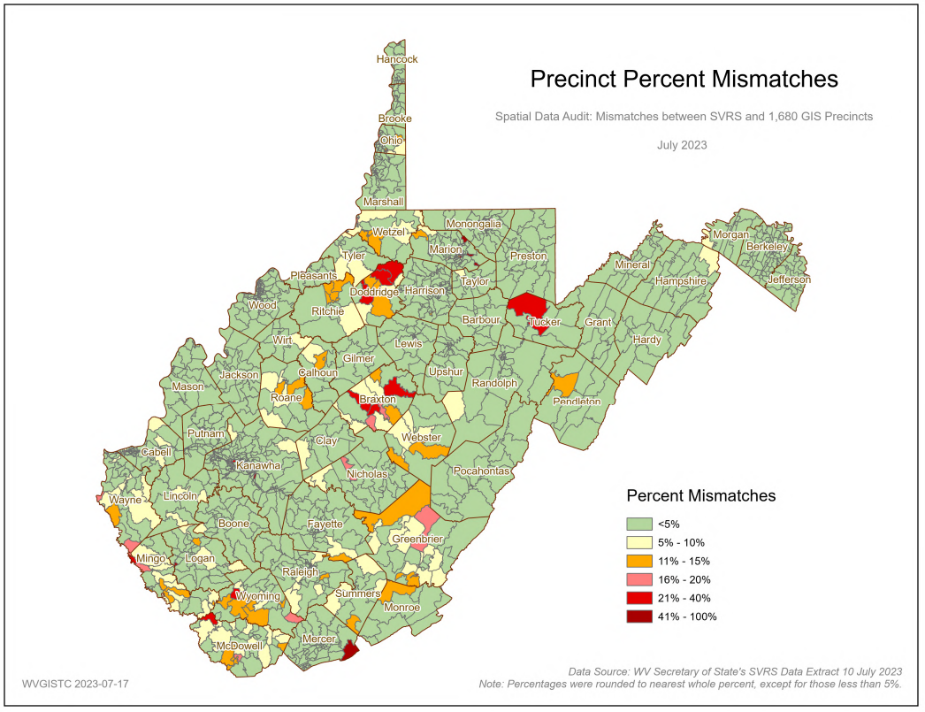
Precinct % SVRS-Geo Mismatch
Precinct Level
SVRS-GEO mismatch < 5%
Ideally < 1%

Slide 21
GeoAnalytics: County Performance Measures
Voting Districts | Deficiency: SVRS-GEO Mismatches
County Level | > 5% SVRS-GEO countywide precinct mismatch; > 10% more severe > 1000 SVRS-GEO precinct mismatches > 20 outside county precinct mismatches < 90% SVRS-GEO matches (all districts: Congressional, WV State, WV House, Magisterial, Precinct)
Precinct Level | # precincts > 100 voters Precinct boundaries not precisely mapped to match SVRS voter assignments
Addresses | Deficiency
% Site Address Matches | < 95% countywide site geocode match rate (valid addresses)
% Unlocated Addresses | > 2% countywide unlocated geocode match rate (invalid addresses)
Updates to SAMS | > 1 year addresses not updated to Statewide Addressing and Mapping System (SAMS)
Address Exceptions | > 1% address exceptions (issues with address quality)
Legal Boundaries | Deficiency
Incorporated Place or County Boundary | 1 or more BAS submissions pending

