Slide 1
How the Proposed Magisterial Districts and Voter Precincts Were Developed
Jefferson County Commission
Public Hearing on Redistricting
November 10th, 2011
Notes:
Tonight I will give a brief background on the decision making that went into this draft proposal.
Although frustrating at times, this exercise was a great application of Geographic Information Systems because it involved multiple data layers from multiple sources, matching addresses from different data sets, summarizing voter totals, mapping voter distribution and analyzing census population data, all for a very practical purpose.
I was directed by the County Commission and Administrator to work with Ms. Painter in Voter Registration to analyze population and voter distribution relative to new Delegate Districts and draft the proposal for new Magisterial Districts and Voter Precincts that is before public review right now. The goal was to effect as little change as possible within the given constraints.
These rules and guidelines I will be reviewing tonight were conveyed to me by the WV State Legislative Redistricting Office and confirmed by the Jefferson County Clerk’s Voter Registration Office and Legal Counsel for the County Commission.

Slide 2
All Lines follow Census Blocks

Slide 3
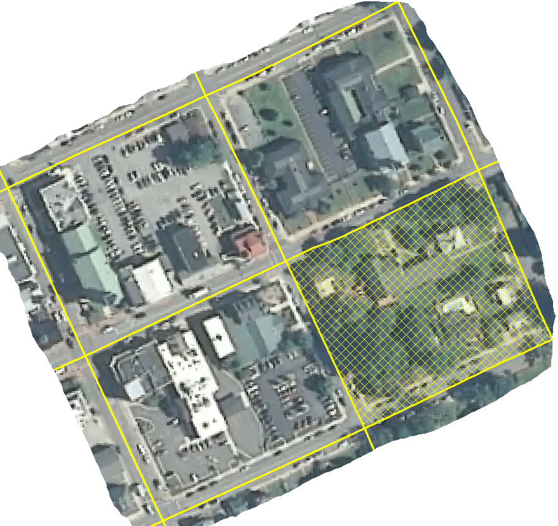
All Lines follow Census Blocks
Smallest geographic unit used by USCB
Enumerated by population
Typically bounded by streets in urban areas but may be bounded by streams, rivers, railroads, power lines, trails, city borders, etc
Notes:
This is what most people think of when they hear the word, “block”
Regular square shapes in an urban setting bounded by perpendicular streets. These and other irregular area make up the smallest geographic unit used by the Census Bureau. They are each assigned the total population living within that block at the time of the 2010 Decennial Census

Slide 4
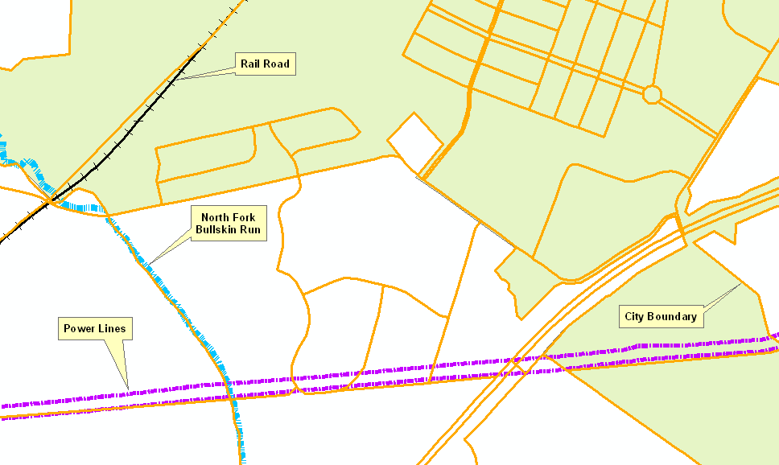
may be bounded by streams, rivers, railroads, power lines, trails, city borders, etc
All Lines follow Census Blocks
Notes:
As I just mentioned, Blocks can also be irregular in rural areas, bounded by visible features on the ground like streams, railroads, power lines and even municipal boundaries

Slide 5
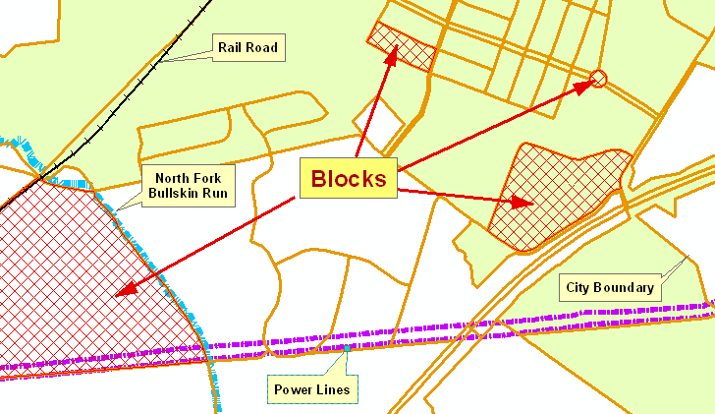
may be bounded by streams, rivers, railroads, power lines, trails, city borders, etc
All Lines follow Census Blocks
Notes:
Only one of these examples has a population total, the rest are zero.
The block between colonial Drive and union ridge Drive in Huntfield
Point out the Huntfield traffic circle and washington high school

Slide 6
All Lines follow Census Blocks
House Delegates draw Delegate Lines

Slide 7
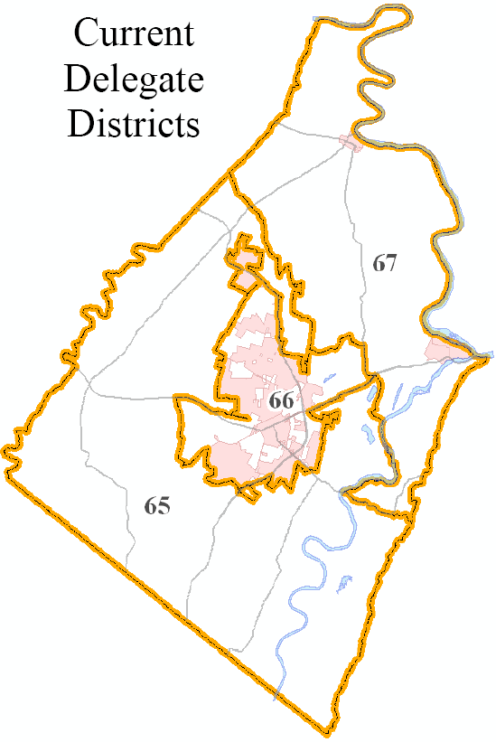
All Lines follow Census Blocks
House Delegates draw Delegate Lines
Received Data Late August 2011
Notes:
These are the boundaries delivered to us in late August. You’ll see why these are a driving factor in magisterial and precinct lines later.

Slide 8
All Lines follow Census Blocks
House Delegates draw Delegate Lines
Delegate Districts relatively equal Population

Slide 9
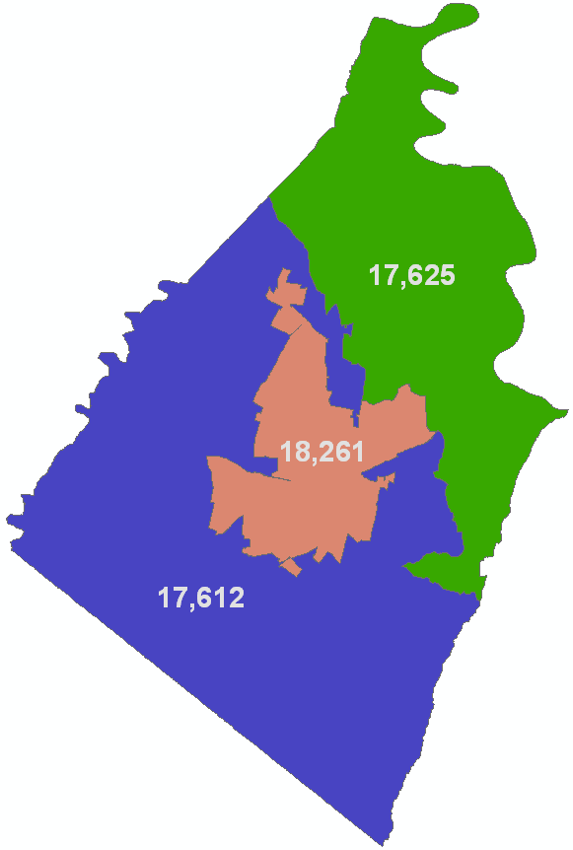
All Lines follow Census Blocks
House Delegates draw Delegate Lines
Delegate Districts relatively equal Population
County Population = 53,498
Target avg per District = 17,833
Notes:
Incidentally, our 2000 population was 42,190
Delegate District
Population Summaries
65 = 17,612 (-1.2%)
66 = 18,261 (+2.4%)
67 = 17,625 (-1.1%)

Slide 10
All Lines follow Census Blocks
House Delegates draw Delegate Lines
Delegate Districts relatively equal Population
Commissioners draw Magisterial Lines

Slide 11
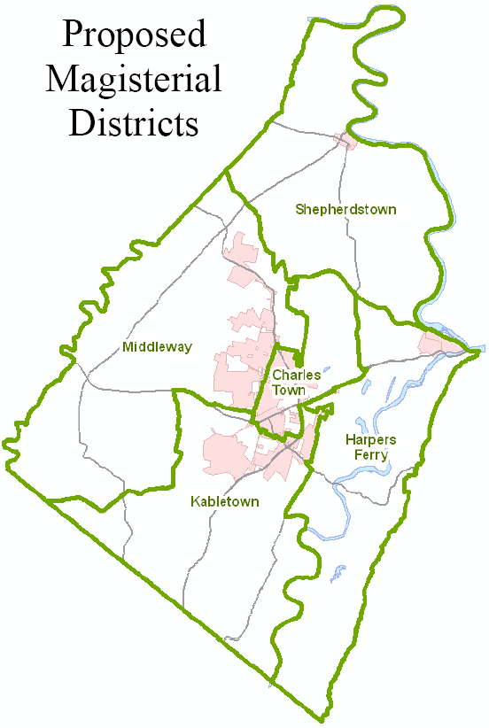
All Lines follow Census Blocks
House Delegates draw Delegate Lines
Delegate Districts relatively equal Population
Commissioners draw Magisterial Lines
Proposed for Public Review on October 27th, 2011
Notes:
Commission has the responsibility to draw Magisterial Lines, this is the topic of tonight’s public hearing.
Later I will touch on some factors that lead to decisions regarding the selection of these draft boundaries.

Slide 12
All Lines follow Census Blocks
House Delegates draw Delegate Lines
Delegate Districts relatively equal Population
Commissioners draw Magisterial Lines
Magisterial Districts relatively equal Population

Slide 13
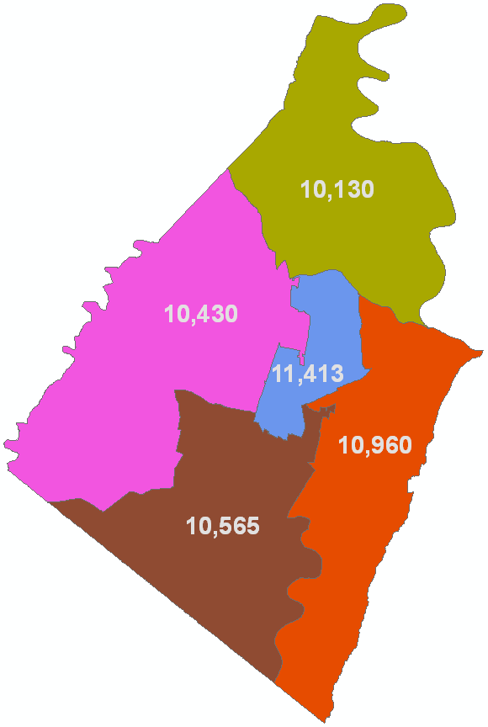
All Lines follow Census Blocks
House Delegates draw Delegate Lines
Delegate Districts relatively equal Population
Commissioners draw Magisterial Lines
Magisterial Districts relatively equal Population
Target avg per District = 10,700
Notes:
While perhaps not in code, I was given a +/- 5% goal for population variation among draft districts.

Slide 14
All Lines follow Census Blocks
House Delegates draw Delegate Lines
Delegate Districts relatively equal Population
Commissioners draw Magisterial Lines
Magisterial Districts relatively equal Population
Magisterial Districts may cross Delegate Lines

Slide 15
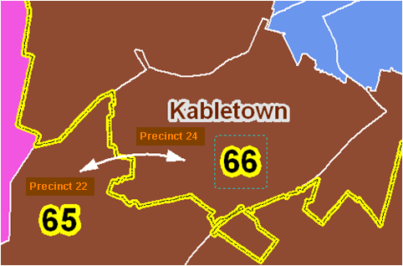
All Lines follow Census Blocks
House Delegates draw Delegate Lines
Delegate Districts relatively equal Population
Commissioners draw Magisterial Lines
Magisterial Districts relatively equal Population
Magisterial Districts may cross Delegate Lines
But must do so by a whole precinct
Notes:
Districts can cross Delegate Lines as long as it is by an entire precinct. No partial extensions by any census blocks that do not wholly comprise a precinct.

Slide 16
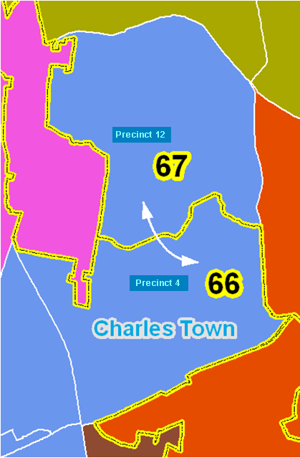
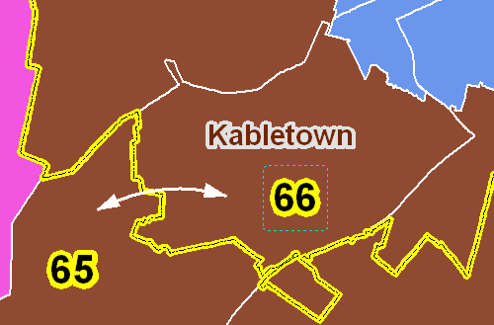
All Lines follow Census Blocks
House Delegates draw Delegate Lines
Delegate Districts relatively equal Population
Commissioners draw Magisterial Lines
Magisterial Districts relatively equal Population
Magisterial Districts may cross Delegate Lines
But must do so by a whole precinct
Notes:
This is an acceptable configuration

Slide 17
All Lines follow Census Blocks
House Delegates draw Delegate Lines
Delegate Districts relatively equal Population
Commissioners draw Magisterial Lines
Magisterial Districts relatively equal Population
Magisterial Districts may cross Delegate Lines
Commissioners responsible for Voter Precincts, often assigned to Clerk
Notes:
This is the time period from September to October when I was directed by County Administrator to work with Voter Registration to analyze distribution of population and voters and draft new magisterial districts. In practice we could not uncouple districts and precincts because one is the building block for the other.

Slide 18
All Lines follow Census Blocks
House Delegates draw Delegate Lines
Delegate Districts relatively equal Population
Commissioners draw Magisterial Lines
Magisterial Districts relatively equal Population
Magisterial Districts may cross Delegate Lines
Commissioners responsible for Voter Precincts, often assigned to Clerk
Voter Precincts can be adjusted periodically
Notes:
Rarely happens to my knowledge
This means that although it is not recommended or desirable, adjustments can be made to accommodate growth or decline in voter totals in a precinct.

Slide 19
All Lines follow Census Blocks
House Delegates draw Delegate Lines
Delegate Districts relatively equal Population
Commissioners draw Magisterial Lines
Magisterial Districts relatively equal Population
Magisterial Districts may cross Delegate Lines
Commissioners responsible for Voter Precincts, often assigned to Clerk
Voter Precincts can be adjusted periodically
Voter Precincts cannot cross Delegate Lines

Slide 20
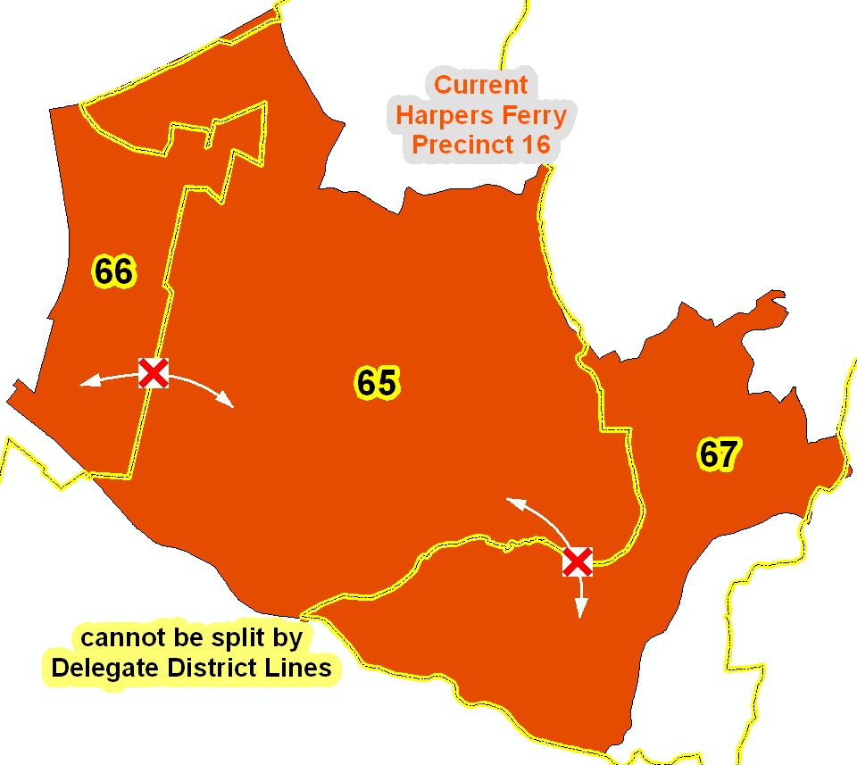
Voter Precincts cannot cross Delegate Lines
Notes:
This is probably the single biggest driver in shaping magisterial districts.
Here is an example of our old (or current) precinct 16 in the HF magisterial district overlayed by our new Delegate Districts.
Because it would spill over into not two but THREE Delegate territories, it must get a haircut. We are essentially forced to lop off the ends and start rebuilding the center from the north or south as long as we stay within the yellow lines.
This is where drafting districts becomes a puzzle. If you shave off from one place, you need to compensate for those lost voters and population in eligible and adjacent census blocks. This is where we could not adhere to as little change as possible. And I’ll show more specifics at the end of this presentation.

Slide 21
All Lines follow Census Blocks
House Delegates draw Delegate Lines
Delegate Districts relatively equal Population
Commissioners draw Magisterial Lines
Magisterial Districts relatively equal Population
Magisterial Districts may cross Delegate Lines
Commissioners responsible for Voter Precincts, often assigned to Clerk
Voter Precincts can be adjusted periodically
Voter Precincts cannot cross Delegate Lines
Voting Precincts contain 300-1500 Voters

Slide 22
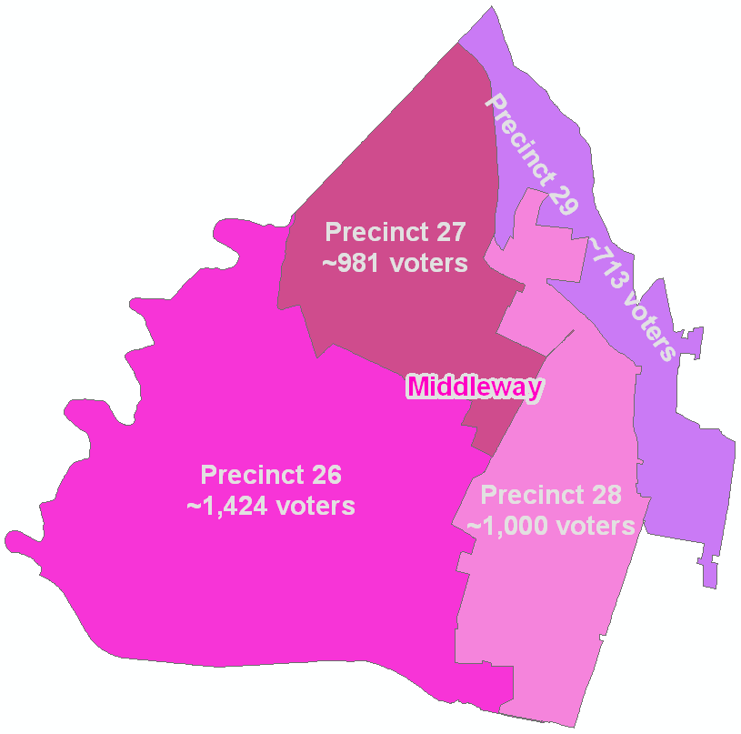
Voting Precincts contain 300-1500 Voters
Notes:
After matching voting records to our 911 physical location addresses, using GIS, we can sum up totals within any geographic area we want.
We tried to trim down previous overpopulated precincts when we could, like here in 27 and 29

Slide 23
All Lines follow Census Blocks
House Delegates draw Delegate Lines
Delegate Districts relatively equal Population
Commissioners draw Magisterial Lines
Magisterial Districts relatively equal Population
Magisterial Districts may cross Delegate Lines
Commissioners responsible for Voter Precincts, often assigned to Clerk
Voter Precincts can be adjusted periodically
Voter Precincts cannot cross Delegate Lines
Voting Precincts contain 300-1500 Voters
Precincts can reach 3000 Voters if split A/B

Slide 24
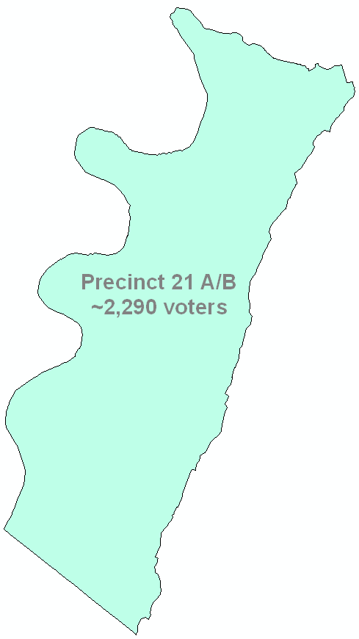
All Lines follow Census Blocks
House Delegates draw Delegate Lines
Delegate Districts relatively equal Population
Commissioners draw Magisterial Lines
Magisterial Districts relatively equal Population
Magisterial Districts may cross Delegate Lines
Commissioners responsible for Voter Precincts, often assigned to Clerk
Voter Precincts can be adjusted periodically
Voter Precincts cannot cross Delegate Lines
Voting Precincts contain 300-1500 Voters
Precincts can reach 3000 Voters if split A/B
Notes:
When it is not possible or practical to split precincts, there is a mechanism to artificially separate them alphabetically in the precinct book at the polling place.
A through M is 21A and N through Z is 21B

Slide 25
All Lines follow Census Blocks
House Delegates draw Delegate Lines
Delegate Districts relatively equal Population
Commissioners draw Magisterial Lines
Magisterial Districts relatively equal Population
Magisterial Districts may cross Delegate Lines
Commissioners responsible for Voter Precincts, often assigned to Clerk
Voter Precincts can be adjusted periodically
Voter Precincts cannot cross Delegate Lines
Voting Precincts contain 300-1500 Voters
Precincts can reach 3000 Voters if split A/B
Precincts should contain their Polling Place

Slide 26
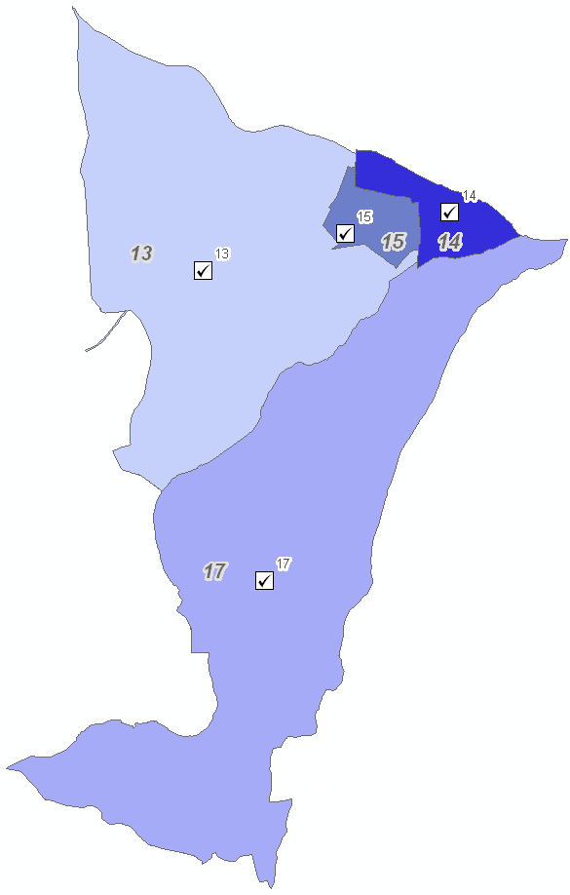
All Lines follow Census Blocks
House Delegates draw Delegate Lines
Delegate Districts relatively equal Population
Commissioners draw Magisterial Lines
Magisterial Districts relatively equal Population
Magisterial Districts may cross Delegate Lines
Commissioners responsible for Voter Precincts, often assigned to Clerk
Voter Precincts can be adjusted periodically
Voter Precincts cannot cross Delegate Lines
Voting Precincts contain 300-1500 Voters
Precincts can reach 3000 Voters if split A/B
Precincts should contain their Polling Place
Notes:
Just an example here of polling places that lie within the boundaries of their precincts.
Not always possible, though, and when we had to we picked the nearest possible location for a polling place to limit hardship of the voter driving too far.

Slide 27
All Lines follow Census Blocks
House Delegates draw Delegate Lines
Delegate Districts relatively equal Population
Commissioners draw Magisterial Lines
Magisterial Districts relatively equal Population
Magisterial Districts may cross Delegate Lines
Commissioners responsible for Voter Precincts, often assigned to Clerk
Voter Precincts can be adjusted periodically
Voter Precincts cannot cross Delegate Lines
Voting Precincts contain 300-1500 Voters
Precincts can reach 3000 Voters if split A/B
Precincts should contain their Polling Place
Polling Places have size and access rules
Public Building preferred
ADA Compliant
Large enough to accommodate voters on election day
Notes:
There were even qualifications for an appropriate polling center

Slide 28
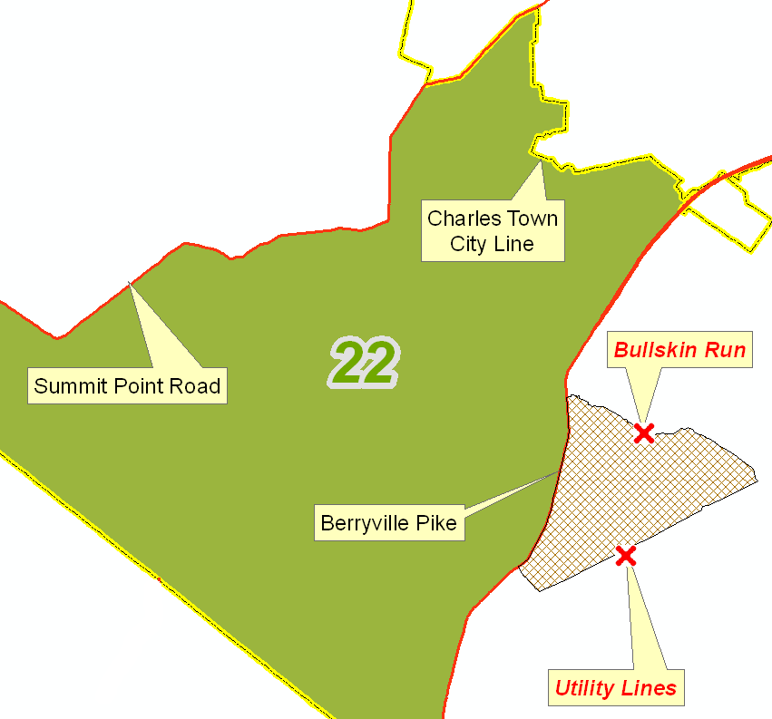
All Lines follow Census Blocks
House Delegates draw Delegate Lines
Delegate Districts relatively equal Population
Commissioners draw Magisterial Lines
Magisterial Districts relatively equal Population
Magisterial Districts may cross Delegate Lines
Commissioners responsible for Voter Precincts, often assigned to Clerk
Voter Precincts can be adjusted periodically
Voter Precincts cannot cross Delegate Lines
Voting Precincts contain 300-1500 Voters
Precincts can reach 3000 Voters if split A/B
Precincts should contain their Polling Place
Polling Places have size and access rules
Use Census Block Lines that “make sense” or are easy to explain
Notes:
Some internal guidelines we placed on ourselves include such things as choosing block boundaries that make sense to people.
It’s easier to explain that your precinct lies between Summit Point Road and Rt 340 than telling someone you vote somewhere because your house is triangulated by a creek, a power line or maybe a feature that doesn’t even exist.

Slide 29
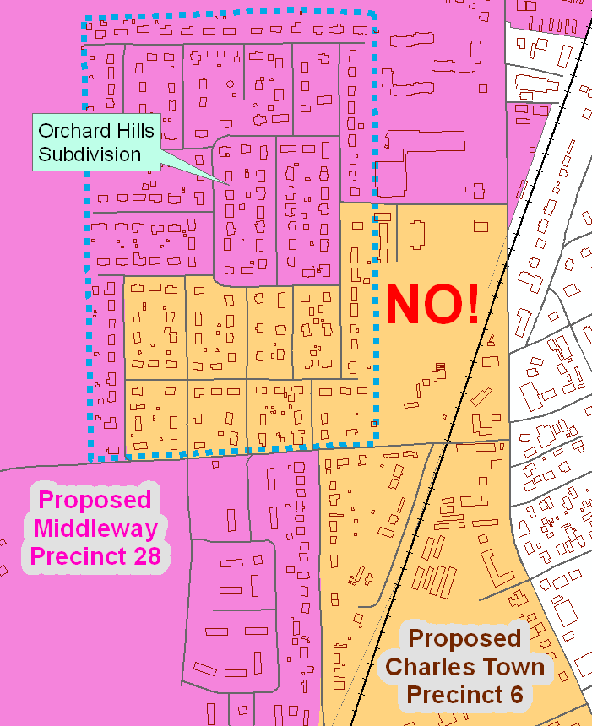
All Lines follow Census Blocks
House Delegates draw Delegate Lines
Delegate Districts relatively equal Population
Commissioners draw Magisterial Lines
Magisterial Districts relatively equal Population
Magisterial Districts may cross Delegate Lines
Commissioners responsible for Voter Precincts, often assigned to Clerk
Voter Precincts can be adjusted periodically
Voter Precincts cannot cross Delegate Lines
Voting Precincts contain 300-1500 Voters
Precincts can reach 3000 Voters if split A/B
Precincts should contain their Polling Place
Polling Places have size and access rules
Use Census Block Lines that “make sense” or are easy to explain
Try not to Split Neighborhoods
Notes:
Here is an example of one thing we tried to avoid: splitting neighborhoods, which has the effect of sending your neighbor across the street to a different polling place than you. That doesn’t make sense to the voter. So when presented with this problem, for example Orchard Hills here, we did not select part of the blocks in the subdivision.

Slide 30
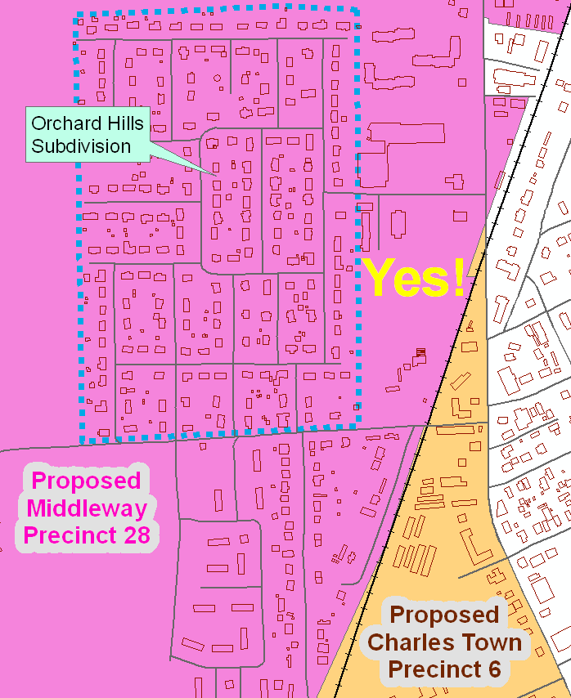
All Lines follow Census Blocks
House Delegates draw Delegate Lines
Delegate Districts relatively equal Population
Commissioners draw Magisterial Lines
Magisterial Districts relatively equal Population
Magisterial Districts may cross Delegate Lines
Commissioners responsible for Voter Precincts, often assigned to Clerk
Voter Precincts can be adjusted periodically
Voter Precincts cannot cross Delegate Lines
Voting Precincts contain 300-1500 Voters
Precincts can reach 3000 Voters if split A/B
Precincts should contain their Polling Place
Polling Places have size and access rules
Use Census Block Lines that “make sense” or are easy to explain
Try not to Split Neighborhoods
Notes:
This arrangement is more appropriate because all neighbors vote in the same precinct and it’s easier to explain the railroad as a natural dividing line.
This problem is unavoidable in some communities due to the presence of a delegate line that may cut through a neighborhood, like in Gap View Village, Briar Run and Shenandoah Junction . We can’t help that situation because remember, precincts cannot cross delegate lines.

Slide 31
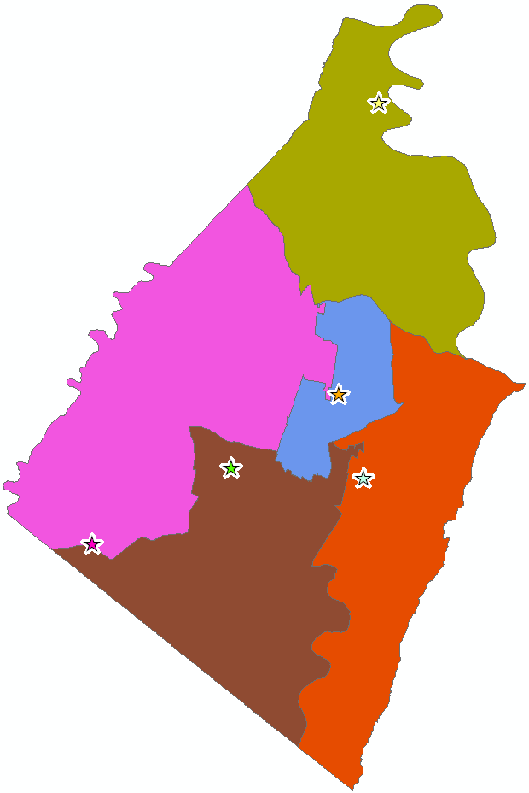
All Lines follow Census Blocks
House Delegates draw Delegate Lines
Delegate Districts relatively equal Population
Commissioners draw Magisterial Lines
Magisterial Districts relatively equal Population
Magisterial Districts may cross Delegate Lines
Commissioners responsible for Voter Precincts, often assigned to Clerk
Voter Precincts can be adjusted periodically
Voter Precincts cannot cross Delegate Lines
Voting Precincts contain 300-1500 Voters
Precincts can reach 3000 Voters if split A/B
Precincts should contain their Polling Place
Polling Places have size and access rules
Use Census Block Lines that “make sense” or are easy to explain
Try not to Split Neighborhoods
Respect Location of Sitting Commissioner
Notes:
We were cognizant not to unseat, by process, any sitting commissioner.

Slide 32
All Lines follow Census Blocks
House Delegates draw Delegate Lines
Delegate Districts relatively equal Population
Commissioners draw Magisterial Lines
Magisterial Districts relatively equal Population
Magisterial Districts may cross Delegate Lines
Commissioners responsible for Voter Precincts, often assigned to Clerk
Voter Precincts can be adjusted periodically
Voter Precincts cannot cross Delegate Lines
Voting Precincts contain 300-1500 Voters
Precincts can reach 3000 Voters if split A/B
Precincts should contain their Polling Place
Polling Places have size and access rules
Constraints to Developing
New Magisterial Districts and Voting Precincts
Use Census Block Lines that “make sense” or are easy to explain
Try not to Split Neighborhoods
Respect Location of Sitting Commissioner
Notes:
Putting this in poker terms, those were the rules of the game and we’ll show you next the hand we were dealt.

Slide 33
How did we assemble the Puzzle with the least change possible?

Slide 34
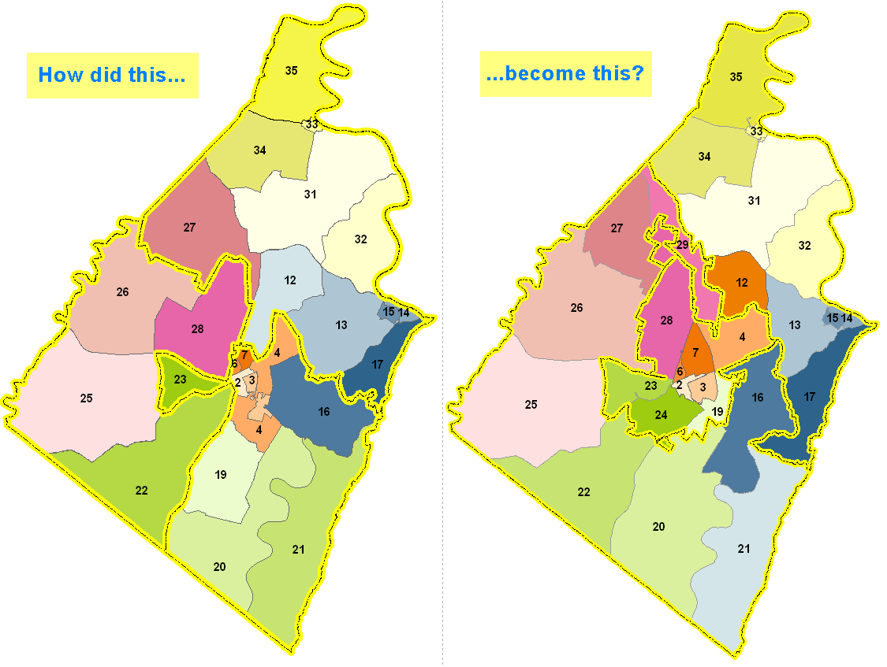
2001 - 2010
2011 proposed
Notes:
Comparison of current v. proposed

Slide 35
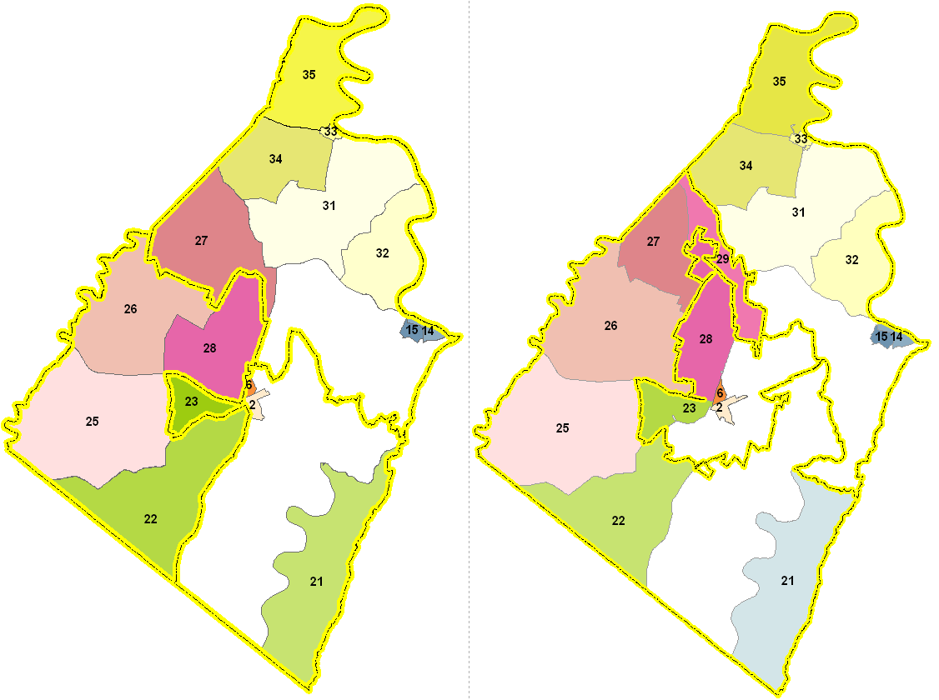
Started with the “easier” precincts
Notes:
I’m mixing my analogies now, but don’t we always start a puzzle by working on the outside border?
These are the precincts that were practically unchanged or had little voter and population change when aggregating just a little bit.

Slide 36
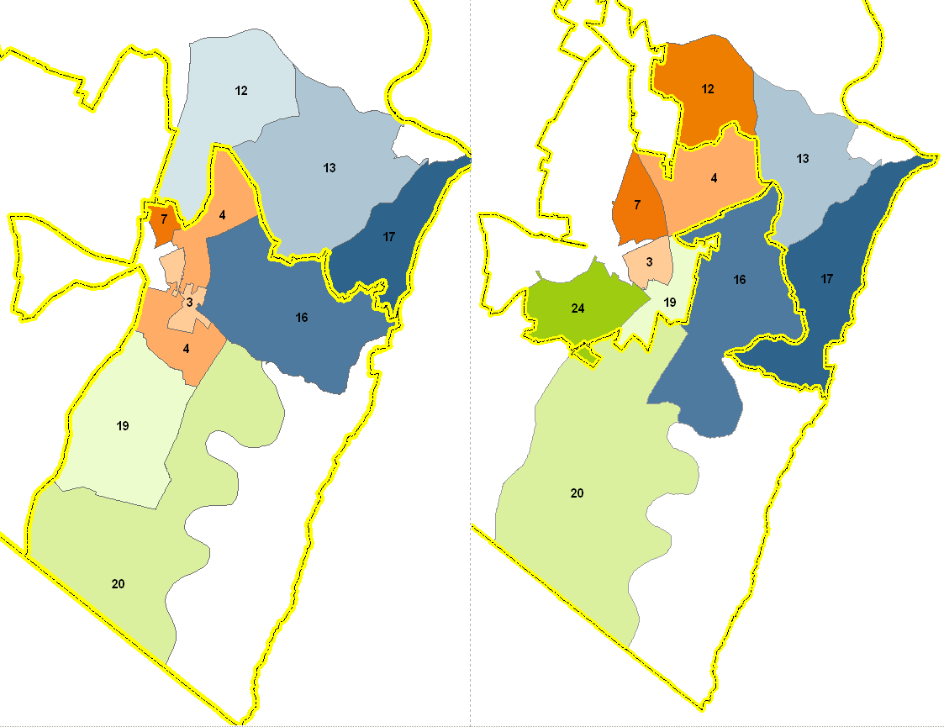
Left with the “tougher” pieces of the puzzle
Notes:
Here are the problem pieces.
The ones with greater population growth and significant interaction with the new delegate district boundaries.
Here’s where we really had to transfer blocks, populations and voters among precincts, sometimes creating new ones, sometimes unsplitting or consolidating old ones

Slide 37
Remember this one?
Notes:
Remember this example?
We had to trim off and transfer obvious block pieces for many of the old precincts in the difficult parts of the puzzle.

Slide 38
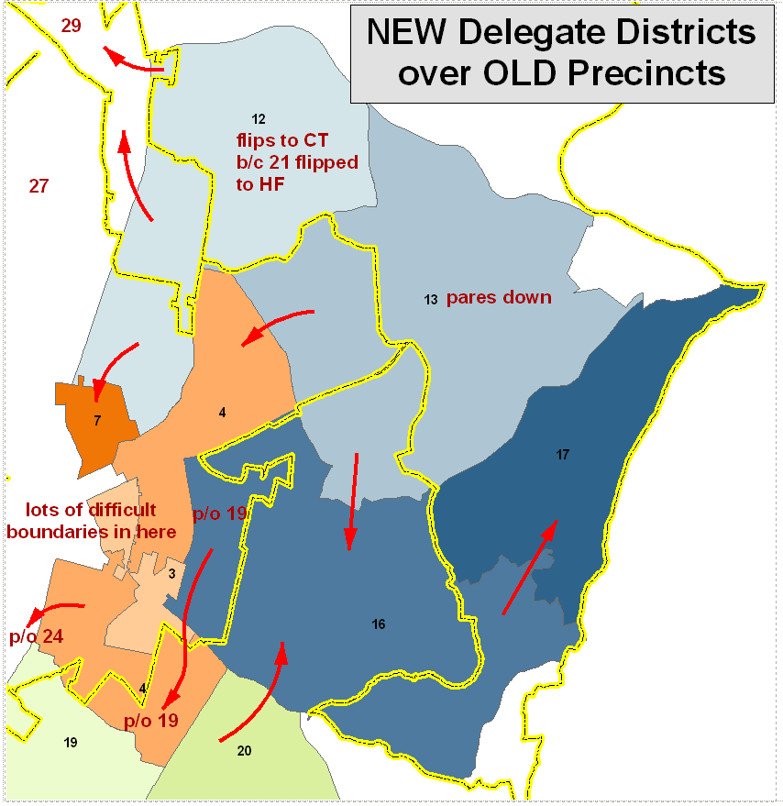
Best example of necessary shifting of whole block areas to new precincts (and sometimes new magisterial districts) due to constraints imposed by NEW DELEGATE LINES
Notes:
This is the best example of how complex this puzzle was. We played by all of the rules I went through earlier and shifted large chunks of census blocks where we had no choice and made up for shortfalls and overages by establishing some new precinct boundaries that hopefully make sense to people.
All the while, we were paying attention to population and voter totals, potential availability for polling places, and impact to voters

Slide 39
…and that’s how it happened.
Thank You
Notes:
Thank you for your attention. I hope everyone has a better understanding and appreciation for the thought and work that went into this draft proposal from multiple departments and staff. These maps are still on display for public review on the Commission’s website, on the Clerk’s website, in each magisterial district, here in this meeting room. I also invite everyone to view this map and many other examples of GIS work in the Court House and the Mason building next week in honor of National Geography Week and GIS Day.
Thank you
Maps have been posted in each Magisterial District for public inspection at the following locations:
Jefferson County Courthouse
Shepherdstown Public Library
South Jefferson Public Library
Bolivar-Harpers Ferry Library
Jefferson County Health Department

