Slide 1
BRAXTON COUNTY Election District Mapping
Voter Registration Points
E-911 Addresses & Road Centerlines (all addresses of smaller roads in single voting precinct
Census Blocks
Topographic Ridges
Tax District or Magisterial Lines on Topographic Maps
Polling Sites
Magisterial Lines align with Voter Precincts

Slide 2
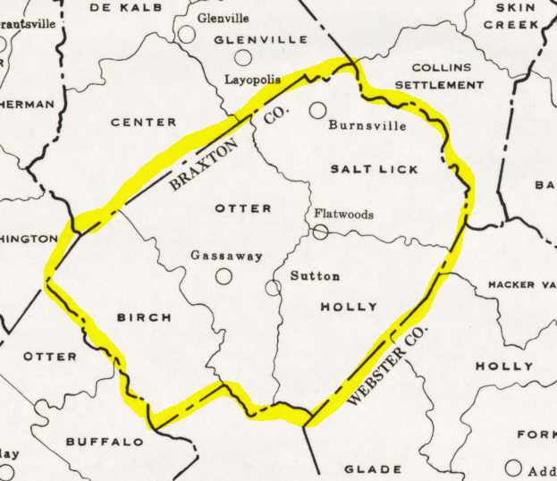
BRAXTON TAX AND MAGISTERIAL DISTRICTS IN 1970
Northern
Western
Eastern
Southern

Slide 3
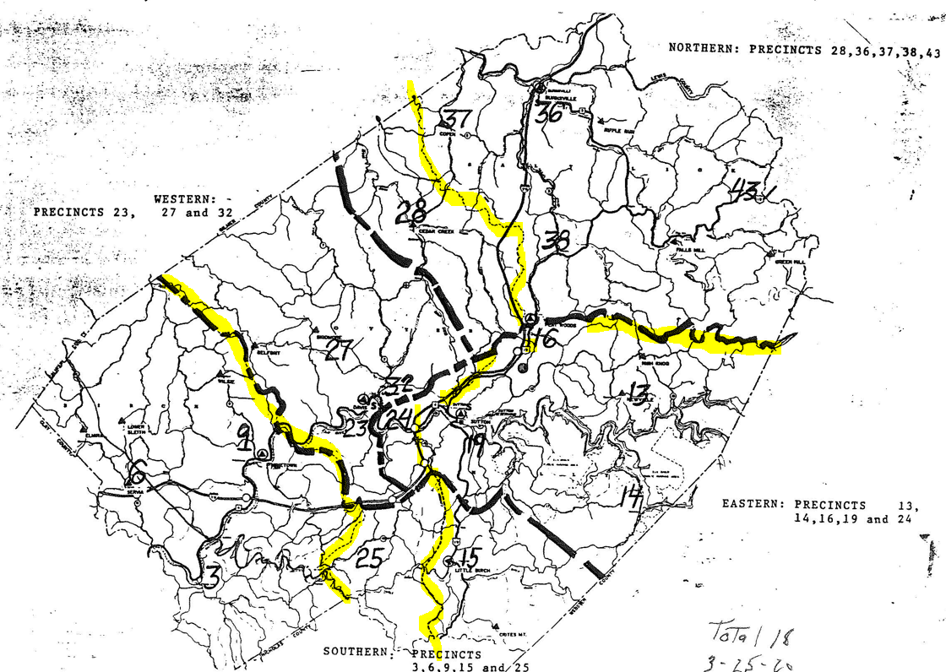
BRAXTON COUNTY ELECTION MAP (GENERALIZED)
Tax District Boundaries (historical Magisterial Districts)

Slide 4
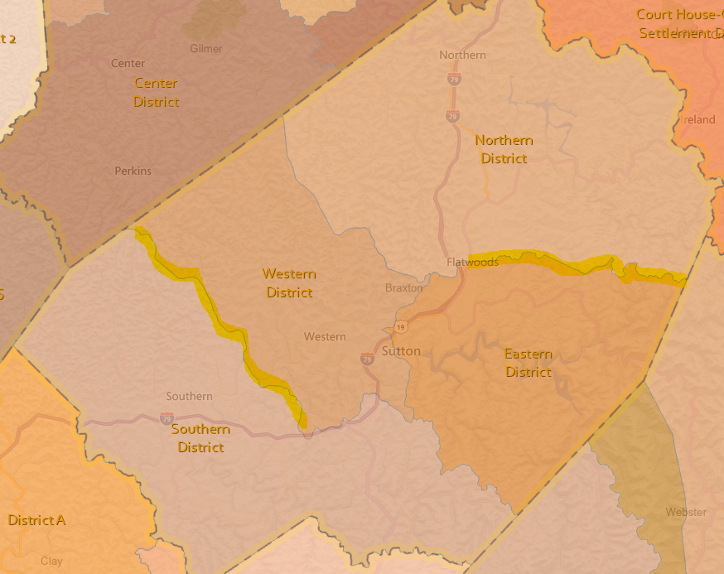
Four Magisterial Districts – Tax District Boundaries on Topo
Tax District Boundaries (historical Magisterial Districts)
Today voting precinct boundaries primarily are defined by the E-911 roads instead of in the past following physical features (ridgelines, streams) of tax assessment district boundaries

Slide 5
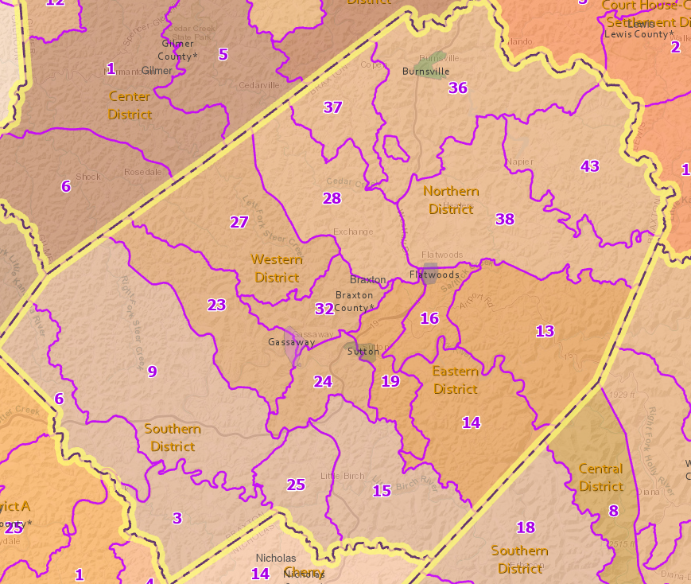
Precincts and Magisterial Districts

Slide 6
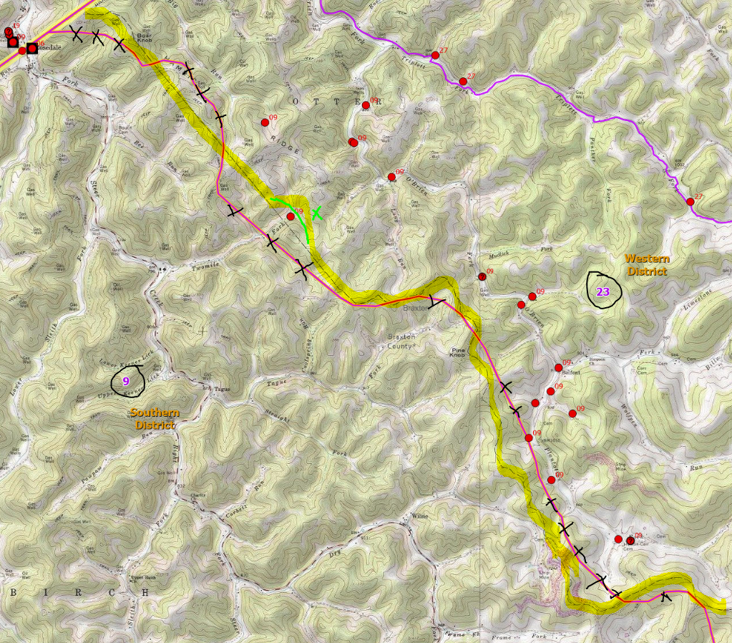
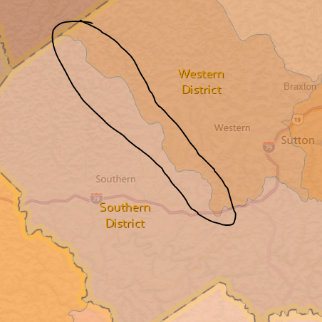
Precincts 9-23 Bdry, Magisterial Western-Southern (Tax District Bdry)
Topo Bdry

Slide 7
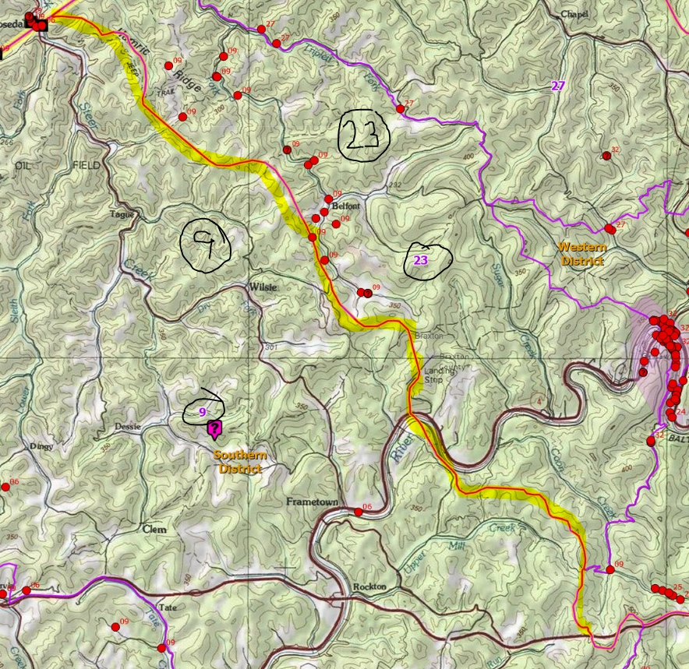
Precincts 9-23 Bdry, Magisterial Western-Southern (Tax District Bdry)
Topo Bdry

Slide 8
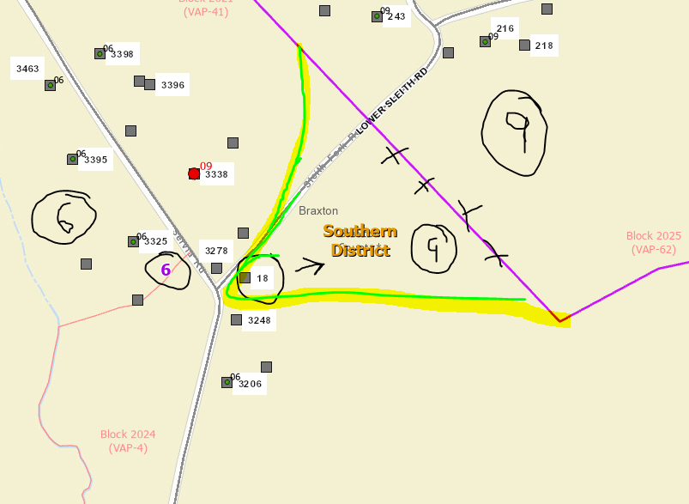
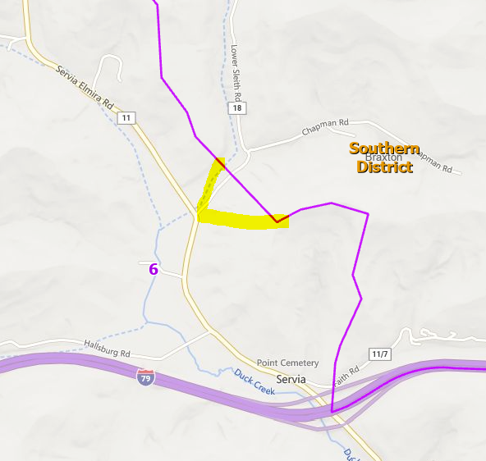
Precincts 6-9 Bdry, Include all structures of Lower Seth Road

Slide 9
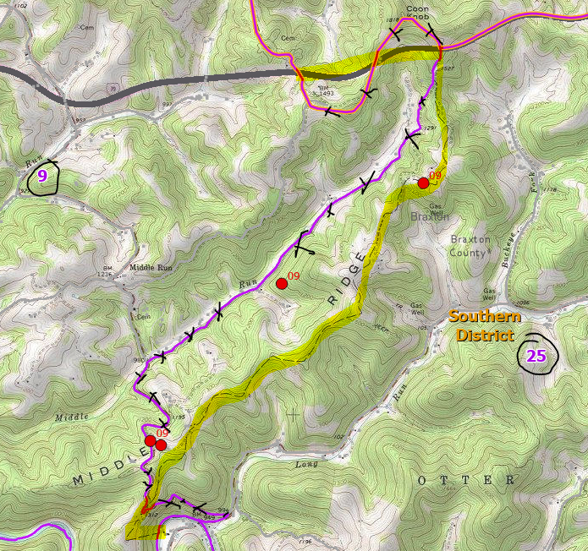
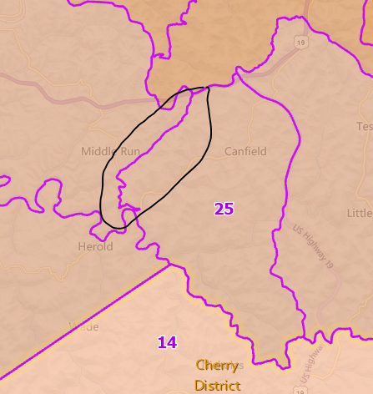
Precincts 9-25 Bdry, (Tax District Bdry)
Interstate
Topo Bdry

Slide 10
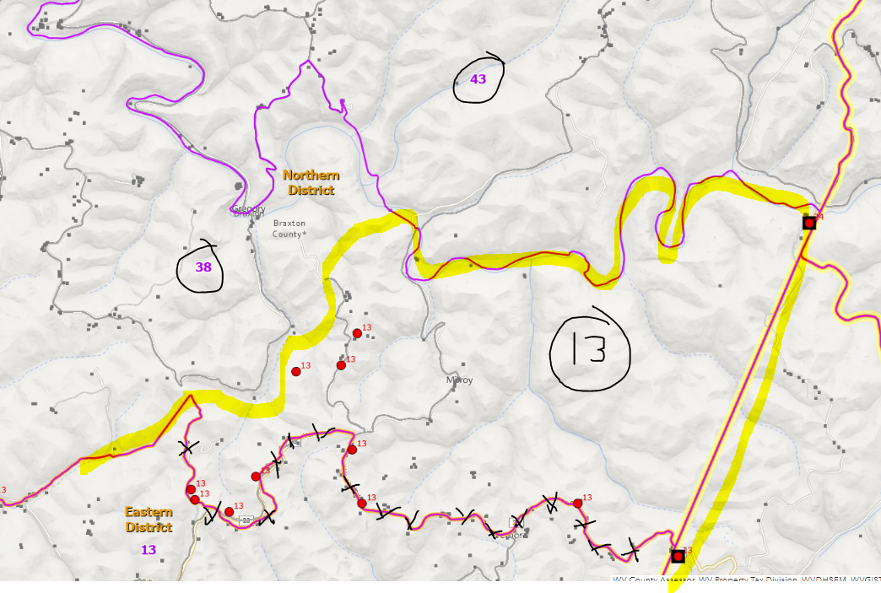
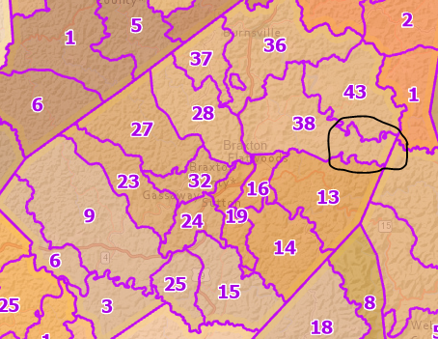
Precincts 13-38 Bdry (include entire Gibson Road)

Slide 11
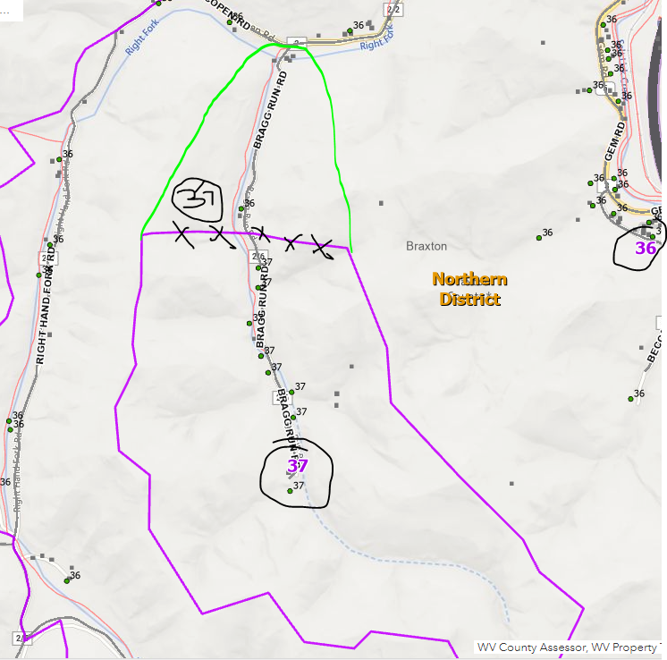
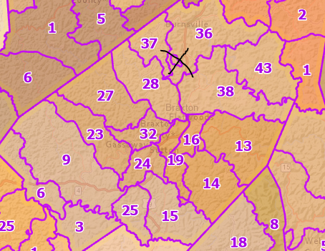
Expand Precincts 37 Island to include all of Bragg Run Road

Slide 12
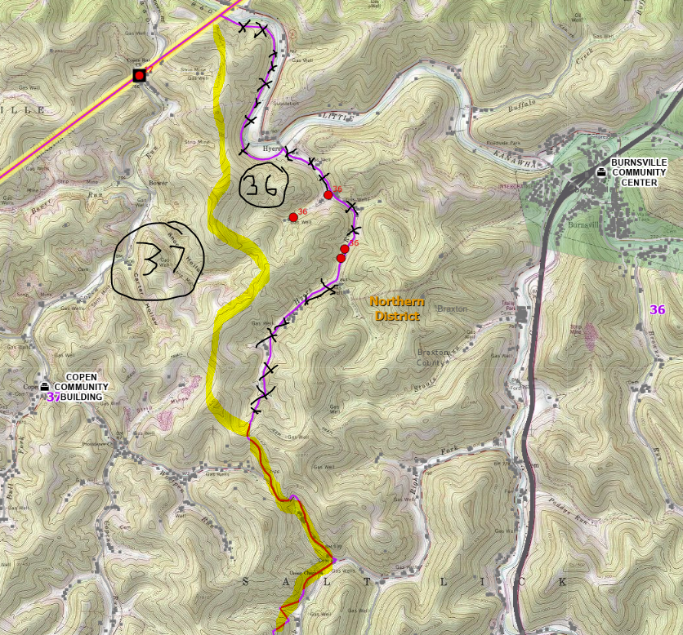
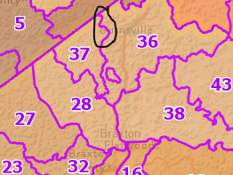
Precincts 36-37 Bdry

Slide 13
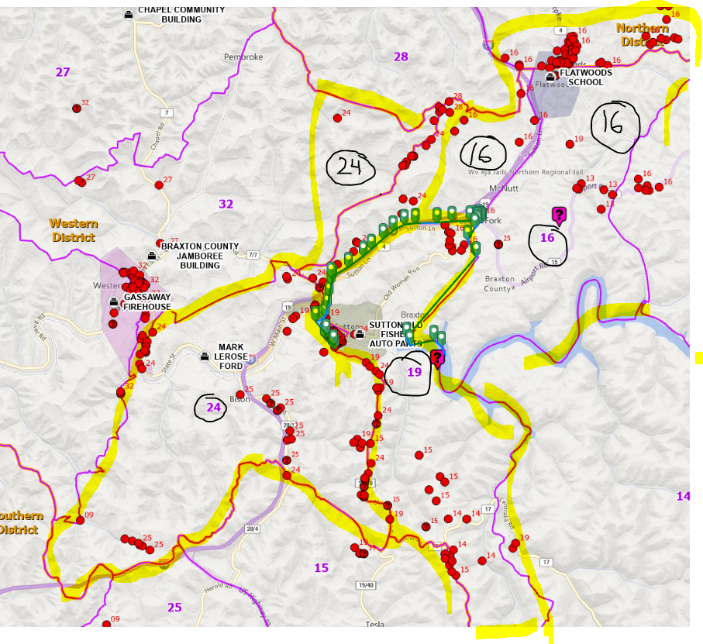
Precincts 24-19-16 Bdry (overview)

Slide 14
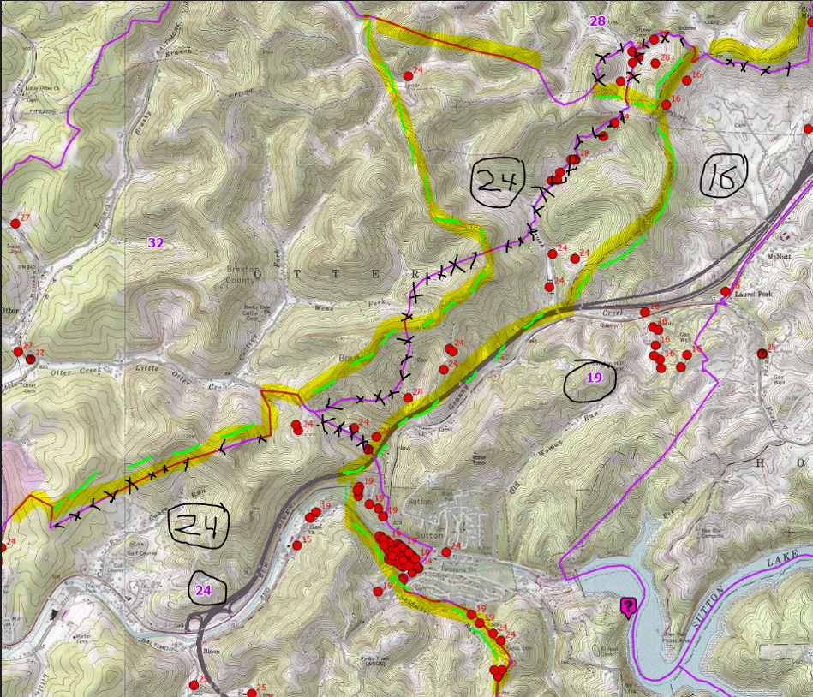
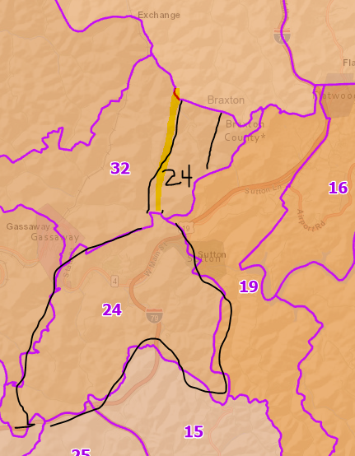
Precincts 24 (north)-16 Bdry, (Tax District Bdry, Ridge Tops, Perkins Fork Road)
Topo Ridge Tax Bdry
Sunrise Drive and Thunder Ridge included in Precinct 28 – map on east-west topo pipeline
Interstate

Slide 15
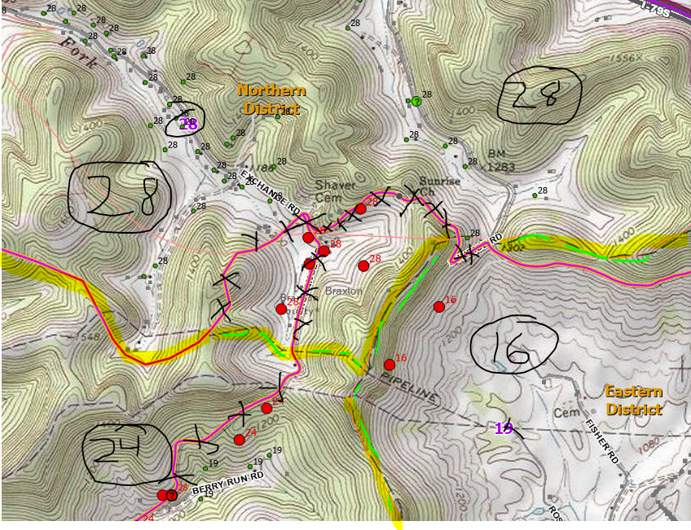
Precincts 24 (north)-16 Bdry, (Sunrise Drive, Thunder Ridge Drive)
Sunrise Drive and Thunder Ridge included in Precinct 28 – map on east-west topo pipeline
Topo Ridge Tax Bdry

Slide 16
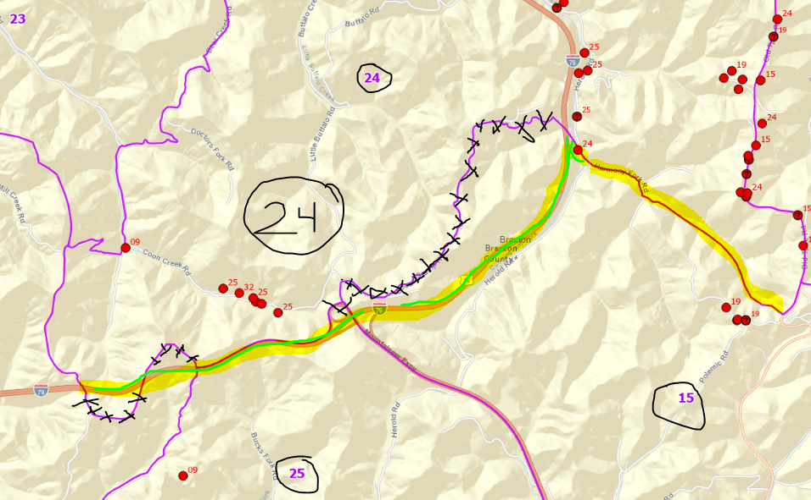
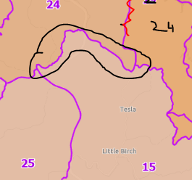
Precinct 24 (south)
Interstate
Interstate
Interstate

Slide 17
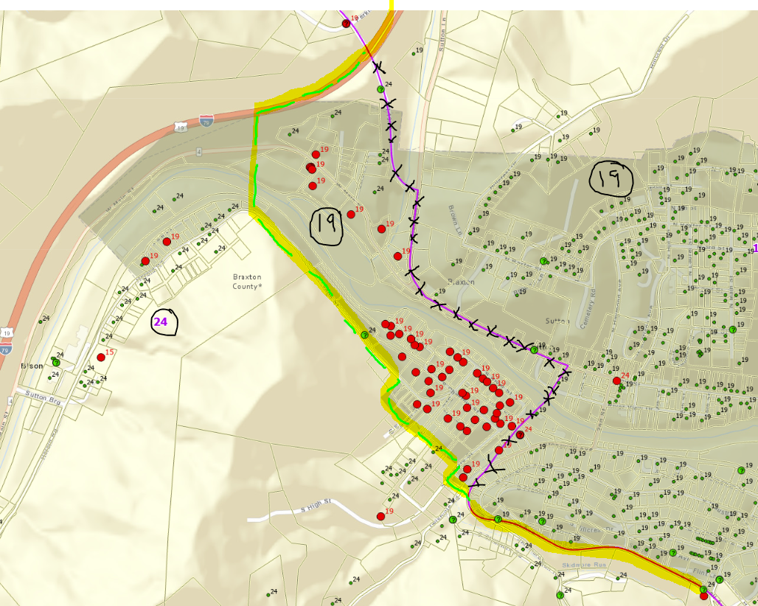
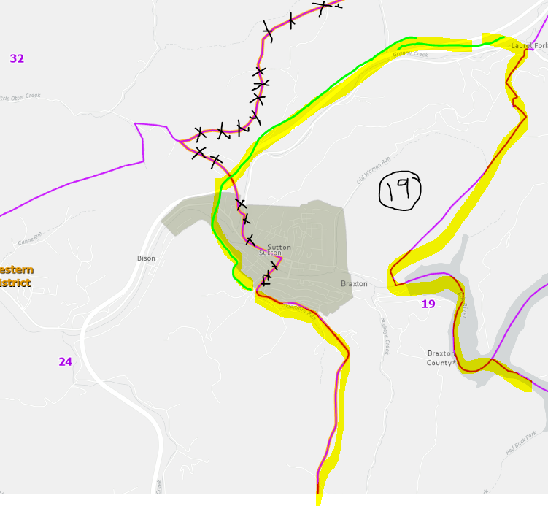
Precincts 19 (Sutton Corporation)
Interstate
Sutton Corporation Boundary needs verified for Census BAS

Slide 18
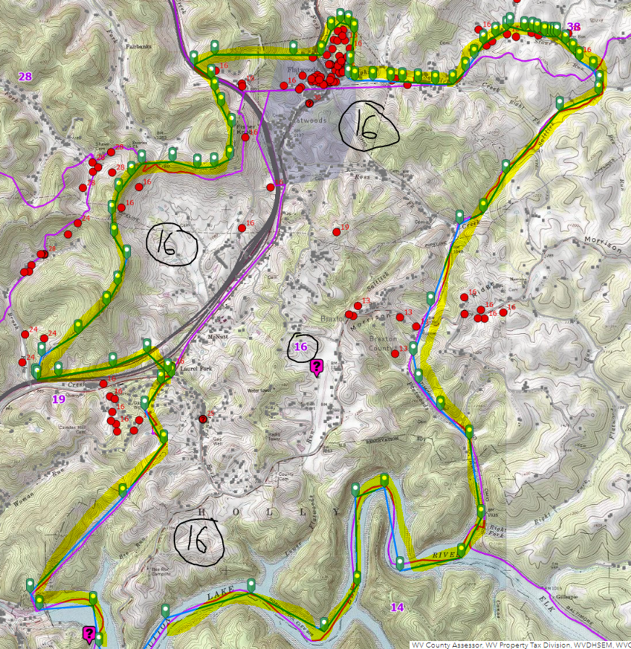
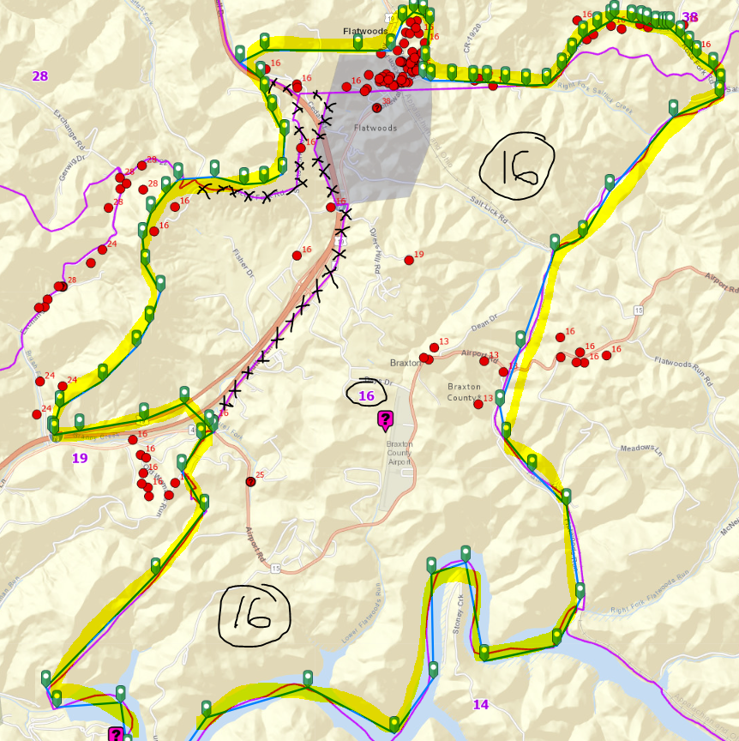
Precinct 16 (overview)
Topo Ridge Tax Bdry

Slide 19
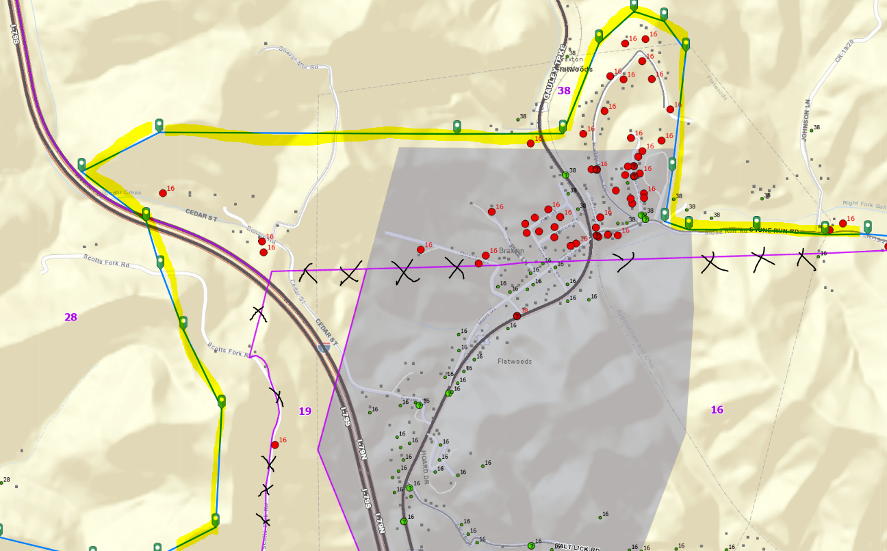
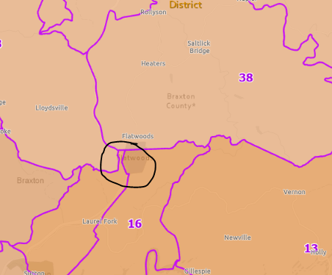
Precincts 16-38 bdrys (north Flatwoods)
Flatwoods Corporation Boundary needs verified for Census BAS
Draw boundary on Stone Run Rd

Slide 20
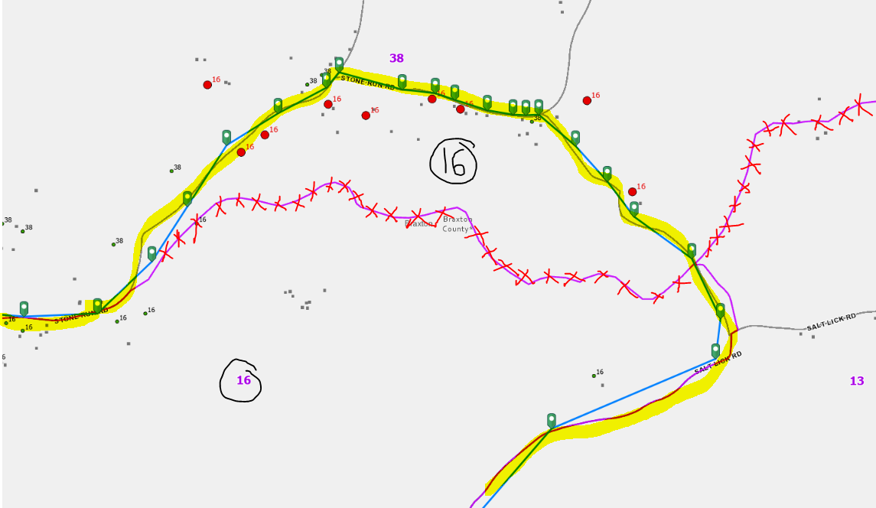
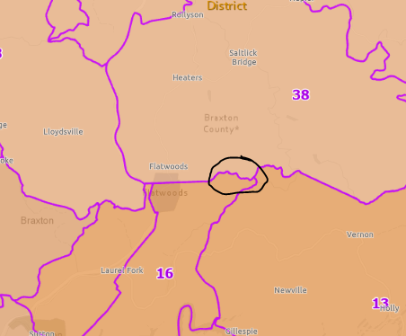
Precincts 16-38 bdry (east of Flatwoods) Stone Run Rd and Ross Fork Rd

Slide 21
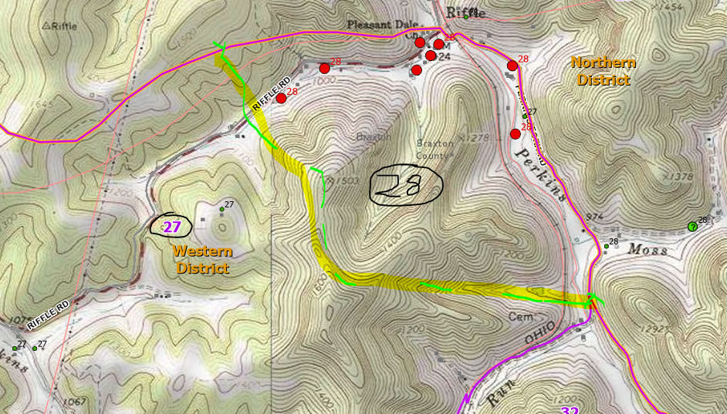
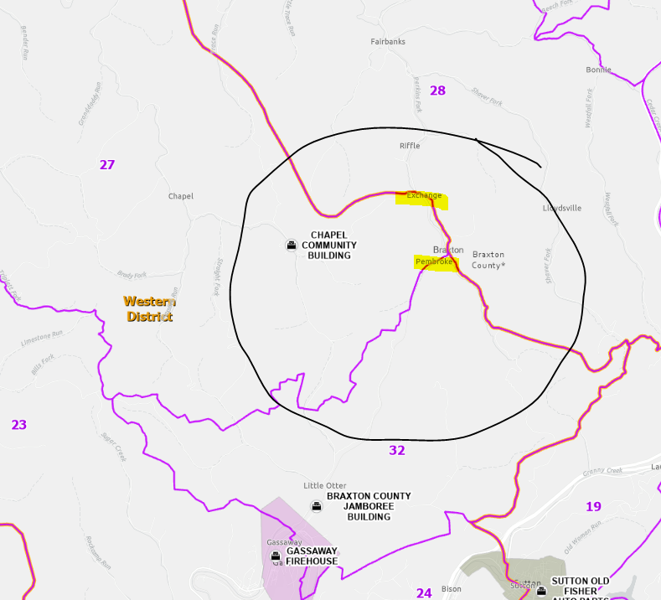
Precincts 27-28 Boundary? at Exchange, WV

