Slide 1
CALHOUN COUNTY: Election District Mapping
Geo-SVRS Voter Match: Ensure Voter Registration Site Points are assigned to the correct geographic precinct. Refer to mismatch spreadsheet or red dots on G-SVRS Tool (www.mapwv.gov/SVRS). Consult with E-911 office about invalid addresses or spatially inaccurate addresses that cannot be mapped to the building footprint (less accurate street address match).
Precinct Boundary Definition Factors:
E-911 Addresses & Road Centerlines
All addresses of smaller roads or roads in hollows/narrow valleys should be in a single voting precinct to minimize multiple road segment definitions in the SVRS
Street Geocodes: Geocode matches to street ranges are problematic for road precinct boundaries
Incorporated Place Boundaries should be accurate and match precinct boundaries
Topographic Ridge Boundaries. In rural counties, typically tax district and historical magisterial district line boundaries follow topographic ridgelines.
Proximity to Polling Sites. Voter point travel time/distance to polling site of precinct
Census Blocks. Follow existing census block edge boundaries if exist
Voting Precinct Boundary Alignment Issues/No Gaps:
Precinct boundaries should align coincidentally with USGS 1:24,000-scale county boundary – not the less accurate Census boundary
Precinct boundaries should align coincidentally with magisterial district lines

Slide 2
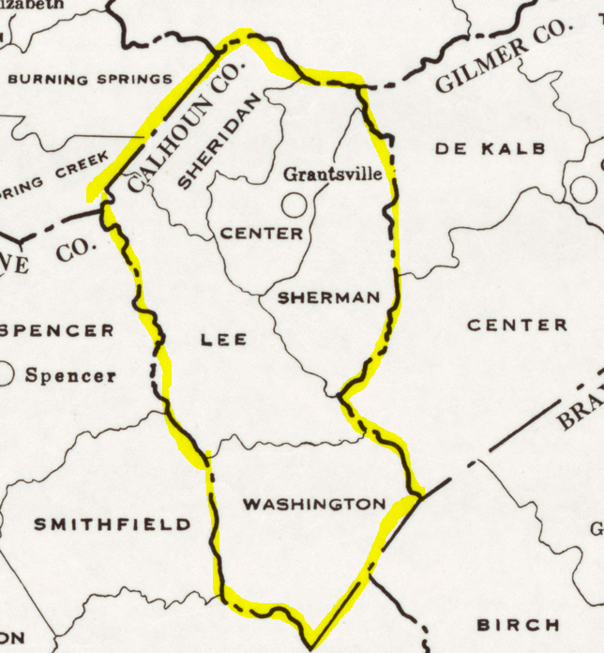
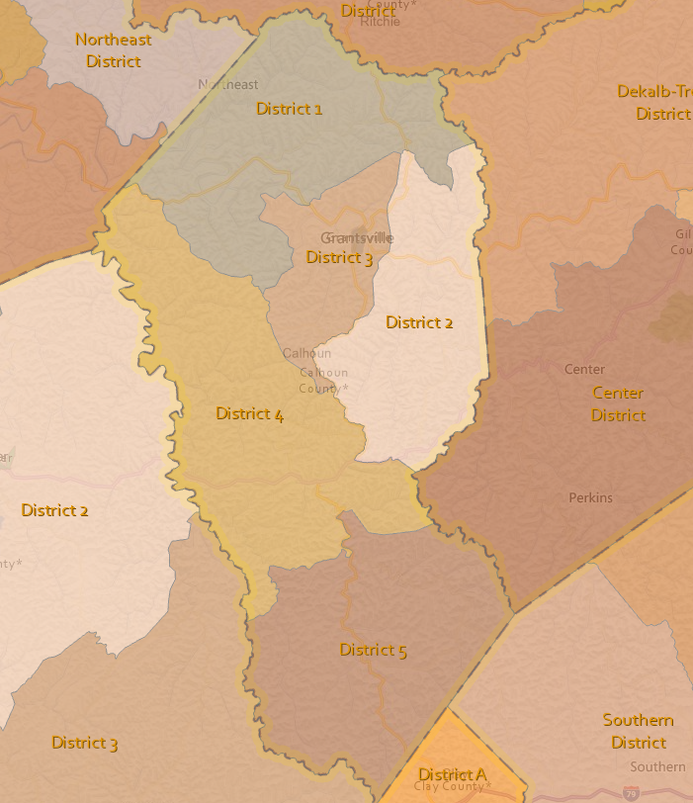
CALHOUN COUNTY: PAST AND CURRENT MAGISTERIAL DISTRICTS
1970 Magisterial/Tax Districts
2023 Magisterial Districts
Tax District Boundaries (historical Magisterial District Boundary)
1
2
3
4
Today voting precinct boundaries primarily are defined by the E-911 roads instead of in the past following physical features (ridgelines, streams) of tax assessment district boundaries
5

Slide 3
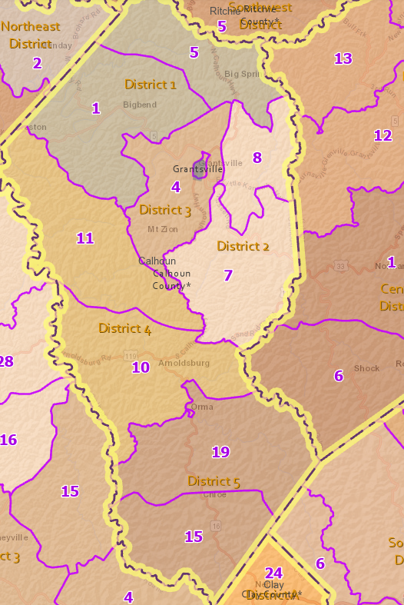
Voting Precinct & Magisterial Districts (Calhoun County)

Slide 4
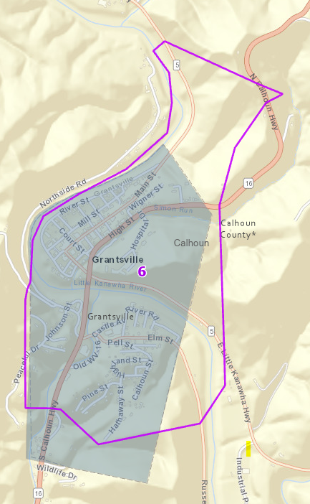
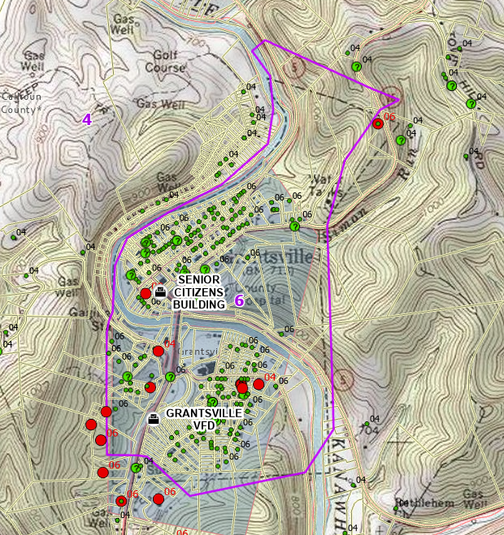
Precincts 6 Grantsville Corp. (Does not match Census or Tax District Bdrys)
Precinct Boundary
Census Municipal Boundary
https://data.wvgis.wvu.edu/pub/Clearinghouse/planningLanduseCadastres/wv_tax_maps/PDF/07_Calhoun_County/02_Grantsville_Corp/

Slide 5
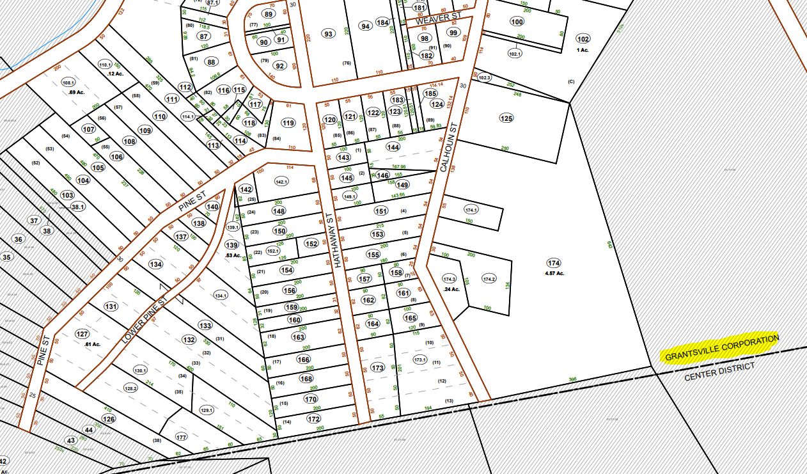
Precincts 6 Grantsville Corporation (Municipal boundary different on tax maps)
Tax Assessment Boundary
https://data.wvgis.wvu.edu/pub/Clearinghouse/planningLanduseCadastres/wv_tax_maps/PDF/07_Calhoun_County/02_Grantsville_Corp/

Slide 6
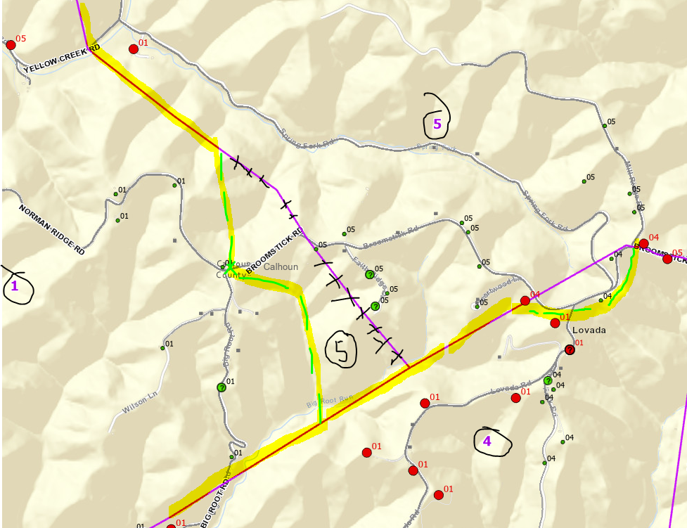
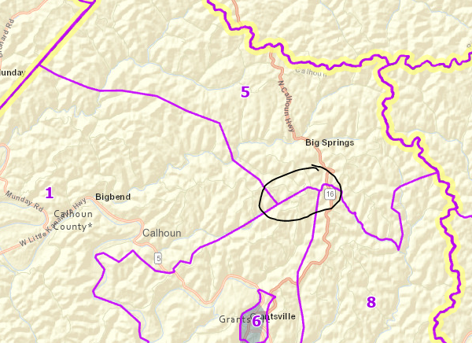
Precincts 5-4-1 Bdrys, (Broomstick Rd – Precinct 5)
Broomstick Road
Broomstick Road

Slide 7
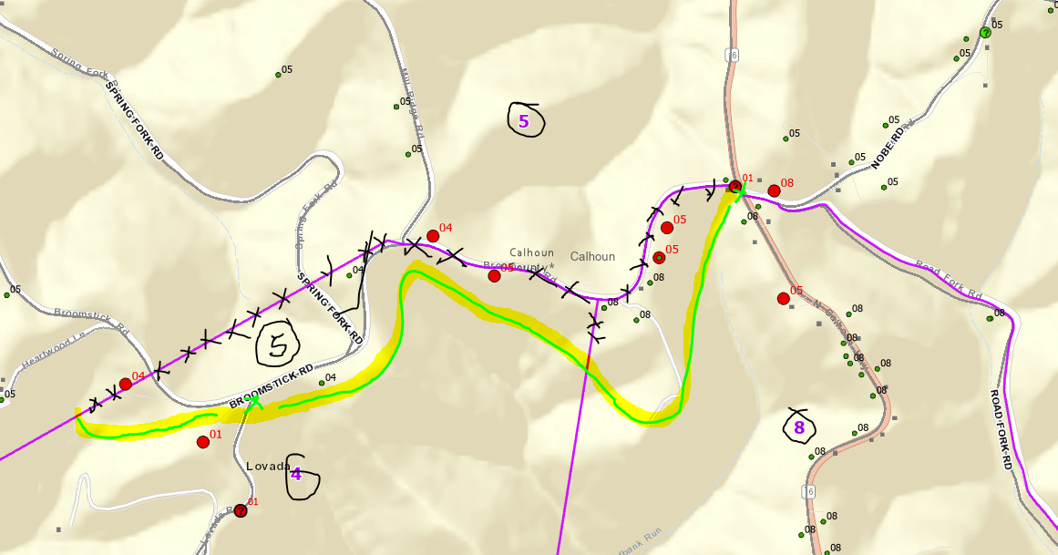
Precincts 5-4-8 Bdrys, (Broomstick Rd – Precinct 5, Lovada Rd – Precinct 4)
Broomstick Road
Lovada Road

Slide 8
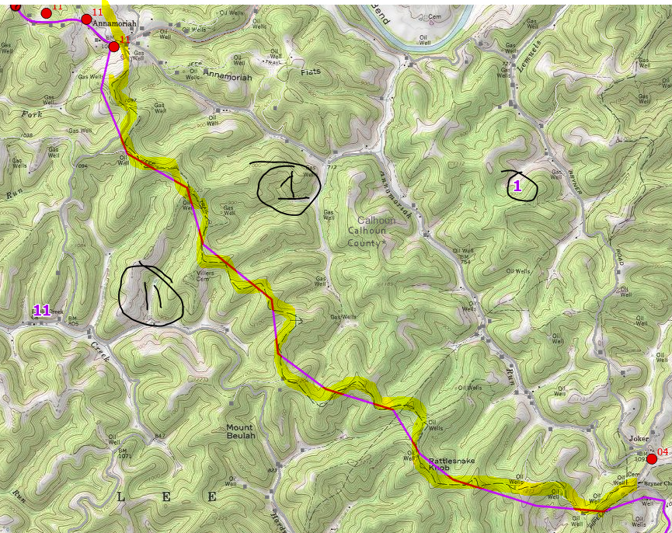
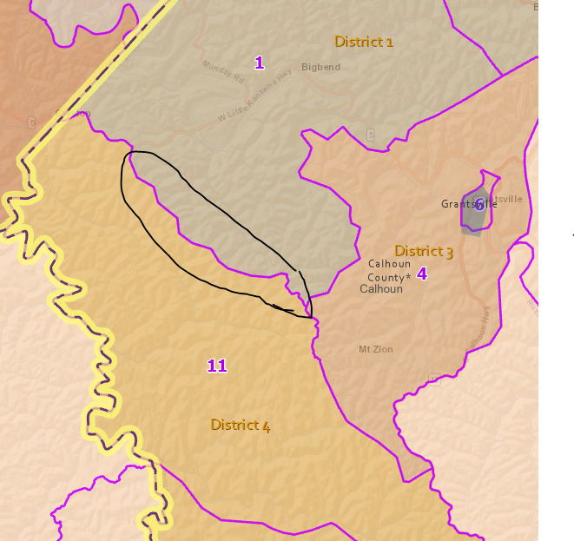
Precincts 1-11 Bdrys (Tax District Boundary - Ridgeline)

Slide 9
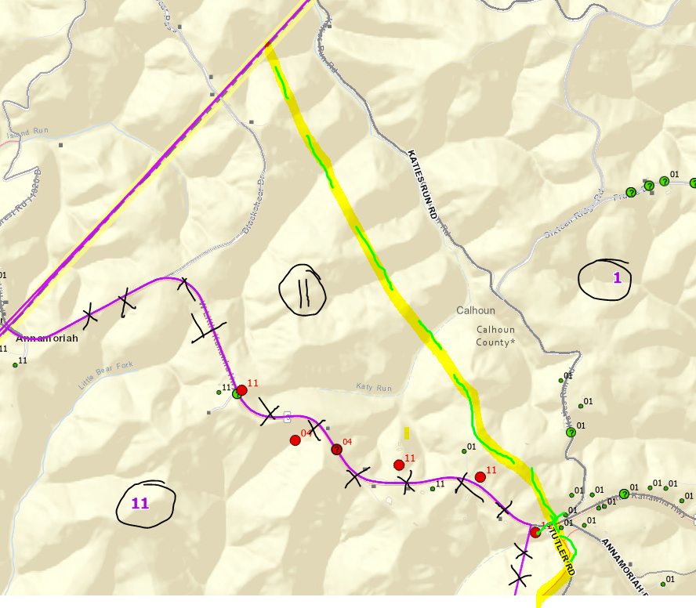
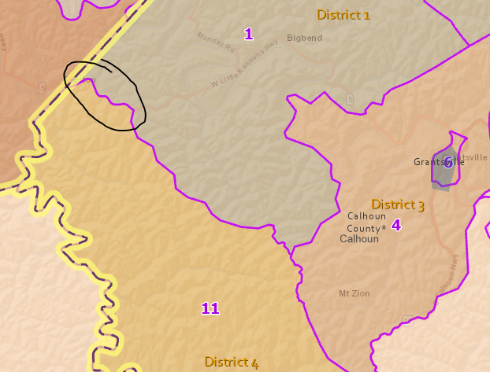
Precincts 1-11 Bdrys (W. Little Kanawha Hwy west of Stutler road)
W. Little Kanawha Highway
Stutler Rd

Slide 10
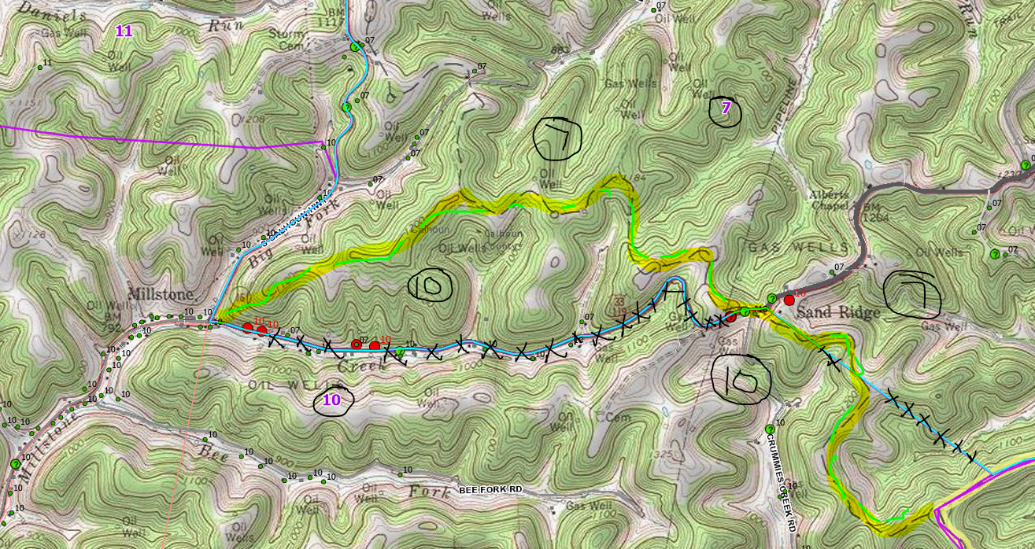
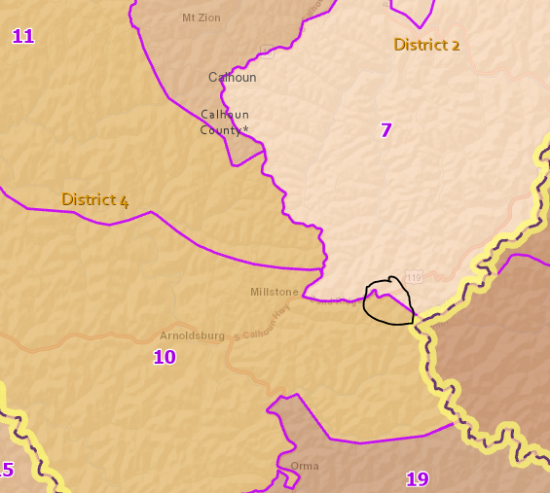
Precincts 10-7 Bdrys, (Crummies Creek Rd – Precinct 10)
Sand Ridge Road
Topo Bdry
Crummies Creek Road

Slide 11
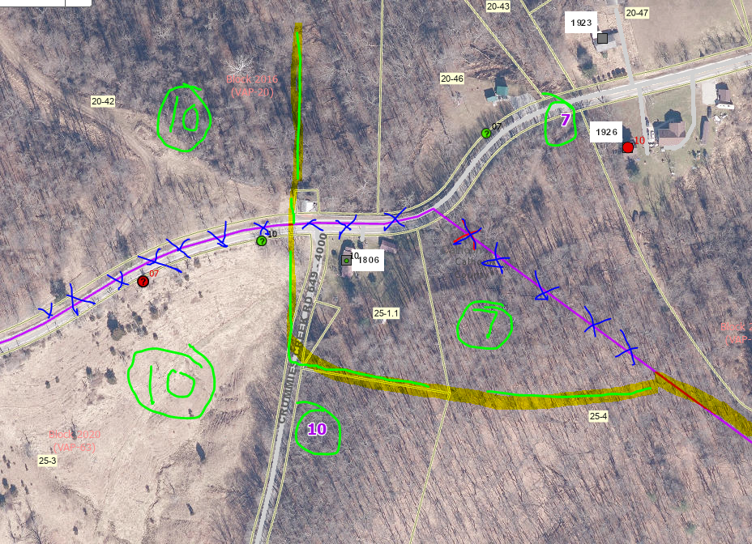
Precincts 10-7 Bdrys, (Intersection Crummies Creek Rd, Sand Ridge Rd)

Slide 12
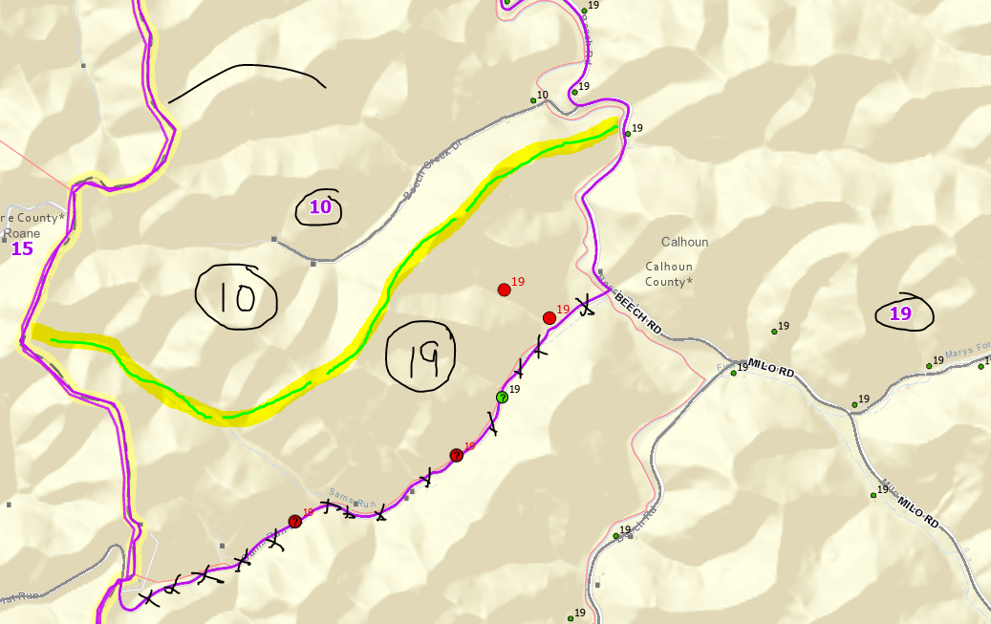
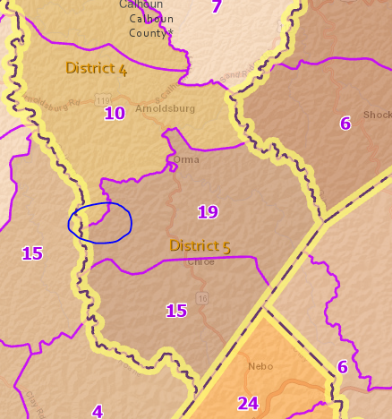
Precincts 10-19 Bdrys, (Sams Run Rd – Precinct 19)
Topo Ridge
Sams Run Road

Slide 13
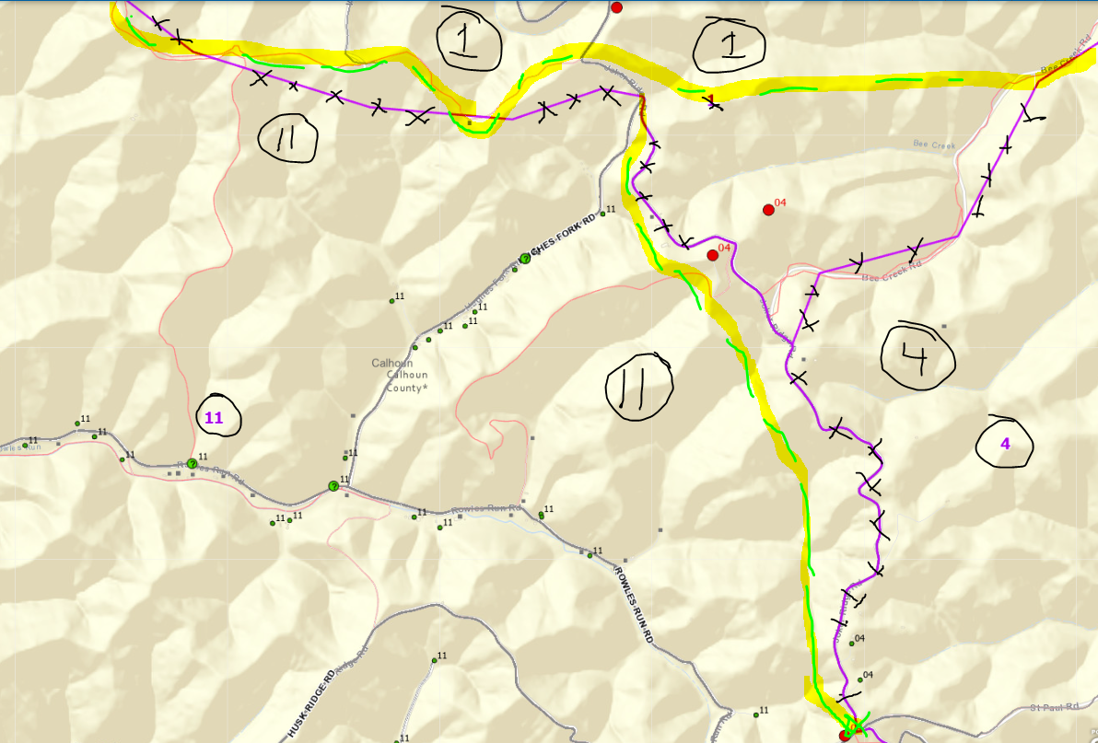
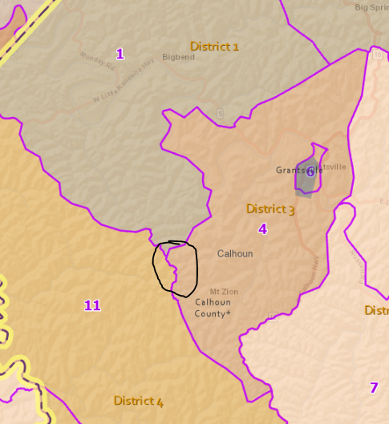
Precincts 1-4-11 Bdrys (Jockers Ridge Road – Precinct 4)
Jokers Ridge Road
Jokers Ridge Road

Slide 14
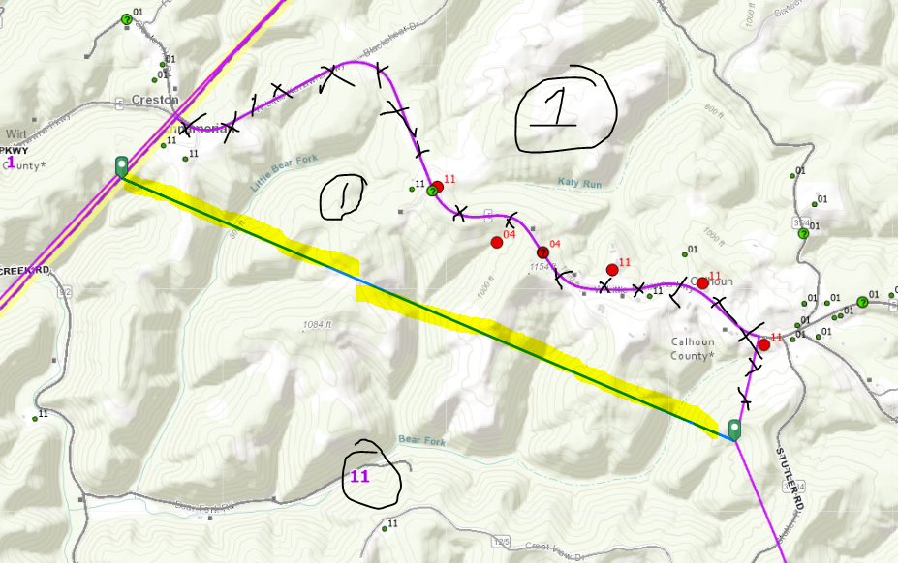
Precincts 1-11 Bdrys (W. Little Kanawha Hwy west of Stutler road)
W Little Kanawha Highway
Stutler Rd

Slide 15
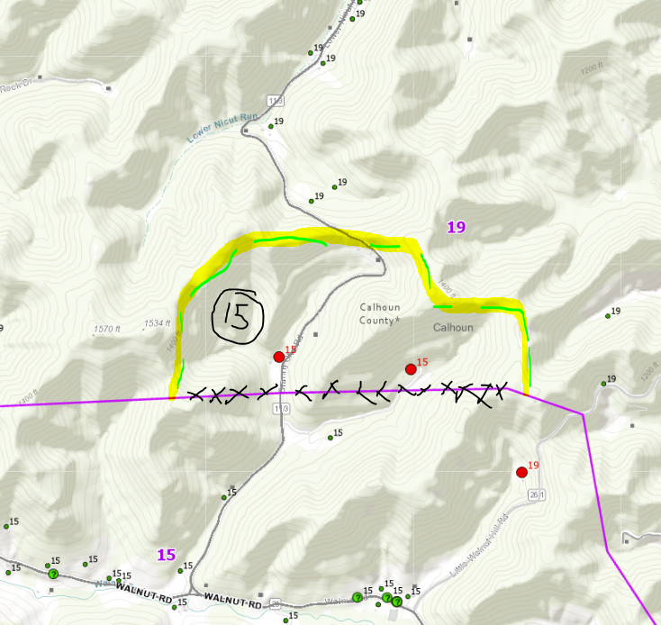
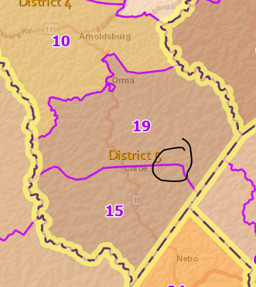
Precincts 15-19 Bdrys, (Granny She Rd – Precinct 15)
Topo Ridge
Walnut Road

