Slide 1
DODDRIDGE COUNTY Election District Mapping
Voter Registration Points
E-911 Addresses & Road Centerlines (all addresses of smaller roads in single
Census Blocks
Topographic Ridges
Tax District or Magisterial Lines on Topographic Maps
Polling Sites
Magisterial Lines align with Voter Precincts

Slide 2
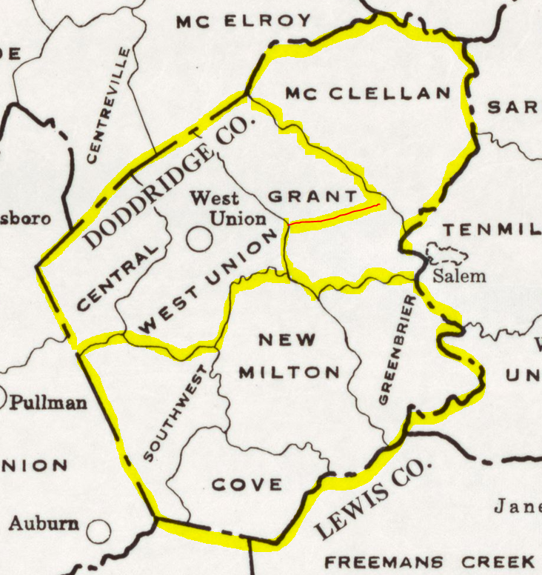
DODDRIDGE TAX AND MAGISTERIAL DISTRICTS IN 1970
Beech
Maple
Beech
Pine
Oak

Slide 3
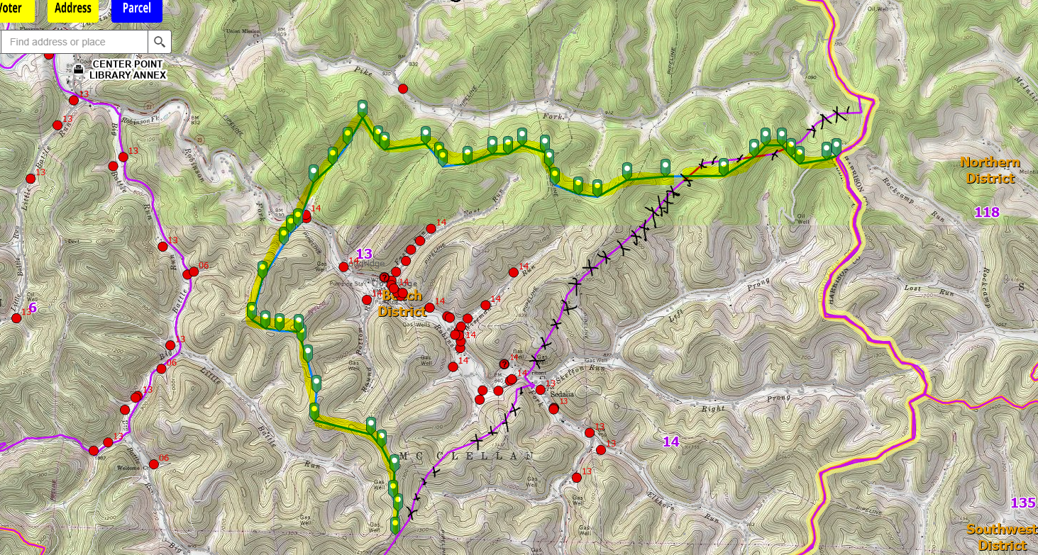
Precincts 13-14 Boundary (Overview)
Topo Ridgeline
Topo Ridgeline

Slide 4
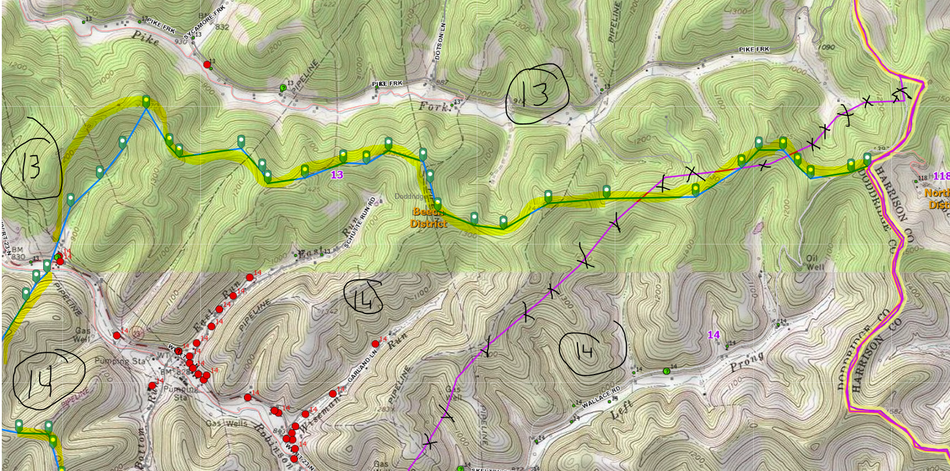
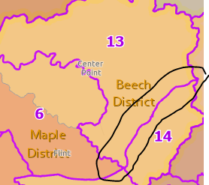
Precincts 13-14 Boundary (North View)
Topo Ridgeline

Slide 5
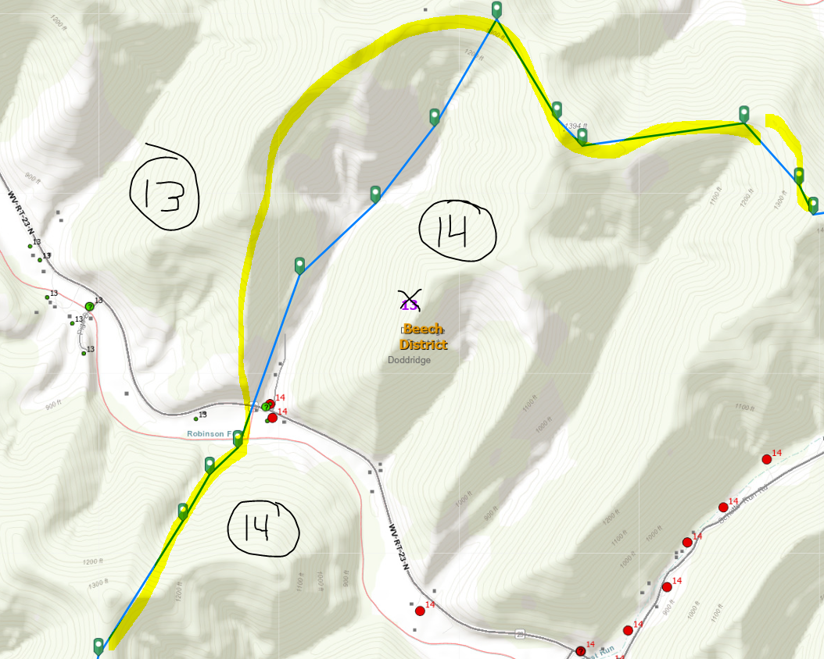
Precincts 13-14 Boundary (Crossing at Route 23)
Topo Ridgeline

Slide 6
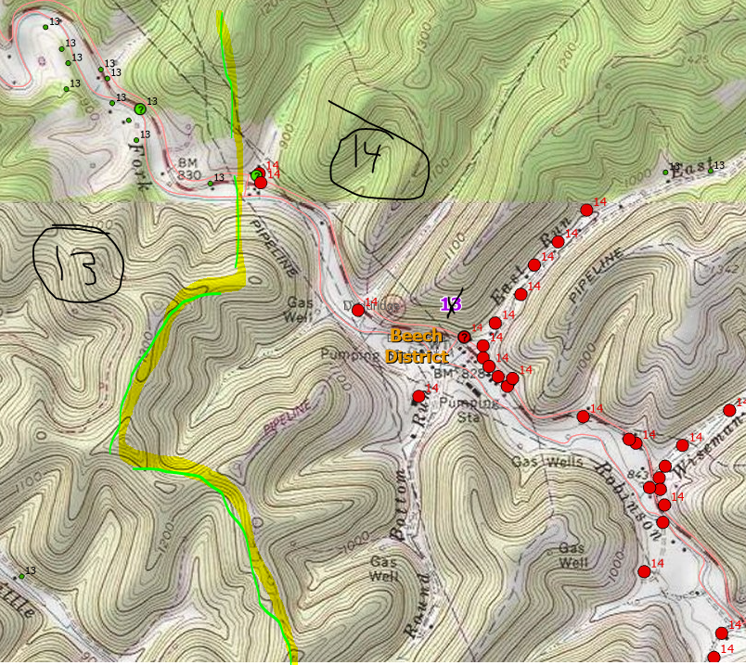
Precincts 13-14 Boundary (Crossing at Route 23)
Topo Ridgeline

Slide 7
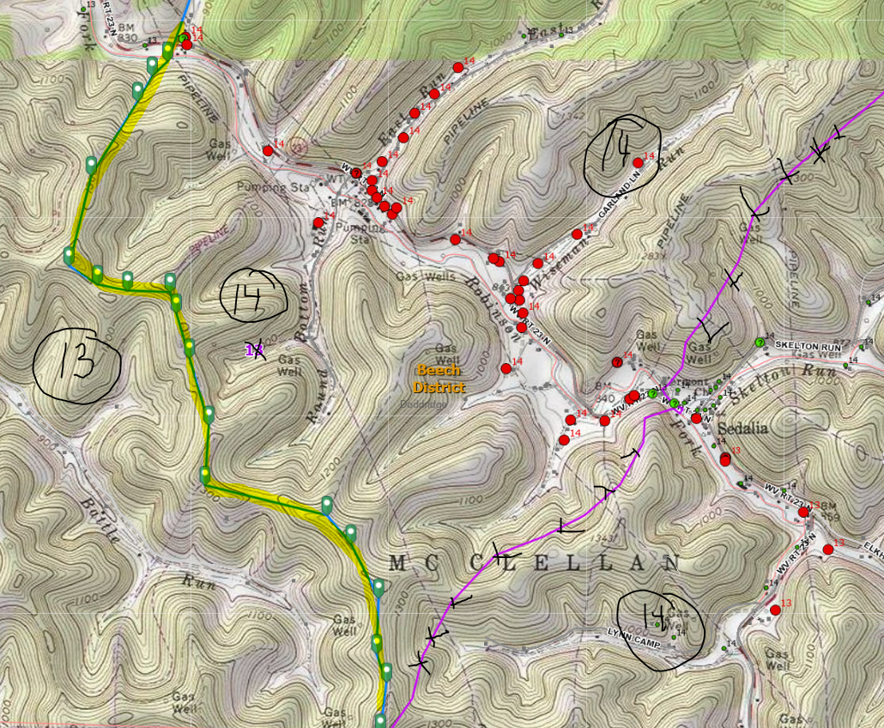
Precincts 13-14 Boundary (South View)
Topo Pipeline

Slide 8
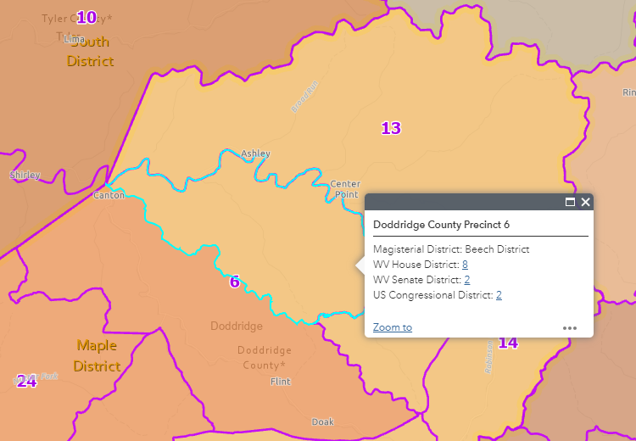
Precinct 6 Beech District needs to be consolidated with Precinct 13

Slide 9
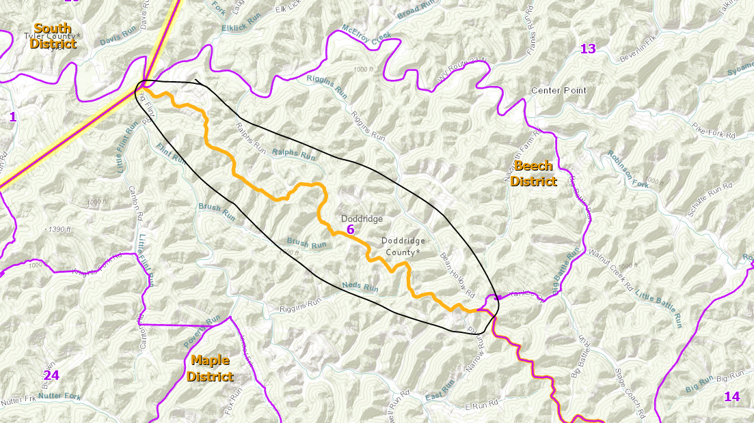
Improve Spatial Accuracy of Beech-Maple Magisterial Districts

Slide 10
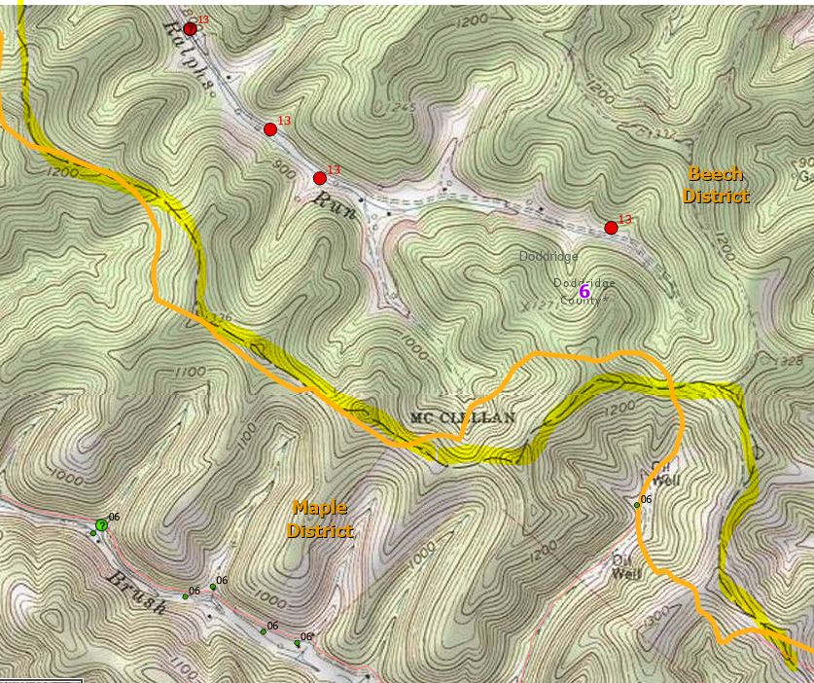
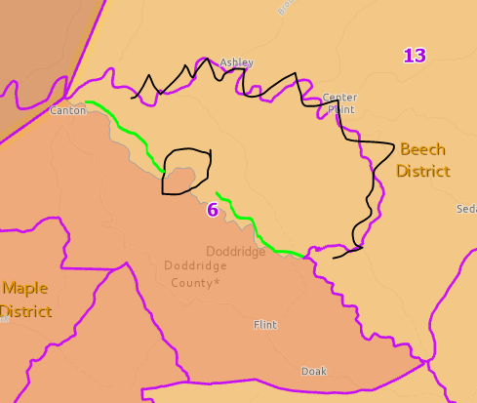
Improve Spatial Accuracy of Beech-Maple Magisterial Districts

Slide 11
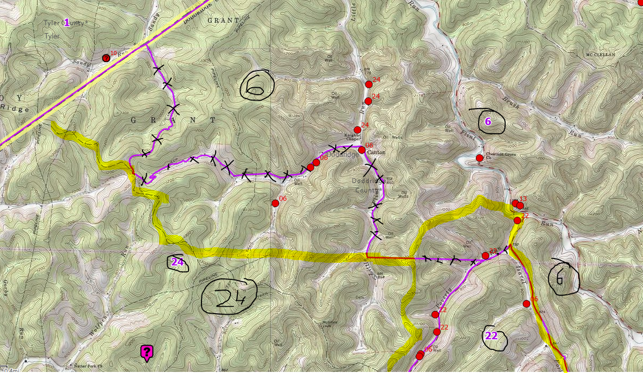
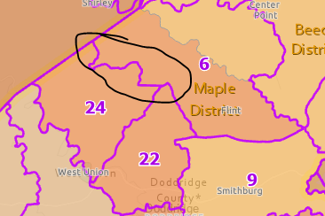
Precincts 6-24 Boundary

Slide 12
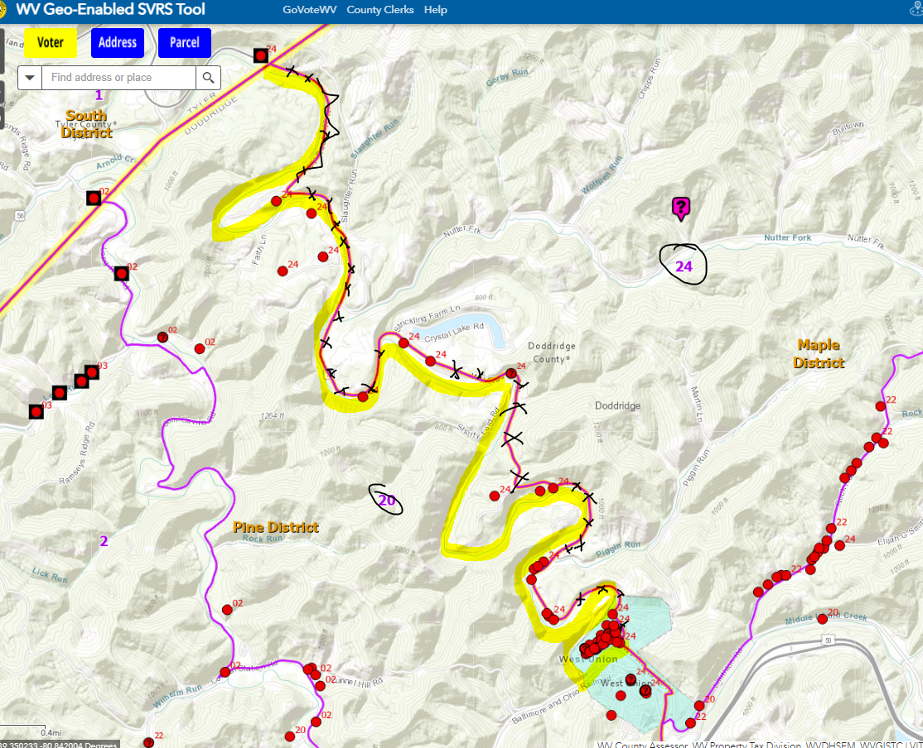
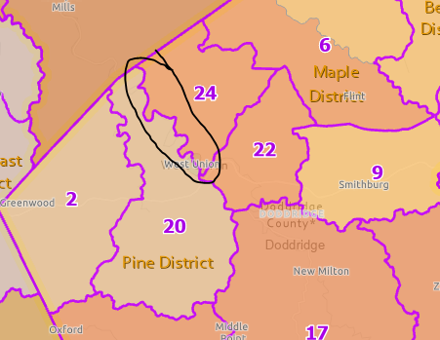
Precincts 20-24 Boundary, Magisterial Maple-Pine (Overview)

Slide 13
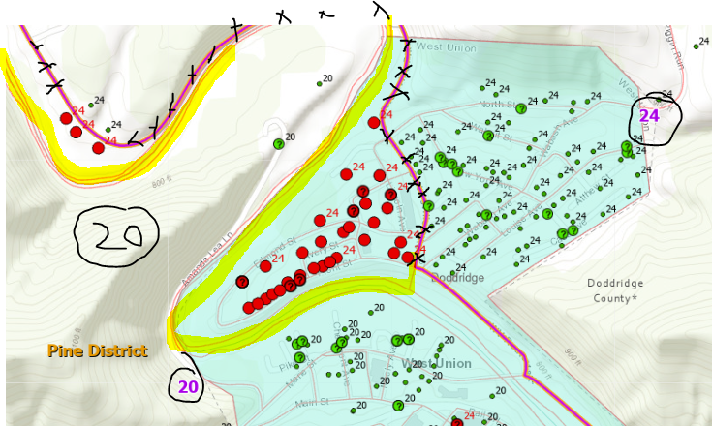
Precincts 20-24 Boundary, Magisterial Maple-Pine (SE or West Union)

Slide 14
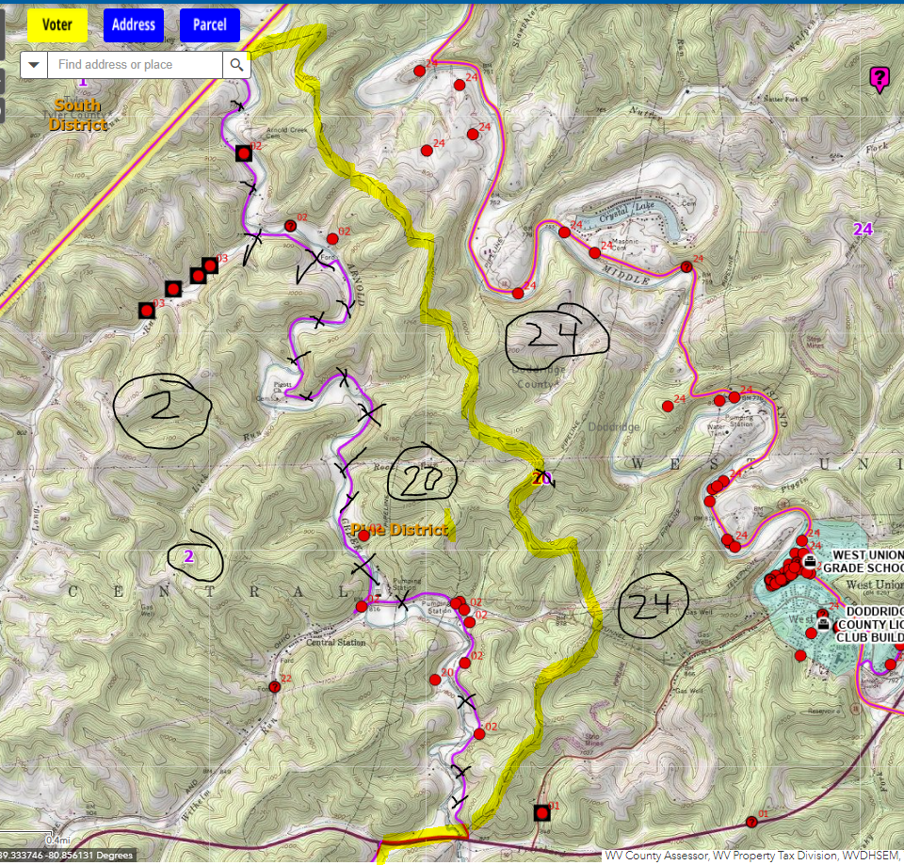
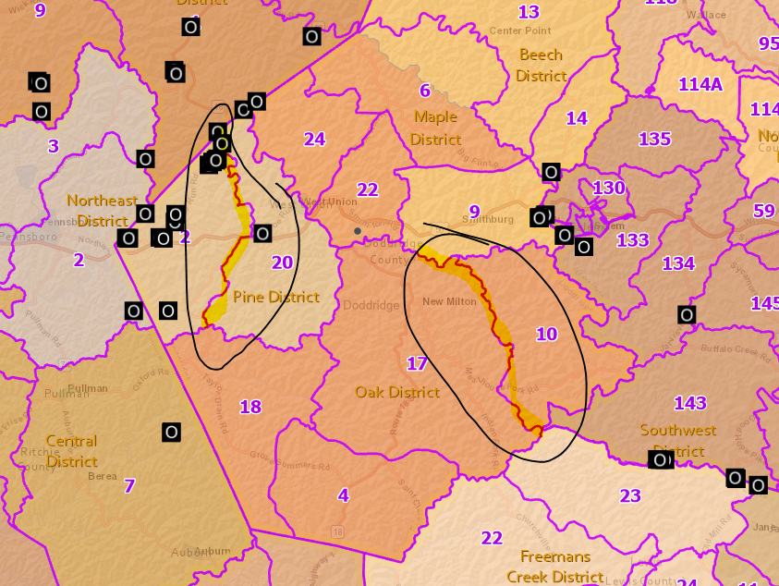
Precincts 2-20 Boundary (North of Route 50) (Tax District Bdry)
Topo Bdry

Slide 15
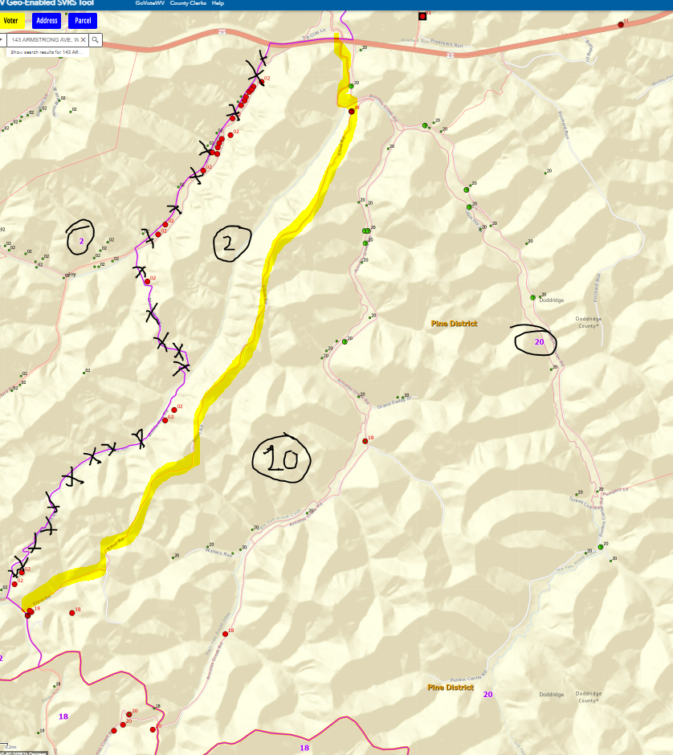
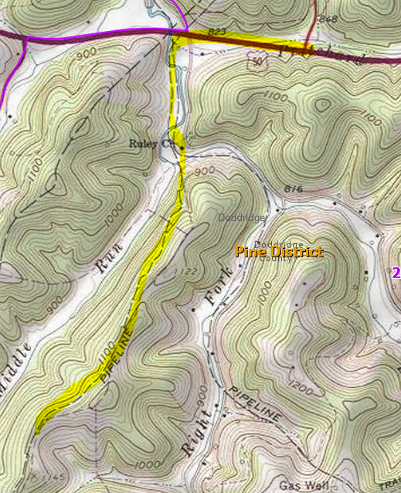
Precincts 2-20 Boundary (South of Route 50)
Topo Pipeline

Slide 16
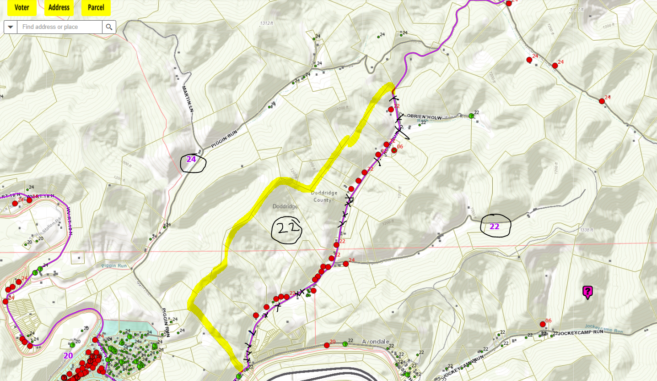
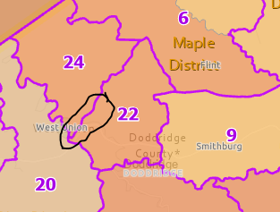
Precincts 22-24 Boundary (NE of West Union)

Slide 17
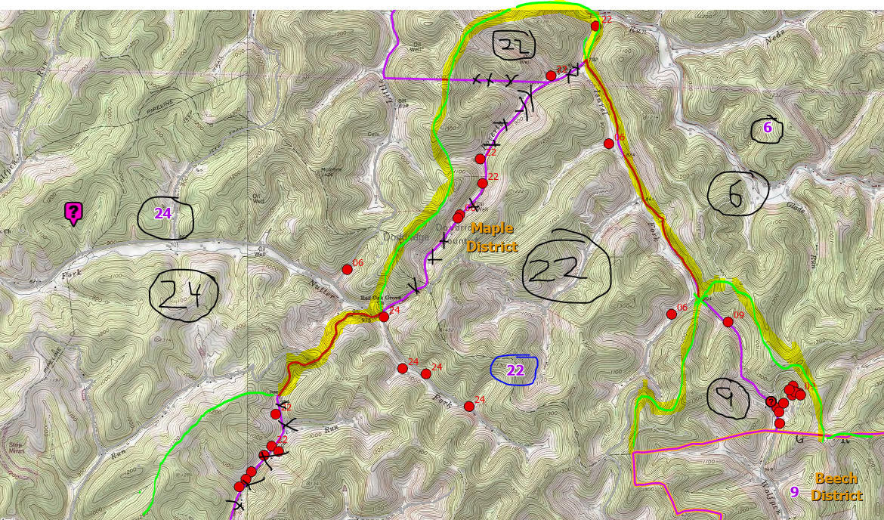
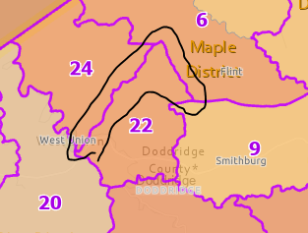
Precincts 22-24-6-9 Boundary
Morgan Run Road (Precinct 9)
Jeckeycammp Run Road (Precinct 22)
Israel Fork Road (Precinct 22)
Rock Run Road (Precinct 22)

Slide 18
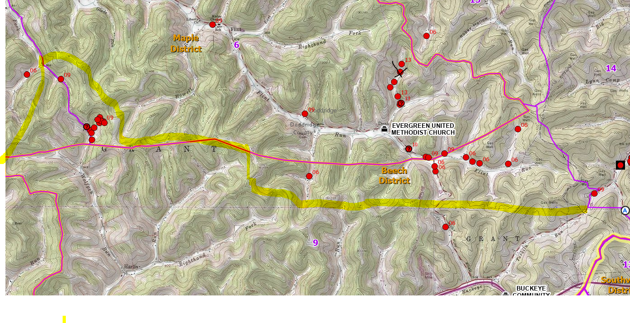
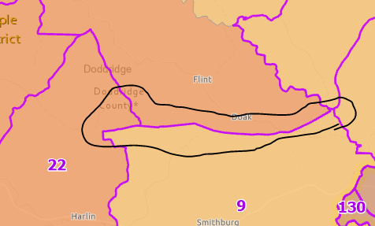
Precincts 6-9-14 Boundary, Magisterial Maple-Beech Boundary (Overview)

Slide 19
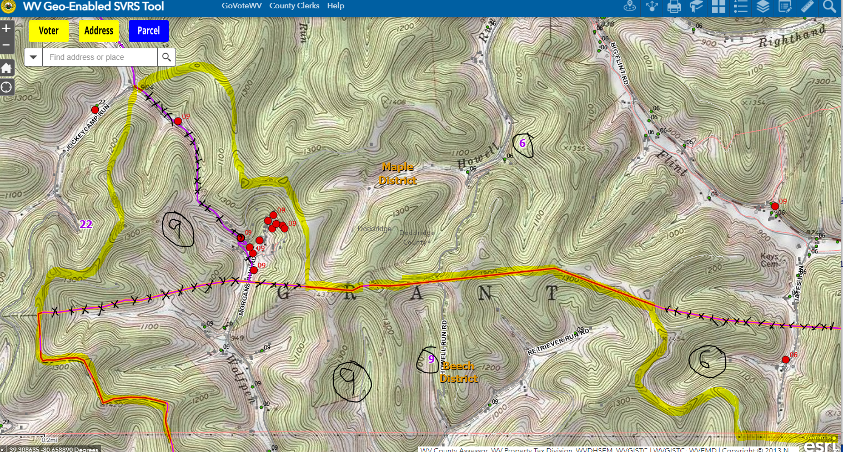
Precincts 6-9 Boundary, Magisterial Maple-Beech Boundary (West View)
All of Morgan Run Road (Precinct 9)

Slide 20
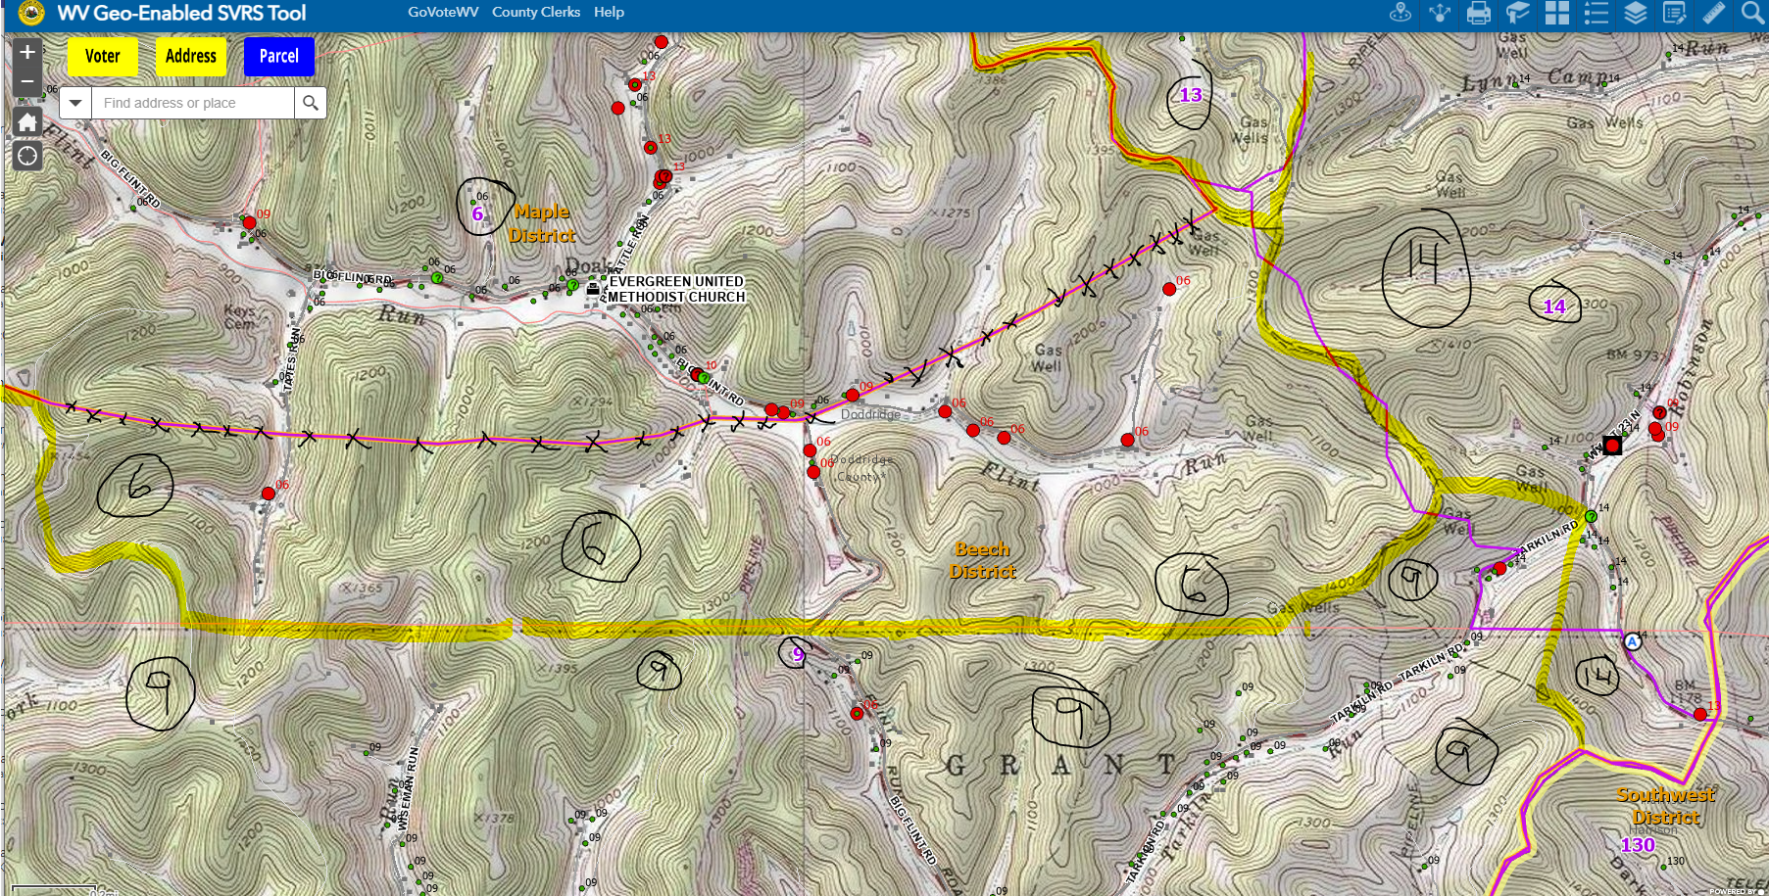
Precincts 6-9-14 Boundary, Magisterial Maple-Beech Boundary (East View)
Topo Bdry

Slide 21
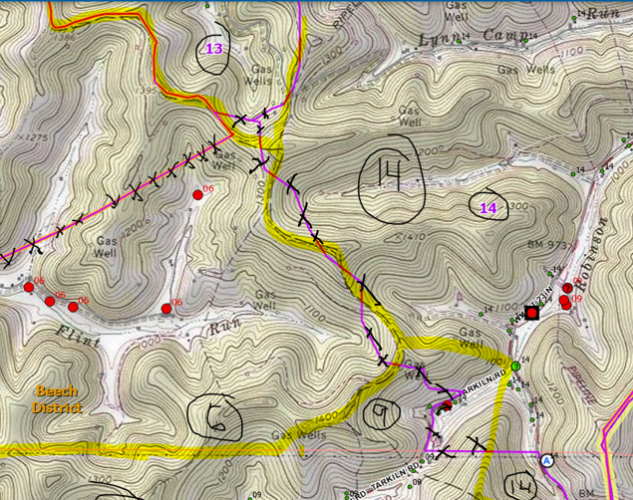
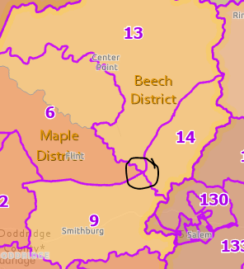
Precincts 6-9-13-14 Intersection, Magisterial Maple-Beech Boundary
Topo Bdry

Slide 22
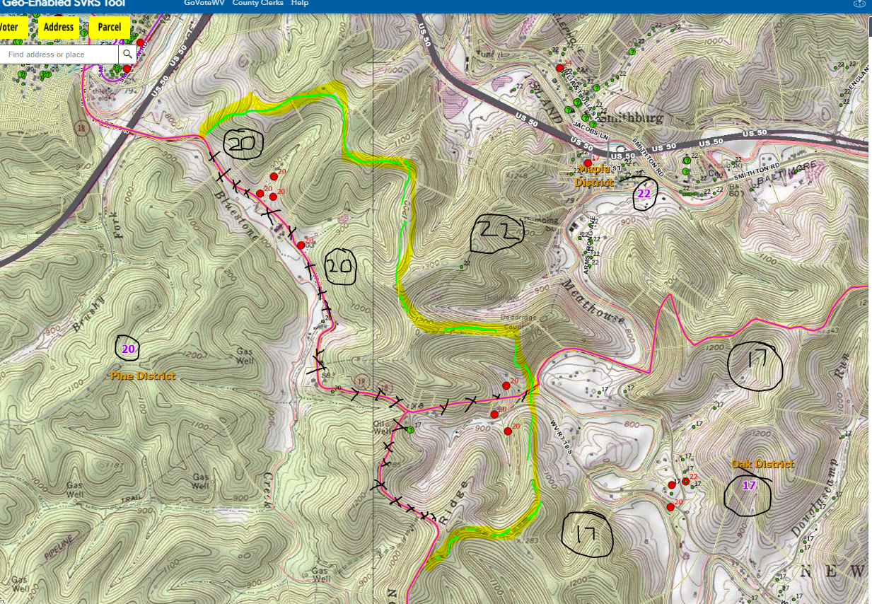
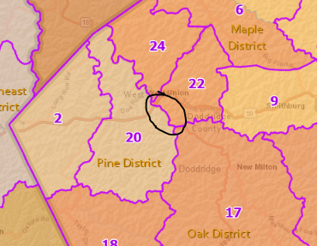
Precincts 20-22-17 Boundary, Magisterial District Maple-Pine

Slide 23
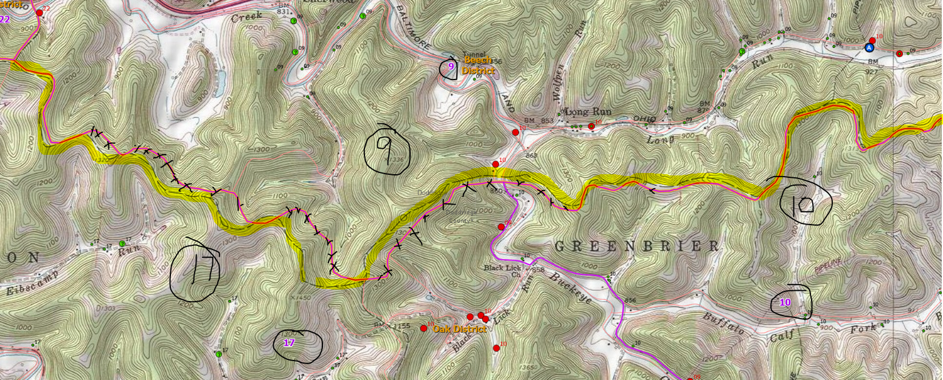
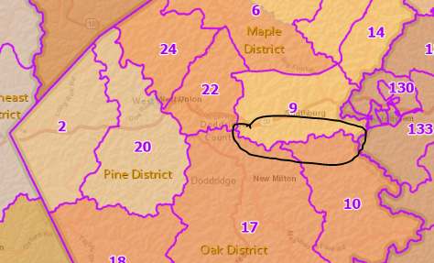
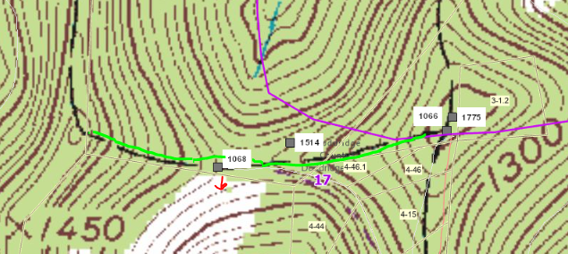
Precincts 9-17-10 Boundary; Magisterial Beech-Oak Boundary
Topo Bdry

Slide 24
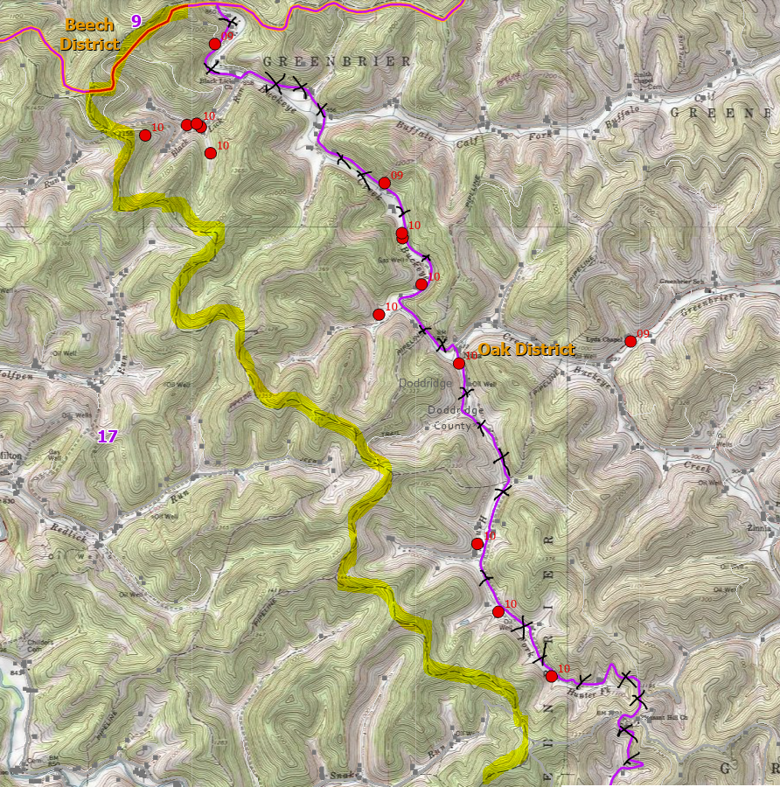
Precincts 10-17 Boundary (North)
Topo Bdry

Slide 25
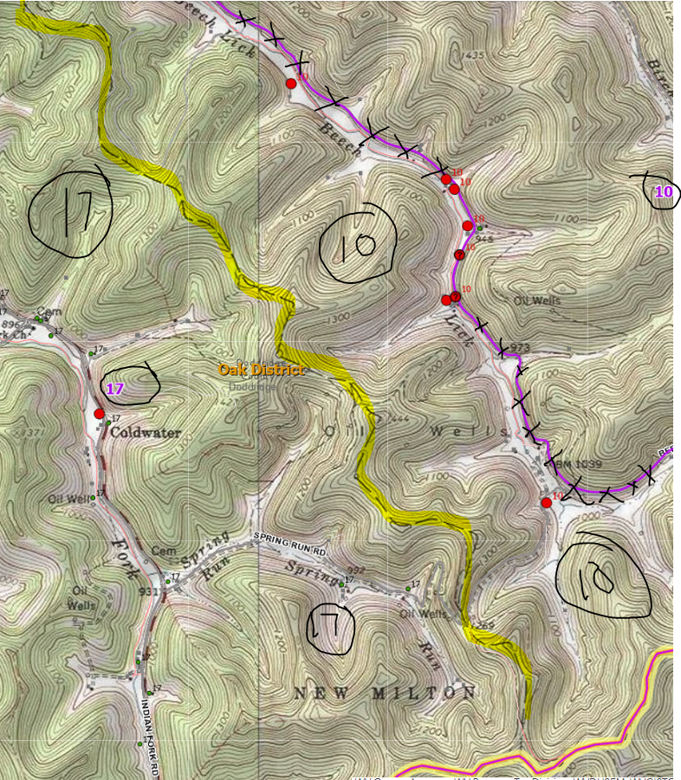
Precincts 10-17 Boundary (South) (Tax District Boundary)
Topo Bdry

Slide 26
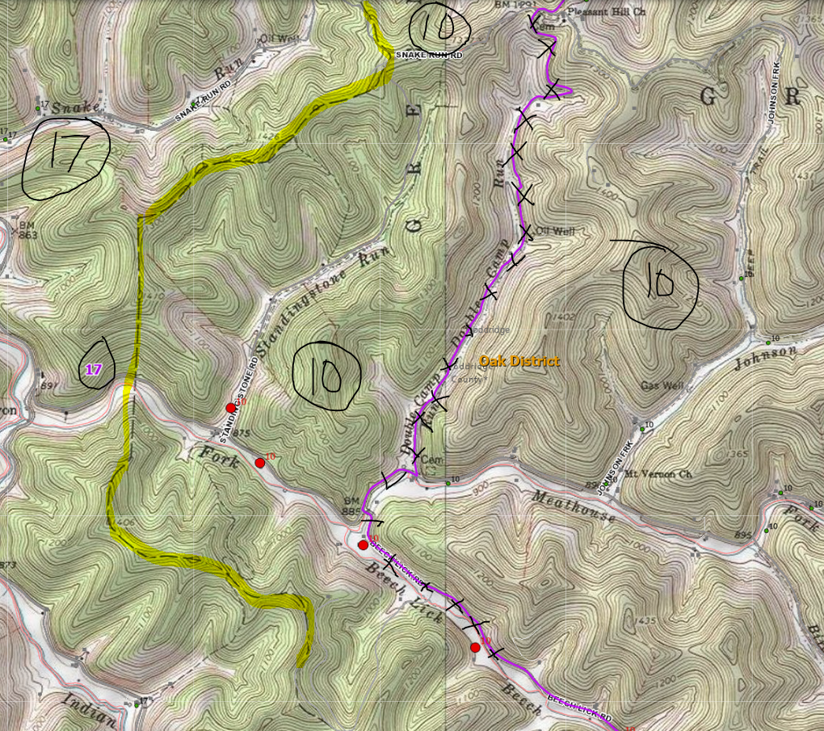
Precincts 10-17 Boundary (Central) (North of Route 50)
Topo Bdry

Slide 27
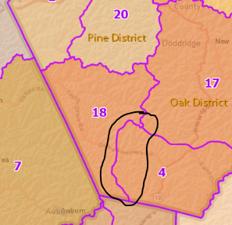
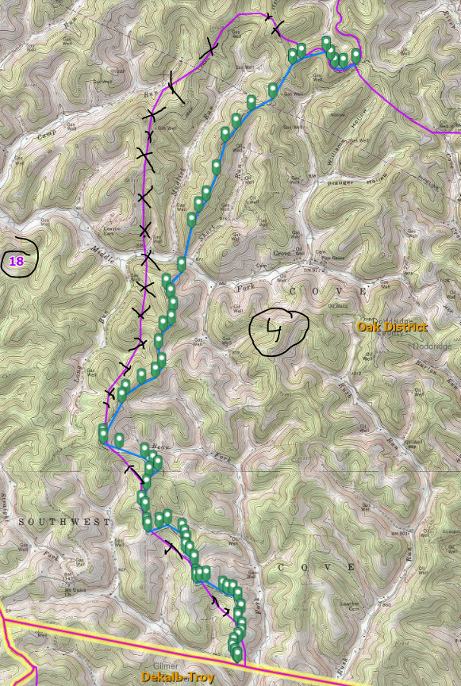
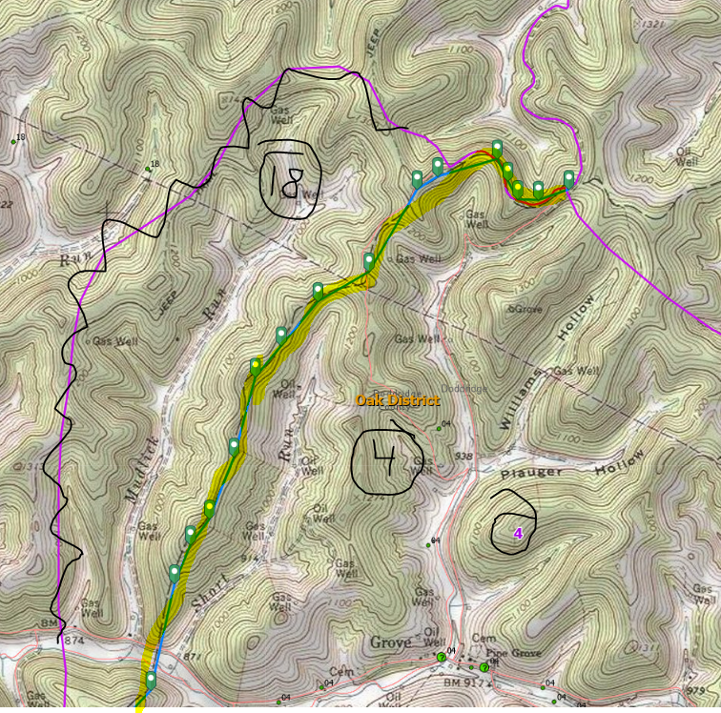
Precincts 4-18
Topo Bdry
Topo Bdry

Slide 28
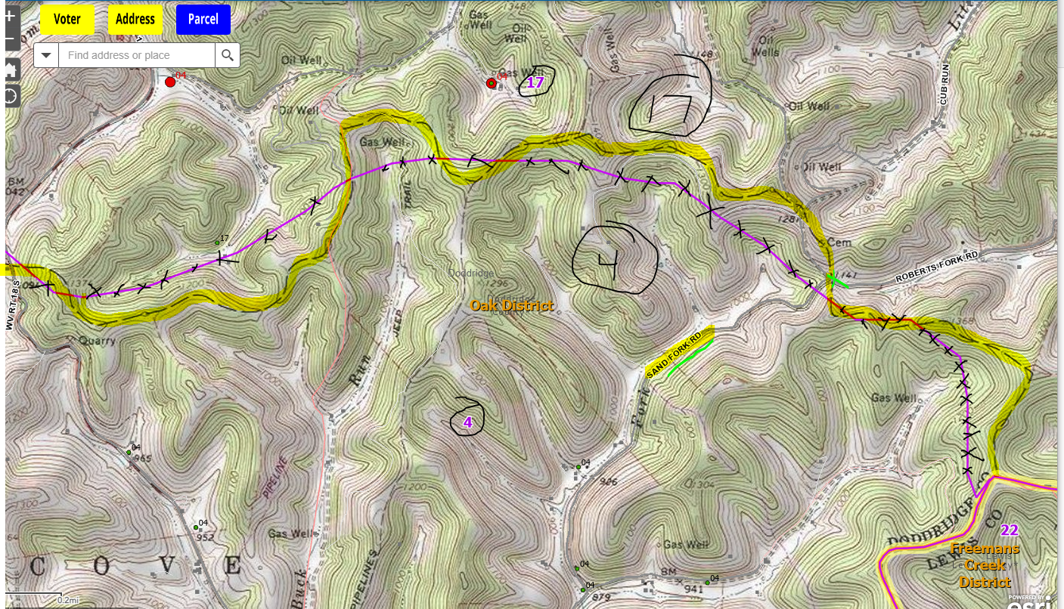
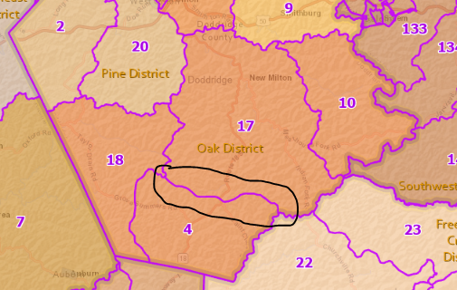
Precincts 4-17 (East View)
Topo Bdry

Slide 29
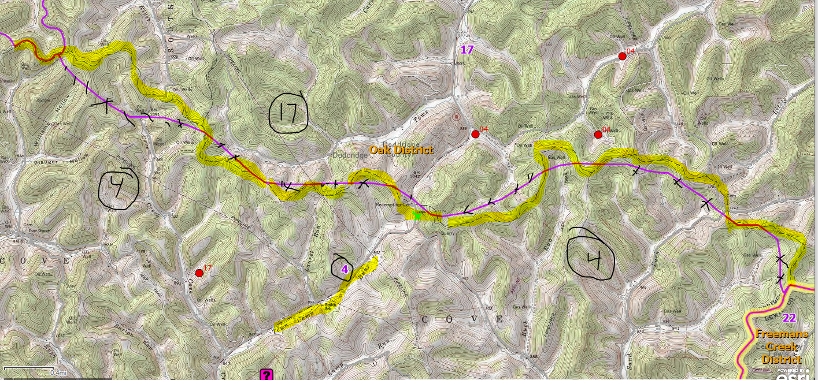
Precincts 4-17 (West View)
Topo Bdry

