Slide 1
RITCHIE COUNTY: Election District Mapping
Geo-SVRS Voter Match: Ensure Voter Registration Site Points are assigned to the correct geographic precinct. Refer to mismatch spreadsheet or red dots on G-SVRS Tool (www.mapwv.gov/SVRS). Consult with E-911 office about invalid addresses or spatially inaccurate addresses that cannot be mapped to the building footprint (less accurate street address match).
Precinct Boundary Definition Factors:
  E-911 Addresses & Road Centerlines
    All addresses of smaller roads or roads in hollows/narrow valleys should be in a single voting precinct to minimize multiple road segment definitions in the SVRS
    Street Geocodes: Geocode matches to street ranges are problematic for road precinct boundaries
  Incorporated Place Boundaries should be accurate and match precinct boundaries
  Topographic Ridge Boundaries. In rural counties, typically tax district and historical magisterial district line boundaries follow topographic ridgelines.
  Proximity to Polling Sites. Voter point travel time/distance to polling site of precinct
  Census Blocks. Follow existing census block edge boundaries if exist
Voting Precinct Boundary Alignment Issues/No Gaps:
  Precinct boundaries should align coincidentally with USGS 1:24,000-scale county boundary – not the less accurate Census boundary
  Precinct boundaries should align coincidentally with magisterial district lines

Slide 2
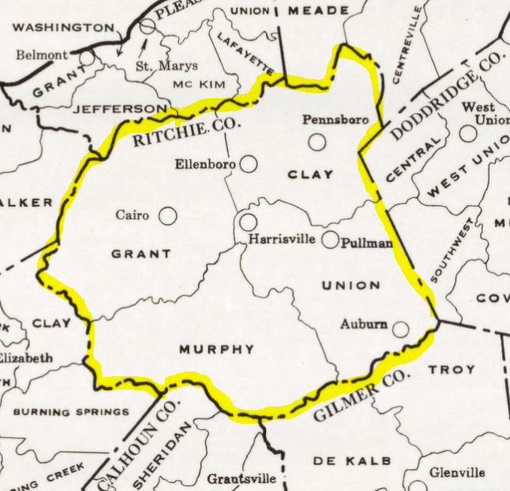
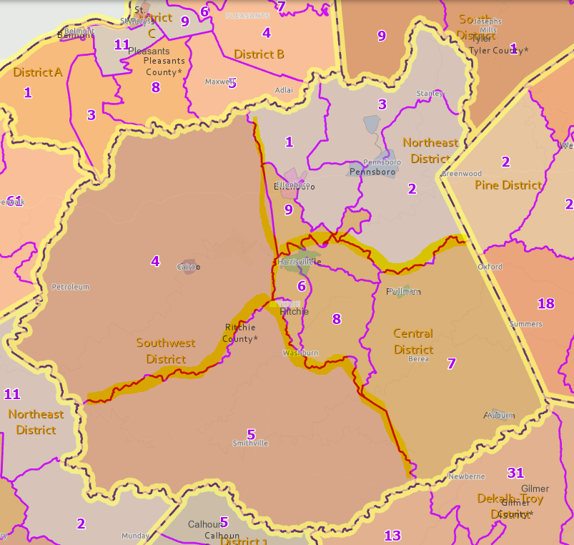
RITCHIE COUNTY: PAST AND CURRENT MAGISTERIAL DISTRICTS
1970 Magisterial/Tax Districts
2023 Magisterial Districts & Precincts
Tax District Boundaries (historical Magisterial District Boundary)
Northeast
Central
Southwest
Southwest
Today voting precinct boundaries primarily are defined by the E-911 roads instead of in the past following physical features (ridgelines, streams) of tax assessment district boundaries

Slide 3
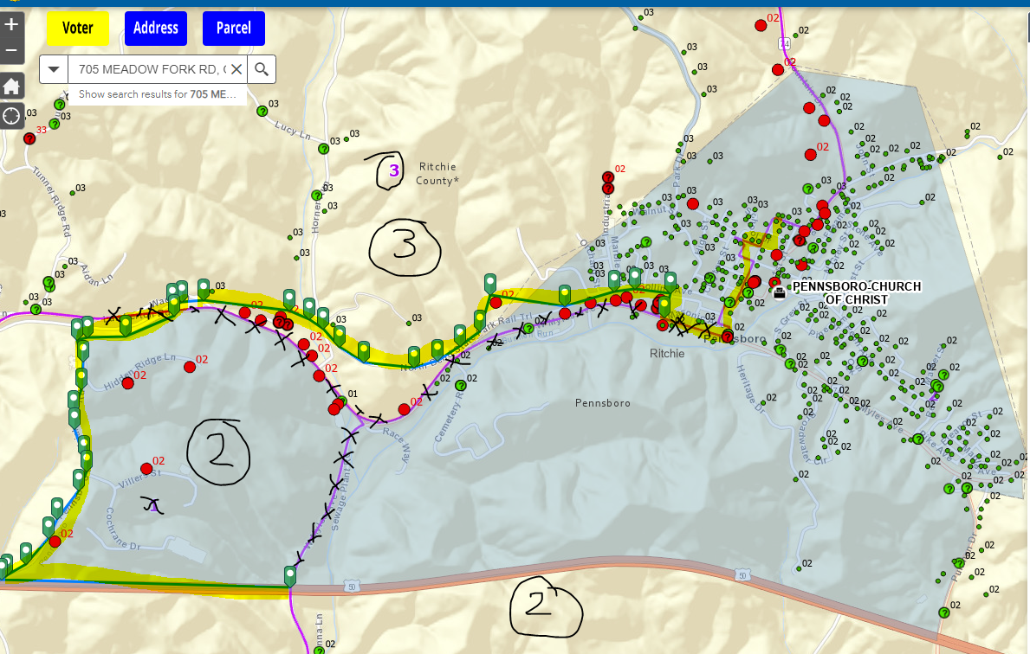
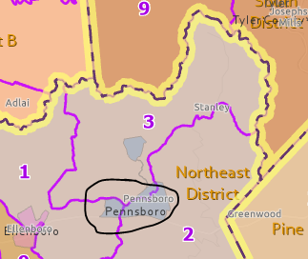
Precincts 2-3 Bdrys, (Pennsboro)

Slide 4
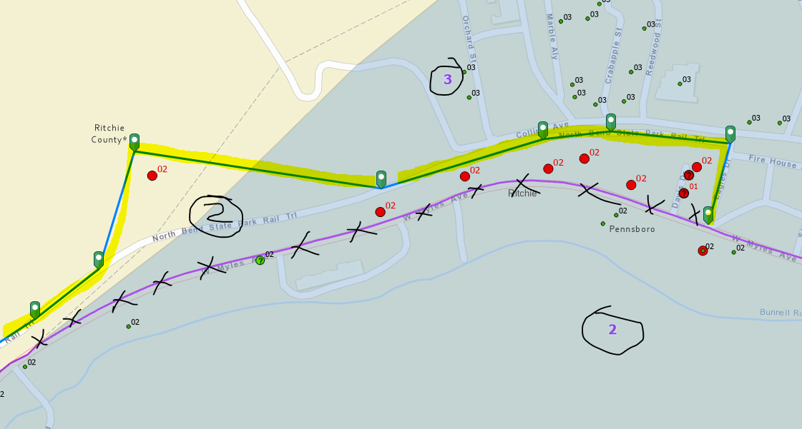
Precincts 2-3 Bdrys, (Pennsboro)

Slide 5
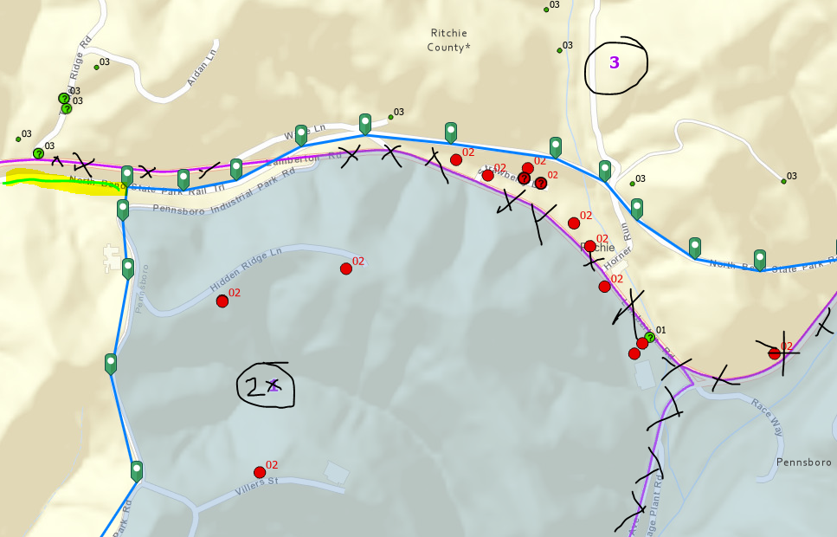
Precincts 2-3 Bdrys, (Pennsboro)

Slide 6
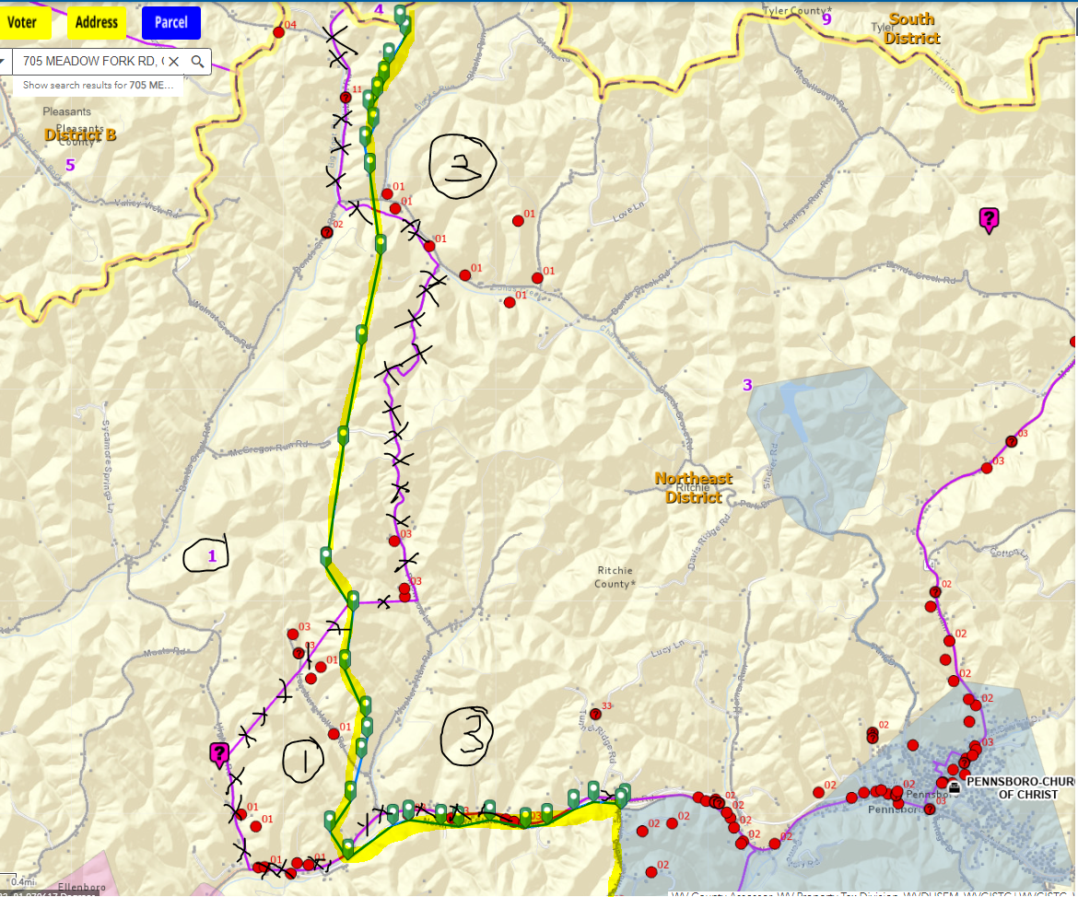
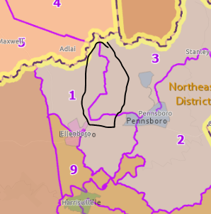
Precincts 1-3 Bdrys

Slide 7
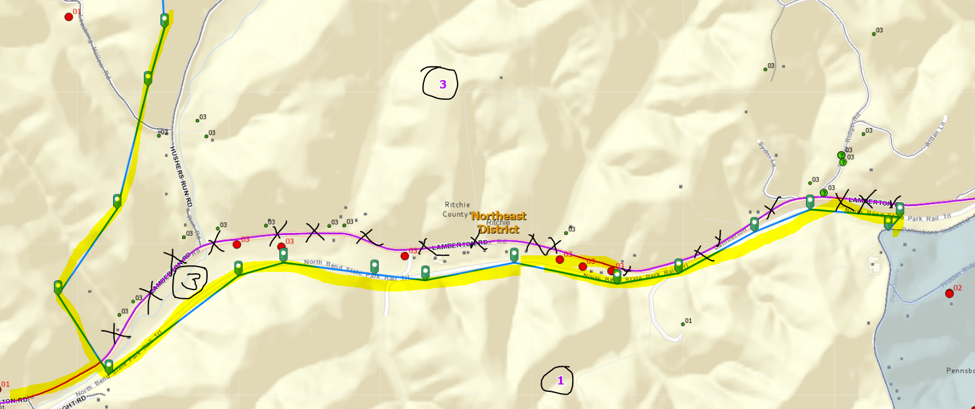
Precincts 1-3 Bdrys
North Bend Rail Trail

Slide 8
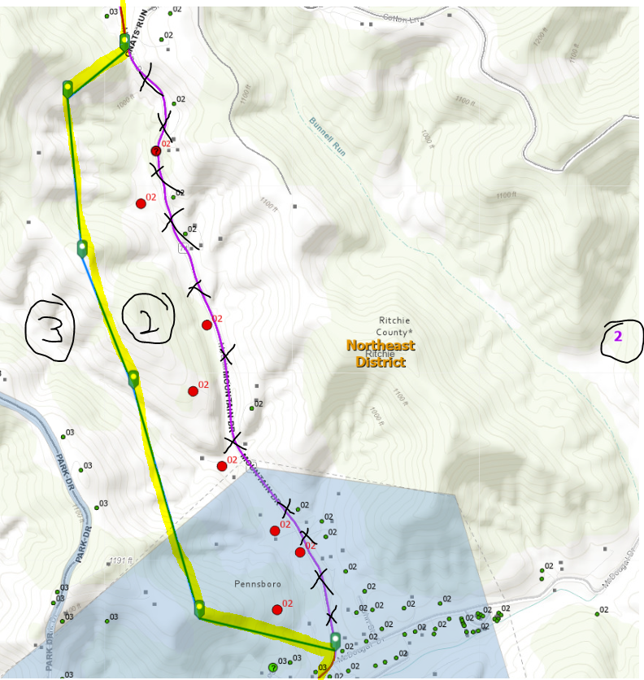
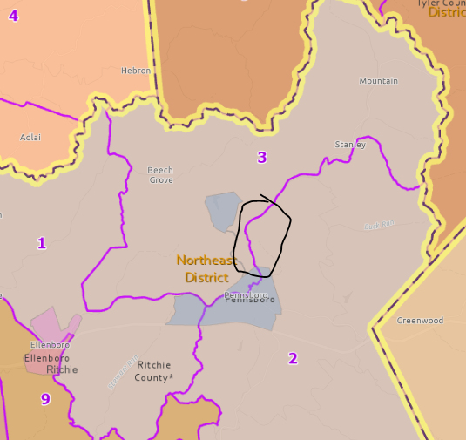
Precincts 2-3 Bdrys
Mountain Drive

Slide 9
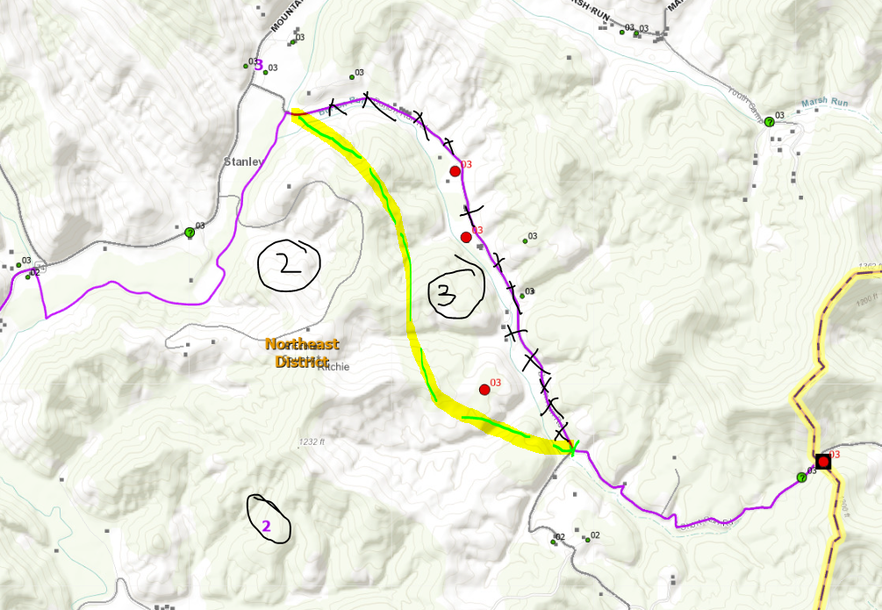
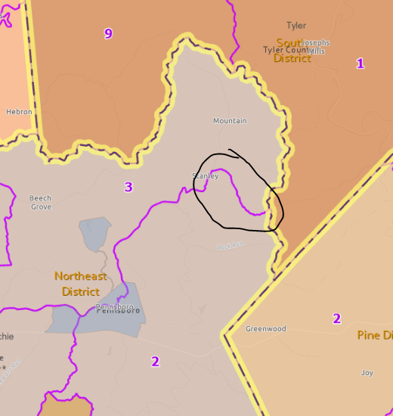
Precincts 2-3 Bdrys
Burton Run Road

Slide 10
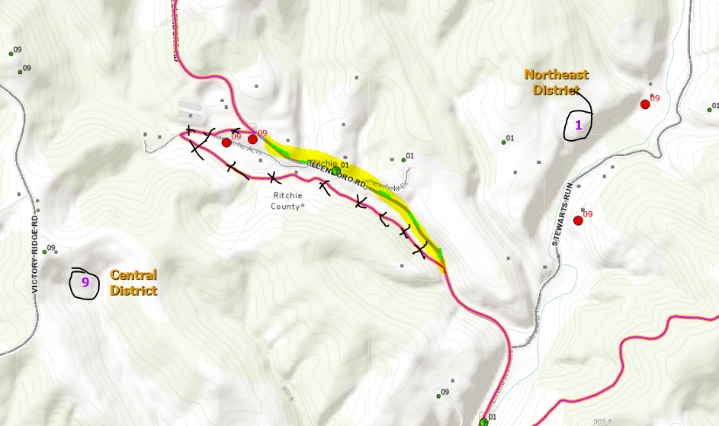
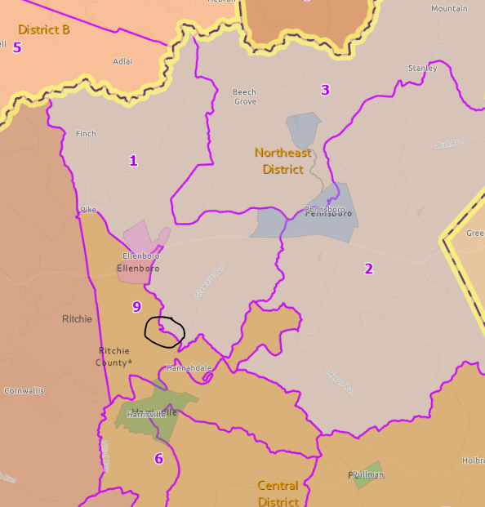
Precincts 1-9 Bdrys (Magisterial Line)
Ellenboro Rd

Slide 11
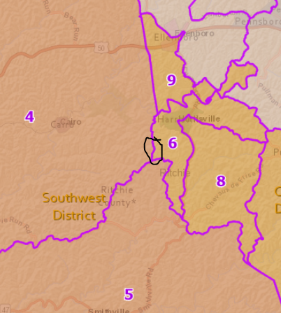
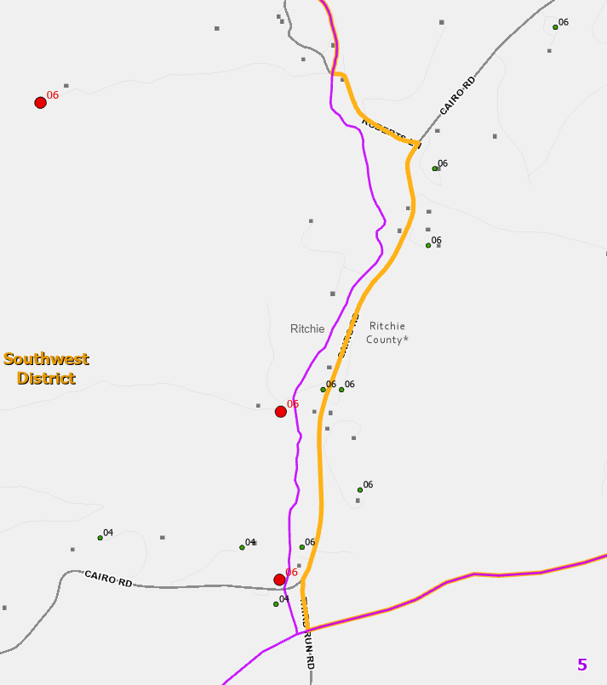
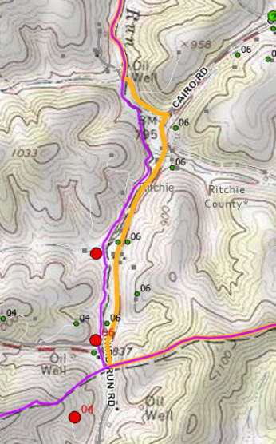
Precincts 4-6 Bdrys (Move Magisterial Line to Precinct Line)
Tax District Bdry
Move orange Magisterial Line from Cairo Rd westward to coincide with purple Precinct Line (tax district boundary)

Slide 12
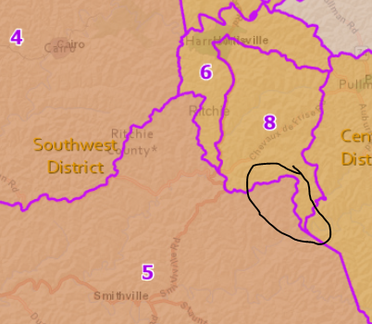
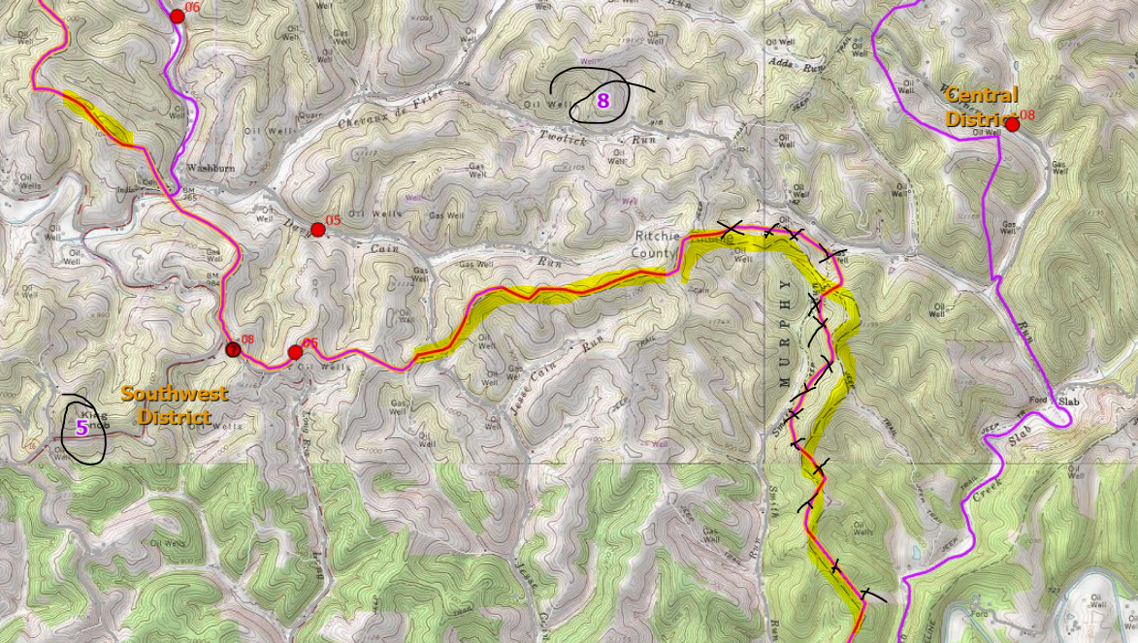
Precincts 5-8 Bdrys (Magisterial Line)
Tax District Bdry

