Slide 2
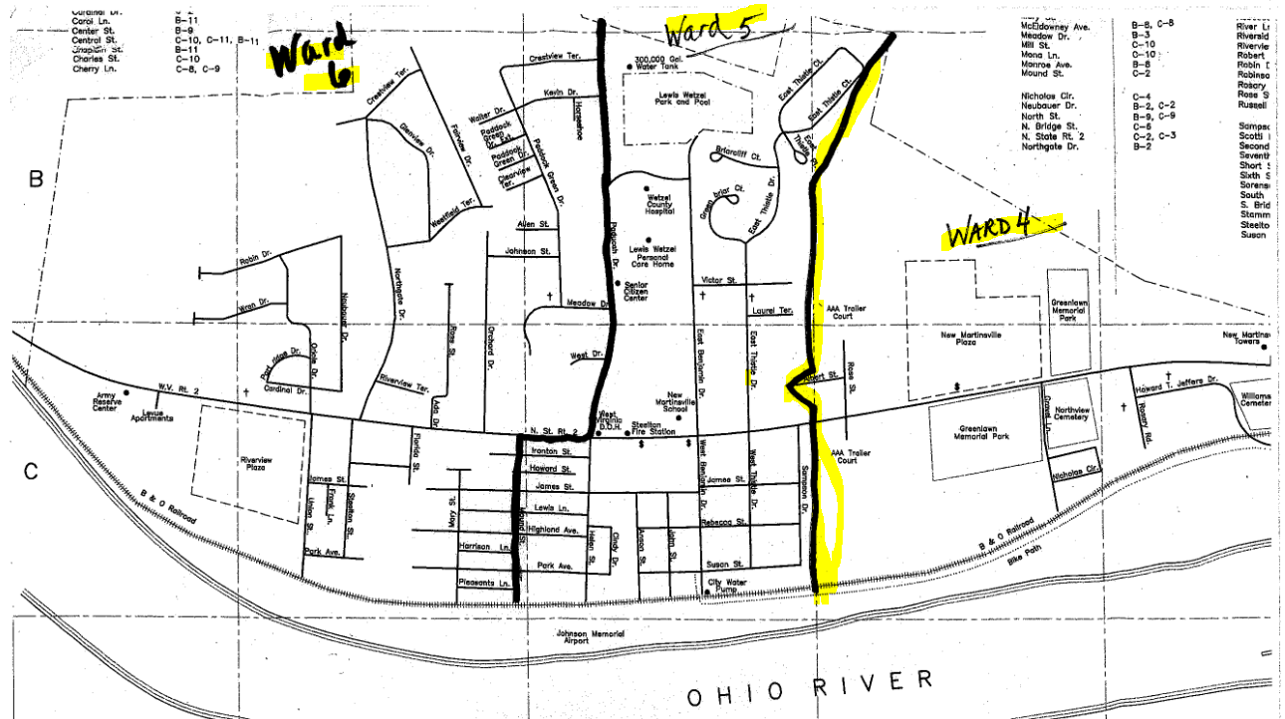
NEW MARTINSVILLE: Precincts 1-3 Bdrys (City Ward Map)
North Bend Rail Trail

Slide 3
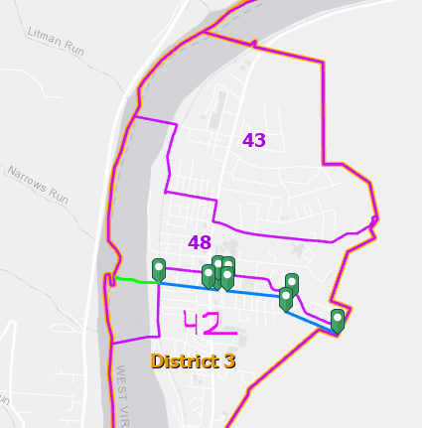
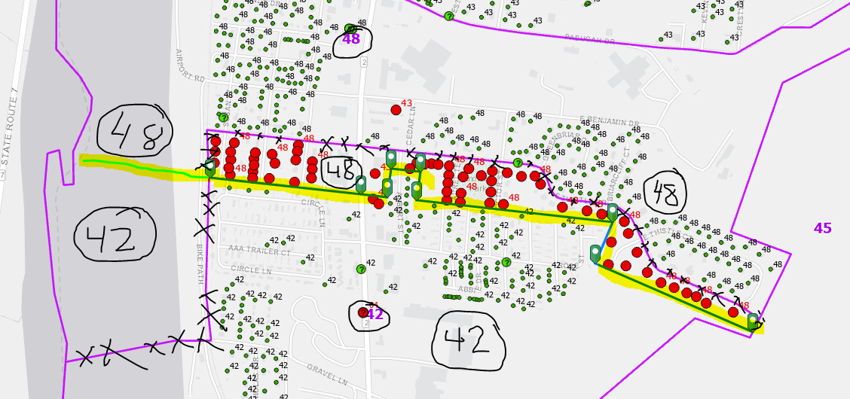
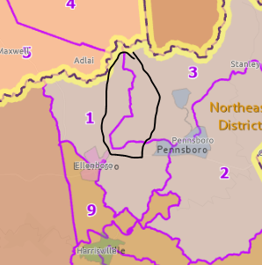
Precincts 42-48 Bdry (Wards 4-5 Bdry)
Ward 5
Ward 4

Slide 4
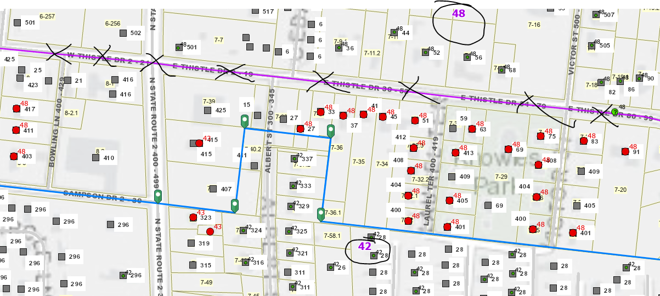
Precincts 42-48 Bdry (Wards 4-5 Bdry) (Albert St. Structures – Precinct 42)
Albert Street E-911 structures in Precinct 42. Follow parcel boundaries.
Ward 5
Ward 4

Slide 5
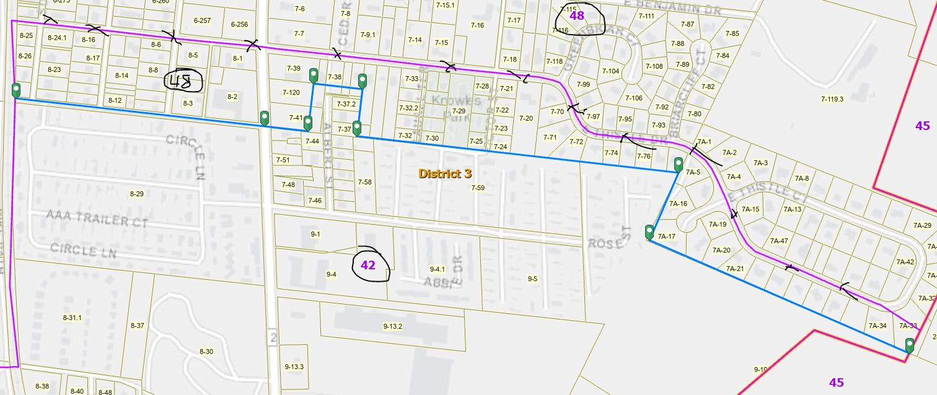
Precincts 42-48 Bdry (Wards 4-5 Bdry) (Follow Parcel Boundaries)
Follow parcel boundaries
Follow parcel boundaries
Follow parcel boundaries
Follow parcel boundaries

Slide 6
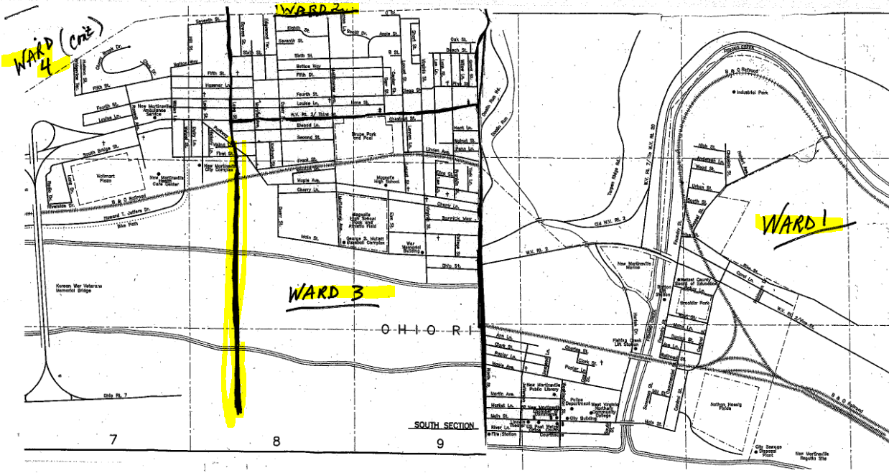
NEW MARTINSVILLE: Precincts 33-42 Bdry (Wards 3-4 Bdry)

Slide 7
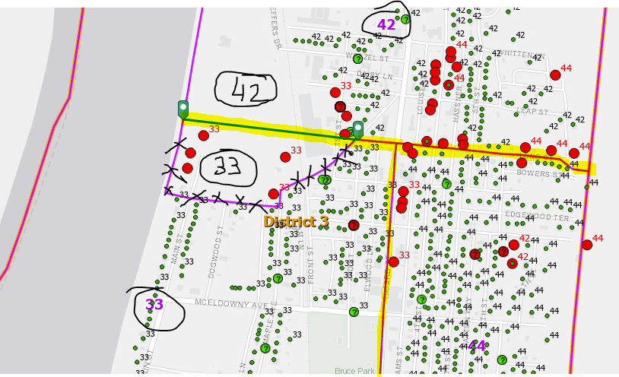
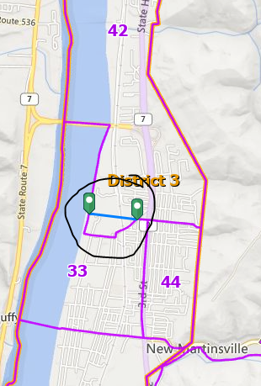
Precincts 33-42 Bdry (Wards 3-4 Bdry)
Ward 4
Extend from Long Street west
Ward 3
Ward 2

Slide 8
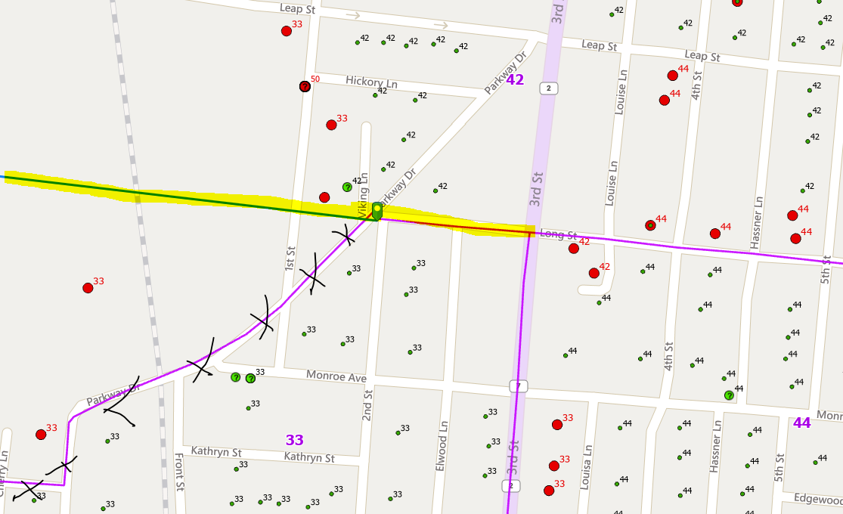
Precincts 33-42 Bdry (Wards 3-4 Bdry)
Ward 4
Extend from Long Street west
Ward 3
Ward 2

Slide 9
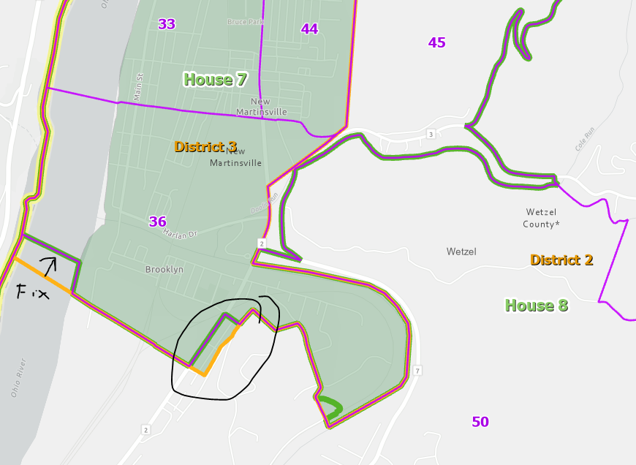
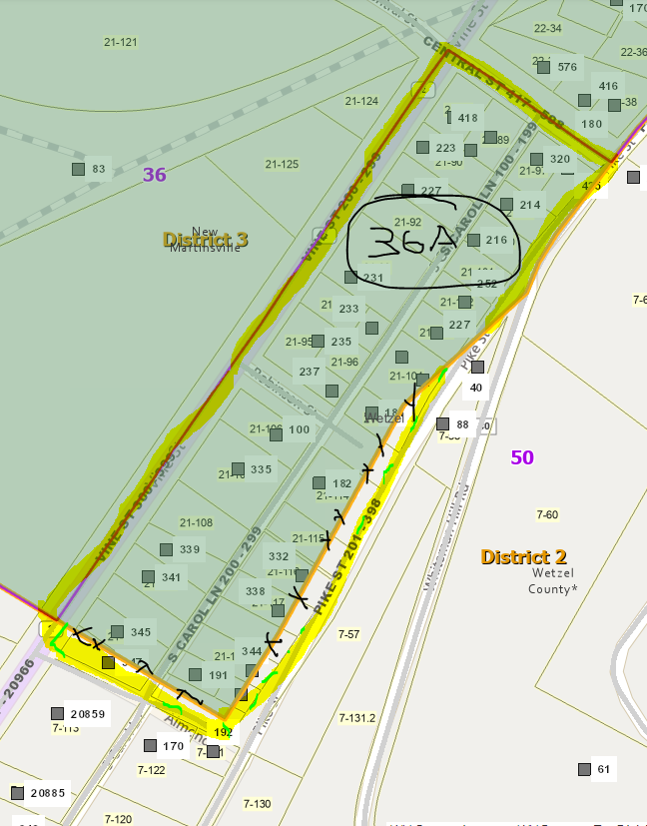
Precincts 36-50 Bdry (Ward 1). Create New Precinct 36A
Ward 1
Create new Precinct 36A for area sandwiched between WV House Line and Magisterial District
Move Precinct 36A and Magisterial Boundaries to Tax Parcel Boundaries for Pike Street & Almond Dr.

