Slide 1
Webster COUNTY: Election District Mapping
Geo-SVRS Voter Match: Ensure Voter Registration Site Points are assigned to the correct geographic precinct. Refer to mismatch spreadsheet or red dots on G-SVRS Tool (www.mapwv.gov/SVRS). Consult with E-911 office about invalid addresses or spatially inaccurate addresses that cannot be mapped to the building footprint (less accurate street address match).
Precinct Boundary Definition Factors:
E-911 Addresses & Road Centerlines
All addresses of smaller roads or roads in hollows/narrow valleys should be in a single voting precinct to minimize multiple road segment definitions in the SVRS
Street Geocodes: Geocode matches to street ranges are problematic for road precinct boundaries
Incorporated Place Boundaries should be accurate and match precinct boundaries
Topographic Ridge Boundaries. In rural counties, typically tax district and historical magisterial district line boundaries follow topographic ridgelines.
Proximity to Polling Sites. Voter point travel time/distance to polling site of precinct
Census Blocks. Follow existing census block edge boundaries if exist
Voting Precinct Boundary Alignment Issues/No Gaps:
Precinct boundaries should align coincidentally with USGS 1:24,000-scale county boundary – not the less accurate Census boundary
Precinct boundaries should align coincidentally with magisterial district lines

Slide 2
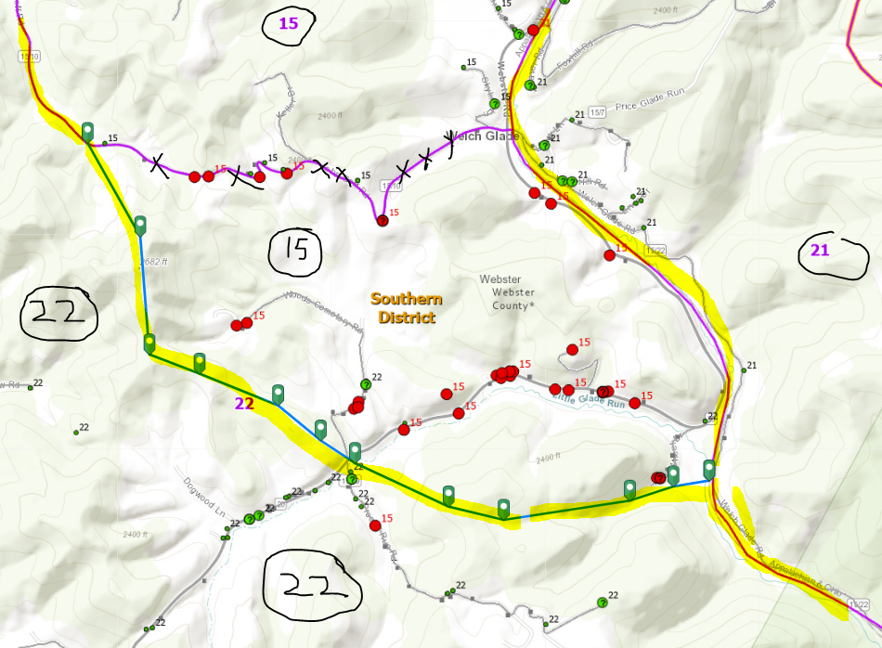
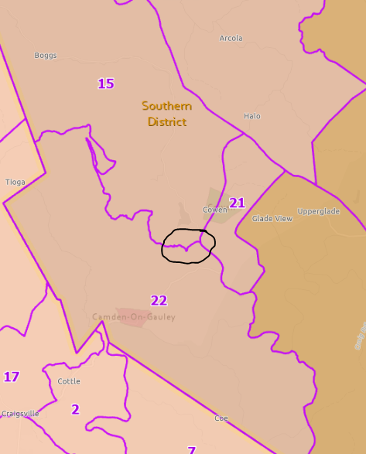
Precincts 15-21-22 Bdrys

Slide 3
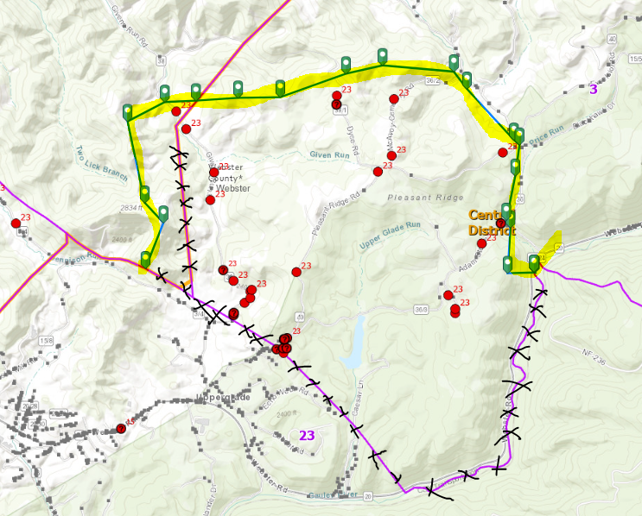
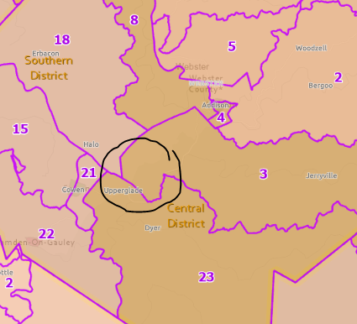
Precincts 3-23 Bdrys

Slide 4
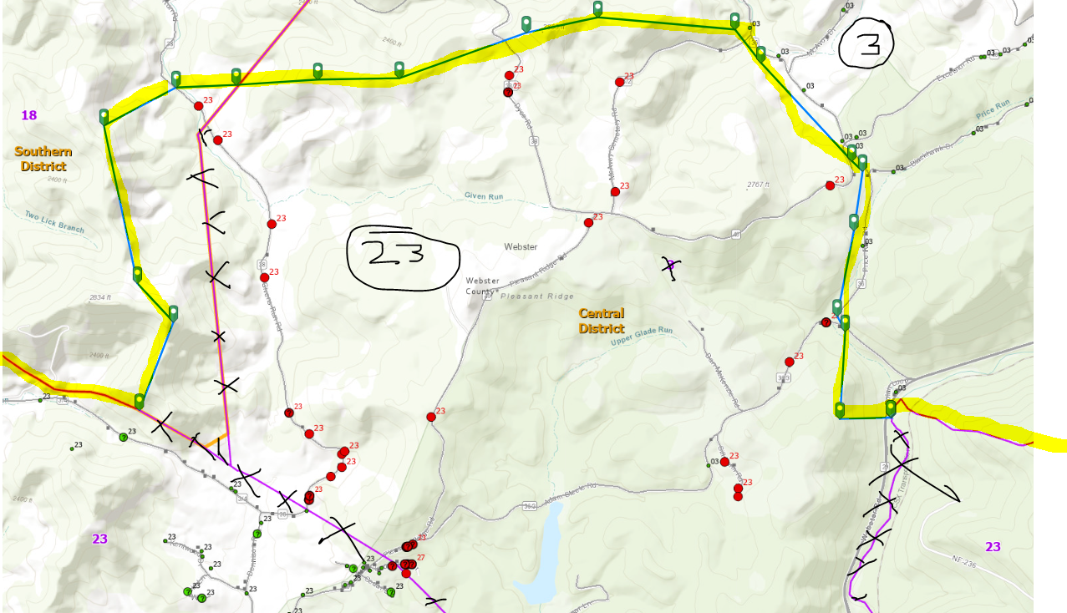
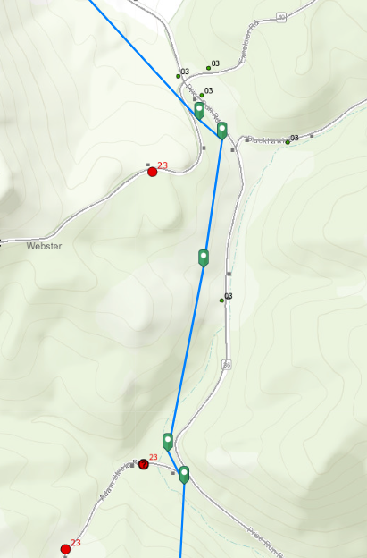
Precincts 3-23 Bdrys

Slide 5
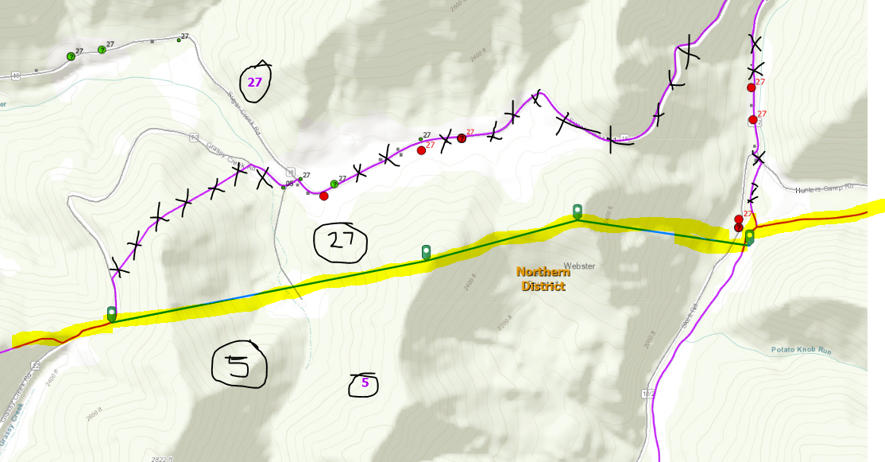
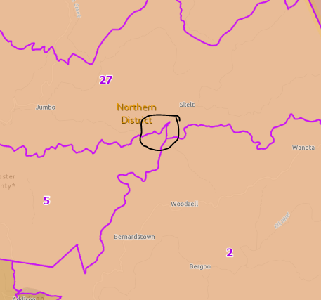
Precincts 5-27 Bdrys

Slide 6
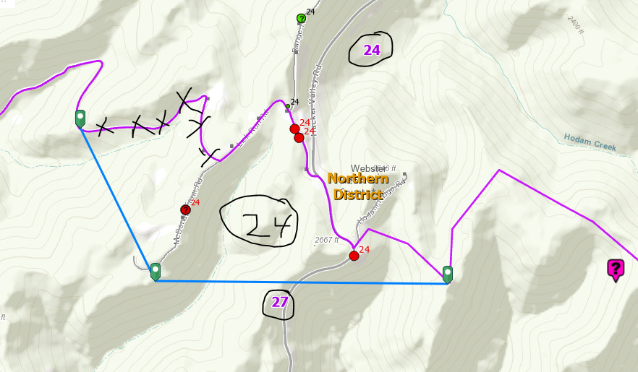
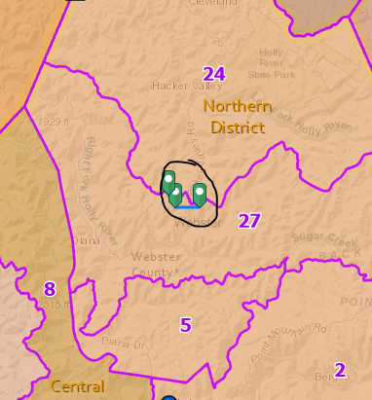
Precincts 24-27 Bdrys

Slide 7
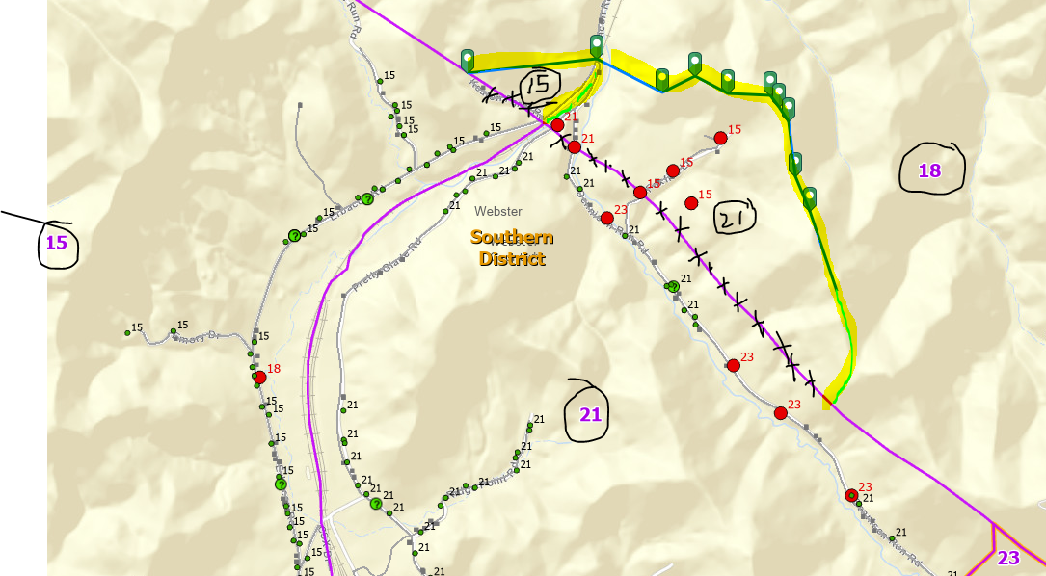
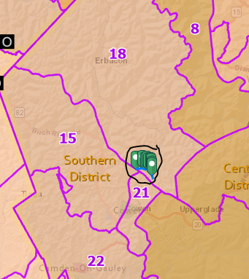
Precincts 15-21-18 Bdrys

Slide 8
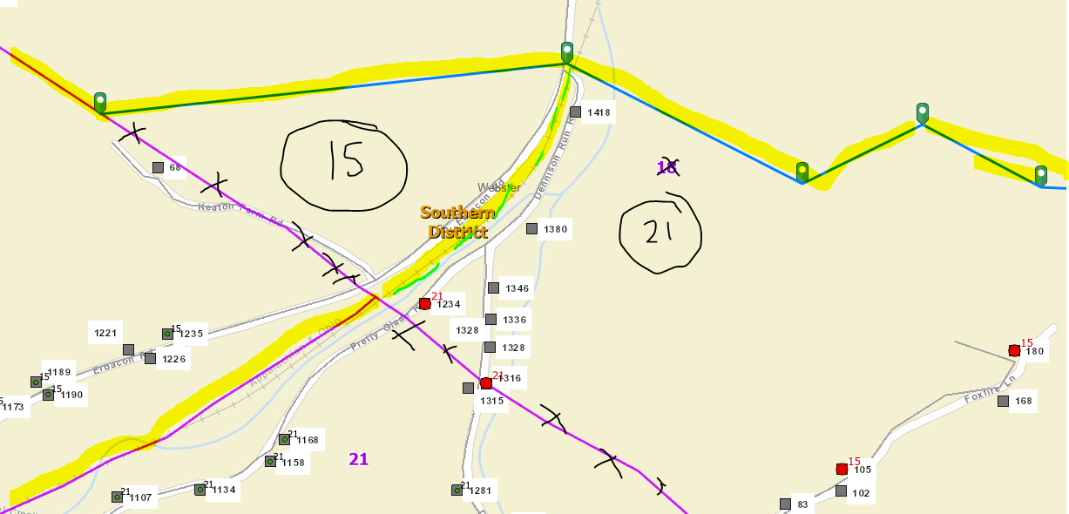
Precincts 15-21 Bdrys

Slide 9
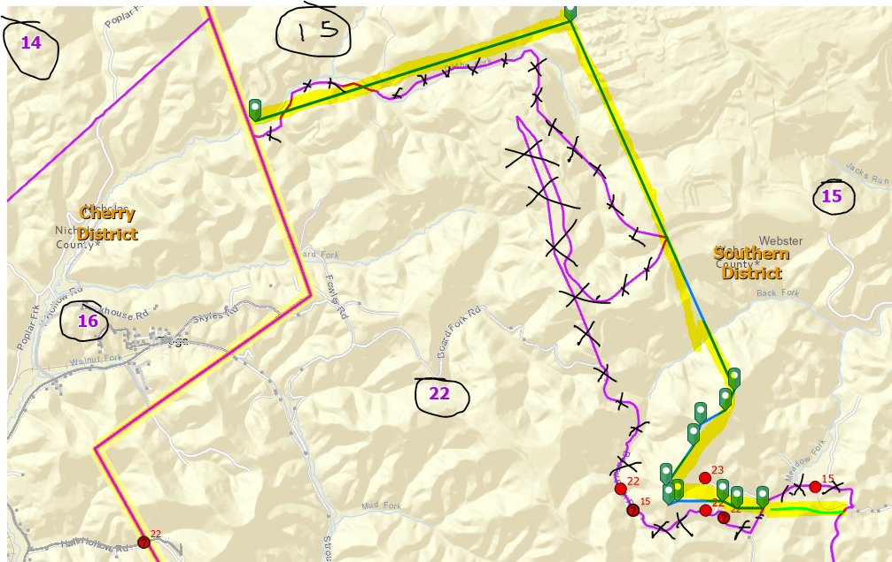
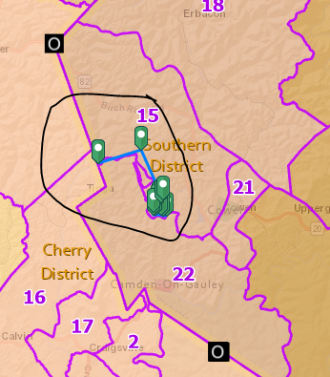
Precincts 15-22 Bdrys

Slide 10
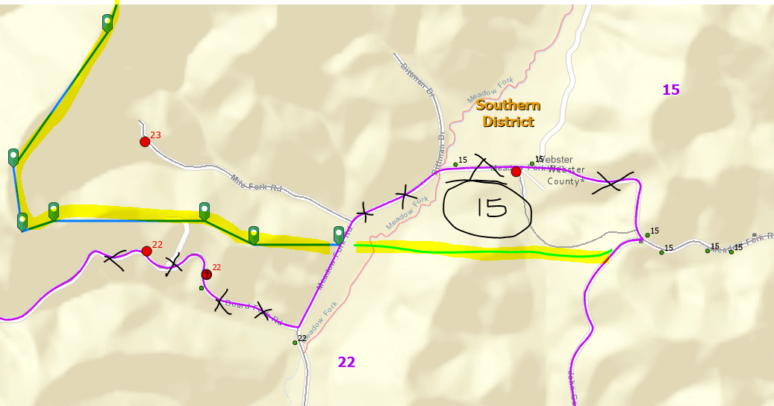
Precincts 15-22 Bdrys

Slide 11
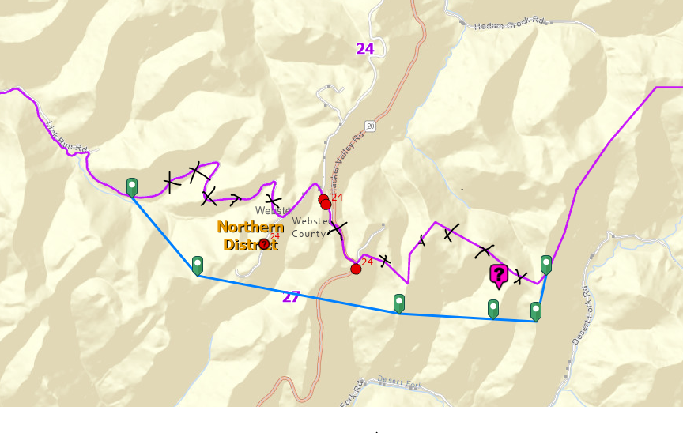
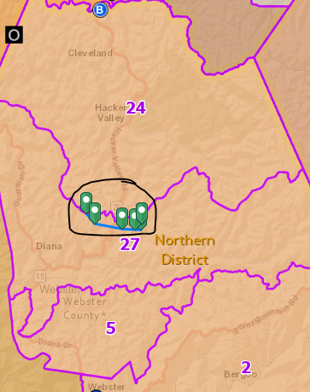
Precincts 24-27 Bdrys

