Slide 1
WV DOT
Scanning Project
Operational Overview

Slide 2
Table of Contents
01
02
03
Project Overview
Project Statistics
Project Management
Overview of processing for plans.
How the project is managed at the WVGISTC.
Current statistics for the project.

Slide 3
01
Project Overview

Slide 4




Operational Flow
Publishing
Preparation
Quality Control
Georeferencing
Building PDF
Image Processing
Scanning
Notes:
Below processes are the base steps, the above are all higher management.

Slide 5
Key Software
Adobe Photoshop
Adobe Acrobat
ArcGIS Pro
Network Drive
Script Based
Microsoft Access

Slide 6
Project Book Preparation
Unpacking
Sorting
File Naming
Plans given by the DOT are moved to the naming pile.
Each folder is checked for organization and sorted.
Plan information is entered into the Database.

Slide 7
Project Book Scanning
04
Scanner is cleaned and set up.
The original scans are relocated to the network drive.
01
03
02
Each page is cleaned and repaired as needed.
Each sheet is scanned and checked for errors.

Slide 8
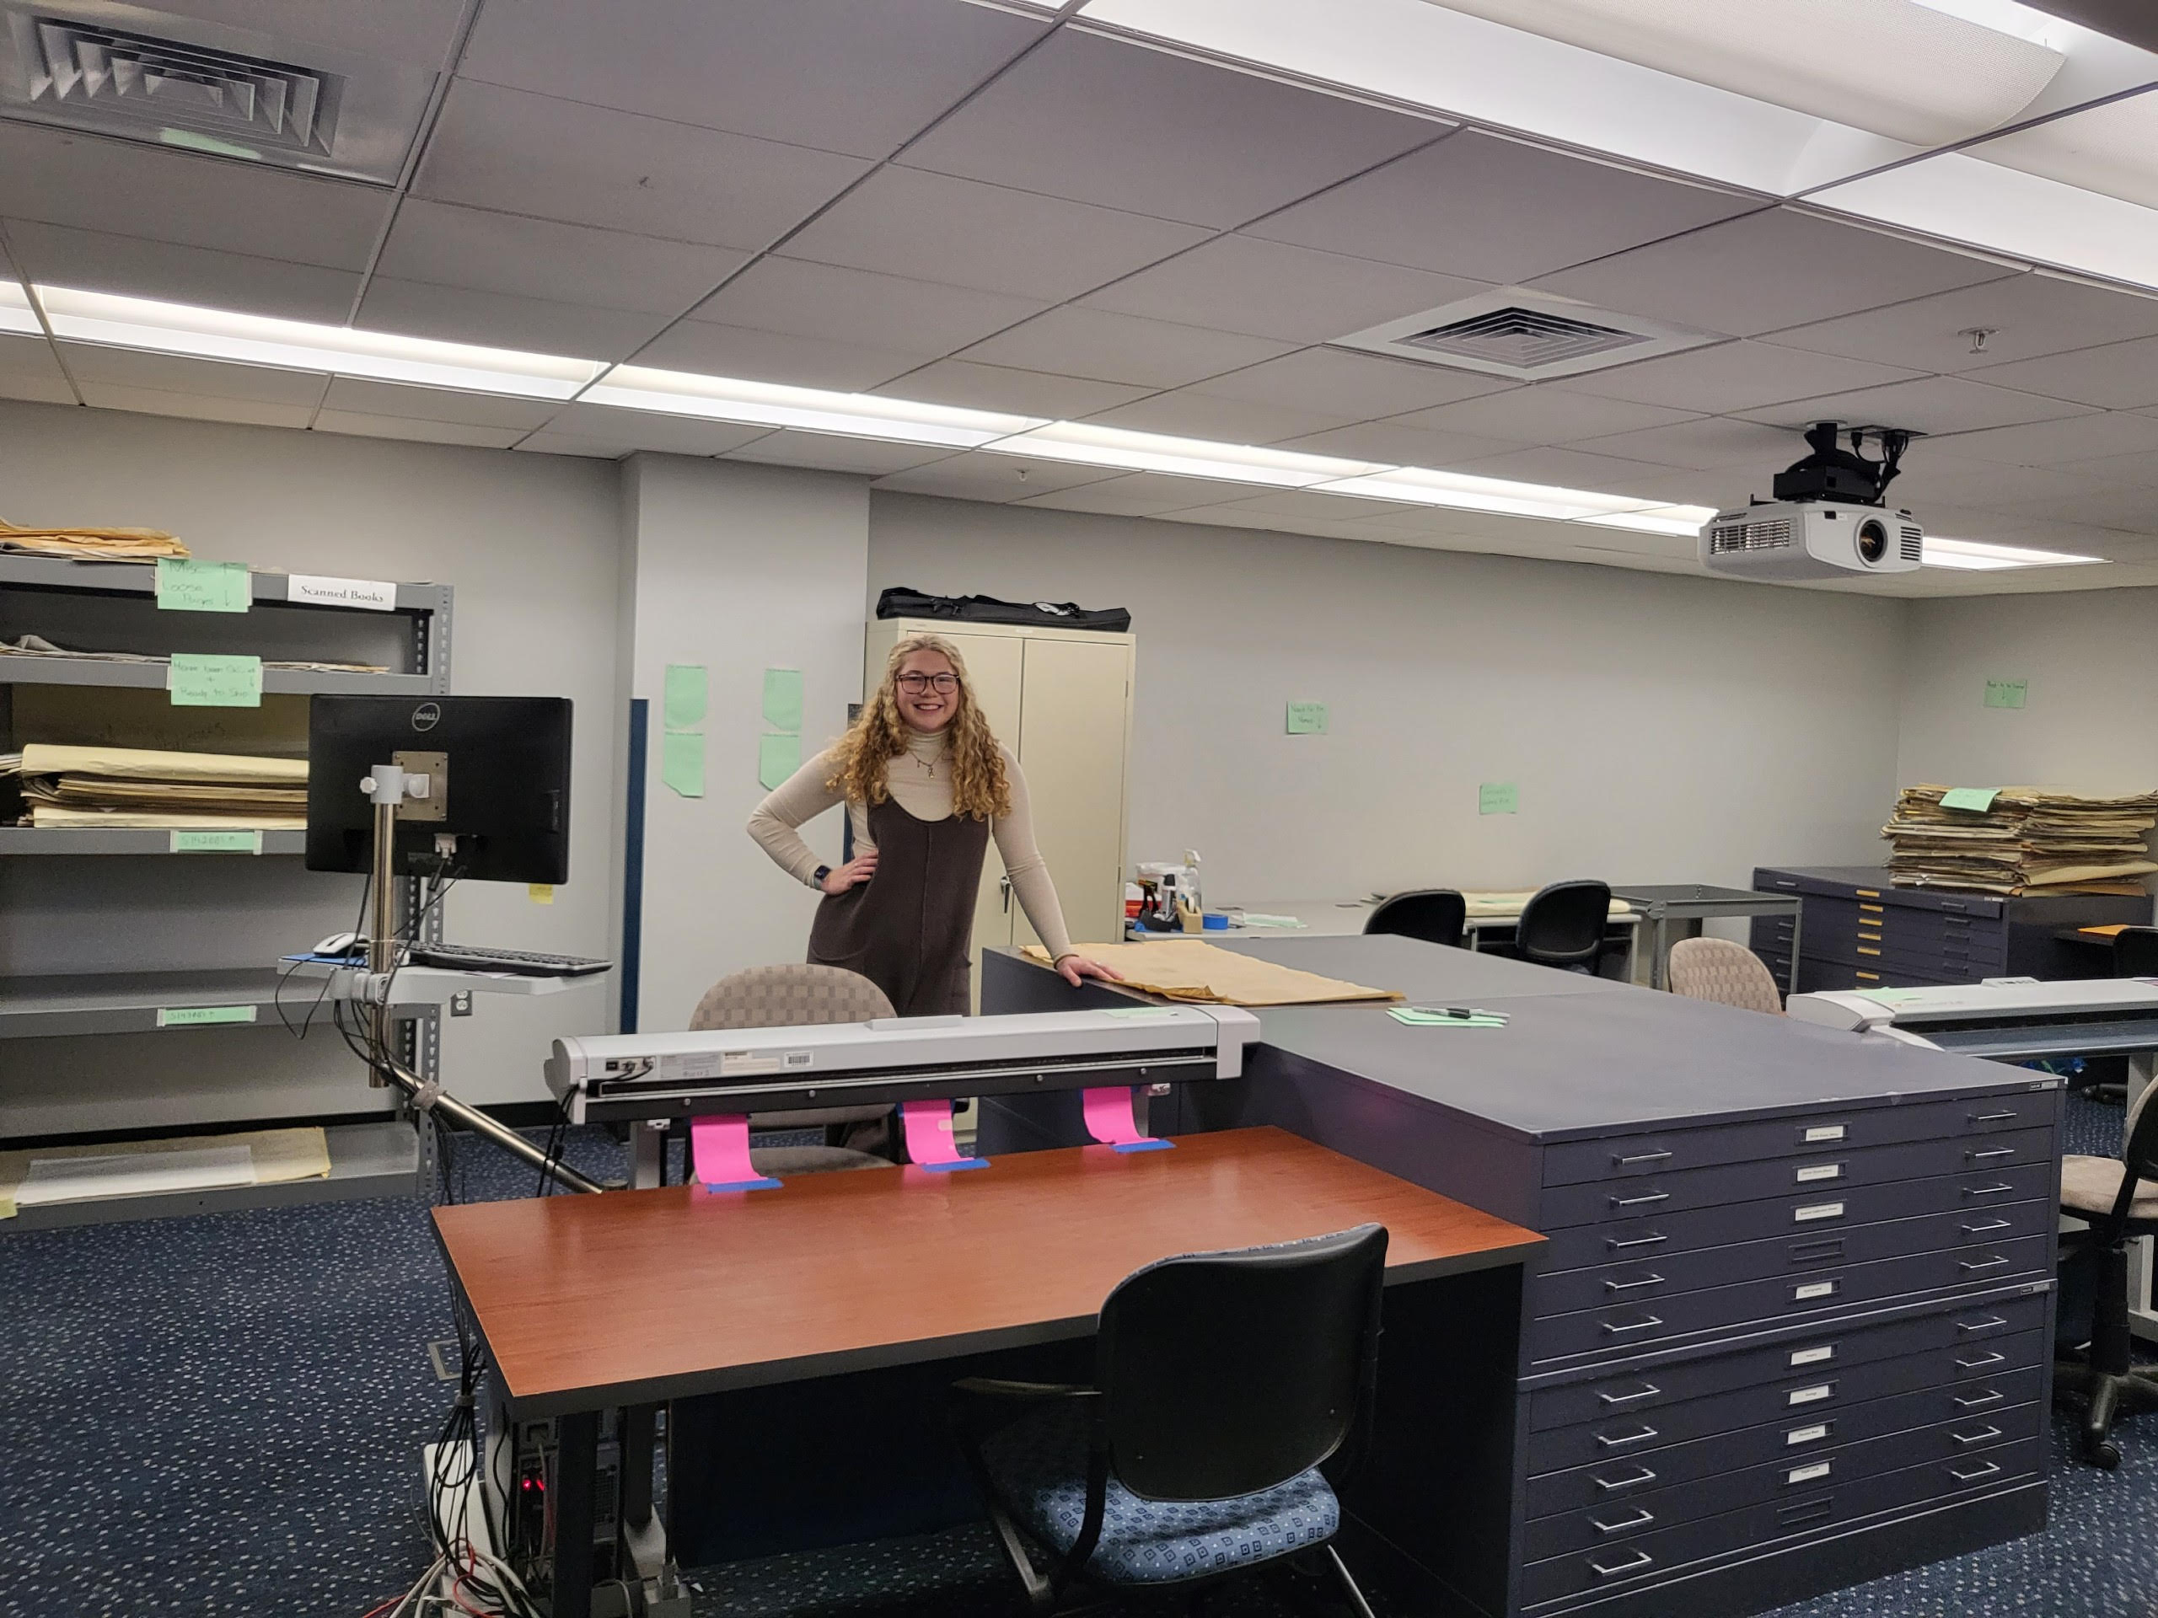
The Tech Center’s Scanning Room
Finished Plans
Plans Needing Named
Plans Ready to Scan
Scanning Stations

Slide 9
Image Processing
Straighten TIFFs
Auto Contrast TIFFs
Each page is straightened to align text for text recognition.
Each page is contrasted for best quality.
Crop TIFFs
Relocate
Each page is cropped to reduce white space and scanner background.
The processed TIFFs are uploaded to the Network.

Slide 10
Building the PDF
04
TIFFs are combined into a single document.
The PDF is relocated to the network drive.
01
03
02
Text Recognition is performed on the document.
The final product is checked for errors and compressed.

Slide 11
Georeferencing
The location of the plan is found on the map.
The GeoTIFF is exported and named.
Plan Location
GeoTIFF Exported
Image Selection
Control Points Set
Relocated
Best page is selected to georeference.
Optimal Control Points are set, transforming the image.
The final compressed folder is uploaded to the network.

Slide 12
Quality Control
Check GeoTIFF
The GeoTIFF is checked for accuracy and quality.
Check PDF
File Rename
The PDF is checked for OCR, artifacts, folds and other errors.
Once approved, the file is renamed using the renaming script.
Check TIFFs
Relocate File
The TIFF folder is checked for accurate quantity.
The file is moved to its final location for complete Project Books.

Slide 13
Publishing
The extracted GeoTIFFs are added to the whole raster mosaic.
The new footprints coordinates are added to the database.
Add Rasters
Update Footprints
Publish GeoTIFFs
Build Footprints
Publish to Website
GeoTIFFs are extracted from their compressed folders.
Using the added rasters, footprint symbology is built for each.
Each plan is toggled to ‘Published’, allowing the website to display them.

Slide 14
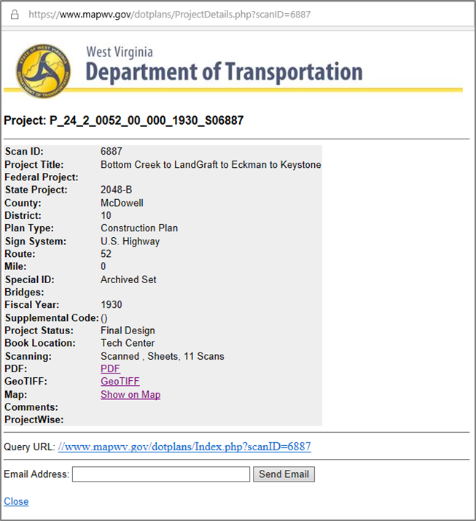
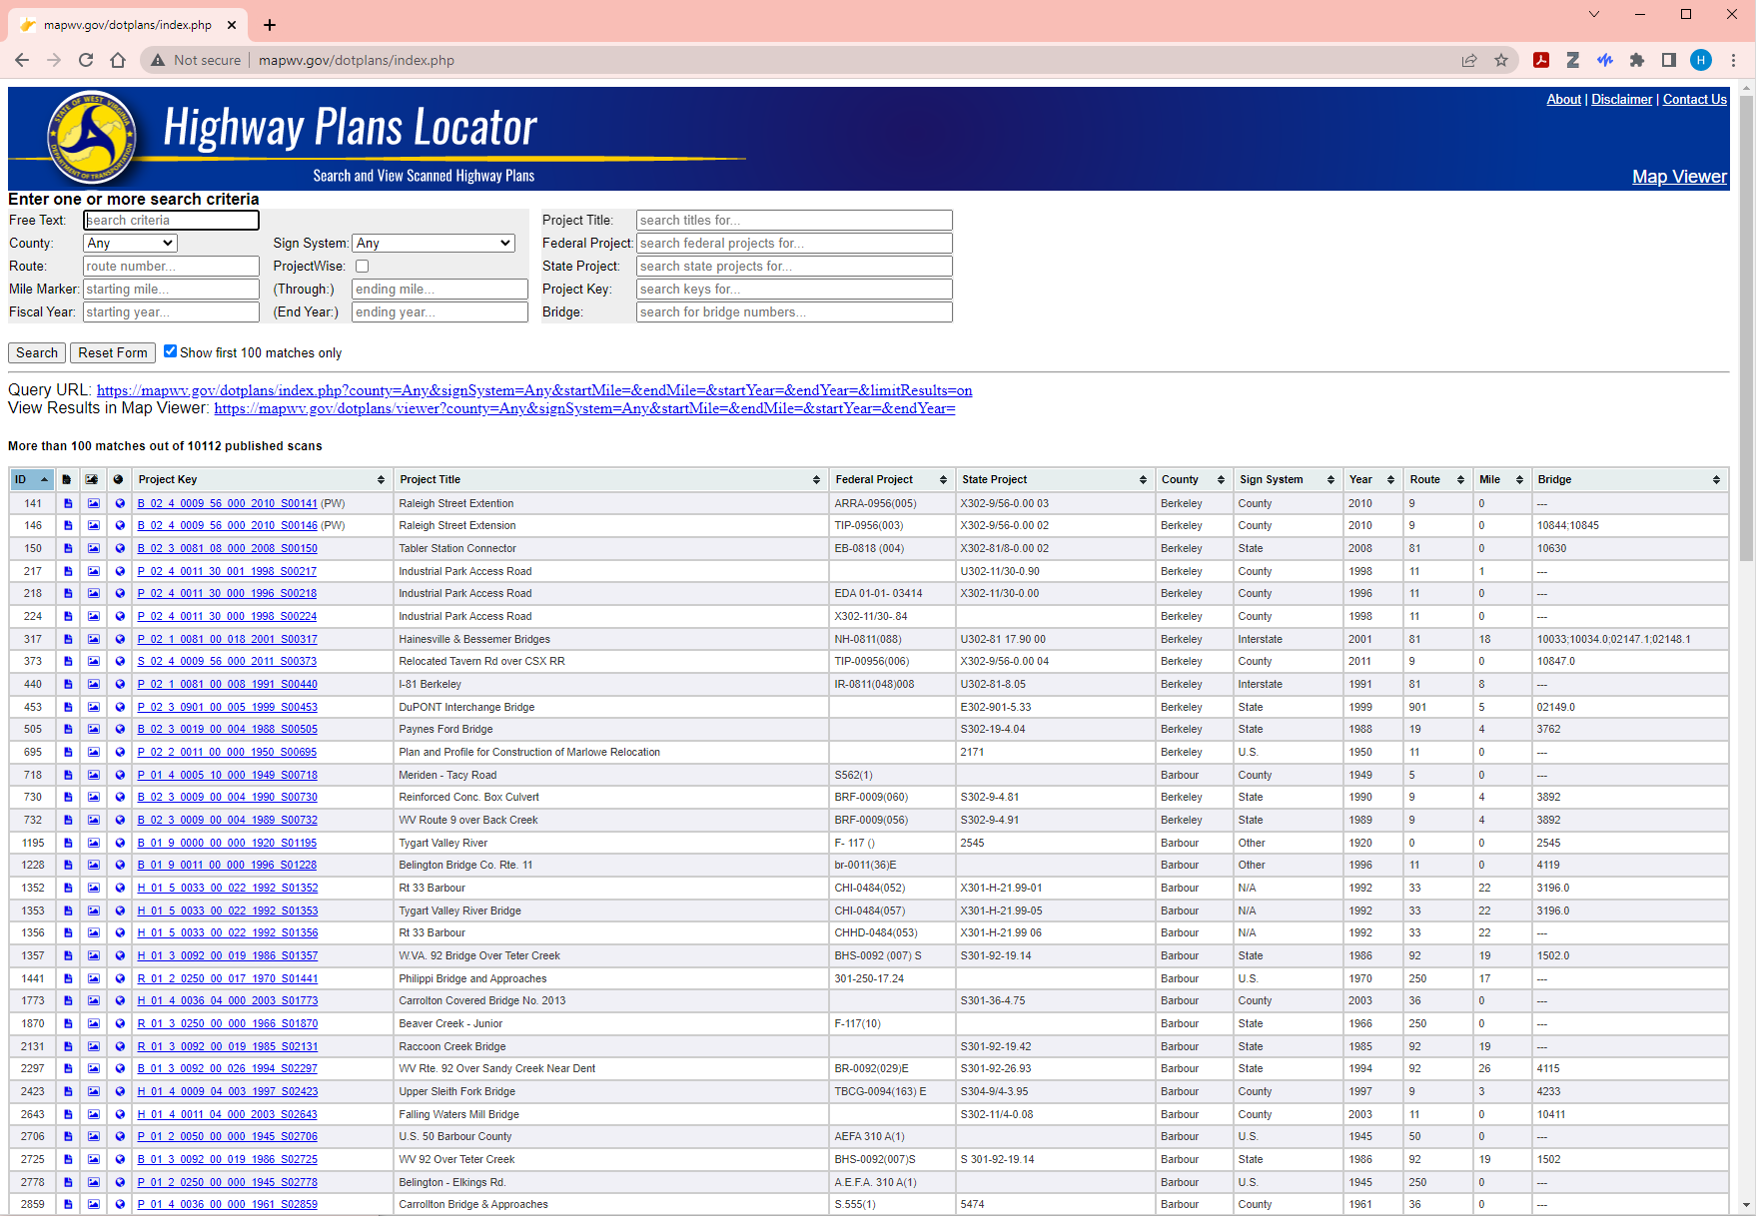
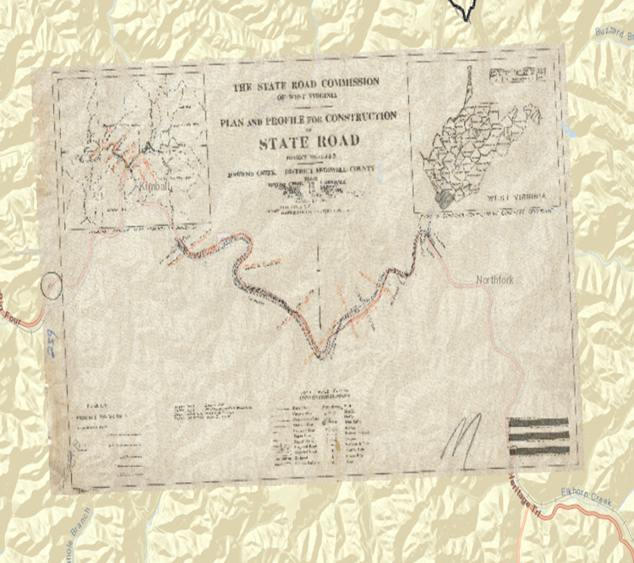
Online Highway Plan Locator

Slide 15
02
Project Management

Slide 16
Organizational Chart
Project Leader
Co-Leader
QC Interns
Base Access
Base Access

Slide 17
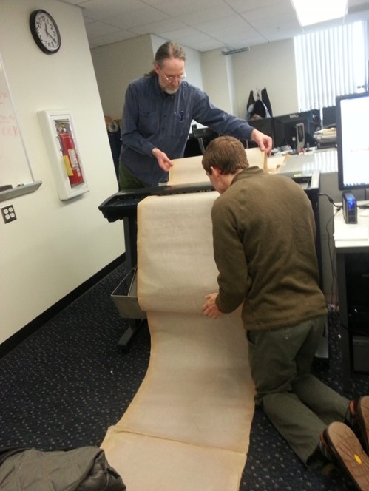
Documentation
Three different documents are used for tracking progress:
DOT_Operator Access Database
DOT Performance Tracker Google Sheet
Web QC Status Google Sheet
Each serves a specific goal. The Access database is for statistics, the Performance Tracker for monitoring the stages of processing, and the Web QC Status for assuring plans on the website function correctly.

Slide 18

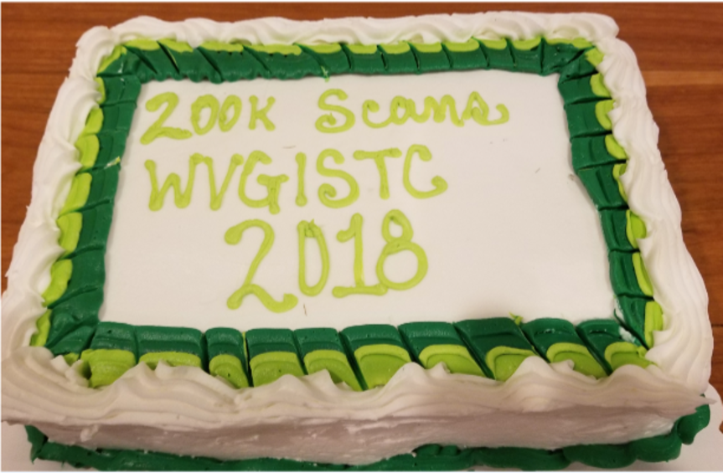
Our Milestones
Currently working through Phase III of the project. Our next milestone is at 400,000 pages scanned. Less than 20,000 to go!

Slide 19
03
Project Statistics
As of March 2nd, 2023

Slide 20
500,000
Sum of Phase I-III deliverables. An estimated 113,152 sheets remain till reaching the projected end of Phase III.
Notes:
Projected number of plan sets left: 1,655. Based on drawers having an average of 5 plans.
Projected number of pages left: 62,228. Based on avg scan count of 37.6.

Slide 21
386,848
10,375
10,165
Sheets Scanned
Plans Scanned
Plans Published

Slide 22
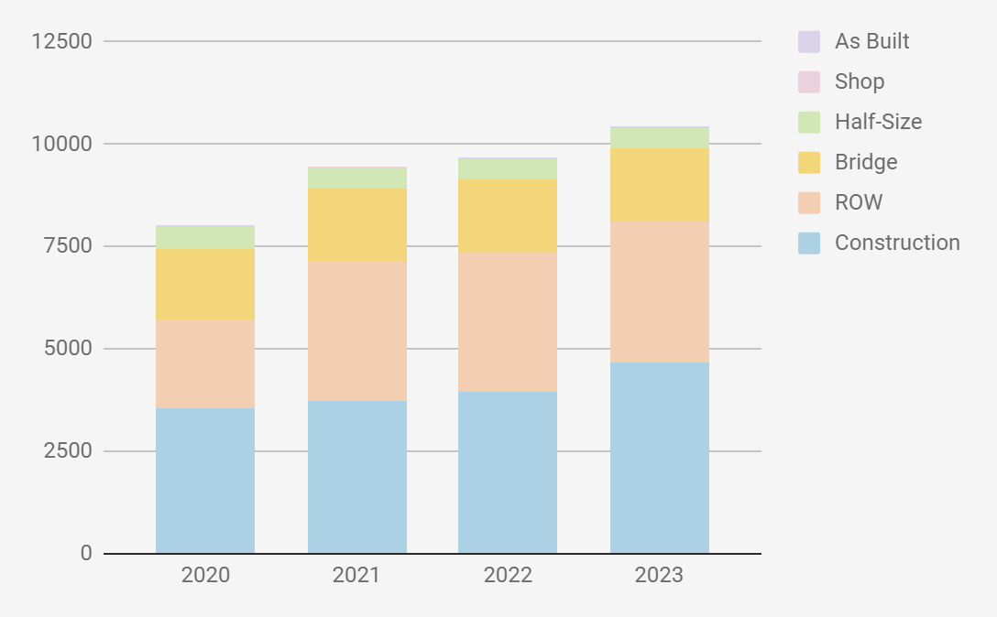
Plan Type Breakdown
Construction Design
Total: 4,670
Right of Way
Total: 3421
Bridge
Total: 1789
Half-Size
Total: 500
Shop Drawing
Total: 22
Total Plans as of February 2023:
10,419
As Built
Total: 17

Slide 23
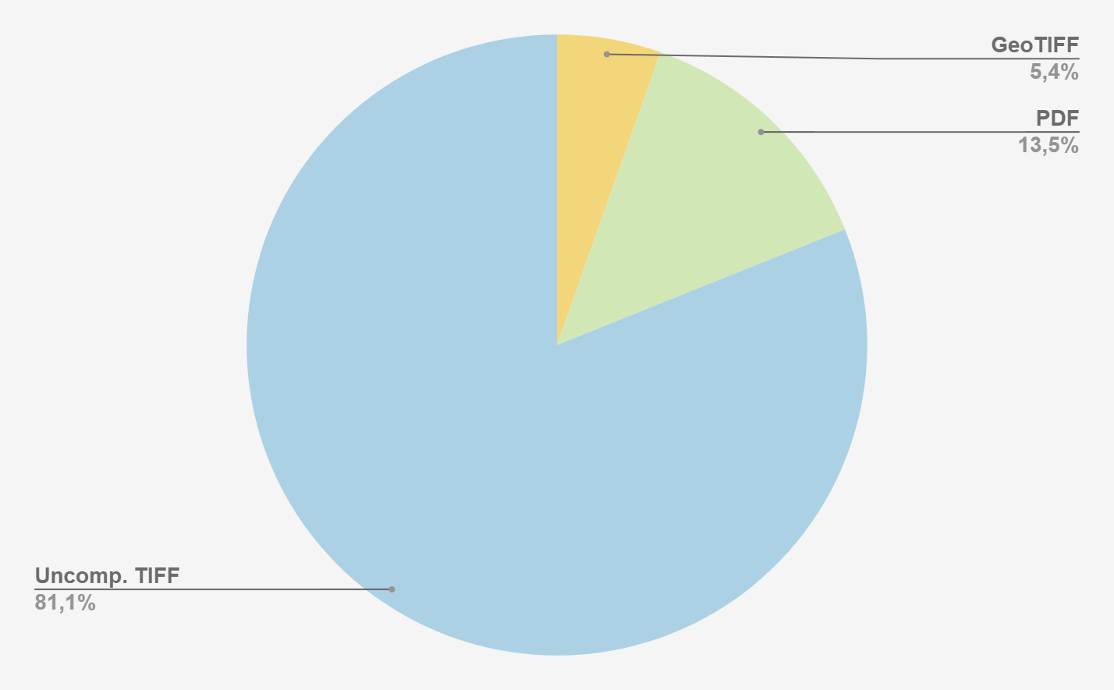
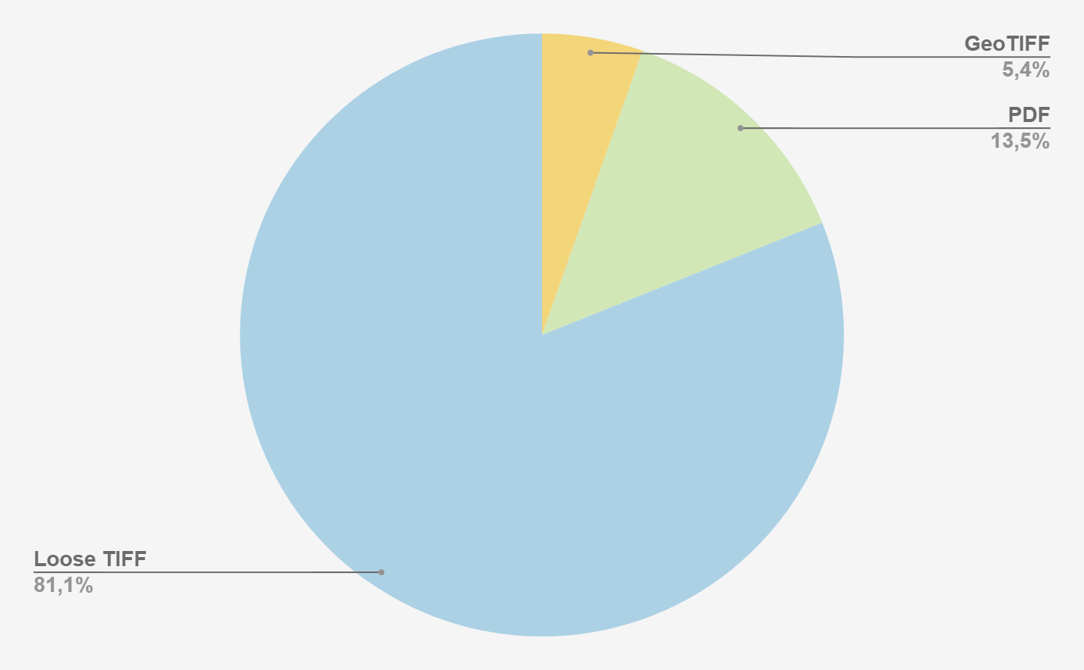
File Size Breakdown
Uncompressed TIFF Files
Loose, processed scan files. Does not include the original scans but does include the unzipped GeoTIFF files.
PDF Files
The PDF’s consist of all the individual pages which make up a project book. Needed for the website.
Compressed GeoTIFF Files
This is the amount of storage the compressed GeoTIFF folders make up. This is needed for publishing.
Our main folder currently holds approximately 4TB of data.
Notes:
10tb server, currently holds 4tb of data not counting original scans.

