Slide 1
Flood Risk Review (FRR) Meeting
Upper Monongahela Watershed
Morgantown, WV
April 12, 2016
Notes:
Alison

Slide 2
Why are we here today?
The Flood Insurance Study (FIS) and Flood Insurance Rate Maps (FIRMs) are in the process of being updated for parts of the Upper Monongahela Watershed.
New Flood Risk Products are being developed to help communities understand and plan for future flood events for the entire Watershed.
A FRR meeting is an opportunity to examine the new study areas, discuss how the analysis and mapping has changed since previous FIRMs, and work collaboratively to ensure the needs of the community and its partners are met.
Notes:
Alison

Slide 3
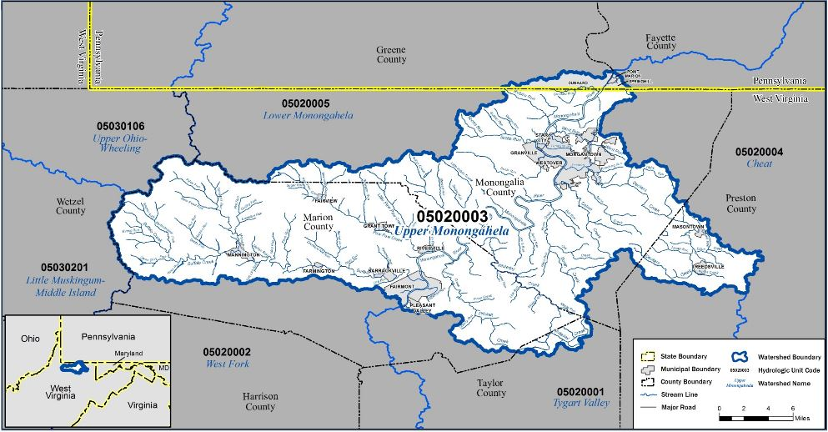
Agenda
Risk MAP Overview
Project Extents
Flood Study Methodology
Where to Get Products
WV Flood Tool
Work Session
Review Maps
Q&A
Notes:
Alison

Slide 4
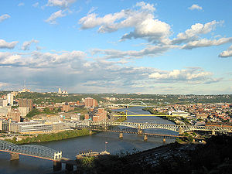
Introductions
Project Team
Federal Partners
State Partners
Local Partners
Academic Partners
Notes:
Alison

Slide 5
What is Risk MAP?
Provides communities with accurate flood maps, and flood information and tools to:
Reduce risk
Enhance their mitigation plans
Better protect their citizens
Increases public awareness and action that reduces risk to life and property.
Mapping Assessment Planning
Notes:
Alison
Risk MAP represents a “whole community approach” to updating flood risk maps. Whole community includes individuals and families, including those with access and functional needs, businesses, faith-based and community organizations, nonprofit groups, schools and academia, media outlets, and all levels of government, including State, local, tribal, territorial, and Federal partners.
In the first stage, with input from local leaders, a watershed is reviewed to determine if there may be a need for new or updated Flood Insurance Rate Maps (FIRMs) or other flood risk products. This decision is based on the current flood risk in the area, available data, increases in development, population affected, and other related factors.
Next, mapping partners and local leaders begin collecting current and historic flood-related data to get a better picture of the area’s flood risk. The entire effort at this point is a fact-finding and knowledge gathering process, appropriately called the “Discovery process.” A public meeting is held during this step for individual citizens to share their experiences and review the data that’s been gathered by the mapping partners thus far. This public meeting is called the "Discovery Meeting.” The information from this meeting helps determine whether a flood risk project is actually needed and, if so, what the scope of the project will be.
Once a flood risk project is initiated, FEMA and its mapping partners move forward with preparing the data, maps, and flood risk products. Community officials provide input and are able to begin considering mitigation measures as the data develops. Community coordination and public involvement is critical and emphasized. As communities are reviewing the Risk MAP products, public meetings take place, before or after the release of preliminary FIRMs, to help communities plan for the future.
Preliminary data and maps are published, more public meetings are held where changes are discussed and feedback is gathered. After an appeal period to sort out any remaining questions or issues, the updated maps are locally adopted and communities really begin using the additional tools and analysis to mitigate areas identified in the process.
The cycle is continuous as there are always new discoveries about risk and new efforts to mitigate them.
Finally, communities can (and should) record those newly identified local actions in FEMA’s Mitigation Action Tracker! This easy-to-use national database helps your State and FEMA Region know how these new tools have helped identify or advance mitigation actions. This is the official record of the work you’ve done to make your community safer. Search online for FEMA’s Mitigation Action Tracker or talk with your State Emergency Management Office to see how best to log the actions your community has identified and advanced.

Slide 6
Risk MAP Program
Notes:
Alison
Tie this in with mitigation, resilience, etc.

Slide 7
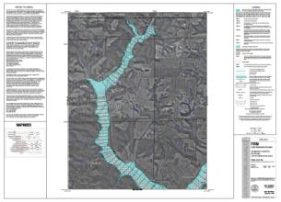
Risk MAP Products
Regulatory Products: Products used for floodplain management and insurance purposes, as part of the National Flood Insurance Program (NFIP).
Flood Insurance Rate Maps (FIRM’s)
 | Flood Insurance Study (FIS)
Notes:
Bob
Explain that there are different sets of products, one is regulatory and ties to insurance, the other is non-regulatory and is focused on flood risk information.

Slide 8
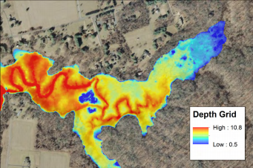
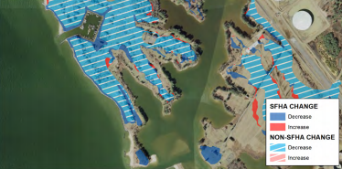
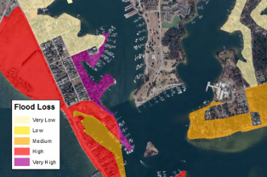
Risk MAP Products
Flood Risk Products: Non-regulatory resources that supplement the regulatory products to view and understand local flood risk.
 | Flood Depth and Analysis Grids
Changes Since Last FIRM
 | Risk Assessments
Notes:
Bob
Provide examples on how to use the data at the community level.

Slide 9
Risk MAP Products
Flood Risk Map
Illustrate an overall picture of flood risk
Flood Risk Report
Explains the concept of flood risk
Identifies useful tools and reference materials
Flood Risk Database
Data for the community to incorporate into local GIS layers to visually communicate flood risk
Notes:
Bob
Be clear that the datasets and everything discussed on the two slides before are DELIVERED via these three methods. It’s not new information, but rather three different ways to deliver the info.

Slide 10
Project Timeline and Schedule
Discovery
Meeting
June 2014
Flood Risk Review Meeting
April 2016
Preliminary
Date
CCO
Meeting
LFD
Effective
Maps
Appeal
Period
90 Days
Notes:
Alison
Brief timeline. Just explain what has been done up to this point and that Bob will talk about the rest later in the presentation.

Slide 11
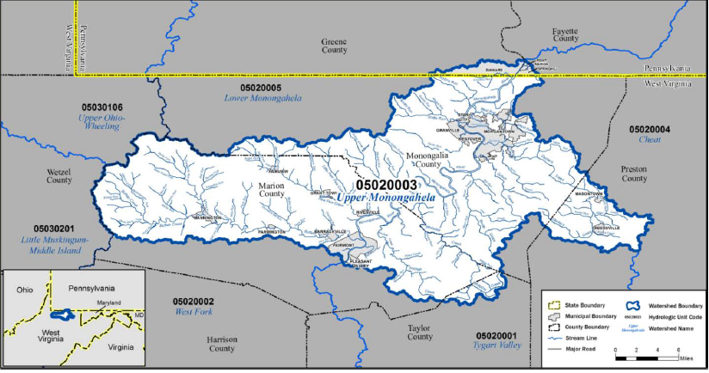
Project Extents
Upper Monongahela Watershed
NW portion of West Virginia
Small area of Southern Pennsylvania
Detailed Restudy Area within
Monongalia County
Marion County
Notes:
Ben

Slide 12
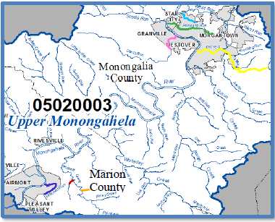
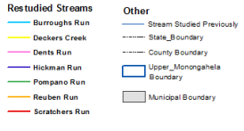
Project Extents: Detailed Restudy
Upper Monongahela Watershed
15 miles of restudy streams
Detailed Study Streams
Deckers Creek
Pompano Run
Dents Run
Hickman Run
Reuben Run
Scratchers Run
Burroughs Run
Notes:
Ben

Slide 13
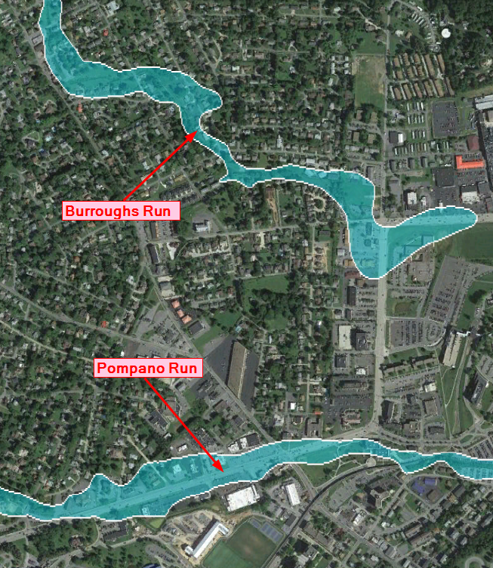
Burroughs and Pompano Runs
Notes:
Ben

Slide 14
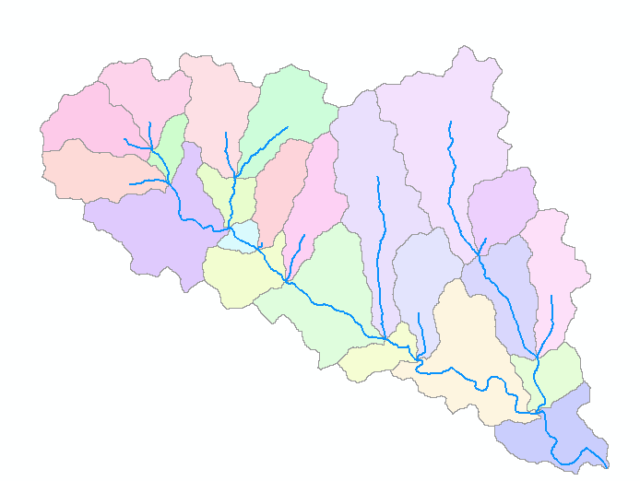
Method of Restudy: Hydrology
USGS Regression Equations
National Urban Equations
For areas that contained more than 10% impervious area
Gage Analysis
Log Pearson Type III analysis
HMS modeling
Updated existing HEC-1 models developed by City of Morgantown
Notes:
Ben

Slide 15
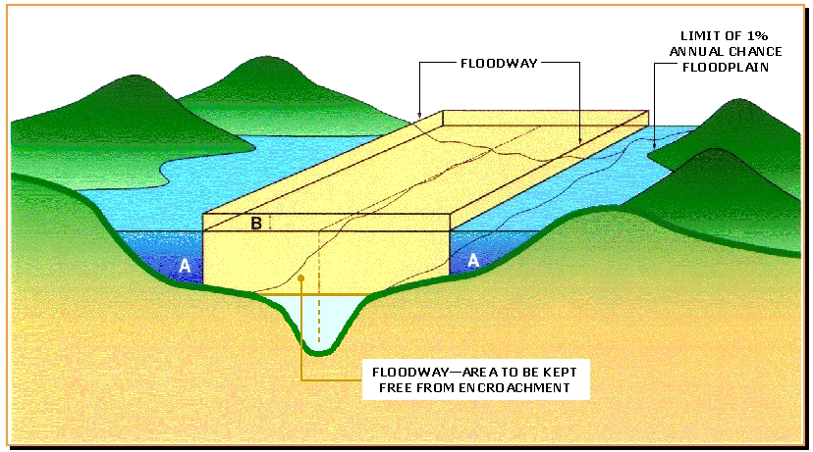
Method of Restudy: Hydraulics
HEC-RAS
Channel and Field Measurements
LiDAR
Used for overbank areas
Floodways
If applicable
Mapping
Zone AE with Base Flood Elevations
Notes:
Ben

Slide 16
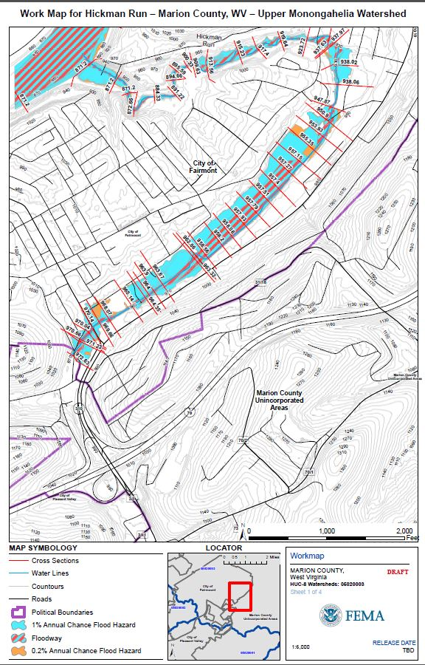
Workmap: Hickman Run
Notes:
Ben

Slide 17
Flood Risk Datasets
Flood Depth Grids Flood Analysis Grids | Whole Watershed Detailed Study Area
Changes Since Last FIRM | Detailed Study Area
Flood Risk Assessment | Whole Watershed
Notes:
Ben

Slide 18
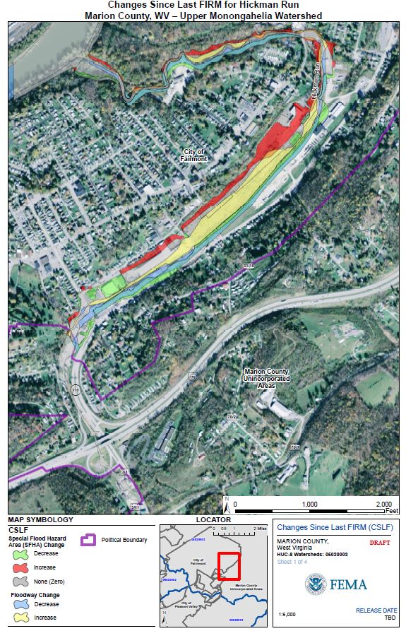
Changes Since Last FIRM: Hickman Run
Notes:
Ben

Slide 19
Project Timeline and Schedule
Discovery
Meeting
June 2014
Flood Risk Review Meeting
April 2016
Preliminary
Date
CCO
Meeting
LFD
Effective
Maps
Appeal
Period
90 Days
Notes:
Bob
When this slide came up before, Alison will talk about what has happened to this point…this slide will be to talk about what happens in the future.
If possible, give relative timeframes and descriptions for Upper Monongahela Watershed.
1) Non-regulatory products developed – Spring 2016
2) FRR Meetings – Spring 2016
3) Incorporate comments –
4) Preliminary Date –
5) CCO Meeting –
6) Appeal Period -
7) LFD -
8) Effective Date –

Slide 20
Flood Risk Products
Flood Risk Map
Illustrate an overall picture of flood risk
Flood Risk Report
Explains the concept of flood risk
Identifies useful tools and reference materials
Flood Risk Database
Data for the community to incorporate into local GIS layers to visually communicate flood risk
Notes:
Bob

Slide 21
Map Service Center
www.msc.fema.gov
Notes:
Bob

Slide 22
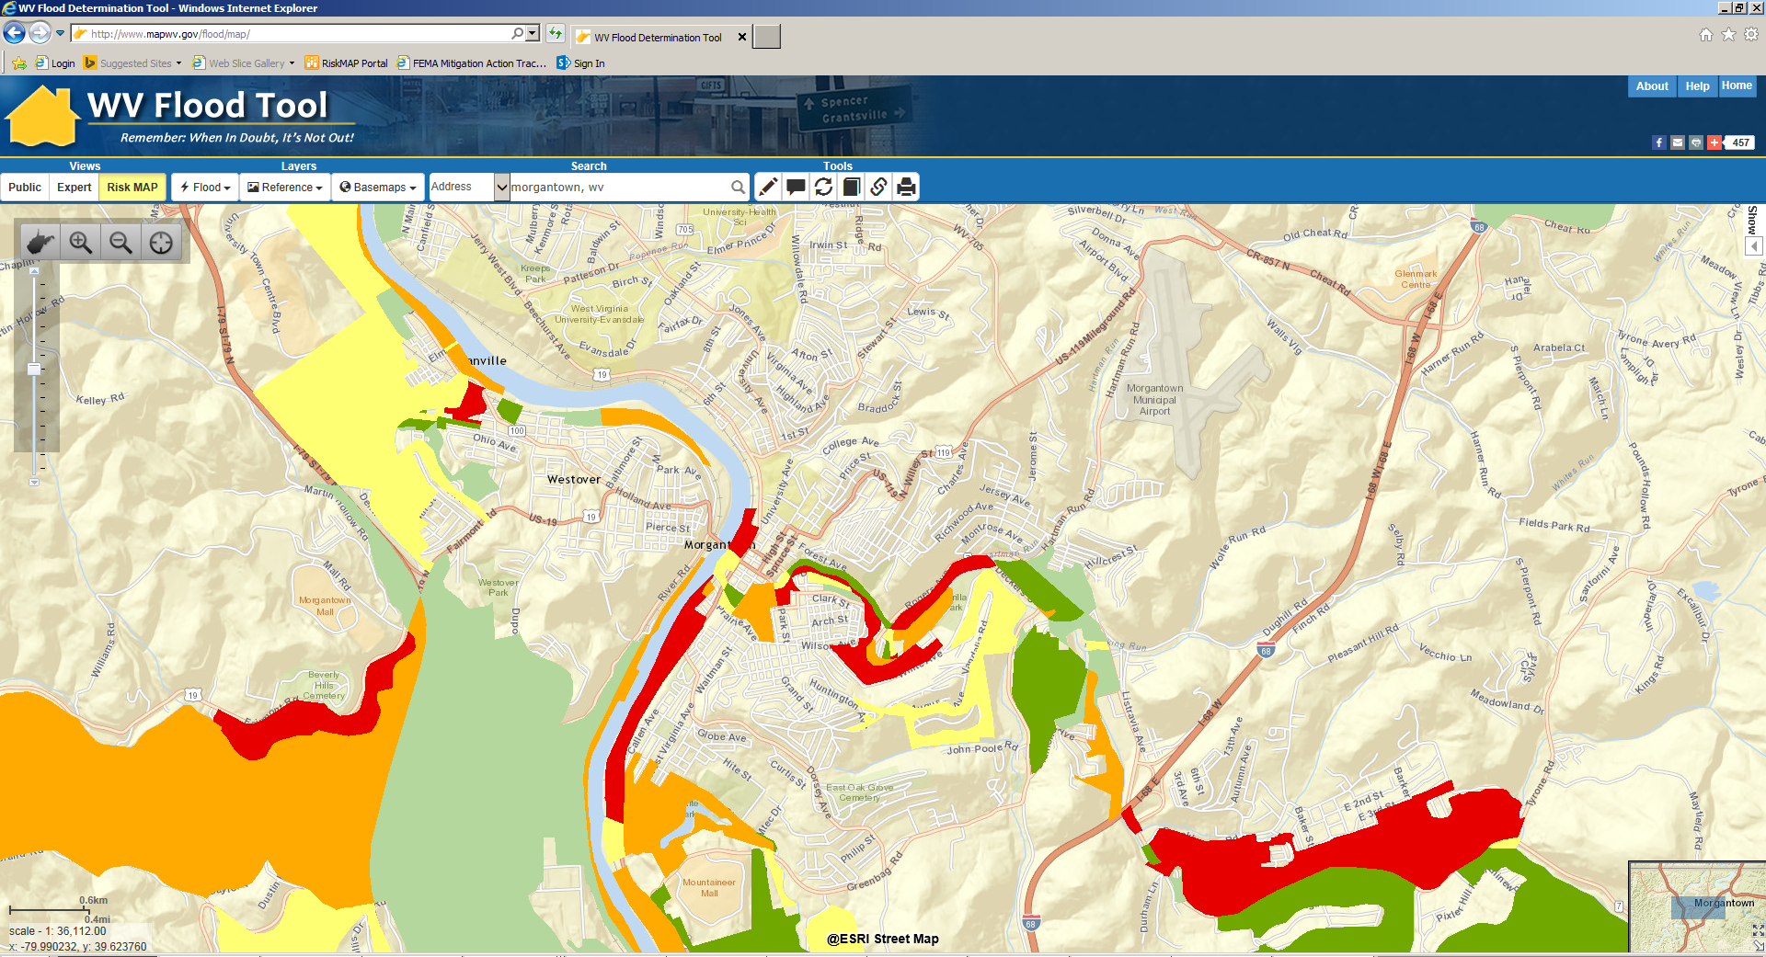
West Virginia Flood Tool
www.mapwv.gov/flood/map
Notes:
Bob, then WVU Representative

Slide 23
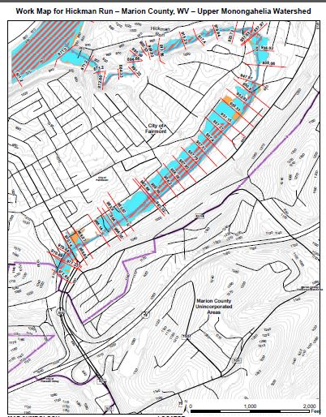
Work Session
Review floodplain mapping and flood risk products for validity.
Computer and printed map stations available.
Ask questions!
Send any feedback to
Ben Kaiser at benjamin.kaiser@aecom.com
Bob Pierson at robert.pierson@fema.dhs.gov
Notes:
Bob
When is the last day they can provide feedback?

Slide 24
Notes:
Bob

