Slide 1
Flood Risk Analysis - Hazus
Hazus is a geographic information system-based natural hazard analysis tool developed and freely distributed by the Federal Emergency Management Agency (FEMA)

Slide 2
Flood Risk Analysis

Slide 3
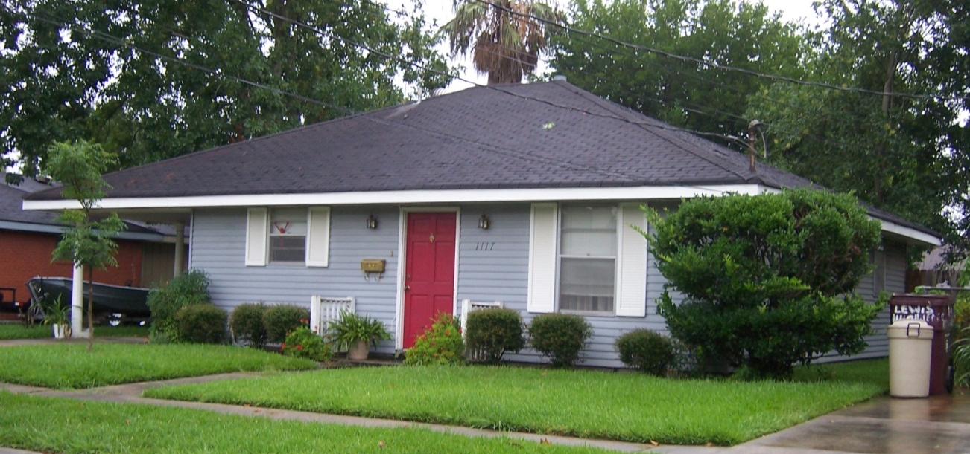
Building Definition
CRS Manual Page 300-4
301.a Definition of “Building”
2 or more exterior walls and a roof affixed to a site
Manufactured (mobile) home
Travel trailer without wheels

Slide 4
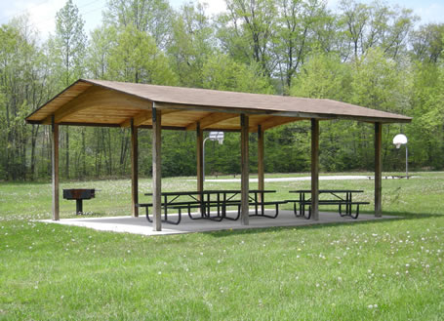
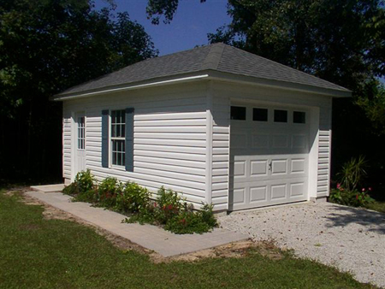
Not a Building
CRS Manual Page 300-5
“Not a Building”
Open pavilions, carports, underground pump stations, trailers, etc. are not buildings
Accessory structures are not counted

Slide 5
Building Identification Questions
Building Category
Identify as a building or accessory structure
Flood-Risk Structure
Is building footprint in floodplain?
Does building point need to be pinpointed in floodplain?
Building Elevated
Has structure been elevated? What is the estimated first floor height? View SteetView imagery.
Individual Building Value $$
What is individual building value for multiple structures on a parcel. Review assessment records.
Bad Resource Data (imagery, parcels, addresses, etc.)
Validated by whom and when

Slide 6
Resource Toolkit
Building Identification Resource Layers
Imagery
Top Down (Best Leaf Off, 2018 NAIP, Commercial)
Oblique
Street View (Esri, Bing)
Parcels
Property Lines
Assessment Records (building identification, value, owner name, address)
Site Addresses
Building Footprints
Floodplain Boundaries

Slide 7
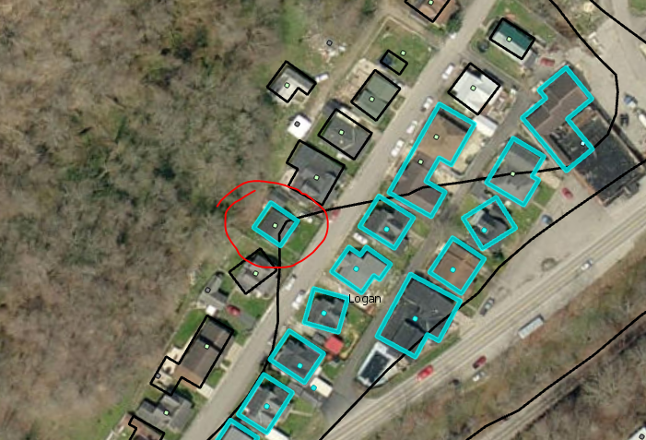
Building Identification - Issues
Site address centroid not in the floodplain but building footprint is
https://www.mapwv.gov/flood/map/?wkid=102100&x=-9132529&y=4555837&l=13&v=1

Slide 8
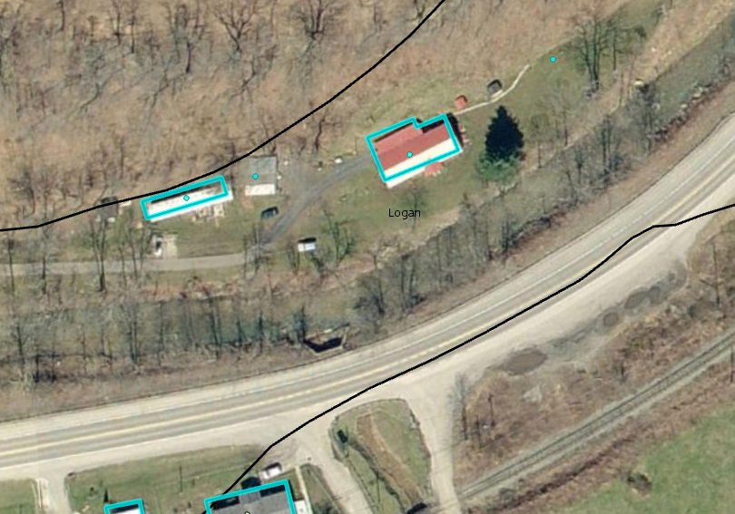
Building Identification - Issues
2. Site point with no building in imagery
3. Site address accessory structures
https://www.mapwv.gov/flood/map/?wkid=102100&x=-9105243&y=4549177&l=12&v=1

Slide 9
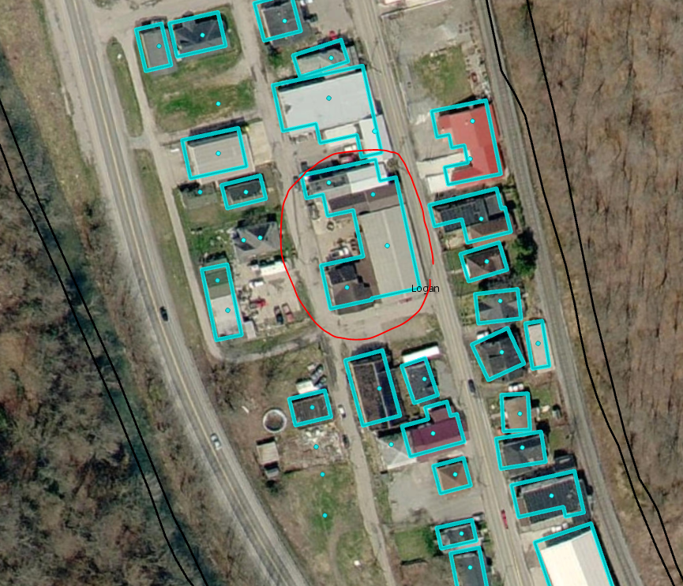
Building Identification - Issues
4. Buildings in close proximity or under canopy combined into single building footprint
https://www.mapwv.gov/flood/map/?wkid=102100&x=-9129149&y=4557222&l=12&v=1

Slide 10
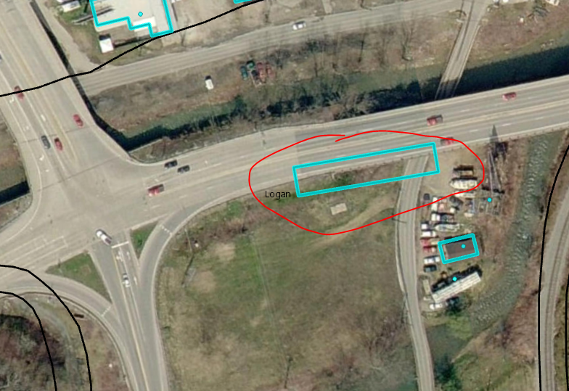
Building Identification - Issues
5. Building footprint but no building on the imagery
https://www.mapwv.gov/flood/map/?wkid=102100&x=-9129214&y=4557668&l=12&v=1

Slide 11
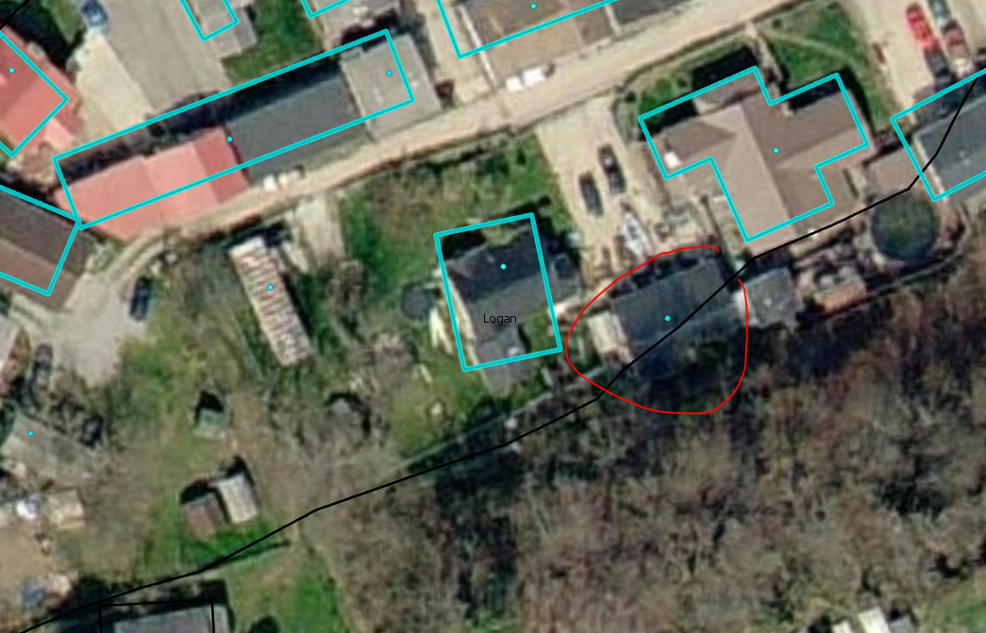
Building Identification - Issues
6. Building with no footprint
https://www.mapwv.gov/flood/map/?wkid=102100&x=-9130145&y=4557438&l=12&v=1

Slide 12
Logan County Building Count
Table 1: Buildings in Floodplain (bSF) for Logan County, WV
 | Logan Unincorporated | Logan Municipality | County Total
Building (Site Address) count | 5734 | 232 | 5966
Building Footprint count | 4678 | 247 | 4925
Average of Site and Footprint counts* | 5206 | 240 | 5446
*A visual check of random locations reveals that site address points overestimate and building footprints underestimate building counts (E.g.: Multiple site addresses in a single footprint, or missing footprints where buildings are observed in aerial imagery). So we take an average of the two values.

Slide 13
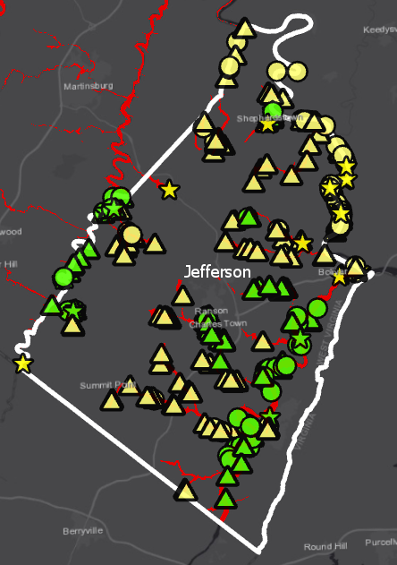
Jefferson County Mapping
** PRODUCTS **
Updated AE Boundary
100-YR Depth Grid
Building Count and Floodplain Area comparisons for effective and non-regulatory (Advisory A/Updated AE) floodplains
Only Effective A Zone
Both Effective & Advisory A
Only Advisory A
Only Effective AE Zone
Both Effective & Updated AE
Only Updated AE
Notes:
Size we need

Slide 14
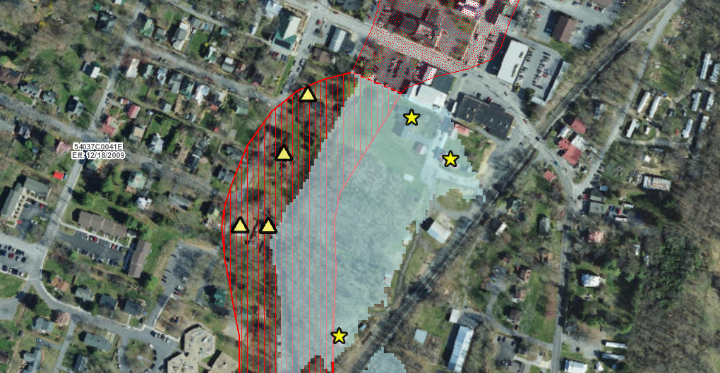
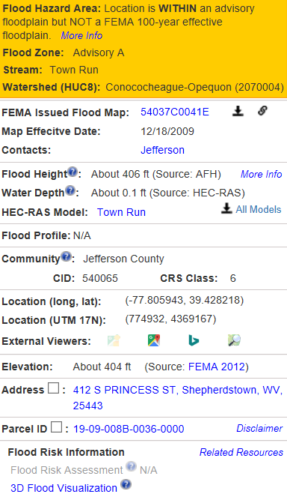
★
Structures WITHIN Advisory Zone A ( ) but not Effective A
Building in Advisory A Zone and not Effective A Zone
Address: 427 S PRINCESS ST, Shepherdstown, WV, 25443
https://www.mapwv.gov/flood/map/?wkid=102100&x=-8661318&y=4783197&l=10&v=1

Slide 15
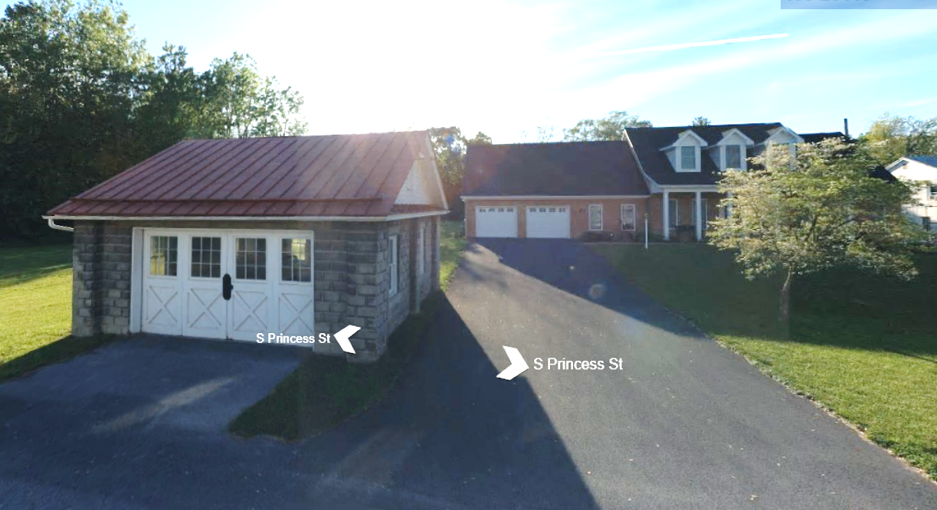
Structures WITHIN Advisory Zone A (Street View)
Address: 427 S PRINCESS ST, Shepherdstown, WV, 25443
https://binged.it/2kXqgfw
Building in Advisory A Zone and not Effective A Zone

Slide 16
Advisory A Zones – Outreach Information
R
▲
Effective IN and Advisory A OUT
▲
▲
●
▲
★
Effective OUT and Advisory A IN
★
Both Effective
& Advisory
(No Change)
Effective Regulatory Floodplain
Advisory A Floodplain
Union | Meaning | Building Changes | Area Changes | Percentage
No Change | IN both Effective and Advisory A | 163 | 3,289 Acres | 54.3%
Advisory A Only | Effective OUT and Advisory A IN | 46 | 242 Acres | 4%
Effective Only | Effective IN and Advisory A OUT | 156 | 2,531 Acres | 41.7%
●
★
▲
The geographic union of Effective and Advisory Floodplains generates a change polygon for flood risk analysis by area. Subsequently the union polygon can be intersected with site-specific structures to analyze the impact of the Advisory Floodplain changes to the Effective Regulatory Floodplain.
Notes:
intercept=erase

Slide 17
Preliminary Building Counts
Jefferson County
100-YR Flood (High Flood Risk)
 | (A) |  | (B) | (A+B) | (C) | (B+C) | (A+B)-(B+C)
FLOOD ZONE | ONLY Effective |  | BOTH Effective & Advisory A | SUM Effective | ONLY Advisory A | SUM Advisory A | Net
Approximate A Zone | 156 |  | 163 | 319 | 46 | 209 | 110
 | (A) |  | (B) | (A+B) | (C) | (B+C) | (A+B)-(B+C)
FLOOD ZONE | ONLY Effective |  | BOTH Effective & Update AE | SUM Effective | ONLY Updated AE | SUM Updated AE | Net
Detailed AE Zone | 229 |  | 122 | 351 | 16 | 138 | 213
500-YR Flood (Moderate Flood Risk)
500-YR |  |  |  | 45
The flood at-risk buildings need to be verified 1) if they are primary or accessory structures; And 2) if on the edge of the flood zone

Slide 18
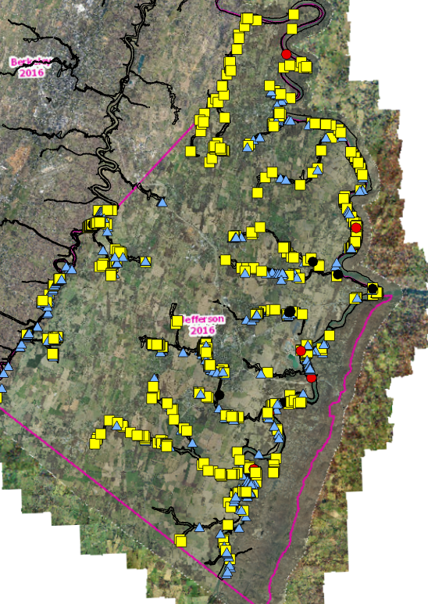
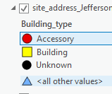
Jefferson County Pilot
Primary building identification preview in Jefferson county

Slide 19
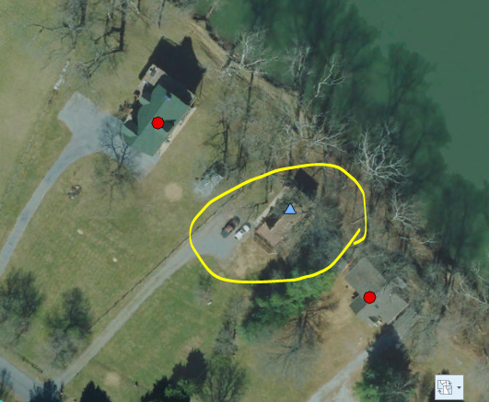
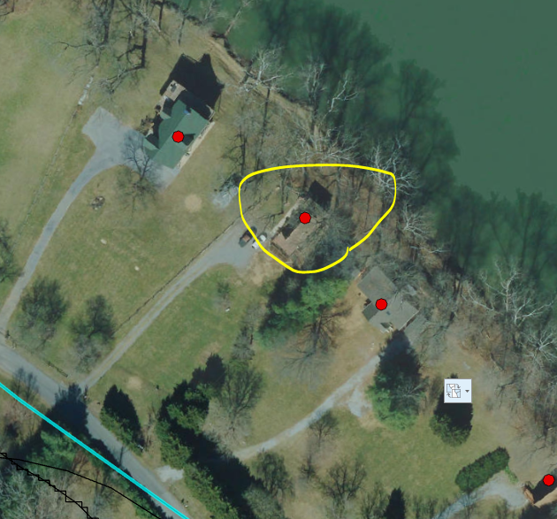
Jefferson County Pilot
Before
After
https://www.mapwv.gov/flood/map/?wkid=102100&x=-8664125&y=4753054&l=12&v=1

Slide 20
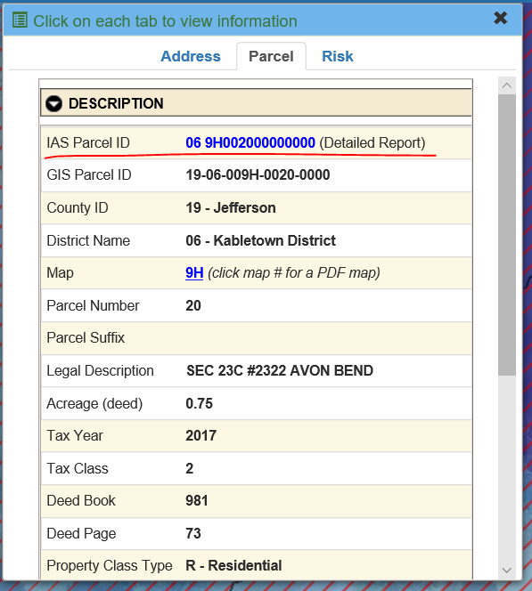
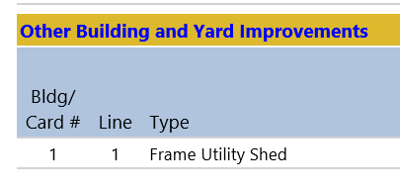
Jefferson County Pilot

