Slide 1
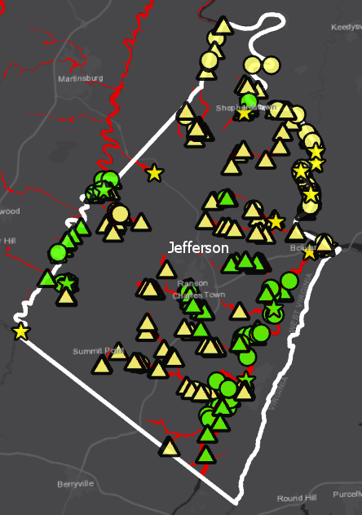

Jefferson county Overview
Only Effective A Zone
Both Effective & Advisory A
Only Advisory A
Only Effective AE Zone
Both Effective & Advisory AE
Only Updated AE
Notes:
Size we need

Slide 2
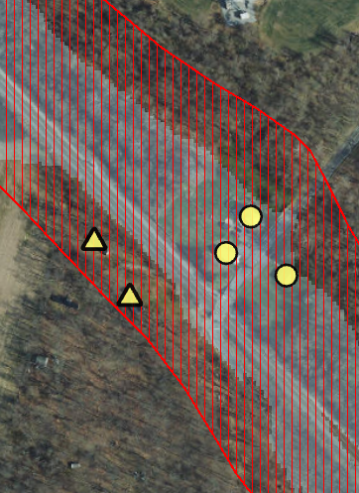
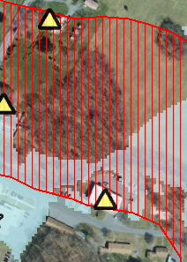
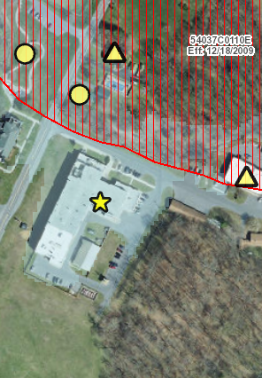
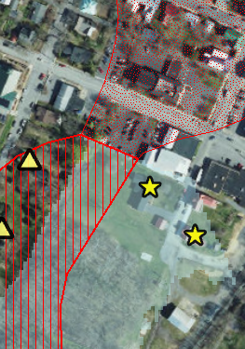
A Zones
Parcel ID: 19-09-0024-0015-0000
Parcel ID: 19-07-0011-0009-0000
Parcel ID: 19-07-0011-0009-0000
Parcel ID: 19-09-008B-0036-0000
Structures ▲ are WITHIN a FEMA 100-year effective floodplain but NOT an Advisory A Floodplain Boundary .
Structures ★ are WITHIN an Advisory A Floodplain Boundary but NOT a FEMA 100-year effective floodplain.
Only Effective A Zone
Both Effective & Advisory A
Only Advisory A
Notes:
Size we need

Slide 3
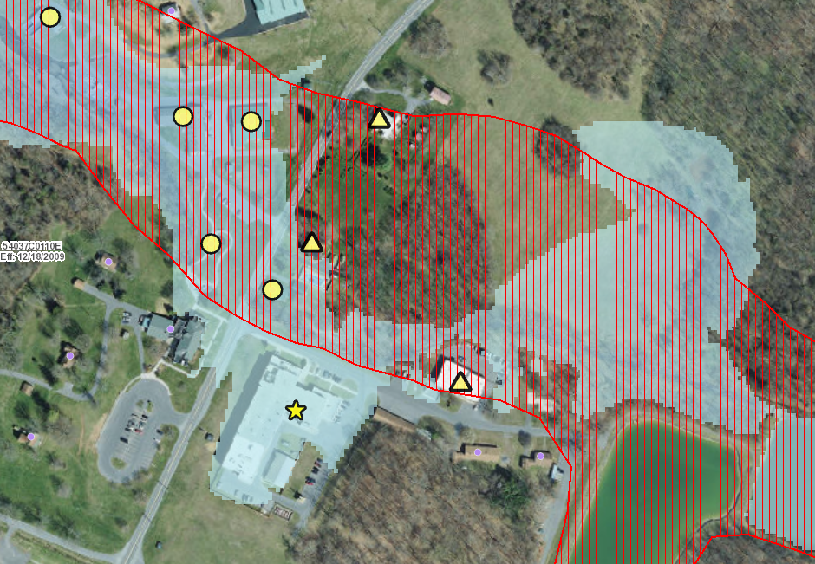
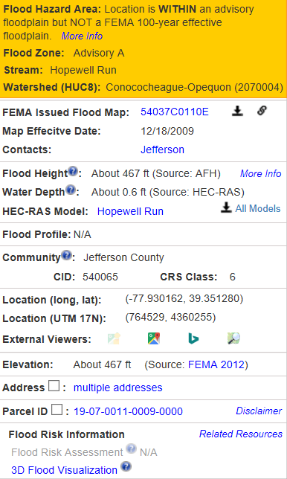
A Zones
Address: 407 RESERVOIR RD, Kearneysville, WV, 25430
https://www.mapwv.gov/flood/map/?wkid=102100&x=-8675146&y=4772115&l=11&v=1

Slide 4
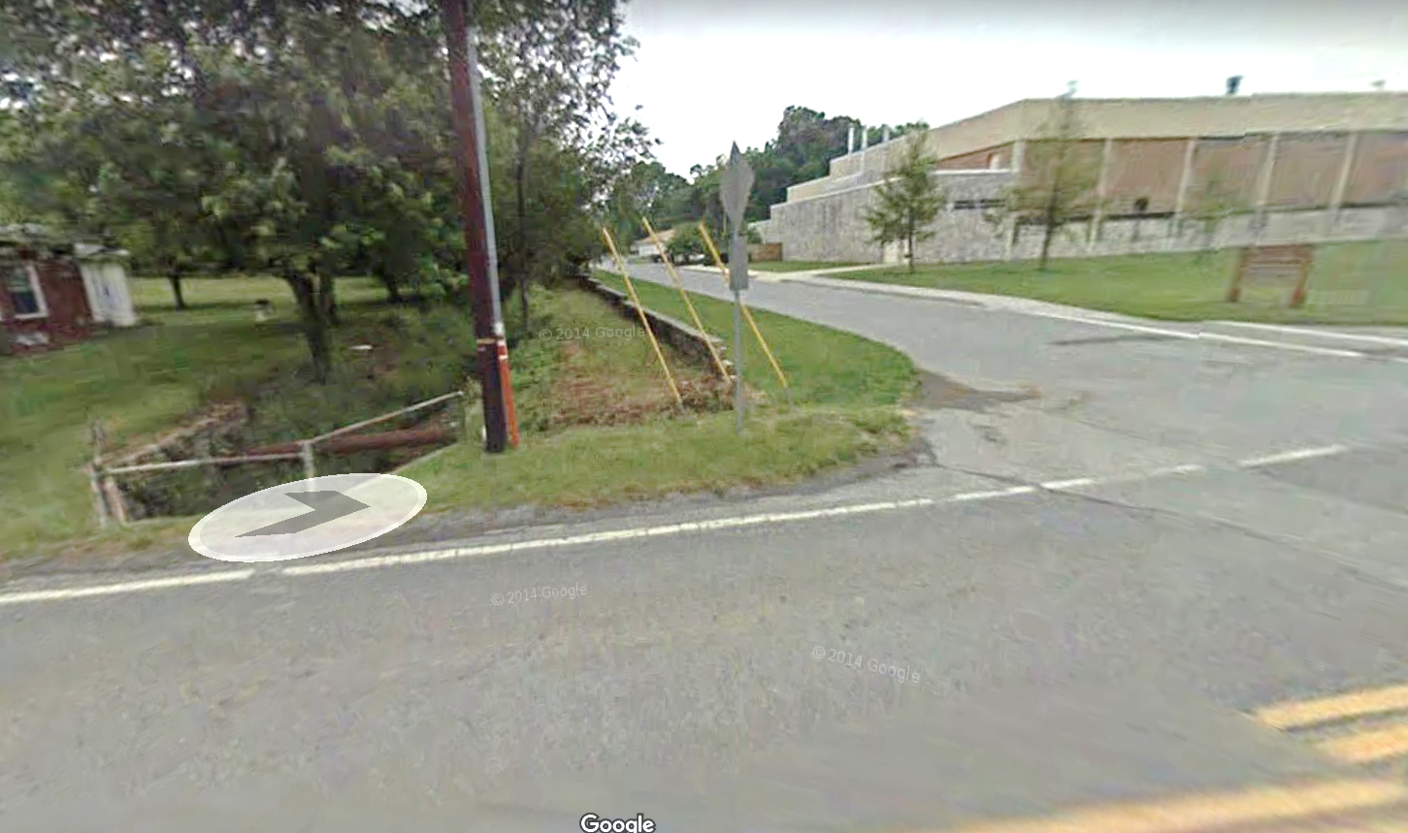
A Zones
Parcel ID: 19-07-0011-0009-0000
Address: 407 RESERVOIR RD, Kearneysville, WV, 25430
https://www.mapwv.gov/flood/map/?wkid=102100&x=-8675146&y=4772115&l=11&v=1

Slide 5
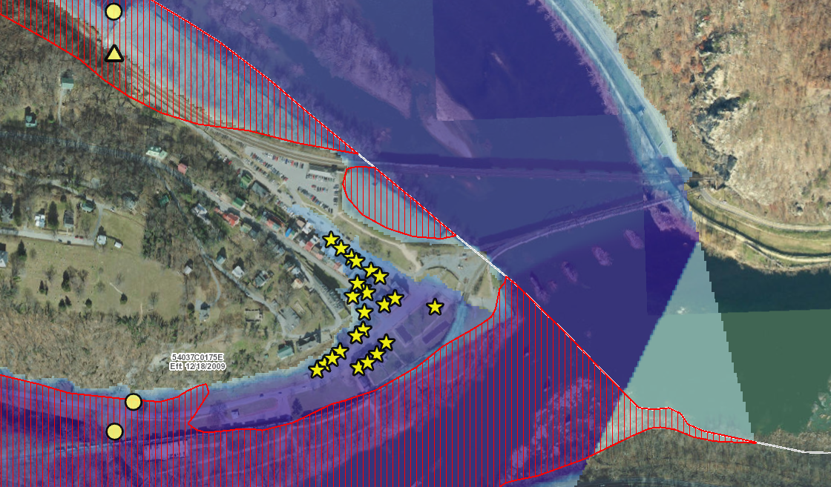
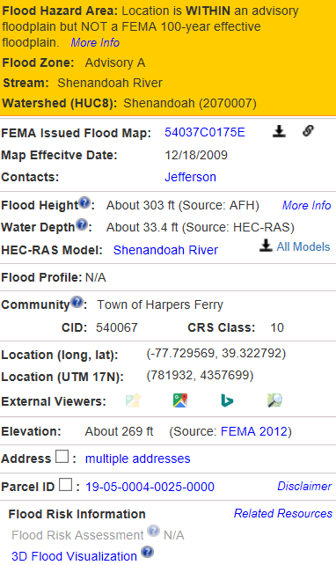
Advisory A Only Clusters
Address: Harpers Ferry National Historical Park
https://www.mapwv.gov/flood/map/?wkid=102100&x=-8652810&y=4768018&l=12&v=1
Notes:
Size we need

Slide 6
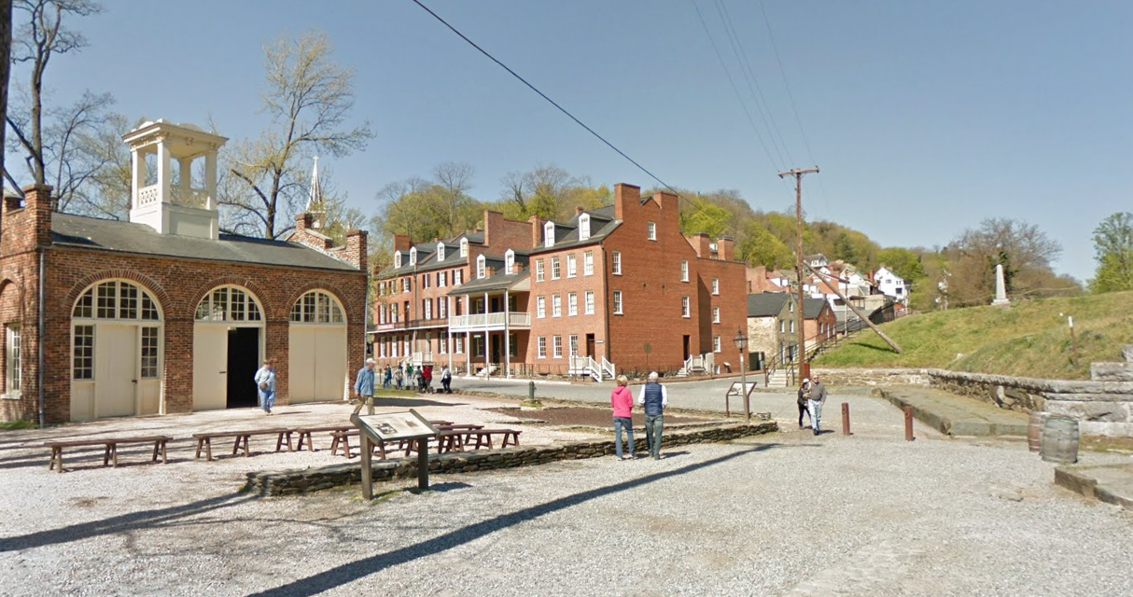
Advisory A Only Clusters Street View
Google Street View
Address: Harpers Ferry National Historical Park
https://www.mapwv.gov/flood/map/?wkid=102100&x=-8652810&y=4768018&l=12&v=1
Notes:
Size we need

Slide 7

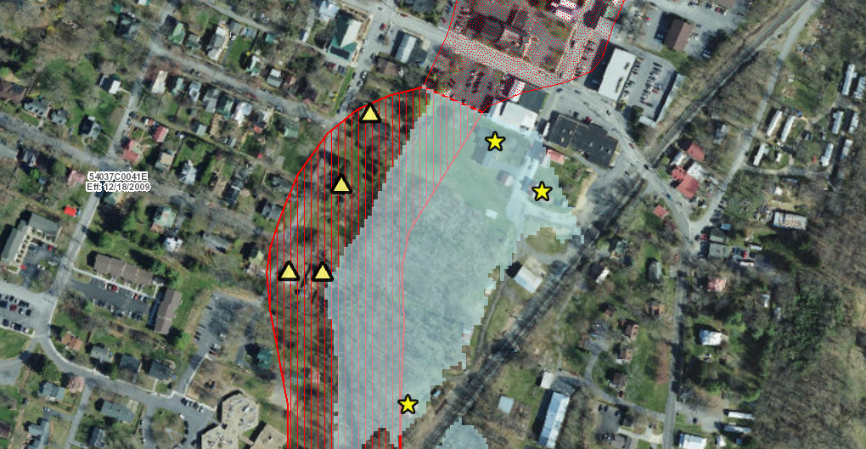
Structures WITHIN Advisory Zone A while NOT in FEMA
Address: 427 S PRINCESS ST, Shepherdstown, WV, 25443
https://www.mapwv.gov/flood/map/?wkid=102100&x=-8661318&y=4783197&l=10&v=1

Slide 8
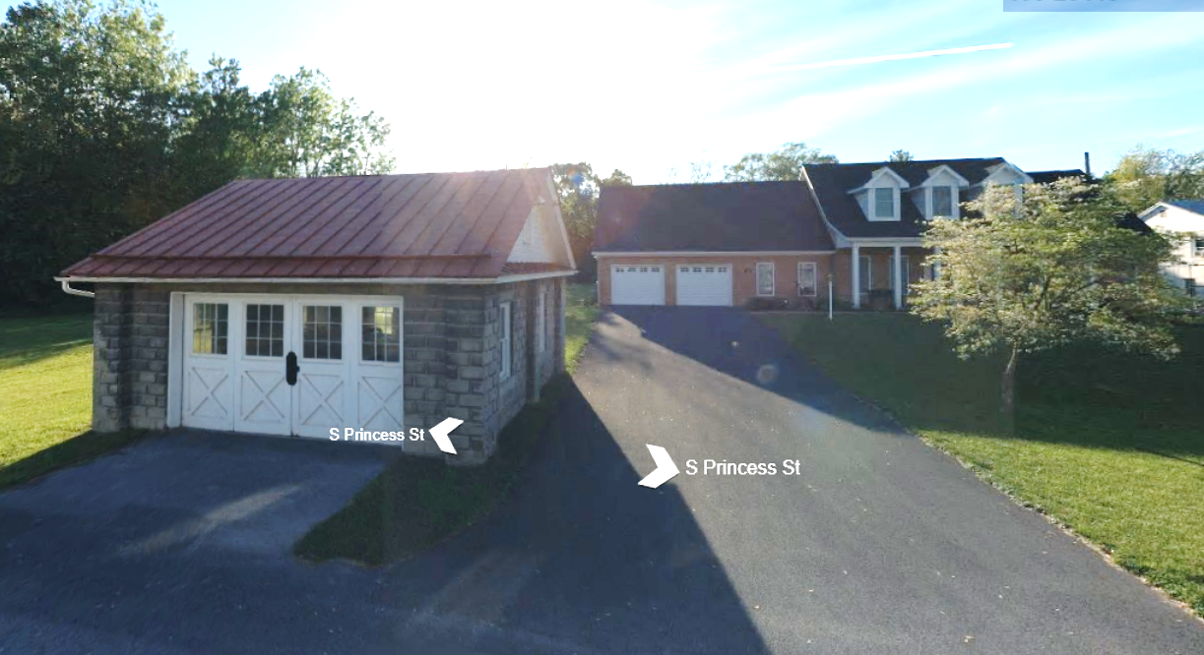
Structures WITHIN Advisory Zone A Street View
Addreass: 427 S PRINCESS ST, Shepherdstown, WV, 25443
https://binged.it/2kXqgfw

Slide 9
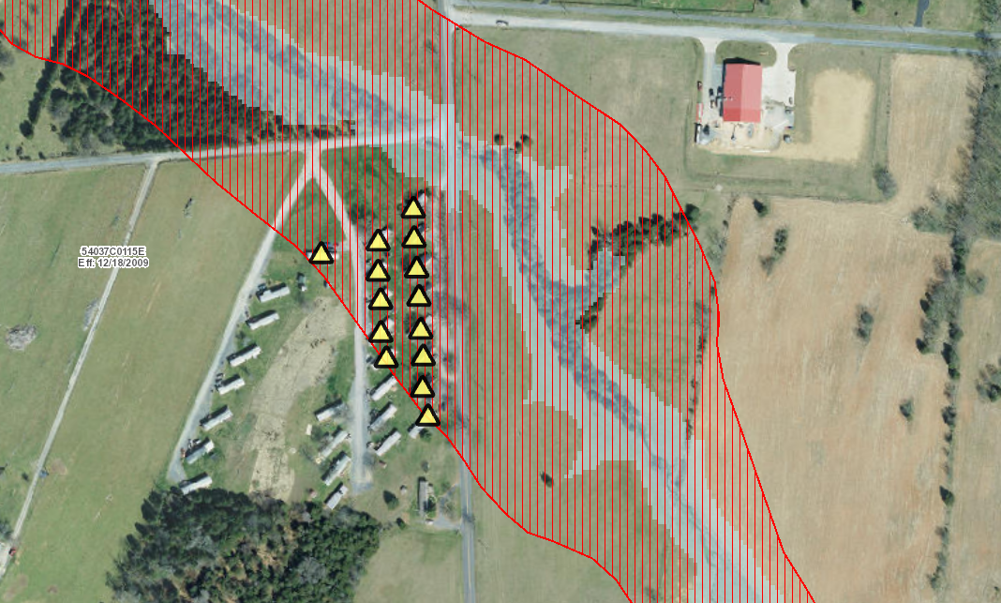
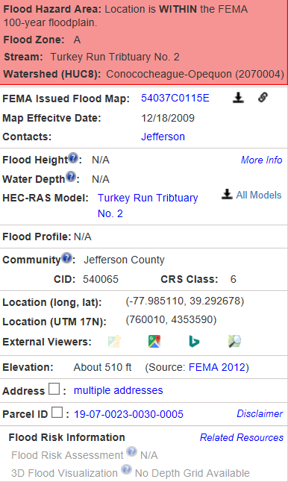
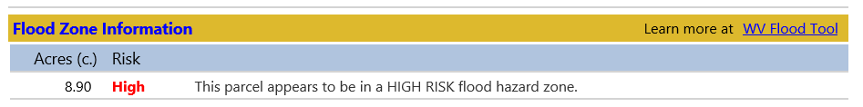
Effective Zone A Clusters
Address: JEAN LEIGHT LN, Kearneysville, WV, 25430
https://www.mapwv.gov/flood/map/?wkid=102100&x=-8681263&y=4763682&l=11&v=1
Notes:
Size we need

Slide 10
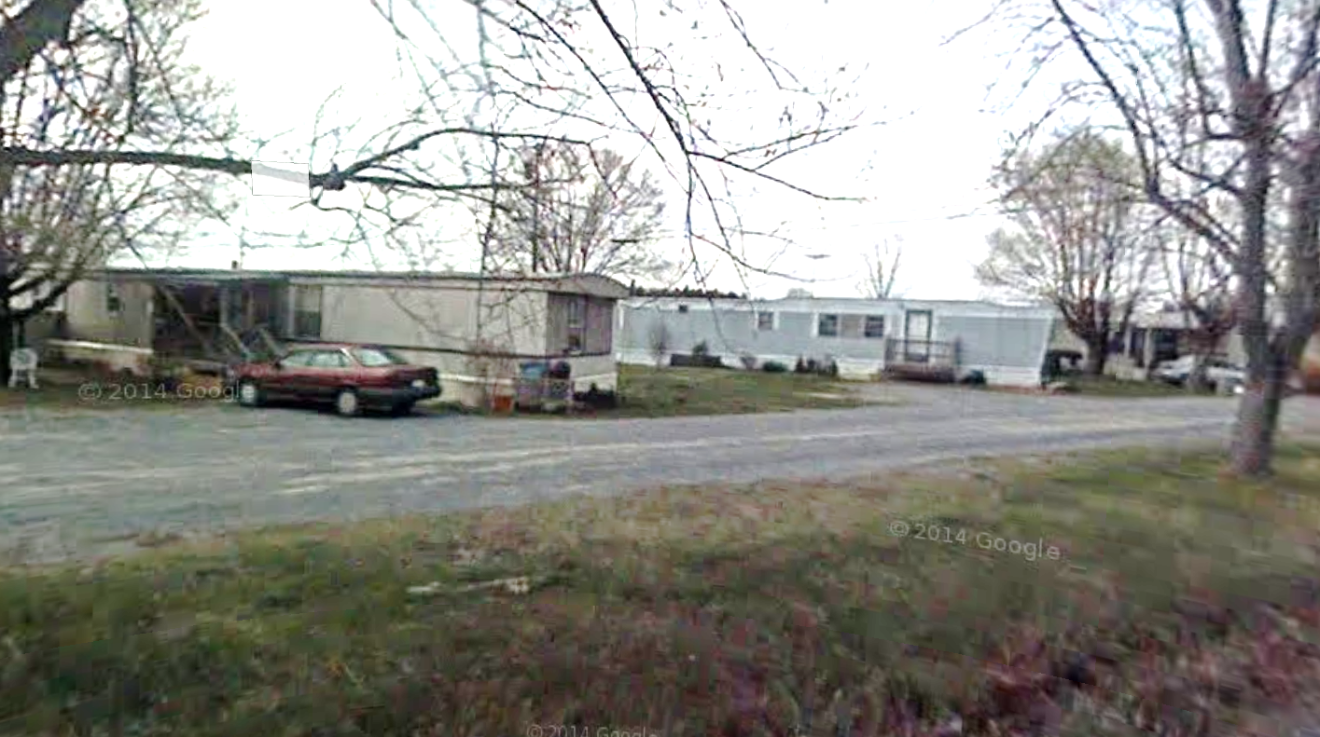
Effective Zone A Clusters Street View
Address: JEAN LEIGHT LN, Kearneysville, WV, 25430
https://www.mapwv.gov/flood/map/?wkid=102100&x=-8681263&y=4763682&l=11&v=1
Notes:
Size we need

Slide 11
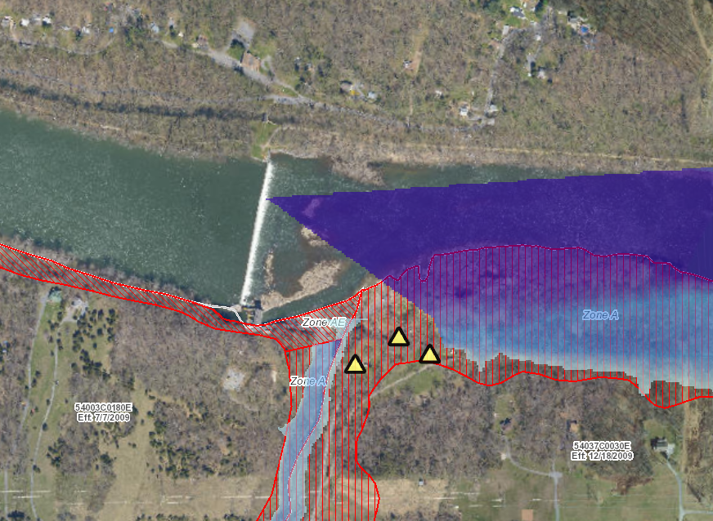
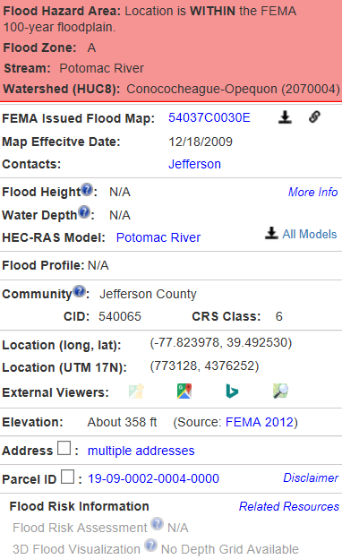
Structures WITHIN FEMA while NOT in Advisory A
119 ACKERMANN LN, Shepherdstown, WV, 25443
https://www.mapwv.gov/flood/map/?wkid=102100&x=-8663322&y=4792469&l=10&v=1

Slide 12
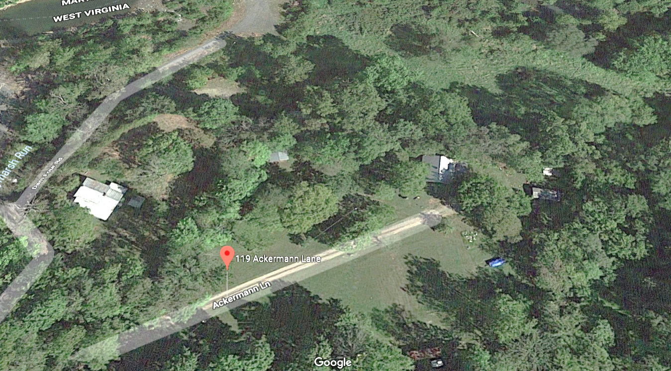
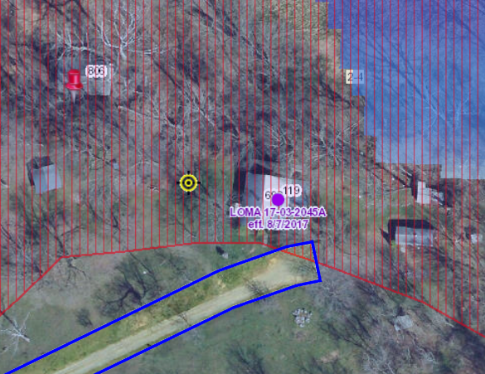
Effective A Only Street View
119 ACKERMANN LN, Shepherdstown, WV, 25443
https://www.mapwv.gov/flood/map/?wkid=102100&x=-8663323&y=4792473&l=12&v=1

Slide 13
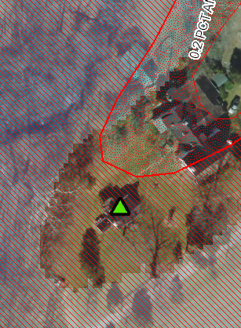
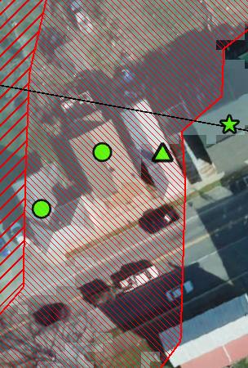
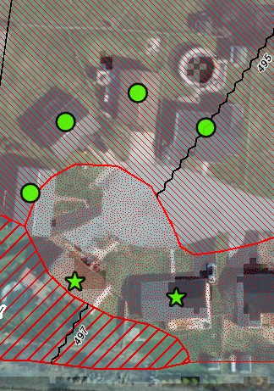
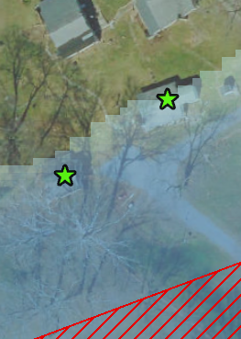

AE Zones
Parcel ID: 19-06-0022-0011-0001
Parcel ID: 19-03-0001-0187-0000
Parcel ID: 19-08-0006-0220-0000
Parcel ID: 19-02-019A-0050-0000
Structures ▲are WITHIN a FEMA 100-year effective floodplain but NOT an Updated AE Floodplain Boundary .
Structures ★ are WITHIN an Updated AE Floodplain Boundary but NOT a FEMA 100-year effective floodplain.
Only Effective AE Zone
Both Effective & Advisory AE
Only Updated AE
Notes:
Size we need

Slide 14
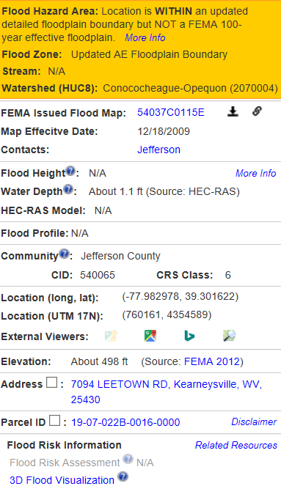
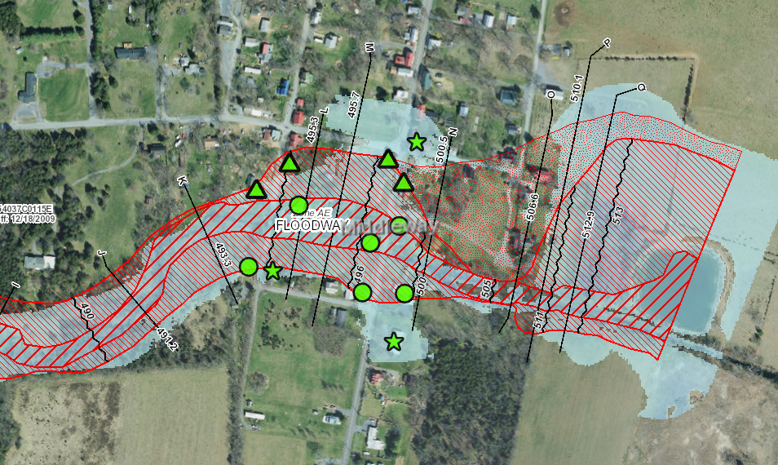
AE clusters
Address: 7094 LEETOWN RD, Kearneysville, WV, 25430
https://www.mapwv.gov/flood/map/?wkid=102100&x=-8681028&y=4764981&l=12&v=1
Notes:
Size we need

Slide 15
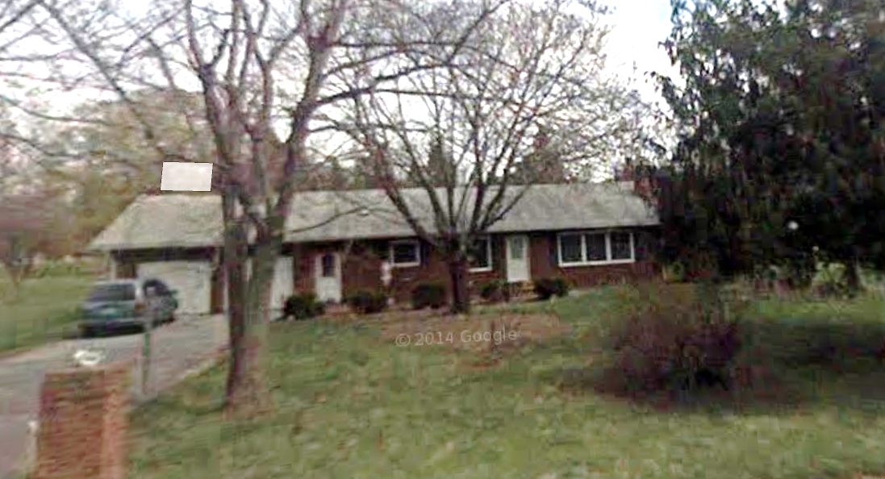
AE clusters
Address: 7094 LEETOWN RD, Kearneysville, WV, 25430

Slide 16

Advisory A Zones – Outreach Information
R
Effective IN and Advisory A OUT
Effective OUT and Advisory A IN
Both Effective
& Advisory
(No Change)
Effective Regulatory Floodplain
Advisory A Floodplain
Union | Meaning | Building Changes | Area Changes | Percentage
No Change | IN both Effective and Advisory A | 163 | 3,289 Acres | 54.3%
Advisory A Only | Effective OUT and Advisory A IN | 46 | 242 Acres | 4%
Effective Only | Effective IN and Advisory A OUT | 156 | 2,531 Acres | 41.7%
●
★
▲
The geographic union of Effective and Advisory Floodplains generates a change polygon for flood risk analysis by area. Subsequently the union polygon can be intersected with site-specific structures to analyze the impact of the Advisory Floodplain changes to the Effective Regulatory Floodplain.
Notes:
intercept=erase

Slide 17
Updated AE Zones – Outreach Information
R
Effective IN and Updated AE OUT
Effective OUT and Updated AE IN
Both Effective
& Updated AE
(No Change)
Effective Regulatory Floodplain
Updated AE Floodplain
Union | Meaning | Building Changes | Area Changes | Percentage
No Change | IN both Effective and Updated AE | 122 | 3,114 Acres | 82%
Updated AE Only | Effective OUT and Updated AE IN | 16 | 285 Acres | 7.5%
Effective Only | Effective IN and Updated AE OUT | 229 | 400 Acres | 10.5%
●
★
▲
The geographic union of Regulatory and Updated AE Floodplains generates a change polygon for flood risk analysis by area. Subsequently the union polygon can be intersected with site-specific structures to analyze the impact of the Updated AE Floodplain changes to the Regulatory Floodplain.

Slide 18
Preliminary Building Counts
Jefferson County
100-YR Flood (High Flood Risk)
 | (A) |  | (B) | (A+B) | (C) | (B+C) | (A+B)-(B+C)
FLOOD ZONE | ONLY Effective |  | BOTH Effective & Advisory A | SUM Effective | ONLY Advisory A | SUM Advisory A | Net
Approximate A Zone | 156 |  | 163 | 319 | 46 | 209 | 110
 | (A) |  | (B) | (A+B) | (C) | (B+C) | (A+B)-(B+C)
FLOOD ZONE | ONLY Effective |  | BOTH Effective & Update AE | SUM Effective | ONLY Updated AE | SUM Updated AE | Net
Detailed AE Zone | 229 |  | 122 | 351 | 16 | 138 | 213
500-YR Flood (Moderate Flood Risk)
500-YR |  |  |  | 45
The flood at-risk buildings need to be verified 1) if they are primary or accessory structures; And 2) if on the edge of the flood zone

