Slide 1
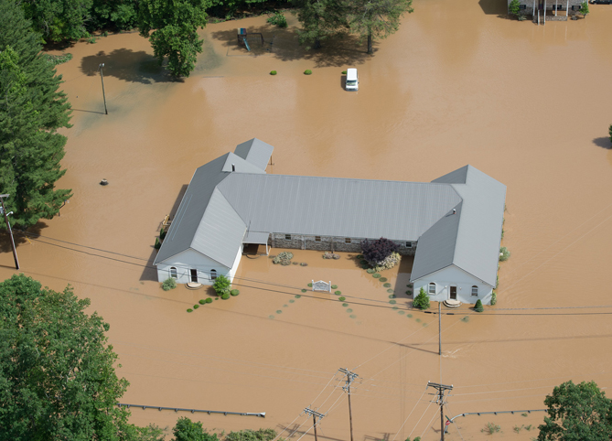
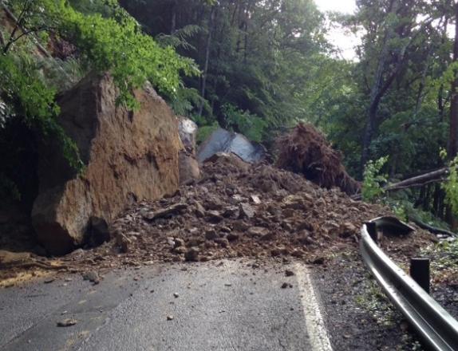
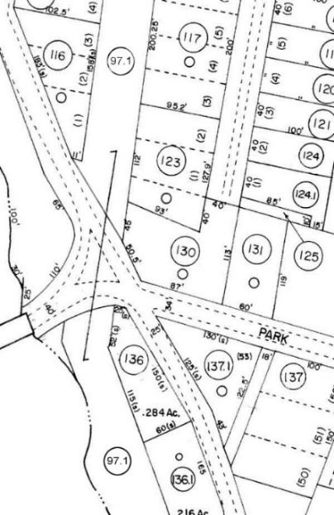
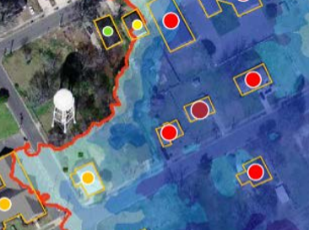
A Statewide Approach to Risk Studies Multi-Hazard Risk Assessment Proposal
Hazard Mitigation Grant Project
Floods Risk (TEIF)
Landslide Risk (TEAL)
Reference Data Development
Identify Site-Specific At-Risk Structures
Statewide
Budget Breakdown
Notes:
WV Map indicating population density

Slide 2
Statewide Hazard Assessment
FEMA/WVDHSEM Hazard Mitigation Grant
Flood Risk Assessments (287 communities)
Landslide Assessments (55 counties)
GIS Data Development (parcels, addresses, imagery)
Site-specific building-level inventories for hazard exposure and loss estimates
Technical support for (1) Local/State Hazard Mitigation Plans and for the (2) Community Rating System (CRS)

Slide 3
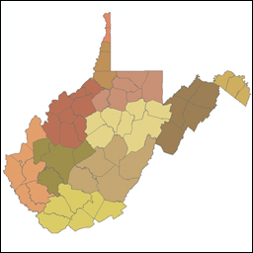
Hazard Mitigation Grant Proposal
Multi-Agency Coordination
Federal Agencies
State Agencies
Universities
Regional Councils
Local Counties
Private Companies
11 Regional Planning & Development Councils
55 Counties
287 communities

Slide 4
Statewide Hazard Assessment
(1) Flood Risk Assessments

Slide 5
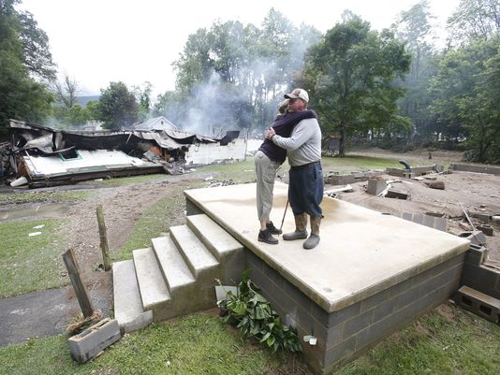
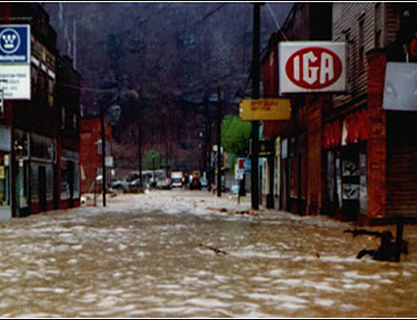
Devastating 2016 June Flood

Slide 6
2016 June Flood Report

Slide 7
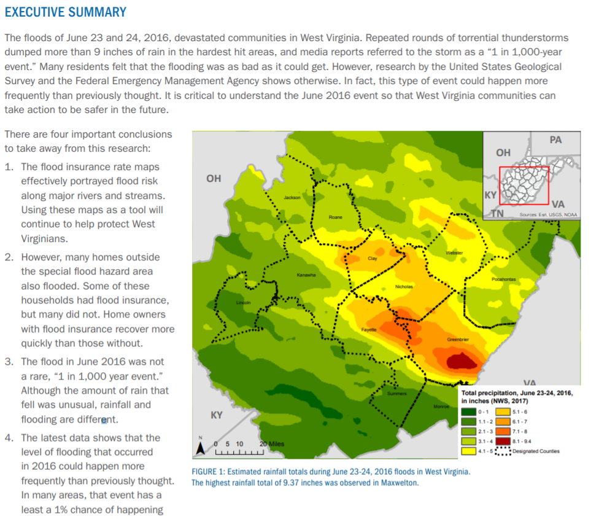
2016 June Flood Report
Joint FEMA and USGS publication
https://www.fema.gov/media-library/assets/documents/167736

Slide 8
Flood Risk Assessment
Site-Specific Flood Risk Assessment Results published on WV Flood Tool (www.mapWV.gov/Flood)
Building-Level Flood Damage Methodology: Hazus Level-2 Flood Loss

Slide 9
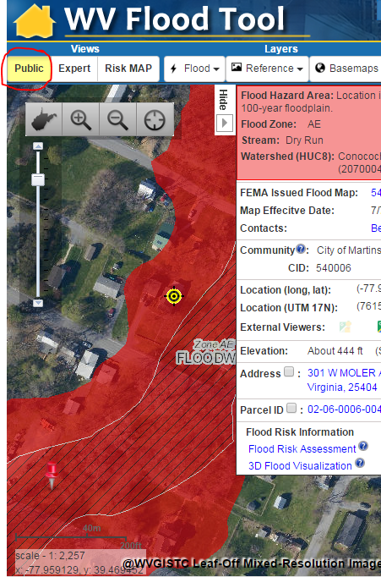
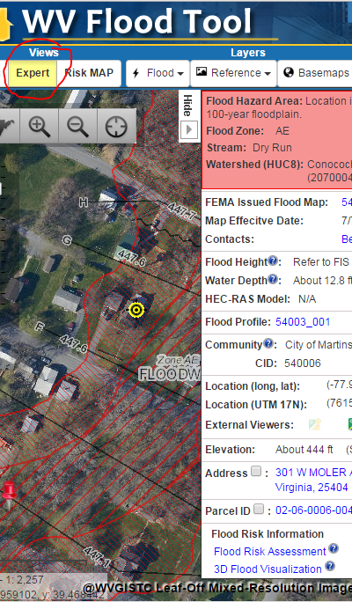
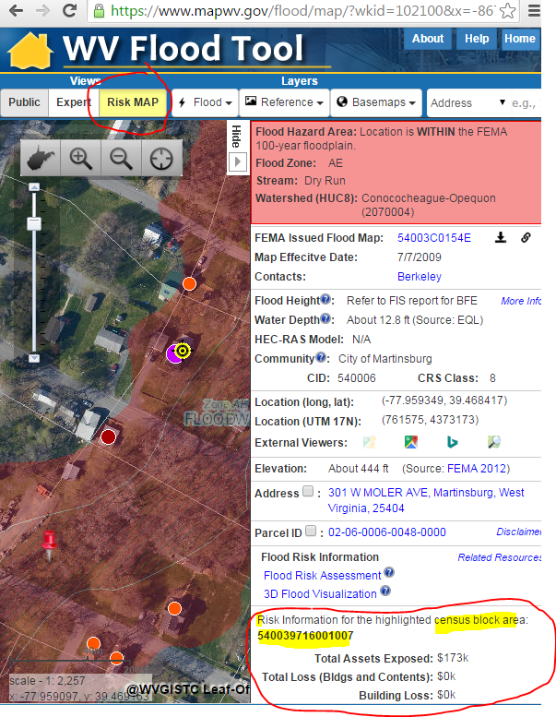
WV Flood Tool Views
Public View
Expert View
RiskMAP View
Quick Determination if IN or Out of Flood Zone
Used by Floodplain Managers to Identify Water Flood Heights
Building-Specific Flood Risk Assessments

Slide 10
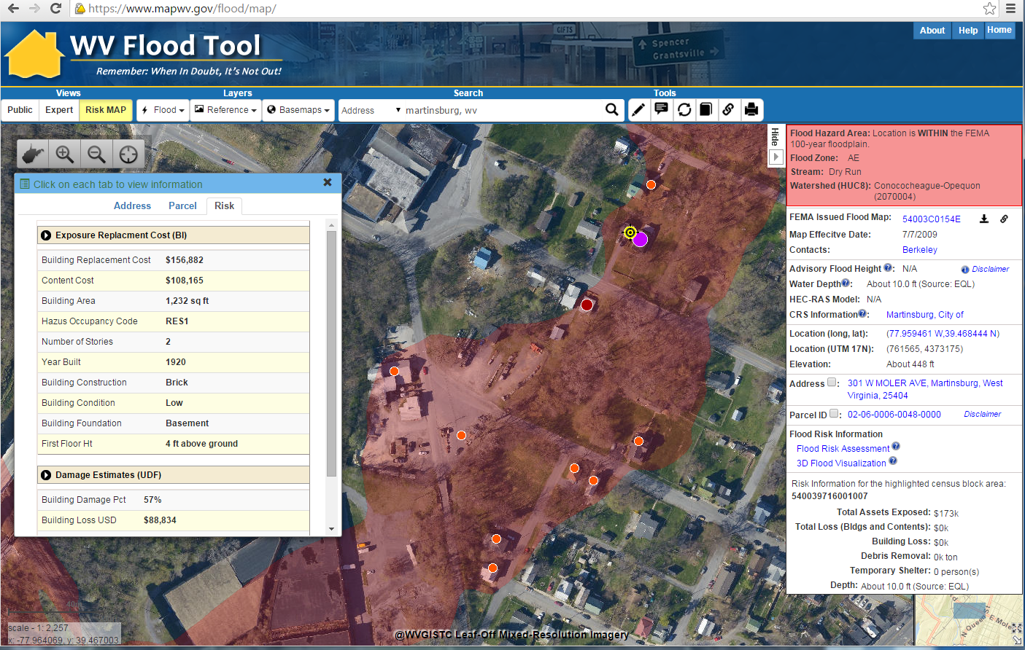
Flood Risk Structures of Martinsburg
Building Flood Loss Damage
57% of Residential Home Damaged at a Loss of $88,834
Flood Risk Building Info
Flood Risk Assessment Building Link
https://www.mapwv.gov/flood/map/?wkid=102100&x=-8678481&y=4788856&l=11&v=2
The Risk MAP view allows for viewing flood loss estimates at the building or structure level for a 1%-annual-chance flood event.

Slide 11
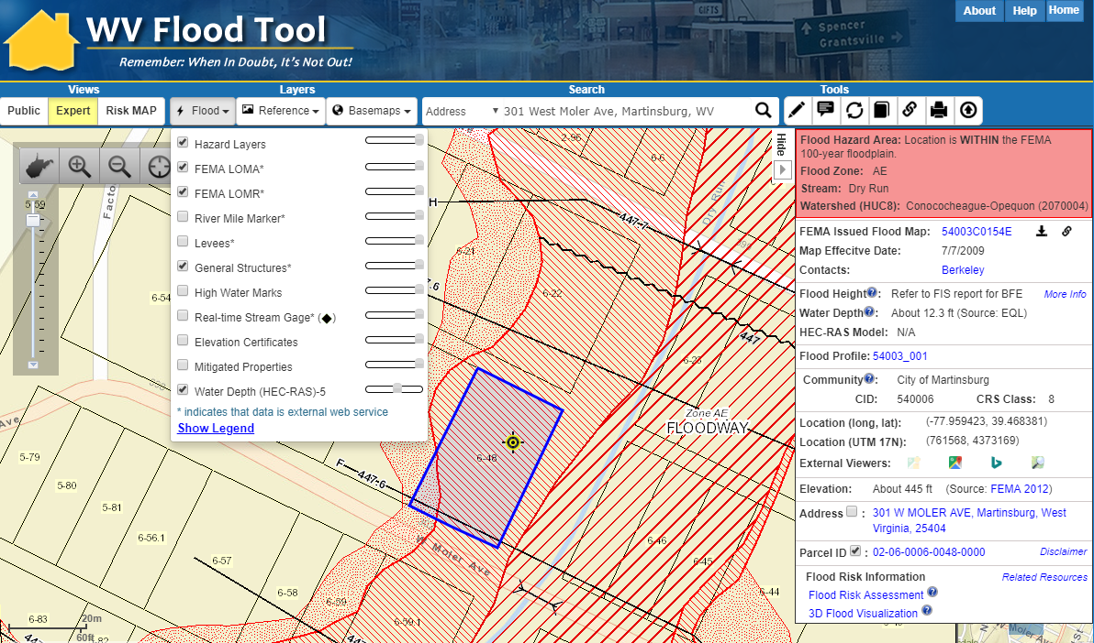
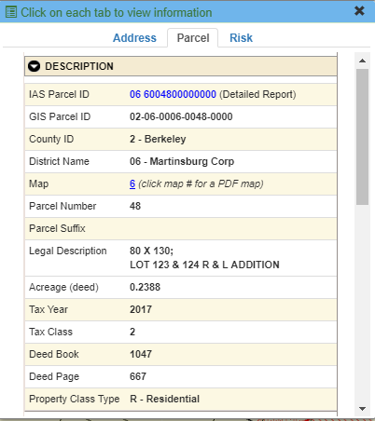
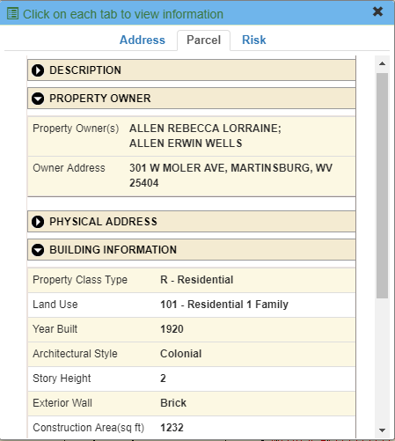
WV Flood Tool: Reporting Flood Risk
(2) Click on Parcel ID to link to Web Report
(1) Click on Parcel ID to open Parcel Tab
https://www.mapwv.gov/flood/map/?v=1&pid=02-06-0006-0048-0000

Slide 12
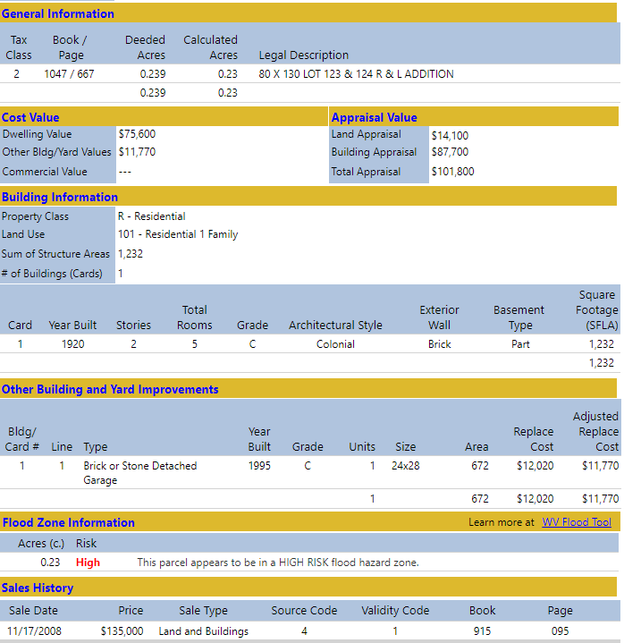
Flood Tool: Assessment Report
Detailed Property
Report
http://www.mapwv.gov/Assessment/?PID=02060006004800000000

Slide 13
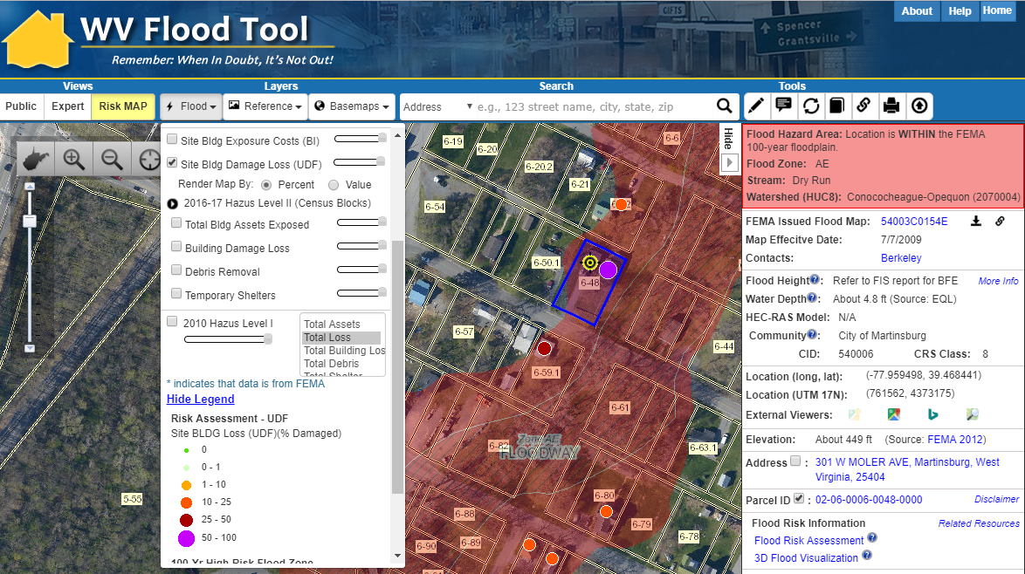
Flood Tool: RiskMAP View
Flood Risk Awareness & Mitigation Planning
https://www.mapwv.gov/flood/map/?wkid=102100&x=-8678412&y=4788996&l=11&v=2

Slide 14
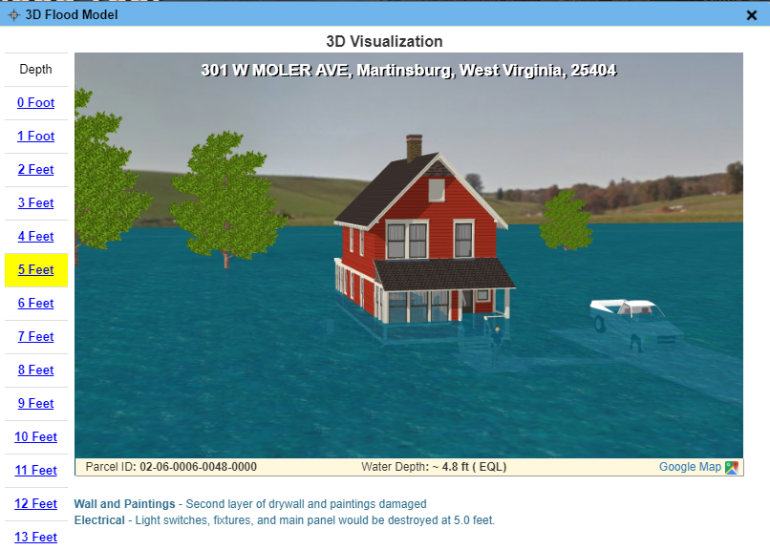
RiskMAP View – 3D Visualization
https://www.mapwv.gov/flood/map/?wkid=102100&x=-8678412&y=4788996&l=11&v=2

Slide 15
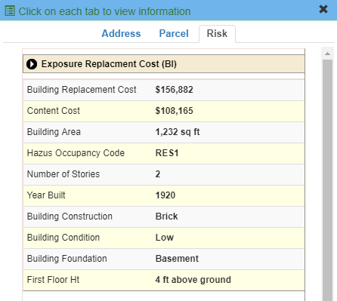
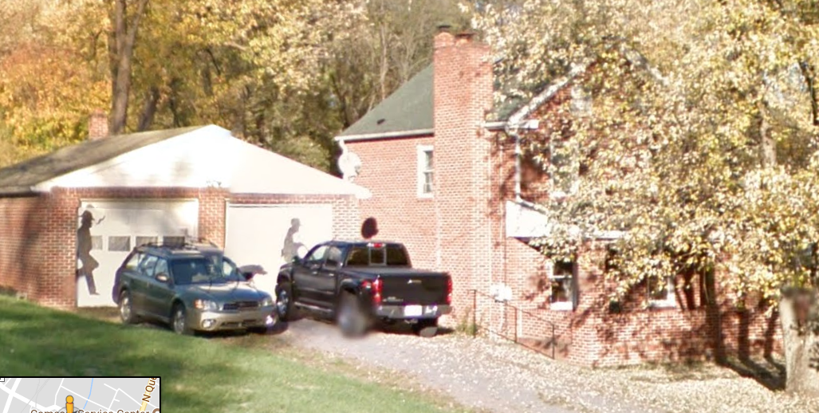
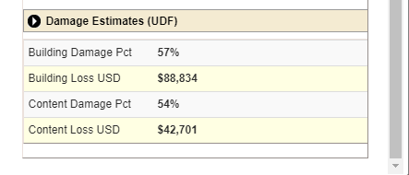
RiskMAP View – 3D Visualization
Building Exposure
Street View Image
HAZUS Loss Estimate
Flood Depth

Slide 16
Flood Risk Analysis – Hazus
Hazus is a geographic information system-based natural hazard analysis tool developed and freely distributed by the Federal Emergency Management Agency (FEMA). The Hazus methodology is used to compute flood damage and loss estimates for buildings.

Slide 17
Flood Risk – Berkeley Springs
Berkeley Springs
WV Flood Tool Application (www.mapWV.gov/flood)
https://www.mapwv.gov/flood/map/?v=0&pid=33-03-002A-0032-0000

Slide 18
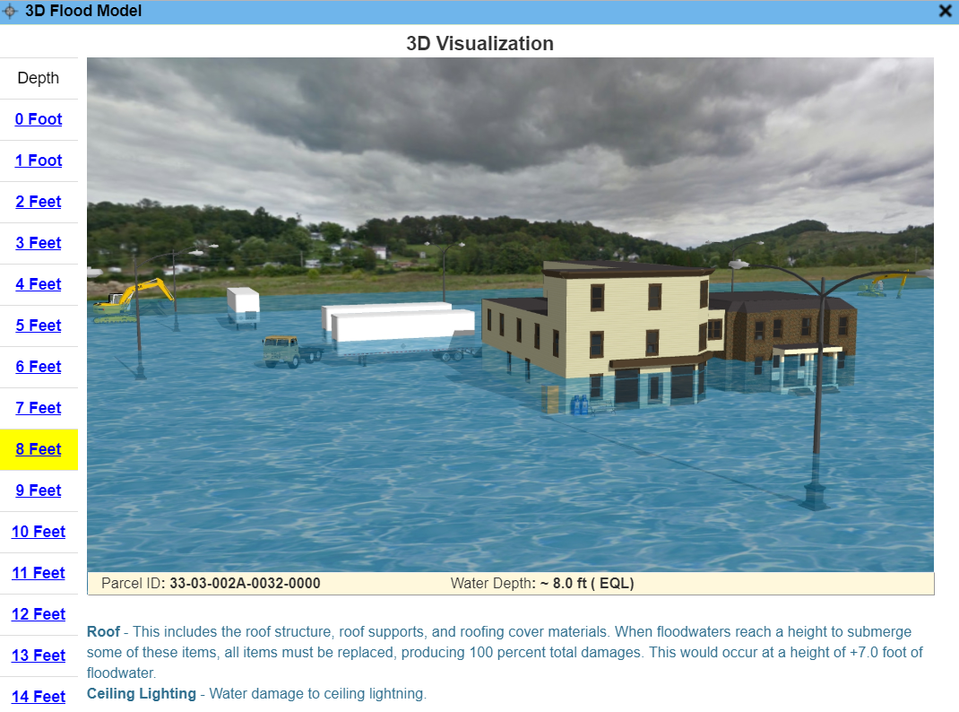
Building-Level Flood Damage
Water Damage Estimate

Slide 19
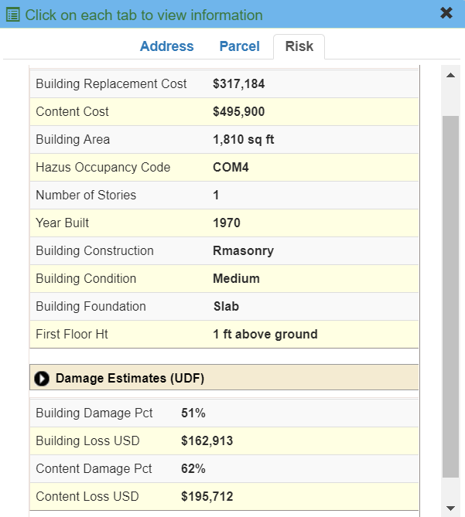
Building-Level Flood Damage
Building Damage Estimate

Slide 20
Building Flood Risk by Property Type
Berkeley Springs

Slide 21
Building Flood Risk by % Damage
Berkeley Springs

Slide 22
Flood Risk Assessment
Building Inventories

Slide 23
Site-Specific Building Inventories
BUILDING INVENTORY
Historical Flood Inundation / Flood Registry
NFIP Repetitive Loss (Internal Use Only)
HAZUS Flood Loss Estimates
Elevation Certificates
Flood Proof or Mitigated Structures
SFHA Building Counts
Levee/Dam Failure Inundation Studies
Building Inventories important for flood reduction activities

Slide 24
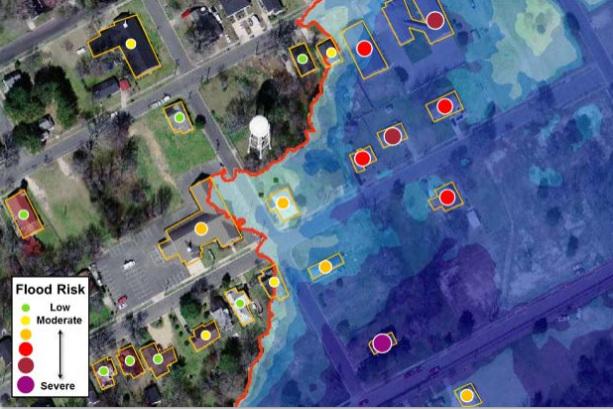
Statewide Flood Risk Structure File
Various Flood Risk Reports by community, watershed, stream name, flood zones, etc. can be generated from the Flood Risk Assessment GIS (FRAGIS).
Structure-specific (called “User-Defined Facilities”, or UDFs, in Hazus) flood risk assessments produce loss estimates at the building or structure level, and can often help facilitate flood risk discussions with individual home- or business-owners in a community. These types of risk assessments can provide valuable information to communities to help pre-screen properties and projects before going through a more in-depth Benefit-Cost Analysis (BCA). Personally-identifiable information (PII) such as property address, name of owner, etc. will not be included in FEMA's Flood Risk Assessment dataset (S_UDF_Pt and L_RA_UDF_Results). Source: Flood Risk Assessment Guidance - https://www.fema.gov/media-library-data/1469146645661-31ad3f73def7066084e7ac5bfa145949/Flood_Risk_Assessment_Guidance_May_2016.pdf

Slide 25
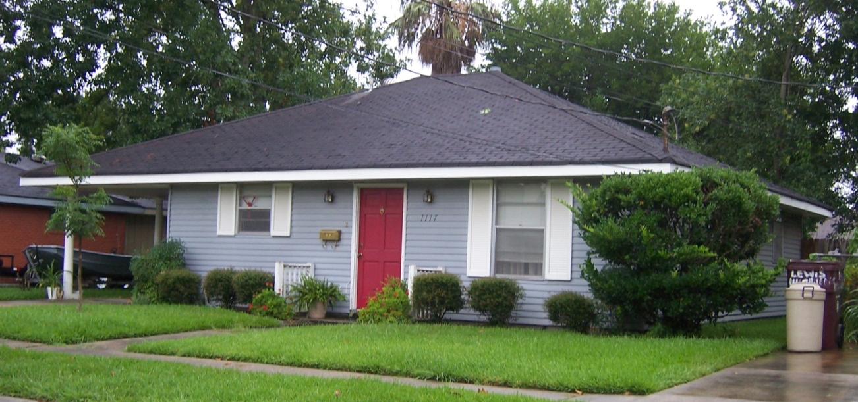
Building Definition
CRS Manual Page 300-4
301.a Definition of “Building”
2 or more exterior walls and a roof affixed to a site
Manufactured (mobile) home
Travel trailer without wheels

Slide 26
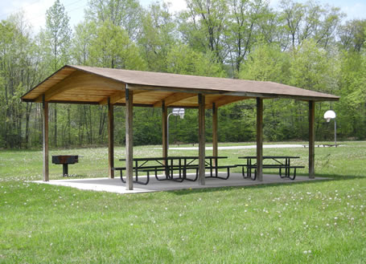
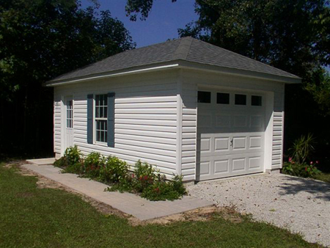
Not a Building
CRS Manual Page 300-5
“Not a Building”
Open pavilions, carports, underground pump stations, trailers, etc. are not buildings
Accessory structures are not counted

Slide 27
Building Identification Resources
Building Identification Resource Layers
Imagery
Top Down (Best Leaf Off, 2018 NAIP, Commercial)
Oblique
Street View (Esri, Bing)
Parcels
Property Lines
Assessment Records (building identification, value, owner name, address)
Site Addresses
Building Footprints
Floodplain Boundaries

Slide 28
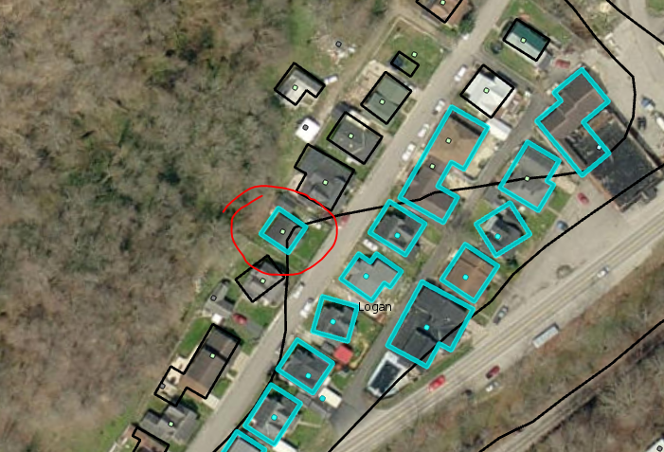
Building Identification – Issue #1
Site address centroid not in the floodplain but building footprint is
https://www.mapwv.gov/flood/map/?wkid=102100&x=-9132529&y=4555837&l=13&v=1

Slide 29
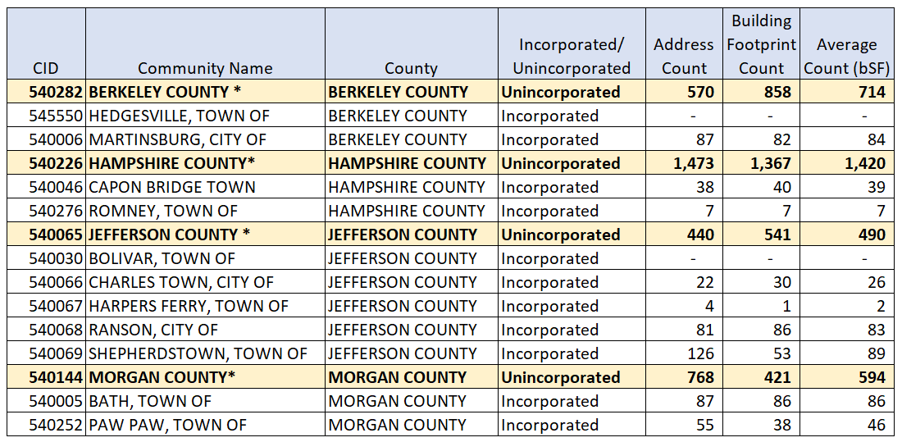
Preliminary Building Counts (bSF)
Preliminary Estimates reveal 100,000 structures in Special Flood Hazard Area

Slide 30
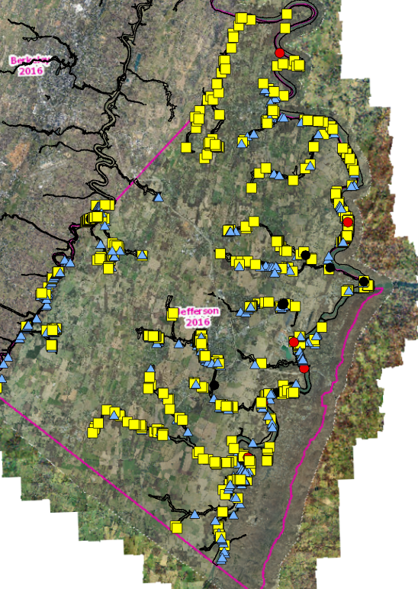
Jefferson County Pilot
Primary building identification preview in Jefferson county

Slide 31
Flood Risk Assessment
New Flood Zones

Slide 32
Flood Zone Types
HIGH RISK (1% Annual Chance Event)
Regulatory – Special Flood Hazard Area (SFHA): Approximate A, Detailed AE
Non-Regulatory: Advisory A, Updated AE
MODERATE RISK
.2% Annual Chance Flood (500-YR Flood)
Within 75 feet of High Risk Flood Zone
LOW RISK
No Flood Hazard Identified

Slide 33
Flood Zone: < zone designation >
Status # | Flood Risk Zone Designation | Message | Flood Degree Risk | Color Warning Status
1 | AE, AH (5), AO (2) | Location is WITHIN the FEMA 100-year floodplain. | High | Red
2 | AE (Floodway) | Location is WITHIN the FEMA 100-year floodplain and floodway. | High | Red
3 | A | Location is WITHIN the FEMA 100-year floodplain. | High | Red
4 | A (Advisory A) | Location is WITHIN the FEMA 100-year floodplain. Advisory Flood Heights available. | High | Red
5 | Updated AE Floodplain Boundary | Location is WITHIN an updated detailed floodplain boundary but NOT a FEMA 100-year effective floodplain. | High | Orange
6 | Advisory A | Location is WITHIN an advisory floodplain but NOT a FEMA 100-year effective floodplain. | High | Orange
7 | Shaded X | Location is WITHIN a moderate flood risk hazard such as a FEMA 500-year floodplain. | Moderate | Yellow
8 | Near Flood Zone | Location is NOT WITHIN identified flood hazard area, but within 75 feet of an identified flood hazard area. | Moderate | Yellow
9 | Out of Flood Zone | Location is NOT WITHIN any identified flood hazard area. Unmapped flood hazard areas may be present. | Low | Green
Three Degrees of Risk: High, Moderate, Low. Four Warning Status Colors: In 100-YR Effective Floodplains (red), Advisory A/Updated AE Floodplains (orange), moderate risk or close to high risk zones (yellow), low risk (green). Three Stacked Floodplain Boundary GIS Files: (1) 100-YR NFHL effective, (2) 100-YR Advisory A-Updated AE, (3) 500-YR NFHL Effective

Slide 34
Flood Zone Determination Sequence
HIGH: 100-YR Effective Floodplain
HIGH: Advisory A or Updated AE Floodplain
MODERATE: 500-YR Effective Floodplain
MODERATE:
Within 75-ft of Flood Zone
LOW: Not in Flood Zone
Flood zone determination sequence important for programming logic
WV Flood Tool first checks query location for High Risk flood zones, then Moderate Risk flood zones.

Slide 35
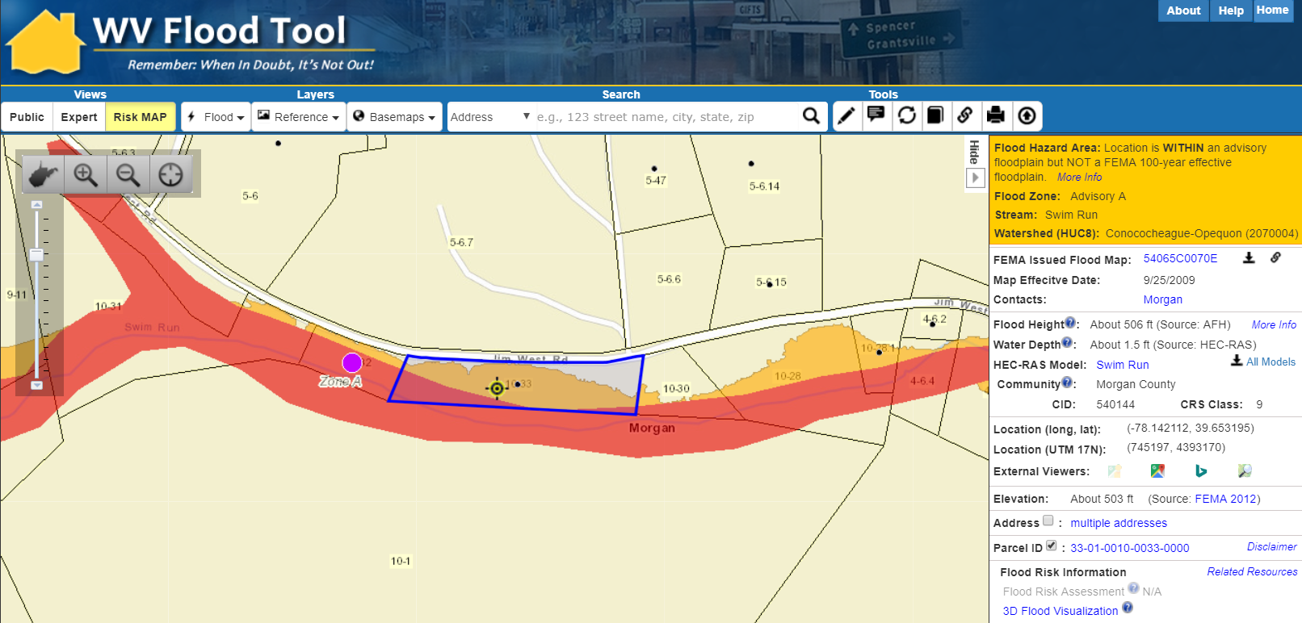
Flood Zone – Structure in Advisory A
Parcel ID: 33-01-0010-0033-0000
https://www.mapwv.gov/flood/map/?wkid=102100&x=-8698746&y=4815674&l=12&v=2
Structure is WITHIN an Advisory A Floodplain but NOT a FEMA 100-year effective floodplain. Parcel ID 33-01-0010-0033-0000 in Morgan County, WV.

Slide 36
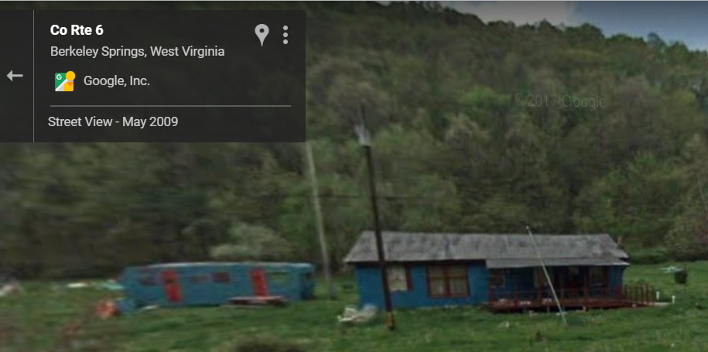
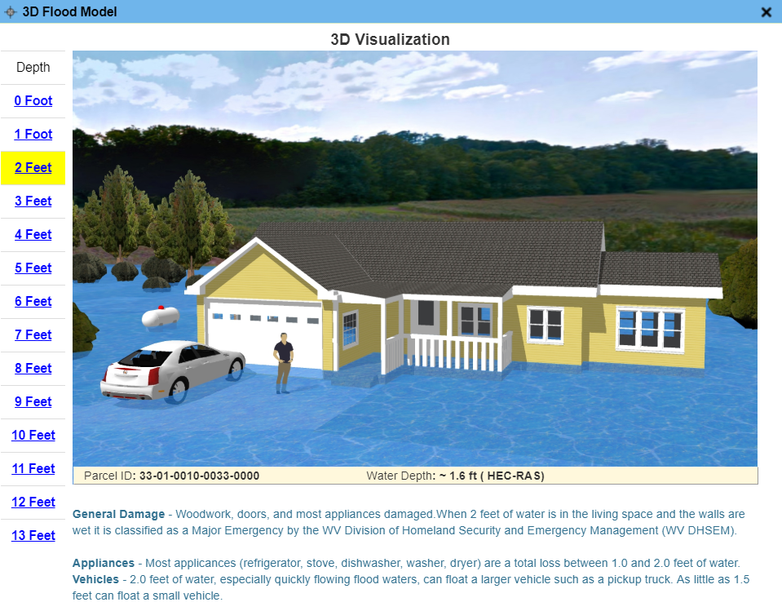
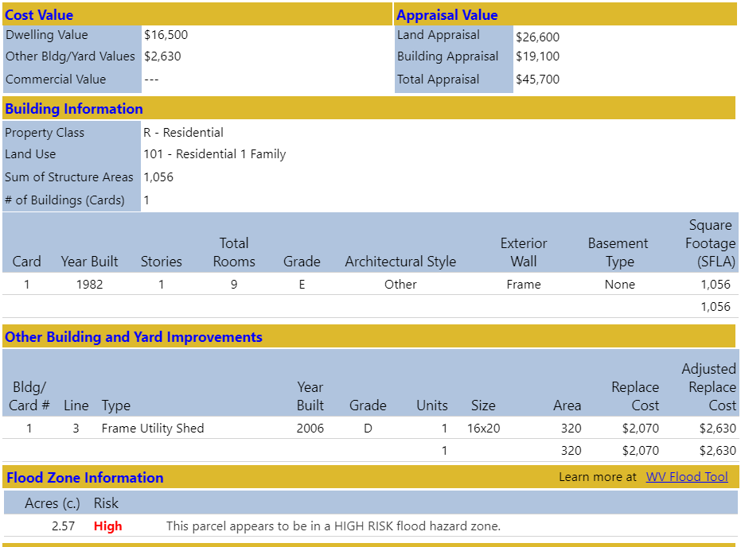
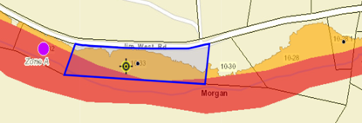
Flood Zone – Structure in Advisory A
Parcel ID: 33-01-0010-0033-0000
Google Street View
Flood Visualization
Web Parcel Report
Flood Zone Map
http://www.mapwv.gov/Assessment/?PID=33010010003300000000

Slide 37
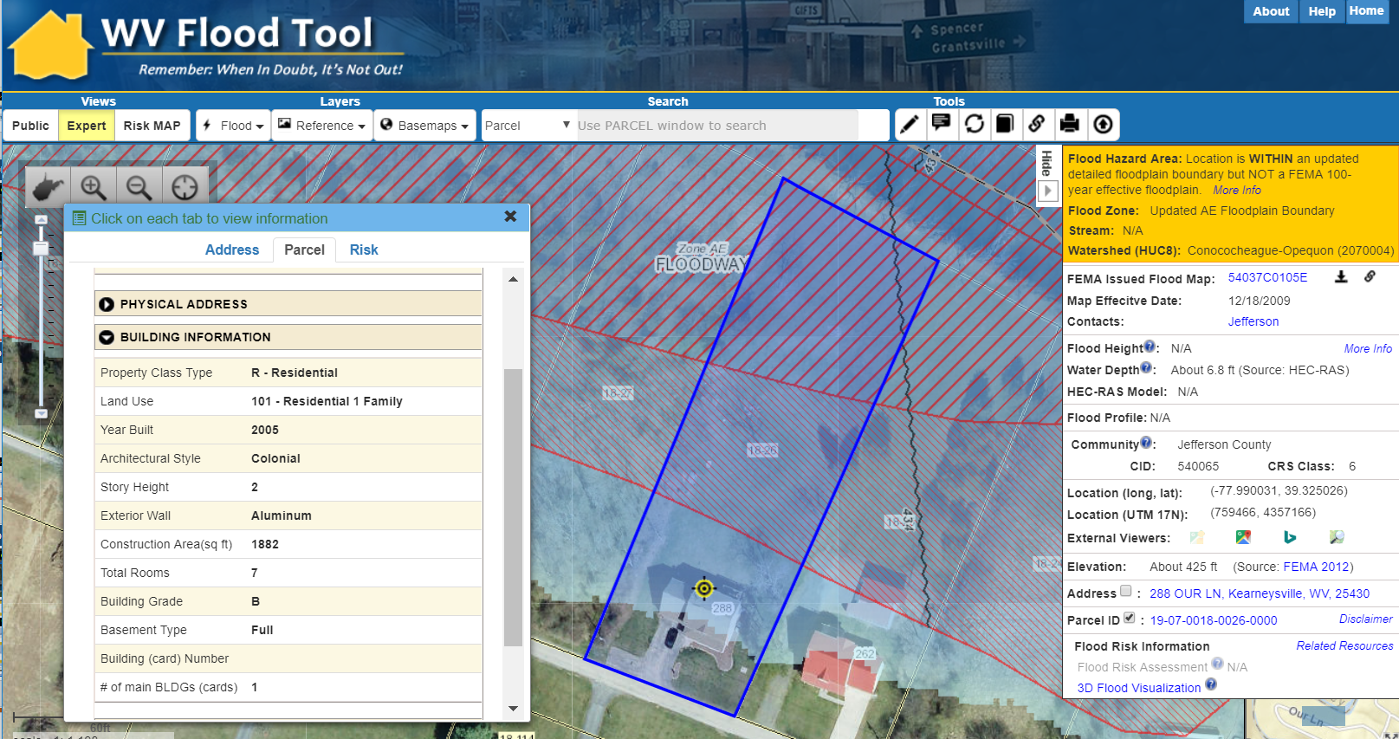
Flood Zone – Updated AE
Parcel ID: 19-07-0018-0026-0000
http://www.mapwv.gov/flood/map/?v=1&pid=19-07-0018-0026-0000
Structure is WITHIN an Updated AE Floodplain Boundary but NOT a FEMA 100-year effective floodplain. Parcel ID 19-07-0018-0026-0000, Address: 288 OUR LN, Kearneysville, WV, 25430. Opequon Creek in Jefferson County, WV.

Slide 38
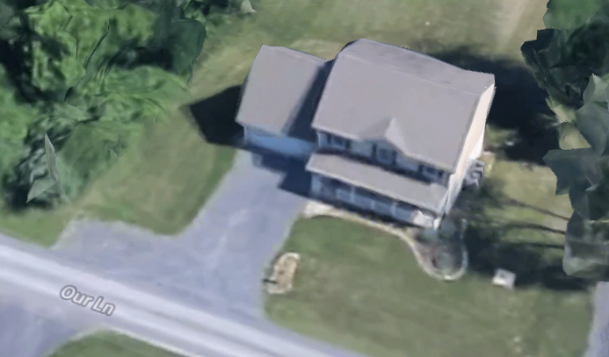
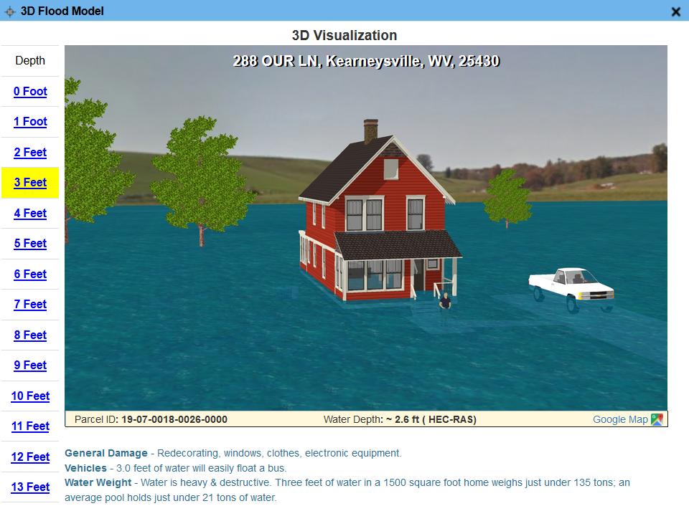
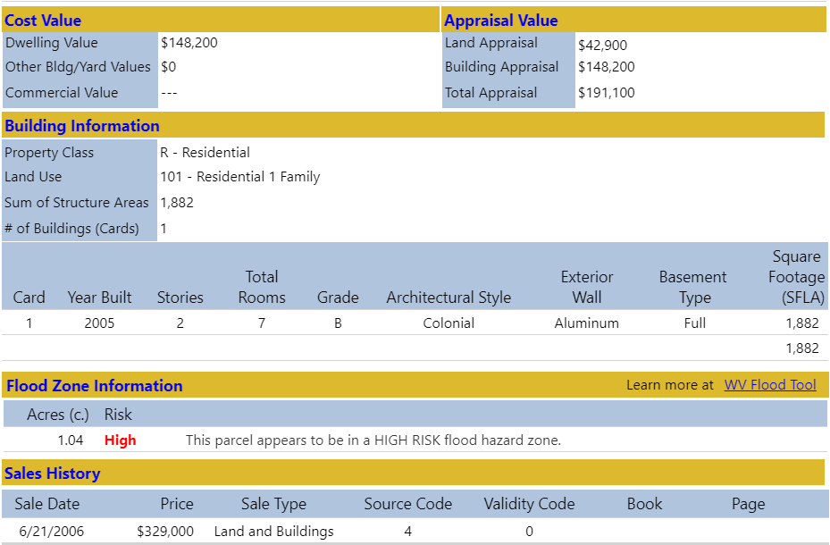
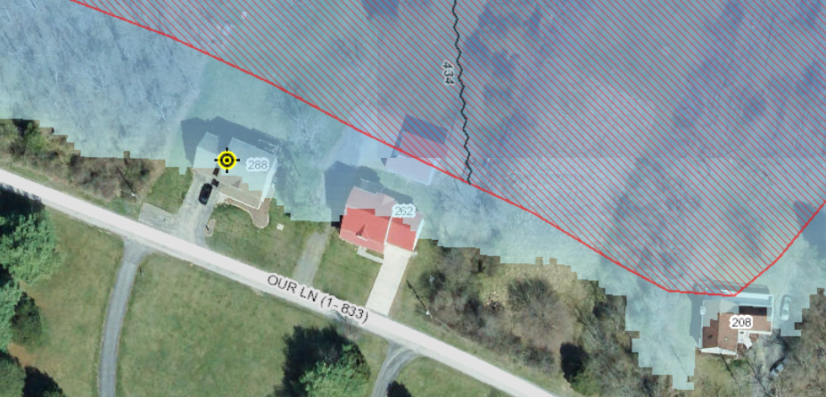
Flood Zone – Updated AE
Parcel ID: 19-07-0018-0026-0000
Google 3D View
https://goo.gl/maps/AQACNLC4XD62
Flood Visualization
Web Parcel Report
Flood Zone Map
http://www.mapwv.gov/Assessment/?PID=19070018002600000000

Slide 39
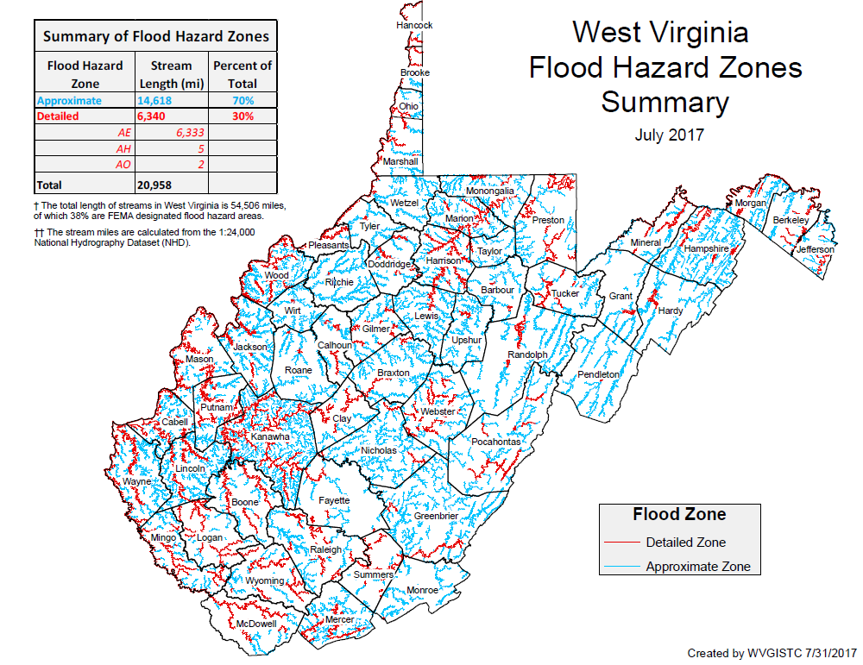
Flood Hazard Zones

Slide 40
Flood Risk Assessment
New Flood Maps (Risk MAP Studies)
& Water Depth Grids (Risk Assessment)

Slide 41
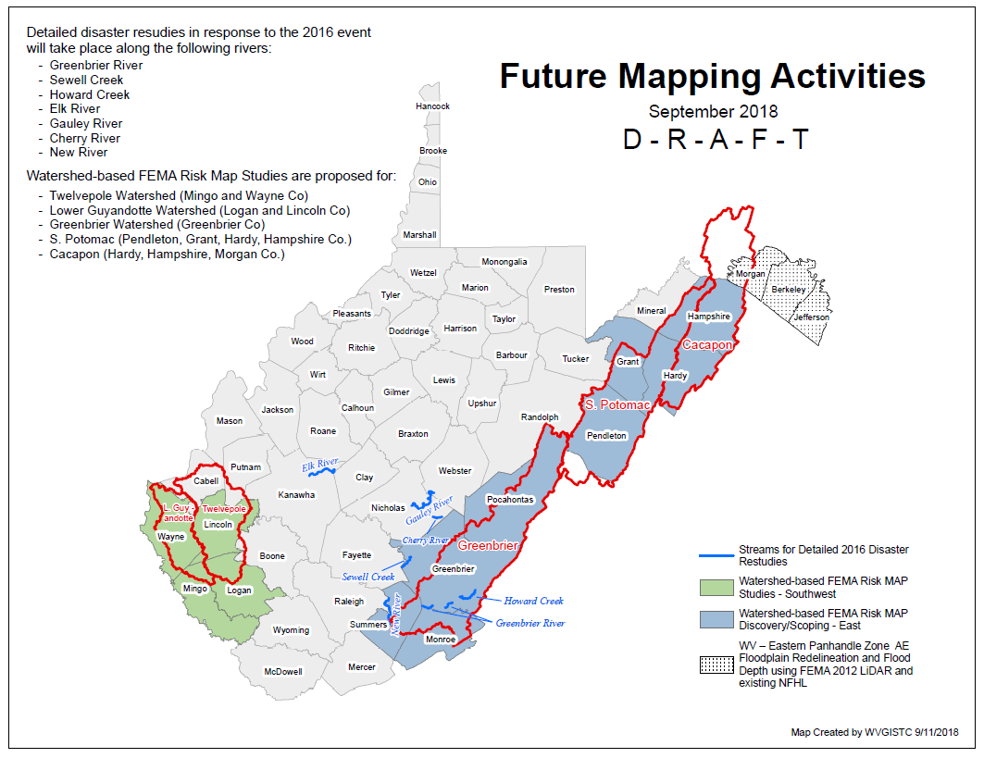
FEMA Flood Risk MAP Studies

Slide 42
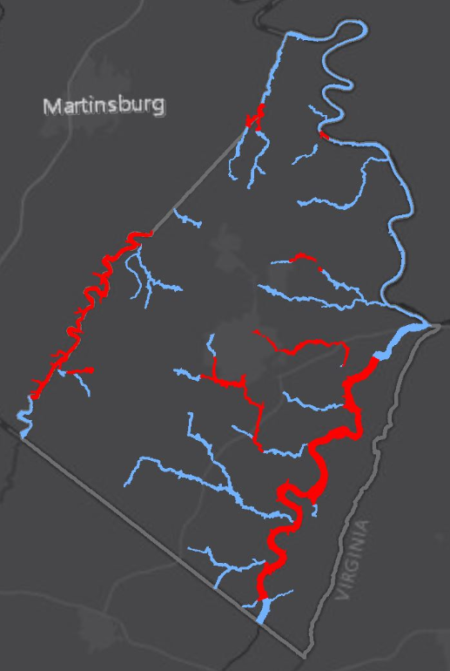
Model-Backed Depth Grids
Preliminary “Model-Backed” Depth Grid for 1% Annual Event Flood for all of Jefferson County
Depth grids derived from FEMA 2010 1-meter lidar elevation data
Water Depth important for 3D flood visualizations and flood risk building loss estimates
Communities receive CRS credit for published water depth grids
Jefferson County
Advisory A Depth Grid (AECOM)
Depth Grid from Updated AE Floodplain Boundary (WVU)
Jefferson County: 162 stream miles of Approximate A Zones, 77 miles of Detailed Flood Zones

Slide 43
Flood Risk Assessment
Community Rating System

Slide 44
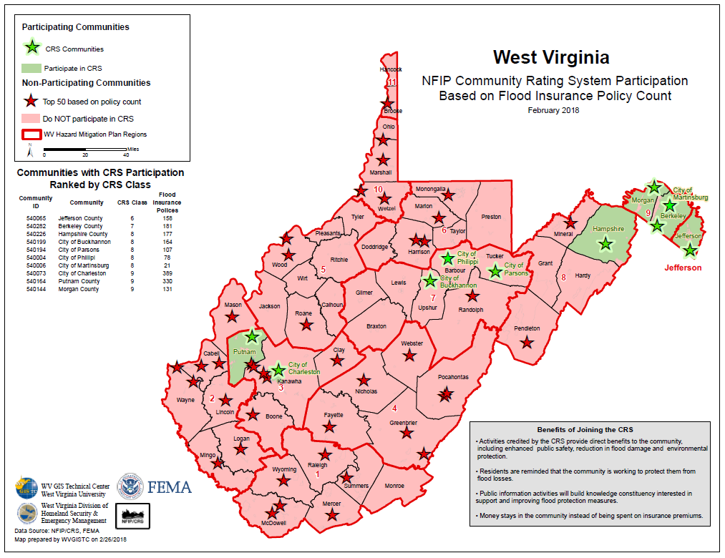
FEMA’s Community Rating System

Slide 45
Support for Community Rating System
Communities with CRS Participation Ranked by CRS Class
Community ID | Community | CRS Class | Flood Insurance Policies
540065 | Jeffereson County | 6 | 158
540282 | Berkeley County | 7 | 181
540226 | Hampshire County | 8 | 177
540199 | City of Buckhannon | 8 | 164
540194 | City of Parsons | 8 | 107
540004 | City of Phillipi | 8 | 78
540006 | City of Martinsburg | 8 | 21
540073 | City of Charleston | 9 | 389
540164 | Putnam County | 9 | 330
540144 | Morgan County | 9 | 131

Slide 46
Statewide Hazard Assessment
(2) Landslide Risk Assessments

Slide 47
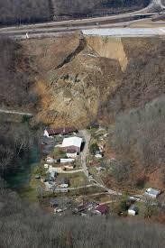
Landslide Risk Assessment
Goals
Develop a landslide inventory
Create valid landslide models for specific WV regions
Generate county-level resolution landslide maps
Create an interactive web map application for displaying landslide models and landslide variables
Use the new landslide models and information to update the State Hazard Mitigation Plan
Did you know?
Landslides are the #2 Hazard in West Virginia
2015 Yeager Airport Slide

Slide 48
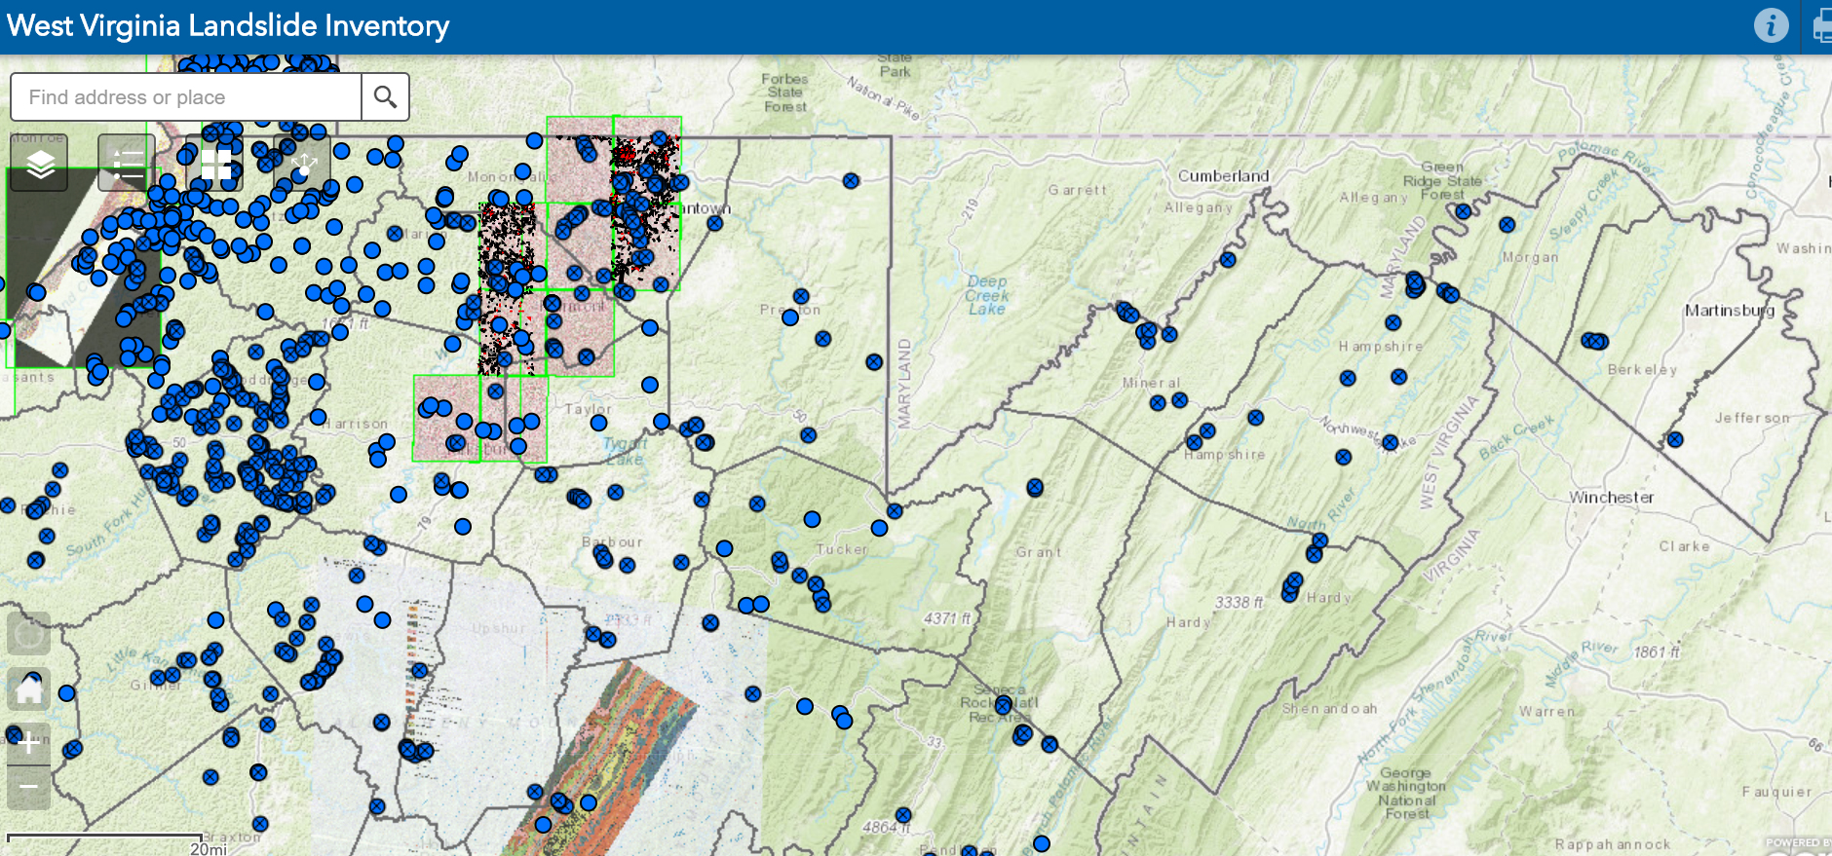
Landslide Incident Inventory
www.mapWV.gov/Landslide

Slide 49
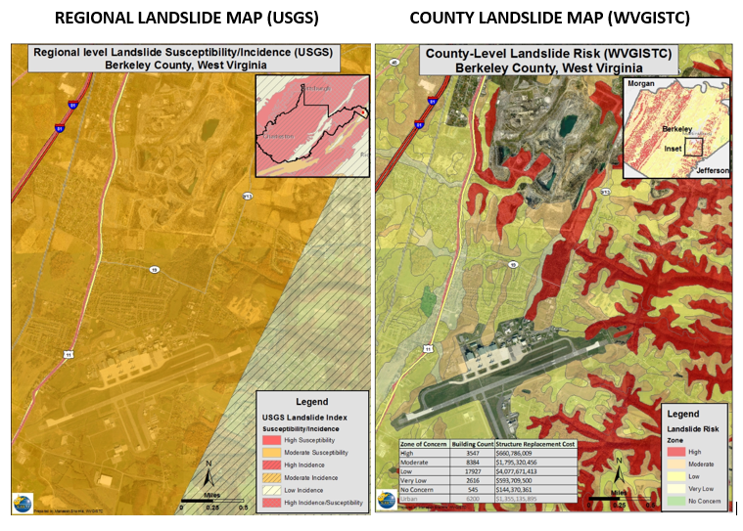
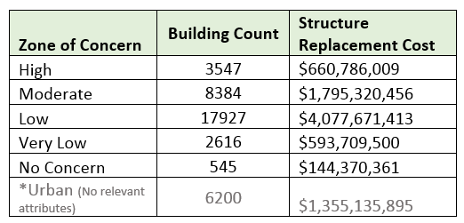
Landslide Susceptibility Maps
Landslide
Risks
Buildings Exposed to Landslide Risks
Risk Assessment table showing building counts along with estimated replacement costs in landslide zones of concern
Landslide susceptibility map showing generalized USGS map and detailed WVGISTC map

Slide 50
Statewide Hazard Assessment
(3) Spatial Data Development

Slide 51
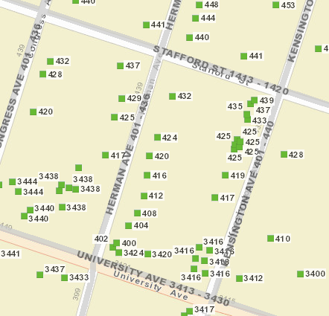
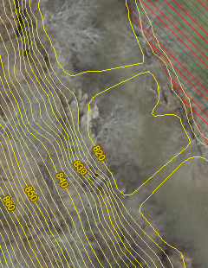
Spatial Data Layers
Parcels Site Addresses Aerial Imagery Elevation
State Spatial Data Infrastructure

Slide 52
State-Level Integration
Parcels
Addresses
Imagery
Elevation
SOURCE: County Assessors
Property Tax Division
Statewide Master Parcel File / IAS
SOURCE: Local Addressing Offices
Division of Homeland Security & Emergency Management
Statewide Addressing & Mapping System
SOURCE: County Offices
WV GIS Technical Center
Statewide Leaf-Off Imagery Service
SOURCE: Local, State, primarily FEMA
WV DEP WV GISTC
Statewide Elevation Web Services
State-level integration allows for statewide mapping products and services

Slide 53
Spatial Data Development
Parcels

Slide 54
Statewide Digital Parcel File
599 Tax Districts
Estimated $6 Million Value for Statewide Parcel File and Assessment Records
347 Districts
252 Corporations
Digital Parcel Sources
Assessor Offices
E-911 Offices
State Tax Department

Slide 55
Assessment Building Info
West Virginia Parcel Property Class Breakdown for Tax Year 2017
Code | Property Class | # of Parcels | Percent (%)
R | Residential | 1,164,470 | 79.61%
F | Farm | 121,384 | 8.30%
A | Apartment | 3,222 | 0.22%
C | Commercial | 65,784 | 4.50%
I | Industrial | 3,105 | 0.21%
X | Exempt | 97,773 | 6.68%
U | Utility | 192 | 0.01%
Other | Not classified | 6,837 | 0.47%
 |  | 1,462,767 | 100.00%
Assessment records are important for building inventories and are used to estimate the total building exposure ($) and building loss ($) for multi-hazards. Often building inventories and corresponding loss estimates are organized by property class.

Slide 56
Parcels link to Owner/Building Info
Residential or Farm Property
DESCRIPTION
GIS Parcel ID | 31-10-0029-0130-0000
Legal Description | BL 12-1/2 LOT 10
Acreage (deed) | 0.0373
Tax Year | 2015
Tax Class | 4
Deed Book / Page | 1259 / 45
PROPERTY OWNER(S)
Property Owner(s) | Smith John
629 PENNSYLVANIA AVE, Morgantown, WV, 26501
https://www.mapwv.gov/flood/map/?wkid=102100&x=-8899684&y=4811867&l=13&v=0
BUILDING INFORMATION
Property Class Type | R- Residential
Land Use | 101 - Residential 1 Family
Year Built | 1911
Architectural style | Conventional
Exterior Wall | Aluminum
Stories | 2
Total Rooms | 8
Building Grade | C
Basement Type | Full
Structure Area | 1,320
Building (card) Number | 1
# of main BLDGs (cards) | 1
APPRAISED VALUES
Land Appraisal | $33,200
Building Appraisal | $29,000
Total Appraisal | $62,200

Slide 57
Parcels link to Owner/Building Info
Commercial or Industrial Property
DESCRIPTION | 84 Lumber
GIS Parcel ID | 31-14-0031-0101-0000
Legal Description | 5.0922 AC;SABRATON
Acreage (deed) | 5.09
Deed Book / Page | 1376 / 234
PROPERTY OWNER(S)
Property Owner(s) | SPIRIT SPE PORTFOLIO
1501 DECKERS CREEK BLVD, Morgantown, West Virginia, 26505
https://www.mapwv.gov/flood/map/?v=0&pid=31-14-0031-0101-0000
BUILDING INFORMATION
Property Class Type | C- Commercial
Land Use | 373 - Retail-Single Occupancy
Year Built | 1994
Stories | 2
Exterior Wall | Brick or Stone
Construction Type | Pre-Engineered Steel
Building Grade | D+
Basement Type | None
Business Living Area | 15,255
Cubic Feet | 292,380
Use Type | 34-Retail Store, 82- Multi-Use Office
COST VALUES
Other Bldg/Yard Values | $67,020
Commercial Value | $227,700
APPRAISED VALUES
Land Appraisal | $378,800
Building Appraisal | $294,700
Total Appraisal | $673,500

Slide 58
GIS Digital Tax Conversion Status
Six counties need assistance with digital tax map conversion

Slide 59
18 Colonial Drive, Ripley, WV
PAPER TAX MAP (static map)
DIGITAL TAX MAP
(interactive, seamless, aerial photo reference, map link to attributes (property info) and graphics (building sketch)
Parcel
04-29-45.5
Parcel 04-29-45.5

Slide 60
What is in a Parcel Identifier
GIS Parcel ID: 31-05-0007-0031-0015
7-31.15
County | 31 (Monongalia County)
District | 05 (Clinton Tax District)
Map | 7
Parcel Prefix | 31
Parcel Suffix | 15
The GIS Parcel ID is a unique number that is the basis for identifying all parcels in West Virginia. The GIS Parcel ID consists of five elements: County code, District code, Map number, Parcel Prefix, and Parcel Suffix.

Slide 61
Tax Mapping 2018
SB 588 New Revenue for Mapping

Slide 62
Funding from WV Statute §59-1-10(8)
http://www.wvlegislature.gov/WVcode/ChapterEntire.cfm?chap=59&art=1&section=10
8) Of the fees collected pursuant to subdivision (1), subsection (a) of this section, $10 shall be deposited in the county general fund in accordance with section twenty-eight of this article, $5 shall be deposited in the county reappraisal fund and dedicated to the operation of the assessor’s office mapping division,
New $10 Deed Recording fee under SB 588, of which $5 portion for county assessor’s mapping office

Slide 63
SB 588 Revenue Dedicated for Mapping Purposes
Based on revenue collected for the WV Courthouse Facilities Improvement Authority, it is possible to project that over $600,000 in revenue is being generated annually for the assessors’ mapping programs from the $5.00 portion of the fee. This is almost ten times the revenue generated under the old system.
Once FY17-18 is complete we will get the audited actual numbers!
Some members of the mapping community are concerned that the new SB 588 revenue will not be fully allocated by assessors for mapping resources.
Increased revenue should be directed towards mapping-related expenses, GIS hardware, map software, map maintenance, digital parcel conversion, web applications, aerial photography, etc.

Slide 64
WV Property Viewer
Statewide Parcel Application and Web Services
WV Property Viewer application (www.mapwv.gov/property)
Online Tax PDF Maps
Web Parcel Reports

Slide 65
WV Property Viewer (Mobile)
www.mapwv.gov/property
682 Killarney Drive, Morgantown, WV
Mobile Home Page
Zoom to E-911 Address
Toggle Layers of Interest

Slide 66
WV Property Viewer (Mobile)
www.mapwv.gov/property
682 Killarney Drive, Morgantown, WV
Touch Parcel for More Info
View Parcel Attributes
Link to Detailed Report

Slide 67
WV Property Viewer - www.mapwv.gov/property
Developed in collaboration with WV Property Tax Division
Modelled after Tennessee Property Viewer
FEMA/State Hazard Mitigation is a business driver for identifying flood hazards. Serves as a gateway to WV Flood Tool.
Key Features:
Statewide parcel attribute searches (e.g., owner name, acreage)
www.mapwv.gov/assessment Integrated with E-911 Statewide Addressing & Mapping System
General info on all properties (R, F, C, A, I, X, U)
Counties/State Agencies can link to Statewide Parcel Web Services
PDF Full-Version Tax Maps https://www.mapwv.gov/taxmaps/?m=31-15-0054 (County Code - District No. - Map ID)
Web Parcel Reports – displays multiple records (e.g., structures)
http://mapwv.gov/Assessment/?PID=28110039000100000000
Free property viewer for county offices with limited resources
Formal release with 2018 Tax Year data in September

Slide 68
Spatial Data Development
E-911 Addresses

Slide 69
Statewide E-911 Address & Mapping File
Property Identification for disaster assessments
Address Match Locators – Geocoding
Validate Parcel Addresses
Emergency Service Zone Boundaries
Other uses:
Fire insurance rates
Flood insurance discounts
Broadband, emergency, hazard reduction, and transportation planning

Slide 70
Statewide E-911 Addresses
Address Issues
Missing Address Site Numbers
Wrong Addresses (98 Graham St. should be 315 Graham St.)
Fairmont, WV
Elkins, WV

Slide 71
Statewide E-911 Addresses
Missing Address Site Numbers
Berkeley Springs, WV

Slide 72
WV Address Issues
 | Address Issues |  |  |  | Community Name
 | Missing Address Information |  |  |  | Boone County*(4) – Danville, Madison, Sylvester, Whitesville, Cabell County*, Calhoun County*, Gilmer County (2) – Glenville, Sand Fork, Grant County (1) – Petersburg, Lewis County*, Marion County*(6) – Barrackville, Fairmont, Farmington, Rivesville, White Hall, Worthington, McDowell County (1) – Bradshaw, Mingo County (1) – Williamson, Morgan County*(2) – Bath, Great Cacapon, Pleasants County (1) – Belmont, Pocahontas County*(3) – Durbin, Hilsboro, Marlinton, Putnam County (6) – Bancroft, Buffalo, Eleanor, Hurricane, Poca, Winfield, Summers County (1) – Bluestone, Tyler County (1) – Friendly, Wayne County*, Webster County*(3) – Addison, Camden-On-Gauley, Cowen, Wyoming County (1) - Mullens
 | Counties 9
 | Municipalities 33
 | Incorrect Address Information |  |  |  | Putnam County*
 | Counties 2 |  |  |  | Randolph County (1) – Elkins
 | Municipalities 3 |  |  |  | Roane County* (2) – Reedy, Spencer
 | Misaligned Addresses or Parcels |  |  |  | Hardy County* (1) – Moorefield
 | Counties 1 |  |  |  | Jefferson County (1) – Shepherdstown
 | Municipalities 3 |  |  |  | Randolph County (1) – Womelsdorf
* Address issues with the entire county

Slide 73
Spatial Data Development
Leaf-Off Imagery

Slide 74
Leaf-Off Aerial Imagery Web Service
https://services.wvgis.wvu.edu/arcgis/rest/services/ImageryBaseMaps/wv_aerial_photos_mixed_resolutions_wm/MapServer?f=jsapi
32 Counties have provided leaf-off imagery for State Imagery Web Service
2018 Mercer County Aerial Imagery

Slide 75
Leaf-Off Imagery
60% of the counties have acquired leaf-off imagery since 2010
What is the cost?
$70 per square mile for aerial imagery
Ideally, leaf-off imagery should not be older than 5 years. Imagery is important for identifying at-risk structures and accurate disaster mapping.

Slide 76
Leaf-Off Imagery Service
https://services.wvgis.wvu.edu/arcgis/rest/services/ImageryBaseMaps/wv_aerial_photos_mixed_resolutions_wm/MapServer?f=jsapi
2018 Jefferson County Aerial Imagery

Slide 77
Spatial Data Development
Elevation

Slide 78
Statewide Elevation Layers
Elevation Grids, Hillshade Grids, Contours, used for Flood Depths, Imagery Orthorectification
Layer | Source | Coverage
SAMB | 2003 SAMB, 3-meter, 10-foot contours | Statewide
Lidar | Lidar, 2-foot or 1-foot contours | Select Areas
SAMB ELEVATION
WV DEP SAMB-Lidar Hillshade
LIDAR ELEVATION

Slide 79
High Resolution Elevation
New FEMA LiDAR Elevation Data is 10x better than 2003 Statewide Elevation Data Set
SAMB Elevation 10 FT Contours
FEMA LiDAR 1 FT Contours

Slide 80
LiDAR-Based 1-FT Contours
Elevation data can be accessed through State Data Clearinghouse - www.mapwv.gov/lidar

Slide 81
FEMA Purchased QL2 LiDAR

Slide 82
Spatial Data Development
Public Lands

Slide 83
Protected Areas Database (PAD-US)

Slide 84
Data Gap Analysis
DATA LAYERS | Morgan | Berkeley | Jefferson
Assessment Data | 2018 | 2018 | 2018
Tax Parcels | 2018 | 2018 | 2018
E-911 Addresses | 2015 |  | 2018
Building Footprints (county source). 2018 BING Source. | None | 2008 | 2018
Aerial Imagery | 2010 | 2018 | 2018
Elevation LiDAR QL2 | 2016 | 2012 | 2012
Water Depth Grid | A Zone | A Zone | A and AE Zones

Slide 85
Contact Information
WVU GIS Technical Center Kurt Donaldson, GIS Manager kurt.donaldson@mail.wvu.edu, phone: (304) 293-9467 Eric Hopkins, GIS Analyst Eric.Hopkins@mail.wvu.edu, phone: (304) 293-9463 Maneesh Sharma, GIS Analyst
Maneesh.Sharma@mail.wvu.edu, phone (304) 293-9466
Kevin Kuhn, GIS Analyst
kkuhn2@wvu.edu, phone (304) 293-9462

