Slide 1
WV Flood Tool - FUTURE DIRECTIONS
Flood Mapping Activity Updates
  Advisory A, Updated AE & Restudies
  Lidar data delivery update
  Other Status Graphics
Quick Comparison of NFHL and WV Flood Tool
WV Flood Tool Planned Updates: Flood Query Panel (new data flood data sources and updating query programming logic)
  Flood Zones
    Updated AE Floodplain Boundaries (e.g, Clear Fork & Jefferson County pilot AE Non-Restudy)
    NFHL Moderate Flood Risk Zones (Shaded X, B)
  Flood Heights
    Base Flood Heights (e.g., Upper Mon Watershed Restudy)
  Composite Depth Grid
    Depth grids based on engineering models from various sources; goal is 5-ft. cell resolution statewide
    Other depth grids (USGS HWM, Hazus, EQL)
Model WV Ordinance for Advisory Zones
Reference Layers for WV Flood Tool (ground elevation, footprints, parcels)
HMGP Multi-Hazard Proposal
Other Topics
January 2018

Slide 2
Flood Mapping Activities
Flood Mapping Activity Updates
  Advisory A
  Updated AE Floodplain Boundaries
  Lidar data delivery update
  Other Status Graphics
    Updated NFIP/CRS Graphic
    Parcels in WV Flood Tool

Slide 3
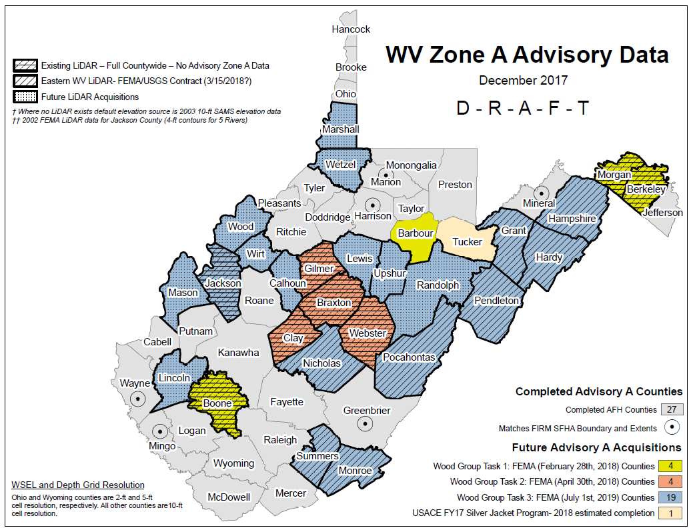
AFH Proposed Schedule

Slide 4
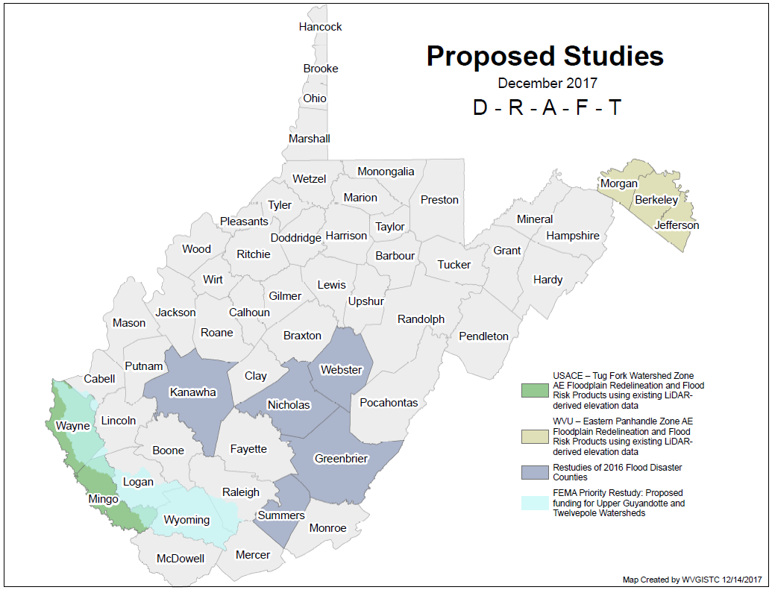
Proposed Flood Studies

Slide 5
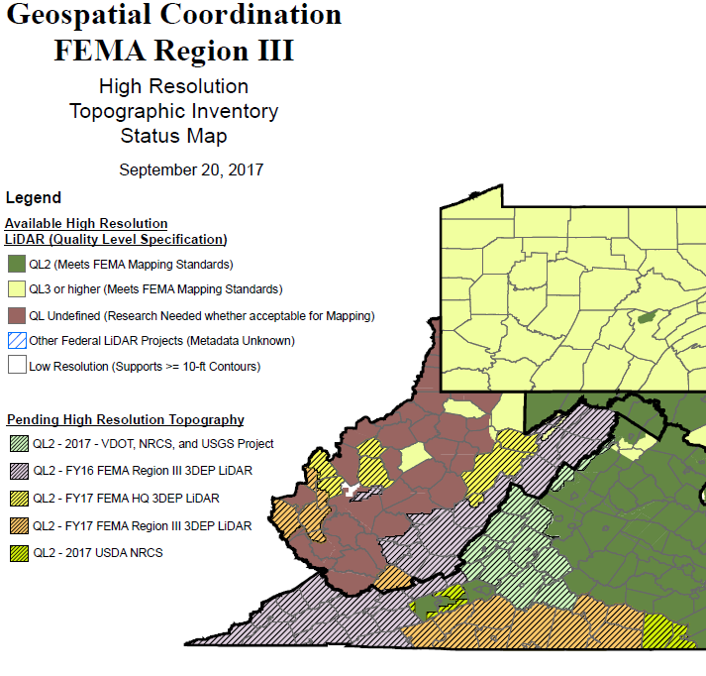
New LIDAR Acquisitions
New FY17 WV Lidar Coverage:
Randolph, Tucker, Mercer, Roane, Wirt, Mason, Wayne, Putnam, Lincoln counties?

Slide 6
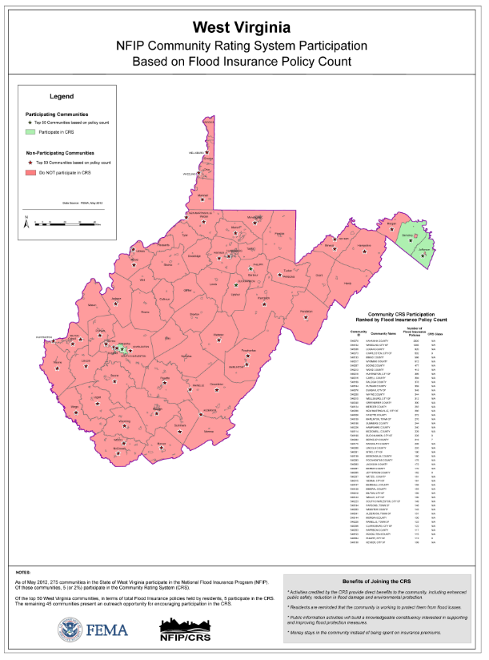
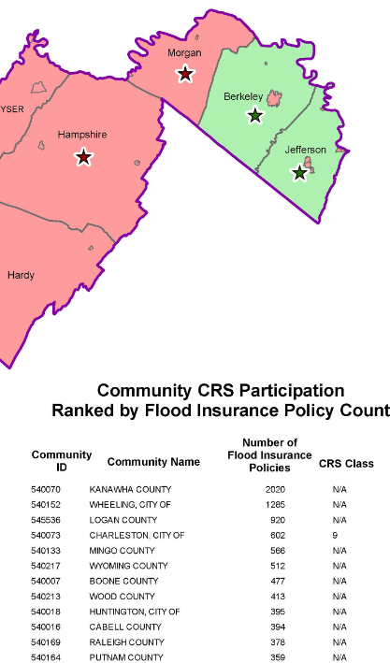
Other Graphics – CRS/NFIP Policies
New 2017-18 WV Lidar Coverage:
Randolph, Tucker, Mercer, Roane, Wirt, Mason, Wayne, Putnam, Lincoln counties?

Slide 7
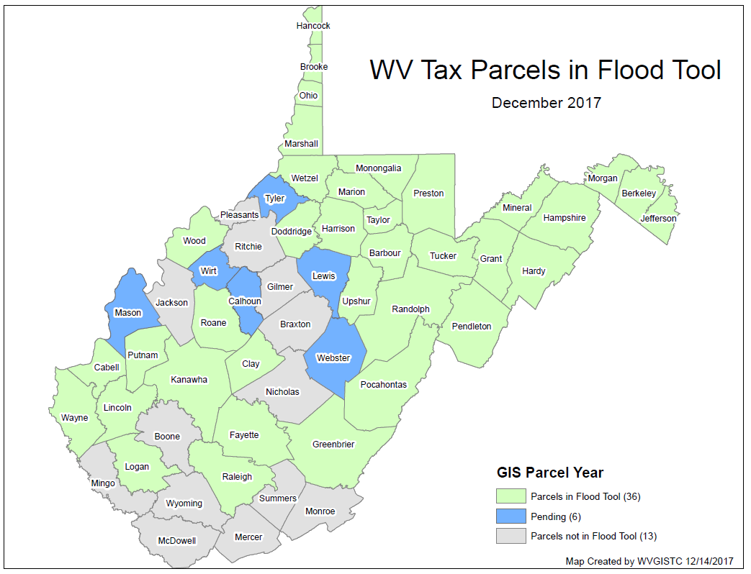
Other Graphics – Parcels in Flood Tool
GIS Parcels

Slide 8
Compare NFHL & WV Flood Tool
Comparison of FEMA’s NFHL Web App and WV Flood Tool

Slide 9
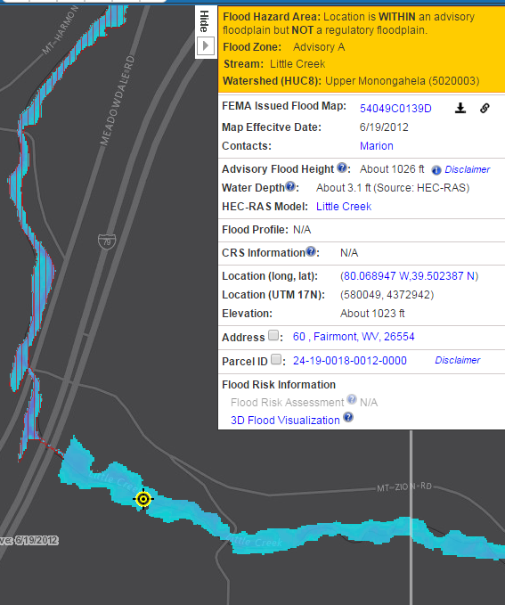
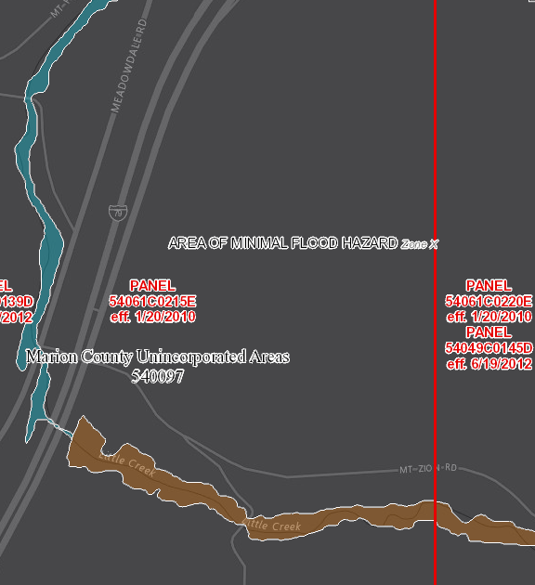
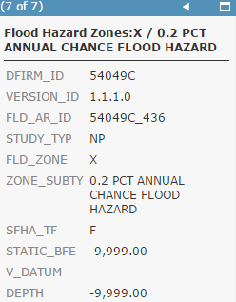
Compare NFHL & WV Flood Tool
WV Flood Tool
NFHL Web App
Advisory A Depth
Shaded X Zone
https://www.mapwv.gov/flood/map/?wkid=102100&x=-8913234&y=4793892&l=9&v=1
https://arcg.is/1K9D1z

Slide 10
Comparison of FEMA & State Applications
 | FEMA’s NFHL ArcGIS.com Web App. | WV Flood Tool (www.mapWV.gov/flood)
WV Application Programming and System Admin. Support | More capacity and resources to sustain web application | Limited capacity and resources to support a web application that is more complex in its presentation of different user views, query logic, external web services, and various flood and reference layers
NFHL Regulatory Layers | Authoritative source of all NFHL layers. Most current. | Web links to ArcGIS REST services or download copy of NFHL layers. Ability to display preliminary flood layers. Missing flood zone labels. Moderate risk hazard zones (Shaded X, B) currently not displayed.
Customization | Less customizable to state and local community preferences | More customized to local floodplain management needs and data resources: User Views for Public, Expert, and Risk Reduction Query Panel Results (refer to Slides 14 & 15) Data Layers (Slide 11) Group flood hazard layers together into single layer (SFHA, X-section, BFE) Revised Floodplain Boundaries: Advisory A and Updated AE (Slides 27-32) Flood Height Data (Slides 17-18) FIS profile images Restudy BFE grids A Zone Advisory Flood Heights (AFH) Water Depth Grids (HEC-RAS, Hazus, EQL, USGS Inundation) (Slides 19-21) State/Local Reference Layers Parcels (Slides 37– 52) Addresses Leaf-Off Imagery Building Footprints (Slide 35) Ground Elevation (Hybrid SAMS-Lidar DEM) – (Slide 34) External Web Data Services (USGS, WV DOT, WV DEP) – (Slide 11) More base map options (Multi-year imagery, hillshade, customized topographic, etc.) Risk Map Layers (e.g., building exposure, building loss estimates, and loss) (Slides 55-60) 3D Flood Visualizations (Slides 61-64)

Slide 11
WV Flood Tool Layers
FLOOD LAYERS | Public View for general public | Expert View for floodplain managers | RiskMAP View for flood risk reduction efforts
Flood Hazard Layers Flood Hazard Zones (9 status conditions) Panel Index (link to FEMA issued map) X-Sections / BFE’s LOMAs / LOMRs* Structures, Levees, Mile Markers* Updated Floodplain Boundaries Flood Height Values (BFE and AFH) Political Areas/CRS Communities | Yes Yes No No No No No Yes | Yes Yes Yes Yes Yes Yes Yes Yes | Yes Yes Yes Yes Yes Yes Yes Yes
Flood Risk Flood Water Depths (HEC-RAS models) Other Water Depths (USGS HWM, Hazus, EQL) Historical High-Water Marks (points) Site-Specific Flood Risk Assessment Data Historical Flood/Dam/Levee Inundation Maps Flood Elevation Certificates (Putnam Co. Pilot) | No No No No No No | Yes No No No No Yes | Yes Yes Yes Yes Yes Yes
Property Mitigation Mitigated Structures/Buyout Properties | No | Yes | Yes
Flood Prediction USGS Real-Time Stream Gages* | No | Yes | Yes
Italics Text = To Be Added * External Agency Web Map Services

Slide 12
WV Flood Tool Updates Planned
Data Layer Development for WV Flood Tool
  Addition and enhancements of flood data layers (e.g., BFE Flood Heights and Updated AE depth Grids)
  Improving data flow of NFHL layer updates to WV Flood Tool
  Ensuring no data integrity issues exist between NFHL and WV Flood Tool layers
New data flood data sources and updating query programming logic

Slide 13
WV Flood Tool Updates Planned
WV Flood Tool Update: Flood Query Panel
  Flood Zones
    Updated AE Floodplain Boundary (e.g, Clear Fork & Jefferson County pilot AE Non-Restudy)
    NFHL Moderate Flood Risk Zones (Shaded X, B)
  Flood Heights
    Base Flood Heights (e.g., Upper Mon Watershed Restudy)
  Composite Depth Grid
    Model-backed Depth Grids from various sources; 5-ft. cell resolution statewide
    Other depth grids (USGS HWM, Hazus, EQL)
New data flood data sources and updating query programming logic

Slide 14
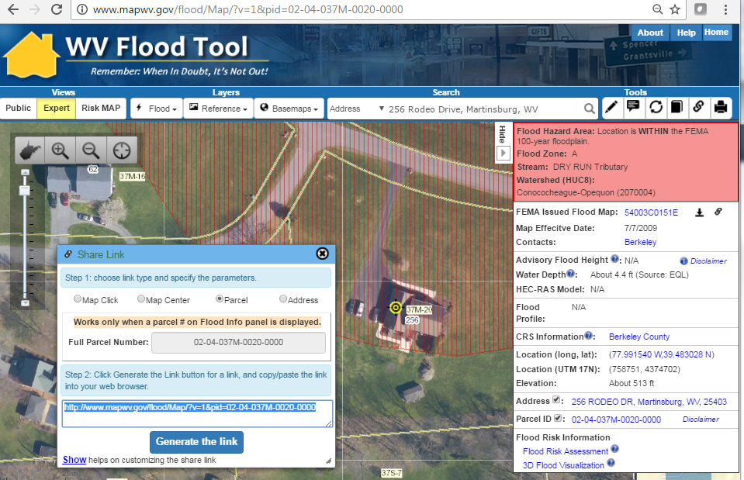
Changes to Flood Query Results
New Data Sources (BFE, Advisory AE, Depth, Elev.)
# | Each Location Query Answers:
1 | In Flood Hazard Area? Flood Zone? Floodway?
2 | Stream name?
3 | Watershed name?
4 | FEMA Issued Flood Map?
5 | Floodplain Manager Contact?
6 | Flood Height value?
7 | Water Depth value?
8 | HEC-RAS Model available?
9 | Flood Profile available?
10 | In a CRS community?
11 | Coordinate x,y location?
12 | Ground elevation value?
13 | Street address location?
14 | Parcel ID location?
15 | Flood risk assessment info?
16 | 3D flood visualization?
1
2
Click Here
3
4
256
Rodeo Dr.
5
6
7
8
9
10
11
12
13
14
15
16
Parcel ID Web Link: http://www.mapwv.gov/flood/Map/?v=1&pid=02-04-037M-0020-0000

Slide 15

Flood Zone: < zone designation >
Status # | Flood Risk Zone Designation | Message | Flood Degree Risk | Color Warning Status
1 | AE, AH (5), AO (2) | Location is WITHIN the FEMA 100-year floodplain. | Hi | Red
2 | AE (Floodway) | Location is WITHIN the FEMA 100-year floodplain and floodway. | Hi | Red
3 | A | Location is WITHIN the FEMA 100-year floodplain. | Hi | Red
4 | A (Advisory A) | Location is WITHIN the FEMA 100-year floodplain. Advisory Flood Heights available. | Hi | Red
5 | Updated AE Floodplain Boundary | Location is WITHIN an updated detailed floodplain boundary but NOT a 100-year regulatory floodplain. More info link. | Hi | Orange
6 | Advisory A | Location is WITHIN an advisory floodplain but NOT a 100-year regulatory floodplain. More info link. | Hi | Orange
7 | Shaded X, B | Location is WITHIN a moderate flood risk hazard such as a 500-year floodplain. | Medium | Yellow
8 | Near Flood Zone | Location is NOT WITHIN identified flood hazard area, but within 75 feet of an identified flood hazard area. | Medium | Yellow
9 | Out of 100-YR Flood Zone | Location is NOT WITHIN any identified flood hazard area. Unmapped flood hazard areas may be present. | Low | Green
Three Degrees of Risk: Hi, Medium, Low. Four Warning Status Colors: In 100-YR Effective Floodplains (red), Advisory Floodplains (orange), moderate risk or close to high risk zones (yellow), low risk (green). Two Floodplain Boundary GIS Files: SFHA.poly and Advisory_FPB.poly

Slide 16
Need to Update Flood Query Logic for new information:
AE Advisory Flood Hazard Areas & Restudy BFE Flood Heights
(1) If location in an Effective Flood Zone (SFHA) then RED message - Flood Hazard Area: Location is WITHIN the FEMA 100-year floodplain.
Display Flood Zone: SFHA: (A, AE, AH, AO); Floodway; Advisory A
  If location in Floodway (SFHA) then add to Flood Zone text: “(Floodway)" This applies only to effective detailed flood zones.
  If location in SFHA A Zone and Advisory A Zone (WSEL_AFH) then add to Flood Zone text “(Advisory A)”. This applies only to Advisory A flood zones.
Display Flood Height: Advisory Flood Height, BFE, Flood Profile
  If location in Advisory A Zone (WSEL_AFH) then display “Flood Height:” About <value> ft. (Advisory Flood Height)”. Disclaimer.
  If location in AE Zone Restudy (WSEL_BFE) then display “Flood Height: <value> ft. (Base Flood Elevation)”. Disclaimer.
  ELSE if location in Detailed Zone (SFHA: AE, AH, AO) and not AE Zone Restudy (WSEL_BFE) then Display “Flood Height: Refer to Flood Profile of Detailed Study”. Disclaimer.
(2) ELSE if location in Advisory Flood Zone (Depth_HEC-RAS) and not in Effective Flood Zone (SFHA) then ORANGE message - Flood Hazard Area: Location is WITHIN an advisory floodplain but NOT a 100-year regulatory floodplain.
If location in Advisory A Zone (WSEL_AFH) then Flood Zone text “Advisory A”.
  Display “Flood Height: About <value> ft. (Advisory Flood Height)”. Disclaimer.
If location in Advisory AE Zone (Depth_HEC-RAS) then Flood Zone text “Updated AE Floodplain Boundary”.
(3) ELSE if location in a moderate flood risk zone or near a high risk zone then YELLOW message
If location within a Shaded X or B Zone of SHFA then YELLOW message - Location is WITHIN a moderate flood risk hazard such as a 500-year floodplain
If location within 75 ft. of Floodplain (Unified FPB Buffer) then YELLOW message - Flood Hazard Area: Location is NOT WITHIN identified flood hazard area, but within 75 feet of an identified flood hazard area.
(4) ELSE if location not in Floodplain (N/A) then GREEN message - Flood Hazard Area: Location is NOT WITHIN any identified flood hazard area. Unmapped flood hazard areas may be present.

Slide 17
Flood Height: < Value >
Flood Height Designation | Flood Height Determination | Disclaimer
Base Flood Elevation (Restudy) | < value> feet (Base Flood Elevation) | Refer to the FEMA FIS Flood Profile to validate base flood elevation.
Advisory Flood Height | About < value> ft. (Advisory Flood Height) | CAUTION CAUTION!! The advisory flood height should be used with caution in the proximity of a culvert, bridge, flood control structure or other impoundment since stream crossings were not included in the hydraulic analyses for approximate floodplains. Also, if the site is close to the confluence with a larger stream, compare the advisory flood height at the location of interest to the advisory flood height or Base Flood Elevation on the larger stream to determine whether the site is within the backwater influence of the larger stream.
Non-Restudy AE | Refer to FIS report | For an accurate BFE determination refer to the Flood Profiles or Flood Elevation Tables in the FIS Report
NEW
NEW
Invisible Composite Query Rasters for flood height values of Water Surface Elevation Level (WSEL) layers: Effective WSEL Grid (E_WSEL_01pct.grid) and Advisory WSEL Grid (A_WSEL_01pct.grid)

Slide 18
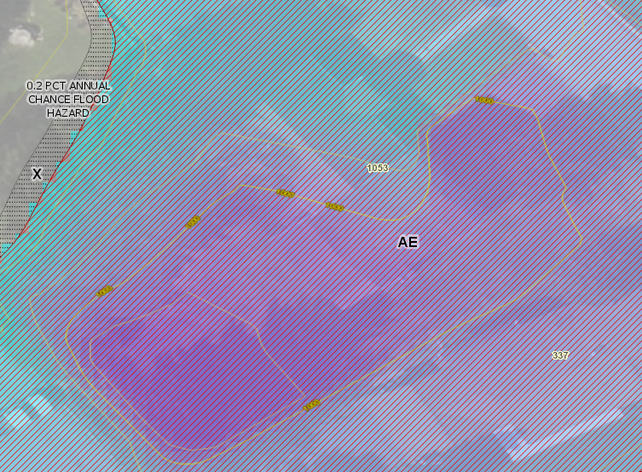
BFE Flood Height (Upper Mon)
Location: 337 Patteson Drive, Morgantown, WV, 26505
Ground Elevation (Back Side of House): 1002 ft (Flood Tool)
Depth: 4.4 feet (Upper Monongahela RiskMAP Study 1% Depth GRID)
Water Surface Elevation/BFE: 1004.5 feet
(Upper Monongahela RiskMAP Study 1% WSE GRID)

Slide 19
Water Depth: about <<value>>
Water Depth | Message | Sources
Water Depth: | About << value >> ft. | Model-Backed Depth Grids Engineering Studies (HEC-RAS) AE Non-Restudy Re-Delineations Other Depth Grids HAZUS EQL USGS Inundation Layers
A statewide “composite” Flood Risk Assessment Depth Grid will be created from model-backed effective and advisory depth grids at a 5-foot cell resolution.
Water Depth Grids are a flood risk assessment product – not a flood regulatory product. Water depths are important for flood loss damages and by flood visualizations of site-specific structures.
Depth grids a source of credits for CRS communities
See FEMA’s Flood Risk Assessment Guidance (May 2016) for guidance on composite depth grids:
https://www.fema.gov/media-library-data/1469146645661-31ad3f73def7066084e7ac5bfa145949/Flood_Risk_Assessment_Guidance_May_2016.pdf

Slide 20
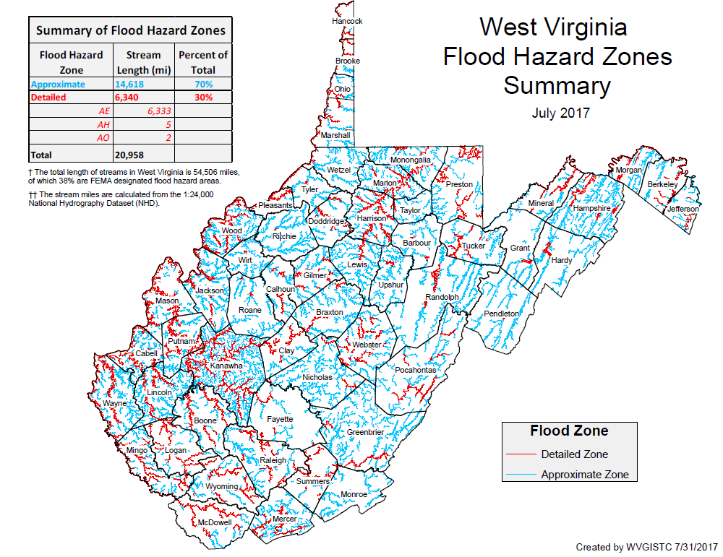
Jefferson County Composite Depth Grid

Slide 21
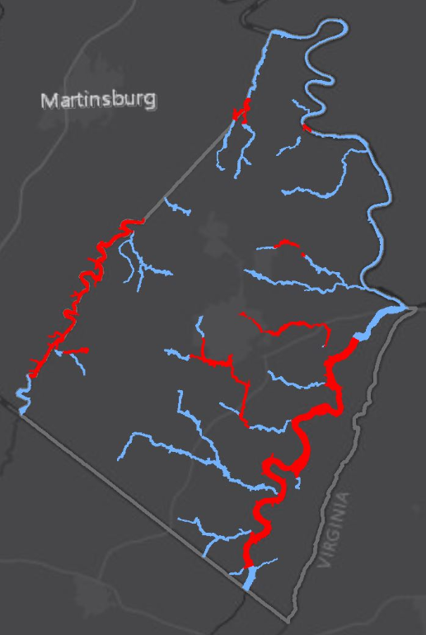
Countywide Depth Grid (Jefferson County)
“Model-Backed” Depth Grid for 1% Annual Event Flood for all of Jefferson County
Depth grids derived from newer 1-meter lidar elevation data
Water Depth important for 3D flood visualizations and flood risk building loss estimates
Communities receive CRS credit for published water depth grids
Jefferson County
Advisory A Depth Grid (AECOM)
Depth Grid from Updated AE Floodplain Boundary (WVU)
Jefferson County: 162 stream miles of Approximate A Zones, 77 miles of Detailed Flood Zones

Slide 22
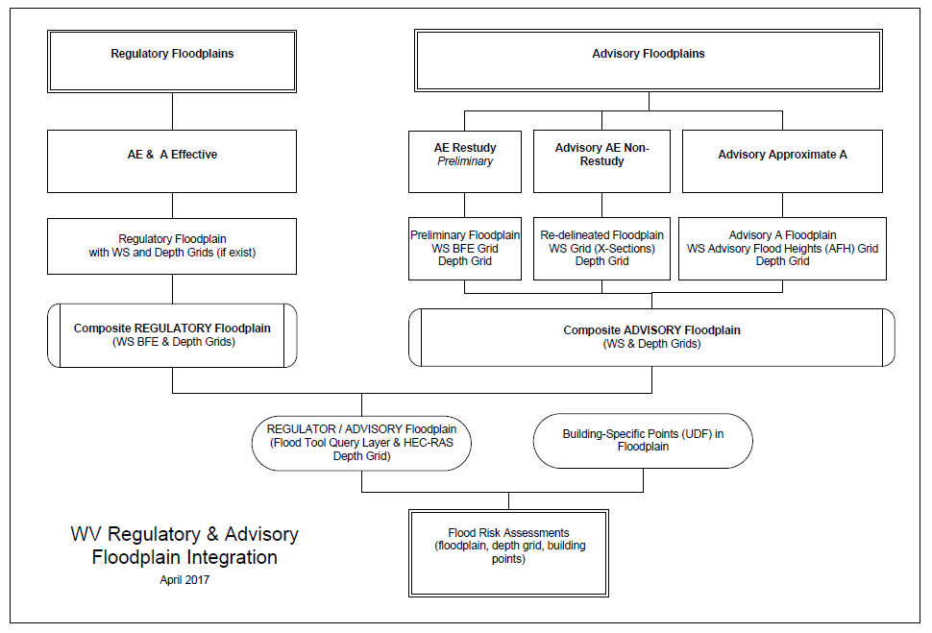

Regulatory vs. Floodplain Boundaries
based on new Topo
Effective Regulatory
Advisory A / Updated AE (new Topo)
Integration
Required

Slide 23

Model Ordinance for Advisory Floodplains
Model WV Ordinance for Advisory Zones
  Also…what is in the “advisory” name for flood heights? Are stakeholders confused?
    Advisory Flood Heights
    Advisory Base Flood Elevations
    Non-Regulatory Base Flood Elevations

Slide 24
WV Model Ordinance – Advisory Zones
Robert Perry's 2010 Vision Statement
  “WV Floodplain Management Coordinator proposes displaying these newly created flood hazard areas on the WV Flood determination tool and having the local governments adopt these areas on separate maps as “Local Flood Hazard Areas” to be managed in accordance with the flood damage reduction requirements of the ordinance.”
What is Needed? WV Model Ordinance Language for Advisory Zones
  Advisory A
  Updated AE
What about CRS credits? Do CRS credits apply to WV Advisory Flood Zones that are adopted as community identified floodplains?
Kevin Sneed to verify with FEMA’s Heather Davis-Jenkins about model ordinance.
2016 WV Model Ordinance:
http://data.wvgis.wvu.edu/pub/temp/FEMA/FRA/Ordinance/WV_Model_Ordinance_2016_FINAL_APPROVED_03-24-16.docx

Slide 25
WV Model Ordinance – Advisory Zones
ARTICLE III – ESTABLISHMENT OF THE SPECIAL FLOOD HAZARD AREA Section 3.1 Identification
  a. The identified special flood hazard area shall be those areas of (community name) which are subject to a one percent or greater chance of flooding in any given year as shown on the Flood Insurance Rate Map (FIRM) and described in the Flood Insurance Study (FIS) prepared for (community name) by the Federal Emergency Management Agency (FEMA) dated (community name) or the most recent revision thereof including all digital data developed as part of the FIS.
  b. The identified special flood hazard area shall also be those special flood hazard areas which have been identified as flood hazard areas by (community name) by use of historic or other technical data and shown on an officially recognized “FIRM”. These areas shall be designated as appropriate with the level of technical data described below and shall be managed accordingly.
Comments from FEMA’s Sarah Wolfe - Floodplain Management & Insurance
  ” The local ordinance outlines the areas where the regulations apply. To be compliant with the NFIP, these areas at a minimum must include the current effective FIS and FIRM (including any revisions). Should a community want to regulate beyond these areas, such as within a “advisory floodplain,” that community would need to formally recognize these additional areas. These areas must be formally adopted or “officially recognized” as such by the community in order for the regulations of the local ordinance to apply. WV ordinances also typically include language for what is commonly referred to as a “community identified floodplain” – areas of flood risk not included on the FEMA FIRM - however no communities in WV (to my knowledge) have formally recognized any of these areas.
Advisory A or Updated AE Floodplains are not recognized as “community identified floodplains” unless formally adopted or “officially recognized” as such in the local community ordinance

Slide 26
WV Model Ordinance – Advisory Zones
Section 4.3 Approximated Floodplain (Zone A)
  Within any Approximated Floodplain Area:
  a. The Floodplain Administrator shall use elevation and floodway information from Federal, State, or other acceptable sources when available to determine the elevation above which development will be reasonably safe from flooding.
Comments from FEMA’s Sarah Wolfe - Floodplain Management & Insurance
  ”As for the use of non-regulatory BFEs that are provided for Approximate A Zones, these can be utilized and enforced by the local floodplain manager because of the specific regulations adopted for Zone A. A minimum requirement of the NFIP is that the floodplain manager utilize elevation and floodway data in A Zone when available from an acceptable source (which would include the information included on the Flood Tool).”
Non-regulatory BFEs (or Advisory Flood Heights) are currently enforceable in FEMA mapped effective Approximate A Zones

Slide 27


Advisory Zones – Outreach Information
R
Regulatory IN and Advisory OUT
Regulatory OUT and Advisory IN
Both Regulatory
& Advisory
(No Change)
Effective Regulatory Floodplain
Advisory Floodplain
Union | Meaning | Building Changes | Area Changes
No Change | IN both Regulatory and Advisory | 1 | 11 m²
Advisory Only | Regulatory OUT and Advisory IN | 2 | 13 m²
Regulatory Only | Regulatory IN and Advisory OUT | 4 | 21 m²
The geographic union of Regulatory and Advisory Floodplains generates a change polygon for flood risk analysis by area. Subsequently the union polygon can be intersected with site-specific structures to analyze the impact of the Advisory Floodplain changes to the Regulatory Floodplain.

Slide 28
Advisory Zones – What is the message for property owners??
Regulatory In but Advisory Out (Lower Flood Risk) – Property owners are not at the highest risk to a 1% Annual Chance Flood but still recommend flood insurance. Owners can acquire an elevation certificate and use the advisory base flood elevation to acquire a LOMA and lower NFIP insurance rates.
Regulatory Out but Advisory In (Higher Flood Risk) – Advisory information indicates a flood hazard area and will be incorporated into future effective regulatory or community identified floodplains. Floodplain managers should recommend property owners of existing structures in Advisory Floodplains that they are at high risk of a 1% Annual Chance Flood and recommend Flood Insurance. New development should not occur in Advisory Floodplains without a detailed study to show development reasonably safe from flooding.
R
Regulatory IN and Advisory OUT
Regulatory OUT and Advisory IN
Both Regulatory
& Advisory
(No Change)
Effective Regulatory Floodplain
Advisory Floodplain

Slide 29
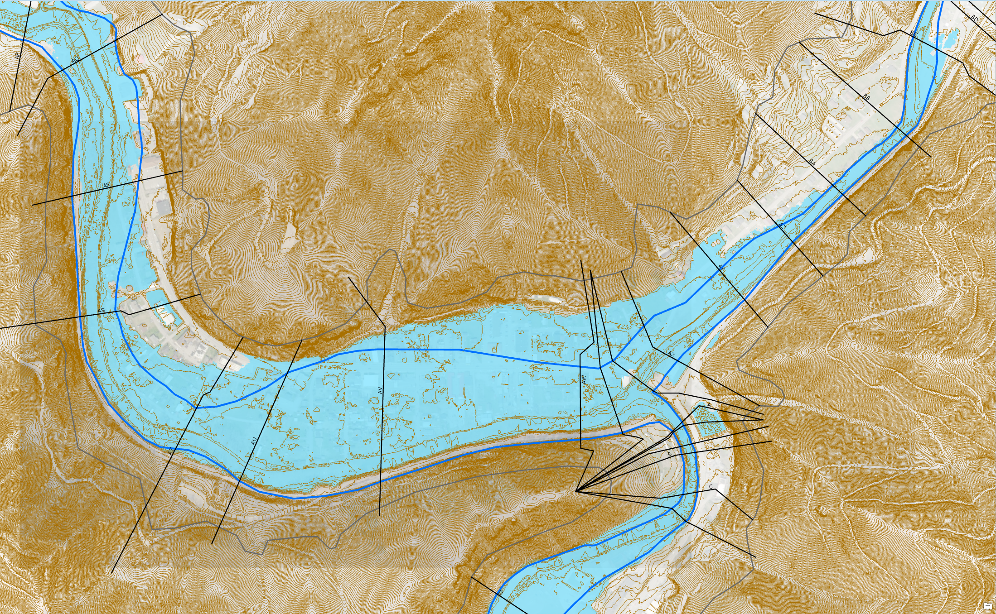
Updated AE Floodplain Boundaries -
Example
Redelineated Floodplain Using New Topo
Regulatory AE Floodplain
Updated AE Floodplain
Updated AE
Zone
Clear Fork
Oceana
Location: Clear Fork, Oceana, Wyoming County, WV
Objective: Zone AE Floodplain Redelineation and Flood Risk Products using existing LiDAR-derived elevation data
https://www.mapwv.gov/flood/map/?wkid=102100&x=-9086441&y=4536103&l=9&v=1

Slide 30
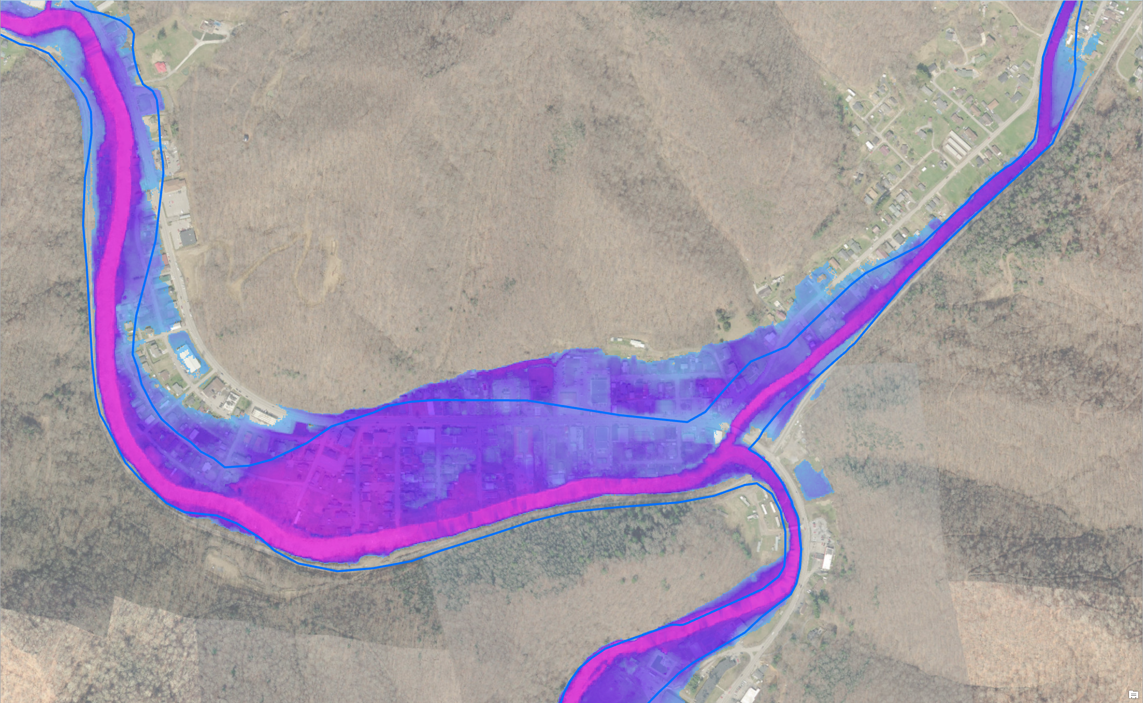

Updated AE Floodplain Boundary -
Depth Grid
Regulatory AE Floodplain
Updated AE
Water Depth
Advisory AE Water Depth
Clear Fork
Oceana
Location: Clear Fork, Oceana, Wyoming County, WV
https://www.mapwv.gov/flood/map/?wkid=102100&x=-9086441&y=4536103&l=9&v=1

Slide 31
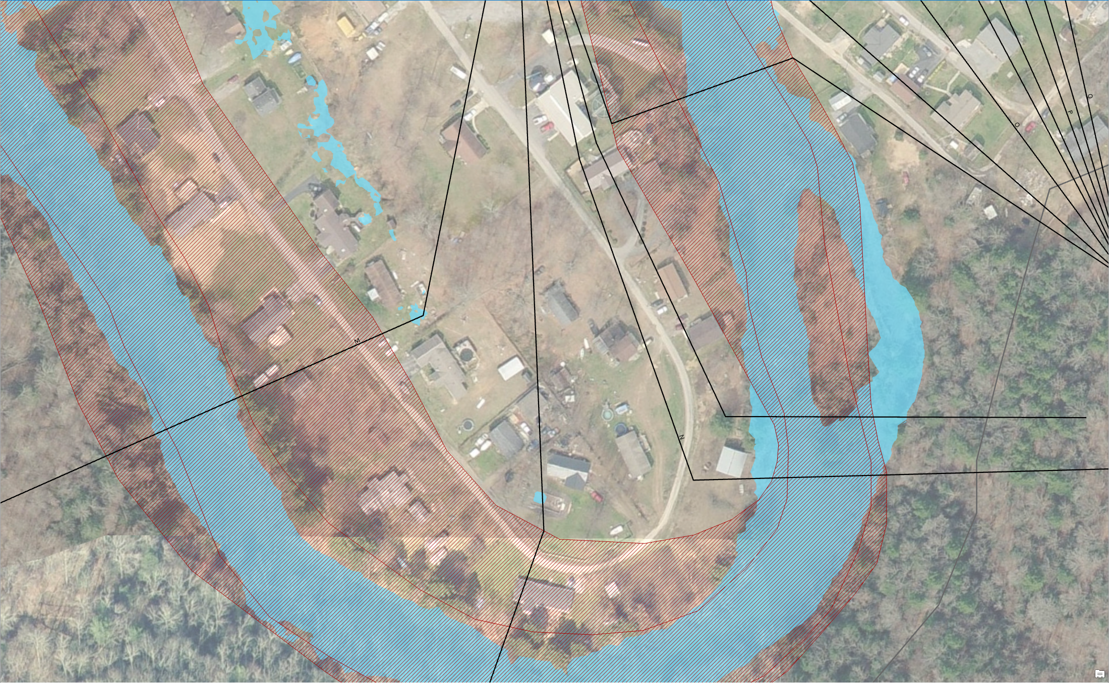
Advisory AE Determinations
Regulatory IN but Advisory OUT
Regulatory AE Zone
Advisory AE Zone
Structures IN Regulatory AE Zone and OUT Advisory AE Zone
What do you tell the public? Acquire an elevation certificate and use the Updated AE Floodplain Boundary information to request a LOMA to amend the effective NFIP map.

Slide 32
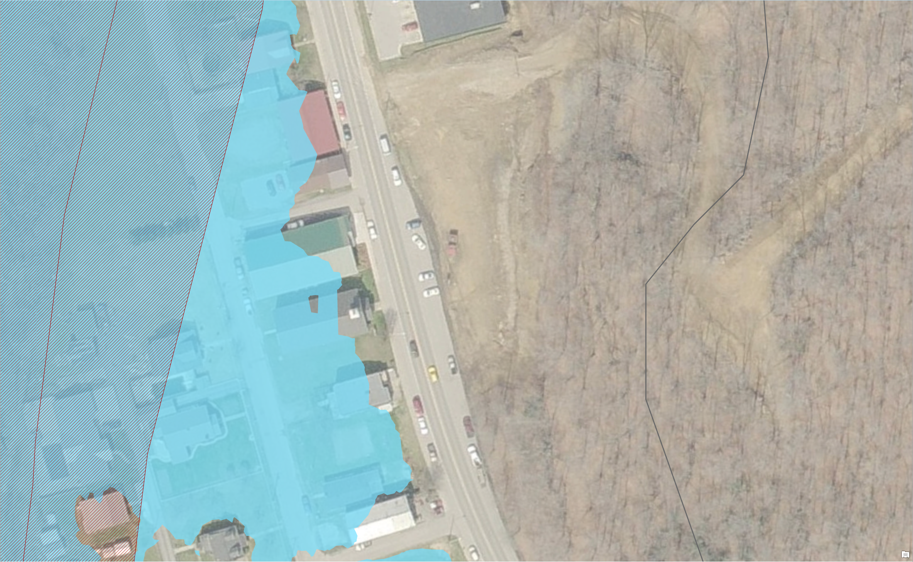
Updated AE Floodplain Boundaries
Regulatory
AE Zone
Regulatory OUT but Advisory IN
Updated
AE Zone
Structures OUT Regulatory AE Zone and IN Updated AE Floodplain Boundary
What do you tell the public? Updated AE floodplain boundary information indicates a flood hazard area and will likely be incorporated into future effective NFIP maps. New development should not occur in updated floodplains without a detailed study to show development reasonably safe from flooding. Recommend purchasing flood insurance for existing structures.

Slide 33
Reference Layers
  Ground Elevation
  Building Footprints
    Created from multiple sources
    Useful for identifying structures and 3D community flood visualizations
  Parcels
    Coordinating Parcel Acquisition in WV
      State/County programs
      DHS HIFLD Secure/CoreLogic (data coordination issues)
      FEMA HMGP proposal
    Statewide Tax Department Real Estate application with flood hazard awareness would increase public awareness

Slide 34
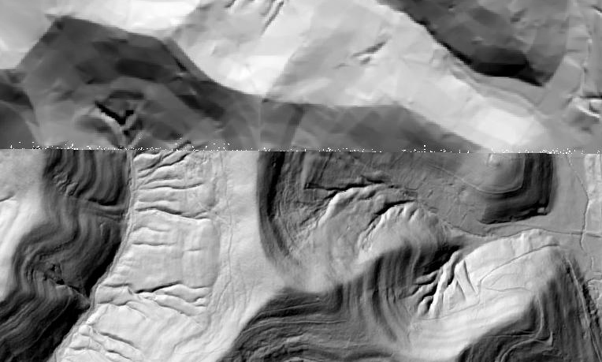
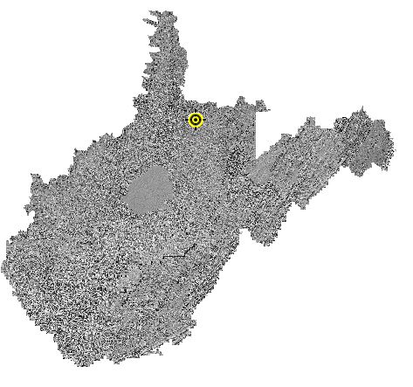
Improved Ground Elevation Layer
New Elevation Layer for WV Flood Tool: Hybrid of SAMB and Lidar elevation layers
Layer | Source | Coverage
SAMB | 2003 SAMB, 3-meter, 10-foot contours | Statewide
Lidar | Lidar, 2-foot or 1-foot contours | Select Areas
SAMB ELEVATION
WV DEP SAMB-Lidar Hillshade
LIDAR ELEVATION

Slide 35
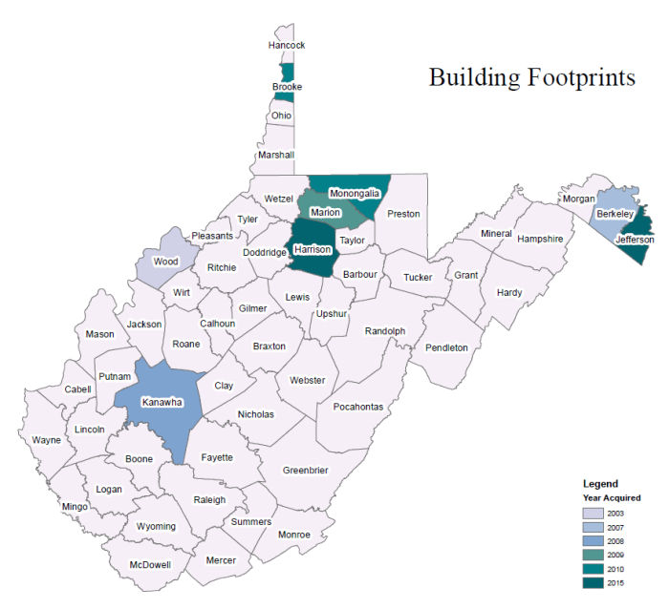
Statewide Building Web Service
Statewide building footprint reference layer created from best available sources
Layer | Source | Coverage
SAMB | 2003 2-ft. resolution leaf-off imagery, Statewide Addressing & Mapping Board (large buildings only) | Statewide
Counties | 6” or better leaf-off imagery | Select Counties
Oak Ridge National Lab(?) | 2016 1-meter Leaf-On, FEMA Region III contract to Oak Ridge National Lab | Statewide
County
How are BUILDING FOOTPRINTS beneficial?
Improves the locational pin-pointing of structures for multi-hazard assessments
Enhances visual representation of structures on 2D flood risk maps
Necessary for 3D flood visualization models
  Building footprints extruded to known heights
  Beneficial to communicating flood risk to communities

Slide 36
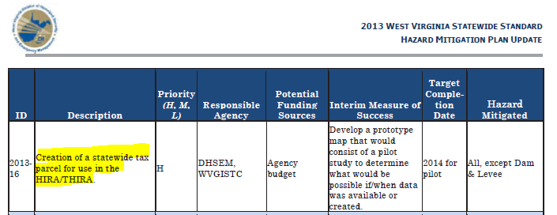
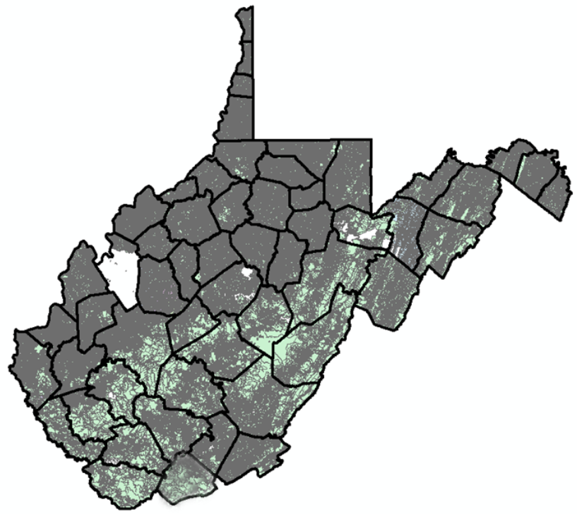
Statewide Digital Parcel File
High Priority
of
2013 State Hazard Mitigation Plan

Slide 37
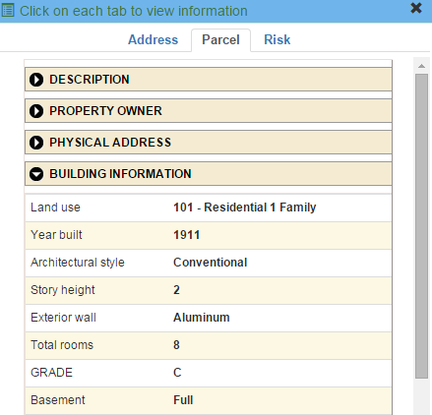
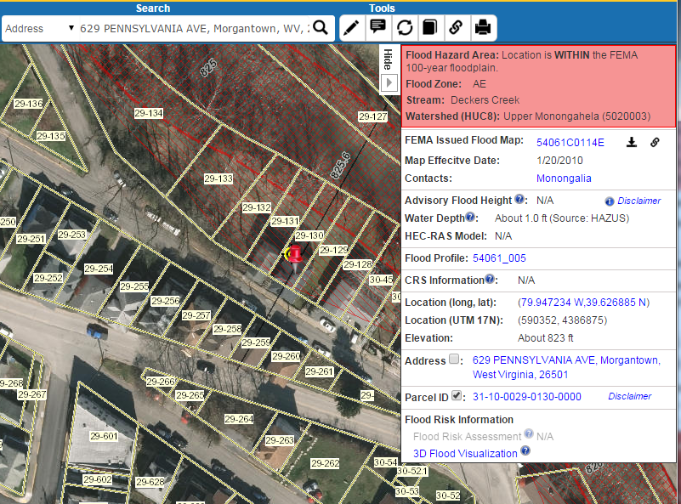
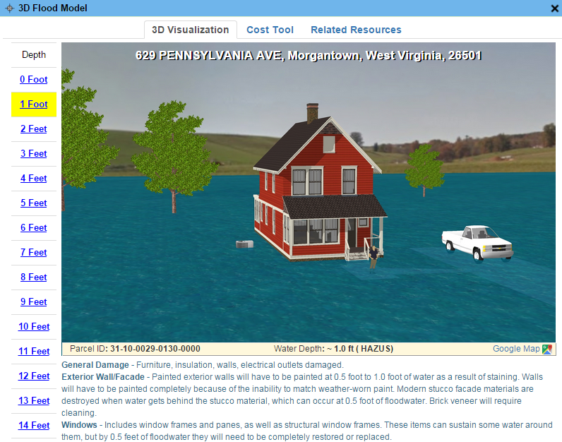
Parcels link to Owner/Building Info
629 PENNSYLVANIA AVE, Morgantown, WV, 26501
https://www.mapwv.gov/flood/map/?wkid=102100&x=-8899684&y=4811867&l=13&v=0
Residential or Farm Property

Slide 38
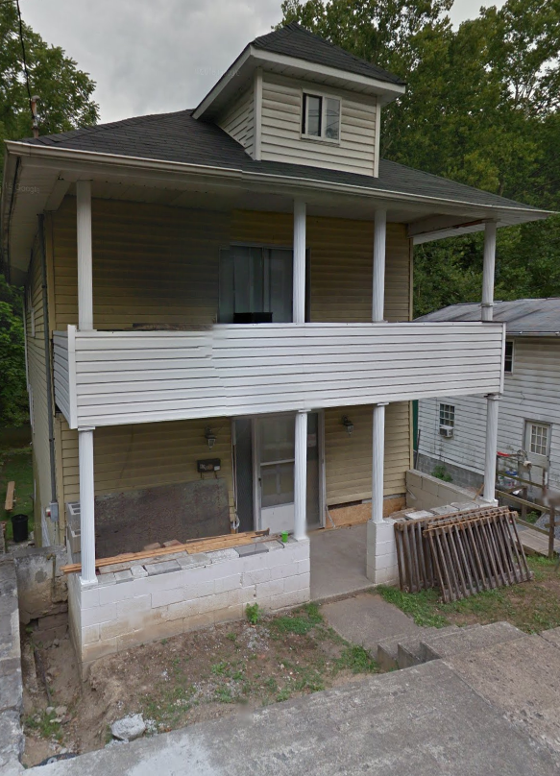
Parcels link to Owner/Building Info
Residential or Farm Property
DESCRIPTION
GIS Parcel ID | 31-10-0029-0130-0000
Legal Description | BL 12-1/2 LOT 10
Acreage (deed) | 0.0373
Tax Year | 2015
Tax Class | 4
Deed Book / Page | 1259 / 45
PROPERTY OWNER(S)
Property Owner(s) | Smith John
629 PENNSYLVANIA AVE, Morgantown, WV, 26501
https://www.mapwv.gov/flood/map/?wkid=102100&x=-8899684&y=4811867&l=13&v=0
BUILDING INFORMATION
Property Class Type | R- Residential
Land Use | 101 - Residential 1 Family
Year Built | 1911
Architectural style | Conventional
Exterior Wall | Aluminum
Stories | 2
Total Rooms | 8
Building Grade | C
Basement Type | Full
Structure Area | 1,320
Building (card) Number | 1
# of main BLDGs (cards) | 1
APPRAISED VALUES
Land Appraisal | $33,200
Building Appraisal | $29,000
Total Appraisal | $62,200

Slide 39
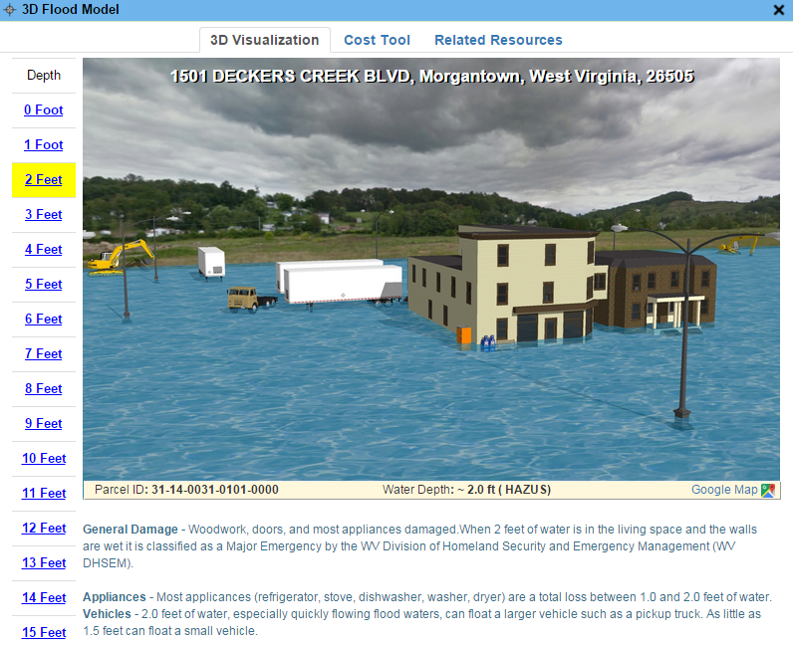
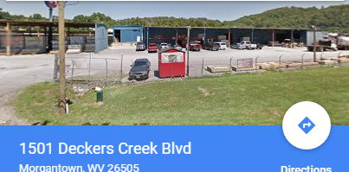
Parcels link to Owner/Building Info
Commercial or Industrial Property
DESCRIPTION | 84 Lumber
GIS Parcel ID | 31-14-0031-0101-0000
Legal Description | 5.0922 AC;SABRATON
Acreage (deed) | 5.09
Deed Book / Page | 1376 / 234
PROPERTY OWNER(S)
Property Owner(s) | SPIRIT SPE PORTFOLIO
1501 DECKERS CREEK BLVD, Morgantown, West Virginia, 26505
https://www.mapwv.gov/flood/map/?v=0&pid=31-14-0031-0101-0000
BUILDING INFORMATION
Property Class Type | C- Commercial
Land Use | 373 - Retail-Single Occupancy
Year Built | 1994
Stories | 2
Exterior Wall | Brick or Stone
Construction Type | Pre-Engineered Steel
Building Grade | D+
Basement Type | None
Business Living Area | 15,255
Cubic Feet | 292,380
Use Type | 34-Retail Store, 82- Multi-Use Office
COST VALUES
Other Bldg/Yard Values | $67,020
Commercial Value | $227,700
APPRAISED VALUES
Land Appraisal | $378,800
Building Appraisal | $294,700
Total Appraisal | $673,500

Slide 40
Total Property Parcels
West Virginia Parcel Property Class Breakdown for Tax Year 2017
(Computed from statewide parcel file that is 95% complete)
Code* | Property Class | # of Parcels | Percent (%)
R | Residential | 1,164,470 | 79.61%
F | Farm | 121,384 | 8.30%
A | Apartment | 3,222 | 0.22%
C | Commercial | 65,784 | 4.50%
I | Industrial | 3,105 | 0.21%
X | Exempt | 97,773 | 6.68%
U | Utility | 192 | 0.01%
Other | Not classified | 6,837 | 0.47%
 |  | 1,462,767 | 100.00%
 | Property Parcels intersecting 100-YR floodplain | 447,831 | 31%
Assessment records are important for building inventories and are used to estimate the total building exposure ($) and building loss ($) for multi-hazards. Often building inventories and corresponding loss estimates are organized by property class.

Slide 41
Parcels in 100-YR Floodplain
Property Class | Count | %
Residential | 320,892 | 72%
Farm | 50,988 | 11%
Exempt | 35,610 | 8%
Commercial | 32,665 | 7%
Apartment, Industrial, Utility | 7,676 | 2%
total (31% of all 1.46 million parcels) | 447,831 | 100%
An estimated 450,000 property parcels or 31% of total 1.46 million statewide parcels intersect the 100-YR floodplain
A more detailed site-specific building analysis is needed statewide
Computed from statewide parcel file 95% complete

Slide 42
Parcels in 100-YR Floodplain

Slide 43
WV Tax Map Products
 | Individual Finished Tax Maps | Web Finished Tax Maps | Digital Parcel File (subset of Digital Tax Map)
Map Content | Parcel Boundary Parcel Identifier Parcel Dimensions Lot Boundaries Contextual Information | Parcel Boundary Parcel Identifier Parcel Dimensions (most viewers) Lot Boundaries (most viewers) | Parcel Boundary Parcel Identifier
Coverage | Statewide* | 30 Counties with Web Viewers | 95% State Coverage**
Current | Yes | Yes | Varies by County
Source | County Assessors | County Assessors | Assessors, E-911, MLMP
Map System | Digital/Manual (80%/20%) | Digital (GIS) | Digital (GIS)
Static or Dynamic | Static - viewed as paper map or fixed image | Dynamic - interactive web maps with online tools | Dynamic - interactive web maps with online tools
Linkable to IAS | No | Yes | Yes
Seamless | No | Yes | Yes
Aerial Photos | No | Yes | Yes
Formats | Paper or Digital (PDF, TIFF) Print-Ready images | Web Map Services | Shapefiles, Geodatabase, CAD Files, Web Map Services
* All paper tax maps are scanned to a digital image-file format by the Tax Department for statewide coverage
** Varying source years when created

Slide 44
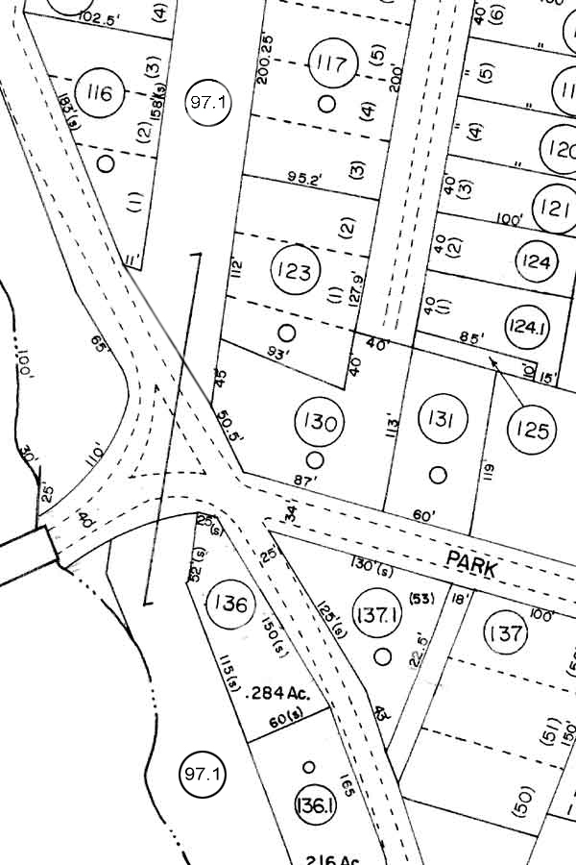
Finished Tax Map Standard 189-3
Show the property and lot lines, set forth dimensions and/or areas, and other cadastral and cultural features that assessors are required by state law to maintain and publish for the public.
Created by either manual or automated methods in accordance with 189-3 standards approved by the Property Valuation Training and Procedures Commission
  Cartographic Design / Layout Specifications
  Map Content
  Maintenance Procedures / Map Currency
  Submission Requirements / County Monitoring

Slide 45
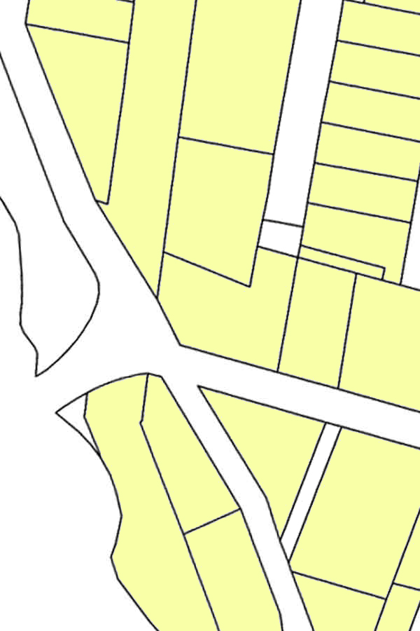
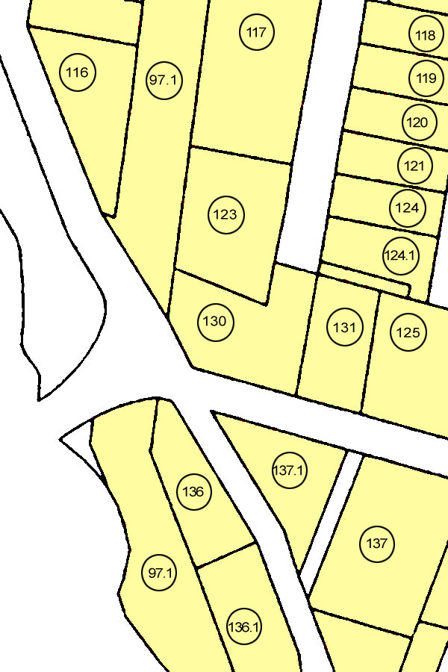
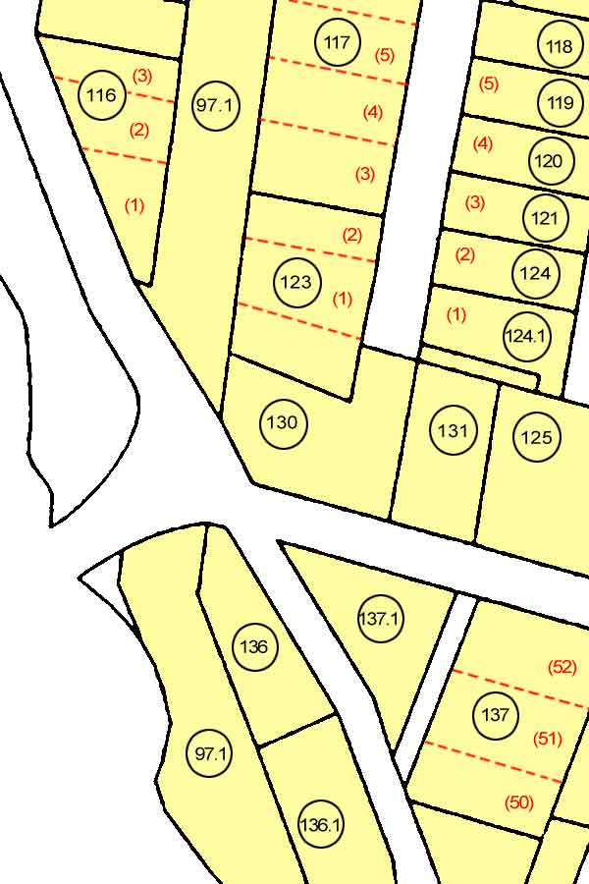
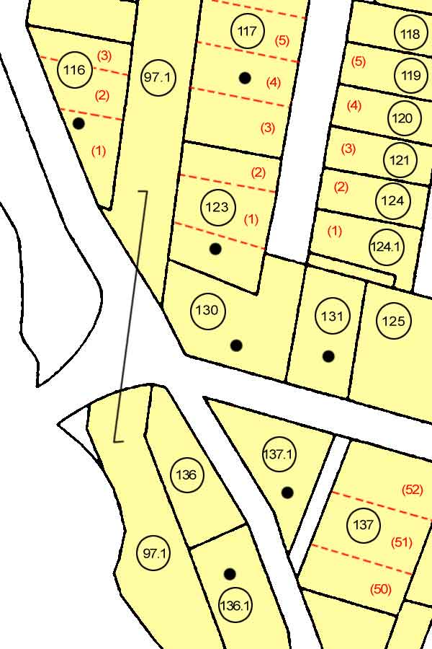
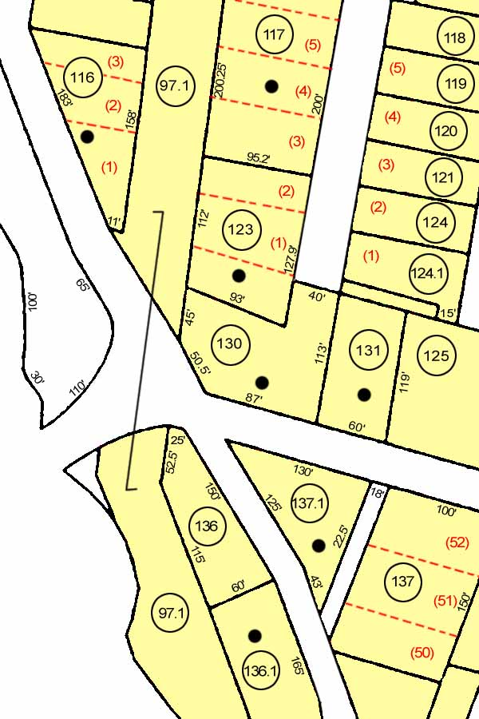
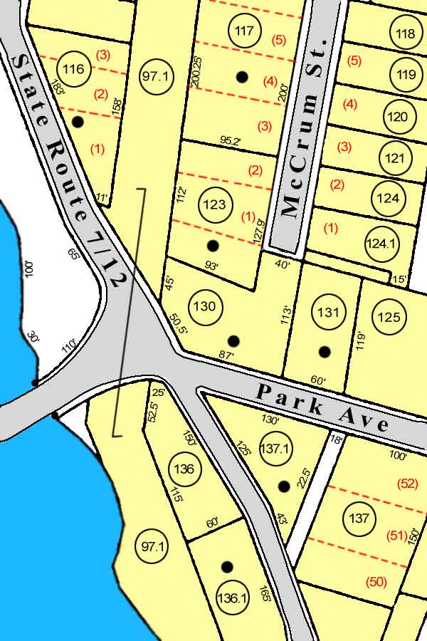
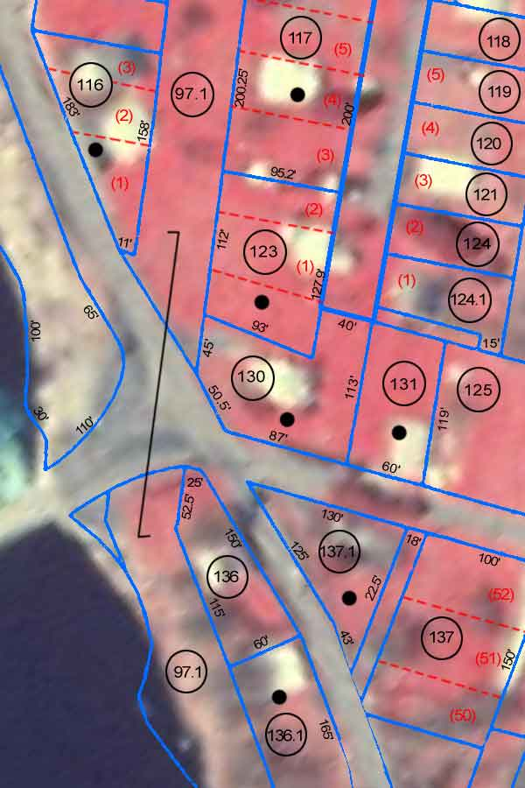
WV Digital Tax Map Products
Parcel Related Features
Geo-Referenced Tax Map
PARCEL BOUNDARY(Shapefiles)
Parcel ID Label
Interior Lot Lines and IDs
Land Hooks and Buildings
Parcel Dimension/Acre Annotation
Reference Datasets
Road and Water Layers
Aerial Photography
FULL or FINISHED DIGITAL TAX MAP (Web Map or Static TIFF/PDF)

Slide 46
Tax Map Survey - Current Trends
GIS Status
GIS | 43
Transition | 7
Paper | 5
Outsource % of Digital/Manual Maintenance
In-House | 29
Outsource | 26
Maintenance
Digital | 43
Both | 5
Manual | 7
GIS Software
ESRI | 49
AUTOCAD | 1
None | 5
May 2017 Survey of County Assessors

Slide 47
Statewide Digital Parcel File
606 Tax Districts
5% or 33 tax districts have incomplete or no digital parcel boundaries
Digital Parcel Sources
Assessor Offices
E-911 Offices
State Tax Department

Slide 48
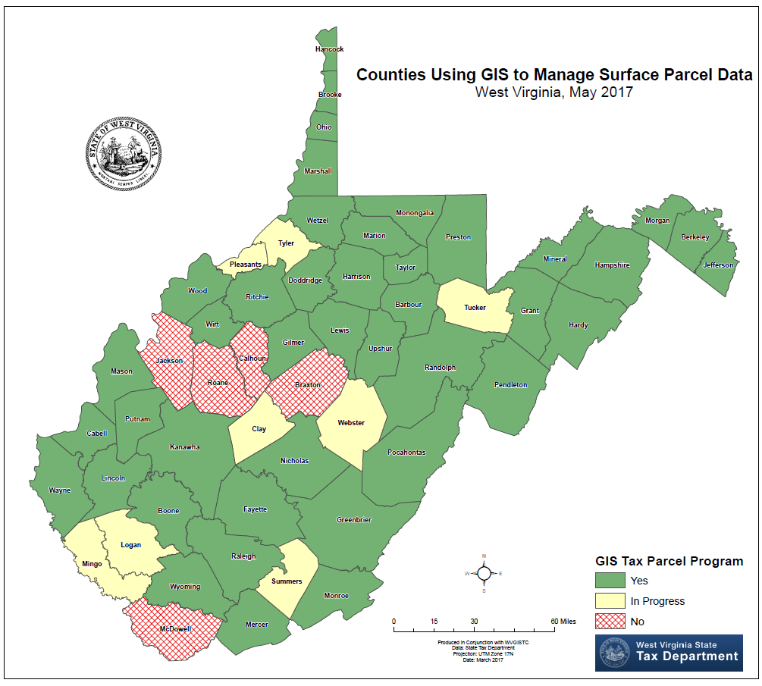
Counties using GIS

Slide 49
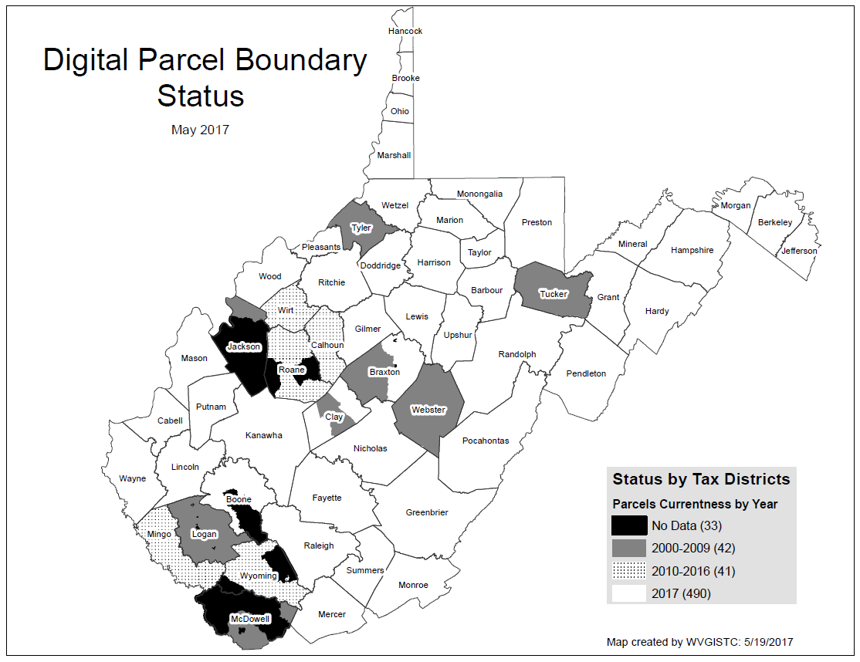
Statewide Digital Parcel File
# | Missing/ Obsolete Data Parcels
1 | Boone
2 | Braxton
3 | Calhoun
4 | Clay
5 | Jackson
6 | Logan
7 | McDowell
8 | Roane
9 | Tucker
10 | Tyler
11 | Wirt
12 | Wyoming
Estimated cost of $420K to achieve a current, accurate, and maintained Full Digital Tax Maps
SB 588 – As of July 5 parcels are free for download instead of $165K to acquire Statewide Parcel File

Slide 50
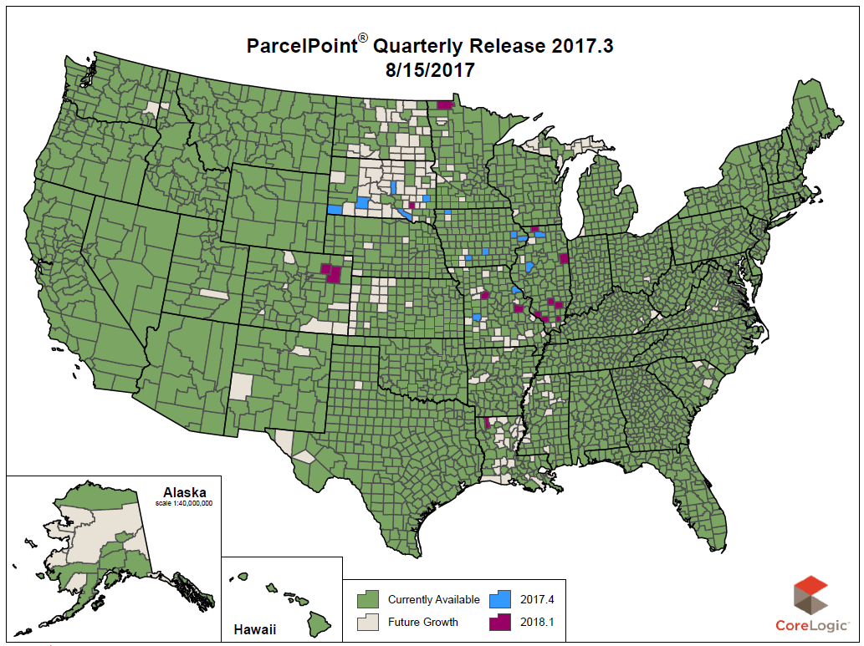
Parcel Bdry Layer – DHS/CoreLogic

Slide 51
Parcel Coordination & Access
West Virginia Process
DHS/FEMA
Process
County Assessors
State-Level Integration
Public Domain
DHS
CoreLogic
(DHS vendor)
HIFLD Secure
Coordination of parcel development efforts between
West Virginia and DHS/FEMA to avoid duplication

Slide 52
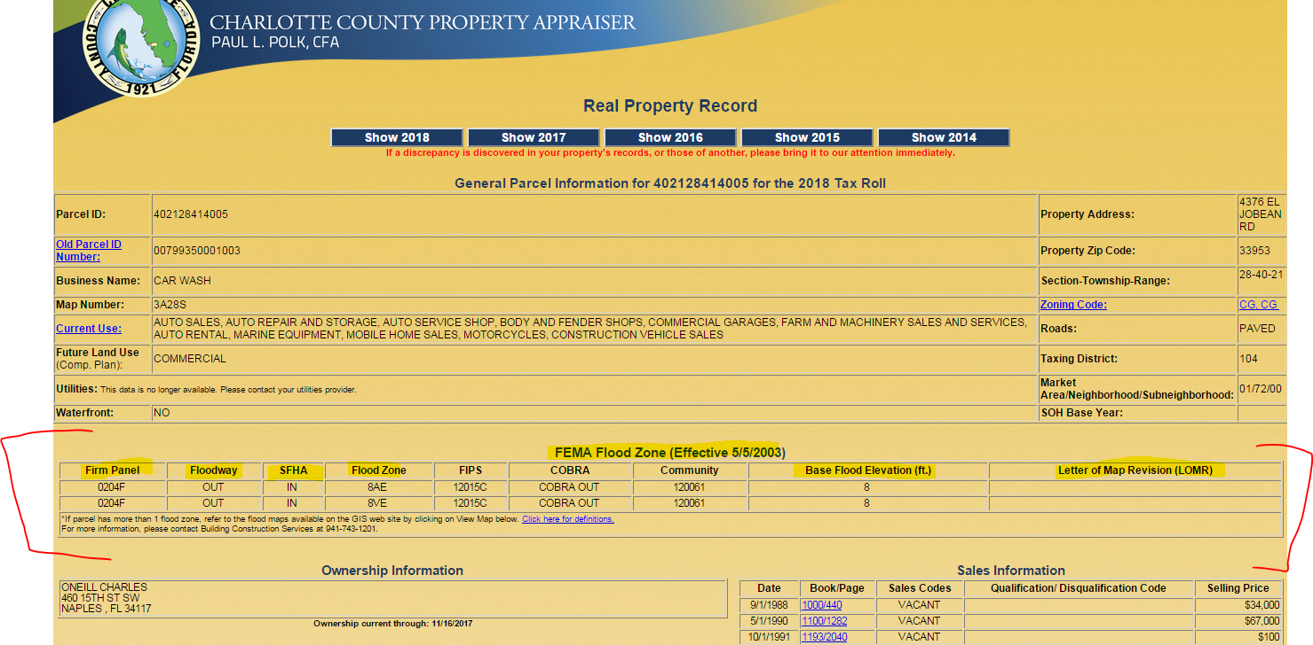
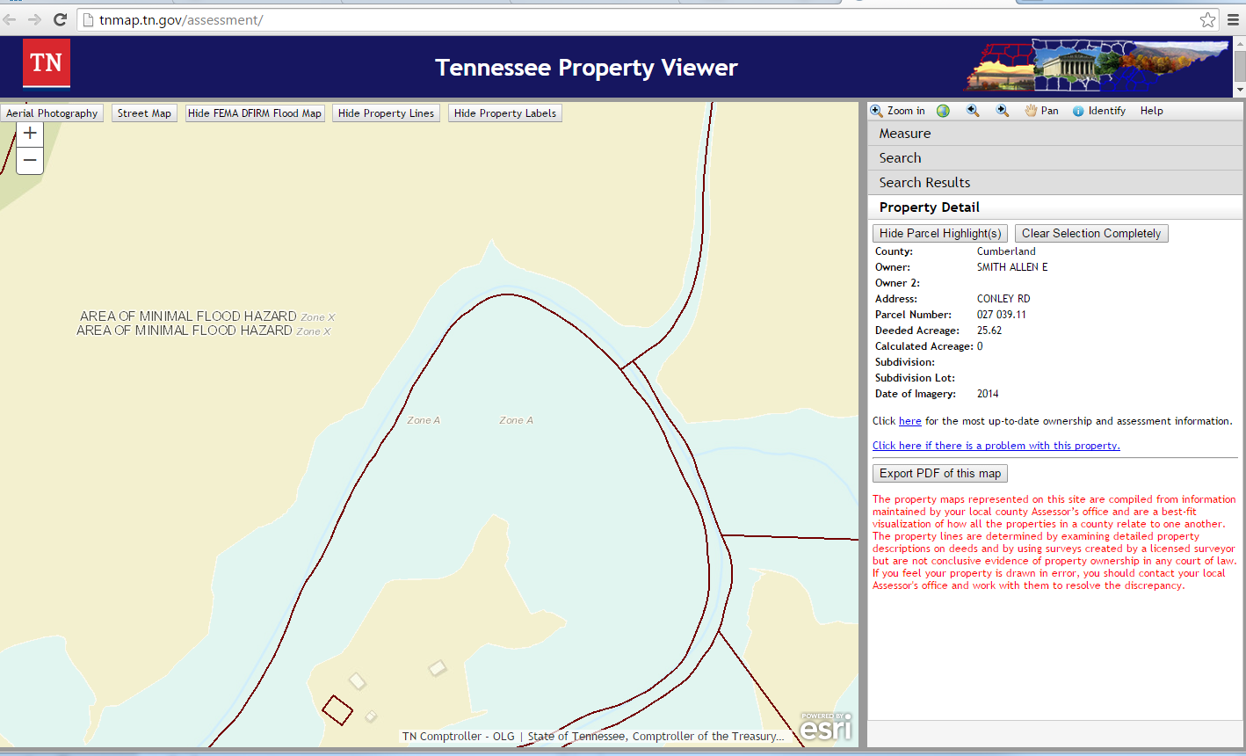
Flood Info/Links in Real Estate Web Apps
<< Charlotte County, Florida >>
https://www.ccappraiser.com/sales_input.asp
<< State of Tennessee >>
http://tnmap.tn.gov/assessment/

Slide 53
Proposed State Multi-Hazard Risk Project
  Project Breakdown
    Focus on flood and landslide hazards
    Statewide building inventory
    Fill in GIS data gaps (e.g., statewide parcel file)
  Detailed Building Inventories for multi-hazard assessments, CRS program credits, etc.
    Statewide building exposure inventory (parcel centroid spatial accuracy or better)
    Site-specific building loss estimates in SHFA/advisory flood zones at building centroid accuracy. Focus on 1%-annual-chance floods.
    Dam/levee inundations areas at parcel centroid accuracy or better
  Proposal Status
    Application at WV DHSEM for submission
    According to Brian Penix, TEIF/TEAL proposal still in the works but the WV Governor changed priorities that have a profound impact on HMGP. HMGP proposal must be submitted to FEMA before March 22 deadline.

Slide 54
Proposed State Multi-Hazard Risk Project

Slide 55
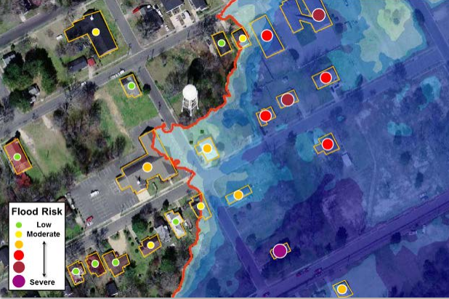
Statewide Flood Risk Structure File
Various Flood Risk Reports by community, stream name, flood zones, etc. can be generated from the Flood Risk Data (FRD).
Structure-specific (called “User-Defined Facilities”, or UDFs, in Hazus) flood risk assessments produce loss estimates at the building or structure level, and can often help facilitate flood risk discussions with individual home- or business-owners in a community. These types of risk assessments can provide valuable information to communities to help pre-screen properties and projects before going through a more in-depth Benefit-Cost Analysis (BCA). Personally-identifiable information (PII) such as property address, name of owner, etc. will not be included in FEMA's Flood Risk Assessment dataset (S_UDF_Pt and L_RA_UDF_Results). Source: Flood Risk Assessment Guidance - https://www.fema.gov/media-library-data/1469146645661-31ad3f73def7066084e7ac5bfa145949/Flood_Risk_Assessment_Guidance_May_2016.pdf

Slide 56
Flood Risk Assessments
Source Data
  Quality digital source data is essential for correctly identifying and producing site-specific structures with accurate replacement values: assessment building records, property parcels, site addresses, leaf-off imagery, and building footprints
  Engage local floodplain managers to quality check building inventories and critical facilities
Building Inventory Tool
  The Building Inventory Tool streamlines the process for creating an inventory of buildings assets exposed to multi-hazards and for executing Hazus flood loss models at the building or structure level. The Tool requires further refinements like updating the building construction tables for commercial/industrial properties and including building information from non-assessment sources. The tool also has to be robust in that building updates can be performed quickly when newer data sources become available.
Building Values
  Structures with significant variance between building replacement values and appraised values should be flagged and reviewed. Certain structures may require substituting the replacement value (cost to replace or rebuild the structure) with the appraised value (resell value).
  Building values for tax-exempt properties like governmental, educational, or religious properties must be derived from other sources such as school and insurance databases. The WV Board of Risk and Insurance Management (BRIM) database is one such source.
Depth Grids
  Accurate and comprehensive flood depth grids are essential for credible building loss damage estimates. Many of the flood risk structures are located in AE Zones where no depth grids exist. A composite depth grid is created from the best available depth grids.
Lessons Learned from Flood Risk Assessment Pilot Studies of Berkeley and Morgan Counties

Slide 57
Building Inventories
BUILDING INVENTORY
Historical Flood Inundation / Flood Registry
NFIP Repetitive Loss
(Internal Use Only)
HAZUS Flood Loss Estimates
Elevation Certificates
Flood Proof or Mitigated Structures
SFHA Building Counts
Levee/Dam Failure Inundation
Studies
Building Inventories important for flood reduction activities

Slide 58
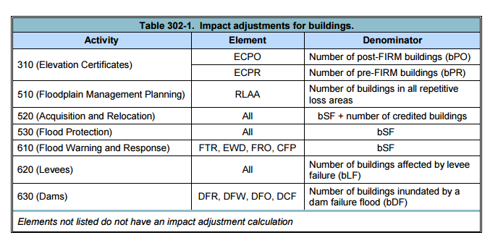
Building Inventories
CRS Activities Requiring Building Inventories
Building Inventories important for flood reduction activities including the NFIP Community Rating System
Source: CRS Coordinator’s Manual
https://www.fema.gov/media-library-data/1493905477815-d794671adeed5beab6a6304d8ba0b207/633300_2017_CRS_Coordinators_Manual_508.pdf

Slide 59
Building Inventories
CRS Activities Require Accurate Building Inventories
301.a. Definition of “Building” (Page 300-4)
Building: For CRS purposes, the definition of what constitutes a building is based on whether the structure is insurable. It must meet the following criteria, which are taken from the definition in the National Flood Insurance Program’s Flood Insurance Manual for insurance agents. A “building” is
A structure with two or more outside rigid walls and a fully secured roof, that is affixed to a permanent site; or
A manufactured home (a “manufactured home,” also known as a mobile home, is a structure built on a permanent chassis, transported to its site in one or more sections, and affixed to a permanent foundation); or
A travel trailer without wheels, built on a chassis and affixed to a permanent foundation, that is regulated under the community’s floodplain management and building ordinances or laws.
“Building” does not mean a gas or liquid storage tank or a recreational vehicle, a park trailer, or other similar vehicle, except as described above.
Examples of structures that are NOT counted as buildings include open pavilions for picnic tables, bleachers, carports with open sides, underground pumping stations, and sheds on skids that are moved to different construction sites.
Source: CRS Coordinator’s Manual
https://www.fema.gov/media-library-data/1493905477815-d794671adeed5beab6a6304d8ba0b207/633300_2017_CRS_Coordinators_Manual_508.pdf

Slide 60
Building Inventories
CRS Activities Require Accurate Building Inventories
302.a. Counting Buildings (Page 300-6)
Accessory structures are not included when counting buildings for calculating impact adjustments. For example, a house with a detached garage and shed is counted as one building. The flood insurance policy is based on the elevation of the house. However, if a lot has several principal buildings, each is counted separately because each normally is insured under a separate policy. For example, a motel with three principal buildings counts as three buildings. If one of the three buildings is an unheated bathhouse for the swimming pool and houses only showers and supplies, then the motel would be counted as two buildings.
To determine building counts, communities may use any method that yields reasonably good estimates of the number of buildings. Building counts should be accurate so they will provide the most useful information for both CRS and community planning. Acceptable methods include
• Using geographic information system- (GIS-) based building footprints,
• Reviewing aerial photographs,
• Using U.S. Census tract data, and
• Using the number of utility connections in an area.
Communities are required to document how they obtained their building counts or estimated building counts.
Building Inventories important for flood reduction activities including the NFIP Community Rating System
Source: CRS Coordinator’s Manual
https://www.fema.gov/media-library-data/1493905477815-d794671adeed5beab6a6304d8ba0b207/633300_2017_CRS_Coordinators_Manual_508.pdf

Slide 61
Buildings in Floodplain
 | # of Structures | Percent (%)
Addressable Structures | 1,010,819 | 91%
Non-Addressable Structures | 101,928 | 9%
total | 1,112,747 | 100%
Buildings in Effective 100-YR floodplains | 99,520 | 9%
Buildings in 100-YR floodplains (Effective and Advisory A/Updated AE) | 106,967 | 10%
Buildings in 100-YR and 500-YR floodplains | 159,804 | 14%
An estimated 100,000 buildings or 9% of all statewide 1.1 million buildings are within the effective 100-YR floodplain.
An estimated 160,000 buildings or 14% of all statewide 1.1 million buildings are within the 100-YR and 500-YR floodplains.
Data Source: Statewide Addressing and Mapping System (SAMS). Some counties track non-addressable structures in the floodplain while other counties do not.
A more detailed site-specific building analysis is needed statewide

Slide 62
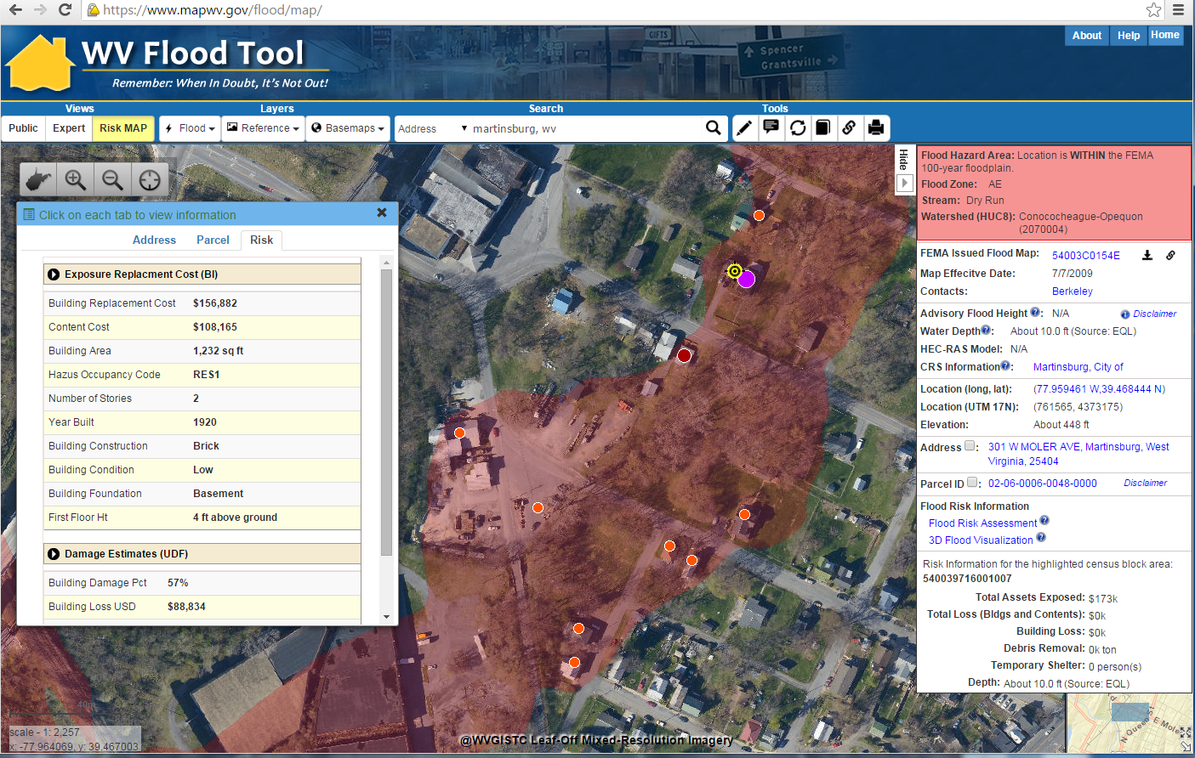

Flood Risk Structures of Martinsburg
Building Flood Loss Damage
57% of Residential Home Damaged at a Loss of $88,834
Flood Risk Building Info
Flood Risk Assessment Building Link
https://www.mapwv.gov/flood/map/?wkid=102100&x=-8678481&y=4788856&l=11&v=2
The Risk MAP view allows for viewing flood loss estimates at the building or structure level for a 1%-annual-chance flood event.

Slide 63
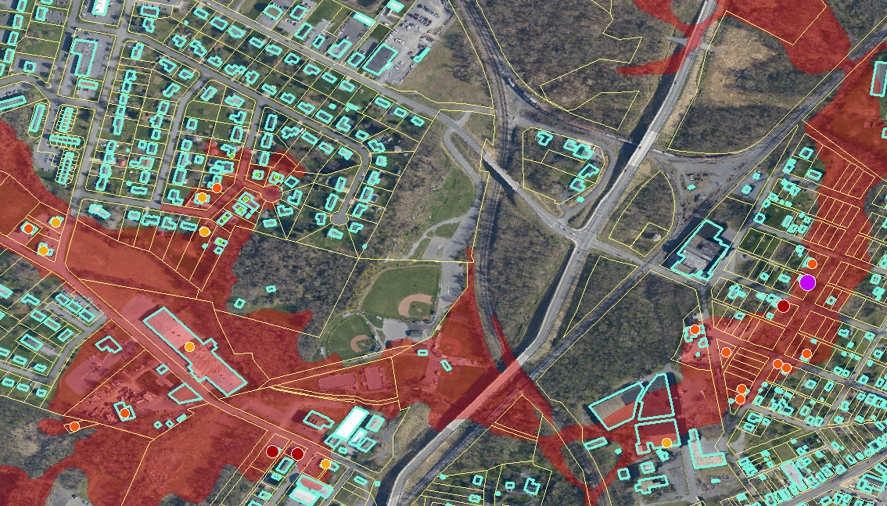
Building Footprints
Building footprints can enhance flood risk assessment maps
Building Flood Loss Damage
57% of Residential Home Damaged at a Loss of $88,834

Slide 64
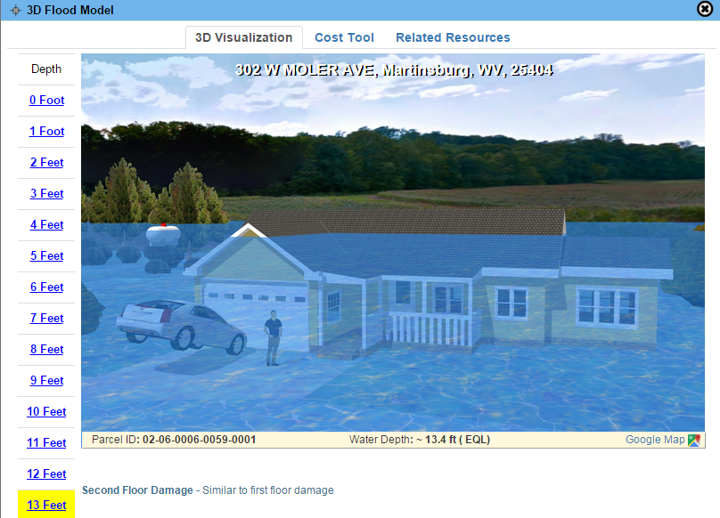
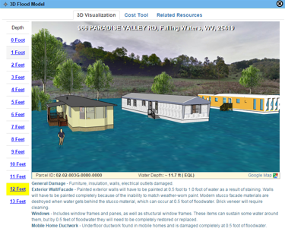
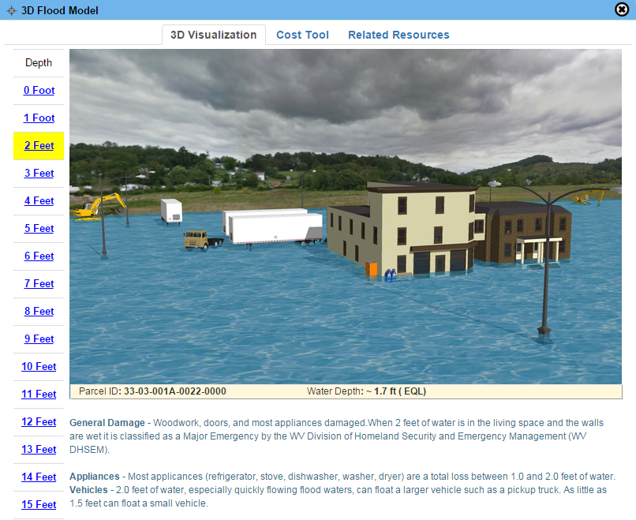
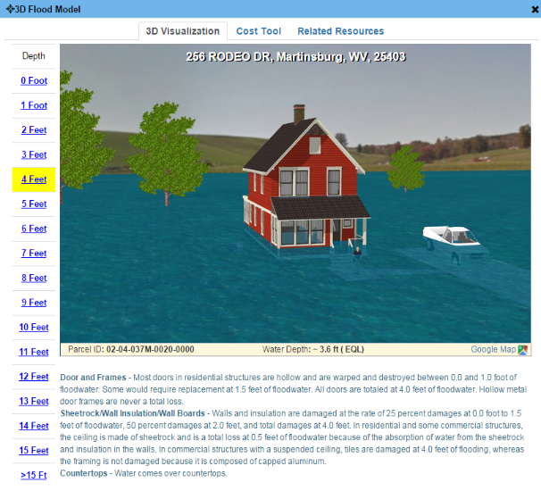
3D Flood Visualizations
Visualizations are easier for non-technical users to understand flood risks to their property in feet of water rather than comprehending the adjacent base flood elevation
1-Story Home
Mobile Home
Commercial
      "The 3D visualization is really cool. Our citizen comes to the counter and says 'there is no way there can be a flood like that.' Then we show them how much water you will get in your house and how much it will cost to repair it. The 3d visual is really good! And then we like the way you can click on a parcel ID and it brings up all the information as far as property owner, tax map and parcel number, deed book, page number - everything is right there. And the building information is really good too because it tells what the structure is made of, whether it has a basement - all the information that we would have to go to another system to pull is right there.“ Source: 3D Flood Visualization Comment from Debbie Robinson, Kanawha County Planning and Development Office
2-Story Home
3D flood visualizations are available statewide for locations where flood depth grids exist. The parcel assessment data fields (land use, stories) are necessary to identify the correct property type: residential one- or two-story homes, mobile home, commercial/industrial, etc.

Slide 65


3D Flood Visualizations
Brooke County
https://www.mapwv.gov/flood/map/?v=1&pid=05-07-W22P-0161-0000
1412 Charles St, Wellsburg, WV, 26070, Parcel ID: 05-07-W22P-0161-0000
      “This is the coolest thing ever….thank you!!!”
      Source: 3D Flood Visualization Comment from Terri Jo Bennett, CFM, Upshur County Building Permit, Floodplain and Addressing and Mapping Coordinator
Upshur County
https://www.mapwv.gov/flood/map/?v=0&pid=49-05-0003-0031-0000
673 Vicksburg RD, Buckhannon, WV, 26201, Parcel ID: 49-05-0003-0031-0000

Slide 66

3D Flood Visualization - Community
Basic Steps for Creating 3D Flood Visualizations
Start with High-Resolution Digital Terrain Model
Overlay High-Resolution Aerial Image
Then add Streets
Then add Building Footprints
Extrude Building Footprints to Known Heights (“sugar-cube” 3D buildings)
Generate Detailed 3D Building Models
Photo-Texture the 3D Building Models
Add Trees and other Landscape/Streetscape Features
Add Flood Overlay (Riverine 1% Annual Chance Flood) Source: NEMAC
The objective is to make the 3D visualizations as realistic as possible in a minimal amount of processing time

Slide 67


3D Flood Visualization - Community
Baltimore Street, Martinsburg, WV
3D
3D Northwest View
WV Flood Tool Conceptual Slide

